Slide 1


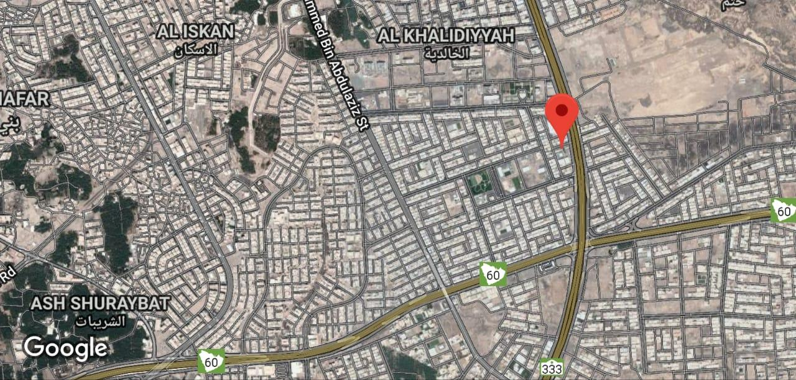

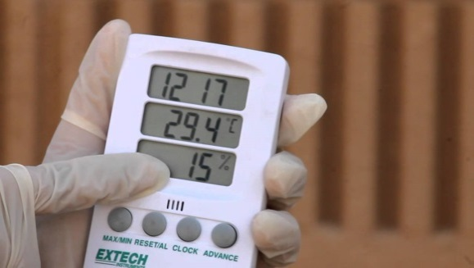
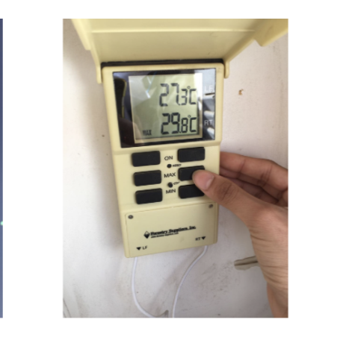
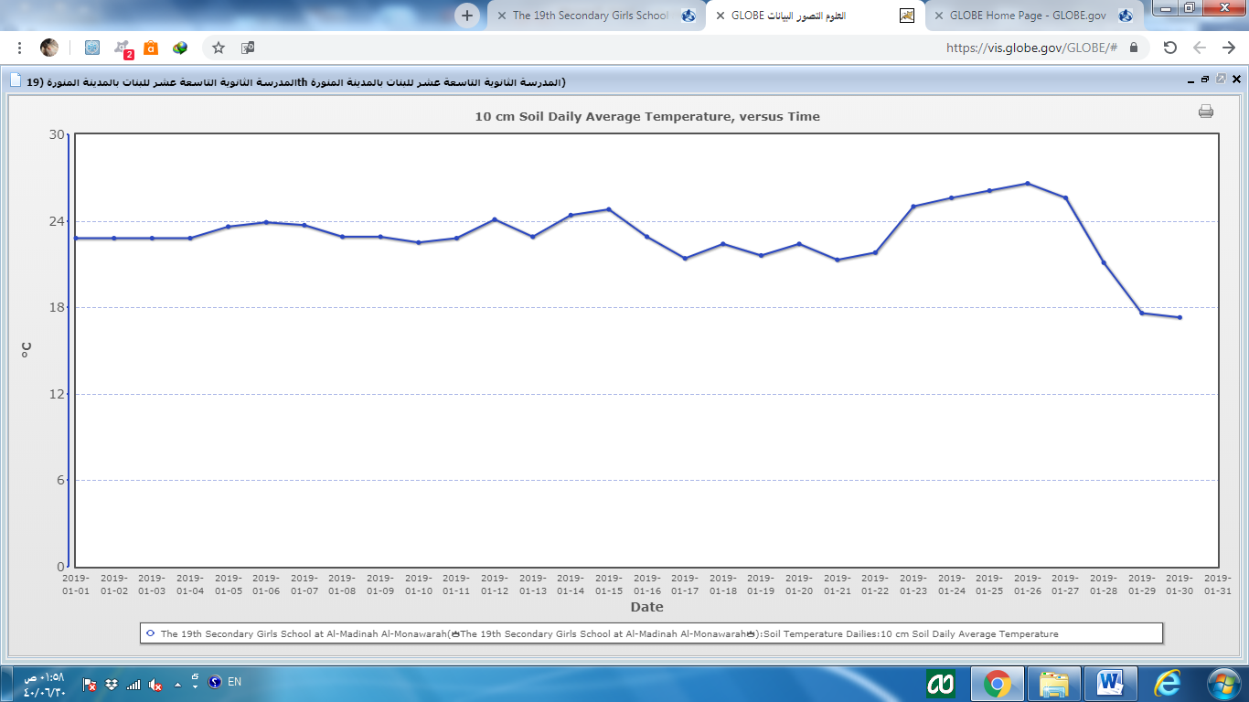
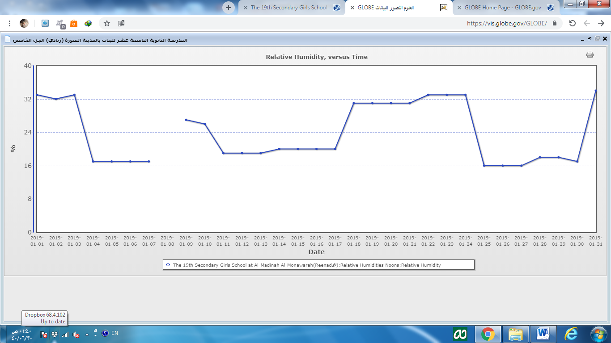
Effect of moisture on soSubmitted
by Secondary School 19
Eastern Medina (High School 19)
24.4574 , 39.6669
Elevation 637
Student : Gomana Malek Karsom
, Lama mohammad Al amode , Fy Abdoalrahman Alsobhe and Esraa Eid Alshalale
Globe Teacher: Ebtisam Ahmed Nahhas
Supervision :
Dr. Nadia S. Al-Kaff and Dr. Nahla A. Bou qellah
Abstract
Materials and Method:
The study carried out in the Secondary school
number 19 in Al-Medinah Al-Munwarah (Figure 2).
Stabile soil temperature was measured during
January 2019 and then start to fluctuate up
and down until the end of the month.
Humidity records during the month of January
2019 were instable of the It started noticeably to decline
. Then records showed fluctuation until the end
of the month. It decreases and returns to rise again
The current research aimed to identify the relationship between soil temperature and relative air humidity (moisture) content. Differences on soil temperature and air moisture levels were observed during the period between 1 -31 of January in this year (2019) in Al-Medinah Al-Munwarah. The data were collected using two digital thermometers for both temperature and humidity. Data was collected and logged into the data sheets to be analyzed. It was found that there was a correlation between soil temperature and air humidity. Results showed that when humidity increased soil temperature decreased. Moreover, when soil temperature raised, relative air humidity reduced. It was concluded that there was a negative correlation between relative humidity and soil temperature.
.
Soil temperature measured as follows :
Measuring soil temperature a depth of 10 cm from soil.
Great soil temperature which was the highest soil temperature in the study site within 24 hours.
Low Soil temperature which was the lowest soil temperature in the study site within 24 hours.
Current soil temperature which was measured at study site
Soil temperature was measured using a device (digital thermometer) (Figure 1).
Relative Humidity was also measured which was the ratio between the amount of water vapor in the air at a certain temperature to the amount of water vapor in the air at saturation degree (Figure 1).
Figure1. Digital thermometer used to record temperature and (left) and air humidity (right).
.
Research Question
Comparison of current soil temperature with January air humidity: 9 GMT
Today | Current soil temperature | humidity
1 | 20 | 33%
2 | 21 | 32%
3 | 19 | 33%
4 | 25 | 17%
5 | 25 | 17%
6 | 25 | 17%
7 | 26 | 17%
8 | 24,6 | 17%
9 | 25 | 19%
10 | 24 | 19%
11 | 25 | 19%
12 | 27 | 19%
13 | 23,1 | 19%
14 | 26 | 20%
15 | 26 | 20%
16 | 25 | 20%
17 | 23 | 20%
18 | 25 | 25%
19 | 25 | 27%
20 | 25 | 29%
21 | 22 | 31%
22 | 21,8 | 33%
23 | 27 | 33%
24 | 28 | 33%
25 | 22 | 16%
26 | 29 | 16%
27 | 26 | 16%
28 | 25 | 18%
29 | 18,3 | 18%
30 | 17 | 17%
31 | 20,9 | 34%
1. Is there a relationship between air relative humidity and soil temperature?
2. Does air relative humidity effect on soil temperature?
Data Analysis
Data analysis showed that the highest temperature recorded in January 2019 was 25 ̊C and the lowest temperature was 17 ̊C and this result indicated a decrease in the temperature of soil (Figure 3).
Humidity percentage recorded at similar period of time as the temperature in January of 2019. The highest humidity recorded 27, whereas the lowest percentage recorded was 16. This result indicates a decrease in the amount of in air moisture Figure 4 showed.
This indicated that the relationship between soil temperatures negatively correlated. The higher humidity, the lower soil temperature was recorded. In contrast, the higher the temperature of soil, the lower the humidity measured.
Figure 3. Temperature measurements for January (1 to 31), 2019. Timing: 9 GMT
Figure 4. Air humidity measurements for January (1 to 31), 2019. Timing: 9 GMT
.
Hypothesis
- There is a positive correlation between soil temperature air humidity.
- The is no correlation between air humidity and soil temperature..
Investigation Plan
Bibliography
Difficulties
There are missing measurements in the site for some days
References:
Feng H and Liu Y (2015) Combined Effects of Precipitation and Air Temperature on Soil Moisture in Different Land Covers in a Humid Basin. Journal of Hydrology, 531, 1129–1140. 10.1016/j.jhydrol.2015.11.016
.Micro-Geographic Encyclopedia
GLOB, Globe Environmental Program protocol
A daily study conducted by the research team to determine the temperature and humidity in the area east of the city to compare them

