Slide 1
IVSS 2019 PROJECT REPORT
.

Slide 2
STUDENTS NAMES
Gloria Ndanu
Anita Chelimo
Ian Wachira
James Mutara
Racheal Kwamboka
Sylvia Wambui
Evelyne Nyambura
Clara Naanyu
Nicole Wairimu

Slide 3
ST. SCHOLASTICA CATHOLIC SCHOOL – RUARAKA, NAIROBI - KENYA
TEACHERS
ERIC NZIOKA MAWEU
AMOS VUNDI KAUI

Slide 4
CONTENT
Title
Abstract
Purpose
Problem
Hypothesis
Procedures
Limitations of the research
Results
Conclusion
Recommendations
Bibliography.

Slide 5
TITLE
RESEARCH ON ZIKA VIRUS PRESENCE IN CENTRAL KENYA

Slide 6
ABSTRACT
Zika virus is a member of the virus family Flaviviridae. It is spread by daytime-active Aedes mosquitoes, such as Aedes aegypeti and Aedes albopictus. Its name comes from the Ziika Forest of Uganda, where the virus was first identified in 1947. Zika virus is related to the dengue, yellow fever, Japanese encephalitis, and West Nile viruses. Since the 1950s, it has been known to occur within a narrow equatorial belt from Africa to Asia.
Kenya is found in East Africa. It borders Uganda in the Western part. In Uganda is where zika virus was first discovered. The presence of zika virus in Uganda is prove that there is zika virus in East Africa and it might be present in Kenya since Kenya and Uganda are neighbours.
Our research will be conducted in Kirinyaga county, in central Kenya which lies within the equator which crosses to Uganda and the rest of the equatorial region in the whole world.

Slide 7
KENYA, GEOGRAPHICALLY

Slide 8
PURPOSE
The purpose of this research is to discover if zika virus might be present in Kenya since Kenya and Uganda are neighbors and lie within the equator latitude.

Slide 9
PROBLEM OF THE RESEARCH
We seek to answer the question; ‘is zika virus present in central Kenya?

Slide 10
HYPOTHESIS
Zika virus presence in kenya is not as doubtful as the society may think. Owing to kenyas neighbourhood with Uganda and presence of large water bodies spread throughout the country, zika virus is present, though in minimal percentage.

Slide 11
PROCEDURE
Different mosquito breeding sites in different parts of Kenya were identified.
Samples of mosquito larva from these different habitats were collected.
Photographs of the larvae and where taken.
Comparison between the photographs and the images in the globe mosquito habitat mapper

Slide 12
LIMITATIONS OF THE RESEARCH
Lack of enough resources
Limited places visited
Constraints on time for the research
Security of the research team
Lack of basic awareness of zika virus to the community
Administrative limitations

Slide 13
SAGANA RIVER, KIRINYAGA COUNTY

Slide 14
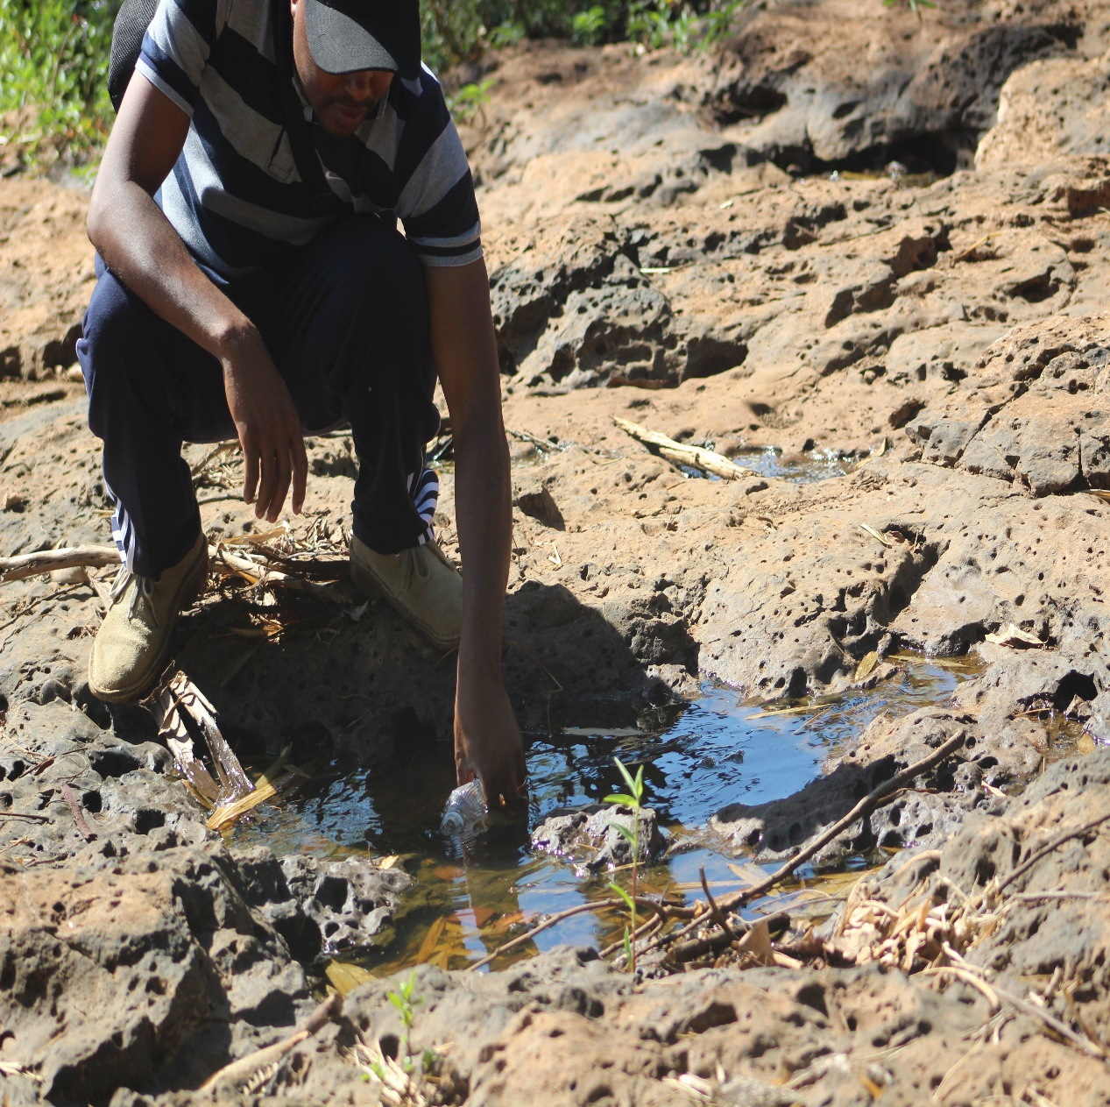
THE TEACHER AT WORK

Slide 15
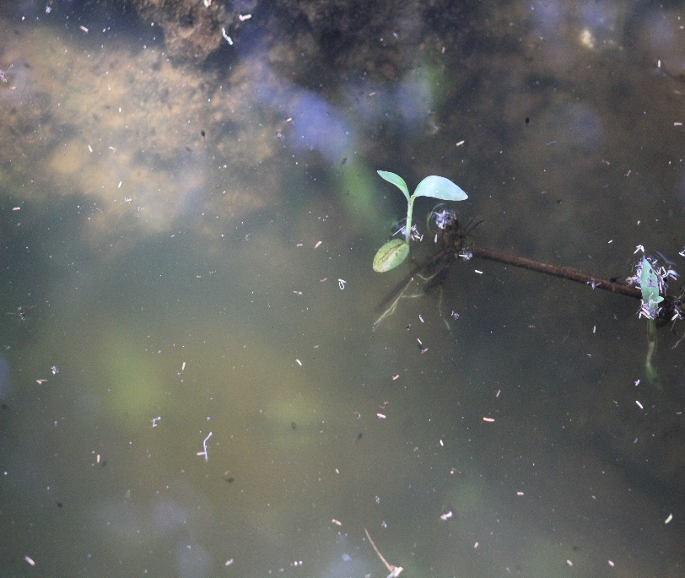
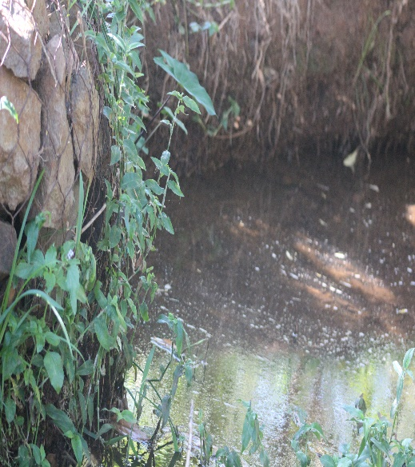
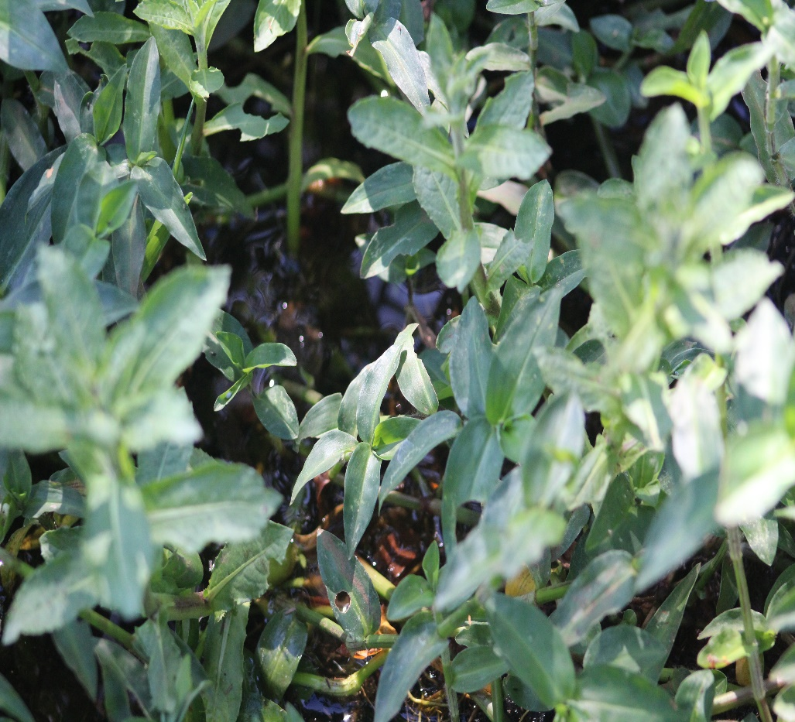
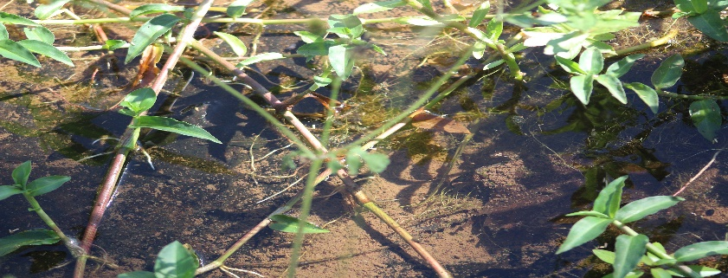
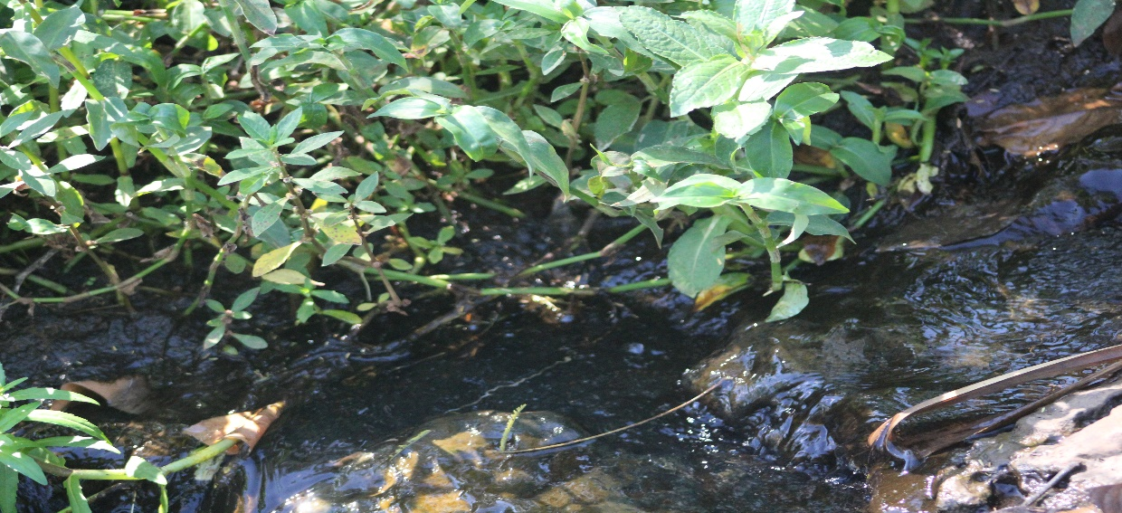
SITE PICTORIAL
.

Slide 16
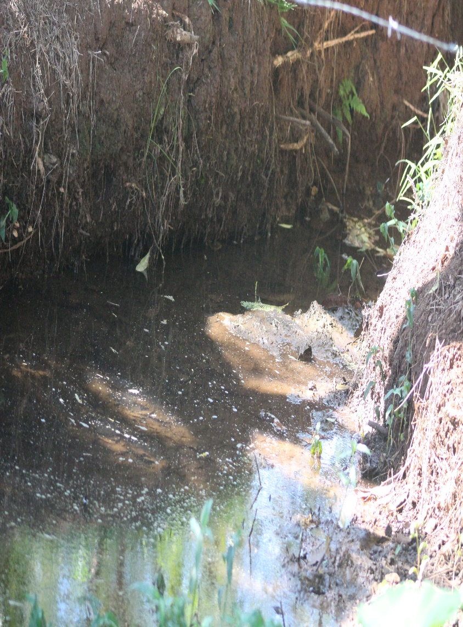
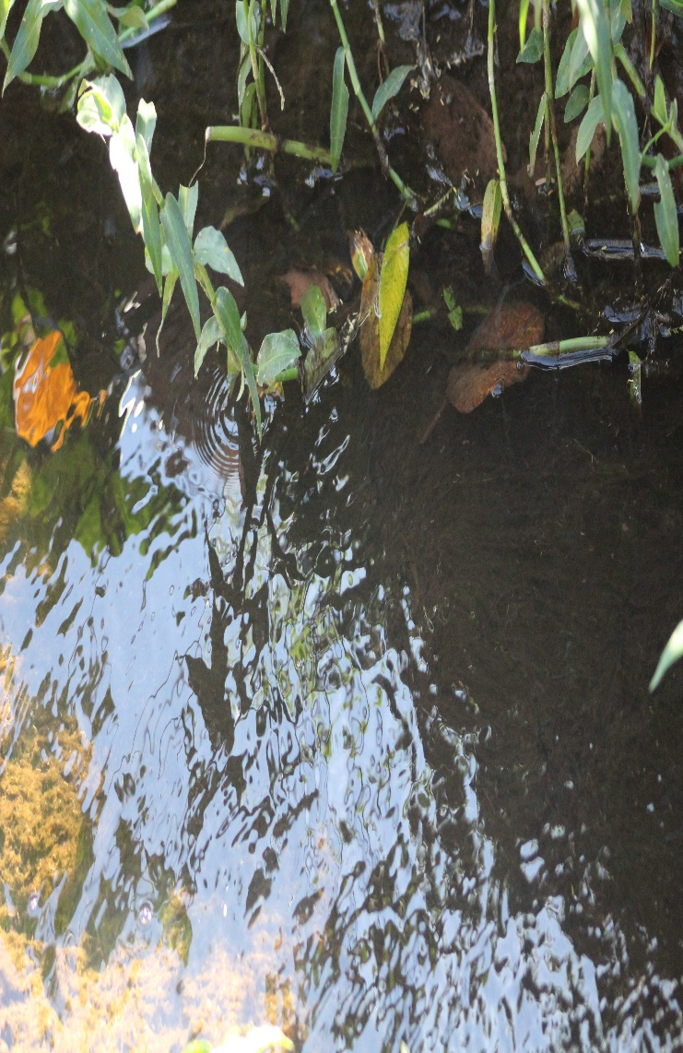
SITE PICTORIALS

Slide 17
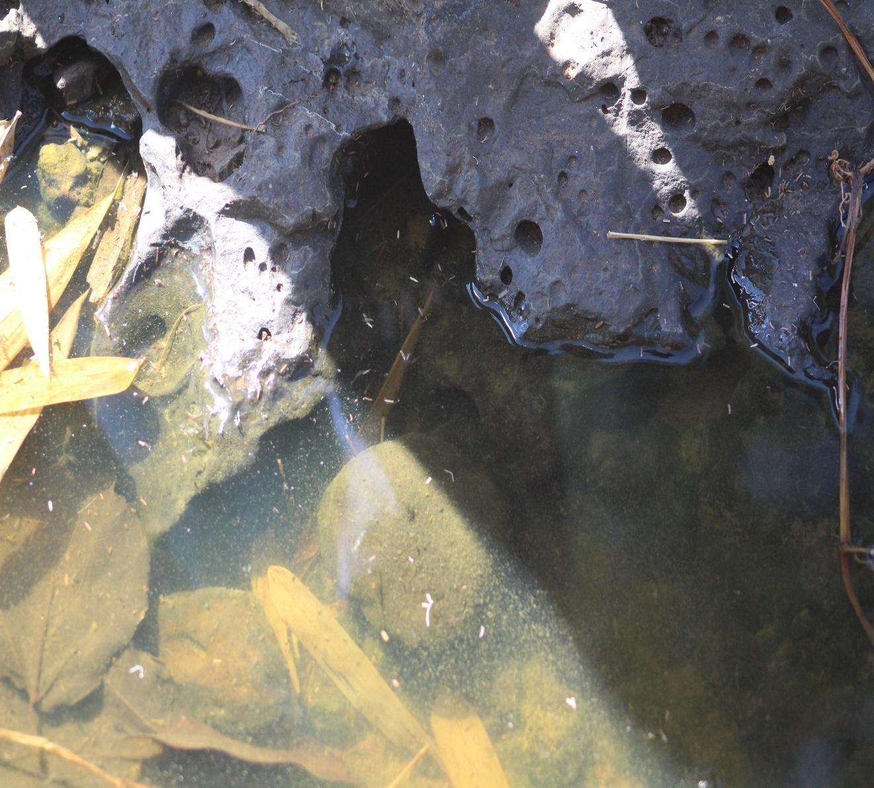
SITE PICTORIAL

Slide 18
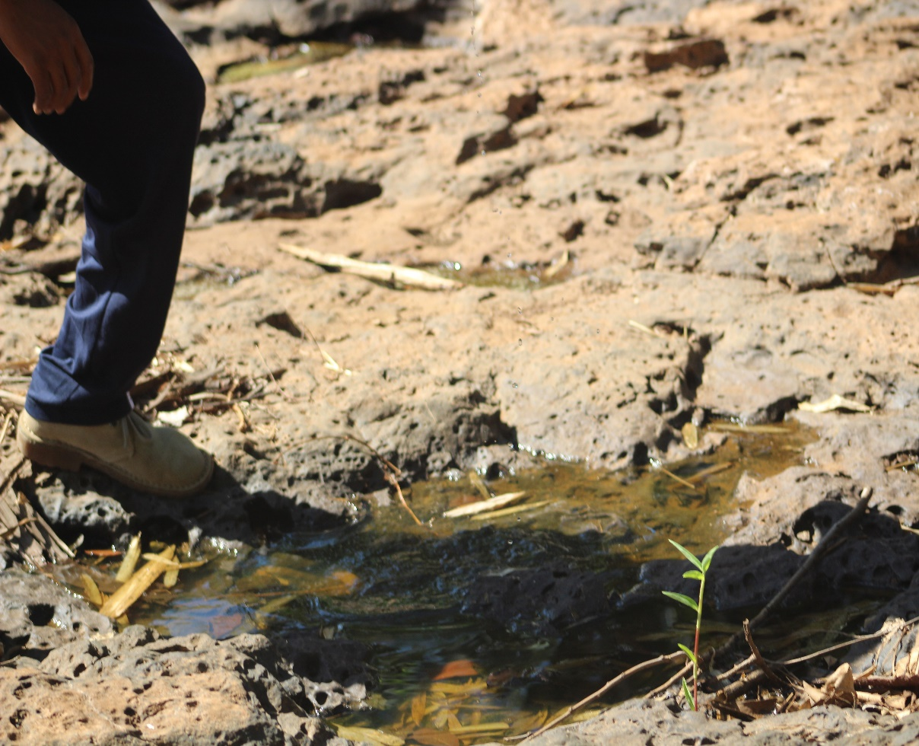

Slide 19
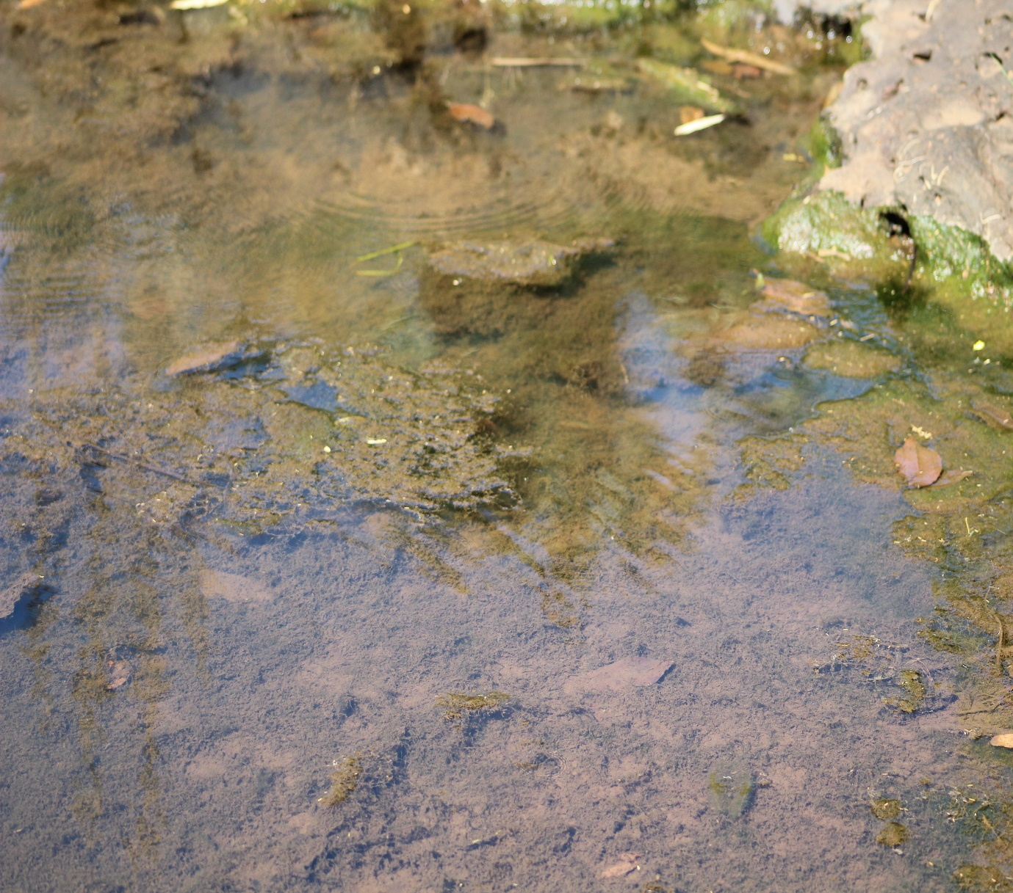
SITE PICTORIALS

Slide 20
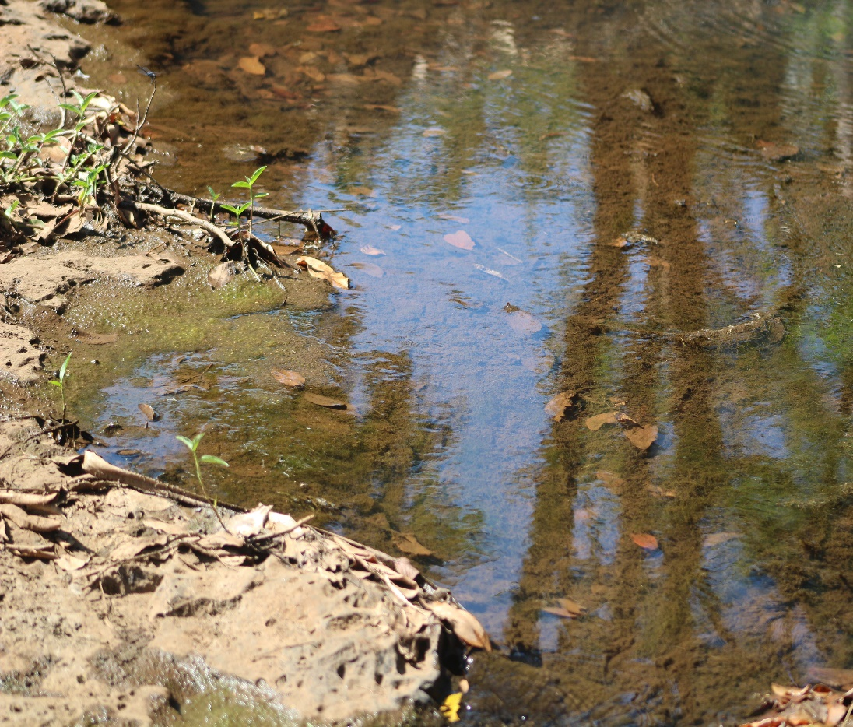

Slide 21
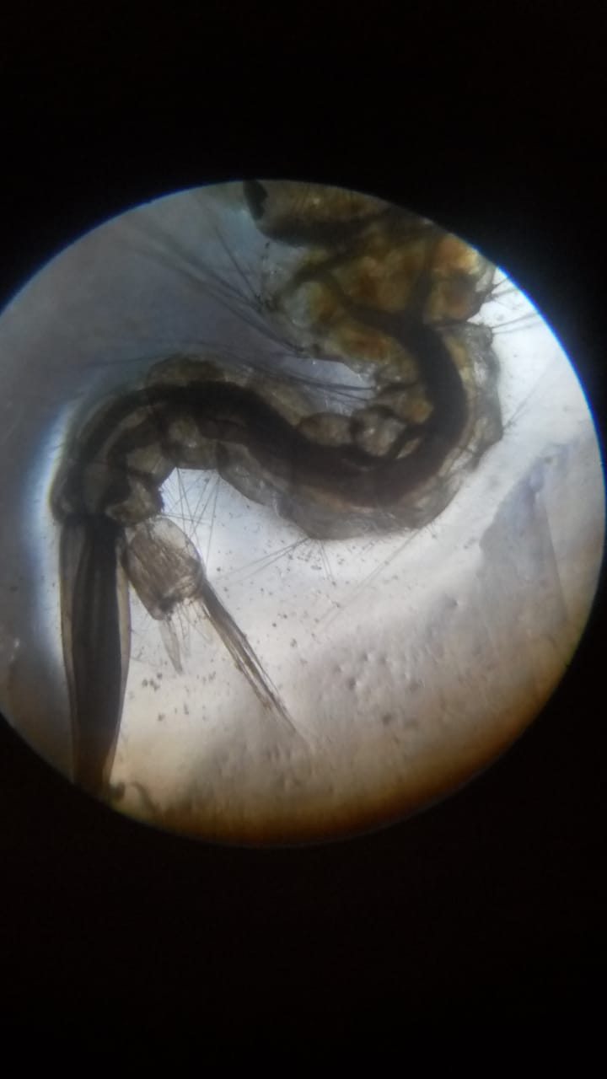
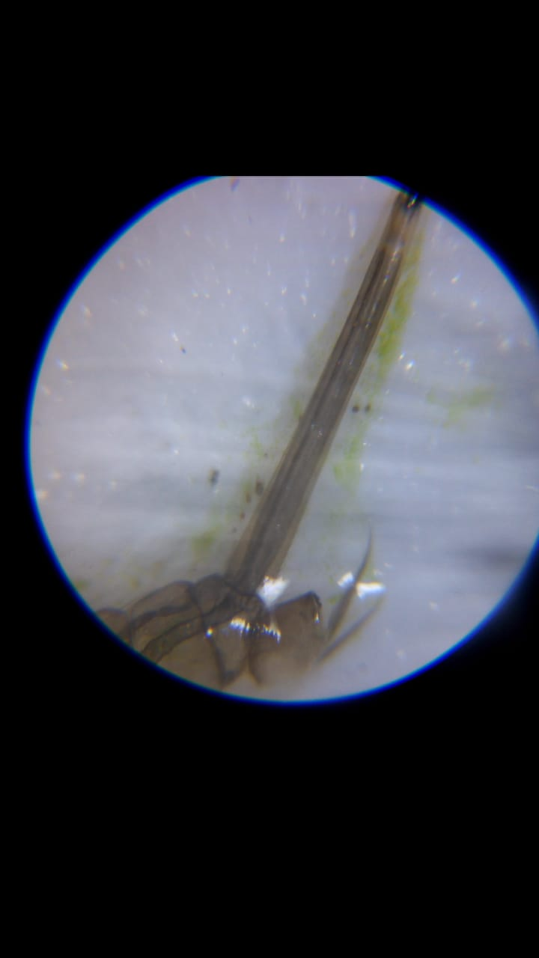
RESULTS
We were interested in central Kenya, Kirinyaga County. The following is a pictorial presentation of what we found out with our students.

Slide 22
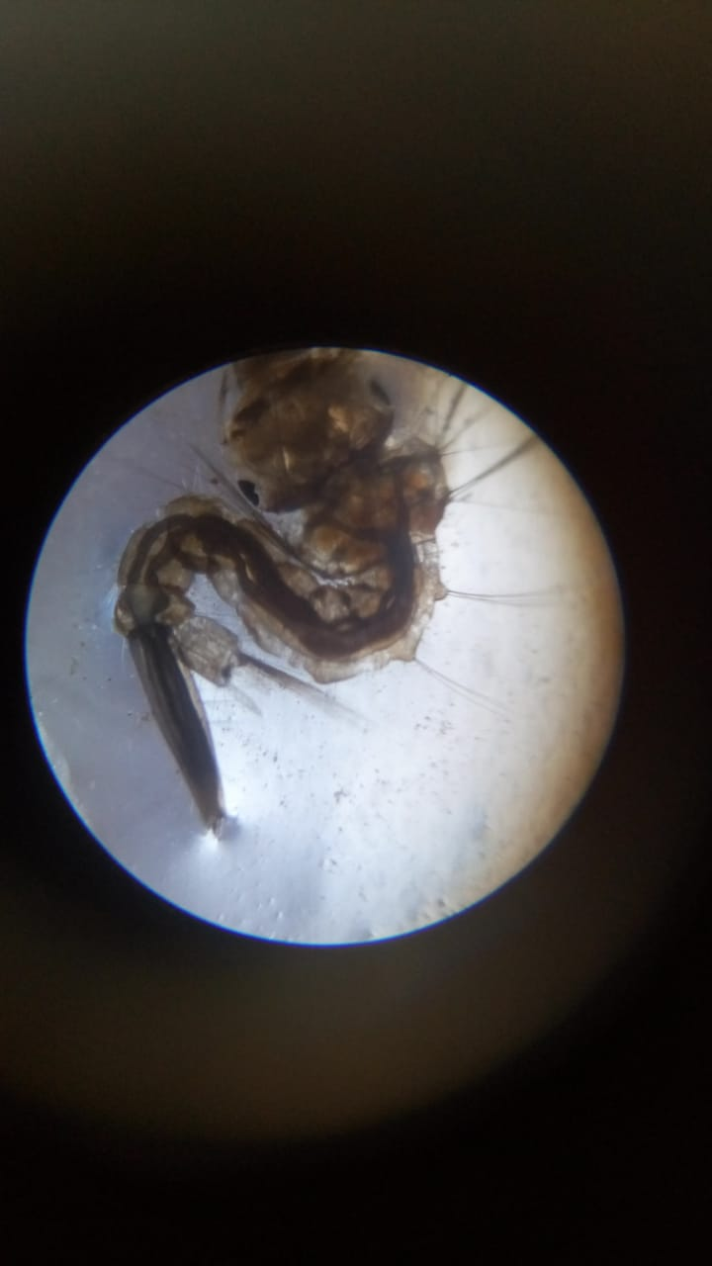
Specimen pictorials

Slide 23
Specimen images

Slide 24
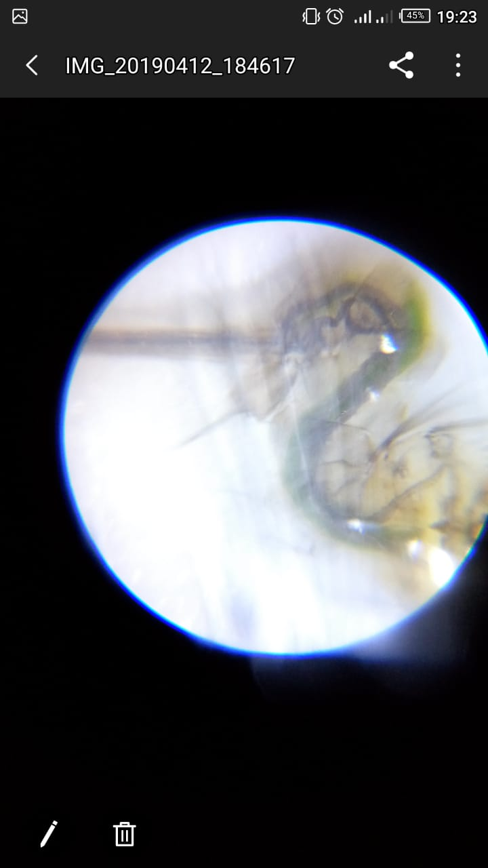
Research images

Slide 25
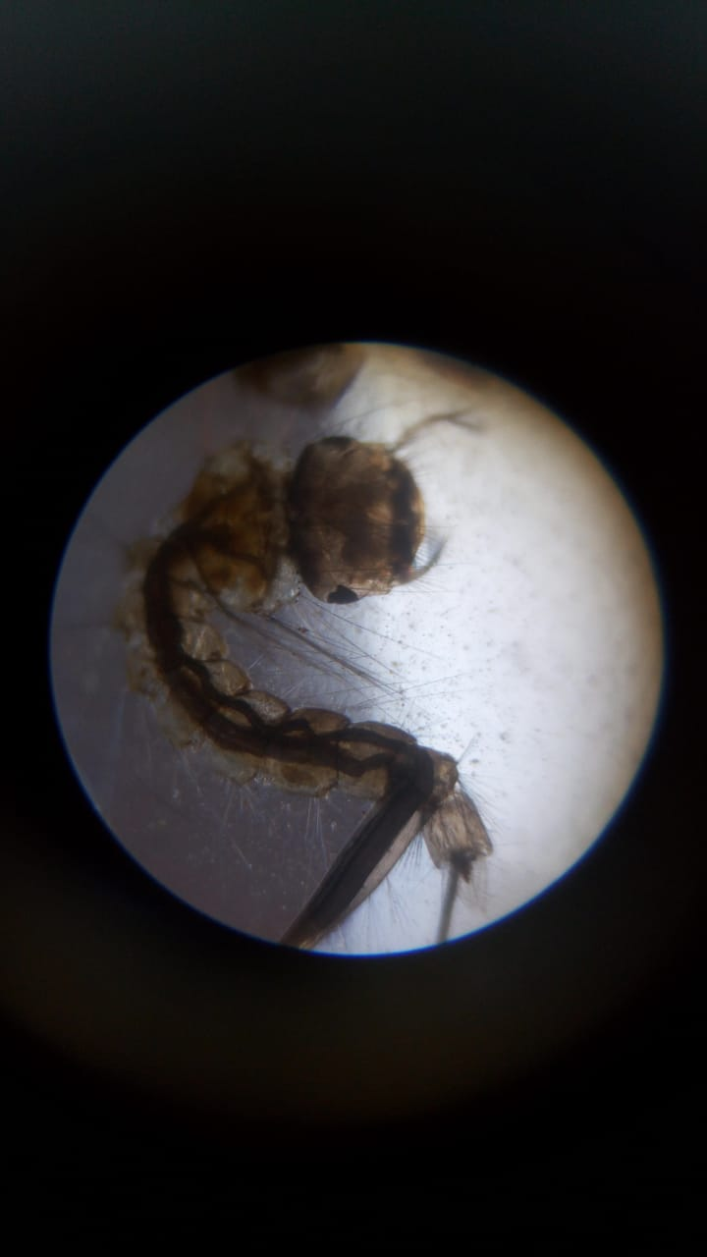
Research images

Slide 26
Discussion
The above slides with intense pictorial work was meant to prove activities done at river Sagana in Kirinyaga county, in central Kenya. From the research we were able to compare the features of the specimens and the standard mosquito habitat mapper illustrations. The heads and the tails would only be similar to those of the aedes egypti and some were the anopheles.
The pictorial work in the following slides shows the standard comparisons of reference.
During our visit to this place, we were able to share with the public the possible presence of zika virus in the country though it sounded a very ne w word to them.
At the same time we extended our discussion and education to inform the public that the best stage of controlling these mosquitoes is at the larvae stage, when they are not harmful, and are easy to identify for comparison on hier specific features.

Slide 27
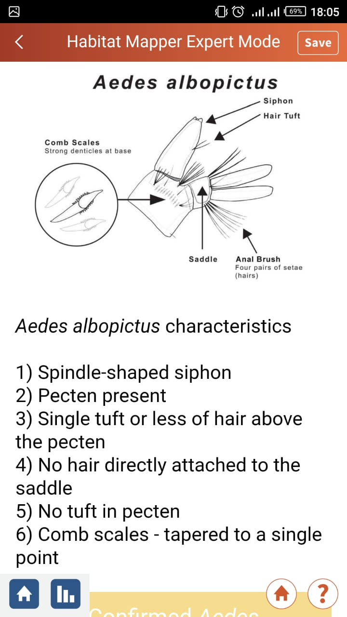
FROM THE HABITAT MAPPER

Slide 28
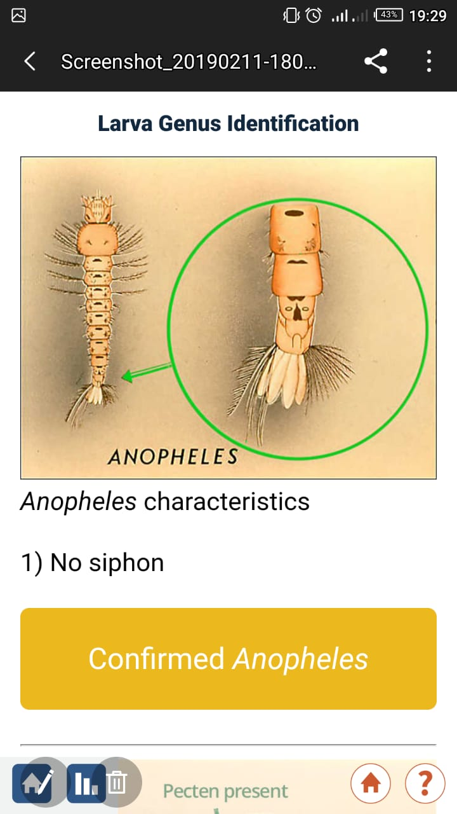
FROM THE HABITAT MAPPER

Slide 29
CONCLUSION
Aedes egypti and anopheles mosquitoes are very common in kenya.
There are high chances that the many cases treated in our hospitals as malaria and may not be malaria as such. Arguably, they may be zika infections.
The fact that we were not very successful to identify in large numbers the zika virus larvae does not quash the fact that it is not present in Kirinyaga County.

Slide 30
RECOMMENDATIONS
The government and interested health personnel and institutions in the country need to invest enough time and other resources to study and research presence of Zika virus in Kenya.
For those institutions without ability to research and offer quality services, they should be assisted to write proposals to the government and other affiliate organisations so that they can get the funding and guidance for quality and informed services, for the greater good of the society.
The government should consider investing enough time and resources in community awareness campaigns which will help enhance open and public knowledge hence make life easy and better for its people.
One of the great challenges to our students was avilablity and logistics of moving from school to these places. This required a number of procurement processes and how we recommend that other schools can be involved in these activities and have their institution administarations easily and carefully support their learners study processes.
More research kits can be availed to the public and education institutions to enhance learning and acquisition of knowledge.

Slide 31
BIBLIOGRAPHY
www.Globe.gov
Globe observer app
Globe Mosquito Habitat Mapper

