Slide 1



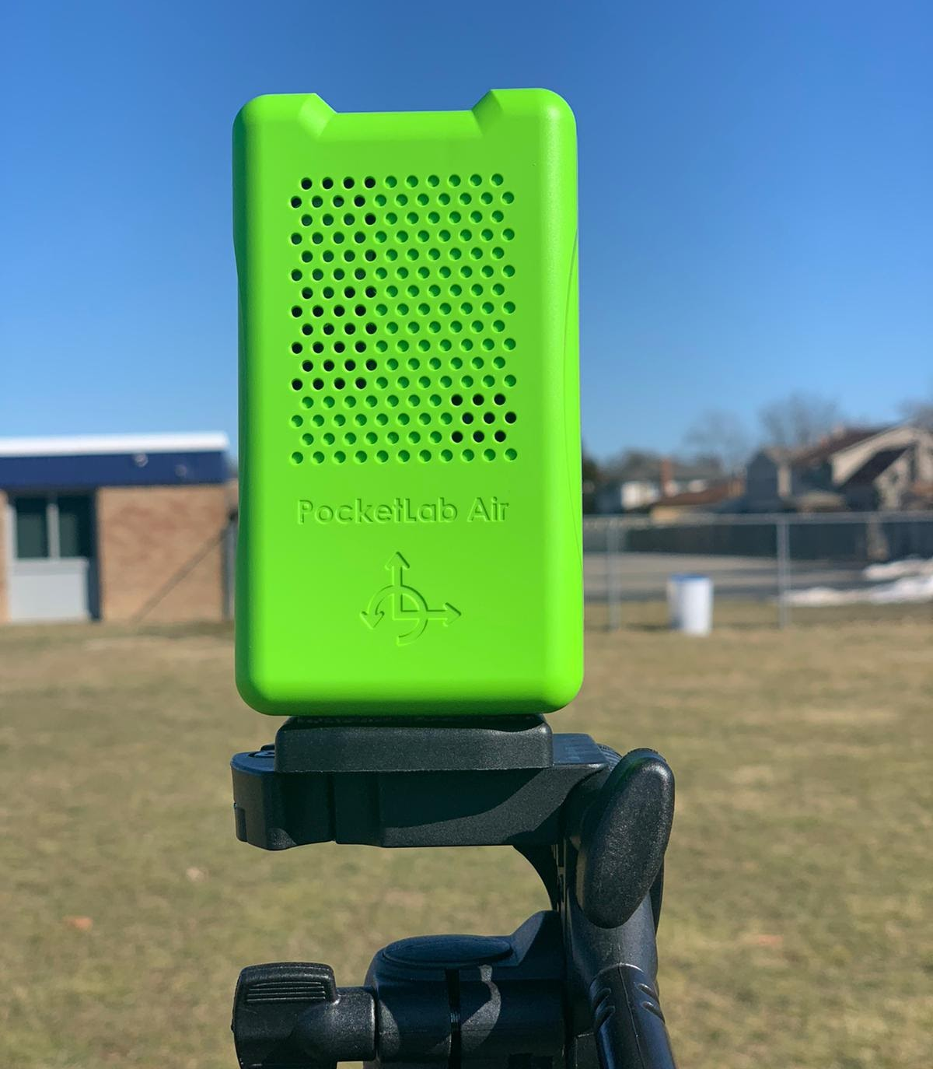
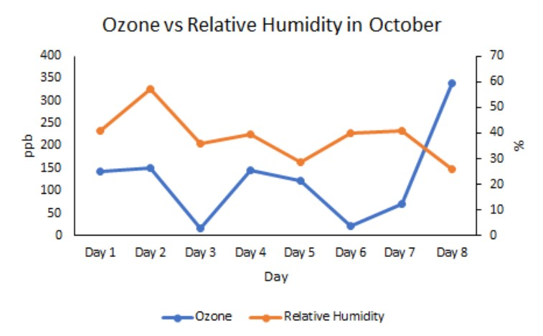
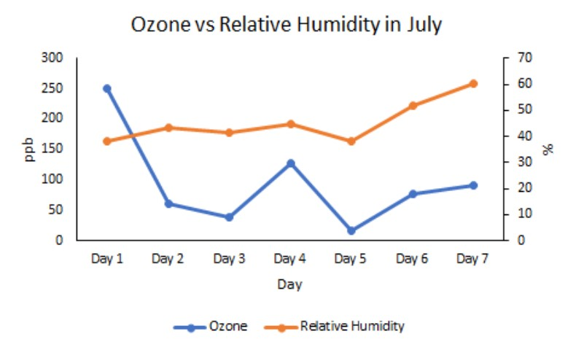
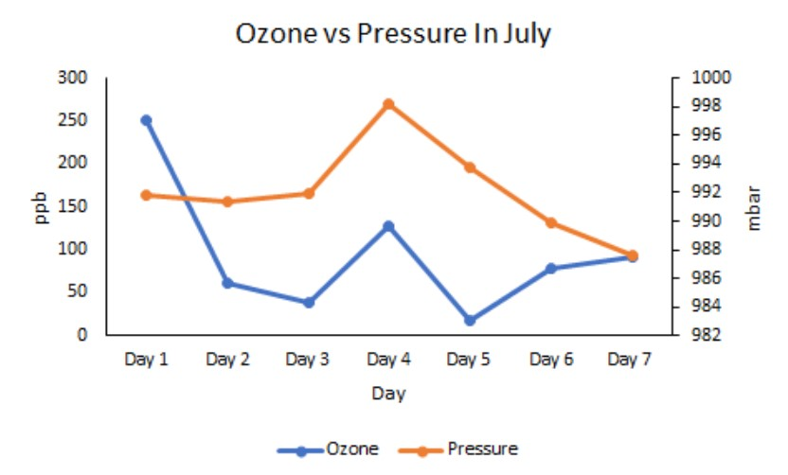
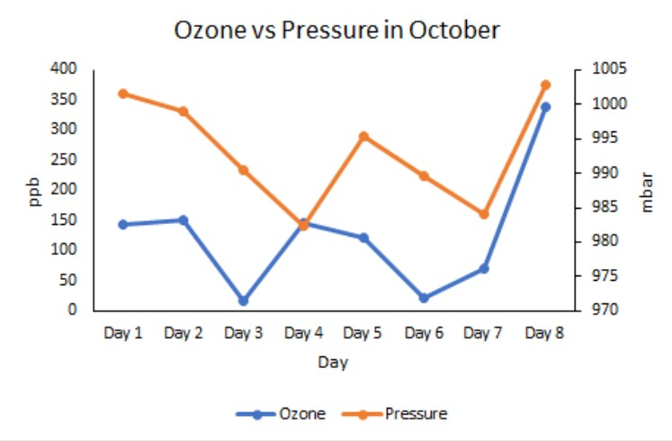
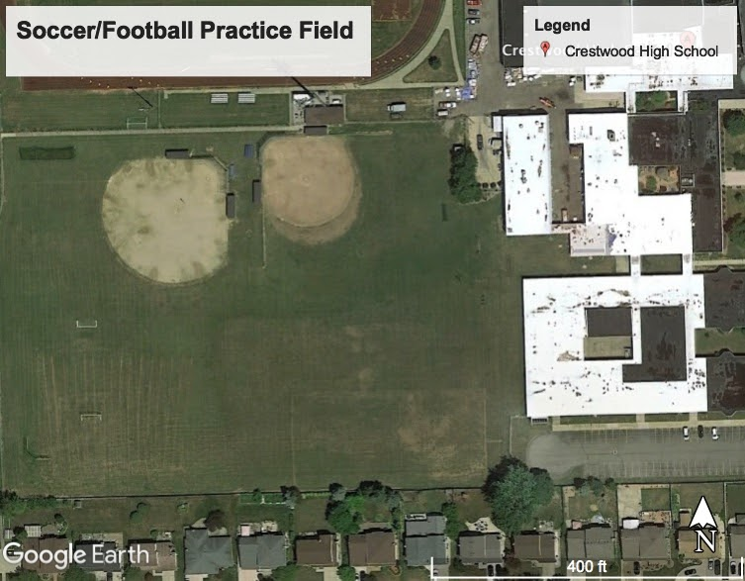
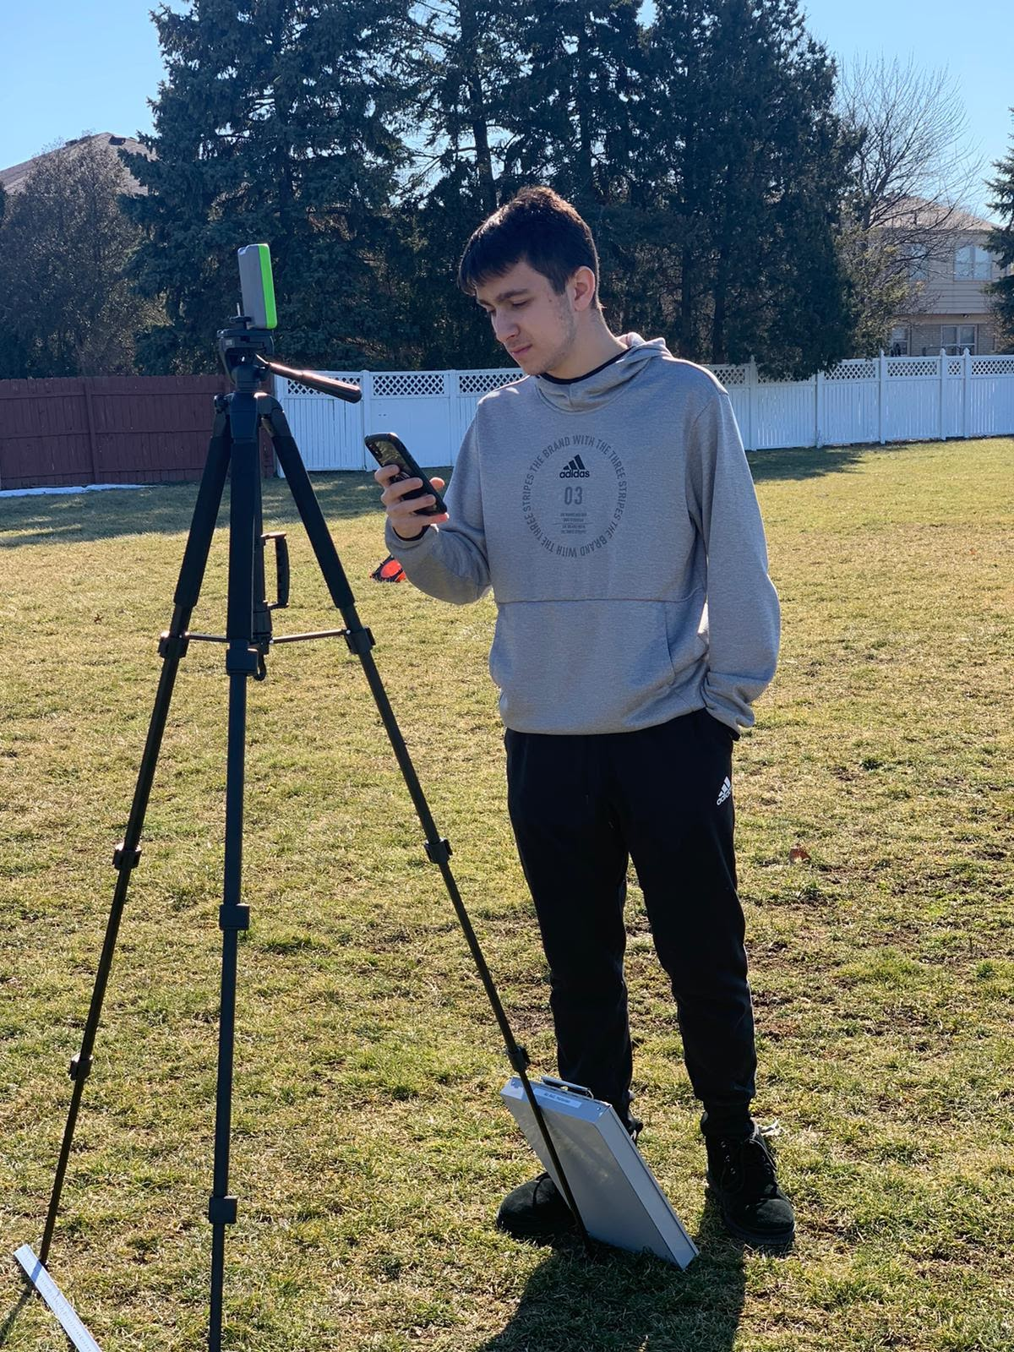
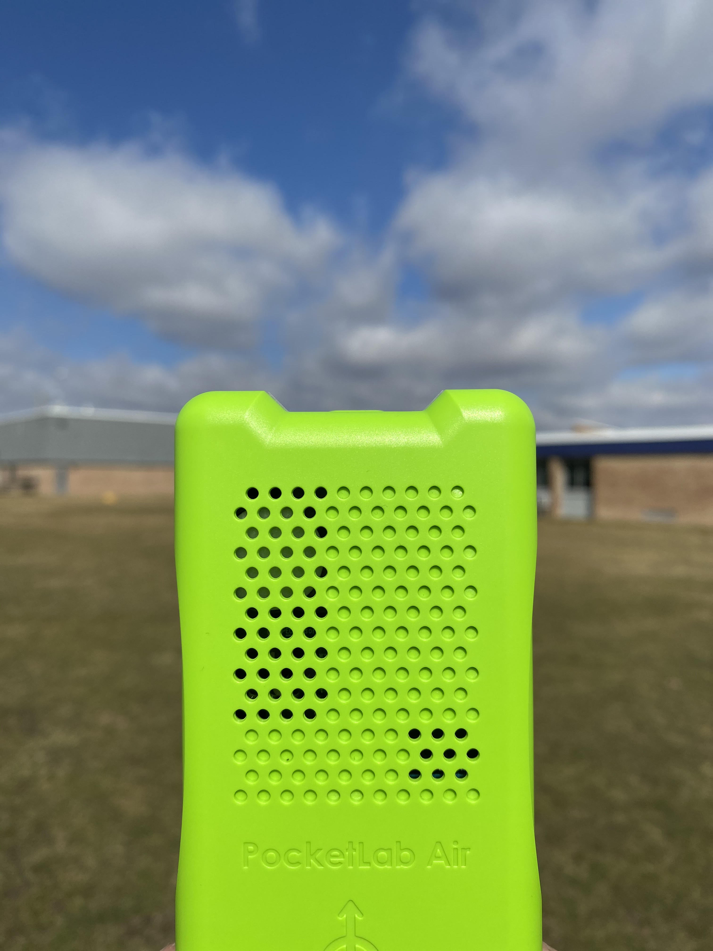

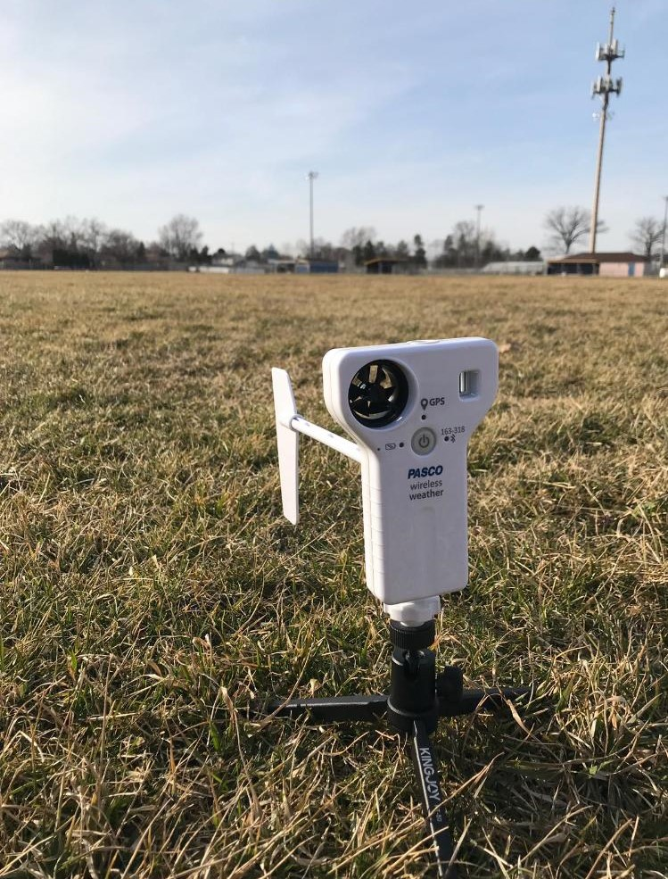
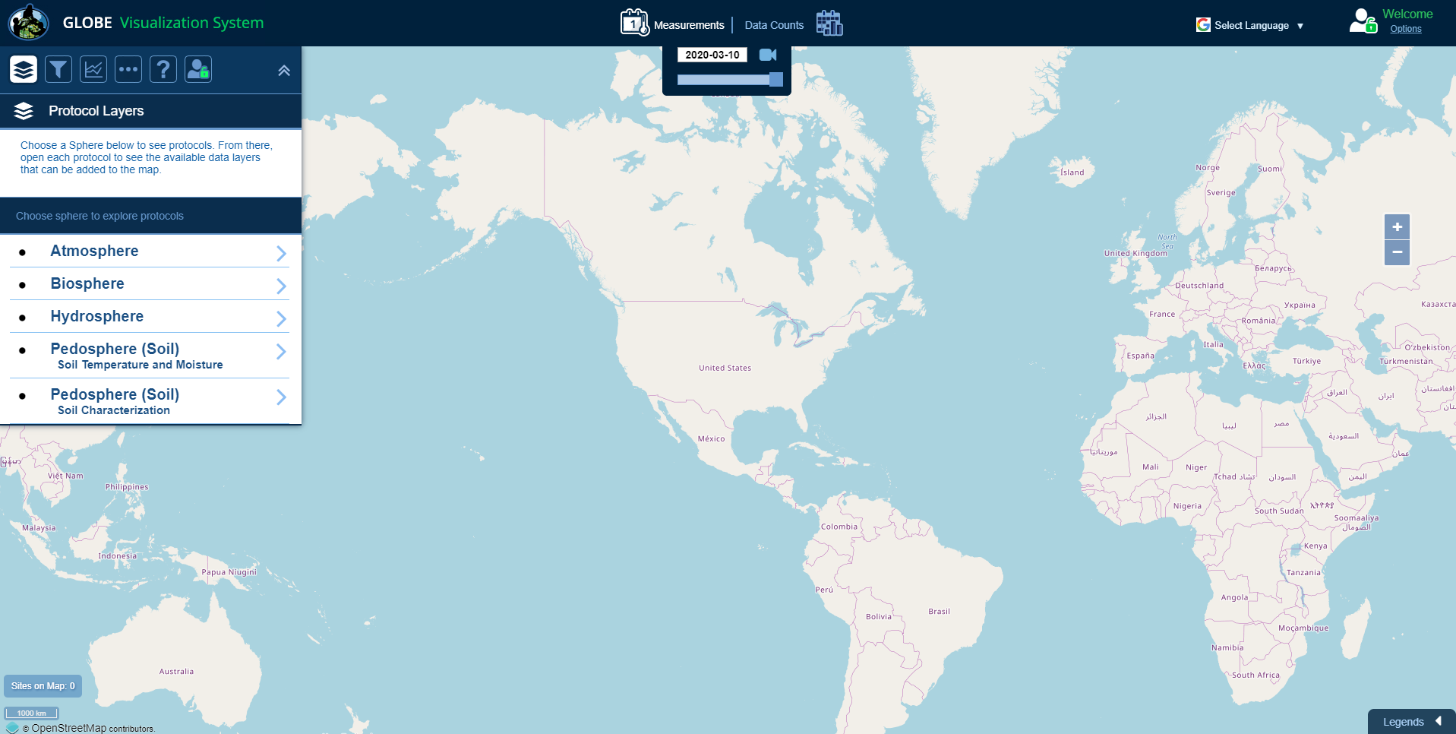
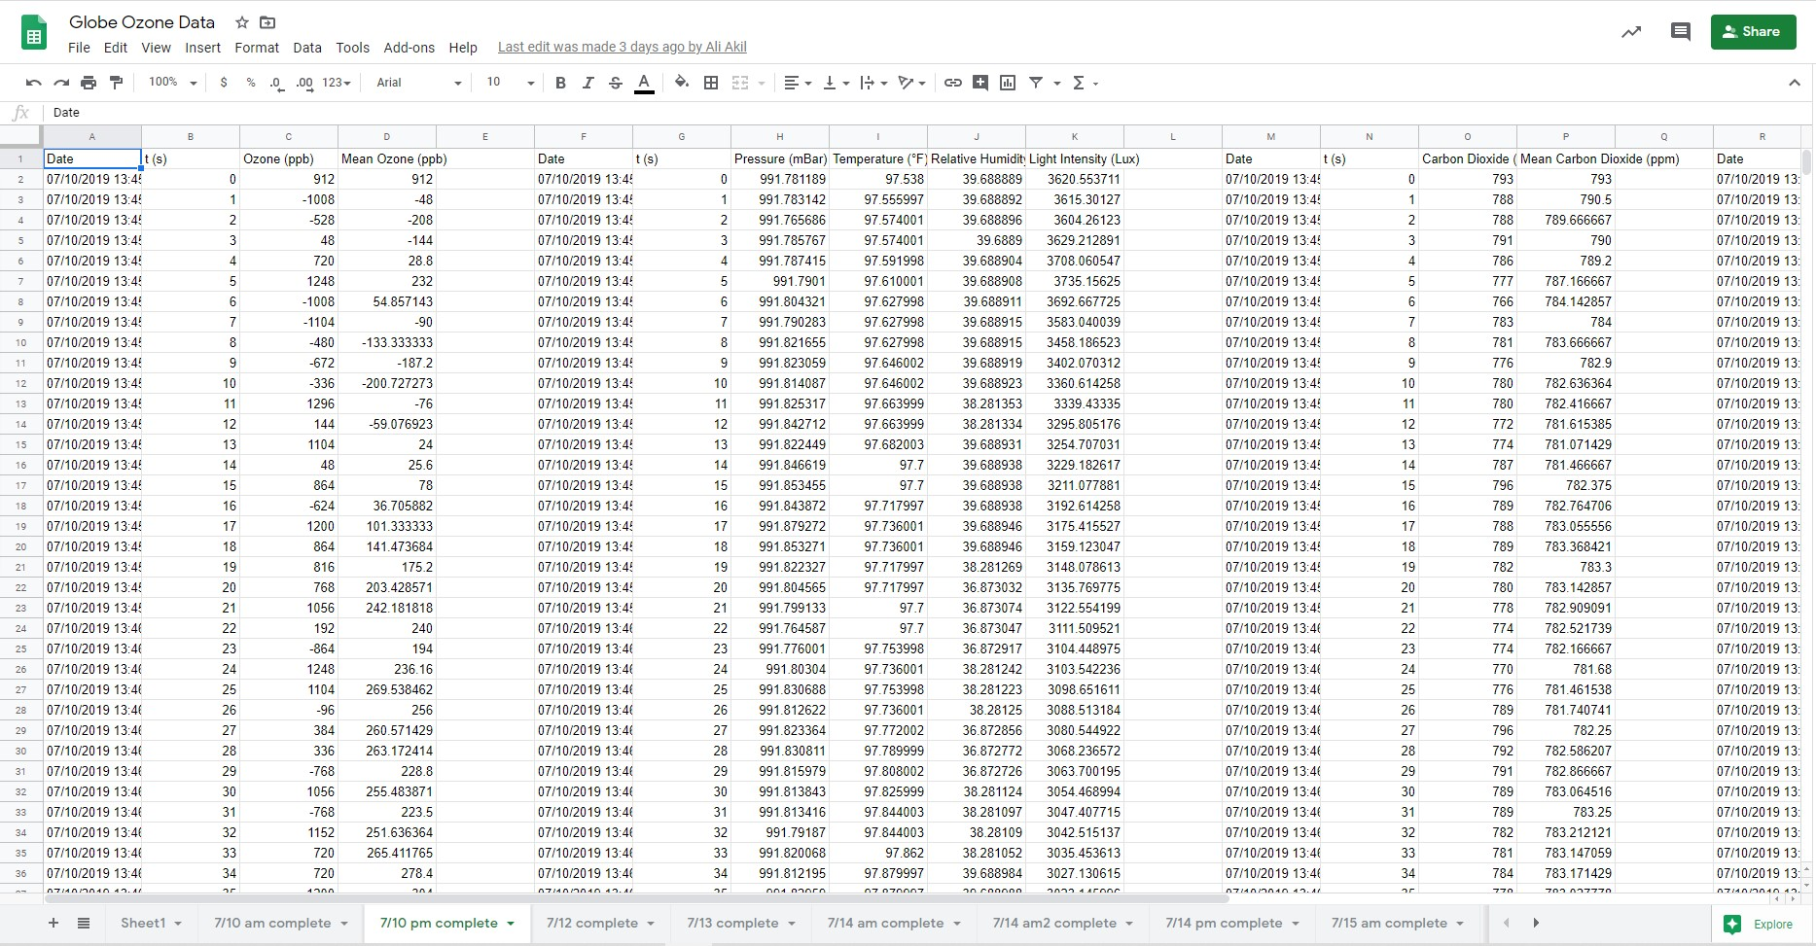
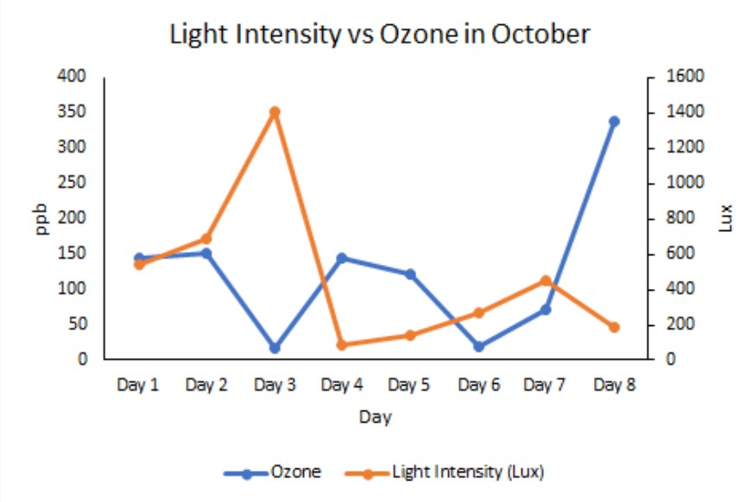
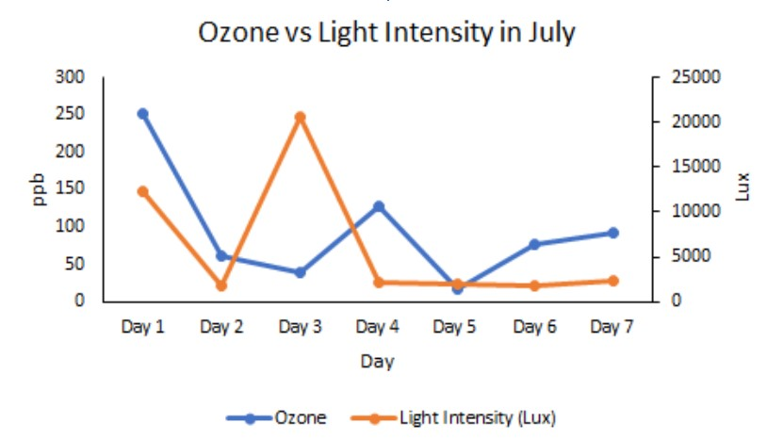
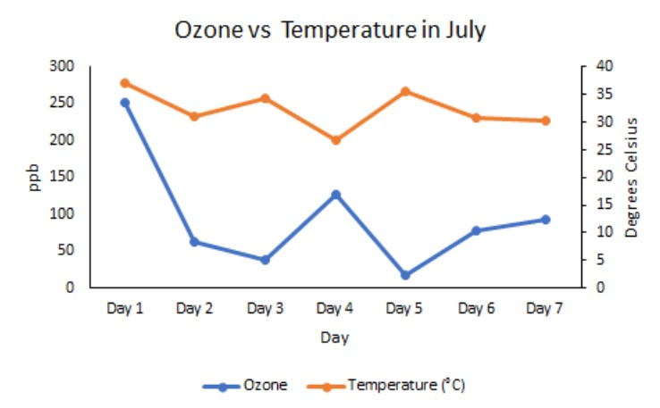
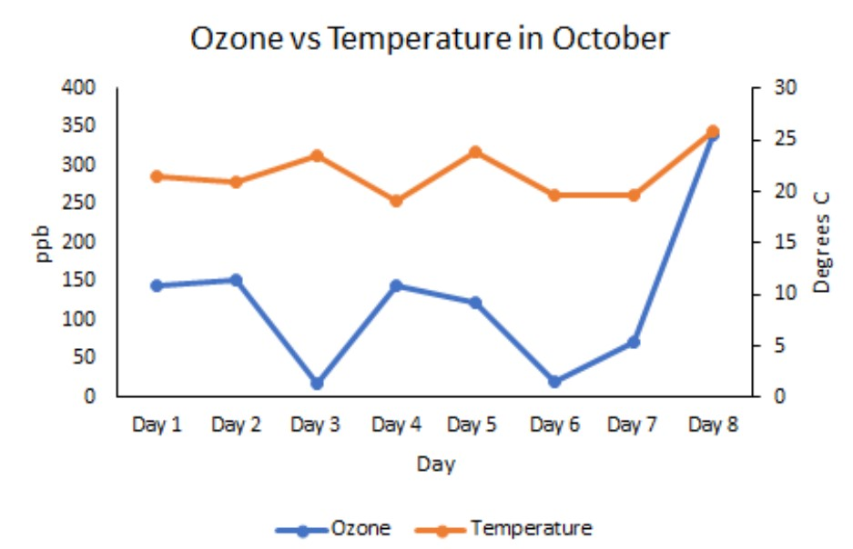
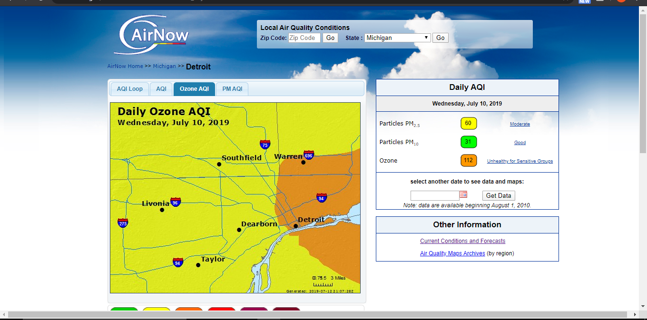
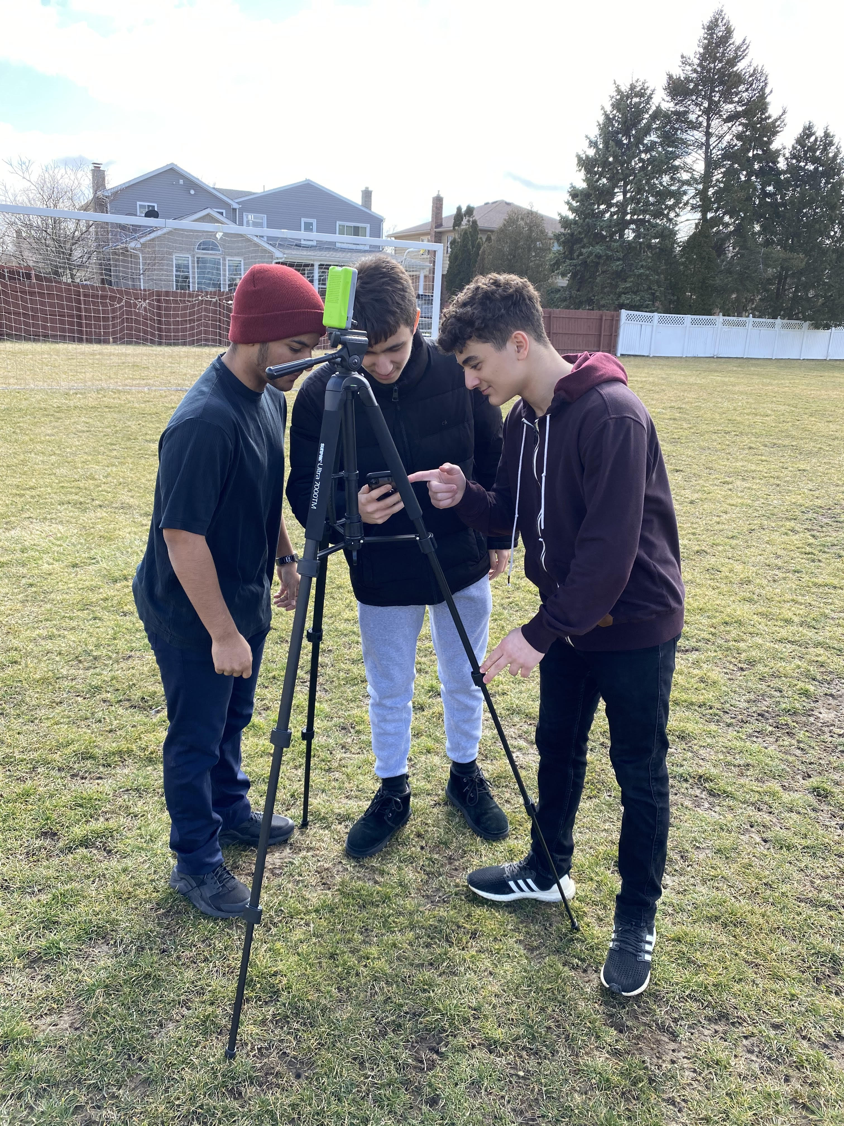
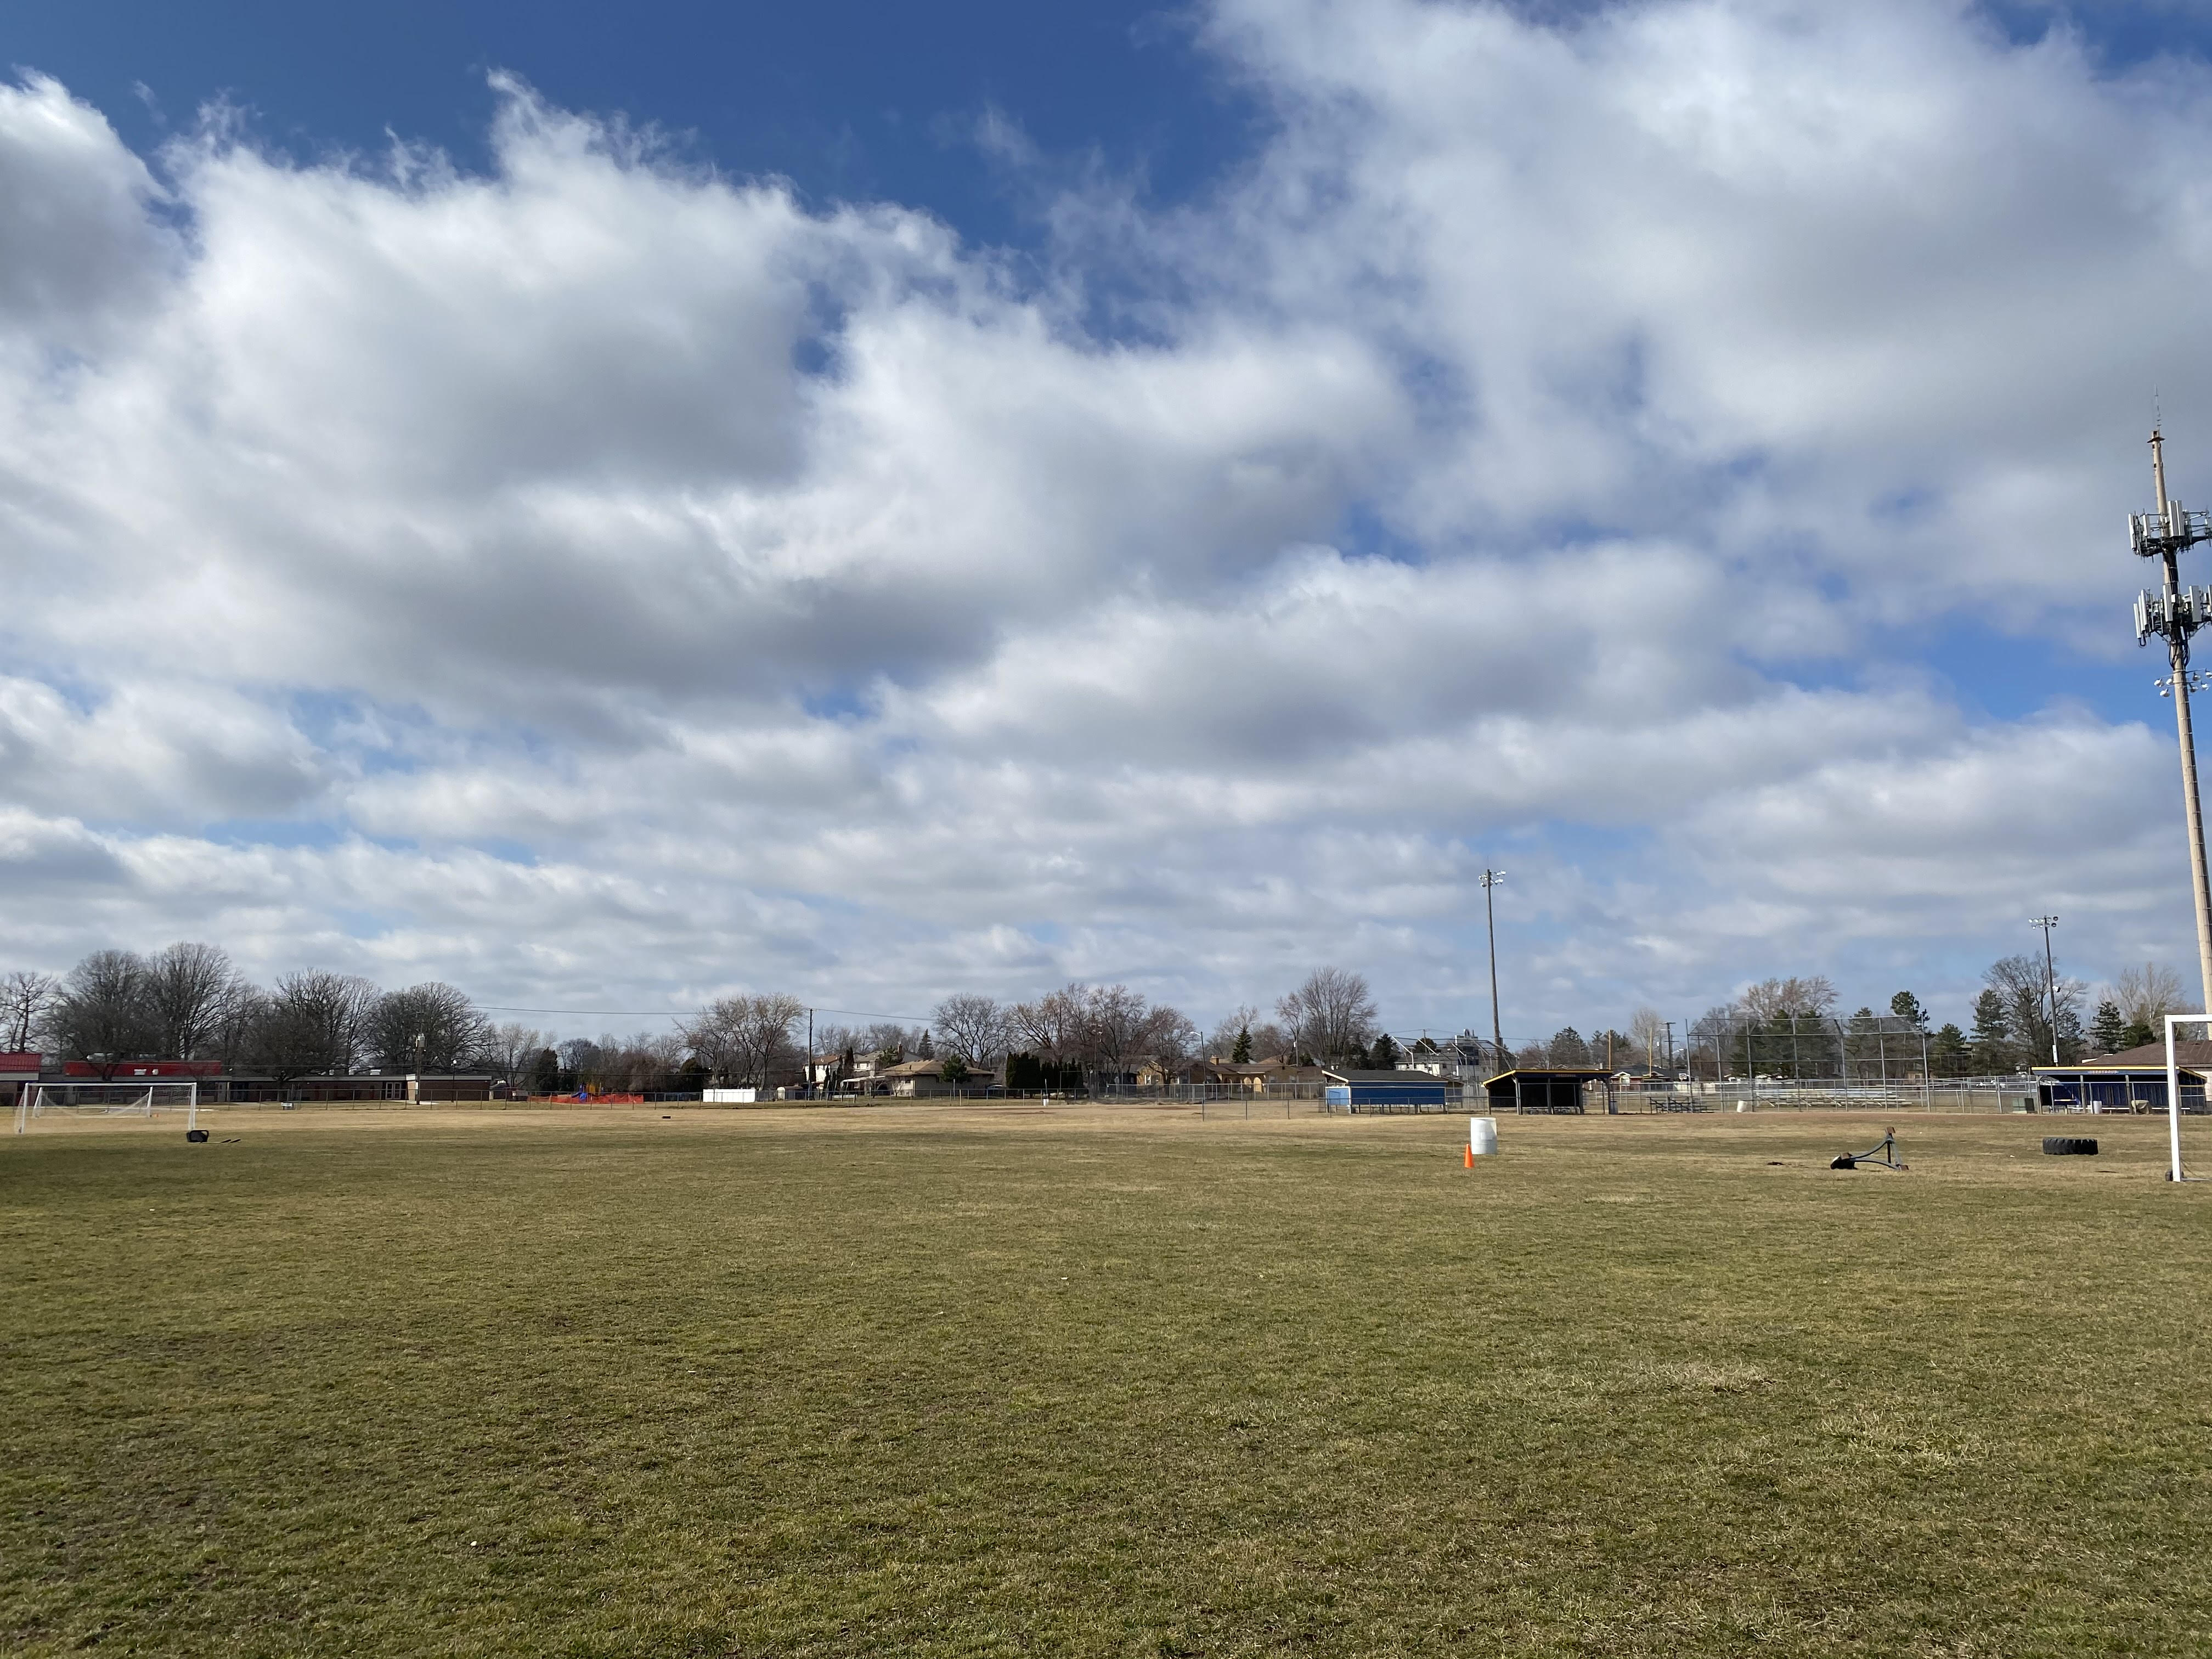
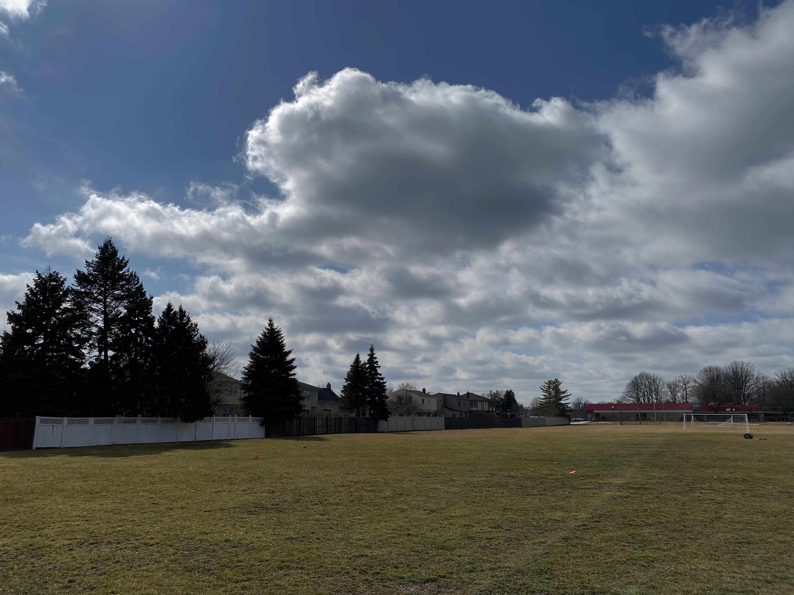
Comparing Select Weather Parameters with Ground-Level
Ozone During the Summer and Autumn Seasons
Adam Ali, Ali Akil, Jelal Muflahi
Crestwood High School – Dearborn Heights, MI
Abstract
Results
Methods
In the stratosphere, ozone molecules play an important role absorbing ultraviolet radiation from the Sun and shielding Earth from dangerous rays. But in the troposphere, near ground-level, ozone molecules are both air pollutants, threatening the health of living things, and greenhouse gases, trapping heat and contributing to climate change. With our research, we sought to compare select weather parameters with surface ozone to determine which impact ozone levels. This would better allow researchers and scientists to prevent future increases in ozone levels. This led us to our research question, to what extent do select weather parameters impact local surface ozone levels? To successfully complete our research, we took daily measurements at our school’s soccer field using the PASCO wireless weather station and the Pocket Lab weather device. It was found that ozone correlated with pressure, relative humidity, and temperature. However, there was no real correlation between light intensity and surface ozone levels.
Take daily measurements at school soccer field
PocketLab device recorded data
Figure 1-2: These graphs above compare surface ozone levels with relative humidity during a week in July and a week in October. You’ll notice that both parameters are relatively correlated, however, if the relative humidity is low then trees will close their stomata and will not take up any ozone allowing it to build up which will result in inverse relations between the two. This is shown on day one in the July chart and on day eight of the October chart.
Figure 1-2: Ozone versus pressure in July vs October. These graphs compare surface ozone levels with pressure during a week in July and a week in October. As shown above you can notice a direct correlation between ozone and pressure.
Enter data into the Globe Database`
Analyze data
Research Questions/ hypotheses
Discussion
How do the ozone levels in mid summer differ from the ozone levels in mid autumn?
How do changes in atmospheric pressure affect ozone levels?
What role does temperature play in the development of ozone?
To what extent does relative humidity affect ozone levels?
To what extent does light intensity affect ozone levels?
When conducting our research, we were faced with some unfortunate challenges that created imperfections in our data. With some scheduling and transportation being out of our control, on some days we were unable to collect our data at the specific time we had originally planned for. Furthermore, our daily averages were based on data recordings of at least 5 minutes, however on some days we let it run for a little longer, so some daily averages are more accurate than others. Additionally, we had hoped to be able to collect data during the winter weather, but due to busy schedules and harsh weather conditions, we were unable to. The data we did collect we converted into graphs which allowed us to see the trends and successfully answer our original research question.
There is a direct correlation between time of year and average ozone levels.
There is no direct correlation between pressure and ozone levels.
There is a direct correlation between increased temperatures and ozone levels.
There is a direct correlation between increased humidity and ozone levels.
There is no correlation between increased light intensity and ozone levels.
Figure 5-6: Ozone versus Light intensity. These graphs above compare surface ozone levels with light intensity during a week in July and a week in October. As shown to you above, there is no correlation between ozone and light intensity.
Figures 7-8: Ozone vs temperature: These graphs compare the ozone levels and temperature in the months of July and October. Ozone's impact is due to changes in temperature. The more ozone the more heat is retained. Ozone leads to heat in the stratosphere, by absorbing ultraviolet radiation from the sun and by absorbing infrared radiation from the troposphere. These graphs show a delayed correlation between the temperature and ozone levels.
Research Implications
Conclusions
Introduction
Scientists monitor ground-level ozone closely in many parts of the world because of the variety of health implications it has on humans. It is especially important in warmer environments as it was observed that the development of ozone increases in warmer temperatures. The numerous health problems associated with it include chest pain, coughing, throat irritation, and congestion. It may worsen to reduce lung function and the inflammation of the linings of the lungs. In severe cases, repeated exposure may lead to permanently scarred lung tissue. Even those with great health are impacted by the effects of ozone as it can lead to trouble breathing. The impact of ozone also extends to wildlife and vegetation as it leads to reduced agricultural and crop yields. By finding how to select weather parameters impact ozone levels, we can determine what factors may lead to future increases in this harmful gas. Knowing what impacts ozone allows researchers to focus on monitoring certain weather parameters and looking into ways that reduce those that increase ozone.
Upon completing our research, it was found that some of the weather parameters we monitored did correlate with ozone levels, while others did not. Our data showed a correlation of ozone with pressure, relative humidity, and temperature. However, it was found that there was no clear correlation between light intensity and surface ozone levels. These findings suggest that researchers should look into ways to control these parameters which would allow them to prevent ozone levels from becoming too high in certain areas. This would allow for cleaner and safer air where there are large events such as those at our high school. When comparing our data with the Michigan Air Quality - AirNow, we found that our data is very similar when we took longer periods of data collection however not so similar on the days that we took a bare minimum of 5 minutes worth of data. We didn’t notice any drastic differences when we compared our data from the month of July to the month in October. Overall though, both Michigan’s Air Quality and our data on surface ozone, temperature, light intensity, relative humidity, and barometric pressure seem to match. Future research may include testing different ways ozone and the weather parameters it is correlated to can be controlled and reduced. Overall, with minimal sources of error, we were able to collect the data needed to answer our original research questions.
From July of 2019 to October, Data was collected on a multitude of weather parameters, that were compared to surface ozone. The ozone layer is the lower part of the Earth's stratosphere and is 20 to 30 kilometers above the surface of the Earth (Abdalrhman Khaled Al Zahrani). Surface ozone can cause several unexpected outcomes from health issues too and even environmental issues. This can be a major issue as CHS is known for its sports and ozone can affect these activities. Furthermore, people in warmer areas tend to experience chest pains, coughing, throat irritation, and congestion (Air Now). In some severe cases, it may worsen to reduce lung function and the inflammation of the linings of the lungs which could lead permanently scarred lung tissue Throughout the year, Crestwood is put to use for multiple outdoor events, so with people constantly being outside for these events and surface ozone continuously increasing, it’ll only cause an increase in problems for the people of our city. Surface ozone may reduce photosynthesis in plants, species diversity, habitat quality, and changes in the water and nutrient cycles. Ozone doesn’t only affect humans, but also our local community. Black cherry, an important part of Michigan's economic success during the cherry season; Tulip Poplar, a native species in Michigan that brings beauty to our city; White Pine, Michigan’s state tree that not only brings beauty but is a key resource in one of our greatest industries of lumbering; and finally the Ponderosa Pine, one of Michigan’s three native species of pine trees (EPA). The trees listed before are all crucial to our community and ecosystems, from economic benefits to keeping habitat diversity. Not only do these trees exist within Crestwood High School but also within our very homes and if the issue of increasing ozone levels continues will not only experience issues at our school but also at our very own homes.
Bibliography
Kavassalis, Sarah C., and Jennifer G. Murphy. “Understanding Ozone‐Meteorology Correlations: A Role for Dry Deposition.” AGU Journals, John Wiley & Sons, Ltd, 31 Mar. 2017, agupubs.onlinelibrary.wiley.com/doi/full/10.1002/2016GL071791.
Good Up High Bad Nearby - What Is Ozone?, www.airnow.gov/index.cfm?action=gooduphigh.index.
“NASA GISS: Research Features: Ozone and Climate Change.” NASA, NASA, www.giss.nasa.gov/research/features/200402_tango/.
“Ozone Generators That Are Sold as Air Cleaners.” EPA, Environmental Protection Agency, 23 Dec. 2019, www.epa.gov/indoor-air-quality-iaq/ozone-generators-are-sold-air-cleaners.
Burrows, Leah. “The Complex Relationship between Heat and Ozone.” Harvard Gazette, Harvard Gazette, 15 Mar. 2019, news.harvard.edu/gazette/story/2016/04/the-complex-relationship-between-heat-and-ozone

Slide 3
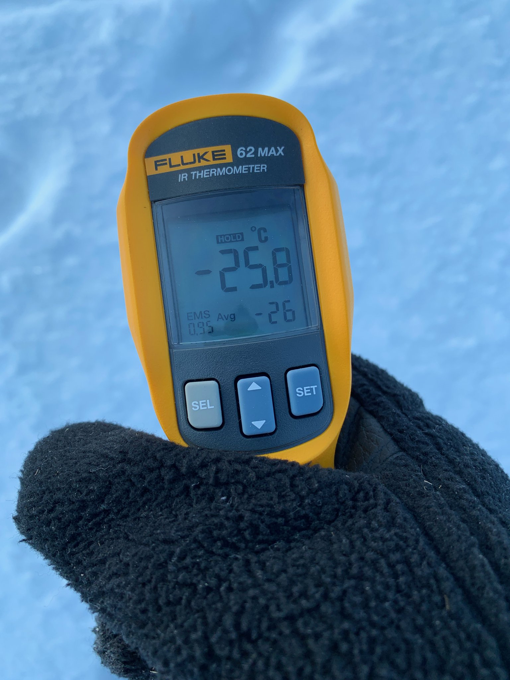
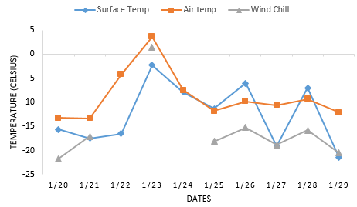
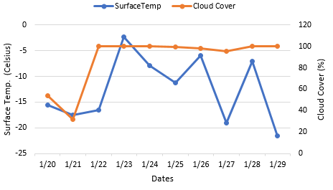
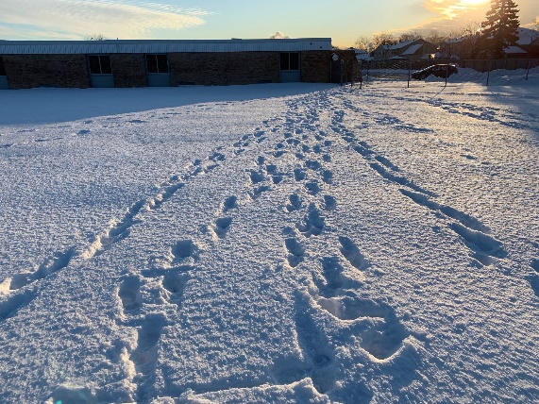
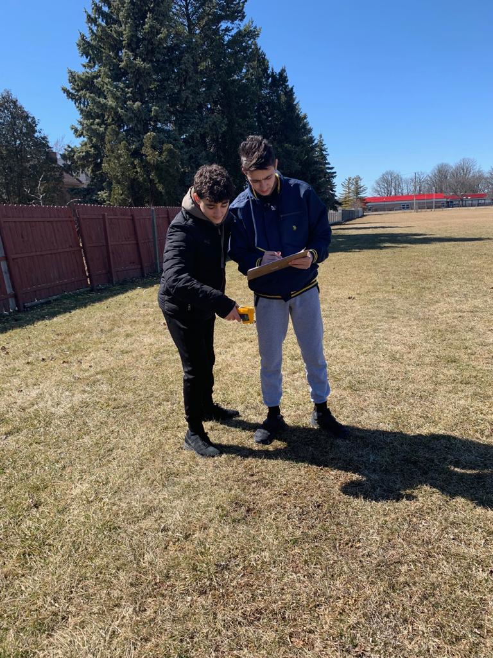
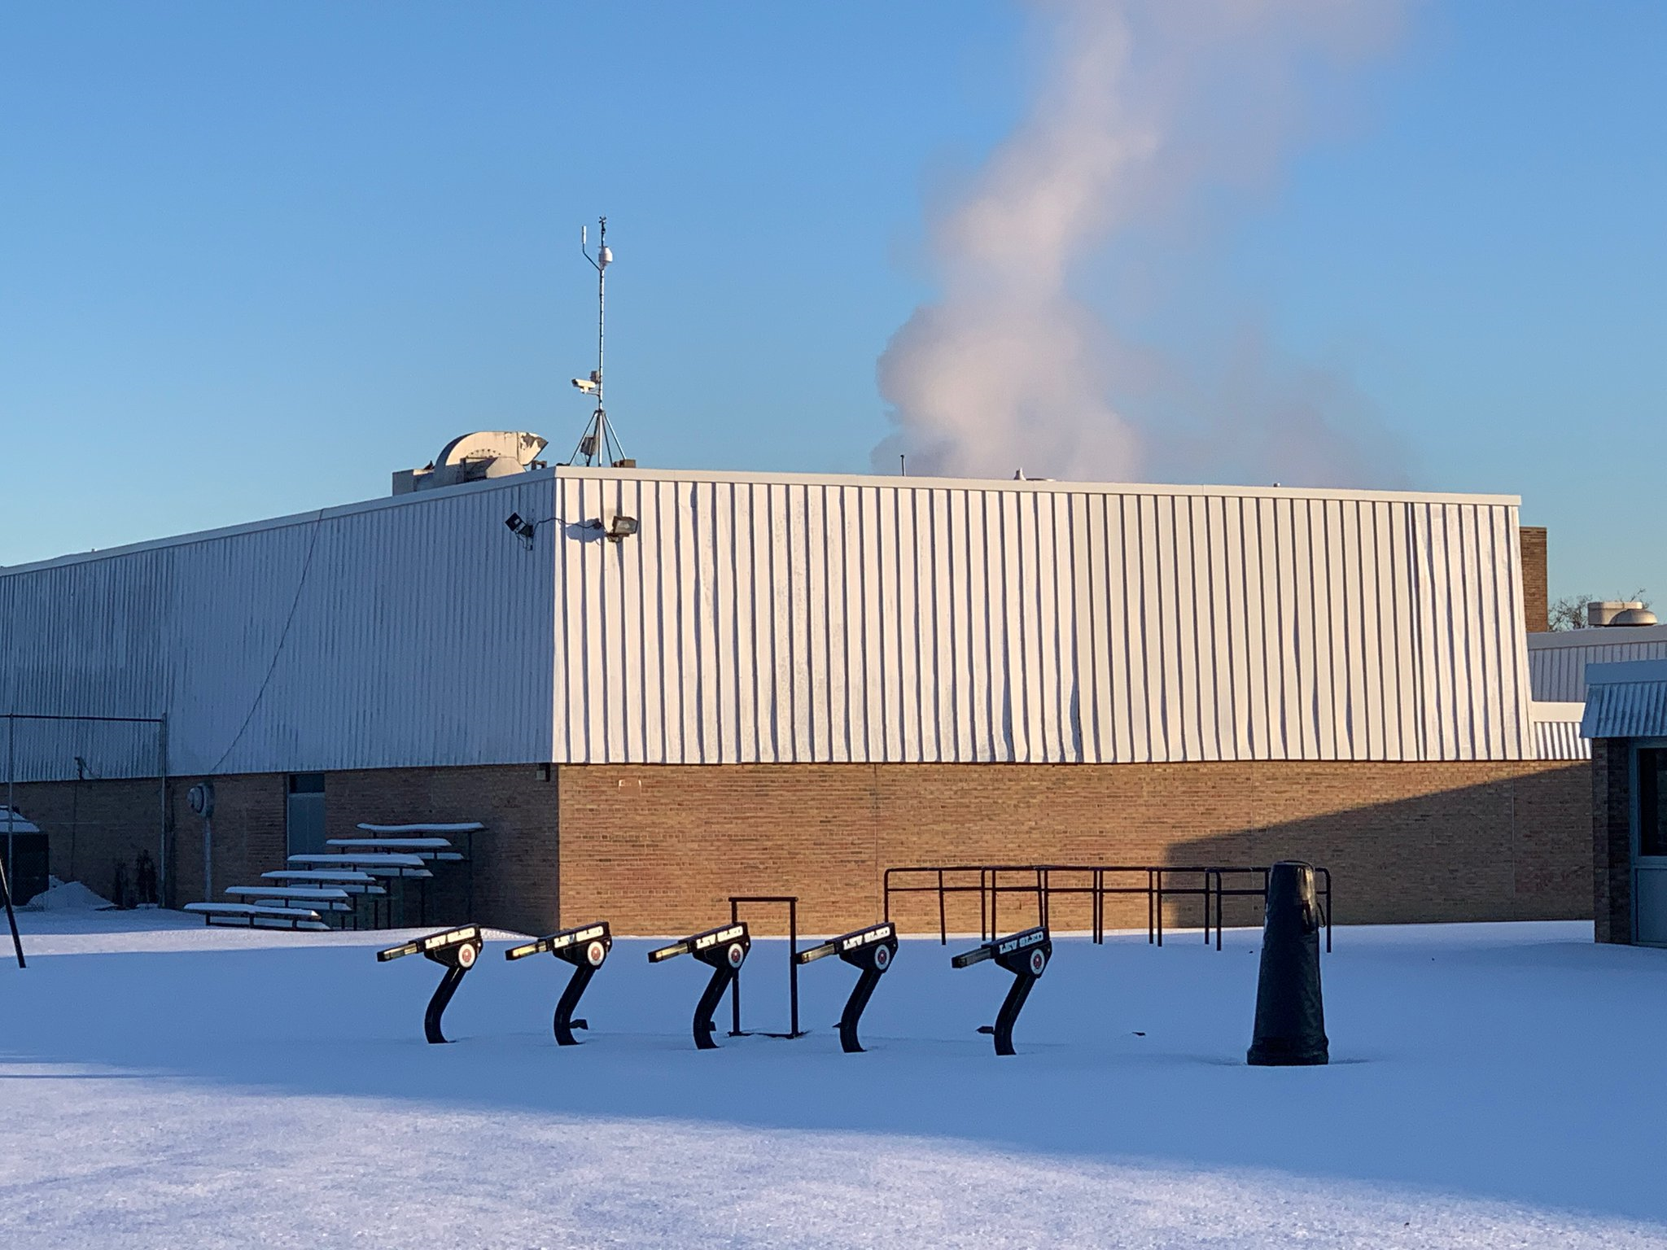

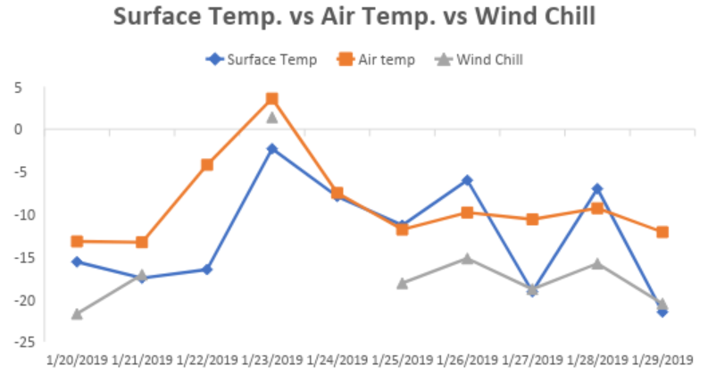
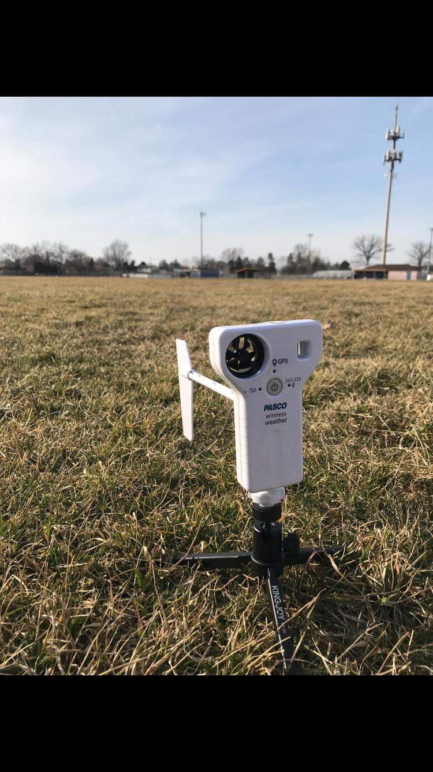
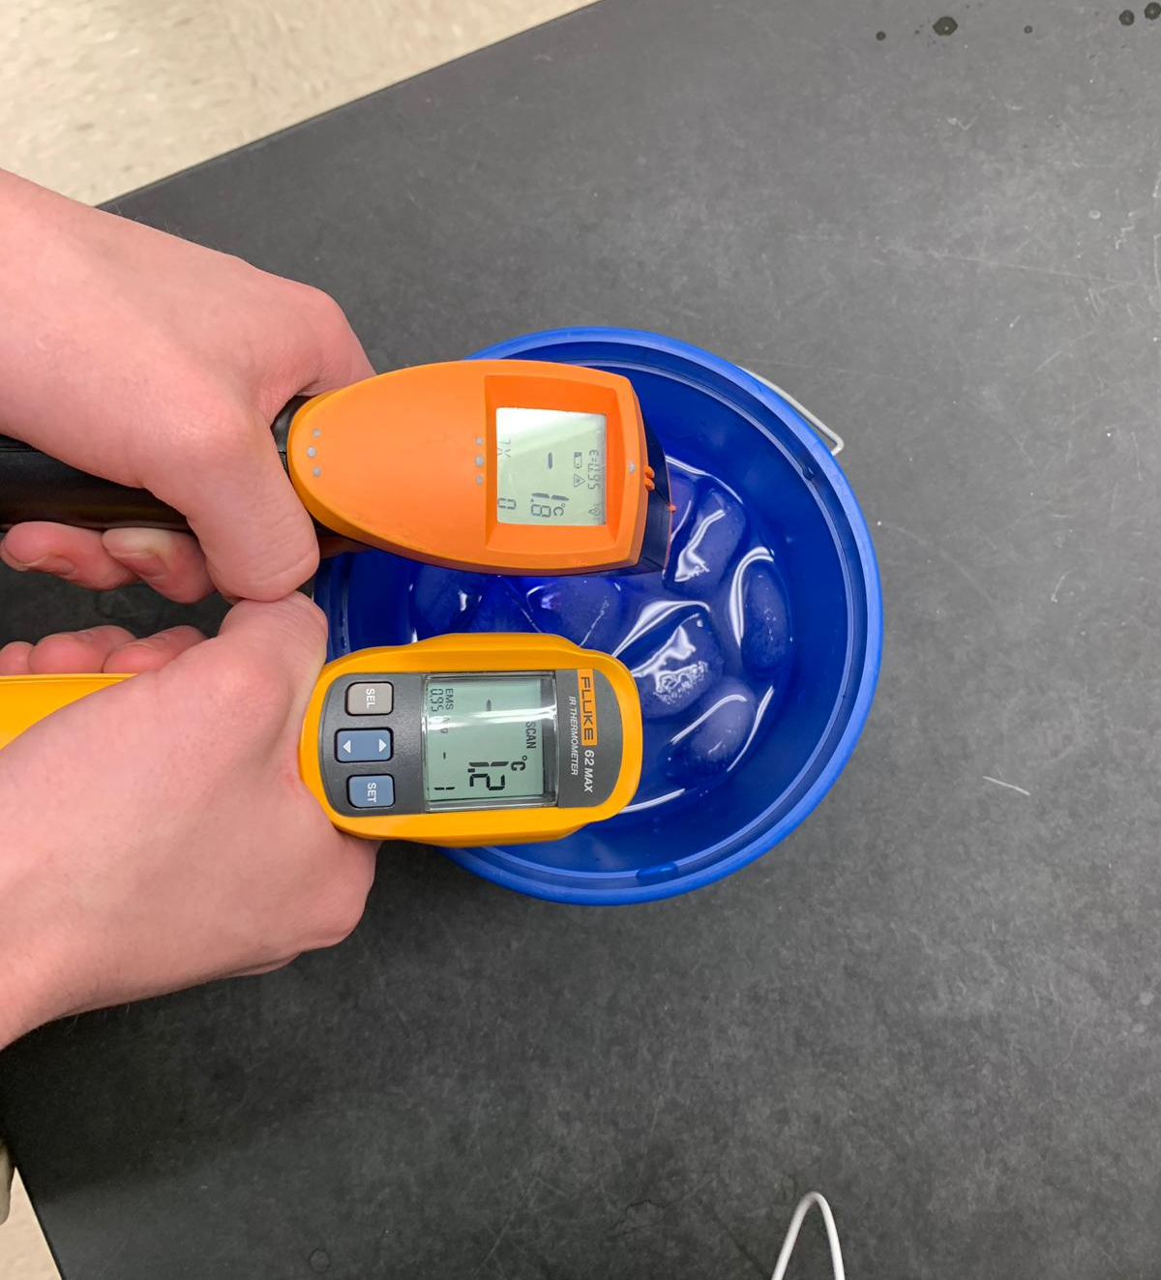
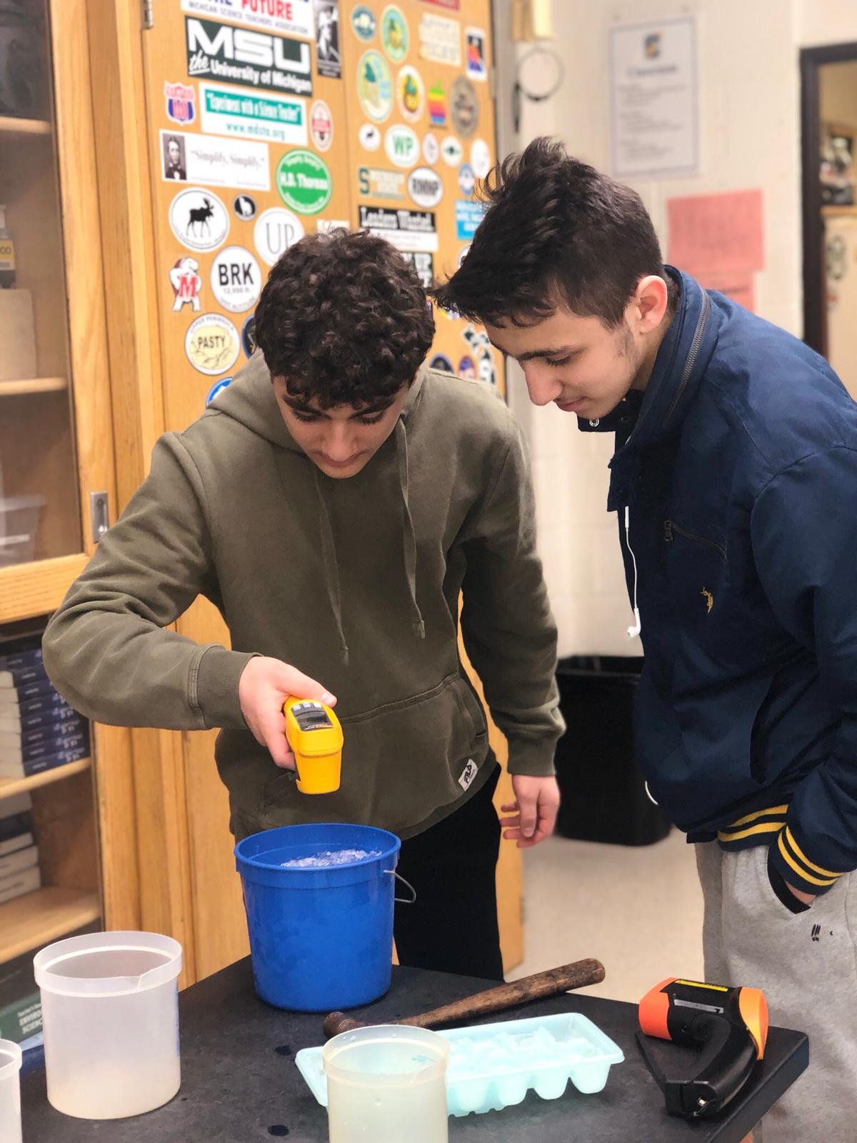
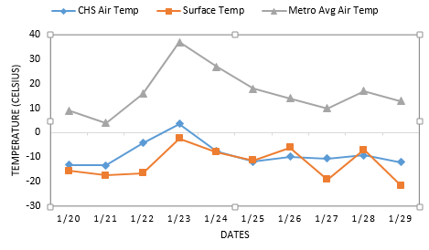
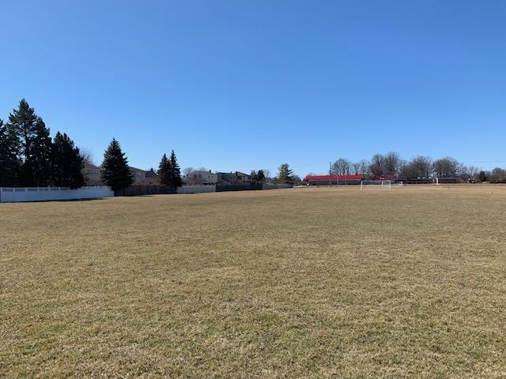

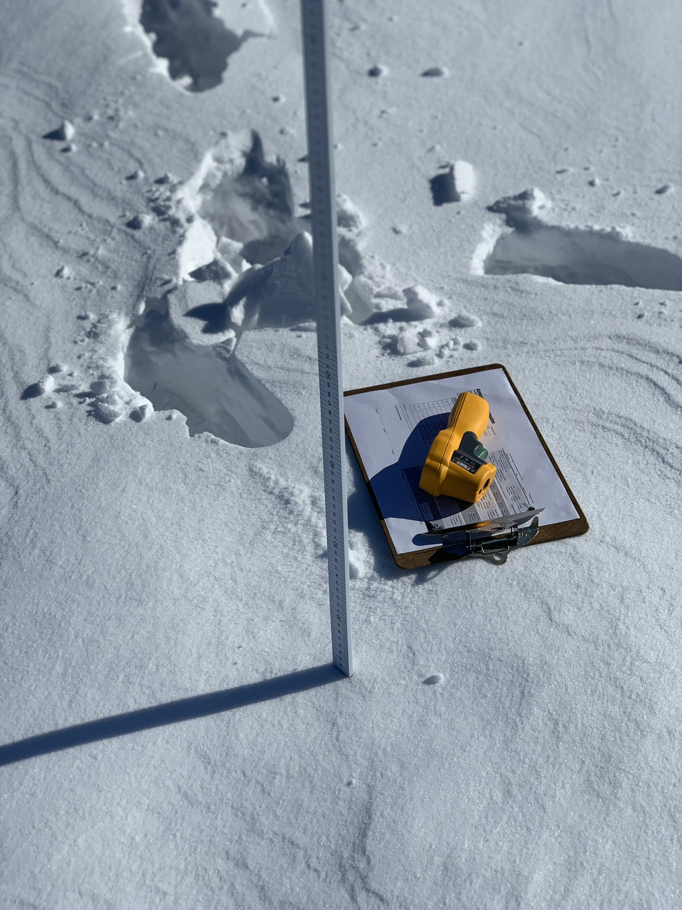
Effects of Select Weather Factors on
Surface Temperature During a Polar Vortex
Adam Ali and Ali Akil
Crestwood High School – Dearborn Heights, MI
Abstract
Results
Methods
Surface temperature is a critical factor that influences local and regional heating because the troposphere we live in warms from the bottom up. Scientists closely monitor surface temperature in their efforts to document and explain our rising worldwide temperatures. This year’s polar vortex in January was a significant recent weather phenomenon. With our research, we sought to determine if there is a correlation between the air temperatures and surface temperatures during this frosty period and if the polar vortex had an effect on the data we collected at all. For the majority of this school year, we have been collecting surface and air temperature data as well as cloud types and other select atmospheric parameters. We found that wind chill was consistently lower than air and surface temperature and the surface temperature was lower than air temperature on all but 2 days. It was also observed that the cloud cover doesn’t correlate with the surface temperature during this period but further research must be done over a longer period of time to confirm this.
Figure 1. Temperature versus windchill. This graph compares surface temperature, air temperature, and windchill during the 2019 Polar Vortex. The correlation between surface temperature and air temperature is fairly proportional with the surface temperature consistently colder than the air temperature. Air temperature and wind chill have a direct relationship with each other except where missing windchill data (due to our automated weather station malfunction in the extreme cold weather) makes it difficult to analyze the entire period.
9 marked locations on site.
Measurements taken everyday at each marked location
Air temperature taken hourly by school’s WeatherBug station
Upload data to Globe database
Contact NASA data specialist, Tina Rogerson
Precision And Accuracy
Analyze data
Figure 2. Surface Temperatures versus Cloud Cover. This graph compares surface temperature with cloud cover. There is no correlation between the two because the cloud cover stayed relatively the same while the temperature varied. If data was collected over a longer period of time, a relationship may have been present.
Conclusions
The two infrared thermometers used to collect the surface temperature data, Fluke 62 MAX IR THERMOMETER and the AUTO PRO Raytek, were calibrated in an ice water solution. In order to be properly calibrated the thermometers must be in a range of -2°C to 2°C, which they both were, ensuring accurate measurements.
There appears to be a one-day time delay between the change in near surface temperature and direct surface temperature. However, this is only true for when temperatures are increasing the first few days, as soon as temperatures began to fall and later stabilize the relative lag between the data is no longer present. Differences in results are caused by the approximate 10-meter height difference between the ground surface and our school’s WeatherBug weather station sensors positioned on above the school roof. Windchill directly correlated with both temperatures that were given. However, cloud cover did not appear to correlate with the surface temperatures, although more data may have been needed to confirm this due to consistent overcast conditions.
According to Judah Cohen, a climatologist at Atmospheric and Environmental Research “Colder temperatures have been arriving later in winter over the past few years.” The collection of the daily measurements could have been more accurate by leaving the handheld infrared thermometers outside for its full suggested 60 minutes which we were unable to do as a result of tests, assignments, or lessons.
A polar vortex is a low-pressure area—a wide expanse of swirling cold air—that is parked in polar regions. Global warming resulting in increased snowfall and frigid temperatures may sound paradoxical, however there is evidence to back it. For example, warmer temperatures in the winter of 2006 caused Lake Erie to not freeze for the first time in its history. This actually led to increased snowfalls because more evaporating water from the lake was available for precipitation. In the past 5 years, Michigan has been plagued with a polar vortex every year in the past 5 years, 2019 being the worst of all.
Potential follow up research could include comparing our surface temperature data with other schools across the country and even globally.
Research Questions
Research Implications
Is there a time delay between change in near surface temperature and actual surface temperature?
Does cloud cover correlate with surface temperature?
Does the CHS air and surface temperature correlate with the temperature of the Detroit Metropolitan area?
Scientists currently use surface temperature data from satellites to monitor weather and climate change around the world. Satellite temperatures of Earth’s surface are very accurate but typically give averaged readings over the large areas they are sampled from. Some climate skeptics currently question if NASA surface temperature data is accurate or not. Because our school is collecting surface temperature measurements at the same place over a period of many years, our data will allow scientists to verify that what data they sense from up on high, is comparable to what we see on Earth’s surface. To better understand the role that surface temperatures play in localized areas, it is important to get data from smaller parcels of land to see specifically how that particular surface responds to incoming solar insolation. Many small-scale and localized factors still need considerable research before a complete understanding of the role surface temperature plays in microclimate settings and at the community level (soil moisture levels, frozen ground, frost levels, etc.). This research found that very few schools consistently collect surface temperature data during the coldest months of the year. Our research found that accurate measurements can be taken throughout the most intensely cold portions of the year if students are properly protected from the elements and the instruments properly acclimated. To identify winter (December-February) heat island effects, it is suggested that GLOBE schools partner together and make a commitment to collect data not just during field campaigns but throughout the coldest months of winter. Only by combining a multitude of data from a whole host of local sites and over a long period of time will we be able to make any true contribution to a deep understanding of how localized surface temperature changes are being affected by climate change. Localized surface temperature data also allows scientists to accurately assess Climate change is currently linked into greater changes in temperatures than seen . By keeping track of the temperature and its increase, we can determine how much time we have left to find a solution to this critical issue. Due to the greenhouse gases released from the burning of fossil fuels the global average surface temperature rose from 1.1 to 1.6 degrees Fahrenheit between the years 1906 and 2005. This, alongside the fact that the rate of temperature increase has doubled in the last fifty years and will continue to rise, demonstrates the importance of recording and analyzing surface temperature data to ensure a healthier and safer future for this planet.
Figure 3. CHS Air and Surface Temperature versus Air Temperature of Detroit Metropolitan area
This graph compares air and surface temperature of Crestwood High School and air temperature of the Detroit Metropolitan area. There is a clear correlation between the two with the CHS temperatures being consistently lower because the recordings were taken much closer to the surface.
Acknowledgements and Citations
  Special thanks to:
  Mrs. Johns for instructing us on how to complete the measurements and providing us with the necessary equipment and always being there to provide support.
  The other globe students for helping collect the necessary data for the research.
  Sara Komaiha and Ali Eter for showing us how to access and use the Globe data.
  Tina Rogerson for providing necessary cloud cover data needed on short notice.
Hypothesis/ Null Hypothesis
There is no correlation between air temperature and surface temperature.
There is a direct correlation between cloud cover and surface temperatures.
There is a correlation between wind chill and surface temperature.
There is no correlation between the CHS air and surface temperature correlate with the temperature of the Detroit Metropolitan area.
Measurement Limitations
US Department of Commerce & Noaa. Learn About the Polar Vortex. National Weather Service(2017). Available at: https://www.weather.gov/dlh/polarvortex. (Accessed: 1st April 2019)
Resnick, B. The Midwest is facing record-breaking cold. Blame the polar vortex. Vox (2019). Available at: https://www.vox.com/science-and-health/2019/1/29/18201196/polar-vortex-2019-des-moines-midwest-record-cold-windchill. (Accessed: 1st April 2019)
Arctic Weather Plunges into North America. NASA Available at: https://earthobservatory.nasa.gov/images/144489/arctic-weather-plunges-into-north-america. (Accessed: 1st April 2019)
Research on Urban Heat-Island Effect. Procedia Engineering (2016). Available at: https://www.sciencedirect.com/science/article/pii/S1877705816332039. (Accessed: 1st April 2019)
Global Warming. NASA Available at: https://earthobservatory.nasa.gov/features/GlobalWarming/page2.php. (Accessed: 1st April 2019)
Rowlatt, J. Polar vortex: What role does climate change play? BBC News (2019). Available at: https://www.bbc.com/news/world-us-canada-47078054. (Accessed: 2nd April 2019)
Unable to take measurements at the same time every day due to tests or lessons.
Harsh Weather conditions prevented us from taking measurements on certain days.
Other students wrote false data that we couldn’t include. For example, putting down the clouds as nimbostratus when it there was no precipitation.
Our school’s WeatherBug station began to malfunction when temperatures reached very low points during the polar vortex, so data was missing for those days.
Other students who collected data may have held the thermometer at an angle instead of straight down.

