Slide 1
Our city under the stars: Do we sleep better after the change of urban lighting?
Students: Maja Hozjak, Katarina Hozjan, Nika Sraka
Mentor: prof. Valentina Pirc Mezga
Secondary school Prelog, Prelog

Slide 2
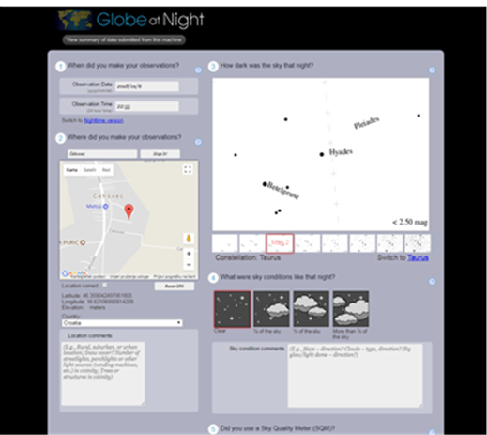
INTRODUCTION
  continuation of the 2014 research
  GLOBE AT NIGHT
  major problem: light pollution caused by inadequate lighting
  aim of the project: to determine how the change of urban lighting impacts our everyday life

Slide 3
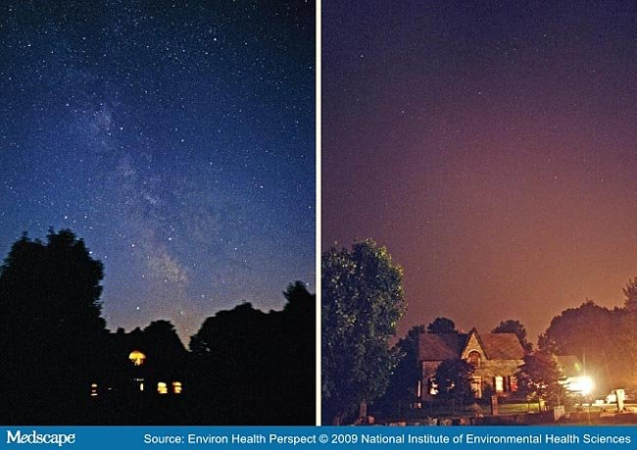
LIGHT POLLUTION
redundant light dispersion
comes as a result of indeadequate lighting
various harmful effects

Slide 4
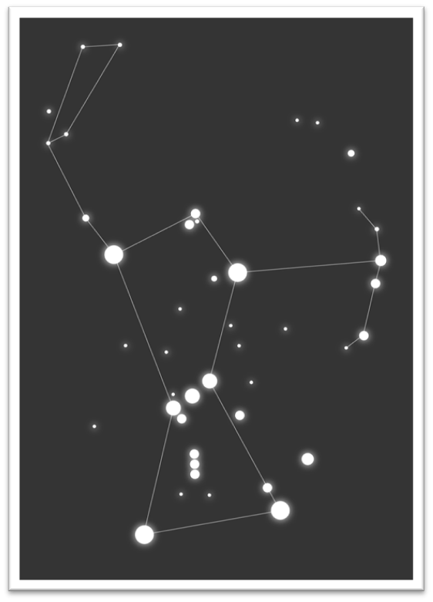
THE ORION CONSTELLATION
appears from the end of September until the end of April
the most remarkable part of the constellation: Orion’s belt

Slide 5
CARE FOR OUR PLANET IS OUR PRIME DRIVING FORCE!

Slide 6
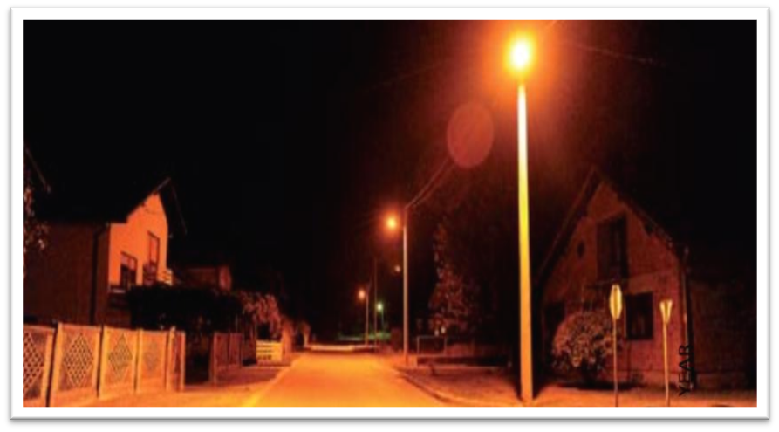
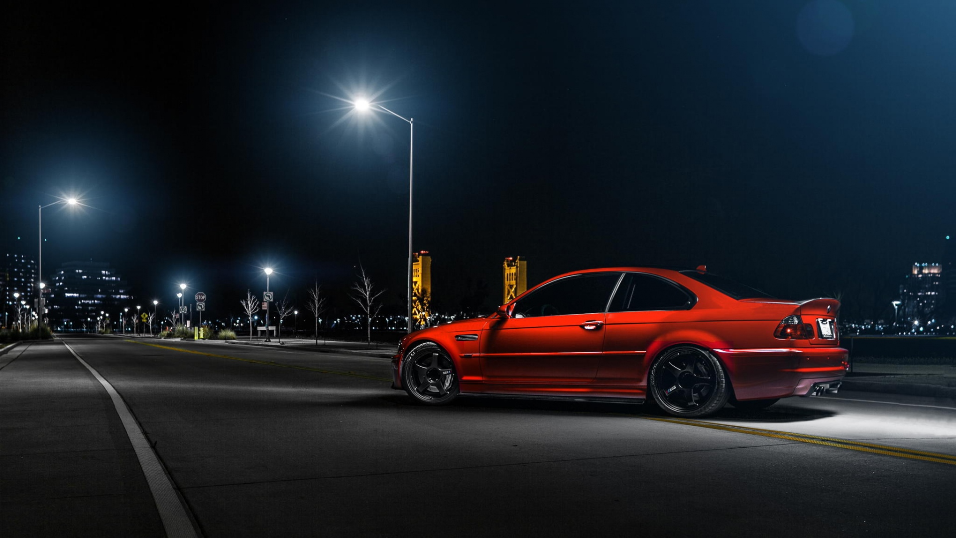
RESEARCH QUESTION:
basic research question: how the urban lightning change affects our sleep

Slide 7
HYPOTHESES
constellation visibility will be worse in the urban area than in the rural area
with the change of urban lighting, drivers aren’t constricted by bad urban lighting
reduced impact of the new „cut off” lighting on the surveyed pattern of the population

Slide 8
RESEARCH METHODS
GLOBE AT NIGHT
observation of the Orion constellation
comparison of the constellation visibility from 3 locations (Prelog, Otok and Čehovec)
- observation period: 6.1.2018. - 19.4.2018.

Slide 9
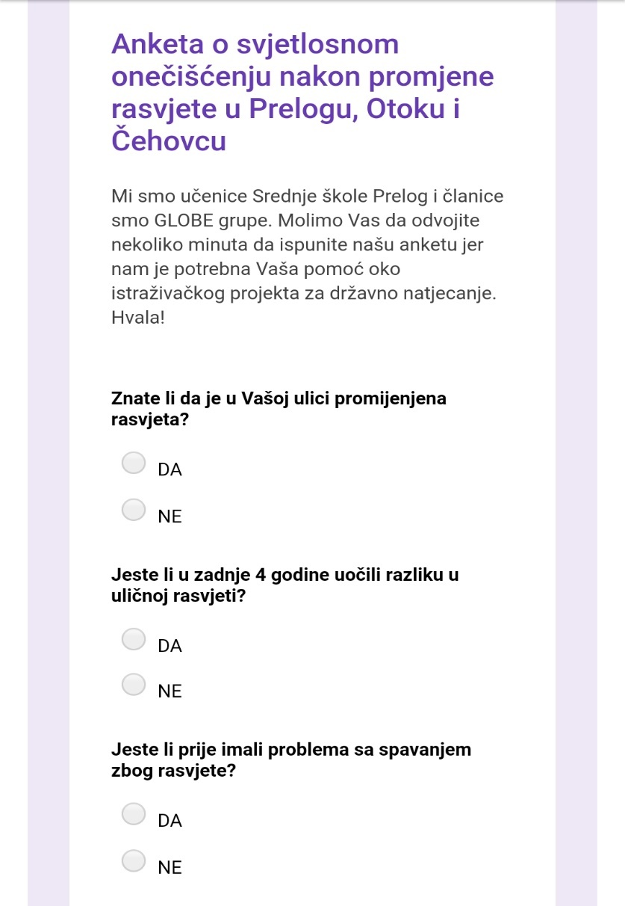
SURVEY
140 inhabitants of Prelog and rural areas of Otok and Čehovec were surveyed
questions about lighting change were asked in the survey

Slide 10
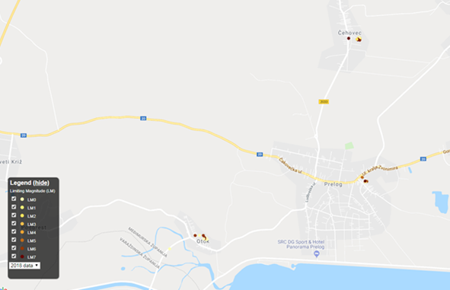
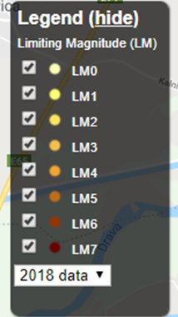
DATA DISPLAY AND ANALYSIS
Magnitude display for Prelog, Otok and Čehovec (Source: Globe at Night)

Slide 11
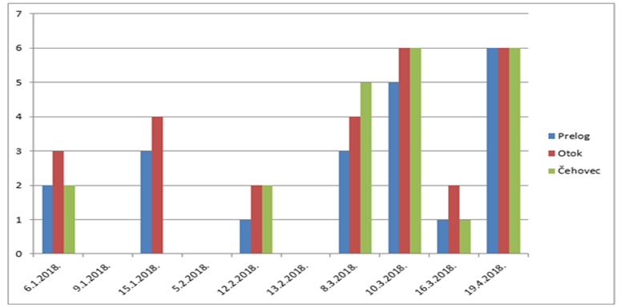
Visibility of the Orion constellation in Prelog, Otok and Čehovec

Slide 12
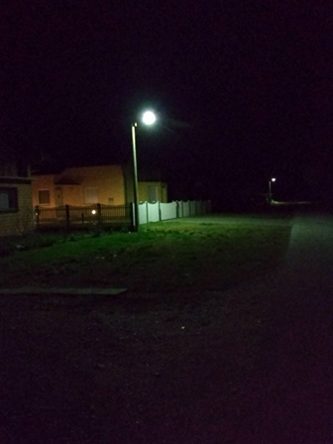
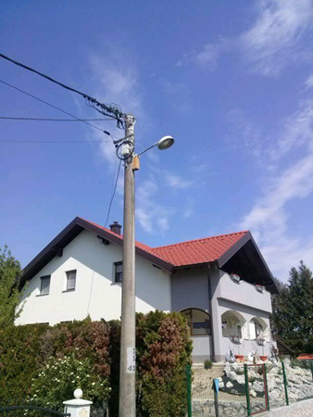
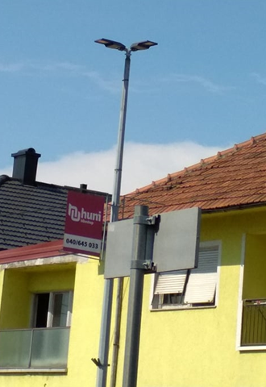
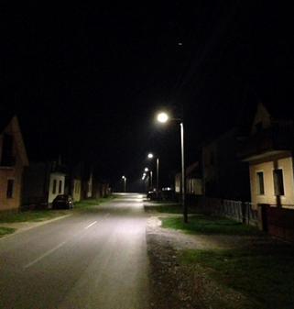
Display of the „cut off” lighting during the day and at night
Display of the old lighting during the day and at night

Slide 13
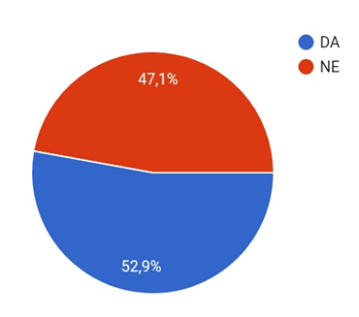
Percentage of subjects who noticed the change in lighting after 2014

Slide 14
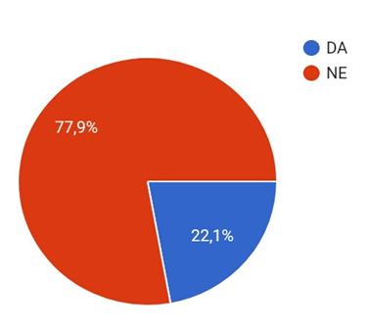
Percentage of subjects who had sleeping problems because of the lighting

Slide 15
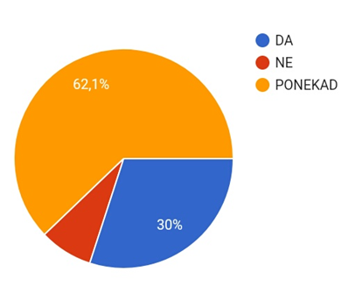
Percentage of subjects (constellation observation)

Slide 16
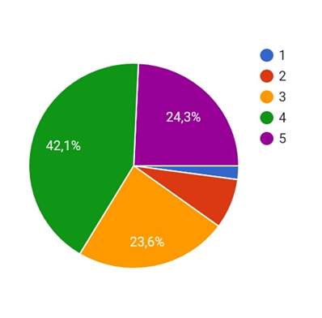
Rated star visibility (1 – poor visibility, 5 – the best visibility)

Slide 17
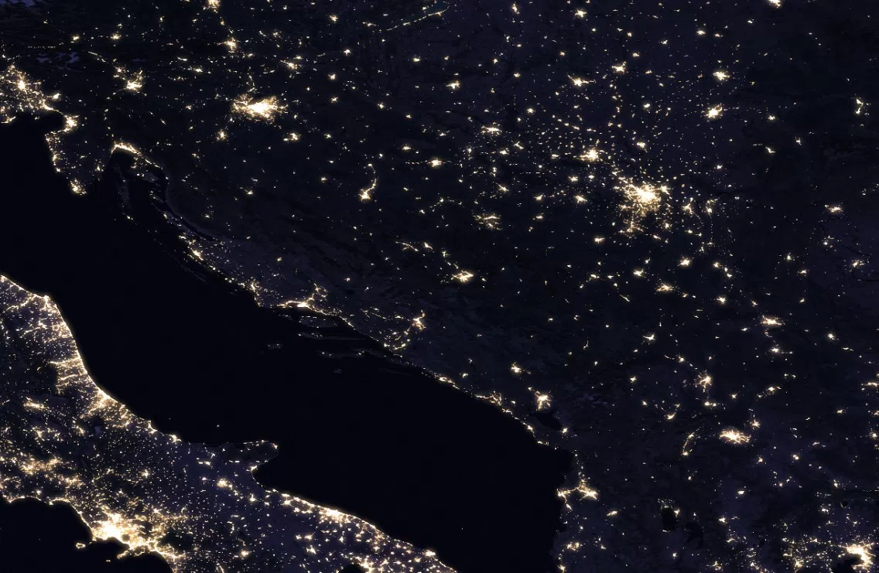

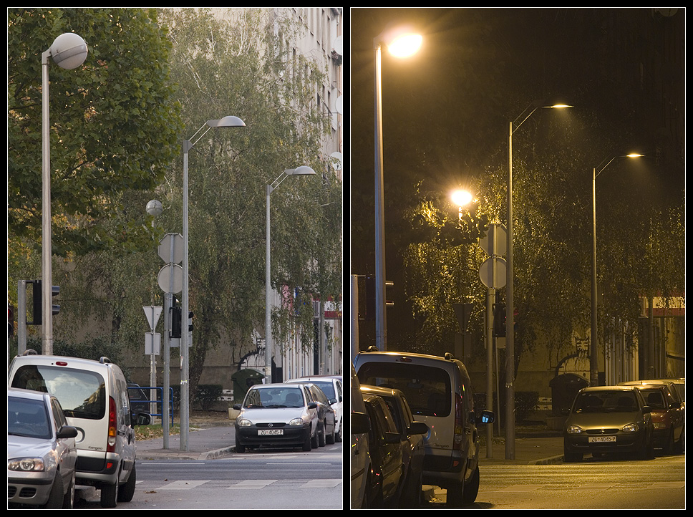
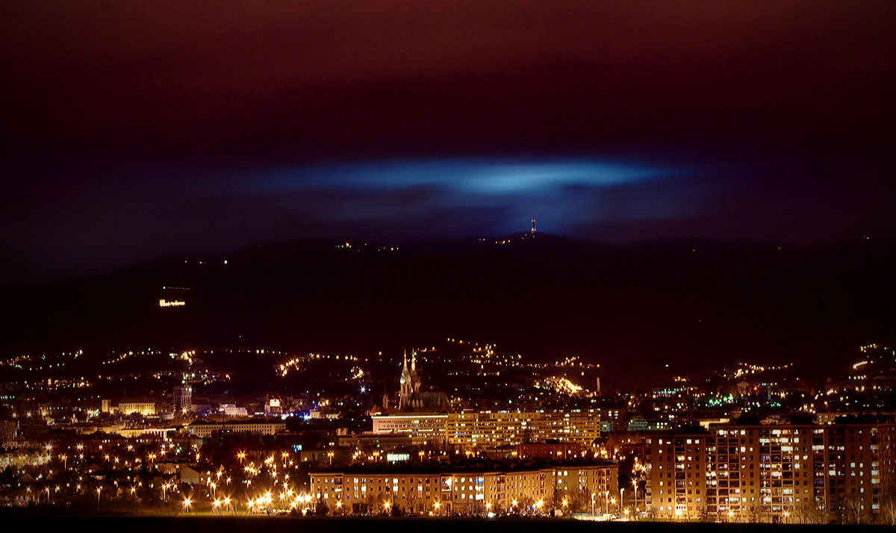
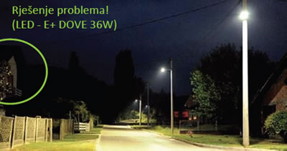
subjects interested in our project:
„Energy Plus” company (Ludbreg)
„Eko rasvjeta” association (Zagreb)

Slide 18
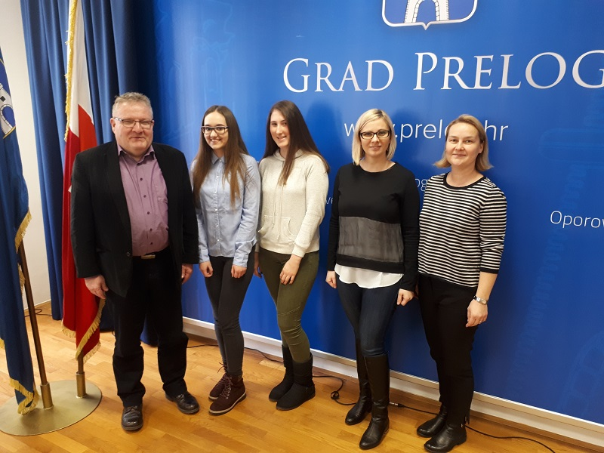
our project was presented to the mayor of Prelog, Ljubomir Kolarek

Slide 19
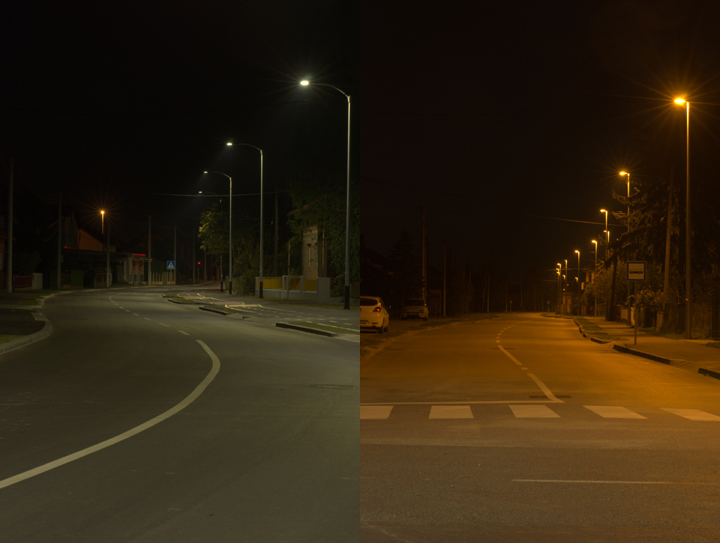
CONCLUSIONS
regarding light pollution, „cut off” lighting brings many improvements sinve the old lighting was replaced
Orion constellation is much more visible in rural areas than in urban areas

Slide 20
with the replacement of the old lighting with „cut off” lighting, there has been a reduction of the light pollution
population doesn’t have any sleeping problems because of the lighting replacement
lighting replacement positively affects local traffic as well

Slide 21
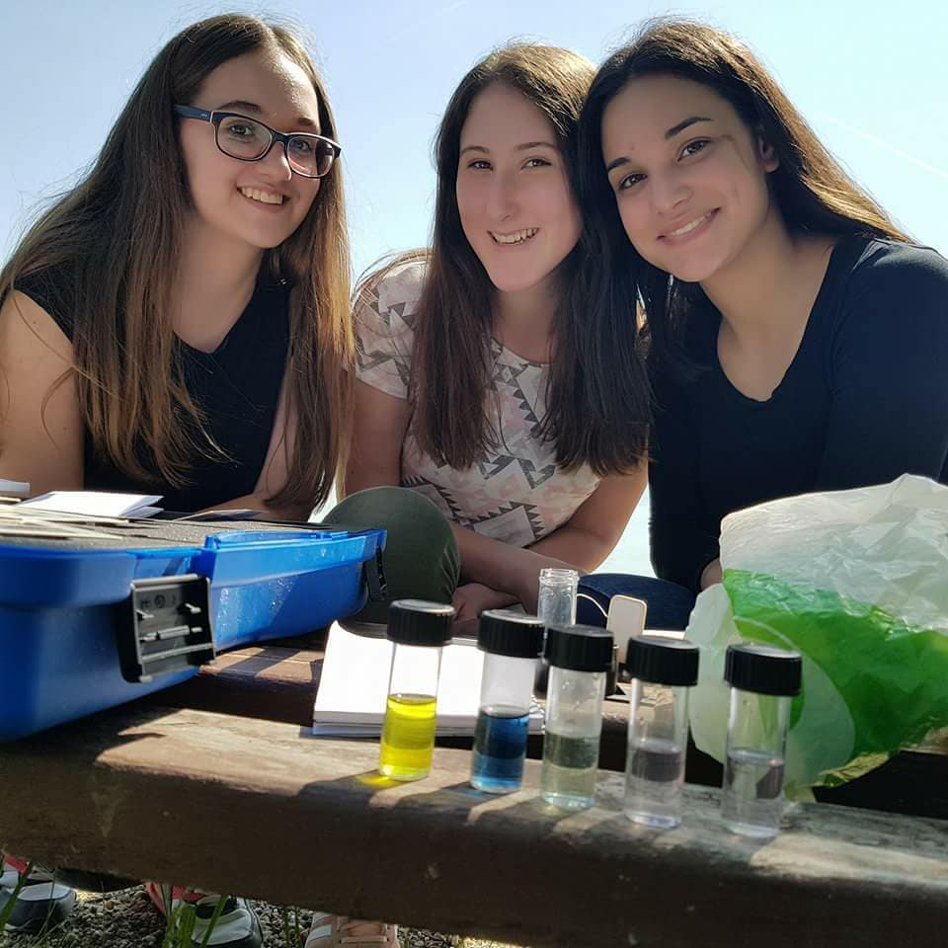
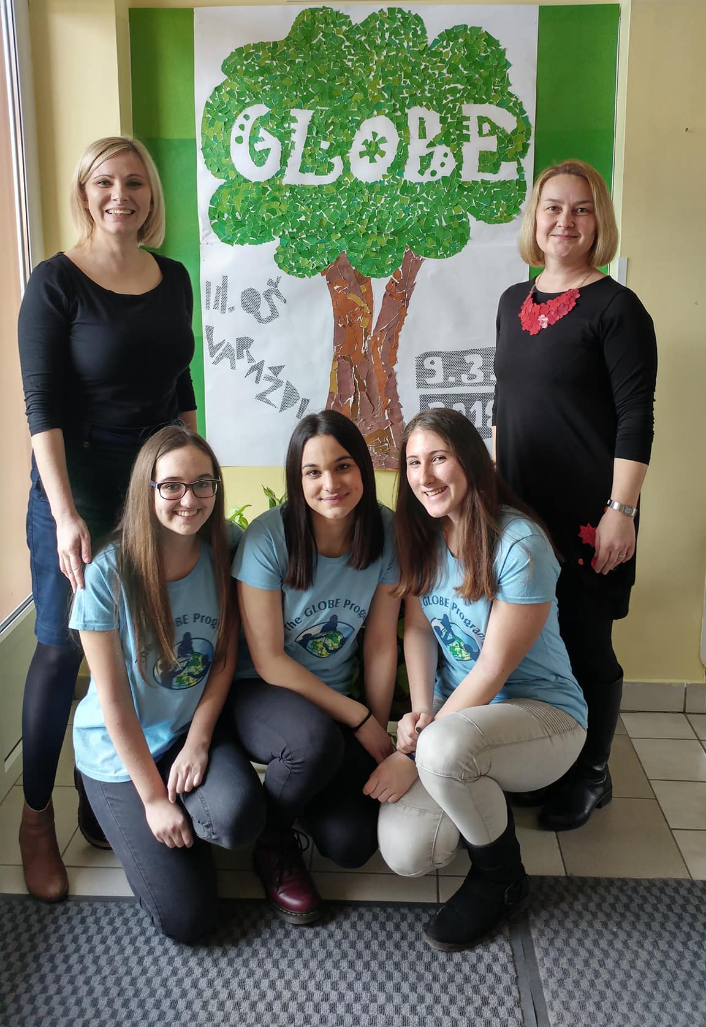
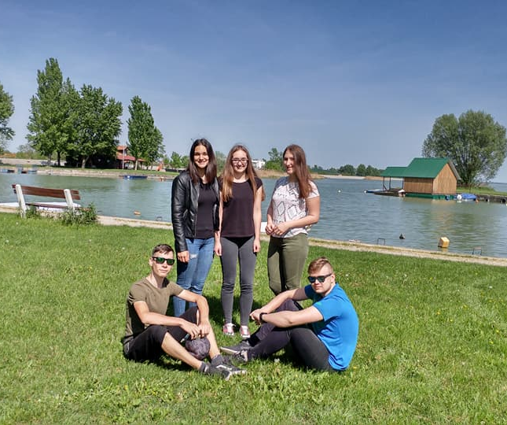
Thank you for your attention!

