Slide 1


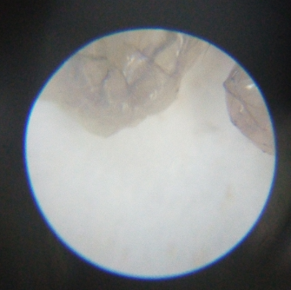
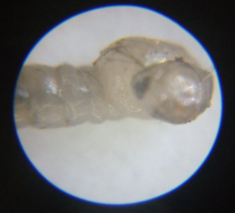
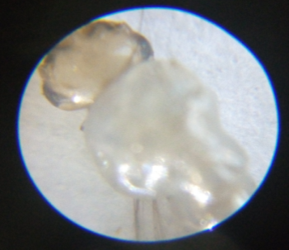
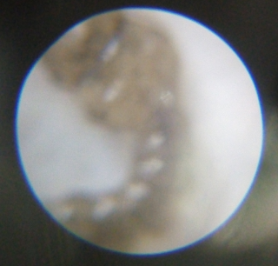
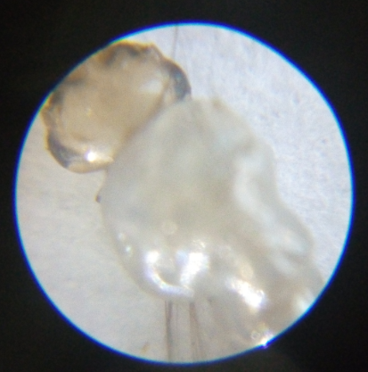
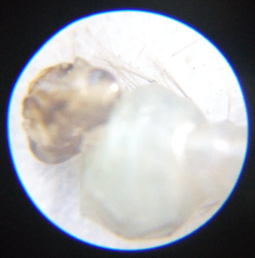
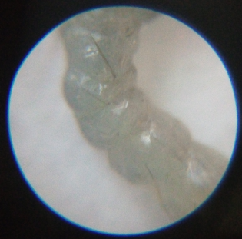
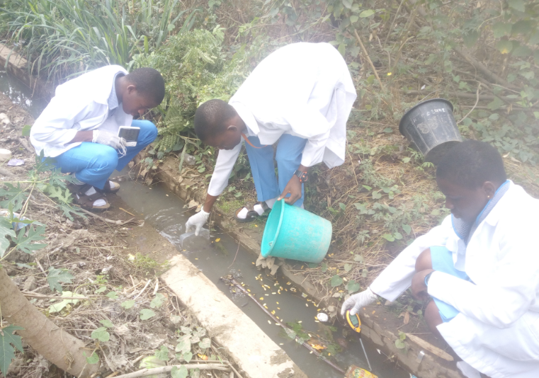
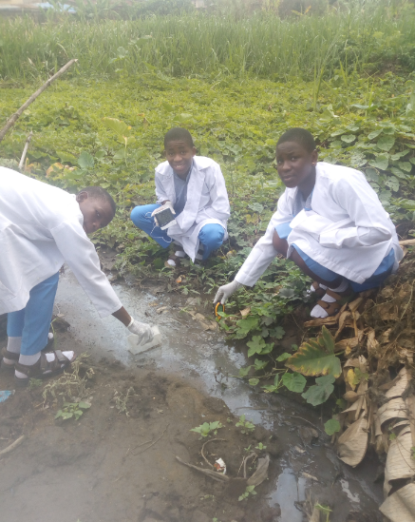
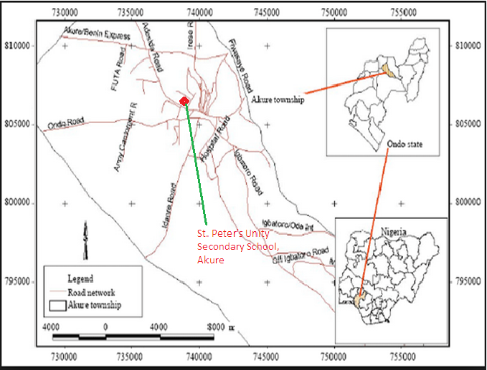
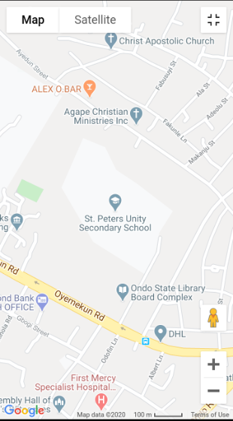
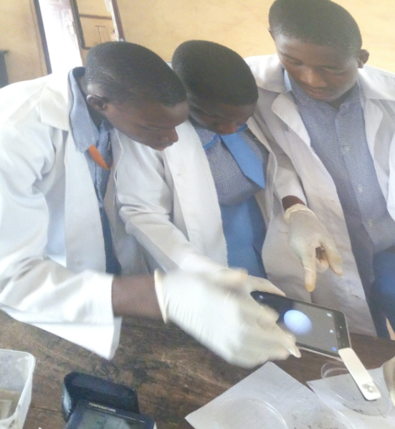
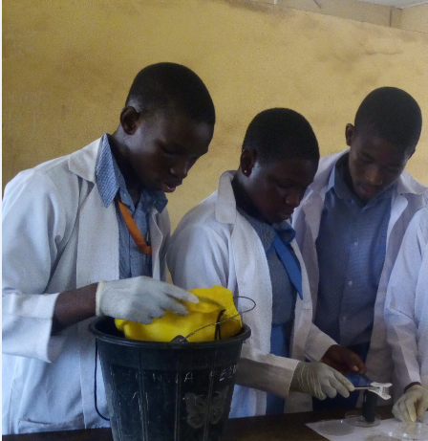
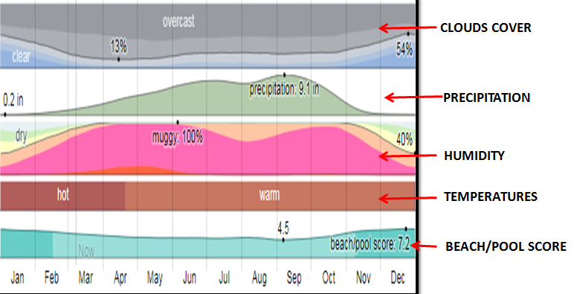
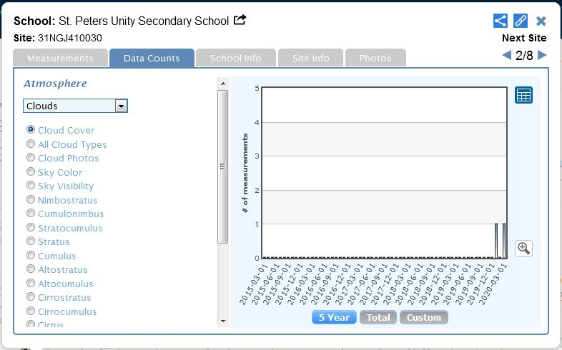


THE SPREAD AND BIODIVERSITY OF MOSQUITOES IN SPUSSA COMMUNITY, AKURE, ONDO STATE, NIGERIA
Principal: Mrs. Feyisola Busari. Teacher: Olawunmi Fasakin. Students: Paul Eke, Kemisola Akomolafe and Temitope Akinsunmade
ST. PETER’S UNITY SECONDARY SCHOOL, AKURE, ONDO STATE, NIGERIA
Abstract
Research Methods
Results
Discussion
The sufferings and pains caused by mosquitoes in our communities cannot be overlooked. These insects propagate their diseases by infecting the host through pathogens. The project was aimed at observing the spread and bio-diversity of mosquitoes in St. Peter’s Unity Secondary School, Akure (SPUSSA) community, Ondo State, Nigeria. The objectives are to identify potential habitats of mosquito larvae, identify different species found in the study area and evaluate the physico-chemical properties of the environmental habitat. The study was conducted within three months. Two mosquito habitat sites were investigated in two locations (hydrosphere sites A and B). Samples of mosquito larvae from the sites were taken to the School’s science laboratory. They were placed in Petri dishes after they were sieved in which the larvae were counted. Clip-on macro lens was used to count the mosquito larvae. The environmental parameters that support the breeding of mosquitoes in the area of study include air temperature range of 32ºC – 39ºC, water temperature range of 26ºC – 35ºC, relative humidity range of 10% - 42% and pH range of 3.5 – 8.0. Site A has less larvae than site B. The genera found in site A are Anopheles (58) and Aedes (19) while that found in site B are Aedes (112) and Anopheles (12). There is need to develop control strategies that will target the vector species.
Keywords: Mosquito larvae, Anopheles, Aedes, SPUSSA, Hydrosphere sites
Planning Investigations
Akure is a city in south-western Nigeria, and is the largest city and
capital of Ondo State. It is situated in the tropic al forest of Africa.
It lies about 7°25’ north of the equator and 5°19’ east of the
Meridian. Akure is a city in south-western Nigeria, and is the
largest city and capital of Ondo State. The city had a population of
484,798 as at the 2006 population census. The materials we used in this study to obtain our data are as follows: Digital Hygro-
thermometer, Clip-on Macro Lens, Digital soil meter (pH), Hand
gloves, Plastic bucket, Plastic containers for scooping , Petri
dishes, GLOBE Mosquito Habitat Mapper App , Camera (Phone
camera) and Net. We collected Larvae for seven weeks (within
January – March 2020) during the day between 10 am and 1 pm.
Carrying Out Investigations
The GLOBE protocols included in this study are Hydrology Protocols - Water temperature and Water pH; Atmosphere Protocols - Air temperature and Relative Humidity. We collected mosquito larvae from hydrosphere site B (a gutter with standing water) by scooping water and from hydrosphere site A (a shallow pool of flowing water with bushy environment). Water samples from the selected sites (A and B) were analyzed for physico-chemical properties such as pH and temperature. The water pH and water temperature were measured using the digital soil meter and digital hygro-thermometer respectively. Counting was done with clip-on macro lens.
Analyzing Data
This location (SPUSSA) contains lots of peridomestic containers such as paper wastes, can, plastic, kitchen wastes, bottles, gutters with stagnant water, puddles and runoff which encourage populations of mosquito developing stages.
The diagrams below are samples of Anopheles and Aedes mosquito larvae we observed with the clip-on macro lens from the investigated hydro-sites A and B.
The abundance of Anopheles species in hydrosphere site A is due to human activities like, pool of stagnant water, domestic runoffs, disposal of household and kitchen wastes which provide numerous breeding sites. The study has revealed that the number of anopheles genera is abundant in hydrosphere site A compared to hydrosphere site B. All species of mosquitoes reported in this study have also been reported by different researchers elsewhere in Nigeria (Adeleke, 2010; Yayock et al., 2014). In SPUSSA community, the Anopheles genera and Aedes genera are the most common species in the study area and are listed among the most effective and efficient dominant vector species of human malaria. It was further observed that physico-chemical parameters of the mosquito habitat determine mosquito oviposition and abundance. The optimal pH recorded in this study has also been reported by other authors (Adebote et al., 2006). The authors reported that pH range of 6.8–7.2 and 7.0–7.4 were suitable for the weakening of the mosquito egg shells for the emergence of its first larvae and that pH less than 5.0 and higher than 7.4 have fatal effects on survival of mosquito species. Optimal temperature suitable for breeding (28.6 °C) in Akure metropolis also concurred with the reports of Clement (1992).
In this study the temperatures we observed are keen factors which affect the abundance and distribution of mosquito in the identified habitats. A research study conducted by Afolabi and Aladesanmi (2018) also shows that the optimal temperature that favored breeding in Akure is 28 °C while mosquito breeding is not likely to be found in temperature below 25 °C.
Tables 1 and 2 display the physico-chemical values and types of mosquito larvae obtained from investigated hydrosphere sites A and B respectively.
Research Questions
Table 1
Table 2
1. Where are the typical breeding habitats of mosquito larva in SPUSSA community?
What are the different genera of mosquitoes found in SPUSSA
community?
3. What are physico-chemical properties that are favorable for breeding mosquito larvae in the study area?
What is the spread/distribution of biodiversity of mosquitoes in
SPUSSA community?
 | Atmospheric Temperature (°C) | Water Temperature (°C) | Relative Humidity (%) | pH | No. of Aedes Larvae | No. of Anopheles Larvae
Week 1 | 39 | 34 | 10 | 6.0 | 3 | 7
Week 2 | 37 | 32 | 11 | 6.5 | 5 | 7
Week 3 | 38 | 35 | 13 | 5.5 | 2 | 12
Week 4 | 36 | 31 | 16 | 6.0 | 0 | 13
Week 5 | 35 | 31 | 22 | 4.5 | 2 | 10
Week 6 | 33 | 28 | 34 | 3.5 | 4 | 5
Week 7 | 32 | 27 | 42 | 4.0 | 3 | 4
 | Atmospheric Temperature (°C) | Water Temperature (°C) | Relative Humidity (%) | pH | No. of Aedes Larvae | No. of Anopheles Larvae
Week 1 | 38 | 29 | 10 | 8.0 | 20 | 1
Week 2 | 37 | 30 | 12 | 7.5 | 23 | 4
Week 3 | 35 | 28 | 12 | 6.5 | 14 | 2
Week 4 | 34 | 26 | 17 | 6.0 | 12 | 0
Week 5 | 35 | 26 | 21 | 5.0 | 16 | 1
Week 6 | 32 | 31 | 35 | 5.5 | 8 | 3
Week 7 | 33 | 28 | 39 | 4.0 | 19 | 1
Conclusions
Introduction
The physico-chemical parameters of the breeding sites as presented in the two tables (Tables 1 and 2) reveal that the atmospheric temperature ranges between 32 – 39°C , water temperature ranges between 26 – 35°C, relative humidity ranges between 10 – 42% and a pH range of 3.5 – 8.0.
The study has revealed that the number of anopheles genera is abundant in hydrosphere site A compared to hydrosphere site B
The abundance and distribution of the mosquito species in the study area may be related to the availability of breeding sites. The Anopheles genera and Aedes genera encountered in the study are potential vectors of malaria and Zika respectively. Lack of good drainage could lead to the abundance of mosquitoes in the study area. Increasing temperature and relative humidity are potentially providing suitable conditions and habitats for mosquitos to spread pathogens. There is need to develop control strategies that will target the vector species. Therefore, effective vector control programmes and public enlightenment especially on human activities that encourage mosquito breeding are recommended. There is need to develop control strategies that will target the vector species.
Malaria is one of the most severe global health challenges facing humanity (World Health Organization, 2014).
In Nigeria it has been shown that abundance of various mosquito species includes the genera Anopheles, Culex, and Aedes (Nwoke et al., 1993).
Zika virus, transmitted through mosquito bites, was first discovered in 1947 and is named after the Zika Forest in Uganda. Zika is spread mostly by the bite of an infected Aedes species mosquito (CDC, 2019).
The diverse aquatic habitats for mosquito breeding always make them occur in adequate population to constitute vectors of disease-causing organisms (Adebote et al., 2008).
St. Peter’s Unity Secondary School, Akure (SPUSSA) is a coeducational institution with domestic wastes, water run-off and farm lands. The school compound has possible places for breeding common mosquitoes.
The study seeks to identify different species of mosquito larvae, the physico-chemical attributes and the distribution of the larvae species in SPUSSA community.
Collection of Mosquito Larvae and physico-chemical properties from Hydrosphere Site B.
Collection of Mosquito Larvae and physico-chemical properties from Hydrosphere Site A.
Bibliography/References
Map of Akure Township in Ondo State, Nigeria showing St. Peter’s Unity Secondary school, Akure Compound (After Ayeni, 2011).
The Map and Location of St. Peter’s Unity Secondary School, Akure, Ondo State, Nigeria (from Google Map).
Identification and Counting of Mosquito Larvae in the Science Laboratory
Adebote, D.A., Oniye, S.J., Ndams, I.S. and Nache, K.M. (2006). The breeding of mosquitoes
(Diptera: Culicidae) in peridomestic containers and implication in yellow fever transmission in
villages around Zaria, Northern Nigeria. Journal of Entomology, 3(2): 180–188.
Adebote, D.A., Abolude, D.S., Oniye, S.J., and Wayas, O.S. (2008). Studies on some
physiochemical factors affecting the breeding and abundance of mosquitoes (Diptera:
Culicidae) in Phytotelmata on Delonix regia (Leguminosa: Caesalpinoidea). Journal of Biological
Sciences, 8(8): 1304–1309.
Afolabi, O.J. and Aladesanmi, C.O. (2018). Seasonal variation in distribution and abundance of
mosquitoes (Diptera: Culidae) in Akure North Local Government Area, Ondo State, Nigeria.
Uttar Pradesh Journal of Zoology, 38(4): 149–159.
Centers for Disease Control and Prevention CDC (2019). Zika Virus.
https://www.cdc.gov/zika/about/overview.html 01/03/2020
Clement, A.N. (1992). Development, nutrition and reproduction of mosquitoes. In The biology of
mosquitoes, London: Chapman and Hall. 536
Nwoke, B.E.B., Nduka, F.O., Okereke, O.M. and Ehighibe, O.C. (1993). Sustainable urban
development and human health septic tanks as a major breeding habitat of mosquito vectors of
human disease in South Eastern Nigeria. Appl. Parasitol. 34:1-10.
WHO (2014). World malaria report 2014. Geneva: World Health Organization
Yayock, H.C., Ndams, I.S., Kogi, E., Ahmed A.B. and Vagime, C.G. (2014). Distribution of
mosquito species in Kaduna metropolis, Kaduna State, Northern Nigeria. Nigerian Journal of
Entomology. Vol.31
Climate Summary of Akure City, Ondo State, Nigeria (Courtesy NASA's MERRA-2 satellite-era reanalysis).
The Principal and the GLOBE Teacher
SPUSSA GLOBE Data

