Slide 1
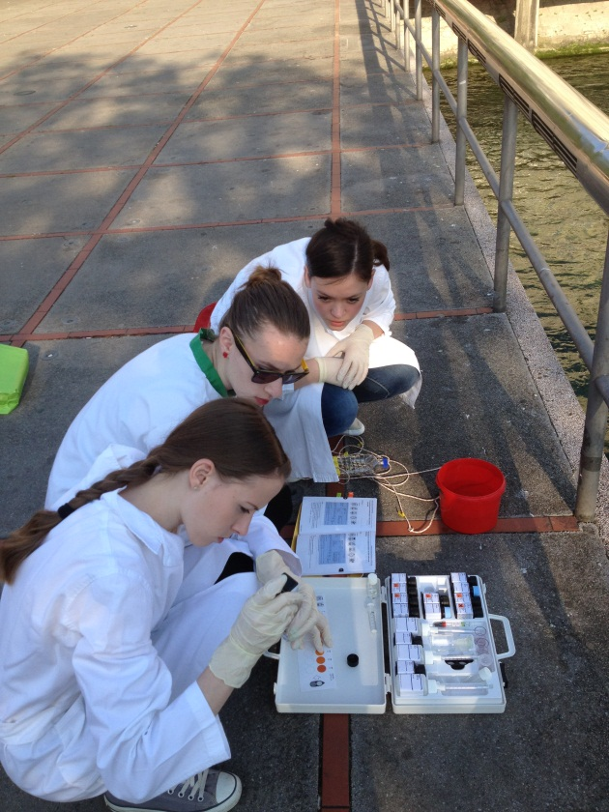
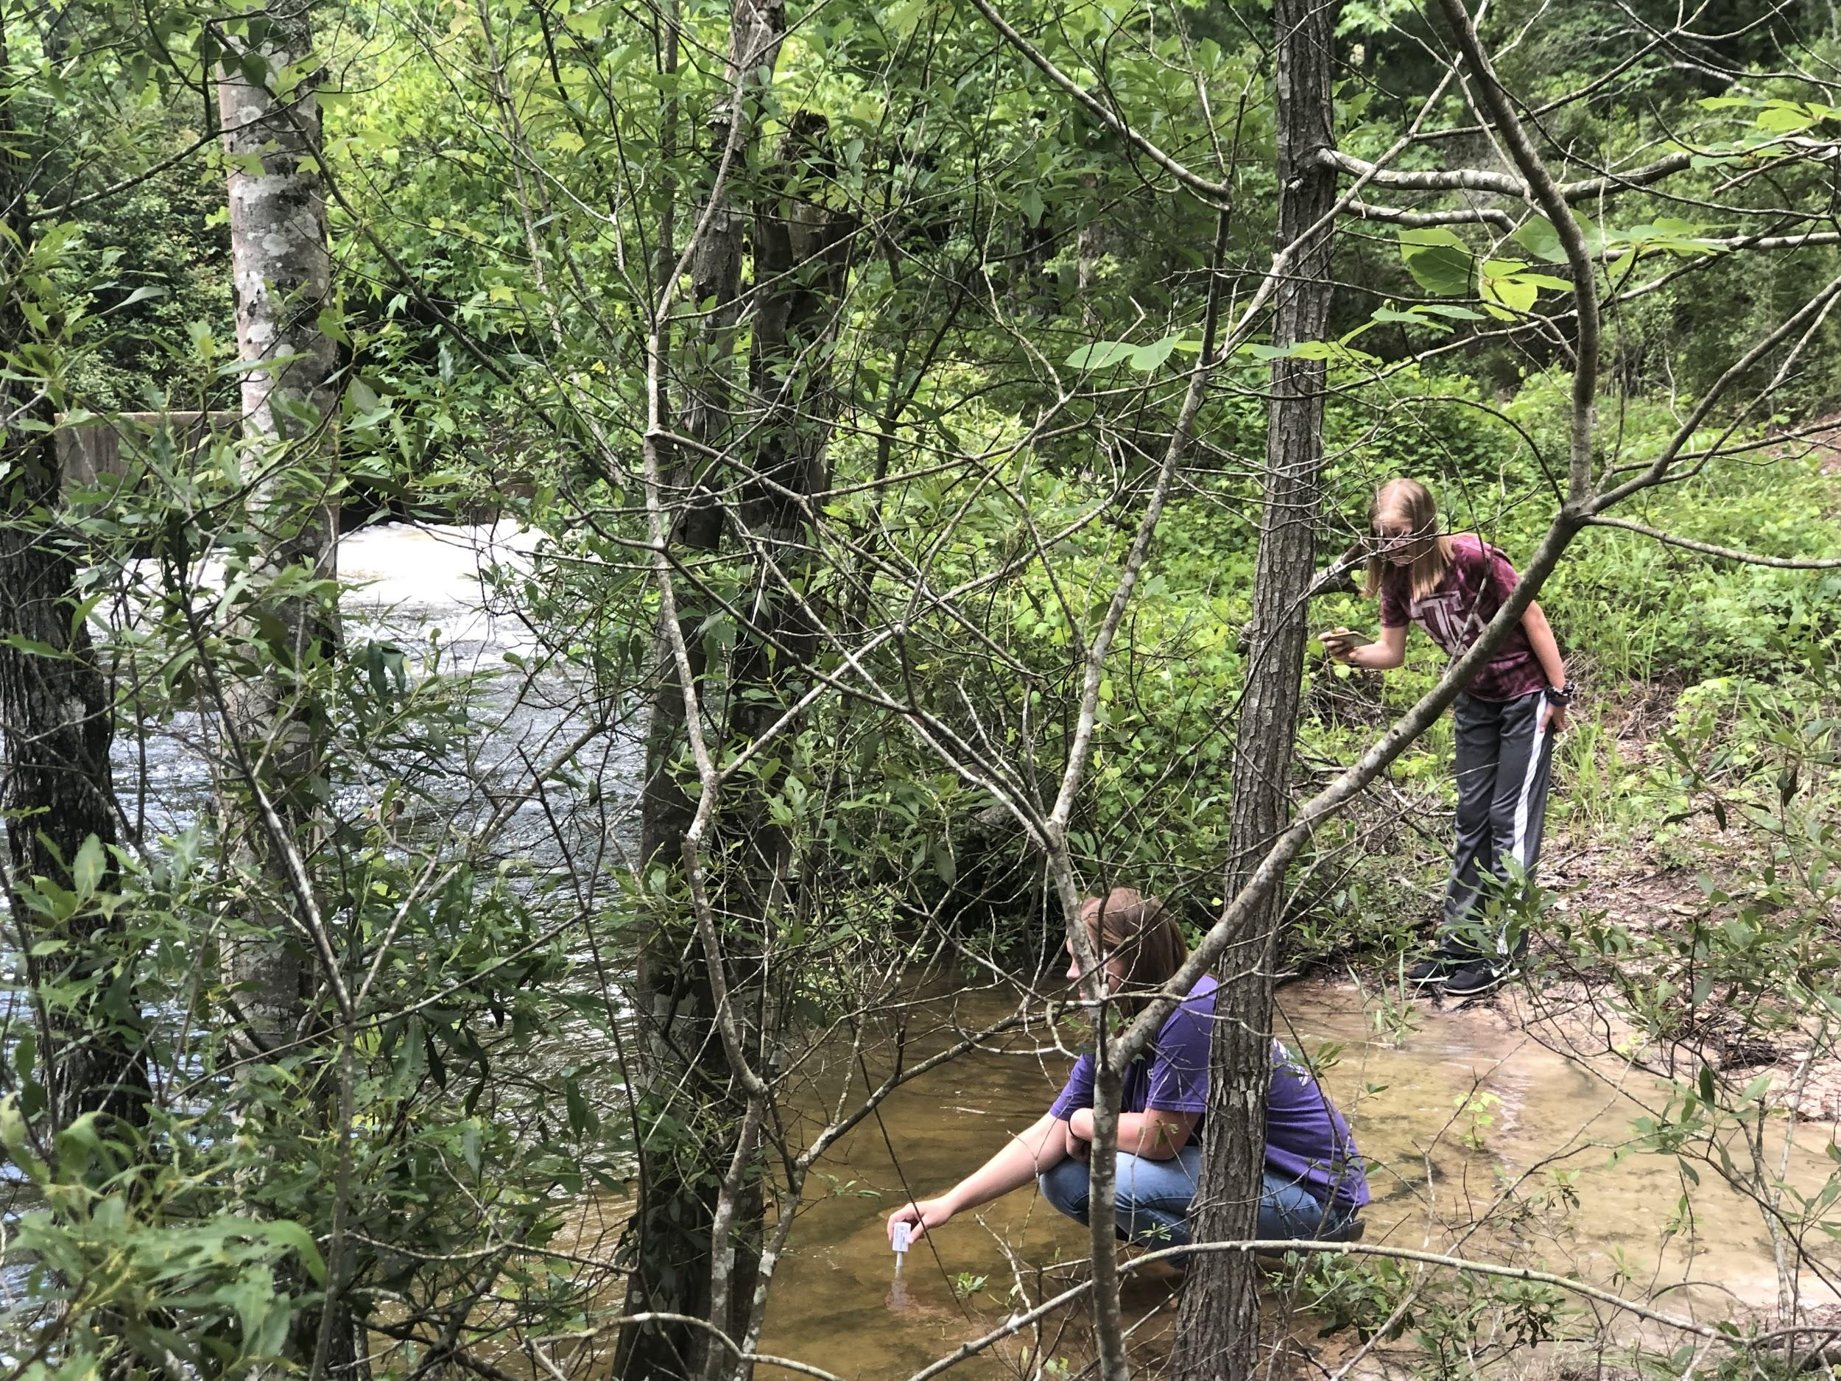
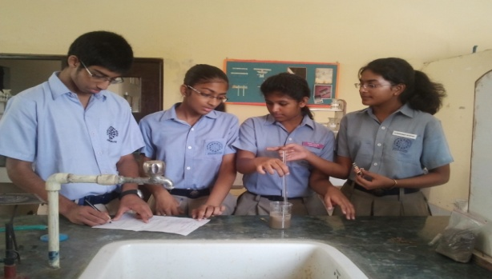
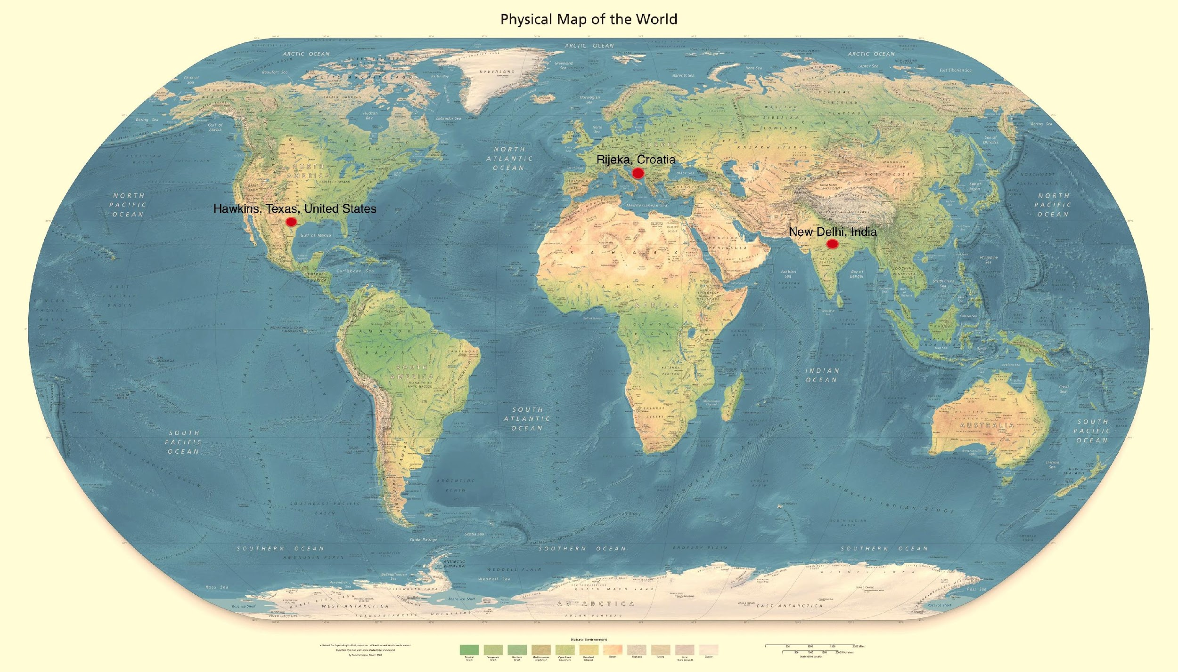
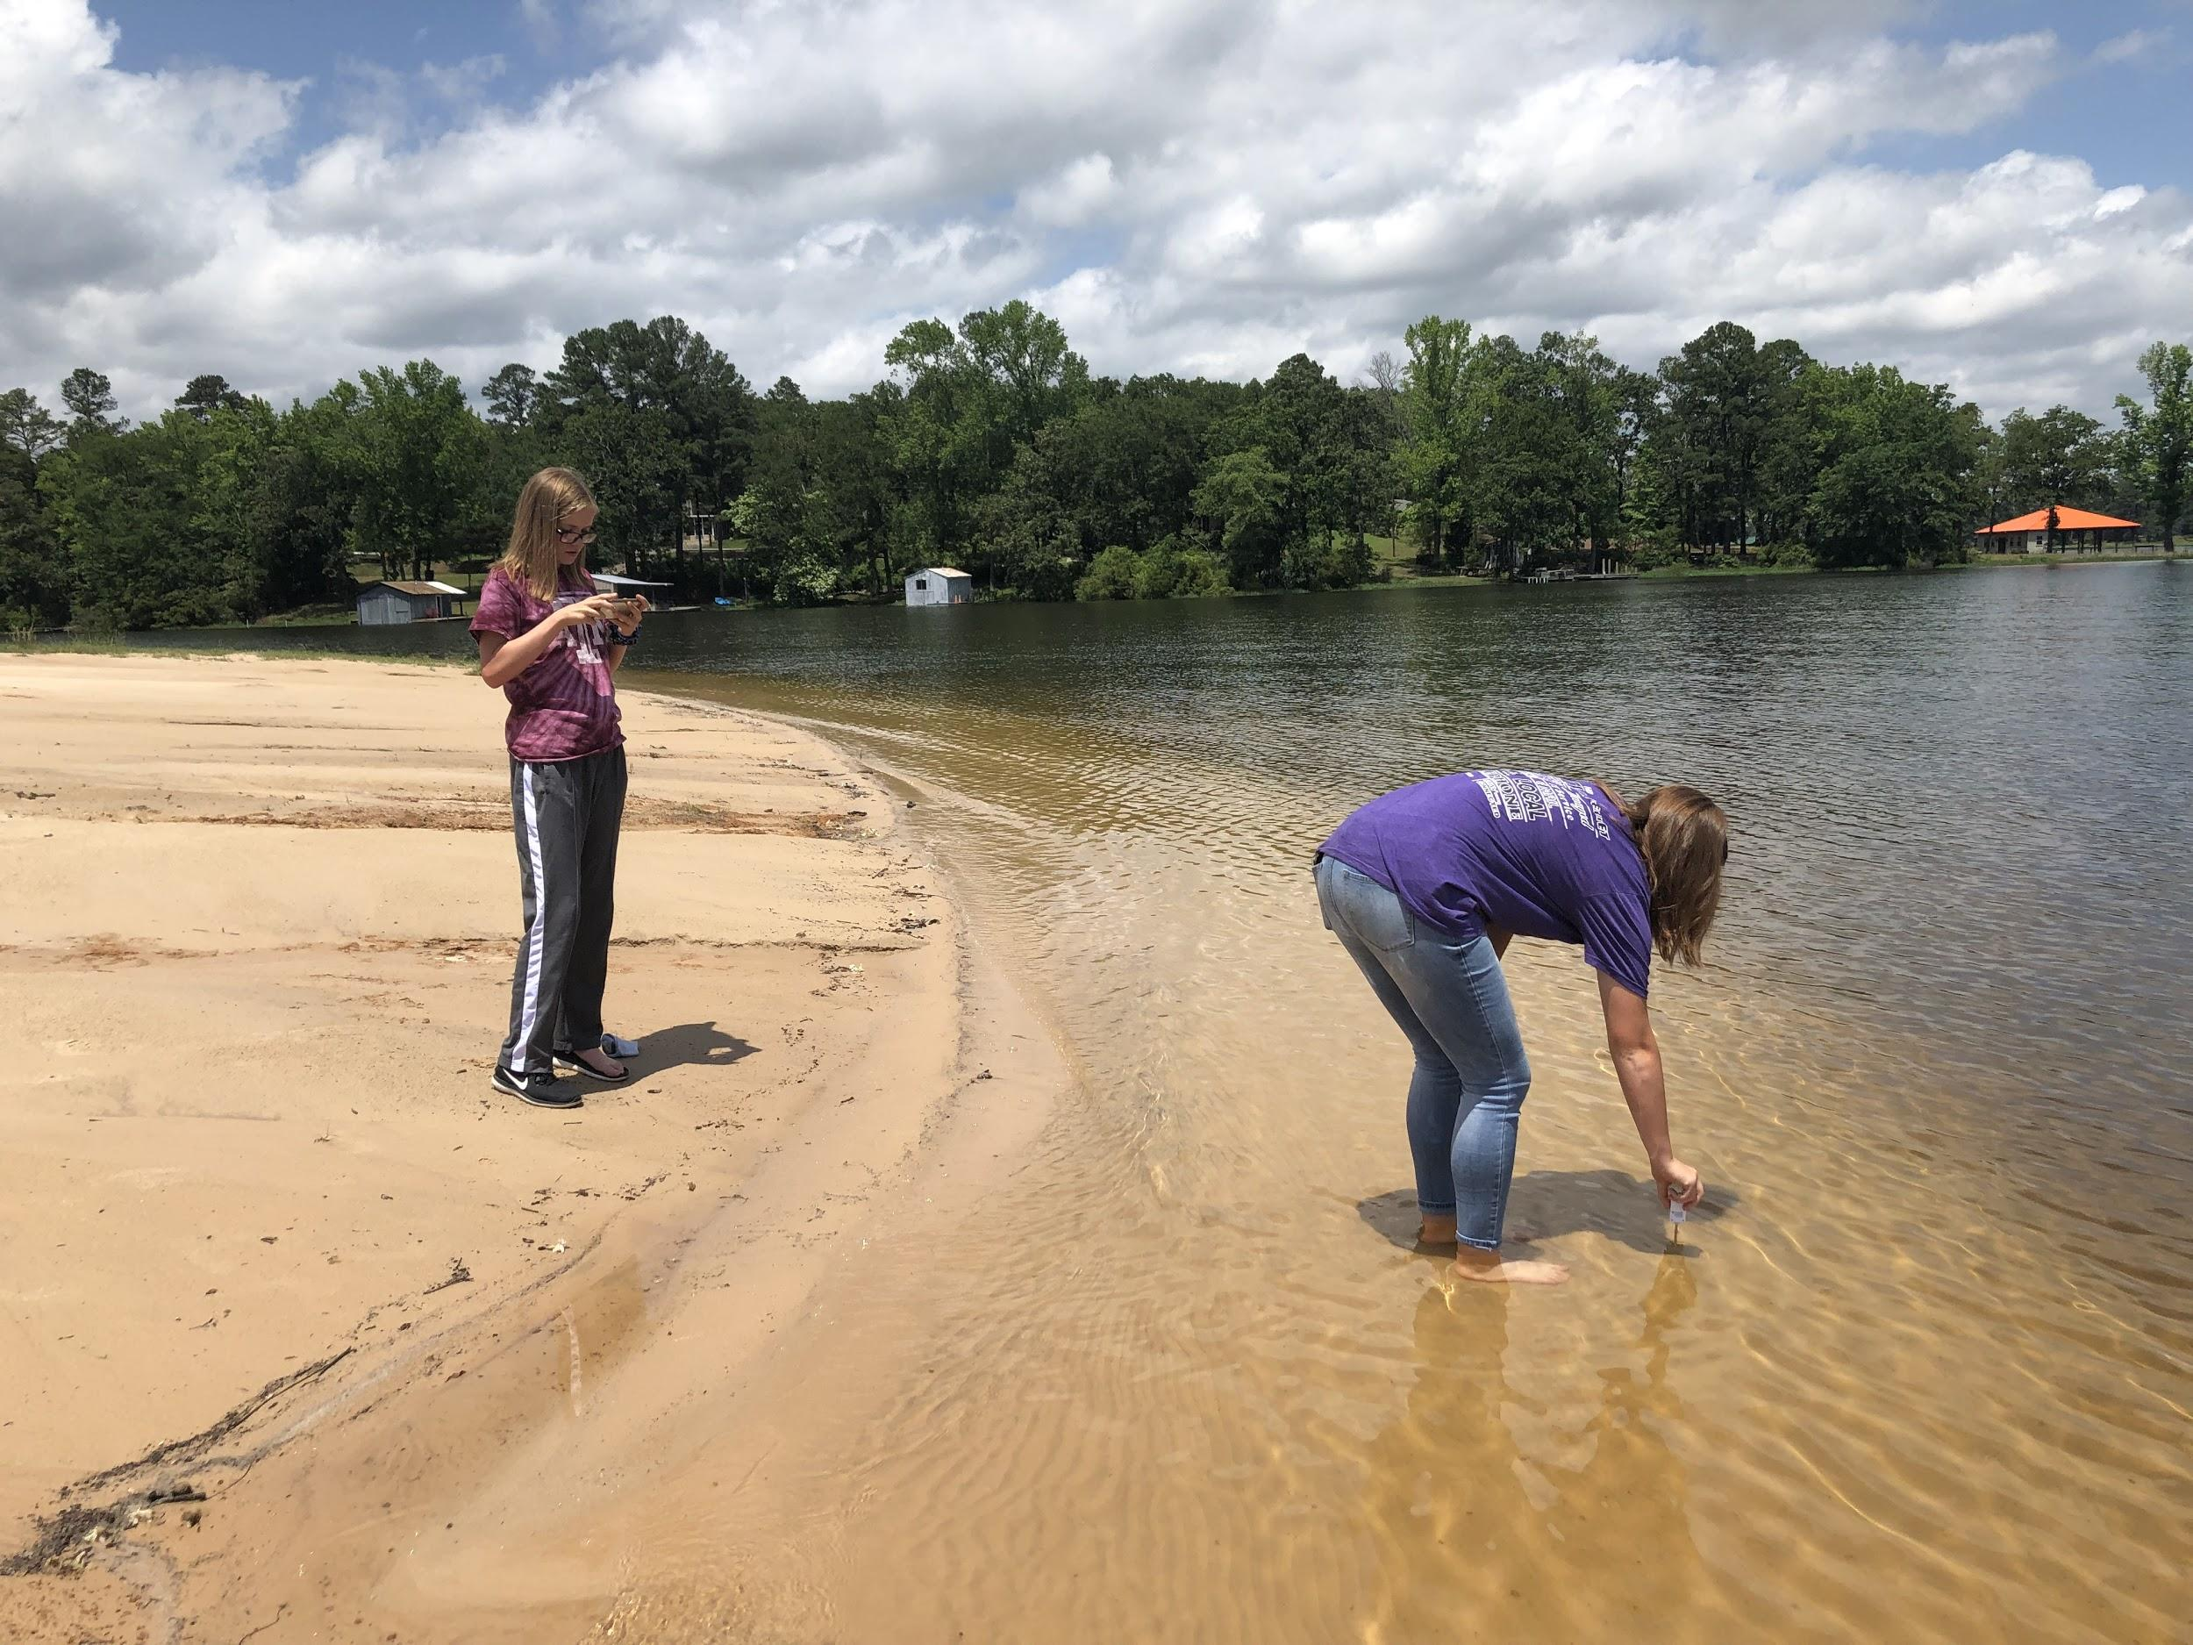
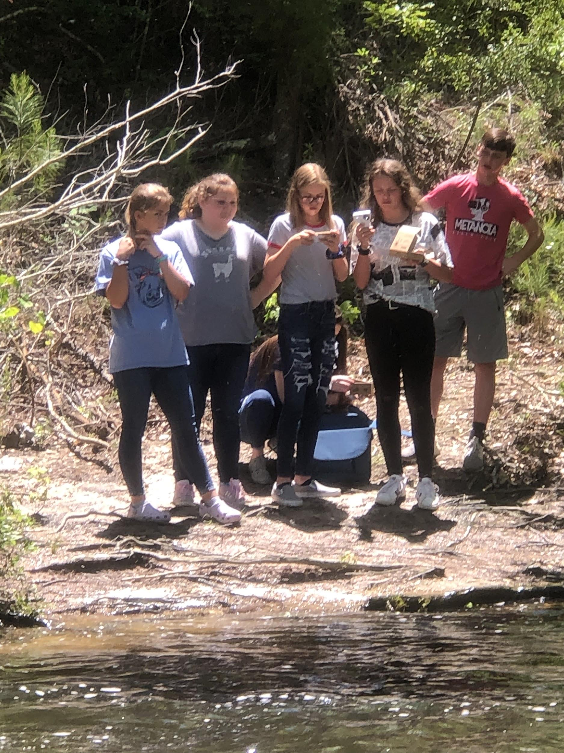
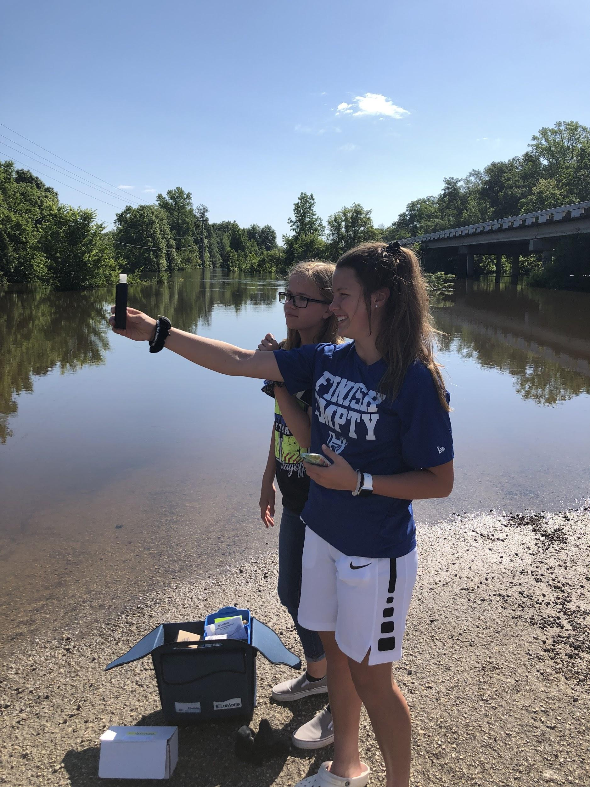
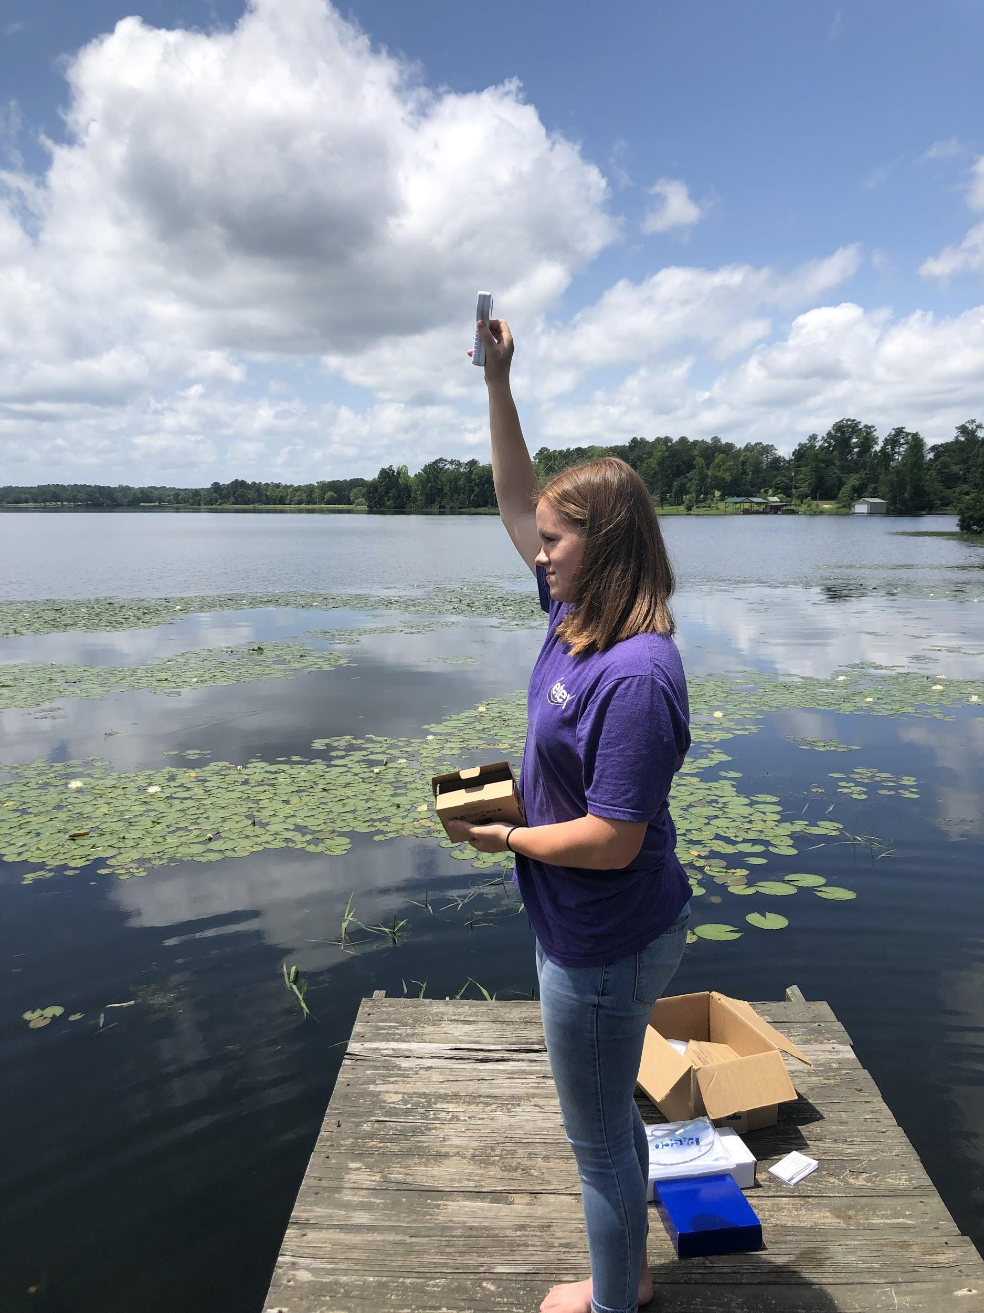
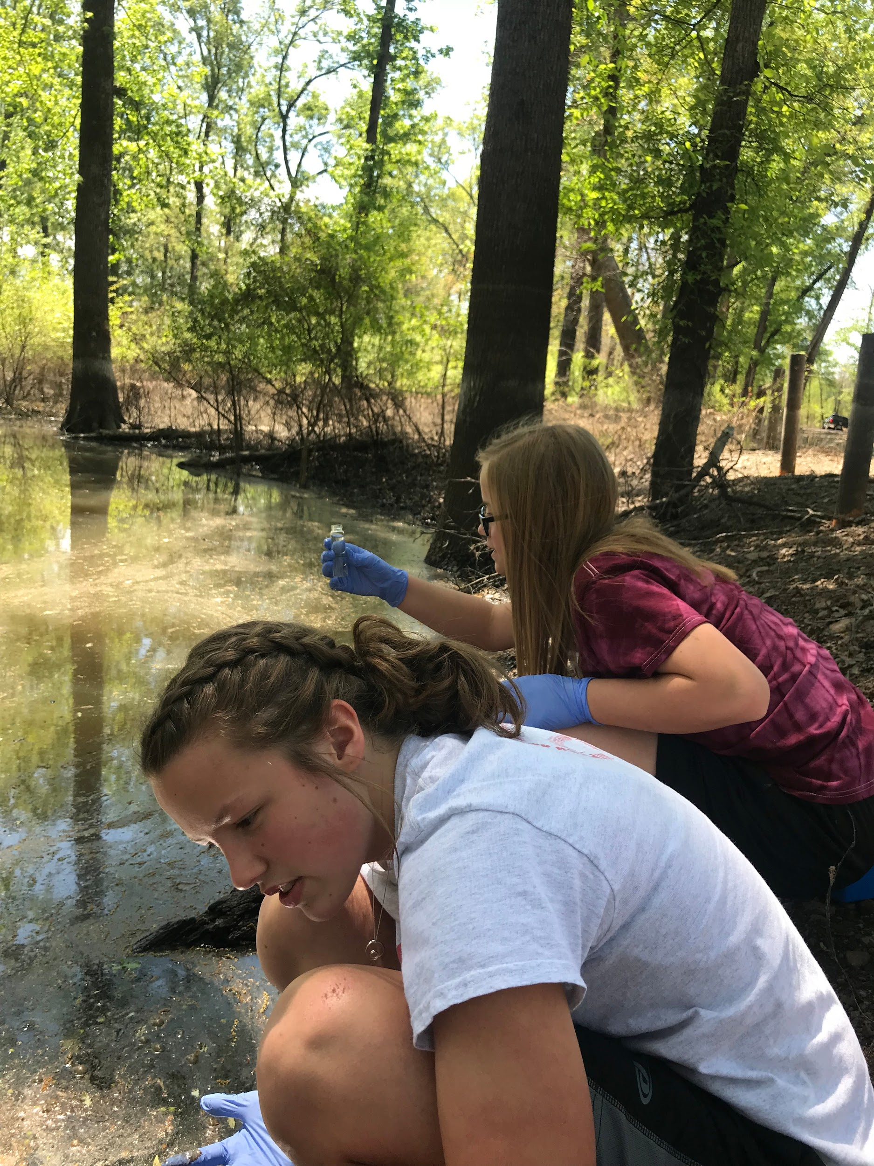
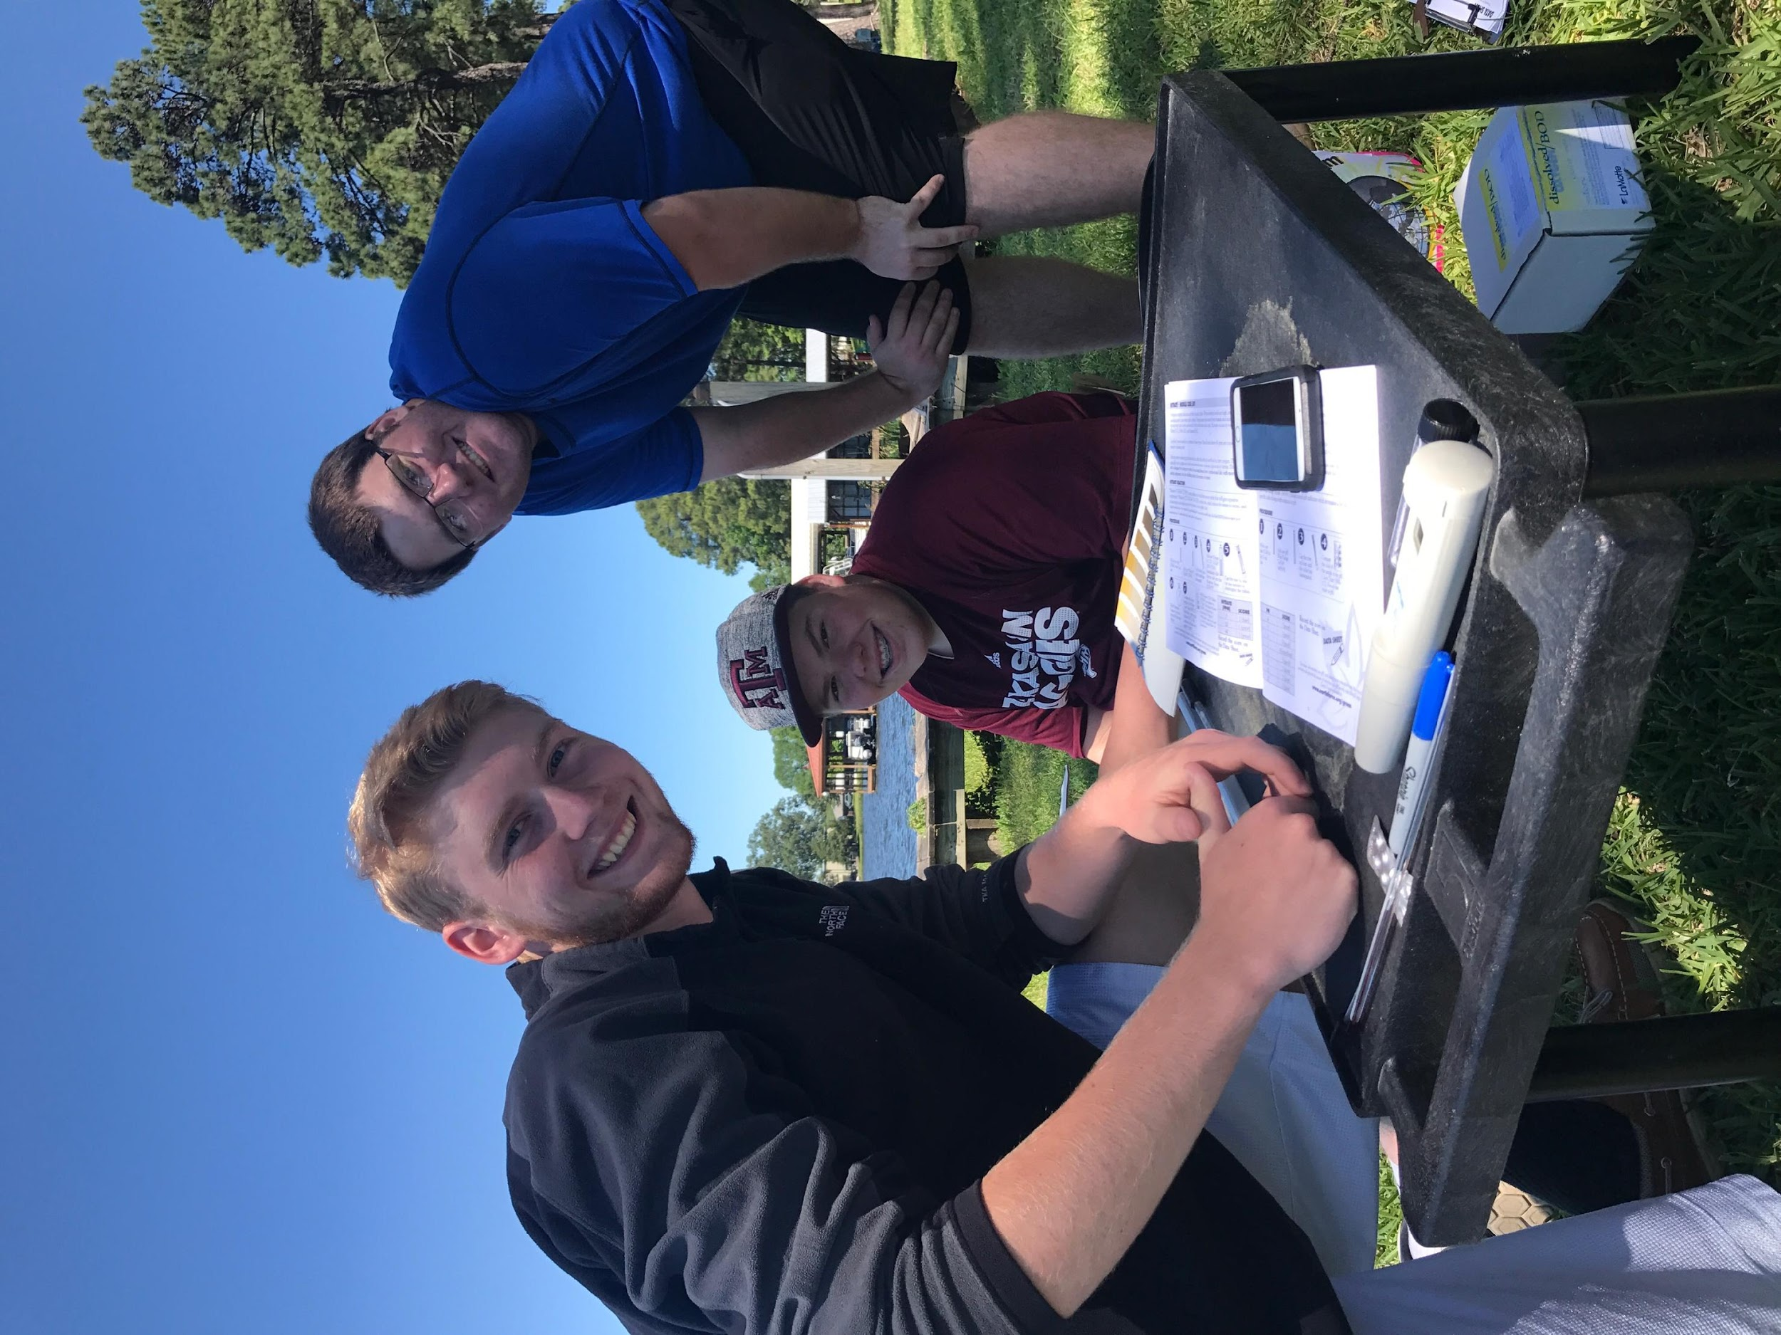
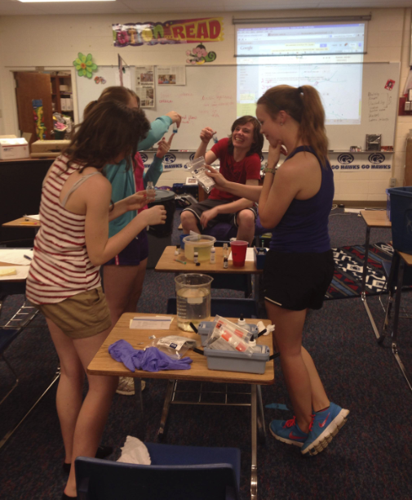
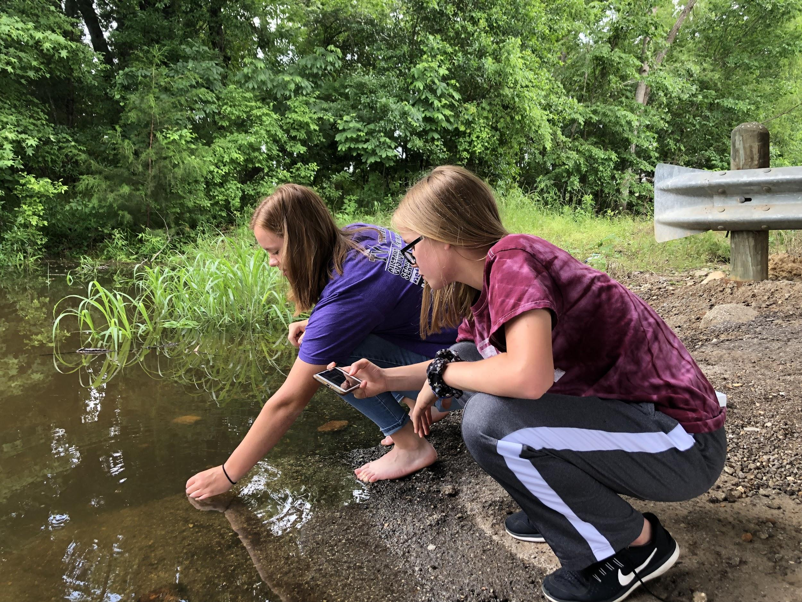
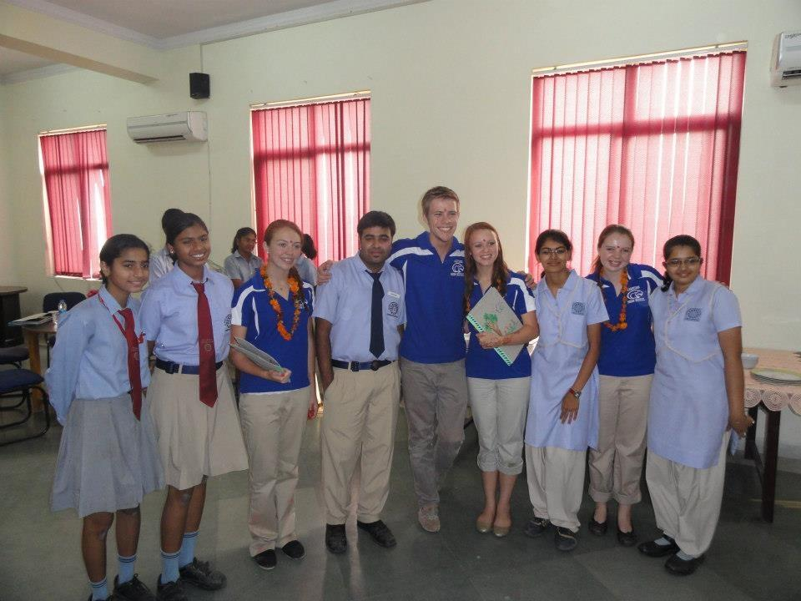
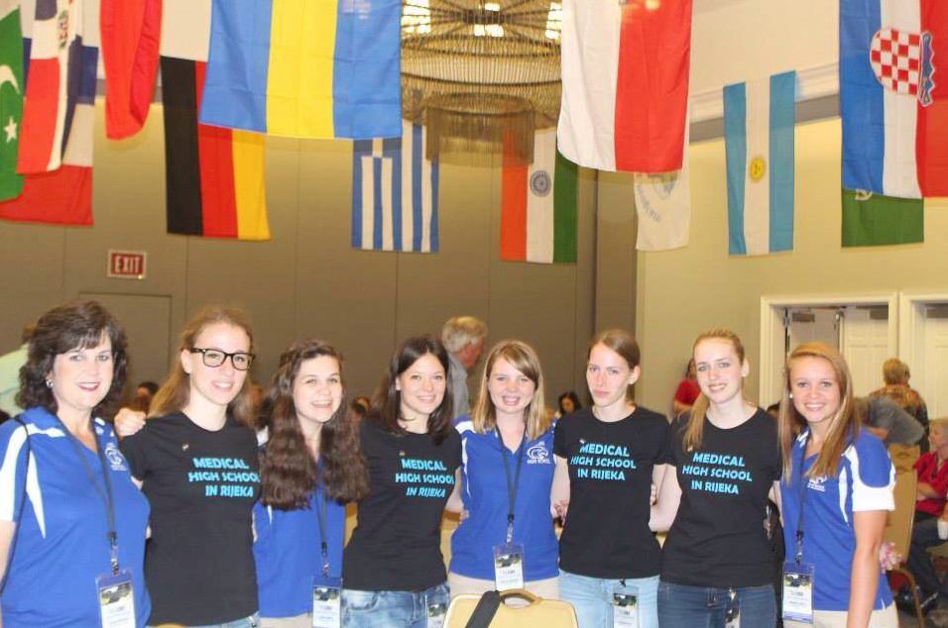
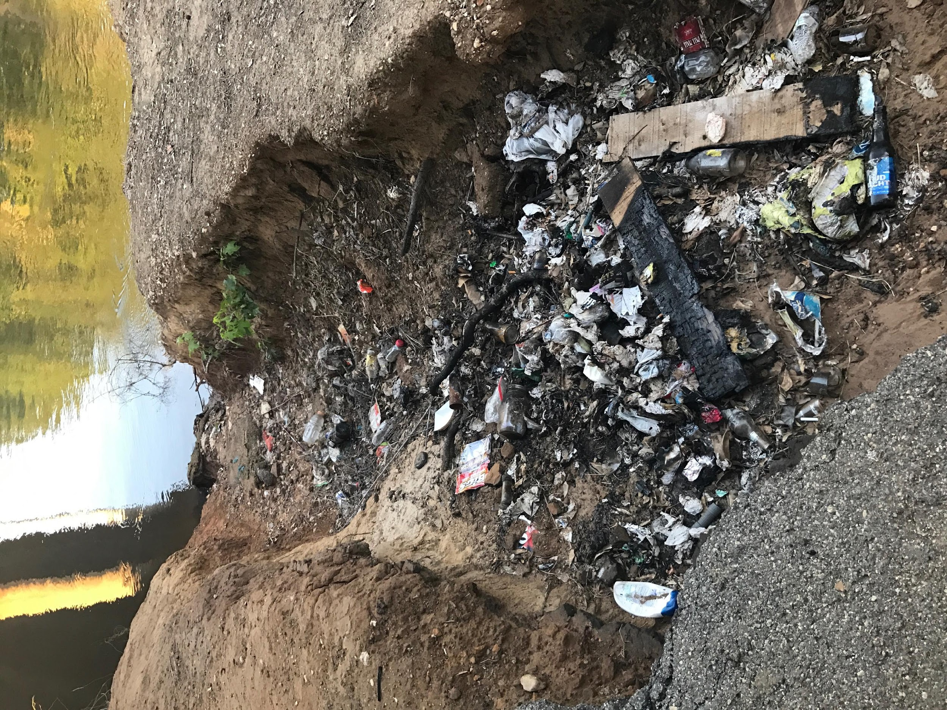
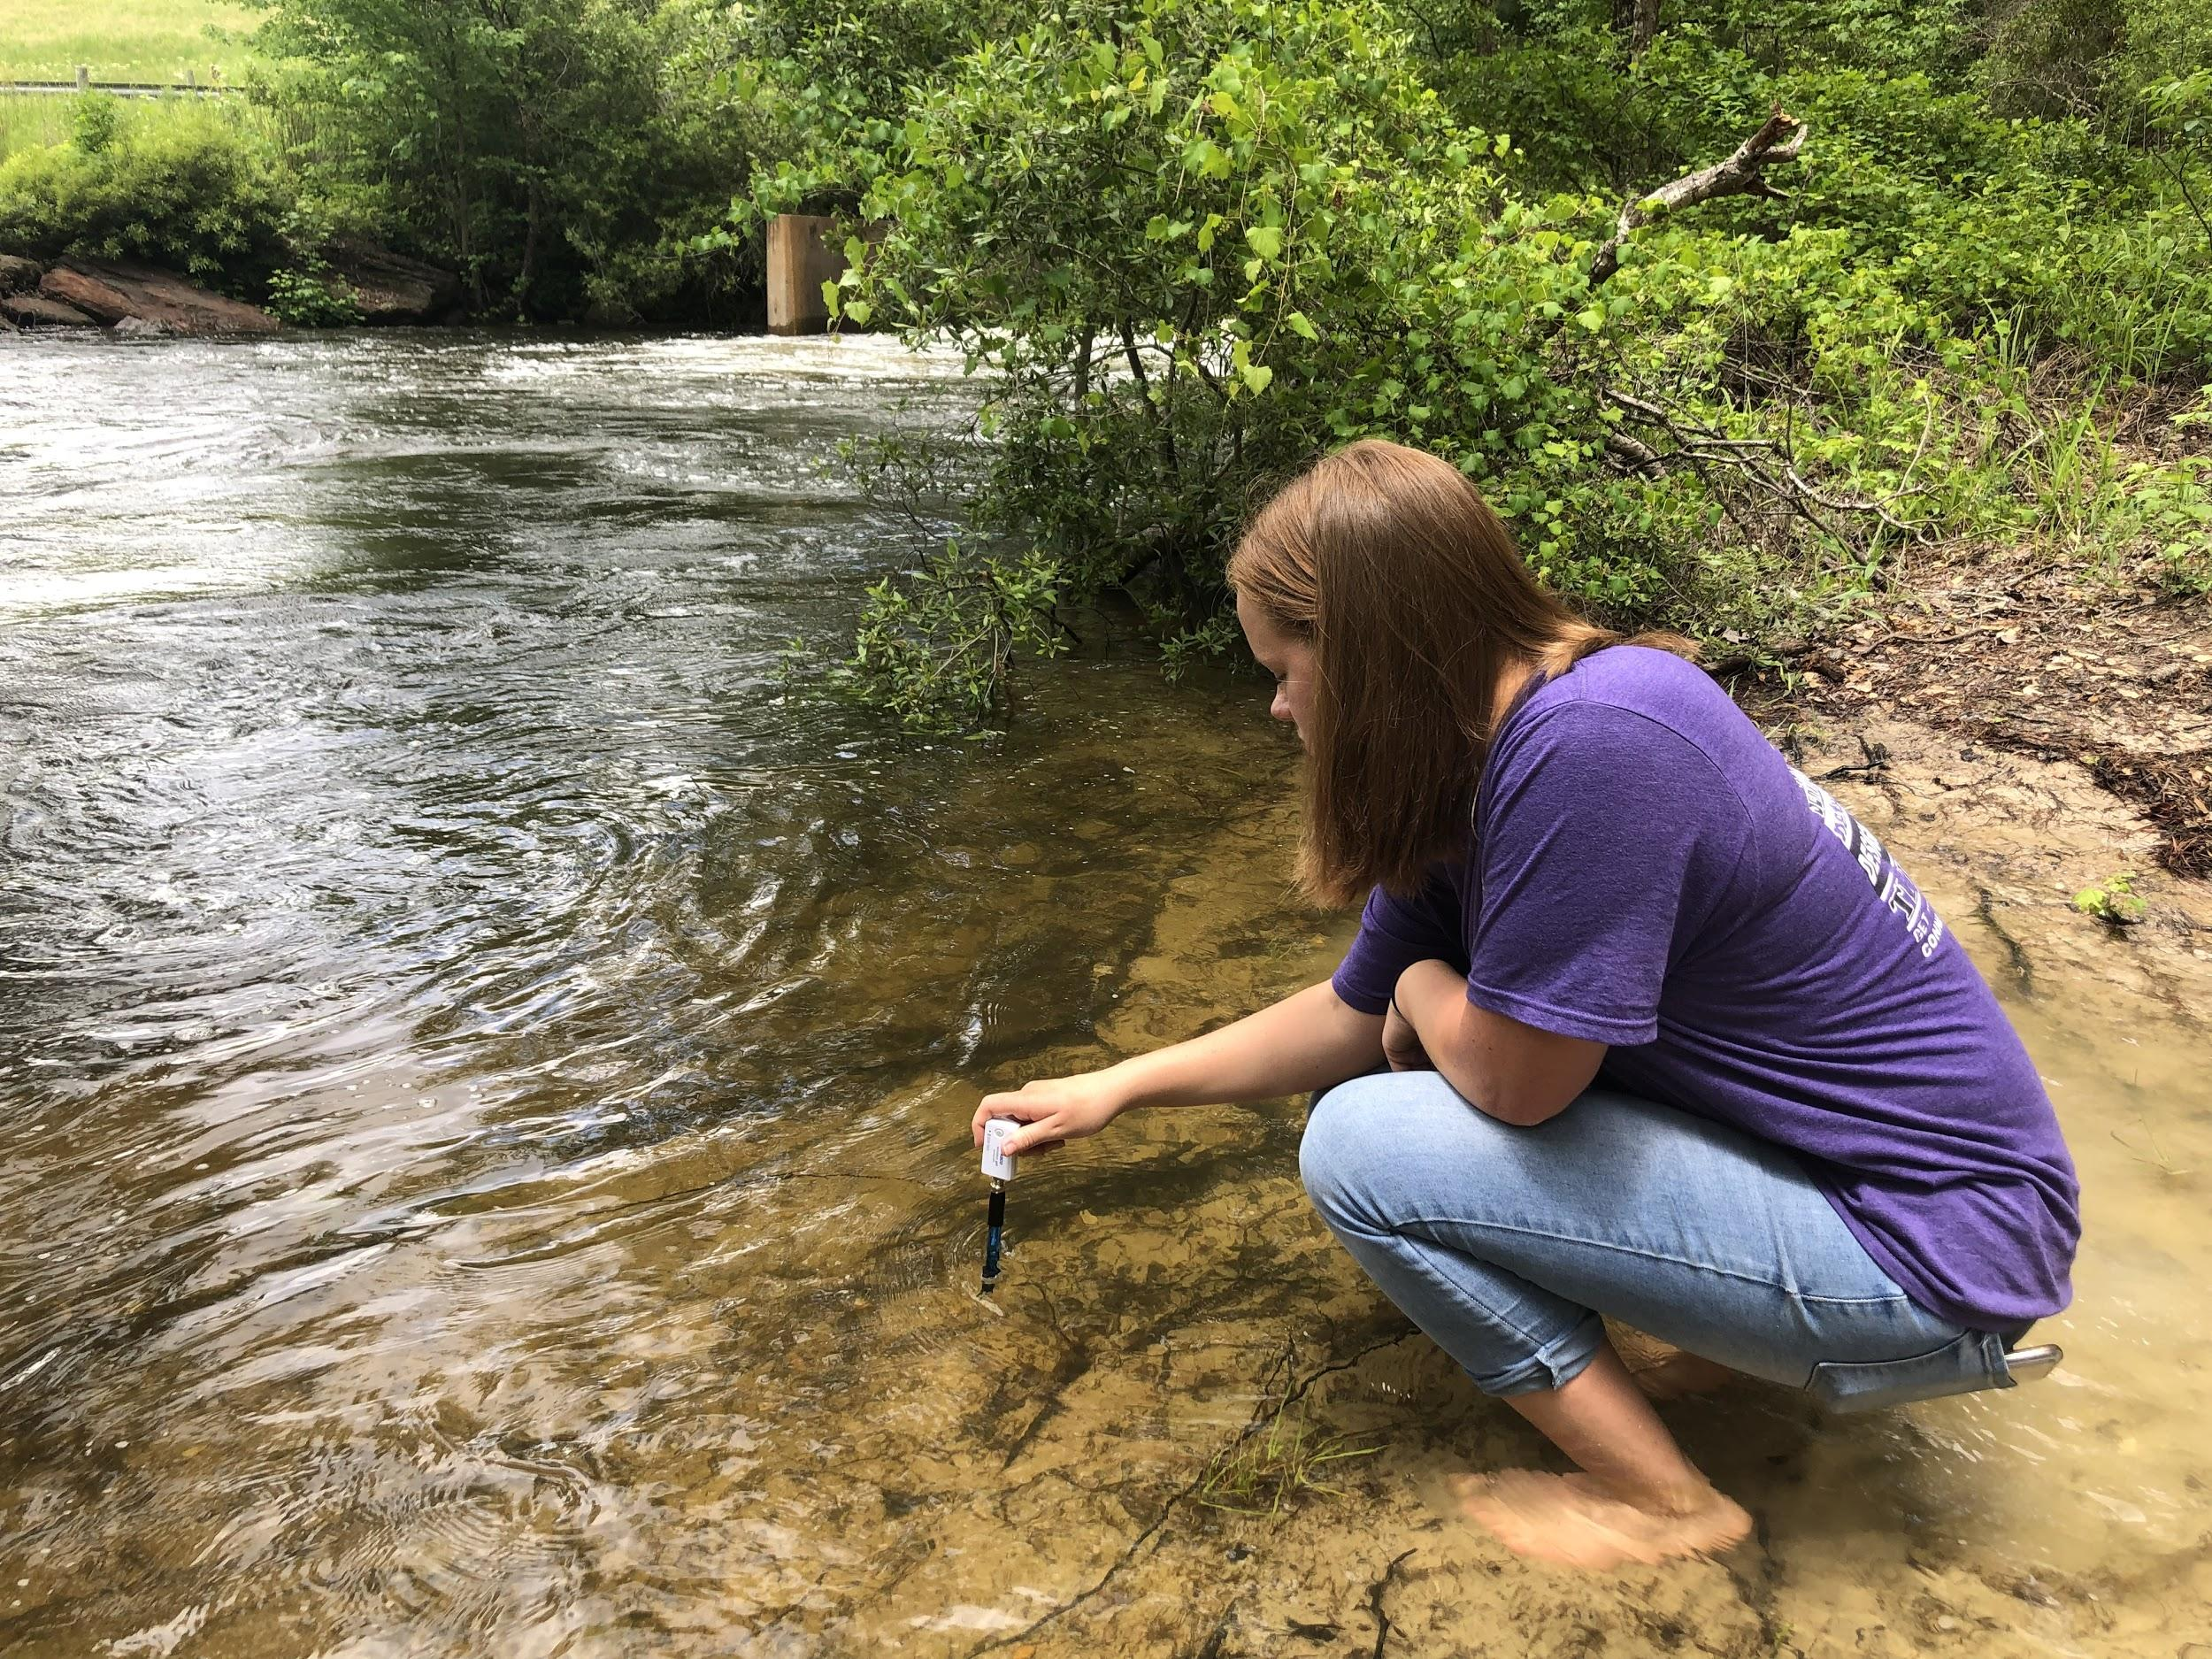
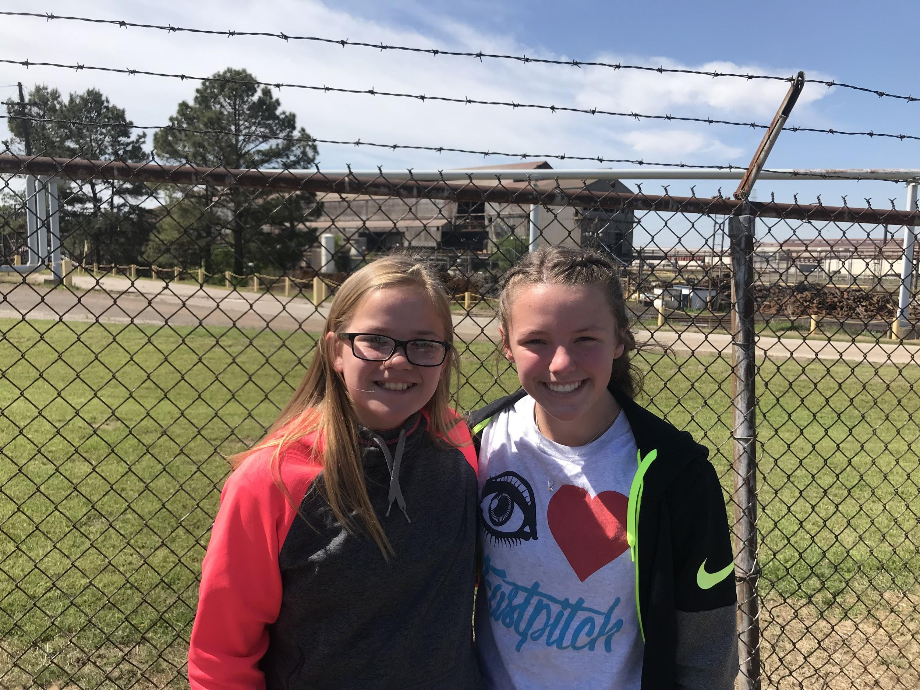
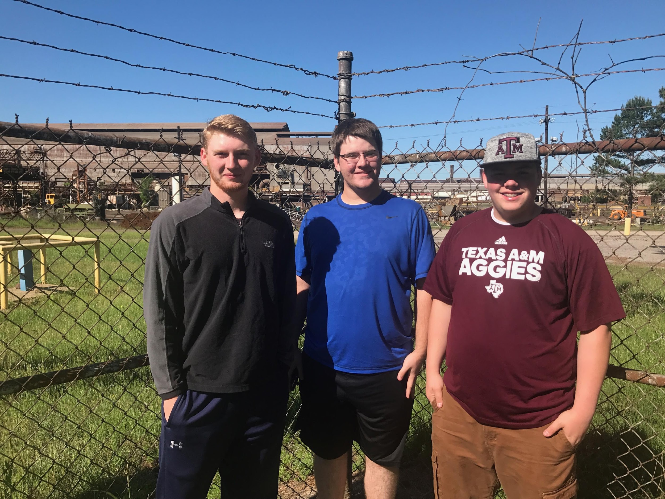
There will be a fold here
There will be a fold here
Hawkins High School TOXIC Water Research Project Morgan Jaco and London Jaco Hawkins Independent School District Hawkins, Texas
Abstract.
Investigation Plan.
Data.
Conclusion.
Hawkins High School has gathered a number of GLOBE measurements from 2010 to the present. We began working on a project involving soil contaminants that quickly evolved into a much larger endeavor. Because water will reveal more about pollution in our natural environment, we shifted our topic of investigation over to the health of local water bodies. By 2013, we were communicating with India and Croatia over their concerns of water quality. We began testing four nearby water sources-- Lake Hawkins, the Sabine River, and 2 sites at Lone Star Lake --and obtained information to be shared across the globe.
We began by researching watershed areas, water pollution, and specific vocabulary involved in hydrology. By correctly following GLOBE hydrology protocols for dissolved oxygen, nitrates, pH, turbidity, water temperature, and macroinvertebrates, we gathered information needed to identify our watershed sites as “polluted” or “unpolluted.”
Upon further investigation we found that there are fish consumption bans at Lone Star Lake, as largemouth bass from this site indicated the presence of mercury “at levels that may pose a threat to human health if consumed.” Mercury was also found in the tissue of various other fish.
Students from Hawkins High School collected data from Lake Hawkins, Lone Star Lake, the Sabine river, and a stagnant tributary to Lone Star Lake, all of which were fresh water. This data was collected over multiple days at varying times throughout each day.
Through our research, we learned sensitive macroinvertebrates we would find in our local watershed areas enjoy shallow water with a fair amount of dissolved oxygen and neutral pH. Since oxygen is more easily dissolved in cooler water, a temperature of about 15 degrees Celsius is a healthy temperature.
In our testing sites, the most abundant amount of macroinvertebrates were found in the riffle portion of our pond, where there was plenty of dissolved oxygen and a temperature of approximately 17.5 degrees Celsius. We discovered 27 caddisflies in our small testing area. Caddisflies are fairly sensitive macroinvertebrates. This reveals the health of our streambed, contrary to prior belief that our water was receiving pollution from anthropogenic activities. At Lone Star Lake no macroinvertebrates were present.
Using GLOBE hydrology protocols on conductivity, dissolved oxygen, nitrates, pH, turbidity, water temperature, and macroinvertebrates, our GLOBE Club investigated local water quality and submitted data to the GLOBE database. All results from the Hawkins sample sites showed very low pollution levels; however, Lone Star Lake tested positive for coliform and had low levels of dissolved oxygen.
Our four sample sites reveal that these surrounding areas are fairly unpolluted. Croatia, though brackish water, is still comparable to our own fresh water and also shows that their previous pollution problem is diminishing and the health of their water channels is rising. Lake Sanjay in India, unfortunately, is experiencing many pollution problems and although people are working to save the lake, there are deviations in the standard measurement for quality water and their collected data. Lone Star Lake, despite the interest in improving its water quality, still faces pollution issues.
Our collaborative research project was started in an effort to not only learn more about our water quality, but also improve where needed. Though this project seems to just be beginning, it is one that will continue on in collaborative investigation.
Research Questions.
Through our research, we would like to investigate macroinvertebrates and the water quality of multiple water sampling sites. From our studies, we understand that some macroinvertebrates are more pollution sensitive than others. Therefore, if pollution-sensitive organisms inhabit a watershed area, a pollution problem is not likely.
What conditions are best for sensitive macroinvertebrates? Have environmental regulations enforced at Lone Star Lake improved water quality? How do our nearby aquatic environments compare to those of Lone Star Lake?
By observing and testing three surrounding aquatic sites, we can learn about our impact, either through agricultural, chemical, or industrial expansion, on our environment.
Many experiments show major differences in the water sites, but this can be attributed to the fact that we investigated freshwater habitats and Croatia inspected brackish water channels. Overall, both of the tested watershed sites do not greatly deviate from the standard for healthy bodies of water. The water tested in India and the Lone Star Lake sites, however, seemed to be experiencing some disruption.
In this specific research project, we collected data from nearby recreational water sources and from Lone Star Lake and compared them with one another as well as with data shared with us from India and Croatia. Each of our schools had their own questions or concerns about the local watershed environment, but also wished to compare data with other countries with similar inquiries.
Research Method.
Discussion of Measurement Limitations.
The first question asked what conditions are best for pollution-sensitive organisms. This question could be easily answered through a short research of macroinvertebrates. Audra Edwards, GLOBE environmental teacher, taught us more about macroinvertebrates, what types would be expected in our watershed areas, and what this could mean about the water quality.
The second question became more specific in asking what types of macroinvertebrates are located in the selected sampling sites. We used the “Define Your Site,” dissolved oxygen, nitrate, pH, turbidity, water temperature, and macroinvertebrate protocols to examine what types of macroinvertebrates could possibly inhabit the four test sites.
Our final question required us to reach out to other schools in order to compare data. Students from a school in Croatia and another in India had begun to build up hydrology projects in water sources of concern by collecting and testing water samples. We communicated with both schools and compared our results.
Like all experiments and investigations, there is room for error in both precision and accuracy. In this aquatic investigation, the same student or student group did not gather all data collected from the sampling sites, and the experiments conducted on said water may not have been uniform. Therefore, data submitted may have some miscalculations. Also, the kits and instruments used have different producers and will have small deviations in veracity. The collection of data includes, as always, human error and limits the meticulousness of the investigation as a whole.
Hypothesis.
Our hypothesis states that if a watershed area is lacking pollution-sensitive macroinvertebrates, a pollution problem is likely. We believe our surrounding watershed areas are fairly unpolluted but would like to test our ideas, as upon investigation, we found evidence of pollutants.
Citations.
Murdoch, T., Cheo, M., & O’Laughlin, K. Streamkeeper’s Field Guide: Watershed Inventory and Stream Monitoring Methods. Everett, WA: Adopt-A-Stream Foundation, 1996.
Dr. Wojnowski, David, Lead Professor of Teacher Education and Project WET/Stream Watch Coordinator, “Macroinvertebrates.” Personal interview. 23 Jan. 2014.
Chakraborty, Vaibhav, and Mrs. Mamta Agrawal. East Point School, New Delhi, India. Online interview. 3 Mar. 2014.
Medicinska Škola u Rijeci, Croatia. Online interview. 12 Jan. 2014.
We would like to compare our results with results from Lone Star Lake, as it is located next to a large steel mill that had been shipped products that were found to be toxic in the 1980s. We would also like to see how/if this water has improved since its contamination 30 years ago.
There will be a fold here
There will be a fold here
Notes:
‹#›

