Slide 1


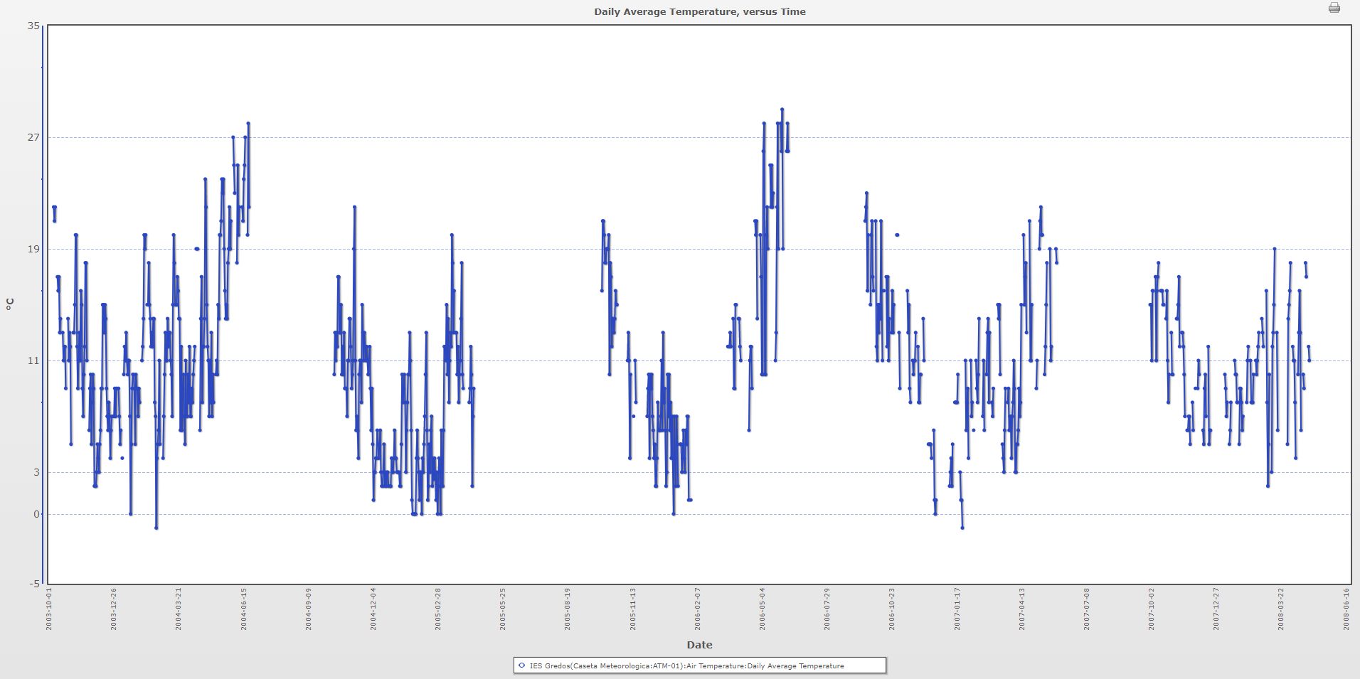
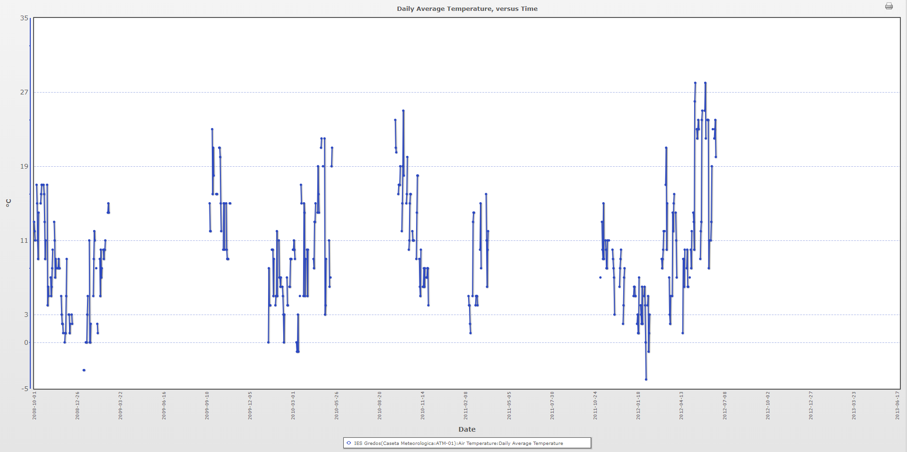
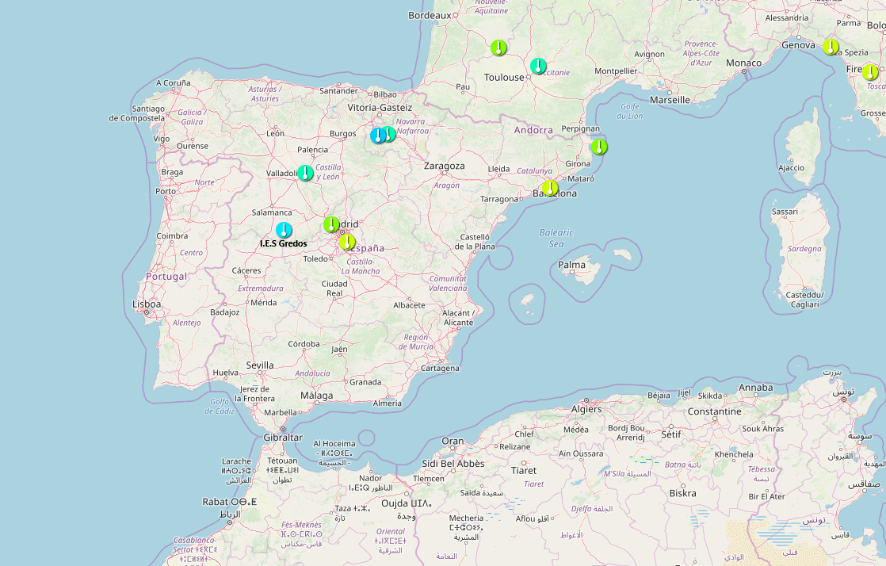
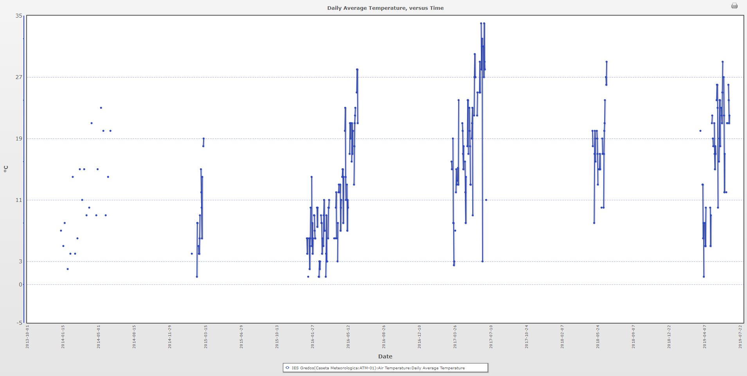
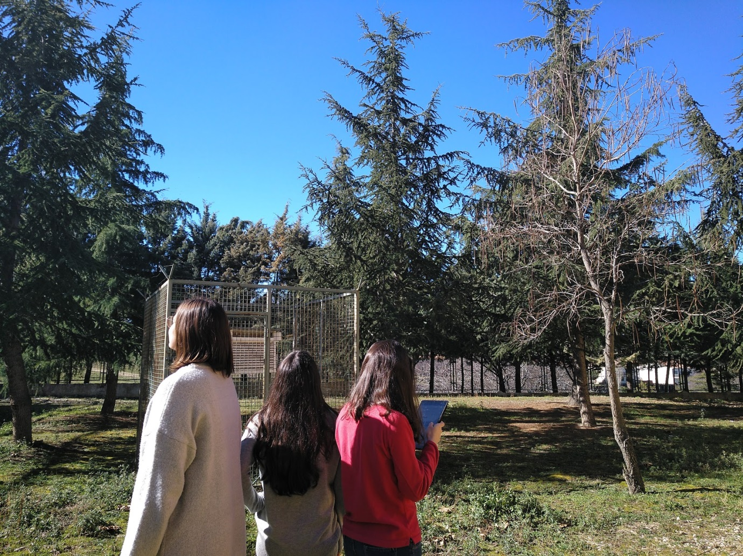
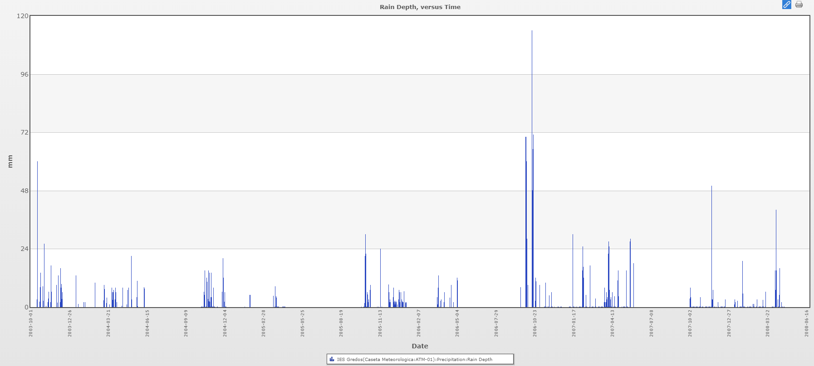
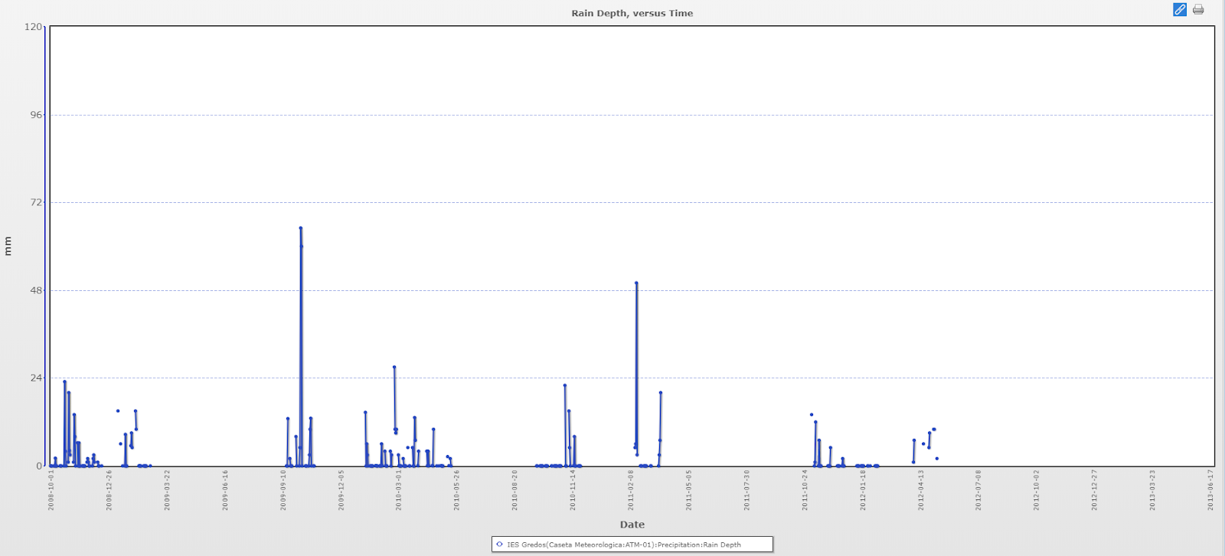
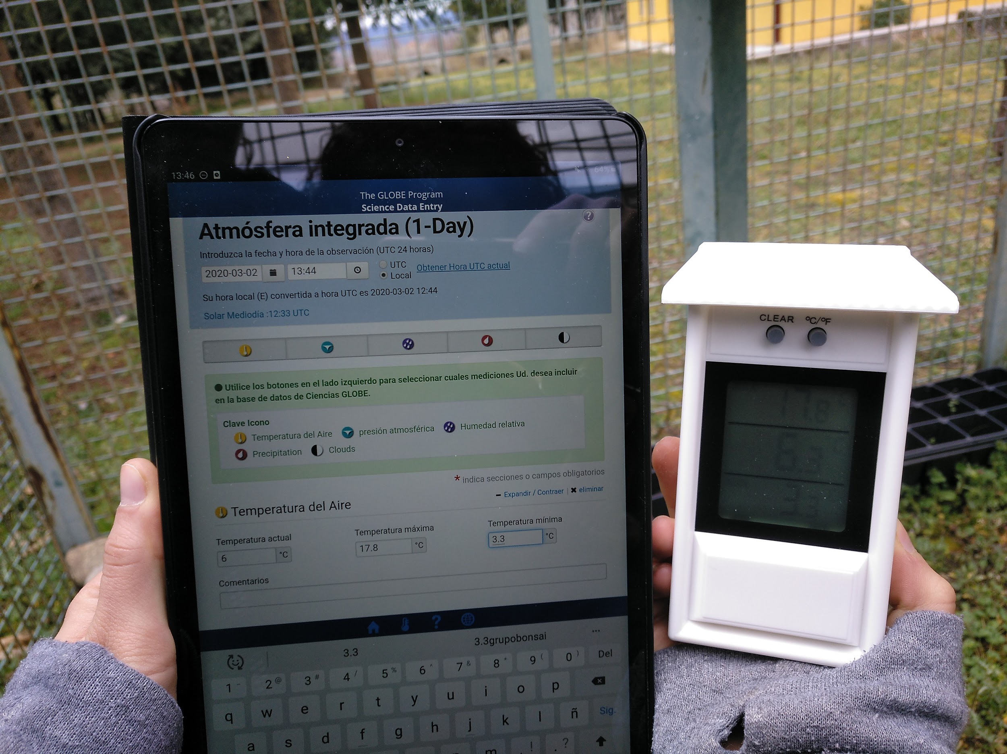
ANALYTICAL STUDY OF VARIABLES AFFECTING CLIMATE CHANGE IN RURAL AREAS
Cárdenas Martín, Beatriz, García-Rojo González, Carlota
Martín Sánchez, Alba
Earth and environmental science
I.E.S Gredos Piedrahita
Abstract
Research Methods
Results
Discussion
The students of 2nd of bachillerato of the IES Gredos ( Piedrahíta, Avila, Spain) have developed the analytical study of temperature and precipitation, to see whether; Could the effects of climate change also be visible in rural areas? For this purpose, through the integrated one-day atmosphere protocol of the GLOBE project, we have compared several graphs obtained from temperature and precipitation data with a five-year periodicity. After analyzing the graphs, with the data collected over the last 16 years, we have managed to observe a temperature increase pattern that coincided with the data observed in other urban and rural areas of our country. Regarding precipitation we have observed a decrease in our area, but we have not observed a pattern similar to the other comparison zones. Therefore, we can conclude by stating that rural areas will also be able to suffer the effects of climate change. Finally, we propose an increase in information based on simple actions that the entire population can take to mitigate the effects of climate change.
Keywords: temperature, precipitation, rural area, climate change
Planning Investigations
Based on NASA's built-in atmosphere protocol:
The place from which we take the data is the Weather Booth SITE_ID:4226. Latitude 40.4557, longitude -5.3215, elevation 1,103 meters.
Our educational center is located near the port of Peñanegra (1,909 m) and is a transition zone between two ecosystems, Mediterranean mountain, formed by oaks and holm oaks and high mountain with herbaceous and shrubs, highlighting the piorno (Cytisus purgans).
Daily data collection of: air temperature (maximum, minimum and current), atmospheric pressure (pressure station), relative humidity of Sling Psychrometer (dry bulb and wet bulb), precipitation (accumulation days and type of precipitation, in addition to its amount sky state, cloud type, and percentage of visibility. To do this we use the instruments of the weather shed, which are a digital thermometer of maximums and minimums (°C), an altimeter (mb), hygrometer (% of humidity) and rainmeter (mm).
Share the data with the GLOBE program.
Obtaining Rain Depth and Temperature (Solar Noon Temperatures Dailies) graphs, with the application of GLOBE.
Analysis of the graphs obtained.
Below are the charts showing the data recorded from 2003 to 2019. We've divided them into two groups, the first three show the temperature data and the last two precipitation data. Finally, we have taken into account that the data between 2017 and 2018 were not registered on regular basis, in order to perform an adequate analysis.
Temperature
Attached charts (1, 2, and 3) show daily average temperature data recorded during school years (September-June) grouped in five years. Absences of data are due to summer holidays. The "v" pattern of each school year is typical of Mediterranean climate, characterized by mild autumns, cold winters and warmer springs
Despite the short period of time that covers our analysis (16 years) and not having recorded the data in the summer period, we can see that the data are consistent with those provided by the IPPC (Intergovernmental Panel on Climate Change) of 2007. We have chosen two schools to compare the data; one from a rural area (IES Juana de Pimentel, Arenas de San Pedro) and another from an urban area (IES Los Enlaces, Zaragoza). In both we observe a similar pattern of temperature increase as reflected in our graphs. However, regarding precipitation data, they do not agree to belong to localities with different rainfall regimes.
After the qualitative analysis of the graphs, we have been able to respond in the affirmative to the initial hypothesis since we observe a pattern of temperature increases that corresponds to the characteristics that describe climate change.
1. This graph shows the temperature data recorded between 2003 and 2008. From this data, we observed a more marked temperature increase from 2006.
Conclusions
Research Question
2. This chart represents the temperatures recorded between 2008 and 2012. Although measurements were scarce during this period, we can see higher temperatures from 2012 .
This project has not only served as a means of verifying that our initial hypothesis was correct, but has shown us the alarming situation where we are.
Precipitation data was recorded by previous colleagues for the last 16 years and by us for the last 6 years since arriving at this school. Then we started analyzing the annual charts without obtaining relevant information. Then we compared the annual temperature and precipitation with similar results. Finally, thanks to the ideas provided by our teacher, we started to group the data into charts from 2 years on. Through this, we could observe a pattern in the behavior of temperatures, which formed a concave structure, beginning with the September data and ending with the June ones. This logical pattern, with average temperatures in autumn, winter and mid-high lows at the end of spring, showed an upward evolution mainly in the last 10 years with a clear hottest year in 2017.
This methodological study has allowed us to analyze the variables that affect global warming and especially climate change. Firstly, we have seen in all centers an increase in temperature and so we can conclude that this increase not only affects to urban industrialized areas¹, but also to rural areas. On the other hand, we would like to emphasize that none of the studied centers showed a clear pattern of precipitation. Therefore, we can say that this increase complicates the prediction of rainfall. As a result, major disasters are caused not only by the meteorological phenomenon but also by the lack of forecast. It alerts the population to reduce human and material damage.
Asking Questions
Since climate change is a topical issue, we believe it is important to analyze the climate-determining variables in rural areas as they can contribute with more information to this global problem.
The motivation of this study was based on the observation of warmer and longer summers and less cold and dry winters. In this way, we raise the following hypothesis: Significant changes in climate variables can also be seen in rural areas.
3. This graph shows the temperature dates from 2013 to 2019. There is a clear rise in temperatures mainly from 2009 on, highlighting a very hot year in 2017 with an average temperature of 34ºC recorded in June.
Precipitation
Precipitation, despite having been studied for the same period of time as the previous variable, has been the only data that has provided us with relevant information are those recorded between 2003 and 2013 due to the shortage of rainfall from 2013.
Introduction
Content Knowledge
Climate change is the biggest obstacle with which society currently encounters. Their results are being globally visible³, affecting all sectors. We must be aware of this and act accordingly.
The IPCC (Intergovernmental Panel on Climate Change) last report⁴ has proposed a new scientific evidence of changes in the climate system and the associated impacts on natural and human systems, with a specific focus on the magnitude and pattern of risks linked for global warming of 1.5°C above temperatures in the pre-industrial period.
There is also (high confidence) global warming has resulted in an increase in the frequency and duration of marine heatwaves⁴. Further, there is substantial evidence that human-induced global warming has led to an increase in the frequency, intensity and/or amount of heavy precipitation events at the global scale (medium confidence), as well as an increased risk of drought in the Mediterranean region (our school).
This problem is of such magnitude that we have developed this study to raise public awareness of how the effects of climate change can also be felt in poorly industrialized rural areas.
Therefore, we believe that we need to provide the population with all the information necessary to be able to raise awareness of the change and to be able to implement measures to slow it down or adapt to its impact. Especially true for the child and adolescent population, which will be the future population facing the severe changes that are coming.
This graph shows the rainfall recorded between 2003 and 2008. Although we note that rainfall is scarce in October 2006, 115 mm of precipitation is reached.
Bibliography
This graph shows the rainfall recorded between 2008 and 2013. As in the temperature chart for this period, measurements are scarce. However, the highest recorded precipitation data are for October 2009 and February 2011, although they do not reach 70 mm of precipitation.
Antonio Ceballos Barbancho - Enrique Morán Tejeda - Manuel Quirós Hernández. Departamento de Geografía - Universidad de salamanca. evolución de las temperaturas y precipitaciones en las capitales de CASTILLA Y LEÓN en el período 1961-2006. Polígonos. Revista de Geografía 2007, nº 17, pp. 59-81.
Francisco Heras, María Sintes, Araceli Serantes, Carlos Vales. Educación ambiental y cambio climático Respuestas desde la comunicación, educación y participación ambiental. Edita CeIda, Centro de extensión Universitaria e divulgación ambiental de Galicia 2010.
Javier Eduardo Mendoza Sabogal, Jorge Enrique, Gutiérrez Valderrama, Marcela Rodríguez Salguero, Ana Derly Pulido, Clemencia Gómez González. Tercera comunicación nacional de cambio climático. IDEAM, PNUD, MADS, DNP, CANCILLERÍA, “Conocer: El primer paso para adaptarse. Guía básica de conceptos sobre el cambio climático” 2016.
Ove Hoegh-Guldberg (Australia), Daniela Jacob (Germany), Michael Taylor (Jamaica). Special report: Global warming OF 1.5 ºC.Chapter 03 Impacts of 1.5ºC global warming on natural and human systems.
Sara del Río González. El cambio climático y su influencia en la vegetación de Castilla y León (España). Itinera geobotánica, Nº. 16, 2005, págs. 5-534
The graphs note that the change in precipitation is not as noticeable as that observed in temperatures. However, by analyzing the data in detail, periods of prolonged drought are detailed considering that in this area precipitation is not abundant.
Notes:
1

