Slide 1


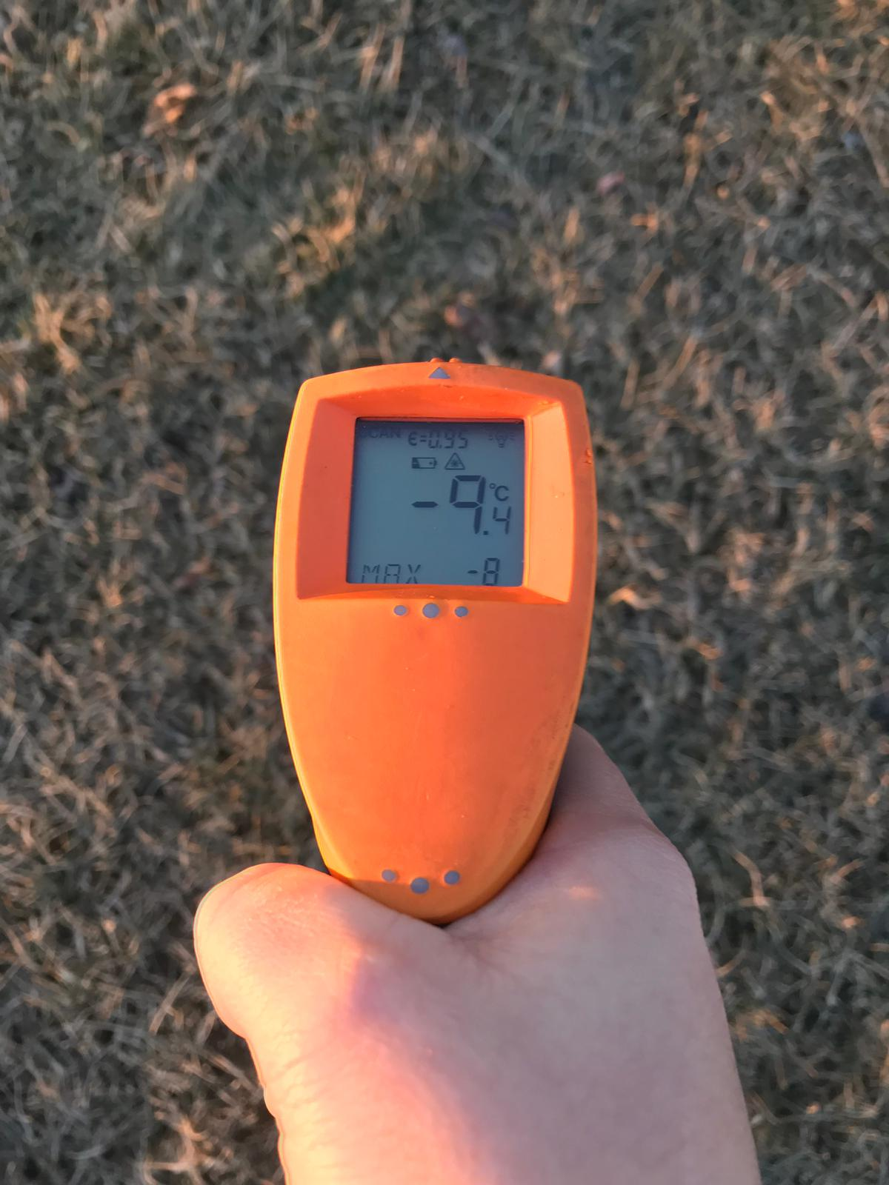
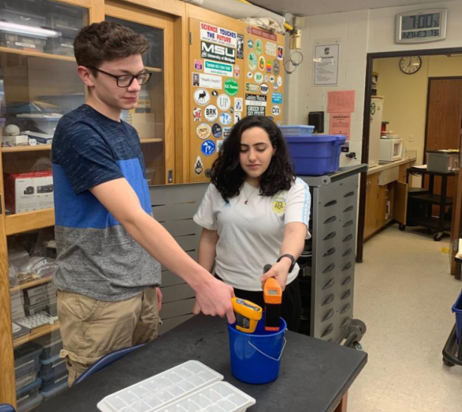
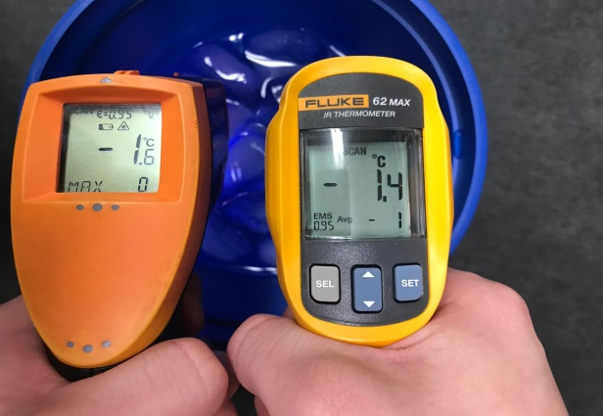
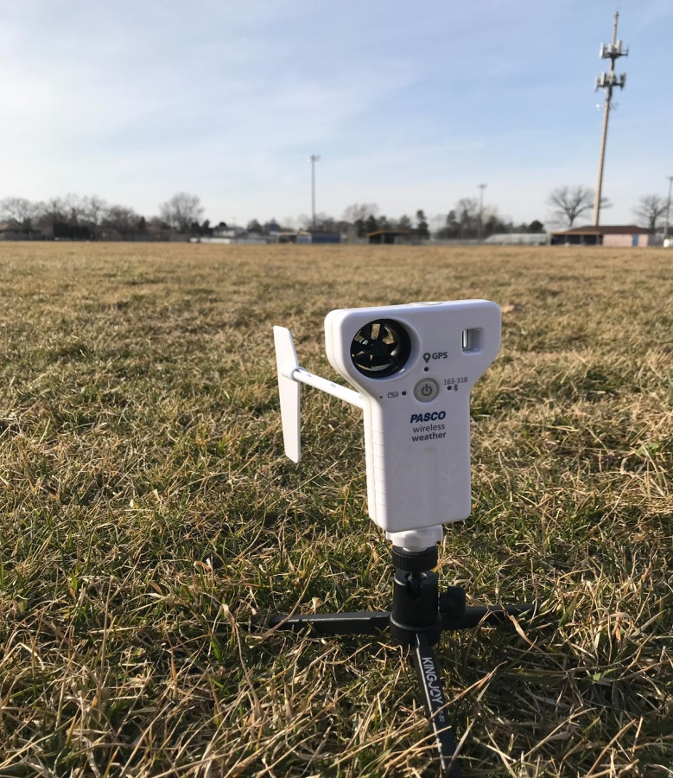
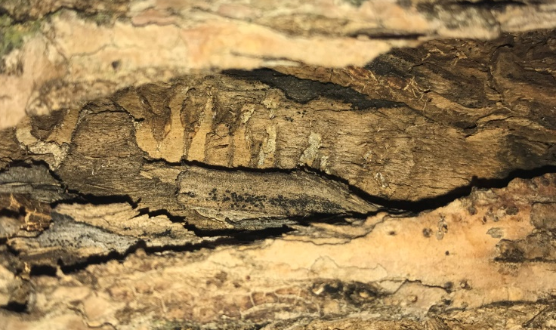

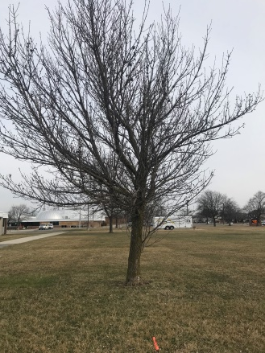
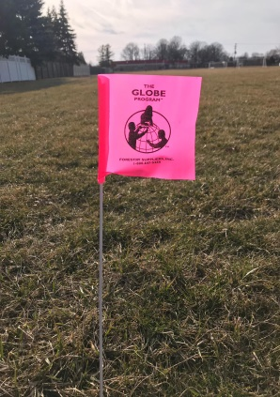

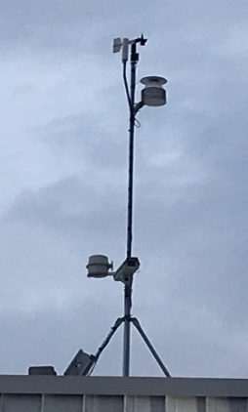
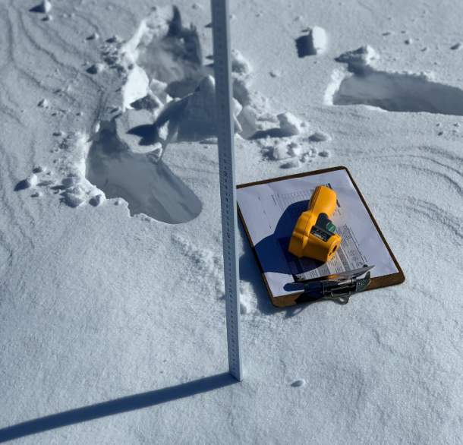
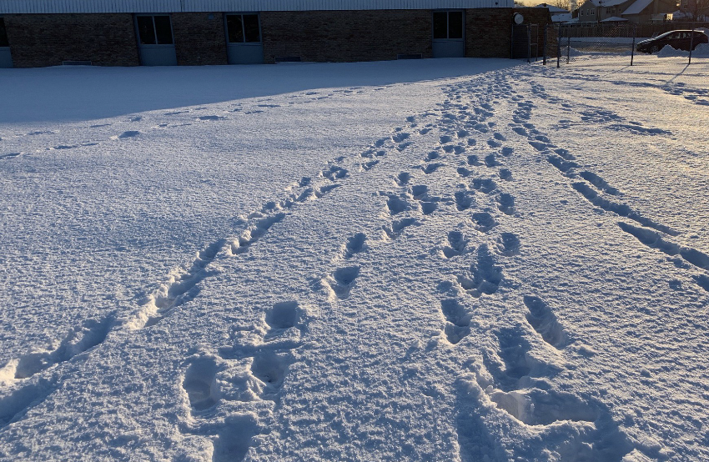

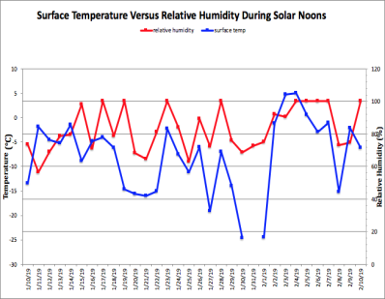
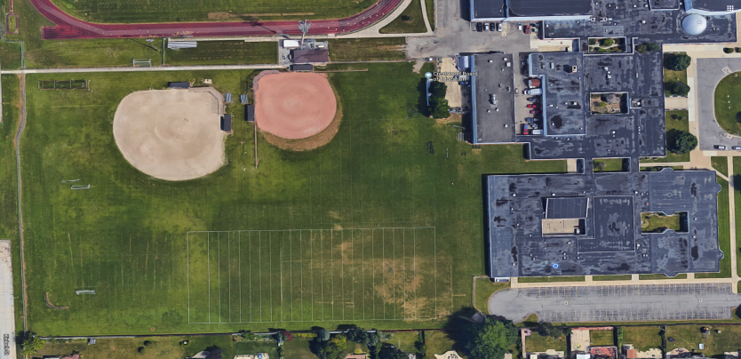
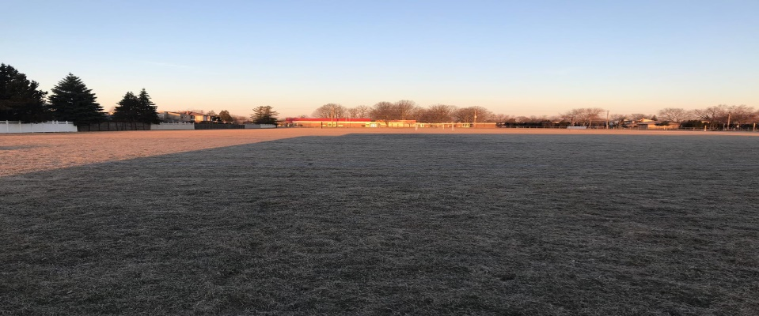
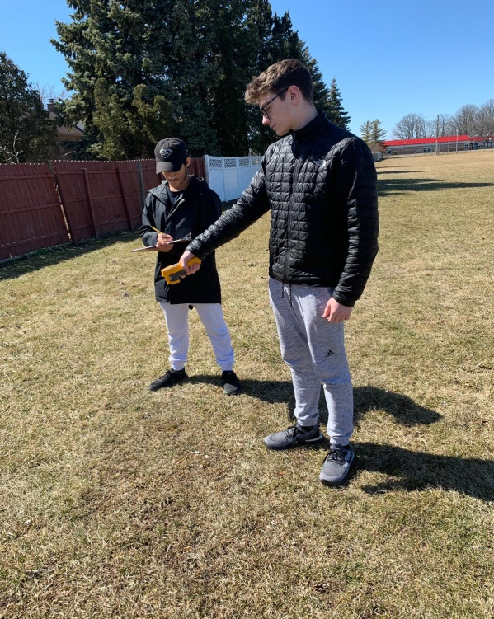

Interactions Between Surface Temperature and
Select Winter Weather Parameters
Itidal Bazzi, Cristian Sanchez, and Jelal Muflahi – Crestwood High School – Dearborn Heights, MI
Abstract
Research Implications
Results
Measurement Precision, Accuracy, and Limitations
Daily surface temperature measurements are a significant variable to consider when working to develop a more complete understanding of how larger weather conditions and patterns affect more local and microclimate sites. This research project was conducted in Dearborn Heights, Michigan; a suburb approximately 18 miles away from the urban center of Detroit. A variety of daily atmospheric data was collected from January through February, 2019 to investigate possible relationships between surface temperature and air temperature, relative humidity, barometric pressure, cloud cover, and winter surface conditions. This research sought to investigate how surface temperature measurements either directly reflect or lag behind other atmospheric variables measured. An additional research goal sought to determine the most significant factors affecting surface temperature increase or decrease during winter months. This research noted that surface temperature correlates closely to air temperature, relative humidity, cloud cover, and barometric pressure. Measurements were often made three (3) times a day but this research focused primarily on the data taken near solar noon. Using the GLOBE surface temperature protocols, other significant data such as ground conditions, snow depth, was noted and entered into the GLOBE website. With Michigan’s variable winter weather patterns, there were several varied weather conditions (wet, dry, sunny, windy, snow, etc.) throughout the study period. After analyzing the atmospheric weather parameters, we have come to a conclusion that there is a steady correlation between surface temperature and the three parameters, air temperature, relative humidity, and barometric pressure. Further research should be done to observe how atmospheric parameters affect the weather at different latitudes and elevations here and worldwide.
Data from NASA satellites on the deniers of climate change are typically inaccurate and only give us an idea of what's going on in the world because they only have sensors that cover large areas. So by taking our own measurements, we are able to confirm our findings allowing for others to come with conclusions over any topic or climate concerns.
We currently have endangered species, such as the Fraxinus, Ash Tree, and the Chimney Swift (an endangered bird), in Crestwood High School's local area. Allowing us to measure surface temperature and other atmospheric parameters will allow us to keep track of them and their behaviors weather that'll be through eating habits or growth in tree ring sizes.
Local atmospheric parameters in our area can also affect one of the greatest things Crestwood is known for, our sports. Measuring the cloud cover and the other parameters we can also gather predictions to whether or not we would have to cancel a game whether it was soccer or track due to a thunderstorm or any occurs weather fluctuations.
The two infrared thermometers that we used, Fluke 62 MAX IR THERMOMETER and the AUTO PRO Raytek, were calibrated in an ice water solution. To be properly calibrated both of the infrared thermometers must in a range of -2°C to 2°C, if not the thermometers are not properly calibrated and therefore cause inaccurate and imprecise results in the data taken by them. When calibrated this process was repeated every six (6) months for the most precise and accurate data. The Fluke 62 MAX IR Infrared Thermometer proved to be more useful during our data collection with a 21% accuracy.
Figure 1: Surface Temperature Vs. Air Temperature Vs. Relative Humidity:
Figure 2: Surface Temperature Verses Relative Humidity:
Above is the graph comparing surface temperature data that was collected from the Fluke 62 IR Thermometer and other weather parameters from the WeatherBug device. The graph shows a correlation between relative humidity, surface temperature, and air temperature. But due to a thermal inversion from January 26th to February 1st showing an inverse correlation between surface temperature/relative humidity and air temperature.
Above shows the correlation between surface temperature and relative humidity. there was an inverse correlation between the two. As surface temperature rises the relative humidity decreases. This is due to the fact that warmer air moisture contain more moisture then cooler air causing relative humidity to be inversely related.
Conclusions
\\\\\\\
There is a significant correlation between surface temperature, air temperature, and relative humidity.
There was also a correlation between surface temperature and barometric pressure however, there is a short delay in barometric pressure showing a correlation but on a time difference.
There is no correlation between surface temperature and cloud cover percent.
The Fluke 62 Max Infrared Thermometer seems to give us a more precise and better data then the Raytek AutoPro ST25 Noncontact Infrared Thermometer.
All findings were verified with Dr. Kevin Cazjkowski.
Methods
Research Questions
To what extent does surface temperature correlate with air temperature, relative humidity, surface cover, cloud cover, and barometric pressure?
How do instrumentation differences affect the results we obtained? Are the instruments we’re using affecting our accuracy, how?
Do the fluctuations of surface temperatures affect the lag time between the following: air temperature, relative temperature, and barometric pressure?
Nine sites are chosen and marked.
Measurements of Surface Temperature on Infrared Thermometers and recorded manually twice a day.
Measurements of select parameters recorded on Weatherbug equipment.
Figure 3: Surface Temperature Verses Barometric Pressure:
Figure 4: Surface Temperature Versus Air Temperature:
Acknowledgments
Above shows a graph on the correlation between barometric pressure and surface temperature. Typically surface temperature and barometric pressure seem to have a correlation between the two being directly proportional however when surface temperature is warm enough it’ll cause the barometric pressure to not correlate and possibly become inversed.
Surface temperature and air temperature have a significant correlation with each other but then around January 26th - February 1st there is a flip and it becomes an inverse correlation between the two. This is also around the time of the Polar Vortex, therefore the possibility of it being a cause is highly probable.
We would like to give a special thanks to:
Mr. David Bydlowski and Dr. Kevin Czajkowski for providing the free transportation and housing to the Iowa trip and helping pay the expenses of our research equipment.
Mrs. Johns for introducing us to GLOBE and giving us the chance show ourselves worthy of this research. We will also like to thank her for giving up her weekends and time after and before school to help us and answer any questions we have had.
NASA data specialist, Tina Rogerson, for giving us correct data on cloud cover.
Ali Eter and Sara Komaiha for guiding us with their ideas and thoughts on our research.
Leanne Alawieh away for assisting us on our graph making and the logistics of the research.
Nathan Johns for recommending how we should have our poster laid out and correcting any mistakes.
Upload data into GLOBE database
Contact Dr. Tina Rogerson.
Analyze Data.
Measurement Limitations
Null Hypothesis
During January 30, 2019 - February 1, 2019 some data was not recorded by our WeatherBug automated weather station. We believe that the extreme wind-chill and cold temperatures led to temporary malfunctions in our instrument. Extremely low temperatures also appear to affect the proper functioning of our battery operated infrared thermometers. We generally do not use a thermal mitt but instead let the instrument acclimate to the outdoor temperatures for an hour as indicated in the GLOBE protocols. This made it impossible to get accurate readings on some days.
Slight fluctuations in availability of time to collect thermometer readings daily.
A typical school day means that there are lots of interruptions and reasons why data can and cannot be collected. We were off from school for a record six (6) days during our study period and not allowed on school grounds, therefore, our teacher had to take readings for us during those times. Sometimes we couldn’t leave class to take readings because of tests, group activities, thunderstorms, etc.
Changes in the type of Infrared Thermometers may have changed our results and data. Thermometer may have changed the accuracy of results.
The GLOBE website wouldn’t display our data without pressing on random atmospheric parameters.
Figure 5: Surface Temperature Versus Cloud Cover:
To the left shows a graph on surface temperature and cloud cover percent. There is no correlation between the two. The percent cloud cover is mainly affected by the atmospheric masses moving through rather than surface temperature.
There is no relationship between surface temperature and air temperature.
There is no correlation between relative humidity and surface temperature.
There is a relationship between cloud cover and surface temperature.
There is no significant correlation between barometric pressure and surface temperature.
There is no difference in the presence of accuracy between the Fluke 62 Max Infrared Thermometer and the Raytek AutoPro ST25 Noncontact Infrared Thermometer.
Works Cited
Relations between Surface Temperature and Air Temperature on a Local Scale during Winter Nights. Relations between Surface Temperature and Air Temperature on a Local Scale during Winter Nights: Journal of Applied Meteorology: Vol 39, No 9 Available at: https://journals.ametsoc.org/doi/10.1175/1520-0450(2000)039<1570:RBSTAA>2.0.CO;2. (Accessed: 1st April 2019)
https://www.google.com/search?client=safari&rls=en&q=Brennan,+J.+What+Happens+to+Relative+Humidity+as+Air+Temperature+Rises%3F+Sciencing+(2019).+Available+at:+https://sciencing.com/happens-relative-humidity-air-temperature-rises-22563.html.+(Accessed:+1st+April+2019)&ie=UTF-8&oe=UTF-8
Google Maps Available at: https://www.google.com/maps/place/Crestwood High School/@42.3220925,-83.2954301,17z/data=!3m1!4b1!4m5!3m4!1s0x883b4b0213de1f69:0x1bc70bc69031a16f!8m2!3d42.3220925!4d-83.2932414. (Accessed: 2nd April 2019)

