Slide 1
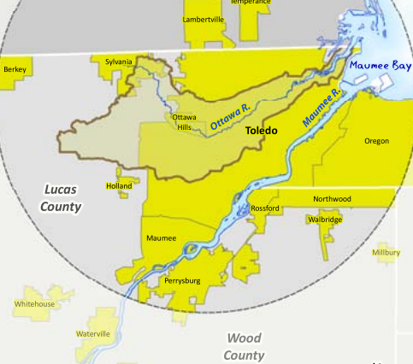
Urban Heat Island Effect
River Temperature Study
Corey Alexander & Kimberly Hasapes

Slide 2
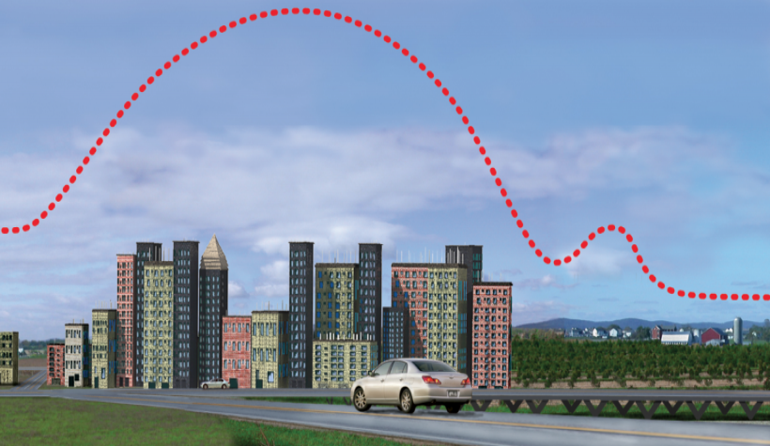
GLOBE Surface Temperature Field Campaign
Focuses on looking at the impact urbanization has on the Earth’s surface temperature and how the surface temperature changes the dynamics of the Earth’s atmosphere.

Slide 3
Question
How does the size of the river affect the temperature in urban areas?
Hypothesis:
The Ottawa River will have a warmer surface temperature

Slide 4
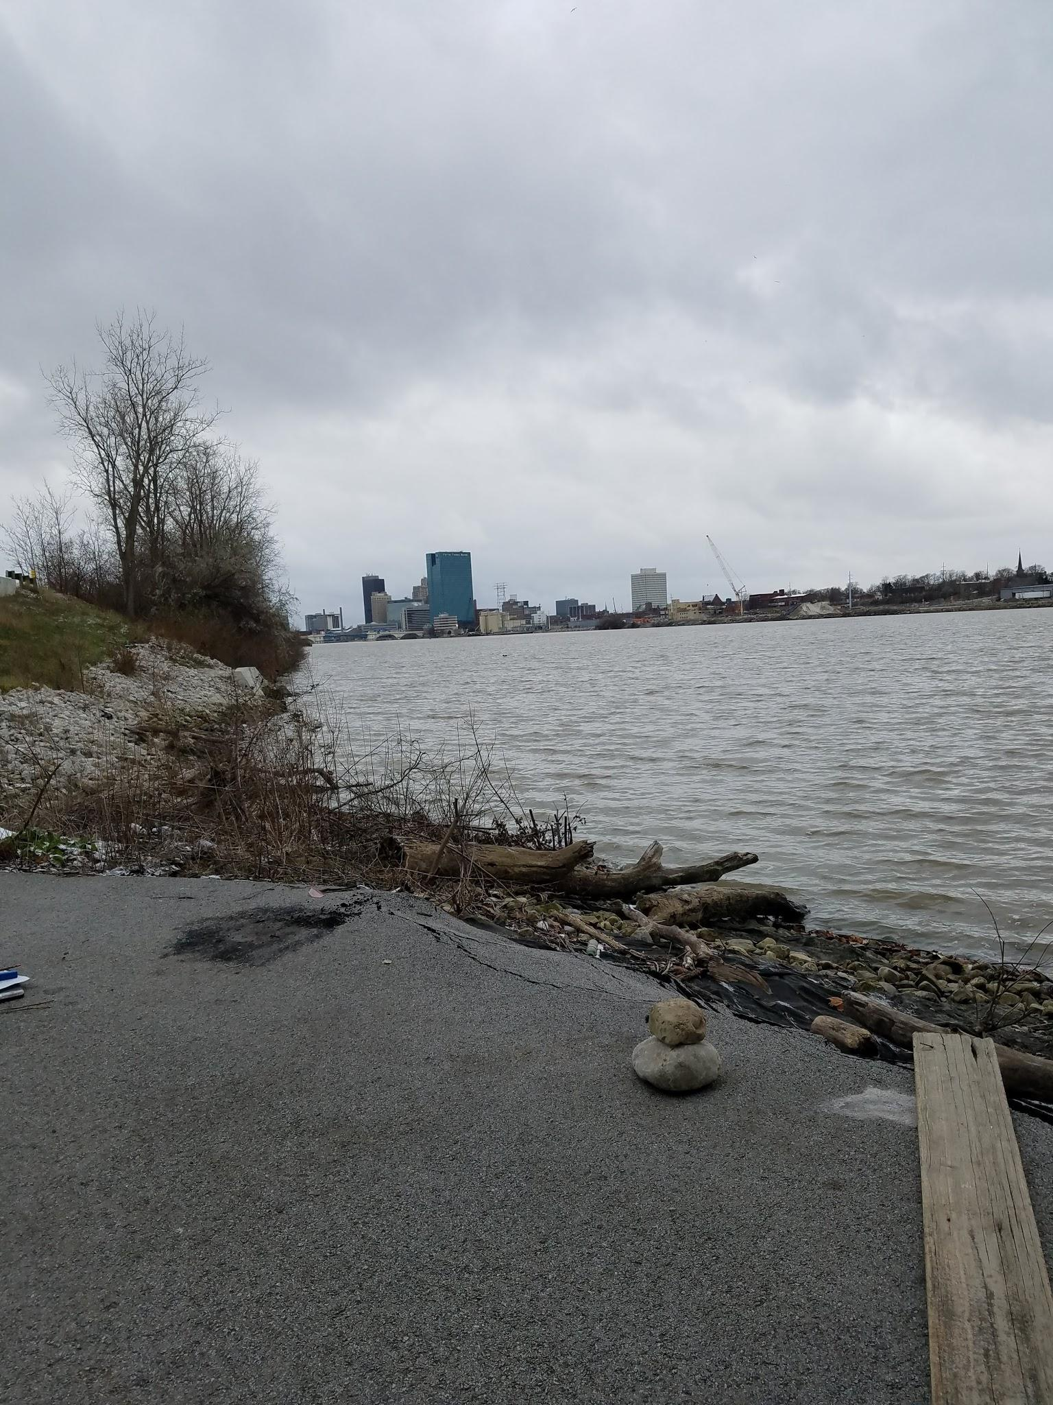
Impacts on Rivers
High pavement and rooftop surface temperatures can heat stormwater runoff.
This heated stormwater generally becomes runoff, which drains into storm sewers and raises water temperatures as it is released into streams, rivers, ponds, and lakes.
Rapid temperature changes in aquatic ecosystems resulting from warm stormwater runoff can be particularly stressful, even fatal to aquatic life.

Slide 5
Protocol
Surface temperatures were conducted throughout the month of November, 2018.
For best accuracy we tested the surface temperature on asphalt, grass, and water. Each temperature reading was taken 9 times.
Our data was gathered between 12:00 pm to 2:00 pm each day so our data was gathered close to the same time.
The location sites were created and data was entered on the Globe website.

Slide 6
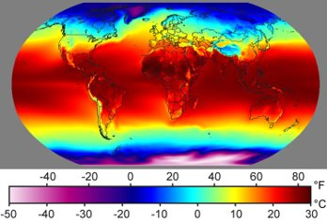
What is Surface Temperature?
Affects all aspects of the Earth’s energy budget.
Surface temperature is the radiating temperature of the ground surface including grass, roads, buildings, trees, and water.
Every object emits electromagnetic energy according to its temperature.
Not all surfaces have the same temperature!!!!!!!!!!!!!!

Slide 7
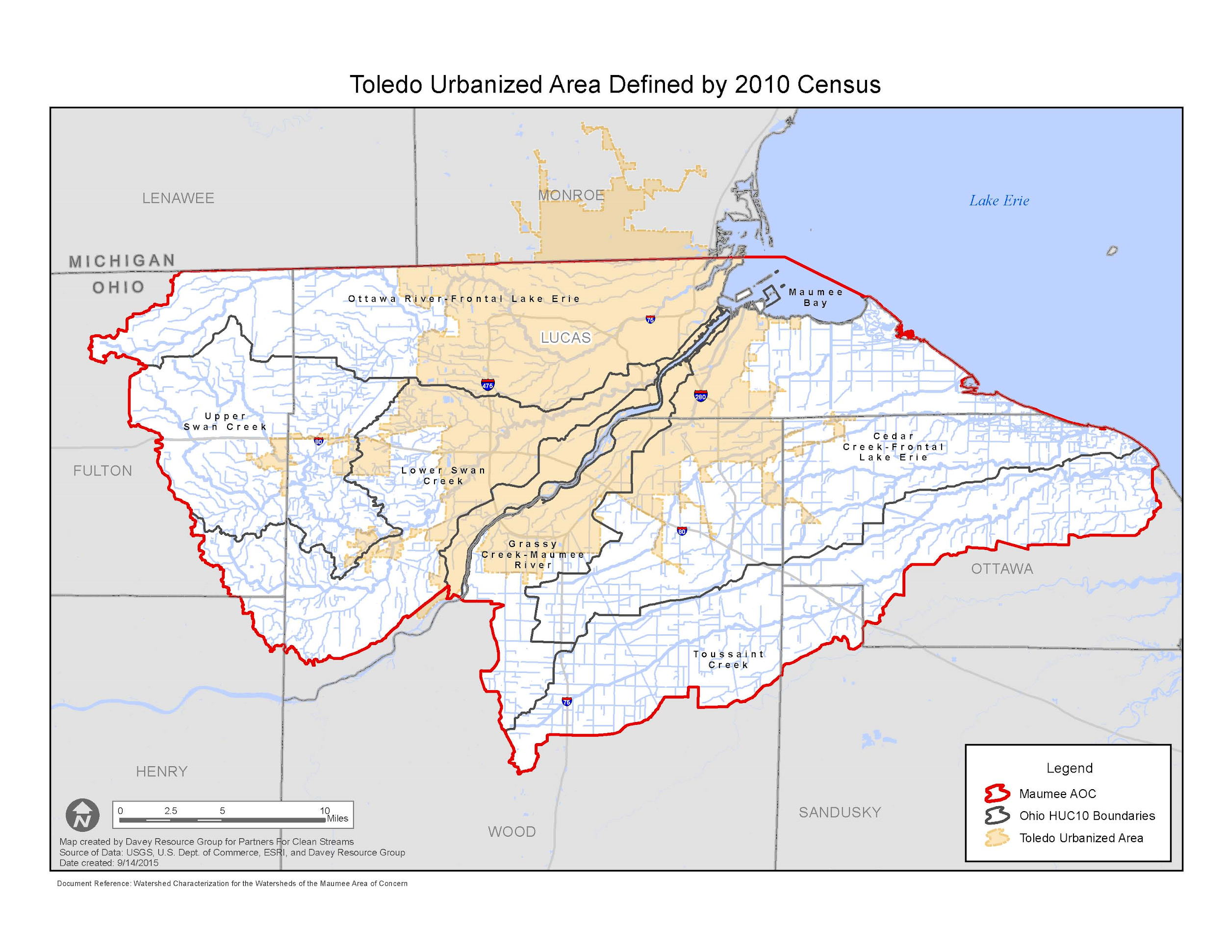

Slide 8
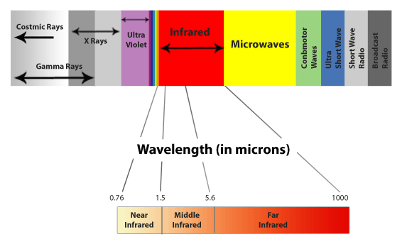
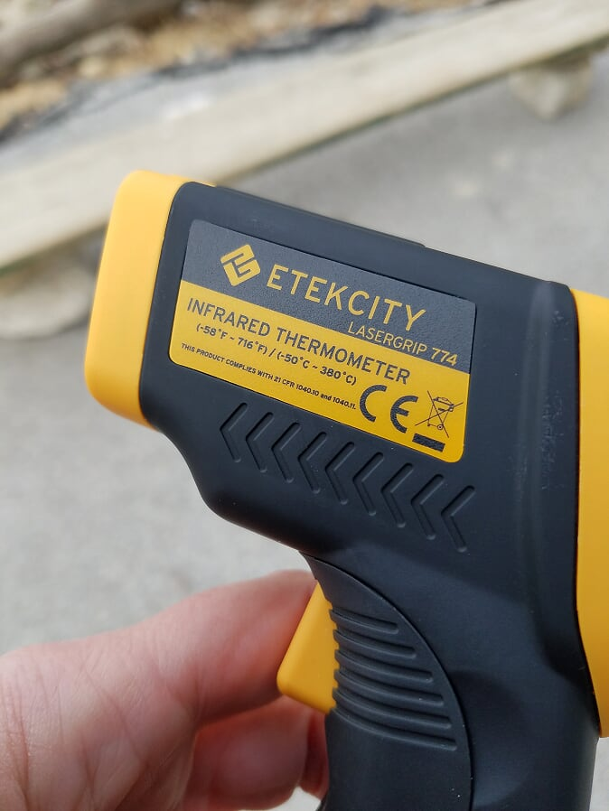
Instrument:
The Infrared Thermometer (IRT) used in the surface temperature protocol measures the emitted electromagnetic energy from Earth’s surface.

Slide 9
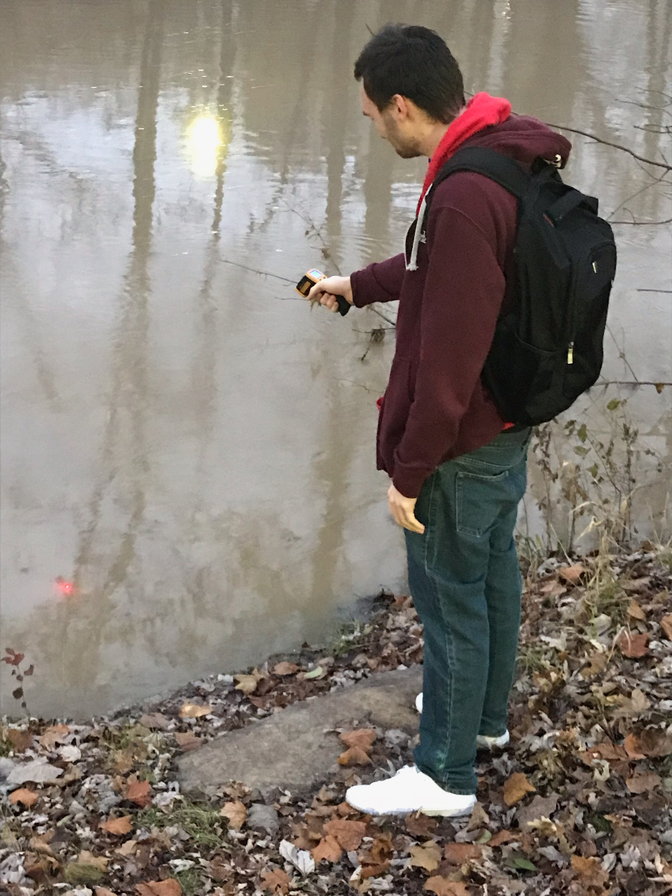
Ottawa River- Site 1
Ottawa River
The Ottawa River is a short tributary that empties into the North Maumee Bay (Lake Erie) less than one mile north of the Ohio-Michigan state line and only 2.3 miles north of the Maumee River mouth.
With the exception of the mouth and the river’s first three-quarters of a mile, the 20-mile Ottawa River flows within Lucas County.
The 27-mile long Ten Mile Creek flows entirely within Ohio, although it meanders within 160 feet of the state line

Slide 10
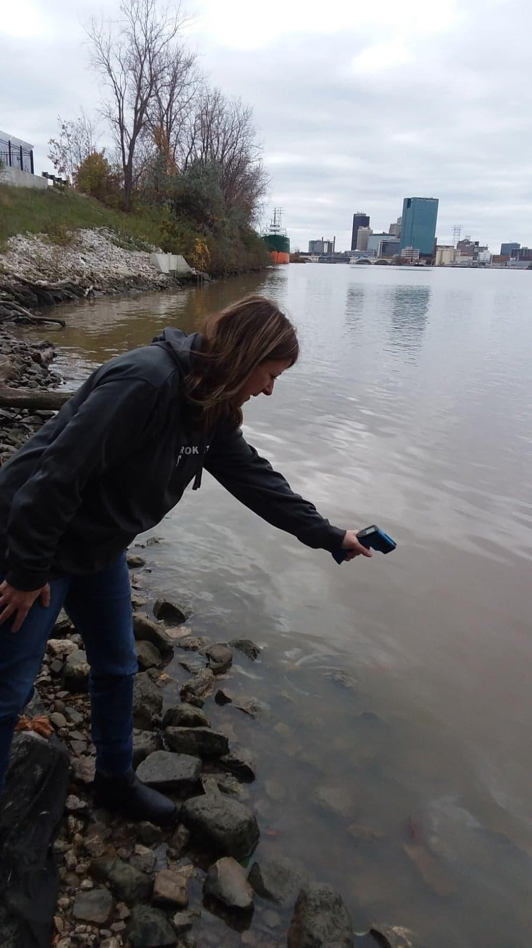
MAUMEE RIVER - SITE 2
Maumee River
The Maumee River drains northeast to Maumee Bay in Lake Erie through Toledo.
The watershed draining to the Maumee River main stem is very large (4,820 square miles in Ohio) and covers all or parts of 20 counties.
Defiance, Napoleon, Perrysburg, Maumee and Toledo are the largest municipalities along the main stem, though there are several other large cities within the watershed draining to the main stem.
The majority of the watershed is cultivated crop land, though concentrated areas of pasture are located in the northwestern and southeastern areas of the watershed. Developed land is approximately 11.5 percent of the land use.

Slide 11
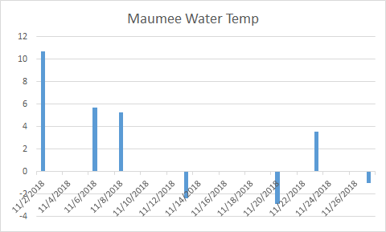
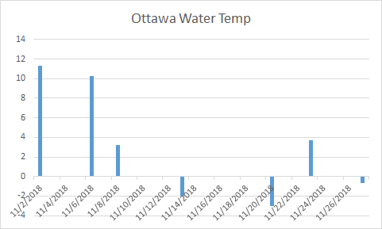
Water Temperature Difference
Maumee Average= 3.161 Celsius
Ottawa Average=3.844 Celsius

Slide 12
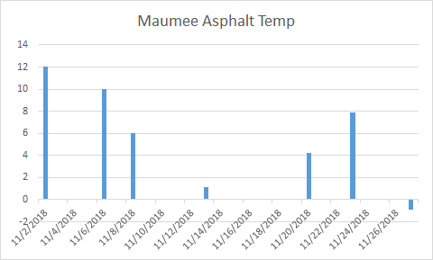
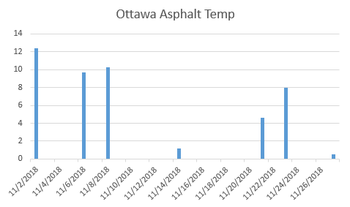
Asphalt Temperature Difference
Maumee average= 6.733 Celsius
Ottawa average= 7.822 Celsius

Slide 13
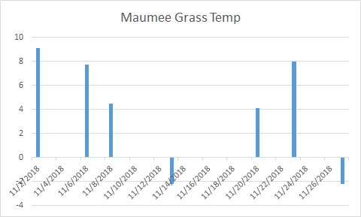
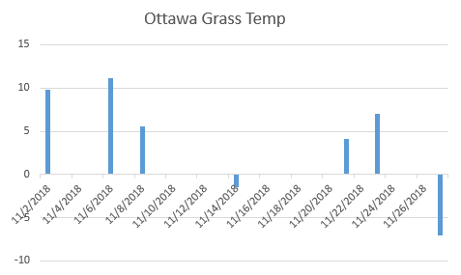
Grass Temperature Difference
Maumee average= 4.18889 Celsius
Ottawa average= 4.869 Celsius

Slide 14
Conclusion
Through our field research we have found that the Ottawa river is slightly warmer than the Maumee river. There are various reasons why the Ottawa River’s surface temperature is warmer. One factor is that smaller streams of water have a increased temperature then larger streams or rivers. Shallow streams are more exposed to meteorological conditions and therefore can have higher temperatures.
More research is needed to answer our question more accurately. To have better results we would need to take more samples, and take them at the same time everyday. Taking samples during summer and winter months would show us the best results, because of the significant temperature change.

