Slide 1
Powering life through Water filtration and underground water storage in southern Africa.
Sisanda Mahlobo
Empangeni High School,
EMPANGENI, SOUTH AFRICA
+27 (0) 35 772 6749

Slide 2
Outline
WATER FILTRATION AND
UNDERGROUND WATER STORAGE,
THE POWER FOR LIFE
AIM
PROCEDURE
Results
DISCUSION AND CONCLUSIONS
LITERATURE REVIEW
Hypothesis

Slide 3
Introduction
South Africa is a country with a coastline extending 2,500 km ( 1,600) miles.
The country has a semi-desert that covers the Northern and Eastern Cape areas.
Although the country is almost surrounded by two oceans, fresh water shortages is common.
For example Cape Town and its surrounding areas have recently experienced the drought that affected the supply of water to households.
During rainy seasons, much of the flood water is washed away, eroding soil and destroying areas earmarked for habitation and farming.

Slide 4
Brief description
Project focuses on how South Africa can harvest and store flood waters in underground tanks The water will be harvested during the floods, purified before entering the underground storage, saved and automatically pumped out to fill the low level dams during the water shortages.
Proposal is to start a community project to grow trees and vegetable gardens along the river banks to ensure that there is enough vegetation to absorb water throughout the seasons.

Slide 5
Research questions
How can south Africa harvest and store flood waters for human consumption during the drought.
What interventions can be put in place to prevent future soil erosion and destruction of properties and farm land.

Slide 6
Objectives
To design a water storage and harvest mechanism of flood waters in south Africa.
To suggest intervention processes aimed at prevent soil degradation.
To propose approaches in reducing water loss

Slide 7
Hypothesis
Investing in Water harvesting and storage will reduce water shortages during droughts in South Africa.

Slide 8
Procedure
To put together the underground storage system, we require:
construction of big tanks underground,
pipes to link the underground tanks with the existing storage dams,
system to monitor the level of water in the existing dam,
the system to automatically bring the water from the underground tanks to the surface dam.

Slide 9
Literature
Literature search indicates that there are different types of sensors that are being used to measure the level of water or any liquid in a tank. Gross (2017) identified the following sensors:
The laser sensors
The pressure sensors
The ultrasonic level sensors
The disadvantage of laser and pressure sensors is that they are very costly, while the ultrasonic level sensor has a reasonable price
Option is to use the ultrasonic level sensor to detect and measure the level of the water in the dams on the surface and trigger automatic release of water from the underground

Slide 10
Design
Build the underground tanks near the UMngeni river, next to Midmar Dam to harvest and store the flood water.
Connect the pipe to link the underground tank with the Midmar dam.
The pipe will be fitted with a valve that will automatically open and close the pipe to regulate flow of water between the tank and the dam.
Put up a filtration system at the point where the water enters the underground storage to purify it before passing through to the tanks.
Mount two level sensors on existing dam that will send the signal to the underground tanks when the water level in the dam reaches below 200 mm or above the limit level.

Slide 11
Design continued
Two transmitter sensors and a receiver are placed at the highest(A) and lowest (B) water level of the dam
The third sensor C is placed at the valve. When level sensor A sends a signal to C (the water is below 200mm) the valve in the pipe to the tunnel opens and water flows into the dam alternatively when B sends to C the water in the dam is above the limit, 235.4 million cubic metes, the valve opens to let the water flow to the underground tunnel to decrease the amount of water above the limit level .

Slide 12
Design illustrated
The level sensor A sends a signal to sensor B (the dam is above or equal to the safe level)h t
The valve opens
no
Close the valve
Is the tunnel full?
Water flows into the underground tunnel
yes

Slide 13
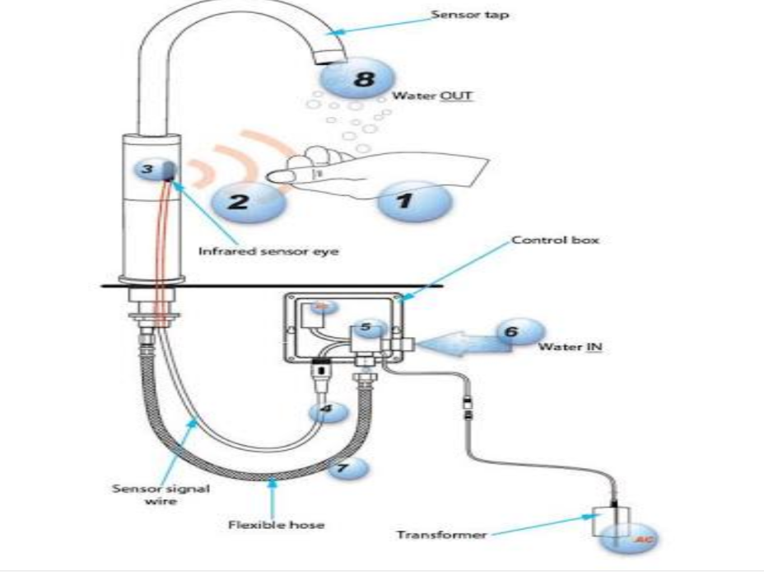
Results
An automated underground storage system filled filtered flood water ready for supply when necessary.

Slide 14
Design of Underground Water Tank (Reservoir)
Tank Dimensions Total area for the four floors = 4 (16 14 14) (13 14 13) = 7040 ft2 Number of residents, N 7040 8/1000 = 56 Daily water requirement 56 5 = 280 ft3 Required volume of UG water tank, V = 2 280 = 560 ft3
Depth of tank, H V1/3 = (560)1/3 = 8.24 Freeboard, F.B. = 0.50 Total depth, D = H + F.B. = 8.74 Assuming L/B = 1.5, Tank area A = LB 560/8.24 = 1.5B B B = 6.73 , L = 10.10
Loads and Material Properties Loads: FF = 10 psf, LL = 20 psf Materials: f c = 3 ksi, ft,ult = 5 f c = 5 (3/1000) = 0.274 ksi, ft,all = ft,ult/2 = 0.137 ksi, fs = 20 ksi fc = 0.45f c = 1.35 ksi, k = 0.378, j = 0.874, R = 0.223 ksi, Rt = ft,all/6 = 0.023 ksi For soil, Angle = 30 Ka = (1 sin )/(1 + sin ) = 0.333
Design Conditions The UG water tank has three basic components; i.e., top slab, sidewalls and base slab The top slab will be designed as normal simply supported slab based on the self-weight and superimposed loads The design of sidewalls and the base slab will be based on assuming (i) Tank full of water but no soil outside, (ii) No water inside tank but soil pressure from outside
The other more critical condition of no water inside but saturated soil outside is avoided here because it might cause instability of the tank itself. Alternately, a provision must be made that the tank cannot be evacuated when the soil is fully saturated.

Slide 15
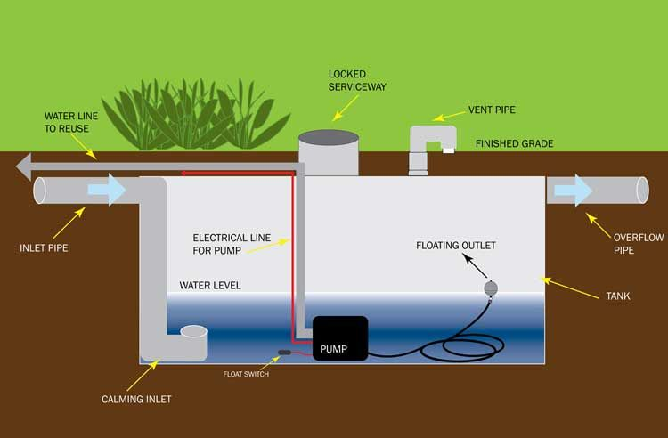
Underground tank

Slide 16
Suggested interventions
Start a campaign to educate the community about preservation of environment and usage of water sparingly.
Encourage the Community to plant the fruit trees along the uMngeni river bank and the gardens on the flat areas next to the river.
Encourage planting trees that do not utilise lots of water during their growth
The vegetation will minimize soil erosion while supplying the community with food supply.

Slide 17
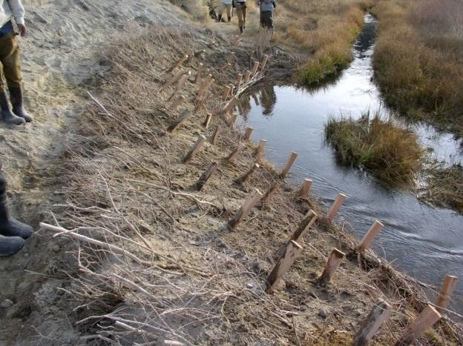
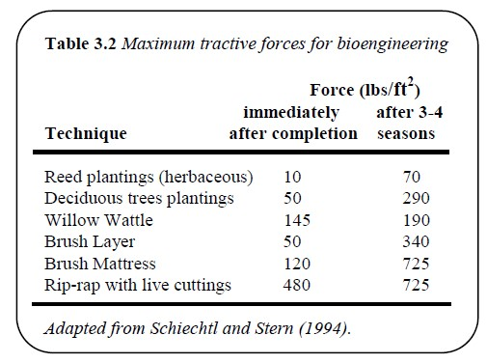
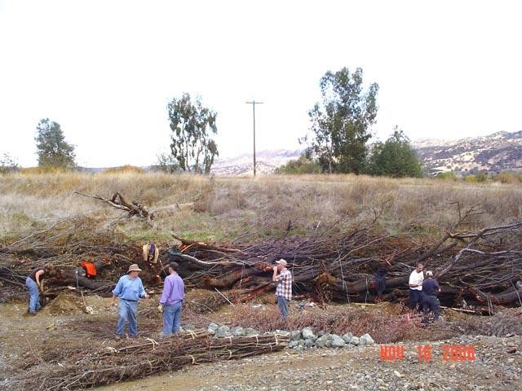
Bioengineering
Use of live vegetation and woody material for bank stabilization.
Often less costly in terms of materials (locally sourced), labor (often hand labor), and, once established, maintenance.
Requires time (several seasons) to establish, but self maintaining and re-generating once establish.
Shear (Pa)
http://www.nrcs.usda.gov
http://www.nrcs.usda.gov

Slide 18
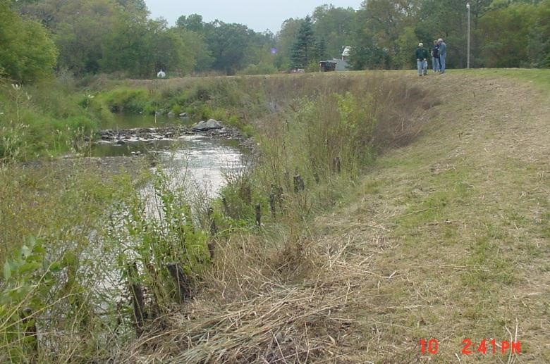
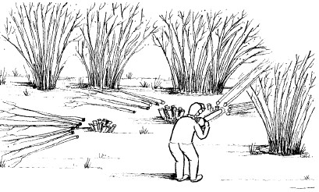
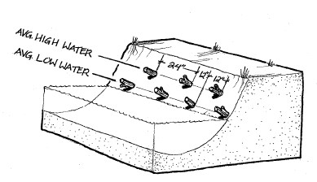
Pole Plantings
Pole plantings or live stakes, provide an inexpensive approach to bank stabilization.
Stakes can often be cut from on-site or nearby vegetation and are planted by hand
Willow Harvesting & Design Sketch

Slide 19
Harvesting water by households

Slide 20
Discussion
While this system is modeled on South African situation, it can be used in areas that experience water shortages but have floods during rain seasons.
The limitation is that it has not been tested before.
It requires engineering expertise which is a scarce skill in South Africa and will have serious financial impact on the project.
It is important to collaborate with scientists, government departments like (DWAS, DEA)

Slide 21
RECOMMENDATION AND CONCLUSION
Further investigation to produce the prototype of the system.
Testing of the prototype.

Slide 22
BIBLIOGRAPHY
www.scielo.org.za
www.wikepedia.org
Gross, K.(2017) Water depth sensing with ultrasonics. MaxBotix Inc
https://www.maxbotix.com/articles/water-depth-sensing.htm
Natural science textbook(via africa)by s.s.s de Beer,D.B Gibbon,R Jones,T.T Kunne,J.A Sampson,T Subramani,A.C Visser,C.E.Whitlock.
www.umngeni.co.za
Autotaps.com
Bentroup, G. and J.C. Hoag. (1998). The practical streambank bionengineering guide. USDA NRCS. Aberdeen, ID. 55p.
Fischenich, J.C. (1989). Channel Erosion Analysis and Control. In Woessmer, W. and D.F. Potts, eds. Proceedings Headwaters Hydrology. American Water Resources Association. Bethesda, Md.
Johnson, A.W. and J.M. Stypula. eds. (1993). Guidelines for Bank Stabilizaton Projects in the Riverine Environments of King County. King County Department of Public Works, Surface Water Management Division, Seattle, Wash.
Julien, P. (2002). River Mechanics. Oxford Press: 434p.
Julien, P. (2010). Sedimentation and Erosion. Oxford Press: 371p.
Kunzig, R. (1989). Wandering river. Discover, 10(1), 69-71.
Sekely, A. C., Mulla, D. J., & Bauer, D. W. (2002). Streambank slumping and its contribution to the phosphorus and suspended sediment loads of the Blue Earth River, Minnesota. Journal of Soil and Water Conservation, 57(5), 243-250.
Terzaghi, K. (1948). Theoretical Soil Mechanics. Wiley: New York. 510p.

Slide 23
Thank you

