Slide 1
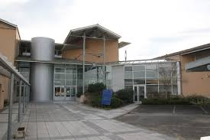

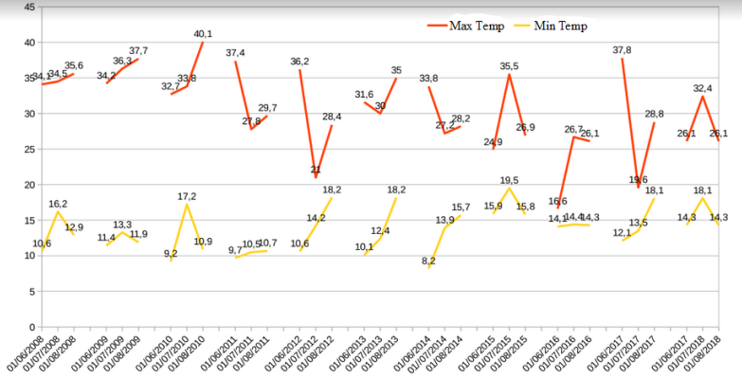
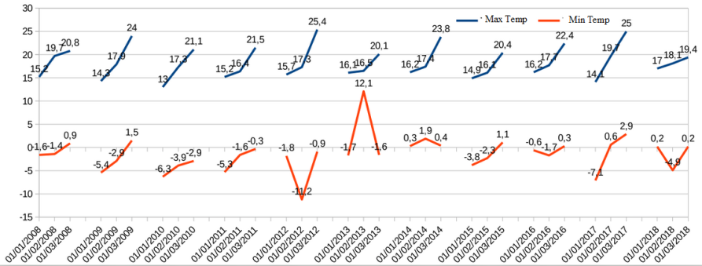
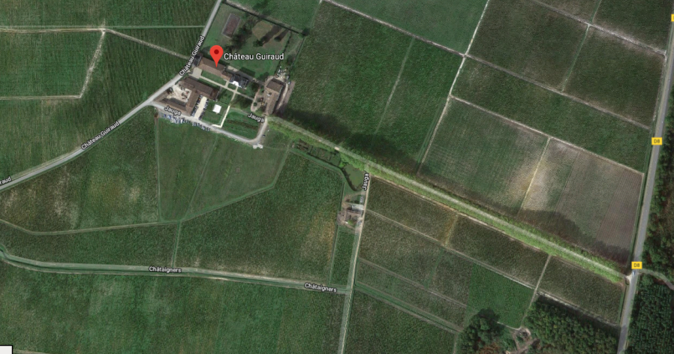
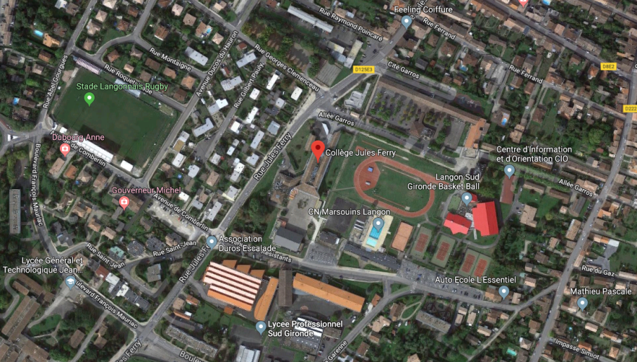
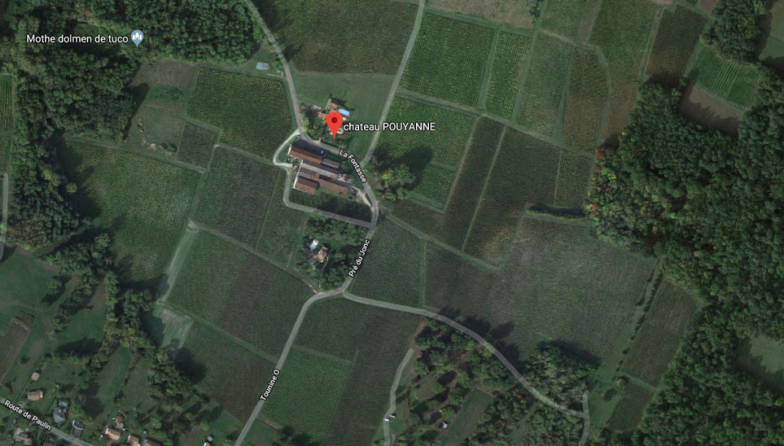
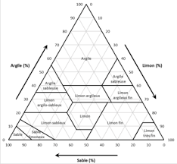
3èmeA
Study of Sauterne’s vineyards
Collège Jules Ferry Langon
Results
The production of Graves and Sauternes wines therefore depends greatly on its geographical, climatic and soil factors. The grape varieties are therefore chosen to withstand the specific conditions of our terroir.
For example, the presence of the Landes forest is important to the selected vine growth locations. Due to the fact that it is located to the West of the vine growth areas, between them and the ocean, it, therefore, not only protects the vineyards from the rain and the winds coming from the ocean, but also brings water through its hydrographic network and provides the humidity necessary to help the vines prosper.
Weather conditions are changing and climate change could lead to a major evolution in the current wineries.
Indeed, the increase of 2°C in the average temperature over the Bordeaux region for the last 30 years has placed the grape varieties that are currently used in our region at the limit of development in favourable conditions.
However, our wine region is special because of the different soils it offers. The clayey and sandy soil allows rainwater to provide the elements necessary for its development without the need to irrigate the vineyard parcels.
Our Wine Region is special thanks to the different soils varieties it offers. Each vineyard has its specificities that give different wines very different tastes. However, the winemaking conditions and the treatments applied to the vine can also change its taste.
Throughout the different studies that we did and from the observed changes in atmospheric composition and the gradual temperature increase over the years, we can conclude that: This is global warming!
This rise in global temperature could lead to the melting of sea ice which could cause an increase in ocean water levels.
This phenomenon could cause the extinction of some animal or insect species.
Ultimately, global warming could change the delicate climate and ecosystem of some grape varieties.
Research Methods
Planning investigastions
Describes the planning process
Carrying Out Investigations
Describes what happened
We ask ourselves a lot of questions like:
- Are these environmental conditions the only ones responsible for the gustatory values of our wines and is it possible within the framework of a technology and expertise transfer to make Sauternes in California and vice versa, what are the differences and could there be an exchange of expertise? We found that the production of Graves and Sauternes wines therefore depends on the geographical factors of their terroir, just as the Californian wines which are also affected by their own geographical factors. First of all, the presence of the Landes forest (in France) and mountains (in California) protect the vineyard from the rain and wind coming from the ocean. Secondly their hydrographic networks bring water and humidity necessary for the cultivation of the grapes.
But what about biologically?
- Is there starch in grapes? We fond that to do this experiment, we had to crush grape and take out the juice. Then we added a few drops of iodic water and gave the solution a good shake. The solution did not become blue, which shows that there is no starch in grapes.
- Is there glucose in grapes? We found that to do this experiment, we put some grape juice drops on the glucose strip. We observed that the strip color became green, this shows there is glucose in grapes. More precisely there is over 20g of glucose per liter of juice.
- Is there acidity in grapes? We found that to measure acidity in a grapes, we used pH-paper. We had to pull out and rip off around 1cm of pH-paper and put a few drops of grape juice on it. Then we compared the pH-paper color to the color scale to determine pH value. The pH-paper color was yellow, which shows that grapes are acid.
- Are there calcium ions in grapes? We did an experiment; we had to shake grape juice with a few drops of ammonium oxalate solution. A white precipitate did not develop which shows there isn't any calcium ions in grapes.
- Is there chloride ions in grapes? We did an experiment; we had to take a few drops of grape juice and add a few drops of silver nitrate solution. The white precipitate was not present which means that there are no chloride ions in grapes.
- Is there water in grapes? We did an experiment: to detect water presence, we had to use anhydrous copper sulfate. We put anhydrous copper sulfate in grape and the solution became blue. This is a positive result which shows that there is water in grape.
-How can we determine the quantity of iron in white wine? We found that if an aqueous iron solution reacts with potassium thiocyanate, the solution becomes red. This red color depends on iron concentration: the more it is red, the more the iron concentration is important.
We did each of the experiments (in the table above) with similar doses and then we did a tenth experiments with 10mL of white wine, 1mL of chlorhydric acid and 1mL of potassium thiocyanate.Then we compared this experiment with the others to determine the amount of iron in white wine. We found there is around 8 to 10mg/L in white wine. This wine can be drunk because there is less than 15mg/L.
- The presence of our vines is connected to the presence of particular weather conditions. What are they exactly and how are they going to change? Throughout the different studies that we did and from the observed changes in atmospheric composition and the gradual temperature increase over the years, we can conclude that: This is global warming! This rise in global temperature could lead to the melting of sea ice which could cause an increase in ocean water levels. This phenomenon could cause the extinction of some animal or insect species. Ultimately, global warming could change the delicate climate and ecosystem of some grape varieties.
We can see that temperatures remain stable between 2008 and 2018 because to see the temperature increasing, we have to study a longer period, for example between 1968 and 2018 (1)
We can see that between 2008 and 2012, there was a big temperature difference between minimum and maximum data but after 2012, maximum and minimum temperatures became closer than before. Since 2008, the maximum temperatures are decreasing (except in 2017) but minimum temperatures remain stable. (2)
We didn’t ask ourselves some questions for soils but we have found that the production of Graves and Sauternes wines therefore depends greatly on its geographical, climatic and soil factors. The grape varieties are therefore chosen to withstand the specific conditions of our terroir. For example, the presence of the Landes forest is important to the selected vine growth locations. Due to the fact that it is located to the West of the vine growth areas, between them and the ocean, it, therefore, not only protects the vineyards from the rain and the winds coming from the ocean, but also brings water through its hydrographic network and provides the humidity necessary to help the vines prosper.
Weather conditions are changing and climate change could lead to a major evolution in the current wineries. Indeed, the increase of 2°C in the average temperature over the Bordeaux region for the last 30 years has placed the grape varieties that are currently used in our region at the limit of development in favourable conditions. However, our wine region is special because of the different soils it offers. The clayey and sandy soil allows rainwater to provide the elements necessary for its development without the need to irrigate the vineyard parcels. Our Wine Region is special thanks to the different soils varieties it offers. Each vineyard has its specificities that give different wines very different tastes. However, the winemaking conditions and the treatments applied to the vine can also change its taste.
Abstract
For datas collection at the Chateaux we used the ground globe protocols and for datas collection at the college we used the atmosphere globe protocols
The organization of data collection is as follows: record local time, UTC time, outside temperature, sky darkness, clouds present, CALITOO datas and if it's raining or if it has rained, the PH of the water. To do this, you must bring the weather station, a CALITOO and PH paper if it rains.
Every day of the week, a group of students take datas from a weather station at the college in Langon and record them on a sheet of paper. These data will then be recorded on globe.gov.
The vineyard rests on a clayey-limestone or calcareous subsoil, on which a more or less thick layer of gravel has been deposited. The most prestigious vintages such as Château Pouyanne are planted on gravelly cups. The layout of the site gives a slightly hilly landscape, the meagre relief being made up of gravel hillocks of a few tens of metres ,The local climate is particular. The Ciron River flows under the vegetal cover of the Landes forest. Its cold water brings moisture. In the fall, this phenomenon creates morning fog that fades during the morning. These mists favour the development of Botrytis cinerea and Le grain se confit, its pulp is concentrated in sugars and the Botrytis cinerea action gives characteristic candied fruit aromas. We has used The Soil Characterization Protocol field guide which enable identifies the soil structure.then after the texture protocol measures the amount of roots, rocks and carbonates and explains how to take a picture of the hole. Also we are used The Soil pH Protocol and this which enable mesured a acidity of soil ans finally we are used The Soil (Pedosphere) Investigation textural triangle which enable identifed a texture of soils
Be a stem storyteller : We have to describe how we creatively shared our project through a blog, a play, a social network account.... :
At the beginning of our project, a journalist from our local newspaper came, he wrote an article about the beginning of our project and all the actions that we will be taken to do for two years. This journalist will then follow us during two years and write many artciles on our project .…
Be a STEM professional:
We have to describe collaboration with scientists or scientific organizations, how they helped us to improve the research methods and precision.
We can get this badge because we worked with many scientists, because with our project, we discovering all the work around wine (like oeunologist, winegrower, etc...) is a scientists. Because for do wine we should knowledge about science or physics. So we worked with a winegrower and an association called "L’auringleta", that was here, all the project for explain us everything about the vine. We also work with nasa because they asked us some informations to compare their informations with our own datas. And we saw other winegrowers.
Be a Data scientist : The final report must include an analysis with our own datas, make inferences, hypothesis, but we can also use these datas to answer questions. We also have to consider other datas from other schools or databases.
We can get this badge because we worked with the data that we collected, such as soil samples, water samples, weather plans, every day students reported the weather conditions. We used all of this to ask ourselves questions to hypothesize and answer our hypotheses. We also made extensive use of globe data, for example we used data from the school of Agen because we needed it.
We also answered a question from NASA asking us to compare their data and data. We ask NASA to verify all our datas.
Discussion
Our project is a scientific and linguistic, named “toujours le vin sent son terroir”. During our studies, we have improved in english and studied our soil thanks to different type of subjects like chemistry, biology or geography. The aim of this project is to compare our observations, our knowledge about our region with California’s wineries. At the beginning, we started with nothing, without any help. But then we got support from many different partners and sponsors, and wihtout them, our studies and finance earnings could not have been possible. After, thanks to them, to our many events (dance shows, parties, bake sales...) and our entry in many scientific contests such as C-Genial, the contest from the teaching ministry, the simposium Globe international, we collected enough money to be able to go to California. During this amazing trip to the United States, the students from the Middle School Jules Ferry in Langon will be the ambassadors of the whole of France, in Califronia.
Are these environmental conditions the only ones responsible for the gustatory values of our wines and is it possible within the framework of a technology and expertise transfer to make a comparaison?
What are the differences? And could there be an exchange of expertise?
Research Question
Are these environmental conditions the only ones responsible for the gustatory values of our wines and is it possible within the framework of a technology and expertise transfer to transform Sauternes wines into Californian wines and vice versa?
What are the differences? And could there be an exchange of expertise?
This is a scientific question because it involves many studies around our environment, a lot of research methods to learn, many analysis about different wines and soils and much more. It is important because it helps us learn about our region and California. It is also a great way of making students learn how to work properly and in a fun way. This question involvs an aspect of Earth's environment locally and globally because during all these studies for our wine region, we had to study our climate. While studying our climate we confirmed what climatologists have been saying: the tempertaures are increasing. So the aspect of Earth's environment which is invloved, is global warming.
Introduction
Our project, named “toujours le vin sent son terroir” is a scientific and linguistic project on two years. The main question we asked ourselves is ‘’we can make Sauternes, a typical wine of our region, in California ?’’. During our studies, we improved in English and we learned about our region, for this we studied the environment in which we live in order to see its peculiarities. To observe the particularities we studied our soil in biology, the microclimate that was in our region in geography or science and the wine making in science. We will compare that in California, where we will study, observe and seek. For example, we will study the soil and see if the soil is the same in California and in our region or if there is the same microclimate in California and in our region, for that we have did many sorties in differents wineries. At the beginning, we started with nothing, without any help. But then we got support from many different partners and sponsors, and wihtout them, our studies and finance earnings could not have been possible. After, thanks to them, to our many events (dance shows, parties, bake sales...) and our entry in many scientific contests such as C-Genial, the contest from the teaching ministry, the simposium Globe international, we collected enough money to be able to go to California. During this amazing trip to the United States, the students from the Middle School Jules Ferry in Langon will be the ambassadors of the whole of France, in California.
During this two years, we have learned the composition of the soil of our region, with this observations, we have conclude the type of soil it takes for make the Sauternes. For the harvest of Sauternes, we have learned that we have to wait that a mushroom named ‘’the botrytis ciniréa’’ grothw on the grape and this mushroom come on the grape thanks to the microclimate and for that we have study how the microclimate is fromed. And we have learned the process of making wine.
GLOBE Badges
The production of Graves and Sauternes wines therefore depends greatly on its geographical, climatic and soil factors. The grape varieties are therefore chosen to withstand the specific conditions of our terroir.
For example, the presence of the Landes forest is important to the selected vine growth locations. Due to the fact that it is located to the West of the vine growth areas, between them and the ocean, it, therefore, not only protects the vineyards from the rain and the winds coming from the ocean, but also brings water through its hydrographic network and provides the humidity necessary to help the vines prosper.
Weather conditions are changing and climate change could lead to a major evolution in the current wineries.
Indeed, the increase of 2°C in the average temperatures over the Bordeaux region for the last 30 years, have placed the grape varieties, that are currently used in our region, at the limit of development in favorable conditions.
However, our wine region is special because of the different soils it offers. The clay and sandy soils allow rainwater to provide the elements necessary for the grape development without the need to irrigate the vineyard parcels. (annexes)
Each vineyard has its specificities that give different wines very different tastes. However, the winemaking conditions and the treatments applied to the vine can also change its taste.
During these 2 years we learned to work with the Gantt diagram and also to use different scientific tools like the Calitoo, a sun photometer which is used to measure aerosols rates.
We learned that if we have grapes, it’s partly thanks to different insects: helpful insects which kill the harmful insects. We have discovered Genodics, a company which uses vibrations to detect diseases of wine and which also help vines grow and develop.
We studied the flora of wine and made a herbarium (in annexes).
During these two years, we had the chance to meet Sophie Ladril, who works for l'Auringleta. She came to teach many different facts about winemaking at different times of the year.
All we have to do now, is wait until we go to California!
Conclusions
(2)
←Climatic characteristics :
Semi oceanic climate
Aspects of land cover :
sandy and clay loam
Study area :
Château Guiraud’s vineyards
Bibliography
↑Climatic characteristics :
Semi oceanic climate
Study zone :
Atmosphere datas of Langon
http://www.agr.gc.ca/fra/science-et-innovation/pratiques-agricoles/sol-et-terre/le-sol-et-l-eau/texture-du-sol-et-qualite-de-l-eau/?id=1197483793077
https://chaireunesco-vinetculture.u-bourgogne.fr/colloques/actes_clima/Actes/Article_Pdf/Jones.pdf
https://fr.climate-data.org/location/8368/
/https://www.globe.gov/
←Climatic characteristics :
Semi oceanic climate
Aspects of land cover :
loamy sand and sandy clay
Study area :
Château Pouyanne’s vineyards
Triangle Textural 3
Notes:
1

