Slide 1


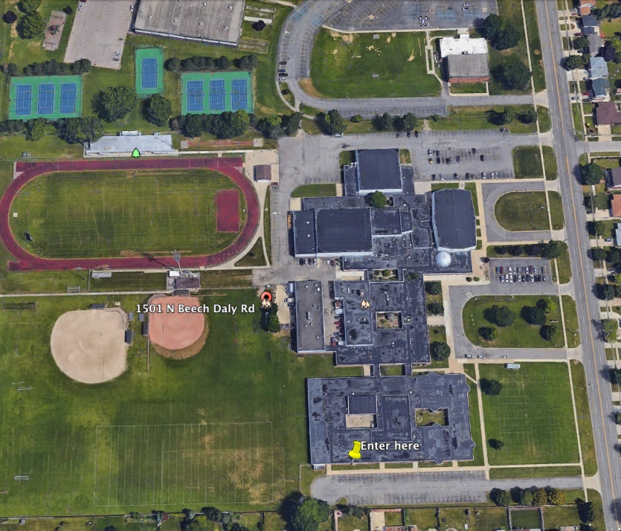
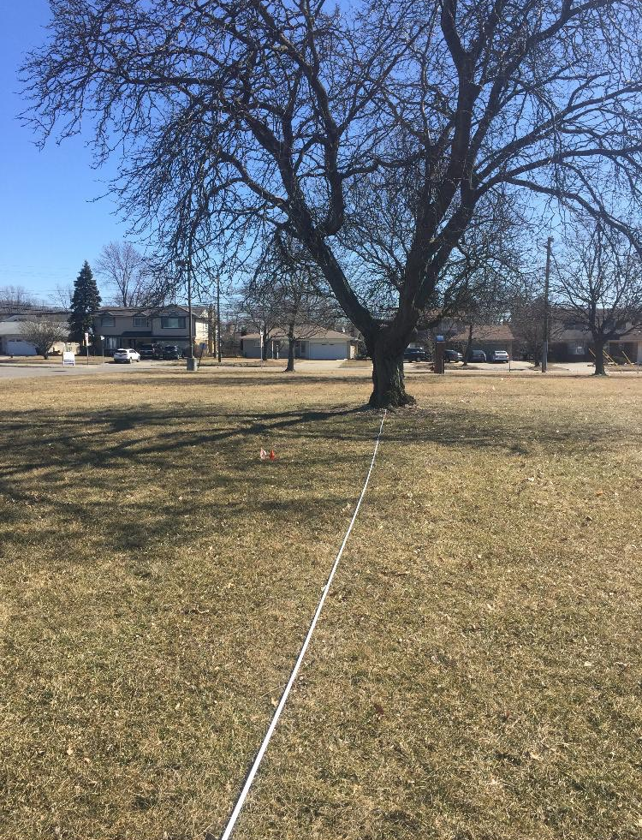
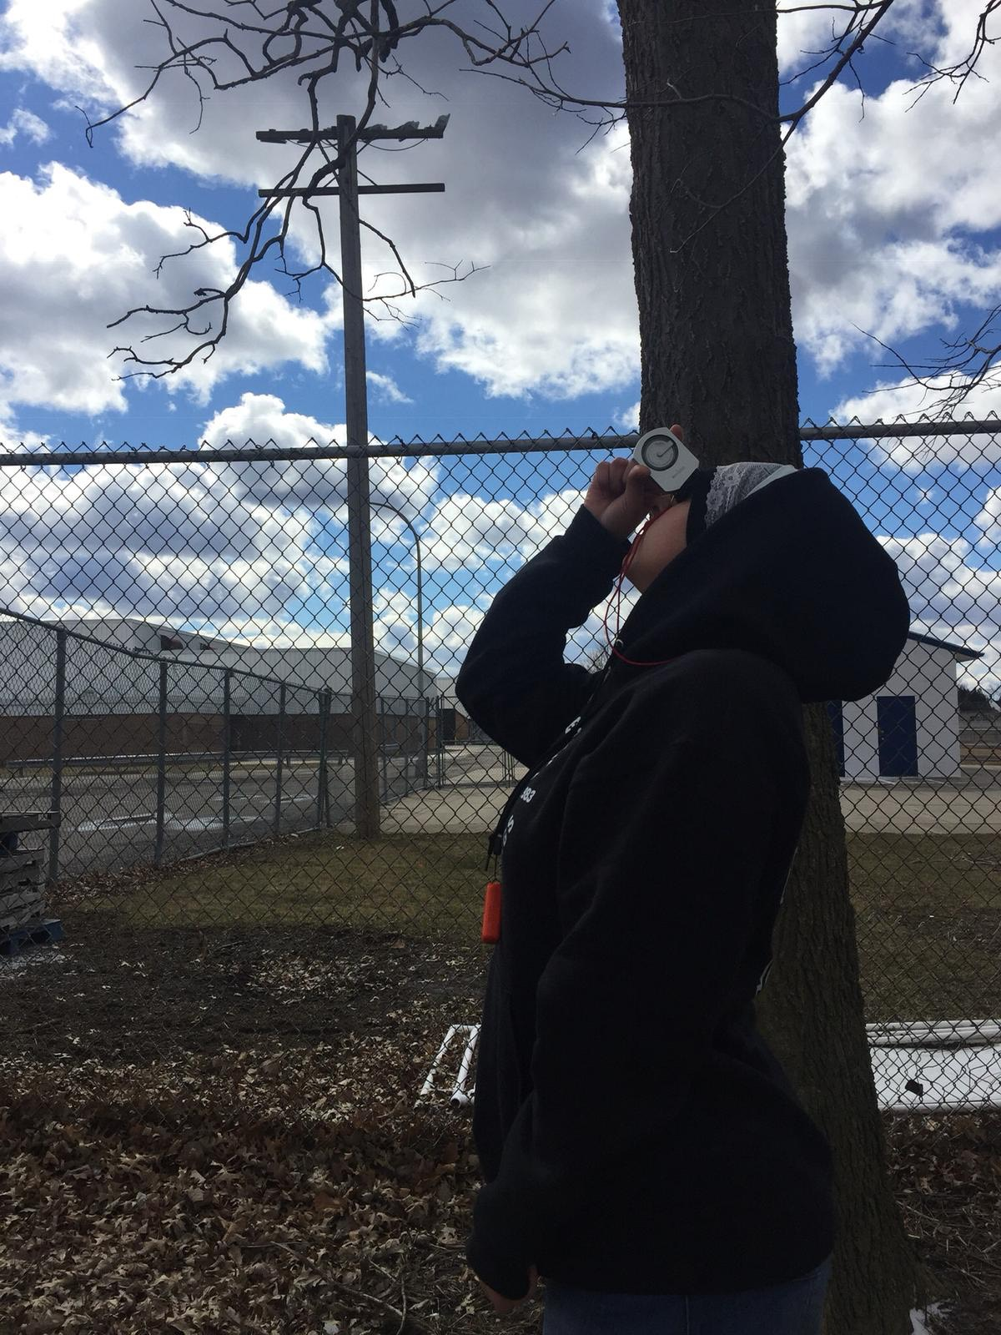
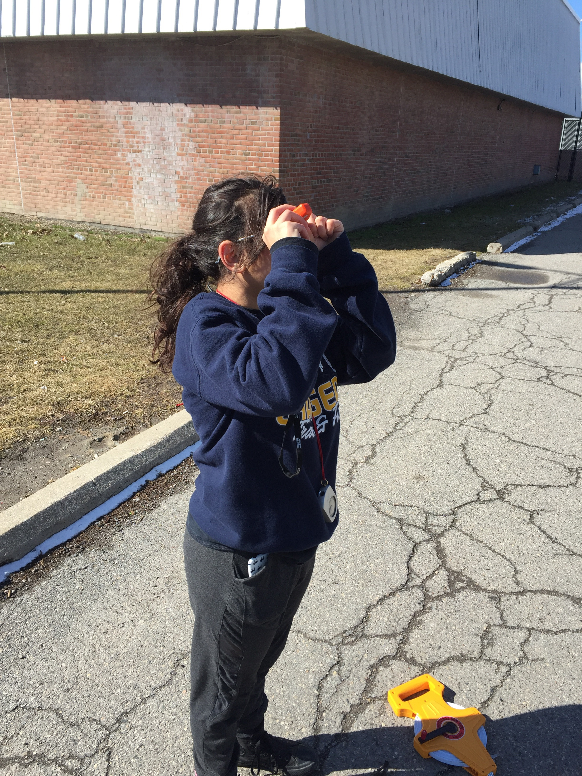
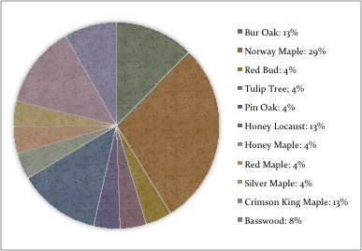
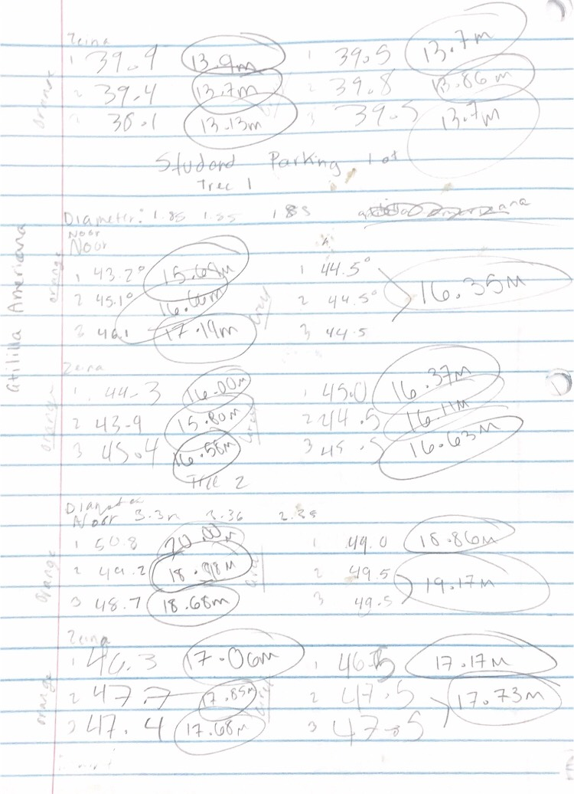
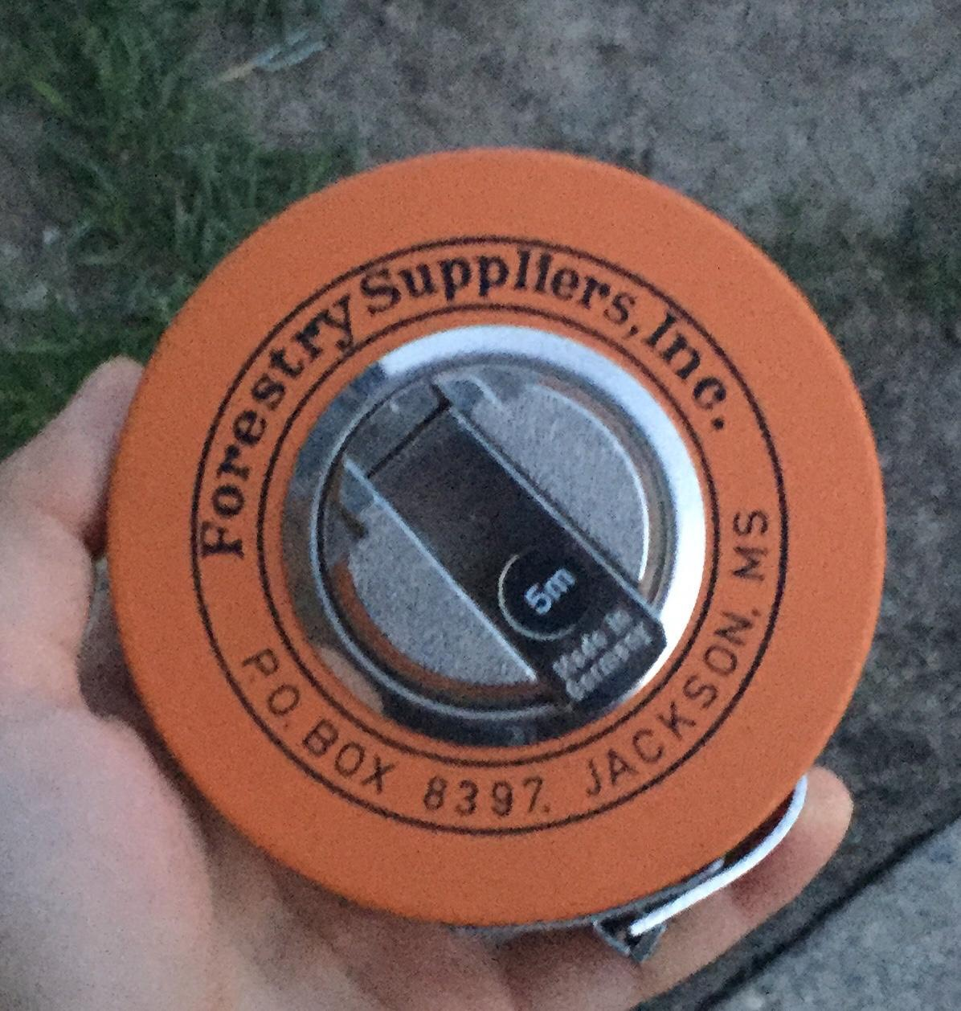
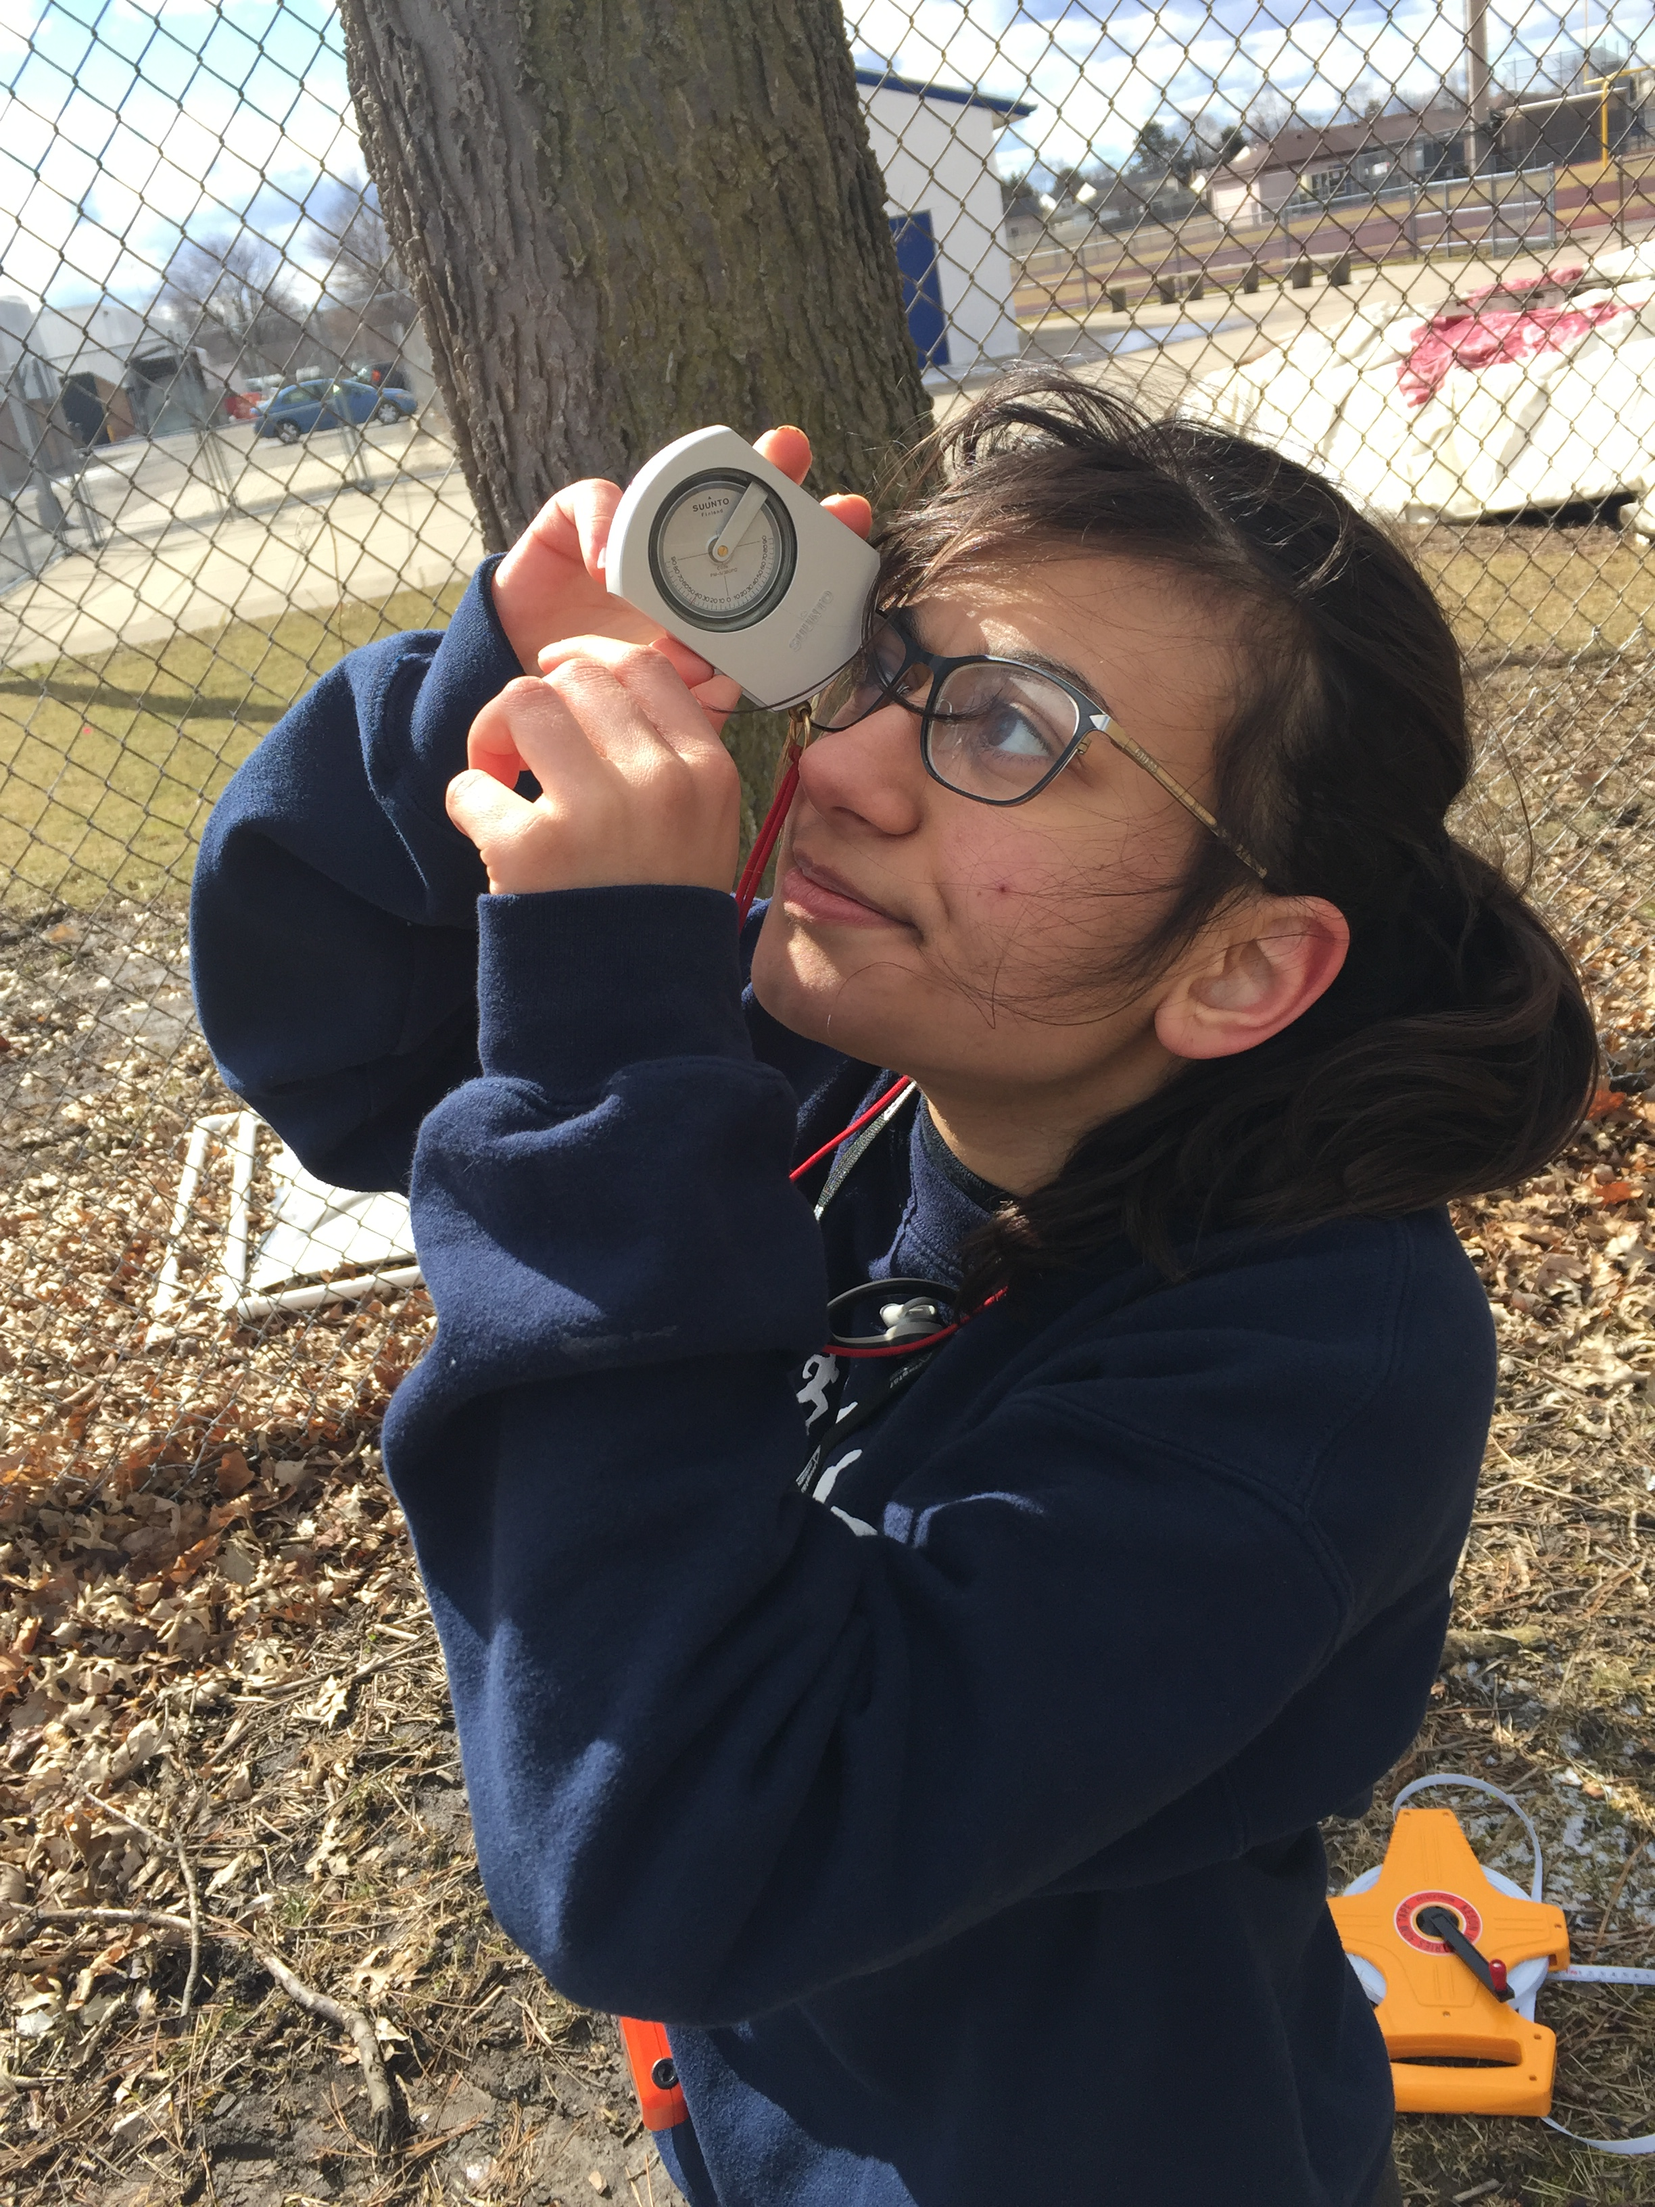
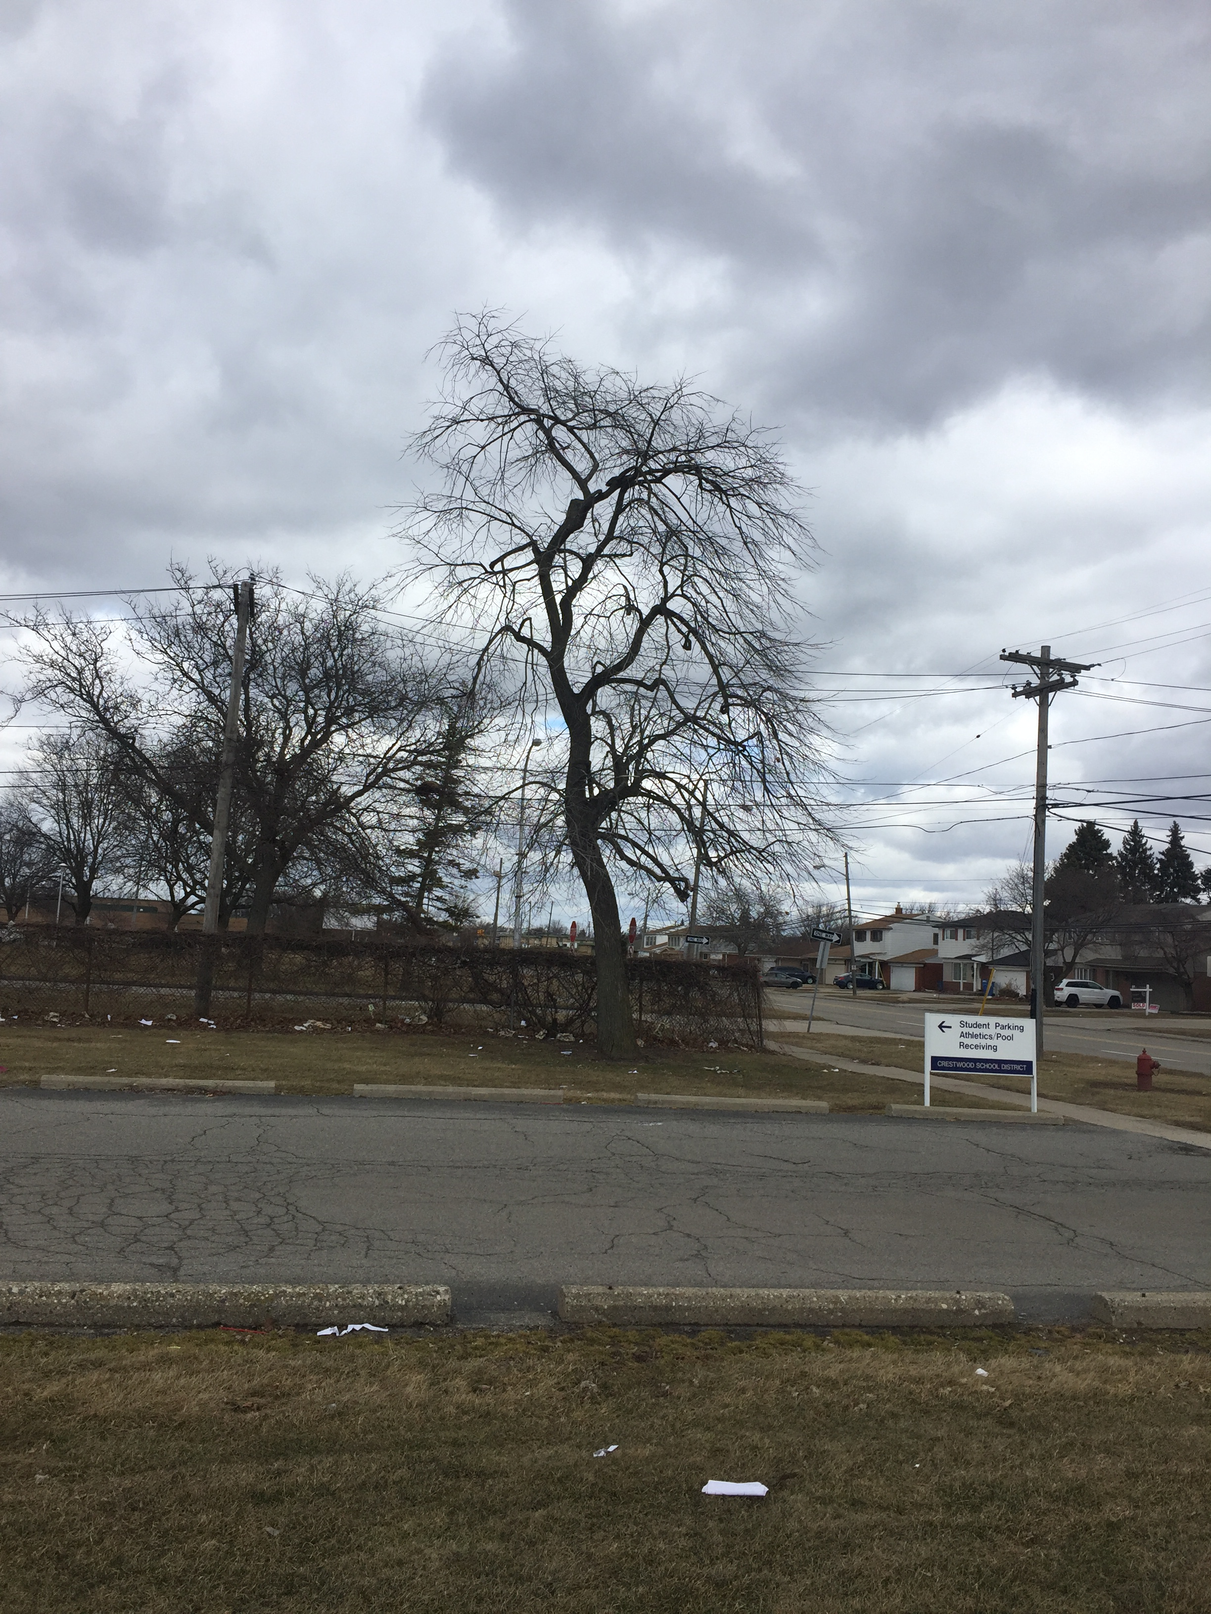
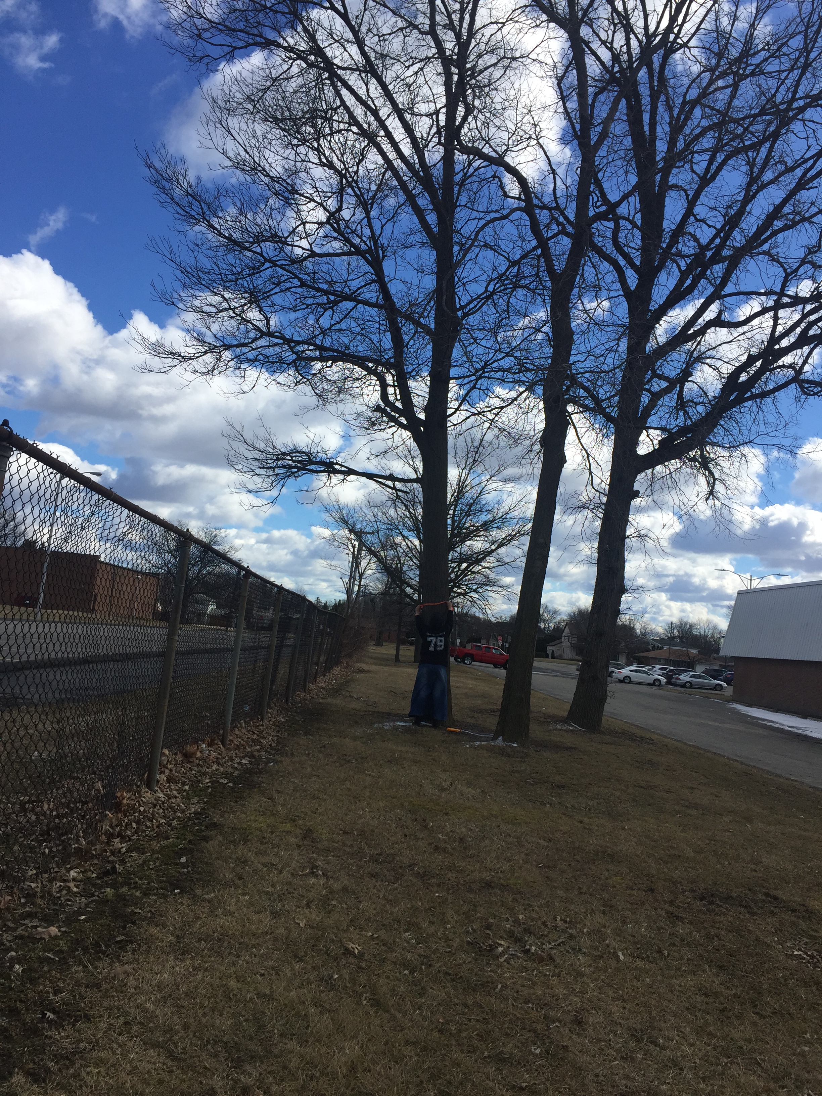
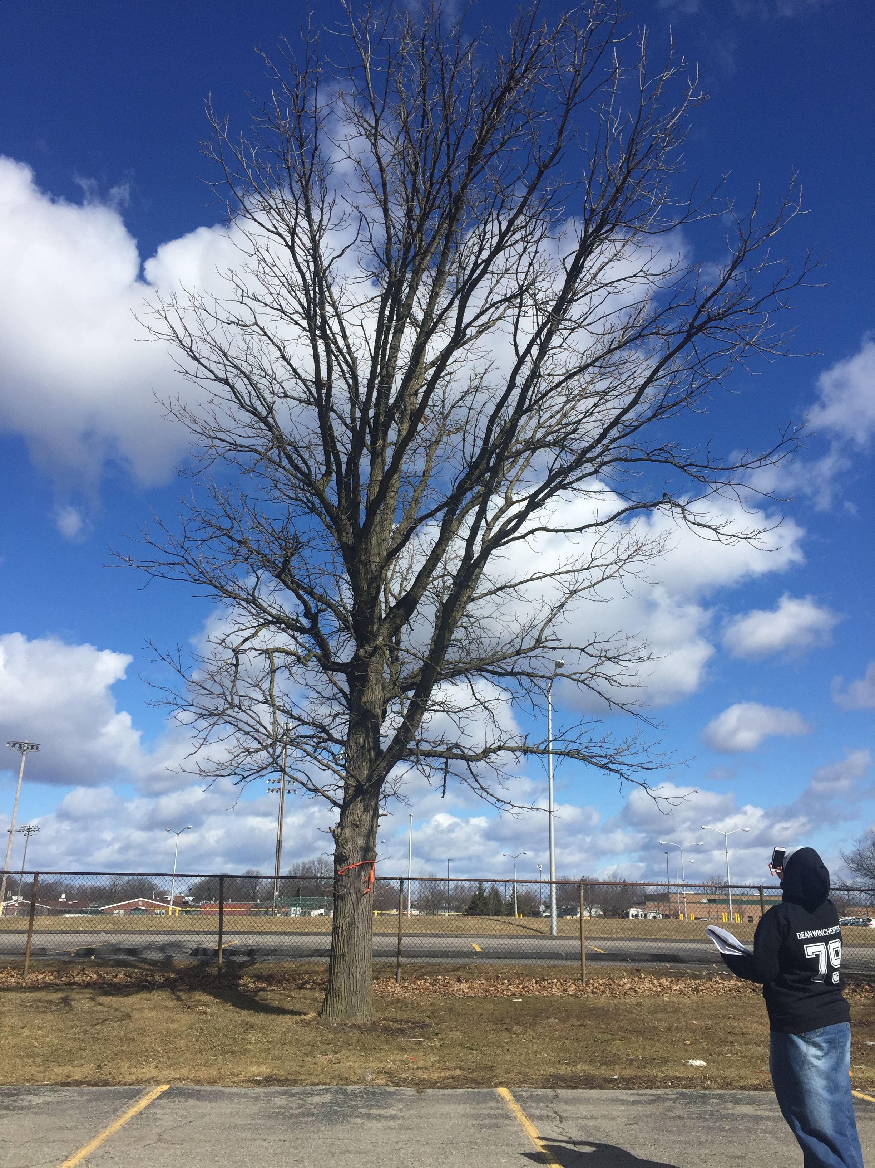
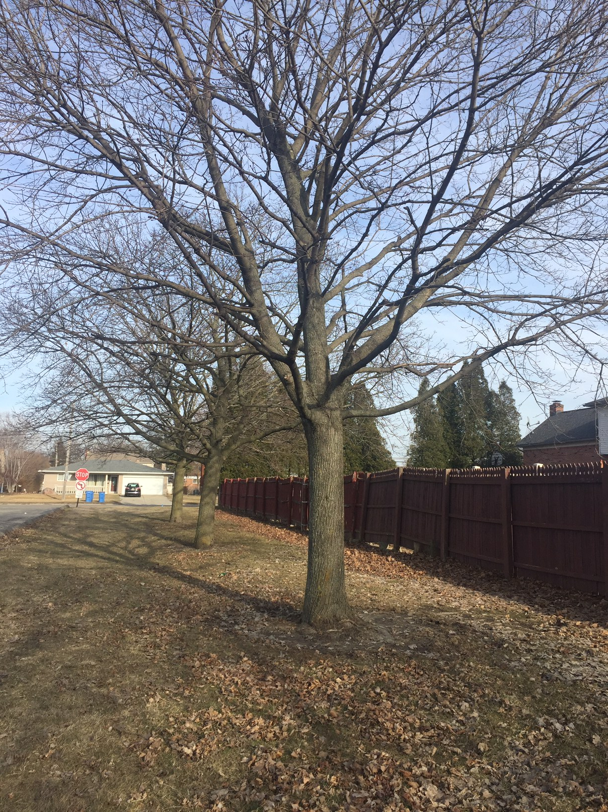
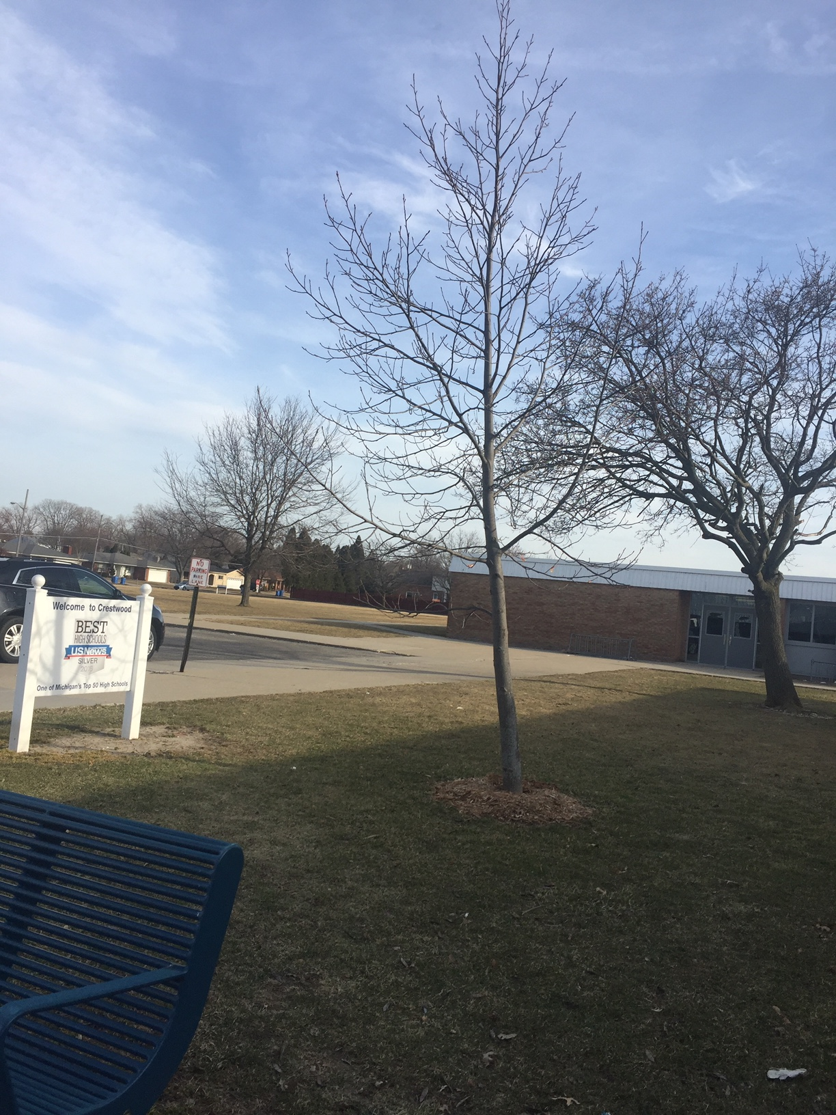
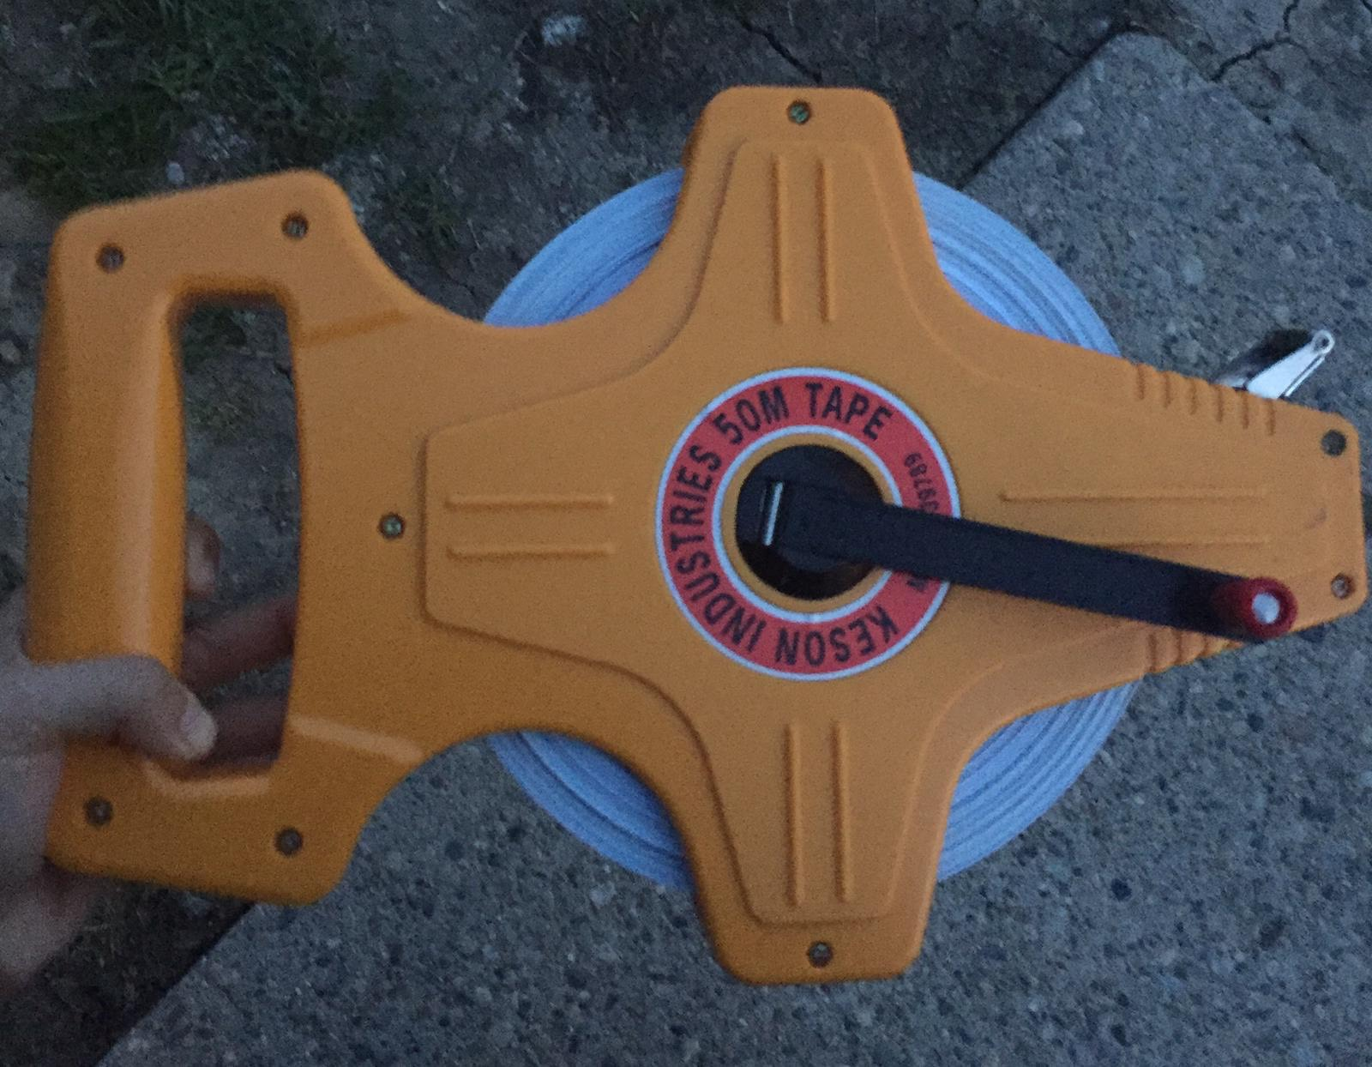
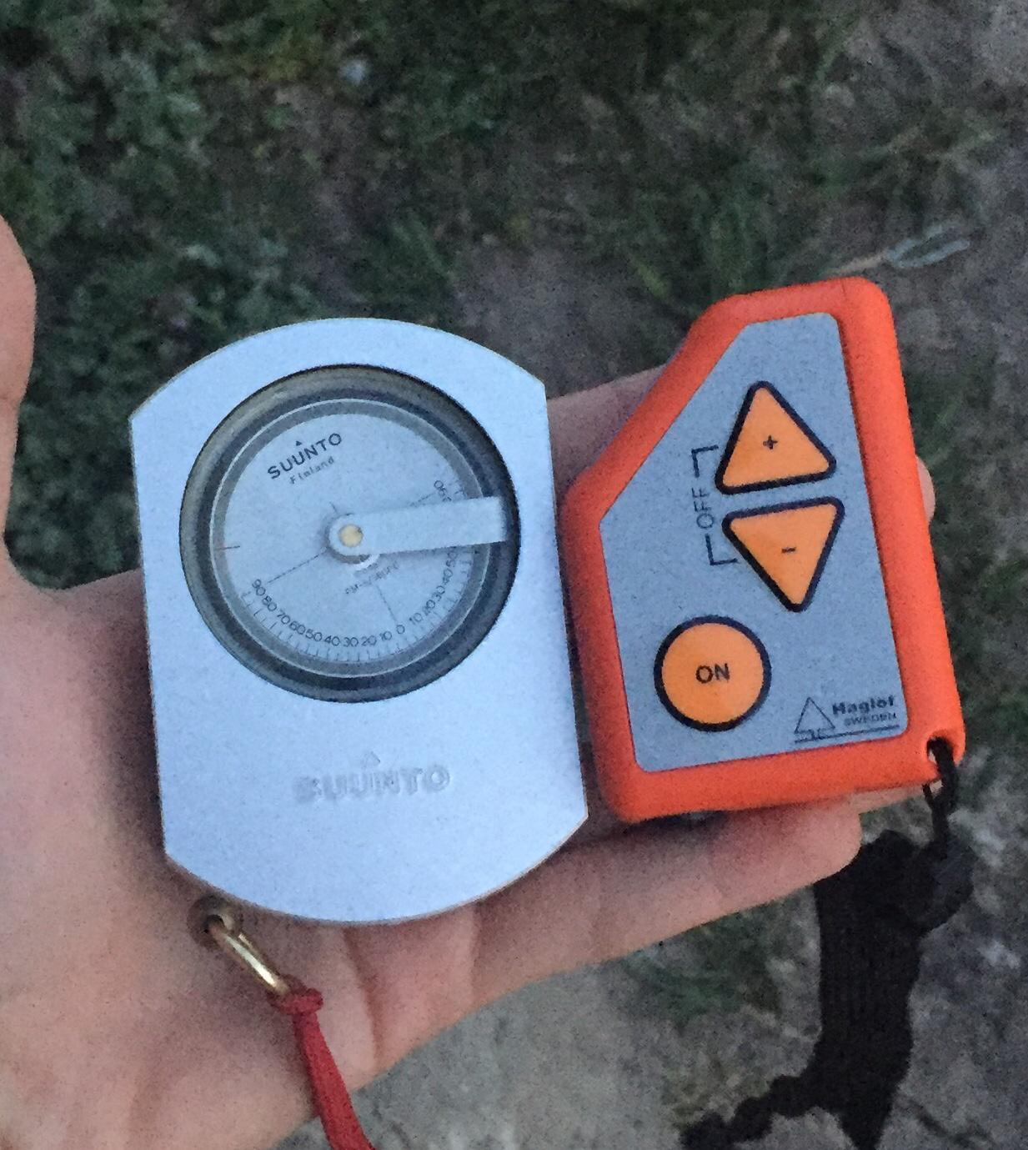
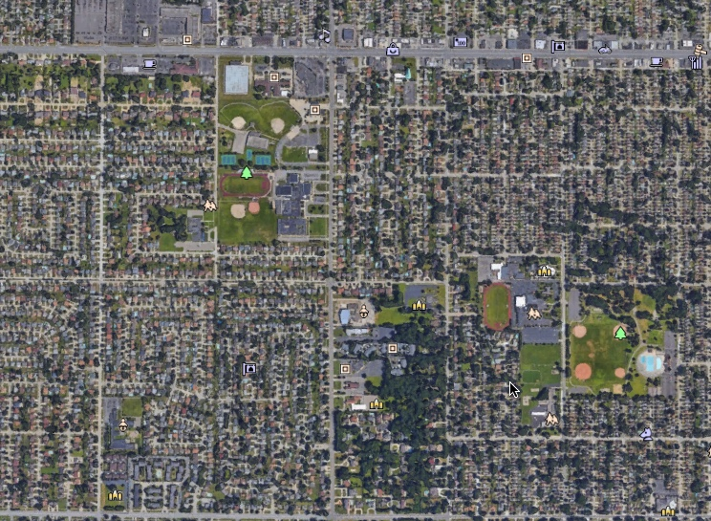
An Assessment of Tree Attributes with Their
Consequences and Impacts on a High School Campus
Noor Abu-Rus and Zeina Jebara-Crestwood High School- Dearborn Heights, MI
Abstract
Methodology
Results
Conclusions
Trees are often one of the most prominent natural features in an urban environment. By measuring the heights and circumferences of trees scientists are able to determine out how factors such as carbon uptake and surface runoff are affected. This research attempted to answer the question of what role each tree species on our campus provides the greatest ecosystem services. Using GLOBE protocols, data was collected on the heights and circumference of eight trees on the Crestwood High School campus. Identification of each species was made using a field guide and verified by a trained professional. Data was entered in the GLOBE database and submitted to a U.S. Forest Service (USDA) i-Tree online program that quantifies the benefits and values of trees. Using i-Tree algorithms it was possible to determine the approximate amount of carbon dioxide taken in by each tree, the amount of storm water runoff which has been avoided, potential energy savings to our high school building, and the amount if air pollution removed each year by the specific species of the measured trees. After analyzing the effects of the trees on the surrounding environment, it was determined that some species provide more ecosystem services than others and how much they contribute varies depending upon size and age. Where trees are planted in relationship to a school building also contributes substantially meaning that the school may need more or less heating or cooling based on where trees are sited. There is a limit to how large the trees are before their ability to sequester carbon dioxide either stays the same or declines.
Materials
The species of the tree does affect the amount of carbon dioxide absorbed by each tree. On our campus there is a Basswood tree with a diameter of 1.05-m. We placed a hypothetical honey locust tree with the same measurements and factor affected the tree into MyTree to figure out that even with the same factors affecting the tree, the honey locust had many more carbon dioxide being absorbed than the basswood.
The Circumference of the tree affects the amount of surface runoff directly since the bigger the tree, the more surface runoff there is that is able to be avoided because of these trees.
Depending on the area where the trees are planted, the effects can either be negative or positive. For example, if trees are planted to the far right of the school, the costs of electricity is able to decrease, but if planted near the school, behind or to the left, the costs will increase due to the shade provided by these trees to require the usage of air conditioning less often as well as absorbing some sunlight through their leaves during the cooler months to reduce the use of a heating system.
A tree takes in carbon dioxide for photosynthesis during its yearly growing season. Trees store a great deal of carbon dioxide when they are young and actively growing. As trees mature, their ability to store carbon slows down and eventually plateaus. For example, a Basswood tree sequesters carbon dioxide until it reaches a circumference of around 90-cm.
Suunto clinometer
HAGLOF EC II-D electronic clinometer
Forestry Suppliers English steel diameter tape
Keson Industries 50-M tape
GLOBE protocols for tree height and circumference
Determine what trees meet the criteria for inclusion in the GLOBE biometry protocols.
Measure 15 meters away from the base of the tree in a straight line.
Measure the heights of the tree 3 times per person with each clinometer
Figure 1. Shows the sum of money that can be saved from each environmental factor from current day to 2029.
Figure 2. The pie chart shows the abundances of different tree species around campus. Each tree has a different effect on the environment.
Use the formula: (TAN of clinometer reading x distance from tree) + (Height from base) to get total tree height
Find the circumference of the trees a total of three times before finding the average.
Enter data into the GLOBE website.
Measurement Limitations
Research Questions
Height and circumferences were measured for 8 of the 24 trees on campus. Some of the other trees are non-native species and will be included in subsequent research.
Tree heights varied by approximately one meter, it was very difficult to get height measurements that varied less. Cold temperatures may have caused the researchers to rush more than they should have. Accuracy may also have been affected by an unsteady holding of the clinometer.
Some trees had multiple high points that could have led to measurement errors.
How do different tree species affect the amount of carbon dioxide absorbed? Do trees sequester more carbon dioxide during youth or maturity?
How does a tree’s height and circumference affect surface runoff?
How can the planting of more trees affect the heating and cooling effects on various sections of our high school?
How does the size of the measured trees affect both amount of carbon dioxide absorbed each year and how much air pollution is removed?
Figure 3. Green areas indicate the best locations near the school to plant trees to save energy. Yellow areas would not benefit from planting trees.
Figure 4. An example of the positive monetary effects of planting a Honey Locust (Gleditsia triacanthos)
Acknowledgements
Null Hypotheses
Tree 4
Basswood
(Tilia americana)
Tree 6
Bur Oak
(Quercus palustris)
Tree 7
Bur Oak
(Quercus palustris)
Norway Maple
(Acer platanoides)
Tulip tree
(Liriodendron tulipifera)
Works Cited
The type of tree species has no effect on the amount of carbon dioxide absorbed and air pollution removed.
The circumference and height of a tree species has no effect on surface runoff.
Planting more trees have no effect on the heating and cooling effects of high school buildings.
There is no limit to the amount of Carbon dioxide a tree can sequester once they reach a certain height, circumference, and maturity.
Use the Shannon-Wiener Index to compare the diversity of the high school’s campus now to what it was before the invasive Emerald Ash Borer from northeastern Asia (Agrilus Planipennis) killed all but one of the ash trees on campus.
Enter trees into i-Tree to see what effects they have on the environment.
Using clinometer
“What Tree Is That? Online.” What Tree Is That? Online Edition at Arborday.org, www.arborday.org/trees/whattree/whatTree.cfm?ItemID=E6A.
“Tree Design v6.0.” i, design.itreetools.org/.
“MyTree by i-Tree.” ITree MyTree, mytree.itreetools.org/.
The GLOBE Program. 2014. "Biosphere Protocol eTraining", https://www.globe.gov/get-trained/protocol-etraining/etraining-modules/16867717/3099387 . Accessed 3/31/2019.
The GLOBE Program. 2014. "Biometry Protocol",
https://www.globe.gov/do-globe/globe-teachers-guide/biosphere?p_p_id=globegovteacherguideportlet_WAR_globegovcmsportlet_INSTANCE_4CcA&p_p_lifecycle=0&p_p_state=normal&p_p_mode=view&p_p_col_id=column-1&p_p_col_count=1&_globegovteacherguideportlet_WAR_globegovcmsportlet_INSTANCE_4CcA_protocolCat=3099391 . Accessed 3/31/2019.
“Benefits of Urban Trees.” SCFC Benefits of Urban Trees, www.state.sc.us/forest/urbben.htm.
Table 1. The table uses the Shannon Wiener Index from the species of viable trees at Crestwood High School to figure out the biodiversity of our school.
Materials
Research Implications
Suunto clinometer (right)
HAGLOF EC II-D electronic clinometer (left)
GLOBE protocols for tree height and circumference
Why Trees? Regardless of what people think, trees are some of the most important living organisms in the world. Not only do they provide oxygen for us to breathe, but according to a study by William Sullivan, ASLA, professor of landscape architecture at University of Illinois at Urbana-Champaign, and Dongying Li, a PhD student there, trees are also proven to relieve stress and improve personal health through their aesthetic views.
We need more GLOBE schools to join this study and the GLOBE Trees Around The World Campaign in order to compare our data. We now realize what effects trees have on our school campus, and would like to extend the research to the trees in our neighborhoods to see how they can positively impact our daily lives.
Honey Locust
(Gleditsia triacanthos)
Acknowledgements
Figure 5. Key for Location of Trees on Crestwood High School Campus. Honey Locust (Gleditsia triacanthos), Honey Locust (Gleditsia triacanthos), Pin Oak (Quercus palustris), Basswood (Tilia americana), Basswood (Tilia americana), Bur Oak (Quercus macrocarpa), Bur Oak (Quercus macrocarpa), Bur Oak (Quercus macrocarpa).
A special thank you to the GLOBE Program and our school’s two local partners, Mr. David Bydlowski (AREN-Wayne RESA) and Dr. Kevin Czajkowski (Mission Earth-University of Toledo) for providing access to equipment used in this research. Without the funding and support of these individuals and their organizations, we would not have been able to accurately collect data. Thank you also to Ms. Jennifer Bourgeault for helping to fund and organize the GLOBE Regional Science Symposiums so we have the opportunity to meet students from all over the Midwest. We would also like to thank Mrs. Diana Johns for encouraging us in our research and also to the administration and school board of our district for allowing us to embark on the trip of a lifetime to Iowa in order to meet like minded students and scientists from all over the region.
Keson Industries
50-M tape
Forestry Suppliers English steel diameter tape

