Slide 1


Slide 2
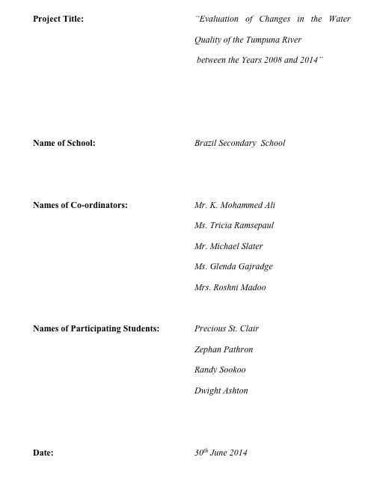

Slide 3
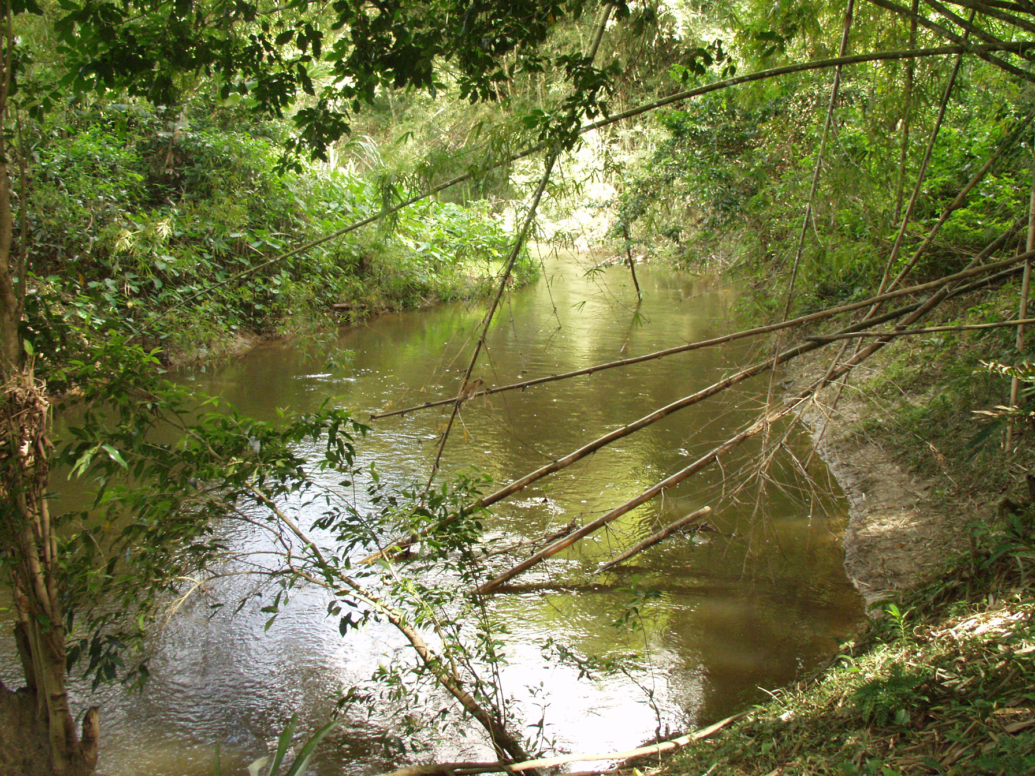

Slide 4
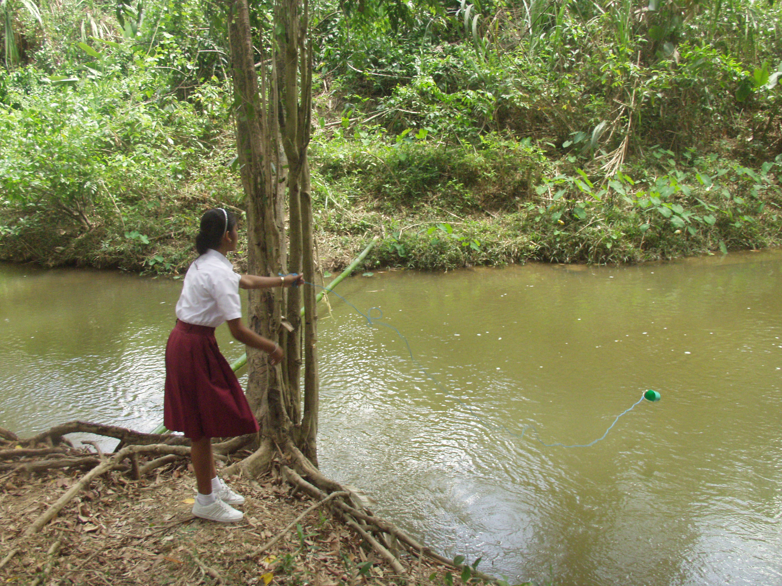

Slide 5
RESEARCH QUESTION
“Does the quality of the water in the Tumpuna River remain at a sufficiently high standard to be safely used to enrich the quality of life of the villagers of Brazil Village, despite the maximized agricultural production coupled with the increased population density?”

Slide 6
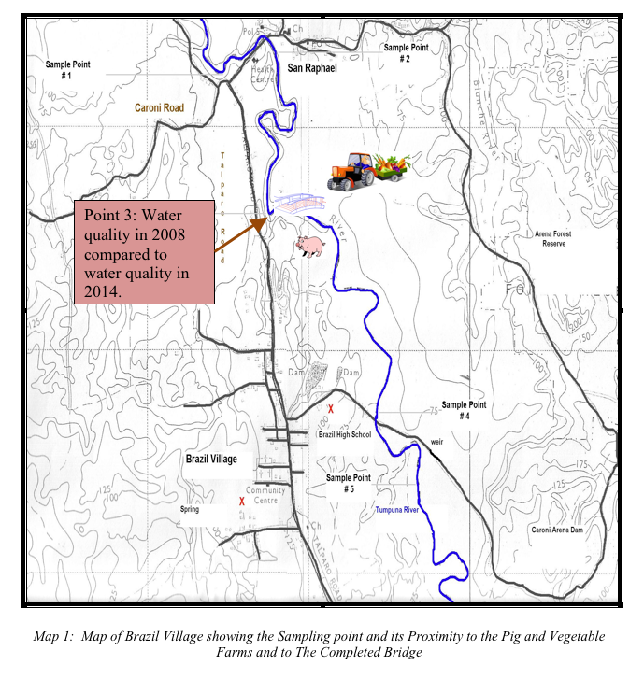




KEY
BRIDGE
VEGETABLE FARM
PIG FARM
SCHOOL
Point 3: Water quality in 2008 compared to 2014.
10.5602ºN, 61.2675ºW, elevation: 25m

Slide 7
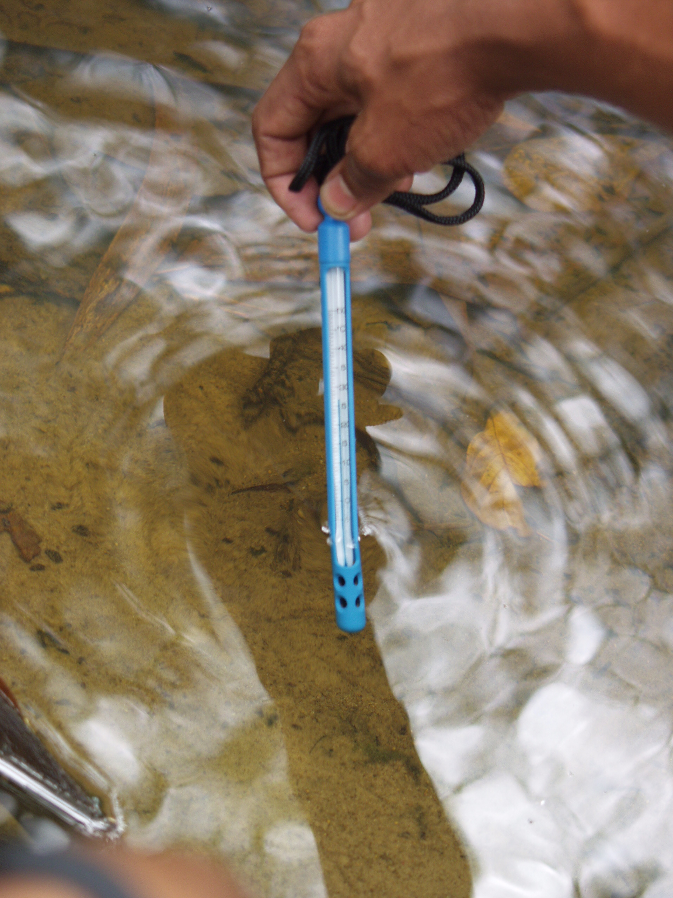
Parameters
PARAMETERS
Student collecting water temperature reading
TEMPERATURE

Slide 8
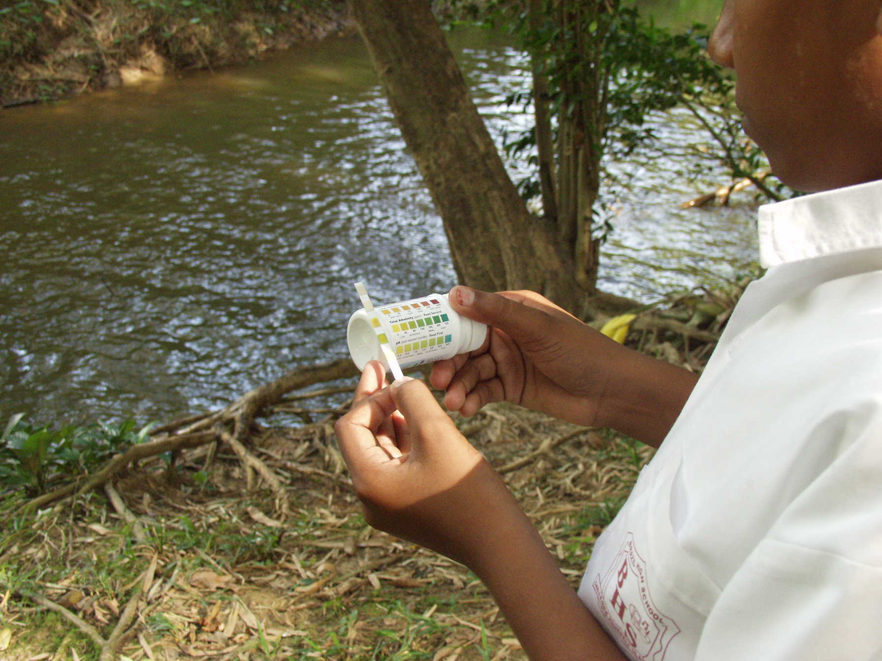
PARAMETERS
Student determining nitrate content
NITRATES

Slide 9
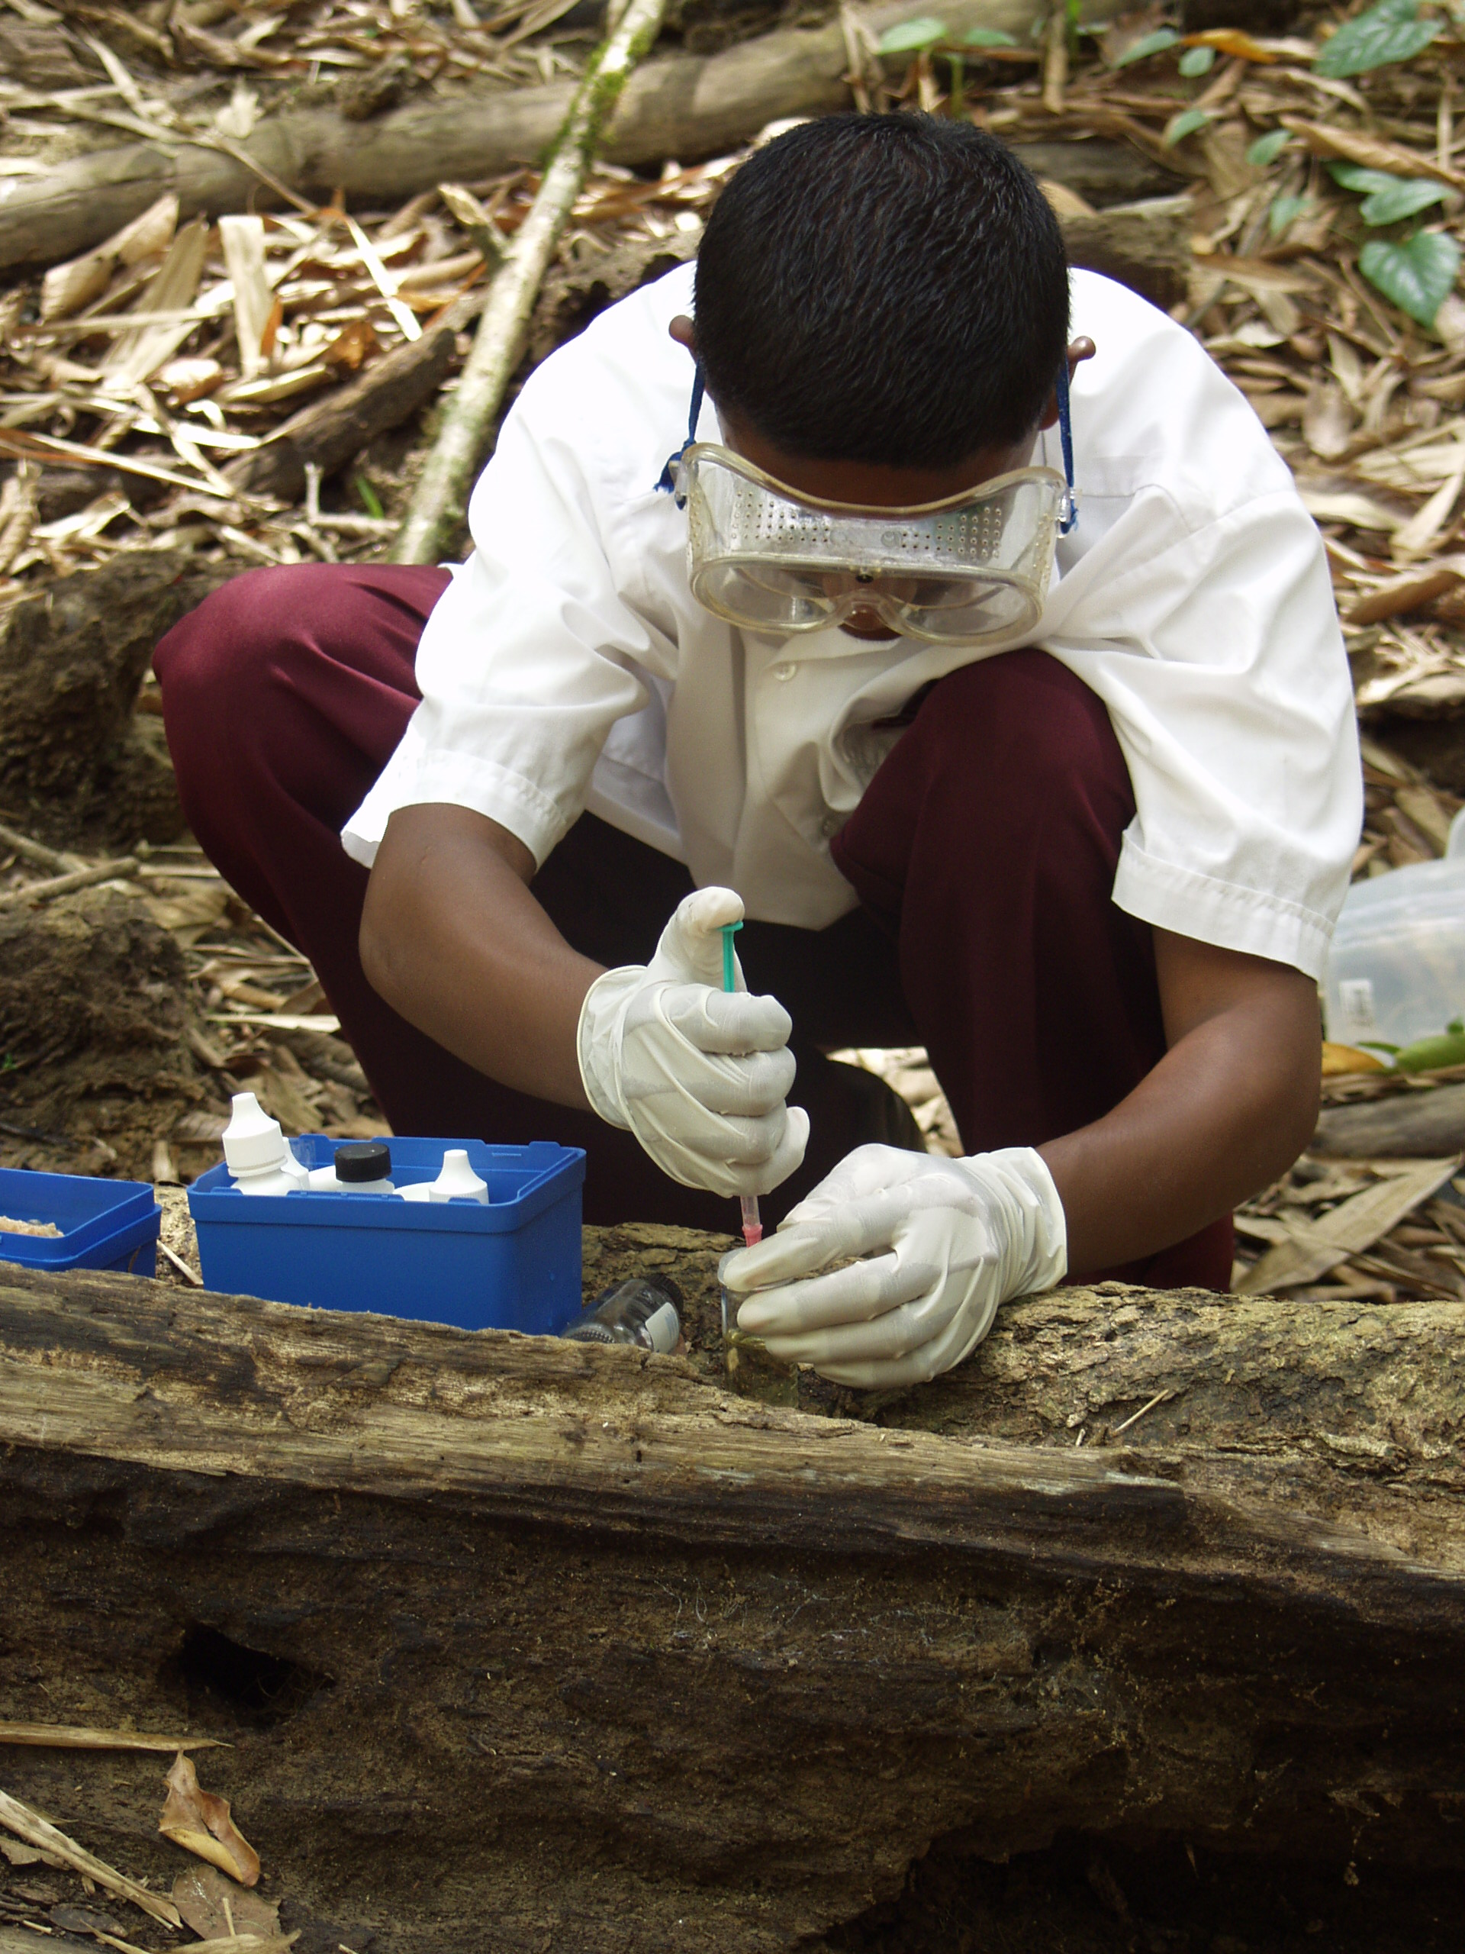
PARAMETERS
DISSOLVED OXYGEN CONTENT
Student determining DOC of water sample

Slide 10
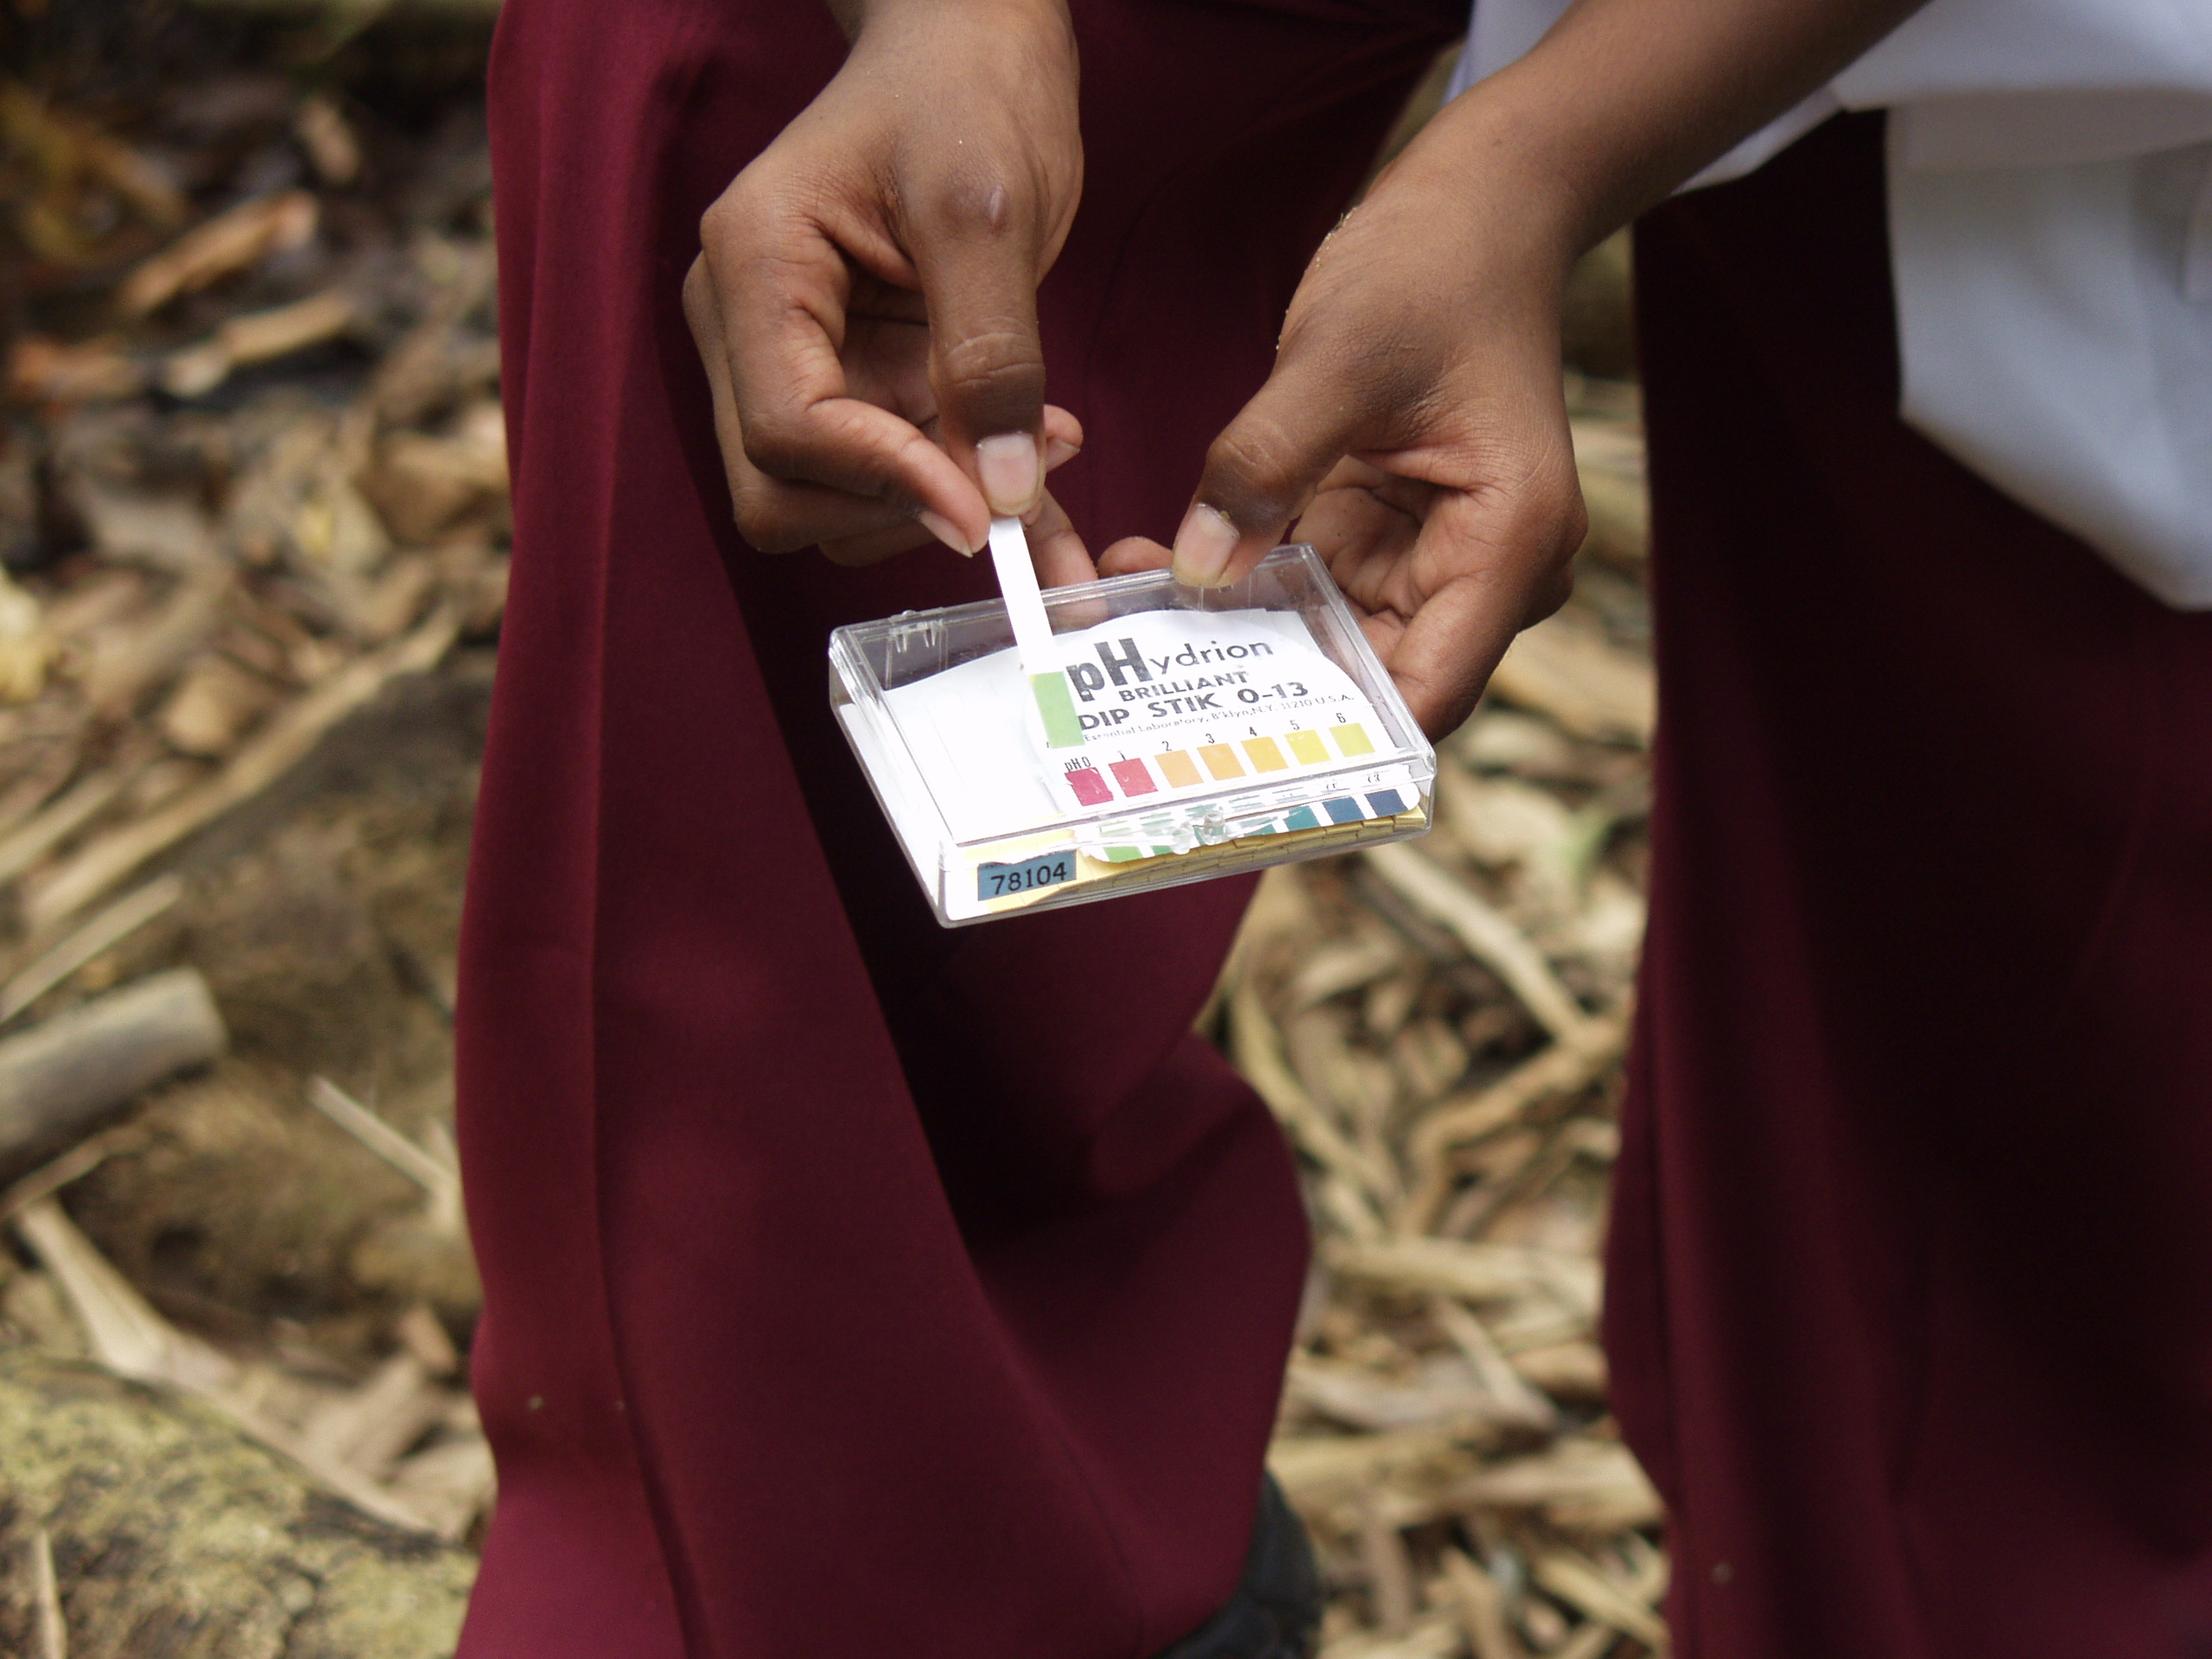
PARAMETERS
Observing pH reading
pH

Slide 11
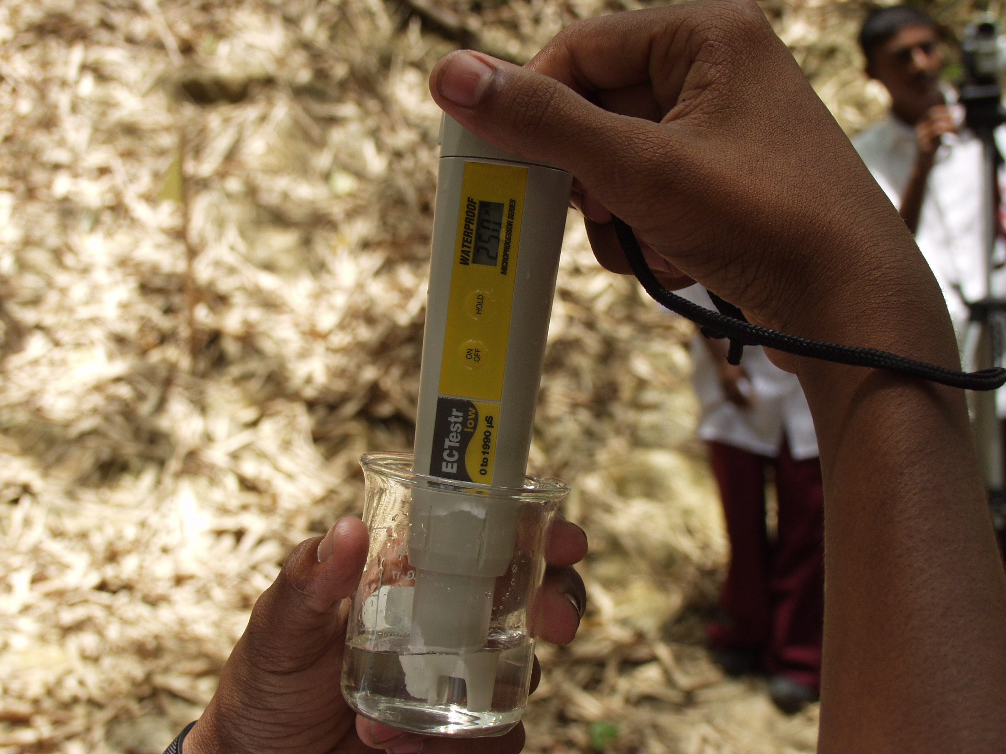
PARAMETERS
Looking at the EC of a water sample
ELECTRICAL CONDUCTIVITY

Slide 12
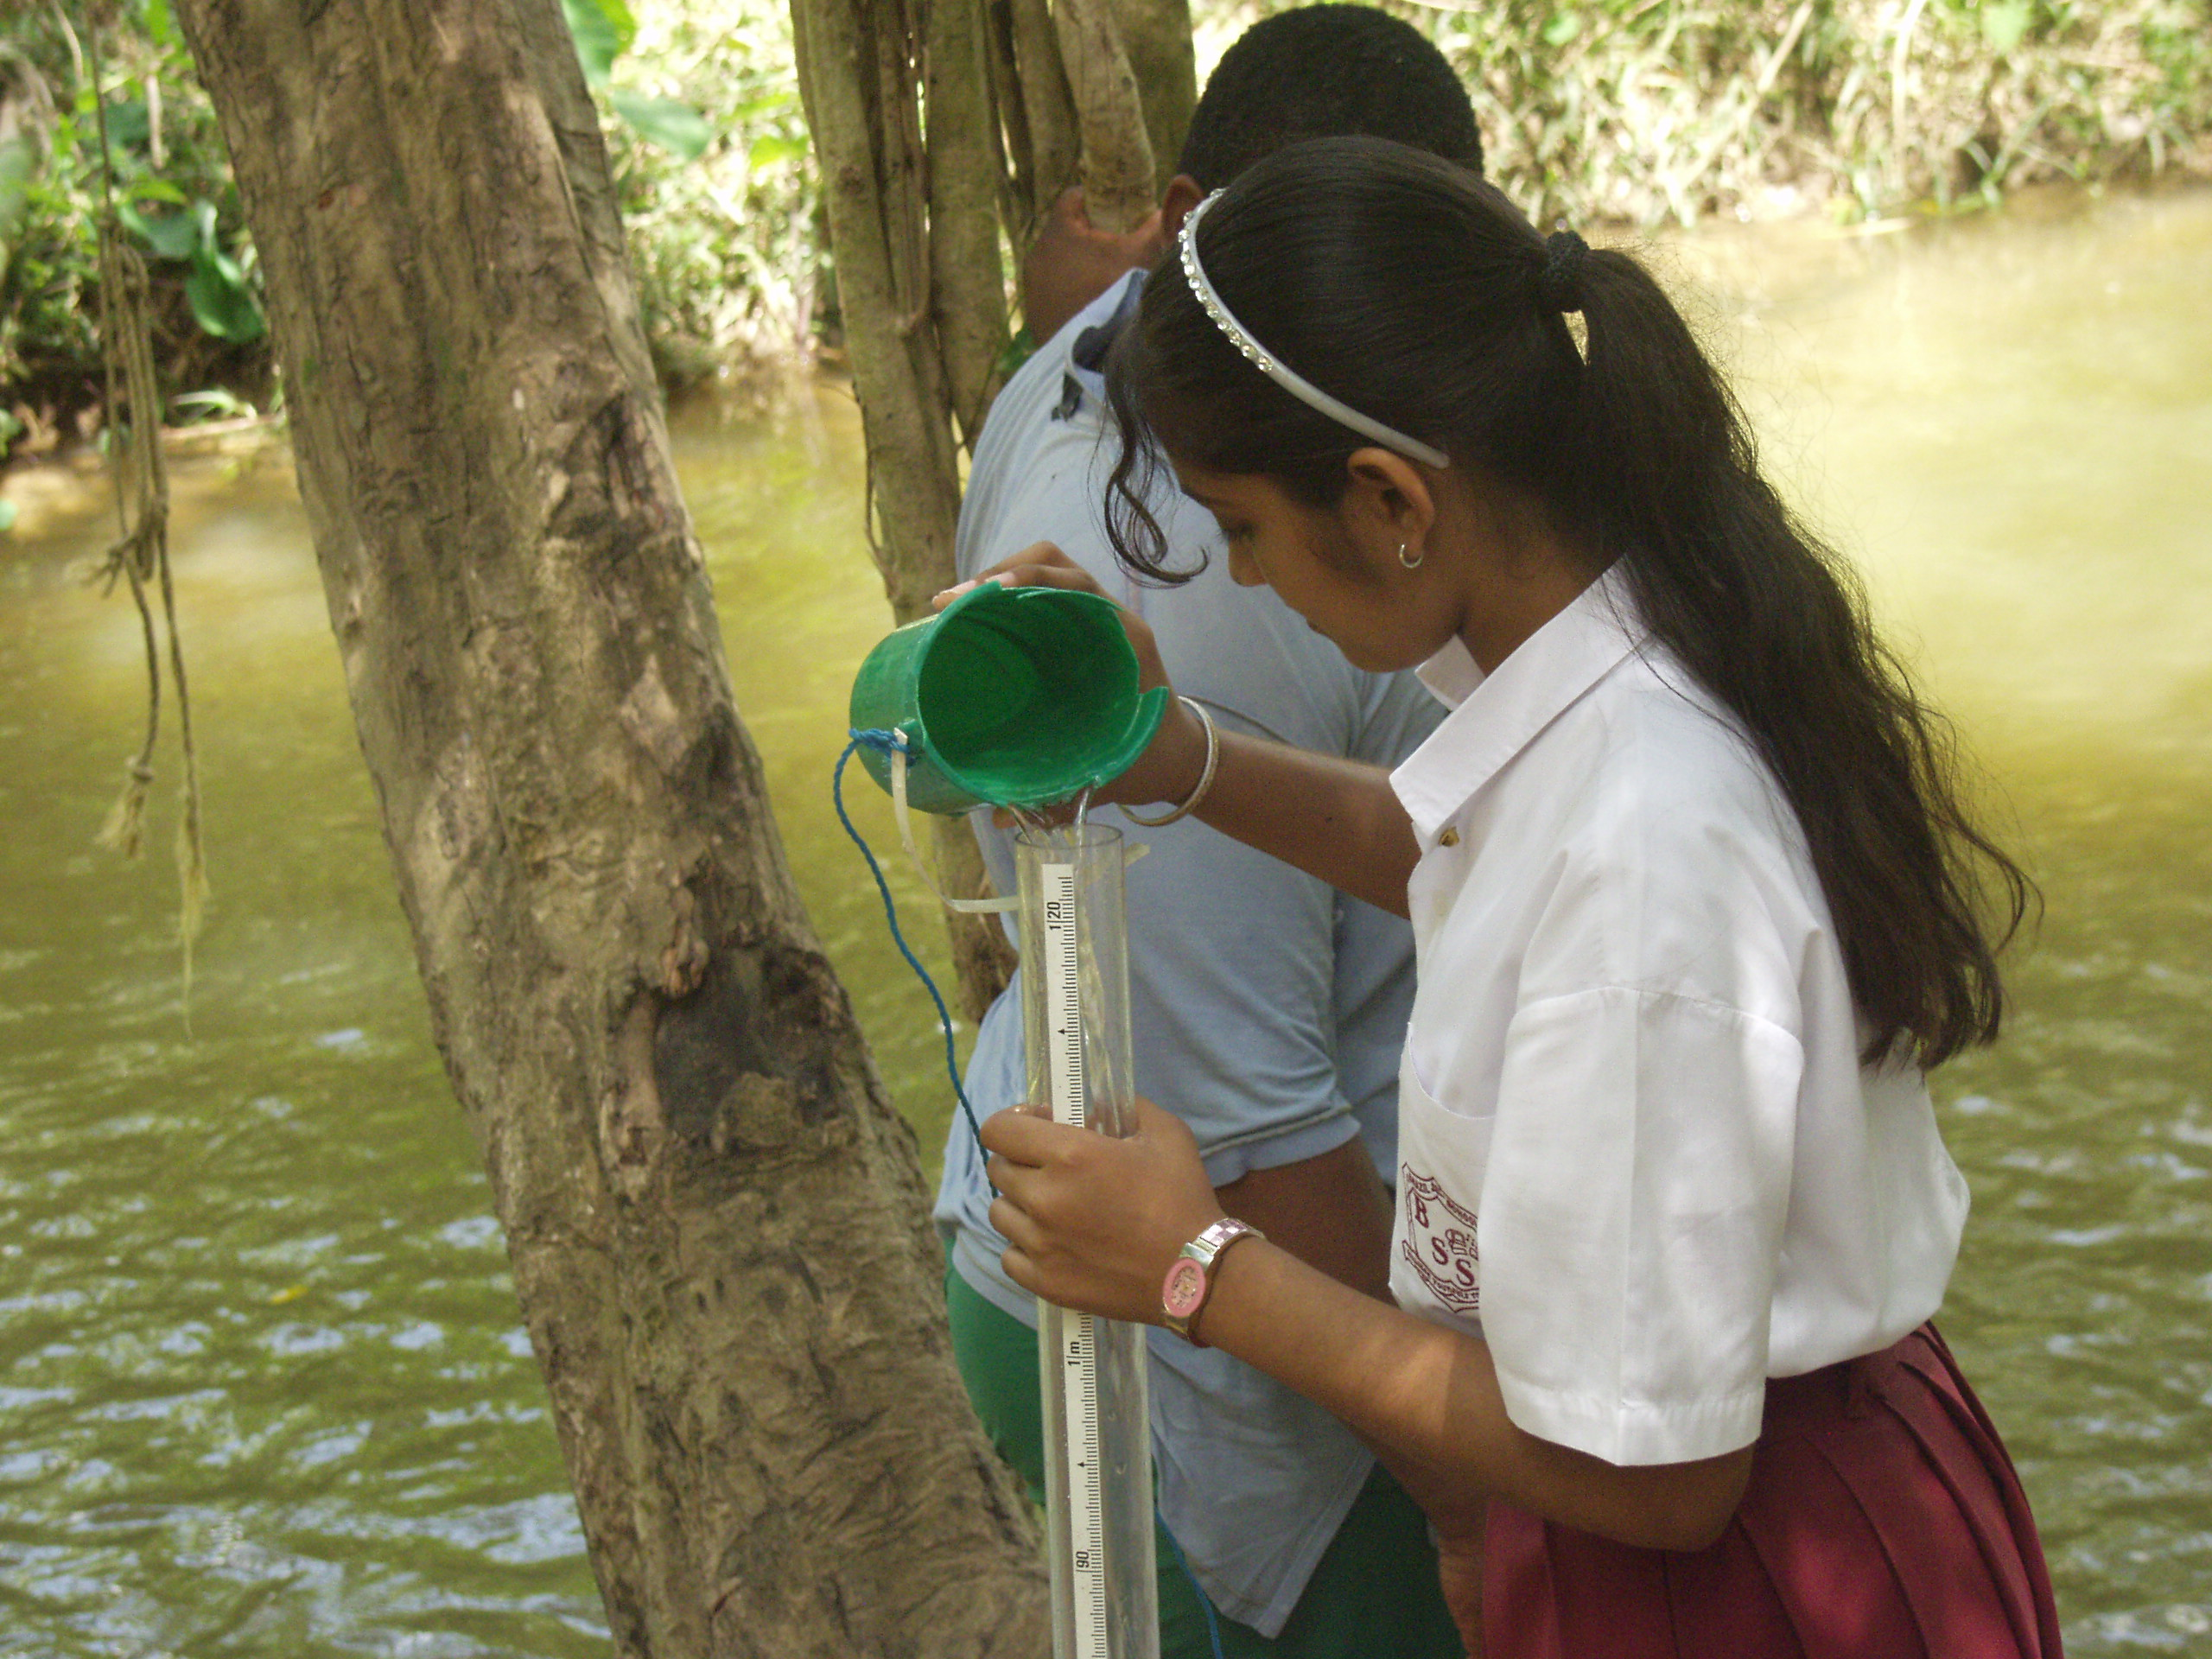
PARAMETERS
Student taking turbidity measurement
TURBIDITY

Slide 13
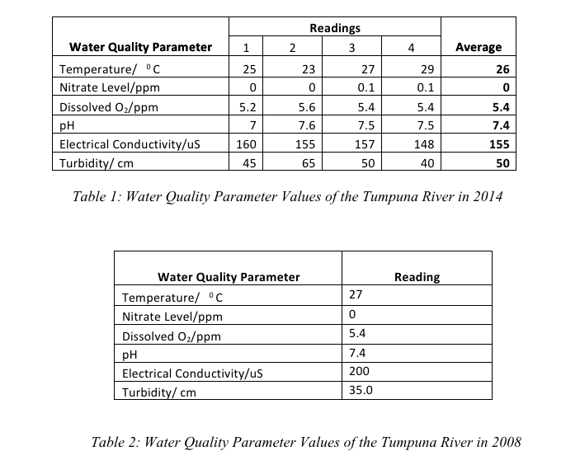

Slide 14
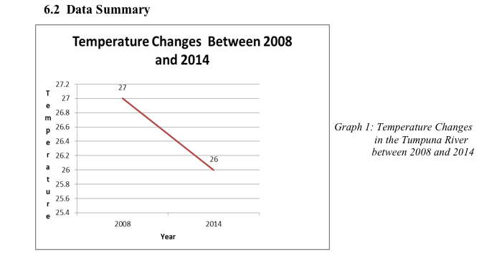
Graph of Temperature/º C vs. Time/years
/º C
No significant change, daily temperature variation is greater than this change.

Slide 15
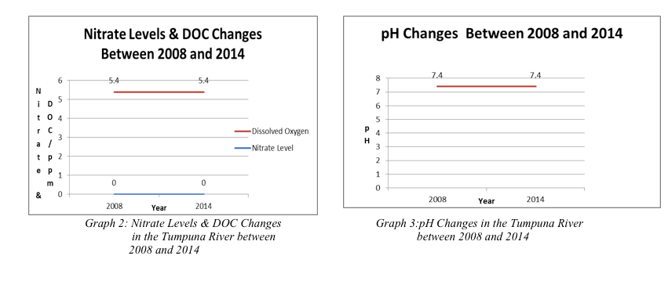
Graph of Nitrate Levels and DOC Changes/ppm vs. Time/years
Nitrate levels and DOC remains constant

Slide 16
Graph of pH changes vs. Time/years
pH values remain constant

Slide 17
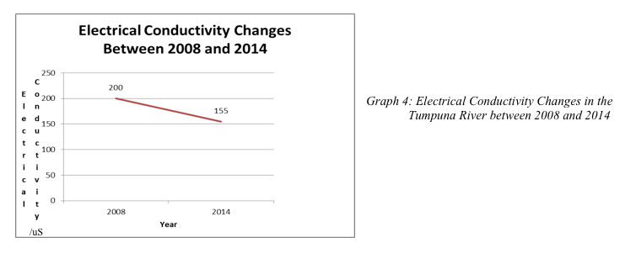
Graph of Electrical Conductivity Changes/uS vs. Time/years
EC dropped slightly, possibly due to the fall in mineral content once the bridge was completed.

Slide 18
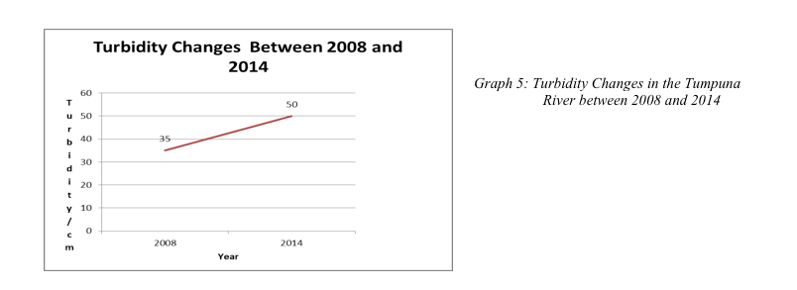
Graph of Turbidity Changes/cm vs. Time/years
Decrease in turbidity observed, possibly because of the completion of the bridge in 2012.

Slide 19
CONCLUSION
Evaluation of the comparison of the water quality parameters collected in 2014 to those collected in 2008 revealed that there was very little change in the quality of the water of the Tumpuna River.

Slide 20
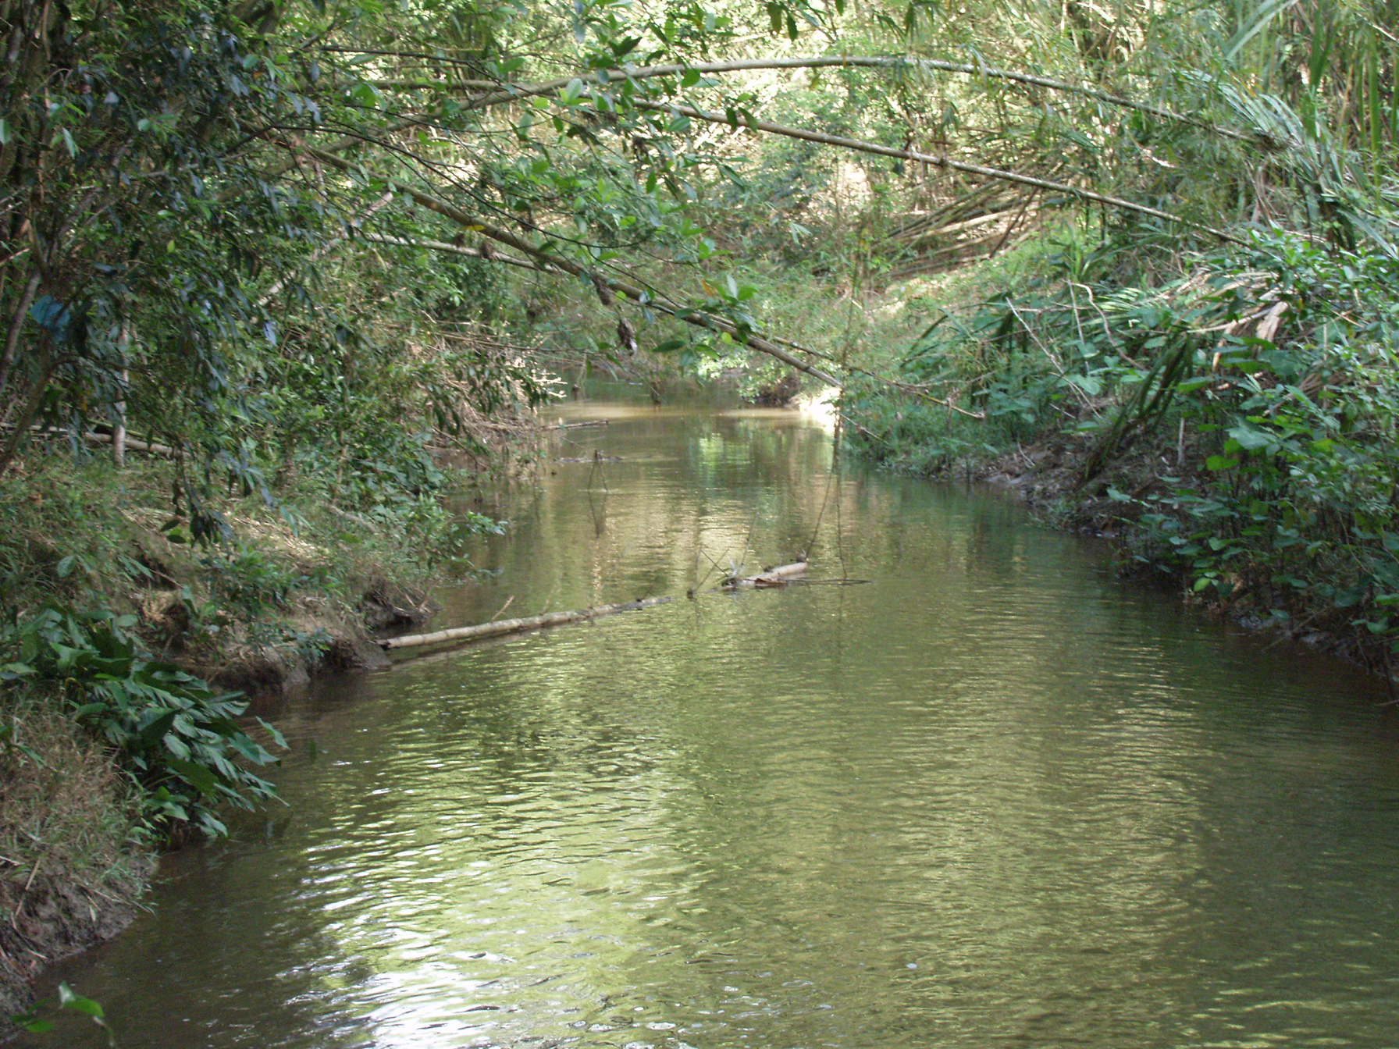
Thank
You

Slide 21
END

