Slide 1
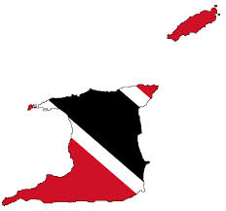
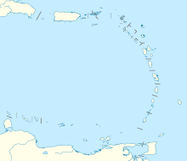
Trinidad and Tobago
AN Experience Beyond Your Imagination

Slide 2
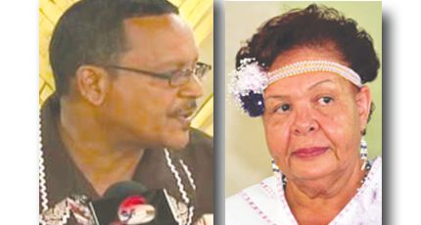
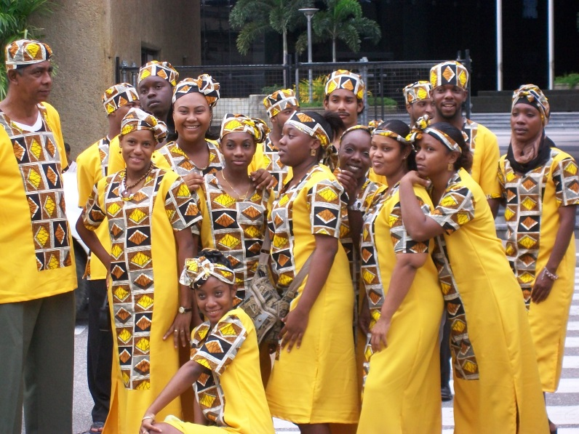

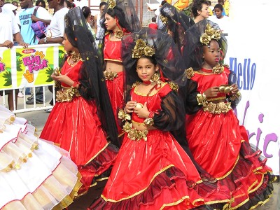
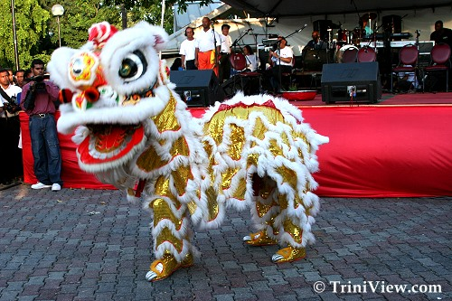
A Rainbow People is what we are called, as our varied ancestry is reflected in the exoctic blend of races seen in all our faces.
Trinidad and Tobago has a rich heritage coloured by our Amerindian, Spanish, African< Indian, Chinese and Portugese ancestors, all of whom have transformed this twin island into a true melting pot of races.

Slide 3
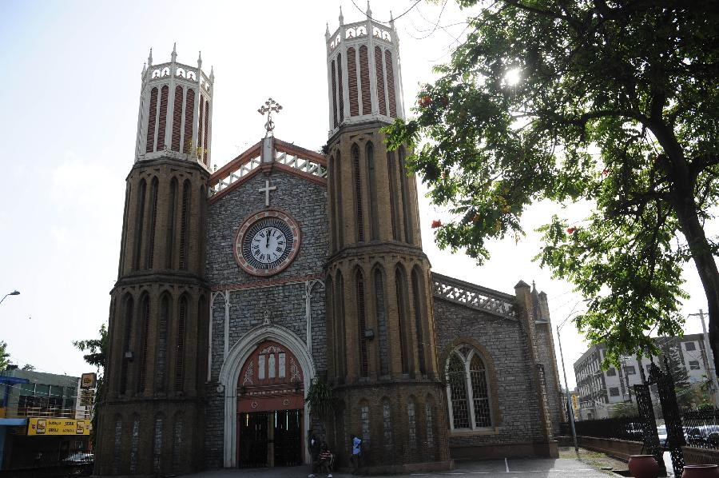
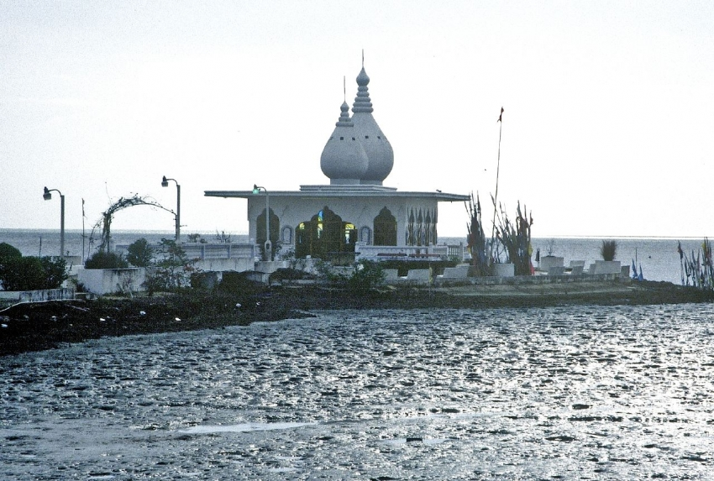
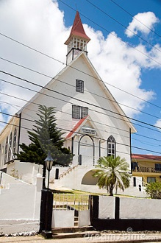
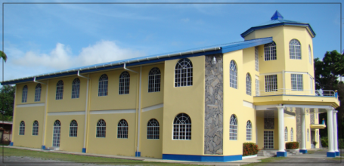
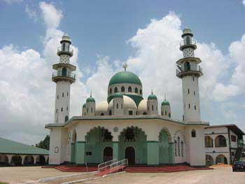
The varied types of places of worship found here are also a reflection of our Cosmopolitan Society.

Slide 4
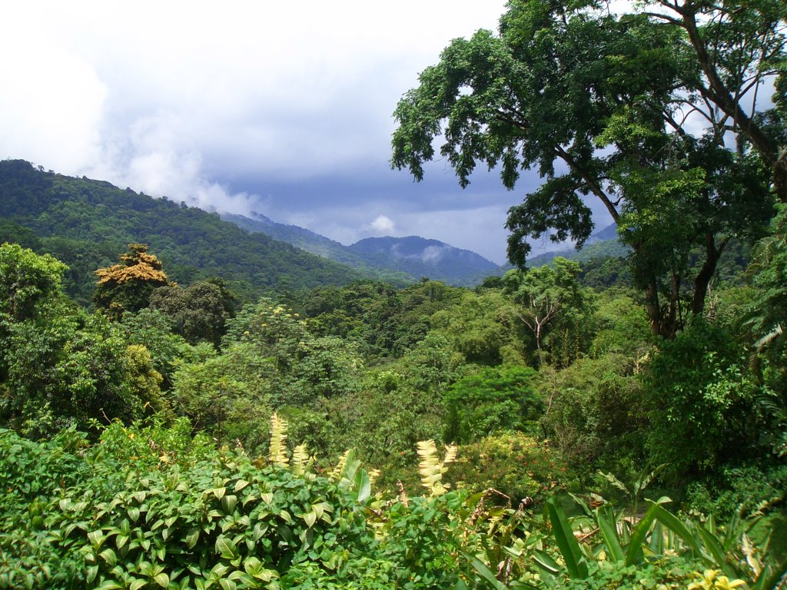
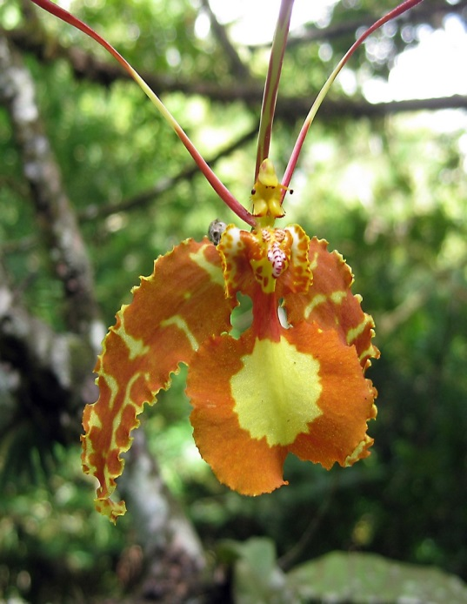
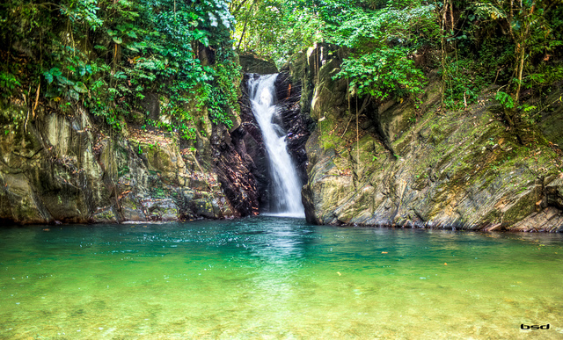

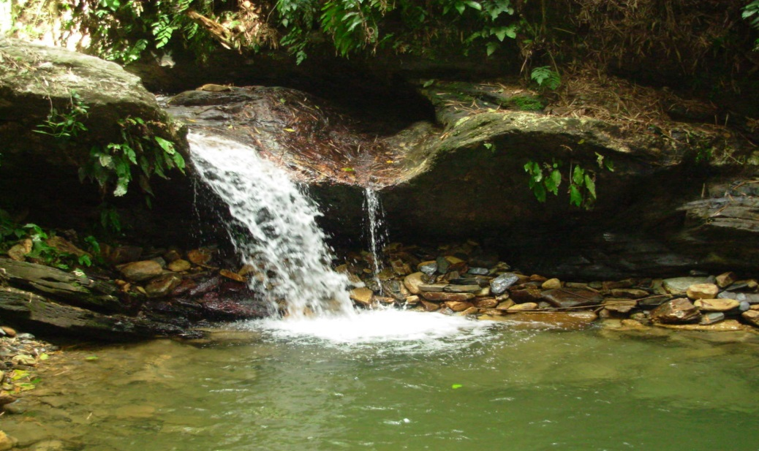

The Rainforest of Trinidad and Tobago is one of the oldest in the Caribbean.

Slide 5
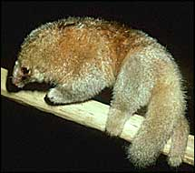

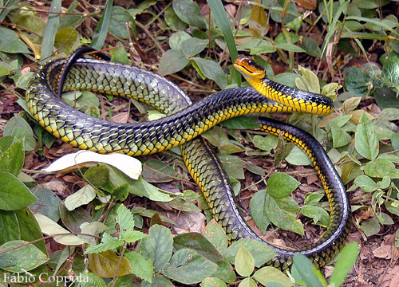

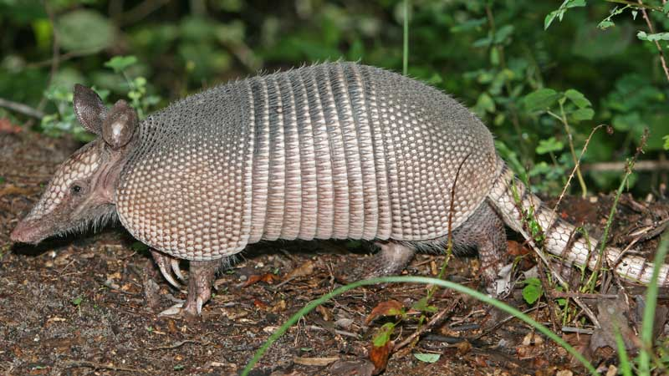
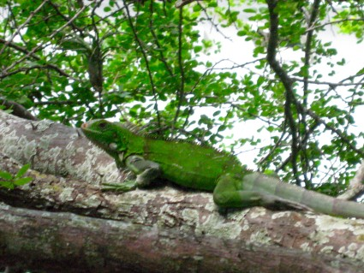
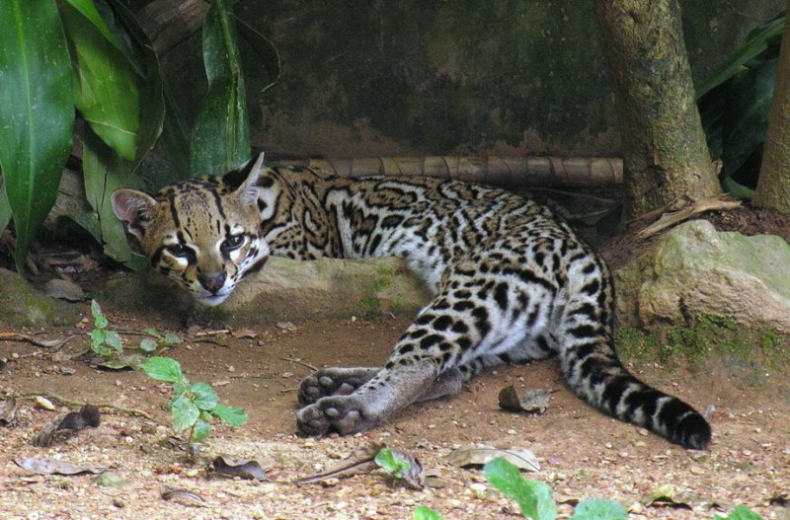
The beauty of our biodiversity is a wonder to be hold.

Slide 6
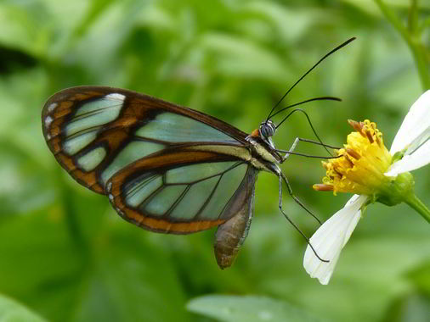
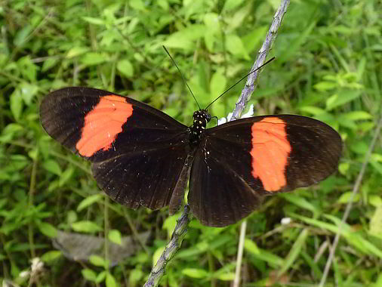

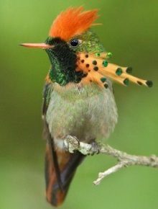

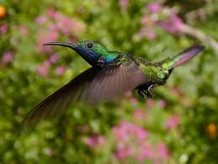
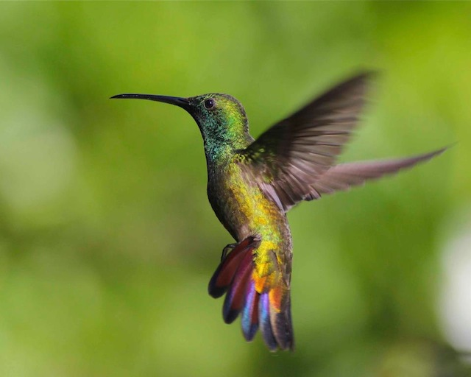
620 species of Butterflies & 16 of Hummingbirds are just the taste of what can be found.

Slide 7
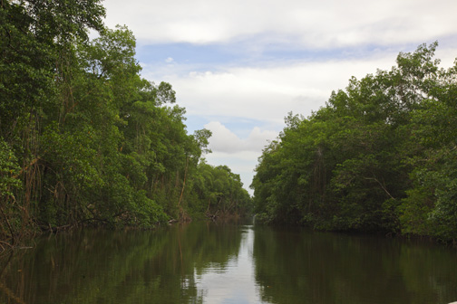
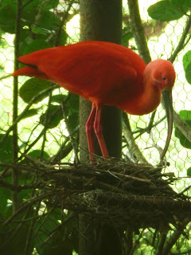
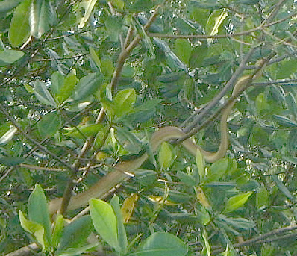
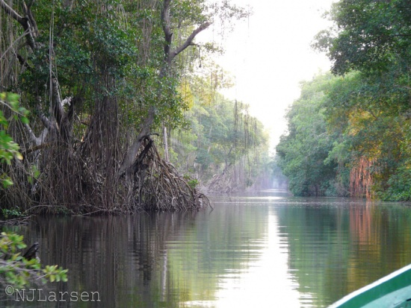
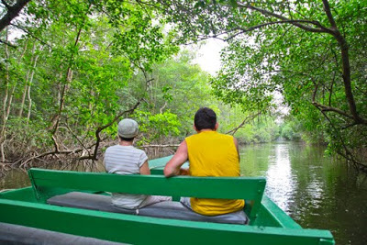
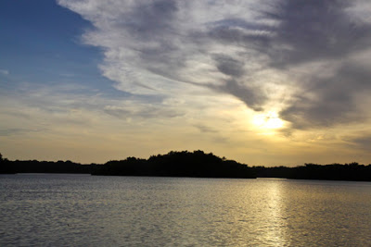
The Caroni Swamp, home to our National Bird the Scarlet Ibis, is a wonderful place to visit.

Slide 8
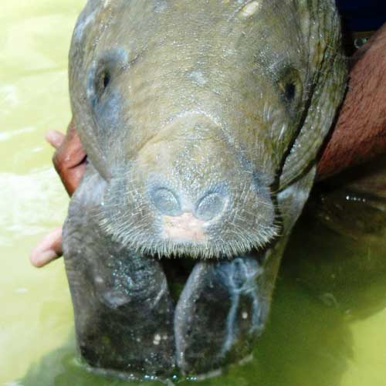
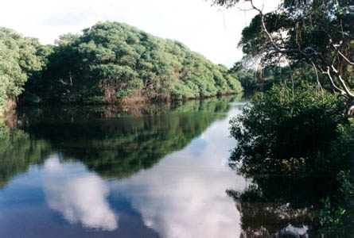
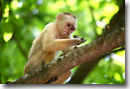
The Nariva Swamp, located on the eastern side of Trinidad, is home to the elusive Manatee among other protected species

Slide 9
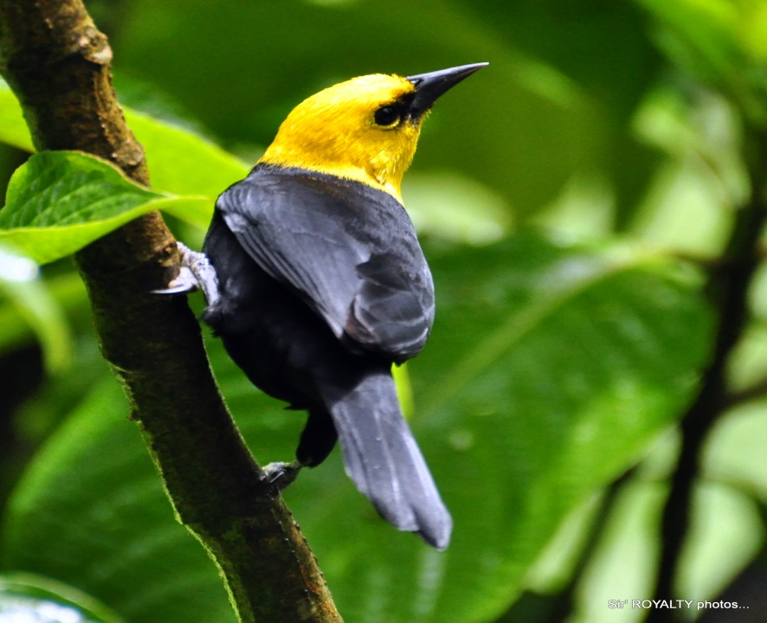
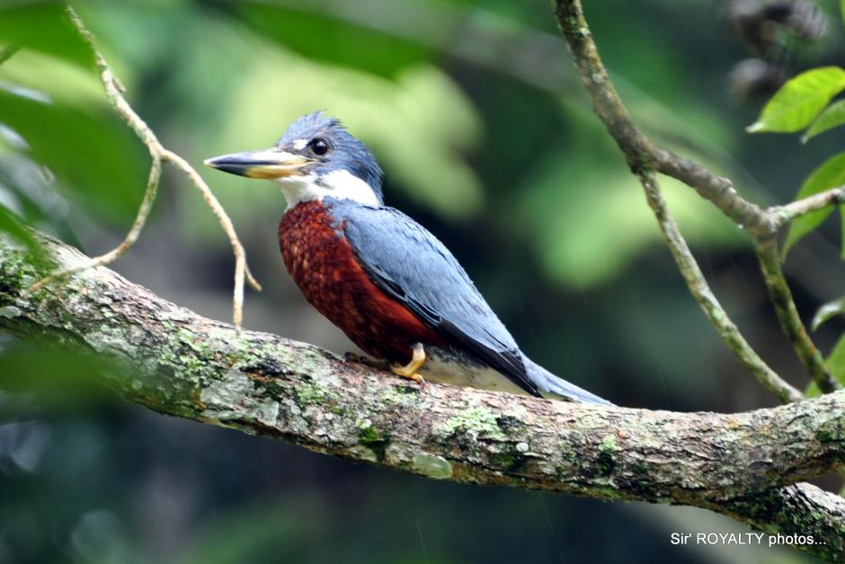
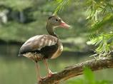
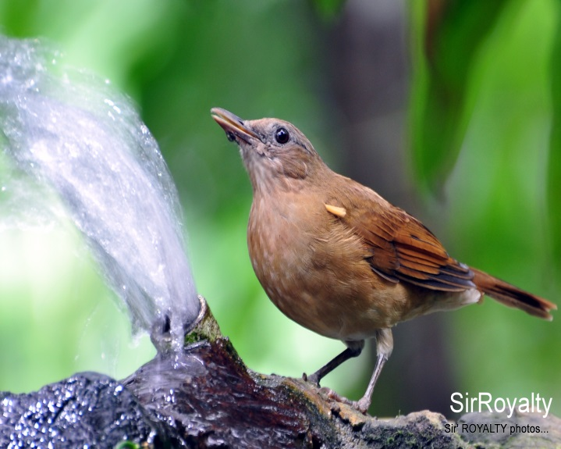
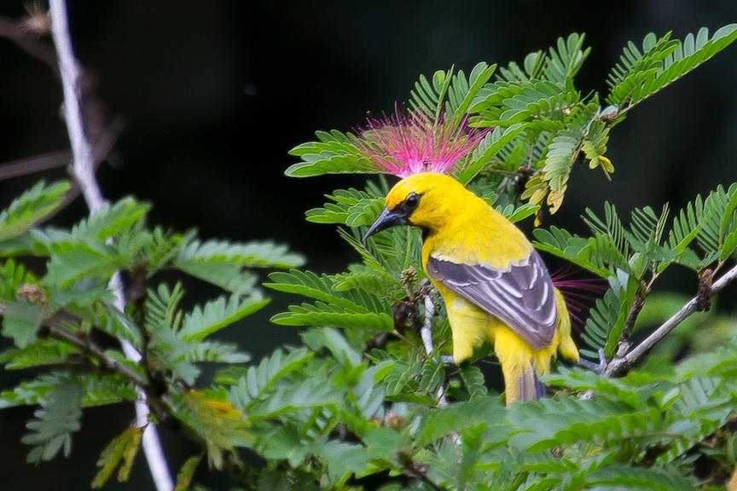
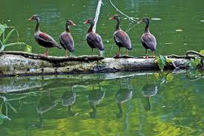
The Pointe-a-Pierre Wildfowl Trust is one of the many nature reserves that can be found on the twin island.

Slide 10
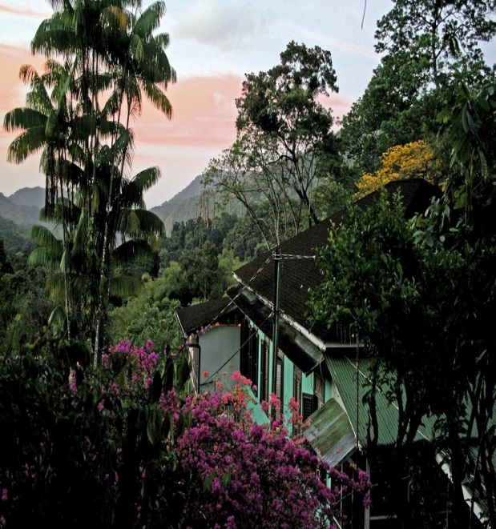
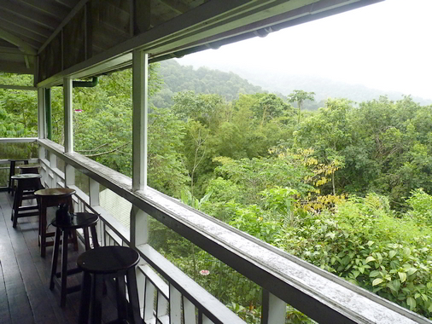
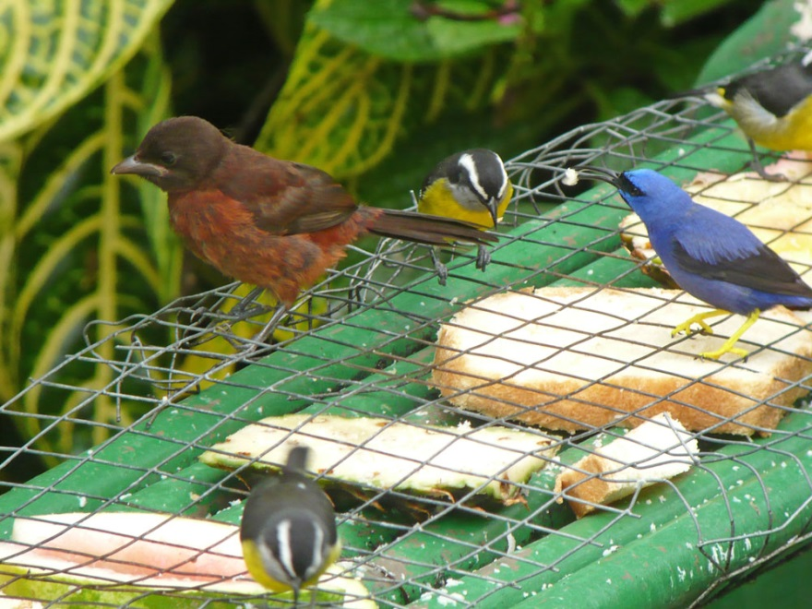


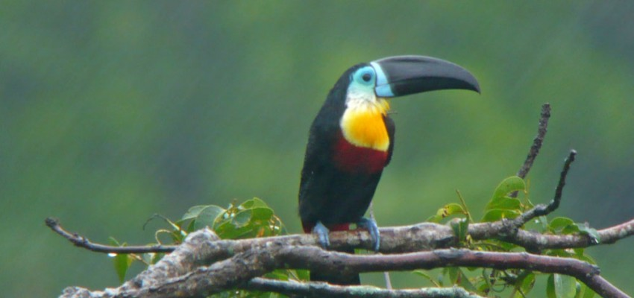
The Asa Wright Nature Centre is another nature resort located in the Northern range.

Slide 11
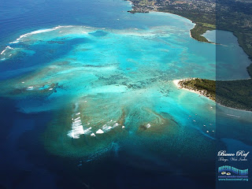
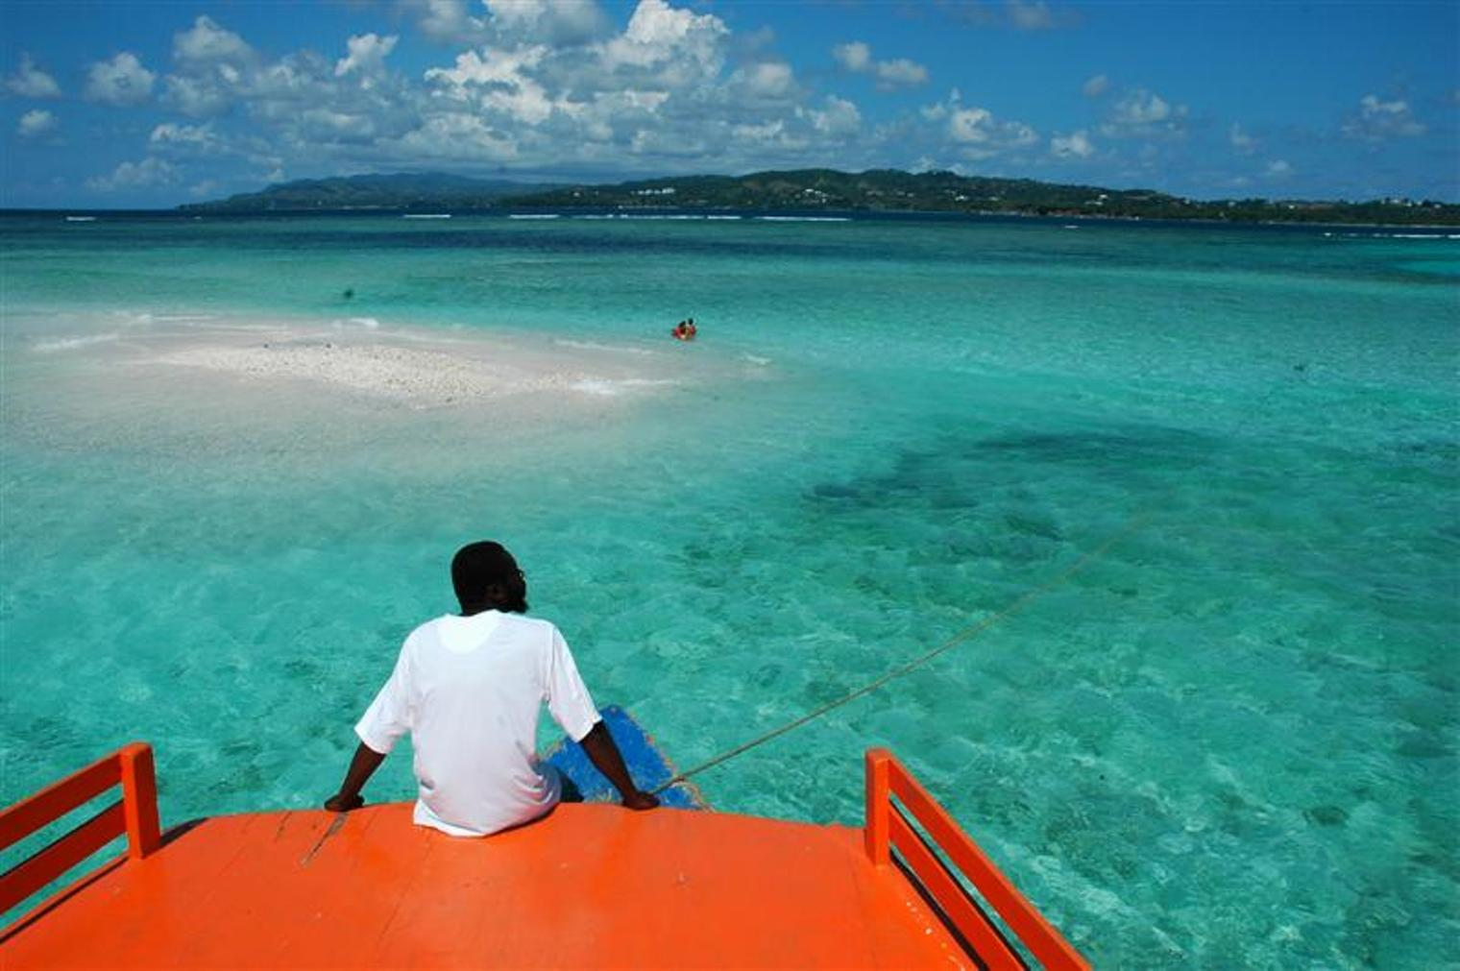
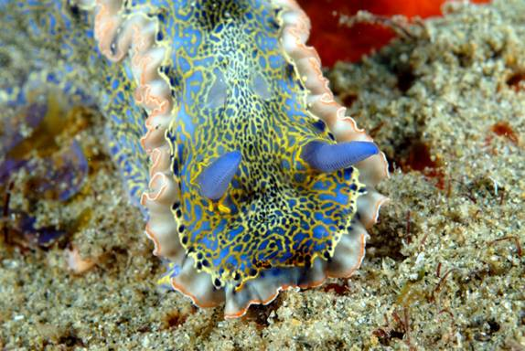
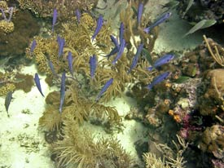
In Tobago, the Buccoo Reef is a beauty to behold.

Slide 12
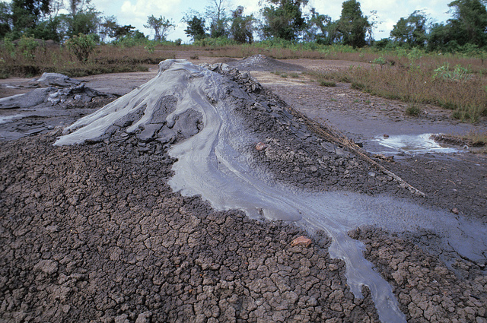
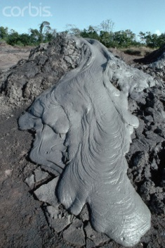

The Devil’s Woodyard is the name of this site which houses a series of mud volcanoes in the south of Trinidad. As legend goes: “The young volcanic site got its name after its first eruption in 1852, Which shook the entire village and fell the tall trees and frightened the Amerindian villagers. Villagers at the time believed that the devil had come from beneath the earth to fell the woods. The mounds of earth which occasionally bubble and hiss continue to amaze visitors of the site."

Slide 13



The Pitch Lake, located in the south of Trinidad, is the largest natural deposit of Asphalt in the world.

Slide 14




Trinidad and Tobago’s Carnival is
The Greatest Show on Earth and birthplace of
CALYPSO and STEELPAN

Slide 15







The Street Parades are enjoyed by both the adults and children.

Slide 16




Then there is PANORAMA
The Largest Steelband Competition in the world.

Slide 17

The Economy
The economy of Trinidad and Tobago is not based however on its natural wonders but on a robust Petrochemical Industry. This is as a result of the large deposits of oil and natural gas within the surrounding seabed.

Slide 18


Trinidad and Tobago
Come visit for yourself and experience an awe inspiring time of your life.

