Slide 1
GLOBE Visualization System
“Vis”

Slide 2
Visualize and Retrieve your Data
Used for mapping data
Focus is on one site, or possibly comparing 2-3 sites
Simple X/Y charts available
Demonstration Topics – Visualization – vis.globe.gov
  Navigate to the visualization system
  The pieces of the visualization system
    Layers, Dates, Filters, Legend, Graphs
  How to view data from a specific protocol on the map
  How to graph and retrieve data for a specific protocol
  Advanced Features
  How to use data counts to find schools that are active in a given protocol
Your Turn
  Activities for you to try with “vis”

Slide 3
The Basics of the Visualization System
Select Goto-> from the top and “Visualize Data”
  Or Go to the homepage and select “Visualize Data”
  Or http://vis.globe.gov
Three Steps to Visualize your Data:
  Select the protocol data you want to see (Add Layers)
  Select the Date you want to see the data for
  Click on a data point on the map to receive table and graph information

Slide 4
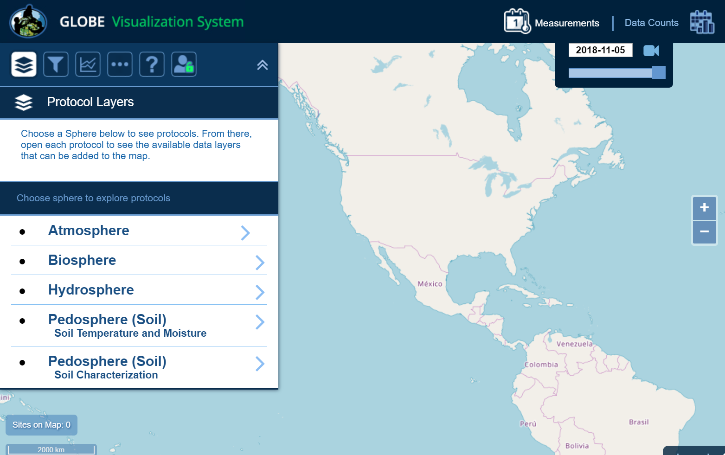
Step 1 – Add Data Layers
Select Which Data to Plot
Start by selecting the Protocol Layers icon, then the sphere your data is in

Slide 5
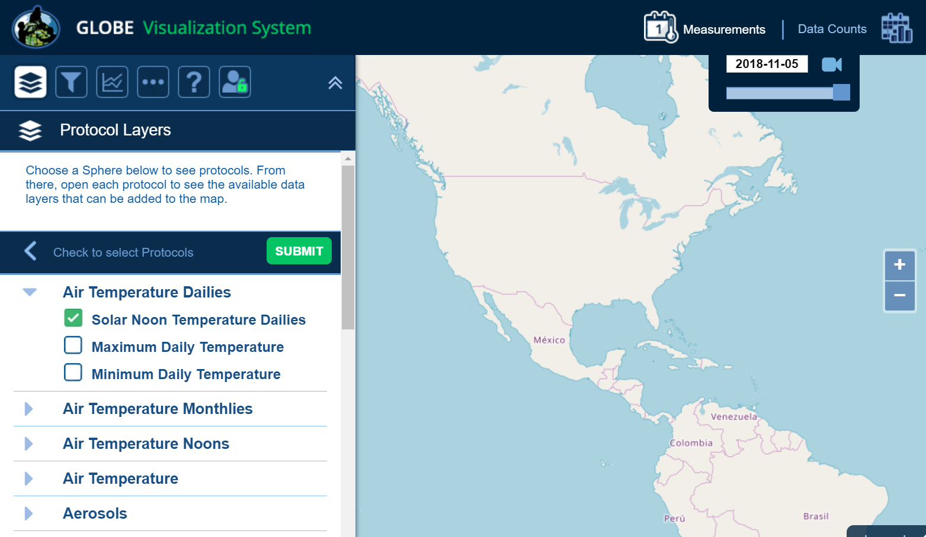
Step 1 – Add Data Layers
Select Which Data to Plot
Select your protocol and “SUBMIT”

Slide 6
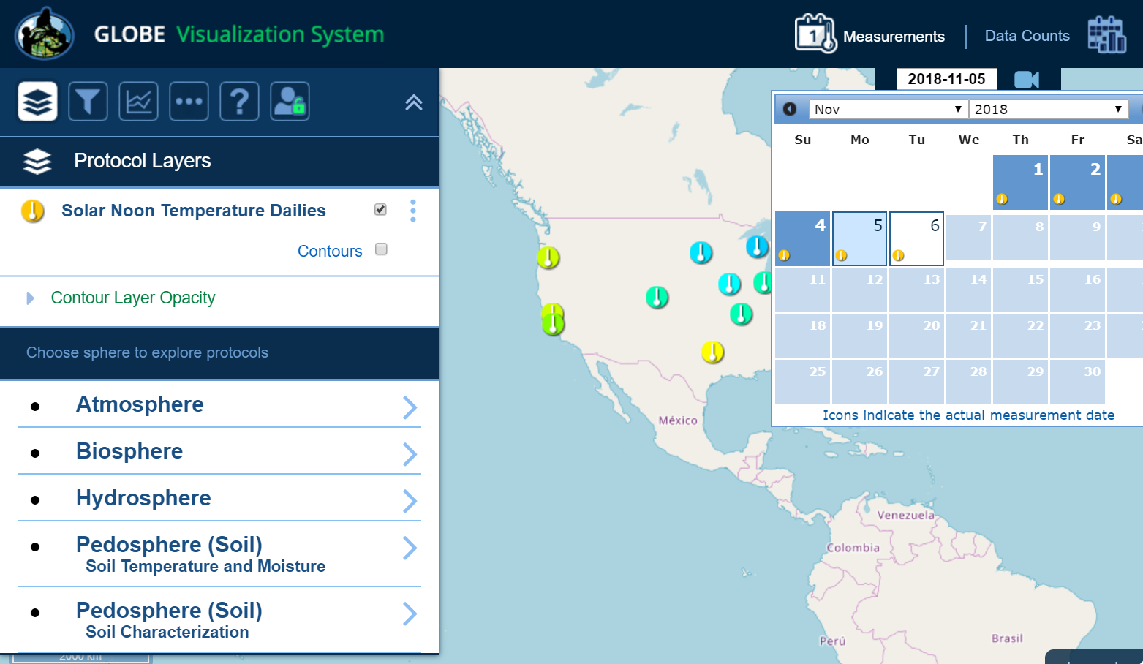
Step 2 – Select the Date
Select the Date
Days which have data will have a small data icon on them

Slide 7
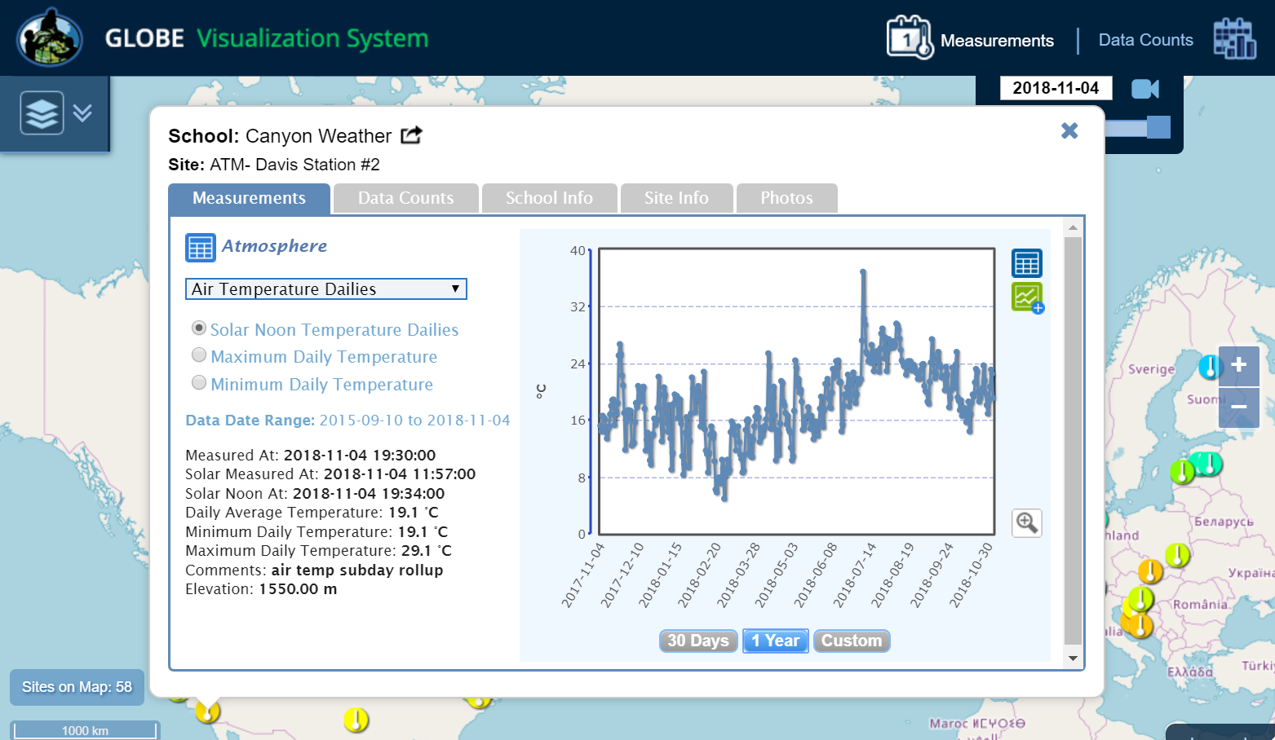

Step 3 – Select the Data Point
Select the Data Point
Click on the data point to see the data at that location

Slide 8
Vis system popup window
See All Atmosphere Data
Go to this School’s Page
See Plot Data in a Table
Add this Data to a Multi-site Plot
Change the X-axis Timeline

Slide 9
Advanced Features
Use Filters - Location/Site/Elevation to find specific locations – school, country, city etc.
Create an animation
Use the graph with the + icon to select multiple data sets to graph
  Allows you to overlay data from multiple sites
Export layers to KMZ format for using with Google Earth and other similar tools

Slide 10
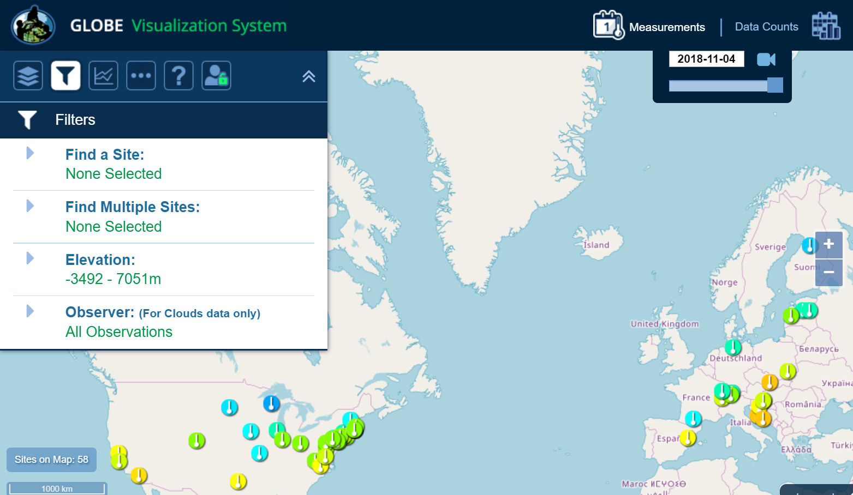
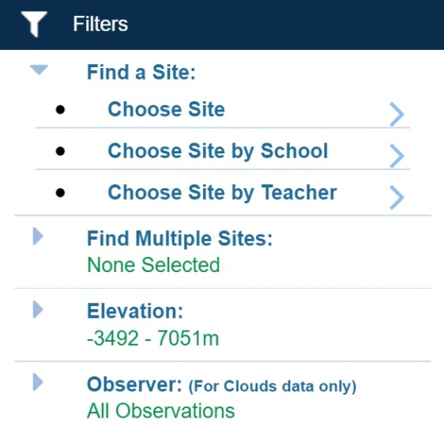
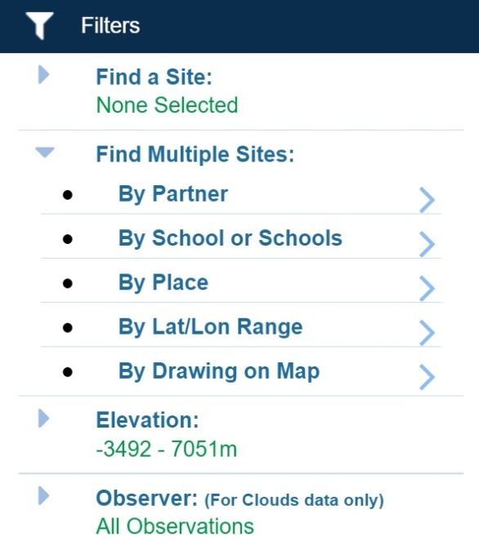
Filter your results
Select Filter Icon
Filter by teacher, school, country, lat/long or other options

Slide 11
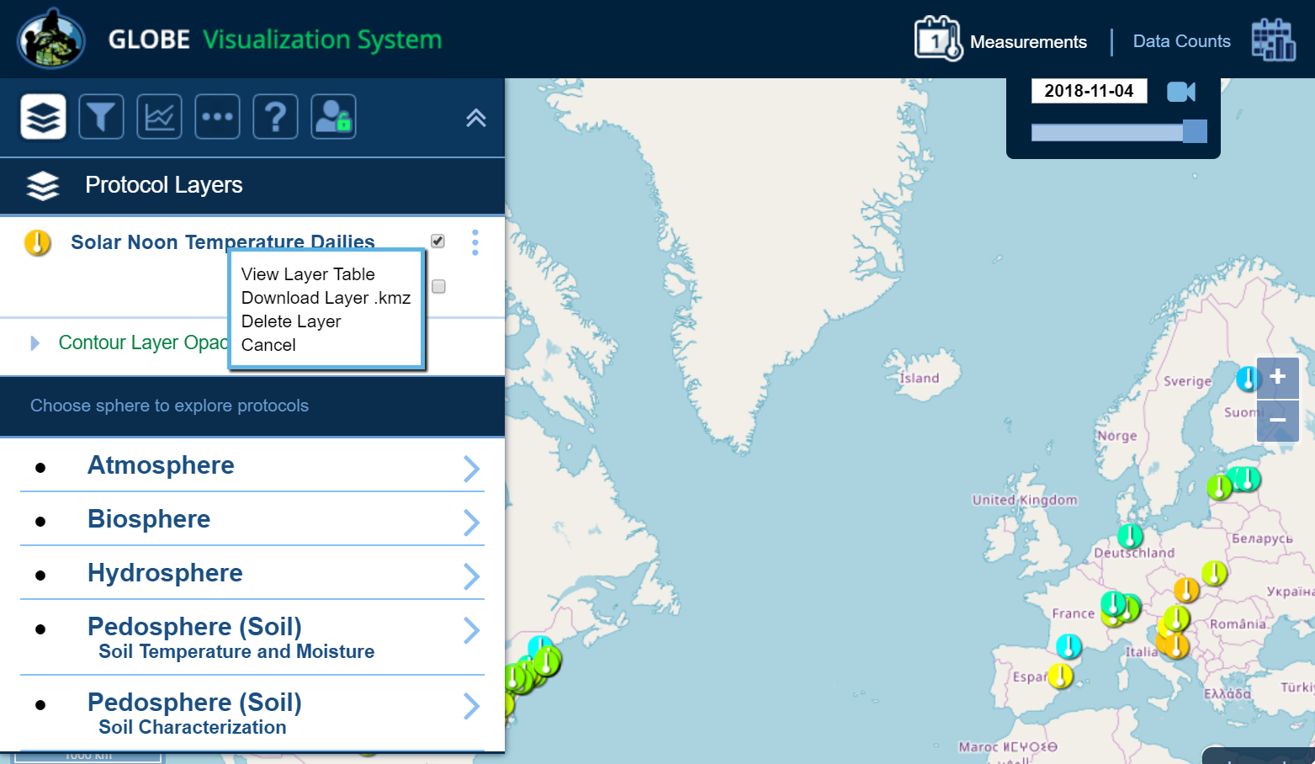
Export Layer
Select Vertical Circles
Any Data Layer can be exported as a table, or downloaded as a KMZ file.

Slide 12
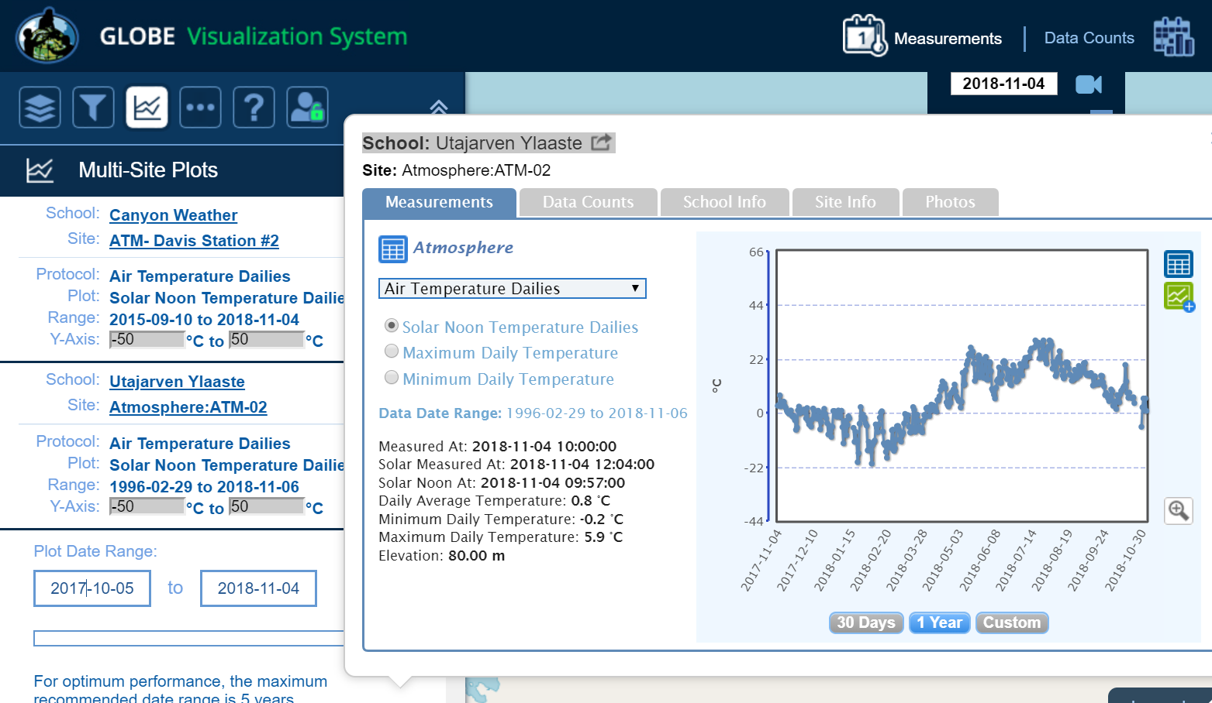
Setup Multi-Site Plot
Overlay multiple plots
Click on the “+” icon in the popup window to select multiple datasets to plot.

Slide 13
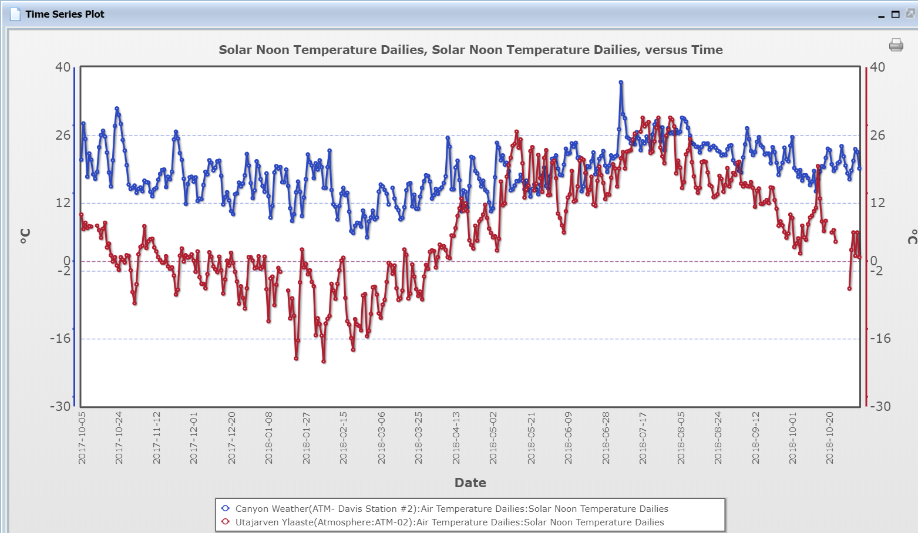
Setup Multi-Site Plot
Multiplot up to 6 data sets
Manual or Auto scale
Choose the time duration you want

Slide 14
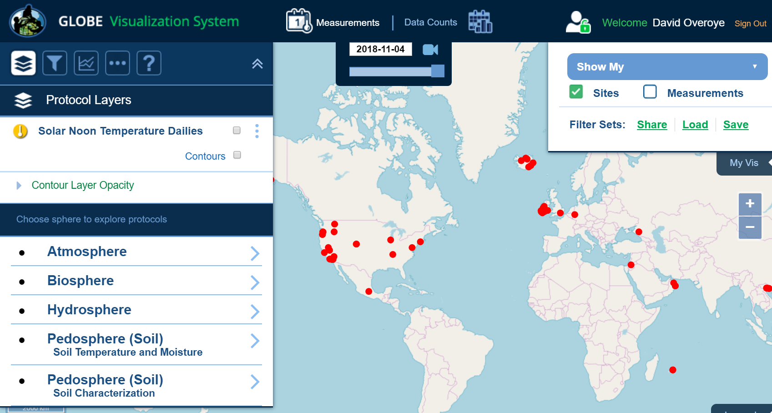
My Vis
Select “My Vis” to show all of my sites, filter the display by my measurements, or share/save/load a set of filters and protocols

Slide 15
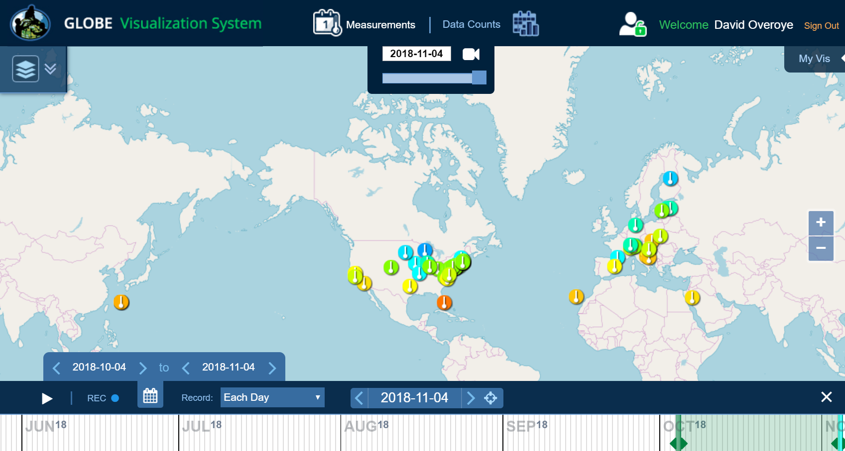
Animating Vis
1) Click on the camera to create an animation
3) Press Play
or use the record icon to save your animation
2) Use the sliders to adjust the date range

Slide 16
Why use Data Counts?
The Data Counts tab tells you how much data a given location has entered in a particular period of time for a given protocol.
Looking for someone to collaborate with? Looking for the most current data? Use Data Counts.

Slide 17
How to Use Data Counts
Select Data Counts on the top menu of the vis system
Select the protocol(s) you are interested in (ie Solar Noon Temperature Dailies)
The map will show the total number of measurements which have occurred at any location since the beginning of the GLOBE program.
Use the Date Range Filter to adjust the date range
Select a site which has data
  You can find the school and teacher if you are interested in collaborating.

Slide 18
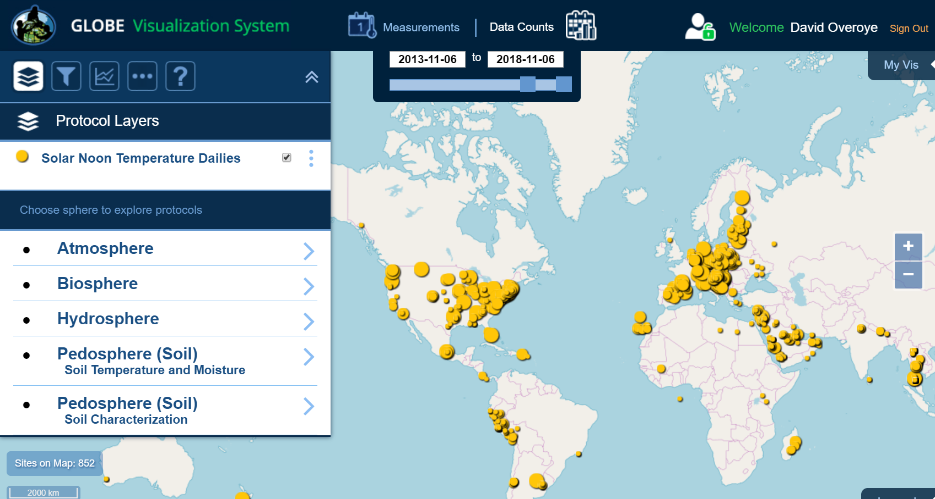
Data Counts
Data counts show how much data was entered at any site for the selected period of time
Bigger dots = More Data
Select Data Counts and a Time Range
Data Counts
Use Data Counts to see which sites have the most data in the selected time frame

Slide 19
Demonstration
Select Air Temp
Choose “yesterday”
Choose a point over Zagreb
Plot the Daily Average temp
Expand to 1 year
Show how to get the data, share the data, go to the school.
Show how to switch protocols in the popup to see the data in other protocols for this school
Show data counts, school info, site info, photos
Clear and show Clouds Data with photo and satellite overlays for “yesterday”
Clear and go to Data Counts for Daily Average Temperature
Change Date range to 2019-01-01 to 2020-01-01
Compare temperature for two schools with a lot of data - X. gimnazija “Ivan Supek” near Zagreb with Prirodoslovna-tehnička škola in Split. What does this tell you about the differences between the two locations?

Slide 20
Your Turn – Weather Tourist
It’s time for a vacation – find a GLOBE School you’d like to visit and determine the best date range to visit based on temperature and humidity.
Ideally - Temperature should be 21-24C with 40-60% humidity.
Go to vis.globe.gov and select Air Temperature Daily Average Layer
Use “Data Counts” for 2019-01-01 to 2020-01-01 and find a large circle – indicating a lot of data is available for the place you’d like to visit.
Click on the large circle and verify there is data available during the year (remember data counts defaults to show 5 years)
Switch to the Measurements Tab in the popup window and plot Air temperature (daily average). Click the + icon to add air temperature to the multiplot.
Switch to Relative Humidity from the pulldown on the popup window and add that to the multiplot
Select Plot All to make your multiplot with temperature and humidity.
Find the best time to visit if you want it to be about 21-24C with 40-60% humidity

Slide 21
Your Turn – Weather Tourist Alternative
Come to Los Angeles!
It’s time to visit Los Angeles. If you want to visit when the temperature is 21-24C and the humidity is 40-60%, what’s the best time to visit?
Add the Air Temperature/Daily Average layer
Zoom in to southern California/los angeles (south west coast of US) and find Canyon Weather (how else could you find this school?)
Use vis to make display a plot of temperature with time and click the green + to add it to a multiplot
Switch to relative humidity and click the green + again to add it to the multiplot
Set the multiplot time range for 2020-01-01 to 2021-01-01 and change the temperature scale to 0 to 50 C, then plot
Use the Multiplot to plot temperature and humidity at the same time and examine the plot
When should you visit?

Slide 22
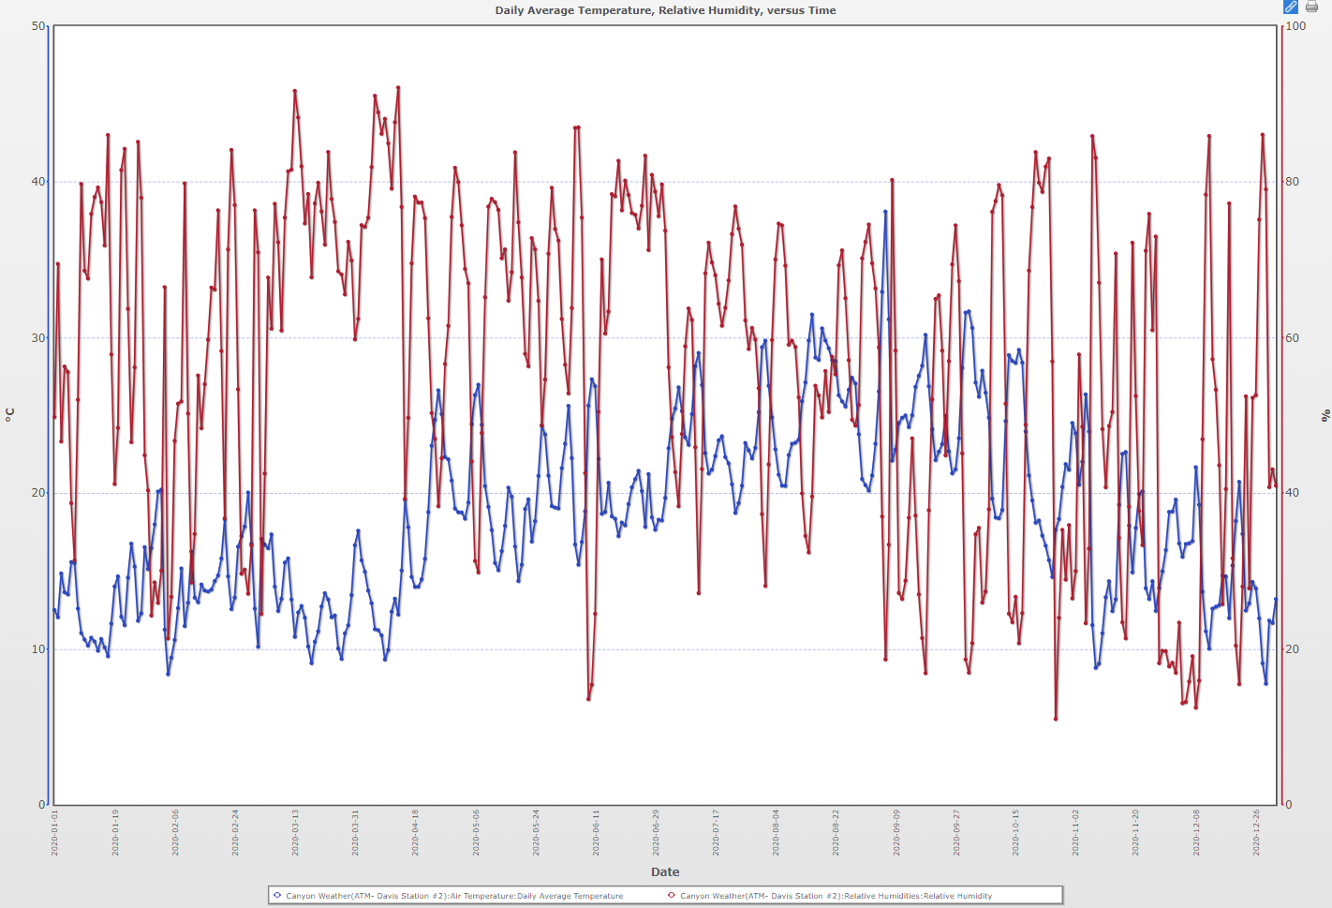
Canyon Weather (Los Angeles, Ca) Multiplot

Slide 23
Your Turn – Compare Temperatures from 2 regions
Select the Air Temperature data for Prirodoslovna-tehnička škola in Split, Croatia and click the green “+” to setup a multi-site plot
Select the Air Temperature data for Colegio Madres Dominicas in Chile
Setup the plot for the date range 11/01/2021 to 3/01/2022, and the axis for 0 to 50 C
  How would you describe the differences or similarities in the temperature between Croatia and Chile during this time (Winter)

Slide 24
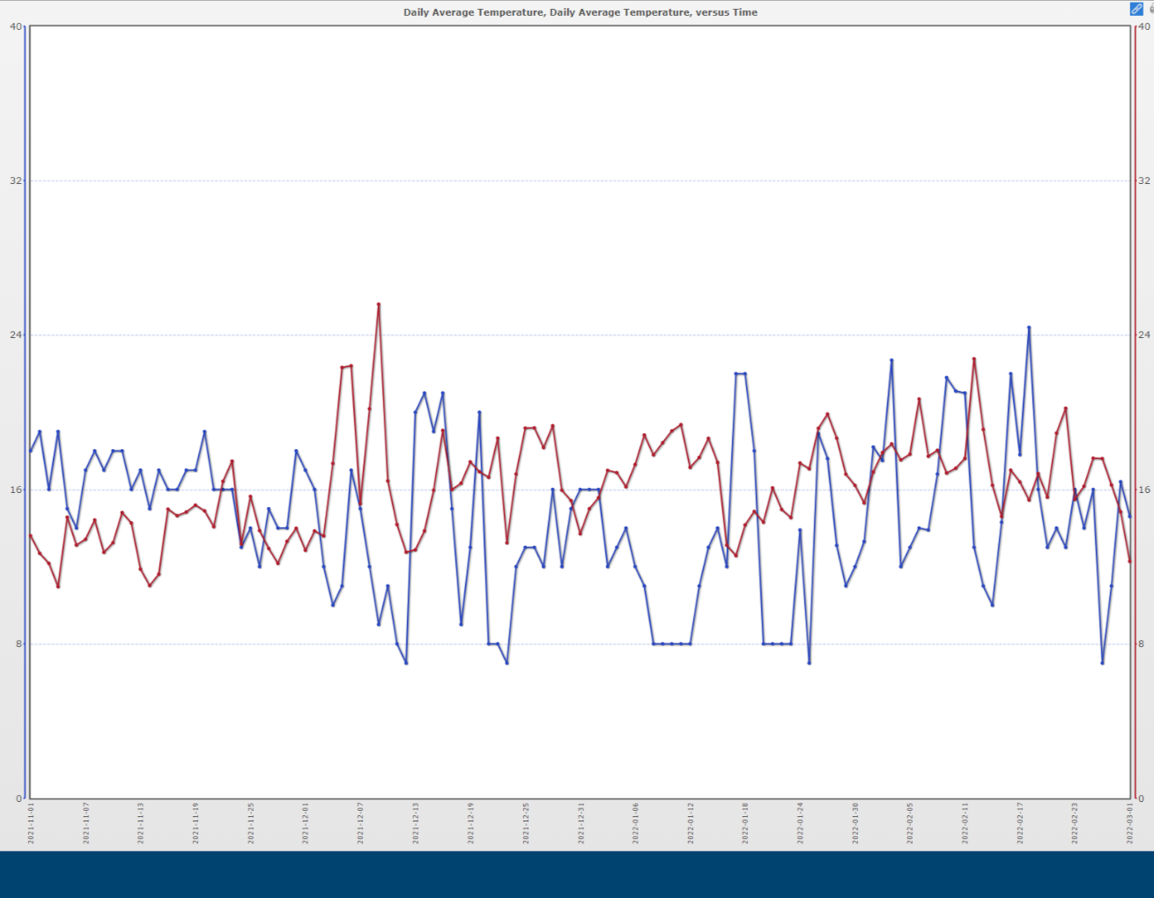
Compare Croatia to Chile 2021-11-01 to 2022-03-01
Blue=Croatia
Red=Chile

Slide 25
Now change the date range to be 10/01/2021 to 10/01/2022
  How would you describe what you see now?
  What do you think is happening?
  What does this tell you about the importance of obtaining longer term data?

Slide 26
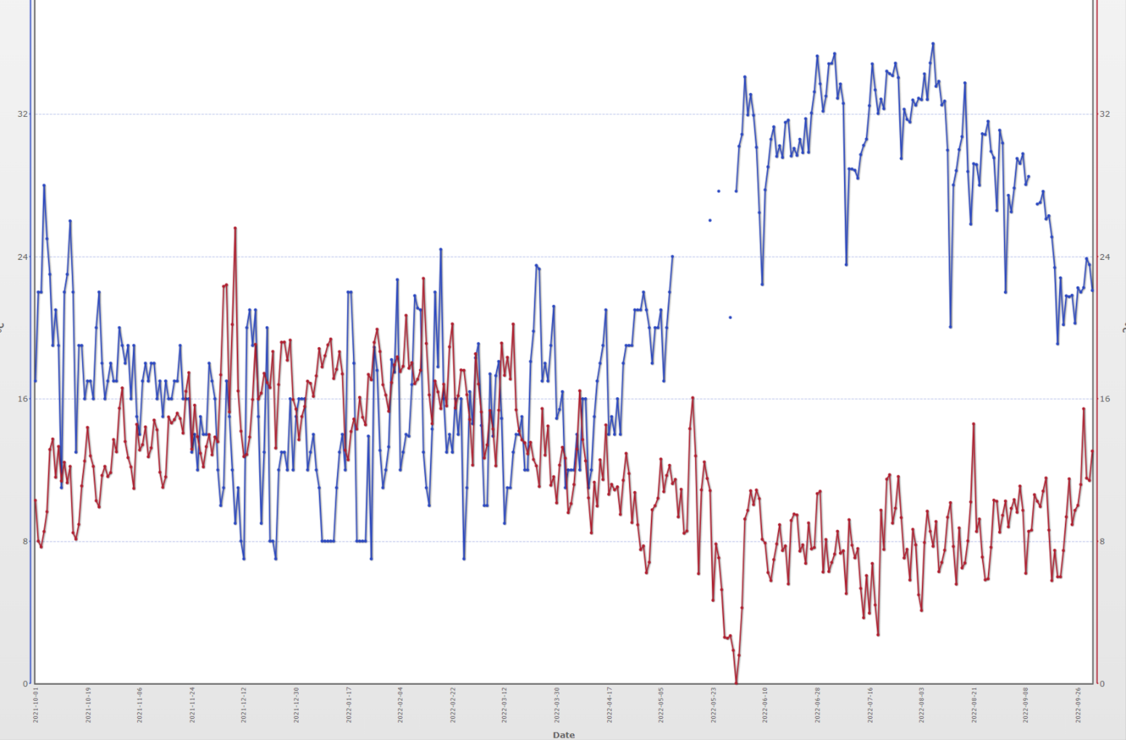
Compare Croatia to Chile 2021-10-01 to 2022-10-01
Blue=Croatia
Red=Chile

Slide 27
Questions?

