Slide 2
Overview
This module:
Reviews the selection of a GLOBE hydrology site
Reviews the water sampling technique used in GLOBE hydrology protocols
Guides the construction of the necessary instrument for this protocol
Provides a step by step introduction of the protocol method
Learning Objectives
After completing this module, you will be able to:
Define water transparency and explain how environmental variables result in different transparency measurements
Understand how the protocol procedures ensure the collection of accurate data
Conduct transparency measurements in the field
Upload data to the GLOBE portal
Visualize data using GLOBE’s Visualization Site

Slide 3
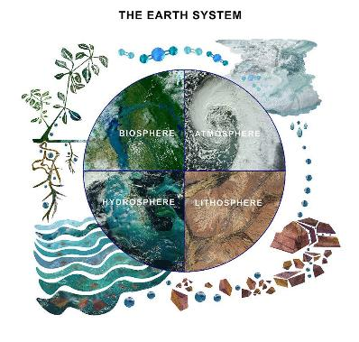
The Hydrosphere
The hydrosphere is the part of the Earth system that includes water, ice and water vapor. Water participates in many important natural chemical reactions and is a good solvent. Changing any part of the Earth system, such as the amount or type of vegetation in a region or from natural land cover to an impervious one, can affect the rest of the system. Rain and snow capture aerosols from the air. Acidic water slowly dissolves rocks, placing dissolved solids in water. Dissolved or suspended impurities determine water's chemical composition.
Current measurement programs in many areas of the world cover only a few water bodies a few times during the year. GLOBE Hydrosphere protocols will allow you to collect valuable data to help fill these gaps and improve our understanding of Earth's natural waters.
The Earth System: Energy flows and matter cycles.

Slide 4
Hydrosphere Protocols
What is the condition of Earth’s many surface waters – the streams, rivers, lakes, and coastal waters? How do these conditions vary over the year? Are these conditions changing from year to year? These are questions that are answered by the hydrosphere investigations in the GLOBE program.
Water Transparency is one the measurements used by GLOBE to describe the status of a water body. Water Transparency measures depth of light penetration into the water.
Water transparency depends on the amount of suspended particles. These can be organic, such as phytoplankton and algae, or inorganic, such as sediments, as well as other dissolved impurities such as organic or inorganic carbonates. These particles contribute to both the color and the transparency of the water.
GLOBE Hydrosphere Measurements
Hydrosphere Study Site
Water Temperature
Water Transparency
Conductivity
pH
Mosquito Larvae
Alkalinity
Dissolved Oxygen
Salinity
Nitrates
Freshwater Macroinvertebrates

Slide 5
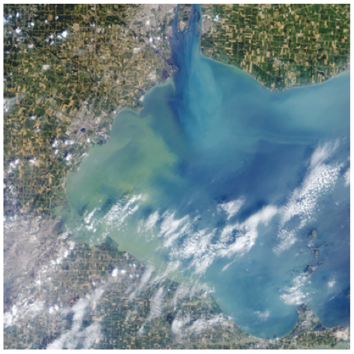
Water transparency describes water clarity. It is measured by determining the the depth of light penetration into the water column from the surface.
The Operational Land Imager (OLI) on the Landsat 8 satellite captured this view of an algae bloom, Lake Erie, August 2014.
Algal blooms such as this significantly reduce water transparency and contaminate onshore drinking water.
Image: NASA

Slide 6
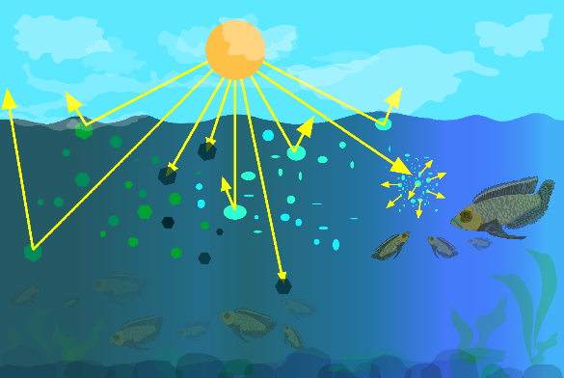
What is Water Transparency?
Particles in the water will reflect, absorb or scatter light, thus determining the depth at which more light can’t penetrate. This is called the extinction depth. The Water Transparency Protocol measures the light extinction depth of the water in your selected Hydrology Investigation Site.

Slide 7
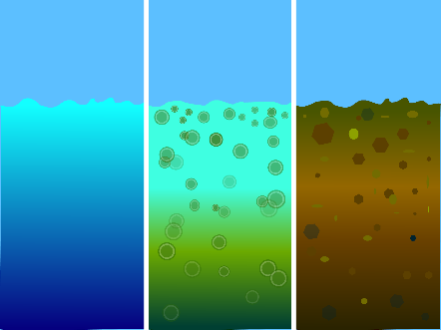
What is Water Transparency?
Suspended particles in our water behave similarly to dust in the atmosphere. They reduce the depth to which light can penetrate. Sunlight provides the energy for photosynthesis (the process by which plants grow by taking up carbon, nitrogen, phosphorus and other nutrients, and releasing oxygen). How deeply light penetrates into a water body determines the depth to which aquatic plants can grow.
Transparency decreases with the presence of molecules and particles that can absorb or scatter light. Dark or black material absorb most wavelengths of light, whereas white or light materials reflect most wavelengths of light. The size of a particle is important as well. Small particles (diameters less than 1 μm) can scatter light.
Blue/Cloudy
suspended carbonates scatter blue-green light
Green
algae and phytoplankton
Brown
sediments

Slide 8
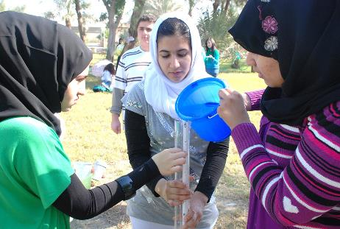
Why Collect Water Transparency Data?
In most countries current measurement programs cover only a few water bodies a few times during the year. As a consequence, the archives of GLOBE hydrology data provides important data about water chemistry and water quality not found elsewhere.
By taking measurements over time in multiple locations, it is often possible to determine the times of year and the source of pollution, for instance, and if necessary, remediate the situation to improve water quality.

Slide 9
Why Collect Water Transparency Data?
Water transparency changes over time in response to environmental factors.
Suspended particles such as phytoplankton, zooplankton, sediment, organic matter...) are optically active components and their density and distribution varies over time. Erosion and run off during a storm is one source of sediment particles. The influx of nutrients such as phosphorus into a water body can cause an algal bloom, greatly increasing the density of these organisms.
The more suspended particles, the less transparency
An increase in suspended particles in a water body will decrease transparency, and light will be unable to penetrate into deeper water.
Light energy is needed by plants to conduct photosynthesis
Less light penetration into the water will affect the health of organisms living in the water body.
Water transparency affects water quality
Suspended particulates impact water quality, both for human consumption and for use by aquatic organisms

Slide 10
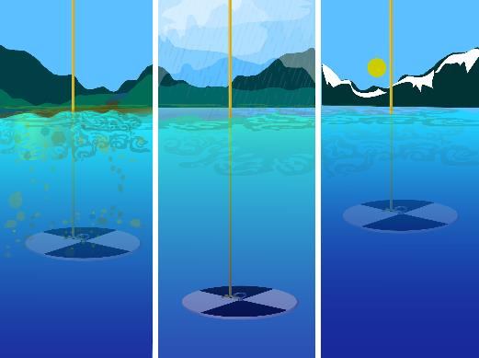
Scientists measure water transparency to determine water body health.
Measurement of water transparency allows scientists to calculate inputs from erosion and nutrients. By taking measurements over time in multiple locations, it is often possible to determine the source of the inputs, and if necessary, remediate the situation to improve water quality.

Slide 11
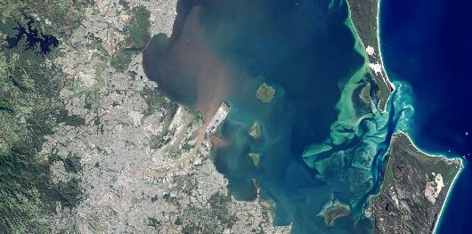
How Your Measurements Can Help
Credit: NASA Earth Observatory
Your observations are valuable contributions to the scientific community and may be used by educators, students, researchers, and the general public to increase environmental awareness and STEM literacy, as well as advance Earth system science. Here is an example of how this might be done for transparency.
Water transparency and color can be observed in satellite imagery. In May 2015, the east coast of Australia was hit by a severe storm and deadly flooding, dropping more than 360 millimeters (14 inches) of rain within about three hours in southeast Queensland, Australia. This image of the Brisbane River entering Moreton Bay was acquired on May 3, 2015 by the Operational Land Imager on Landsat 8.
As a result of the rainfall, flash flooding caused distinct river plumes to form along the coastline. Flood waters usually contain elevated levels of sediment and colored dissolved organic matter (CDOM). Sediment tends to scatter red light, and CDOM absorbs blue light. As a result, a brown color is visible where the Brisbane River mouth where these two optical phenomena work in concert. Further from the mouth, the coarser sediments tend to settle to the bottom but the CDOM is still observed in the water column absorbing blue light. What is coloring the yellow-green patches in the water? Scientists believe it is CDOM, but ground verification is needed to be sure.

Slide 12
How to Collect Your Data
Simultaneous or Prior Investigations Required to do Water Transparency Measurements
You will need to define your Hydrosphere Study Site. A Hydrosphere Study Site can be any surface water site that can be safely visited, although natural waters are preferred.
Sites, in order of preference, may include:
Streams or rivers
Lakes, reservoirs, bays or ocean
Pond
Irrigation ditch or other water body, if those above are not available
The Hydrosphere Investigation Data Sheet is used to record all the hydrosphere measurements, including Water Transparency. You will also want to map your Hydrosphere Site at some point.
To define you study site you will need these documents:
Selecting and Documenting your Hydrosphere Study Site
Hydrosphere Investigation Data Sheet
Mapping your Hydrosphere Study Site Field Guide

Slide 13
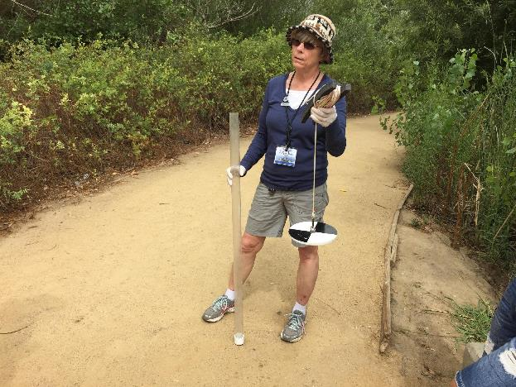
Determine Which is Appropriate for Your Water Body: Secchi Disk or Transparency Tube?

Slide 14
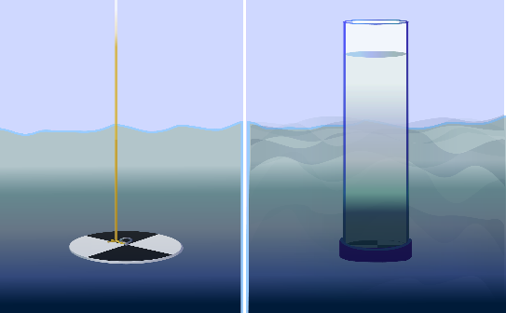
How to Collect Your Data: Select Appropriate Instrument
First, determine if your study site has deep, still water or shallow and/or flowing water. If the water is deep and still, you will use a Secchi Disk for your water transparency measurements. If the water is shallow or flowing, you will use a Transparency Tube (also called a Turbidity Tube). If you will be using the Secchi Disk, use instructions in the the Water Transparency Secchi Disk Field Guide.
Secchi Disk used with deep and still water
Transparency Tube used with shallow or Flowing water

Slide 15
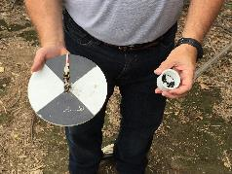
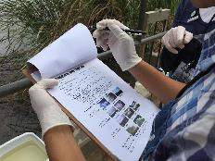
Secchi Disk Protocol Overview
Assemble field equipment
Collect site data
Conduct cloud type and cloud cover measurements
In the Field: Take the measurements using a Secchi disk
Repeat 3 times to ensure accuracy and precision
Verify that the data from the three measurements are within 10 cm of the mean, (but do not average your data for reporting)
Report your data to the GLOBE Citizen Science website

Slide 16
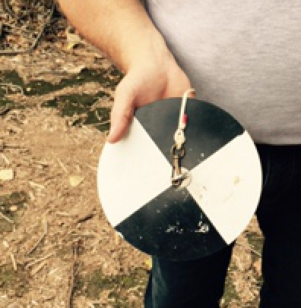
Time Requirements
Time to complete protocol: About 10 minutes
Frequency: Ideally, weekly measurements at the same sampling site
.
Ease of Protocol: Beginner Level

Slide 17
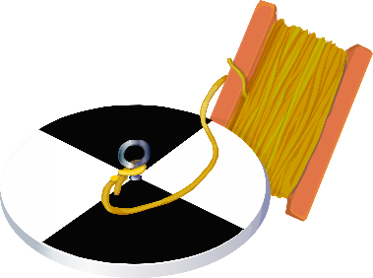
Assemble Field Equipment
Secchi disk
with rope attached
Latex or Nitrile gloves
Permanent marker or pencil
Meter stick
Clothespins (optional)

Slide 18
Assemble Field Documents
Before measuring water transparency cloud type and cover must be measured for the site. Measurement of water transparency must be done in the shade to avoid sun glare and differences in visibility.
What You Need:
Hydrosphere Investigation Data Sheet
Cloud and Contrail Cover Protocol Field Guide
Cloud and Contrail Type Protocol Field Guide
Globe Cloud Chart

Slide 19
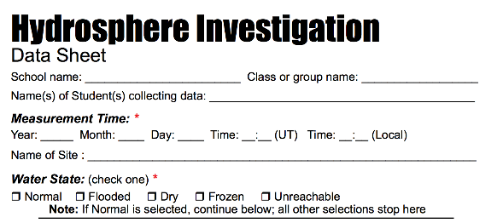
In The Field
Fill out top portion of Hydrosphere Investigation Data Sheet
(or app) (will need citizen science version w/o school, class and student)

Slide 20
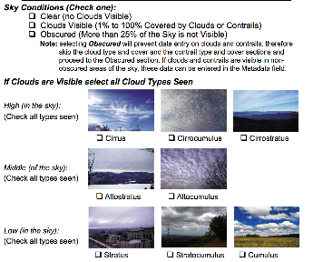
In The Field
On data sheet, characterize the sky conditions and clouds

Slide 21
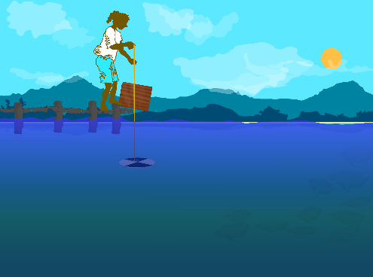
In the Field
Stand so that the Secchi disk will be shaded or use an umbrella or cardboard to shade the measurement area.
If you cannot reach the water surface, establish a reference height. This can be a railing, a person’s hip, or the edge of a dock. All measurements should be taken from this point.
SAFTEY Before lowering the Secchi disk put on Latex or Nitrile gloves

Slide 22
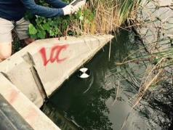
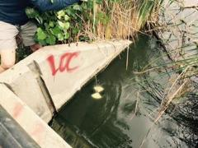
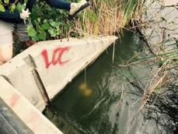
In the Field
Lower the Secchi disk until it disappears.

Slide 23
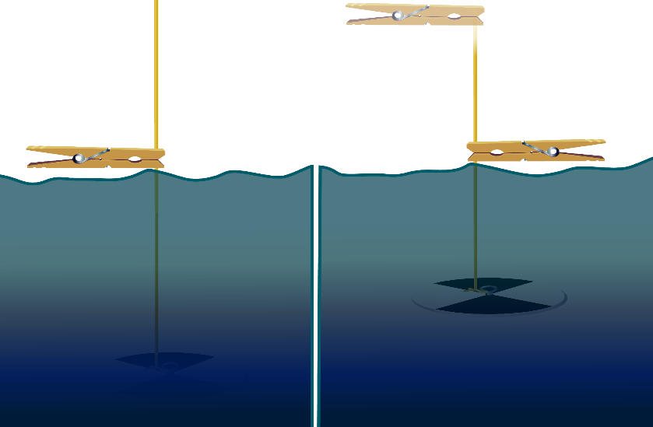
In the field • Deploy the Secchi disk
1. Lower disk
into the water until it just disappears
2. At water surface mark rope with clothespin
3. Lower disk again
another 10 cm into water
4. Raise disk
until it reappears
Tip: If you can’t reach the water surface
from where you are standing, mark the
rope with a clothespin at your reference
height (such as a dock).

Slide 24
Record your data
There should now be two points marked on the rope. Record the length of the rope between each mark and the Secchi disk on your Hydrosphere Investigation Data Sheet to the nearest cm.
If you marked the rope at the water surface, record “0” as the distance between the observer and the water surface.
If you marked the rope at a reference point, lower the disk until it reaches the surface of the water and mark the rope at the reference point. Record the length of the rope between the mark and the Secchi disk as the distance between the observer and the water surface.
distance from reference point to surface of water
Secchi depth

Slide 25
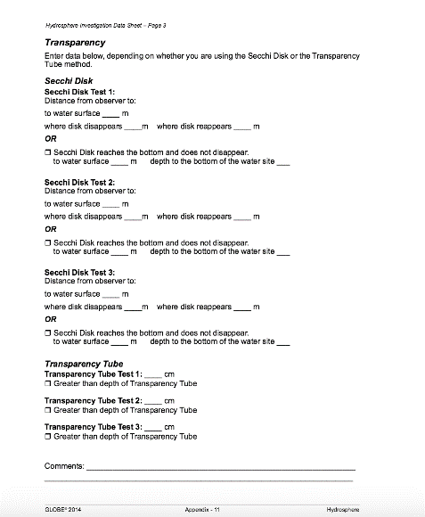
Repeat the Secchi disk measurement for a total of 3x and record your data

Slide 26
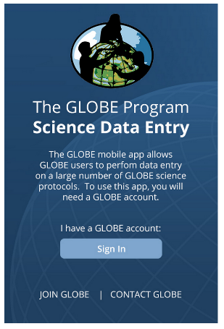
Entering Data on the GLOBE Website
Live Data Entry: Upload your data to the official
GLOBE science database
Email Data Entry: Send data in the body of your email (not as an attachment) to DATA@NASAGLOBE.ORG
Mobile Data App: Download the GLOBE Science Data Entry app to your mobile device and select the right option.
For Android via Google Play
For IOS via the App Store

Slide 27
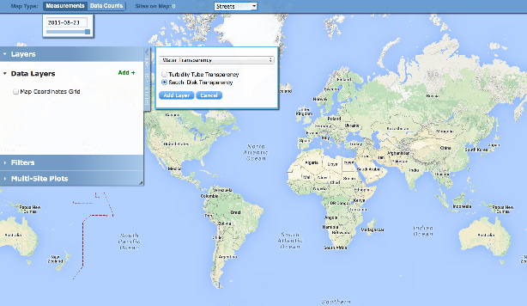
Visualize and Retrieve Data
GLOBE provides the ability to view and interact with data measured across the world. Select our visualization tool to map, graph, filter and export Secchi Disk transparency data that have been measured across GLOBE protocols since 1995.
Select Secchi Disk transparency data from drop down menu
Link to step-by-step tutorial on using the GLOBE Data Visualization Tool

Slide 28
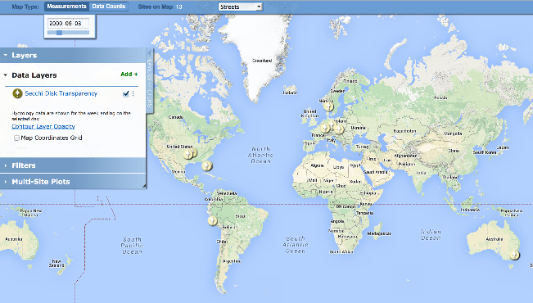
Visualize and Retrieve Data
Select the date for which you need Secchi Disk Transparency data, add layer and you can see where data is available.
Locations where Secchi Disk Transparency data is available for the week you selected

Slide 29
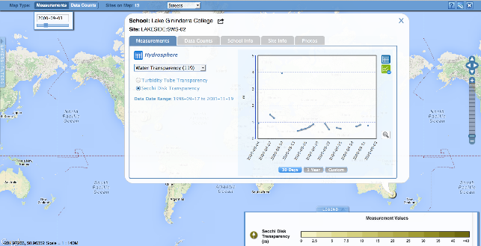
Visualize and Retrieve Data
Select the sampling site for which you need Secchi Disk Transparency data, and a box will open with a data summary for that site.
Clicking on a location will open to a map note providing Secchi Disk Transparency data for that location and time. Follow instructions in the tutorial to download data as a .csv file for analysis.

Slide 30
Review questions to help you prepare to measure Water Transparency at your Hydrosphere Study Site
What does water transparency measure?
What kind of suspended particles are found in water bodies?
The absolute depth at which light can penetrate through a water column is called ______?
The more suspended particles, the (more/less) transparency.
When water is still and deep, the appropriate transparency instrument is (Secchi disk/Transparency Tube).
Your three replicate measurements should be within _______cm of the mean.
Why do you need to take your transparency measurement in the shade?
Why is it necessary to describe cloud cover when taking transparency measurements?
What are some reasons water transparency measurements may change over the course of a year?
What safety precautions should you take prior to conducting any of GLOBE’s hydrosphere protocols?

Slide 31
You have now completed the slide stack. If you are ready to take the quiz, sign on and take the quiz corresponding to Water Transparency Secchi Disk Protocol.
You can also review the slide stack, post questions on the discussion board, or look at the FAQs on the next page.
When you pass the quiz, you are ready to take Water Transparency Secchi Disk Protocol measurements!

Slide 32
Additional
INFO
A. What is water transparency?
B. Why collect water transparency data?
C. How your measurements can help
D. How to collect your data.
E. Entering data on GLOBE Website.
F. Understand the data.
G. Quiz yourself
H. Additional
resources
Frequently Asked Questions
When comparing data between sites, do you need to make an adjustment for data taken at the water surface compared to data taken from a bridge or dock?
This distance is not used to adjust the Secchi disk data. However, reporting the distance between the observer and the water helps in data interpretation.
My students are using a pond for our hydrosphere measurements. They go out in a boat and use a Secchi disk for the transparency. We are not sure of the two measurements we are asked to give. They measure the line at the surface of the water to the top of the disk when it disappears and reappears. What is the other measurement?
For the other measurement, distance from where you read the line to the water surface, you should enter zero. Some schools will make Secchi disk readings from a bridge or pier, and report the depth measured using a reference level that is not the water surface, but some distance above the water surface. So they need to also enter the distance from the pier to the water. That way we have all of
the raw data in the database.

Slide 33
Additional
INFO
A. What is water transparency?
B. Why collect water transparency data?
C. How your measurements can help
D. How to collect your data.
E. Entering data on GLOBE Website.
F. Understand the data.
G. Quiz yourself
H. Additional
resources
For More Information Contact
www.globe.gov

