Slide 1
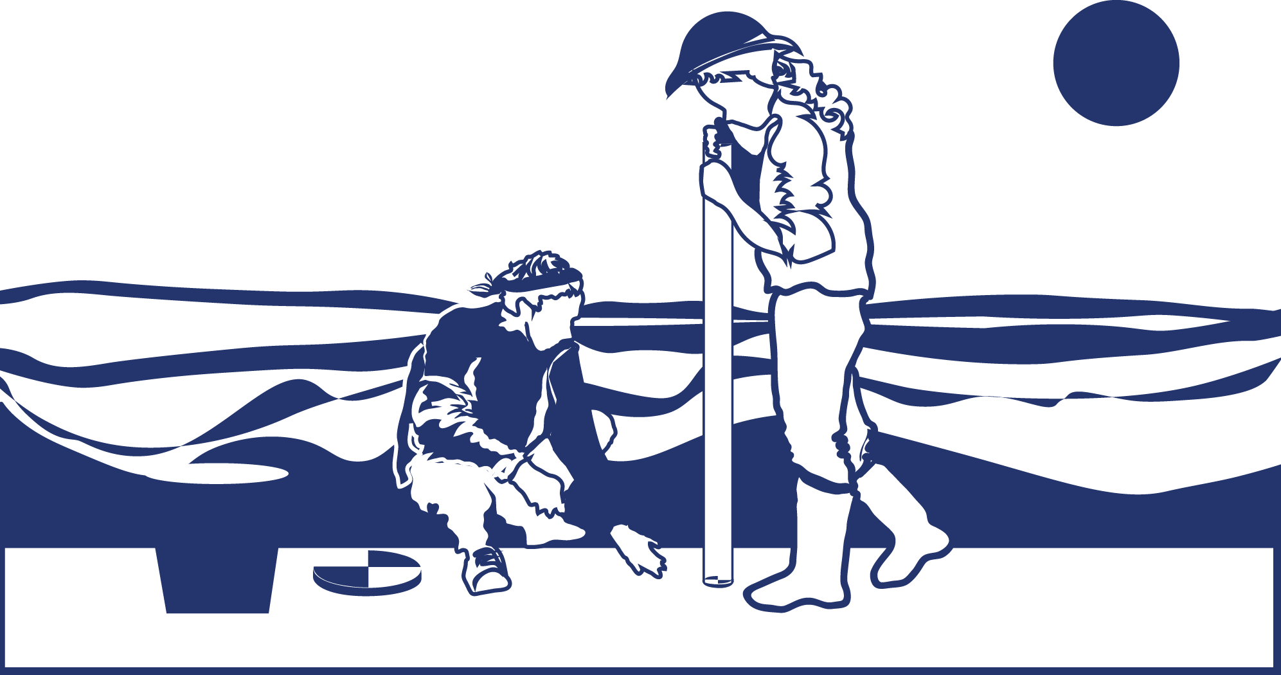
Intro SLide

Slide 2

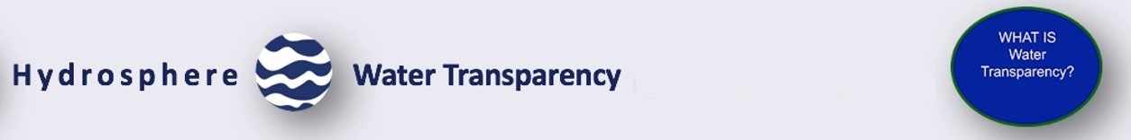
Overview
This module:
Reviews the selection of a GLOBE hydrology site
Reviews the water sampling technique used in GLOBE hydrology protocols
Guides the construction of the necessary instrument for this protocol
Provides a step by step introduction of the protocol methods
Learning Objectives
After completing this module, you will be able to:
Define water transparency
Explain how environmental variables result in different transparency measurements
Describe how the protocol procedures ensure the collection of accurate data
Conduct transparency measurements in the field
Upload data to the GLOBE portal
Visualize data using GLOBE’s Visualization System
Estimated time to complete this module: 1.5 hours

Slide 3
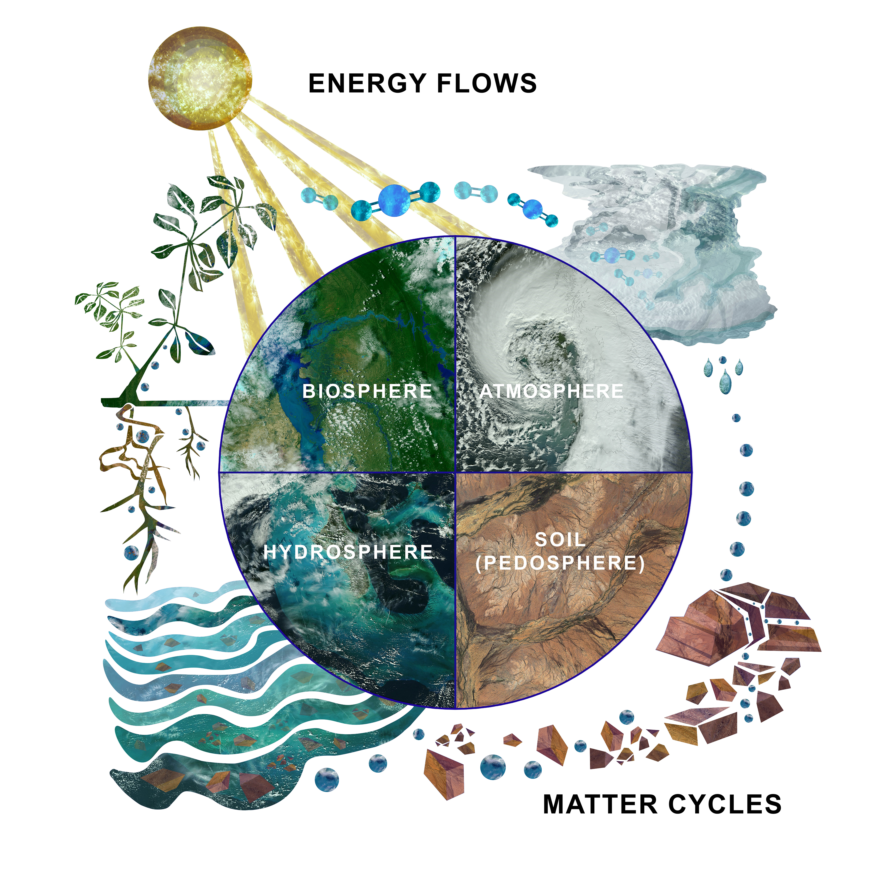
The Hydrosphere as part of the Earth System
The hydrosphere is the part of the Earth system that includes water, ice and water vapor. Water participates in many important natural chemical reactions and is a good solvent. Changing any part of the Earth system, such as the amount or type of vegetation in a region or from natural land cover to an impervious one, can affect the rest of the system. Rain and snow capture aerosols from the air. Acidic water slowly dissolves rocks, placing dissolved solids in water. Dissolved or suspended impurities determine water's chemical composition.
Current measurement programs in many areas of the world cover only a few water bodies a few times during the year. GLOBE Hydrosphere protocols will allow you to collect valuable data to help fill these gaps and improve our understanding of Earth's natural waters.
The Earth System:
Energy flows and matter cycles.

Slide 4
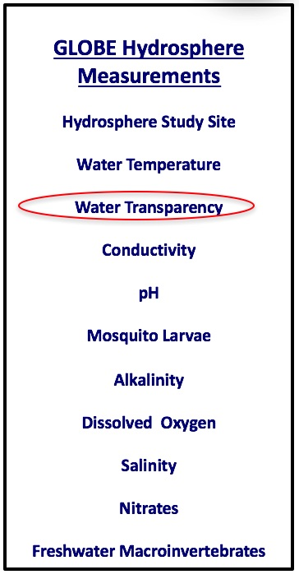
Hydrosphere Protocols
What is the condition of Earth’s many surface waters – the streams, rivers, lakes, and coastal waters? How do these conditions vary over the year? Are these conditions changing from year to year? These are questions that are answered by the hydrosphere investigations in the GLOBE program.
Water Transparency is one of the measurements used by GLOBE to describe the status of a water body. Water Transparency measures depth of light penetration into the water.
Water transparency depends on the amount of suspended particles. These can be organic, such as phytoplankton and algae, or inorganic, such as sediments, as well as other dissolved impurities such as organic or inorganic carbonates. These particles contribute to both the color and the transparency of the water.

Slide 5
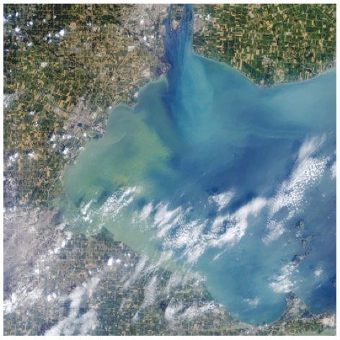
Water Transparency Describes Water Clarity
Water transparency is measured by determining the depth of light penetration into the water column from the surface. Algal blooms such as this, significantly reduce water transparency and contaminate onshore drinking water. The Operational Land Imager (OLI) on the Landsat 8 satellite captured this view of an algae bloom, on Lake Erie, in August 2014. More
Image: NASA Earth Observatory

Slide 6
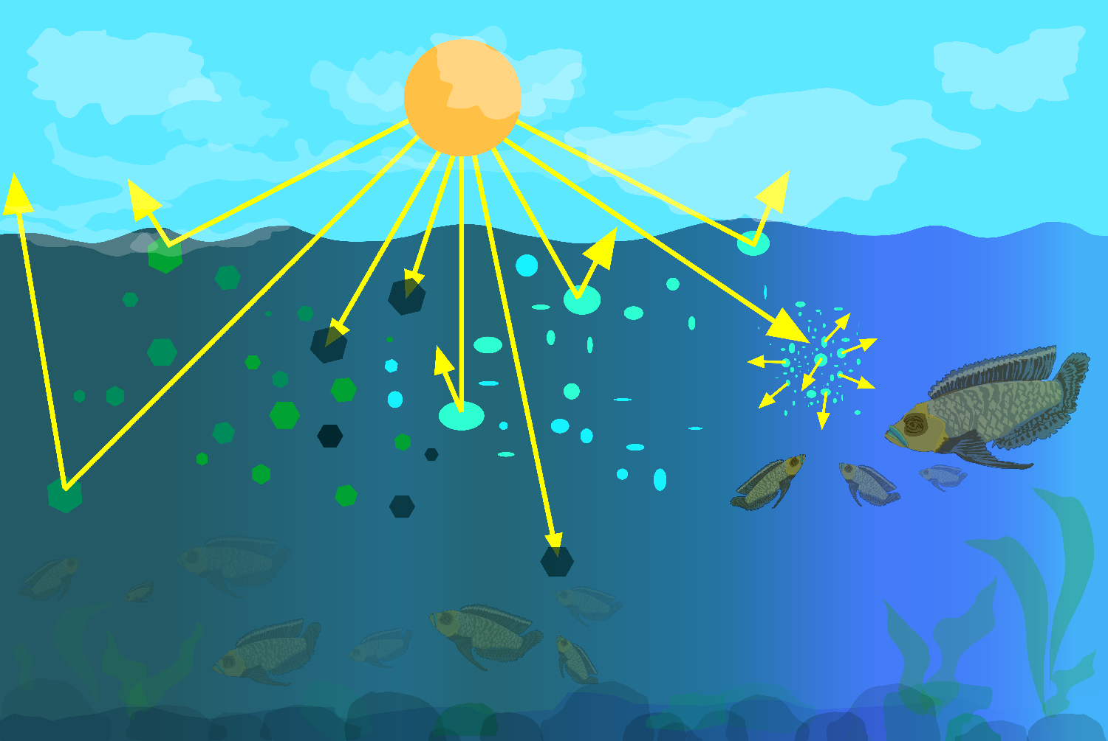
What is Water Transparency?
Particles in the water will reflect, absorb or scatter light, thus determining the depth at which light can no longer penetrate. This is called the extinction depth. The Water Transparency Protocol measures the light extinction depth of the water in your selected Hydrosphere Study Site.

Slide 7
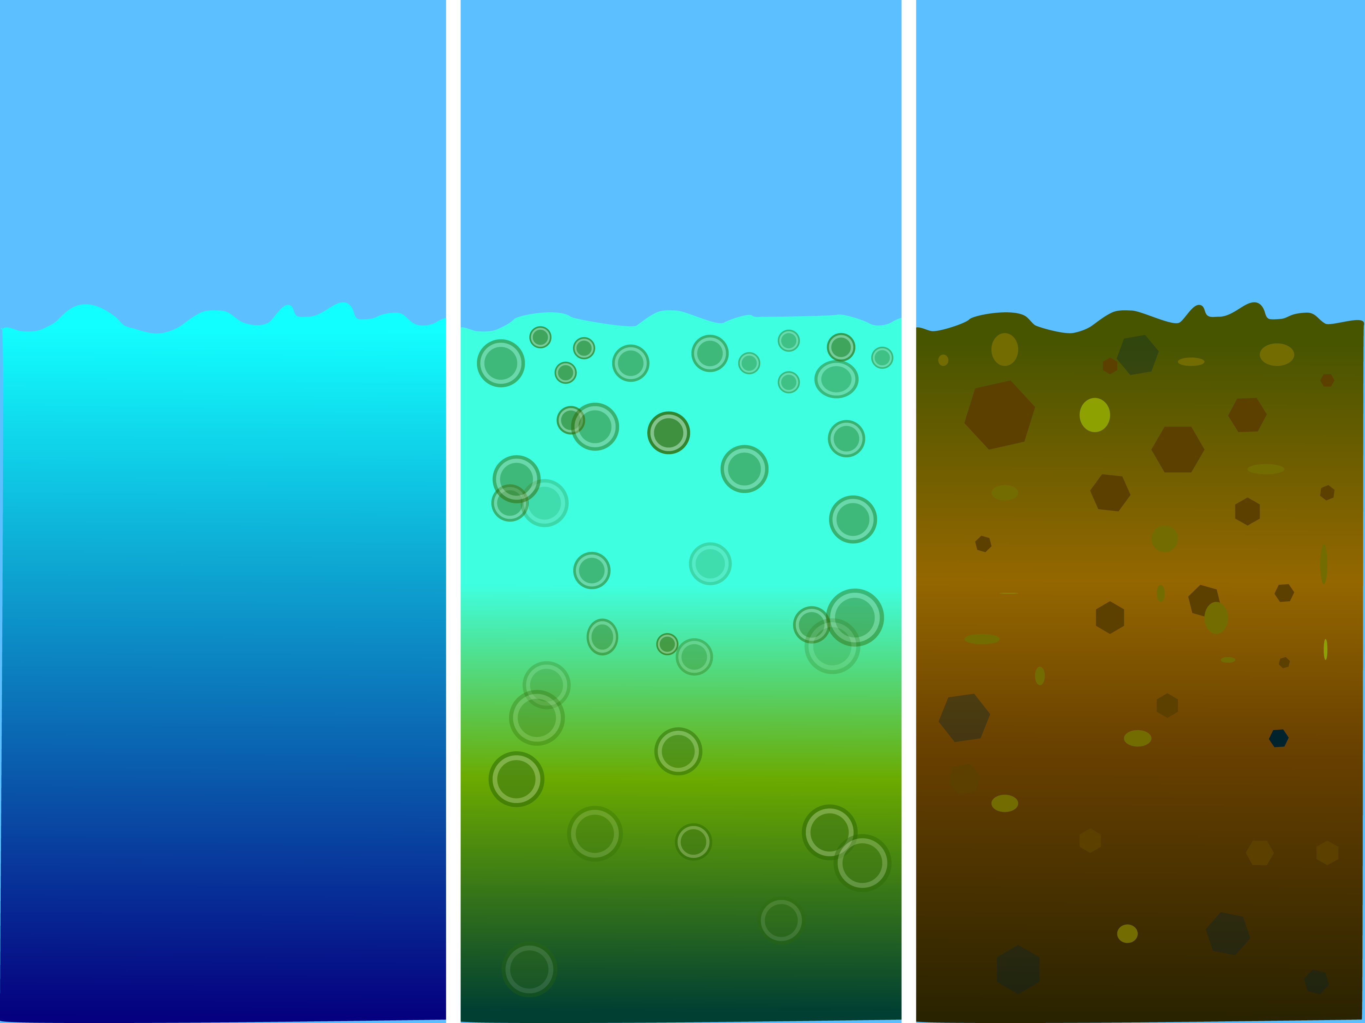
Particles in water absorb and scatter light
Suspended particles in water behave similarly to dust in the atmosphere. They reduce the depth to which light can penetrate. Sunlight provides the energy for photosynthesis (the process by which plants grow by taking up carbon, nitrogen, phosphorus and other nutrients, and releasing oxygen). How deeply light penetrates into a water body determines the depth to which aquatic plants can grow.
Transparency decreases with the presence of molecules and particles that can absorb or scatter light. Dark or black material absorb most wavelengths of light, whereas white or light materials reflect most wavelengths of light. The size of a particle is important as well. Small particles (diameters less than 1 μm) can scatter light.

Slide 8
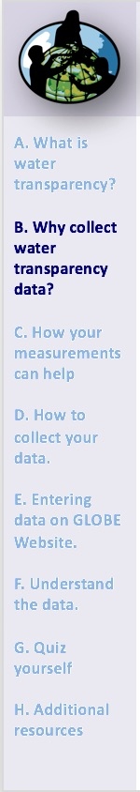
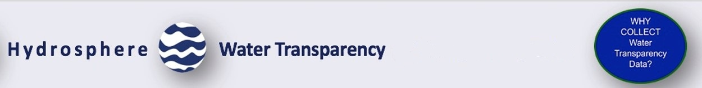
Why Collect Water Transparency Data?
In most countries, current measurement programs cover only a few water bodies a few times during the year. As a consequence, the archives of GLOBE hydrosphere data provide important information about water chemistry and water quality not found elsewhere.
  By taking measurements over time in multiple locations, it is often possible to determine the times of year and the source of pollution, for instance, and if necessary, remediate the situation to improve water quality.

Slide 9
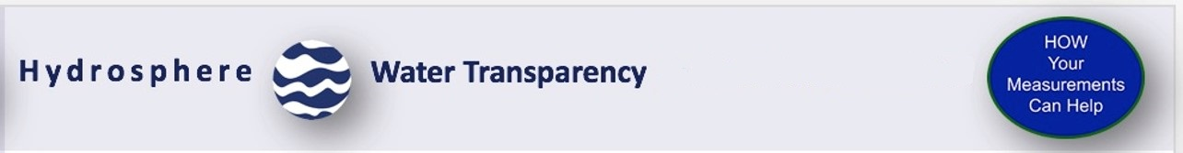
Summary: Water transparency changes in response to environmental factors
Water transparency changes over time in response to environmental factors.
Suspended particles such as phytoplankton, zooplankton, sediment, organic matter... are optically active components and their density and distribution varies over time. Erosion and run off during a storm is one source of sediment particles. The influx of nutrients such as phosphorus into a water body can cause an algal bloom, greatly increasing the density of these organisms.
The more suspended particles, the less transparency
An increase in suspended particles in a water body will decrease transparency, and light will be unable to penetrate into deeper water.
Light energy is needed by plants to conduct photosynthesis
Less light penetration into the water will affect the health of organisms living in the water body.
Water transparency affects water quality
Suspended particulates impact water quality, both for human consumption and for use by aquatic organisms.

Slide 10
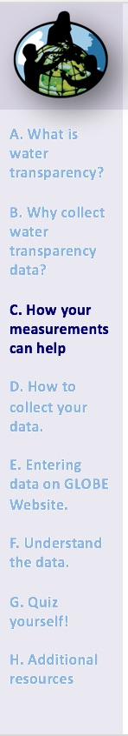
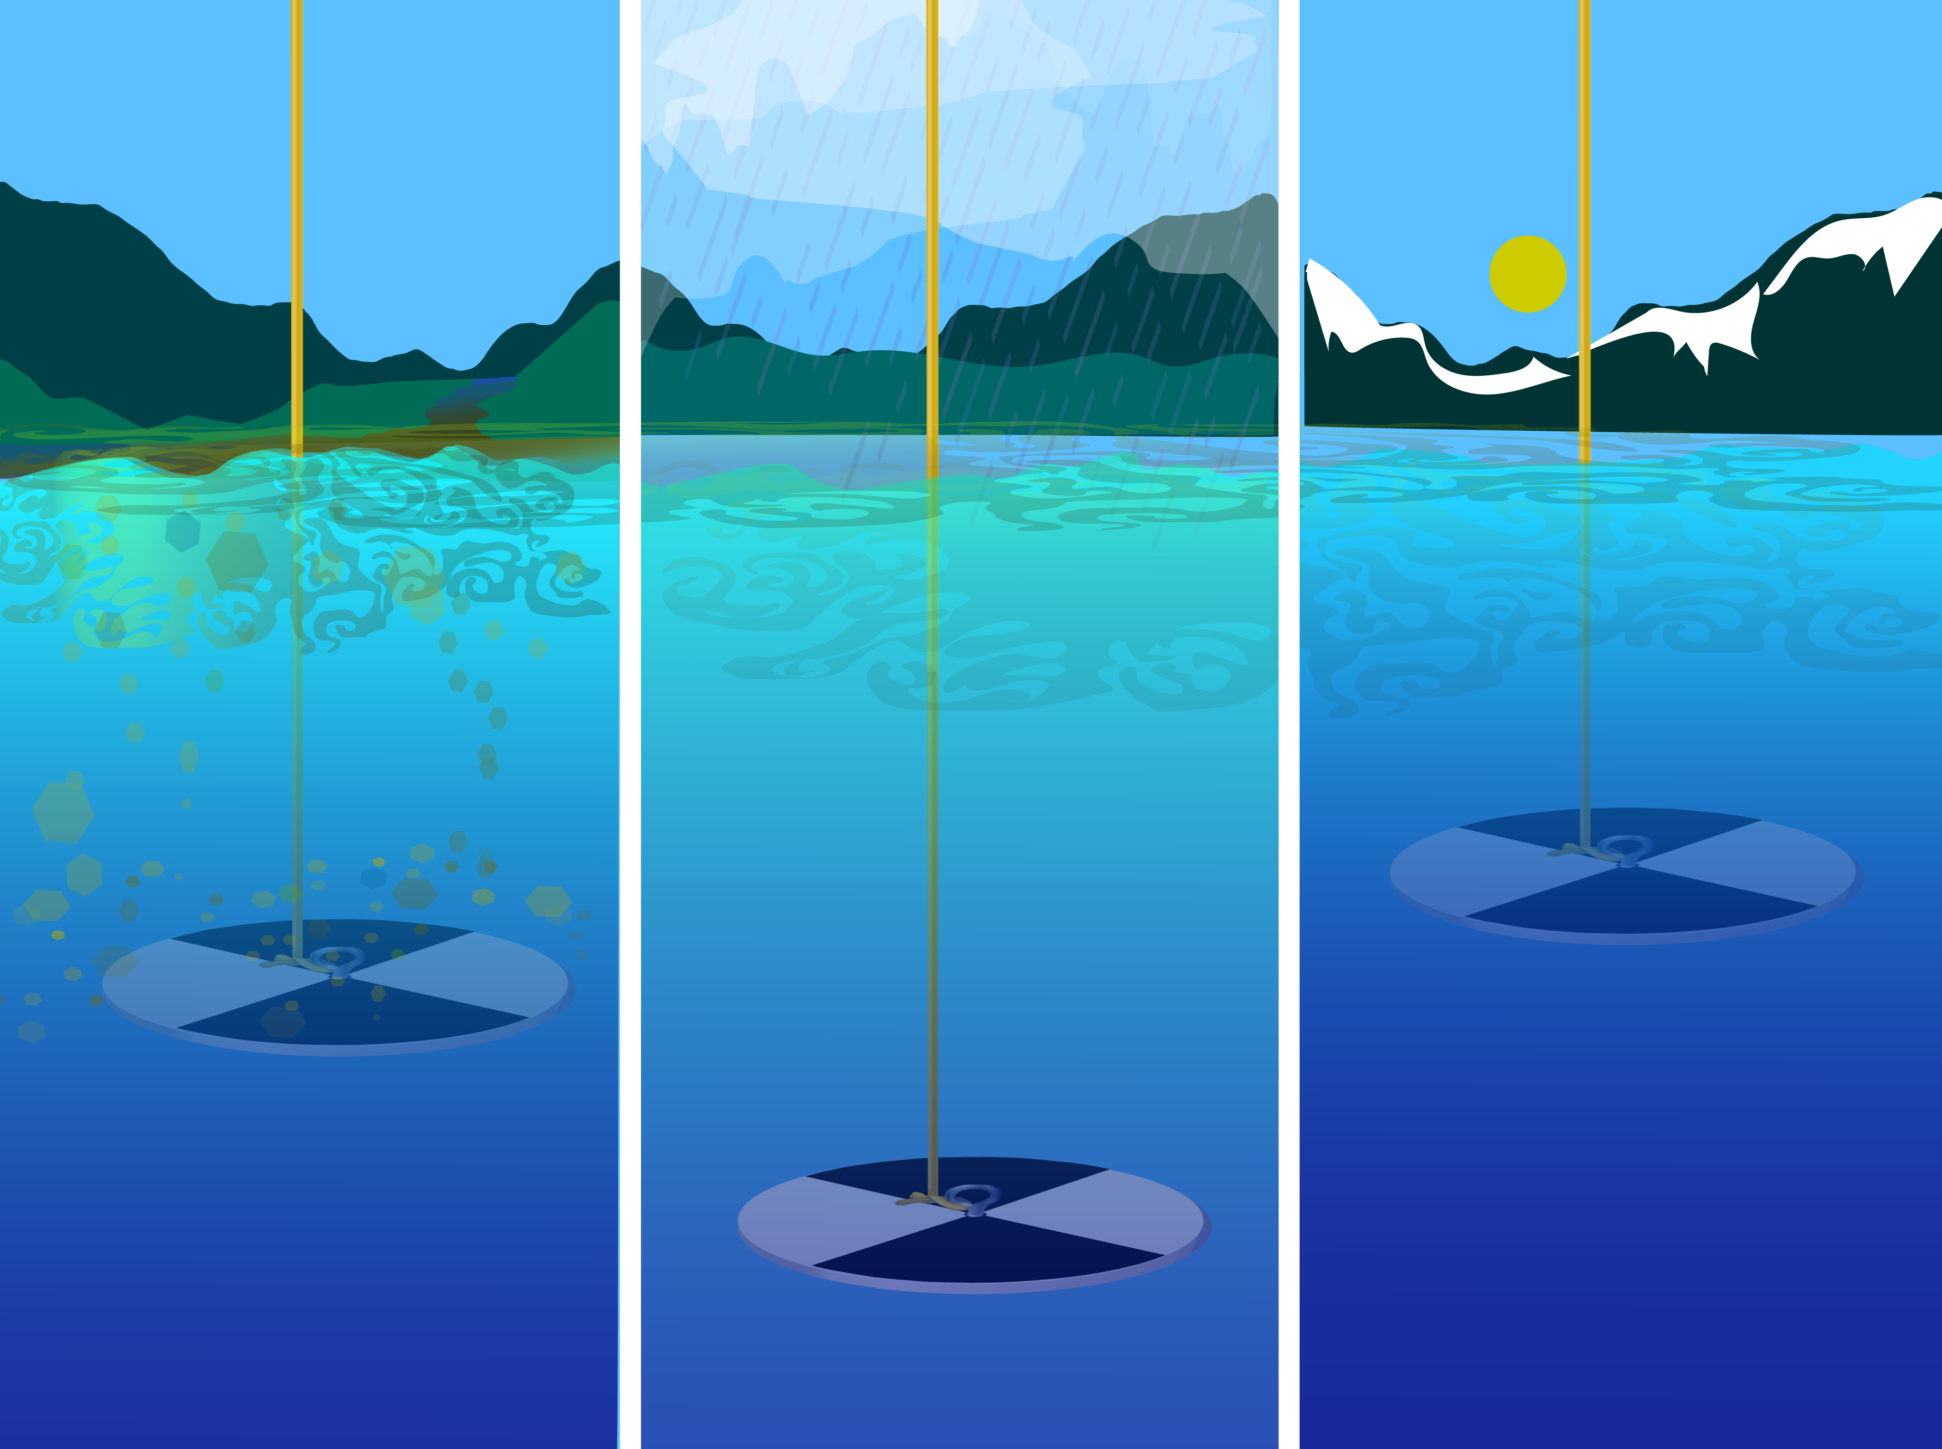
Scientists measure water transparency to determine water body health.
Measurement of water transparency allows scientists to calculate inputs from erosion and nutrients. By taking measurements over time in multiple locations, it is often possible to determine the source of the inputs, and if necessary, remediate the situation to improve water quality.

Slide 11
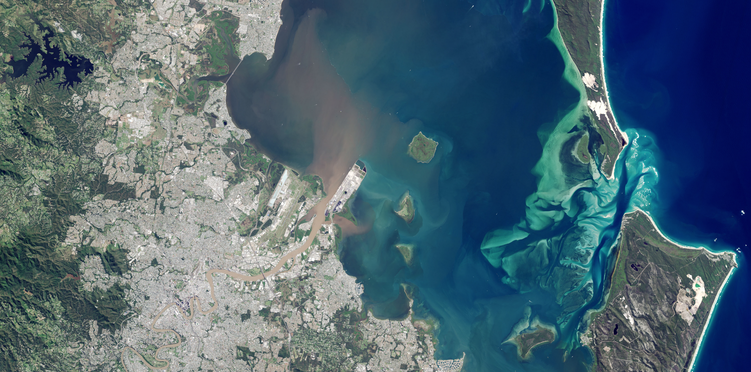
How Your Measurements Can Help-1
Credit:
NASA Earth
Observatory
Water transparency and color can be observed in satellite imagery. In May 2015, the east coast of Australia was hit by a severe storm and deadly flooding, dropping more than 360 millimeters (14 inches) of rain within about three hours in southeast Queensland, Australia. This image of the Brisbane River entering Moreton Bay was acquired on May 3, 2015 by the Operational Land Imager on Landsat 8.

Slide 12
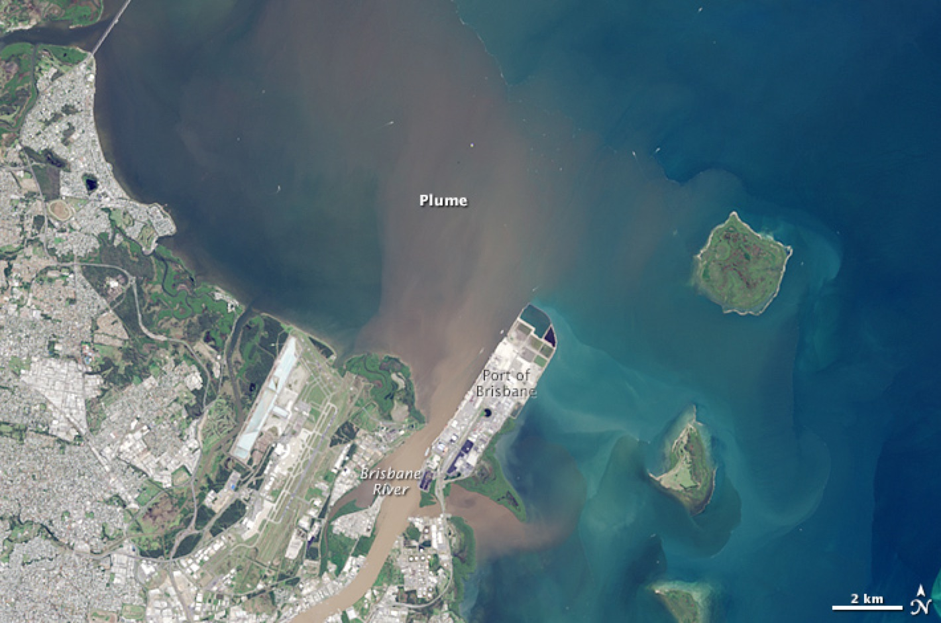
How Your Measurements Can Help-2
Credit:
NASA Earth
Observatory
As a result of the rainfall, flash flooding caused distinct river plumes to form along the coastline. Flood waters usually contain elevated levels of sediment and colored dissolved organic matter (CDOM). Sediment tends to scatter red light, and CDOM absorbs blue light. As a result, a brown color is visible at the Brisbane River mouth where these two optical phenomena work in concert. Further from the mouth, the coarser sediments tend to settle to the bottom but the CDOM is still observed in the water column absorbing blue light. What is coloring the yellow-green patches in the water? Scientists believe it is CDOM, but ground verification is needed to be sure. More

Slide 13
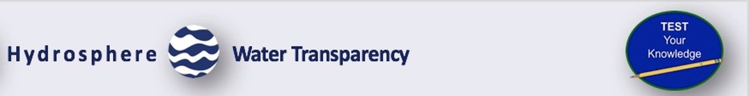
Let’s do a quick review before moving onto data collection!
Question 1
Which of the following suspended particles can influence the depth of light penetration in the water column?
Organic, like algae
Inorganic, like clay or silt
Dissolved impurities, such as carbonates
All of the above
What is the answer?

Slide 14
Let’s do a quick review before moving onto data collection!
Answer to Question 1
Which of the following suspended particles can influence the depth of light penetration in the water column?
Organic, like algae
Inorganic, like clay or silt
Dissolved impurities, such as carbonates
All of the above ☺ Correct!
Were you correct?

Slide 15
Let’s do a quick review before moving onto data collection!
Question 2
Why are GLOBE water transparency data important?
Because most water bodies in the world are not sampled by other scientists, the data provides important information that would not otherwise be collected.
It provides an opportunity for students to collect data that they can use in their own environmental investigations.
It allows students to monitor water quality in their community.
Transparency data can be used as ground validation of data collected by satellites.
All of the above.
A and B only.
What is the answer?

Slide 16
Let’s do a quick review before moving onto data collection!
Answer to Question 2
Why are GLOBE water transparency data important?
Because most water bodies in the world are not sampled by other scientists, the data provides important information that would not otherwise be collected.
It provides an opportunity for students to collect data that they can use in their own environmental investigations.
It allows students to monitor water quality in their community.
Transparency data can be used as ground validation of data collected by satellites.
All of the above. ☺ Correct!
A and B only.
Were you correct? Now let’s look at the GLOBE Protocol for measuring water transparency using a Transparency Tube (Turbidity Tube) or a Secchi Disk.

Slide 17
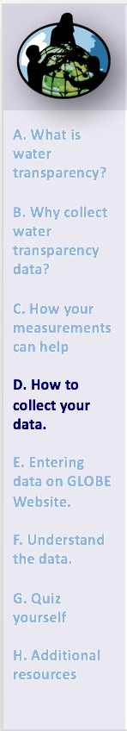
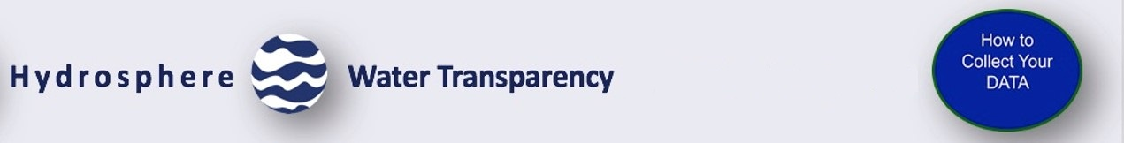
Protocol at a Glance
When | Weekly, if possible
Where | Hydrosphere Study Site
Time Needed | 10 minutes
Prerequisites | Described Hydrosphere Study Site
Key Instruments | Transparency (Turbidity) Tube OR Secchi Disk
Skill Level | Beginner
References | GLOBE Cloud Chart Transparency Tube Transparency Protocol Field Guide OR Secchi Disk Transparency Field Guide

Slide 18
How to Collect Your Data
Simultaneous or Prior Investigations Required to do Water Transparency Measurements
You will need to define your Hydrosphere Study Site. A Hydrosphere Study Site can be any surface water site that can be safely visited, although natural waters are preferred.
Sites, in order of preference, may include:
Streams or rivers
Lakes, reservoirs, bays or oceans
Ponds
Irrigation ditches or other water bodies, if those above are not available
The Hydrosphere Investigation Data Sheet is used to record all the hydrosphere measurements, including Water Transparency. You will also want to map your Hydrosphere Site at some point.
To define you study site you will need these documents:
Selecting and Documenting your Hydrosphere Study Site
Hydrosphere Investigation Data Sheet
Mapping your Hydrosphere Study Site Field Guide

Slide 19
Water Transparency Protocol Methods
This slide set covers two methods to measure water transparency:
Water Transparency Protocol Using a Secchi
Water Transparency Protocol Using a Transparency Tube

Slide 20
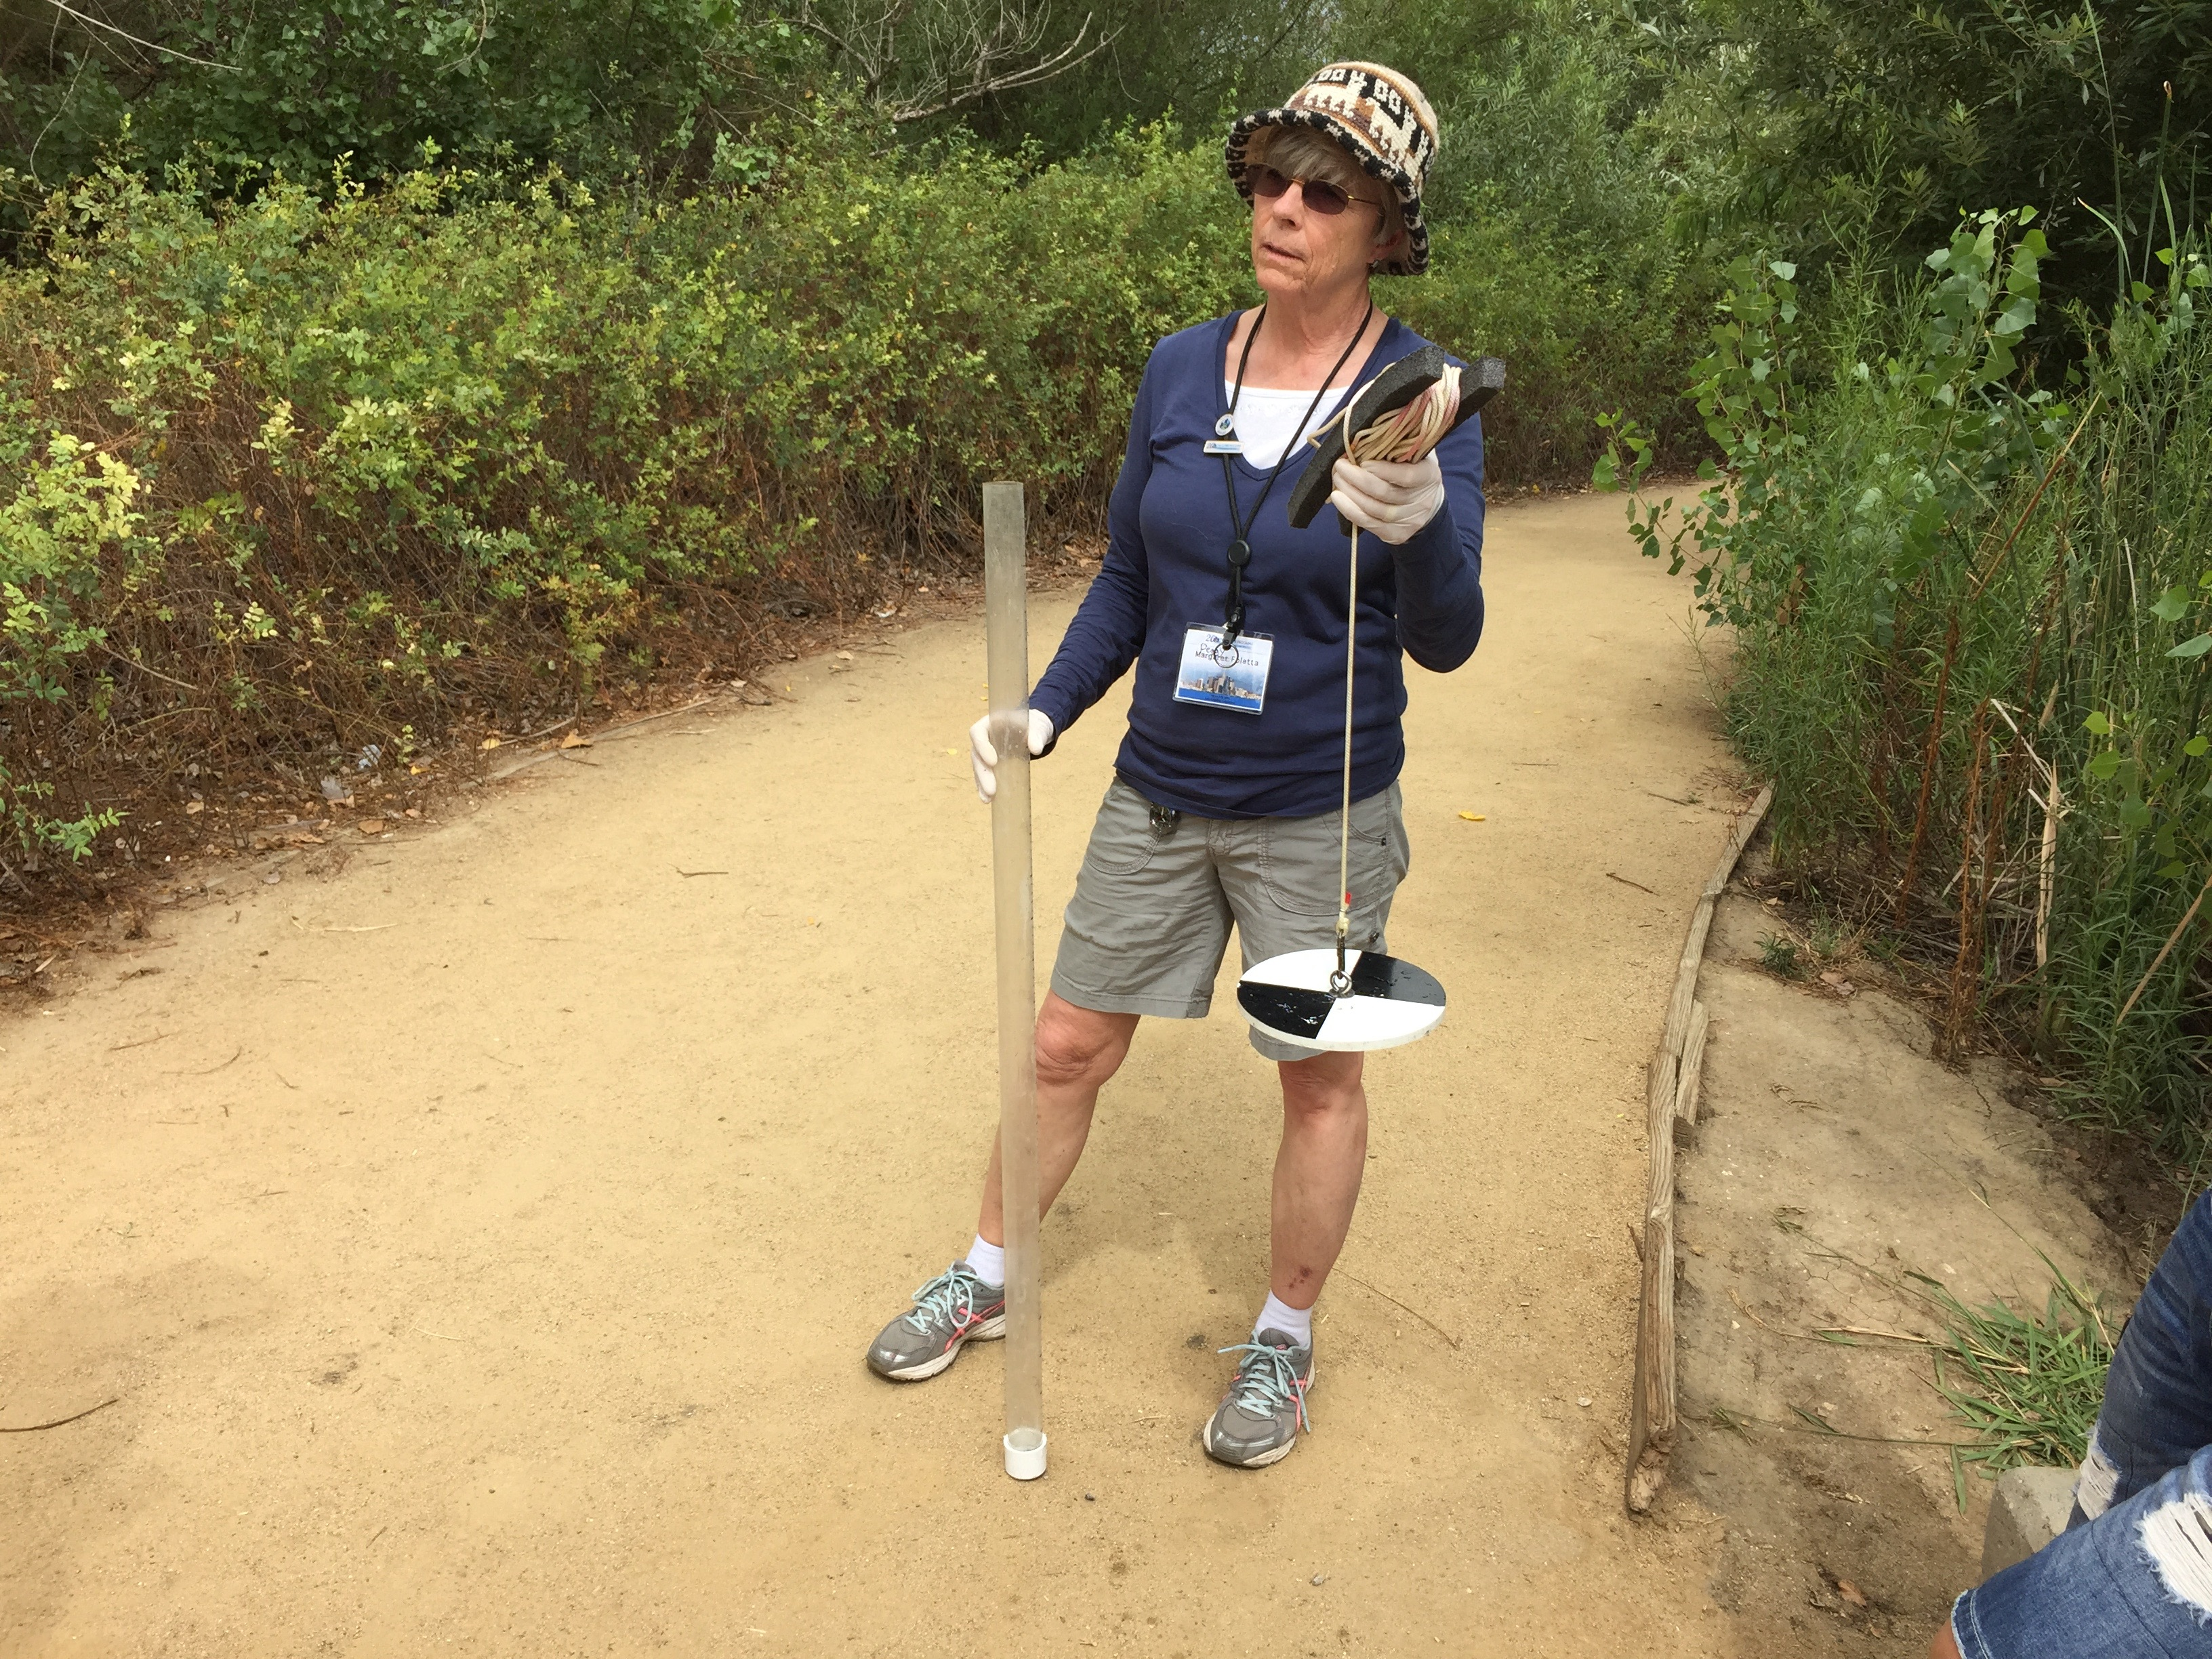
Determine Which is Appropriate for Your Water Body: Secchi Disk or Transparency Tube?

Slide 21
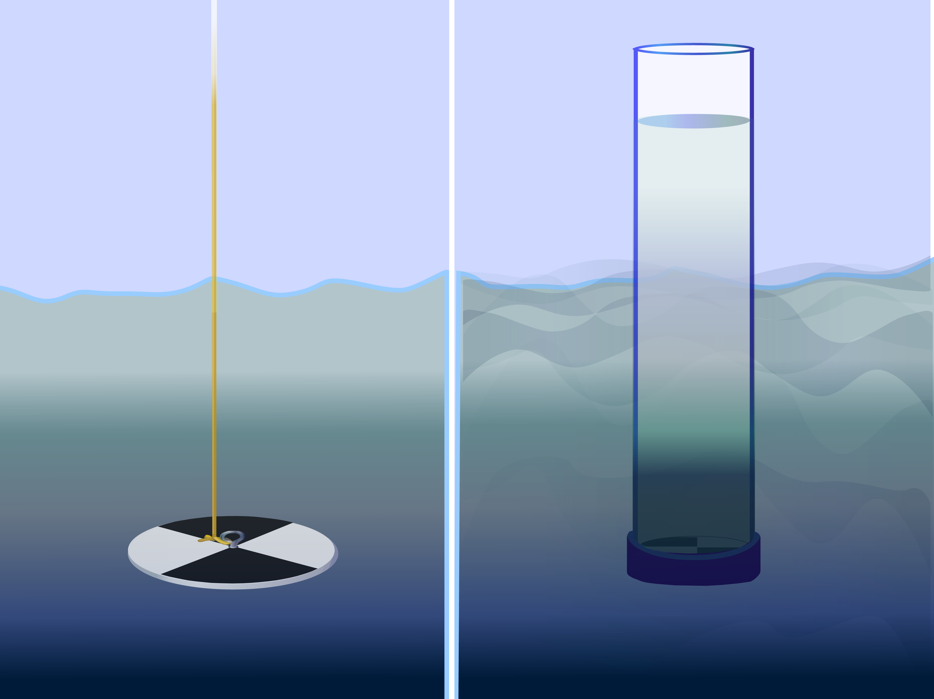
How to Collect Your Data: Select Appropriate Instrument
First, determine if your study site has deep, still water or shallow and/or flowing water. If the water is deep and still, you will use a Secchi Disk for your water transparency measurements. If the water is shallow or flowing, you will use a Transparency Tube (also called a Turbidity Tube).
Secchi Disk used with deep and
still water
Transparency Tube used with
shallow or Flowing water

Slide 22
General requirements for both methods
Whether you are using the Secchi Disk Method or the Transparency Tube Method, it is required that you:
Assemble the documents you will need in the field.
Follow Safety Steps during your work at the field and in the lab.
Make sure that you make your transparency measurements in the shade to avoid sun glare and differences in visibility.
Fill out a Hydrosphere Investigation Data Sheet .
Describe the Sky Conditions, Cloud Type and Cloud Cover.

Slide 23
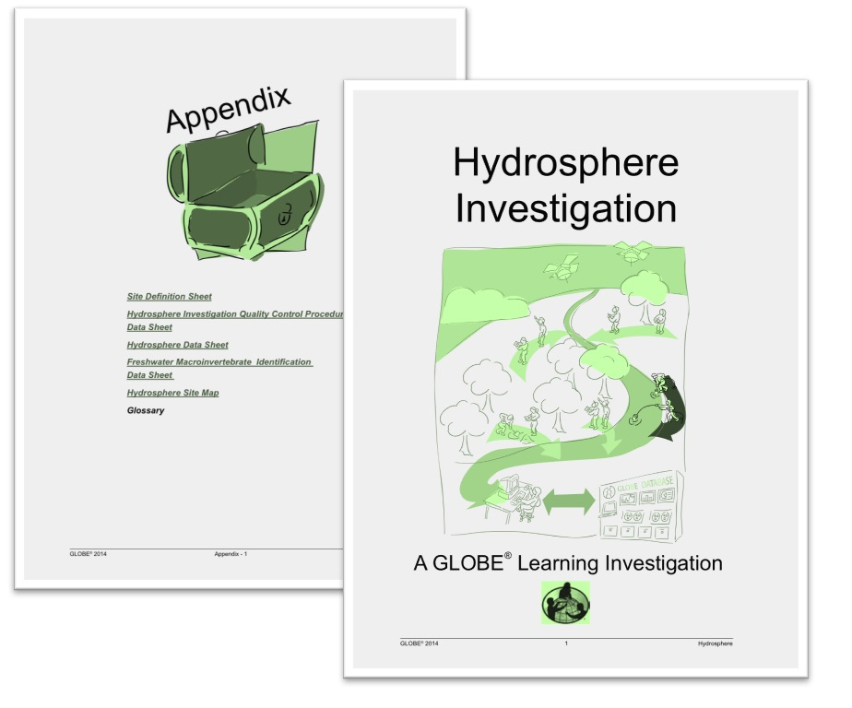
Assemble Documents Needed in the Field
What You Need For Both Methods:
Hydrosphere Investigation Data Sheet
Cloud Type and Cover Protocol Field Guide
Contrail Type and Cover Protocol Field Guide
GLOBE Cloud Chart
What You Also Need For Secchi Disk:
Secchi Disk Transparency Protocol
What You Also Need For Transparency Tube:
Transparency Tube Transparency Protocol
Collecting Water Sample in a Bucket

Slide 24

Safety Steps
Safety is important when conducting the Hydrosphere protocols. While you will need to use your judgment in selecting only hydrosphere study sites that are safe to access and sample, additional precautions are needed:
Students should wear protective gloves and goggles when handling water samples and chemicals to avoid splashing on exposed areas.
When doing GLOBE Hydrosphere Protocols, it is important to protect students from exposure to biting insects, including mosquitoes. Ask your students to wear clothes that cover the body so there is little bite area exposed. It is also advisable to apply insect repellent if you are sampling during the mosquito breeding season.

Slide 25
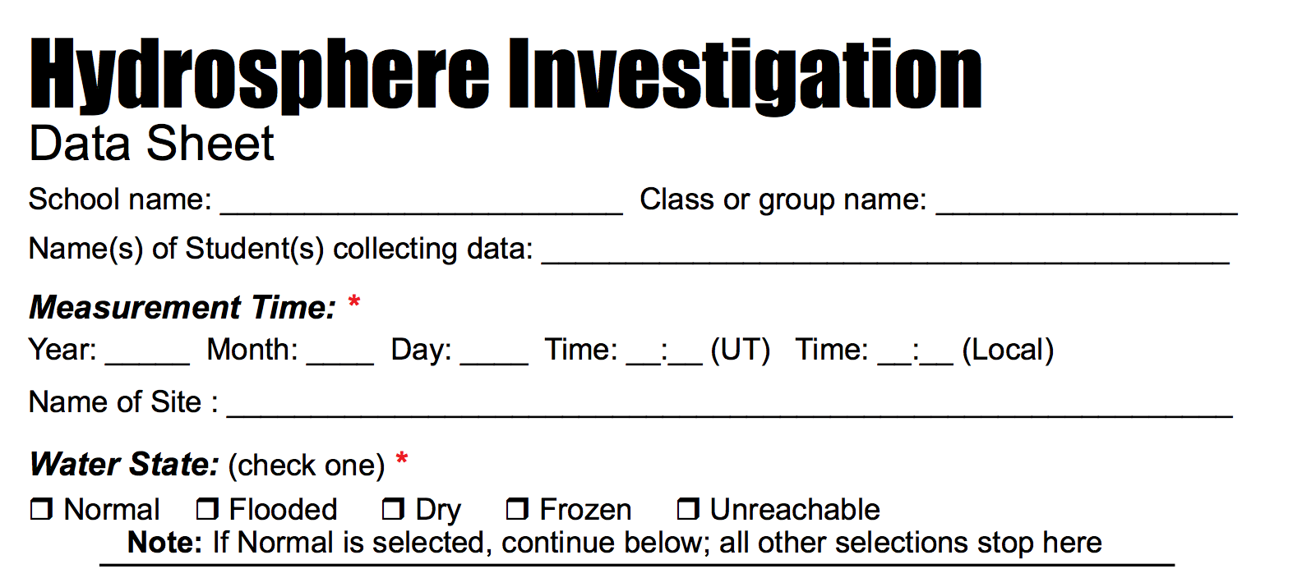
Hydrosphere Investigation Site Data
Fill out top portion of Hydrosphere Investigation Data Sheet

Slide 26
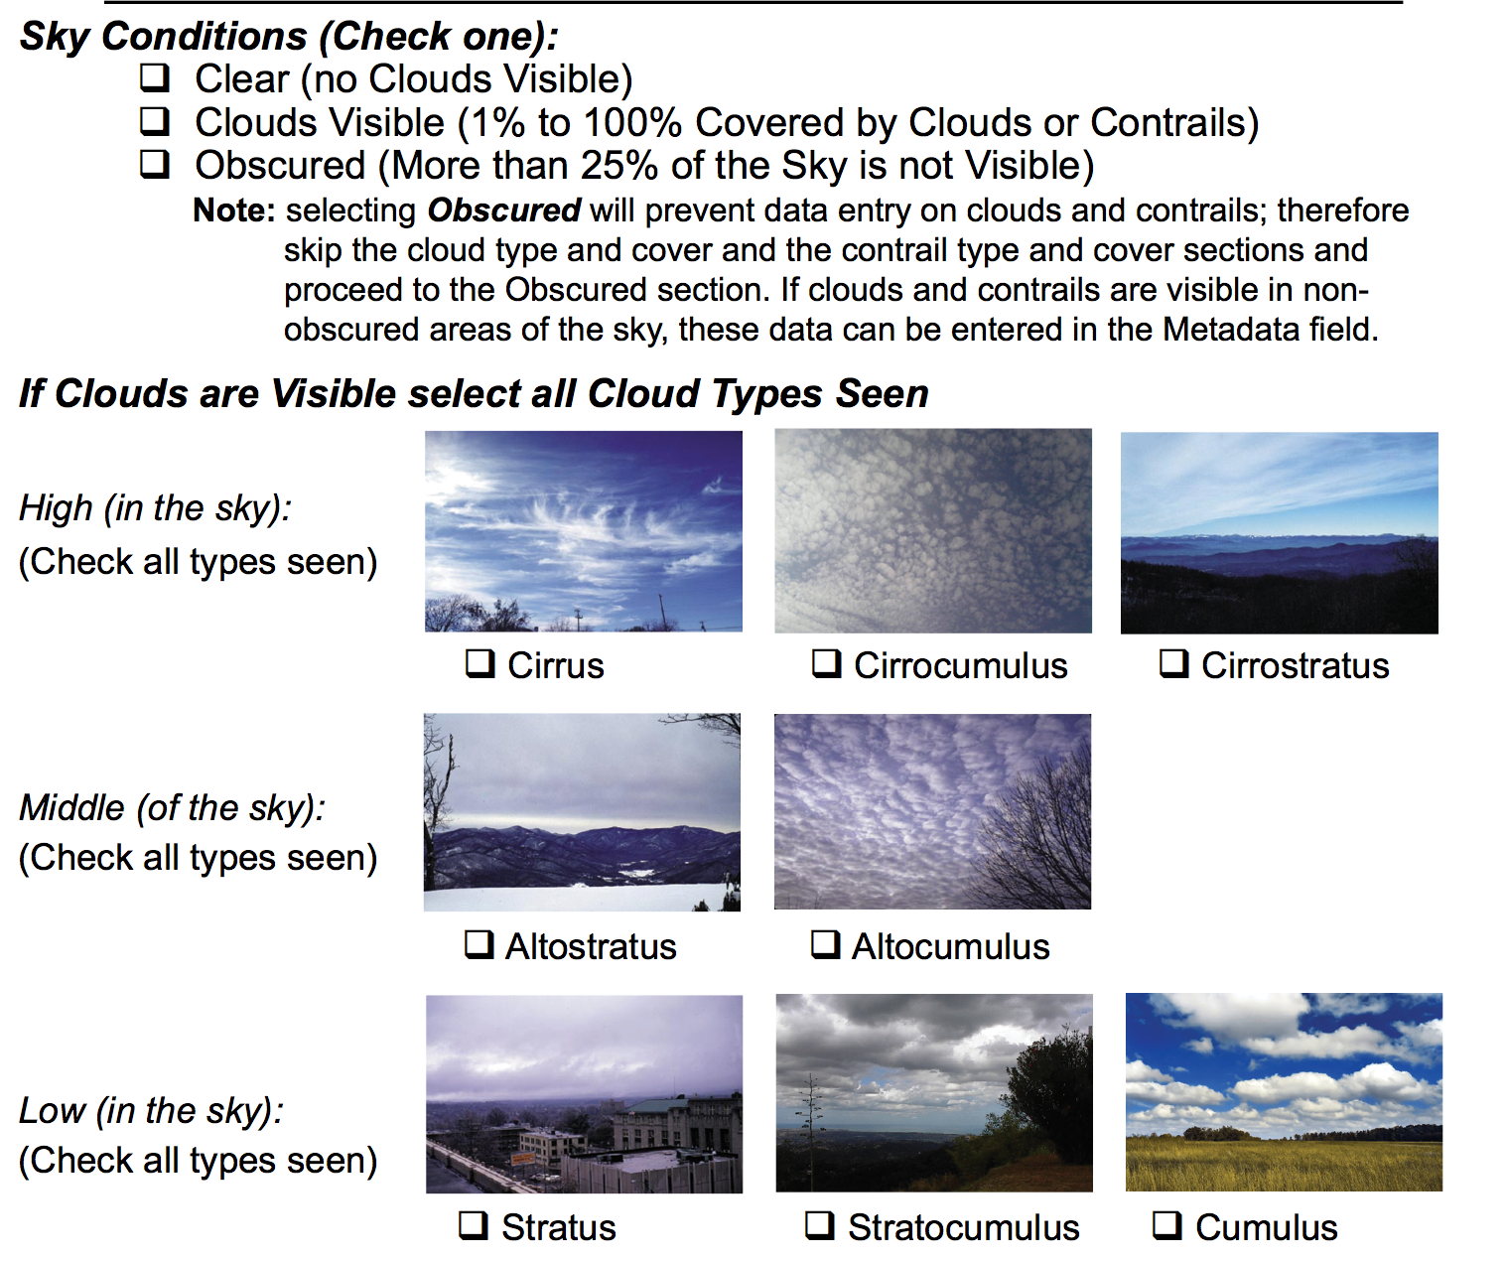
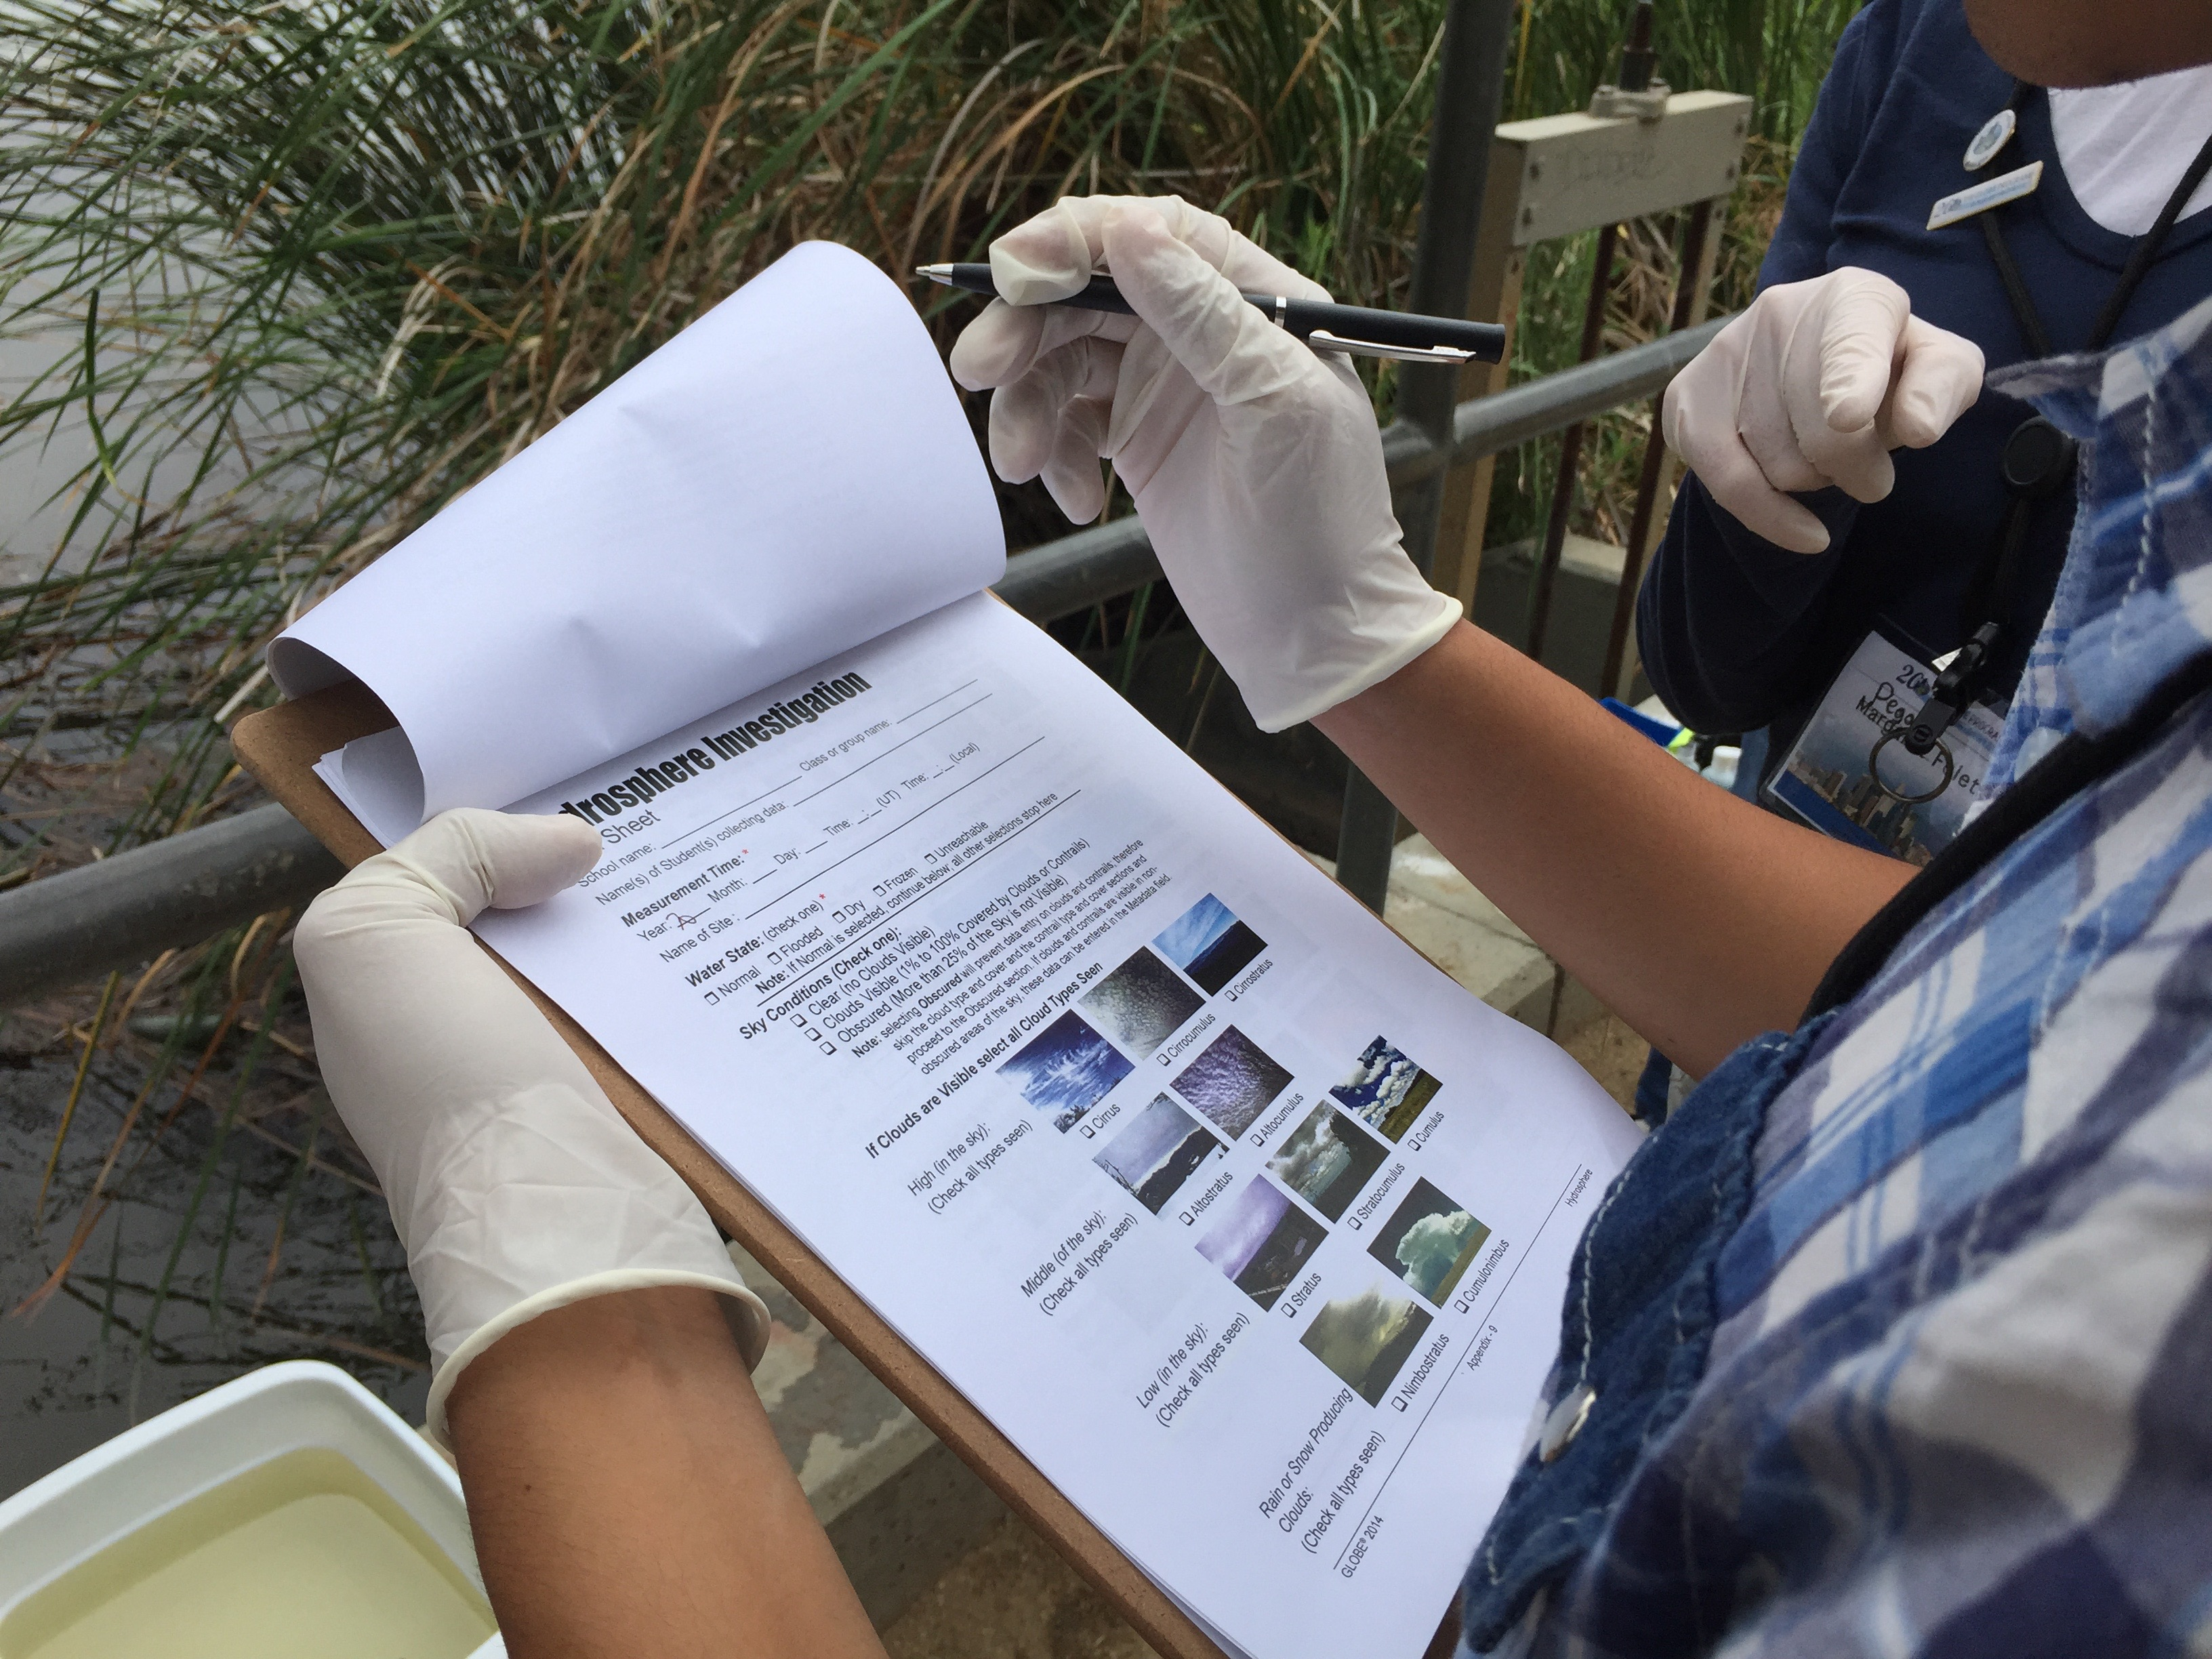
Describe the sky conditions and clouds

Slide 27
I. Water Transparency Protocol Using a Secchi Disk

Slide 28
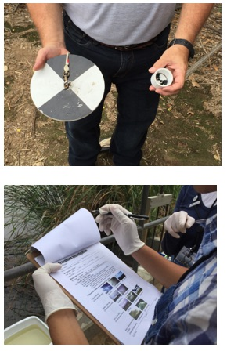
Secchi Disk Protocol Overview
Assemble field equipment
Collect site data
Conduct cloud type and cloud cover measurements
In the Field: Take the measurements using a Secchi disk
Repeat 3 times to ensure accuracy and precision
Verify that the data from the three measurements are within 10 cm of the mean, (but do not average your data for reporting)
Report your data to the GLOBE website

Slide 29
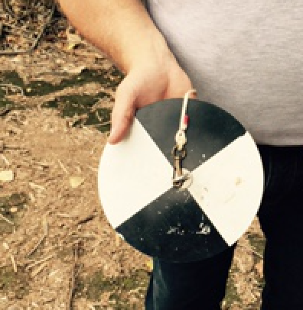
Time Requirements for Secchi Disk Method
Time to complete protocol: About 10 minutes
Frequency: Ideally, weekly measurements at the same sampling site
Ease of Protocol: Beginner Level

Slide 30
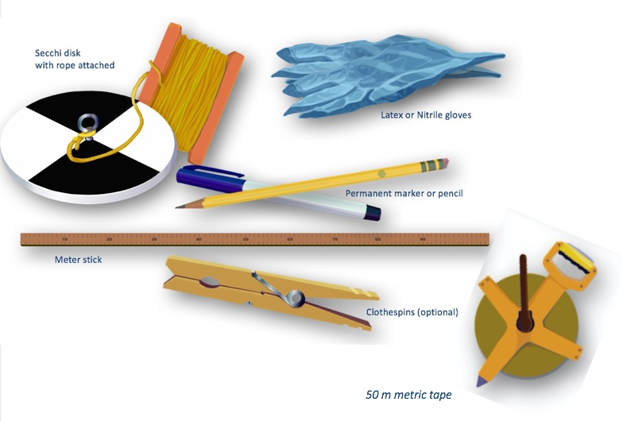
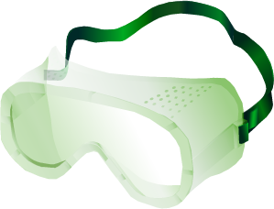
Assemble Field Equipment for Secchi Disk Method

Slide 31
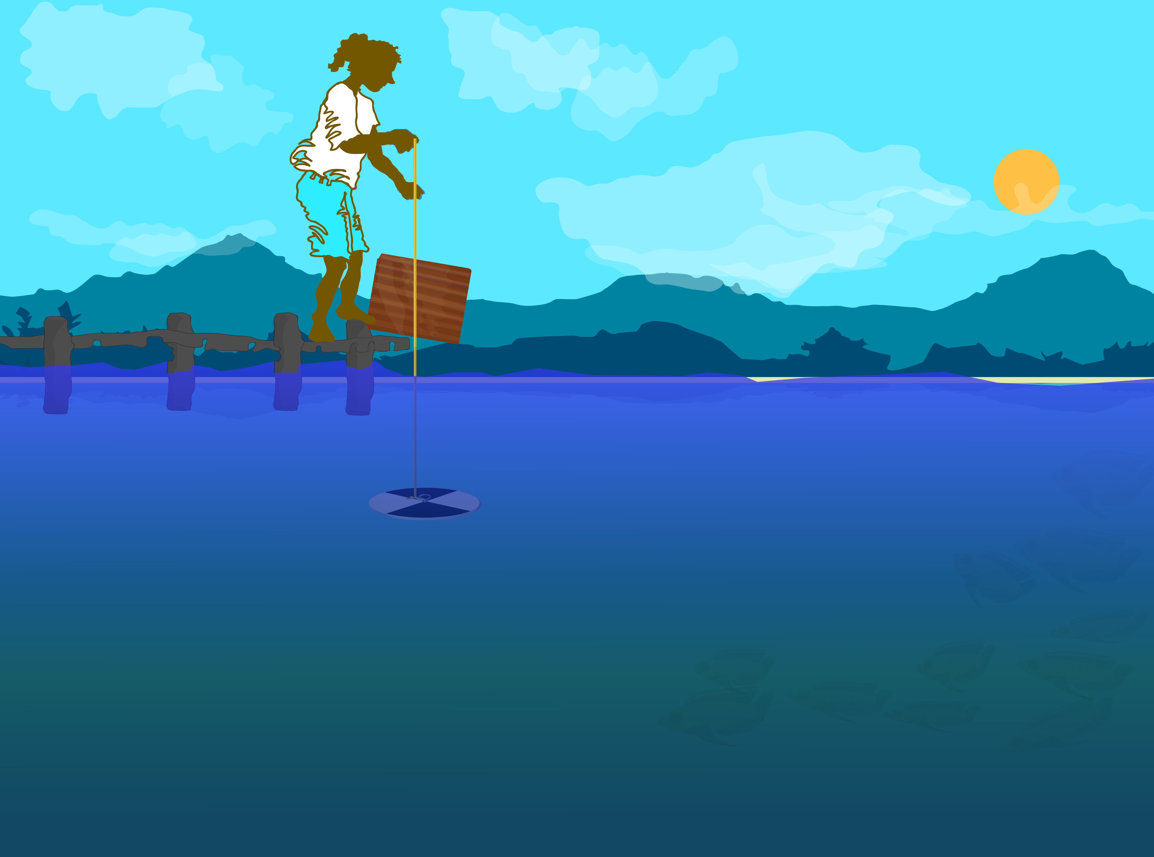
Proper Technique Using the Secchi Disk
Stand so that the Secchi disk will be shaded or use an umbrella or cardboard to shade the measurement area.
If you cannot reach the water surface, establish a reference height. This can be a railing, a person’s hip, or the edge of a dock. All measurements should be taken from this point.

Slide 32
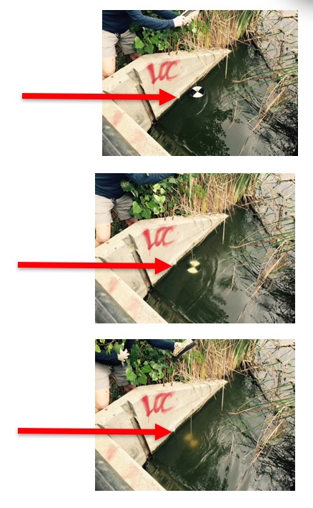
Lower the Secchi Disk until it disappears under the water
Lower the Secchi disk gradually. As it is lowered, the black cross will become less visible. Eventually it will disappear completely.
Note: You will need to remove sunglasses/goggles when lowering the Secchi Disk, so you can identify the extinction depth correctly. Replace your goggles before you pull up the Secchi disk.

Slide 33
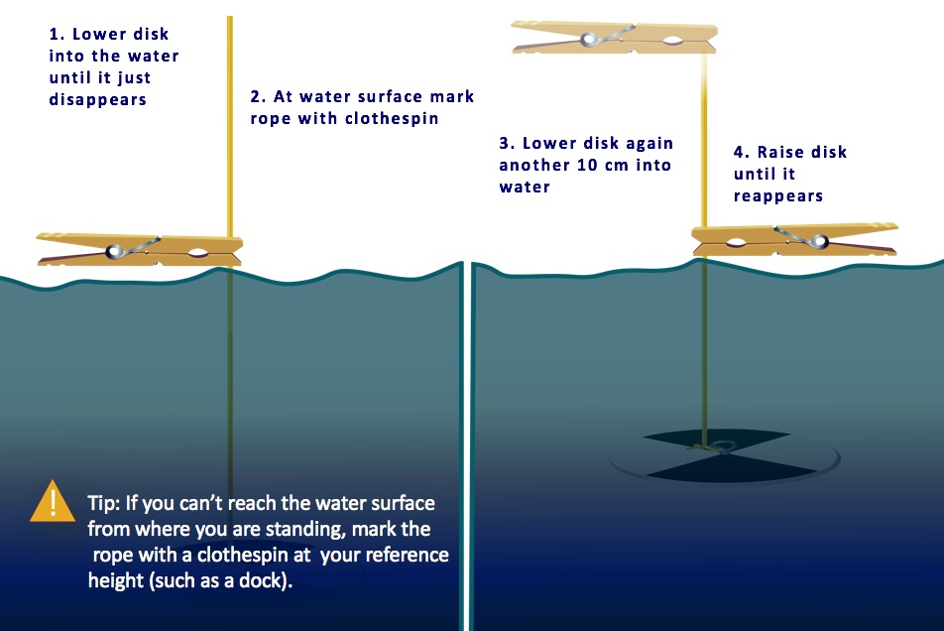
Marking the Secchi Depth

Slide 34
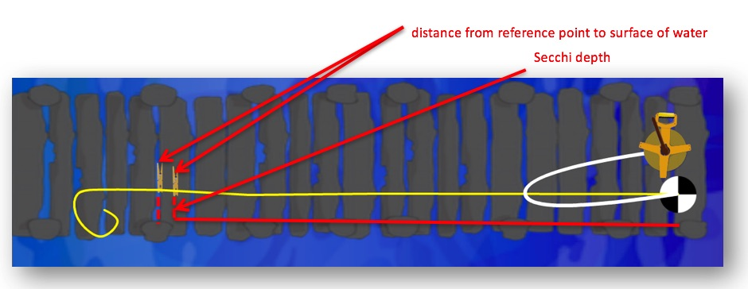
Measure the length of rope
There should now be two points marked on the rope. Record the length of the rope between each mark and the Secchi disk on your Hydrosphere Investigation Data Sheet to the nearest cm.
If you marked the rope at the water surface, record “0” as the distance between the observer and the water surface.
If you marked the rope at a reference point, lower the disk until it reaches the surface of the water and mark the rope at the reference point. Record the length of the rope between the mark and the Secchi disk as the distance between the observer and the water surface.

Slide 35
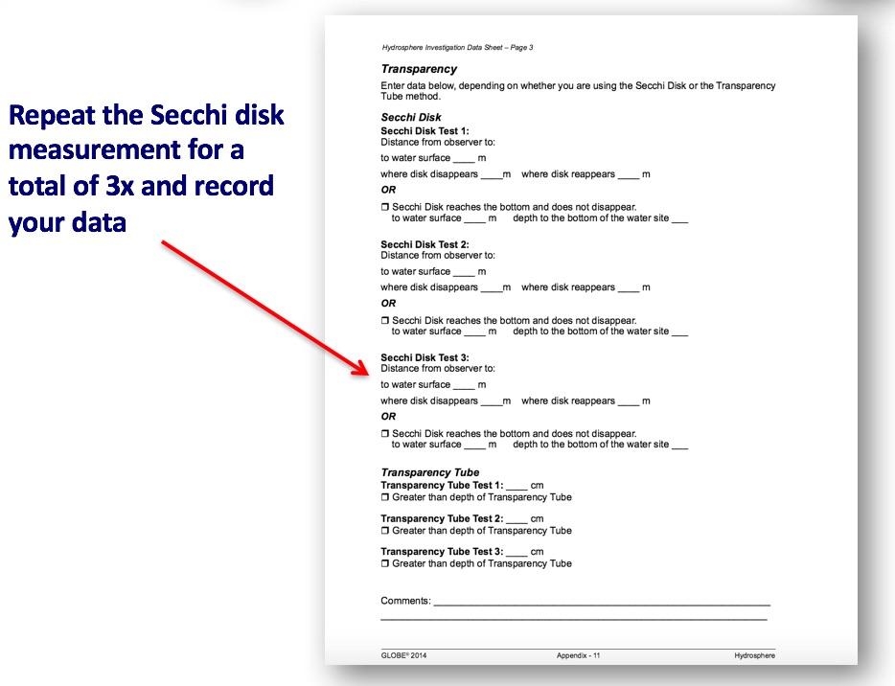
Repeat measurement 3 X for Secchi Disk Method and you are done!

Slide 36
II. Water Transparency Protocol Using a Transparency Tube

Slide 37
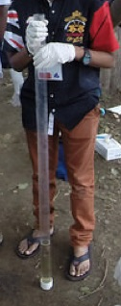
Transparency Tube Protocol Overview
Assemble field equipment
Collect site data
Conduct cloud type and cloud cover measurements
In the Field: Take the measurements using a transparency tube
Repeat 3 times to ensure accuracy and precision
Verify that the data from the three measurements are within 10 cm of the mean, (but do not average your data for reporting)
Report your data to the GLOBE website

Slide 38
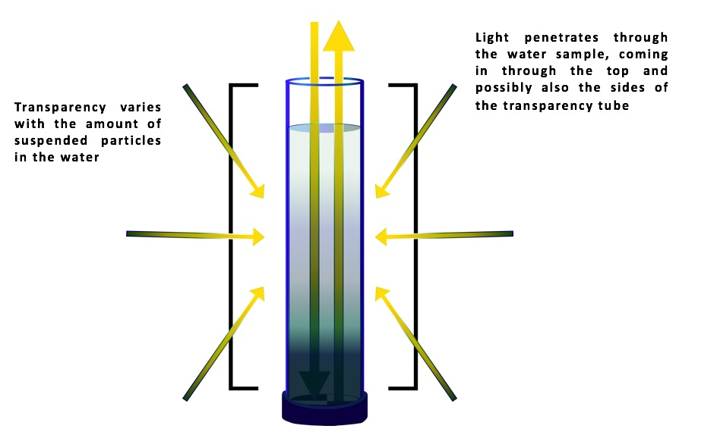
Using the Transparency Tube
The transparency tube measures light penetration through surface waters.

Slide 39
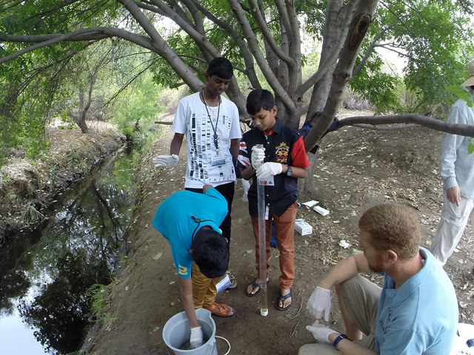
Time Requirements for Transparency Tube Method
Time to complete protocol: About 10 minutes
Frequency: Ideally, weekly measurements at the same sampling site
Ease of Protocol: Beginner Level

Slide 40
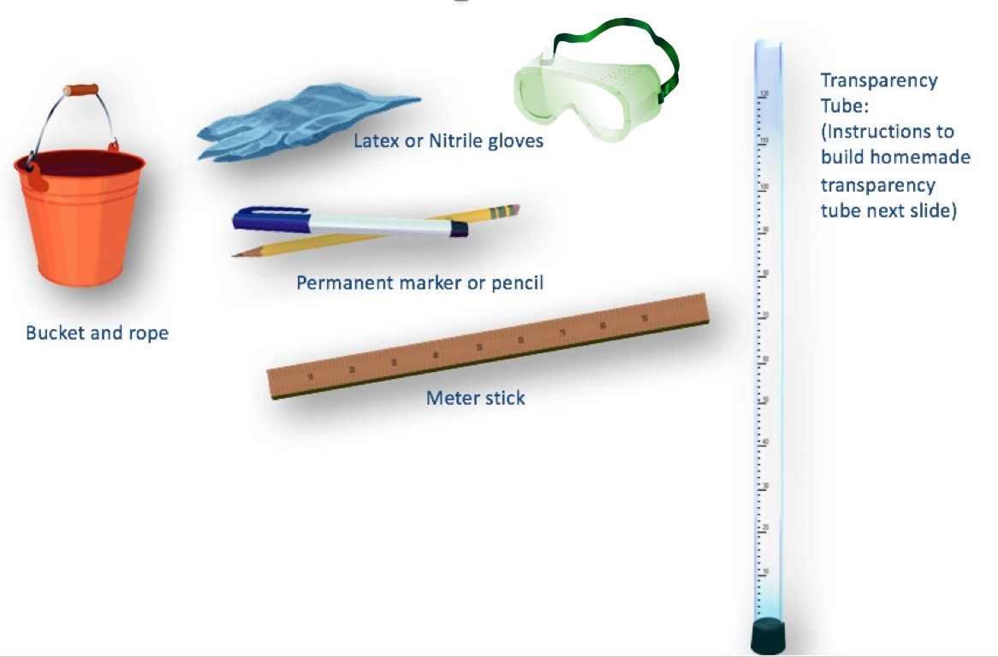
Assemble Field Equipment for Transparency Tube Method

Slide 41
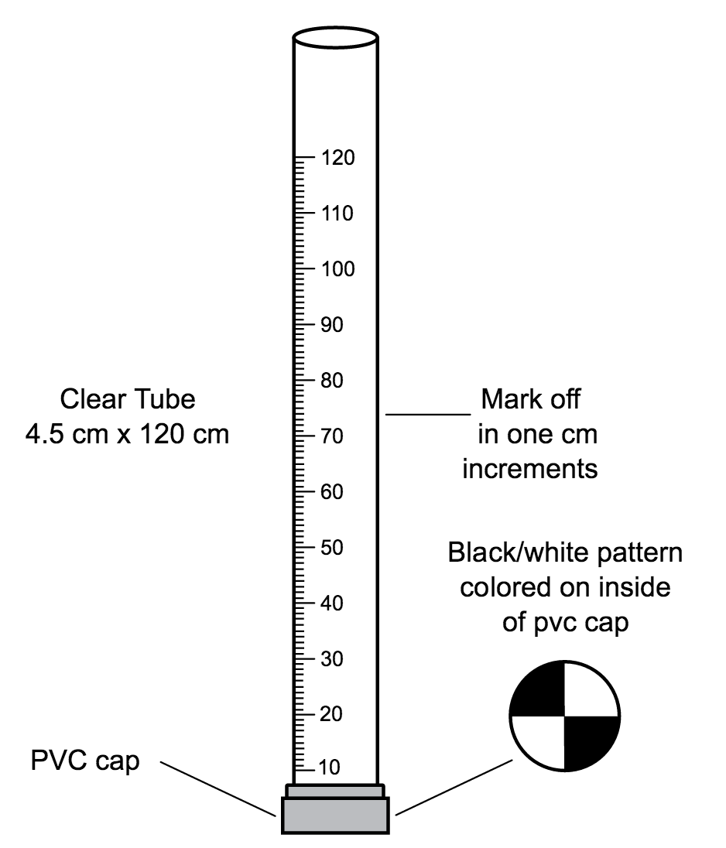
Instrument Construction Instructions for Making a Transparency Tube
Materials:
*Clear tube approximately 4.5 cm x 120 cm
PVC cap (to fit snugly over one end of the tube)
Permanent black marker
Meter stick or meter tape
Construction:
1. On the bottom of the inside of the PVC cap, draw a Secchi disk pattern (alternating black and white quadrants) with the black permanent marker.
2. Put the PVC cap over one end of the tube. Cap should fit tightly so water cannot leak out.
3. Use the marker and meter stick to draw a scale on the side of the tube. The bottom of the inside of the PVC cap where the Secchi disk pattern is drawn is 0 cm. Mark every cm up from that point.
4. A shutoff valve can be installed near the bottom of the tube to allow water to escape in a controlled manner; this would resemble commercially-available transparency tubes. You can also drill a small hole near the bottom that you can plug with your finger when you are making measurements.
*Many hardware stores carry long tubes for protecting fluorescent light bulbs. These are inexpensive and make excellent transparency tubes. If these are not available, any long, clear plastic tube may be used: the length is more important than the diameter.

Slide 42
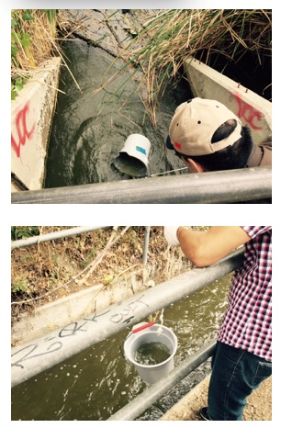

In the Field: Collect Your Water Sample
Put on protective gloves
Collect a surface water sample as follows:
  Rinse bucket with water from the site to avoid contamination. Do not use distilled water to clean the bucket.
  Hold tightly onto the rope.
  If your sampling site is a stream, throw the bucket out to a well-mixed area (a riffle), a little distance from the shore. Ideally, the water should be flowing at least slightly. If you are sampling from a lake, bay, or the ocean, stand on the shore and throw the bucket as far out as possible to collect your sample.
  If the bucket floats, jostle the rope until some water enters the bucket.
  You should always take a sample from the top surface water. Be careful not to let the bucket sink to the bottom or stir up bottom sediment.
  Allow the bucket to fill about 2/3 to 3/4 full and pull it back in with the rope.
Be sure to rinse bucket with sample water

Slide 43
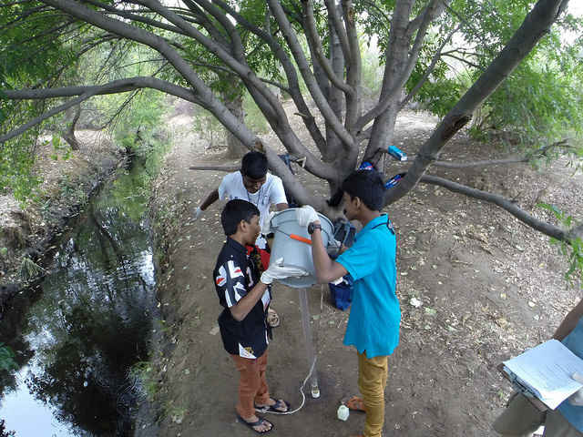
Filling the Transparency Tube with water sample
Stand with your back to the sun, so that the transparency tube is shaded.
Pour sample water slowly into the tube using a cup. Look straight down into the tube with your eye close to its opening.
Stop adding water when you can’t see the Secchi pattern at tube’s bottom.
Measurement of water transparency must be done in the shade to avoid sun glare and differences in visibility.

Slide 44
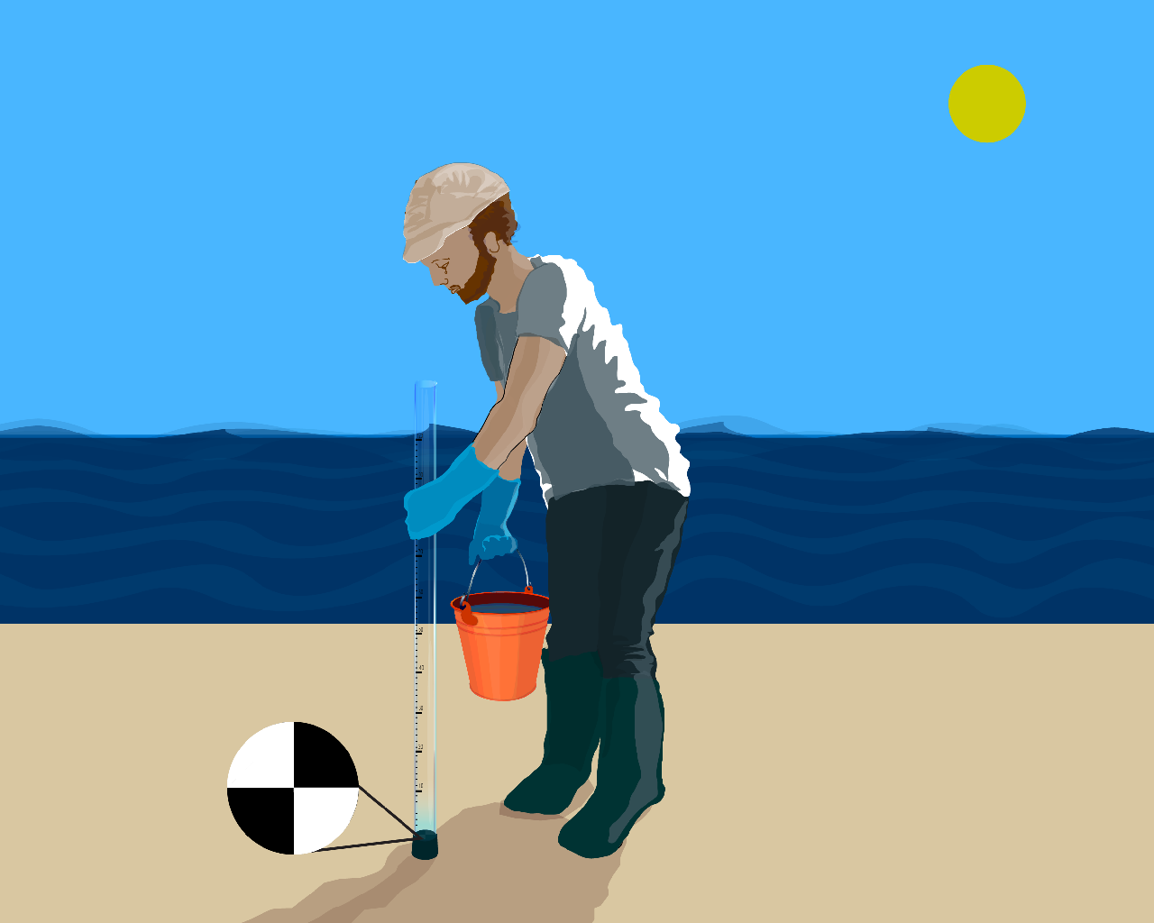
Collect your Data Using the Transparency Tube
Rotate the tube slowly as you look to ensure that you can’t see the Secchi pattern. The Secchi pattern at the bottom of the tube should be completely unrecognizable when you look through the tube.

Slide 45
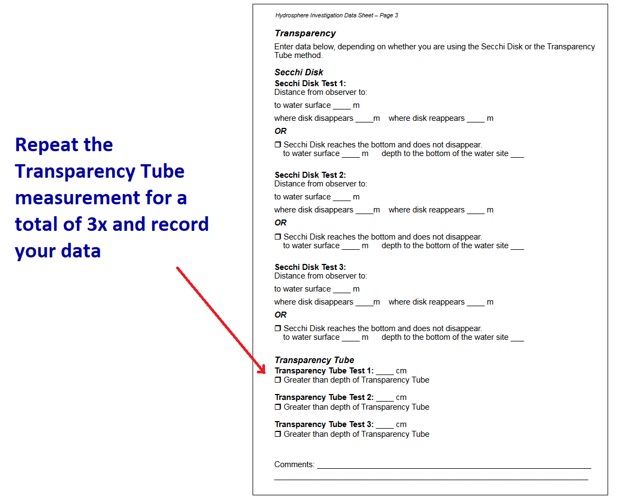
Repeat measurement 3 X for Transparency Tube Method and you are done!

Slide 46
Let’s do a quick review before moving to GLOBE data reporting and visualization! Question 3
If you have deep, still water, what is the water transparency method of preference in GLOBE Hydrosphere investigations?
Secchi Disk Method
Transparency Tube (also called turbidity tube) method
What is the answer?

Slide 47
Let’s do a quick review before moving to GLOBE data reporting and visualization! Answer to Question 3
If you have deep, still water, what is the water transparency method of preference in GLOBE Hydrosphere investigations?
Secchi Disk Method ☺ Correct!
Transparency Tube (also called turbidity tube) method
Were you correct?

Slide 48
Let’s do a quick review before moving to GLOBE data reporting and visualization! Question 4
How many replicate measurements should you make to ensure your data are reliable?
Only once, since it is a very straightforward protocol and since there are no chemical measurements; there is less chance of human error.
Three times, report the average of the three measurements.
Three times, report all three measurements.
What is the answer?

Slide 49
Let’s do a quick review before moving to GLOBE data reporting and visualization! Answer to Question 4
How many replicate measurements should you make to ensure your data are reliable?
Only once, since it is a very straightforward protocol and since there are no chemical measurements; there is less chance of human error.
Three times, report the average of the three measurements.
Three times, report all three measurements. ☺ Correct!
Were you correct?

Slide 50
Let’s do a quick review before moving to GLOBE data reporting and visualization! Question 5
When scientists take water transparency measurements, they also describe other conditions that may affect their measurements. What are they?
Lithosphere-the local rock types
Atmosphere-the cloud conditions
Biosphere-the plants found by the side of the water
What is the answer?

Slide 51
Let’s do a quick review before moving to GLOBE data reporting and visualization! Answer to Question 5
When scientists take water transparency measurements, they also describe other conditions that may affect their measurements. What are they?
Lithosphere-the local rock types
Atmosphere-the cloud conditions ☺ Correct!
Biosphere-the plants found by the side of the water
Were you correct?

Slide 52
Let’s do a quick review before moving to GLOBE data reporting and visualization! Question 6
What safety precautions should you take in the field with your students?
Students should wear protective gloves and eyewear
Protection from biting insects, such as wearing clothes that limit skin exposure and using insect repellent
For this protocol, it is not necessary, because the Water Transparency methods do not use dangerous chemicals
A and B
What is the answer?

Slide 53
Let’s do a quick review before moving to GLOBE data reporting and visualization! Answer to Question 6
What safety precautions should you take in the field with your students?
Students should wear protective gloves and eyewear
Protection from biting insects, such as wearing clothes that limit skin exposure and using insect repellent
For this protocol, it is not necessary, because the Water Transparency methods do not use dangerous chemicals
A and B ☺ Correct!
Were you correct? Now let’s review the procedure for reporting and visualizing GLOBE data.

Slide 54
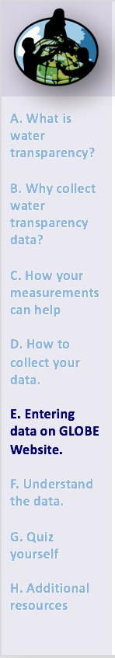

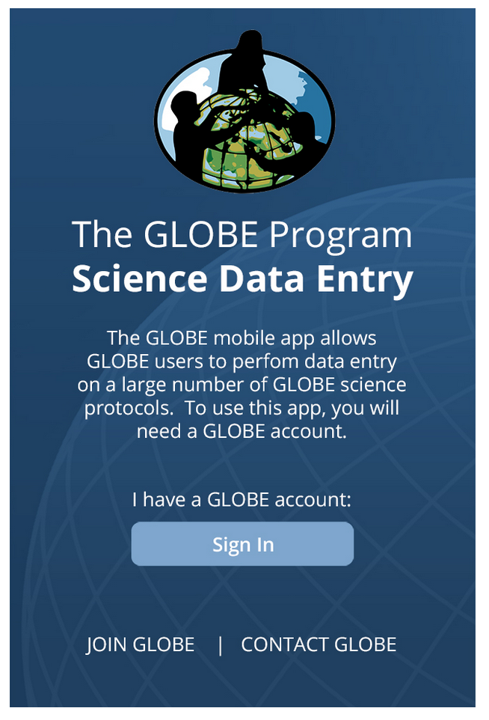
Submitting your data to GLOBE
Live Data Entry: Upload your data to the official
Email Data Entry: Send data in the body of your email (not as an attachment) to DATA@GLOBE.GOV
Mobile Data App: Download the GLOBE Science Data Entry app to your mobile device and select the right option.
  For Android via Google Play
  For IOS via the App Store

Slide 55
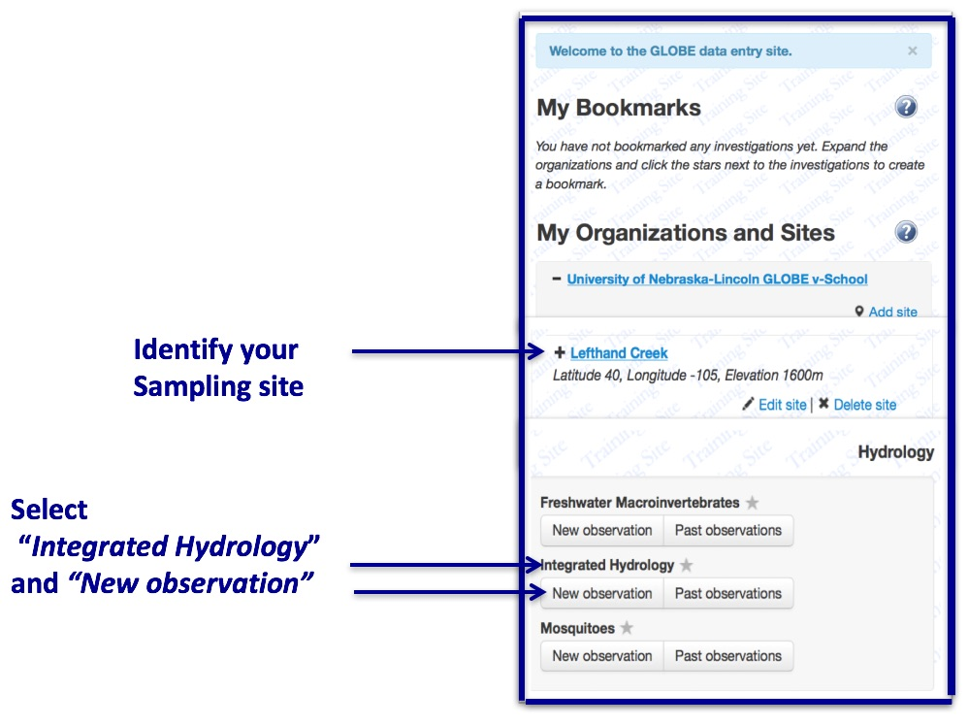
Entering your data via Live Data Entry or Data Entry Mobile App- Step 1

Slide 56

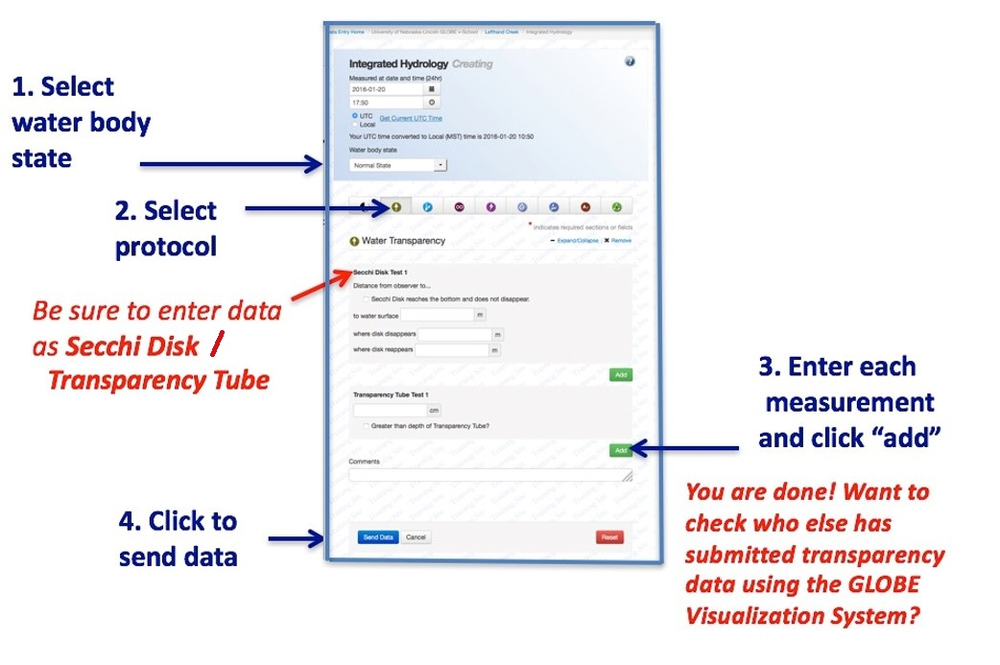
Entering your data via Live Data Entry or Data Entry Mobile App- Step 2

Slide 57
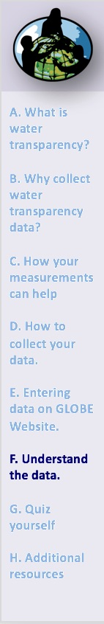
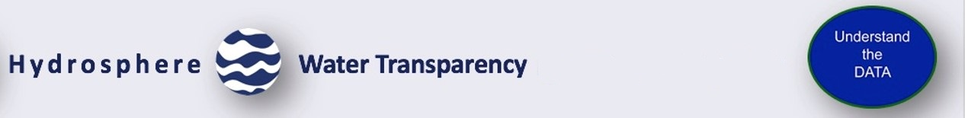
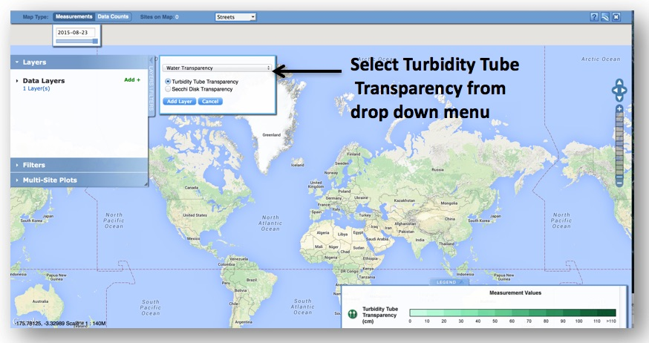
Visualize and Retrieve Data- Step 1
GLOBE provides the ability to view and interact with data measured across the world. Select GLOBE’s Visualization System to map, graph, filter and export transparency tube data that have been measured across GLOBE protocols since 1995. Note that the terms Transparency Tube and Turbidity Tube are interchangeable.
Link to step-by-step tutorial on using the GLOBE Data Visualization System

Slide 58
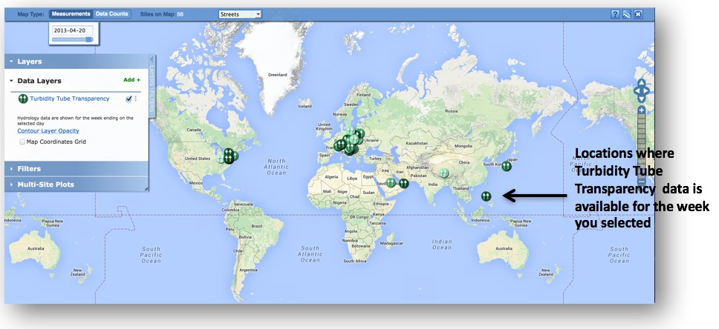
Visualize and Retrieve Data- Step 2
Select the date for which you need Transparency data, add layer and you can see where data is available.

Slide 59
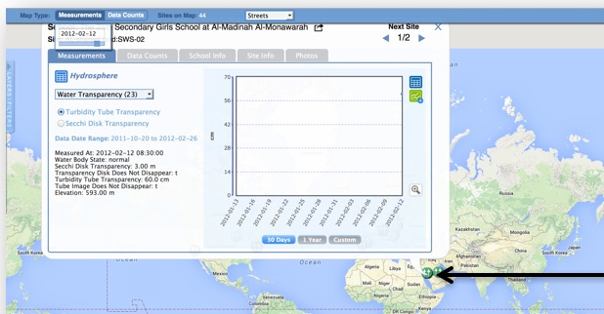
Visualize and Retrieve Data- Step 3
Select the sampling site for which you need Transparency data, and a box will open with a data summary for that site.
Clicking on a location will open to a map note providing Transparency data for that location and time. Follow instructions in the tutorial to download data as a .csv file for analysis.

Slide 60

Review questions to help you prepare to measure Water Transparency at your Hydrosphere Study Site
What does water transparency measure?
What kind of suspended particles are found in water bodies?
The absolute depth at which light can penetrate through a water column is called ______?
The more suspended particles, the (more/less) transparency.
When water is still and deep, the appropriate transparency instrument is (Secchi disk/Transparency Tube).
Your three replicate measurements should be within _______cm of the mean.
Why do you need to take your transparency measurement in the shade?
Why is it necessary to describe cloud cover when taking transparency measurements?
What are some reasons water transparency measurements may change over the course of a year?
What safety precautions should you take prior to conducting any of GLOBE’s hydrosphere protocols?

Slide 61
Are you ready to take your quiz?
You have now completed the slide stack. If you are ready to take the quiz, sign on and take the quiz corresponding to Water Transparency Transparency Tube Protocol.
When you pass the quiz, you are ready to take Water Transparency Tube Protocol measurements!

Slide 62


Frequently Asked Questions- FAQs
When comparing data between sites, do you need to make an adjustment for data taken at the water surface compared to data taken from a bridge or dock?
This distance is not used to adjust the Secchi disk data. However, reporting the distance between the observer and the water helps in data interpretation.
My students are using a pond for our hydrosphere measurements. They go out in a boat and use a Secchi disk for the transparency. We are not sure of the two measurements we are asked to give. They measure the line at the surface of the water to the top of the disk when it disappears and reappears. What is the other measurement?
For the other measurement, distance from where you read the line to the water surface, you should enter zero. Some schools will make Secchi disk readings from a bridge or pier, and report the depth measured using a reference level that is not the water surface, but some distance above the water surface. So they need to also enter the distance from the pier to the water. That way we have all of the raw data in the database.

Slide 63
Connections to the Classroom: Suggested Sequence of Learning Activities from the GLOBE Teacher’s Guide
• The Water Walk Learning Activity sets the stage for developing a baseline knowledge and interest in your Hydrosphere Study Site.
• The Model a Catchment Basin Learning Activity provides the big picture view of the students’ watershed and the water and study site in relation to this watershed.
• Map Your Hydrosphere Study Site. At the beginning of your study as part of defining your site, and once each year thereafter, create a map of the Hydrosphere Site and take photographs.
• The Practicing Your Protocols Learning Activity guides students through learning how to use the instruments and following the protocols so they collect reliable data.
• Begin Field Sampling. Go to the site and begin the weekly measurements for water.
• Use the Looking at Data section at the end of each protocol as a guide to examine your data, ask questions and interpret what you find. Start linking water data to other GLOBE measurements.
• Focus on Key Science Ideas by performing the following Learning Activities:
- Water Detectives and The pH Game introduce students to key water chemistry variables and to the need of using instruments to take certain measurements.
- Modeling Your Water Balance lets students explore how to use their data for modeling.

Slide 64

Please provide us with feedback about this module. This is a community project and we welcome your comments, suggestions and edits! Comment here: eTraining Feedback
Questions about the information in the module? Contact help@globe.gov
Credits
Slides:
Russanne Low, Ph.D., University of Nebraska-Lincoln, USA
Rebecca Boger, Ph.D., Brooklyn College, NYC, USA
Art and Illustrations:
Jenn Glaser, ScribeArts
More Information:
The GLOBE Program
NASA Earth Science
NASA Global Climate Change: Vital Signs of the Planet
The GLOBE Program is sponsored by these organizations:
Version 12/1/16. If you edit and modify this slide set for use for educational purposes, please note “modified by (and your name and date)“ on this page. Thank you.

