Slide 1
GLOBE Programme in Mauritius
Regional Meeting 2024 In Cameroon

Slide 2
Relaunching of GLOBE Programme in 2023
GLOBE Programme was relaunched in Mauritius in 2023 following the Regional Meeting 2023
Country Coordinator is selected at the level of Director/Assistant Director in the Ministry of Education
Training of 20 Educators and Heads of Schools from 20 pilot schools was carried out by Mark and Rogeline in May 2023
The schools then started implementing the GLOBE Programme

Slide 3
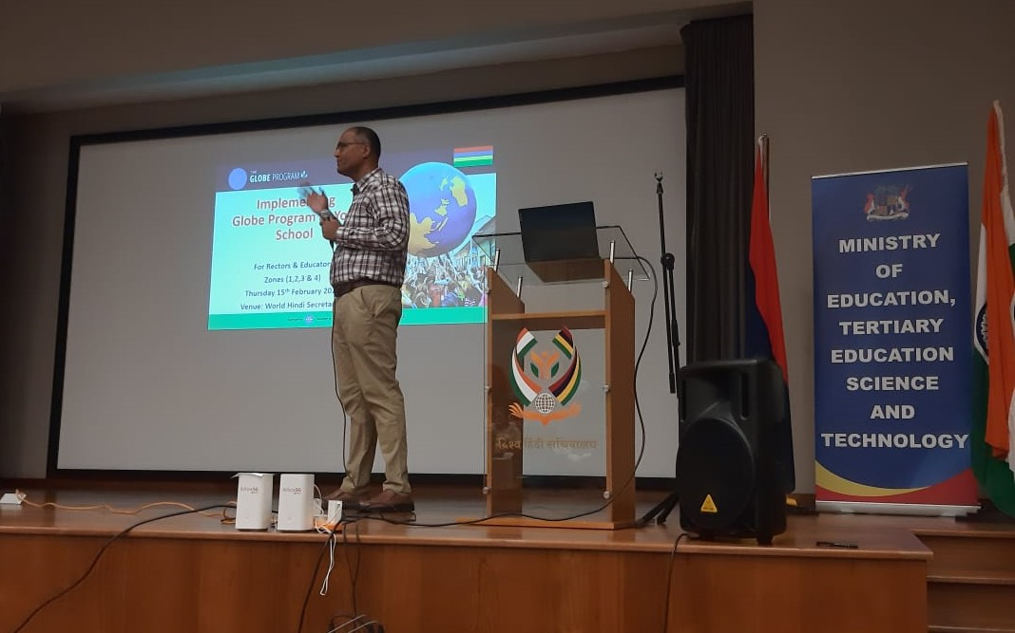
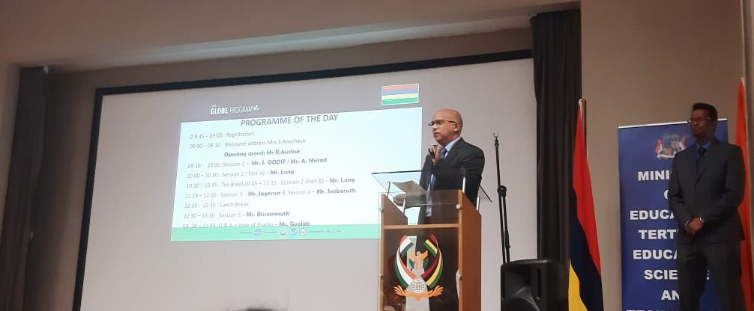
Workshop organized by the Ministry
In February 2024, a workshop was organized by the Ministry to present the GLOBE Programme to 40 secondary schools. The resource persons were from thegroup of Rectors and Educators from the 20 pilot schools who were already implementing GLOBE

Slide 4
Schools doing GLOBE Programme
As at date, the programme has been presented to 61 secondary schools
18 schools actively participating in the programme
One school, Queen Elizabeth College won the data challenge for December 2023 at the Regional level. They were awarded a cash prize

Slide 5
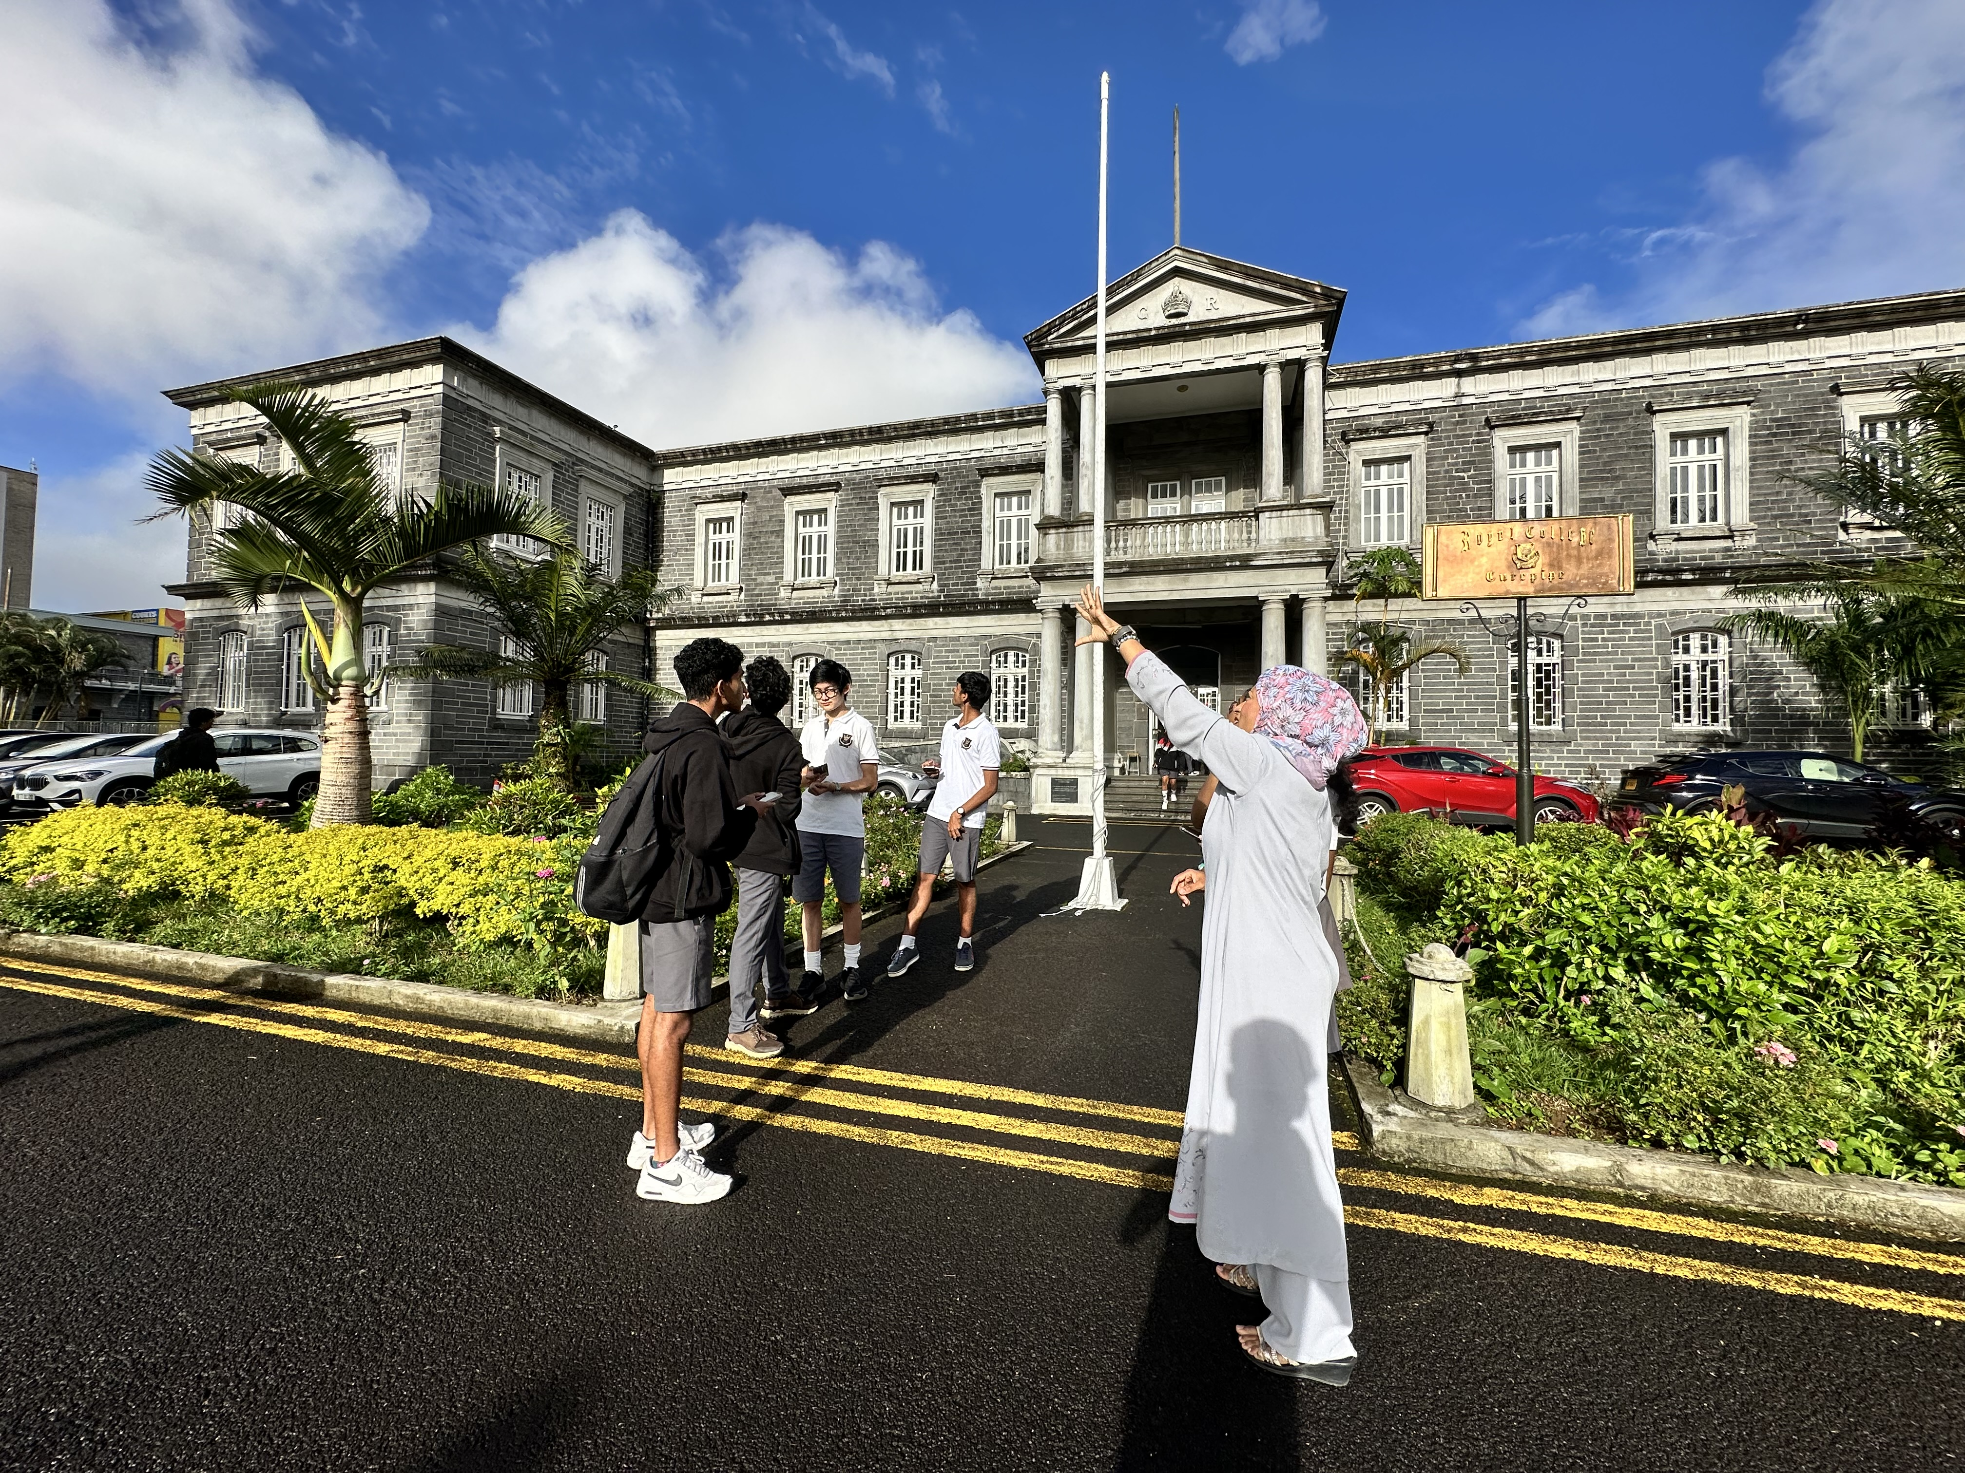
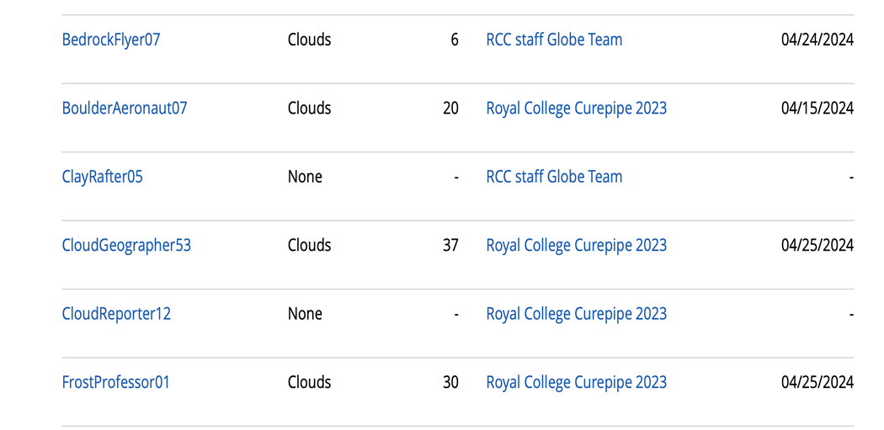
Royal College Curepipe (RCC)
GLOBE Teacher and students observing clouds in the sky for a data upload
Clouds data uploads by RCC GLOBE Student
Clouds data uploads by RCC GLOBE Students

Slide 6
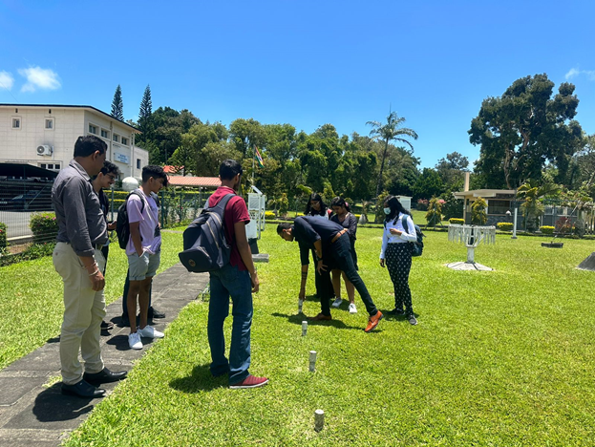
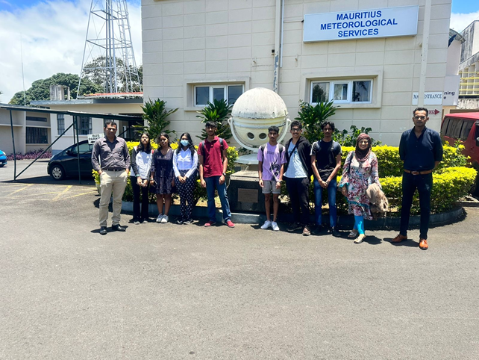
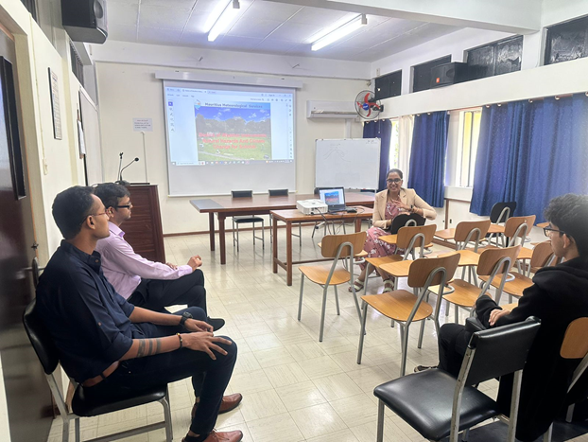
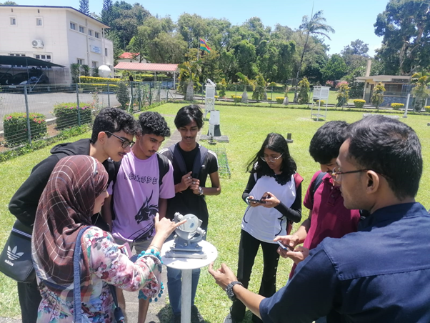
Collaboration with Stakeholders
Visit at Mauritius Meteorological Station

Slide 7
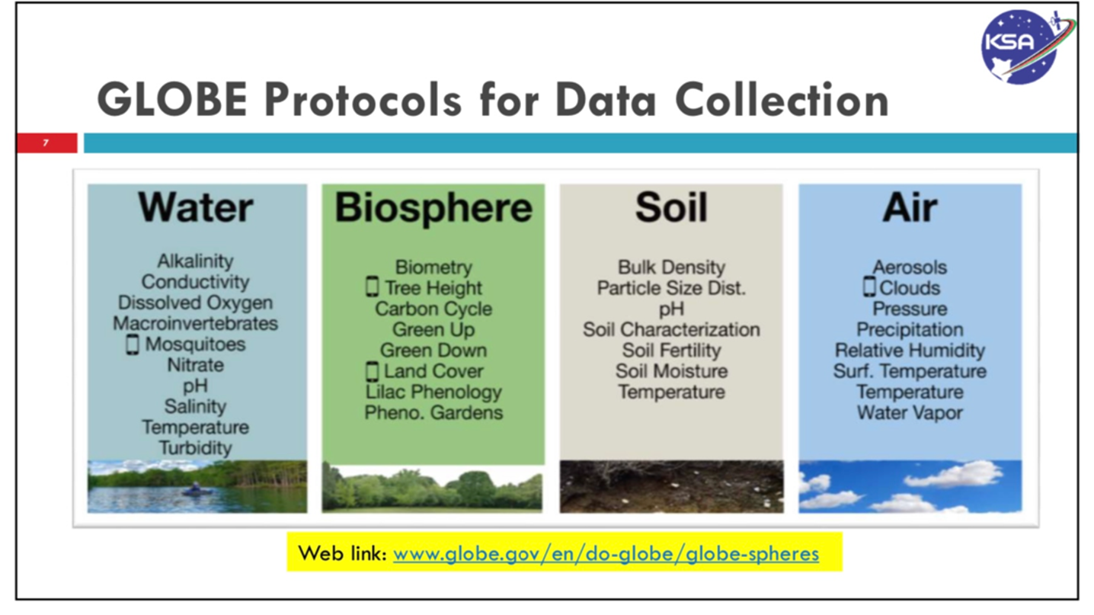
RCC-Plan for 2024
Objective of RCC :to move to other
protocols soon like alkalinity and
mosquitoes and tree heights,
thus growing as GLOBE
Earth scientists

Slide 8
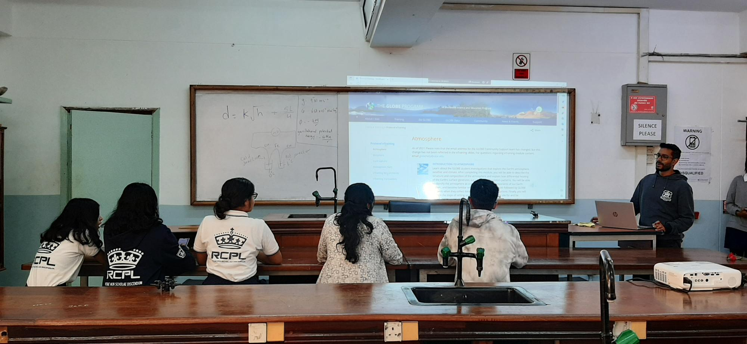
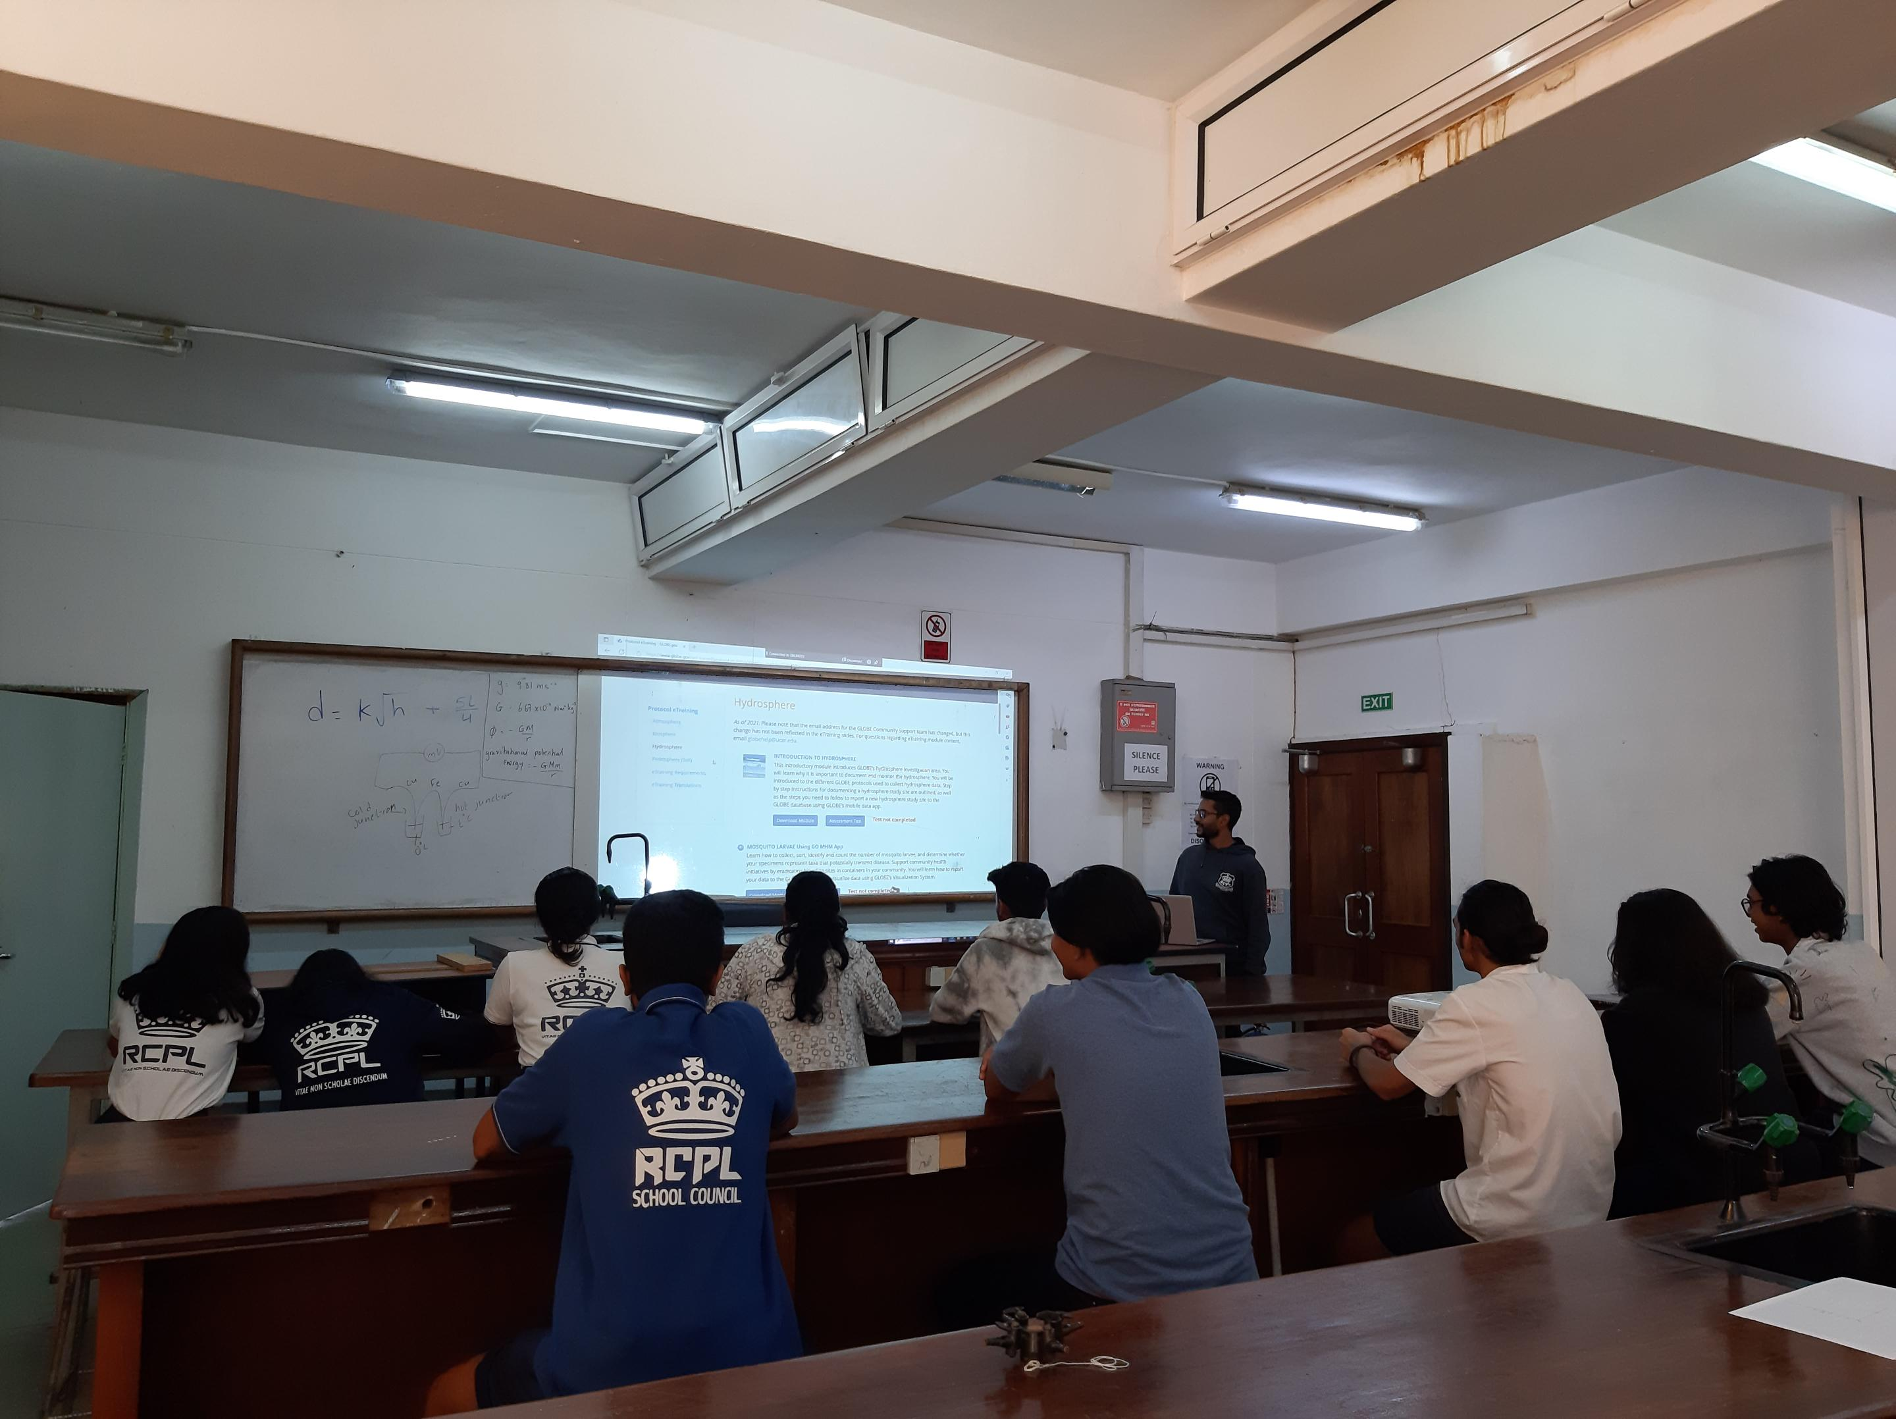
Royal College Port-Louis (RCPL)
We started with a few interested student and the number grew after a week

Slide 9
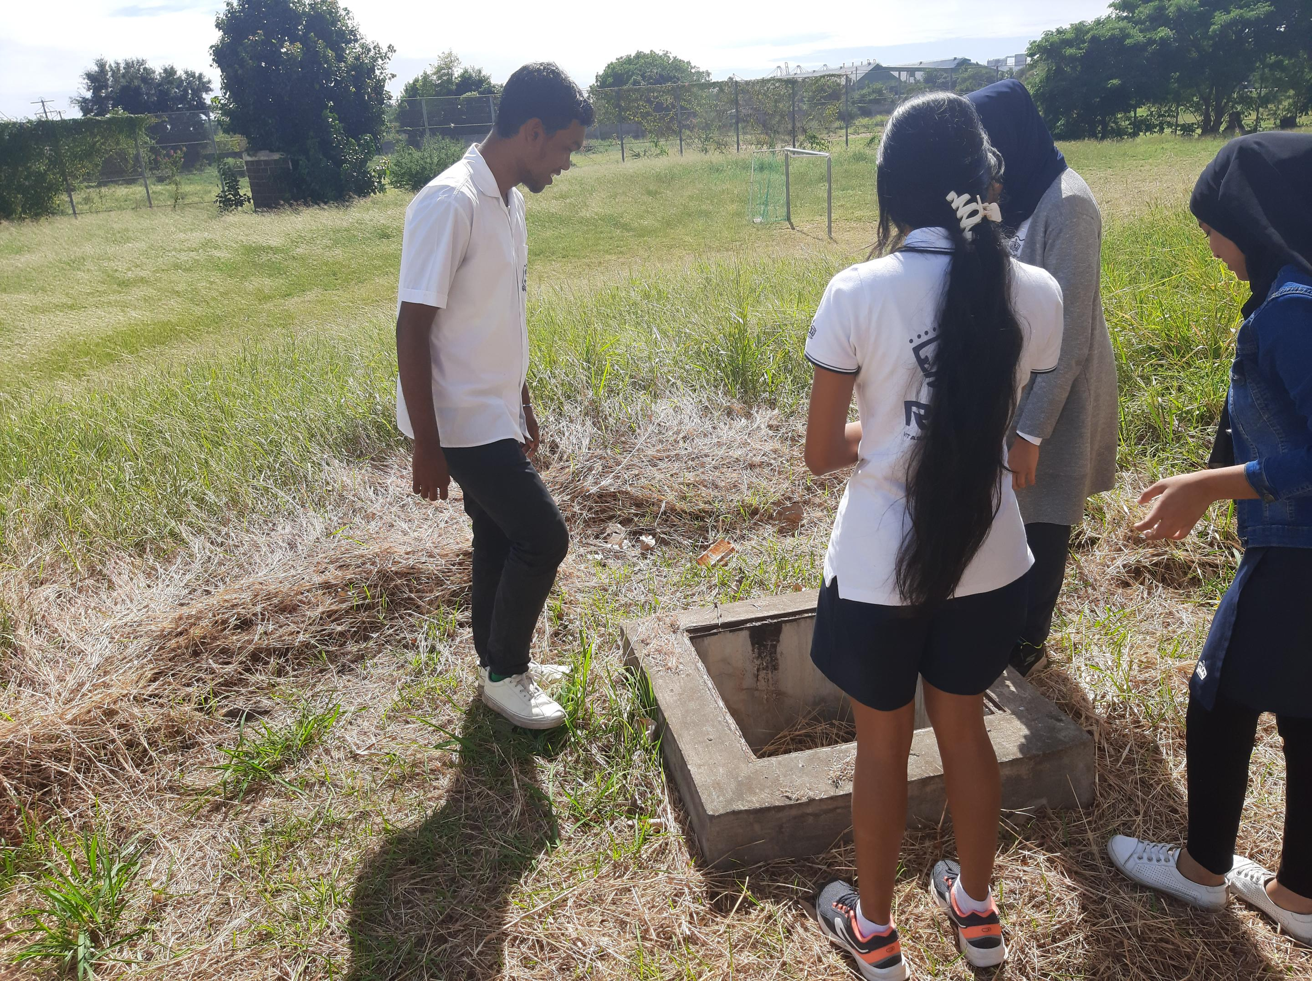
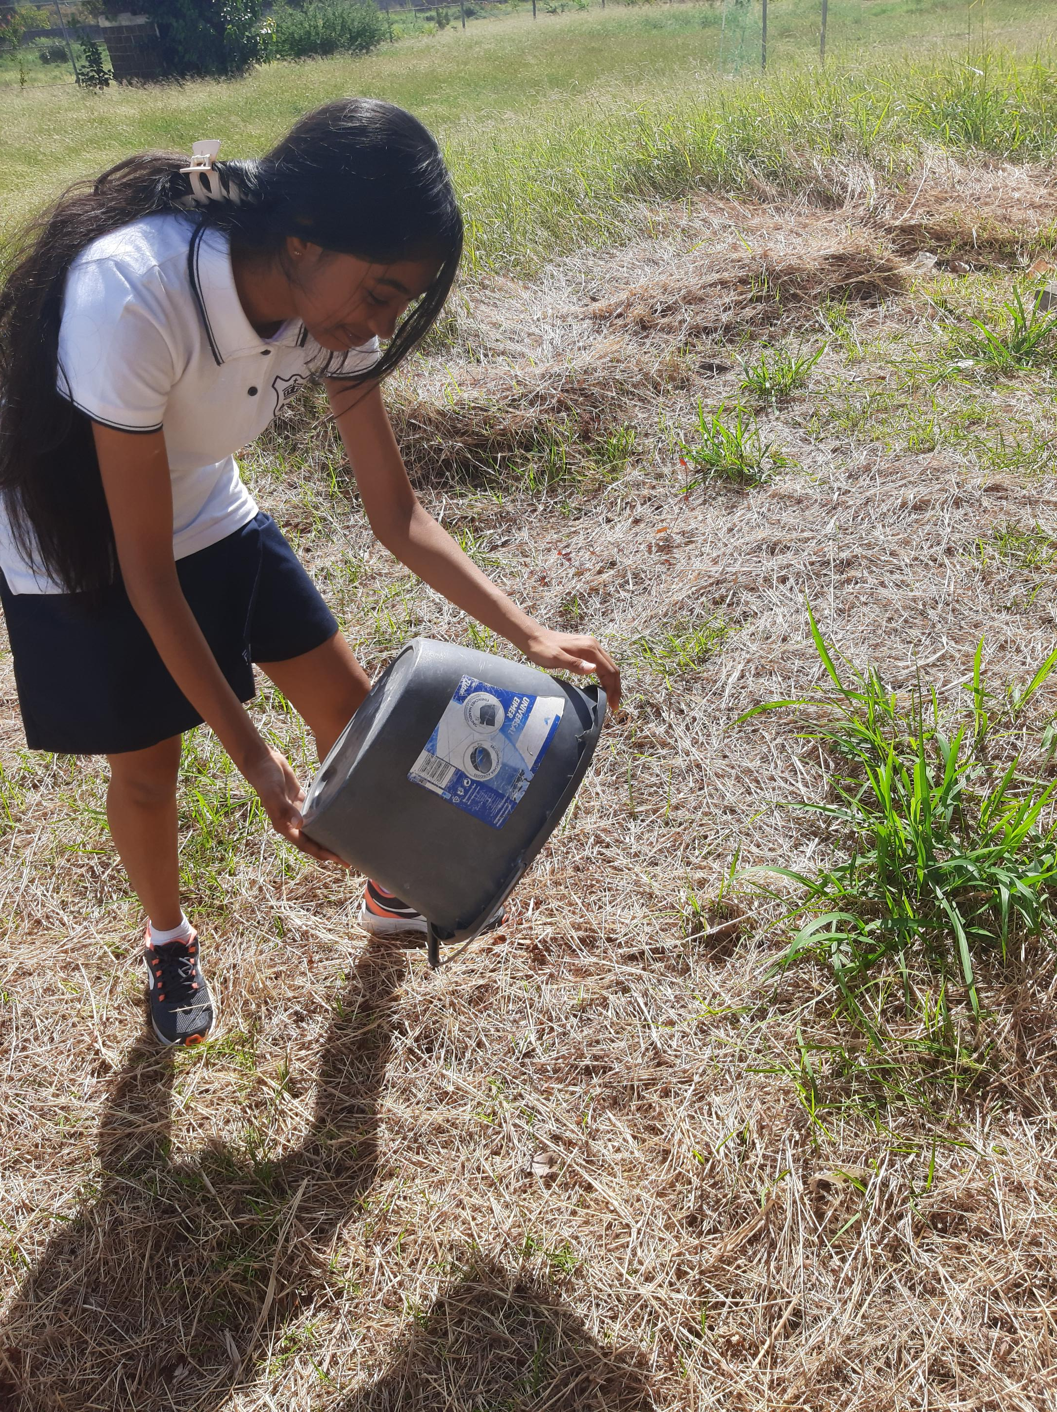
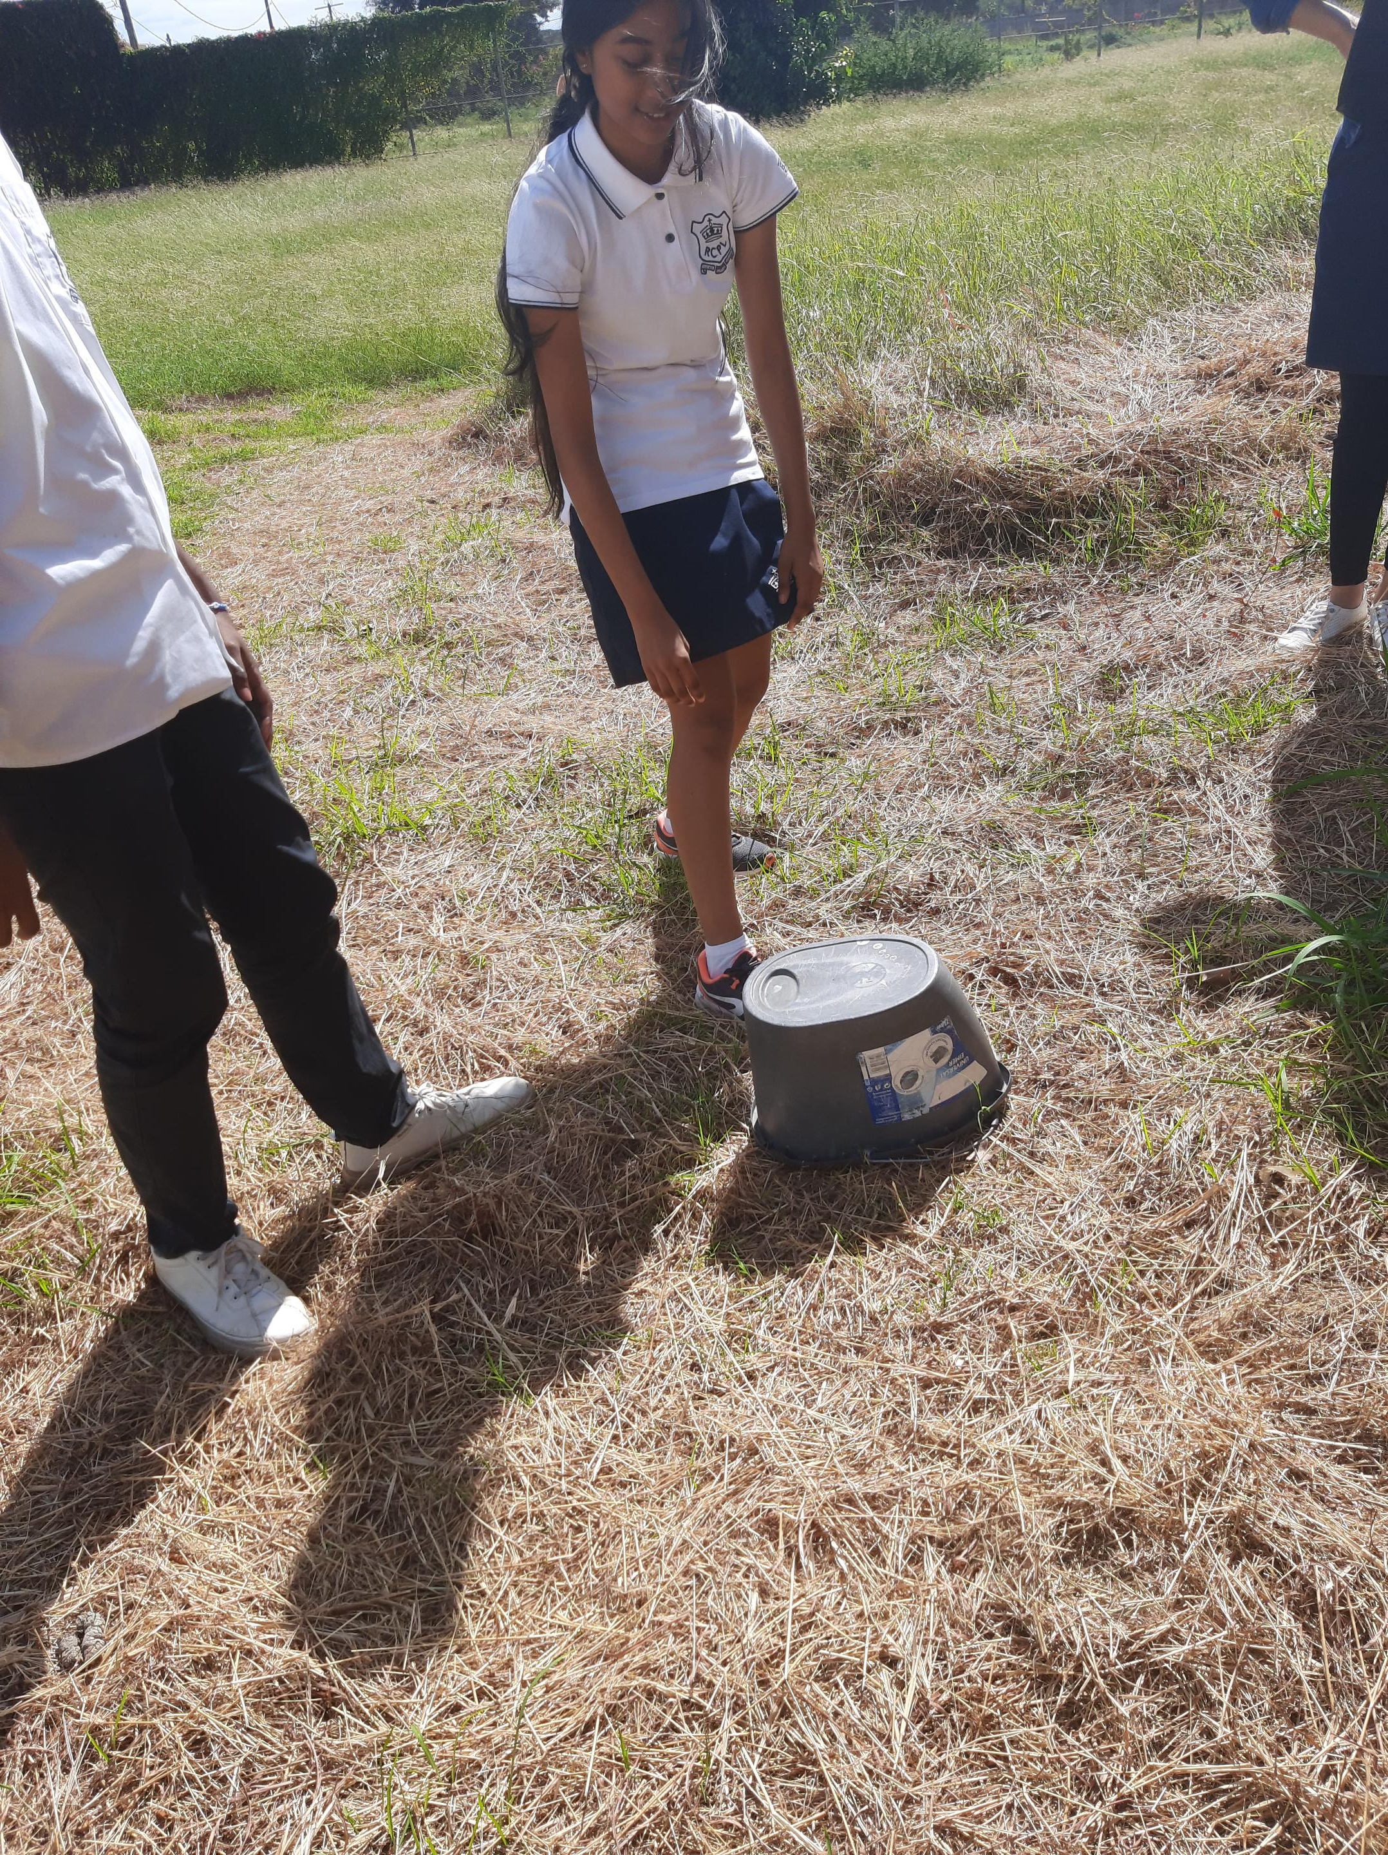
Collecting Data
Introducing mosquito Habitat mapper
Students discarding accumulated rain water after observation

Slide 10
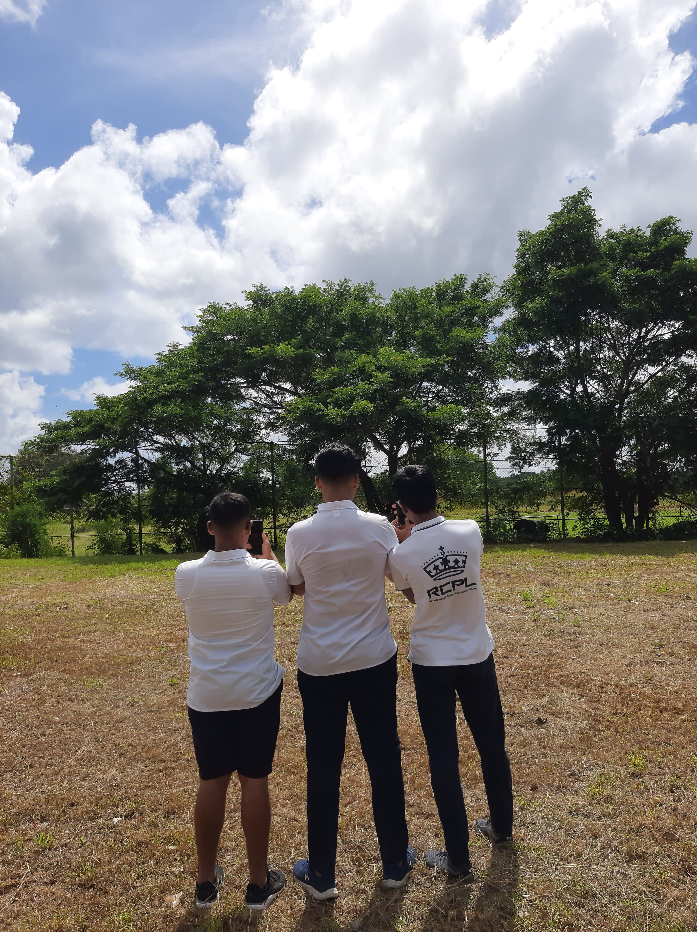
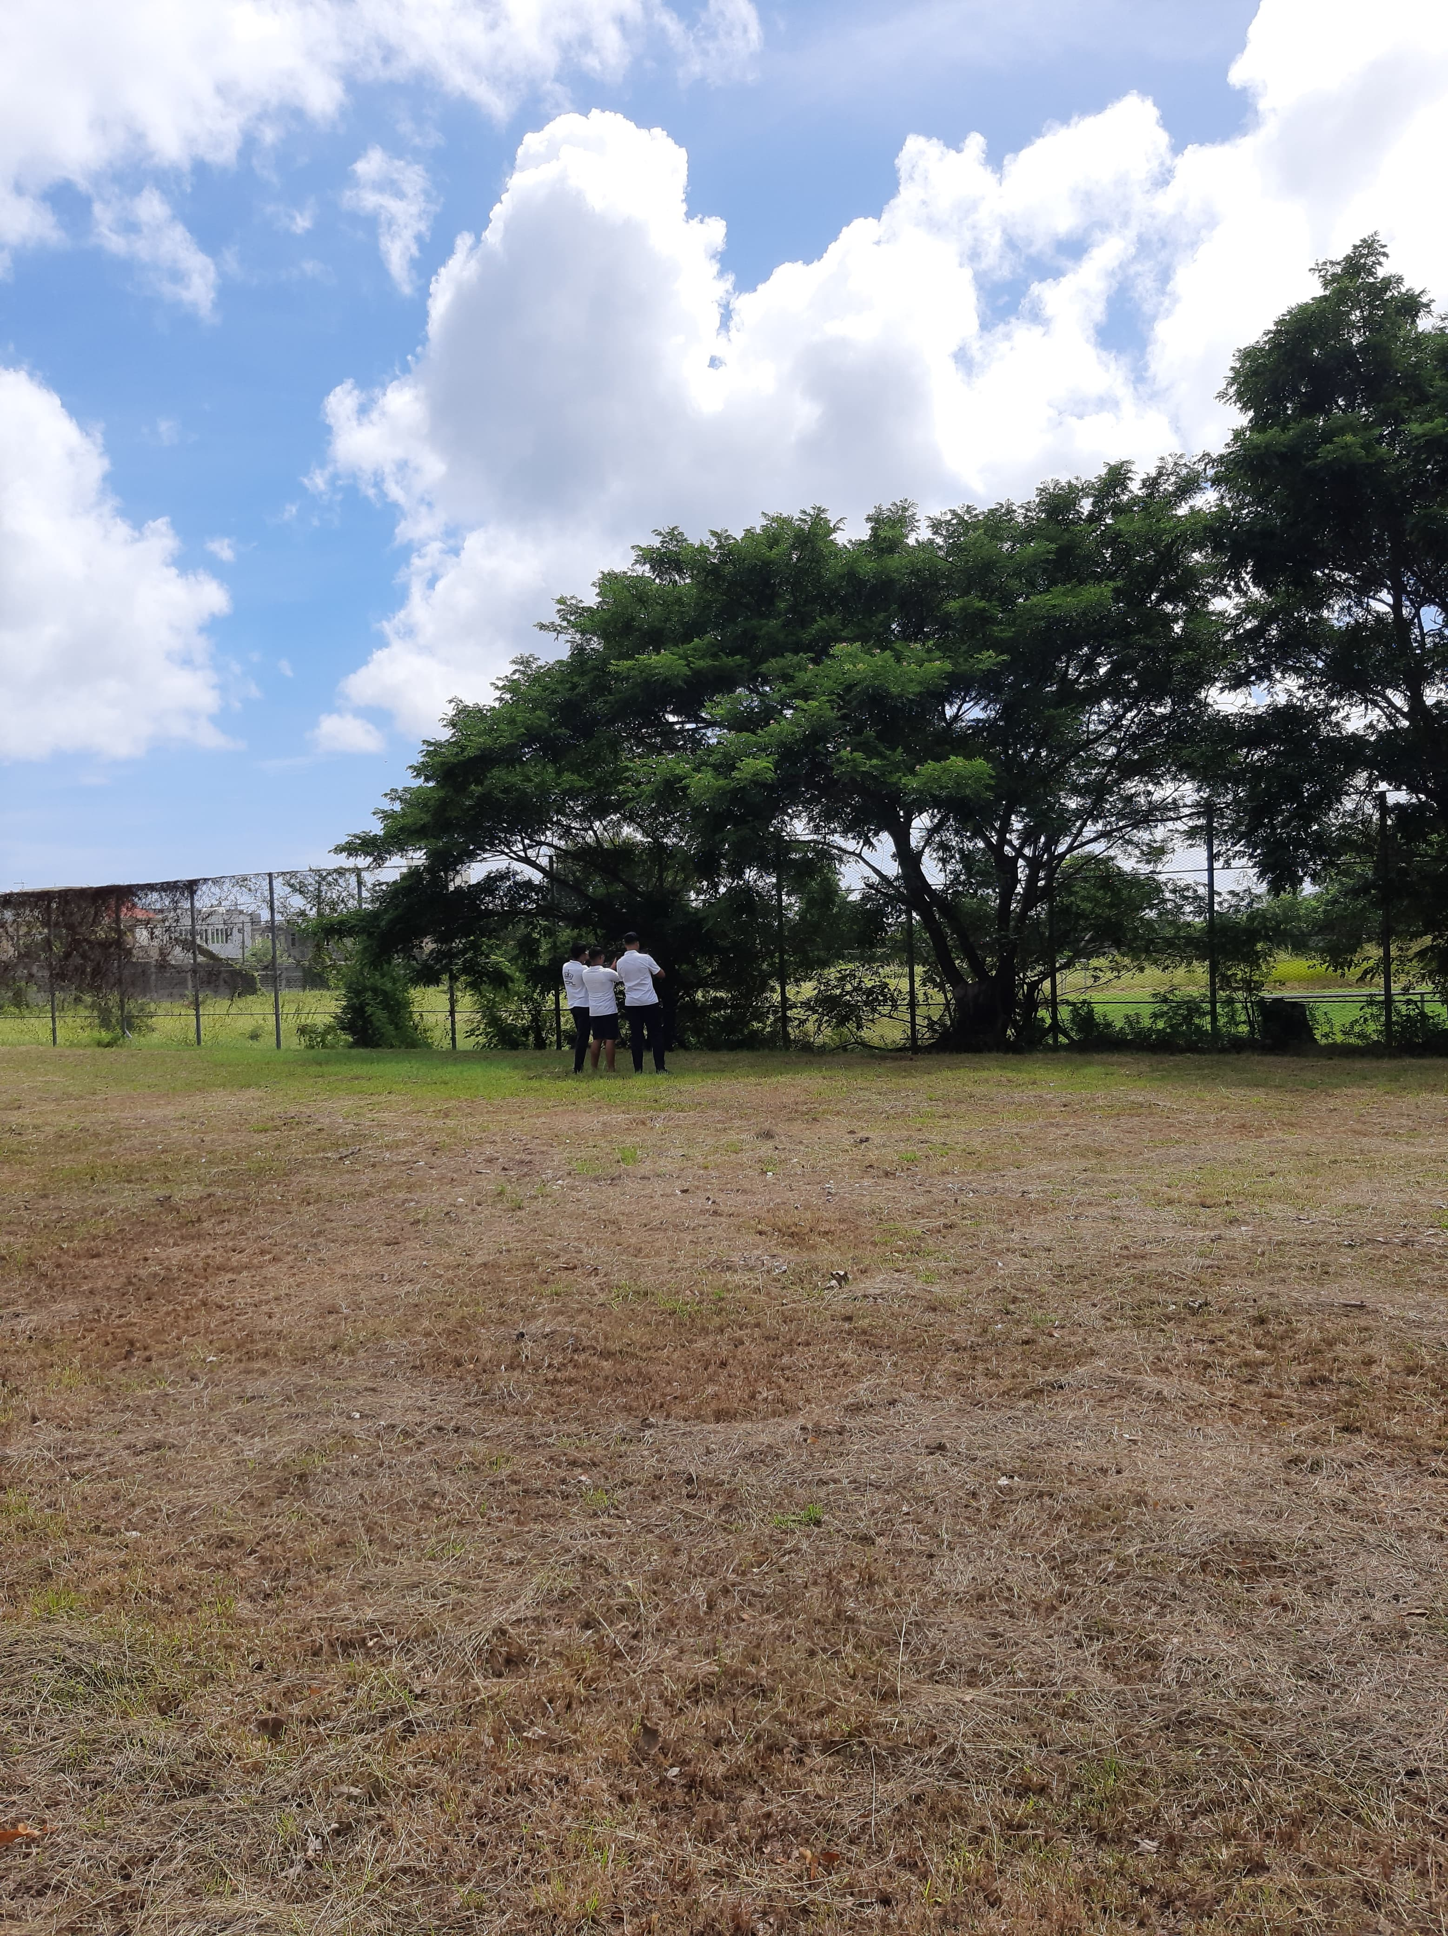
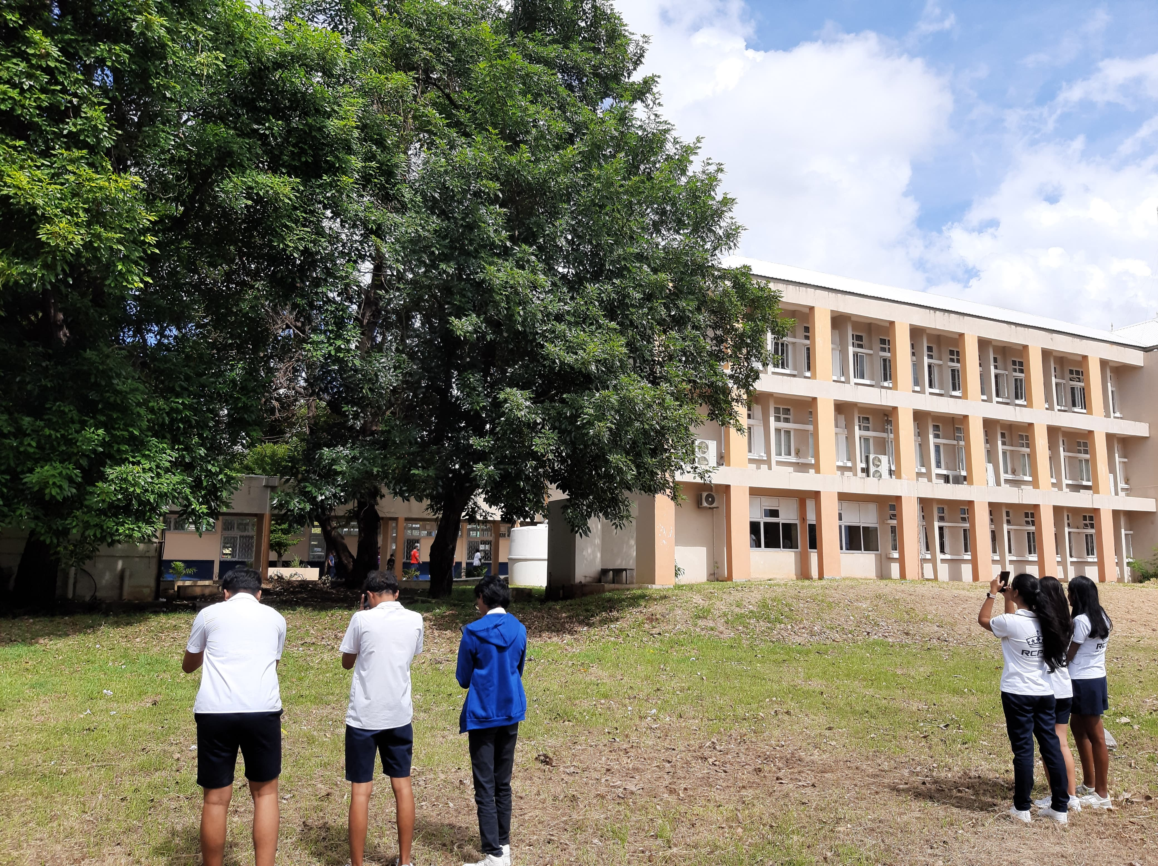
Collecting Data
Trees data collection

Slide 11
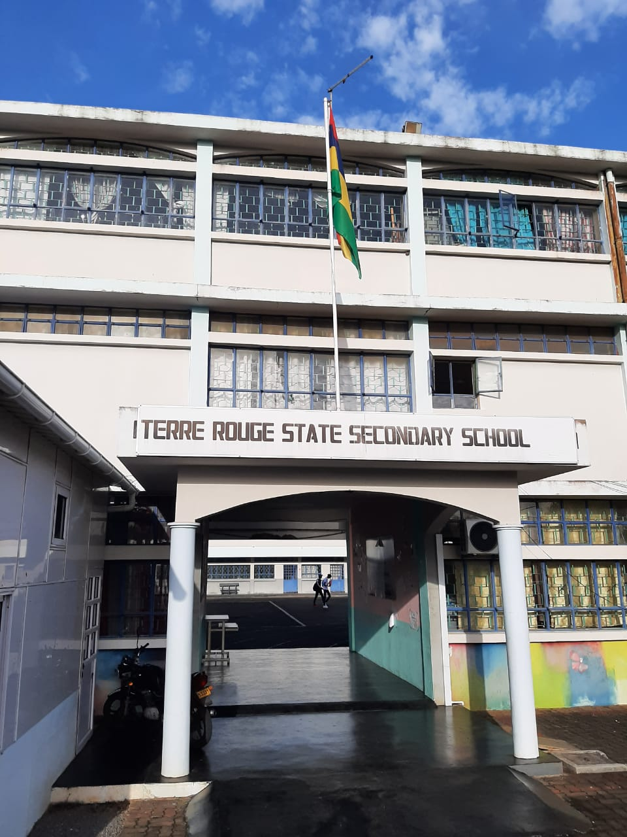
Terre Rouge SSS

Slide 12
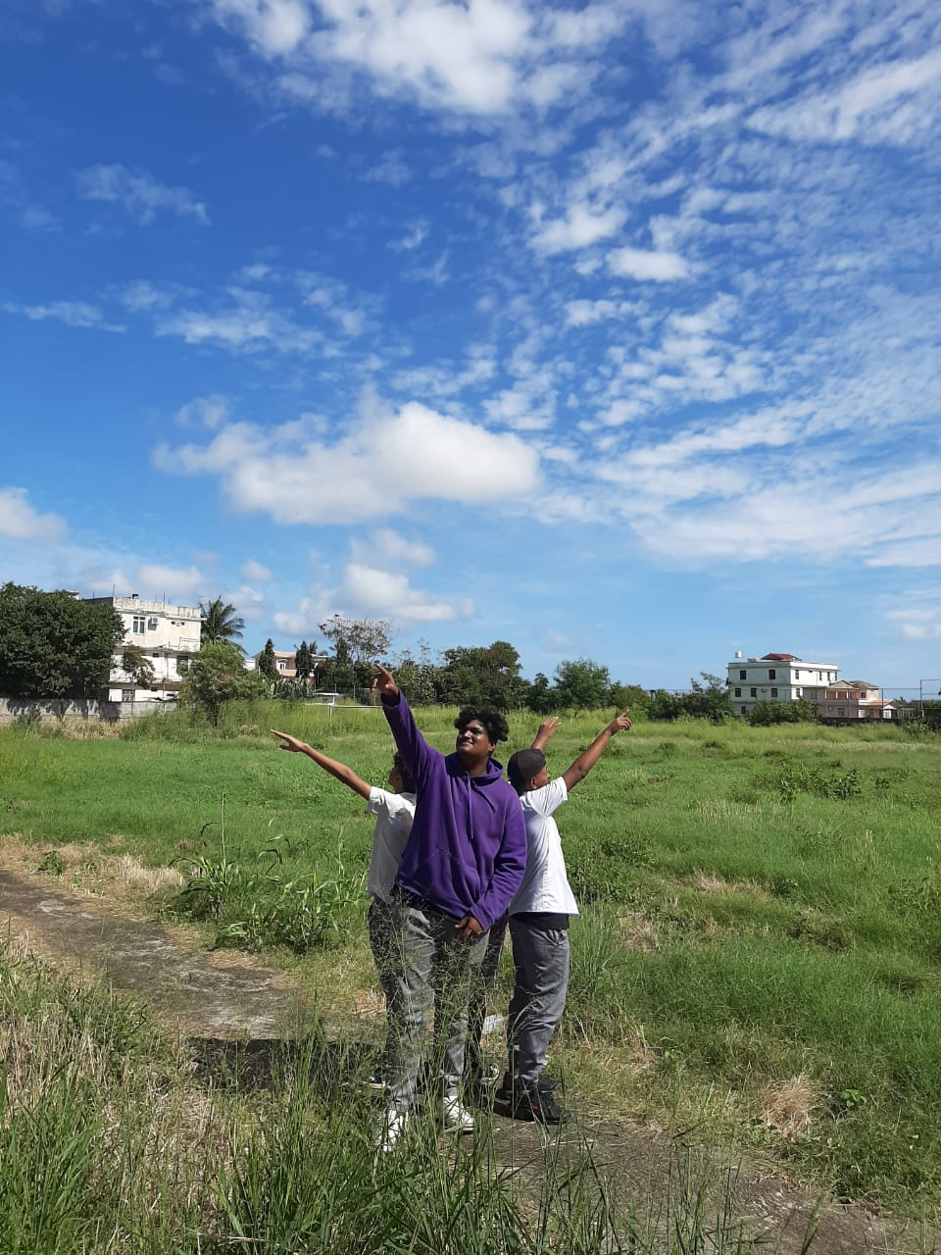
Terre Rouge SSS
Atmosphere
The protocols being used:
Cloud
Cloud Observation

Slide 13
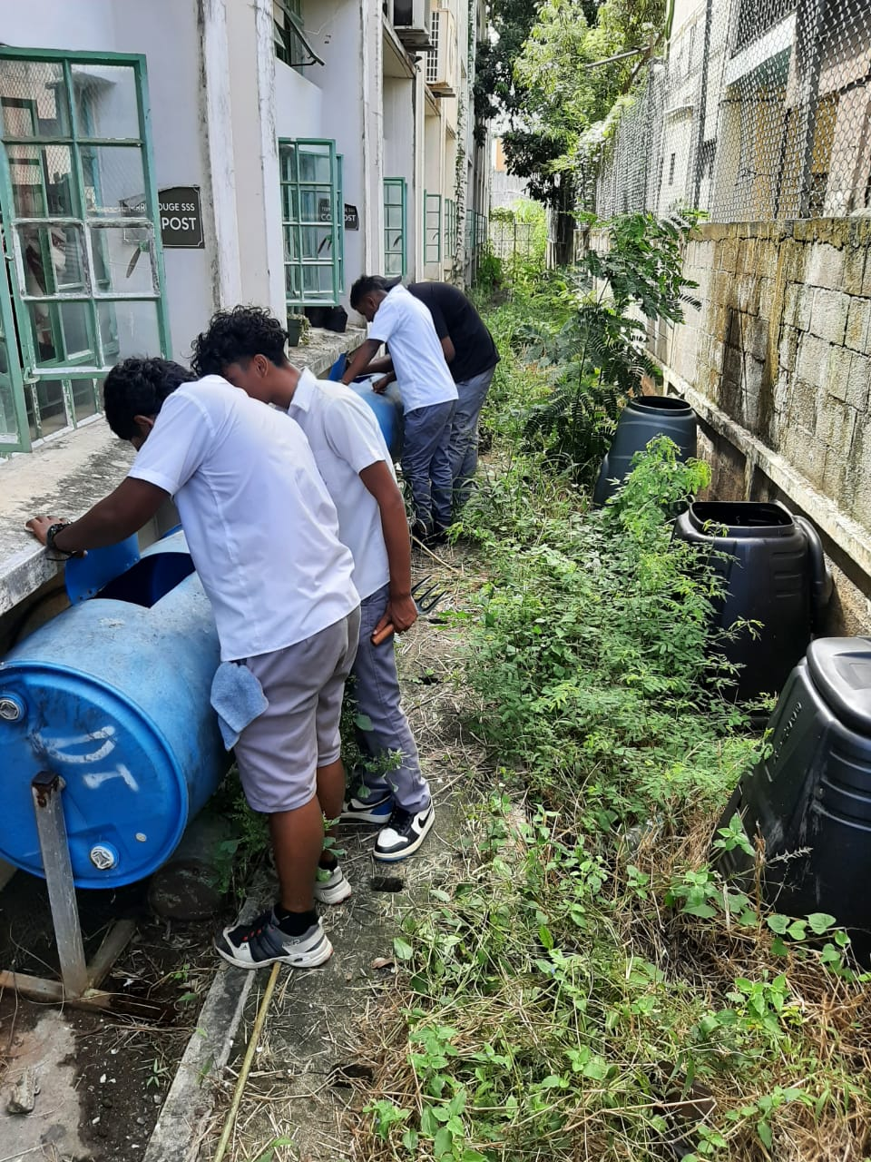
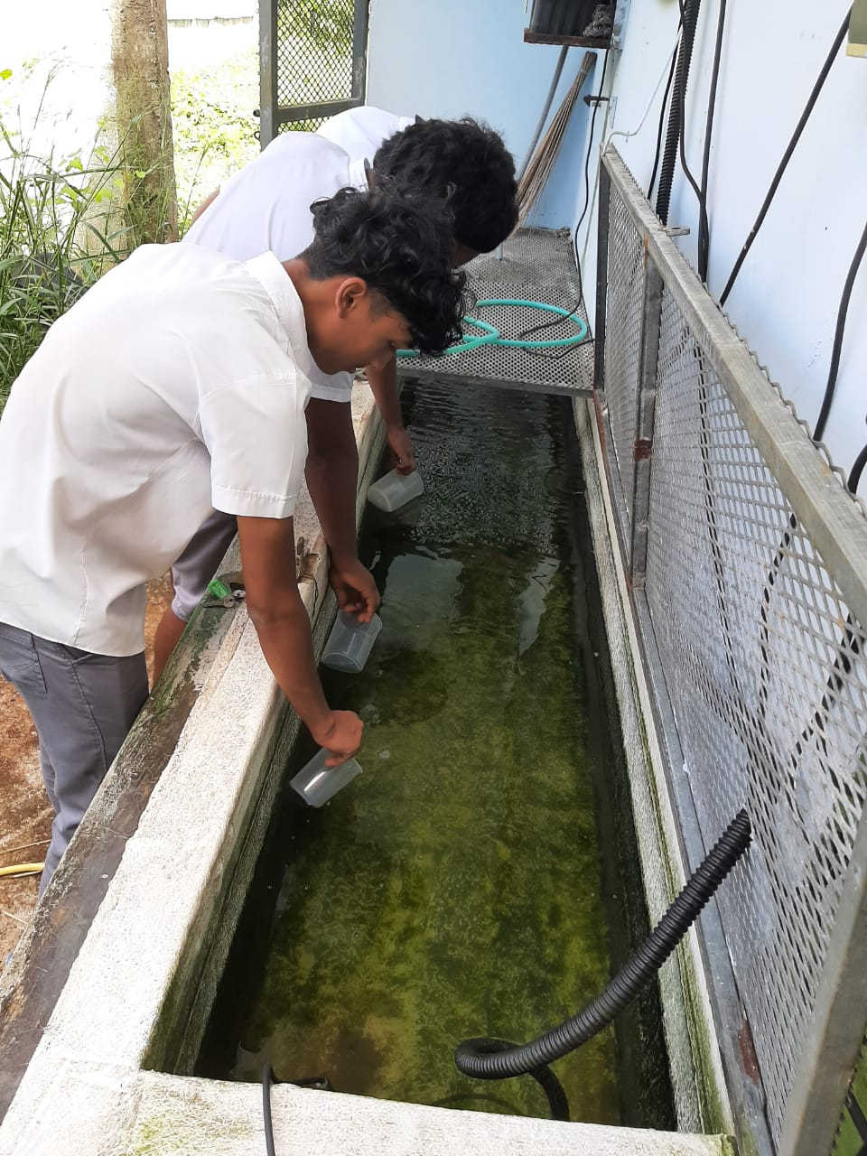
Hydrosphere
The protocols being used:
Mosquito Mappers
pH of Water
Collection of Water Sample for pH Analysis
Searching for Mosquito Breeding Grounds

Slide 14
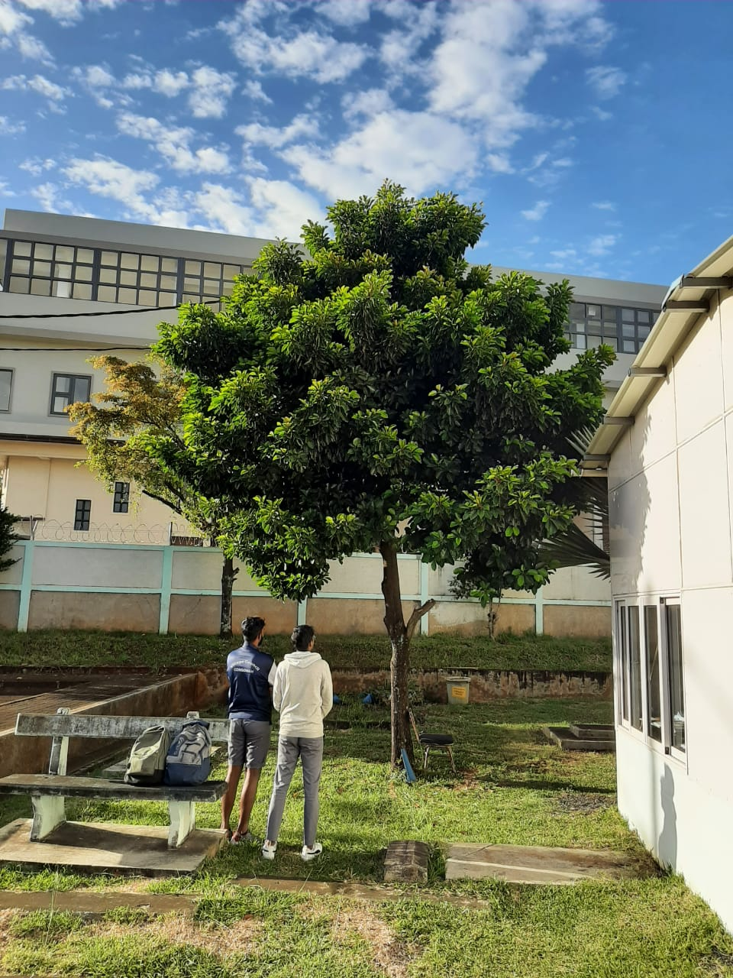
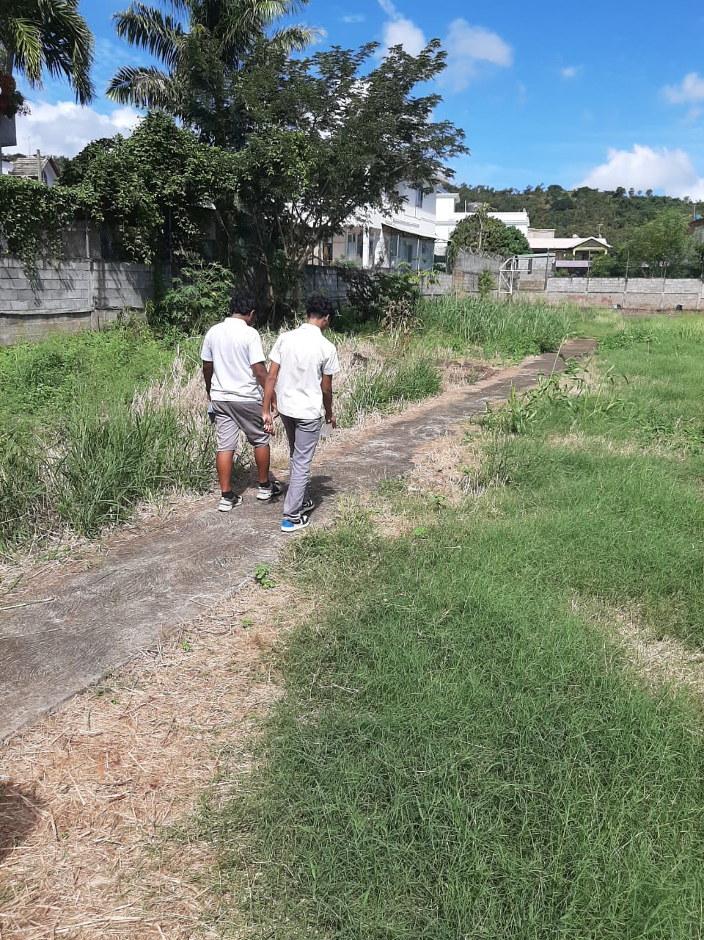
Biosphere
The protocols being used
Biometry (Height of Trees)
Land cover
Measuring Height of Tree
Land Cover

Slide 15
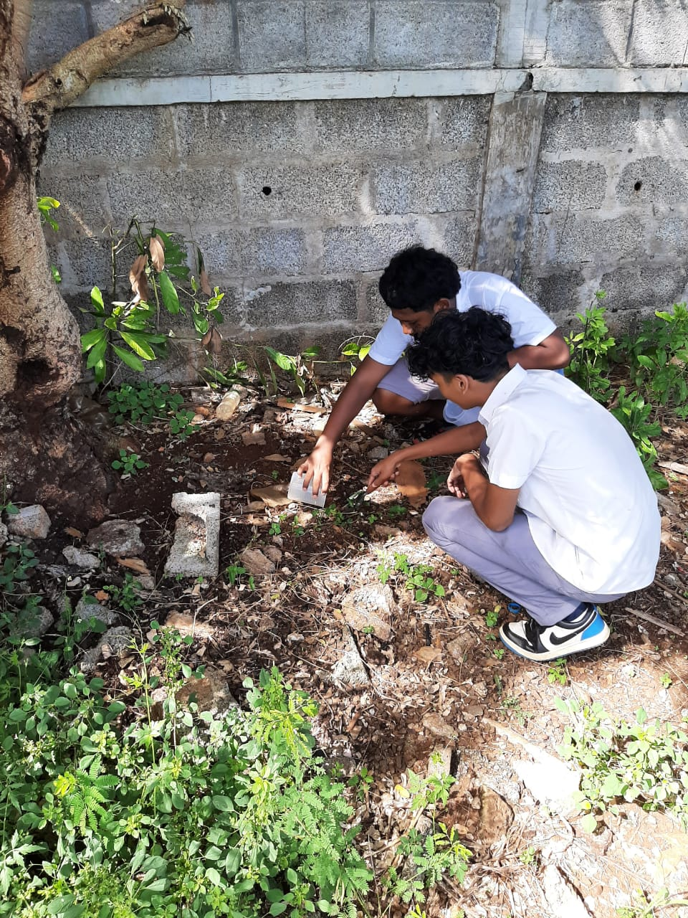
Pedosphere
The protocols being used
1. Soil particle density
Collecting Soil Sample for Density Analysis

Slide 16
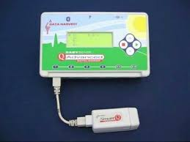
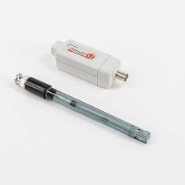
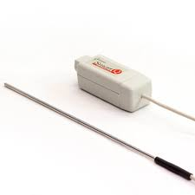
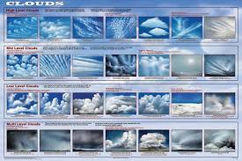
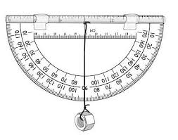
Equipment Used
Temperature Probe
Data Logger – School Data Harvest System
pH Probe
Cloud Chart
Angle Protactor

Slide 17
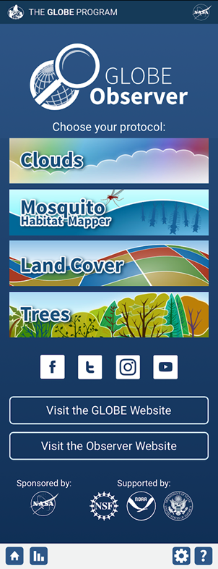
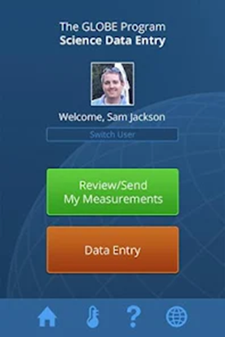
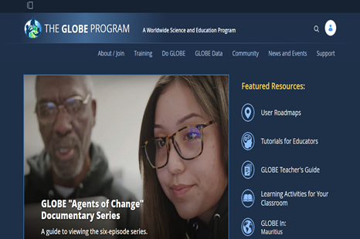
Data Entry System Used
GLOBE Website/ GLOBE Observer Website
Data Entry App - Mobile
GLOBE Observer App

Slide 18
Collaboration With Stakeholders
Rajiv Gandhi Science Centre- Science Fair/ Project
Technology Education Applied Science Curriculum – Salinity and pH measurement
Eco schools
Ministry of Environment
Ministry of Local Government
Albion Fisheries Centre
Mauritius Oceanography Institute

Slide 19
Queen Elizabeth College- Winner of Data Challenge in December 2023

Slide 20
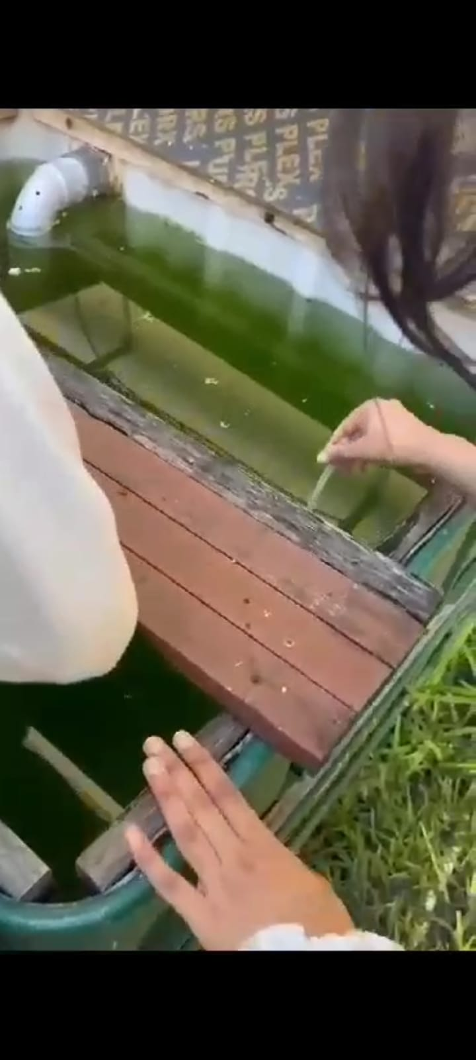
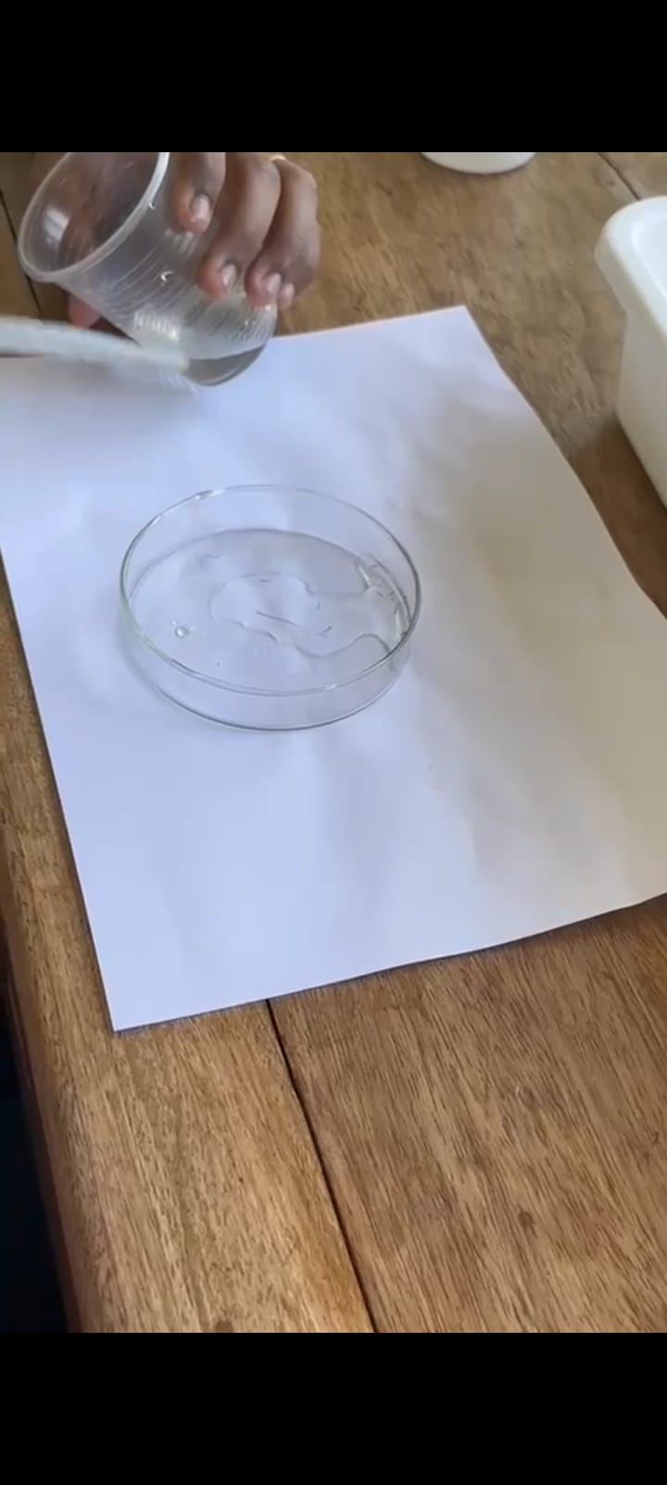
Student using the mosquito Habitat Mapper
Mosquito larvae are collected from an area of stagnant water.
The larvae are carefully placed in a petri dish.

Slide 21
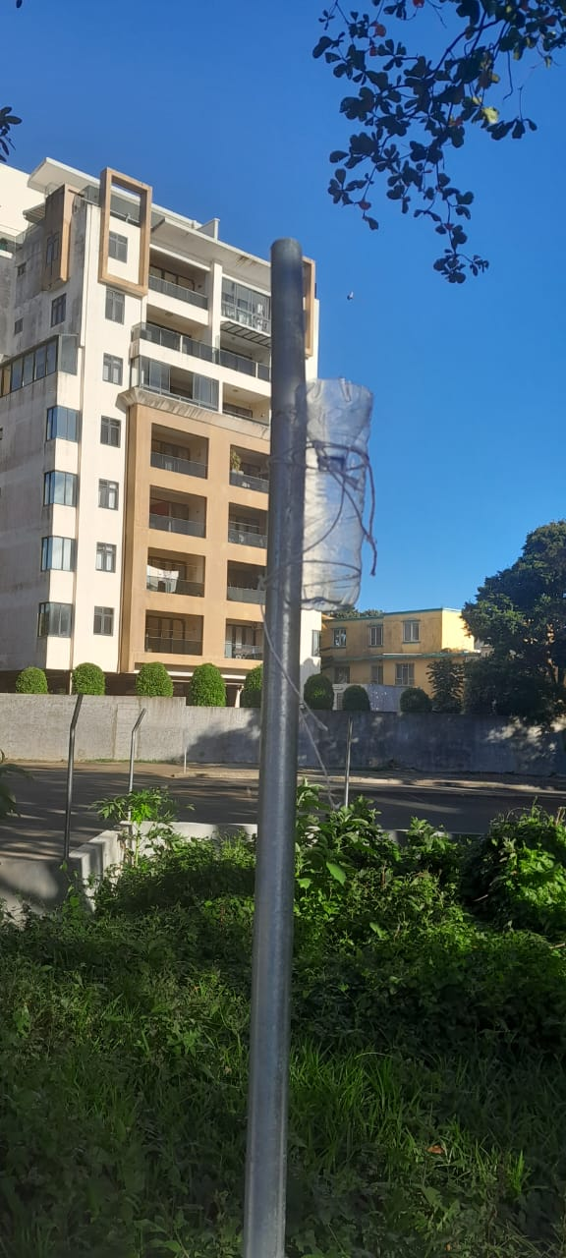
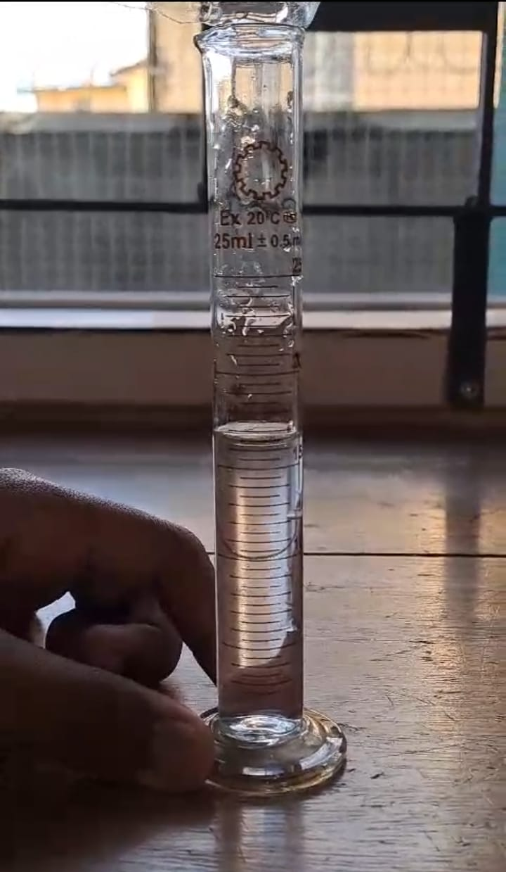
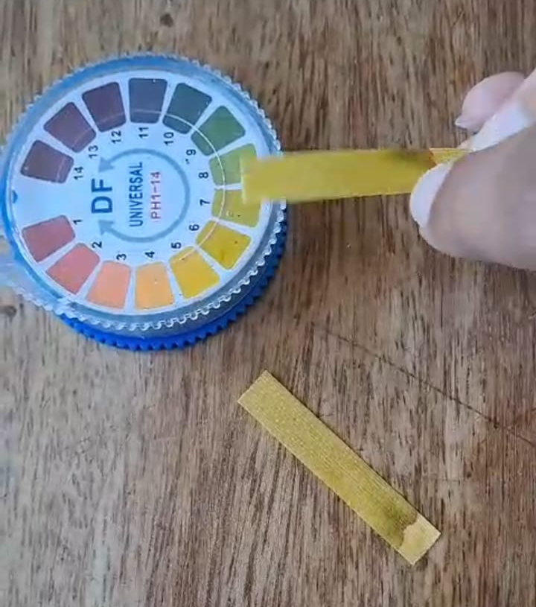
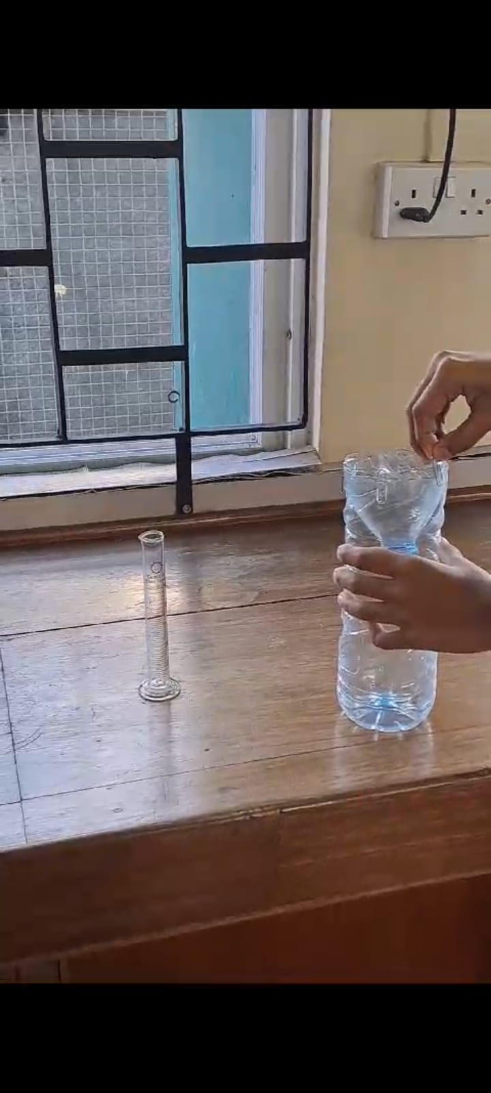
Students collecting data on precipitation

Slide 22
Student’s project based on The 2024 Symposium's theme was "Climate Investigations: Understanding Earth as a System,"

Slide 23
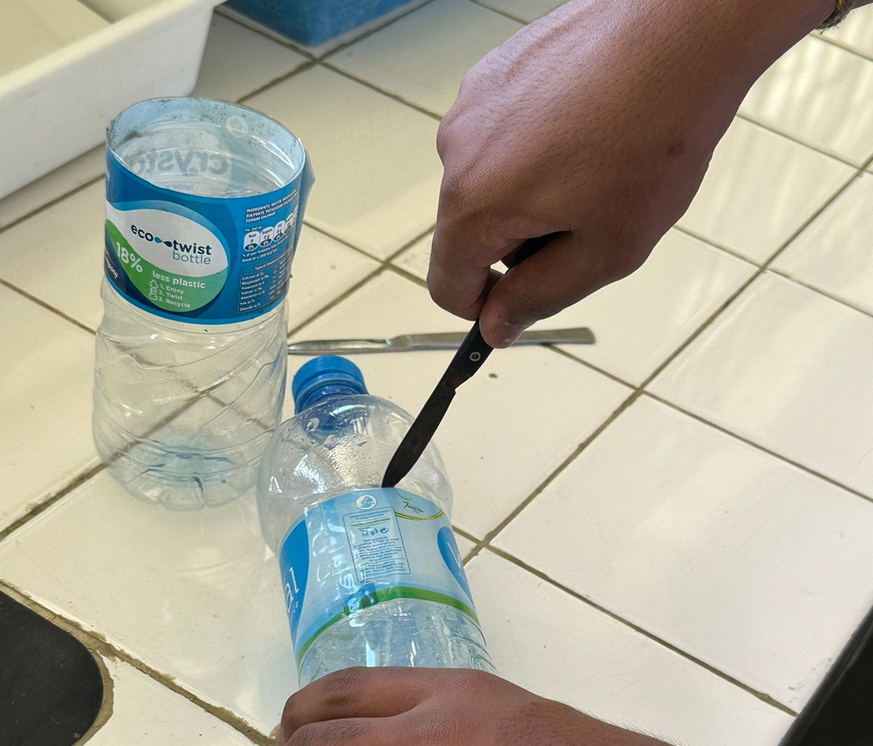
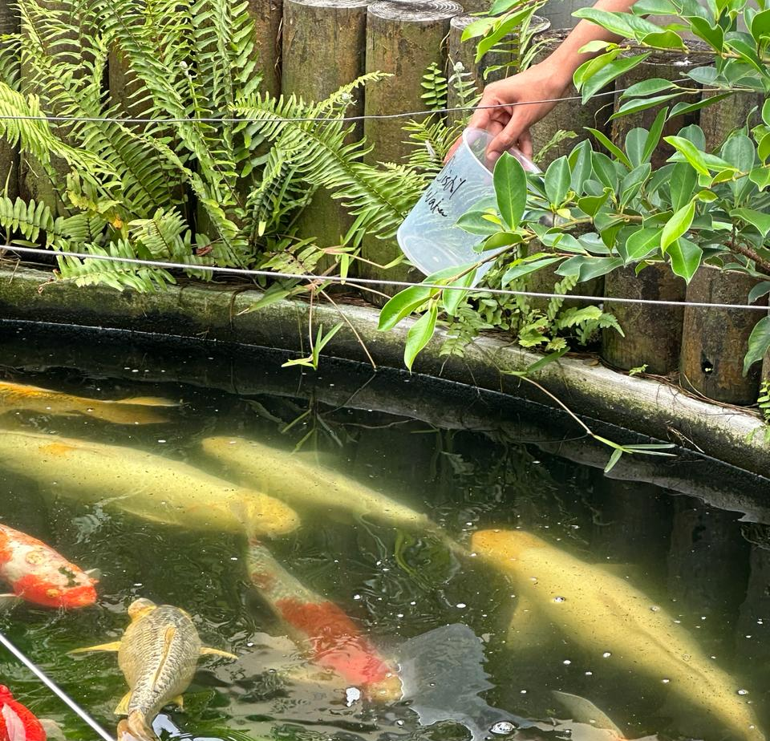
SOLUTIONS THAT THEY CAME UP WITH:TO REDUCE WASTAGE
Students used empty plastic bottles to grow lettuce plants as a model for home gardens to promote the culture of self-dependency when there is a shortage of food crop
s.
They reutilised water from the school fish pond which has to be changed within intervals of a few days to grow lettuce plants. Thus reducing the wastage of water.

Slide 24
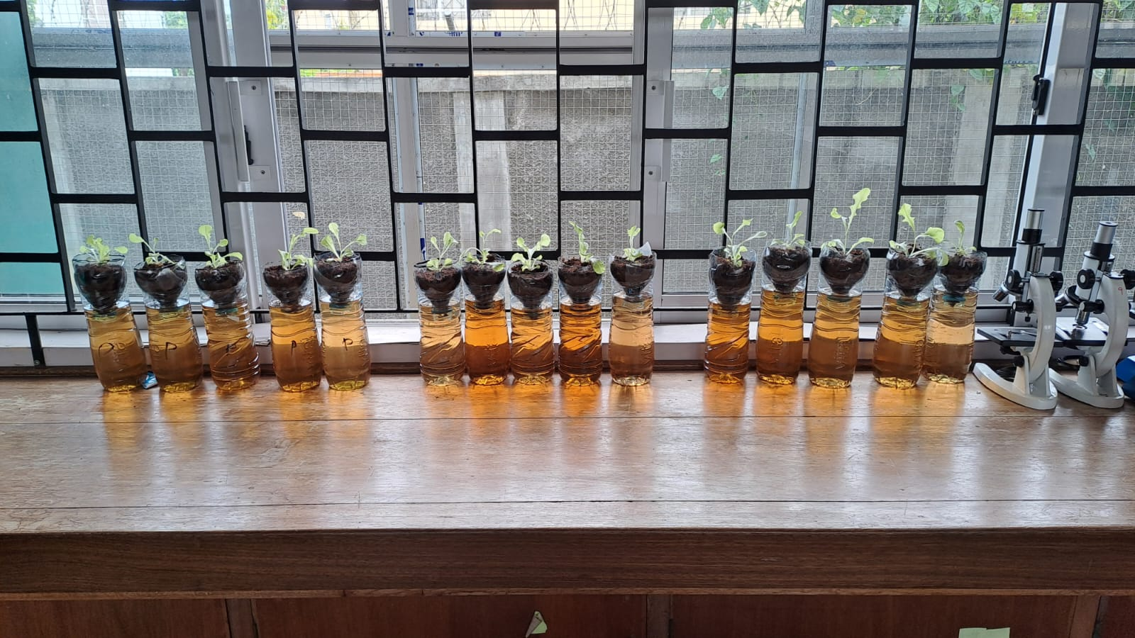
The plants were then placed in the plastic bottles as shown and they were left near the window- where they could get enough sunlight.

Slide 25
Way Forward
Working in collaboration with the NGO running Eco Schools in Mauritius to promote GLOBE Programme
Seek collaboration with Rajiv Gandhi Science Centre and the Mauritius Institute of Education (responsible for curriculum development and teacher training), Mauritius Meteorological Station and the US Embassy
Following Regional meeting, share information with schools implementing GLOBE Programme
Encourage Educators to follow the e-training
Keep record of Alumni

