Slide 1
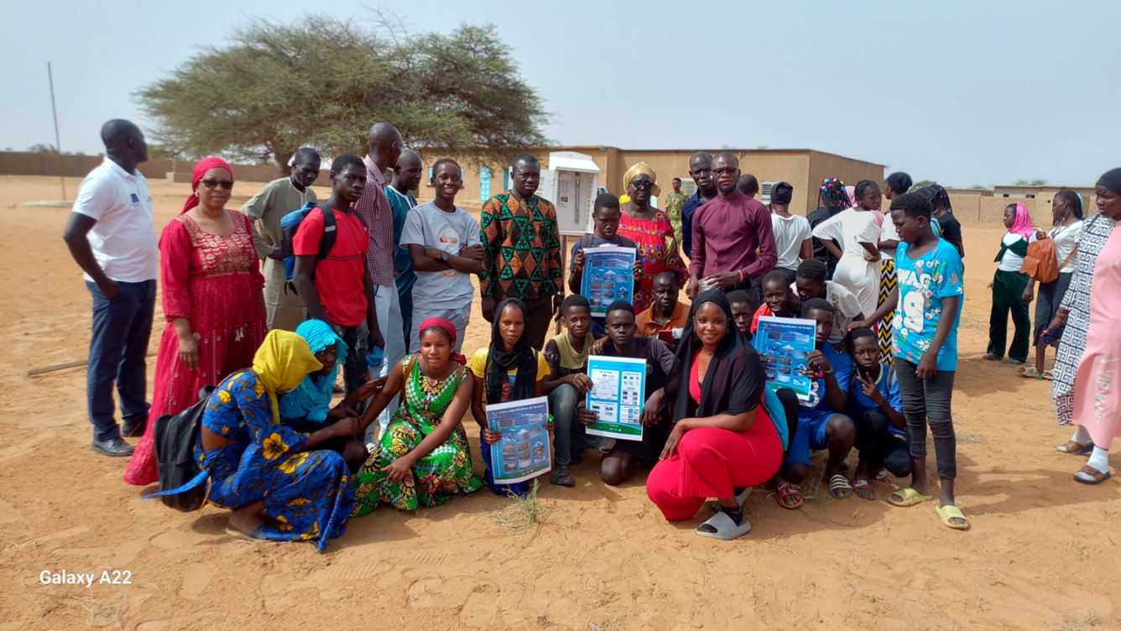
Report GLOBE Senegal

Slide 2
Number of Schools Reporting currently Data over Past Year: 4
Lycée de Ranérou
Lycée Alboury Ndiaye
CEM Syer
Lycée de Thilmakha

Slide 3
Program Implementation, International Cooperation in GLOBE Network, and Activities
Presentation of the positif impact of GLOBE in education during the annual meeting 2023 in DENVER, CO
Participation online of WWD with GLOBE Italy
Participation of GLOBE Senegal to the celebration of the WED
Training teachers and students of program GLOBE/SERVIR
Monitoring of GLOBE/SEVIR-AO
Participation to IVSS 2024

Slide 4
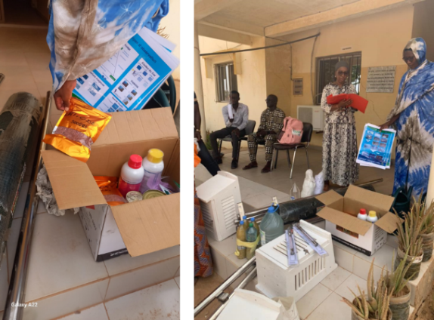
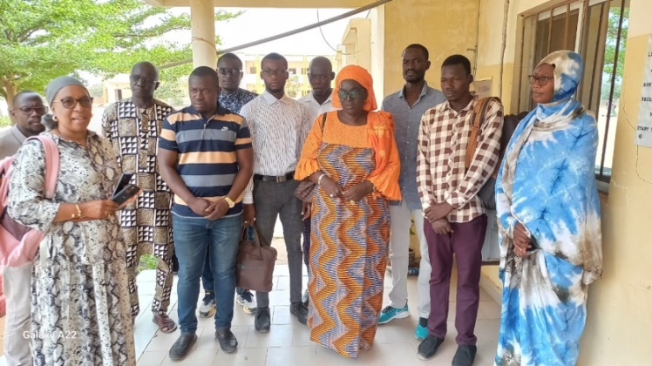
Photos illustrations

Slide 5
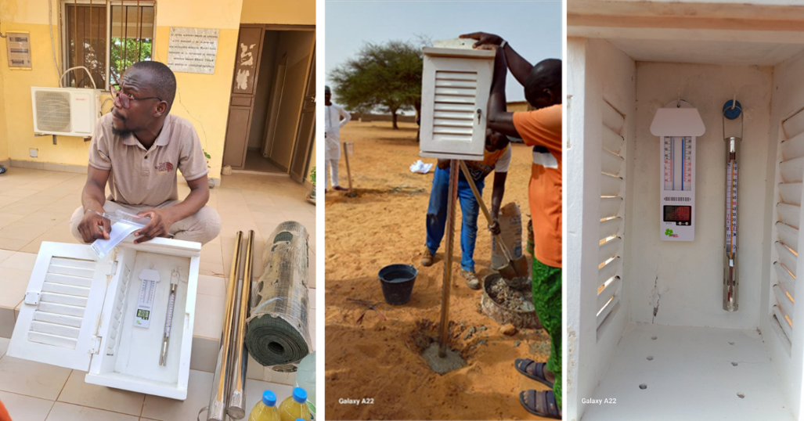

Slide 6
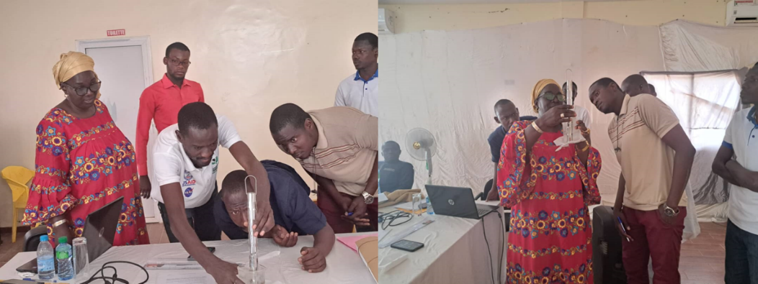

Slide 7
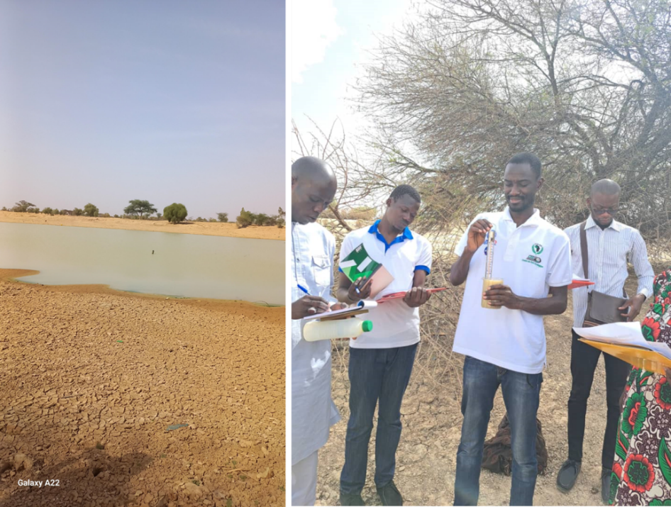
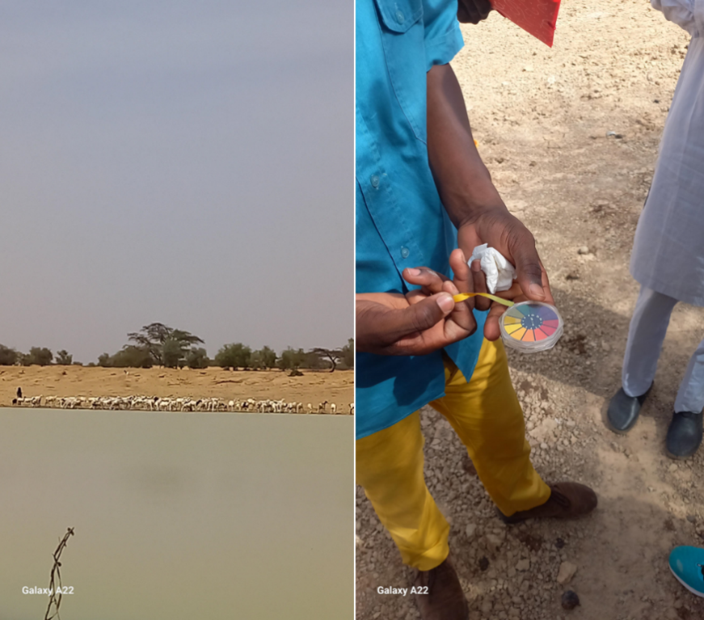

Slide 8
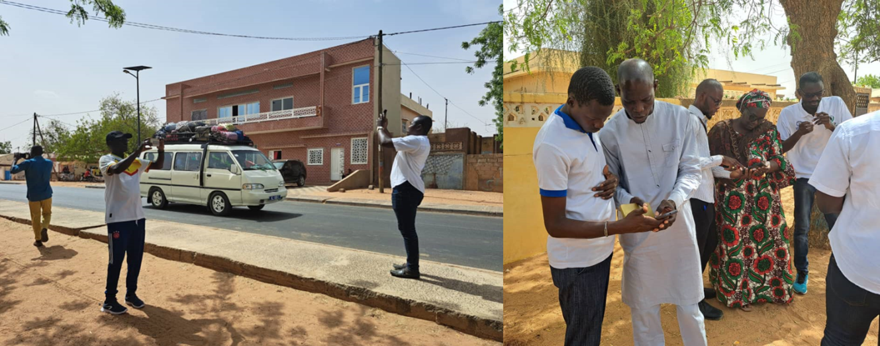

Slide 9
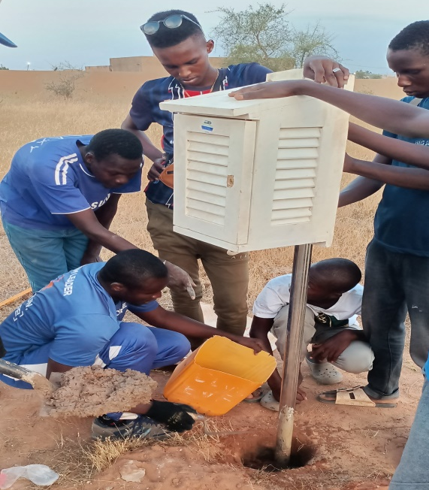
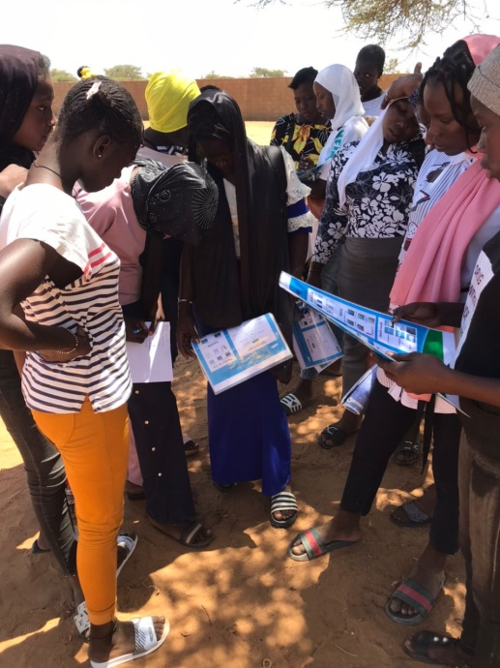
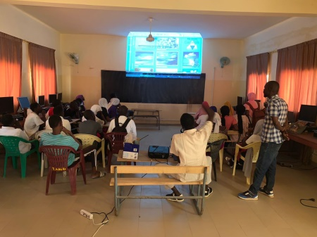

Slide 10
Number of data in GLOBE webside with SERVIR-AO
établissement | CEM SYER III Louga, SN | LYCEE ALBOURY NDIAYE Louga, SN | LYCEE DE RANEROU Matam, SN
statut | Currently reporting | Currently reporting | Currently reporting
période | 12/04/2021 au26/02/2024 | 09/04/2021 au 26/04/2024 | 04/09/2021 au 19/04/2024
Données hydrologie | 12 | 33 | 0
Données atmosphère | 356 | 249 | 482
Total / club | 370 | 282 | 482
Total Servir/GLOBE, SN | 1134

Slide 11
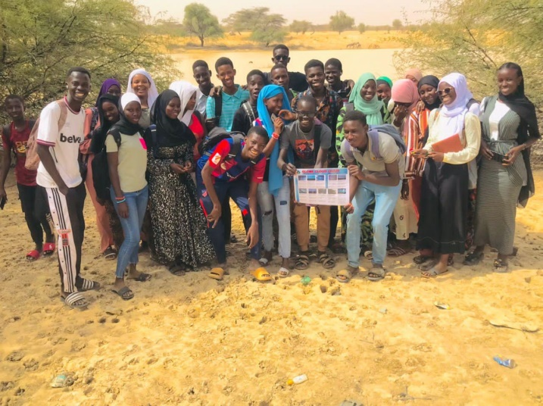
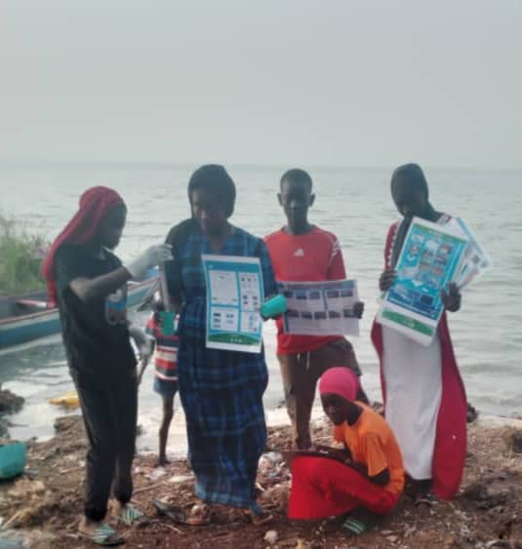
IVSS Senegal 2024
Title: Contribution of GLOBE students’research to the issue of water and agriculture in Ferlo, Senegal

Slide 12
4 badges
  I Make an impact
  I am a Data Scientist
  I am a problem solver
  I am a Student researcher

Slide 13
EWG
Participation to all monthly EWG meeting
Climat and climat change
Certification process trainers and mentor trainers
Teachers training and do more presentiel workshops
Selection of IVSS winner

Slide 14
My opinions
communication
Following the recommendations of the CC at the 2023 regional meeting in Cape Town, I present a template information letter already shared by the EWG with Simon. This could improve communication between GIO, RCO and governments. African governments need this communication to feel the proximity of GLOBE and this will facilitate CC advocacy for our governments to support GLOBE more at the national level. for sending a letter, once agreed, RCO simply asks the CCs to update the emails of the government contacts in the country contact page of the GLOBE site.
Climat change: we can propose an learning materials or un training module on climate change for education with local illustrations showing the CC
IVSS rewads
IVSS is a way of motivation and visibility of the program. We need to make it more inclusive and equitable. Give a prize with a trip and think of other consolation prizes. We must maximize finances and try to do a lot of things with the little finances. You should have few students because the trip is expensive and take the rest of the money to buy other things such as cell phones or computers.

Slide 15
Merci

