Slide 1
GLOBE Africa Regional Meeting Technology Update
David Overoye/Cornell Lewis
Science Systems and Applications, Inc.
March, 2022

Slide 2
Agenda
Today
Overview of Recent Accomplishments
Work in Progress
Tomorrow
Future Plans and priorities
Issues/Concerns/Questions

Slide 3
Recent Accomplishments
GLOBE
A new hosting environment
GLOBE Observer and Data Entry
Multilingual Support for eTraining
Trainer/Mentor Trainer Workflow
GLOBE Observer
New Mosquito Habitat Mapper
SciStarter Affiliate Tool
Geofencing Projects

Slide 4
New hosting environment for GLOBE (launched 9/21)
Moved GLOBE from it’s original Amazon hosting service to an AWS cloud environment operated by NASA
Improves security within NASA control with no cost increase
No visible change to GLOBE users
Staging environment created March 2021
Production live September 25, 2021
Old staging and production decommissioned October, 2021

Slide 5
New Data Entry – Merging data entry with GLOBE Observer (launched 7/21)
Brings GLOBE Observer and GLOBE Data Entry apps together. You will only need one app – GLOBE Observer
Supports protocol “bundles” – grouping of protocols
Create your own Bundle
Use GLOBE specified bundles
Simplifies site creation and data entry
Looks the same on mobile and desktop, iOS and Android
Initial launch with Atmosphere protocols, July, 2021

Slide 6
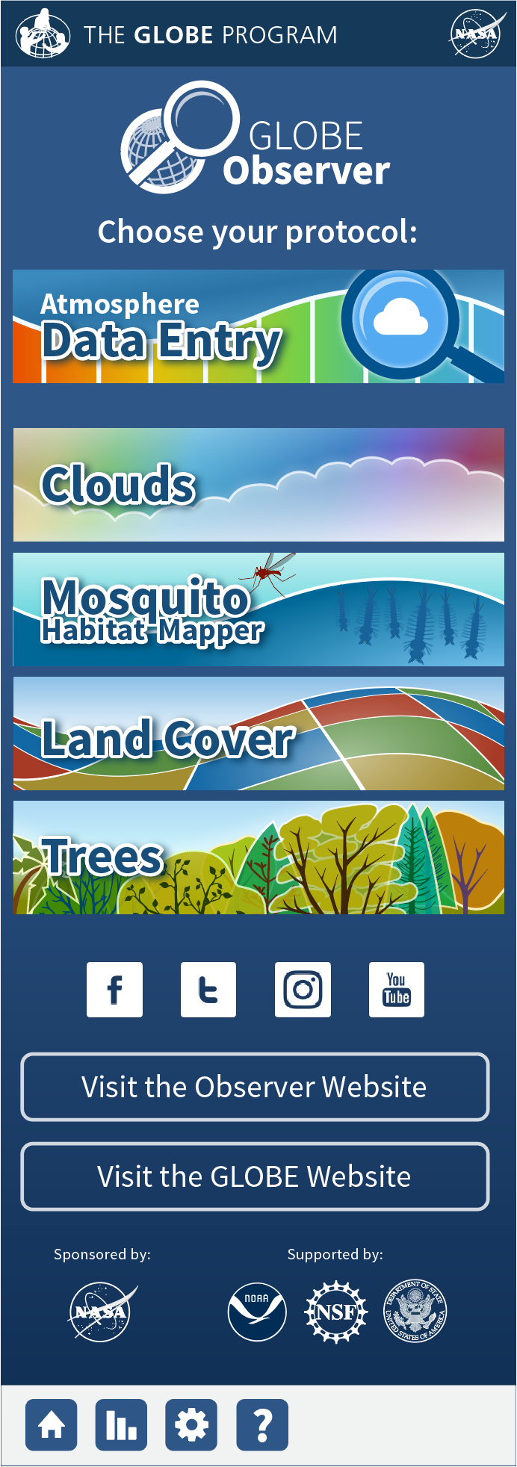
How does it work with GLOBE Observer?
One view for trained/verified GLOBE users
Link at the top to all of GLOBE Data Entry (atmosphere initially)
One view for GLOBE Observers
Looks the same – just the 4 observer protocols
GLOBE Policy requires only users who have been trained and verified to be able to access the additional protocols. Etraining alone is not sufficient.

Slide 7
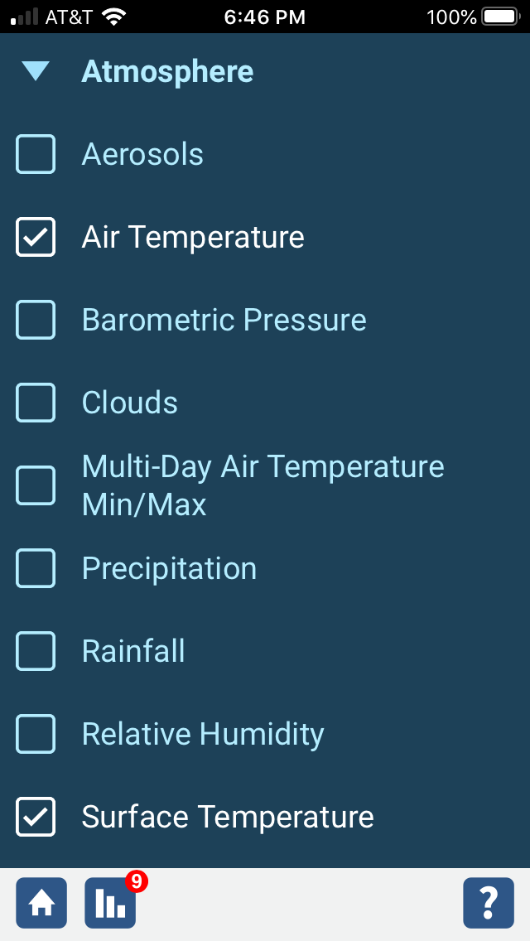
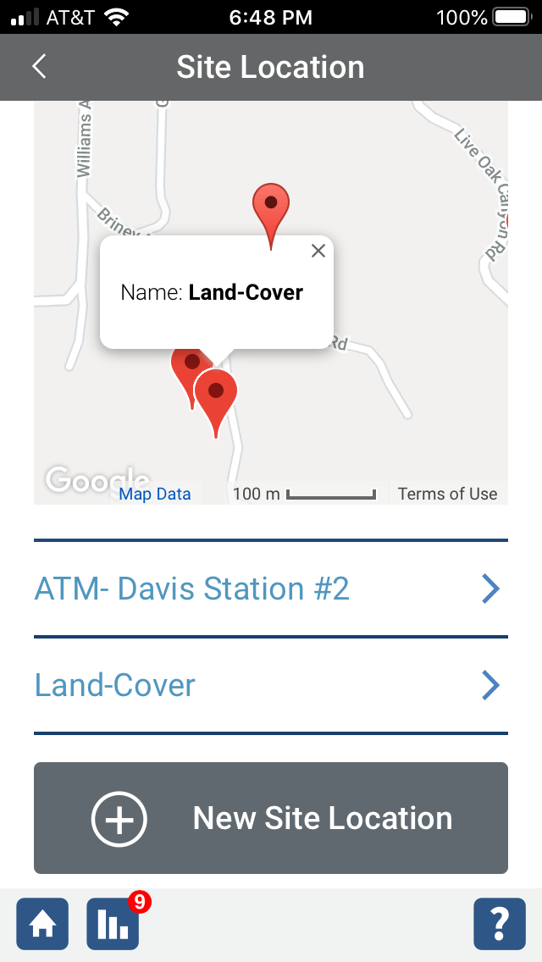
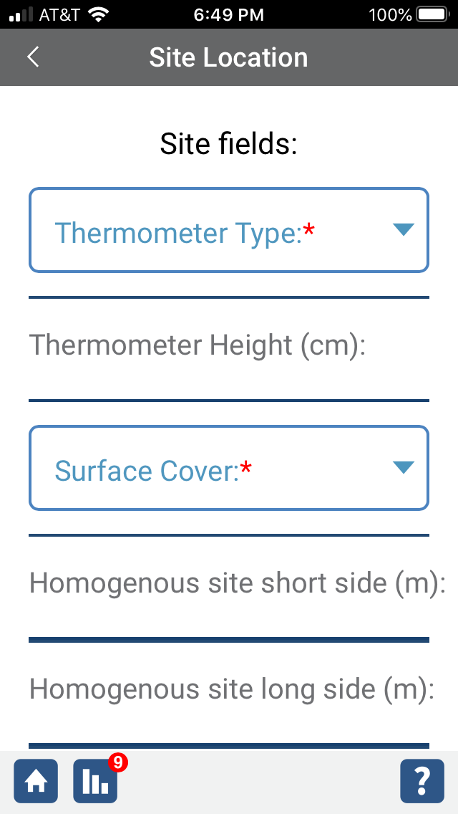
New System
Choose your School (if more than one school)
Choose the protocol(s) you want to do
Choose your site from list or map
If you’ve never done that protocol before at that site, the system will prompt you with any required site definition fields (many protocols don’t have any)
Enter data

Slide 8
Multilingual support for Etraining Testing (launched Oct, 2021)
GLOBE Etraining has been modified to add support for multilingual testing.
Select Spanish test modules are now available.
Others languages are possible if someone wants to translate the tests.

Slide 9
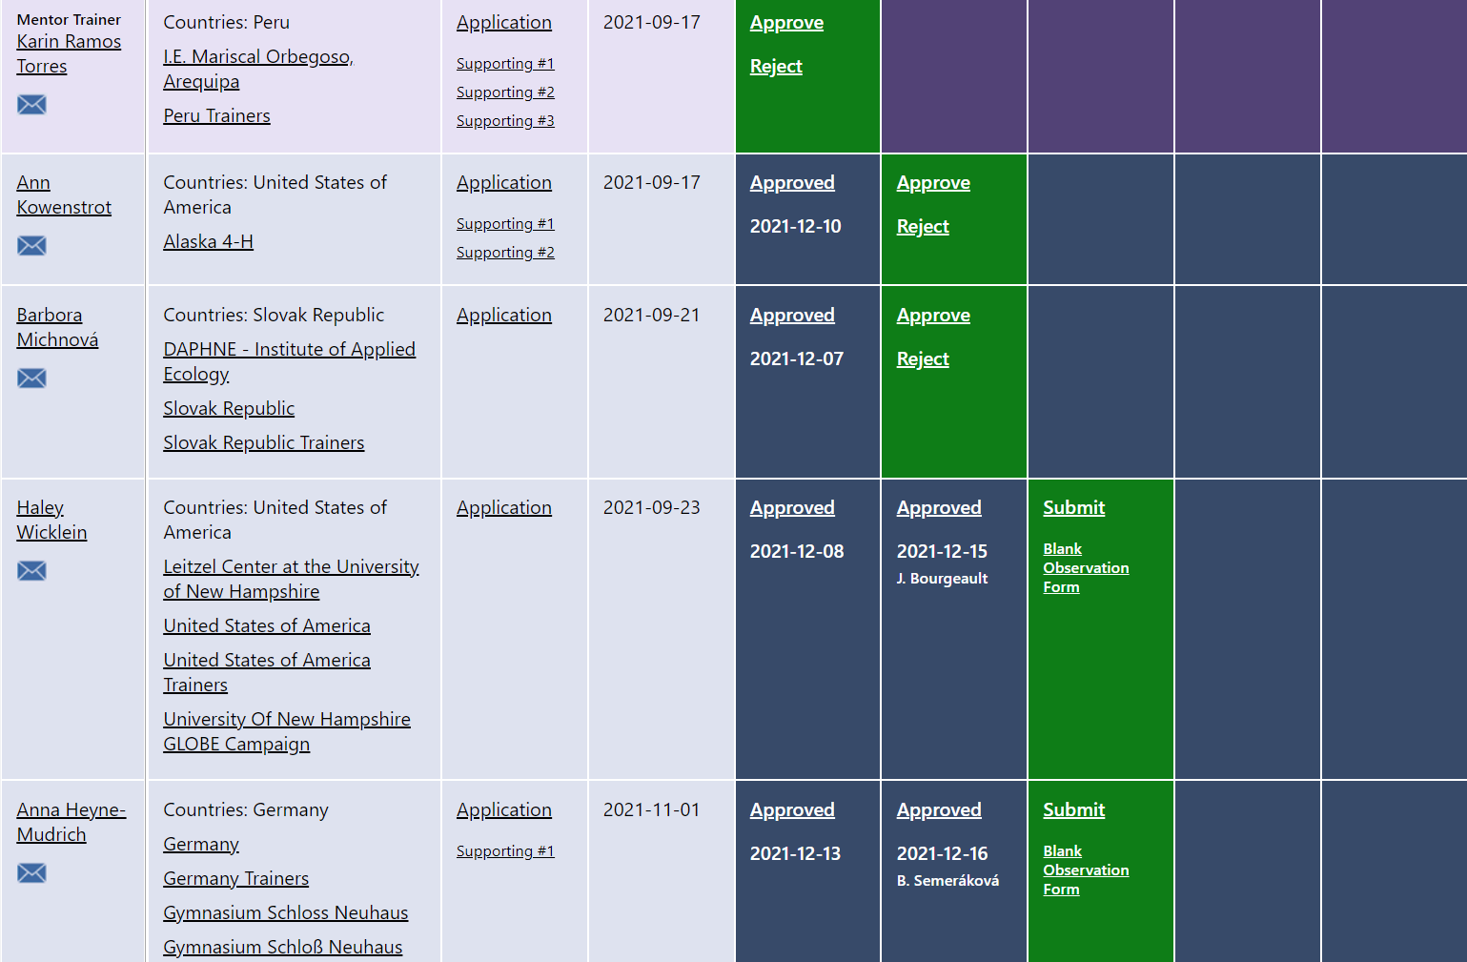
New Trainer Process and Workflow (released 11/21)
Built a new process and dashboard for reviewing and approving new GLOBE Trainers and Mentor Trainers
Approx 25 Trainers and 12 Mentor Trainers are in process as of 1/22
Applications include people from all regions
Trainer Dashboard

Slide 10
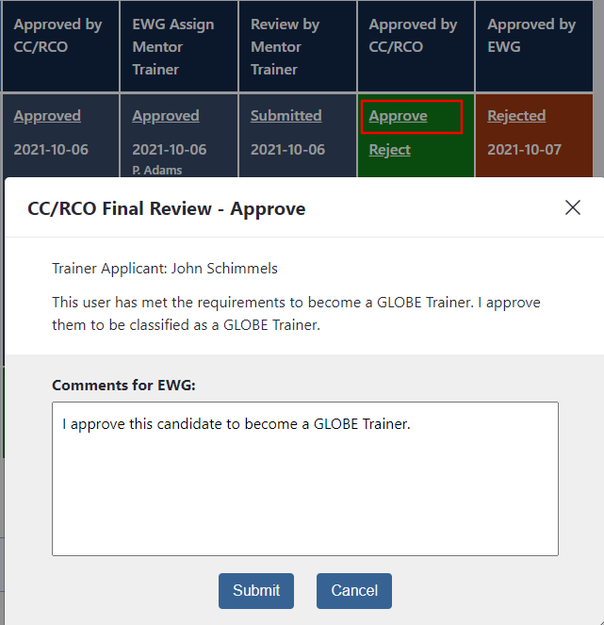
Trainer Dashboard Actions
Actions on each column are specific to the user and the workflow step
CC/RCO can only approve in columns 5 and 8.
EWG can only approve in columns 6 and 9
Mentor Trainer can only submit their review in column 7.
You will only see applicants from your country or region. EWG and Helpdesk will see all applicants
Clicking on Approve or Reject will create a popup which will allow you to put in additional comments which will be recorded and sent to the reviewer in the next step in the approval process.
Clicking reject will return the applicant to the previous step in the workflow

Slide 11
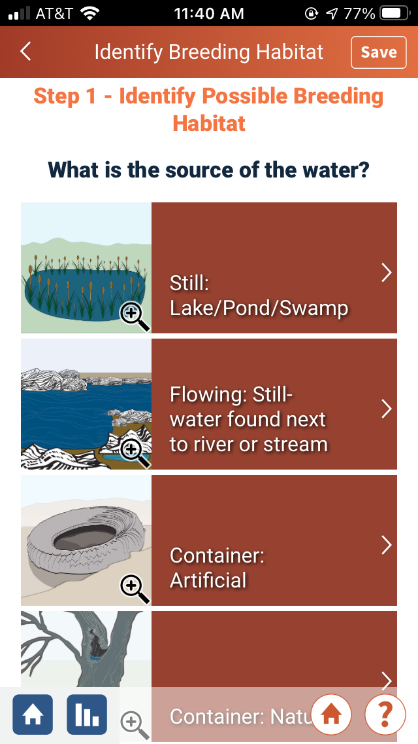
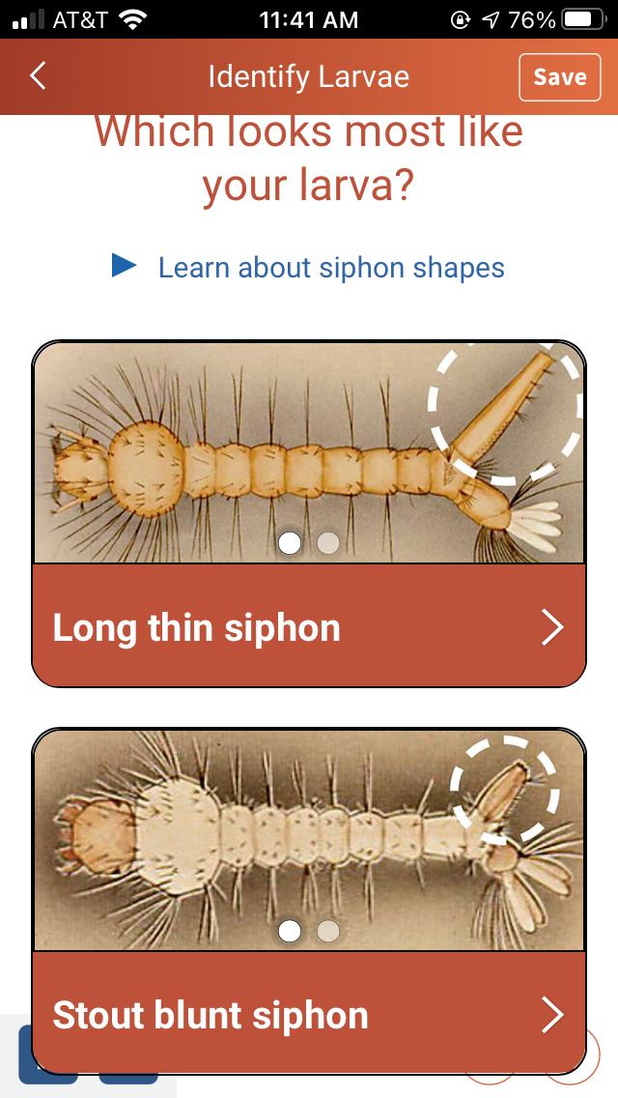
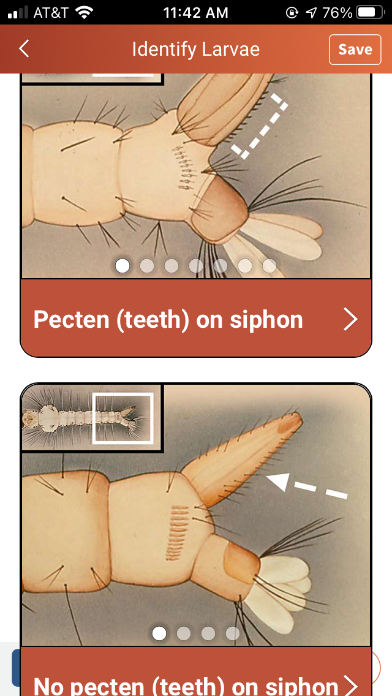
GLOBE Observer – New Mosquito Habitat Mapper (July, 2021)
Dichotomous key - more visual…less text

Slide 12
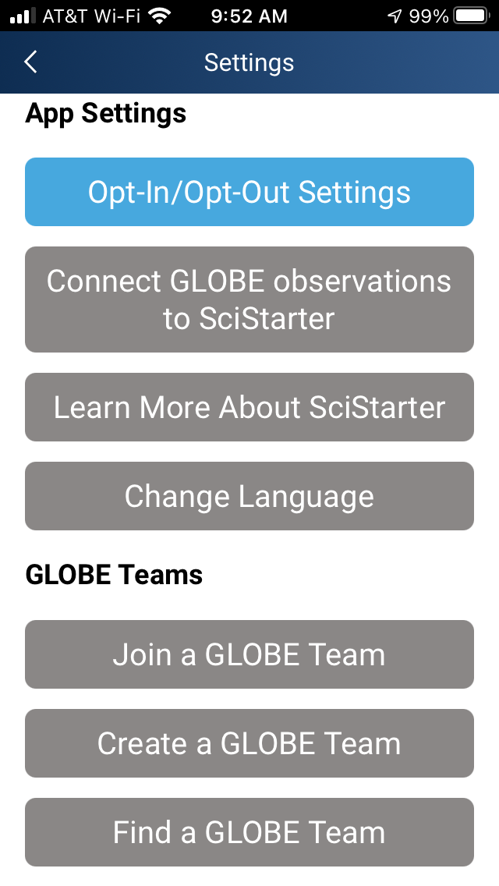
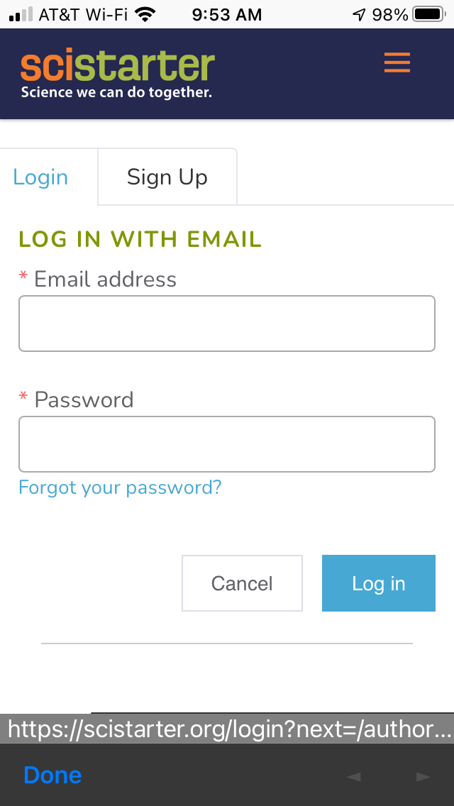
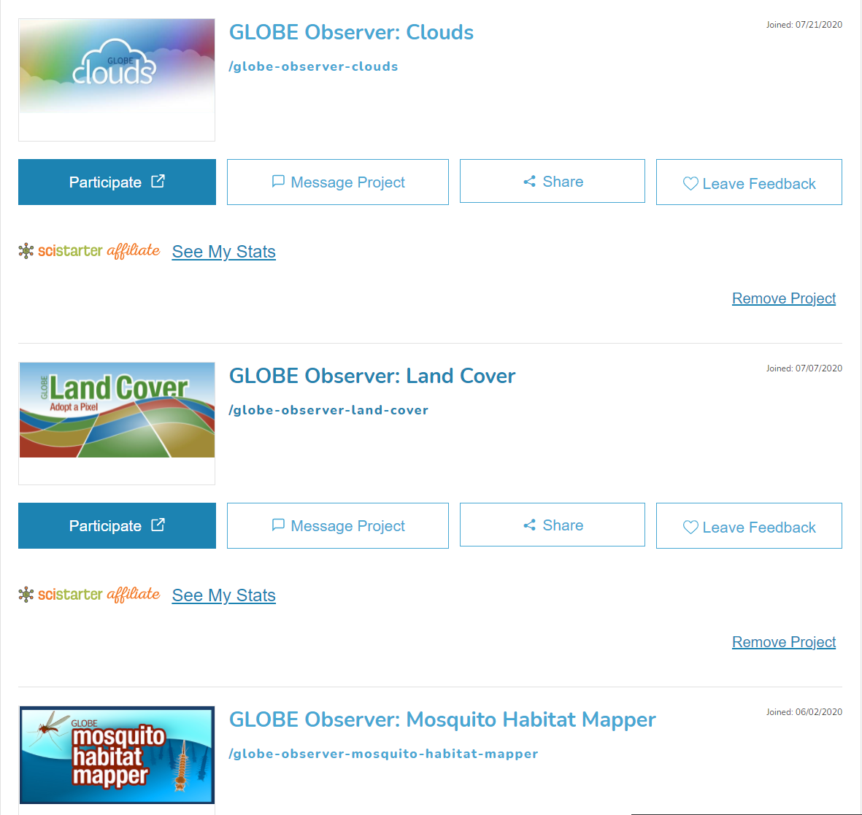
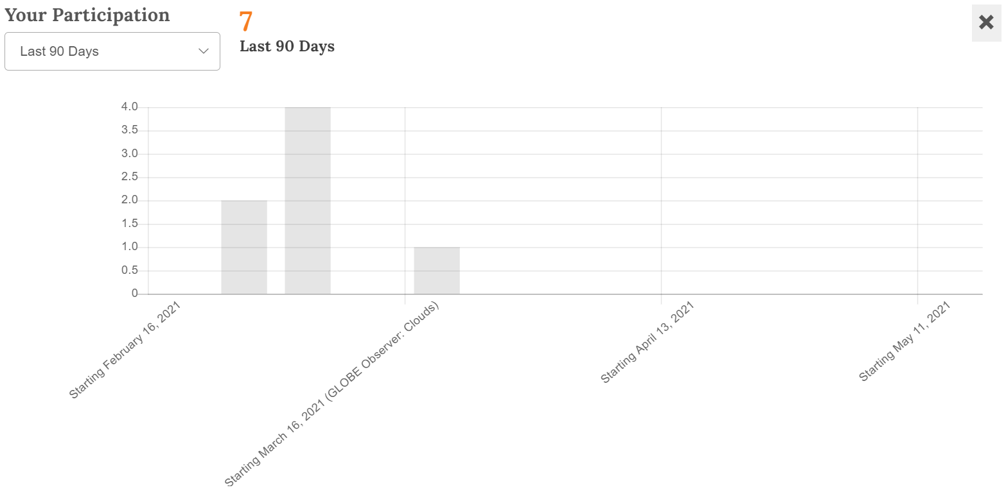
GLOBE Observer – SciStarter Tracking (July 2021)
Integrated GLOBE Observer measurements with SciStarter – track your Observer observations within SciStarter (Primarily US-based)

Slide 13
New geofencing capability for GLOBE Observer (production 11/2021 – Testing expected 1/22)
Creating the ability for scientists and others to request data collection within a geofenced region for a specific time period

Slide 14
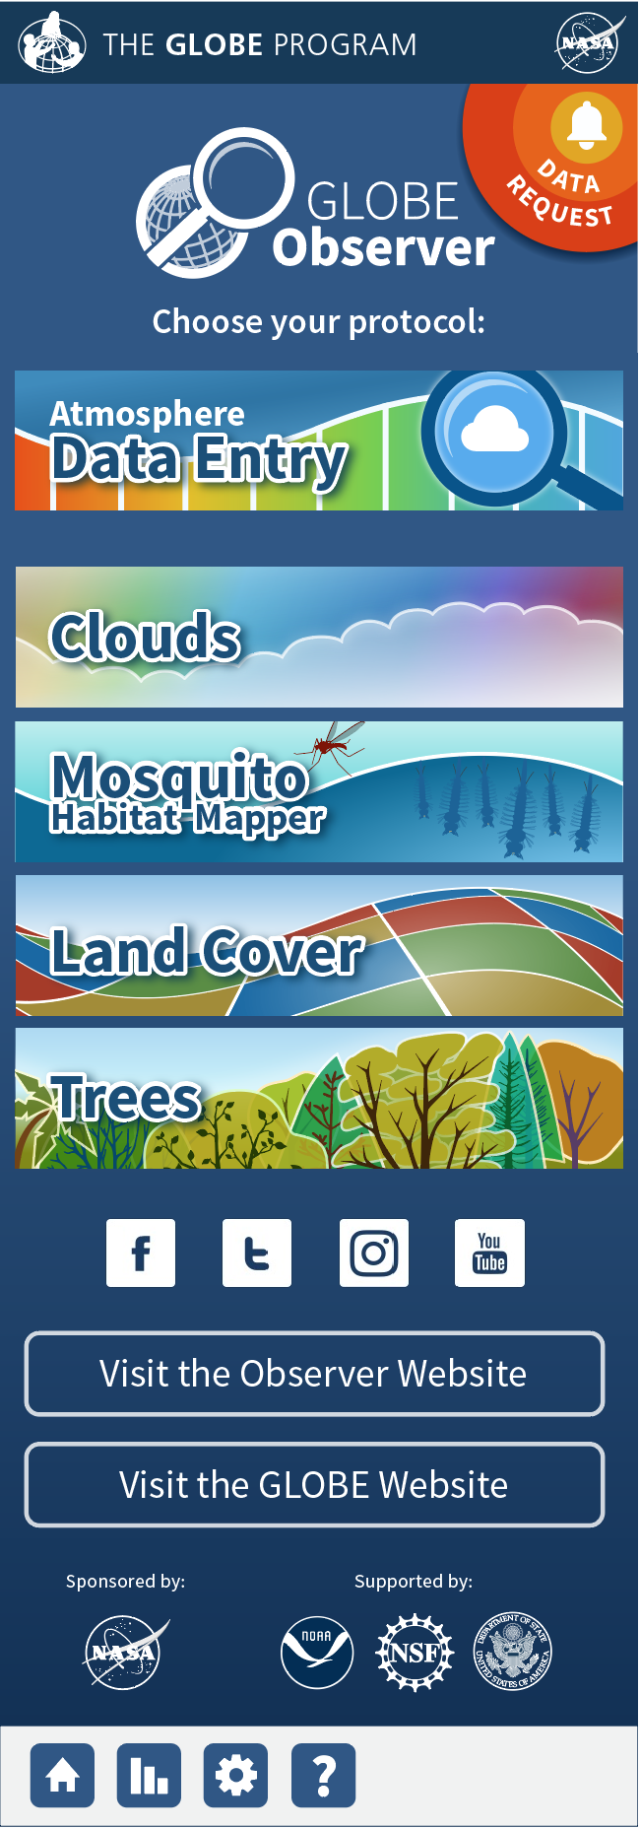
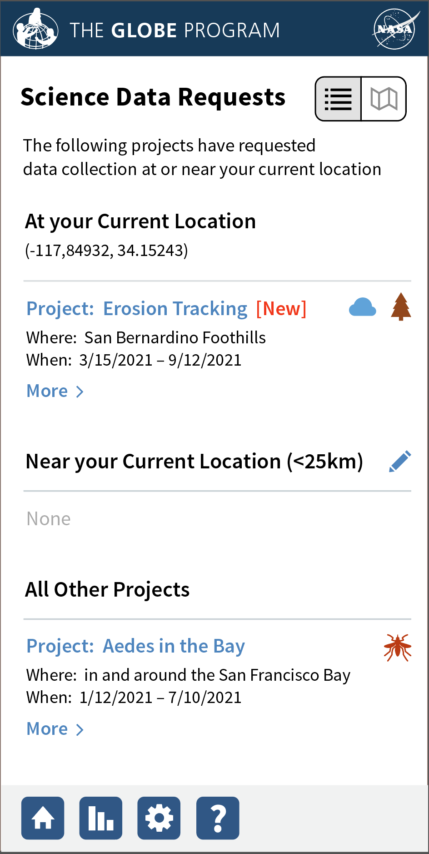
New geofencing capability
Users are notified when they are in or near an area of interest

Slide 15
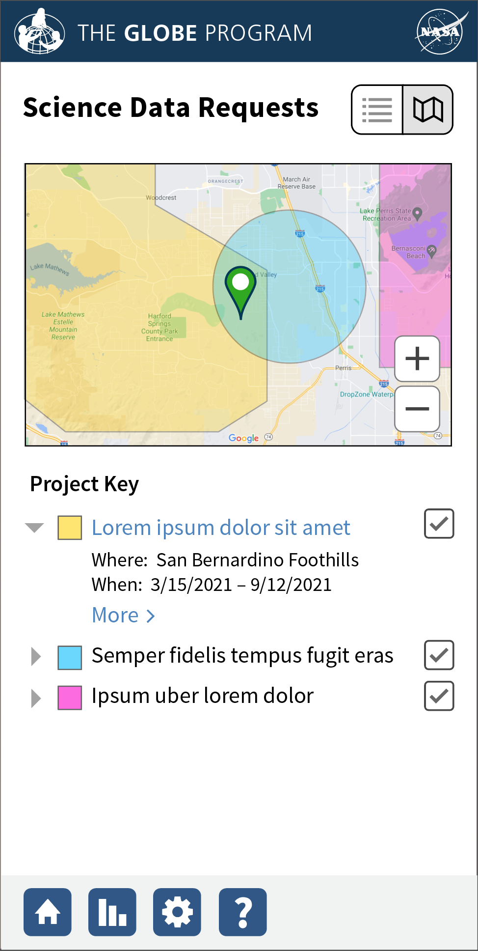
New geofencing capability
Users are notified when they are in or near an area of interest

Slide 16
Enhancements In Progress 2021/2022
GLOBE
Automated Photo Approval/Amazon Rekognition
Section 508 (for people with visual impairments) improvements to the app

Slide 17
GLOBE Observer in progress

Slide 18
Automated Photo Approval / AI
We developed and tuned Amazon’s Rekognition service to identify images which are possibly problematic (faces, text, inappropriate content)
Working the AI into a workflow which will automatically approve some images and flag others for human review.
Faces, text will be automatically blurred.
Expected to implement a needed check to GLOBE Educator (and student) images.

Slide 19
Section 508 app improvements
Reviewing app implementation to identify places to improve readability by a device based screen reader and ensure appropriate visual contrast

Slide 20
Day 2: Enhancements coming
Student Account Improvements
My Observations
GLOBE Teams
New Site Architecture and Account Creation
And put questions in the padlet and we will work to address tomorrow
https://padlet.com/africaregionglobe/8i7h58gekbty7omk

Slide 21
Improved Student Management
(expected 6/22)
Data entered by students will be associated with the student account to allow teachers to track the student’s observations
Create the ability to support user Screen Names for those who are unidentified in the system (Student accounts and Observer accounts)
This will allow students to be identified on GLOBE teams and school pages without having to display their real names.
This will allow observers to see themselves represented on the site

Slide 22
Improved My Observations Portlet
(expected 6/22)
Users will be able to see their measurements for all protocols using the My Observations portlet.
Direct link to the My Observations portlet will be under the ‘Go To’ Menu.

Slide 23
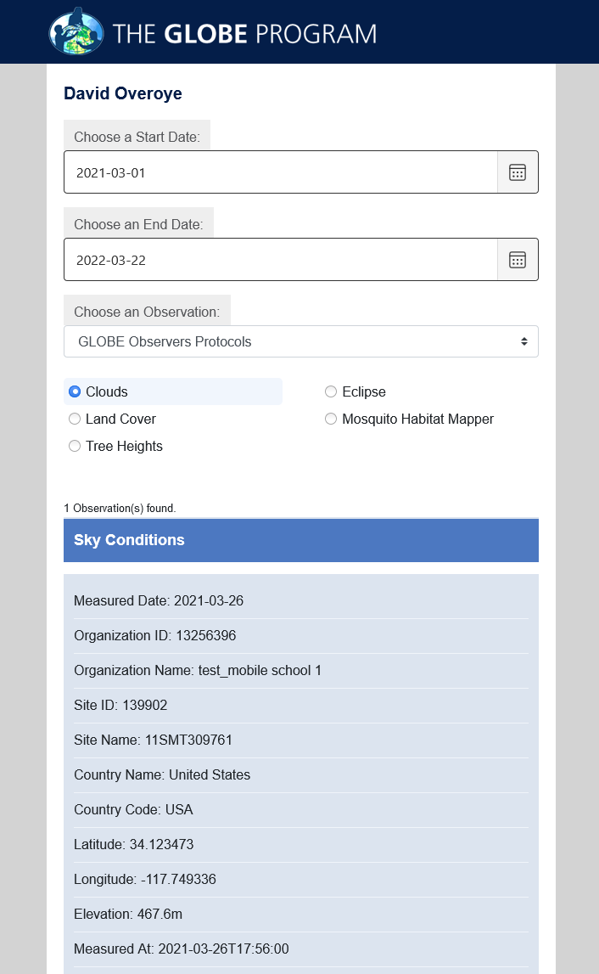
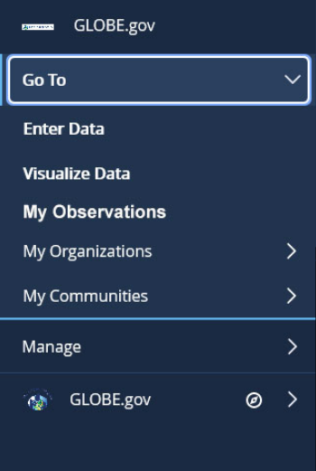

Slide 24
Improved Student Management (expected 6/22)
A portlet will be added to ‘My Pages’ to allow teachers to more easily:
Manage and track their student’s observations.
Create student accounts (in bulk) with a new and improved system.
Export student records
Manage and track their GLOBE Teams

Slide 25
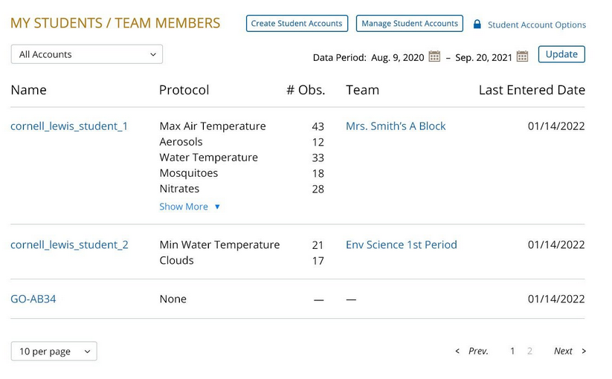
6/22

Slide 26
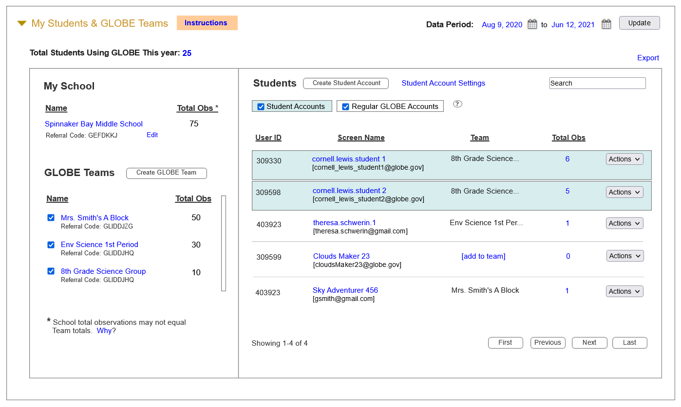
11/22

Slide 27
Enhancements to GLOBE Teams (expected 6/22)
Team members and their measurements will display on GLOBE team pages.
GLOBE Teams shall have the option of associating and displaying team members and their measurements by data period (school year, for example). This will allow teachers to reuse GLOBE teams each year for their classrooms.

Slide 28
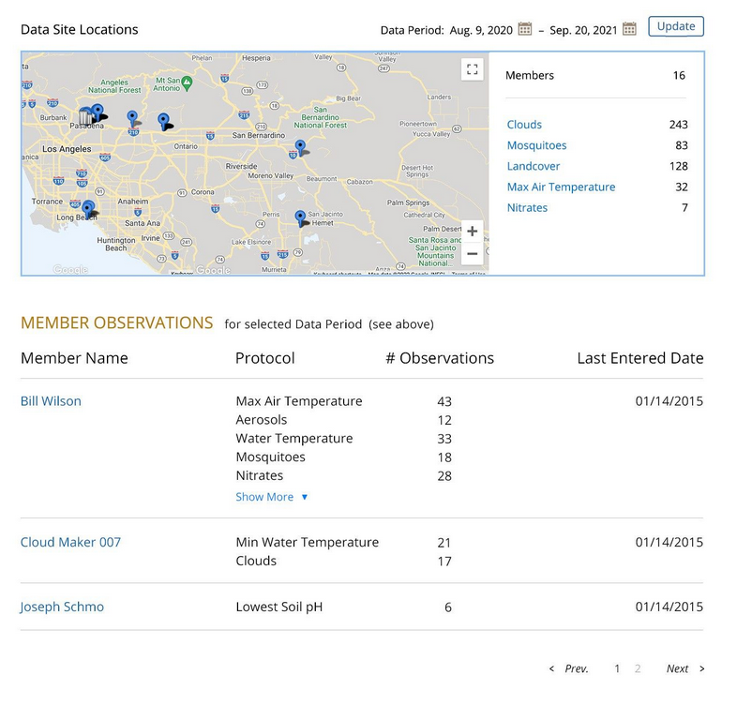

Slide 29
Planned Enhancements for later this year
Improved Account Creation Process
Simplified, single path for all users
Improved Site Architecture
Reorganizing sections and content based on community feedback.

Slide 30
Simplified Account Creation/Getting Started Process
Issue:
Currently a user who wants to join GLOBE chooses to create a GLOBE Observer account which provides limited capabilities, or a GLOBE Teacher account, which after training and validation provides a full set of capabilities. The two paths follow different processes with different approvals required. This has caused confusion to users, and difficulty for Country Coordinator, US Partners, helpdesk and others who try to support users who transition from the GLOBE Observer account to a GLOBE Teacher account.
Approach:
One initial account type instead of two, with a single path to upgrade. New capabilities to support the new workflows need to be built, existing user accounts will need to be migrated to the new statuses, workshop tool updates will be implemented, and screen name creation added to the account creation process.
Why now?
This has been an annoyance for some time as we've seen users sign up for GLOBE Observer and then become trained and/or verified GLOBE users. The 2 paths need to be simplified so all users follow an identical path of enhanced capabilities through the system. All stakeholders in the system have agreed this would be extremely useful. We also will add the screen name enhancement to this account workflow so everyone can choose a screen name when they create an account

Slide 31
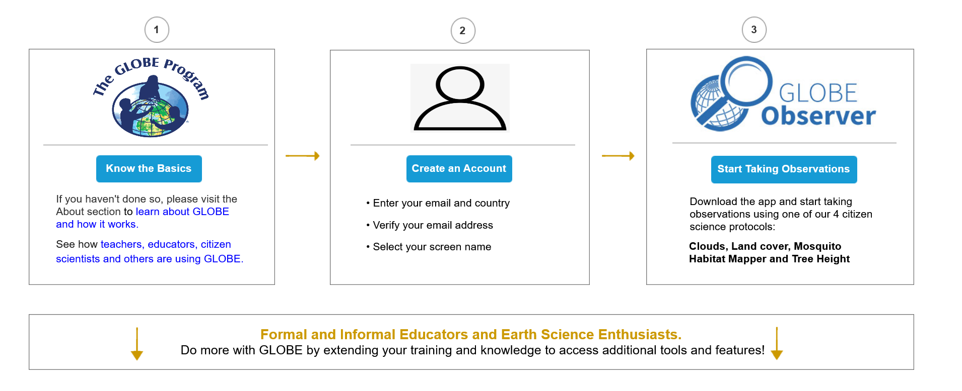
Simplified Account Creation/Getting Started Process

Slide 32
Clearer Paths to becoming a GLOBE Educator (currently known as a GLOBE Member)

Slide 33
Implement new site architecture and associated capabilities
Issue:
A significant amount of time has been spent gathering requirements and defining an approach for an improved GLOBE site architecture to help address user feedback concerning the difficulty finding information on the site, and artificial legacy divisions.
Approach:
The new architecture modifies the top-level navigation, moves content appropriately and requires new capabilities primarily focused in the protocol, etraining and tutorials sections of the site.
Why now?
Users are frequently overwhelmed by the amount of content on the GLOBE website and can find it difficult to find needed information. A large effort was undertaken to better organize and improve the site, and finally remove certain legacy content constraints. Design was completed quite some time ago, but no progress has been made to date given other priorities.

Slide 34
Improved Site Architecture
Existing
Proposed

Slide 35
Other Future Enhancements
Additional MyPage Dashboard Enhancements
Improved Page Layout and Creation Tools
Teacher / School Reward System Improvements
Google translate for all pages
User Avatars

Slide 36
My Page Dashboard
Customizable “dashboard” for GLOBE Educators to easily find their data, resources and content they use the most.
Better organized content for guests to quickly learn about the GLOBE Member.
A more effective interface to share accomplishments, awards, recognition and interests.

Slide 37
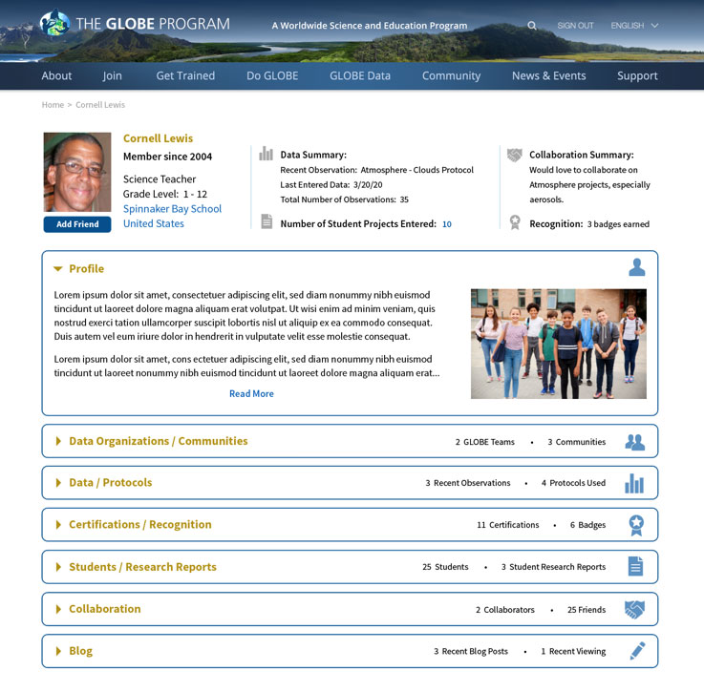
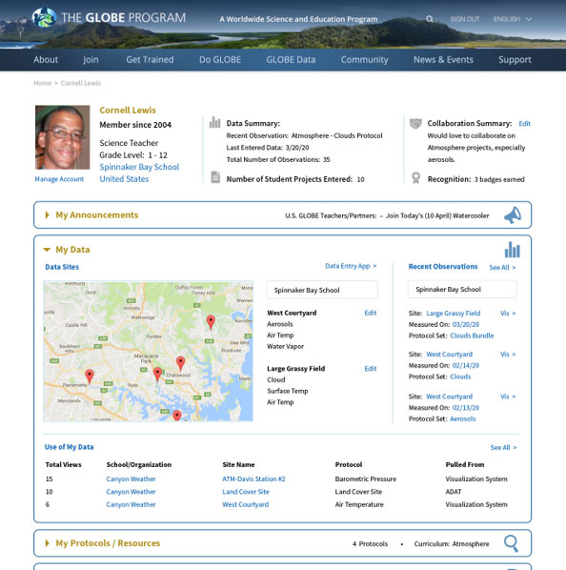

Slide 38
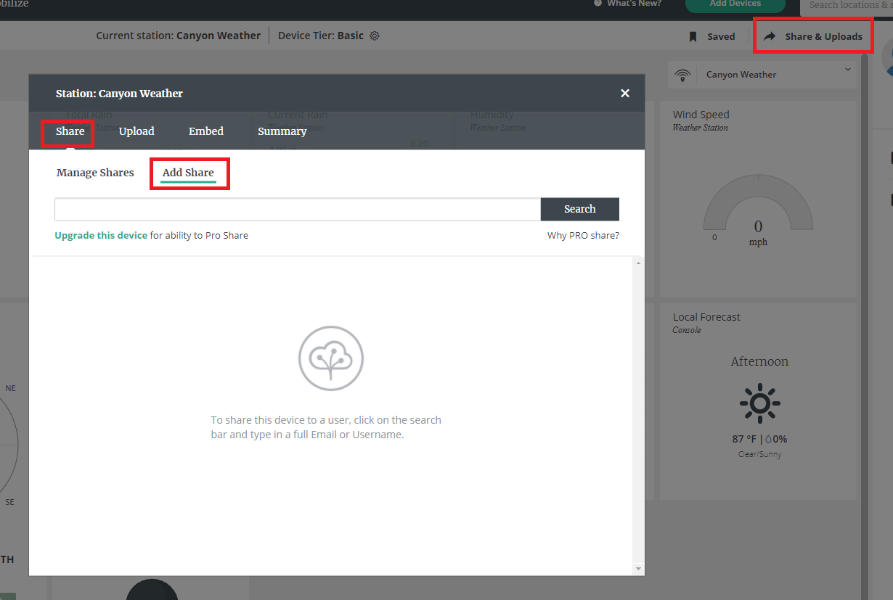
Davis Stations
“consumers requiring GLOBE support should purchase the WeatheLink USB (6510USB) or WeatherLink Serial (6510SER) datalogger and use the PC software to push data to our WeatherLink.com.”
“WeatherLink Live is one of the products not supporting GLOBE uploads”
Path Forward for Davis
Davis has an API which we can pull data from. Davis has agreed they will support us to use their API – no cost to GLOBE or users
We need to build the “Pull Data” capability – like we do for EarthNetworks
GLOBE users will need to Share their data with us
Plan to work this in the months ahead
Looking at EMDE as a possible interim solution

Slide 39
Support for other weather stations
Complete the build of an API-In which allows others to send data directly to GLOBE – think a modernized version of Email Data Entry
We currently use an API to send data to GLOBE for all atmosphere protocols (GLOBE Observer), so this task leverages that work to allow something other than GLOBE Observer to send data to GLOBE through a programmatic interface
Could be used by PAWS3D, other weather station manufacturers. Could potentially be used by HOBO sensors – but someone would need to build an interface to send to GLOBE

Slide 40
Concerns/Questions? Let us know if you’d like a separate help session or have any questions – glad to accommodate during the meeting
David.Overoye@ssaihq.com
Cornell.Lewis@ssaihq.com
Science Systems & Applications, Inc

