Slide 1
Africa Regional Meeting 2022
21 - 23 March 2022
HOW CAN WE VALUE ADD OR MAKE ALUMNI MORE
VISIBLE IN OUR COUNTRIES
Ylliass Destin LAWANI
EWG Member
GLOBE Africa
Benin GLOBE Assistant Country Coordinator
https://www.globe.gov/web/ylliass

Slide 2
AGENDA
1- Overview of GLOBE Alumni
2- Accomplishments
4- Challenges
5- Questions and Comments

Slide 3
OVERVIEW OF GLOBE ALUMNI
“The GLOBE Alumni Organization is a corps of volunteers dedicated to serving the GLOBE Program. The Alumni support and assist Country Coordinators, Partners, teachers, students, and communities in their implementation and expansion of GLOBE and contribute to the sustainability of the Program.”
Notes:
That means a GLOBE Alumni is “A ‘graduate’ of the GLOBE Program who is willing to volunteer his/her time to contribute to the success and sustainability of GLOBE.”

Slide 4
Our Mission
To form a corps of volunteers to serve the GLOBE Program (National, regional and international level)
To establish a different medium of assistance between education and science communities.
To facilitate international/interregional partnerships between schools, educators, and students
To serve as energizers and motivators for other GLOBE Alumni and students
To partner with organizations that promote Youth Leadership

Slide 5
Value-added
Youth-engagement and excitement.
Youth Events
Ambassadors/Training support
Support for Student Scientific Research
Perception of GLOBE Program’s vitality.
Furtherance of student excitement about and engagement in STEM disciplines.
Promotion of STEAM disciplines
Leadership
Youth green entrepreneurship

Slide 6
GLOBE ALUMNI IN AFRICA
Benin
Cameroon
Ethiopia
Gabon
Ghana
Kenya
Madagascar
Nigeria
Senegal
South Africa
Tanzania
Togo

Slide 7
ACCOMPLISHMENTS
GLOBE Alumni is an active part of GLOBE community in the world since 2005. It had proven to be self-sustaining groups in several GLOBE countries within the regions. Number of projects organized or co-organized by GLOBE alumni raised awareness of GLOBE Alumni Community and GLOBE PROGRAM itself. It is a key component in the revitalization and sustainability of the GLOBE Program in the regions.
In Africa the involvement of the GLOBE Regional office and its Director in supporting ideas and financing Alumni initiatives is highly appreciated and strongly helps the GLOBE Africa Alumni Coordination Office (based in Benin) to promote the GLOBE program and support the Country Coordination’s.
Since 2010 many activities had been done.

Slide 8
Volunteering (Translation of GLOBE materials –IVSS as judges and coaches– administrative assistance during GARM-Creation of banners for Meetings)
Team Member of the Kilimandjaro Expeditions
Google Group Discussions. Posts included topics such as events, recruitment, web development, facebook communication and arranging for Skype meetings.
Virtual Meetings of regional leaders (Alumni country representatives)
With the support of the regional office we have been associated to the establishment of a collaboration betwen Ghana and Germany
With the support of the GIO :
we was part of the team which worked on the 2017-2022 GLOBE strategic plan
We are representing the africa region in the Evaluation working group

Slide 9
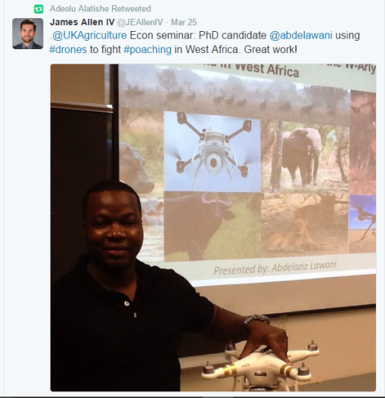
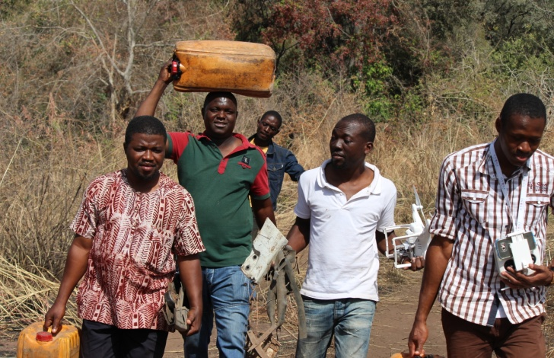
Work with GLOBE Schools on continent (Benin, Tanzania, Ghana, Nigeria, Togo, Madagascar, etc.) and in other region (Hawkins High school (USA) with adopt a highway project, Paderborn school germany, etc
Participation to the project named « Contribution to the biodiversity conservation through anti-poaching drones in the W-Arly-Pendjari Parks ». This project which aims to train on geographic information systems (GIS) and the use of drones to identify unsustainable illegal practices for sustainability of biodiversity in WAP. It also aims to collect data that will be used to develop air surveillance and environmental monitoring programs.
Notes:
For more informations on this project https://www.facebook.com/dronesnetwork/

Slide 10
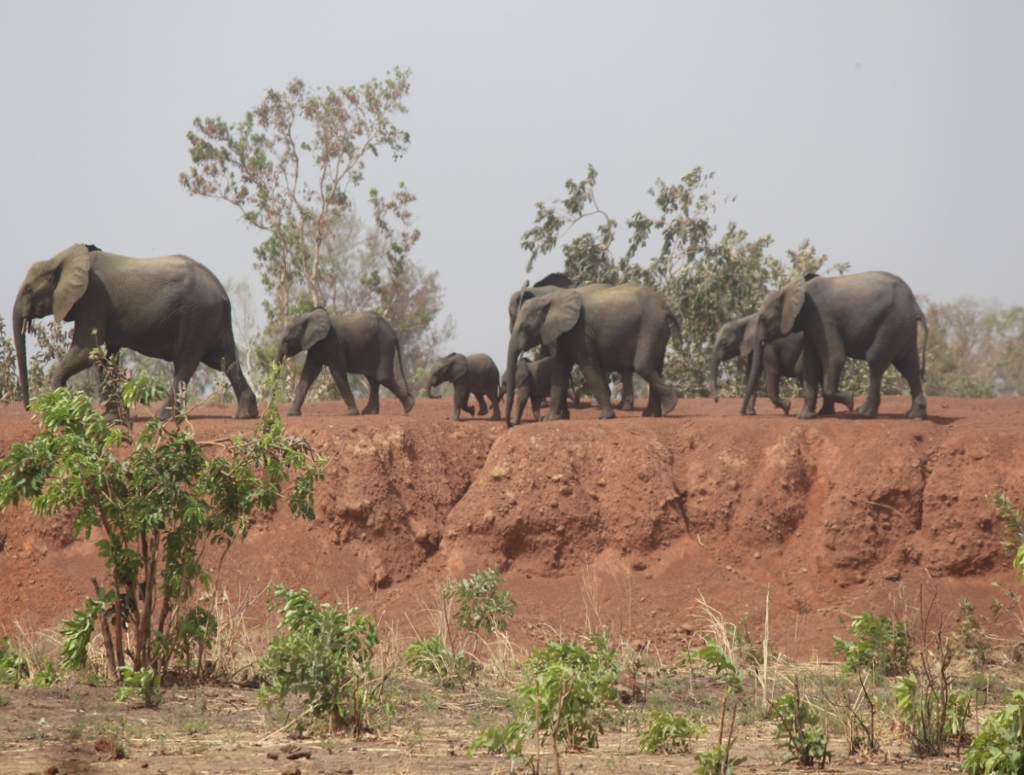
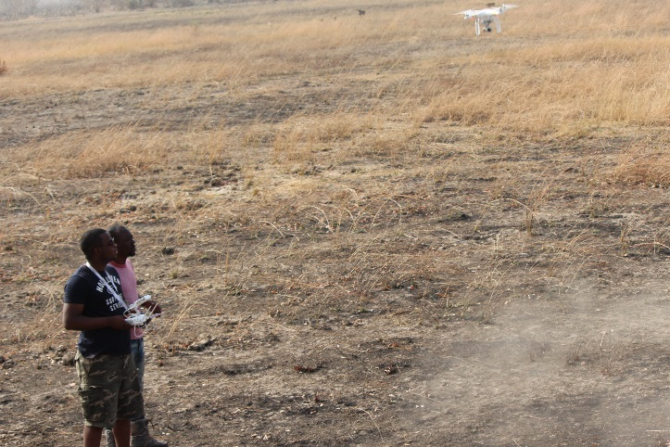
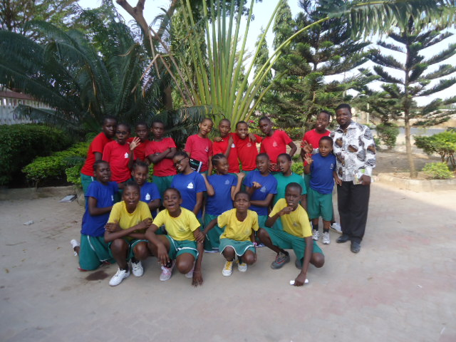
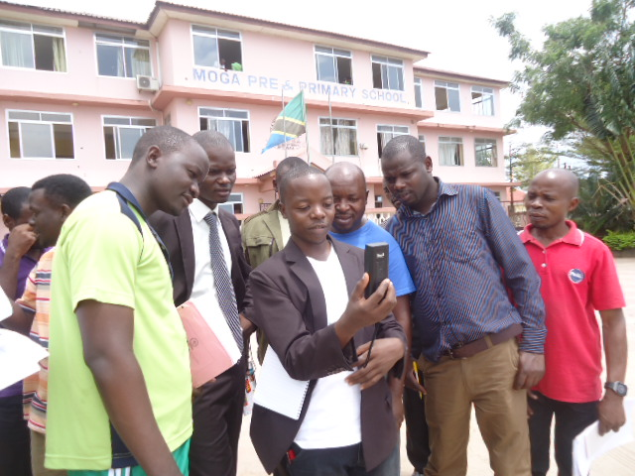
Notes:
More pics at https://www.facebook.com/africa.globe.5/posts/961774887222194?pnref=story

Slide 11
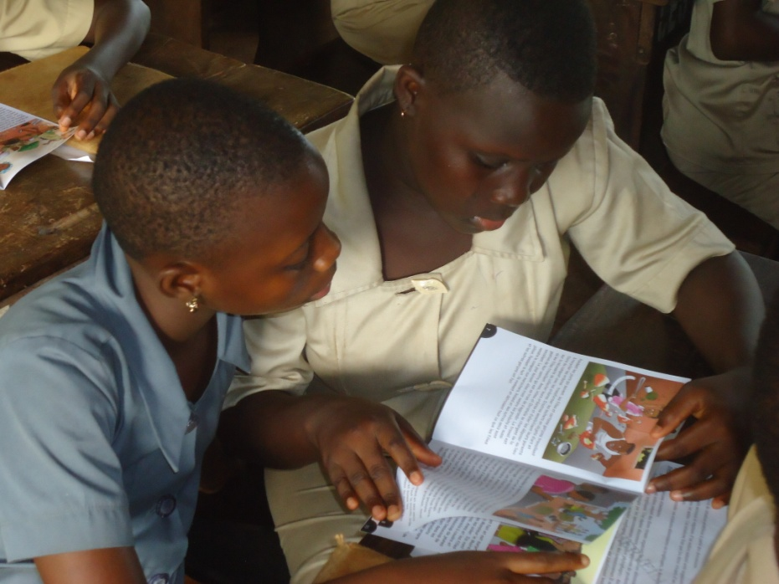
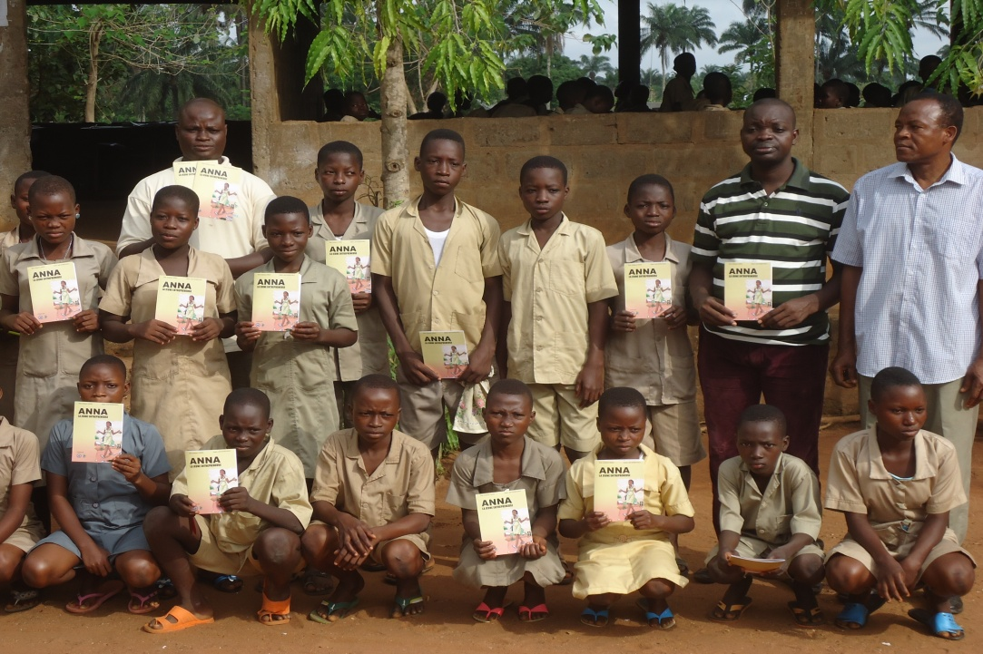
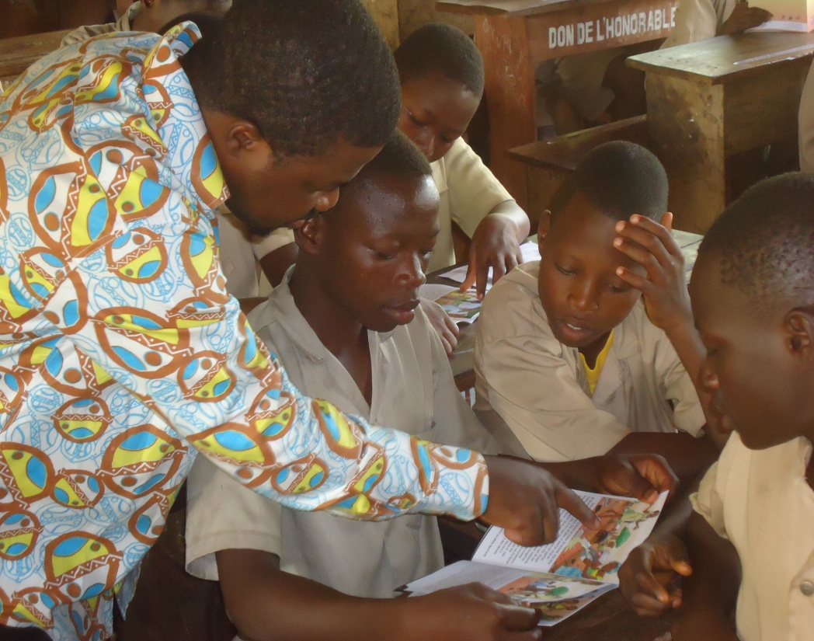
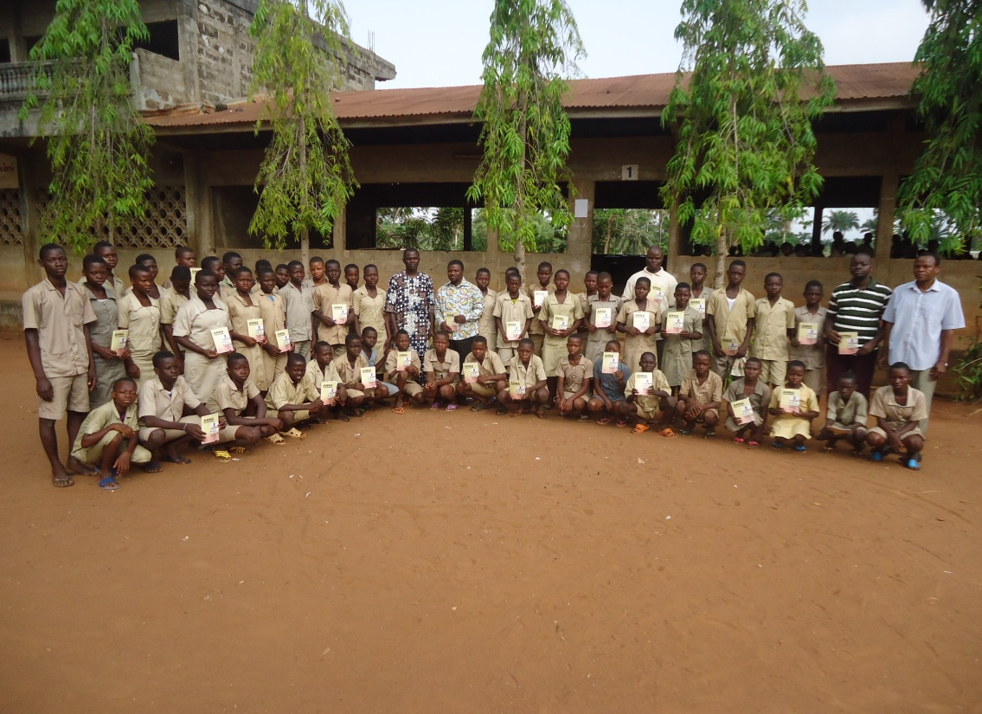

Slide 12
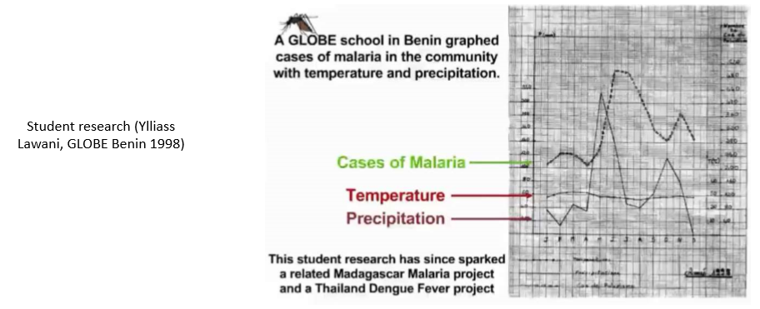
Alumni and the GLOBE Zika Project
In 1998 a group of Benin students (currently GLOBE Alumni) presented their research at the first GLOBE learning Expedition (GLE) held in Helsinki in Finland. This research were about the effect of precipitation and temperature on Malaria prevalence in Benin. It is said that this research inspired the GLOBE Zika education and prevention project.

Slide 13
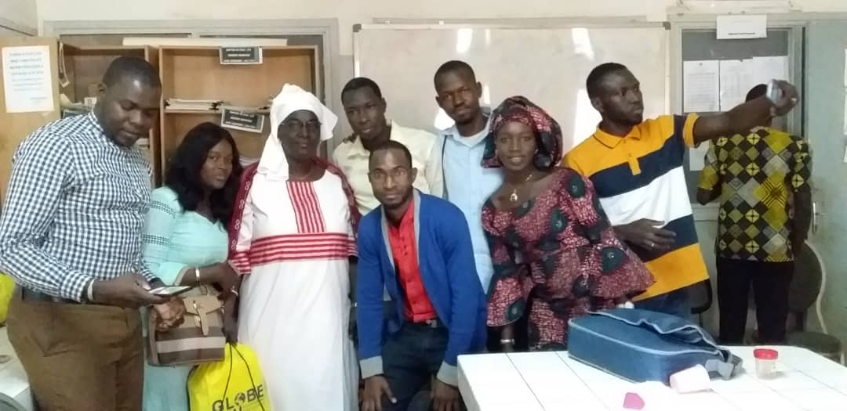
Birane Diouf and his students at the Lycee Seydina Limamoulaye
In Senegal a group of Alumni (above with the GLOBE Country Coordinator, Mrs. Fall) were closely associated to the implementation of the GLOBE Zika Education and Prevention Project. Their different actions and their commitment have contributed to make Senegal the first contributor of data to the project.
Notes:
GLOBE "Mission Mosquito" Spotlight on Senegal : https://www.globe.gov/globe-community/blogs/community-blogs/-/blogs/52154278/maximized

Slide 14
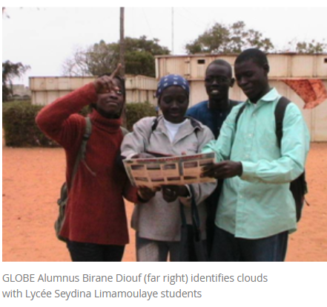
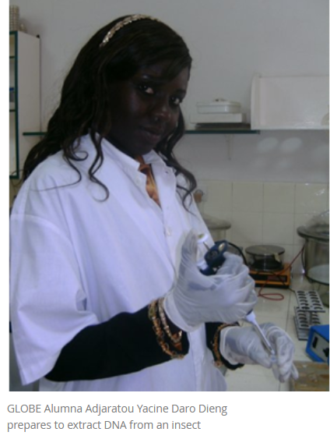

Slide 15
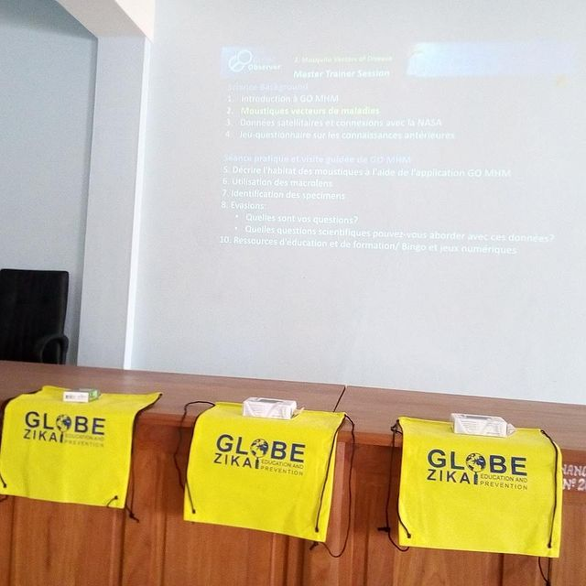
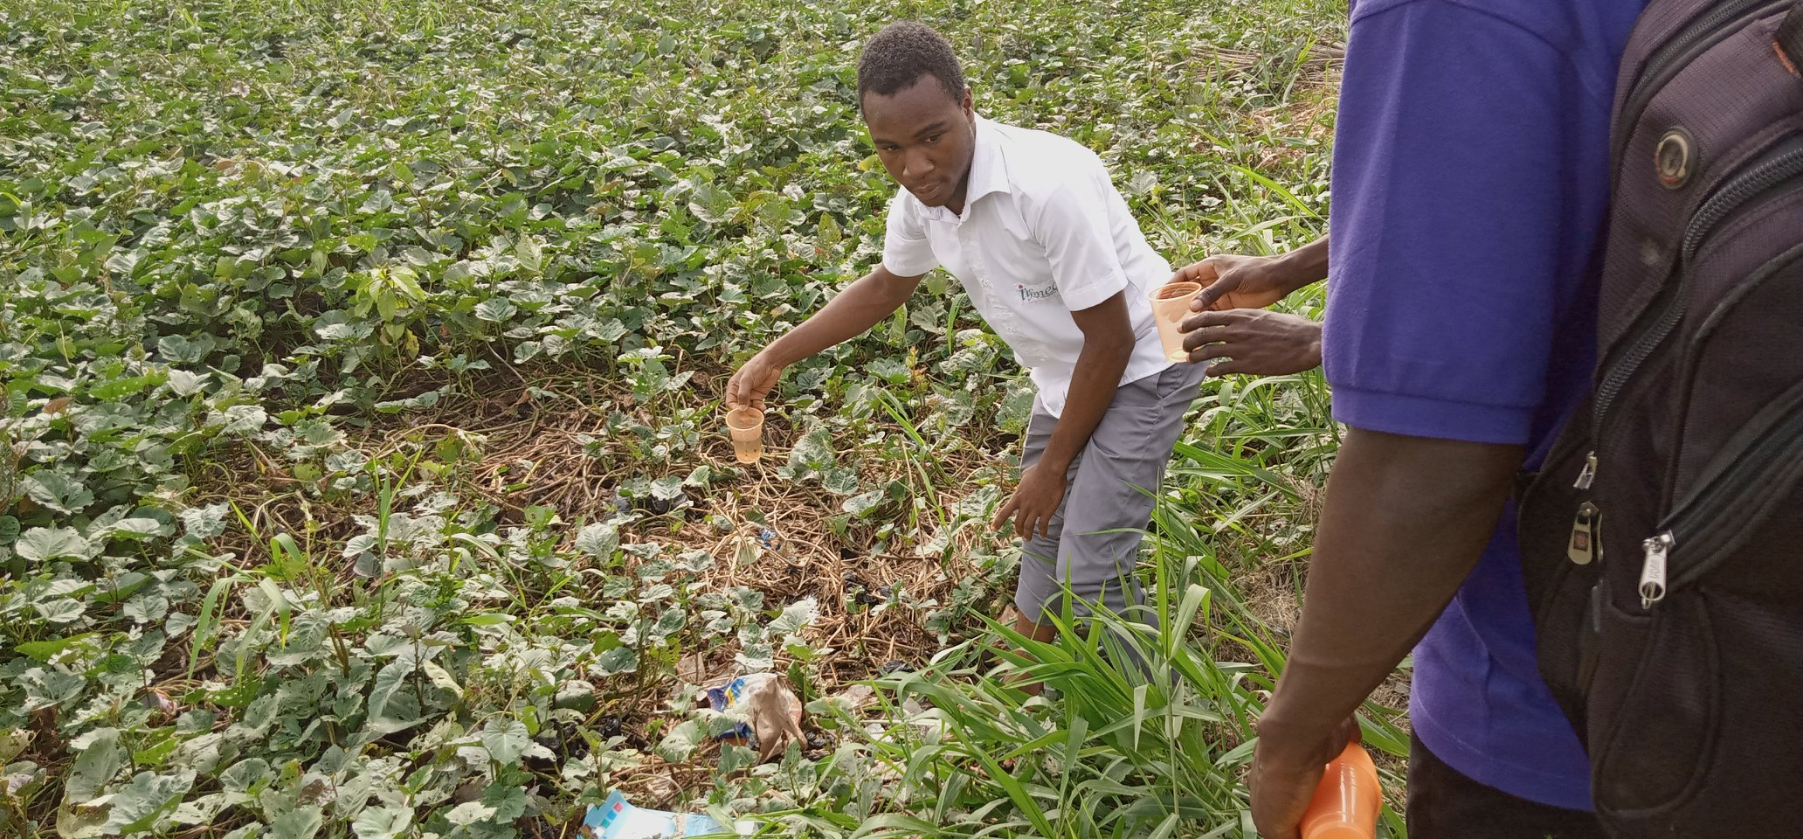
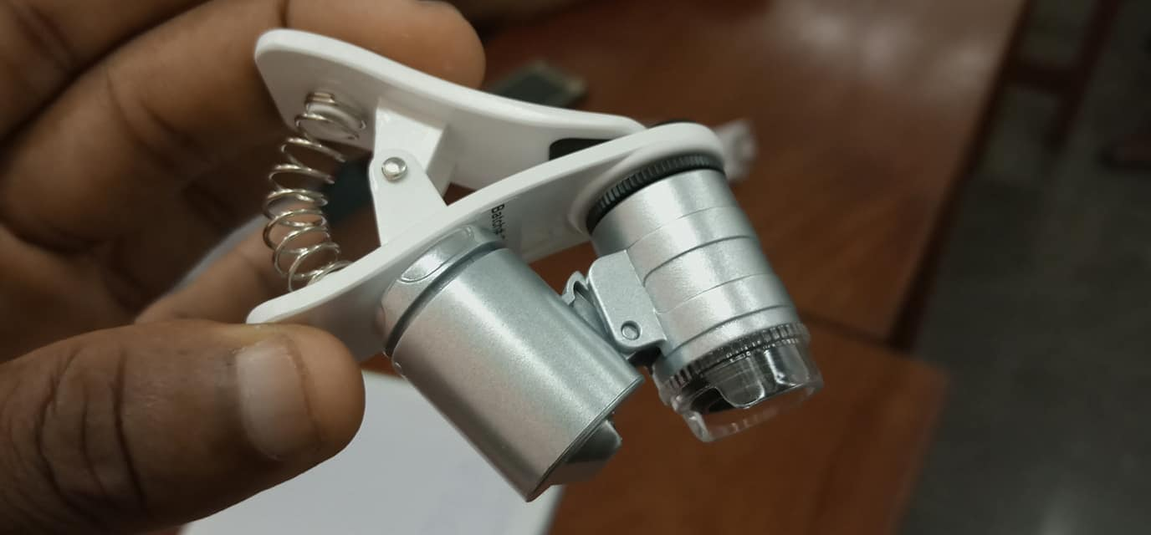
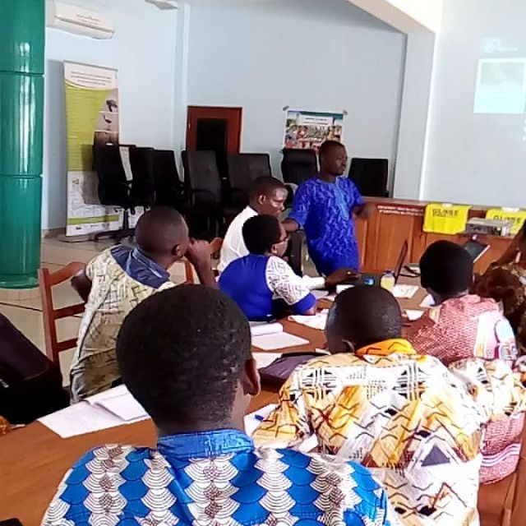
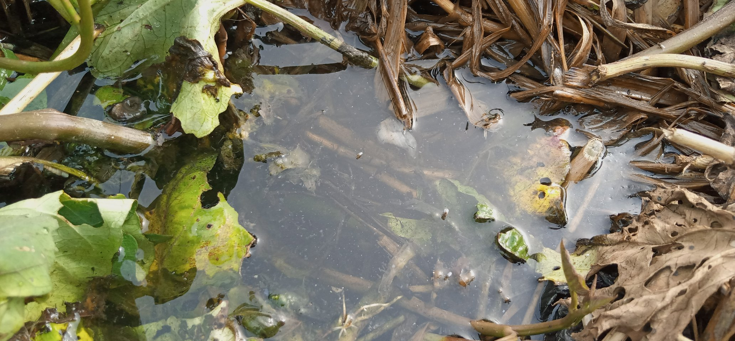

Slide 16
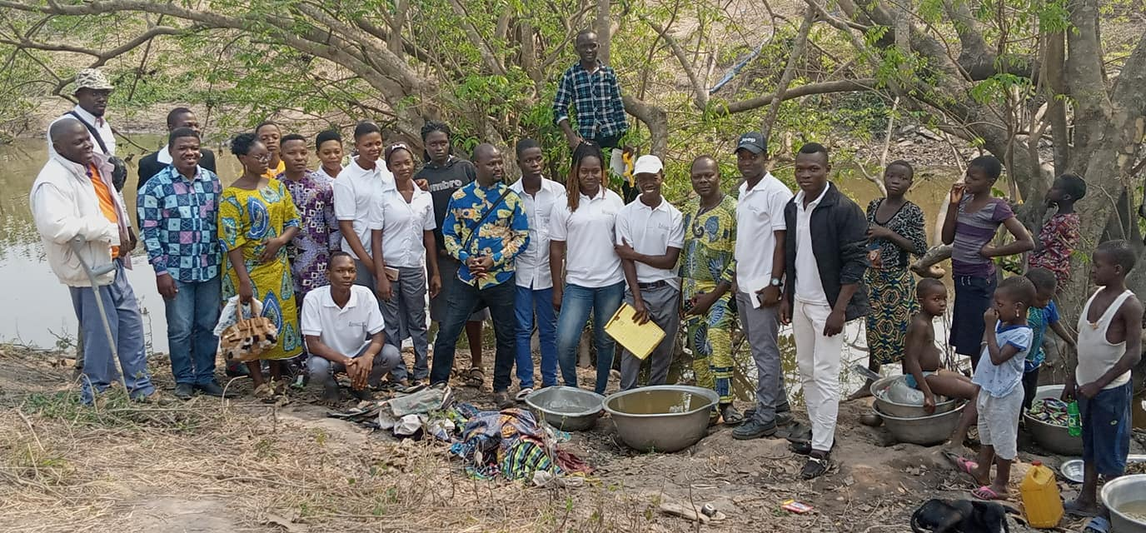
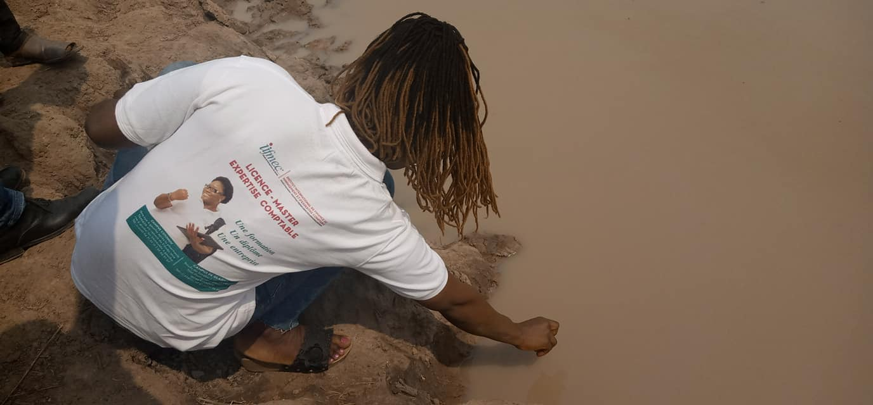
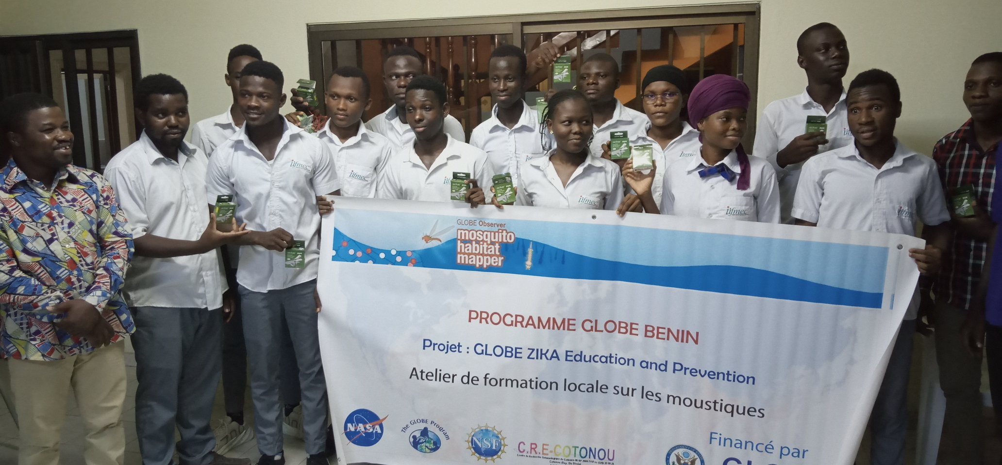
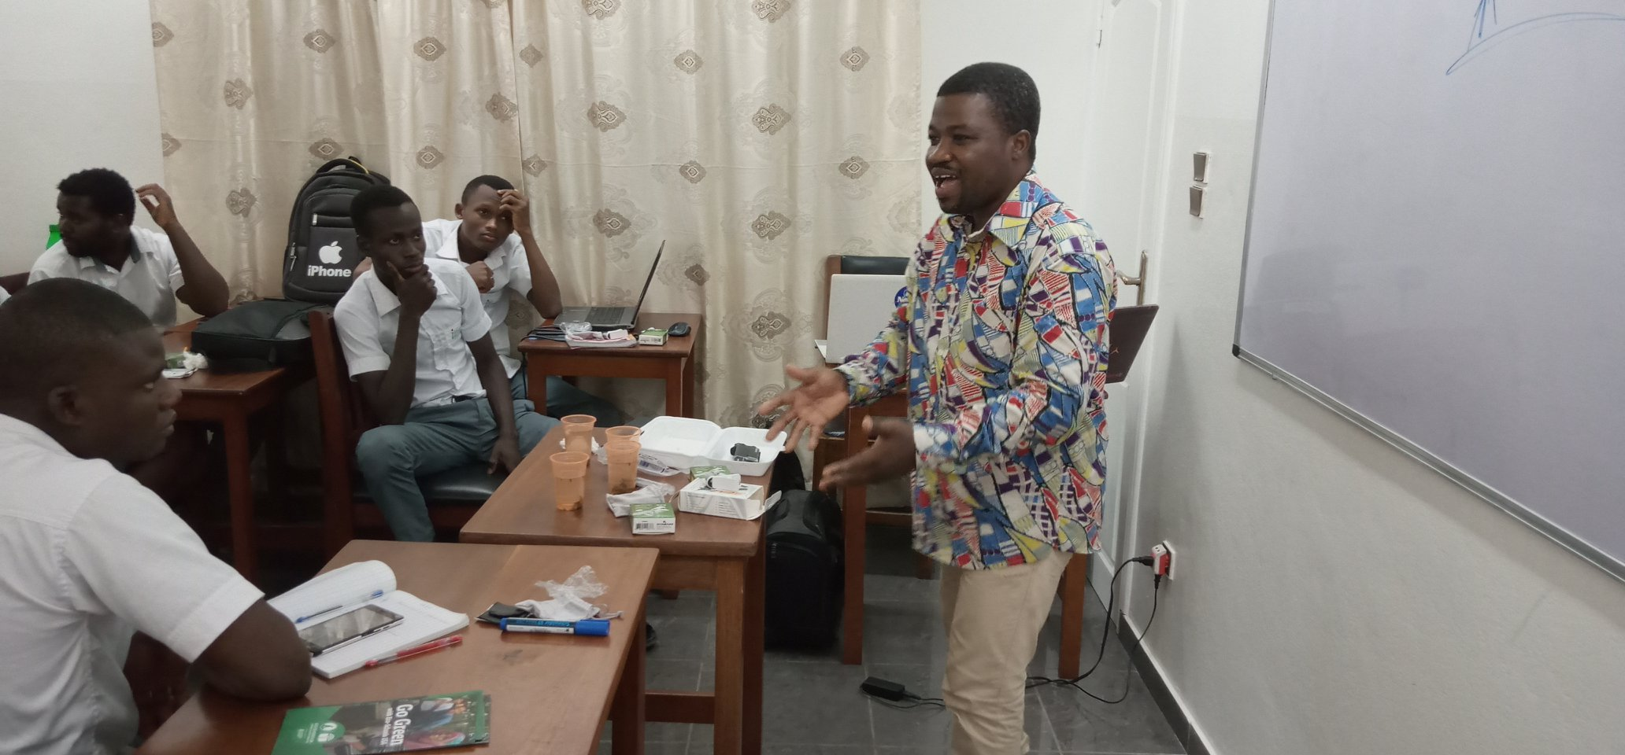

Slide 17
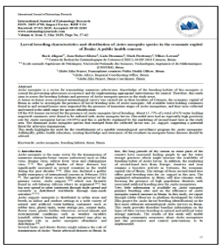
PUBLIC HEALTH RESEARCH
“Assessment of population dynamics and biting trends of Aedes aegypti in northern Benin: Public health implications.” International Journal of Mosquito Research in October 2018
Lead author was the Francophone Regional PHO, Dr. Rock Aikpon
Co-authors: Mark Brettenny (Regional Coordinating Officer) & Ylliass Lawani
This research presents important findings about the biting behavior of Aedes mosquitoes in Benin, and the probability of exposure to Aedes aegypti mosquitoes (based on the indoor and outdoor collection of 485 adult Aedes aegypti mosquitoes)
Download this article at entomologyjournals.com/archives/2019/vol4/issue3/4-3-26

Slide 18
ALUMNI CROSS-BORDER ACTIVITIES
A GLOBE Alumni from Benin Mr. Halile specially was really engaged with IVSS. He left Benin in 2017 to Niger where he was teaching in IPF KOURA-MATAMEYE. He created a GLOBE section in this school under the supervision of the Country Coordinator. In 2019 he participated in the IVSS with 6th - 8th Grades (Middle School, ages 16 -20)students. Their research on the ‘’ Typology and evolution of the number of mosquito habitats in Matamèyè ‘’ won the IVSS african region first price in 2019. Unfortunately he could not get the price and could not attend the 2019 annual meeting, due to a lack of funding to get air tickets for himself and his students in Niger.
Notes:
The alumni headquater was really engaged in the background with Niger GLOBE country coordinator to help them to grap some funds with sponsors. Unfortunately the delay was too short to rise these funds.
Mr. Halile went back in Benin in 2020 and worked closely with Abdou Wadoude BOUSSARI, another talented globe alumni, currently a biology teacher in ATCHOUKPA secondary school on Bénin, to participate in the 2020 IVSS. They won the special first DoS price, and their students could present virtually at the 2020 annual meeting.
https://www.globe.gov/do-globe/research-resources/student-research-reports/-/projectdetail/globe/typology-and-evolution-of-the-number-of-mosquito-habitats-in-matameye
https://www.globe.gov/documents/10157/953cab33-614c-4261-917a-a4475dfeb1b5

Slide 19
GLOBE STUDENTS RESEARCH
4 GLOBE students from 3 schools ADELABOU Halilath, ANAGO Fourkone, BOUSSARI Ihissanou and FAGBOHOUN Mouhsine, under the supervision of their GLOBE teachers Mr. PARAÏSO Halile Fidèle and Mr. BOUSSARI Abdou Wadoud (both GLOBE Alumni) submitted their research at the 2020 GLOBE IVSS
They won the DoS Zika prize for Africa Region and could present their research at the 2020 GLOBE Virtual Meeting.
Students also received a certificate for attending /presenting at the 2020 GLOBE Virtual Meeting
Notes:
https://www.globe.gov/web/globe-mosquito-project/overview/ivss-and-zika-project

Slide 20
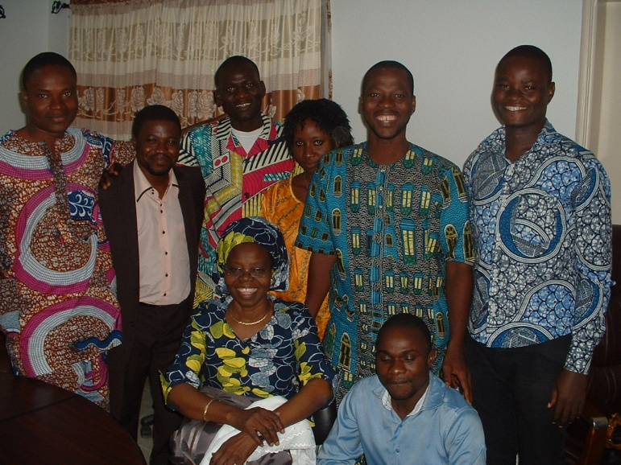
Alumni represent the link between the past and the future of the program
In Africa, the relationship with elders is "sacred", why alumni celebrate their former teachers, principals and coordinators. In many schools, they have been known to continue the program in the absence of GLOBE teachers or during the transition to a new teacher. Above Alumni group with their Country coordinators (Paul from Madagascar on left, and Alidjennatou ALIOU from Benin on the right)

Slide 21
PROMOTION OF GLOBE ALUMNI WORLDWIDE
Usie existing GLOBE alumni channels to reach them worldwide (GLOBE Alumni group (https://groups.google.com/g/globe-alumni a goggle open group to be reactived), Globe alumni regional representations ( with existing alumni chapters with GLOBE regional offices), Alumni page on GLOBE website (https://www.globe.gov/web/alumni)
The GLOBE alumni survey (https://www.globe.gov/documents/10157/82036655/Alumni+Survey+w+Intro.pdf/eabcc84d-43b6-dd69-49de-3fd13b766dbb?t=1625675445552) should be put in Survey Monkey (www.surveymonkey.com), the survey link posted on GLOBE website, and also sent out in the existing GLOBE alumni channels, the GLOBE News Brief, GLOBE forums, emailed, shared by group members across their networks, discussed at National/Regional and Annual Meetings
Populate the GLOBE alumni page on GLOBE website https://www.globe.gov/web/alumni by automatically regrouping all registered GLOBE alumni. GIO can make this page the official communication channel for GLOBE alumni
Use GLOBE and existing GLOBE Alumni social medias to reach future Alumni
Students vlogers initiative to attract emerging Alumni

Slide 22
CHALLENGES
Strenghten alumni networks (nationally, regionally and internationally).
Identify funding sources and fundraising skills.
Use all the funding opportunities to raise funds for the national coordination's
Continue assisting GLOBE CCs, regional offices and GIO
Assure the establishment of GLOBE Alumni organizations in the countries where they don’t exist
Populate GLOBE alumni surveys available on GLOBE websites
Organize a GLOBE Alumni international meeting funded by GIO and sponsors

Slide 23
Thank you for your attention!

