Slide 1
GLOBE Asia – Pacific Regional Coordination Office
Theme GLOBE for All – Connecting the Community (January’22 – February’23) AP RCO Coordinator - Dr. Desh Bandhu www.globe.gov

Slide 2
Summary of Activities in the Region
As we get to the new normal after the COVID -19 pandemic and as a precautionary measure for the GLOBE community we continue conducting some of our GLOBE activity in the region virtually and for a few we gathered together. One positive thing that we learn during the pandemic that we can meet any time just digitally and we have been utilizing the digital resources to connect with the regional GLOBE Community to strengthen the program in the region in various ways.
Since January 2022 to February 2023 AP RCO has organized 11 Webinars for GLOBE community in the Region.
AP RCO also organized a Two GLOBE e- Training workshop for Bhutan, which is a newly added country in our region. One from 25-29 April’22 and the second one on October 31, November 23, November 29, December 09 and the last one on December 19, 2022.
AP RCO uploads all the webinar recording on its YouTube Channel for wider Circulation and community engagement and share details to the regional community through Social media Platforms.
Some of the Regional highlight is mention in this presentation.

Slide 3
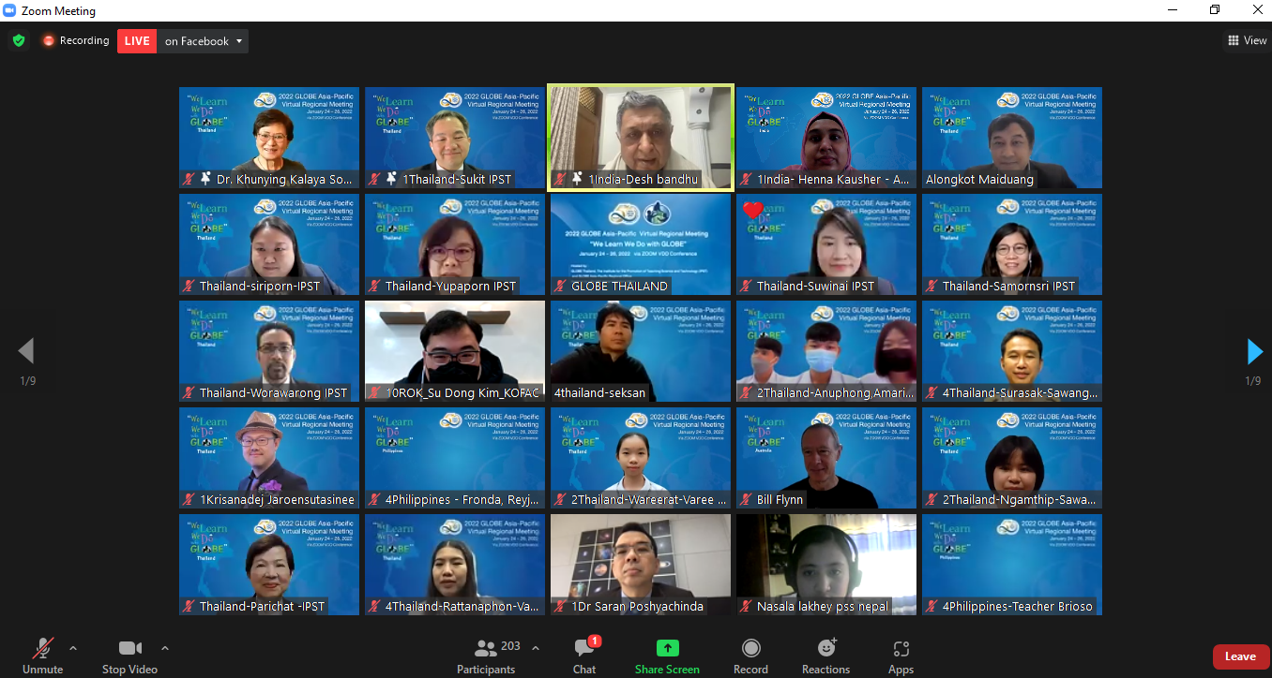
Webinar to increase regional engagement in GLOBE Program

Slide 4
Webinar on “Follow up of 2022 AP RM ".
The GLOBE Asia-Pacific regional Coordination Office hosts a webinar on 11th February 2022 for Country Coordinators, GLOBE Partner and community Member in the region host a follow up webinar for 2022 AP RM to finalize the plans for 2022 GLOBE Activities in the Region such as Training Programs, Students exchange, expedition & GLOBE Campaigns.
It was discussed during the webinar that the Asia – Pacific region will promote the activity on micro plastic as this has become a serious issue and suggested by country coordinators in the region. As well as on Mosquito Campaign, Study of Soil, Air Quality awareness Campaign and Waterbodies IOP.
2022 Lake Pokhara Expedition was also finalized during the webinar.
Expedition to the Sea in Male, Maldives was also proposed during the webinar.
AP RCO also announces its plans for Capacity Building Training in the Region during 2022 AP RM.

Slide 5
Coordinator AP RCO detailing the plan activity for 2022 during the 2022 AP RM follow up webinar on 11th Feb’22.

Slide 6
Webinar on the Promotion of Microplastic Monitoring Protocol in Taiwan
Asia – Pacific Regional Coordination Office organized webinar on Promotion of Microplastic Monitoring Protocol on 4th March 2022.
Dr. Prof. Pay-Liam Lin, Coordinator, GLOBE – Taiwan partner presented the Status of micro plastics Protocol in Taiwan.
28 participants from 10 countries in the region attended the webinar. Participants including Teachers, Scientist & Country Coordinator’s from the region.
Dr. Prof. Pay-Liam Lin shares with the participants the details of the curriculum about marine education, teaching material & activities on marine education.
He also shares with the participants about the teaching plan for teachers who are interested in Microplastic monitoring.

Slide 7
Dr. Pay Liam explain the protocol undertake by the students in Taiwan.

Slide 8
Webinar to promote GIO Earth Day activities
The GLOBE Asia-Pacific regional Coordination Office hosts a webinar on 25th March 2022 for Country Coordinators, GLOBE trainers, and GLOBE teachers in the region on “To Promote Earth Day with The GLOBE Program - Collect, Visualize, Connect!”
AP RCO, shares the details of Air Temperature Data Challenge to celebrate 27th Anniversary of The GLOBE Program!
AP RCO shares the details before the start of the challenge to all CCs in the region..
AP RCO also shares details about other Regional & Global Challenges such as Trees Around the GLOBE Campaign, Regional data Collection.
AP RCO also shares the details about the upcoming GLOBE Annual Meeting from 25-28 July 2022 .
The webinar was attended by 12 active GLOBE countries.

Slide 9
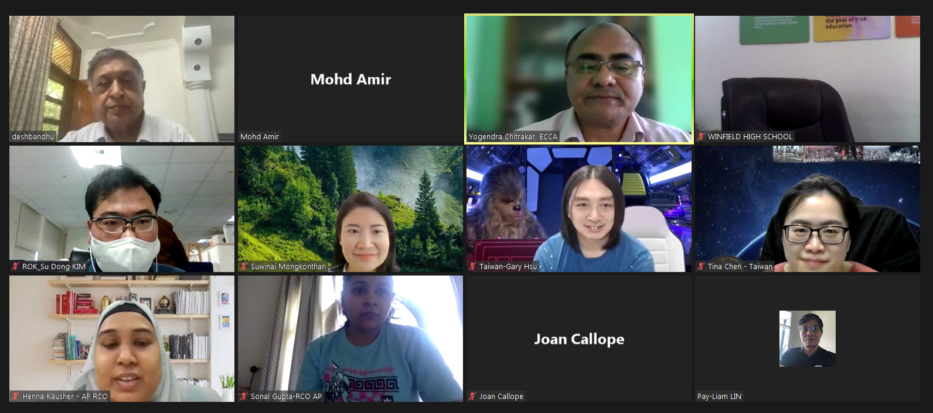
Virtual group photograph of Participants of Webinar on 25nd March 2022
Dr. Desh Bandhu explaining the Air Temperature Data Challenge to the audience. .

Slide 10
Webinar on GLOBE Capacity Building Project for Asia – Pacific Region
Asia-Pacific regional Office hosts a webinar on 18th April 2022 for CCs, in the region and to discuss about “Reinventing Community Engagement and Empowerment through Data Literacy and Learning activities of the GLOBE Program” i.e. GLOBE Capacity Building Project for Asia – Pacific Region.
AP RCO shares the Objective, Learning outcome as well as proposed Training methodology.
The principal objective of the Project is to enhancing the capacity of the GLOBE trainers through data literacy on GLOBE Protocols.
RCO also share its interest to organizing e- training protocol workshop for some GLOBE Protocol to strengthen the trainer pool in the region.
Virtual & Face to Face Training of 34 GLOBE Trainers from the regional countries to take place in two phases. 1st one for Asian Countries & the 2nd one for Pacific Countries.

Slide 11
Coordinator, GLOBE AP RCO Sharing the activities details with CCs in the Region.

Slide 12
Webinar on Soils in Schools
Asia-Pacific regional Office hosts a webinar on 27th May 2022 for CCs, GLOBE trainer, Teachers and Students on “Soils in Schools”.
This webinar was to encourage GLOBE teachers and students to develop skills on GLOBE Soil Protocol.
The webinar was presented by Dr. Rod Allen De Lara, GLOBE Country Coordinator- Philippines & Joan Callope, GLOBE Assistant Country Coordinator- Philippines.
The Webinar was attended by 98 participants including 43 students from Nepal and 10 from Bhutan and from nine GLOBE Countries.
Dr. Rod Also encourages Students to create IVSS Project related to Soil Protocol.

Slide 13
Dr. Rod Allen De Lara, CC GLOBE – Philippines Sharing why we need to study Soil Characterization to the Participants.

Slide 14
Webinar with AP Working Group members
Asia-Pacific regional Office organized webinar with Working Group members from AP Region on 05th August’2022
The webinar was organized so the newly appointed WG members and have the opportunity to meet Regional Community and to develop working relationships between WG members and CCs.
All the WG members presented a brief about their work what are there focus in GLOBE.
The webinar was attended by 21 participants from 7 countries (India, Palau, Philippines, Sri Lanka, Thailand, Taiwan - Partner and Vietnam)
It was the first time for two WG members to interact with the Regional community.

Slide 15
Francis Murillo Emralino DEI working Group member presenting to the participants.

Slide 16
2022 Lake Pokhara Expedition
Summary ( http://www.globeasiapacific.org/lake-pokhara/index )
43 Participants from 08 countries participated in the 2022 Lake Pokhara Expedition from 27th September to 03rd October.
Bhutan, India, Nepal, Philippines, Thailand, Taiwan Partner, USA (GIO).
02 officials from US Embassy – Nepal (Mr. Patrick Gan - Regional Environmental Officer & Ms. Sulakchana Rai) attended the Expedition.
Ms. Sivani Rasanayakam, Environment, Science, Technology and Health Officer in American Embassy in Dhaka, Bangladesh also join us during the Expedition.
Participants visited GLOBE school, ICIMOD Knowledge Park at Godavari during the Expedition.
Participants study the Lake Fewa Site and do Protocols on Hydrosphere ( Water Temperate, pH, TDS, and Transparency) Biosphere (Land Cover and Tree Height), Atmosphere (Air Temperate, Clouds, Surface Temperature) and Pedosphere (Soil Temperature and Soil characterization)
Participants also conducted the Mosquito Protocol using the GLOBE Observer App. and contributed with data entries to the GLOBE database via the GLOBE Observer App.
Participants also shares their research done on water bodies in their home country with other Participants, which leads to a discussion on future collaboration among different Students. Participants also shares their best GLOBE Practices that they have organized to keep their local community motivated and informed about their local environment.
AP RCO prepare relevant resource material including equipment's for the Expedition and shares it with the participants.
Future
RCO plans to continue with the Lake Pokhara Expedition on 9-10/2024.

Slide 17
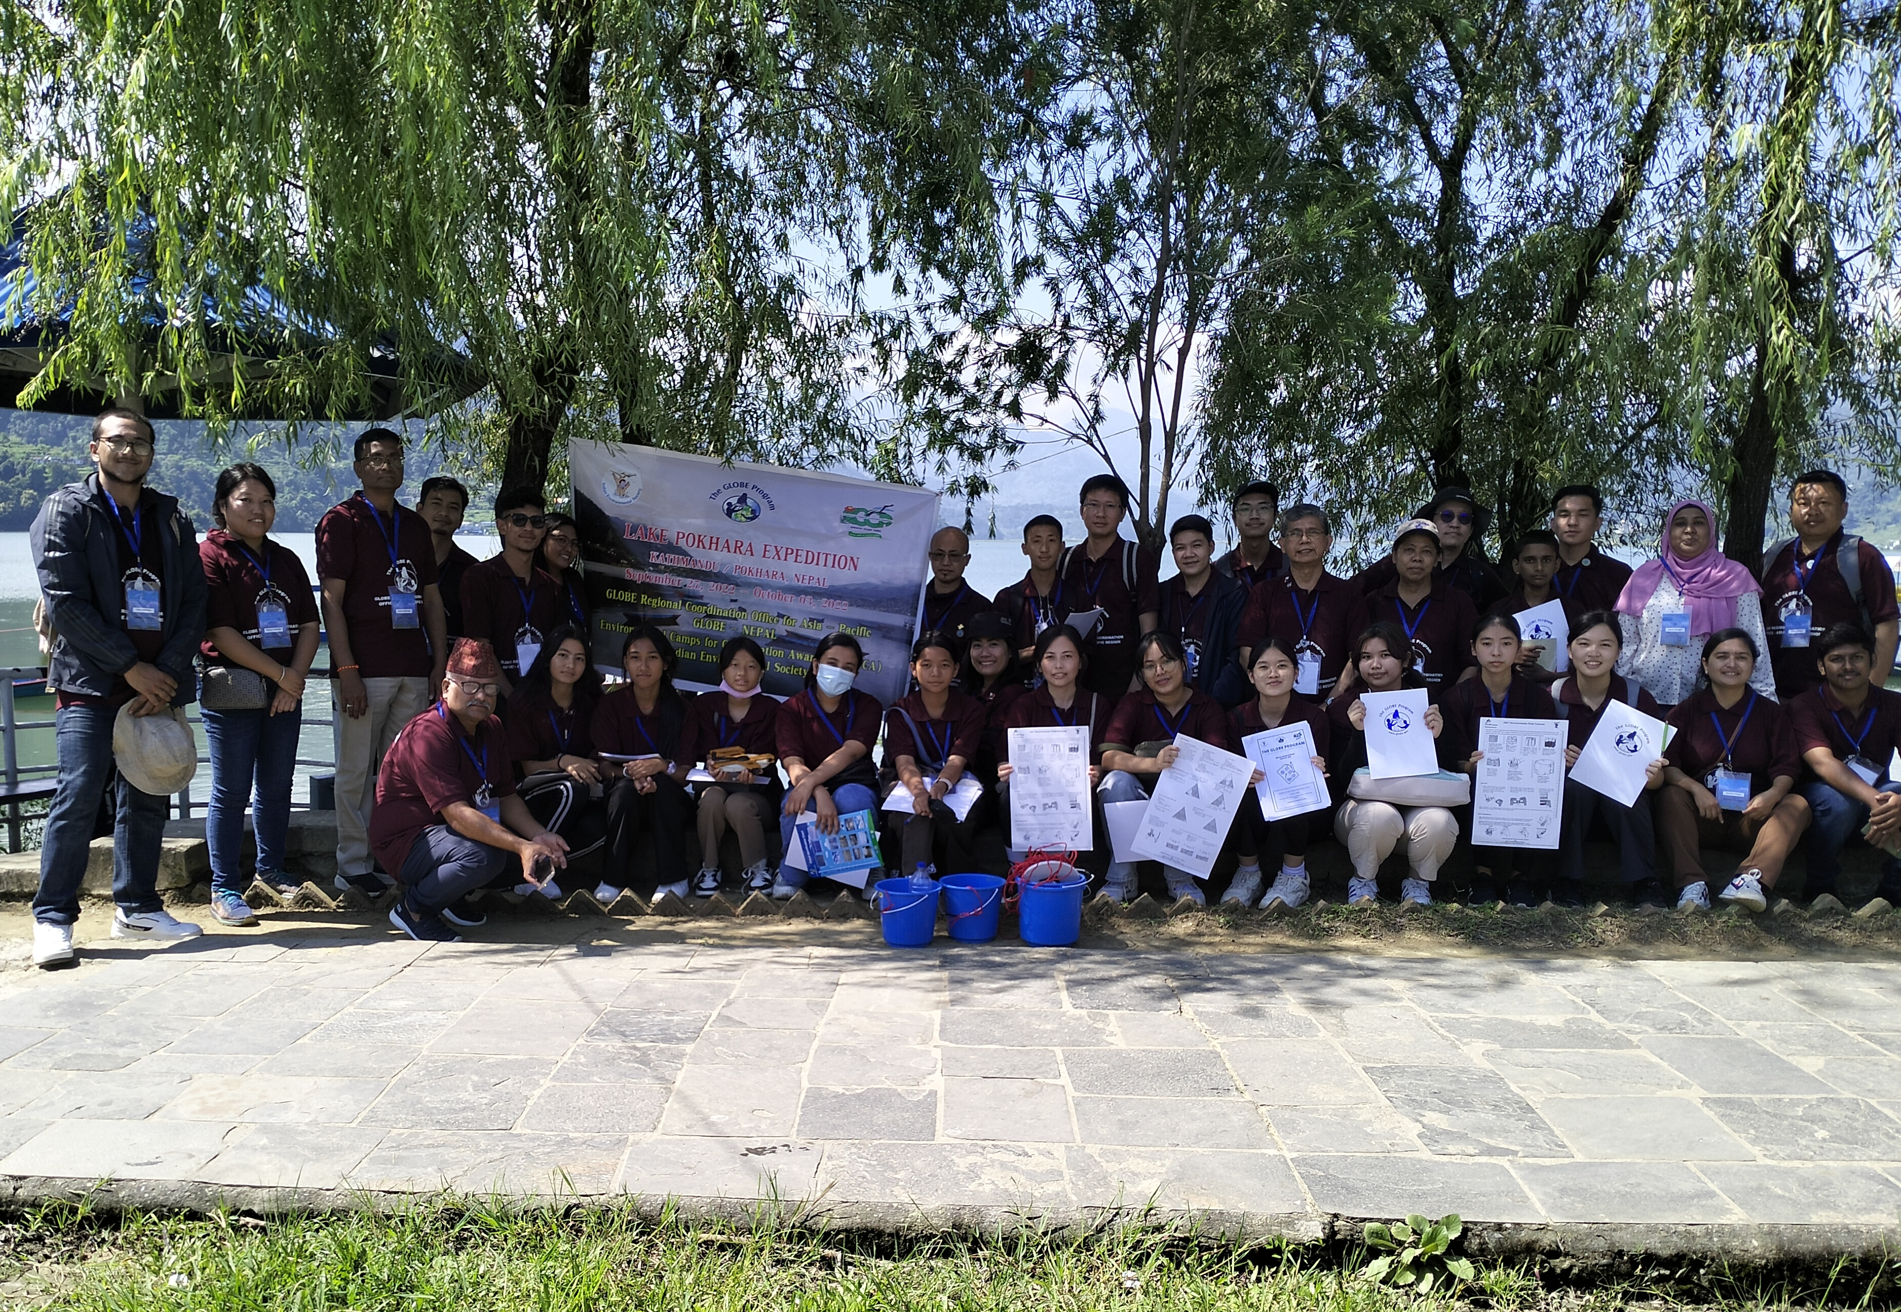
Group photograph of Participants from 2022 Lake Pokhara Expedition

Slide 18
Agents of Change – Episode 5: GLOBE in Asia and Pacific
The GLOBE Implementation Office set out to tell the story of how The GLOBE Program impacts people and communities around the world. Throughout the worldwide GLOBE community, many agents of change were identified; “multipliers” who spread the work of GLOBE and inspire others to have an impact, too.

Slide 19
the GLOBE Asia – Pacific Virtual Wetland Symposium
AP RCO organized the GLOBE Asia – Pacific Virtual Wetland Symposium on 8th December 2022 and on 2nd February 2023 which marks World Wetlands Day.
16 students projects using GLOBE Protocols to Study Wetland was presented by Various Students Presenters on 8th December 2022.
The Symposium on 8th December was attended by 134 participants from 6 countries in the Region. (Australia, India, Nepal, Philippines Thailand, Taiwan)
The 2nd Part of the Symposium will held on 2nd February 2023 on International Wetland Day.
6 students projects from Nepal, India & Philippines presented their research projects on local wetland during the 2nd Feb’23 Symposium.
94 participants including Students Participated from 10 Countries in the Region Australia, India, Bhutan, Nepal, Philippines, Palau, Thailand, Sri Lanka, Micronesia and Taiwan)
This Symposium was an opportunity for GLOBE Students to showcase and share their research Paper/ presentation.

Slide 20
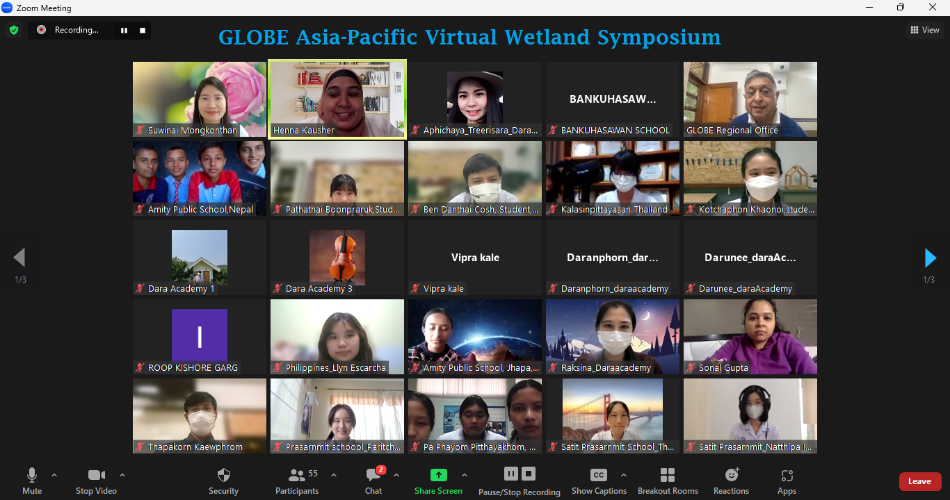
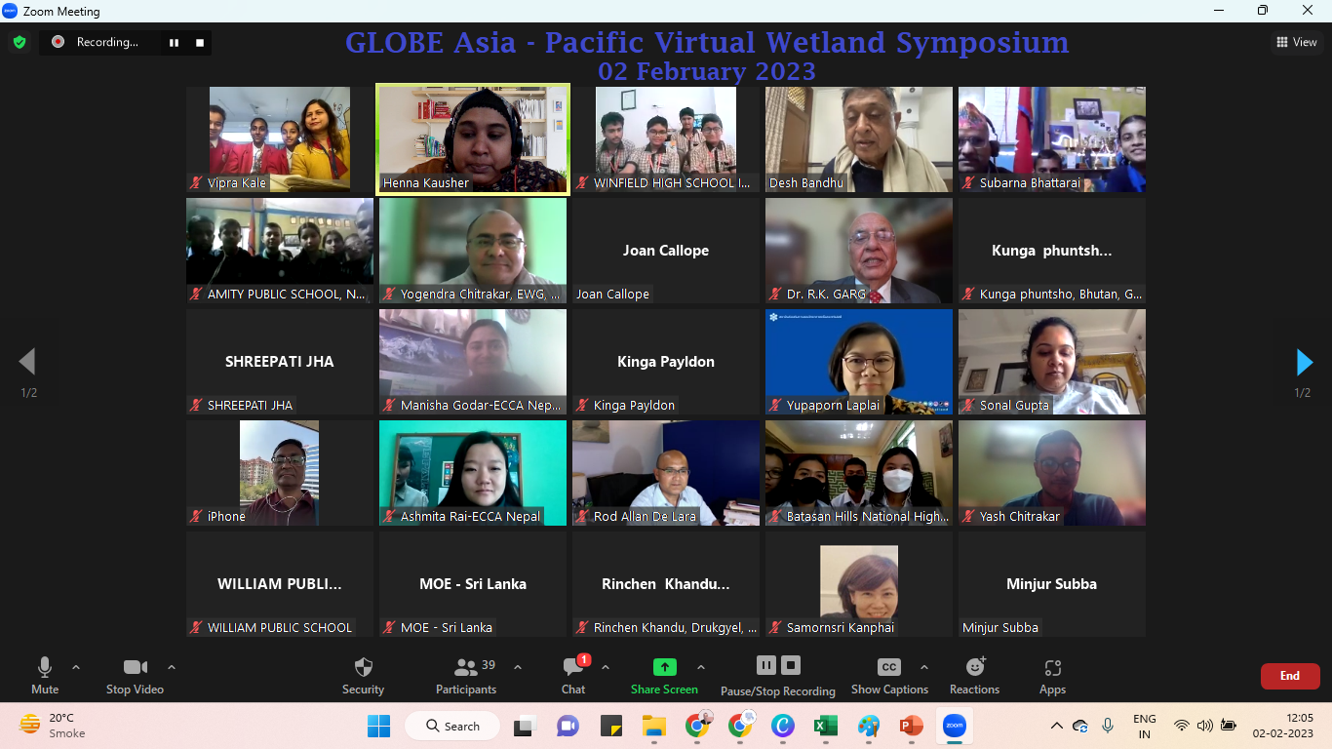
Virtual Group Photograph from Symposium on 8th Dec’22.
Virtual Group Photograph from Symposium on 2nd Feb’23.

Slide 21
Bhutan GLOBE Teacher Training Workshop
AP RCO help organize GLOBE Teacher Training Workshop for GLOBE – Bhutan from 25 to 29 April 2022.
13 teachers from Bhutan got train in 4 GLOBE Protocols including Atmosphere, Biosphere, Pedosphere & Hydrosphere.
This was the second e-training in the region on dedicated to learn all about GLOBE program.
AP RCO help Organized training on Atmosphere Protocol that was held on October 31, 2022. for GLOBE Teachers to become Trainers / Mentor Trainers.
AP RCO & GLOBE – Organized training on Biosphere Protocol that was held on November 23, 2022. for GLOBE Teachers to become Trainers / Mentor Trainers.
AP RCO & GLOBE – Organized training on Pedosphere (Soil) Protocol that was held on November 29, 2022. for GLOBE Teachers to become Trainers / Mentor Trainers.
AP RCO & GLOBE – Organized training on Hydrosphere Protocol that was held on December 09, 2022. for GLOBE Teachers to become Trainers / Mentor Trainers.
AP RCO & GLOBE – Organized Concluding Session with Trainees QnA that was held on December 19, 2022. for GLOBE Teachers to become Trainers / Mentor Trainers.

Slide 22
GLOBE STAR Stories from Asia – Pacific Region
GLOBE Asia – Pacific Regional Coordination Office submits 8 GLOBE Star from Jan’22 to Feb’23.
GLOBE Taiwan Partnership Teachers Use Multidisciplinary Approach to Tackle Environmental Issues - Feb 07, 2022
GLOBE Asia and Pacific Regional Meeting: “We Learn We Do with GLOBE” Develops Spirit of Scientific Learning and Collaboration. - Feb 09, 2022
First Teacher Training Workshop Takes Place in GLOBE Bhutan – “Milestone in Scaling Up Efforts to Engage Youth” - Mar 01, 2022
GLOBE Taiwan Partnership Workshop Focuses on Microsplastics Monitoring to Gain Deeper Understanding and Raise Awareness - Apr 06, 2022
Training in GLOBE Nepal Enhances “Chain of Learning” - April 25, 2022
Asia and Pacific Regional Coordination Office Hosts GLOBE Learning Expedition in Kathmandu and Pokhara, Nepal - Nov 15, 2022
AP RCO have submitted 2 more GLOBE Star and they will go live soon the GLOBE.gov page.

Slide 23
GLOBE CAPACITY BUILDING TRAINING IN ASIA - PACIFIC REGION
The first Virtual Training of 19 Participants from Asian Countries was held on 15th February 2023.
19 GLOBE Trainers Selected by respective CC from 9 countries in Asia region (Bhutan, Mongolia, Maldives, Nepal, Philippines, Sri Lanka, Thailand, Taiwan – Partner & Vietnam) on all four GLOBE Protocols with selected Learning activities and Data Viz was conducted darning the training.
Team of Trainers
Atmosphere Protocol - Dr. Desh Bandhu
Hydrosphere Protocol - Dr. R.K. Garg
Biosphere Protocol – Dr. Watcharee Ruairuen
Pedosphere (Soil) Protocol - Dr. Rod Allan De Lara
GLOBE Data & Visualization - Ms. Joan B. Callope
The second phase i.e. the Face to Face for these 19 GLOBE Trainers on all four GLOBE Protocols with selected Learning activities and Data Viz was conducted darning the training will be held on 14- 18 March’2023.
The training for 16 GLOBE Trainers from pacific region ((Australia, Fiji, Japan, Micronesia, Marshall Island, Palau, Republic of Korea, & New Zealand) will be held in July 2023.
Notes:
For the Last 10 years, the AP RCO has been doing the Promotion & coordination for GLOBE program in the Region. As mentioned earlier, till date more than 5000 teachers from schools scattering in 19 different countries have been trained as GLOBE Teacher. This number is very less as compared to the number of schools and total geographic area of the region. It is essential to increase the number of GLOBE Trainers on GLOBE protocols to have effective implementation of GLOBE program in the region. There is need for capacity building of the teachers on GLOBE program which is unique Hands -on -science education program.
The GLOBE Program has the potential to involve students/ youth in environmental monitoring activities. The training of Trained GLOBE teachers under the GLOBE Program will be helpful for implementing the idea of Capacity Building to involve students, strengthen the technical skills of the students, regular monitoring activities, promoting students research activities on environment.

Slide 24
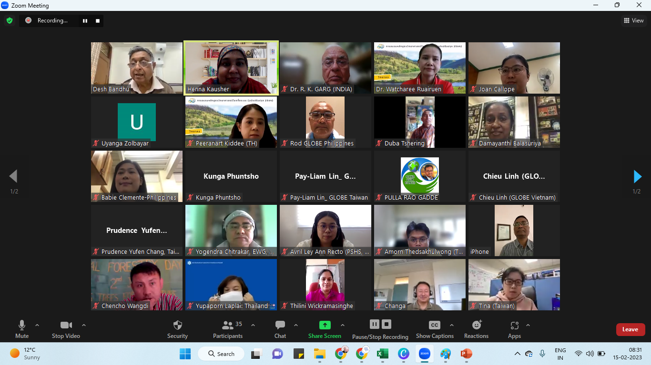
Virtual Group Photograph from CBP Training on 15th Feb’23.
Notes:
For the Last 10 years, the AP RCO has been doing the Promotion & coordination for GLOBE program in the Region. As mentioned earlier, till date more than 5000 teachers from schools scattering in 19 different countries have been trained as GLOBE Teacher. This number is very less as compared to the number of schools and total geographic area of the region. It is essential to increase the number of GLOBE Trainers on GLOBE protocols to have effective implementation of GLOBE program in the region. There is need for capacity building of the teachers on GLOBE program which is unique Hands -on -science education program.
The GLOBE Program has the potential to involve students/ youth in environmental monitoring activities. The training of Trained GLOBE teachers under the GLOBE Program will be helpful for implementing the idea of Capacity Building to involve students, strengthen the technical skills of the students, regular monitoring activities, promoting students research activities on environment.

Slide 25
THANKS!
iesindia@gmail.com
ap.region.globe@gmail.com

