Slide 1
The GLOBE program in Maldives
By: EPA

Slide 2
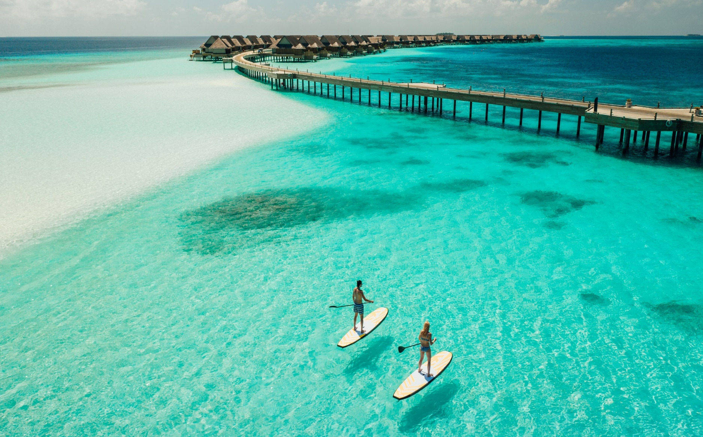
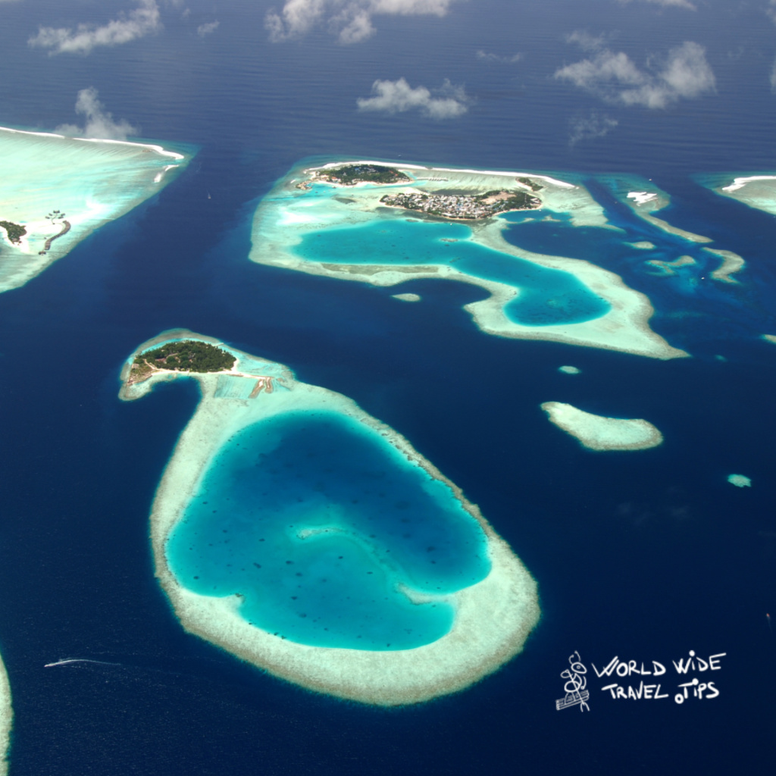
Introduction
Republic of Maldives, is situated in the Indian Ocean. It consists of 1,192 coral islands grouped in a double chain of 26 atolls, that stretch along a length of 871 kilometers (541 miles) north to south, 130 kilometers (81 miles) east to west
It’s territory is roughly 90,000 sq. km. including the sea area.
Land area of all the islands comprises 298 sq. km.
It is one of the smallest countries in the world. We have around 557,751 inhabitants.

Slide 3
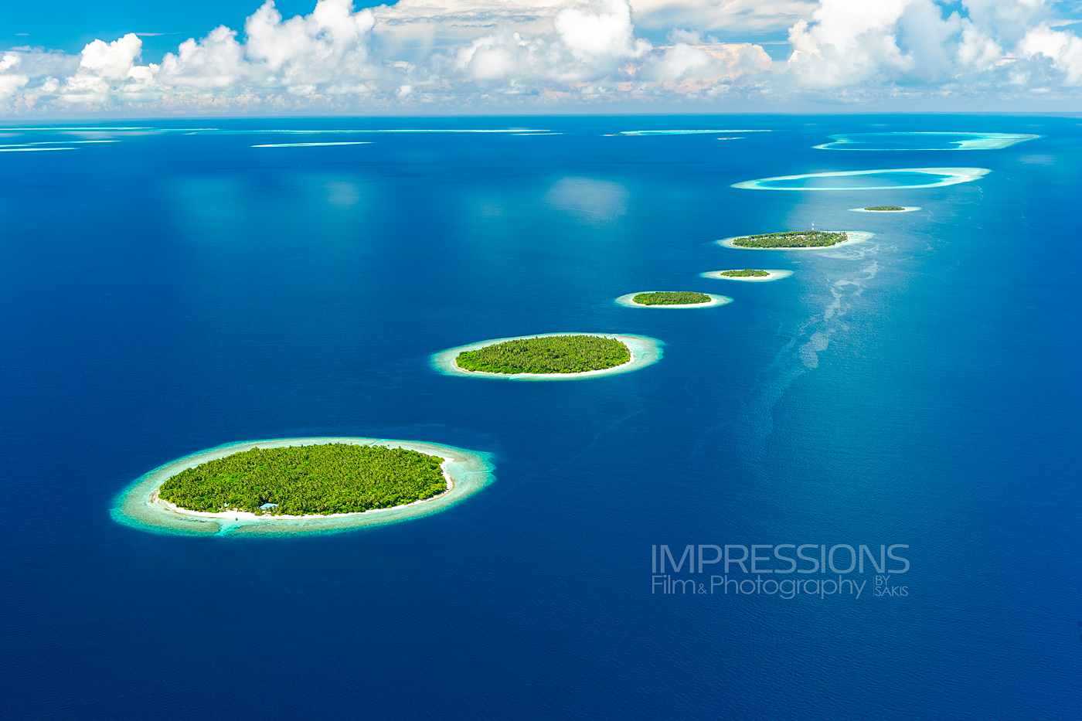
Introduction
Lowest lying country in the world, with maximum and average altitude of only 2.4 m above sea level
It is considered as the country to be most affected by global warming and climate change.
The climate is tropical monsoon type with average yearly rainfall of 1900mm.
Average temp is 28 degree Celsius and average relative humidity 75 %.

Slide 4
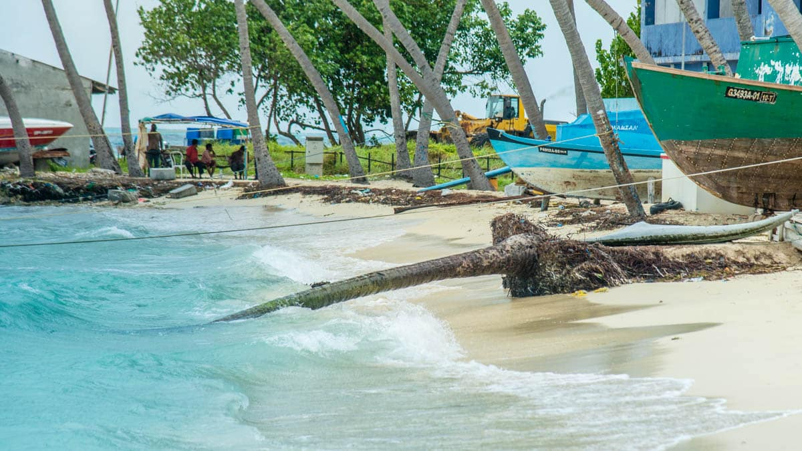
Erosion & Sea level rise

Slide 5
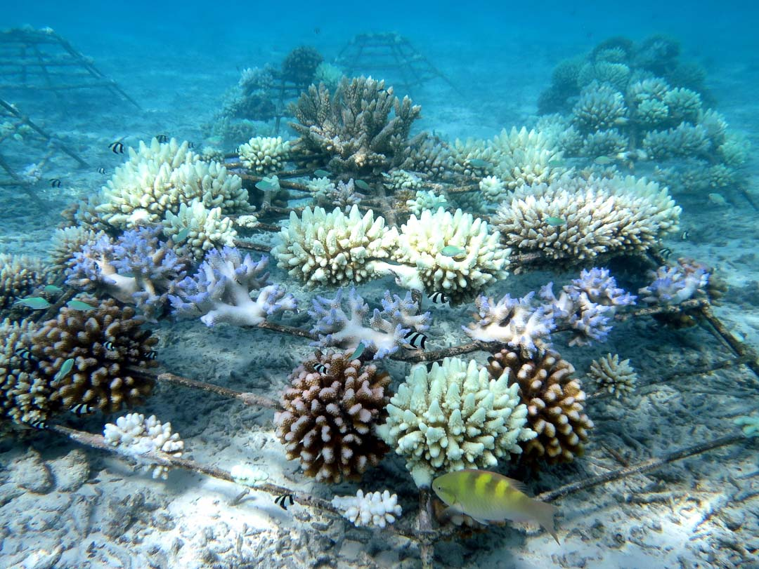
Coral Bleaching

Slide 6
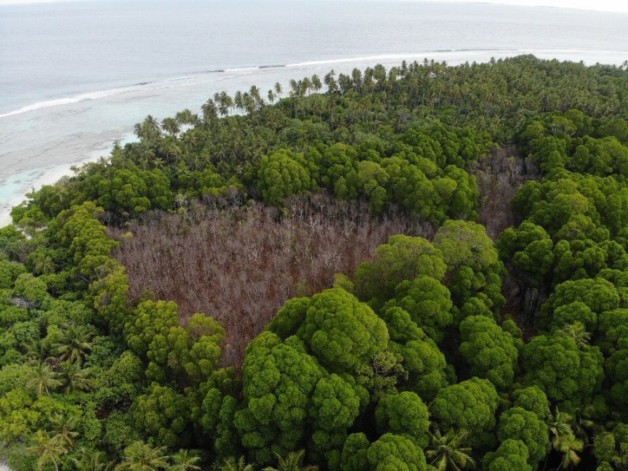
Mangrove die off

Slide 7
The GLOBE program in Maldives
Joined in the year 2003
20 schools identified as GLOBE schools
Preparations are underway to train the GLOBE teachers in Schools

Slide 8
The GLOBE program in Maldives
Targeted research area
Flora and fauna investigations
Soil investigation
Water quality investigation
Atmosphere and climate patterns
Plastic pollution

Slide 9
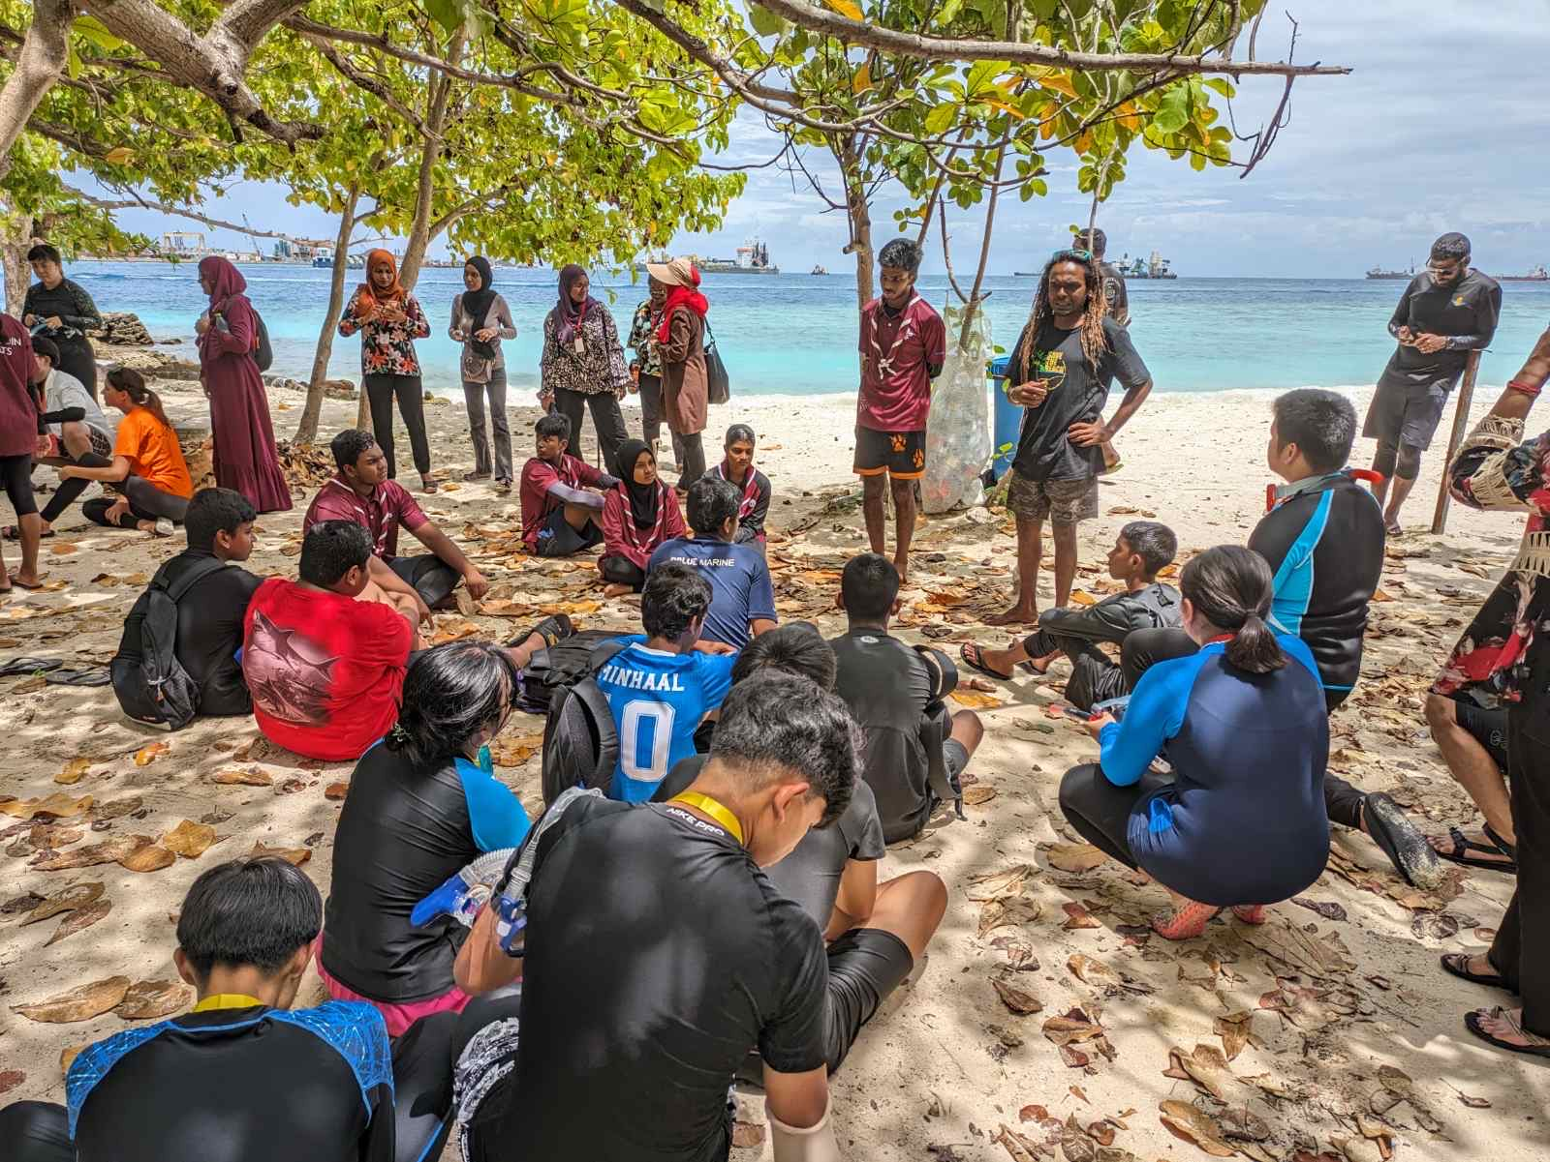
The Globe learning expedition to the sea in Maldives 2023

Slide 10
The Globe learning expedition to the sea in Maldives 2023
A team from Asia-Pacific region visited on 1st to 3rd October 2023
The team included of 30 international participants, including students, teachers and GLOBE Coordinator for Asia-Pacific Region
And 68 local participants
The Team visited 2 Schools in Maldives, which included Ghaazee School from Hulhumale’ and Muhiyiddeen School from Vilimale’.

Slide 11
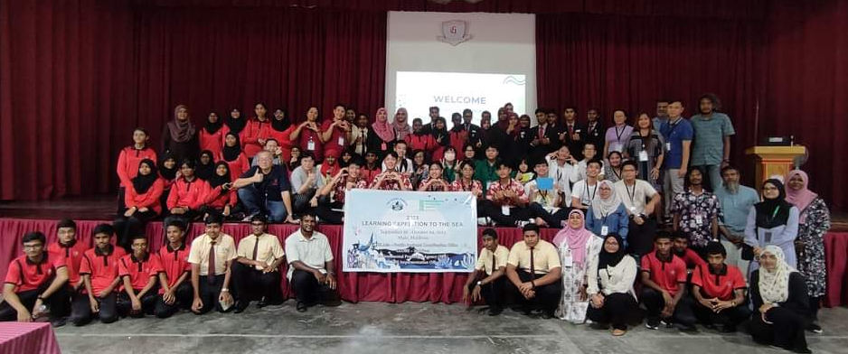
GLOBE School Presentations in Ghazee SCHOOL

Slide 12
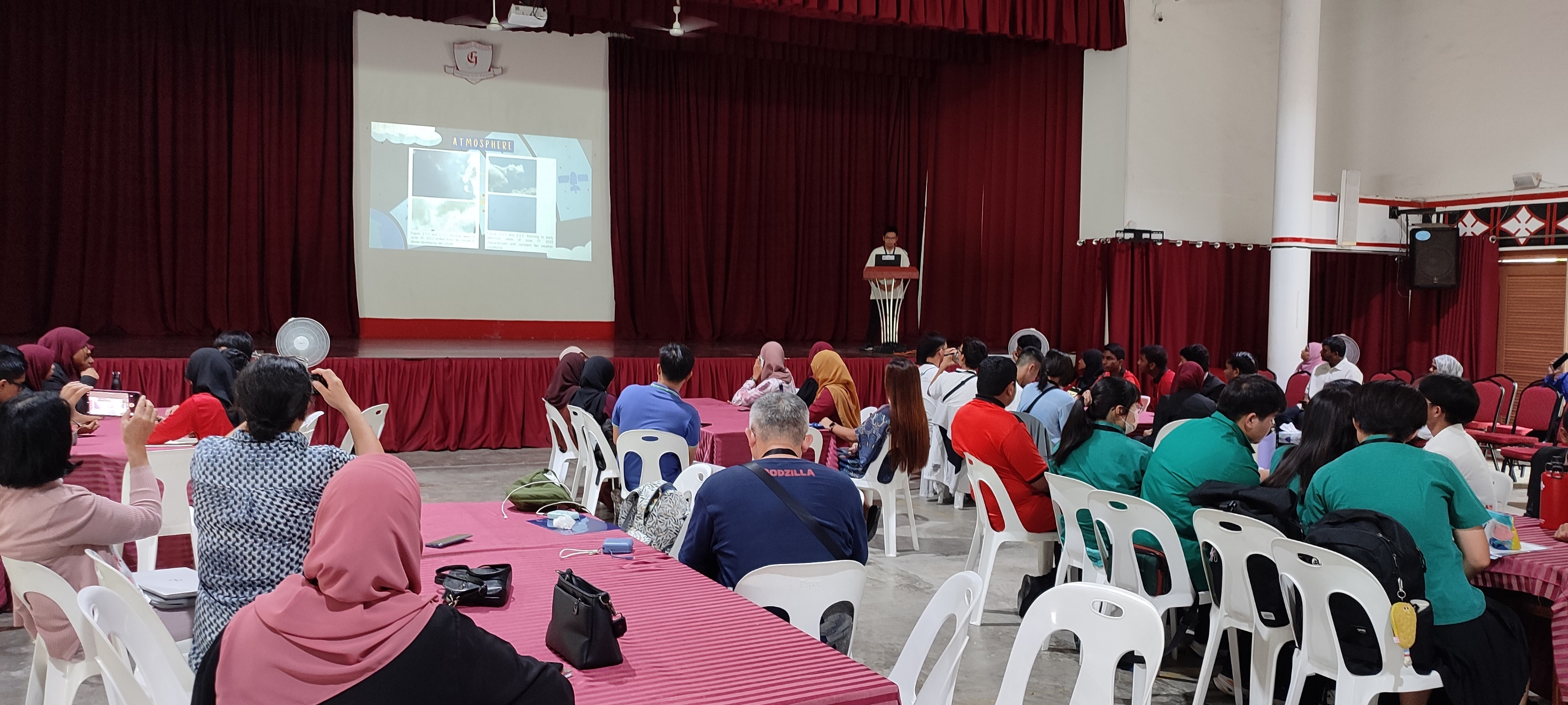
Student presentations

Slide 16
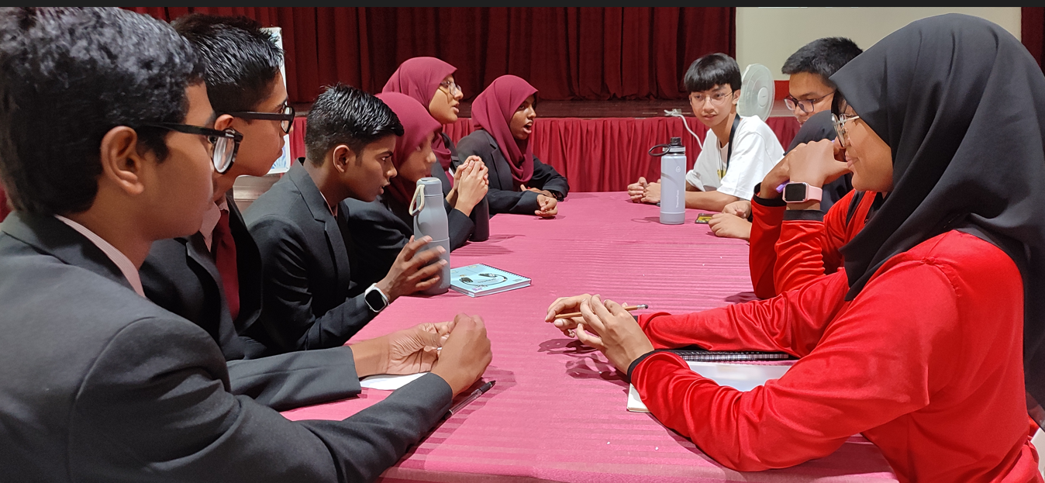

Slide 17
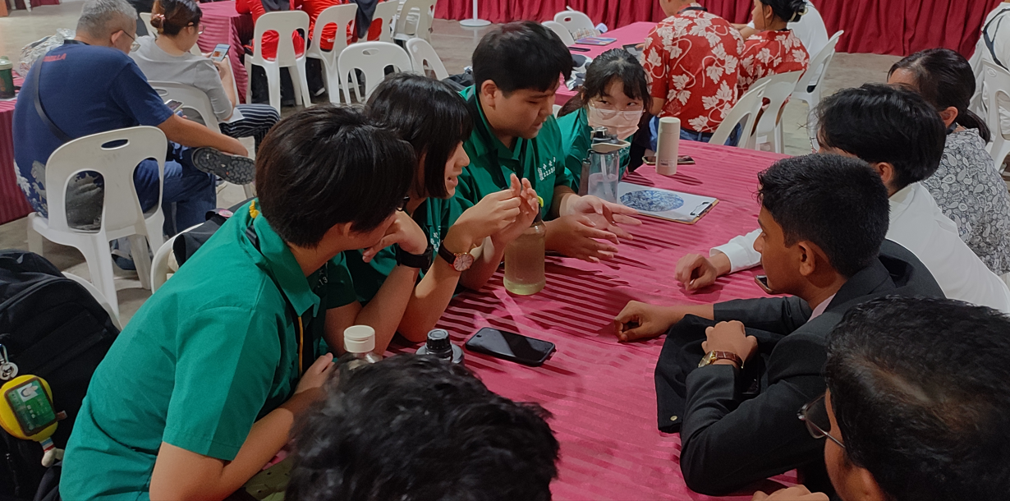

Slide 18
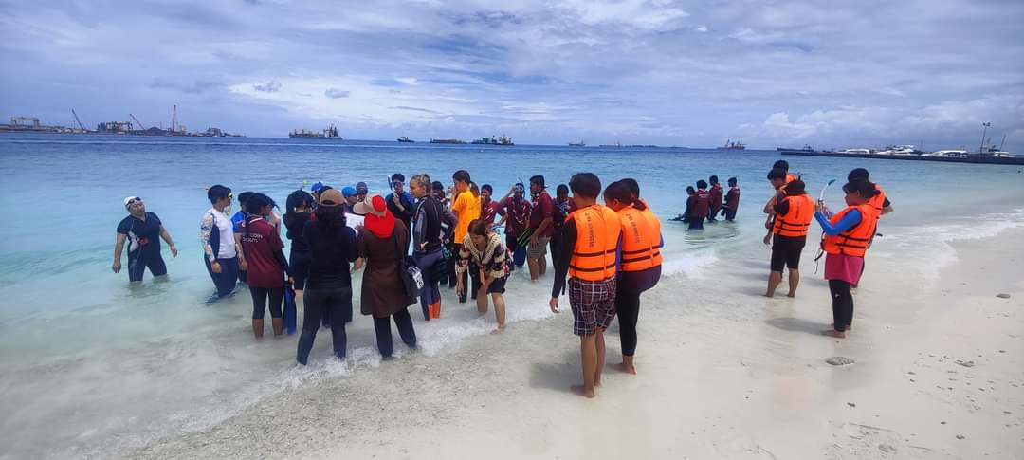
Muhiyddheen School visit
Coral rehabilitation and nursery program of Muhiydeen School

Slide 19
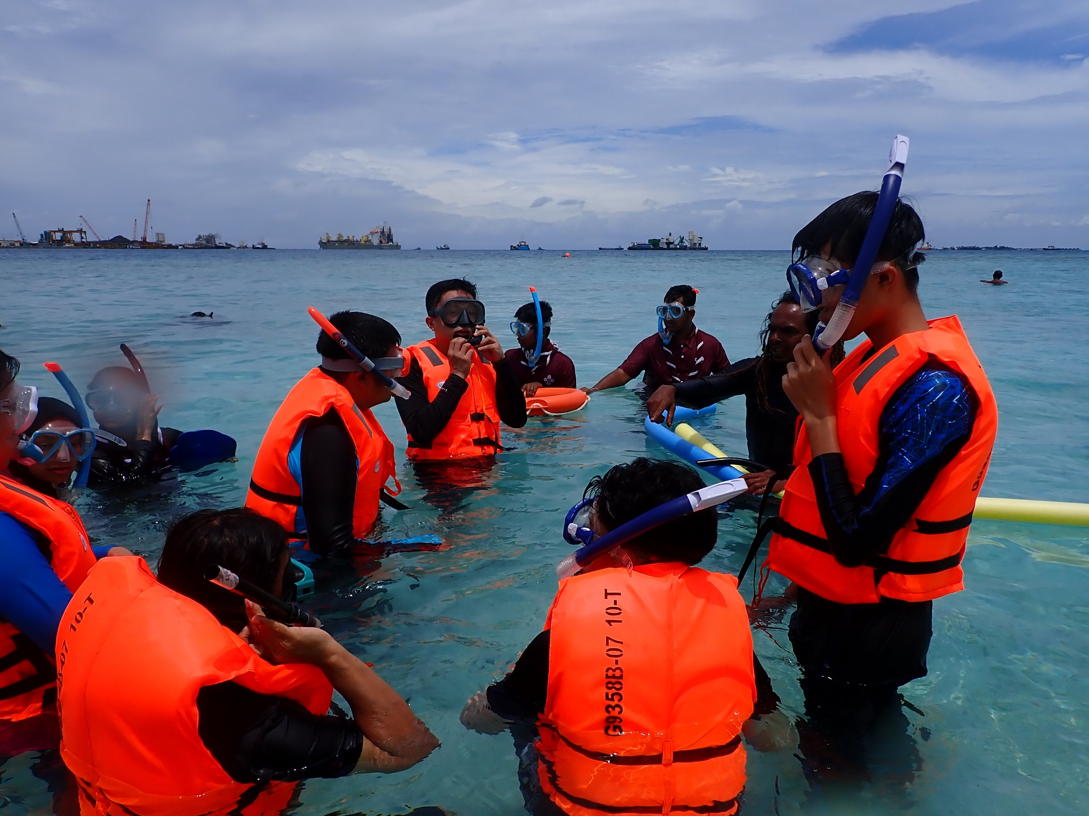

Slide 20
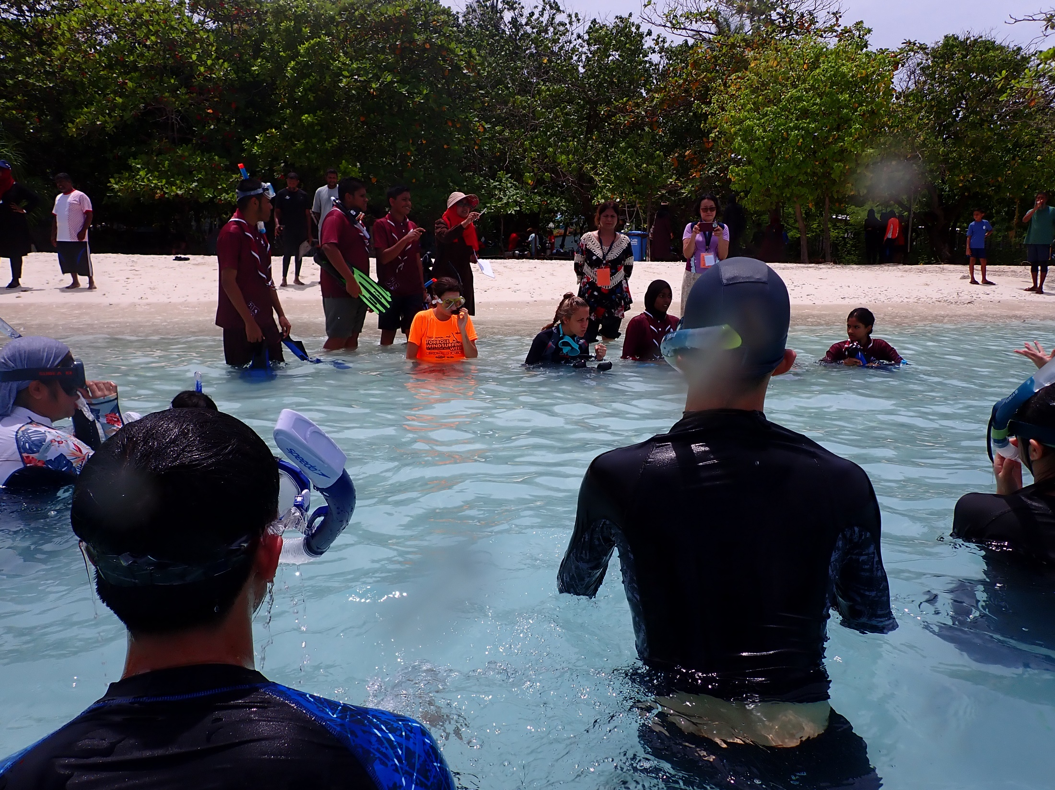
Notes:
Villigili muhidheen school scout
Coral planting and nursery

Slide 21
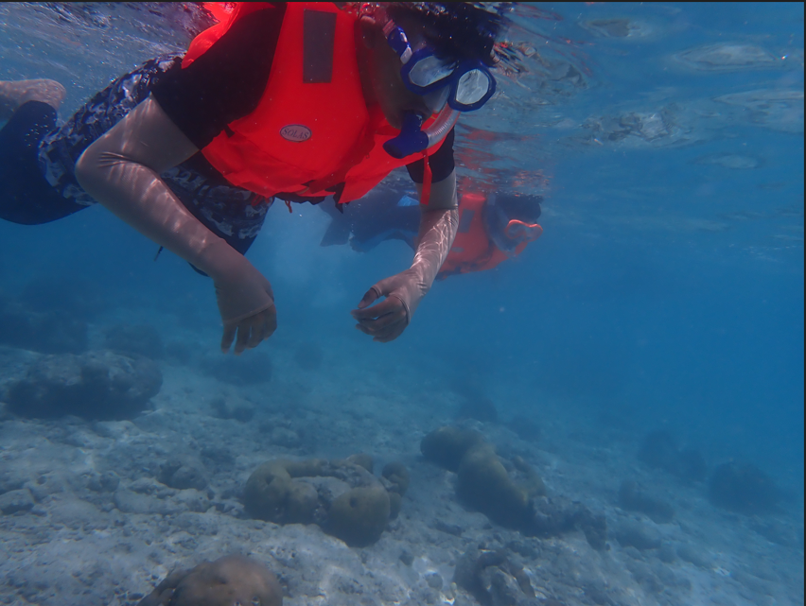
Notes:
Villigili muhidheen school scout
Coral planting and nursery

Slide 22
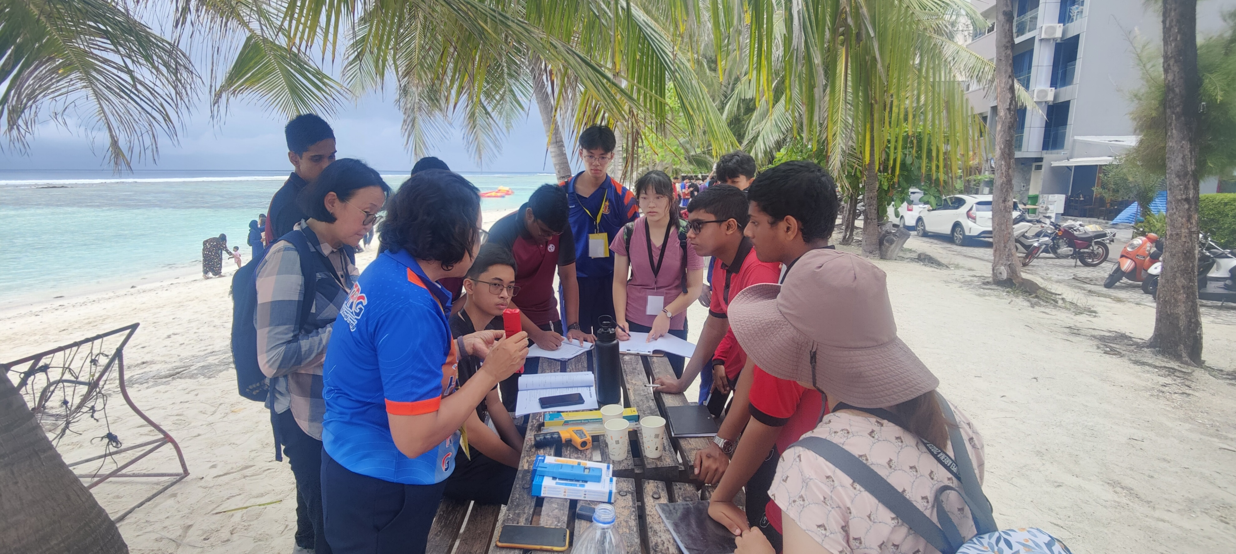
PROTOCOL EXERCISES in Hulhumale

Slide 23
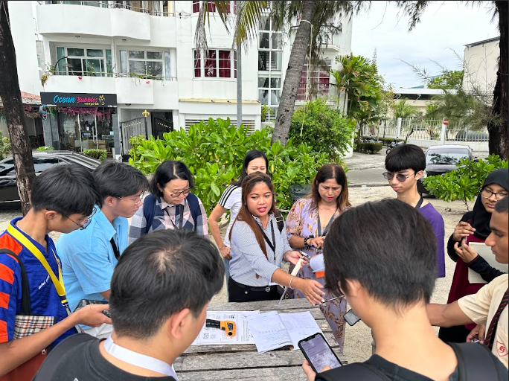

Slide 25
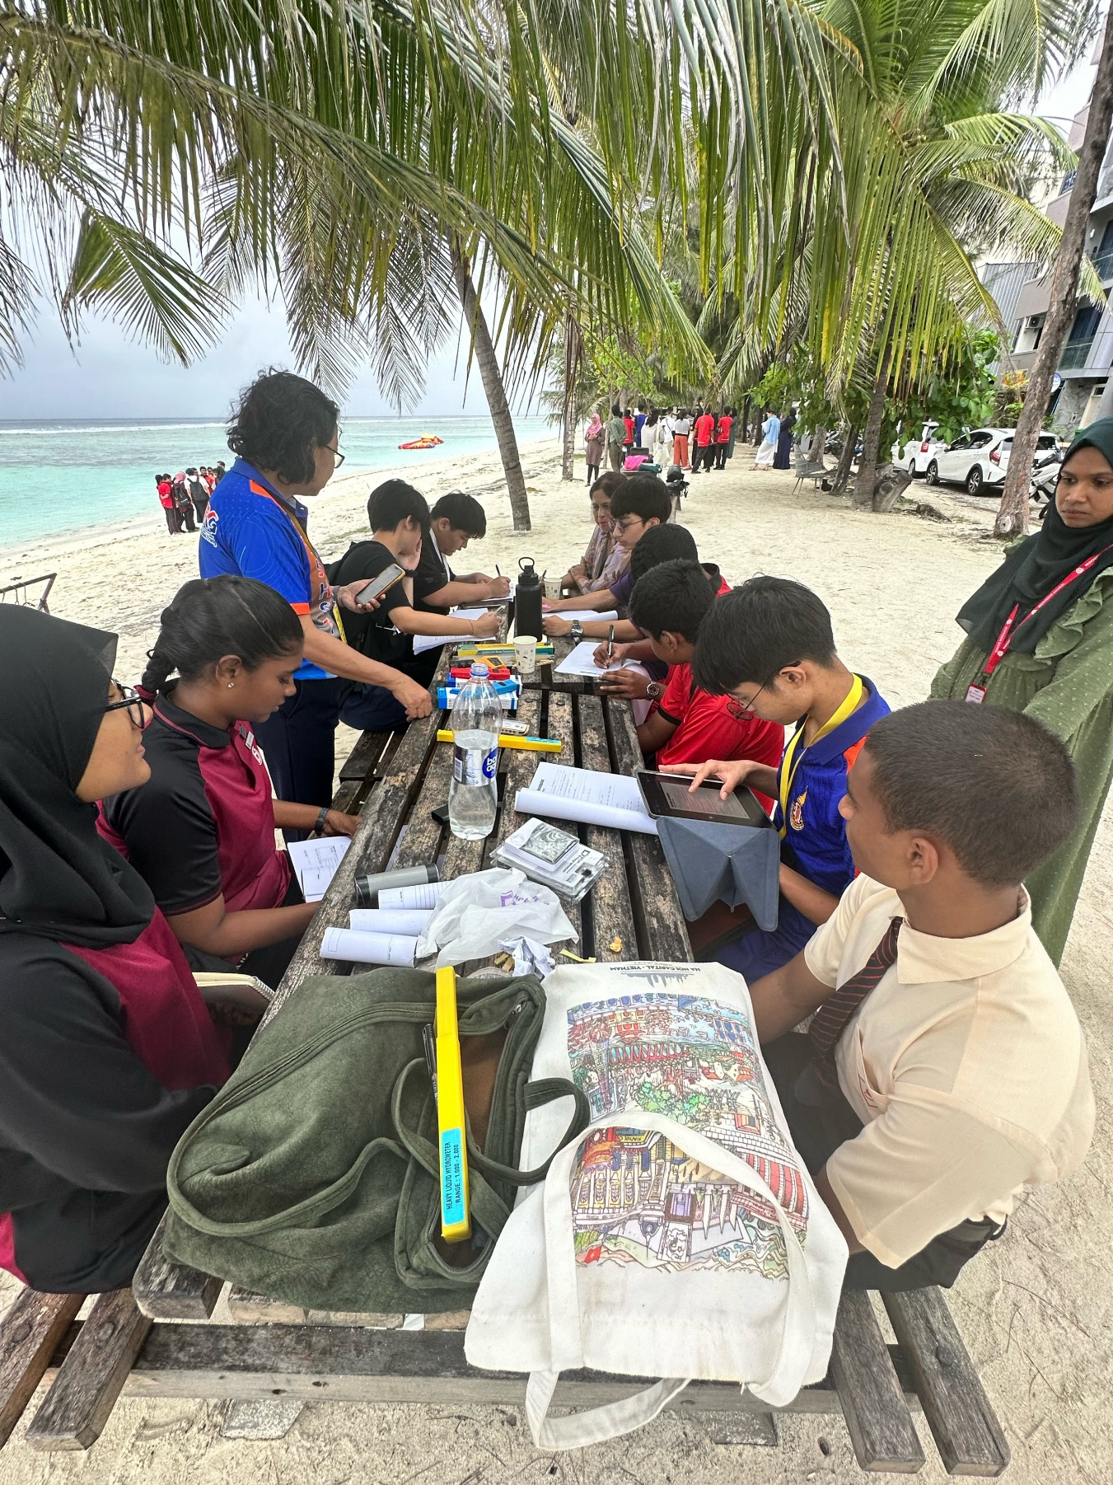
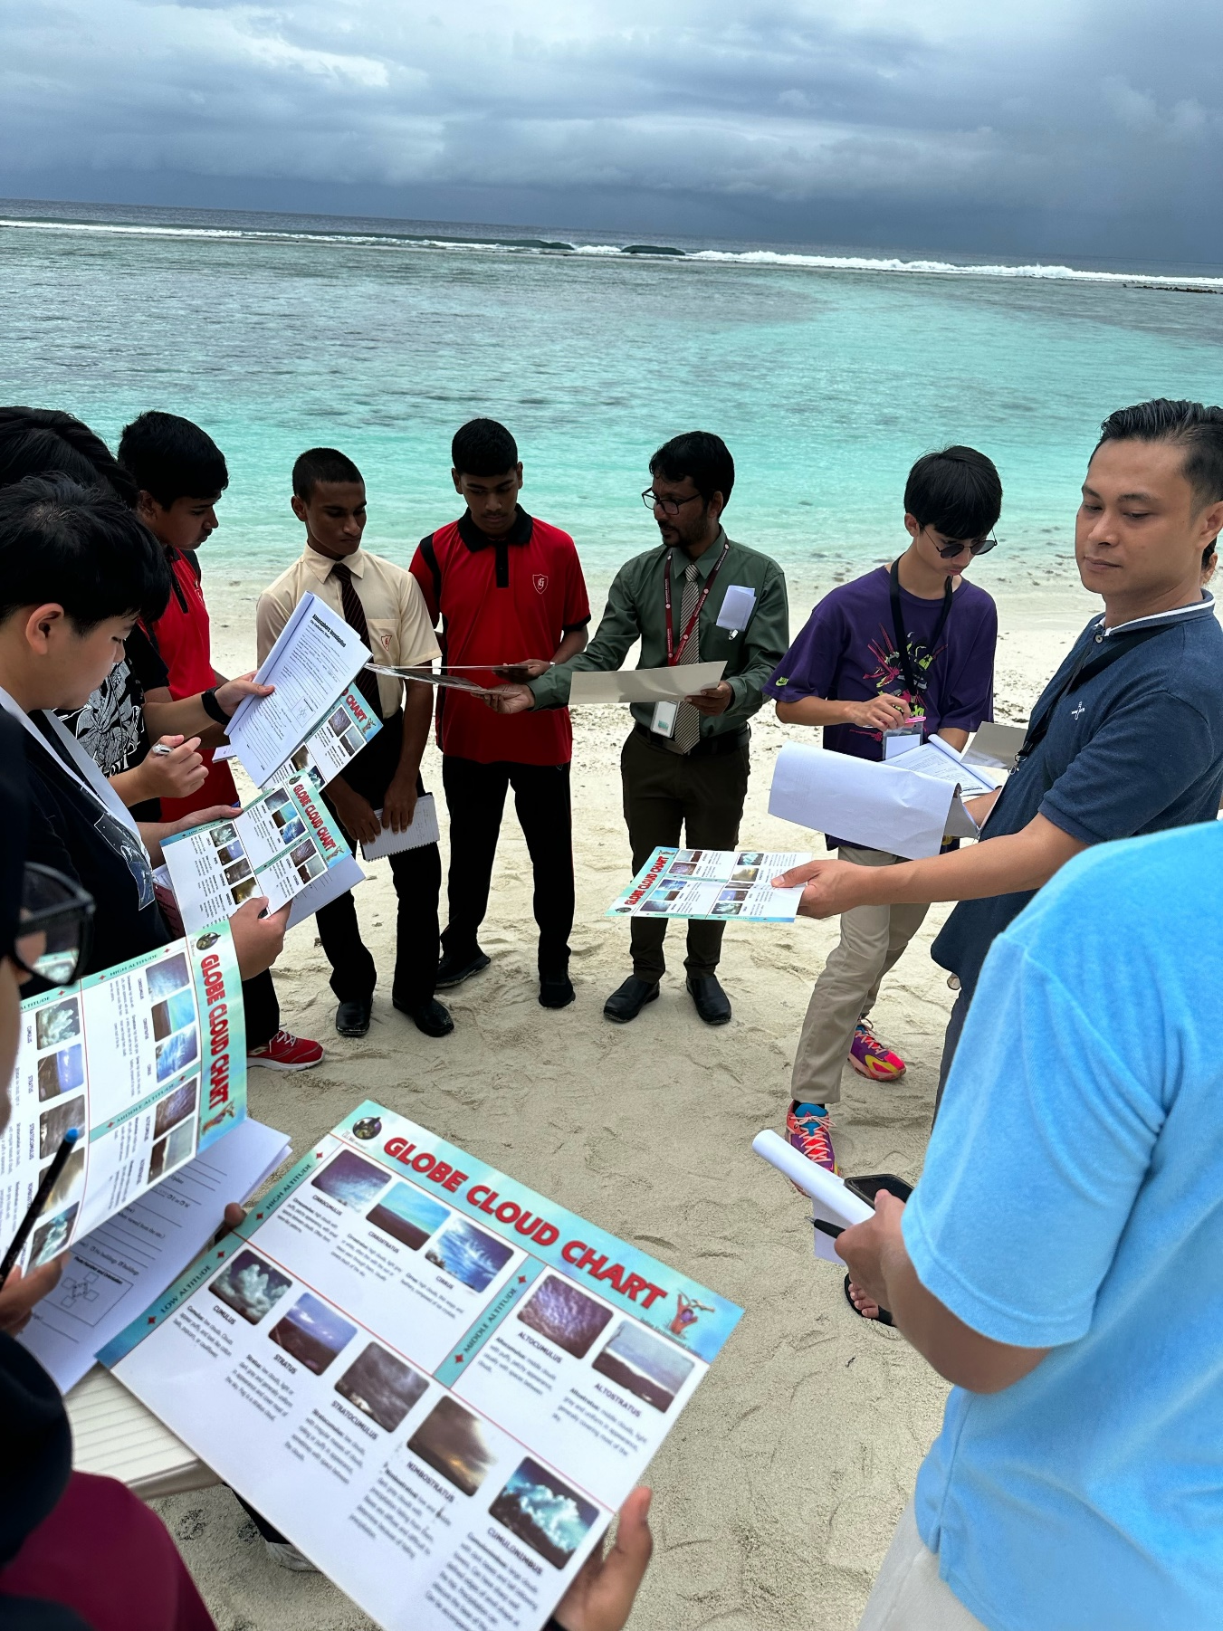
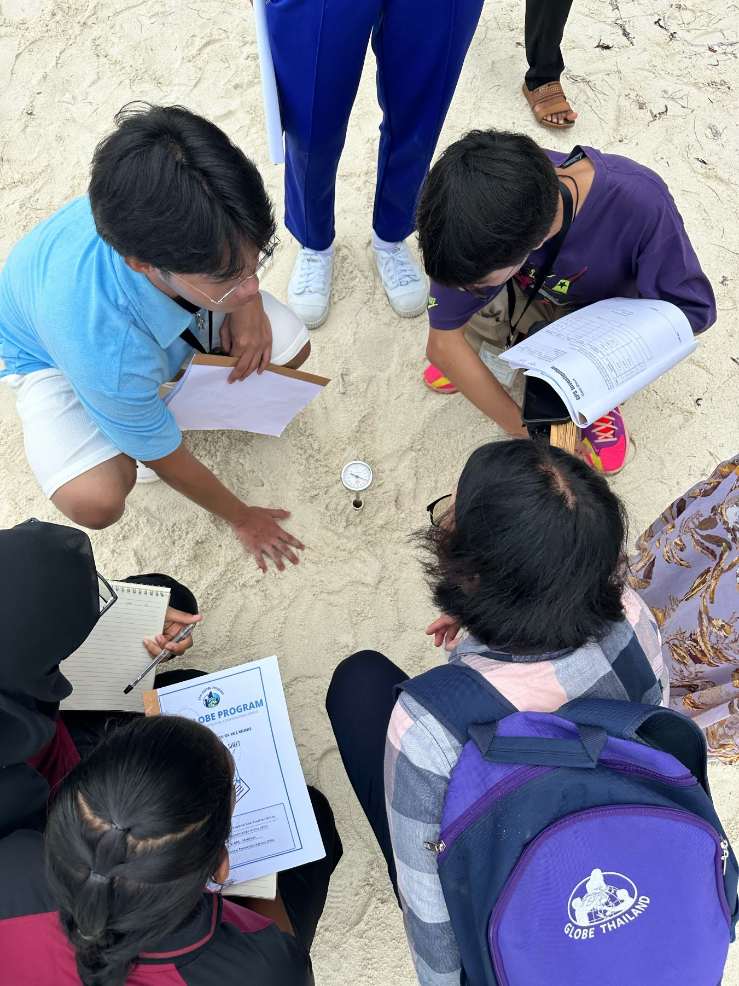
Notes:
Globe protocols with the international and local students

Slide 27
Challenges and Ways Forward
Education Sector
COVID related lag in academic year
Access to instruments and equipment for school labs
School interest in activities
Ocean current movements
Reef flora and fauna
Micro-plastic pollution assessments (being developed)
Way Forward
Identified interested schools and promoted GLOBE
Training teachers planned for 2025
National STEM programs initiated
STEM emphasised in the National Curriculum

Slide 28
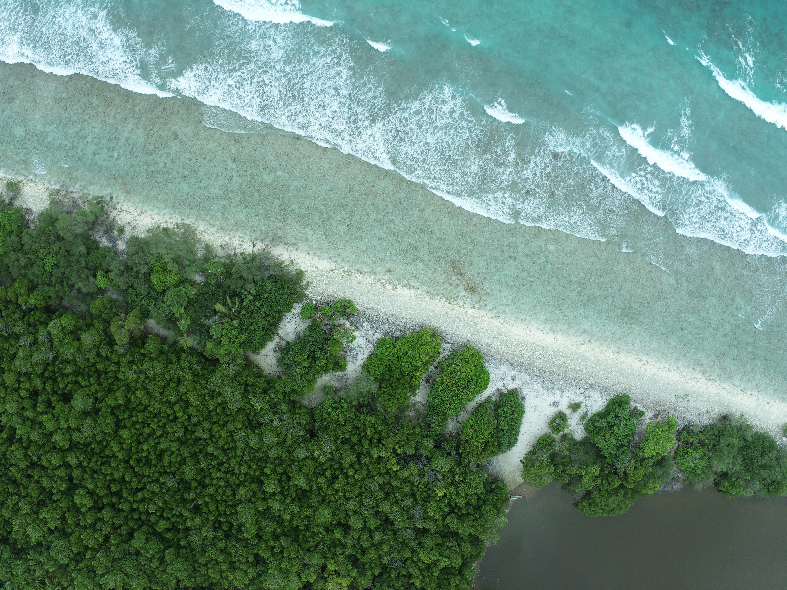
Thank You

