Slide 1

GLOBE Asia Pacific Regional Meeting
April 15-18, 2023
Male, Maldives
Yogendra Chitrakar

Slide 2



Established in 1987 as a non-profit, nonpolitical, non-govt. org.
Pioneered the concept of children’s nature club (in Nepal) in1992
Awards:
1991 and 2001 by the Government of Nepal
1993, International Rolex Award (for ECCA’s unique methodology)
2005, Global Development Marketplace (for Solar Tuki), World Bank, Washington DC, USA
2007, Tech Museum Awards (category Economic Development) (for Solar Tuki), The Tech Museum of Innovation, California, USA
2008, Nepal Development Marketplace (for safe drinking water campaign)
2014, Nature Conservation Award, Nepal Academy of Science and Technology (NAST)

Slide 3

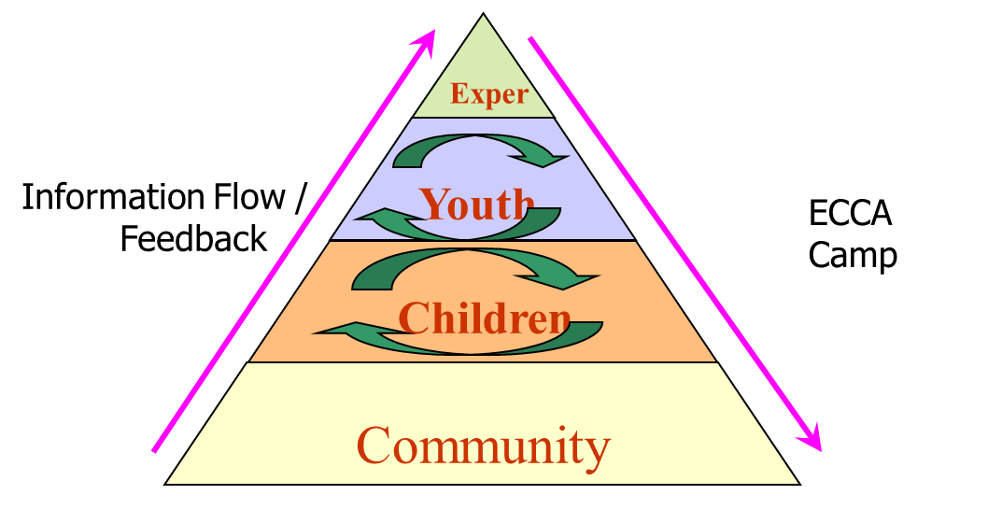



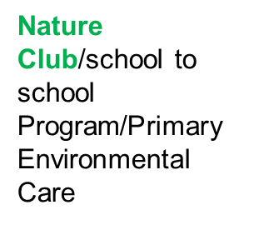
ECCA Mission and Methodology
ECCA shall be a Professional Volunteer Organization dedicated to securing a sound ecological future
ECCA shall create a platform for youths and school children to lead positive change in environmental conservation and community development
ECCA shall support the development of conservation-related entrepreneurship

Slide 4
Field of Work
Environment, Climate Change, Disaster Management, Natural Resource Management, Nutrition, Food Security, Enhancing Livelihood
Education for Sustainable Development and School Environment Improvement
Child rights and development
Appropriate Technology / Renewable Energy
Water, Sanitation and Hygiene (WASH)
Redevelopment and Reconstruction

Slide 5
GLOBE Current Status
Launched: March 3, 2000
Cooperating Organizations
  ECCA – Country Coordinator
  Government & Private Schools
  different stakeholders according to the needs and projects
Participation
  20 Schools
  The current Focus is on 5 Private schools (1 school in East Nepal and 4 schools within the valley) and 15 other government schools and introduced the GLOBE program concept in 18 schools of remote government schools
  Number of Schools Reporting Data over the Past Year: only 5 schools
Funding Status
  ECCA Self Funding integrating with different programs and project activities.
Protocols Implemented
  Atmosphere – training and data entry
  Hydrology – training and data entry
  Land coverage only training
  Mosquito

Slide 6


Program Implementation, International Cooperation in GLOBE Network, and Activities over the Past Year (categorized by GLOBE Strategic Plan 2018-2023 Goals):

Slide 7
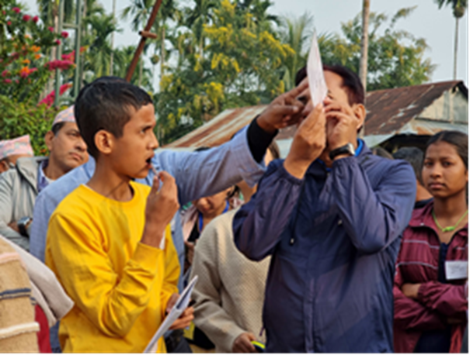
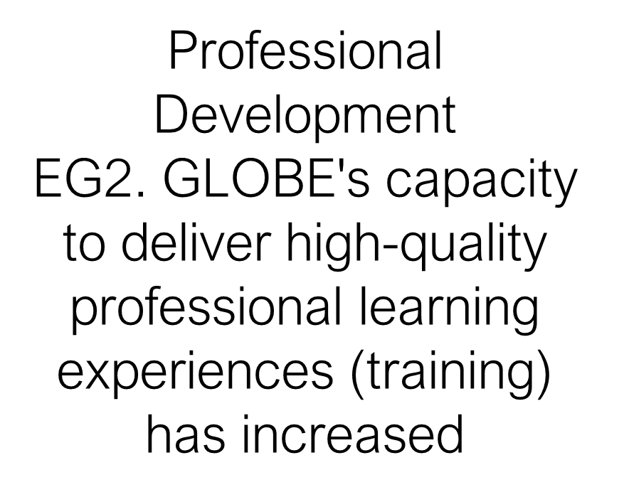
1. Education
ECCA has provided GLOBE training altogether for 22 youths, 25 teachers, 24 SMC, 2 Education unit representatives, and 42 students. Altogether, it approached 25 schools in five districts where the trained youth support training school students. (To know, to do, to sustain approach)
The program's main goal was to increase awareness of the GLOBE Program and its protocols. ECCA provided GLOBE kits to all remote schools and guidance on using them for new members of nature clubs and teachers.
The youth or GLOBE alumni have been supporting GLOBE activities whenever required.

Slide 8


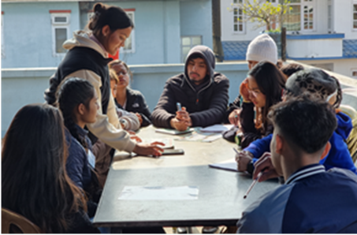
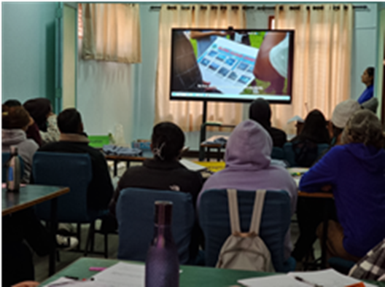
ECCA organized a Counsellor Training Camp for 22 youths from 11 colleges in the ECCA training hall on Jan 17 -18, 2022.
The training was provided to college youth to send to different village schools and train the teachers and students to improve their education skills.

Slide 9

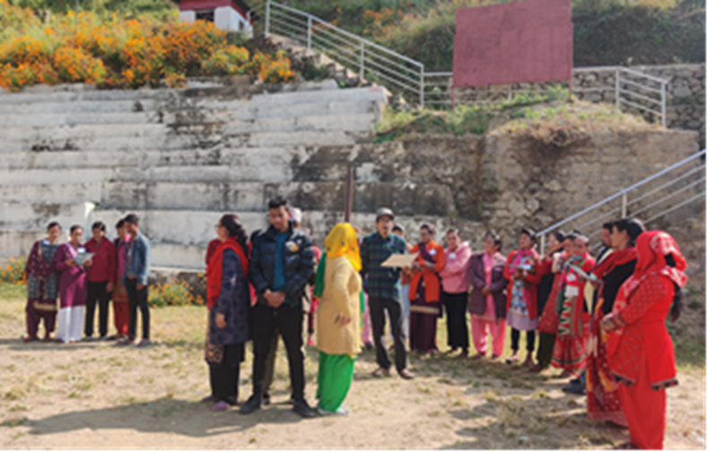
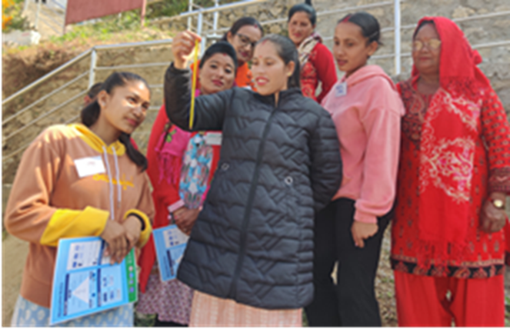
ECCA organized two ECD (Early Childhood Development) trainings for teachers and school stakeholders of five remote schools of Malu village, Tamakoshi Rural Municipality, Dolakha, and 14 remote schools of Lothar and Korak villages, Rapti Municipality of Chitawan in November 2023.
The training focused on teaching practices, development of ECD materials, and practicing science activities based on GLOBE protocols, mainly on atmosphere protocols such as cloud observation and temperature for primary students. ECCA has also provided support by supplying cloud charts and thermometers to schools where data will be displayed in classrooms with cloud names and temperature

Slide 10

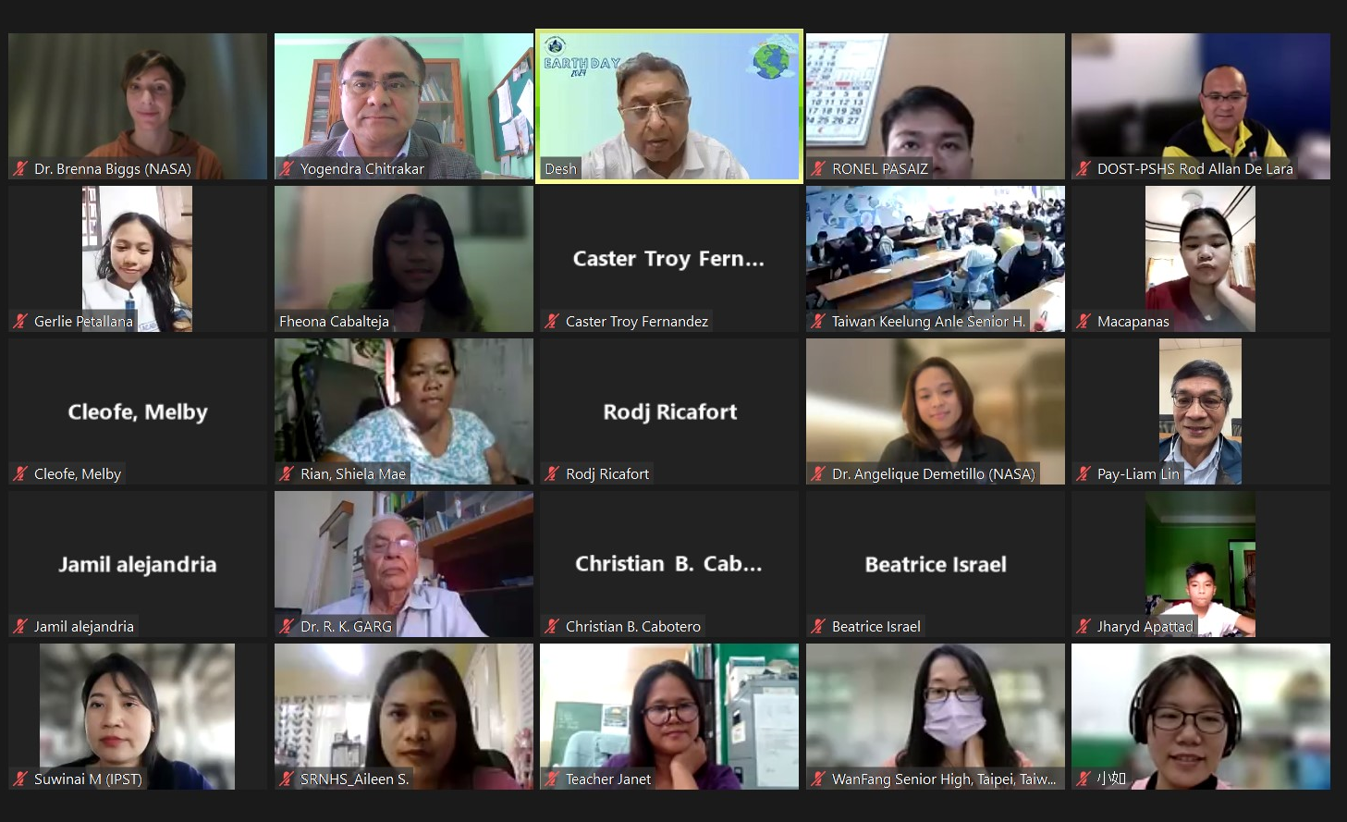
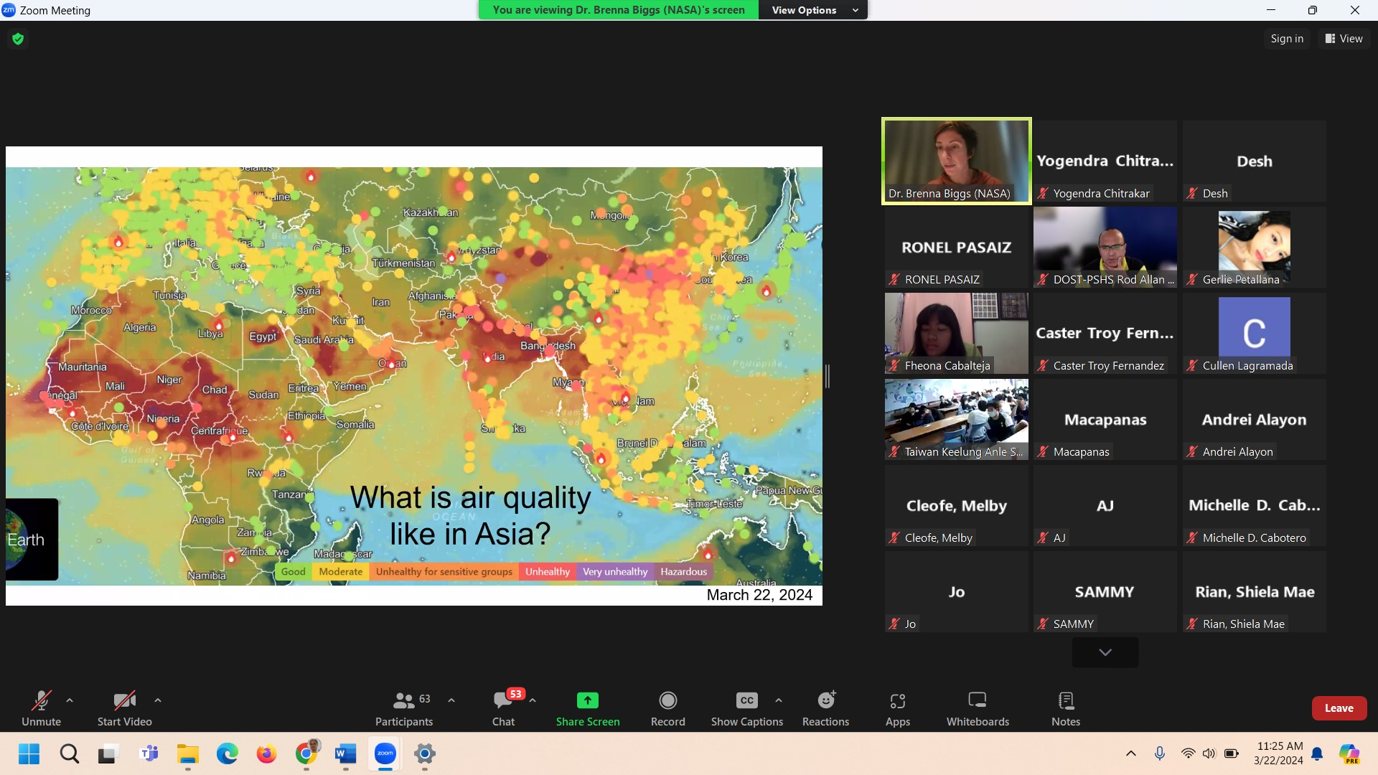
GLOBE schools’ teachers, students, and GLOBE trainers and alumni participated in different online/virtual capacity-building webinars organized by RCO.

Slide 11
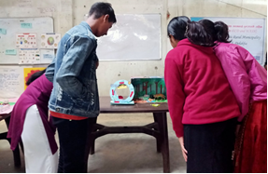
2. Science
Student Investigations
EG3: Students develop high-quality STEM investigations of Earth systems phenomena from a local to global scale perspective.
Science Projects
SG4. Increase the number of projects focused on environmental awareness and contributing to environmental benefits:
After the GLOBE training program, all supported schools started doing science activities using GLOBE protocols which were presented in APR webinars, and submitted their artifacts in different forums. It has enhanced the schools to do science and create interest in STEM education and integrated it into their subject lesson activities.

Slide 12
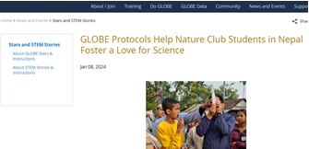
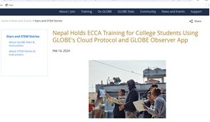
3. Community
The engagement of schools in GLOBE programs and their activities are reflected in different forums like GLOBE webinars and GLOBE Star reports on the GLOBE website. Besides, they are planning to share their works through IVSS. ECCA submitted the four different star reports and published them on the globe websites.
EG4. Information on GLOBE’s educational impact is regularly shared by the community:
Interactions and Collaboration
CG2. Increase interactions and collaborations among local, regional, and international GLOBE communities through events and activities.

Slide 13
4. Technology
ECCA encourages their GLOBE Students and GLOBE observation & enter data, but still, there is less data entry though they do GLOBE activities regularly.
ECCA emphasizes the training of teachers & students on the GLOBE webpage & use of GLOBE Science Data Visualization to develop research projects.
ECCA also proposed encouraging students & teachers to observe and use GLOBE data to prepare research projects.
In this section, ECCA needs to work more to make schools easy on data entry.
Data Systems
TG1. The use of GLOBE data systems (data collection, data entry, visualizations, ADAT, and retrieval) has increased

Slide 14
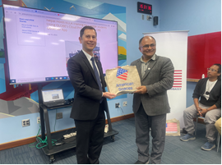
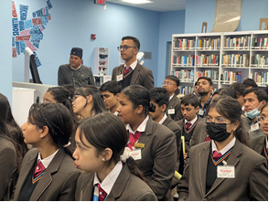
5. Communications
Nepal schools, students, and GLOBE trainers are in the communication link through AP GLOBE Messenger Group, email, and another separate messenger group who participated in different programs.
There were sharing meetings on the GLOBE program in Nepal with Mr. Patrick S. Gan, Regional ESTH officer for South Asia in the US Embassy on Feb 9, 2024, and interaction with college students on Air Awareness and The GLOBE Program.
Interactions and Collaboration
CG2. Increase interactions and collaborations among local, regional, and international GLOBE communities through events and activities.
Communication Pathways
CMG1. Improve the communication pathways among the GLOBE community

Slide 15
Plans and Ideas for 2024:
Celebration of World Water Day in Patan Durbar Square, Lalitpur, March 22, 2024
GLOBE training program for students (HOPE School) –April 22, 2024
National School Clubs Conference – May 20-25, 2024 in Himalaya Drishya Resort, Dhulikhel, Kavre. (GLOBE side events and exhibition)
GLOBE training program for college youth – October 2024 in ECCA, Kathmandu
Refresher training on GLOBE for teachers and students – November/December 2024.

