Slide 1
GLOBE – Mongolia
Coordinator of Mongolia: R.Ulziibayar

Slide 2
GLOBE IN MONGOLIA
Cooperating Organizations: General Authority for Land Administration, Geodesy and Cartography (GALAGC), U.S.Embassy in Ulaanbaatar, General Agency of Education(GAE) and other representiativie
Funding by:General Authority for Land Administration, Geodesy and Cartography, GIO
Participated schools: “New beginning”, “New Era”, Khentii province’s “Berkh ” international schools, Khentii, Selenge, Umnugobi, Arkhangai province’s schools, 11th school, New Mongol, Orgil in Ulaanbaatar, “ (total 28 schools)
GLOBE protocols used:
Atmosphere: cloud type, contrail type protocol, precipitation
Pedoscope: Moisture in the Soil, Soil characterization
Hydrosphere: pH (precipatation)
Organizing committee: Established under the resuution, director, GAE (members 5)

Slide 3
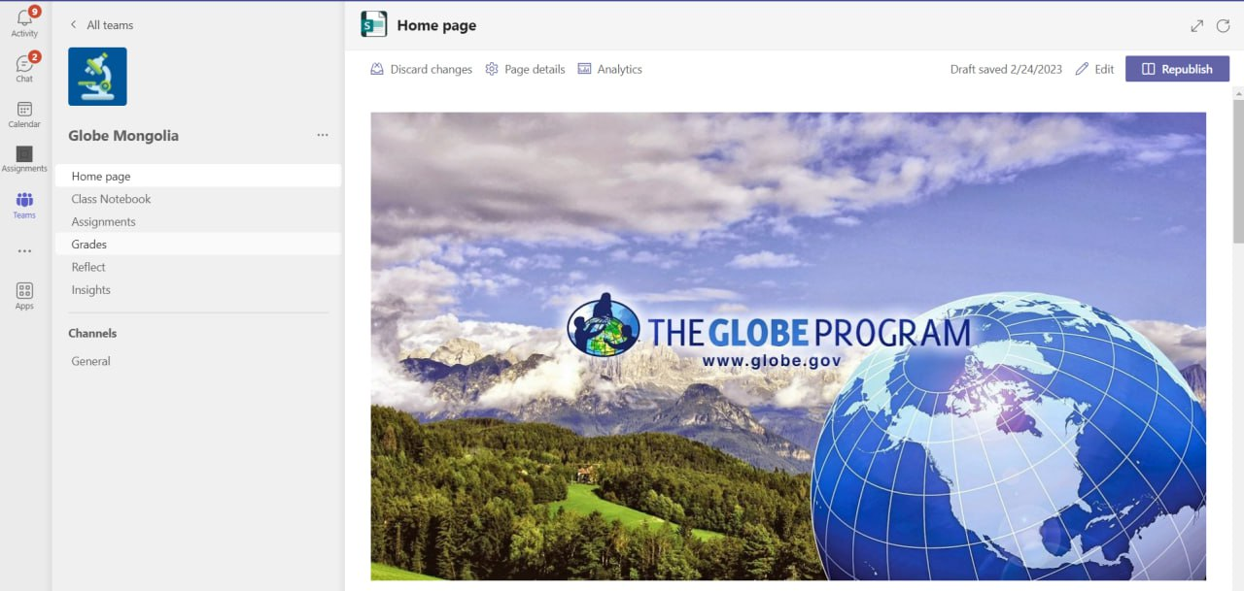
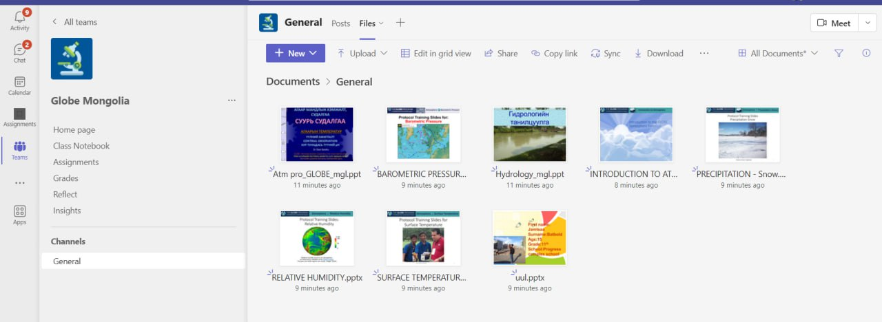
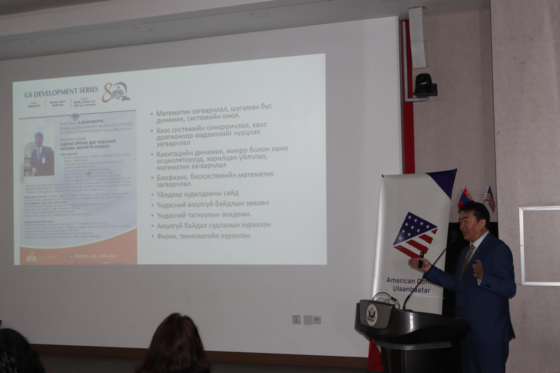
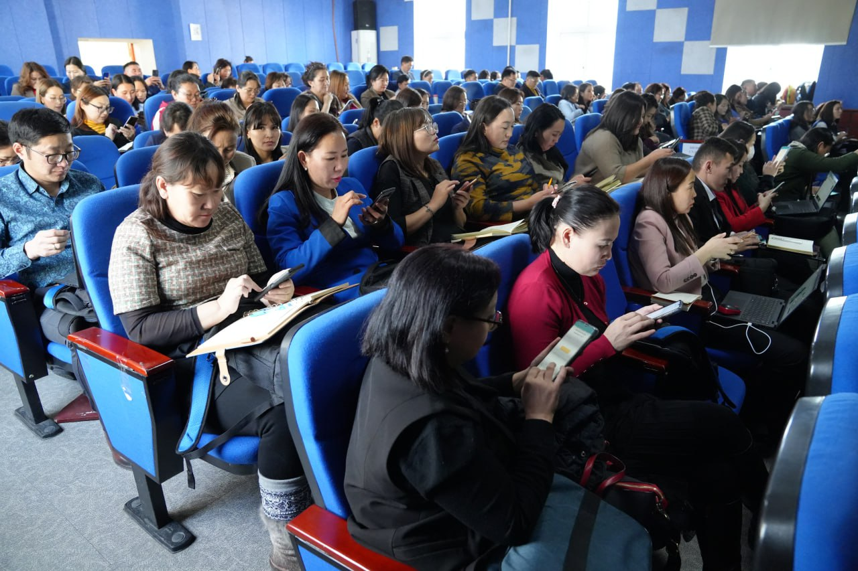
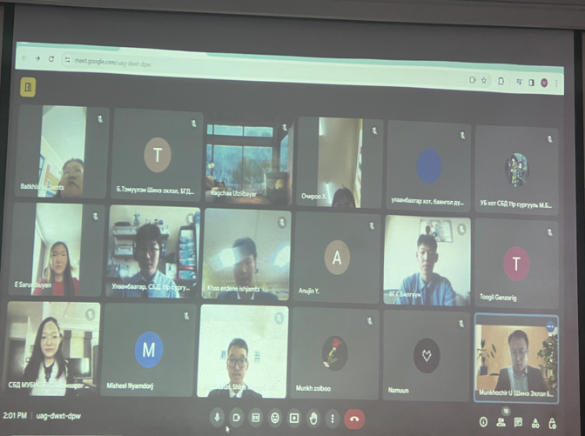
GLOBE TRAINING
Prepared and translated from GLOBE (pedoscope protocol)
Revised and submitted by Medle e-school site
In service-teacher training for natural science teacher by online for school teachers

Slide 4
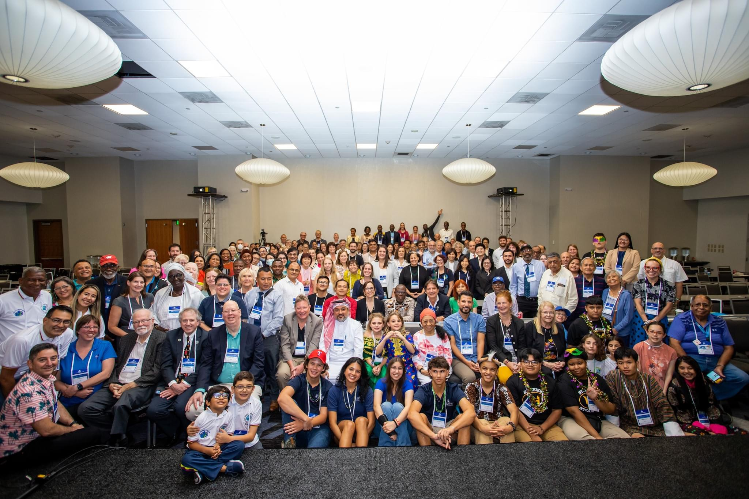
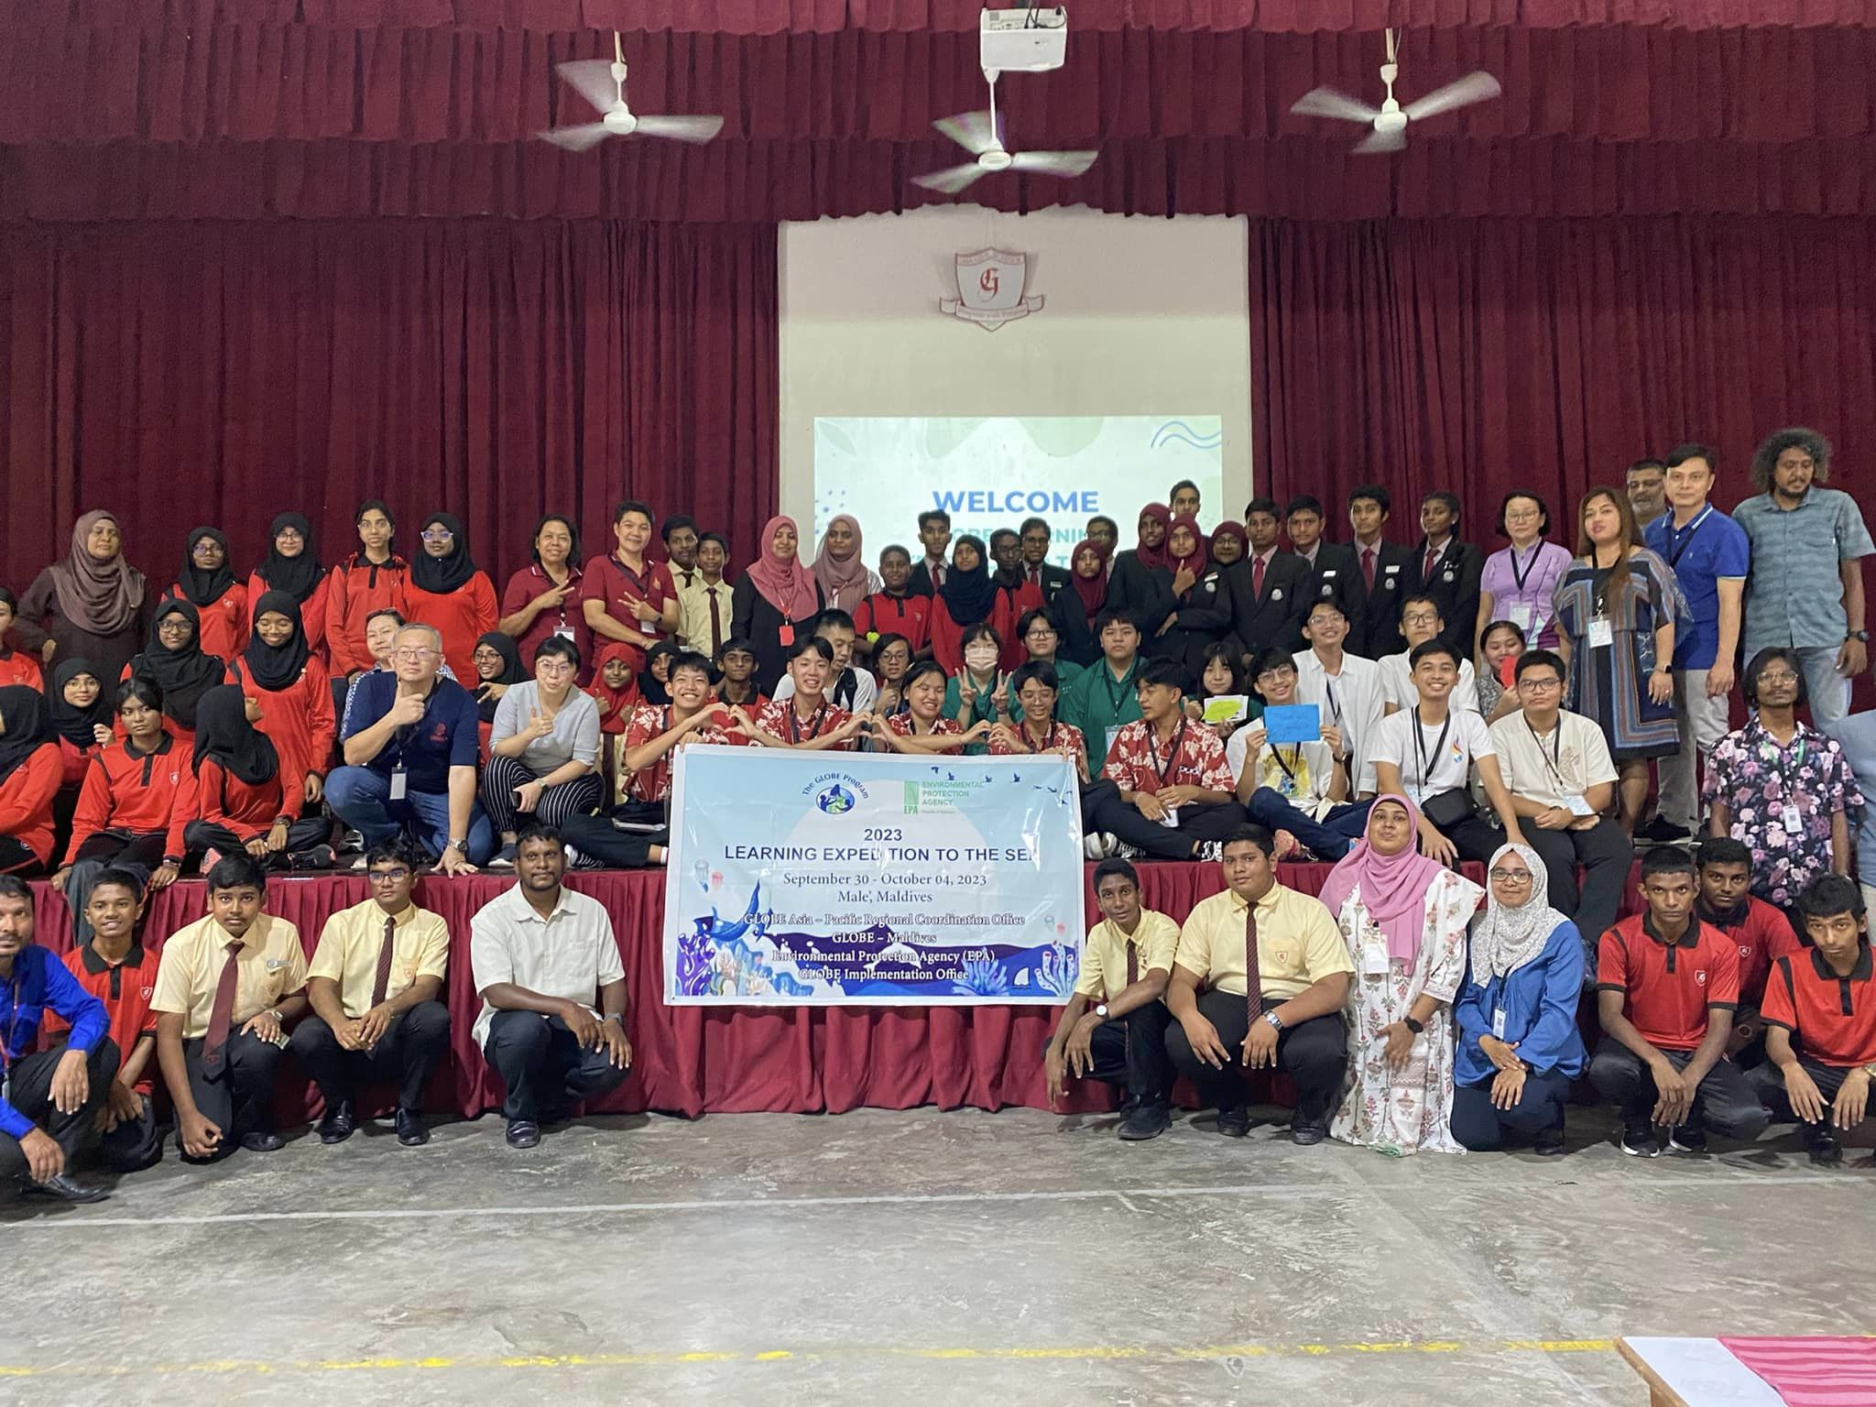
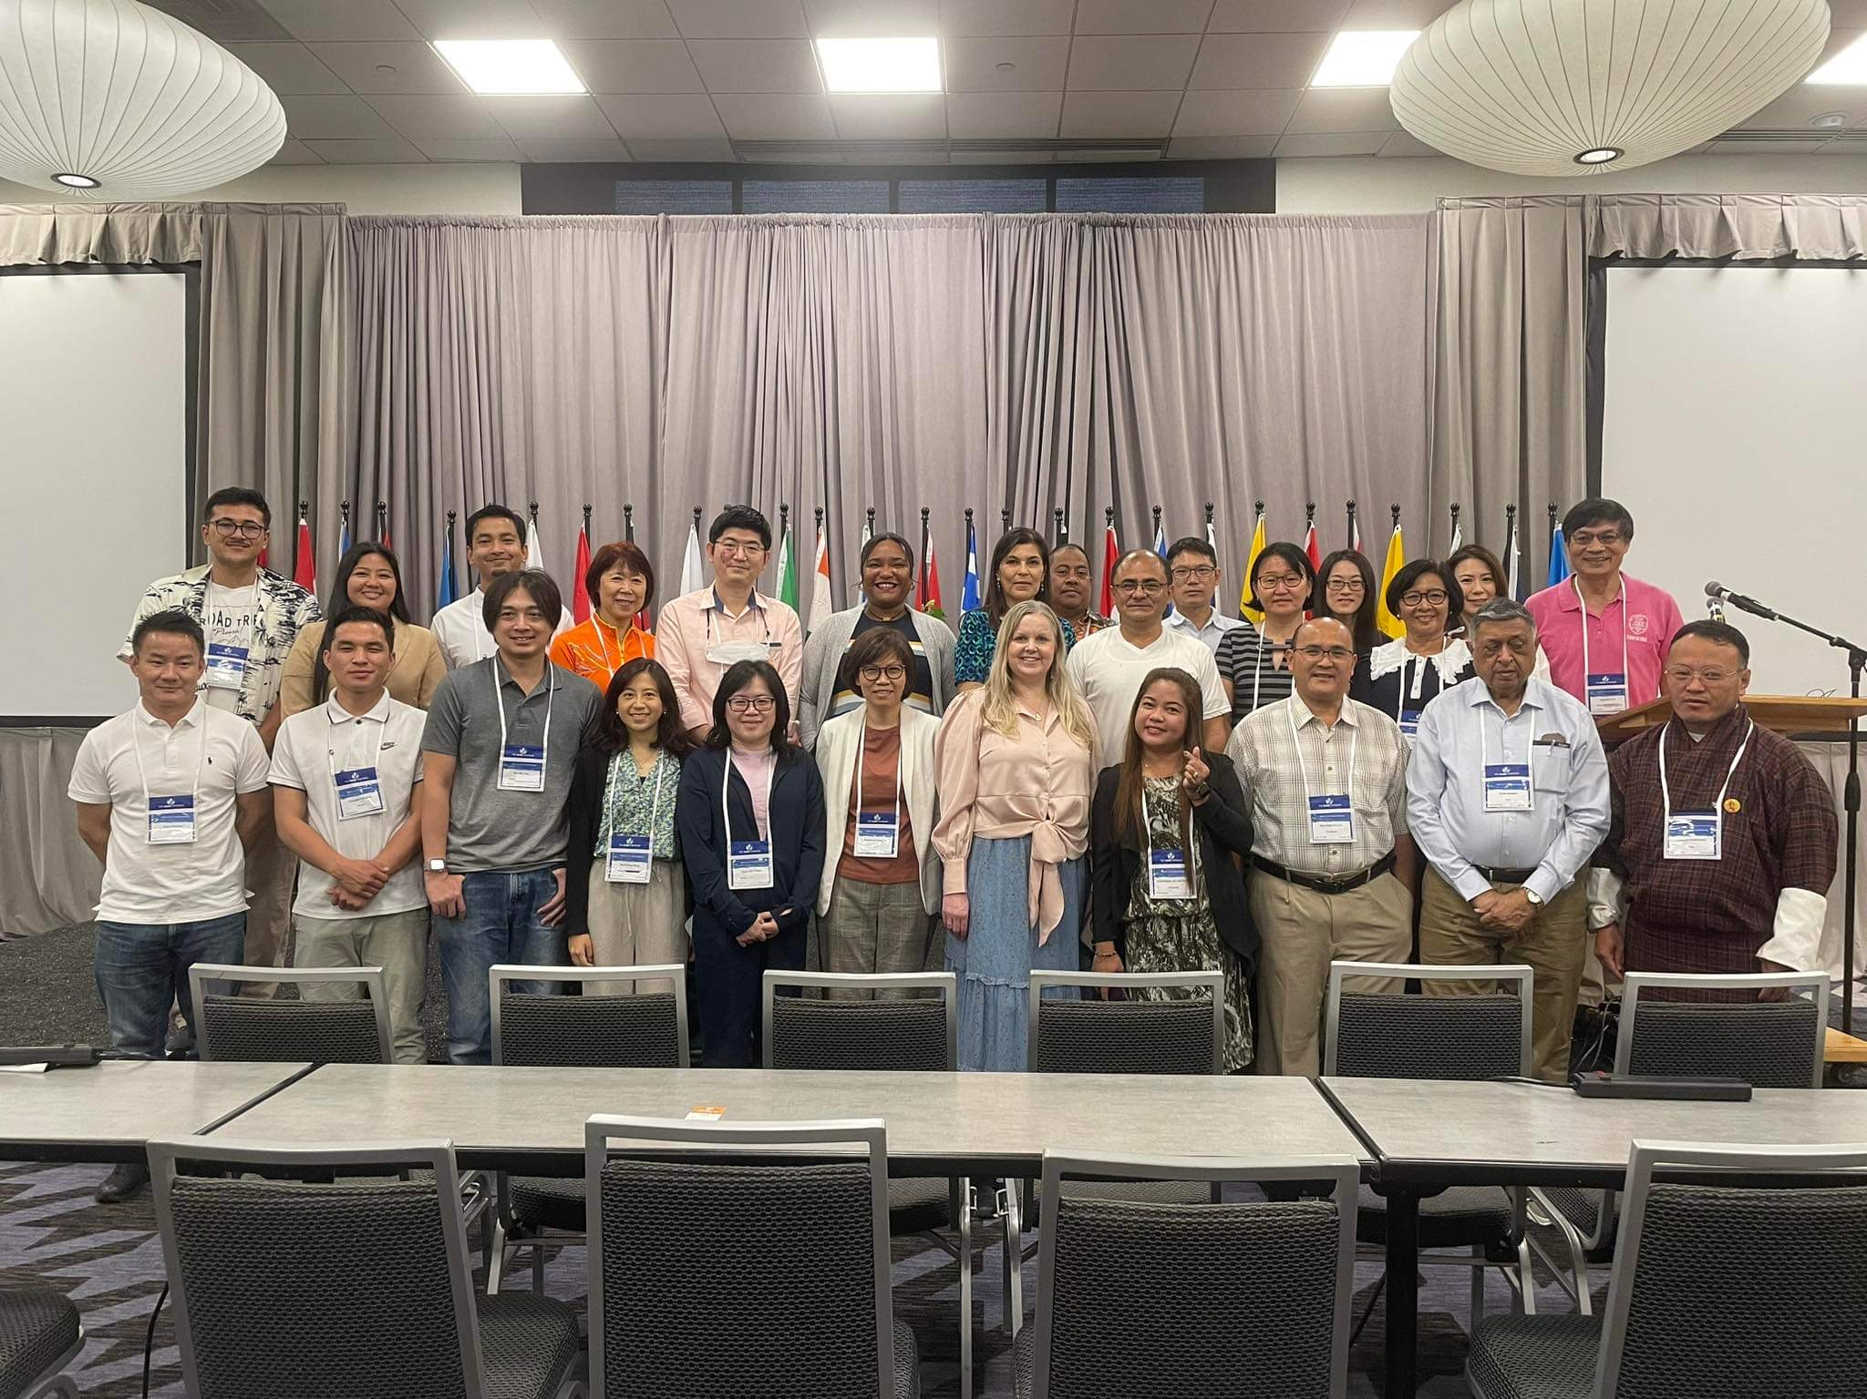
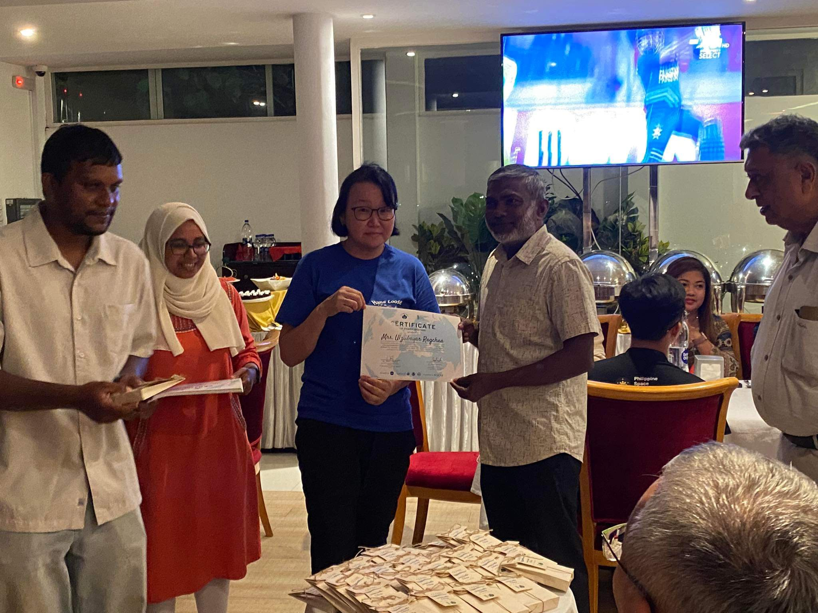
-Participated at annual meeting in Denver, Boulder, in June2024, which supporting GIO, 2023.VII, Denver
-Participated event “2023 Learning Expedition to the Sea”, Male, Maldives with 1student, 1 teacher

Slide 5
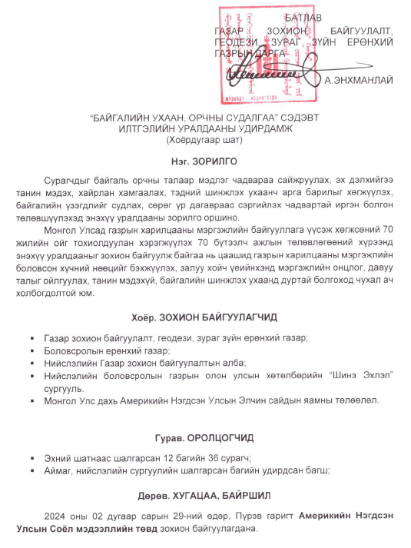
Student’s science competitins
-Under the resolution approved by General Authority for Land Administration, Geodesy and Cartography (GALAGC), announced and supported competitions among the for higher and middle school students in national level
-Organized competitions:
1. “Natural Science and Environment investigation” (XII.2023-II.2024), at the national level, 2 stages, New Beginning school (II.15.2024).52 involved student’s research, 120 schools), Americian Corner Ulaanbaatar (II.28-29.2024), 14 student’s took oral and poster presentations, 8 awarded, 30% align Globe Protocol consist content collecting data, measurement and research method and climate change
    2.“Soil, water and air investigation” (III.2024-V.2024), ongoing
Notes:
Student’s science competition. Under the resolution approved by MECS "Let's Explore our environment” oral and poster competition was announced among among students at the higher and secondary schools which was organized at the New Era school on 10, April 2023. The completion was at 2 stages.
A.At the first stage, more than 40 more presentation were sent to us to participate in the competition those are posters and presentations in English and Mongolian and by which 30 were from international schools and others were from local and rural schools. Judge team consists of 5 members those are the scientists from Land and Water Investigation at the Institute of Geography and Geo-Ecology and MULS, and MSUE. The brief of presentation “Science fair” publishing which sent to the first stage competition was that distributed to participated schools. The photos of the first stage was posted in website.
Student’s science competition. Under the resolution approved by MECS "Let's Explore our environment” oral and poster competition was announced among among students at the higher and secondary schools which was organized at the New Era school on 10, April 2023. The completion was at 2 stages.
A.At the first stage, more than 40 more presentation were sent to us to participate in the competition those are posters and presentations in English and Mongolian and by which 30 were from international schools and others were from local and rural schools. Judge team consists of 5 members those are the scientists from Land and Water Investigation at the Institute of Geography and Geo-Ecology and MULS, and MSUE. The brief of presentation “Science fair” publishing which sent to the first stage competition was that distributed to participated schools. The photos of the first stage was posted in website.

Slide 6
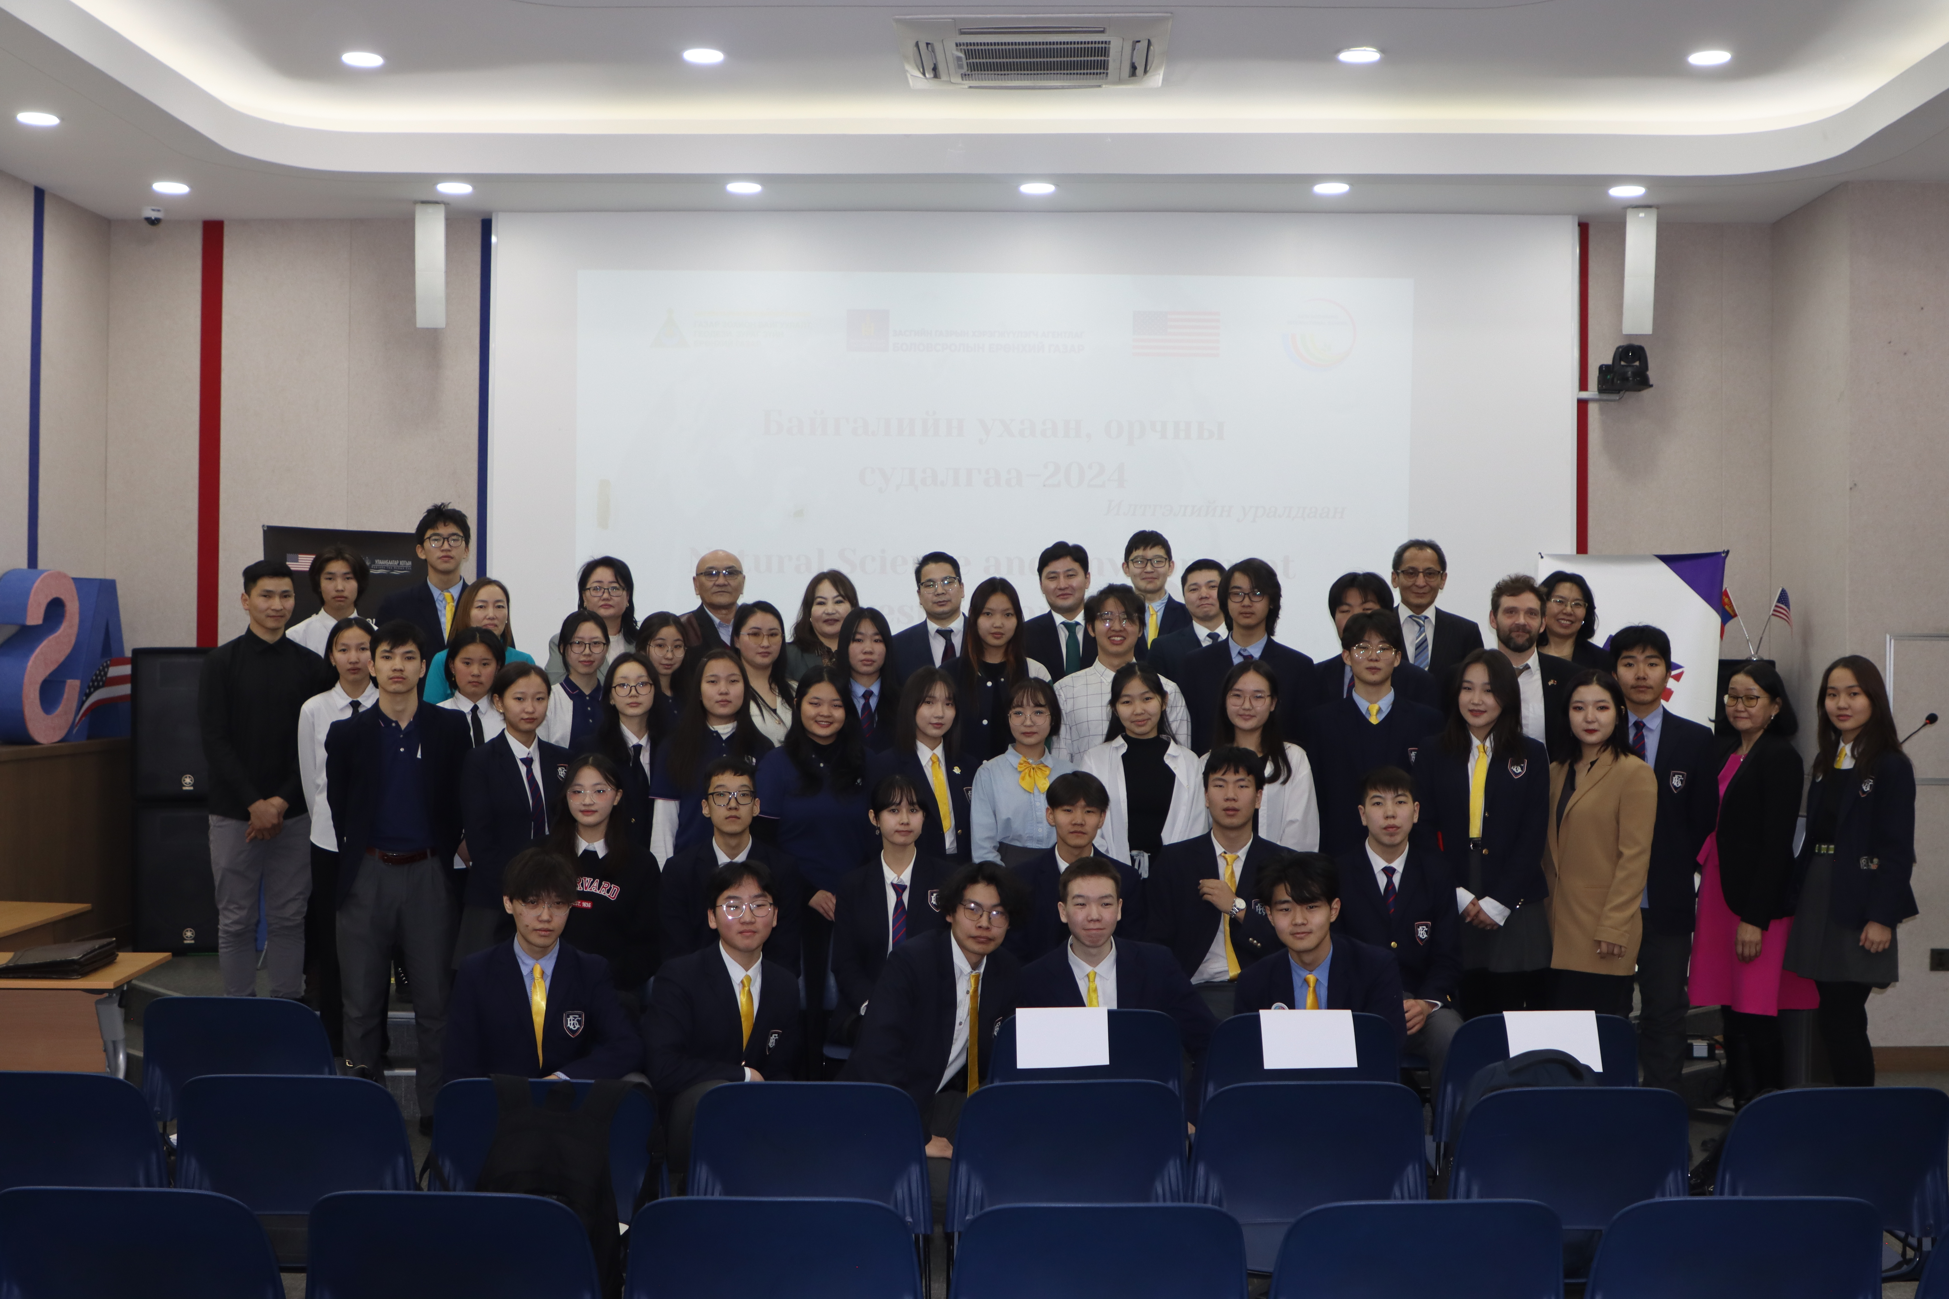
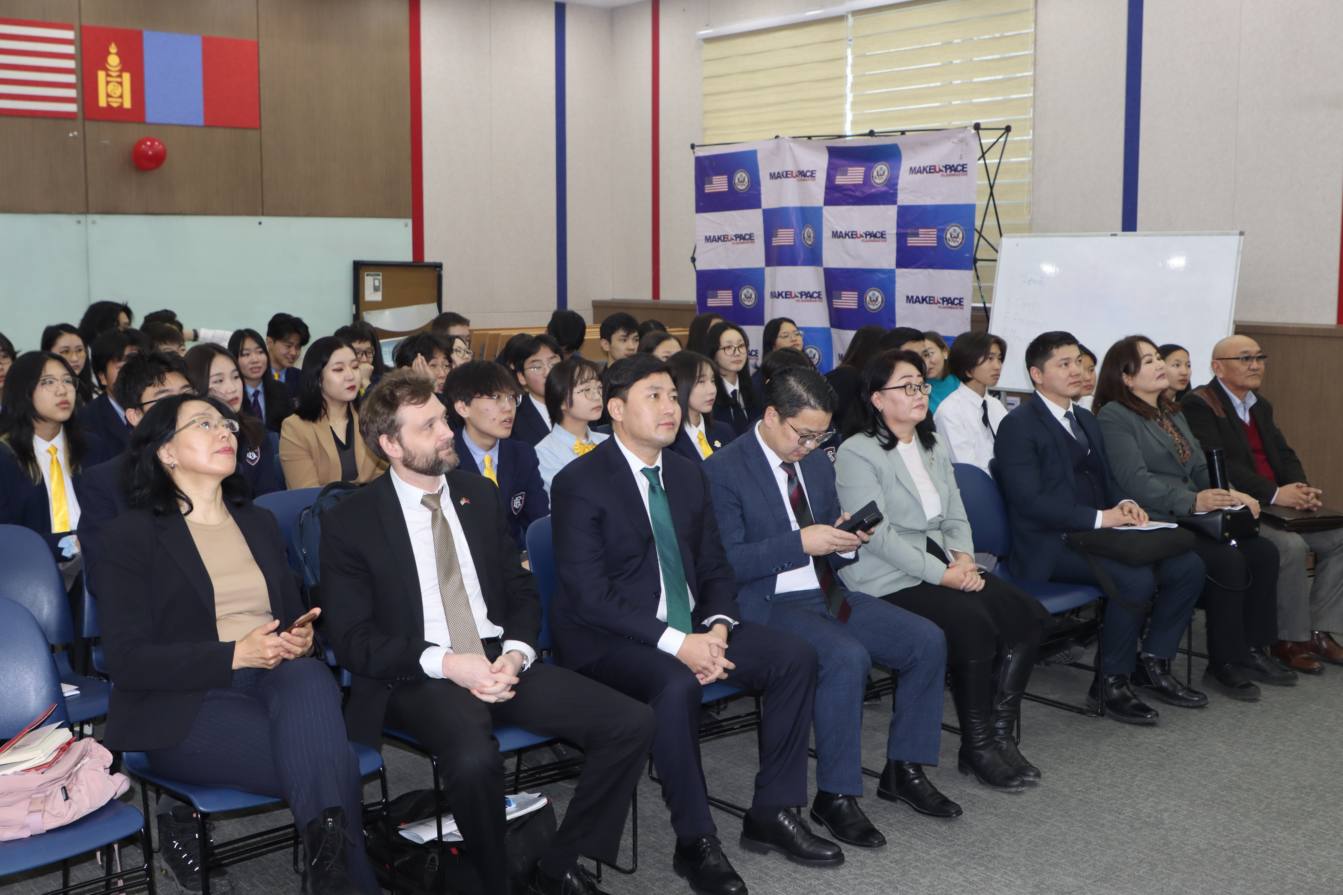
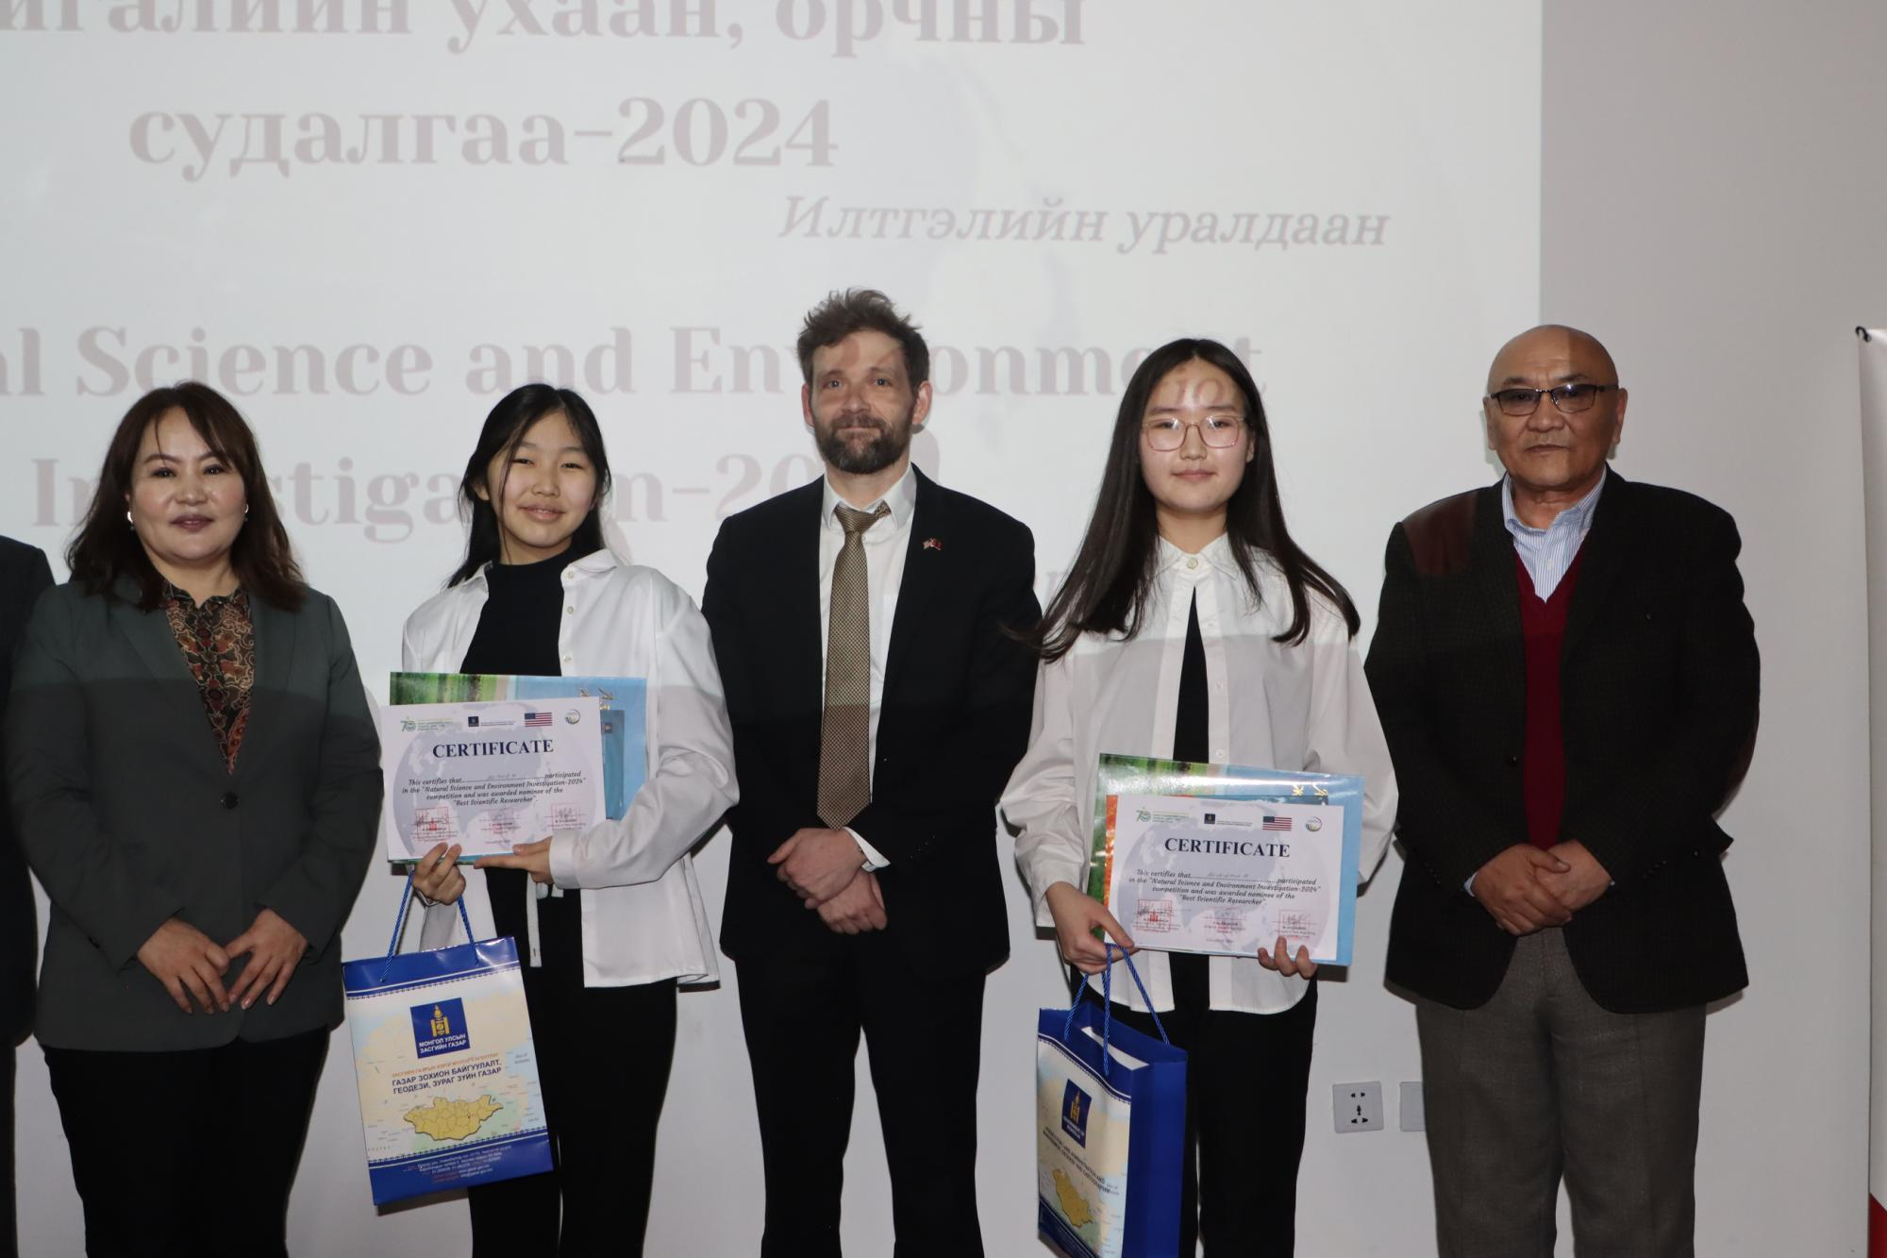
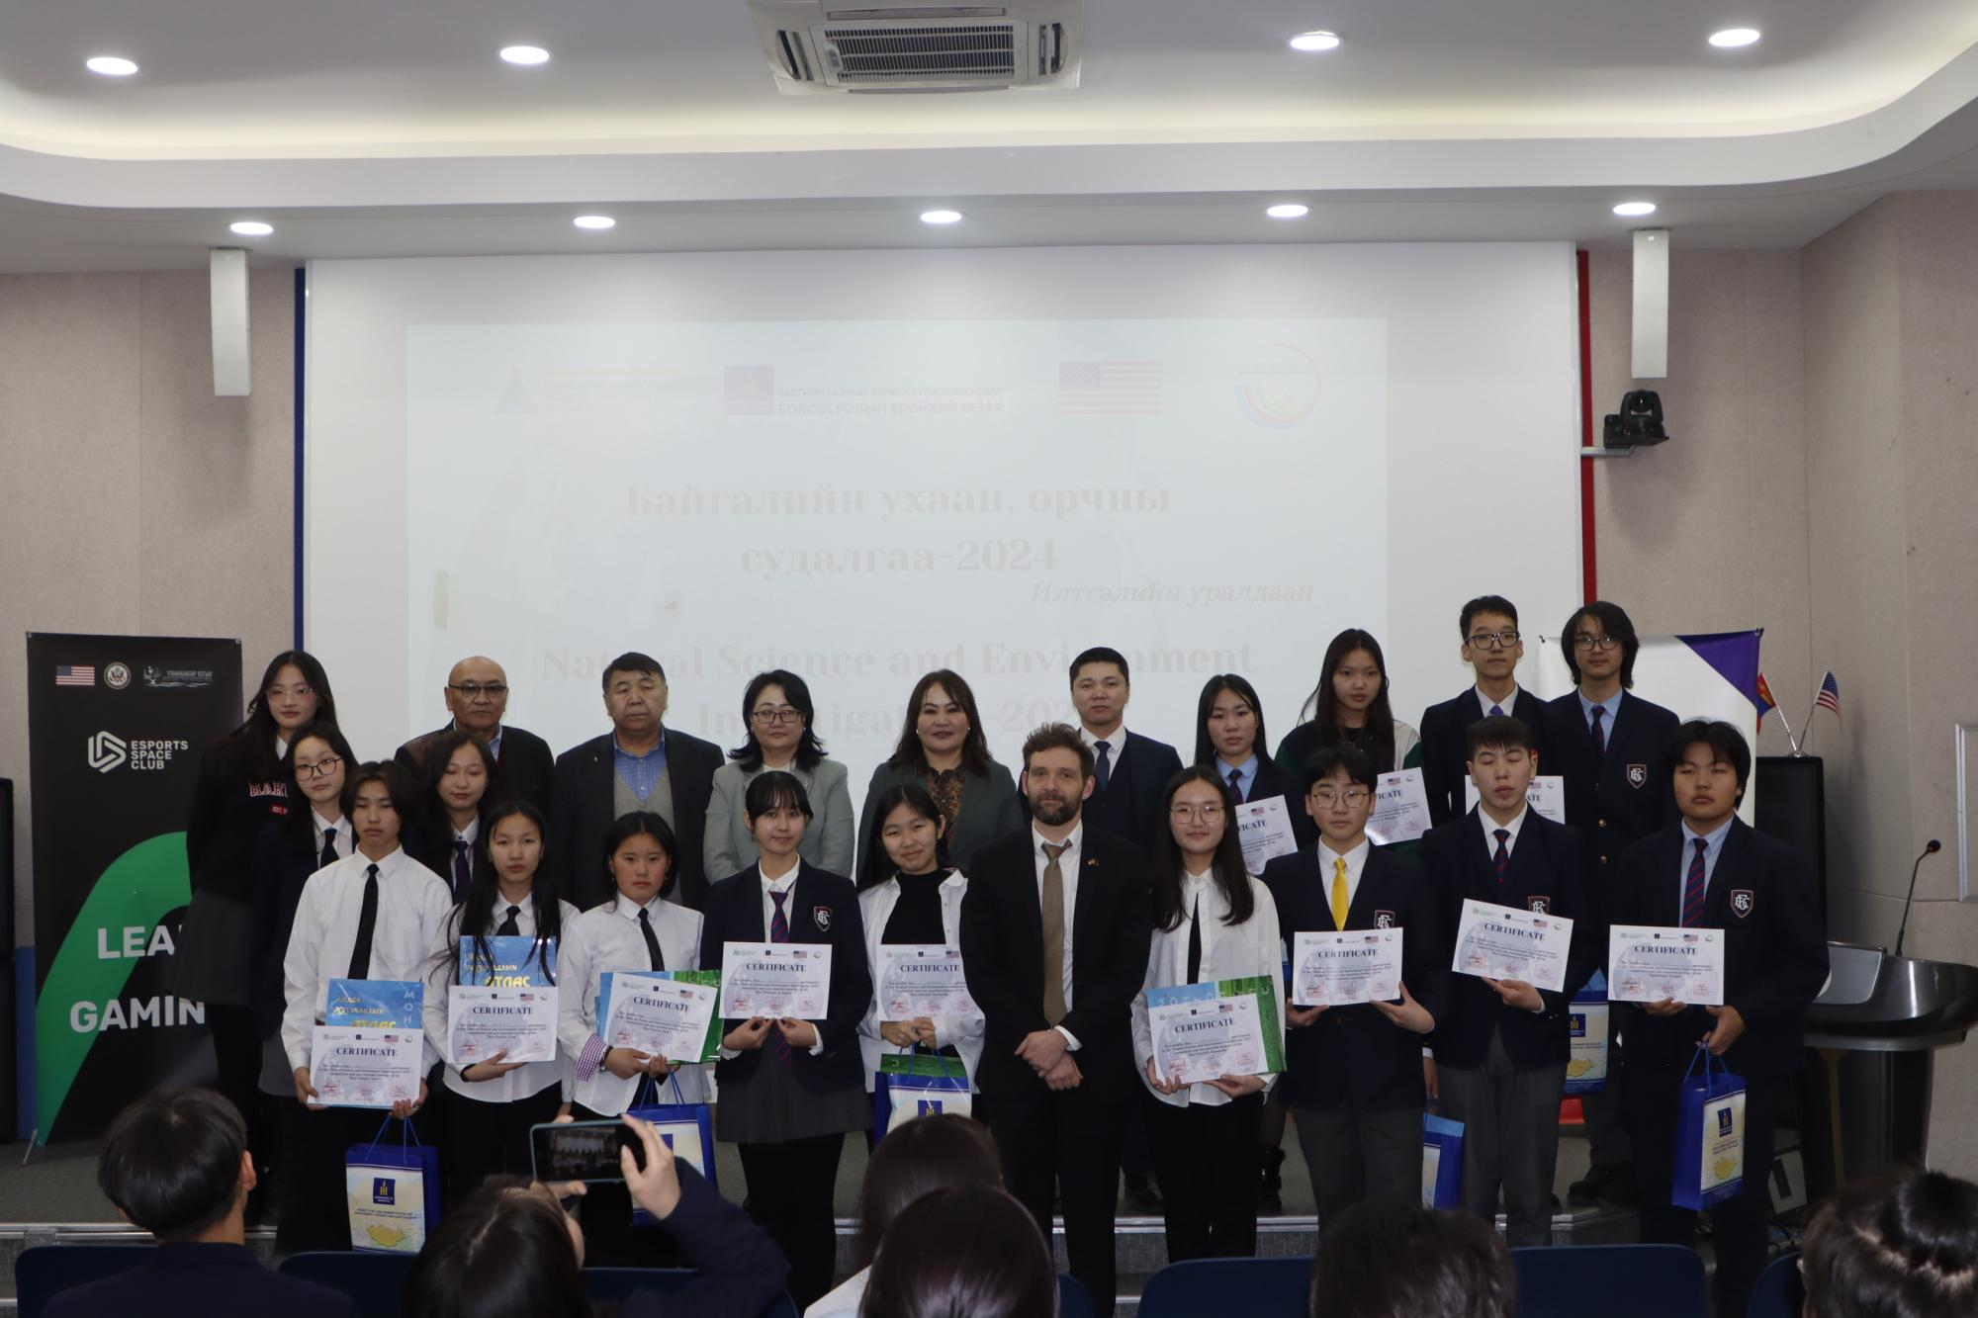
“Natural science and Environmental investigation” competition
Газар зохион байгуулалт, геодези,

Slide 7
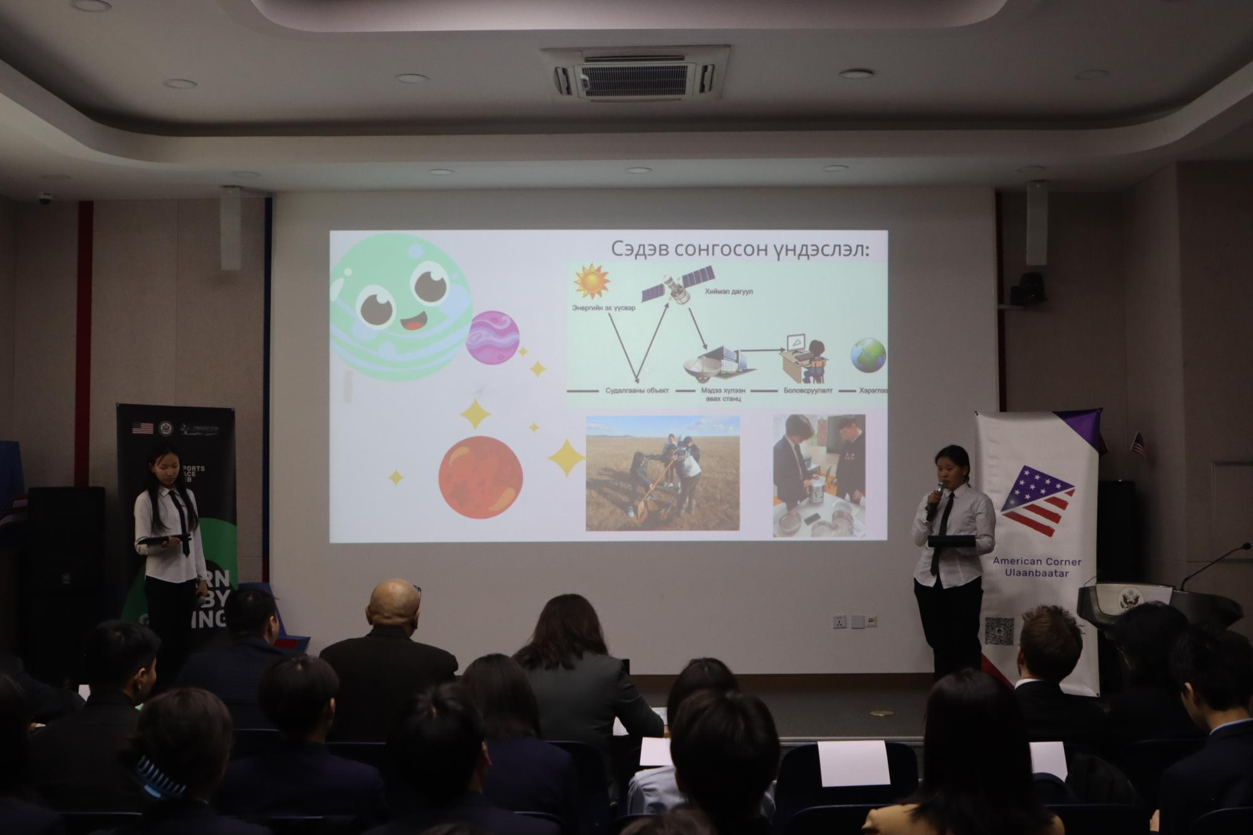
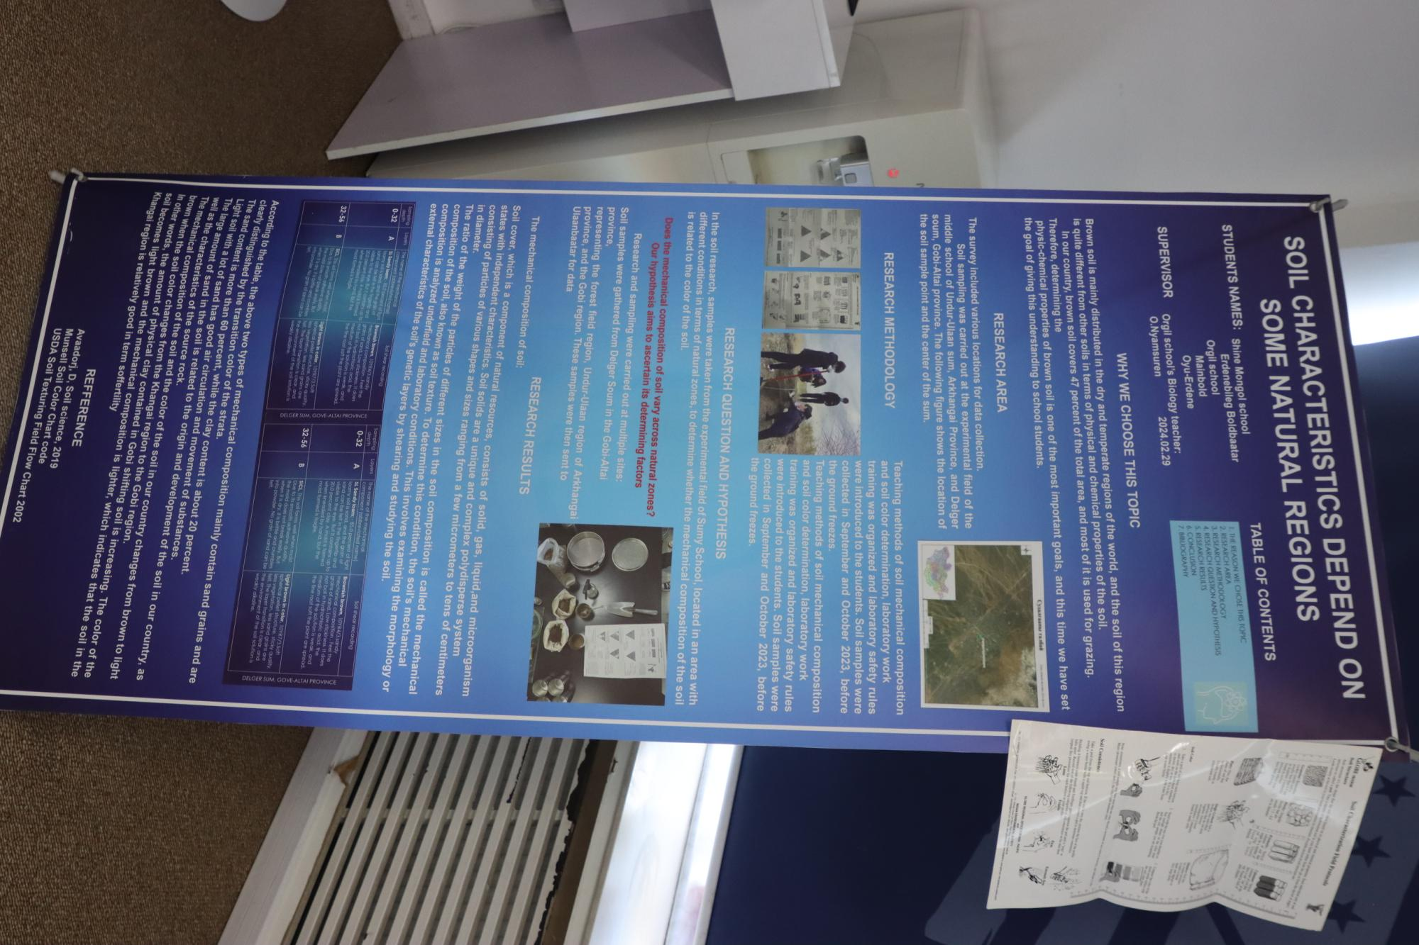
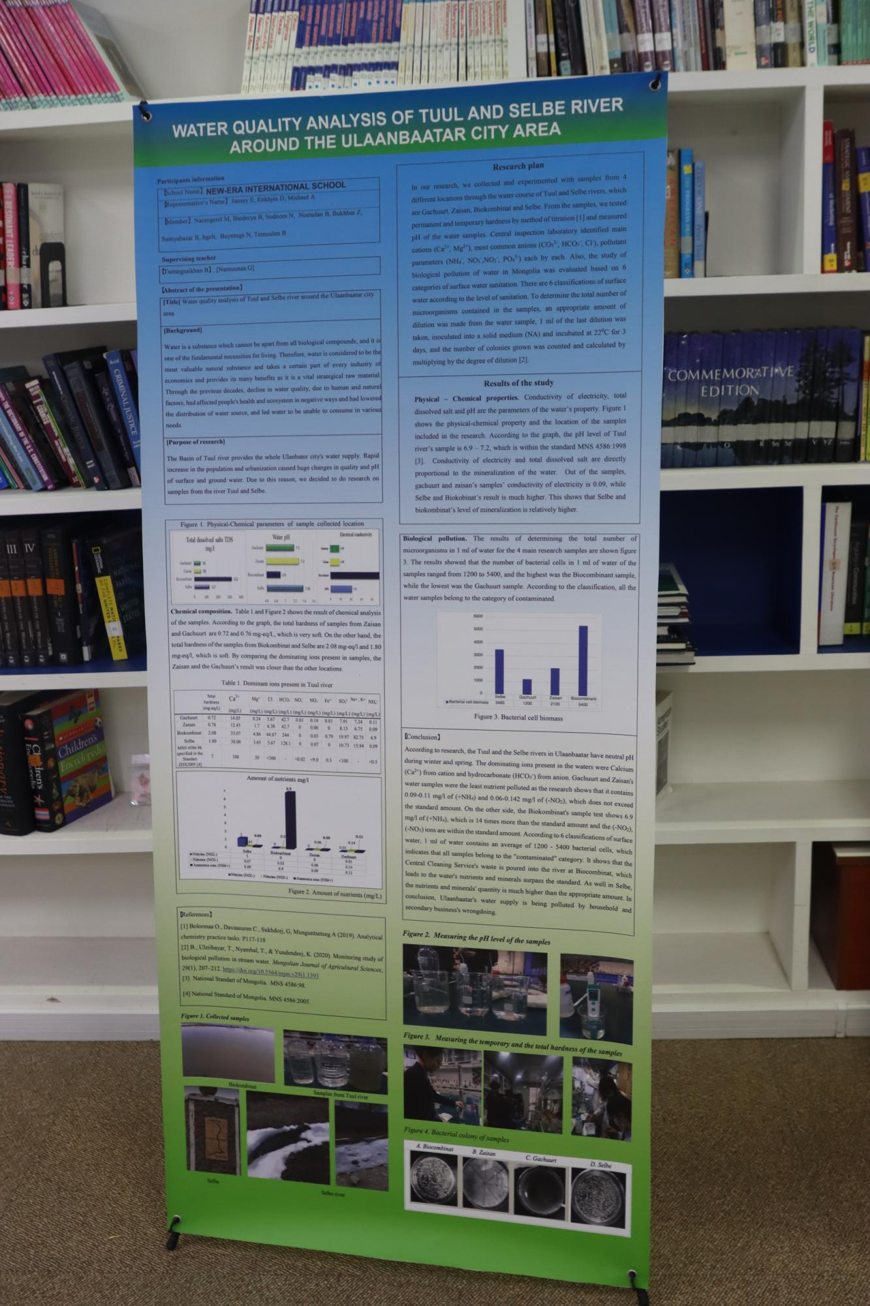
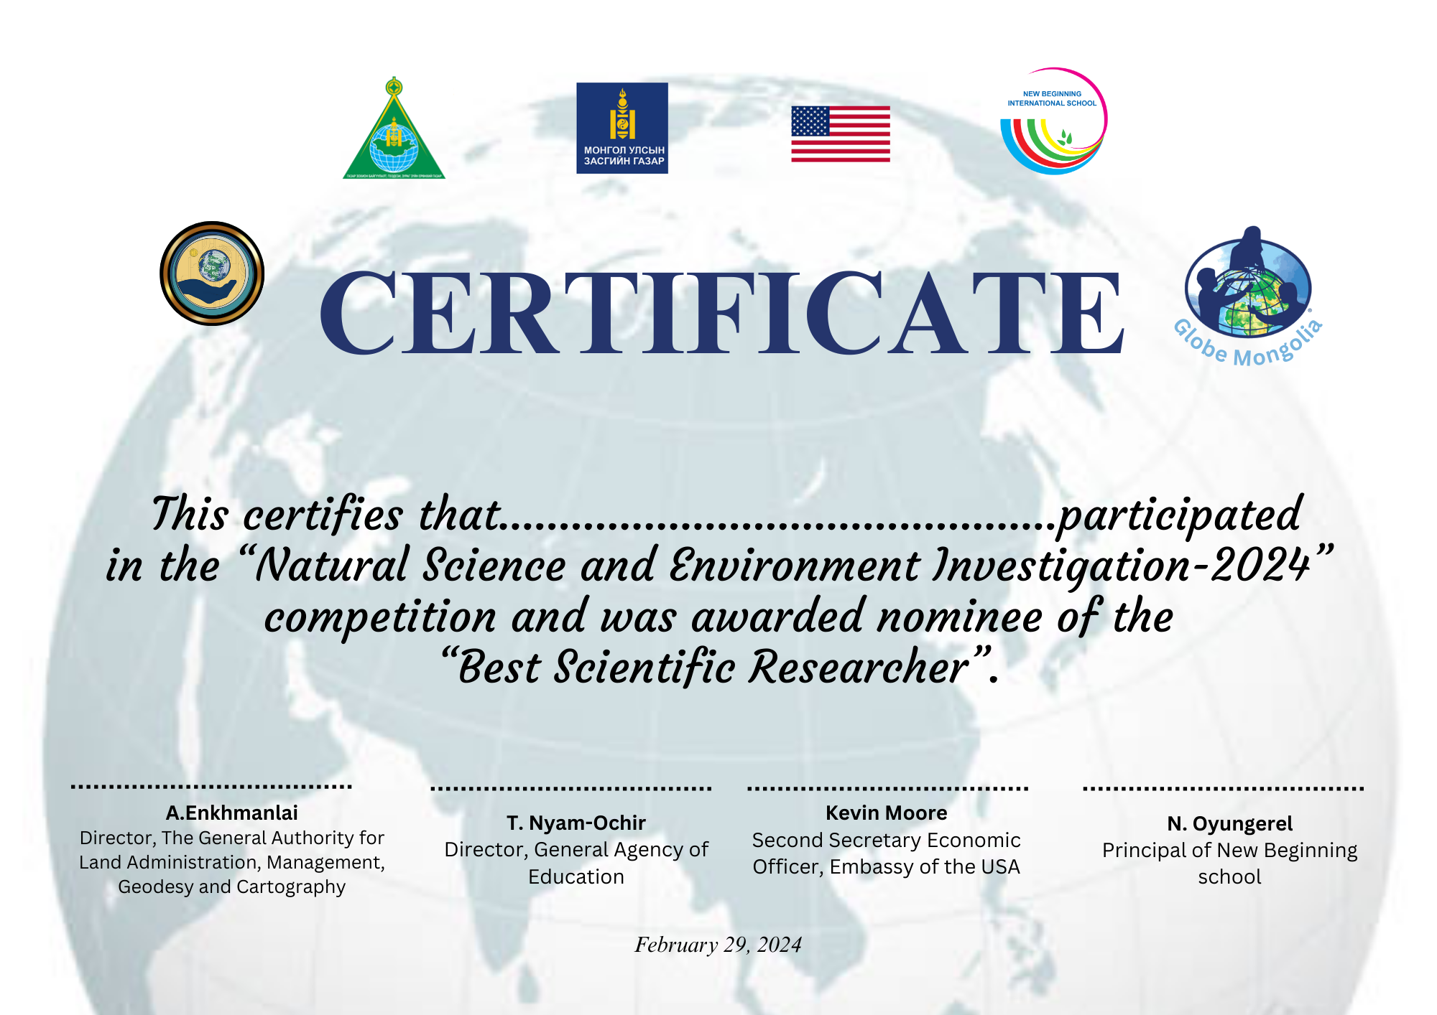
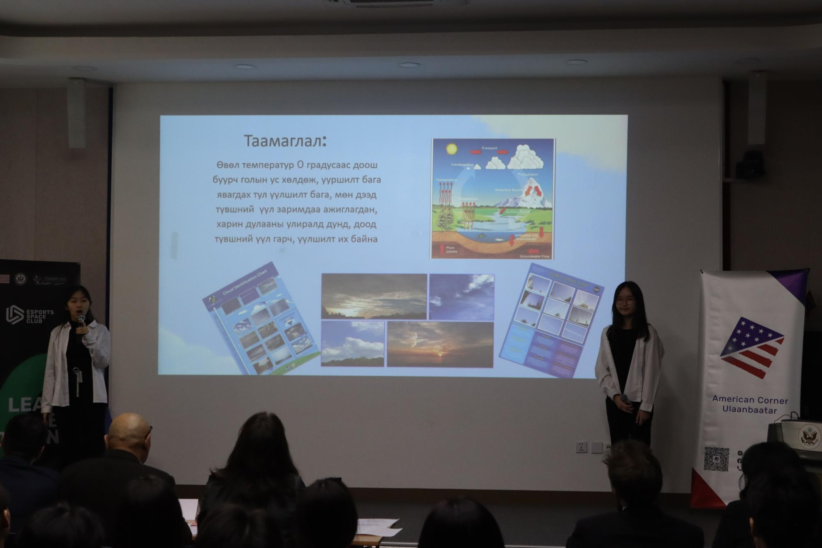
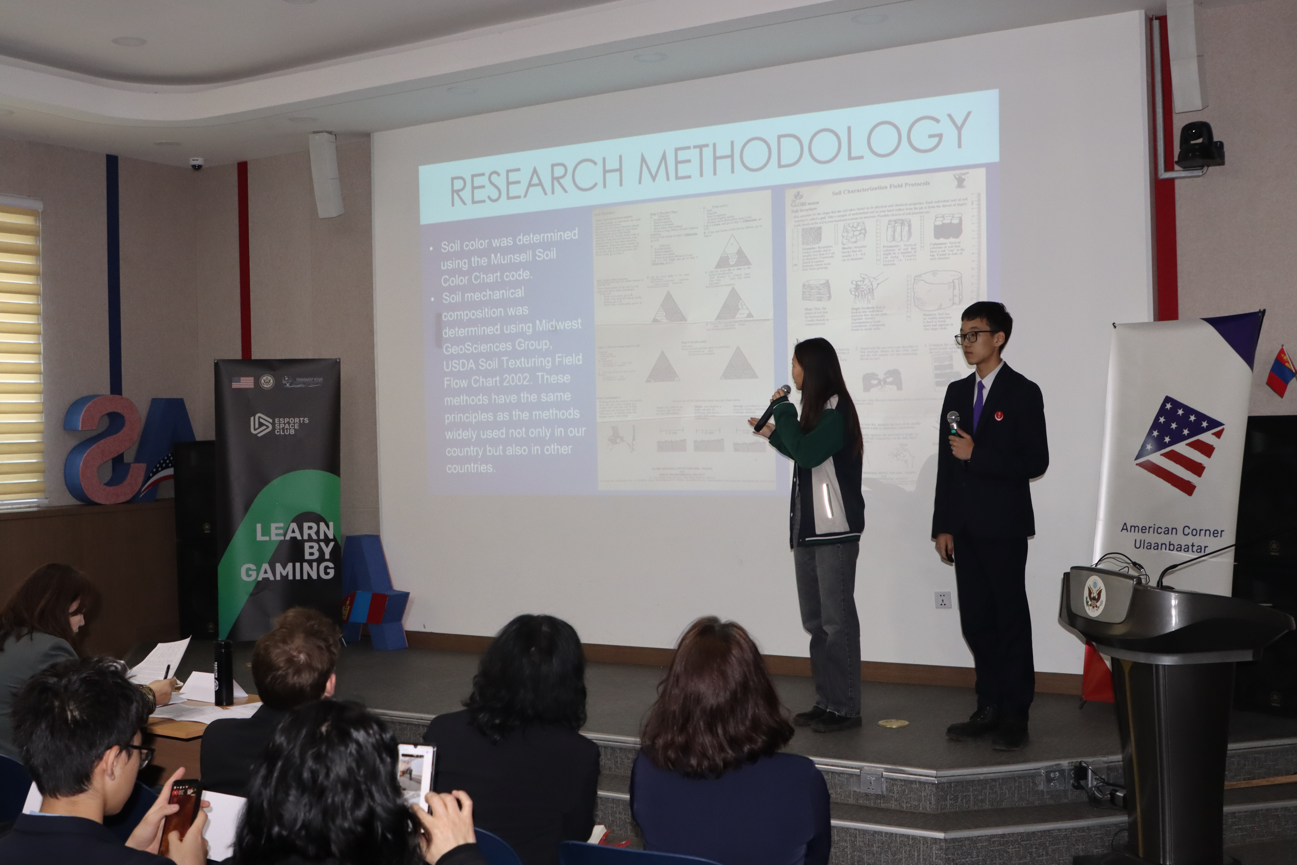
The competition in UB

Slide 8
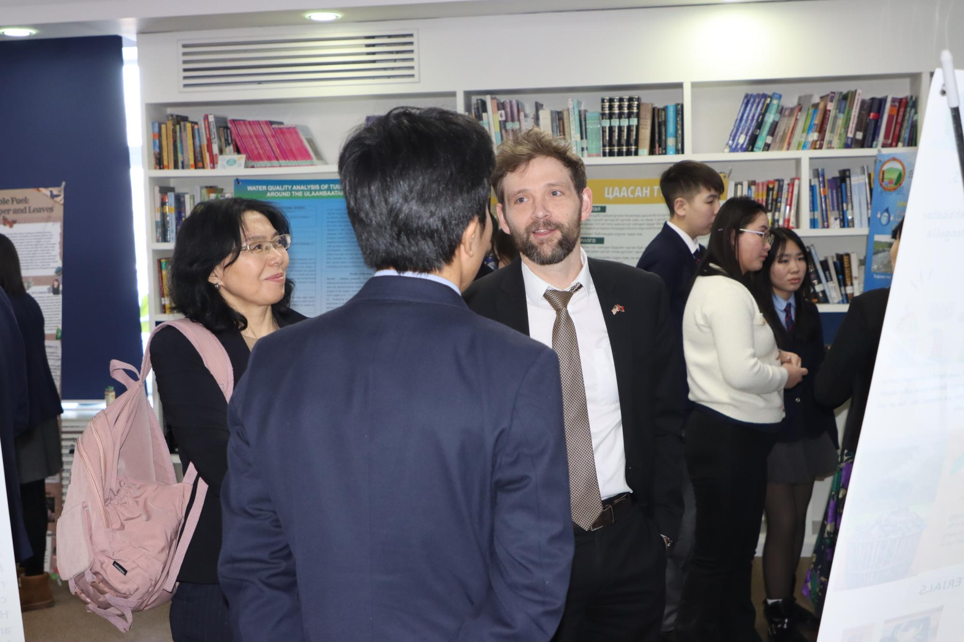
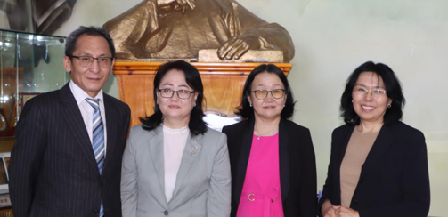
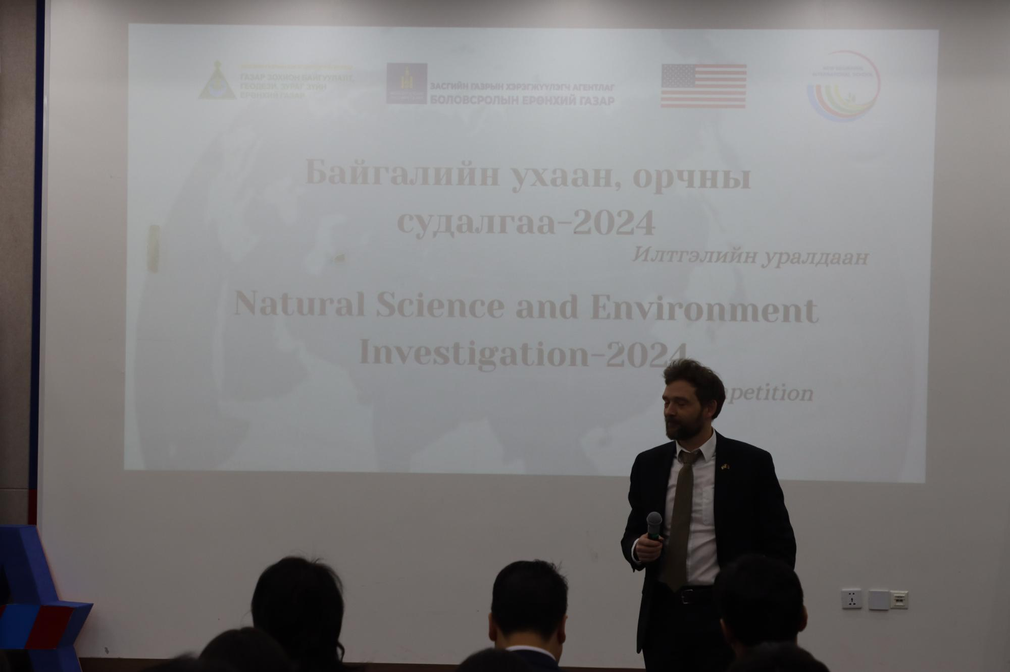
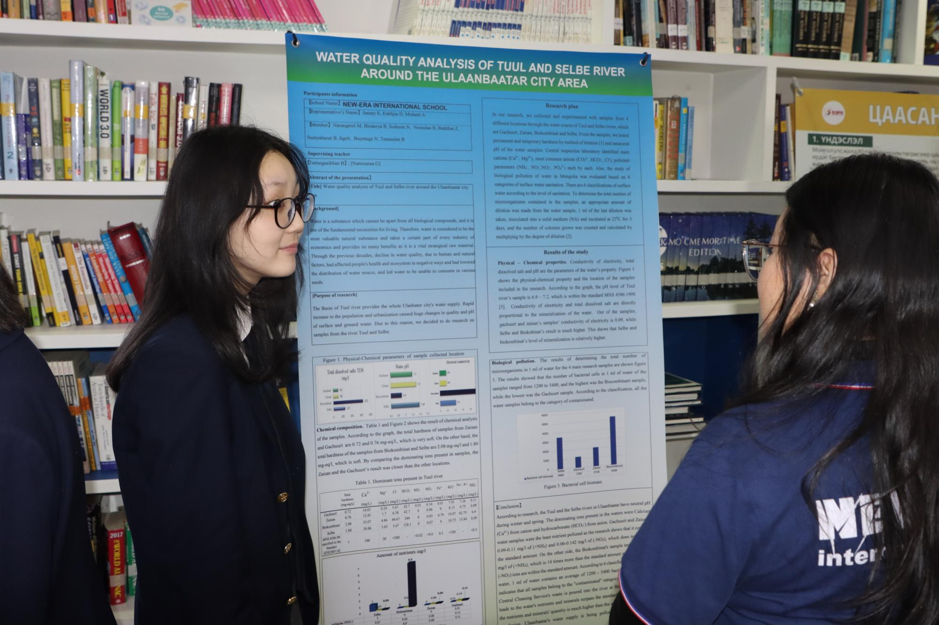
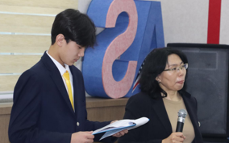
COOPERATION between the USA Embassy & Globe MNG (Nov.2023)
-Visited to US Embassy, informed with Second Secretary Economic Officer, Embassy of the USA, Mr.Kevin Moore
бид хэд авахуулсан зураг
-Organised campaign “Collect data pedoscope”, “Obsrevation the clouds, trees”, “Air Quality in UB”, /October,2023/

Slide 9

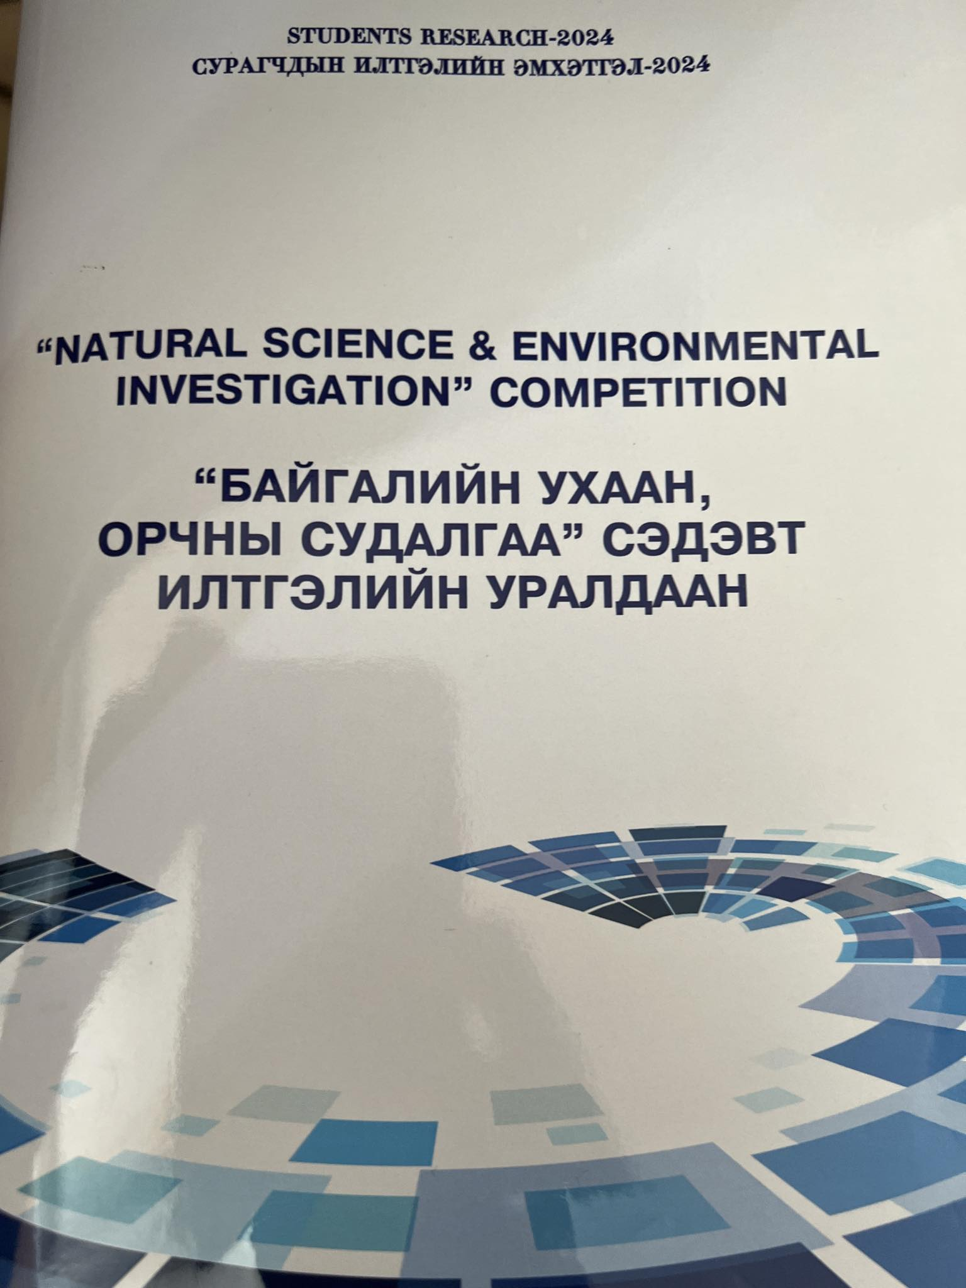
Highlighted activities:
Submitted the students’s research report IVSS-2024
Translated pedoscope protocols, prepared, revised handbooks
Revised and published best 18 student’s research report
Prepared the student’s research handbooks and translation of pedoscope protocols (Moisture in the Soil, Soil characterization, pH of water ) and disseminated.
Notes:
Student’s science competition. Under the resolution approved by MECS "Let's Explore our environment” oral and poster competition was announced among among students at the higher and secondary schools which was organized at the New Era school on 10, April 2023. The completion was at 2 stages.
A.At the first stage, more than 40 more presentation were sent to us to participate in the competition those are posters and presentations in English and Mongolian and by which 30 were from international schools and others were from local and rural schools. Judge team consists of 5 members those are the scientists from Land and Water Investigation at the Institute of Geography and Geo-Ecology and MULS, and MSUE. The brief of presentation “Science fair” publishing which sent to the first stage competition was that distributed to participated schools. The photos of the first stage was posted in website.
Student’s science competition. Under the resolution approved by MECS "Let's Explore our environment” oral and poster competition was announced among among students at the higher and secondary schools which was organized at the New Era school on 10, April 2023. The completion was at 2 stages.
A.At the first stage, more than 40 more presentation were sent to us to participate in the competition those are posters and presentations in English and Mongolian and by which 30 were from international schools and others were from local and rural schools. Judge team consists of 5 members those are the scientists from Land and Water Investigation at the Institute of Geography and Geo-Ecology and MULS, and MSUE. The brief of presentation “Science fair” publishing which sent to the first stage competition was that distributed to participated schools. The photos of the first stage was posted in website.

Slide 10
Activities plan of 2024
To participate student exchange program, in Hanoi, Vietnam
Capacity building training for natural science in Arkahnagai province
To participate annual meeting in New York
To organize campaign align the soil pedoscope, climate change under the guidance
Approved by GALAGC activities plan (preparing national level soil monitoring, which participate students teachers based on pedoscope protocol (from May to October)
Disseminate the handbooks to local schools

Slide 11
Thank you for you kind cooperation

