Slide 1
THE COUNTRY REPORT: THE GLOBE PROGAMME IN SRI LANKA
GLOBE Asia Pacific Regional Meeting
Damayanthi Balasuriya
Former Country Coordinator
GLOBE Programme
Sri Lanka

Slide 2
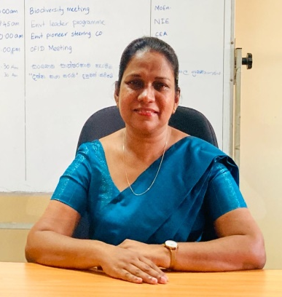
Profile
Name : Dilrukshika Hettiarachchi
Function : Country Coordinator, Sri Lanka
Organization : Ministry of Education
E mail : hiddhettiarachchi@gmail.com
Telephone No: 094 112177379/ 094 718329917
WhatsApp : 094 718329917

Slide 3
Cooperating Organizations
Provincial Departments of Education (9)
Central Environment Authority
Government Universities
Funded by: General Education Modernization Project (GEMP), Government of Sri Lanka

Slide 4
Community 122 schools and 161 teachers
Province | No of schools
Western | 45
Central | 12
Southern | 14
Northern | 4
Eastern | 3
North Western | 14
Uva | 4
Sabaragamuwa | 15
North Central | 11

Slide 5
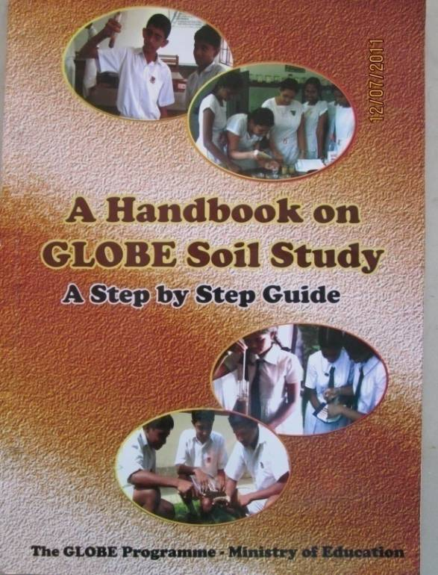
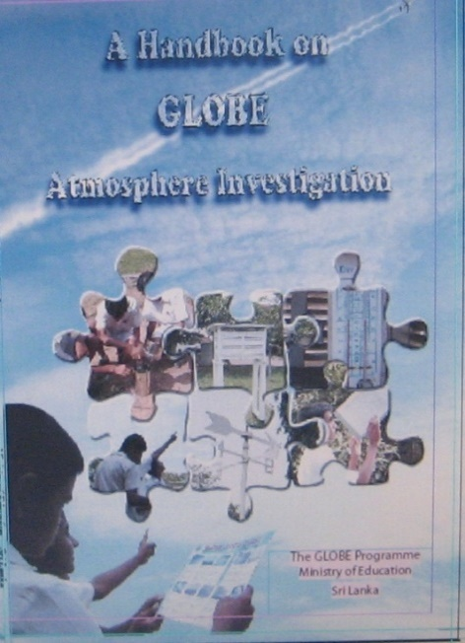
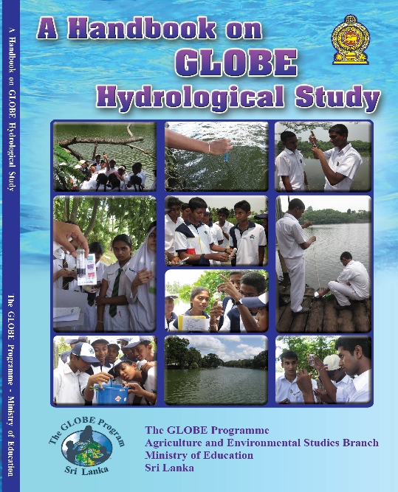
GLOBE Protocols Used In Sri Lanka
Atmosphere
Hydrosphere
Pedosphere
Biosphere
Research

Slide 6
GLOBE Activities in Sri Lanka
1. Expanding the programme
2. Quality improvement

Slide 7
Online and onsite Student training programmes
Online and onsite teacher training programmes
Capacity building workshops for teachers on student research projects
Education officer training and awareness programmes
Protocols:- Atmosphere Hydrosphere Pedosphere Biosphere
Refresher Training for the GLOBE Teachers
Beginner Training for the newly appointed GLOBE Teachers
Research on Atmosphere Hydrosphere Pedosphere Biosphere
Earth as a System
Protocols:- Atmosphere Hydrosphere Pedosphere Biosphere
Research

Slide 8
2. Quality Improvement of the Programme
Appointing provincial and zonal monitoring officers to monitor the GLOBE programme
Student project evaluation programmes under the Sustainable Development Programme
Environmental pioneer programme
Green Schools programme
Tree planting programmes
School farms programme

Slide 9
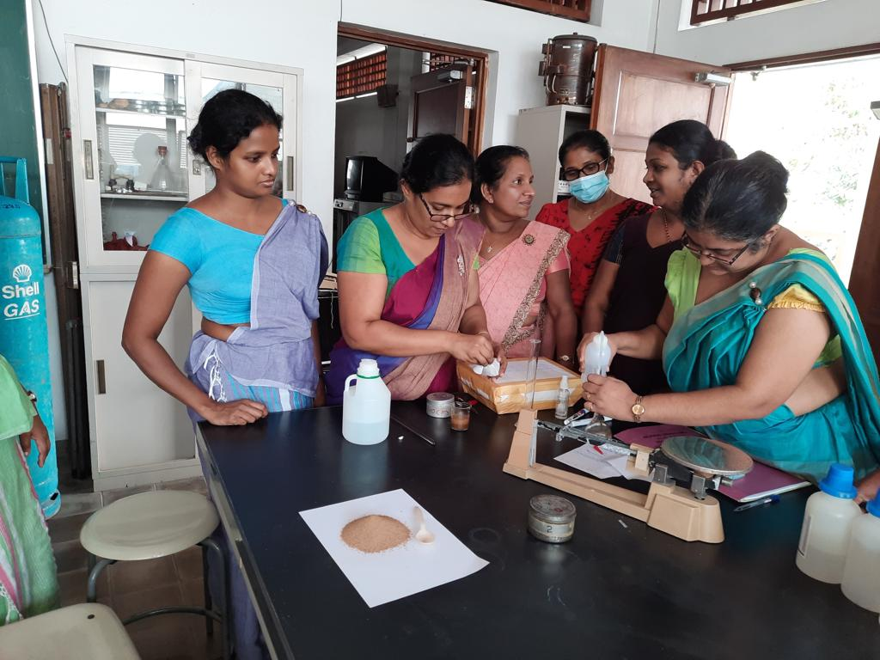
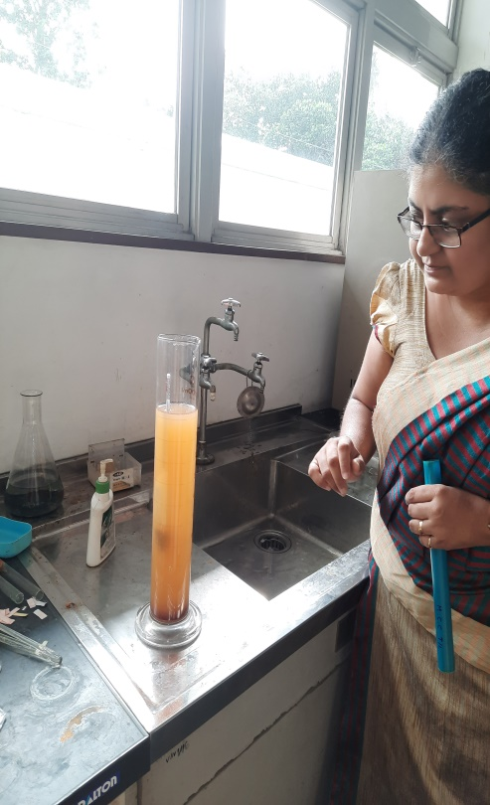
Pedosphere

Slide 10
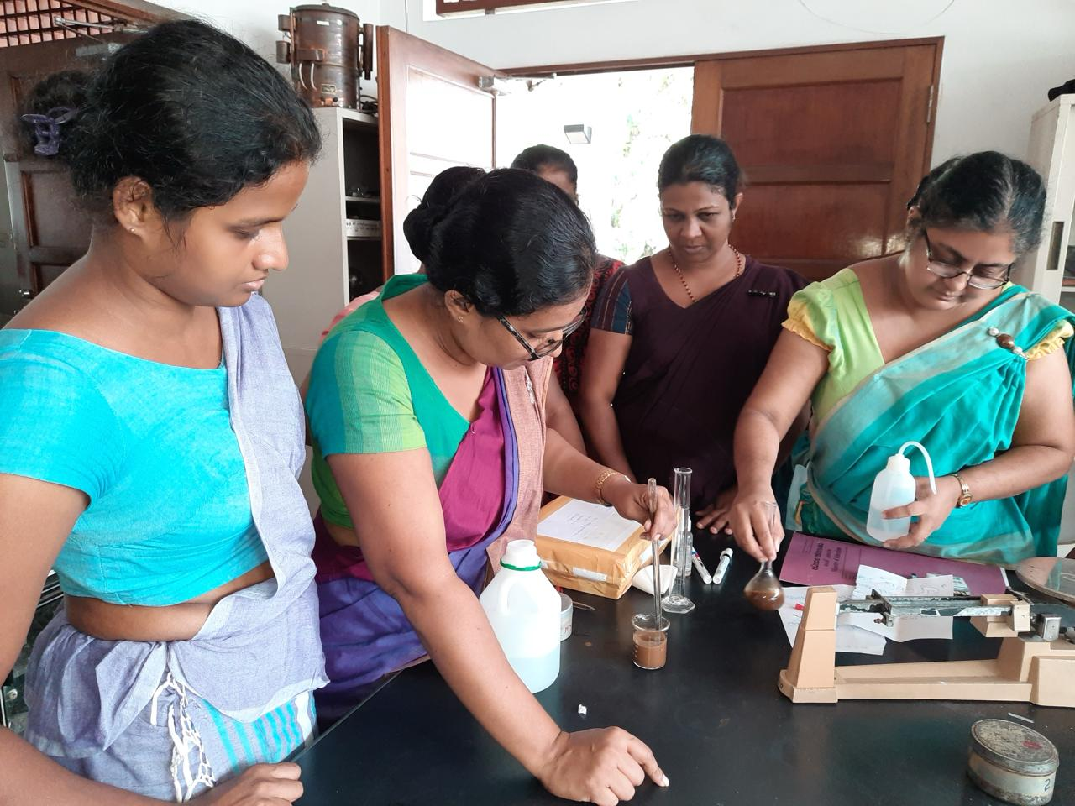

Slide 11
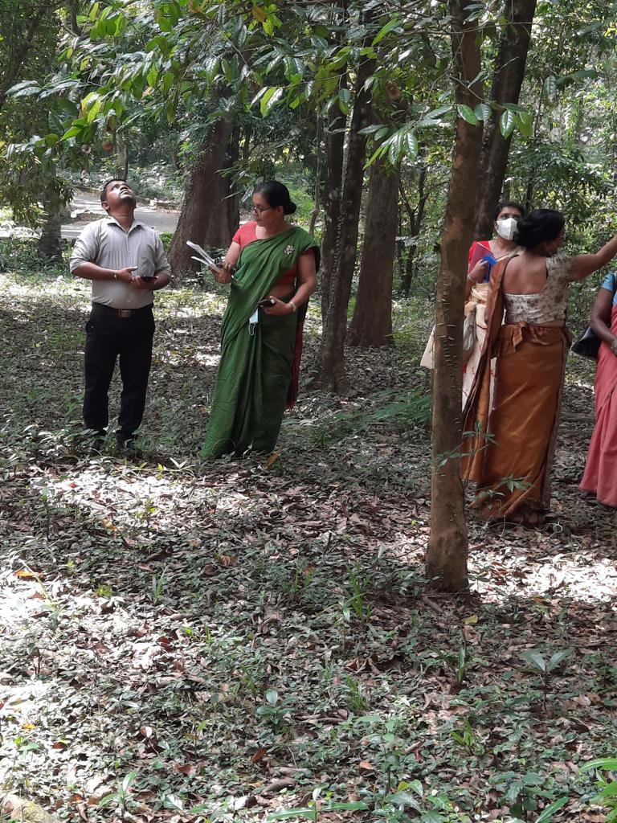
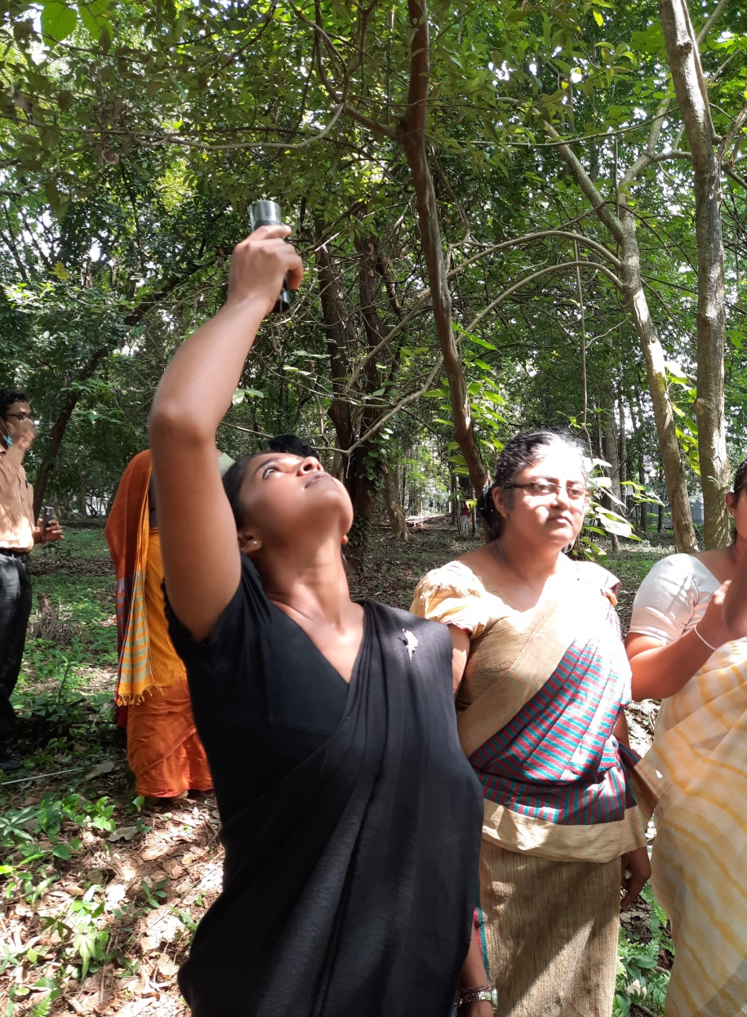
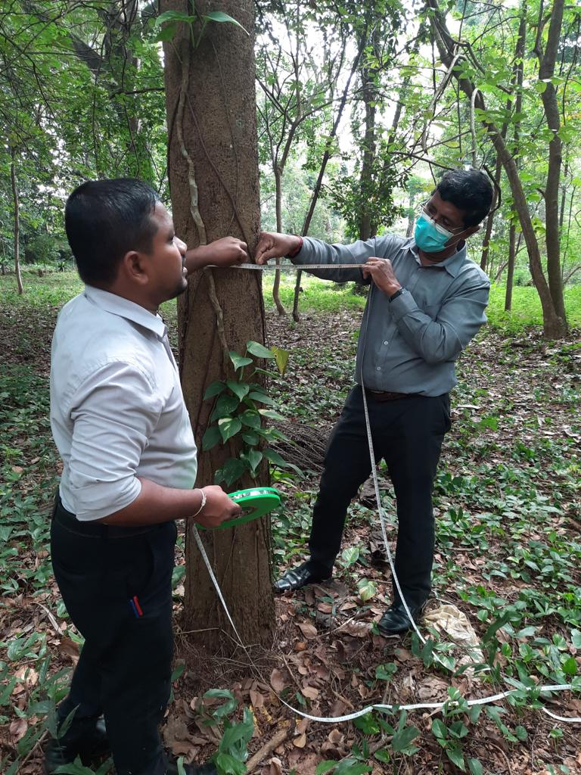
Biosphere

Slide 12
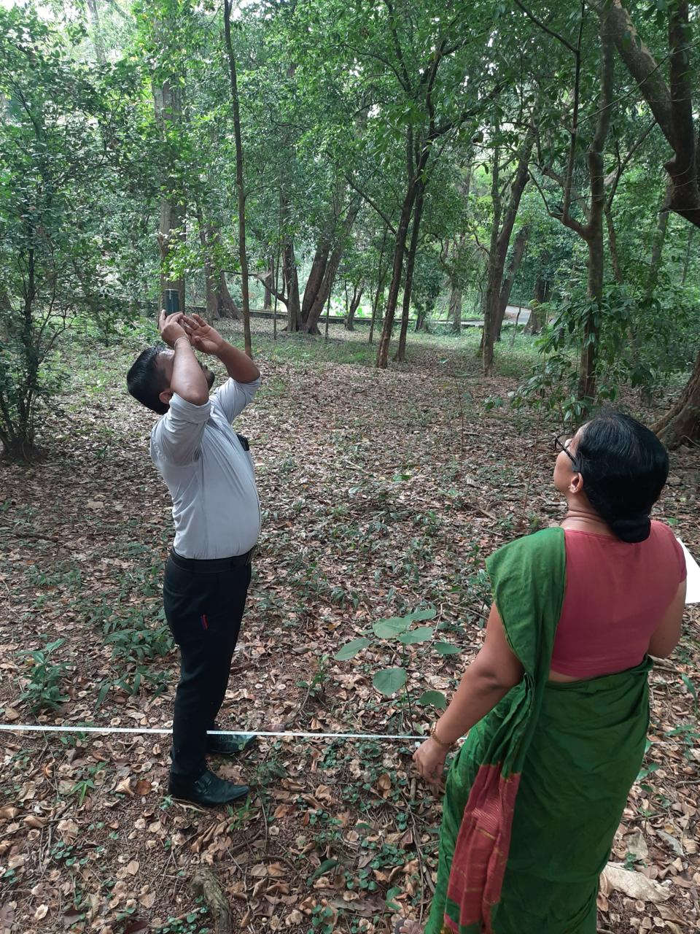

Slide 13
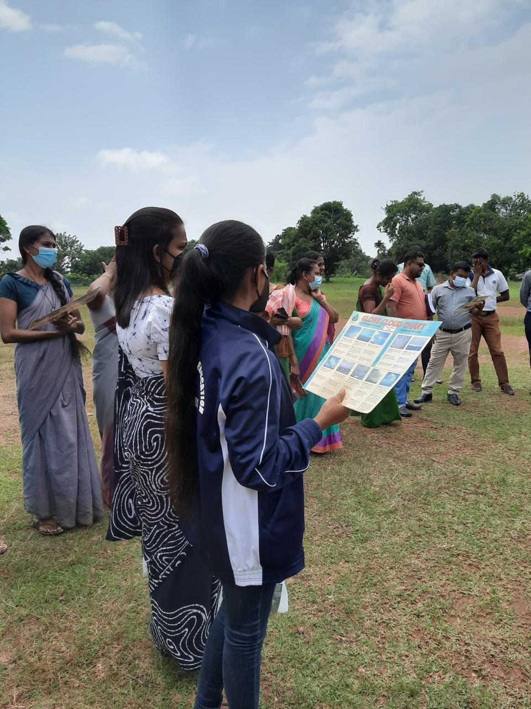
Atmosphere

Slide 14
At National Institute of Education, Maharagama, Colombo

Slide 15
Hydrological Protocol In Parallel with World WatER DAY 2024

Slide 16
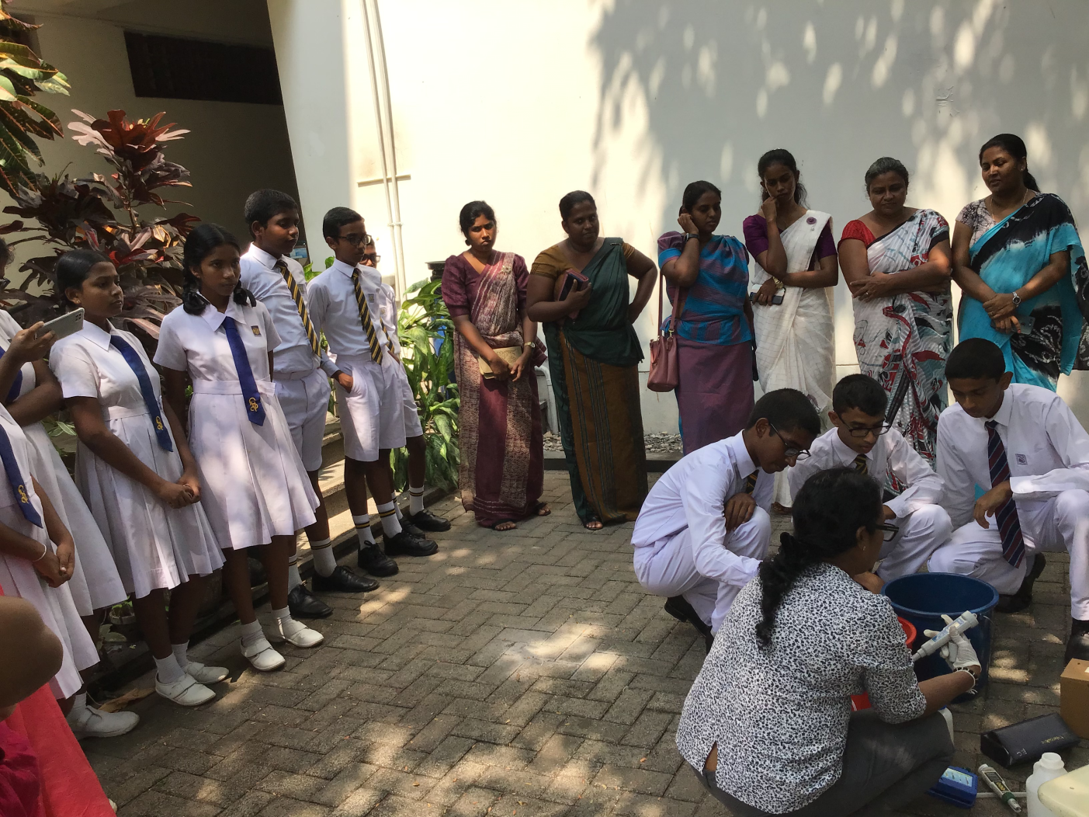
Hydrological Protocols IN PARALLEL WITH WORLD WATER DAY

Slide 17
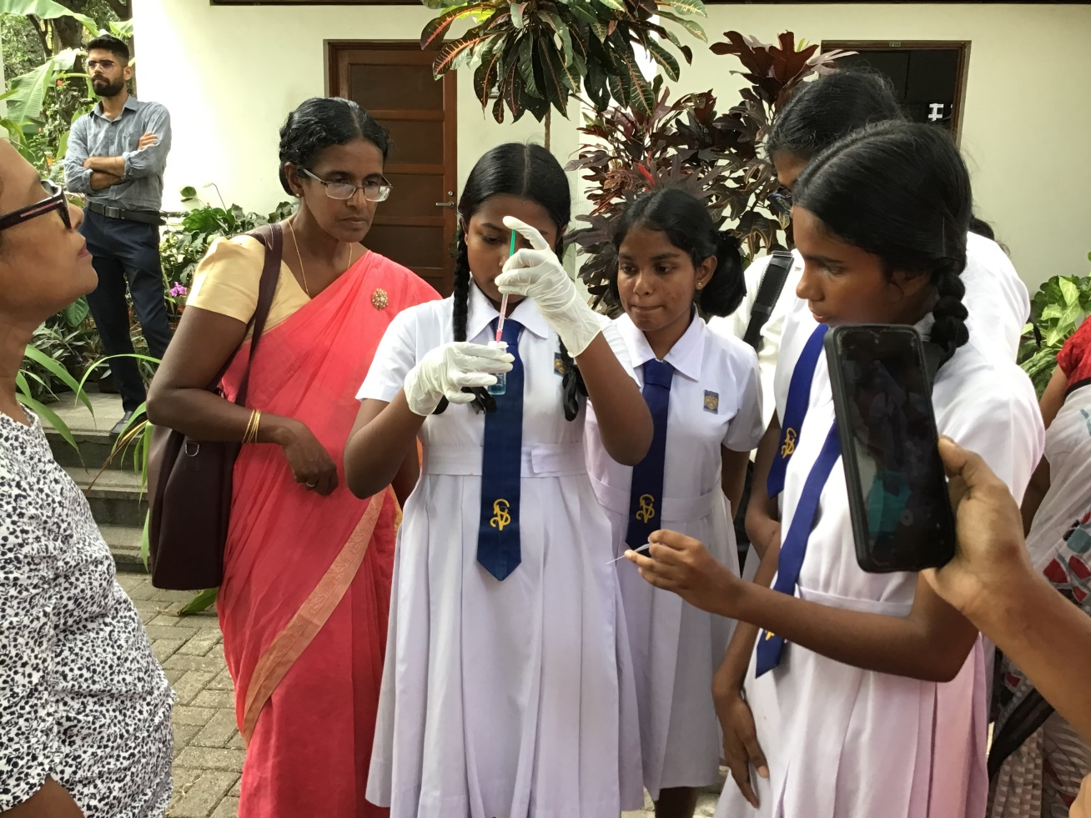
Continued…..

Slide 18
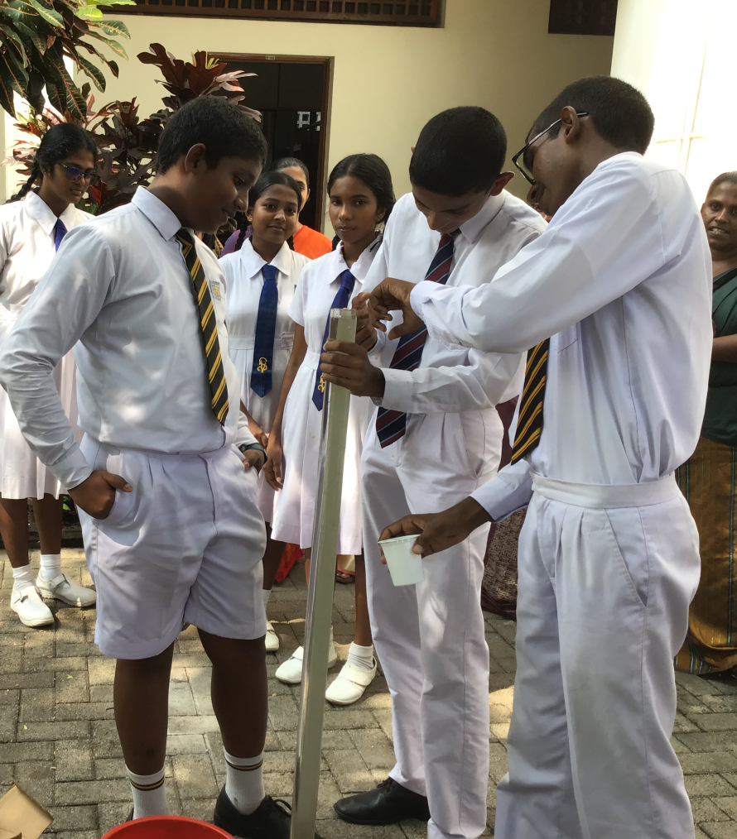
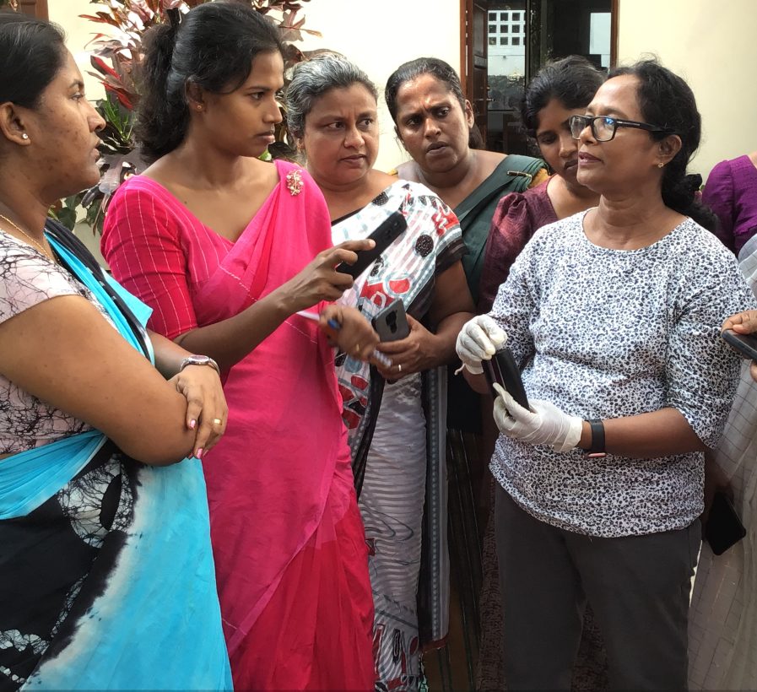

Slide 19
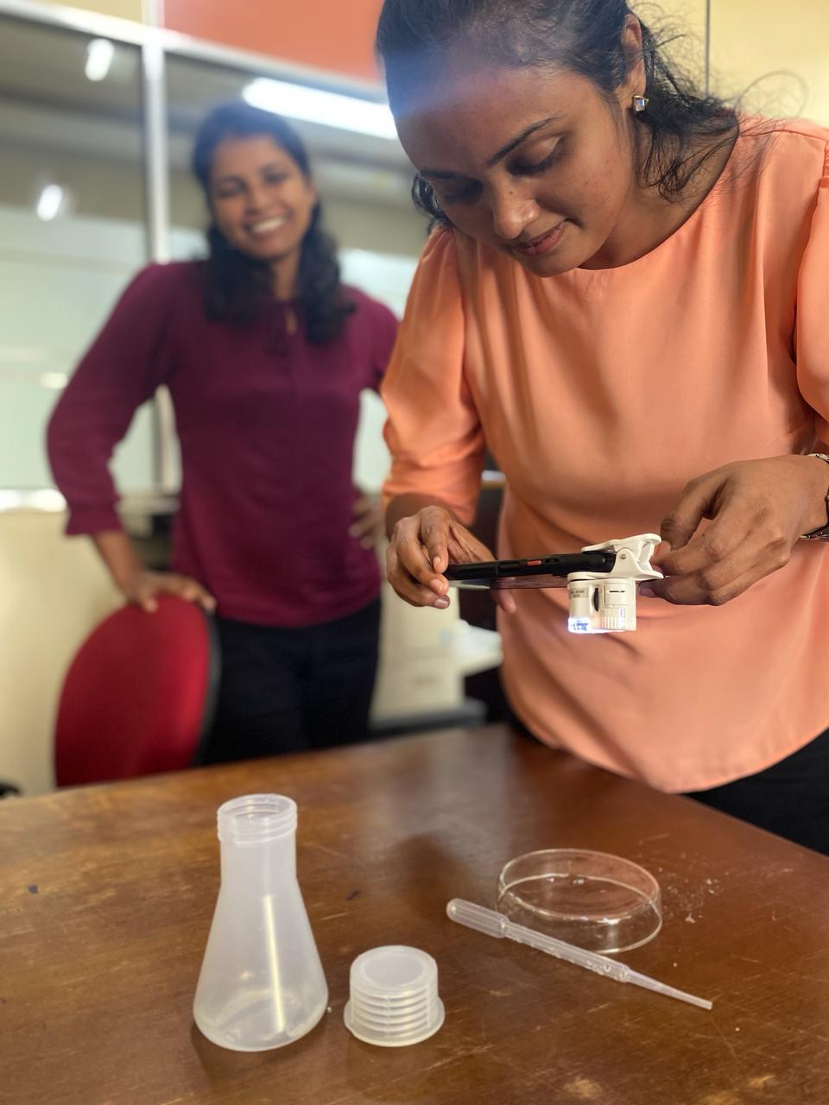
Mosquito Protocol

Slide 20
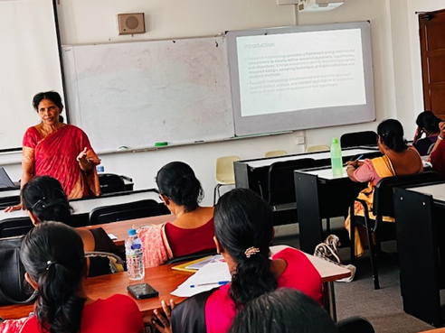
StUDENT Research

Slide 21
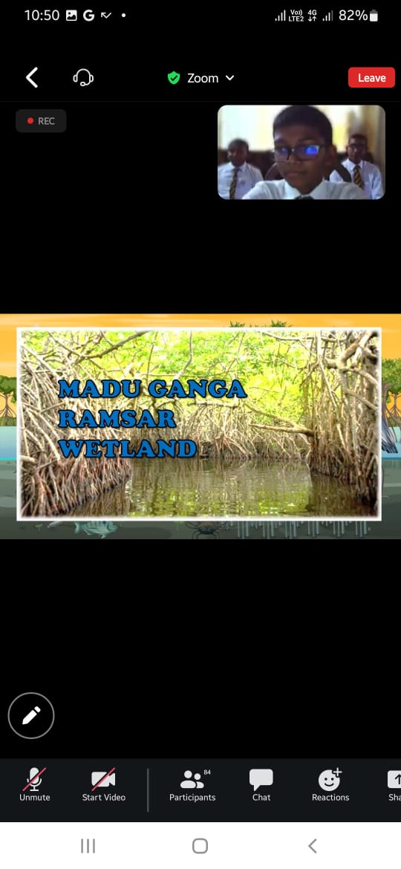
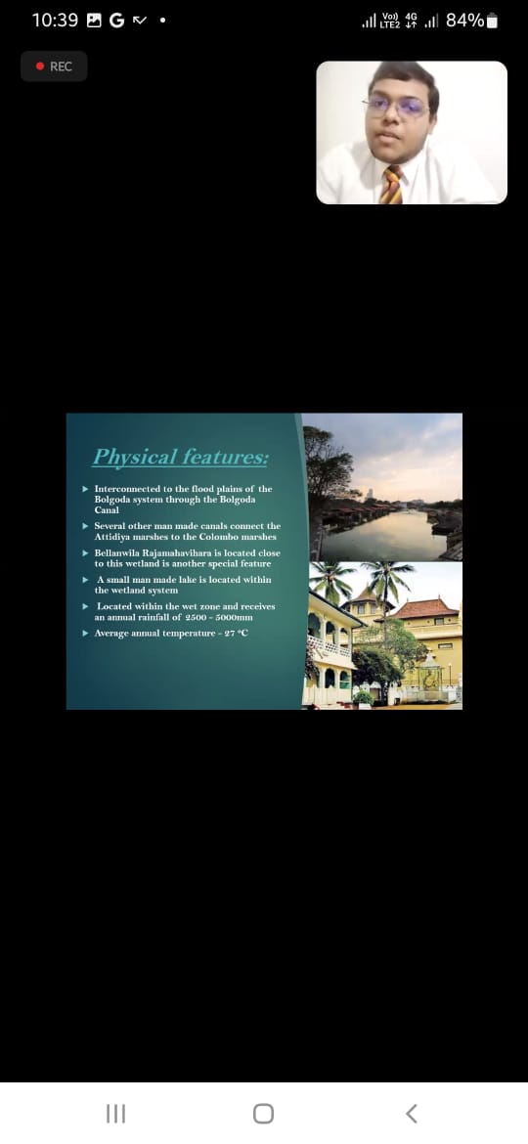
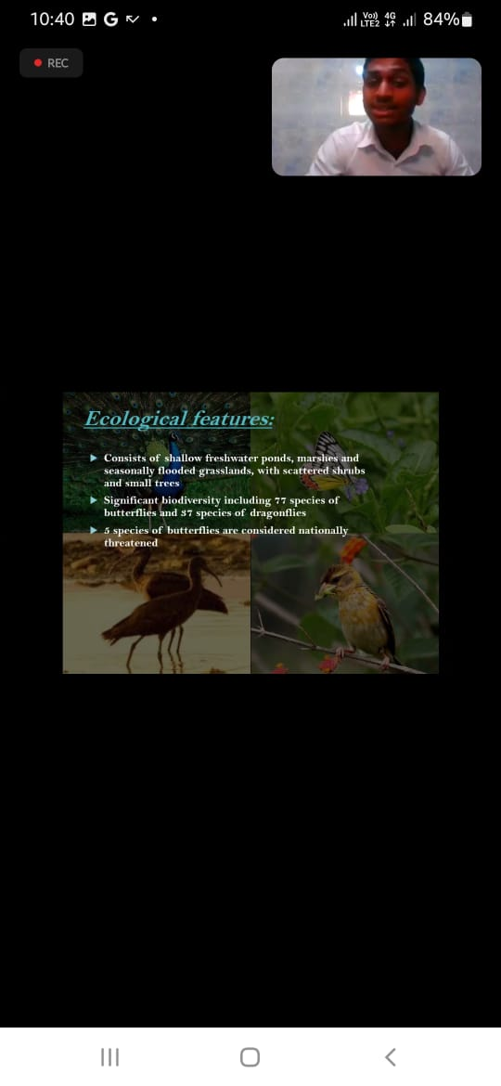
Wetland day Students Presentations

Slide 22
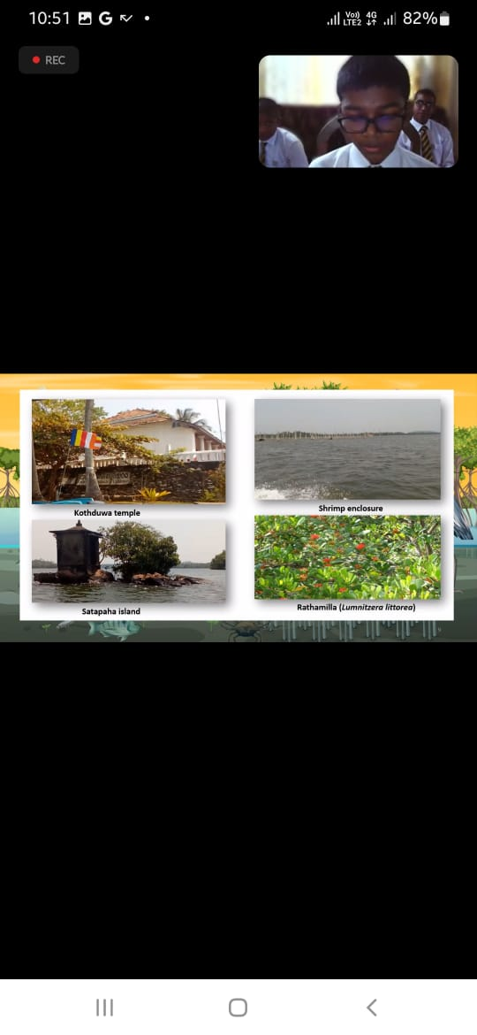
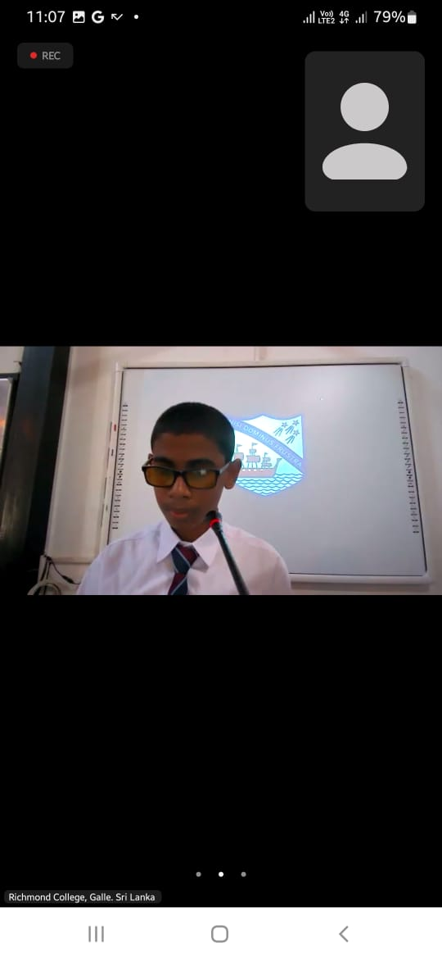
Continued….

Slide 23
Challenges
Economic crisis in Sri Lanka
Lack/limitation of internet facilities for data entry
Increased charges for internet facilities
Lack/ limitation of capital allocation to purchase equipment
Outdated existing equipment
Difficult to allocate extra time within school hours to conduct GLOBE protocols

Slide 24
Way Forward
Provide GLOBE equipment to schools
Strengthen GLOBE Societies/clubs in schools
Motivate teachers and students by appreciation
Continuation of student research project evaluation programme
Conduct national GLOBE learning expedition

Slide 25
Way Forward
Introduce elementary GLOBE for primary students
Expand student project work through the Environmental Pioneer and Green School programmes
Commemoration of special Environmental days with GLOBE teachers & students. Ex. Wetland Day, Water Day, Environment Day, Earth Day etc.
Contribution of regional collaborative projects

Slide 26
STAFF
Name | Designation | Institute
Mrs. Dilrukshika Hettiarachchi | Country Coordinator | Ministry of Education
Miss. Damayanthi Balasuriya | Former Country Coordinator/Trainer
Mr. Tuder Senarathne | Former country coordinator/Trainer
Mrs. Shanthi Siriwardana | Trainer
Mrs. Chethika Ambalangodage | Trainer | Central Environmental Authority
Mrs. Vinodya Wijesuriya | Assistant Trainer | Western Provincial department of Education
Mrs. Asha De Silva | Assistant Trainer | Ministry of Education
Mrs. Thilini Wickremasinghe | Assistant Trainer | Ministry of Education

Slide 27
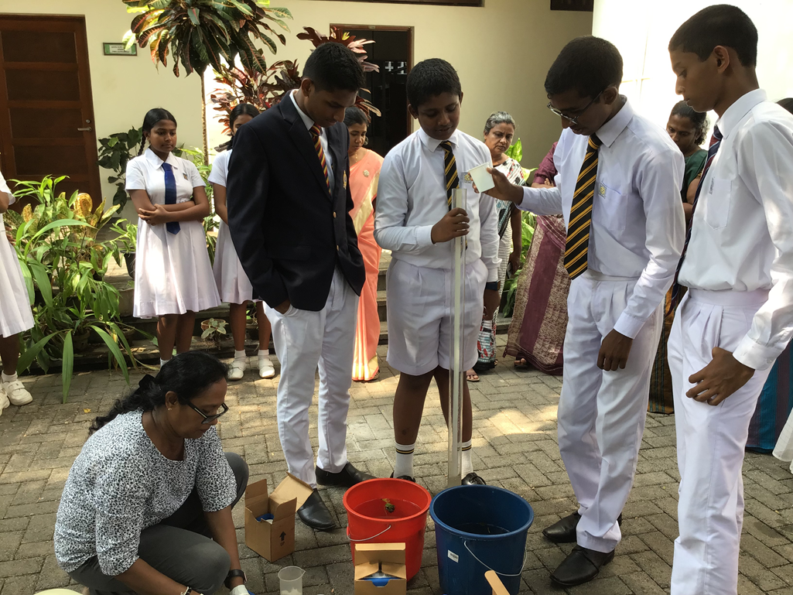
Thank You

