Slide 1
Asia and Pacific Region Meeting
April 15-18, 2024
MALE
The Maldives
GLOBE Implementation Office Update
Dr. Tony P. Murphy, Director Community Engagement and Program Strategy
tmurphy@ucar.edu

Slide 2
Welcome to second in person meeting since 2022
Welcome to the 12 Country Coordinators and Assistant Country Coordinators attending the meeting ( countries in region)
Update from GLOBE Implementation Office (GIO) and the Data Information Systems (DIS)
Update from you about the development of GLOBE in your countries
Update from the Regional Coordination Office (RCO)

Slide 3
Highlights from 2023-24
Science data continue to increase, pushing the count to over 250 million measurements
Work continues on protocol deactivation and proposal process
Over 1 million satellite matches for the GLOBE Observer Cloud matches
Trainer certification process launched and online processing continues to be refined
Data literacy activities
New staff hired at GIO
A new version of the Country Coordinator Guide is available
Revisioning with the Working Groups the role of the groups over the next 10 years

Slide 4
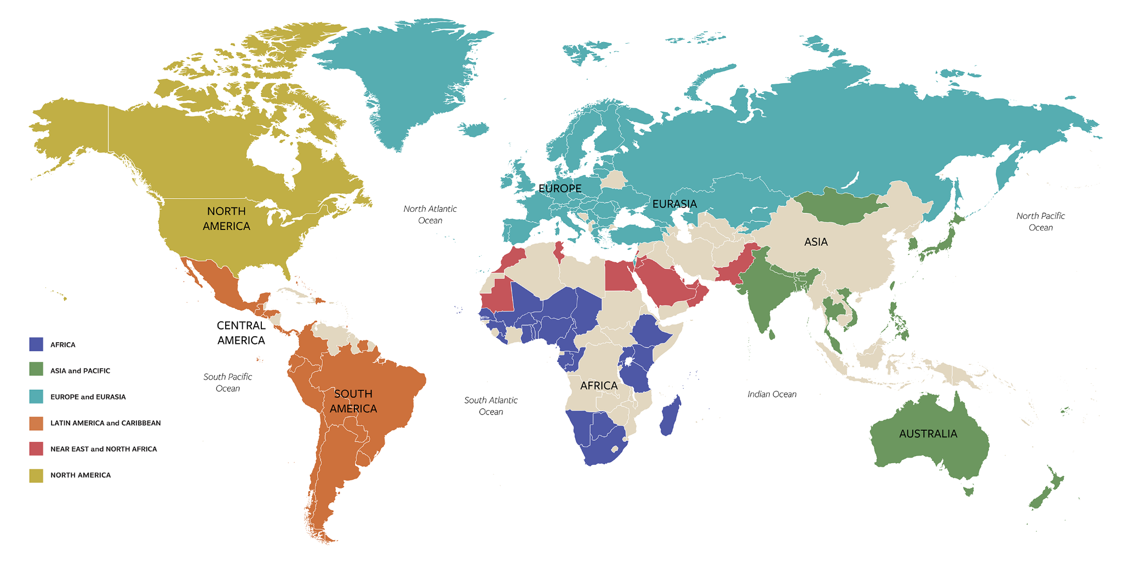
GLOBE-UN Science Summit 2023
On September 20th, GISN members from the GLOBE Community presented about their use of GLOBE data.
On September 21st, GIO Director and one representative from each of the GLOBE six regions
presented on the alignment of their work with the SDGs at the 2022 UN General Assembly Science Summit. Two US partners acted as moderators for the panel. Over 200 participants.
Notes:
Pegi Pavletic
Ramona Mercieca

Slide 5
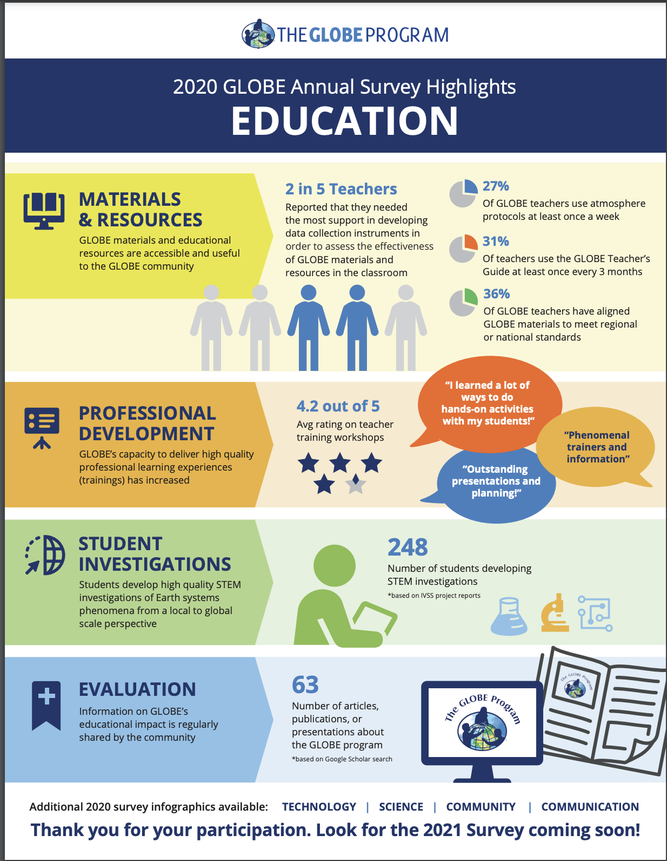
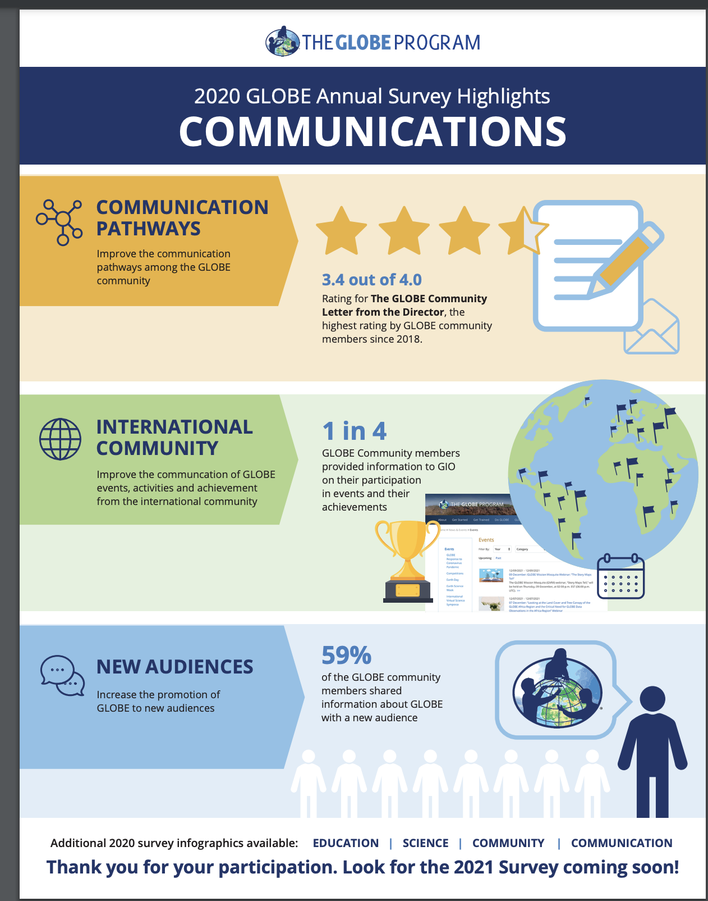

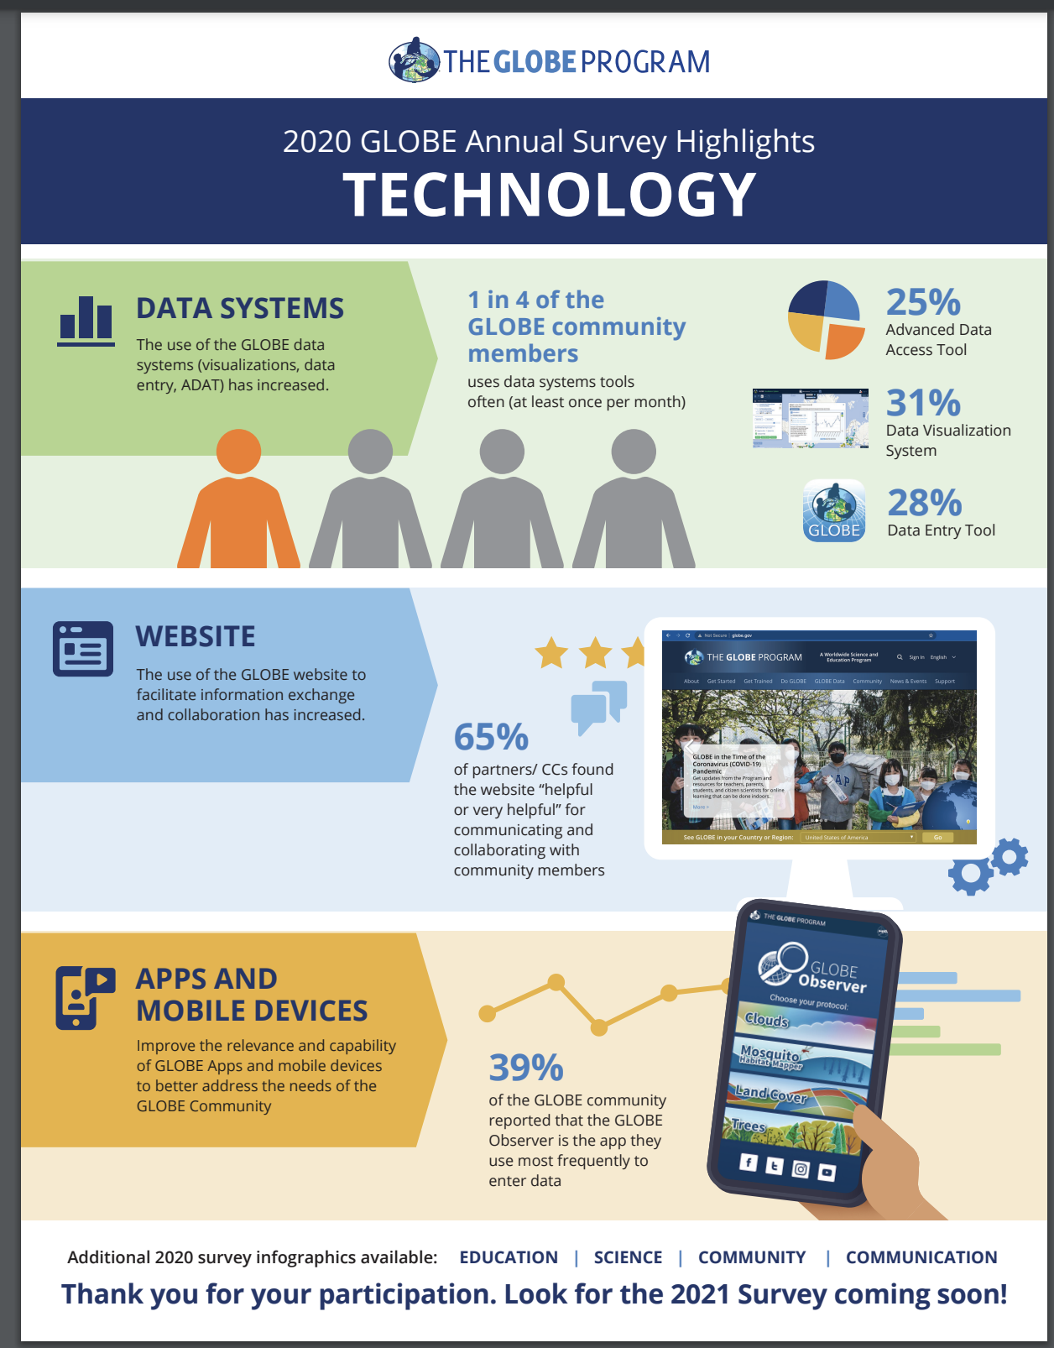
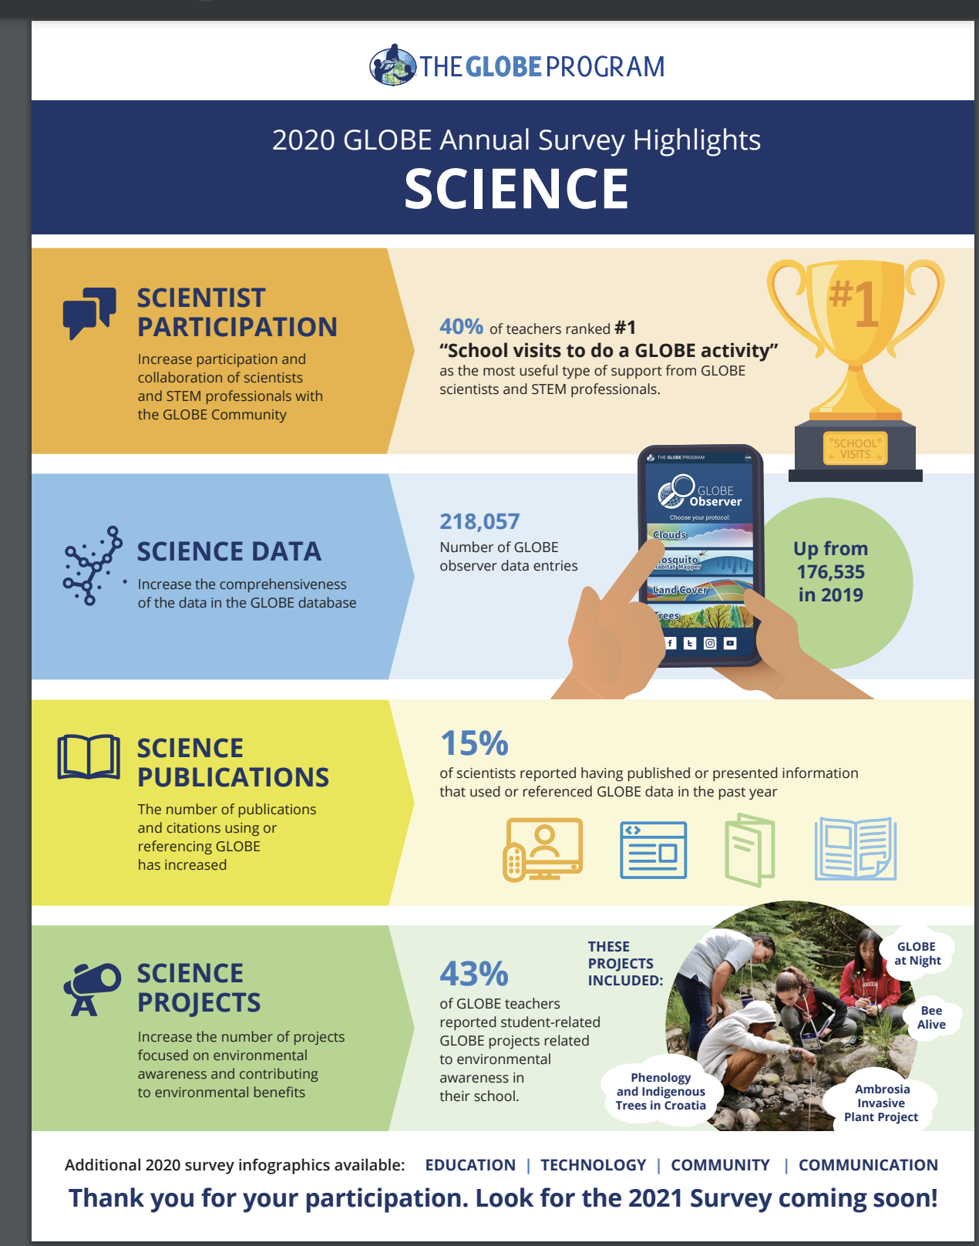
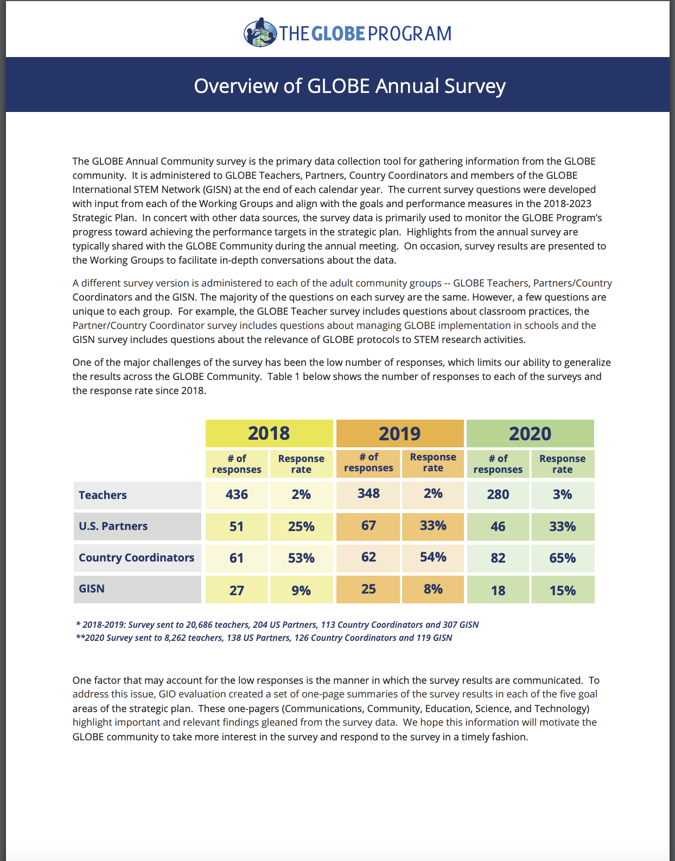
Notes:
Still produce products in multiple languages with the assistance of the RCOs, such as the GLOBE Strategic Plan.
Publish infographics from the annual survey in more useable formats for you.
All available on the website.

Slide 6
Highlights for 2023/24
New learning activity submission process and repository
Increased outreach to the GISN and involvement with the group
Enhancements to and content refresh for the website (DIS and GIO)
All data entry forms in The GLOBE Program’s app, GLOBE Observer
Continuing field campaigns and expeditions in regions
  Year of Climate and Carbon Campaign
  Empatico Feasibility Study
In person GLOBE Annual Meeting.
  To be Held in Fredonia, NY
  Mid-July
Increased Communications about and at regional meetings

Slide 7
A
BIG
BIG
BIG
THANK YOU

Slide 9
GLOBE Implementation Office
For assistance contact
Community Support Team globehelp@ucar.edu
Regional Coordination Office
For assistance contact ee.region.globe@gmail.com

