Slide 1
Website Report – 2018/2019 What’s New and What’s Coming
Cornell Lewis
Science Systems and Application, Inc.

Slide 2
What’s New – Mobile/Data Entry (Since the last Regional Meeting in Vietnam)

Slide 3
GLOBE Observer – New Land Cover App
The Land Cover app enables citizen scientists (GLOBE Observers) to photograph with their smartphones the landscape, identify the kinds of land cover they see (trees, grass, etc.), and then match their observations to satellite data. Users can also share their knowledge of the land and how it has changed.
Land cover maps are helpful for assessing risks from disaster like floods or fires, for defining wildlife habitat, for understanding change, and addressing many other scientific questions.
The app includes fun tutorials on how to photograph and analyze land cover.
Go to https://observer.globe.gov for more info

Slide 4
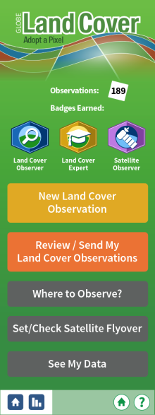
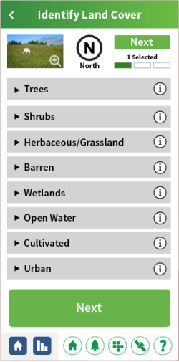
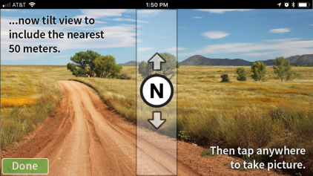

Slide 5
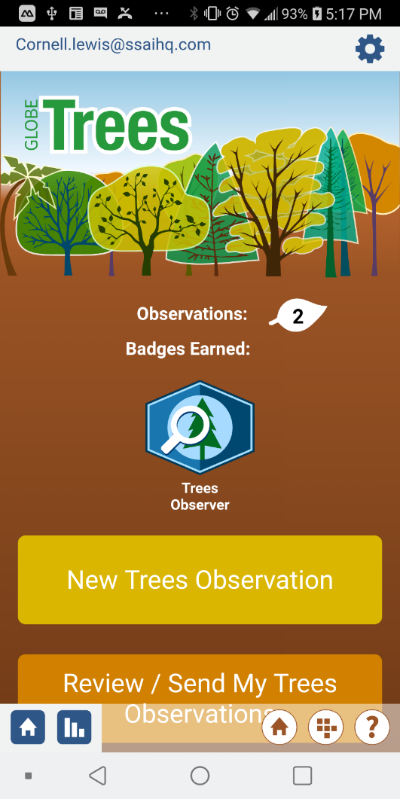
GLOBE Observer App – Tree Height
In collaboration with ICESat-2 mission.
The GLOBE Observer Trees App assists citizen scientists (GLOBE Observers) to catalog tree data, with an emphasis on measuring tree height.
Recording tree height provides 2 major benefits:
It is used to track how trees are changing over time, and can help estimate the amount of trees that make up an area’s biomass - the total mass of organisms in a given area or volume
NASA's ICESat-2 mission is measuring Earth’s height from space. Citizen science tree height observations provide useful validation data for NASA scientists to compare to what the mission is observing

Slide 6
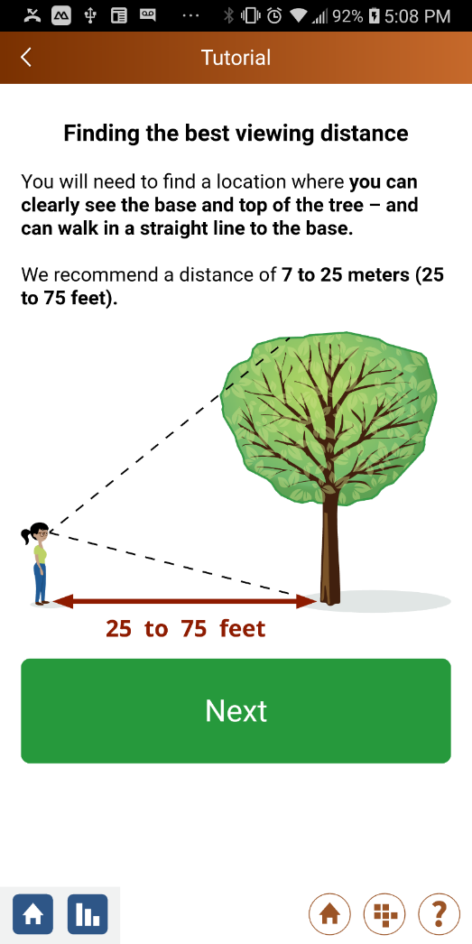
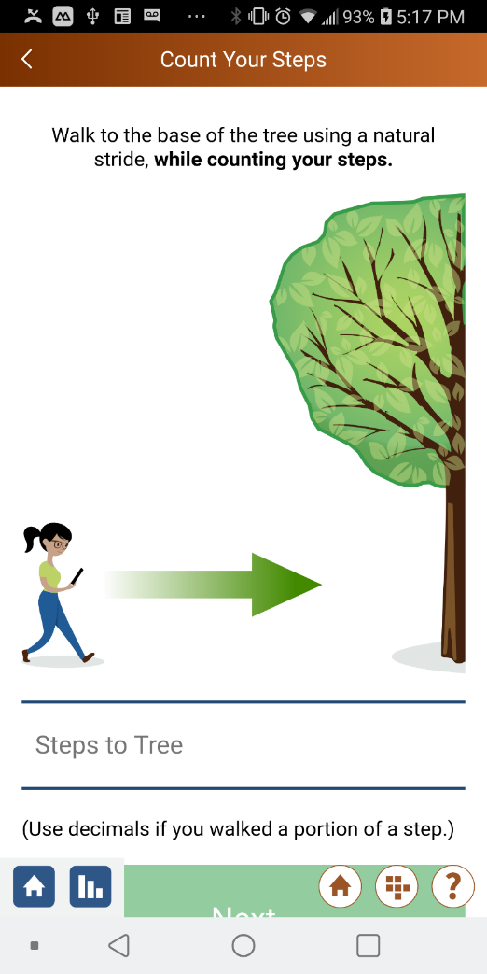
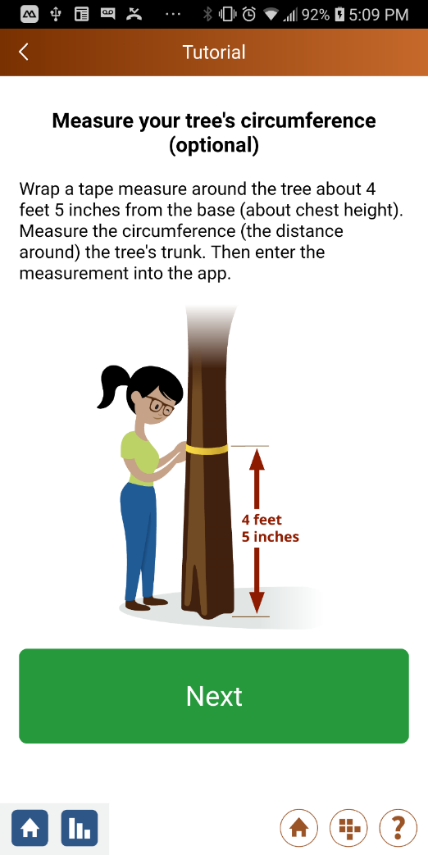
GLOBE Observer – Tree Height

Slide 7
New Tree Height App – YouTube Video

Slide 8
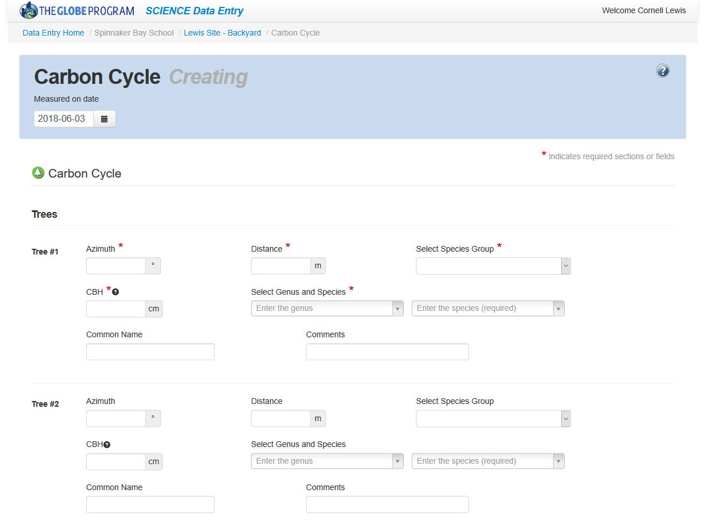
GLOBE Data Entry App – Carbon Cycle Protocol
Added new protocol that allows students/teachers to enter measurement data for each of the 3 types of vegetation selected (tree, shrubs, herbaceous) to calculate the carbon storage

Slide 9
What’s New - Website?

Slide 10
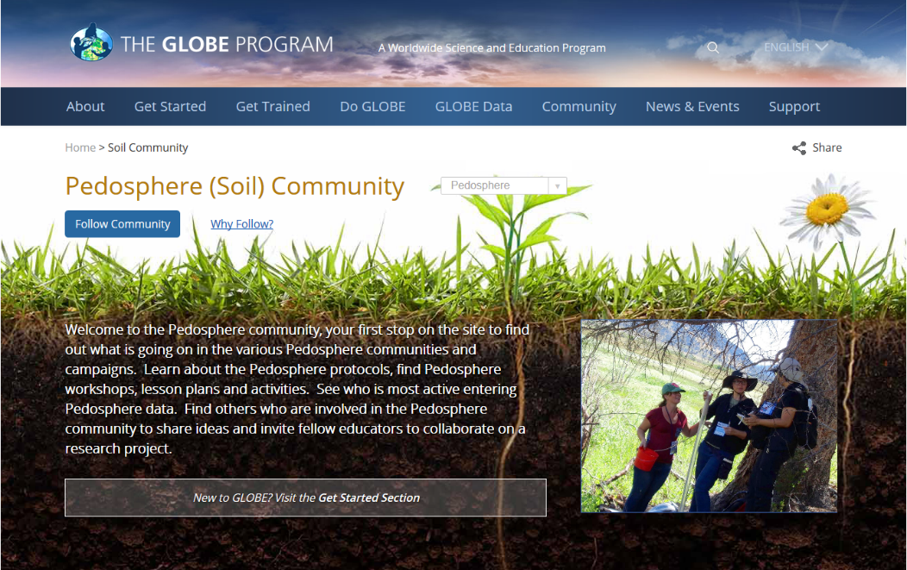
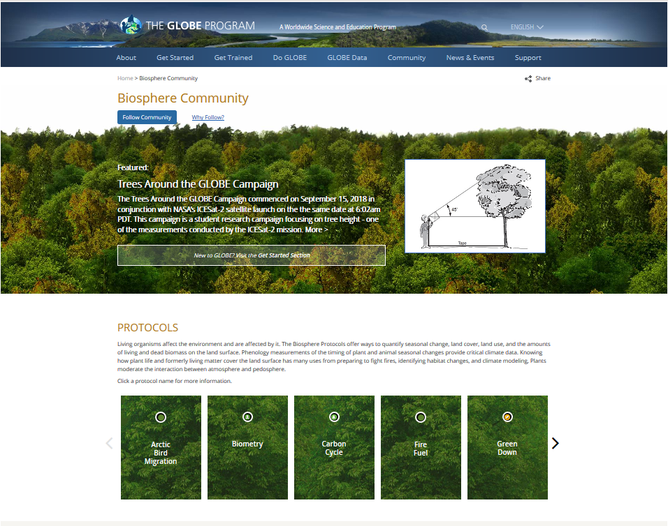
Website Enhancements
New Earth Sphere Communities
Your first stop to see what’s going on in a sphere community (Atmosphere, Biosphere, Hydrosphere, Pedosphere and Earth as a System)
Learn about sphere protocols
Find learning activities (new), lesson plans (coming soon) and other resources
See who’s active and entering sphere data
Find others to share ideas and collaborate on sphere projects
Do GLOBE > By Earth Sphere

Slide 11
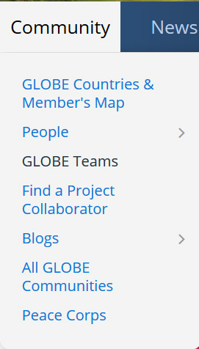
GLOBE Teams
All GLOBE participants can create a GLOBE ‘team’ organization (private or public).
Anyone can join a private team (with a referral code given out by the team manager) or a public team.
Users can associate their data with an organization that consists of friends, family and co-workers.
Each team has a page that shows total members, site locations and total observations by protocol.
The team creator can manage their team using an easy to use interface.
Future phases may include user identifiers like avatars to allow observations to be identified by member.

Slide 12
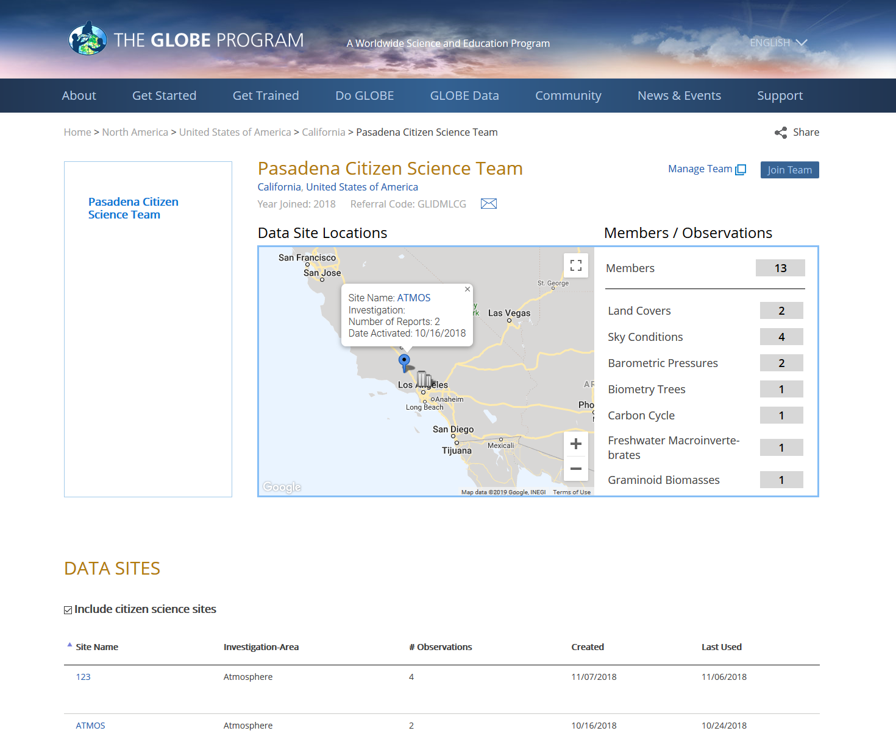
GLOBE Teams

Slide 13
Joining a School with a Referral code
All schools now have a referral code that can be used to join a school.
Referral codes can be entered on the school page or when creating a new account on the GLOBE Observer app.
Students, parents, citizen scientists can associate their data with a school.
If you are a member of the school or the CC, you will see the referral code on the school page
Future phases may include user identifiers like avatars to allow teachers to track student measurements.

Slide 14
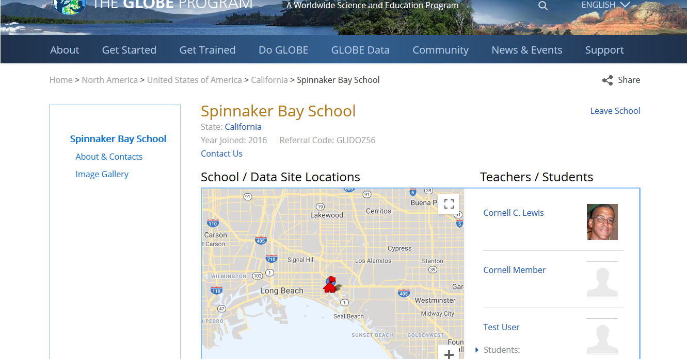
Joining a School with a Referral code

Slide 15
Demos
Earth Spheres
GLOBE Teams

Slide 16
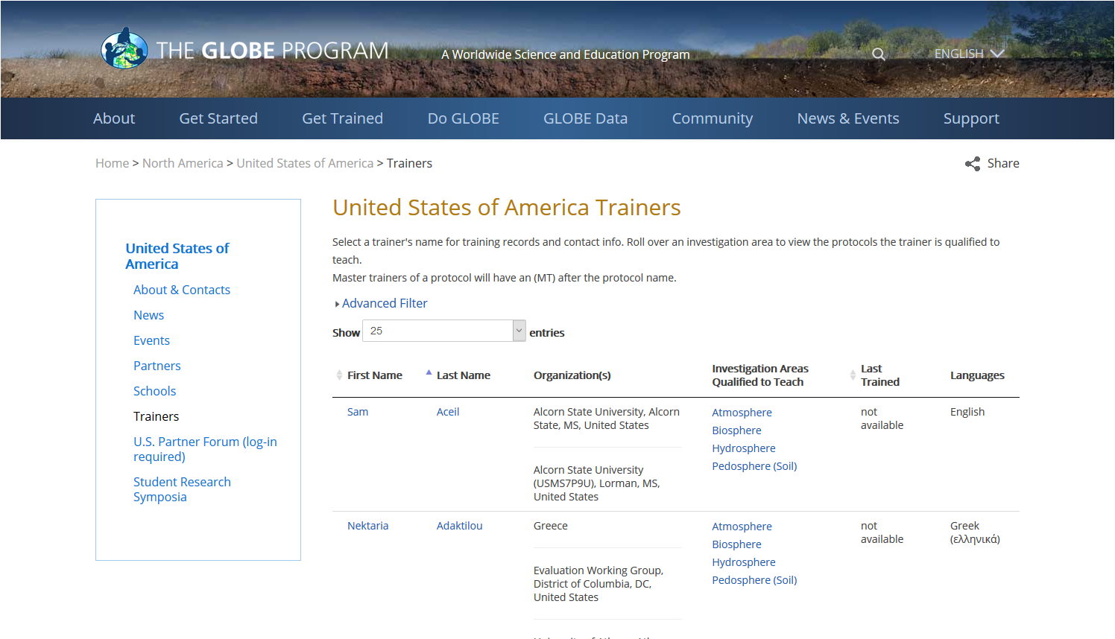
Website Enhancements
Find a trainer in a country – searchable list page with trainer’s name, organization, languages they speak and protocols they are certified to train

Slide 17
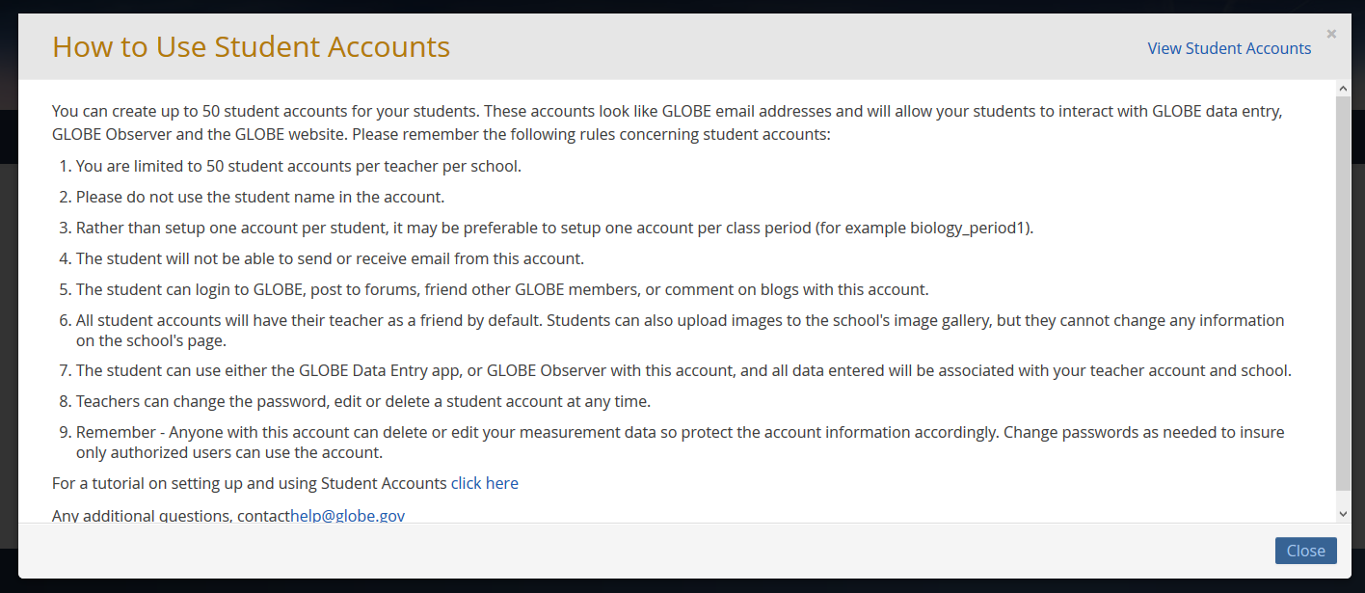
Website Enhancements
Increased the maximum number of student accounts to 50 (per teacher school account) and added help instructions.

Slide 18
Organization Management Tools
Partner Email Notifications
New Account Email Reminders –
Weekly email reminder if there are requested accounts that need approval
Monthly member report with a link to your partner dashboard
Workshop Email Reminders –
Pending workshop reminders
Workshop completion reminders

Slide 19
Partner Email Notifications
Member | Number | Description
Account Requested | 5 | Teachers who have requested to join GLOBE and are waiting for approval.
Account Approved | 15 | Teachers whose account has been approved but have not started the training process.
Pre-Candidate | 5 | New teachers who are registered for an upcoming workshop.
Candidate | 5 | New teachers who are registered for an in-process workshop.
Newly Workshop Trained | 7 | Teacher who have completed training at a workshop in the last 30 days (additional date filter options available).
Newly eTrained | 8 | Teachers who have been eTrained in the last 30 days (additional date filter options available).
GLOBE Members | 75 | Fully trained GLOBE Teachers.
Untrained GLOBE Observers | 20 | GLOBE Observers in your organization who are untrained (i.e. - have not completed eTraining) These are citizen scientists in your country/organization who have registered with the GLOBE Observer app.
Trained GLOBE Observers | 100 | GLOBE Observers in your organization who have been trained through the eTraining system.

Slide 20
New Account Email Notification
Sent every week if there are pending requested accounts
Dear Country Coordinator,
Just a reminder, there are (5) new GLOBE accounts from your country waiting for your approval. These users cannot begin their training until their accounts are approved.
Log in to your dashboard to manage your members.

Slide 21
Workshop Email Notifications
One week after the workshop was created, if pending and then every week up to the workshop date.
Just a reminder that your Hydrology training workshop is scheduled to begin on 5/25/19 but the status is still ‘pending’ and therefore teachers cannot register for the workshop.
Please Log-in to the workshop admin to change the workshop status to active.

Slide 22
Workshop Email Notifications
Sent one week before the workshop begins, if active
Just a reminder that your Hydrology training workshop is scheduled to begin on 5/25/19.
Check list:
Has everyone been approved and registered? Please login and check the workshop’s roster.
Be sure to change everyone’s registration status to ‘in-session’ when the workshop begins so everyone can enter test data.

Slide 23
Workshop Email Notifications
Sent one day after the workshop ends if it’s not marked as closed and the participants are not marked as completed (or no show). Sent weekly for 2 months
Now that the Hydrology training workshop has completed, just a reminder to do the following:
Check list:
Ensure everyone’s registration status has been changed to ‘Complete’. This will give new GLOBE teachers the ability to enter live data on the website and will grant them full site permissions as a regular GLOBE member.
Close the workshop by changing the status on the Manage workshop page.

Slide 24
Website Enhancements - Workshops
Workshop tool is now available in Spanish (other languages can be added if google translate is “good enough”)
Simplified workshop form and interface
Modified system to allow trainers to administer workshops
All trainers were added to a new trainer organization under their GLOBE country to facilitate managing workshops

Slide 25
What’s New – Visualization / ADAT?

Slide 26
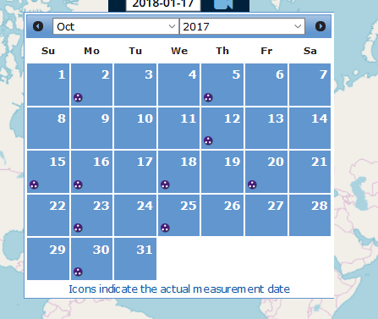
Vis Enhancements
Protocol icons are displayed on the vis calendar to identify the days that have measurements

Slide 27
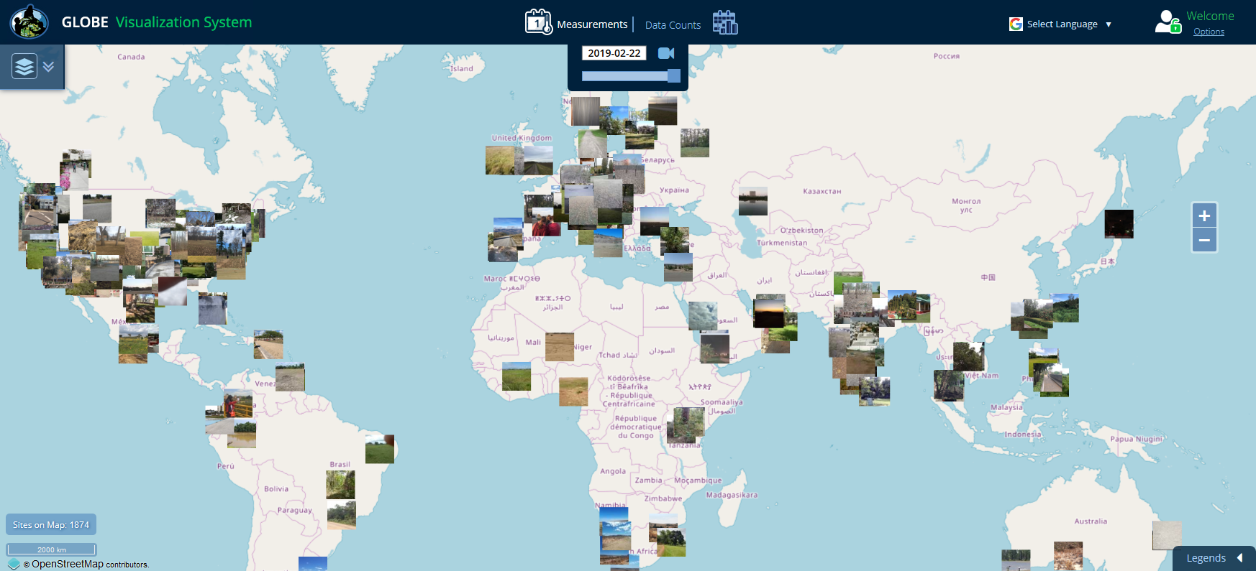
Vis Enhancements
New photo layers for Clouds, Mosquito Habitat Mapper and Land Cover

Slide 28
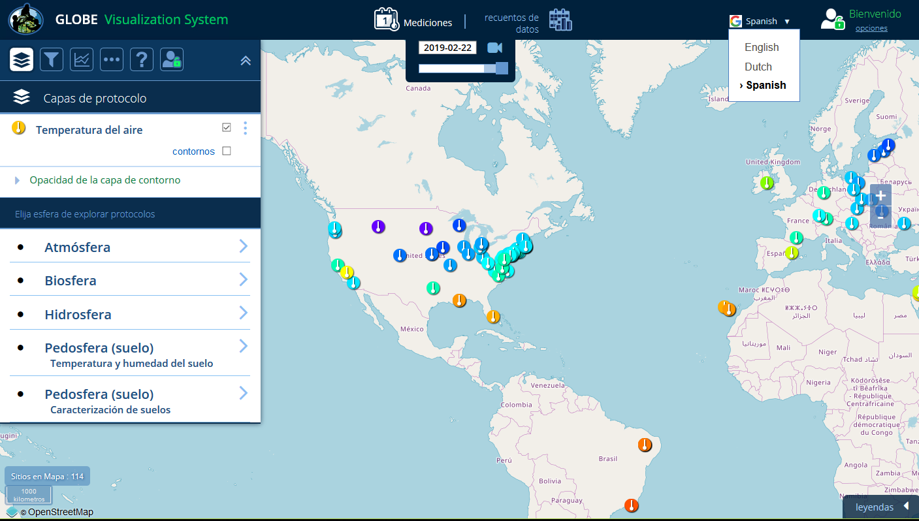
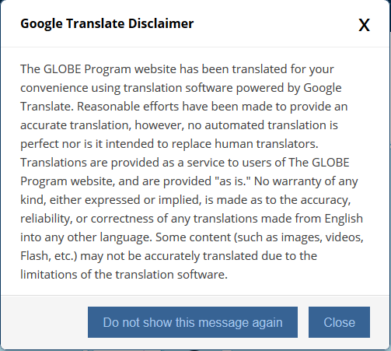
Vis Enhancements – Language Translations
Available in Spanish and Dutch (Others can be added if google translations are “good enough”)

Slide 29
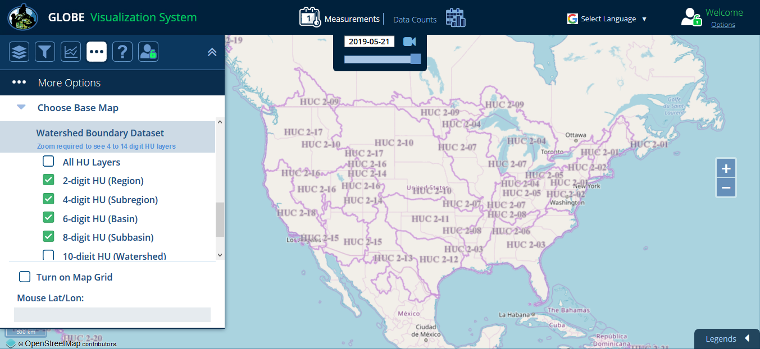
Vis Enhancements – Watershed Boundary Base Map
Only US initially but base layers for other countries can be added

Slide 30
Vis Enhancements
Tree Height and Carbon Cycle protocols added
Visualize all observations under a school or schools
Customizable Y-Axis ranges for multi-site plots
Time intervals for Land Cover data – 1 day, 1 month, 1 yr, 5 yr or All

Slide 31
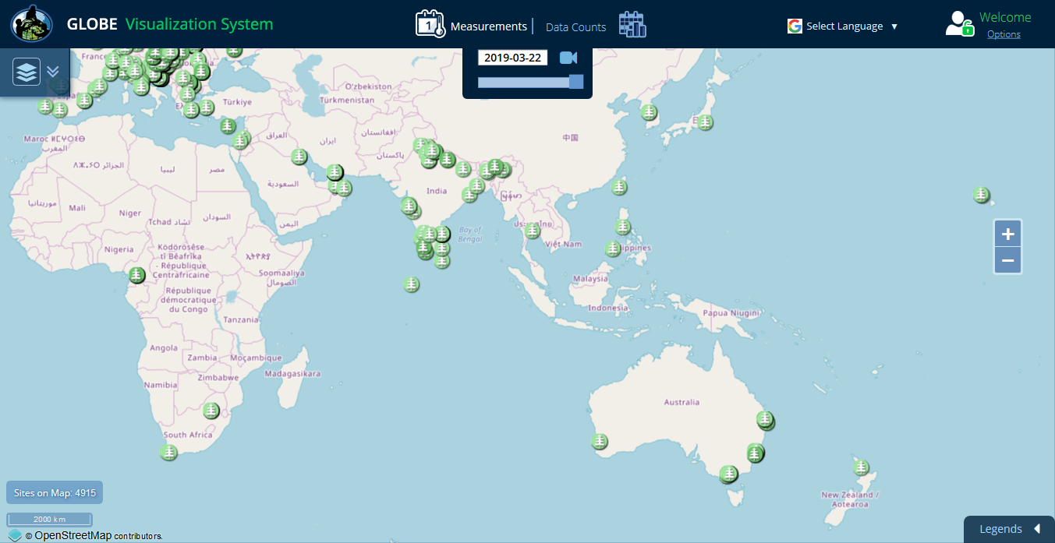
Vis Enhancements – Tree Height observations in your region

Slide 32
ADAT System Enhancements
Filter ADAT using ‘And’ option for protocols (i.e. find all sites with aerosol and air temp)
Added Spanish and Dutch language with Google translate disclaimer (others can be added)
Improved interface for mobile viewing
Added units/descriptions to column headers on export
Re-organized the data export columns
Added Carbon Cycle and Tree Height protocols
Added photo URLs to output files
Significant performance improvements

Slide 33
Future Enhancements

Slide 34
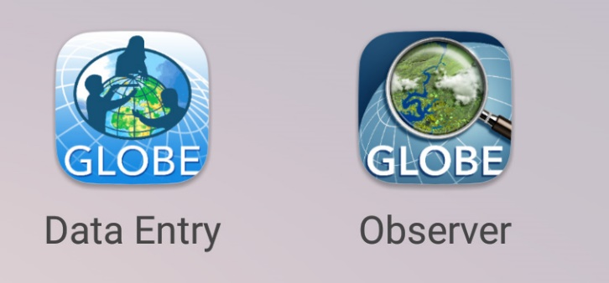
Data Entry – Streamlining and Improving DE
Leverage the lessons of the GLOBE Observer app to further simplify GLOBE Data Entry
Working to merge the two apps (GLOBE Observer/GLOBE Data Entry) into a single app. Same code, similar interface for App and Desktop
Easier to create sites
Easier to enter protocol data
Customize data entry with the protocols you use
All Atmosphere protocols will be done first

Slide 35
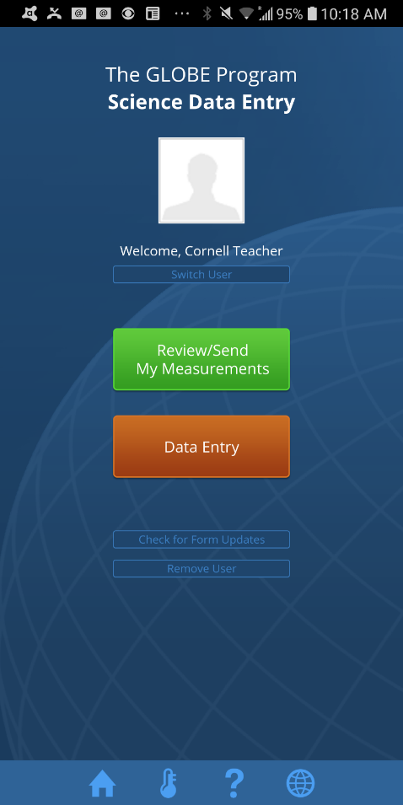
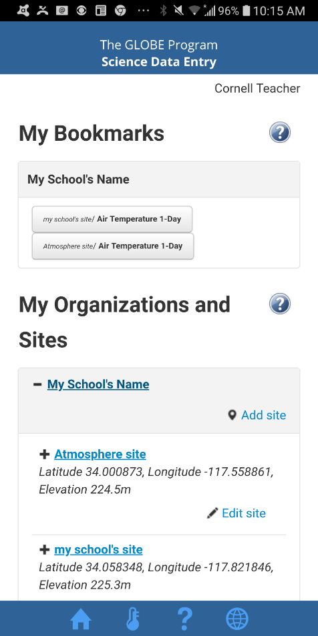
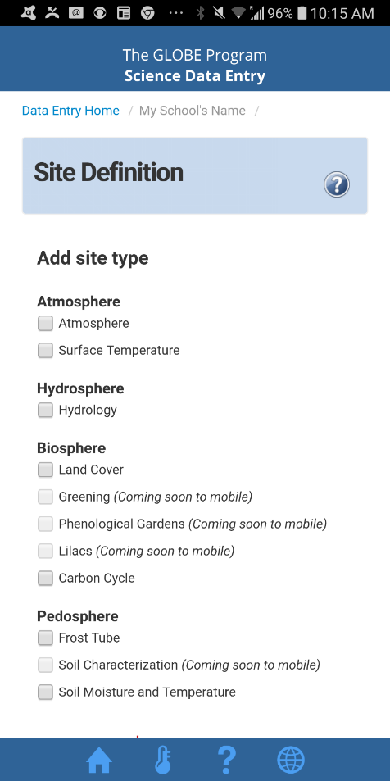
Data Entry – Streamlining and Improving DE
Current Data Entry App

Slide 36
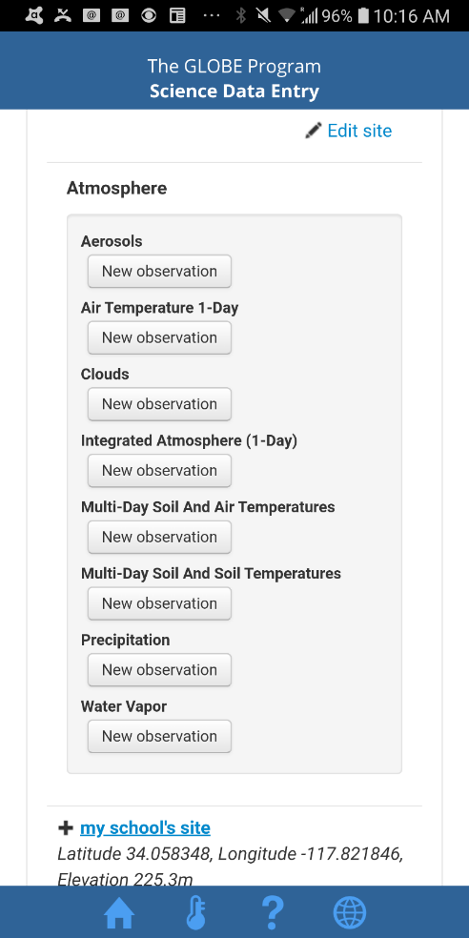
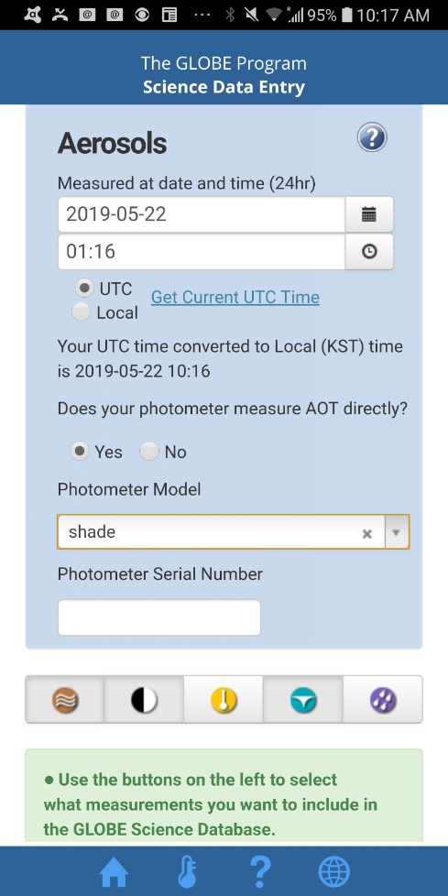
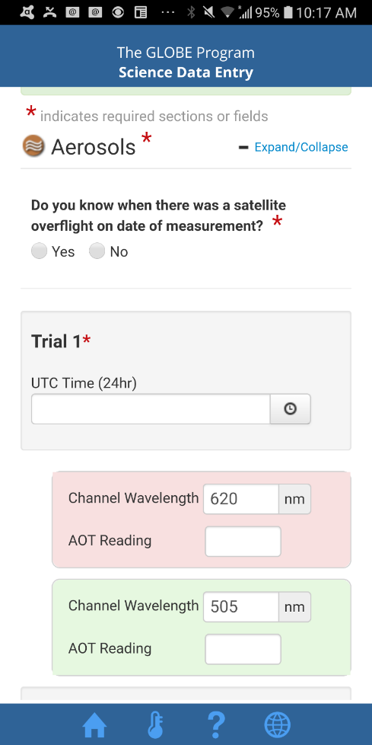
Data Entry – Streamlining and Improving DE
Current Data Entry App

Slide 37
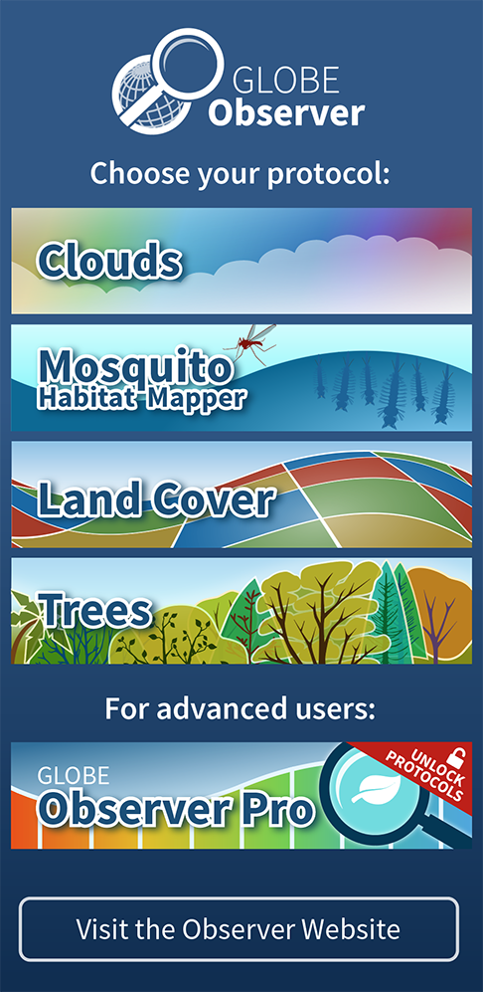
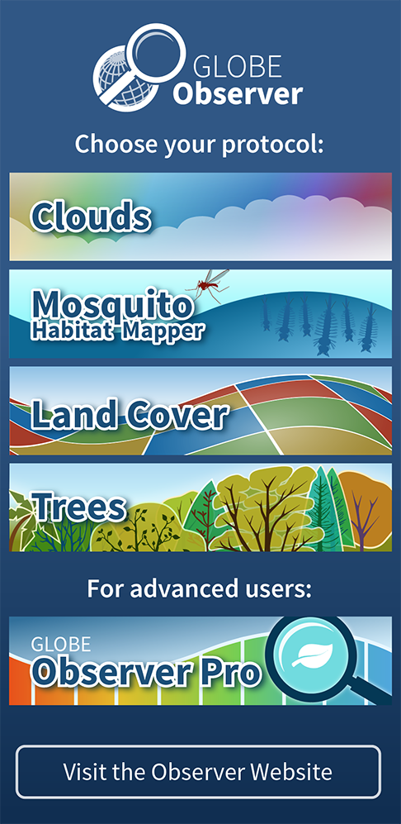
Data Entry – Streamlining and Improving DE
Untrained
Trained

Slide 38
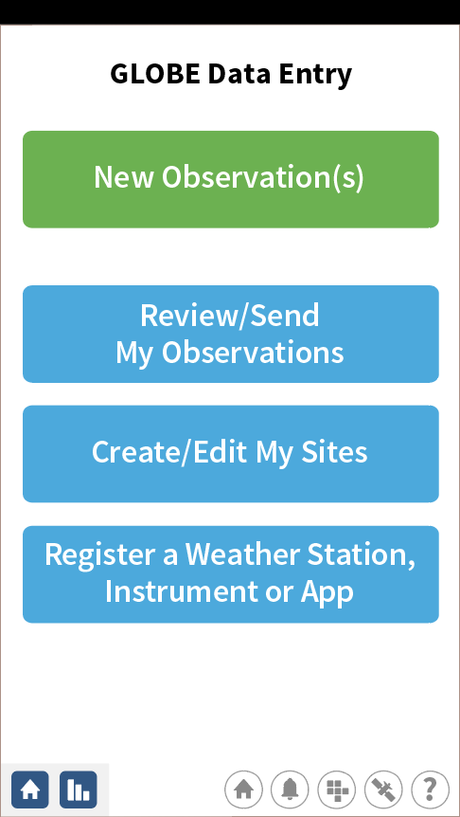
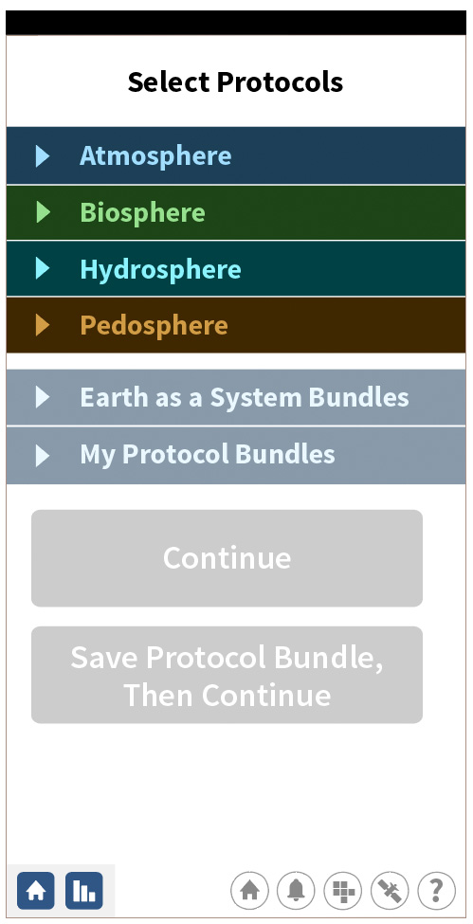
Data Entry – Streamlining and Improving DE

Slide 39
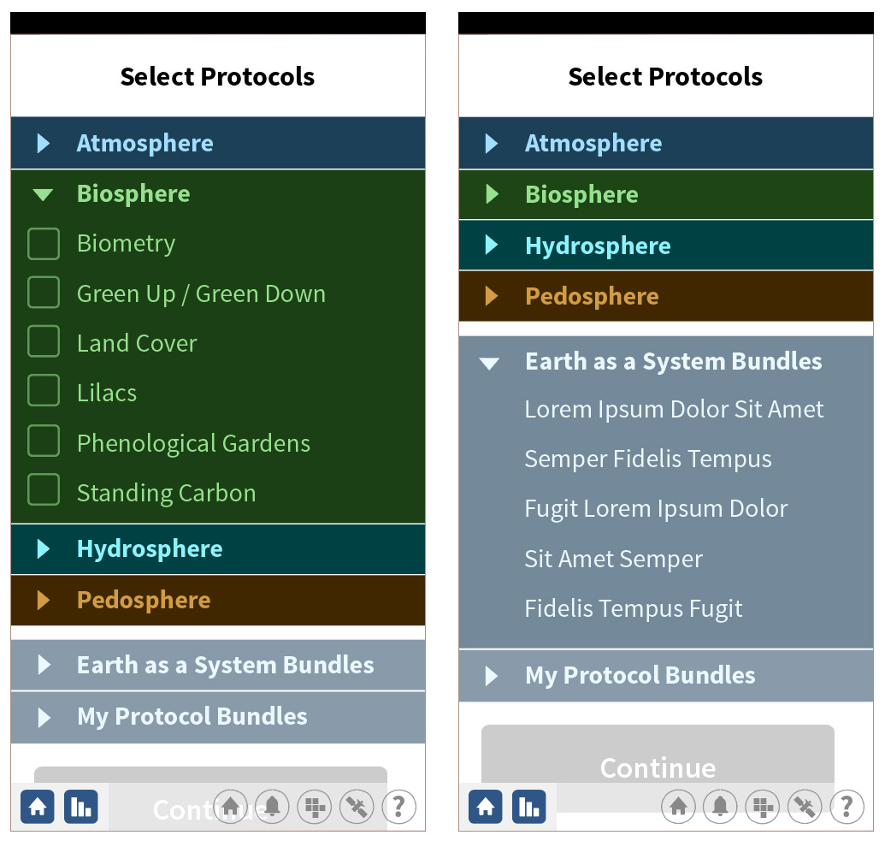
Data Entry – Streamlining and Improving DE

Slide 40
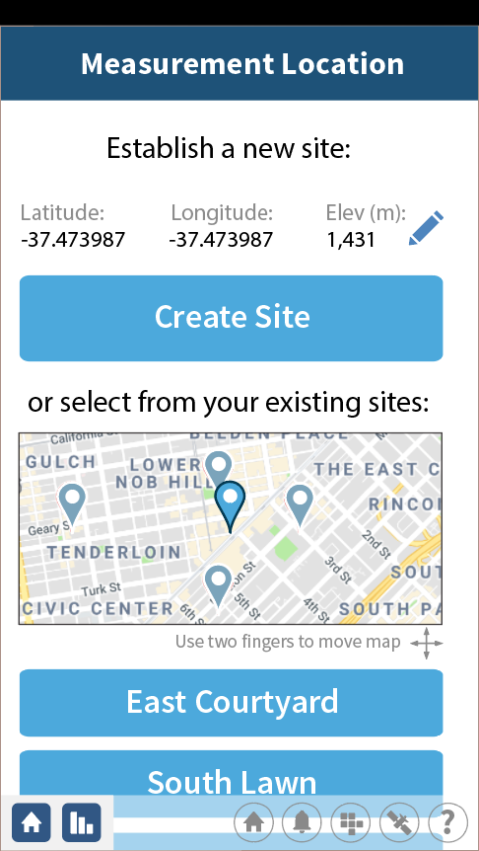
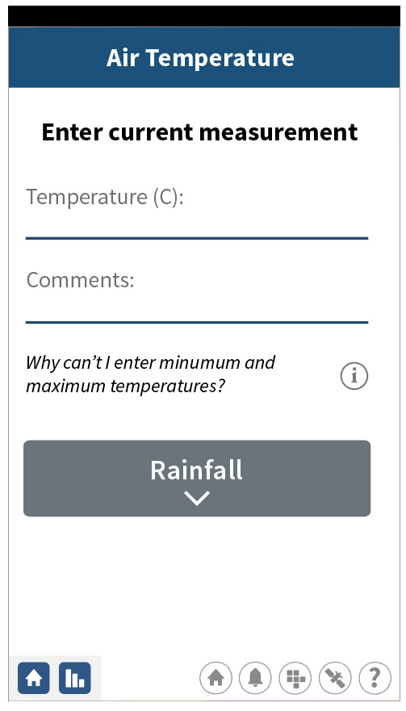
Data Entry – Streamlining and Improving DE

Slide 41
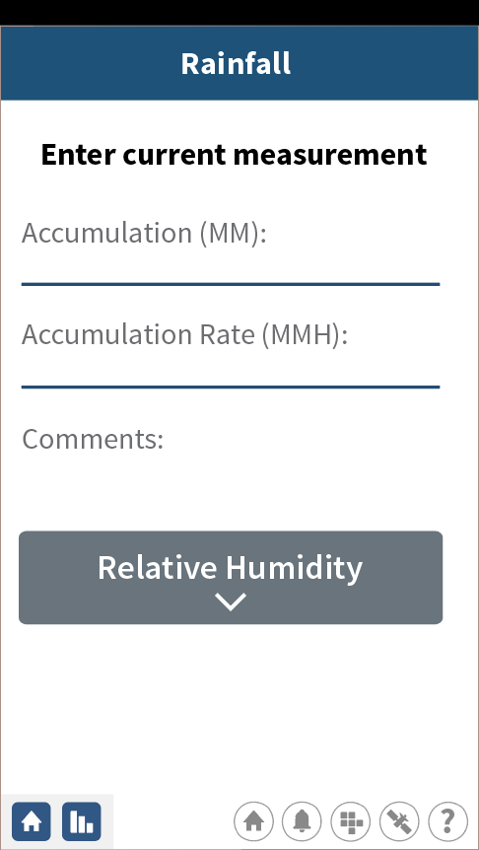
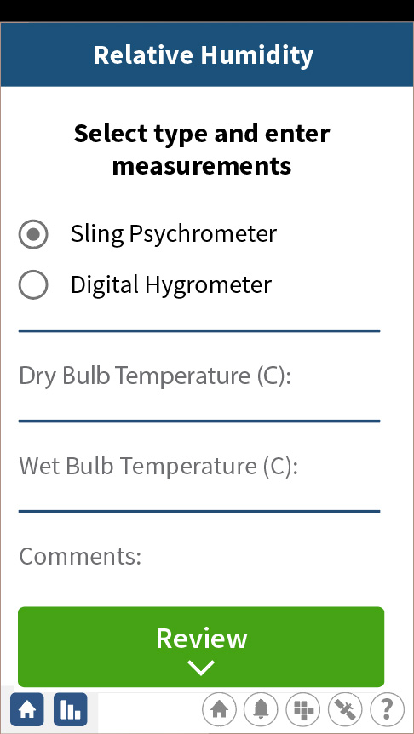
Data Entry – Streamlining and Improving DE

Slide 42
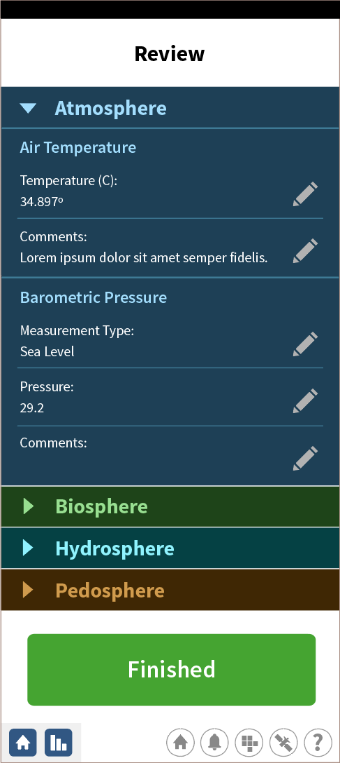
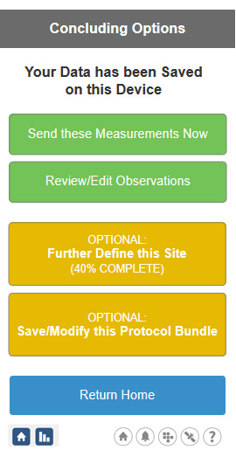
Data Entry – Streamlining and Improving DE

Slide 43
Data Entry – Streamlining and Improving DE

Slide 44
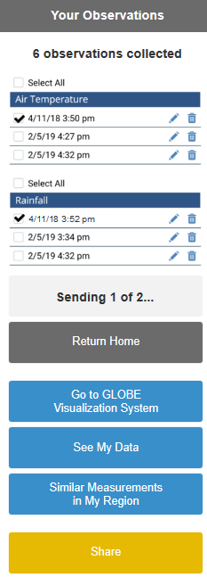
Data Entry – Streamlining and Improving DE

Slide 45
API-Out (Application Programming Interface)
Build an API which allows users to pull data from GLOBE programmatically
Programmatically = something I can call via a program/script/URL
Simple but useful interface
Fast
Provides support for getting data that is similar to ADAT

Slide 46
API-Out Status
Implemented Elasticsearch – fast search engine to support the API
Built an API which is being tested in production now
Live on production – by the end of May
Still in test but available here: https://api.globe.gov/search/swagger-ui.html#/

Slide 47
API-Out

Slide 48
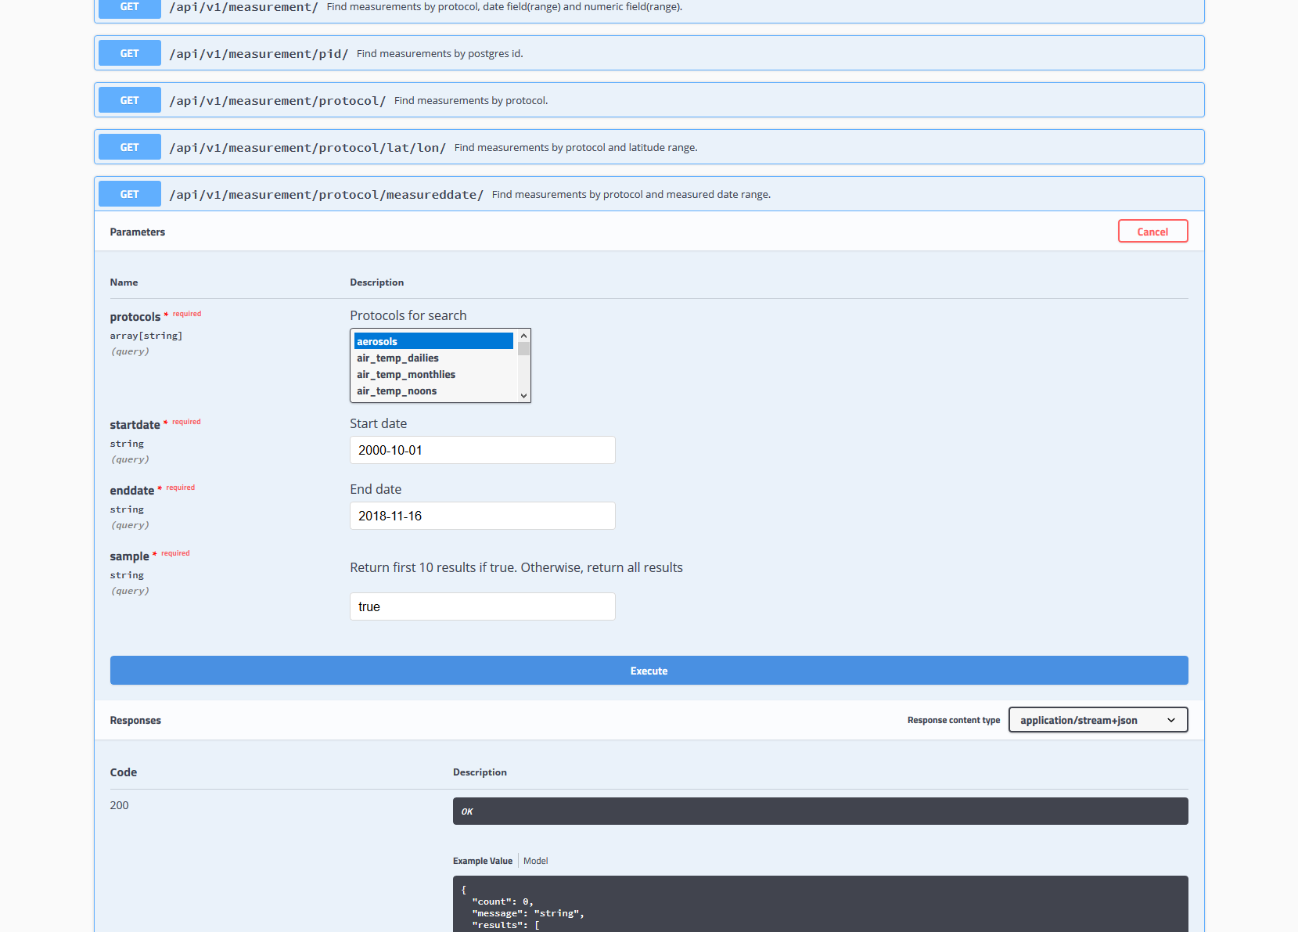
API-Out

Slide 49
API-In
API-In allows others to send data to GLOBE (like email data entry only without the email)
Device manufacturers or others can send data to GLOBE
Protected with a developer key that we provide to the vendor
Also requires the user to register their device with GLOBE
Currently air temperature, humidity, winds, barometric pressure, rainfall, land cover, clouds, mosquitoes are implemented in our dev environment.
Plan to roll out all with the remaining atmosphere protocols with the release of GLOBE Observer app and all atmosphere protocols
Partial documentation here: https://apidev.globe.gov/docs/#introduction

Slide 50
Future Web Enhancements
Simplification of User account types and the approval process.
Language Translations – using Google translate, the entire web site will be translated into other languages. Initially, we will offer the languages found on the Data Entry app (10 languages).
Data Reporting tool – display observations at the protocol level for users (similar to the school reporting tool).

Slide 51
Future Web Enhancements
A new version of the website software (Liferay 7.1) is coming with an improved admin interface and new tools and features.
This is a significant upgrade which will require involvement from all Liferay developers.
No new enhancements will be introduced to the website while the upgrade is taking place (scheduled to be completed in December 2019).
Enhancements/updates will continue on the app, visualization and ADAT systems.

Slide 52
Visualization / ADAT Enhancements
Ability to import Vis layers as overlays into the ArcGIS system
Simplified layer structure for layers with Dailies and Noons.

Slide 53
Support during the regional meeting
I’m here to assist and answer questions. Sometimes 5 minutes can save you a lot of frustration…please ask questions, make suggestions
Available for one-on-one training if something doesn’t seem right, or you need a tip. There’s a sign-up sheet to setup a time for tomorrow.

Slide 54
Questions?
If you’d like to review this presentation, you can find it on the Asia and Pacific web page:
https://www.globe.gov/web/asia-and-pacific/home/documents
Located in the regional meeting folder

