Slide 1




Global Learning and Observations to Benefit the Environment (GLOBE) Activities – India’s Journey
Government of India
Ministry of Environment, Forest & Climate Change
Environment Education Division

Slide 2

Programmes of Ministry
01
National Green Corps ‘Ecoclub’
EEAT
NGC- ‘Ecoclub’
Capacity Building
NNCP
GLOBE
(Target group: Classes VI -XII & College level)
Global Learning Observations to Benefit Environment (GLOBE) programme
Green Good Deeds (GGD) initiative
National Nature Camping Programme
02
(Target group : Classes VI -XII & College level)
03
Capacity Building programme
(Target group : students and teachers)

Slide 3
GLOBE Program
MoEF&CC is the nodal agency for the implementation of GLOBE program.
Signed a MoU with US National Oceanic and Atmospheric Administration, USA (NOAA) in August, 2000.
GLOBE programme converged with Ecoclub program (2018-19).
Program was restructured and revived with all the modalities.
The country position was shared in the meeting of Country Coordinator held in Korea in 2019.

Slide 4
GLOBE – India’s Framework
Identified 1000 Ecoclub schools are registered as GLOBE schools and made active 2019-20 in five regions (North, South, East, West and Central India).
Total six trainings provided in six States (Telangana, Kerala, Gujarat, Odisha, Madhya Pradesh and Rajasthan)
One Globe Train –the –Trainer workshop held in Nov 2019
Hands-on training to teachers on GLOBE protocols (Atmosphere, Biosphere, Hydrology and Pedosphere) in cooperation with RCO officials.
Teachers are involved in providing training to students who are taking observations on above protocols and uploading on the GLOBE website https://www.globe.gov/.
Each State has been allocated funds to conduct GLOBE activities.

Slide 5






Partners in GLOBE- State Nodal Agencies
Centre for Environmental Studies
Rajasthan State Bharat Scouts and Guides
Environmental Planning and Coordination Organisation
Kerala State Council for Science and Technology
Gujarat Ecological Education and Research Foundation
Telangana National Green Corps

Slide 6
GLOBE Implementation
Country Coordinator Meeting in Korea
May 2019
Six States identified
July 2019
GLOBE program orientation
August 2019
Each State identified 150 GLOBE schools
September 2019
Trainings provided on four protocols to 1000 teachers
Sept – Nov 2019
GLOBE Train- the-Trainer workshop
Nov 2019

Slide 7
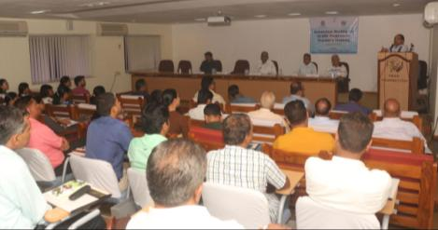
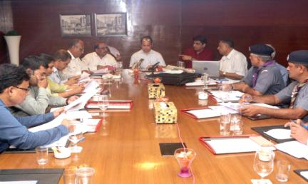
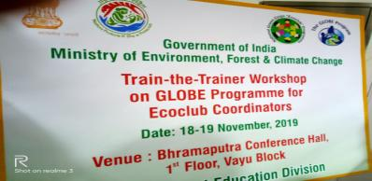
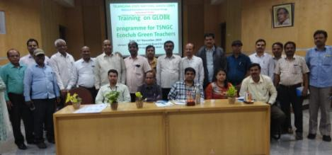
Glimpses of GLOBE training programme

Slide 8
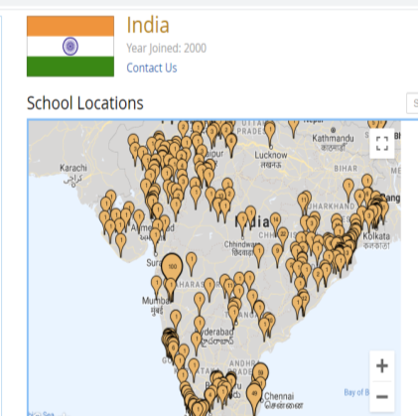
Observations and Reporting
1000 Schools (registered in the year 2019)
1000 Fully Trained GLOBE Teachers
60 Masters Trainers
40,000 students trained
Data Reporting Activity
Year 2019 – Large number of schools have started collecting data on protocols and 54 schools have uploaded 13639 observations so far.

Slide 9
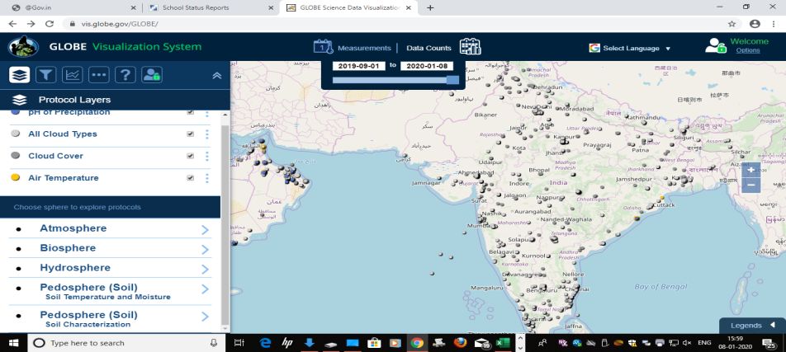
Atmosphere protocol observations
Total observations : 7889

Slide 10
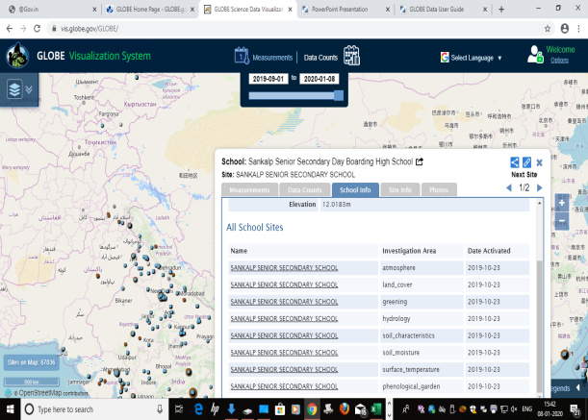
Appreciation from GLOBE
Sankalp Sr. Secondary School, Odisha received an appreciation from NASA GLOBE Cloud Team for exact reporting of cloud observations under the Atmosphere protocol.

Slide 11
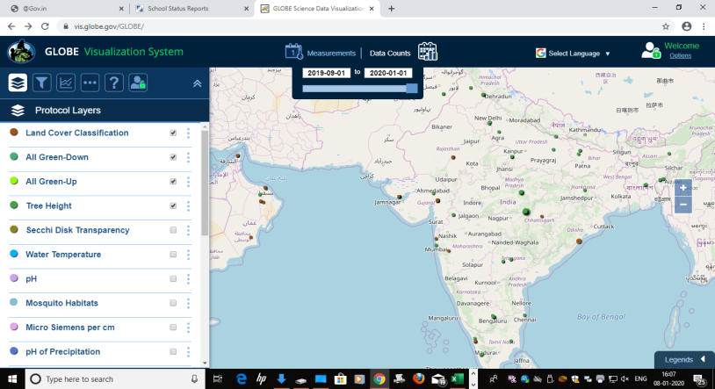
Biosphere protocol observations 5179

Slide 12

Hydrology observations data 341

Slide 13
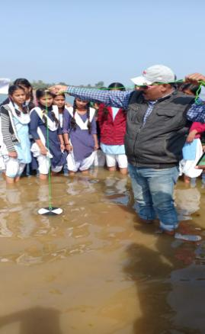
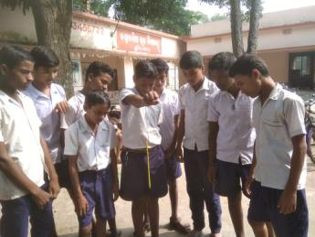
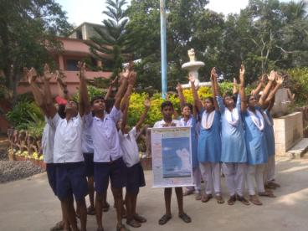
Students recording observations

Slide 14
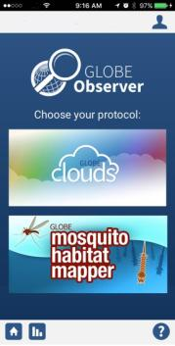

Zika Education and Prevention Project-India’s position
As part of GLOBE activity, India participated in ZIKA Education and Prevention project.
A total of six Country Mosquito trainings (CMTs) have been organised in four States namely Delhi, Gujarat, Haryana and Madhya Pradesh (110 teachers participated)
Consolidated report of the trainings was submitted to GIO.
LMT has been in demand and more and more teachers are planned to be trained by the Ministry.

Slide 15
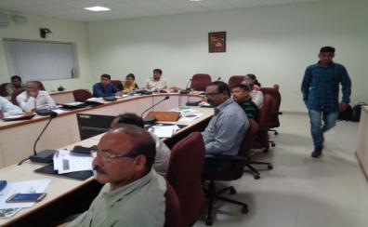
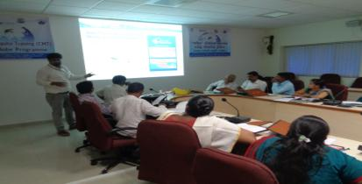
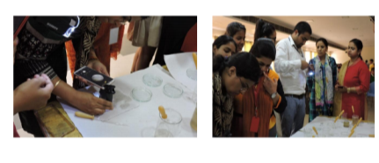
Glimpses of Zika training

Slide 16
Way Forward
Expansion of GLOBE schools (from 6 States to 15 States)
From 1000 schools to 2500 Schools.
Enhancing reporting of data including new protocols
Under Zika Project, India intend to organise 4 to 6 trainings in year 2020
Faculty and student exchange programme.

Slide 17
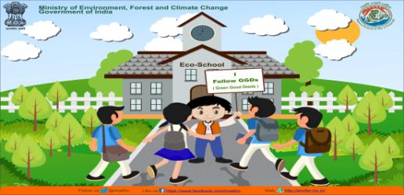
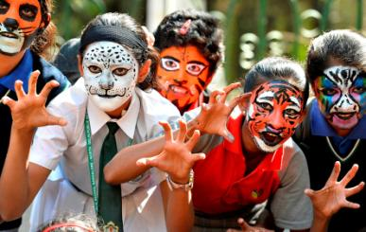
THANK YOU

