Slide 1

I would like to begin by acknowledging the Traditional Owners of the land that we’re meeting on today, and pay my respect to their Elders past, present and emerging
Notes:
Here in Adelaide the Kaurna people are the traditional custodians of the Adelaide Plains.

Slide 2
Commonwealth Scientific and Industrial Research Organisation
Notes:
CSIRO been around for just over 100 years. Employed by CSIRO past 10 years in a variety of roles.

Slide 3
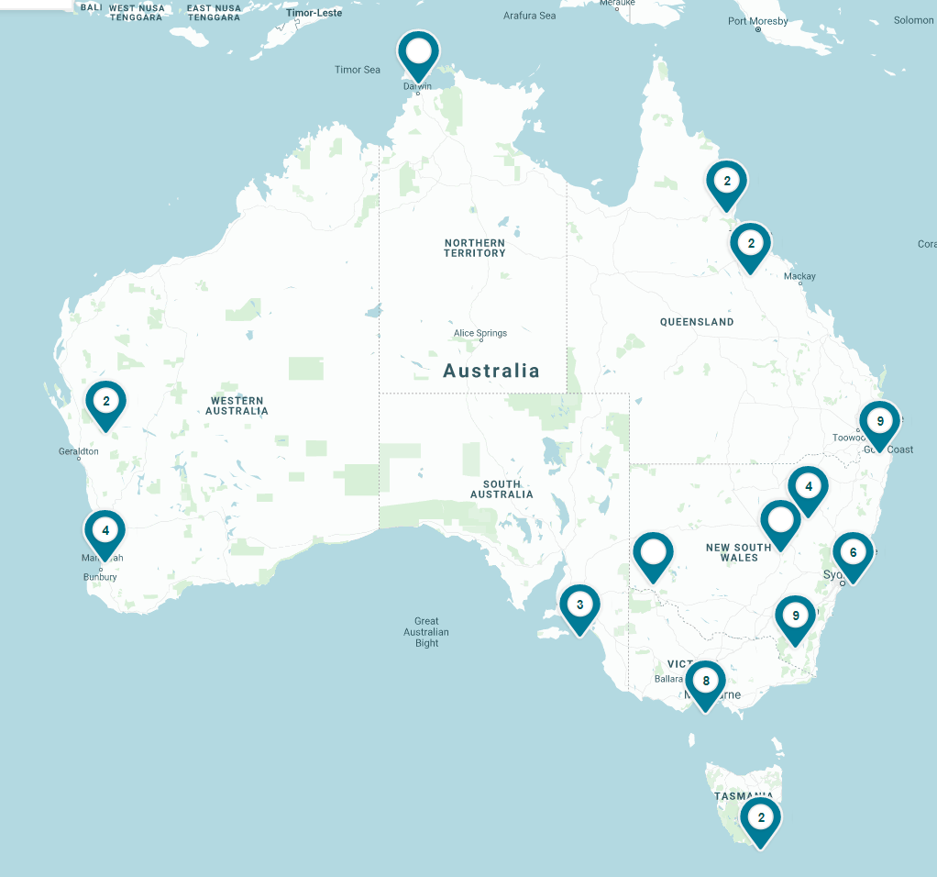
5,500 dedicated people
Across the world including Australia,
Singapore, Vietnam, US and Chile
$4.5B+ a year
Value delivered to the Australian economy through our science and technology
57 sites
One of the world’s largest multidisciplinary
science and technology organisations
Notes:
CSIRO is spread around the country as well as overseas interests. My location - Adelaide, South Australia.

Slide 4
Key areas of research
Animals
Environmental Impact
Health and Medical
Indigenous Science
Natural Disasters
Natural Environment
Plants
Production
Technology and Space
Our research and development
We are one of the largest and most diverse scientific research organisations in the world.
Our research focuses on providing solutions in nine core areas.
Notes:
Research areas are varied. Some research in response to immediate issues – Covid 19 etc.
Some research in response to future issues and challenges.

Slide 5

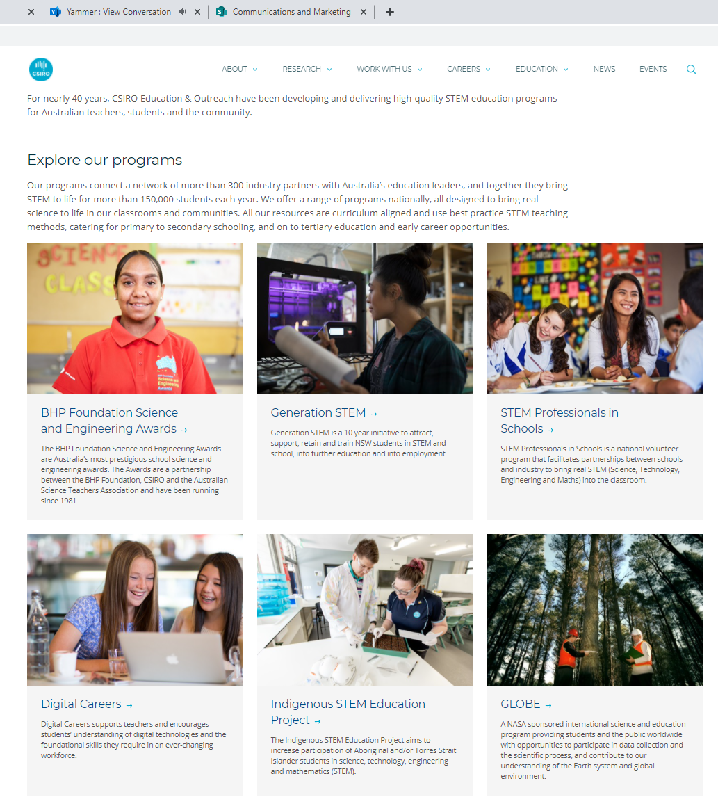
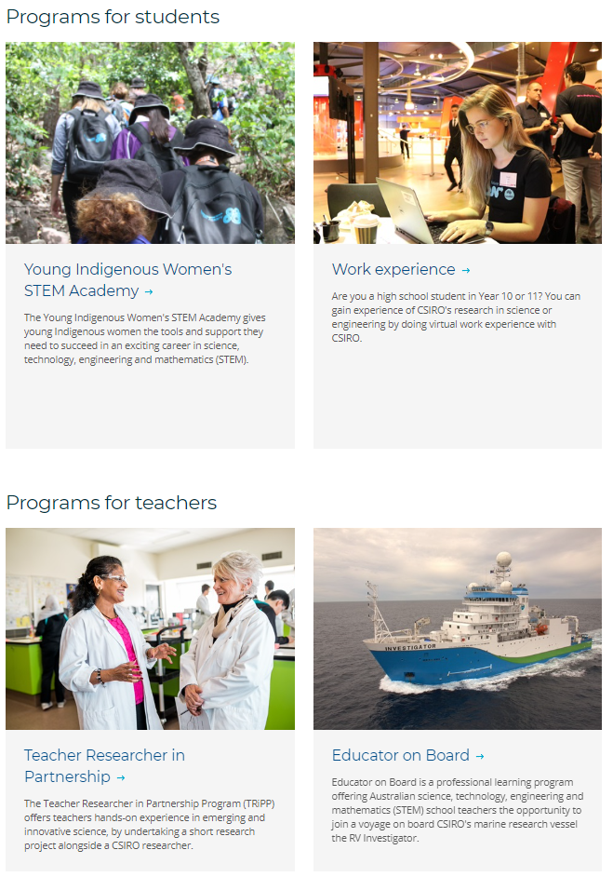
Notes:
Around 15 education programs some student focused some teacher focused

Slide 6
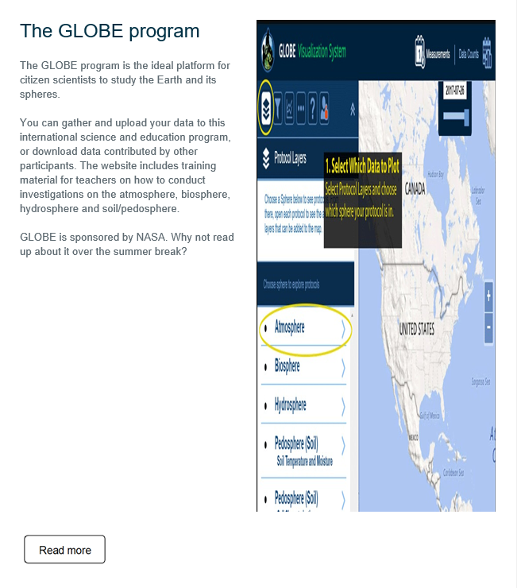
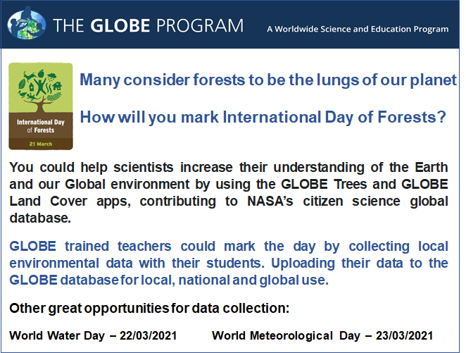
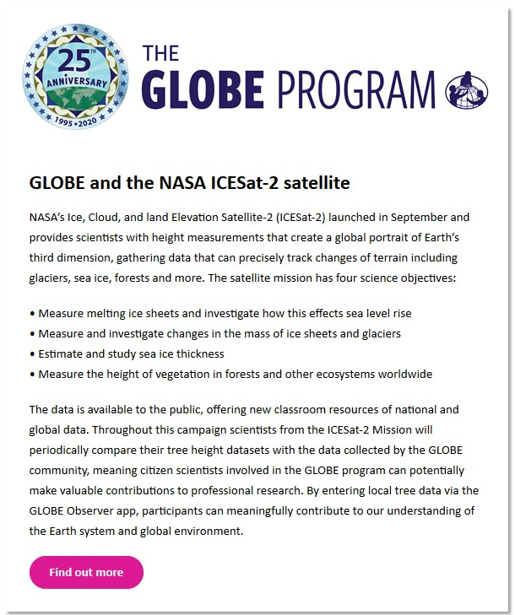
1
2
3
Notes:
Throughout the year GLOBE has been advertised via a number of media:
#1 Information and graphic used by Geoscience Australia for GLOBE Webinar, one of GeoSciAus’ public seminars, #2 Insert for CEdO school term newsletter (sent to CEdO subscribers), #3 ICESat-2 info emailed to CEdO subscribers

Slide 7
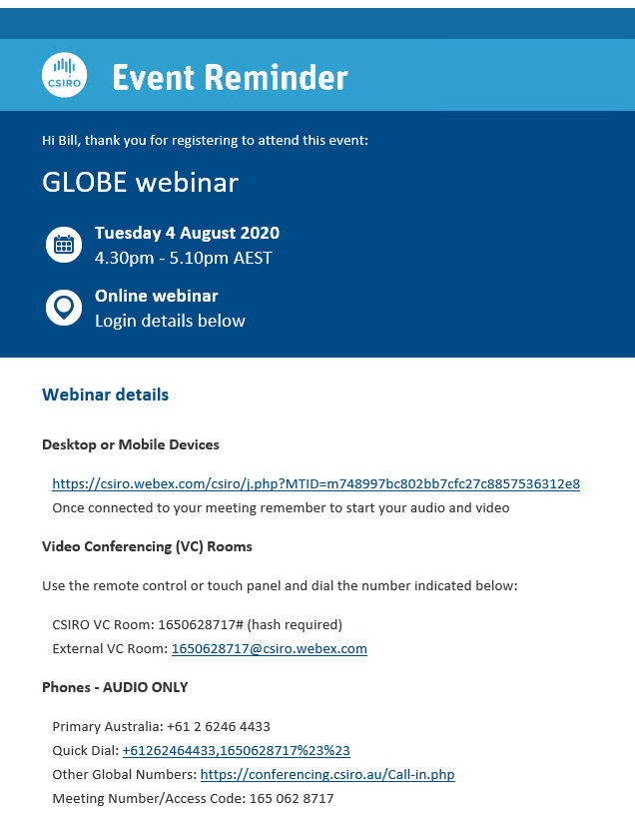
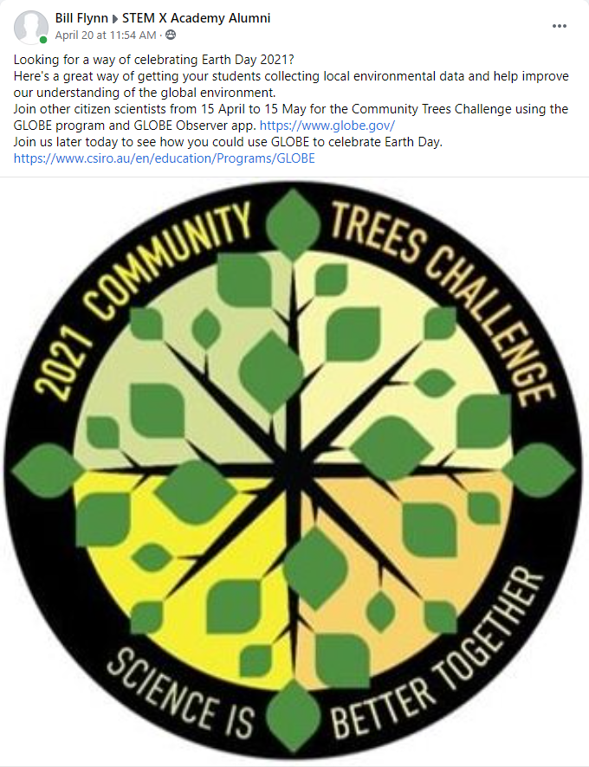

5
4
6
Notes:
#4 facebook post in STEM X alumni (400 members of group, majority teachers) #5 GLOBE Webinar login reminder, #6 GLOBE program Webinar invitation (emailed to CEdO subscribers)

Slide 8
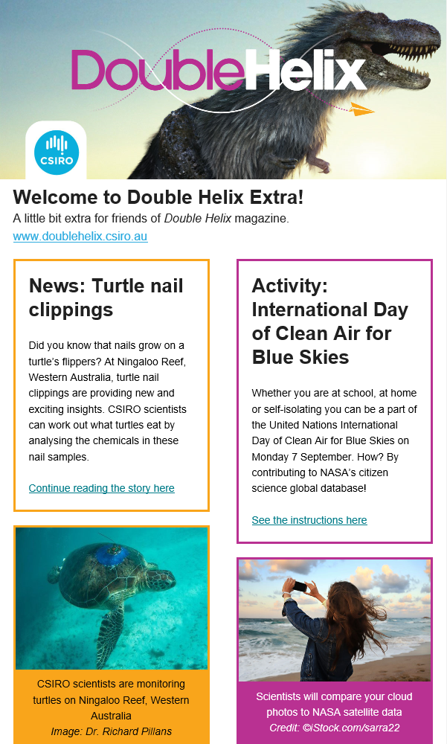
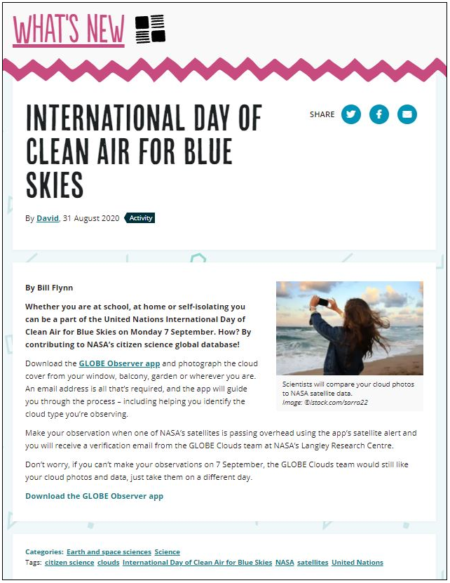
7
8
Notes:
#7 DH Extra, #8 DH Blog

Slide 9
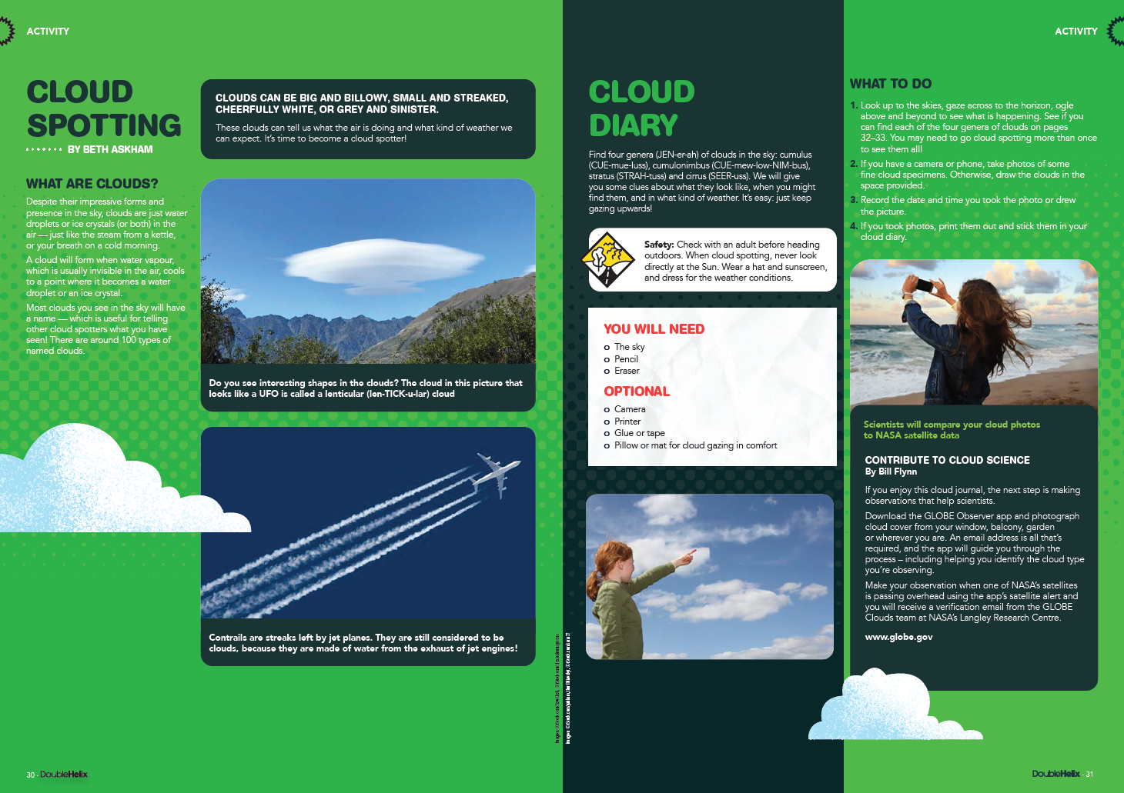
Notes:
GLOBE Observer featured in hard copy Double Helix Magazine

Slide 10



7 webinars from 1 June 2020 to 30 April 2021
164 attendees in total
1 face to face conference session 1 June 2020 to 30 April 2021
16 attendees in session
Notes:
Direct engagement!

Slide 11
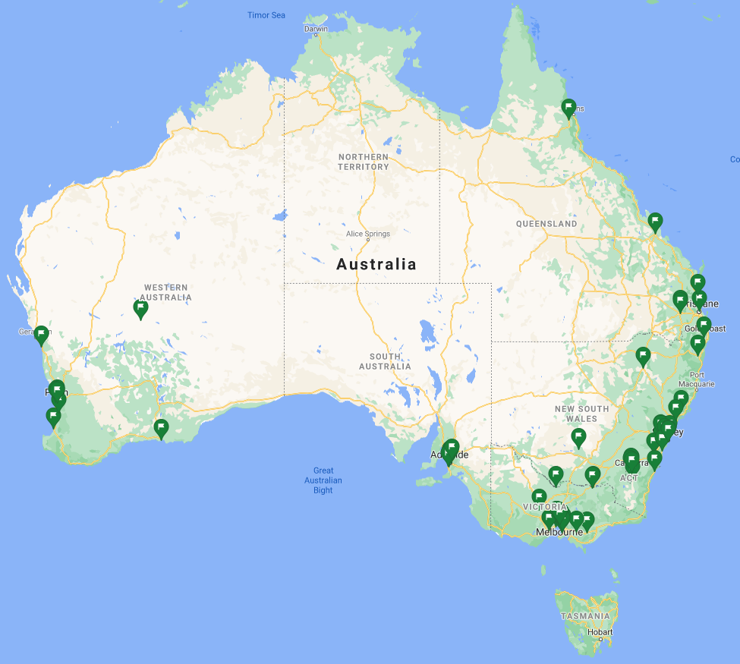
114 Teacher/Educator approved accounts
48 GLOBE Members
Including 4 eTrained,
1 June 2020-30 April 2021
2480 Untrained GLOBE Observers
Teacher/Educator
approved accounts
Notes:
GLOBE Australia current stats.

Slide 12
Notes:
Mapping GLOBE protocols to Australian Curriculum

Slide 13
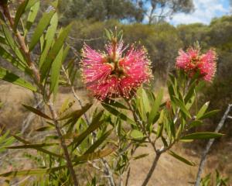
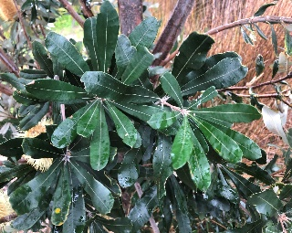
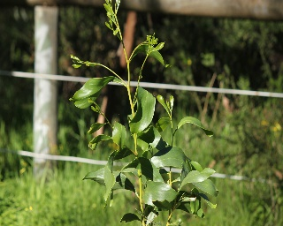
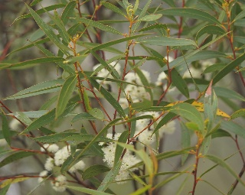
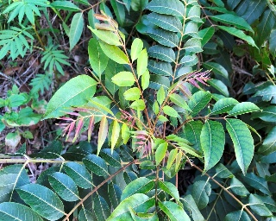
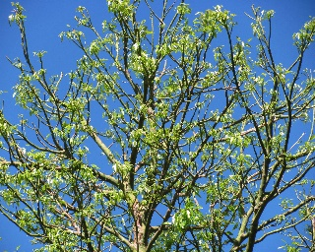
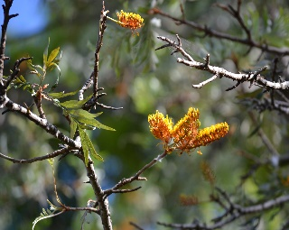
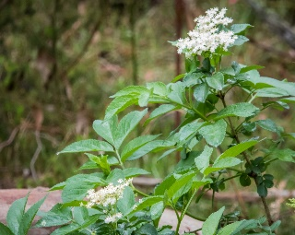
Green Up/Green Down
Purpose
To observe plant green-up and report data that will be used by scientists to validate satellite estimates of the beginning of the plant growing season
Callistemon
Banksia
Acacia
Eucalyptus
Image: David Sando
Image: Gunther
Image: Geoffrey Cox
Image: Reiner Richter
Red Cedar
Illawarra Fire tree
Grevillea
White Elderberry
Image: Martin Bennett
Image: ClimateWatch
Image: ClimateWatch
Image: vagabondvoyager
Notes:
Identifying Australian native/introduced flora and fauna for use in GLOBE protocol/activity
Look at growing seasons and possible impacts of climate change etc…
How does Green Up/Green Down vary across GLOBE sites?
This option is likely to be daily/alternate days over a few weeks in spring/autumn

Slide 14
Priorities 2020/2021:
Recruit schools to GLOBE
Complete curriculum map
Develop data collection kits
Deliver more teacher PL
Present GLOBE at conferences!
CSIRO/ASA/NASA GLOBE Project timeline | Jul-20 | Aug-20 | Sep-20 | Oct-20 | Nov-20 | Dec-20 | Jan-21 | Feb-21 | Mar-21 | Apr-21 | May-21 | Jun-21
GLOBE training/conference | 12-16/7/20 GLOBE Annual Conference |  |  |  |  |  |  |  |  |  | GLOBE Asia Pacific Country Coordinators Mtg (Taiwan) May 3-7
Teacher PL:
Online info sessions |  | 4/08/2020 |  | 27/10/2020 |  | 3/12/2020 |  | 24/02/2021 |  | 28/04/2021 |  | 9/06/2021
F2F workshops/conferences |  |  |  | Australian Citizen Sci Conference 8&9/10-Postponed until mid 2021
 |  |  | 29/9-2/10 AAEE Conference, WA-Now cancelled |  |  |  |  |  |  |  |  | Australian Citizen Sci Conference Date not yet confirmed-mid 21!
Miscellaneous |  |  | 7/9 International Day of Clean Air for Blue Skies - 29/9 International Day of Awareness of Food Loss and Waste | 16/10 World Food Day - 20/10 World Statistics Day |  | 5/12 World Soil Day |  | 11/2 International Day of Women and Girls in Science | 3/3 World Wildlife Day - 14/3 International Day of Mathematics - 21/3 International Day of Forests - 22/3 World Water Day - 23/3 World Meteorological Day | 22/4 International Mother Earth Day |  | 5/6 World Environment Day - 8/6 World Oceans Day
 |  |  |  |  |  |  |  | International Open Data Day. Date TBC
Advertising & Communications | Term 3 newsletter NOTE deadline for entry 1.6.20 |  |  | Term 4 newsletter NOTE deadline for entry 1.9.20
Investigate synergies
IDEAS:
Australian Citizen Science Day hosted by libraries. Contact the Australian Citizen Science Association to float the idea.
International Open data Day - short snippets by O&A/Data 61 scientists to celebrate open data Day
Can we get someone from NASA!?
Notes:
Timeline for GLOBE activities

Slide 15
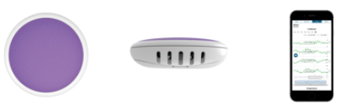
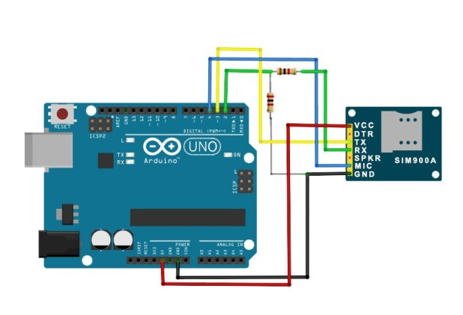

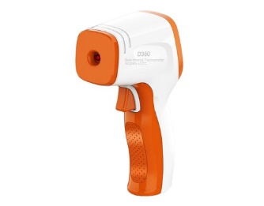

Collecting data
‘Stand-alone’ sensors
Microcontrollers
Manual collection
Notes:
Supporting teachers increase environmental awareness through data collection.
Variety of options for collecting data!
Microcontroller such as Arduino, Raspberry pi, Micro:bit using a range of sensors depending on protocol/s selected. Microcontroller set up as a data logger with data accessible through Bluetooth or onboard SD card recorder.
Stand alone sensors with data accessible through Bluetooth.
GLOBE have a good number of protocols where data can be collected using basic equipment or none at all such as cloud observations

Slide 16
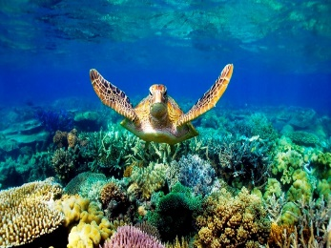
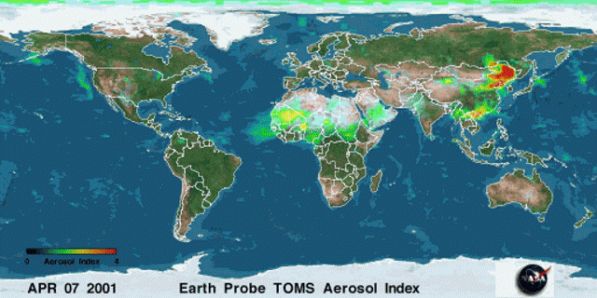
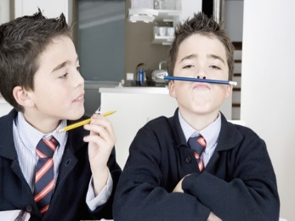
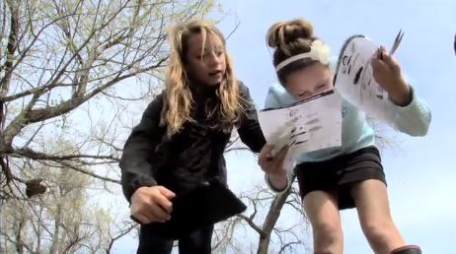
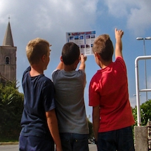
Why do GLOBE?
Advance environmental awareness
Contribute to scientific understanding of the Earth
Help students reach higher levels of achievement in science and mathematics
Experiential hands-on learning
‘Real world’ data collection for use in science research
Notes:
Advance environmental awareness – students are contributing to and accessing global environmental data, sparking curiosity about the things we see around us everyday.
Contribute to scientific understanding – Professional scientists are able to access the data collected by students from around the world to help in their research.
Help Students achieve – GLOBE is very cross-curricula and provides a comprehensive range and variety of activities and opportunities to engage students.
Hands-on – from the very basic identifying cloud type to building, programming and using your own wifi enabled weather station.
Real world data collection – Professional scientists are able to access the data collected by students around the world.

Slide 17
Thank you
GLOBE is sponsored by the US National Aeronautics and Space Administration (NASA) and is delivered in Australia through a partnership between the Commonwealth Scientific and Industrial Research Organisation (CSIRO) and the Australian Space Agency.
Education and Outreach
  Bill Flynn
  Education Specialist
    +61 08 8305 0635
    william.flynn@csiro.au

