Slide 1

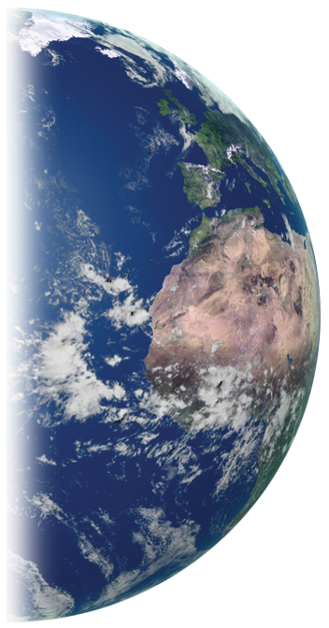
THE GLOBE PROGRAM
The GLOBE Program
Asia and Pacific Region Meeting
May 3-4, 2021
Taiwan
Dr. Tony P Murphy
GIO Director

Slide 2
THE GLOBE PROGRAM
WELCOME!!
To the COUNTRIES REPRESENTED
A BIG THANK YOU FOR
ALL YOU DO FOR
GLOBE!!
SPONSORS
Notes:
15 COUNTRIES REPRESENTED from 18 in Region

Slide 3
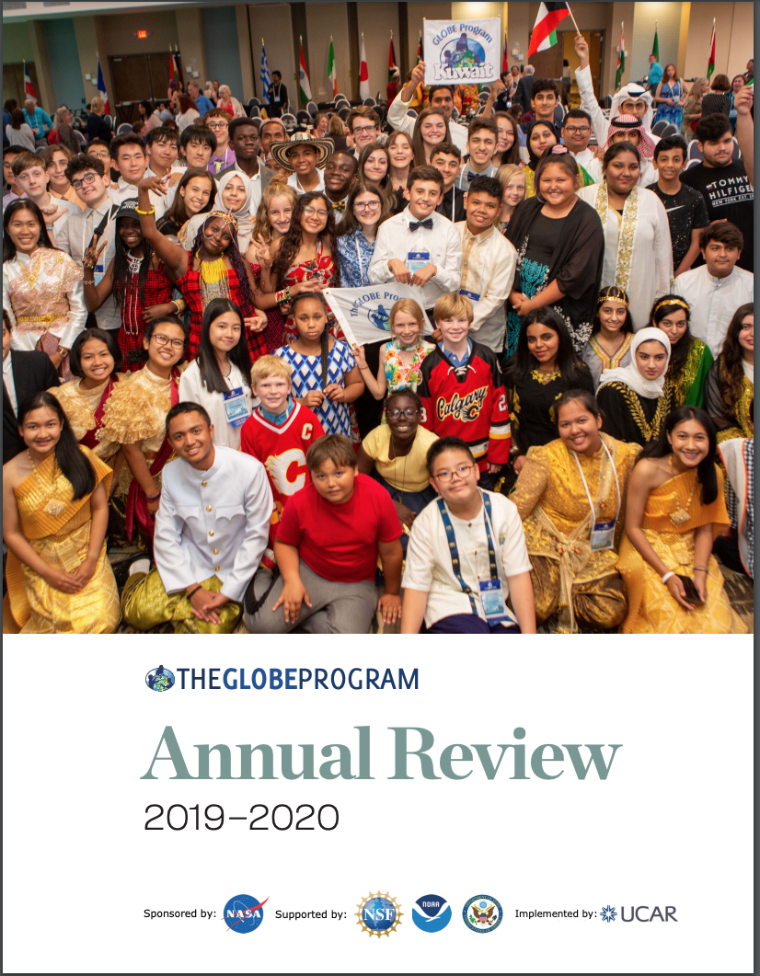
Annual Review
THE GLOBE PROGRAM
Despite the pandemic the community has grown stronger and tighter because of the support from the RCO and GIO
GIO purchased an additional ZOOM Channel to facilitate connections between the RCOs and their CCs.
Each RCO has a different schedule and content for the ZOOM calls, generally on a monthly basis.
These have proven very successful in making and maintaining connections, used as a professional development vehicle and for updates on the program and the region.

Slide 4
Annual Review
THE GLOBE PROGRAM
Using the website to disseminate resources to the community through special pages on the pandemic
General GLOBE Page
https://www.globe.gov/news-events/globe-events/coronavirus-pandemic
Asia and Pacific Page
https://www.globe.gov/web/asia-and-pacific/home/how-to-globe-under-covid-19
Thank you for staying engaged in the program in this tough time

Slide 5
Zika Education and Prevention Project
THE GLOBE PROGRAM
Originally to be a two year project, because of No Cost Extensions, it lasted 3.5 years
As of March 31, 2021 (funding from DoS ended)
Participating countries
Total data: 204,560:
  166,361 points from participating countries
  38,199 points from other countries

Slide 6
Zika Education and Prevention Project
THE GLOBE PROGRAM
 | Total # of people trained, as of Jan 27, 2021 | Total number of workshops (completed*)
A&P | 1712 | 112
Africa | 1356 | 76
LAC | 1261 | 70
Total | 4329 | 258
A wonderful initiative that allowed the following to occur:
  Webpage with many resources including eTraining modules
  Training in the project and exposure to the program
  Large number of data collected and entered
  Students using data for research
  Enhancements to the Mosquito Habitat Mapper tool on the GO app
  Mosquito Bundle
  Articles and published papers
  Video

Slide 7
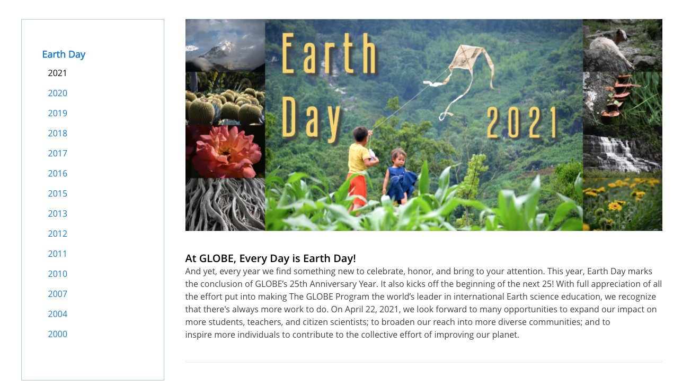
Earth Day 2021
THE GLOBE PROGRAM

Slide 8
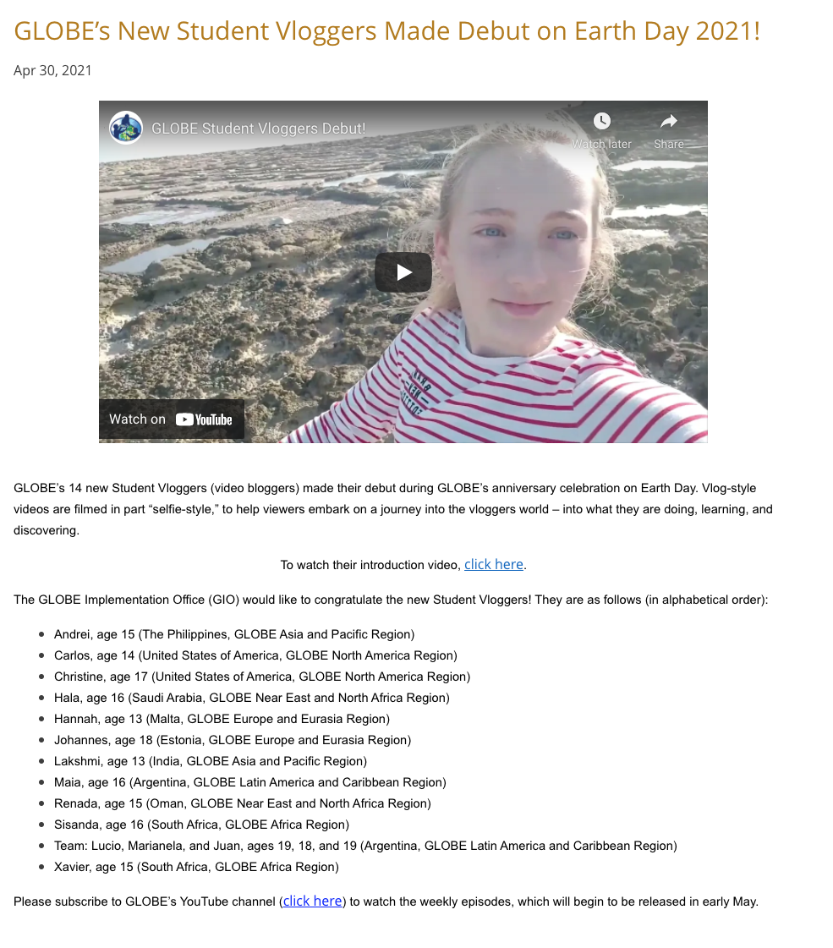
Vloggers
THE GLOBE PROGRAM
A pilot initiative
Two students from each region
One female and one male
From this region:
Student from:
The Philippines
India
Will document through videos what they are doing, learning and discovering with GLOBE

Slide 9
International Virtual Science Symposium
THE GLOBE PROGRAM
In 2021, 242 projects were submitted from 20 countries, 79 projects were eligible for the drawing.
On Earth Day, 22 April 2021, 7 projects were selected to receive stipends. Each projects received a four-star student research badge and at least two other optional badges.
Selected project from this region:
Title: Effect of population density on burrow characteristics in the fiddler crab (Uca bengali)
Teacher: Patchara Pongmanawut
School:Princess Chulabhorn Science High School Trang
Location: Thailand

Slide 10
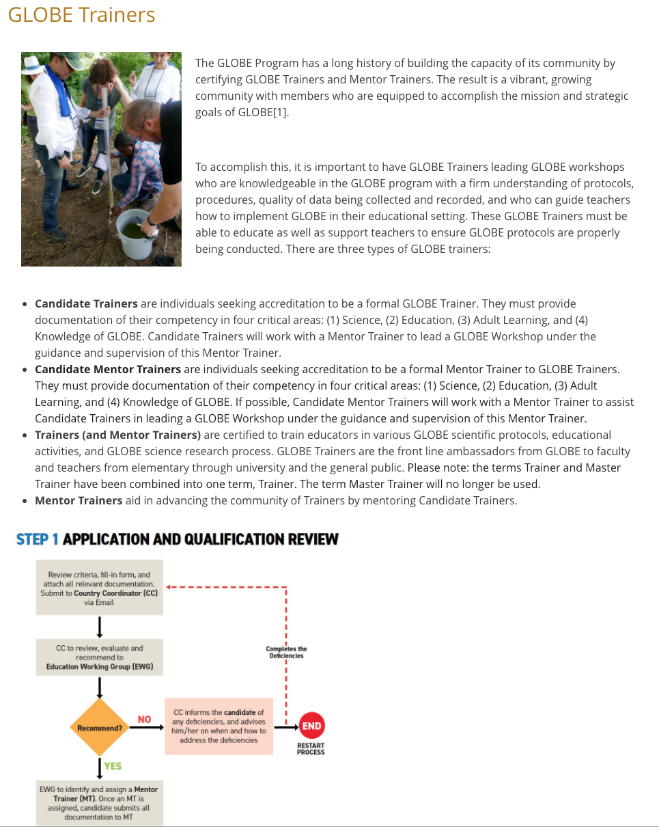
Training Process
THE GLOBE PROGRAM
Training process site
documents

Slide 11
Protocols
THE GLOBE PROGRAM
Deactivation Report
  Report submitted by Science Working Group
Protocol Proposal Process
  Science Working Group beginning development of new process

Slide 12
Working Groups
THE GLOBE PROGRAM
Five Working Groups
  Diversity, Equity and Inclusion
  Education
  Evaluation
  Science
  Technology
Nomination Process

Slide 13
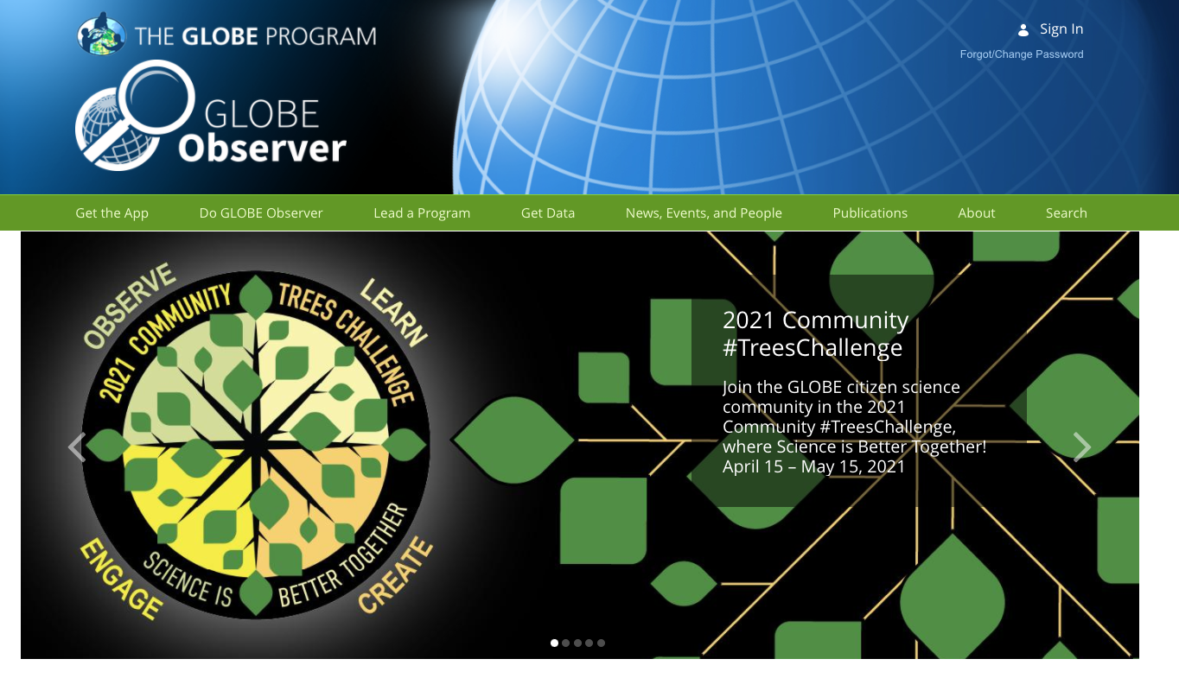
GLOBE Program’s App
GLOBE Observer
THE GLOBE PROGRAM
Continued enhancements of tools
Number of campaigns
Published article

Slide 14
International & Community
THE GLOBE PROGRAM
Series of Regional Meetings and annual meeting all virtual
Newest country to join:
  Bhutan

Slide 15
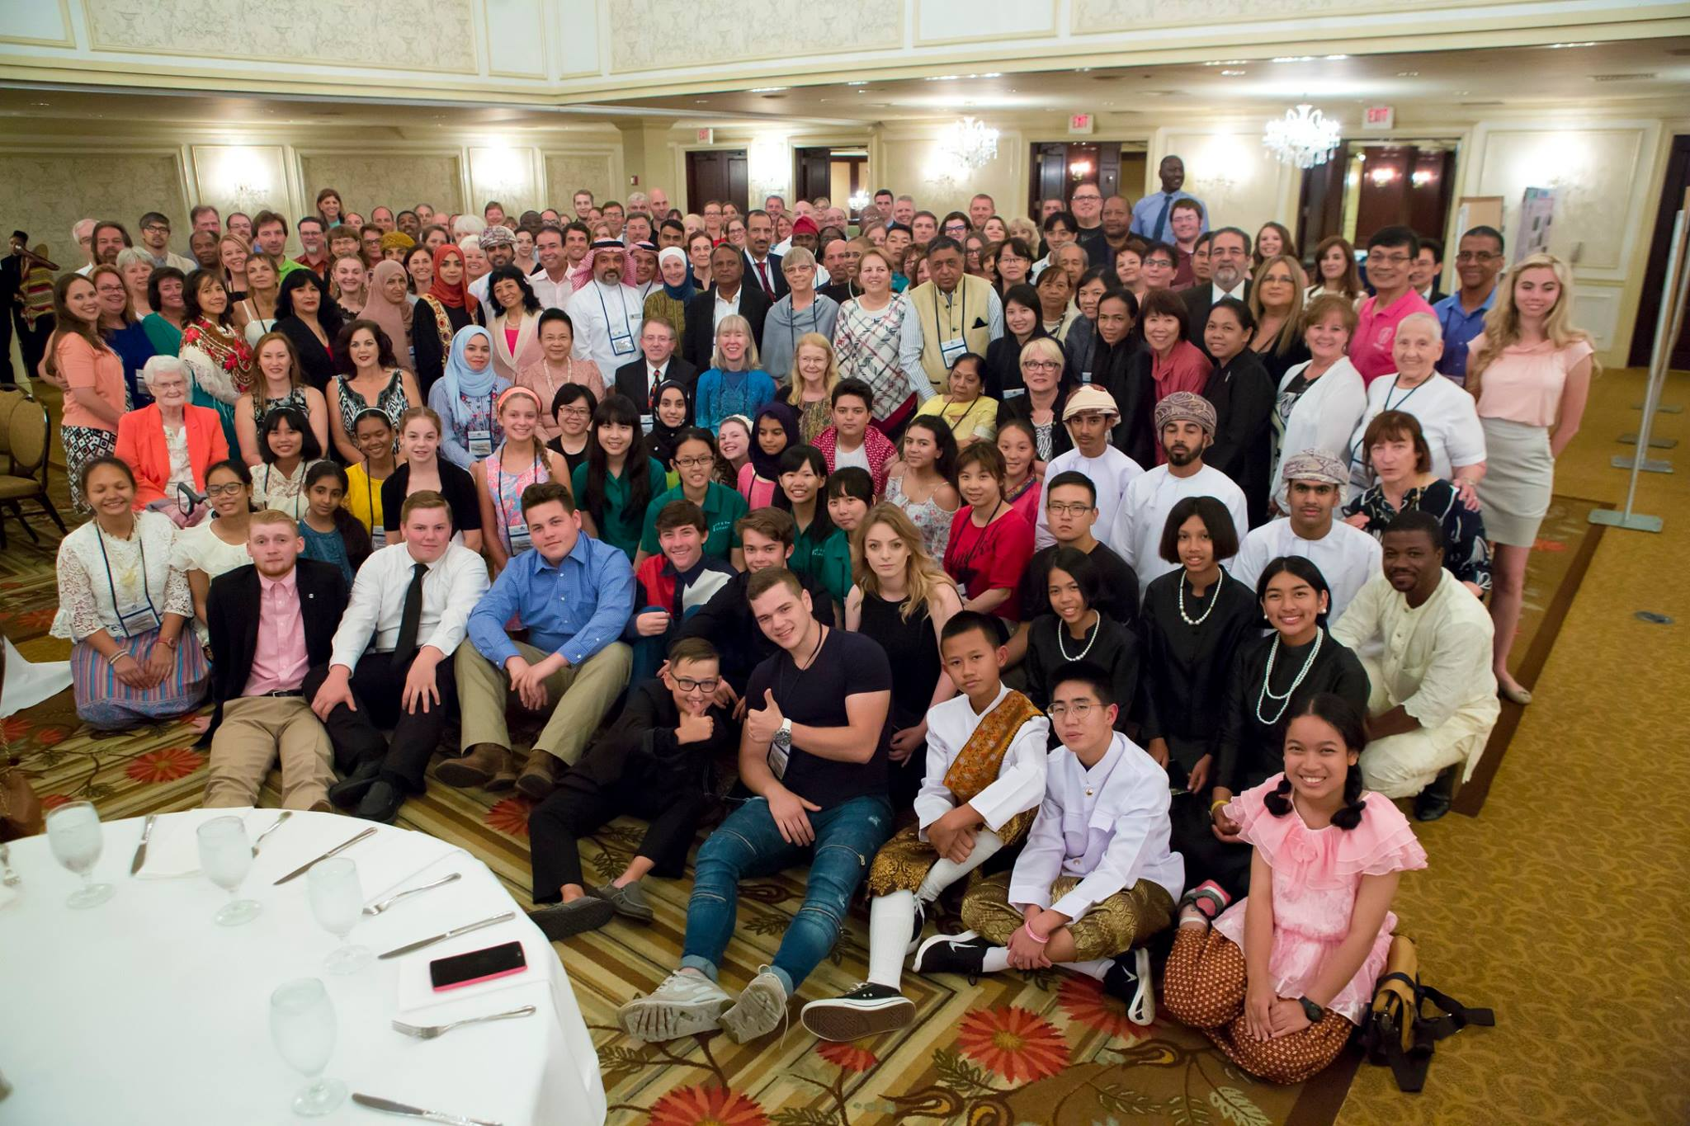
International & Community
THE GLOBE PROGRAM
Notes:
250 participants from 40 countries

Slide 16
Questions globehelp@ucar.edu
THE GLOBE PROGRAM

