Slide 1
Data Literacy Learning Activity - Atmosphere
Air Temperature across GLOBE on the same day

Slide 2
Air Temperature across GLOBE on the same day
Topic: Comparison of the air temperature measured at different locations at similar latitude the same day (noon local time).
Age of students: 7-12
Skills developed: graph construction (incl. correct description of axis and legend), comparing the data of the same parameter, asking questions on why the data differ from each other
Prerequisities: basic knowledge of the GLOBE Visualization Tool
Big Idea: There are various local factors that impact the air temperature at particular study site (altitude, relief and weather conditions such as windspeed, cloud cover, precipitation etc.)

Slide 3
Content
Slide 4: Work Assignement for students
Slides 5-7: Instruction on how to find and filter out selected range air temperature data in the GLOBE Visualization Tool – following the process that the teacher from Zadar school did with her class.
Slide 8: The dataset students can work with (in case you don´t want to spend time looking for the more up-to-date dataset or data from the latitude of your school)
Slides 9-11: Examples of the graphs constructed manually by students

Slide 4
Work assignment for students:
Task:
Compare air temperature measured on March 25, 2022 in GLOBE schools, Latitude 43 to 45, Longitude -180 to 180 and construct a graph of those readings. Comment: Latitude was derived from that on which Zadar school was located (Lat: 44.1173°), you can come with your own.
Steps:
Find schools (sites) on the (moreless) the same latitude, which collected the data for air temperature on the given date
Construct the graph displaying the different air temperatures coming from the selected locations
Make sure you describe the graph correctly (axis, scale, units, legend)
Interpret the data displayed and ask quesions (Why the temperature differs? What local factors influence the temperature?)

Slide 5
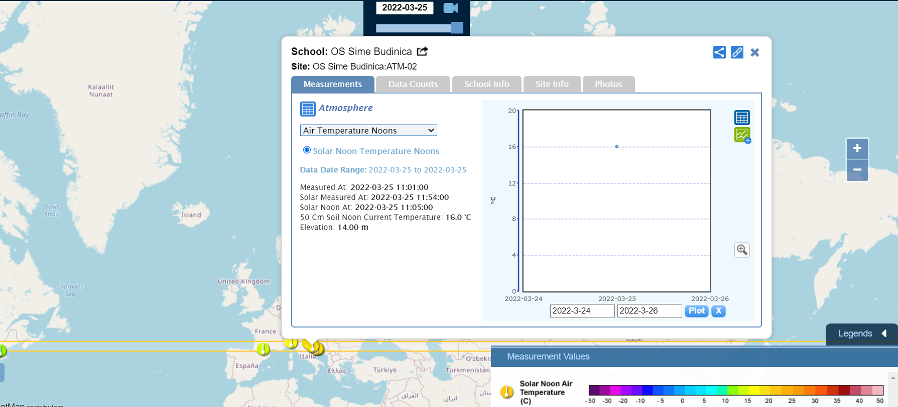
The activity is based on the assigment from Elementary School Sime Budinica, Zadar, Croatia (teacher Zrinka Klarin) that they did as a part of 2022 Earth Day Air Temperature Challenge. You can follow the steps of Zrinka´s students – see the slides that follow.

Slide 6
Step 1: finding schools that measured air temp. on 25 March 2022 and are located in the given Latitude – see set up of the filter:

Slide 7
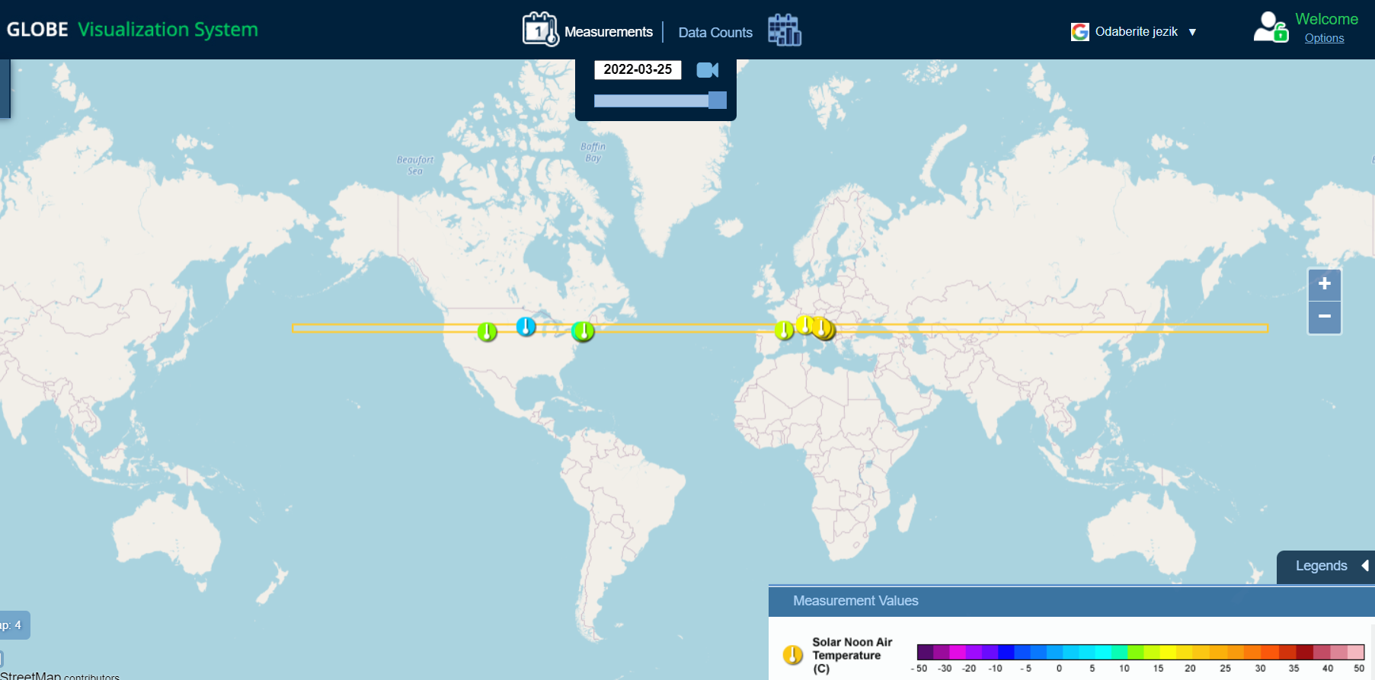
Step 2: analyzing results given by the Visualization Tool

Slide 8
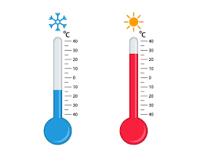
Step 3: Recording the name of all selected GLOBE schools along with the air temperature for the given date:
GLOBE schools located in the belt and air temperatures measured at each school:
Willow Creek Elementary School, USA 11.5°C
Sibley East Middle High School, USA 1.1°C
Lone Oak Campsites , USA 13.1°C
1.Lycée Henri Matisse Cugnaux, France 12.7°C
Italy GLOBE v-School, Italy 16.8°C
OŠ dr Mate Demarina, Croatia 17.6°C
OS Sime Budinica, Croatia 16.0°C
OS Josip Pupacic, Croatia 16.1°C

Slide 9
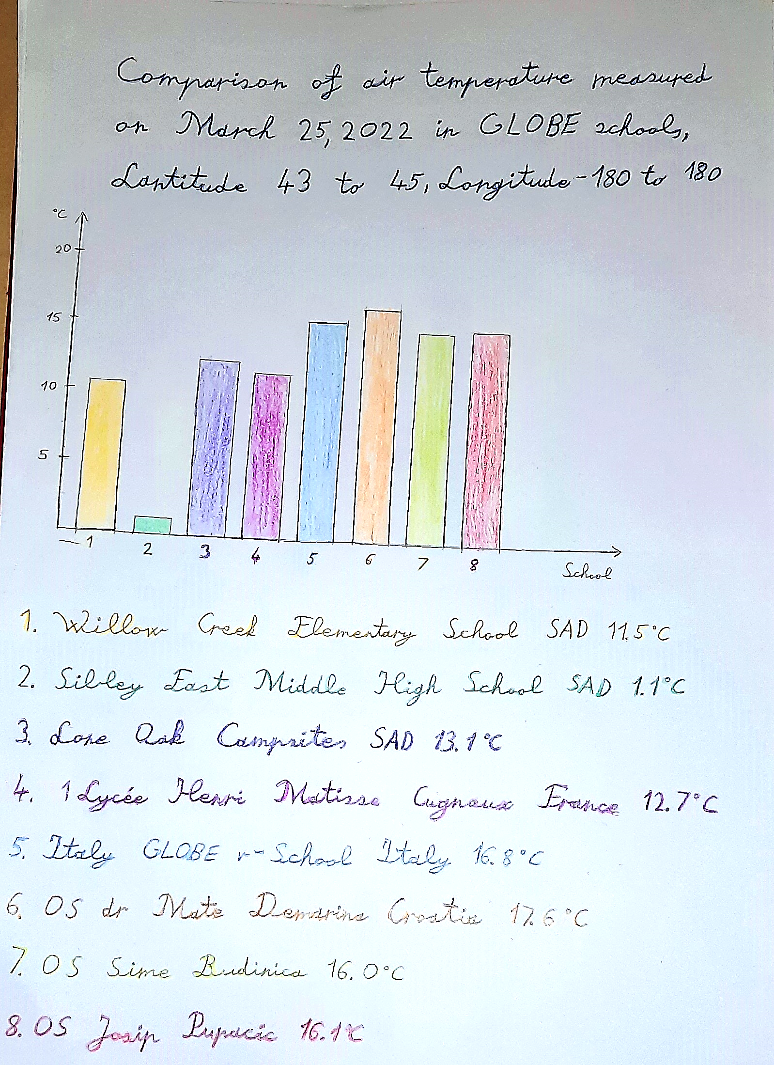
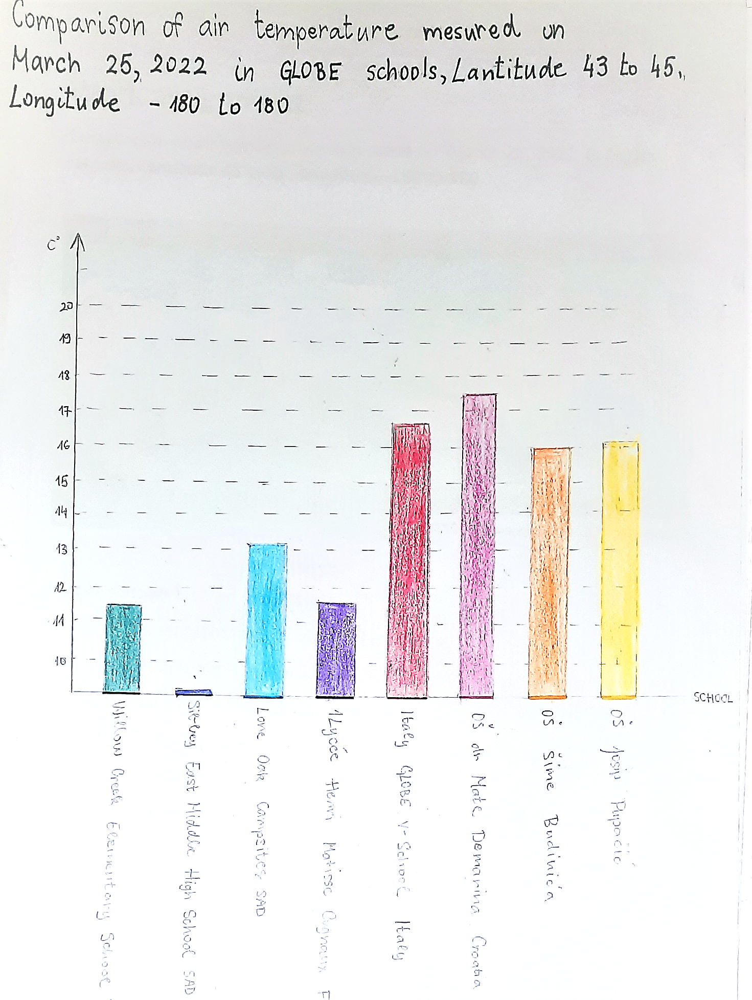
Step 4: students constructing the graph manually

Slide 10
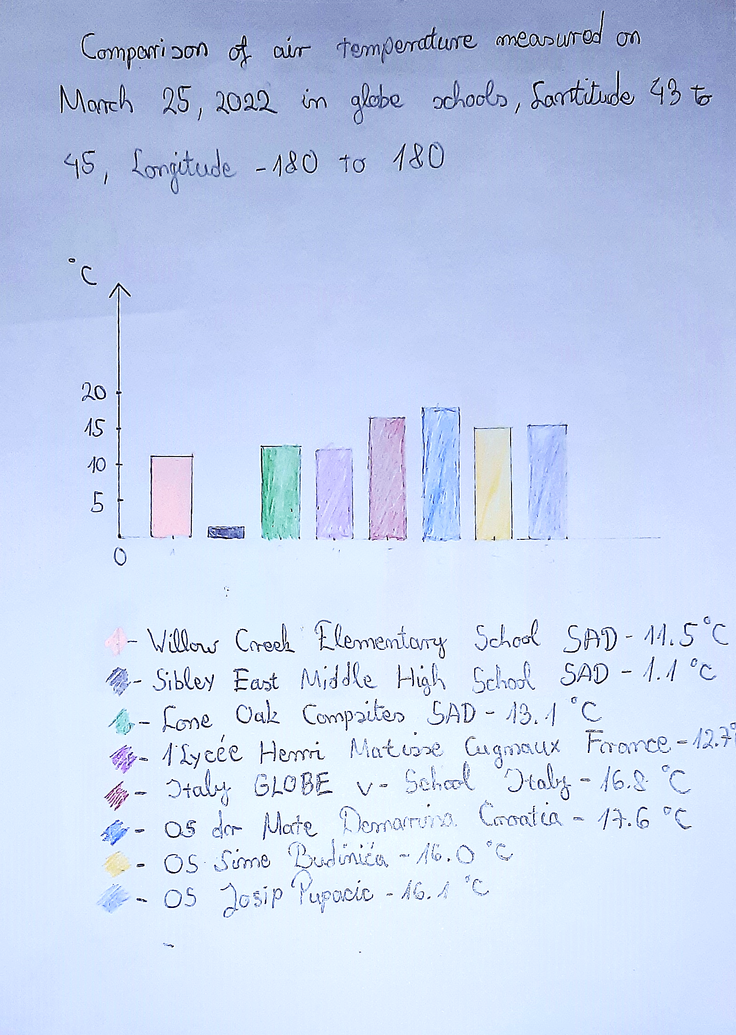
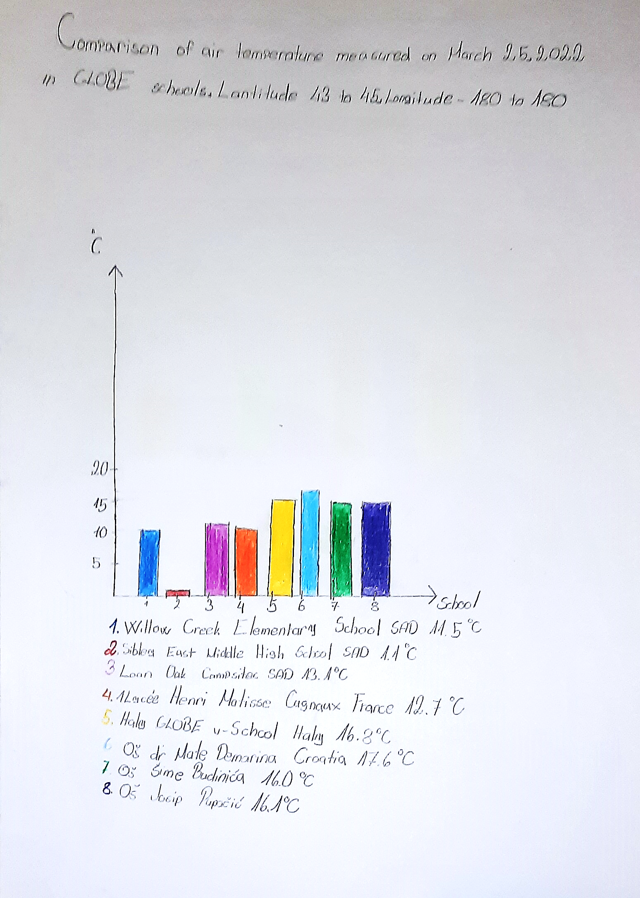

Slide 11
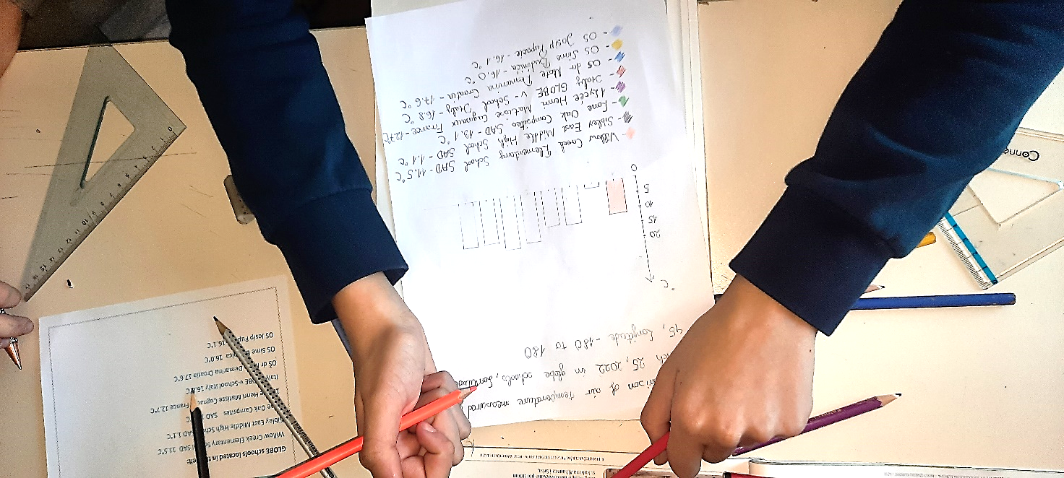
Hope you liked the activity!

Slide 12
The data literacy learning activity was prepared by GLOBE Program Europe and Eurasia Region Coordination Office, inspired by a real classroom activity coming from a GLOBE school. Thanks to the teacher Zrinka Klarin, from Elementary School Sime Budinica, Zadar, Croatia for the inspiring idea, photos and materials.

