Slide 1

Data Literacy Learning Activity – Atmosphere/Hydrosphere
Air and Water Temperatures Changes during the Year

Slide 2
Air and Water Temperatures Changes during the Year
Topic: Comparison of water and air temperatures measured at the same location over the year.
Age of students: 10 - 13
Skills developed: data comparison; finding differences when using different scales; data interpretation; trend differences of temperatures during the year; deeper understanding of the complex interactions between air and water temperatures
Prerequisities:
Big idea:

Slide 3
Air temperature vs. Water temperature
Pasvalys P. Vileisis Gymnasium, Lithuania
The school is located in the town of Pasvalys, which is the northern part of Lithuania
Hydrosphere site is on the River Levuo
Around 200 measurements recorded in 2022 – quite a good dataset

Slide 4
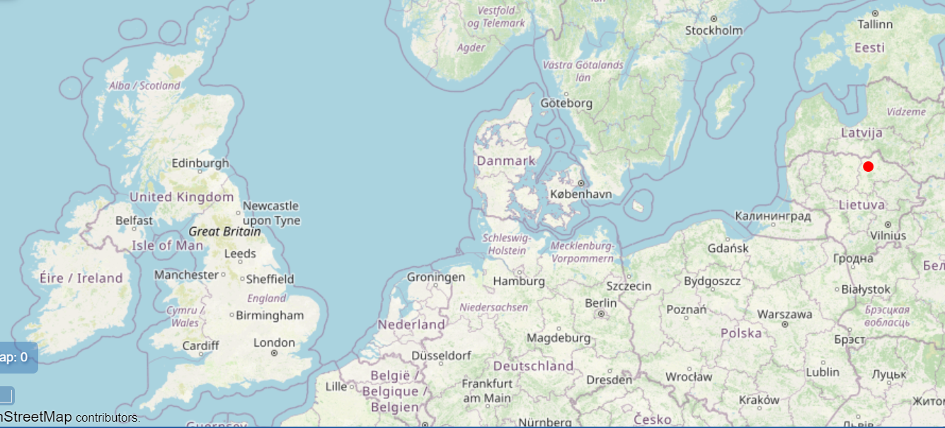
Site
Name | Vileisis:SWS-01
Latitude | 56.067°
Longitude | 24.44°
Elevation | 32.8m

Slide 5
Work assignment for students:
Task
Compare the same datasets (air temperature measurements in blue and water temperature measurements in red) that are displayed in graph A and graph B and interpret the data from the graph that displays the data better.
Steps/ questions
Can you tell why the data look different on the graph A and graph B?
Which graph (A/B) is more appropriate for correct data interpretation? Why?
What is the highest water temperature and highest air temperature in that year (approximately)?
What is the lowest water temperature and lowest air temperature in that year (approximately)?
Looking at the trend of air temperature and trend of water temperature over the year, what differences you can see? What does those tell you about the dynamics of atmosphere and hydrosphere?

Slide 6
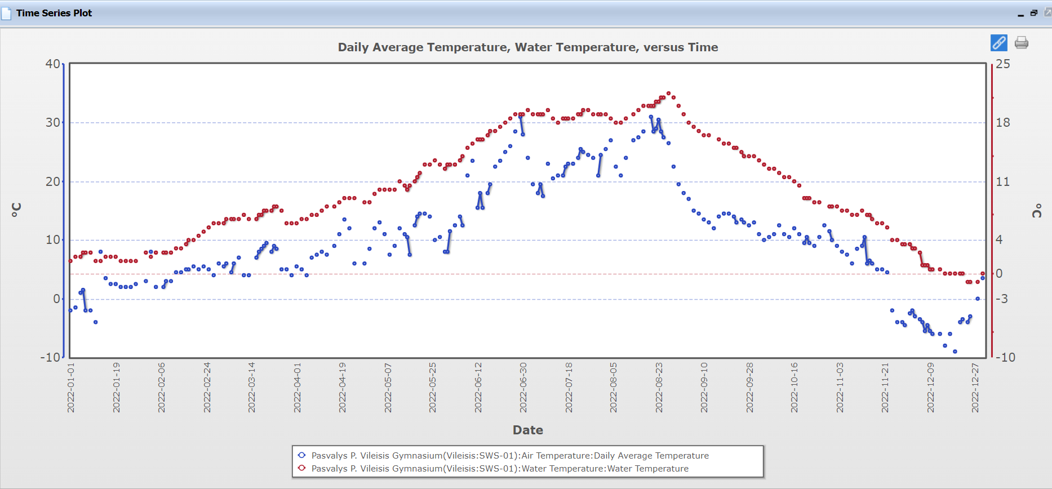
Graph A

Slide 7
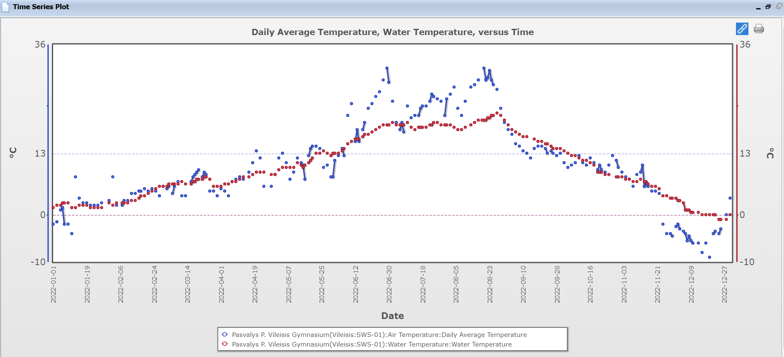
Graph B

Slide 8
For answers to the questions go to the next slide ☺

Slide 9
Answers
1. The same datasets (air temperature measurements in blue and water temperature measurements in red) are displayed in both graphs. Can you tell why the data look different on the graph A and graph B?
The difference is in the scale of the Y axis: graph A has different scale for each parameter, while graph B has the same scale for both parameters.
2. Which graph (A/B) is more appropriate for correct data interpretation? Why?
Therefore, the graph B gives us correct display, based on that we can interpret the data as both dataset represent temperatures and if we want to compare the air and water temperature we should have the same scale on Y axis.
3. What is the highest water temperature and the highest air temperature in that year (approximately)?
The highest water temp.: 21,5 °C The highest air temp.: 31 °C
4. What is the lowest water temperature and the lowest air temperature in that year (approximately)?
The lowest water temp.: -1 °C The lowest air temp.: -9 °C
5. Looking at the trend of air temperatures and trend of water temperature over the year, what differences you can see? What does those tell you about the dynamics of atmosphere and hydrosphere?
Water mass tends to be more stable when it comes to the change of temperature, does not warm up or cool down that fast as air mass.

