Slide 1

Data Literacy Learning Activity - Biosphere
Comparison of Tree Height Measurements

Slide 2
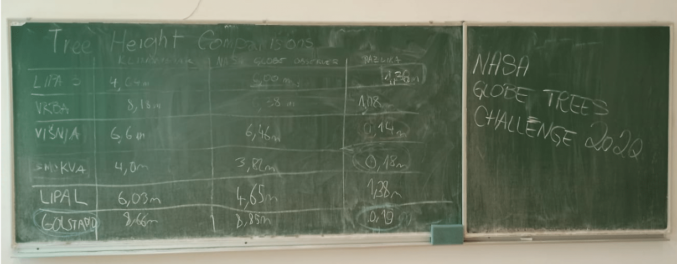
Evaluation of Tree Height Measurement Data
Topic: Comparison of tree height measurement results using clinometer and GLOBE Observer app
Age of students: 12-15
Skills developed: the ability to compare two data sets, analyze and interpret the differences and recognize and identify potential sources of measurement error in these data sets
Prerequisities: Basic knowledge of tree height measurement using GLOBE Observer App and clinometer
Big idea: Knowing the height of trees, gives us valuable information about the characteristics of the ekosystem in which they grow.
Critical thinking and evaluation of measured data are essential for obtaining good results from height measurements as well as other scientific investigations.

Slide 3
Content of the activity
Slide 4: Introduction
Slide 5-6: Description of the methods used for the measurements
Slide 7: Work assignment for students
Slide 8: Data to be used for the aktivity
Slide 10: Answers to the questions for students

Slide 4
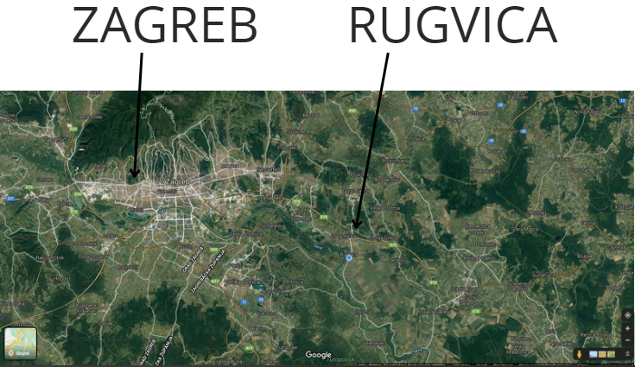
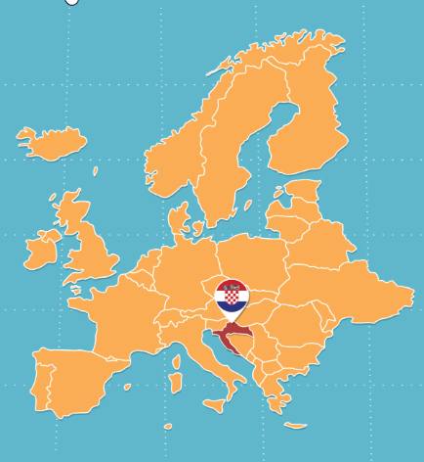
Introduction
The activity is based on results of Elementary school Rugvica, Croatia.
Students measured height of nine trees
They used two methods of measuring a tree height – clinometer and GLOBE Observer app
Students compared results and tried to find out, which measurement method is more precise

Slide 5
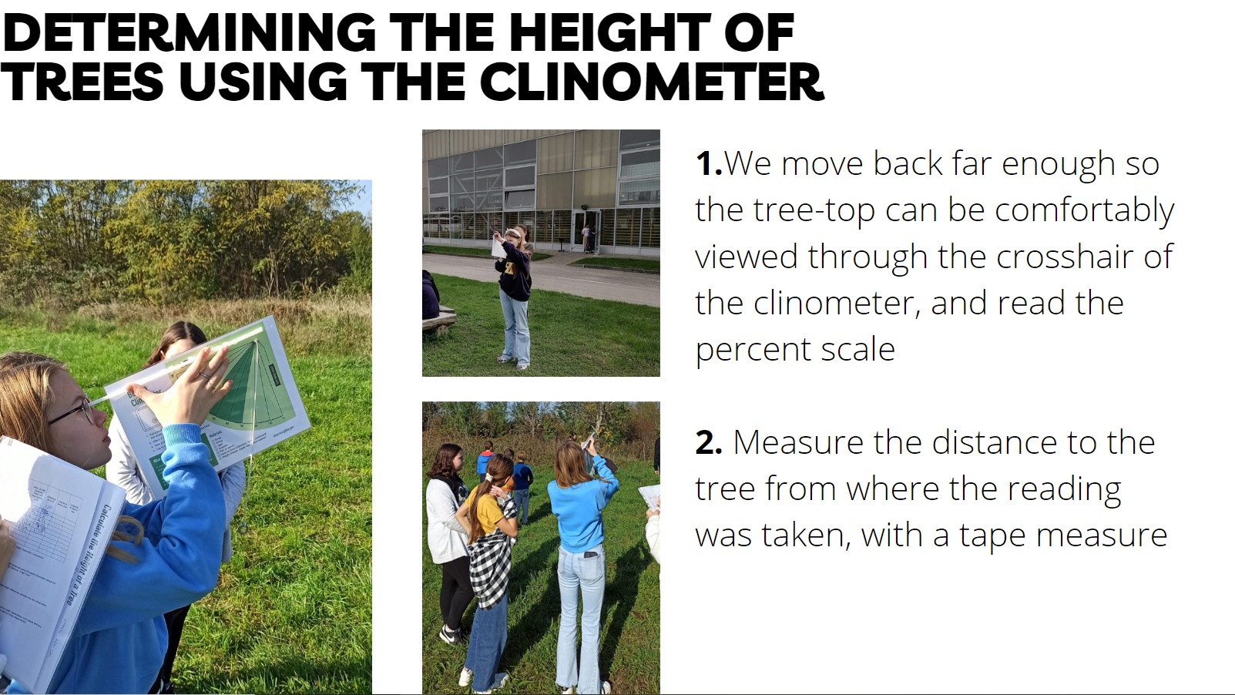

Slide 6
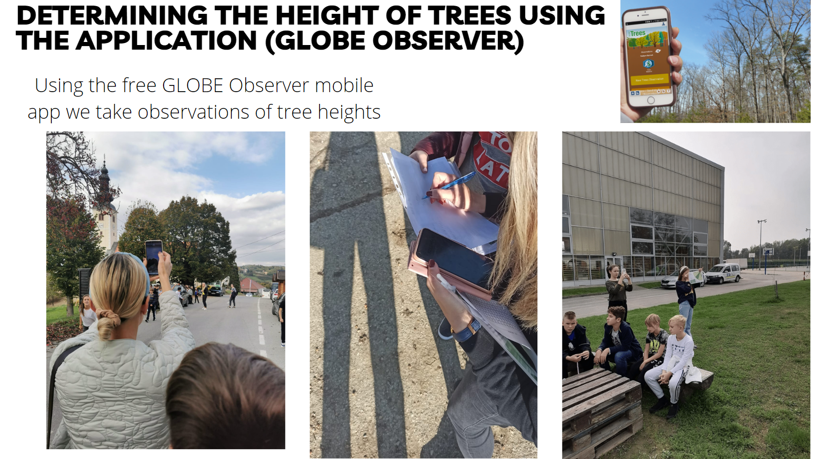

Slide 7
Work assignment for students
Task
Compare the two datasets (data measured using clinometer and data meausered by GLOBE Observer) and answer the questions below.
Steps/ questions
Find out which tree had the biggest/smallest difference between the measurement results
Is it possible to say that we measure greater height using one method than the other?
Can you tell for which trees the measurement was the most accurate?
Which of the trees was most likely measured with a significant error ? What can be the source of the error?
Looking at the data, can you make a conclusion, which measurement method is more precise?

Slide 8
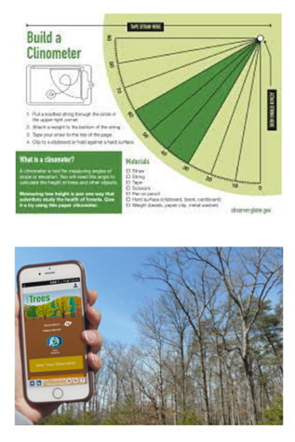
Comparison of data
Tree | Clinometer (m) | GLOBE Observer (m) | Difference (m)
1. White poplar 1 (Populus alba) | 8,74 | 7,72 | 1,02
2. White poplar 2 (Populus alba) | 8,00 | 6,52 | 1,48
3. Bare tree | 8,66 | 8,85 | 0,19
4. Lime tree 3 (Tilia cordata) | 4,64 | 5,00 | 0,36
5. Willow (Salix babylonica) | 8,18 | 6,38 | 1,8
6. Cherry (Prunus cerasus) | 6,60 | 6,46 | 0,14
7. Lime tree 2 (Tilia Cordata) | 6,03 | 4,65 | 1,38
8. Fig tree (Ficus carica) | 4,00 | 3,82 | 0,18
9. Grey willow (Salix cinerea) | 16,42 | 11,95 | 4,47

Slide 9
For answers to the questions go to the next slide ☺

Slide 10
Answers
1. Find out which tree had the biggest/smallest difference between the measurement results
  The biggest difference: tree No 9 The smallest difference: tree No 6
2. Is it possible to say that we measure greater height using one method than the other?
  No, for some trees the height was bigger when measured by clinometer for other when measured by GLOBE Observer
3. Can you tell for which trees the measurement was the most accurate?
  At the first sight, we can see that four trees have small difference between the two measurements (tree No. 3, 4, 6, 8)
  However we should always relate the difference to the total height of the tree. (for example for tree No. 3 it would be 0,19/8,85 = 0,02147 x 100 = 2,15 %
4. Which of the trees was most likely measured with a significant error ? What can be the source of the error?
Tree No 9 - The error source can be: more students use the same phone and do not adjust the height or lenght of pace in the app; not seeing the tree top properly; error in measuring the distance to the tree etc.
5. Looking at the data, can you make a conclusion, which measurement method is more precise?
  No, it is not possible. We would need more measurement results for each tree done by each method.

Slide 11

The data literacy learning activity was prepared by GLOBE Program Europe and Eurasia Region Coordination Office, inspired by a real classroom activity coming from a GLOBE school.
Thanks to the teacher Zrinka Klarin, from Elementary School Sime Budinica, Zadar, Croatia for the inspiring idea, photos and materials.

