Slide 1
Data Literacy Learning Activity - Biosphere
Comparison of the green-up timing at different locations

Slide 2
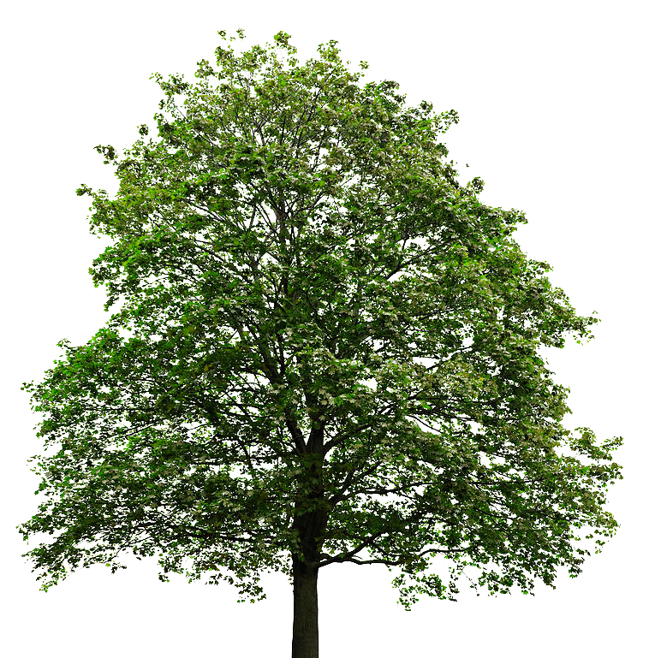
Comparison of the green-up timing at different locations
Topic: Comparison of the timing of budburst and leaf growth at two locations in Croatia (Varaždin and Belišće)
Age of students: 10-12
Skills developed: comparing and examining collected datasets, calculating average, finding potential measurement errors
Prerequisities: Basic knowledge of the green-up protocol
Big idea: Phenology green-up observations provide important information about changing patterns in nature. A good understanding of the measurement results is important for their correct interpretation and comparison.

Slide 3
Content of the activity
Slide 4: Introduction
Slide 4-5: Description of the methods used for the measurements
Slide 6: Work assignment for students
Slide 7: Data to be used for the activity
Slide 9: Answers to the questions for students

Slide 4
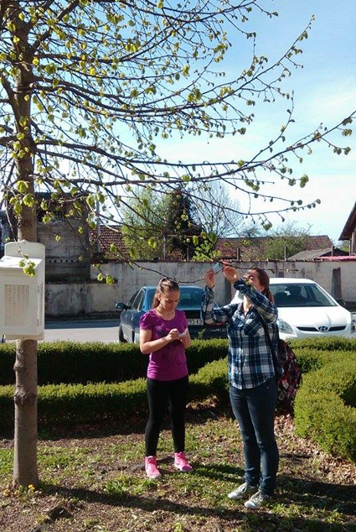
Introduction
The data were collected by students of 3rd Primary school Varazdin (teacher Marina Balažinec) and Primary school Ivana Kukuljevića Belišće (teacher Lidija Tivanovac )
Both schools observed a lime tree (Tilia cordata Mill.) for several years, compared results and cooperated

Slide 5
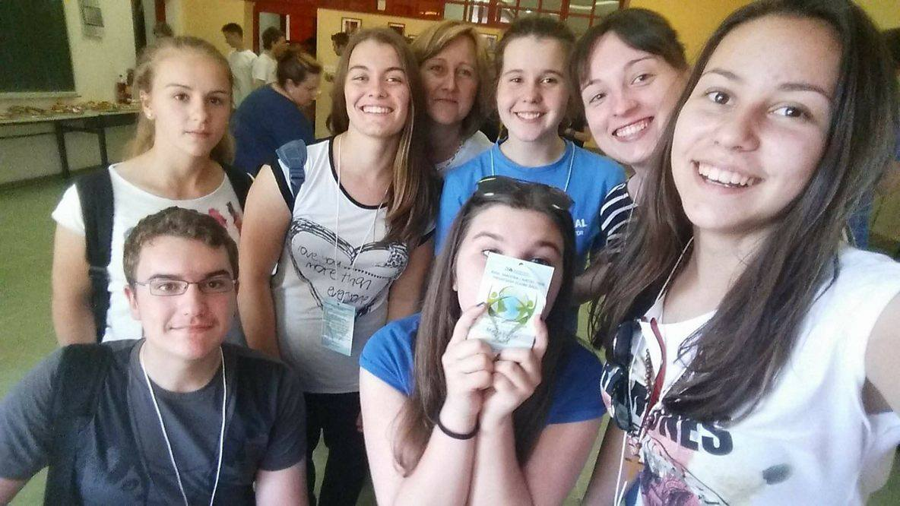
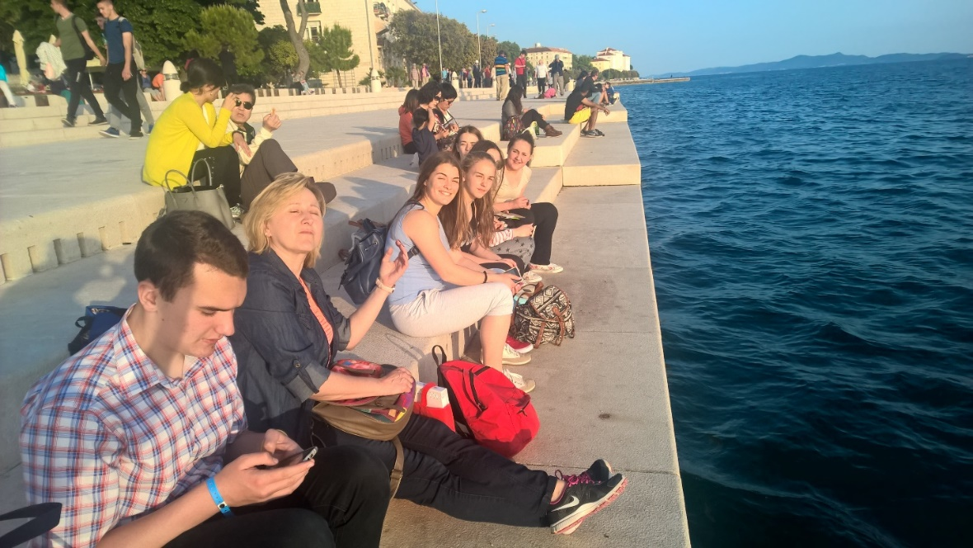
And after 5 years of collaboration and friendship between two 300 km distant schools, observing the same tree – lime (Tillia cordata)
Varaždin, altitude: 202 m
Belišće, altitude: 93 m

Slide 6
Work assignment for students
Task
Compare data from the two locations and find out what is the difference between the pattern of greening up.
Questions
How many days on average does the Green Up period last in each location?
Can we clearly say on what location Green Up starts earlier in general?
What is the meaning of the figures highligted in red?
Why do you think there is „no data“ marked in column 6 for year 2017?

Slide 7
Data – Lime tree
1 - year | 2 - Time of budburst Varazdin | 3 - Time of budburst Belisce | 4 - End of Green up period Varazdin | 5 - End of Green up period Belisce | 6 - Duration of green up period Varazdin | 7 - Duration of green up period Belisce
2015 | 6.4. | 7.4. | 25.5. | 19.5. | 48 | 42
2016 | 30.3. | 24.3. | 27.5. | 4.5. | 58 | 41
2017 | 27.3. | 28.3. | Data not recorded | 8.5. | No data | 41
2018 | 29.3. | 13.4. | 9.5. | 8.5. | 41 | 25
2019 | 21.3. | 28.3 | 21.5. | 16.5. | 61 | 49
2020 | 9.3. | 3.4. | 4.5. | 28.4. | 56 | 25
2021 | 12.3. | 12.4. | 26.4. | 21.5. | 45 | 39
2022 | 6.4. | 31.3. | 27.5 | 12.5. | 61 | 42

Slide 8
For answers to the questions go to the next slide ☺

Slide 9
Correct answers
How many days on average does the Green Up period last in each location? In Varazdin it is approx. 53 days, in Belisce it is approximately 38 days.
Can we clearly say on what location Green Up starts earlier in general? No, we can not, there is too much variation over the the years – sometimes budburst starts almost the same date, some years the tree in V wakes up earlier, but the other year it is B that starts first
What is the meaning of the figures highligted in red? Those are the extreme data that are far from the average data - the Green Up period was too short. It is always good to look at the extremes, as they may show special conditions, or they might be caused by an error done during observation, reporting or calculation.
Why do you think there is „no data“ marked in column 6 for year 2017? This is related to the column 4 of the same year, where „no data was reported“. That is why the calculation of the Green up period could not be done.

Slide 10
The data literacy learning activity was prepared by GLOBE Program Europe and Eurasia Region Coordination Office, inspired by a real classroom activity coming from a GLOBE school. Thanks to the teacher Marina Balažinec from Primary school Varazdin and to the teacher Lidija Tivanovac from the Primary school Ivana Kukuljevića Belišće and to their students for the inspiring idea, photos and materials.

