Slide 1

Data Literacy Learning Activity - Pedosphere
Soil properties along the Cetina River basin

Slide 2
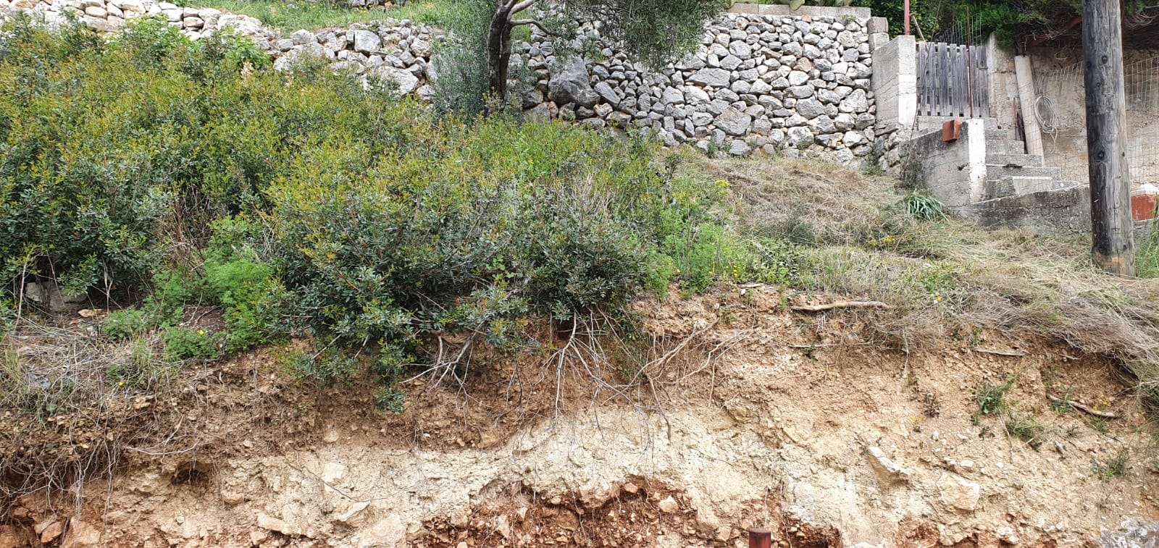
Soil properties along the Cetina River basin
Topic: Looking at the soil properties along the river stream from its origin to the sea and interpreting the data collected.
Age of students: 12-15
Skills developed: understanding and interpretation of data collected, finding similarities and differences in data collected, basic orientation in the data clustered in a spreadsheet, learning about soil characteristics
Prerequisities: basic knowledge on Soil Characterization and Soil Types
Big Idea: Soil is not only one, there is a huge diversity in soil types and properties, even at such a small area along a single river basin. Diverse ecosystems can be found along the river - the soil type (along with othe factors of microclimate and relief) very much determines the vegetation growing on the surface.

Slide 3
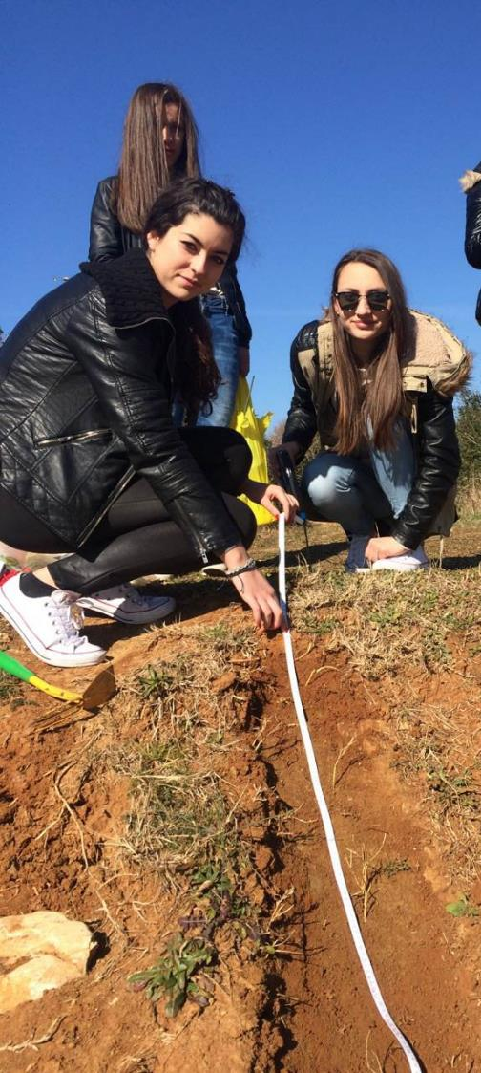
Content
Slide 4-6: Introduction and reference to the original student research, including the map of the study sites along the river and soil analyzis photo documentation
Slide 7: Work assignment for students
Slide 8: Spreadsheet that students work with. The data collected present the physical and chemical properties of the soil samples taken at 9 study sites along the river.
Slide 9-13: Additional photo documentation of various sites along the river basin – can be used for demonstration different vegetation types
Slide 15: Correct answers
Slide 16: Additional resource – soil texture triangle

Slide 4
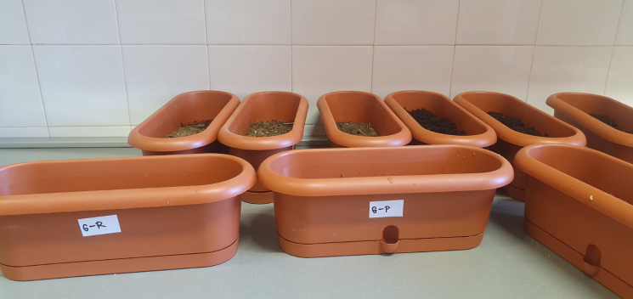
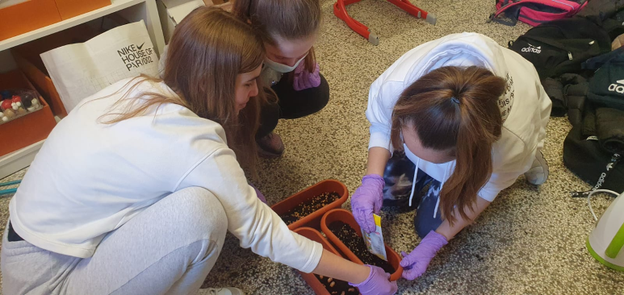
Introduction
The data were collected by students of Elementary school Josip Pupačić Omiš, Croatia (teachers Tamara Banović and Ivica Štrbac)
The aim of the original research was to test whether different types of soil affect the germination and growth of selected plants
This data literacy learning activity focus only on the first part of the student research, which was analyzing the soil samples and determining the soil properties at 9 sites along the Cetina River basin.

Slide 5
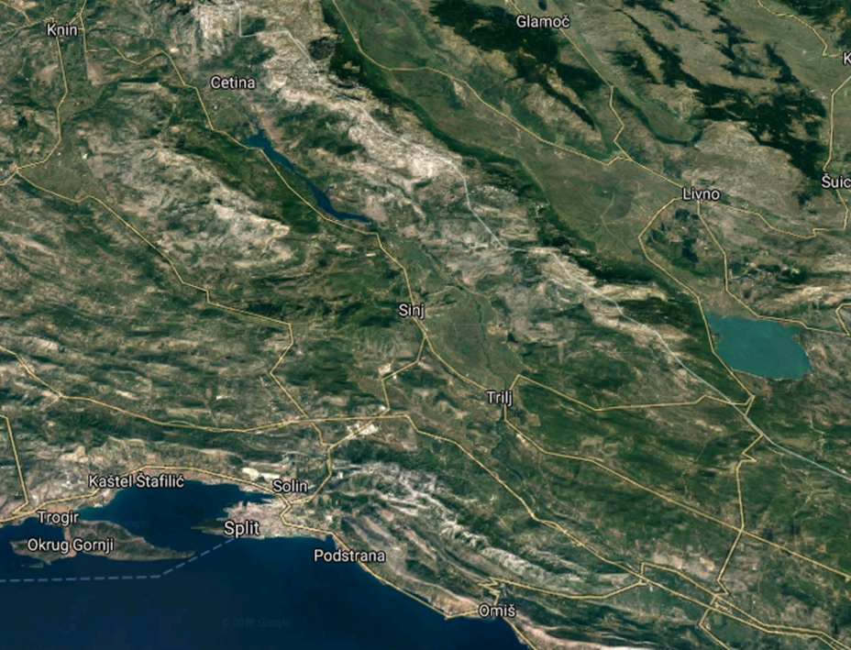
Site locations along the Cetina River, where the soil samples were collected
1 - Vrlika
2 - Hrvace
3 - Sinj
4 - Ruda
5 - Trilj
6 - Ugljane
7 - Blato na Cetini
8 - Gata
9 - Omiš
1
2
3
4
5
6
7
Research period :
December 2019. - January 2020.
November 2021. - February 2022.
8
9

Slide 6
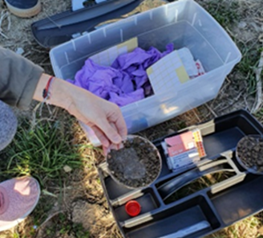
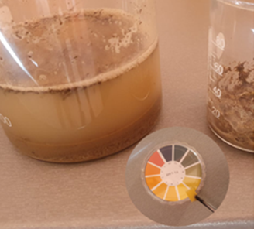
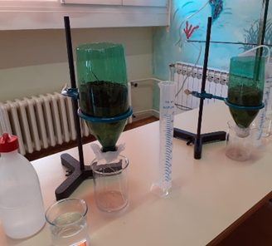
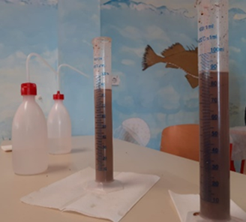
Determination of physical and chemical properties of soil
Using the GLOBE protocols:
soil characterization (consistency, structure and texture of the soil)
pH-value of the soil
Infiltration
a
b
Photos:
field sampling,
determining the pH value of the soil
Infiltration
determination of soil texture
c
d

Slide 7
Work assignment for students:
Task:
Understand and interpret the data on soil properties collected by GLOBE students from Omiš School.
Steps – Look at the table 1 at next slide:
What is the prevailing soil color?
Why do you think the pH of soil is 7 or 7,5? Find out about the type of rock/minerals typical for the Cetina River area (near Omiš city, Croatia). You can either look at the photos below or look it up.
What would be a typical soil pH in the area where you live?
What soil texture is prevailing in the area of the Cetina River?
Indicate four soil samples that had the biggest capacity to retain water. What have those four samples in common?
Which soil parameter inffluence the most how fast the water pass through the soil? Which type of soil allows water to pass through quickly and which one allows the water to pass very slowly?

Slide 8
Physical and chemical properties of the soil
Table 1 Results of physico-chemical soil properties at selected localities in the Cetina River basin
Soil sampling station | Soil color | pH - value | Soil consistency | Soil structure | Soil texture
9 - Omiš | gray-brown | 7,5 | firmly | grainy | sands
8 - Gata | brown | 7 | slightly | granular | clay loam
7 - Blato n/C | brown | 7,5 | slightly | granular | silt loam
6 - Ugljane | red | 7 | slightly | lumpy | silt loam
5 - Trilj | brown | 7,5 | slightly | prismatic | clay
4 - Ruda | brown | 7,5 | slightly | lumpy | clay
3 - Sinj | brown | 7 | brittle | lumpy | clay
2 - Hrvace | red | 7,5 | slightly | grainy | silt loam
1 - Vrlika | brown | 7,5 | slightly | grainy | silt loam
Time of passage of the first drop through the soil/s | Volume of retained water in the soil/mL
9 | 2
36 | 14
31 | 18
32 | 19
48 | 11
52 | 10
58 | 12
28 | 20
30 | 22

Slide 9
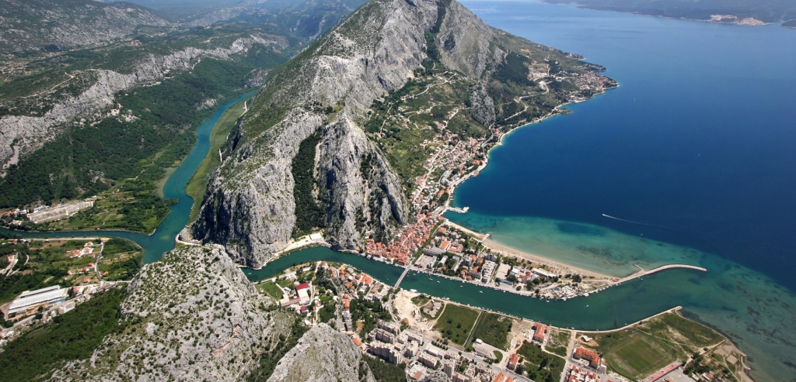
Figure 1 Omiš – The Cetina River meets the sea

Slide 10
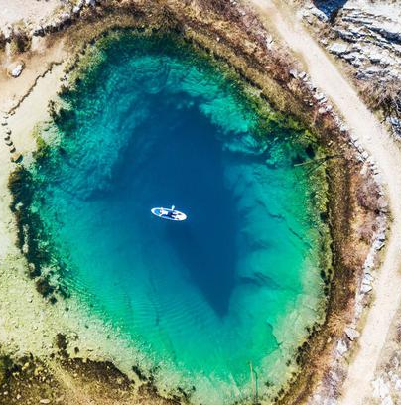
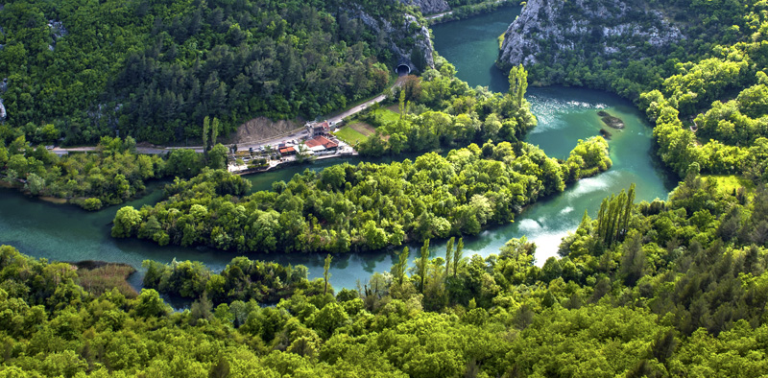
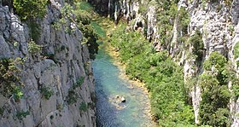
Figure 2 Source of the Cetina River
Figure 3 and 4 Cetina River canyon

Slide 11
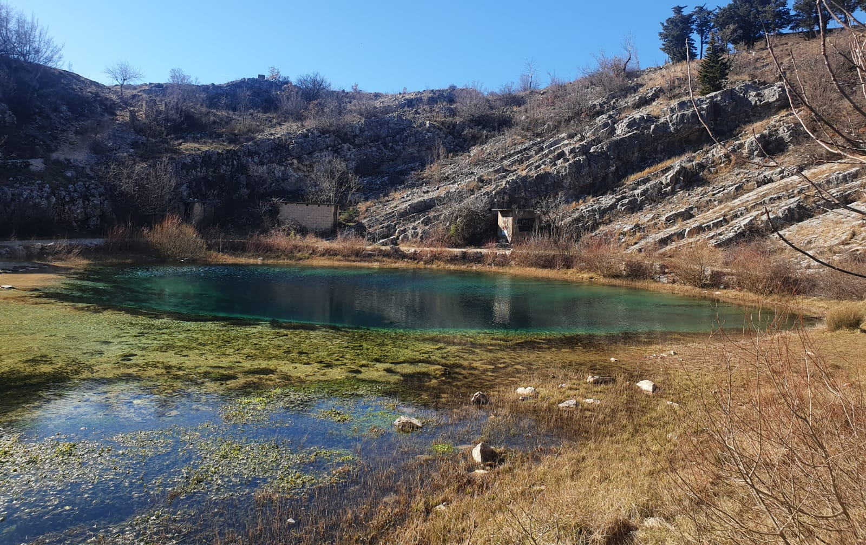
Figure 4 Vegetation in the upper reaches of the Cetina River

Slide 12
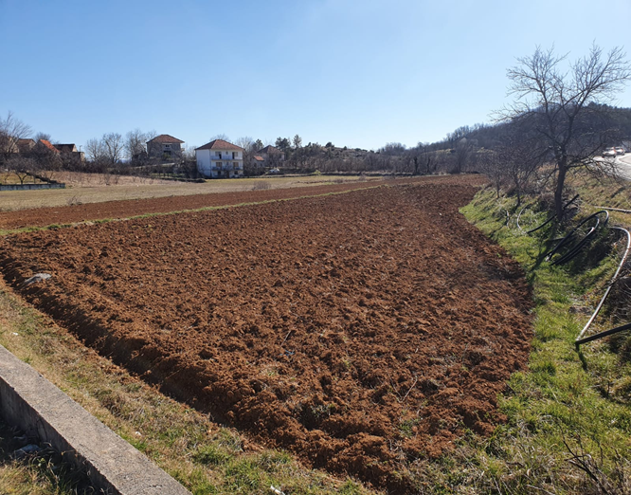
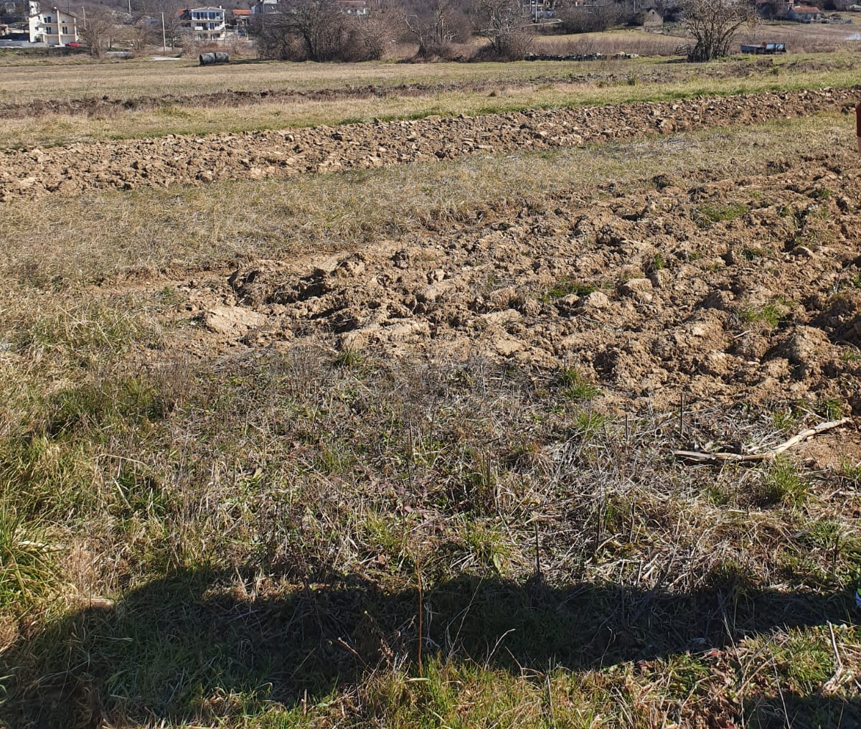
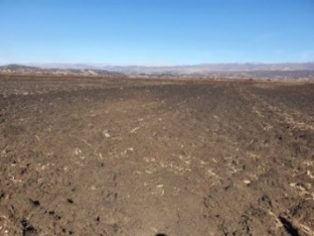
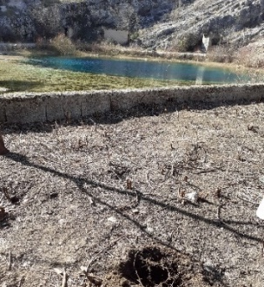
Figure 5 Vegetation in the middle course of the Cetina River

Slide 13
Figure 6 Vegetation in the lower reaches of the Cetina River

Slide 14
For answers to the questions go to the next slide ☺

Slide 15
Answers to the questions:
What is the prevailing soil color? brown
Why do you think the pH of soil is 7 or 7,5? Find out about the type of rock/minerals typical for the Cetina River area (near Omiš city, Croatia). You can either look at the photos below or look it up. The typical rock of the area is limestone, which contain calcium and is alcaline.
What would be a typical soil pH in the area where you live?
What soil texture is prevailing in the area of the Cetina River? Silt Loam
Indicate four soil samples that had the biggest capacity to retain water. What have those four samples in common? Study sites 1, 2, 6 and 7 (Vrlika, Hrvace, Ugljane, Blato) – they all show silt loam texture.
Which soil parameter inffluence the most how fast the water pass through the soil? Which type of soil allows water to pass through quickly and which one allows the water to pass very slowly? It is the soil texture and structure. The grainy and sandy soil allows the water to pass quickly, while the clay and lumpy soil does not allow the water to pass easily

Slide 16
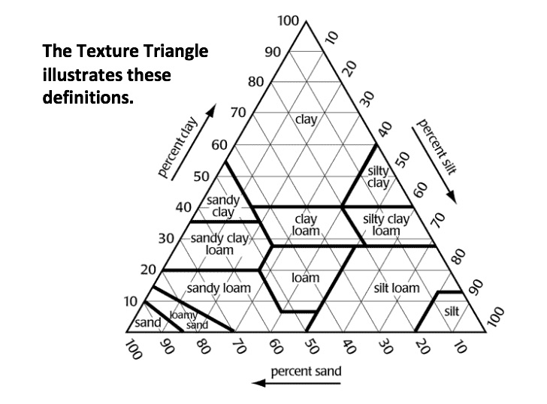
Soil Texture Triangle
Soils are grouped into 12 texture class names depending on how much sand, silt, and clay is in each sample.
For more details on soil texture and other soil properties please refer to the GLOBE e-training modules:
https://www.globe.gov/get-trained/protocol-etraining/etraining-modules/16867724/12276

