Slide 1

Aerosol data:
What it means?
Why it matters?

Slide 2
Objectives: to better understand what the data collected means & its importance for science
We will review in turn the:
Interpretation AOT measurements
Link between aerosols and pollution
Significance of aerosol data
Contribution of GLOBE

Slide 3
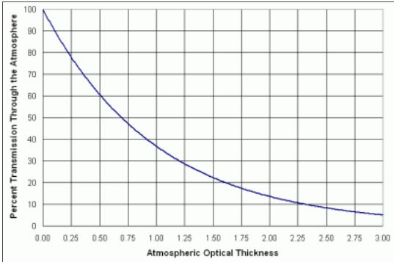
Interpreting AOT measurements
The higher the AOT, the more sunlight is scattered by aerosols present in the atmosphere. Therefore, the less sunlight is received at ground level.
The relation between the percentage transmission of sunlight and AOT is quite ‘steep’ as illustrated by the graph. An AOT of 0.25 means that over 20% of sunlight was scattered by aerosols before reaching the ground.
The sky is very hazy for an AOT of 0.5 and over.
On the contrary, the air is clear for AOT smaller or equal to 0.1

Slide 4

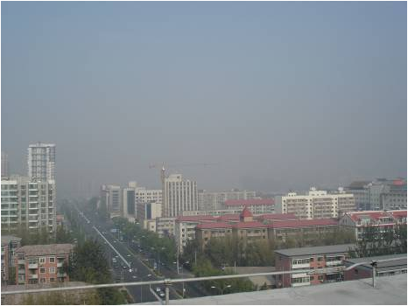
Contrasted observations by naked eye (China)
Clear sky, high visibility.
Sky obscured, very poor visibility (higher AOT).
Notes:
It is generally agreed that, because of higher concentrations of aerosols, skies in many parts of the world are hazier than they were one or two centuries ago, even in rural areas.

Slide 5
Aerosols and pollution

Slide 6



Sources of aerosols can be local
The below man made emissions negatively impact the quality of the air we breathe:
Fossil fuel burning for heating.
Particles from traffic.
Burning of the uplands.

Slide 7
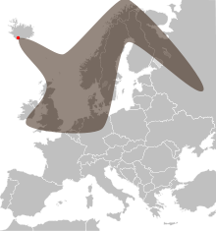

Aerosols can also travel great distances
Sand from the Sahara covering cars in Europe.
Volcanic ashes disrupting air traffic in 2010.

Slide 8

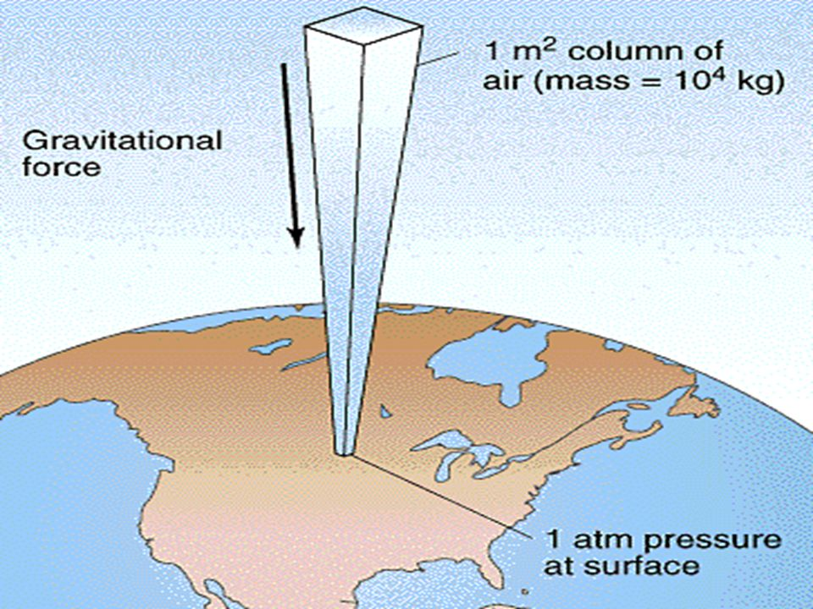
How does Calitoo measurements compare to air monitoring stations?
Calitoo and other sun photometers measures particles in a column of air.
Instruments in air quality monitoring stations focus on ground level pollution and usually measure several pollutants, including particles and gases (e.g. NOx).
Calitoo
Monitoring station

Slide 9
So, what is the relation between AOT and pollution?
A high AOT can be an indicator of the presence of pollutants in the air; further data from a local air monitoring station can confirm this.
A low AOT means that there are little particles in the column of air studied. However, this does not mean that:
This is true in the rest of the area; a highway or a fire 200 meters away may be a localised source of pollution.
Other pollutants such as NOx require other instruments to be measured.

Slide 10
Significance of aerosol data

Slide 11
To improve climate modeling
The impact of aerosols on the atmosphere is one of the most significant and uncertain aspects of climate change projections.
The observed global warming trend is less than expected from the increase in greenhouse gases, and much of the difference can be explained by aerosol effects.
Aerosols impact climate in many ways, including through direct scattering, absorption of incoming solar radiation and the formation of clouds and precipitation.

Slide 12
2) For their impact on health and business
Health and air quality policies: there is growing concern for the impact of aerosols on human health, hence the importance of monitoring them.
Business including the solar energy sector, which is dependent on sunlight or commercial aircraft that can be impacted by volcanic ashes and dust storms.

Slide 13
Contribution of GLOBE

Slide 14
Aerosols are measured:
From space using satellites such as MODIS-Terra or Calipso.
From the ground using monitoring devices:
  There are a few global aerosol networks measuring the aerosol chemical, optical or physical properties, including AERONET and GAW.
  Citizens collecting aerosol data as part of the GLOBE programme.
Measurements from space need to be calibrated using ground monitors. Schools taking measurement with Calitoo help provide information for areas where there is no professional ground monitoring station.

