Slide 1
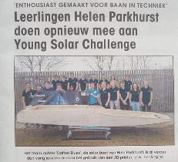
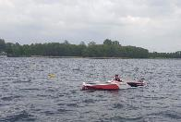
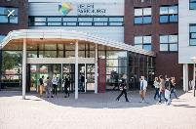
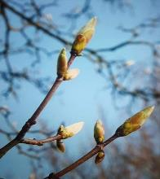
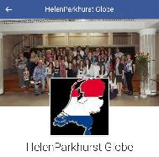
GLOBE Netherlands
Maaike Vollebregt
Teacher Helen Parkhurst,
Biology, physics and research & design
Assistant country coördinator
Member GLOBE expert group

Slide 2
Our projects in the Netherlands
National counting of Macro invertebrates
National light measurement
Mein Rhein project
Building the Grow app and lesson materials
Strategic meetings
Participate in Climate planet
GLOBE Science fair
Virtual Science fair
GLOBE –expert group.

Slide 3
Macro invertebrates
National new research project on small water animals together with Wageningen University
Notes:
We have set up our own project for water animals. The system of globe.gov is to complicated and nobody uses it. Because many students very much like the water animals investigation we have set up our own project.

Slide 4
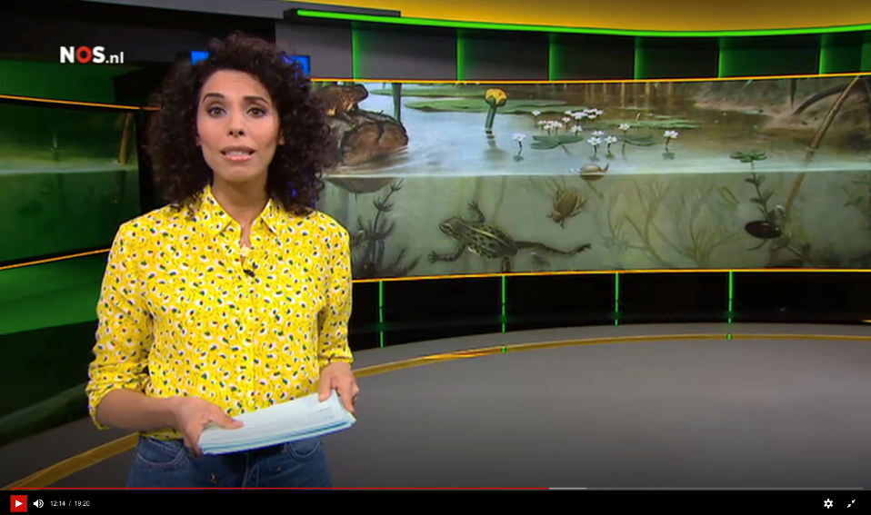
Media attention
National television, radio and news papers

Slide 5
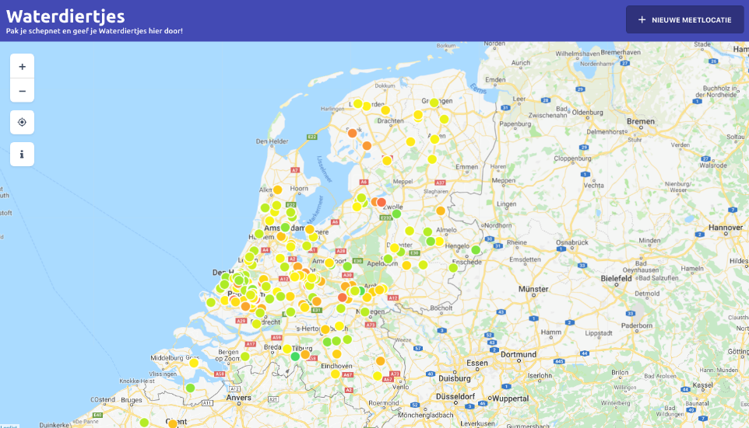
Results
Hundreds of measurements in the entire country

Slide 6
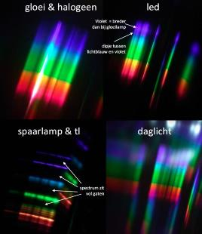
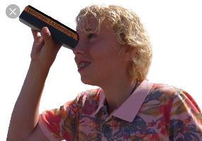
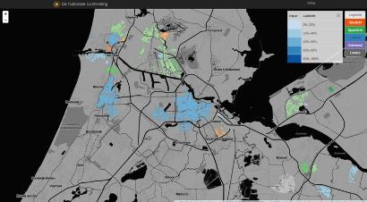
National light measurment
Students do research about the question:
How sustainable is the lighting in your neighborhood?

Slide 7
Notes:
Project van Jelle Kabbes (die was vorig jaar op de europese globe bijeenkomst, dus de mensen kennen hem wel) is van start gegaan. Hij heeft een hoop scholen gevonden en onder andere subsidie gekregen om een nieuwe app te bouwen om onderling gegevens uit te wisselen..

Slide 8
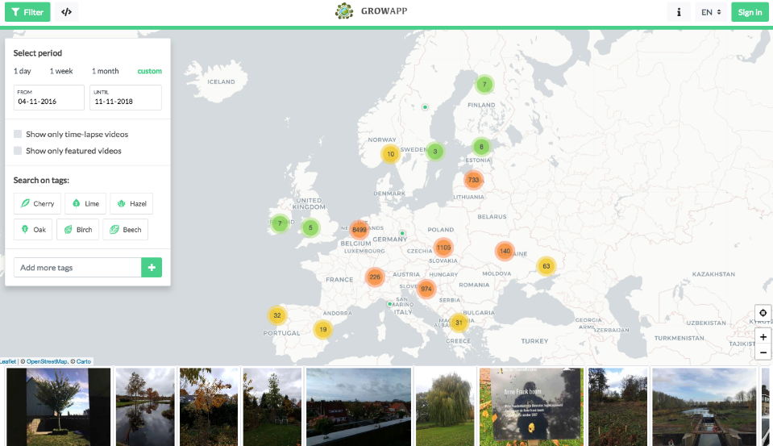
GrowApp
A new version of the GrowApp will be launched soon. With a new app and new site that will make it more easy to filter on recent pictures

Slide 10
Strategic meeting
Ambassadors of GLOBE (director national meteorological institute, director national environmental institute, rector magnificus Wageningen University) get together to discuss opportunities for projects in the field of citizen science at the school of Jelle Kabbes (Rembrandt) where a weather hut, built by student, is opened.

Slide 11
Climate planet
Giant globe with 3d projection inside about climate change. Including a teaser about GLOBE in the Netherlands

Slide 12
Climate planet
Giant globe with 3d projection inside about climate change (live NASA satellite). Including a teaser about GLOBE in the Netherlands

Slide 13
FASE IV. Presenteren op Science Fair
GLOBE Science Fair
Notes:
National science fair. Students from all over the country share their globe research

Slide 14
Awards
Notes:
They can win an award by the scientific jury, but there is also a public award (students rate each other) and an award for the globe games.

Slide 15
Science Fair 2019
Winning team Science Fair
Goese Lyceum, winner of GLOBE Science Fair 2018, receives a cheque from US ambassador to go to the GLE

Slide 16
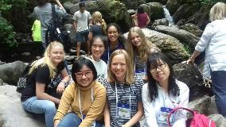
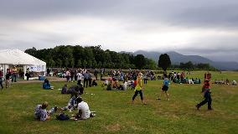
Virtual Science Symposium
Helen Parkhurst students win virtual science symposium with research on the influence of fire works on air quality
GLOBE Annual conference 2019, Detroit, Michigan
Notes:
Hier kun je zelf vast nog wel wat leuke foto’s bij zetten of iets bij vertellen ;-)

Slide 17
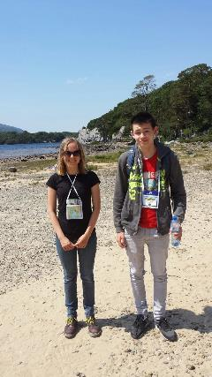
GLOBE Learning Expedition
Participation by two Dutch schools

Slide 18
GLOBE – EXPERT GROUP
Each Globe module has a scientist and a expert teacher.
Three times each year they meet each other
Expert – teacher is the contact person to other schools in the Netherlands
Scientist and expert-teacher writeing lesson materials for the dutch student and teachers.
Globe module | Scientist | Teacher
Water | Edwin peters | Alexander Meyer Renate Boxem
Weather & Climate |  | Jelle Kabbes Roeland van Oss
Aerosols | Jos van Geffen | Koen Michels
Soil | Liesbet Dirven | Frans Bezemes
Phenology/Grow-app | Arnold van Vliet | Maaike Vollebregt

