Slide 1
GLOBE Ambassador Schools in Latvia
Krisjanis Liepins
GLOBE Europe and Eurasia Regional Meeting 2018
CNES, Toulouse, France
12.-13.11.2018

Slide 2
What is GLOBE Ambassador School?
New initiative GLOBE Latvia launched on Year 2018
To reward most active schools in
GLOBE data entry
Research
and
GLOBE publicity

Slide 3
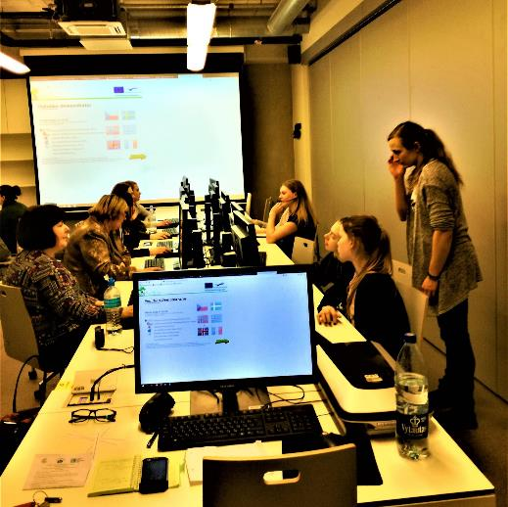
Awarding Ceremony of 1st GLOBE Ambassador Schools
Awarding of first 10 GLOBE Ambassador schools took place on the March 13th at the final conference of the project “Young Environment Explorers for Future Latvia”

Slide 4
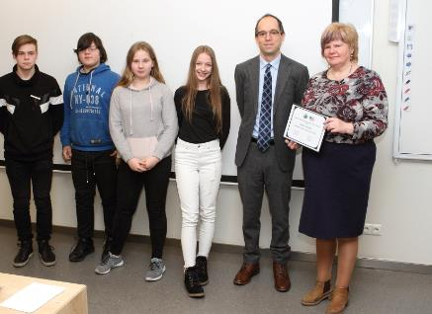
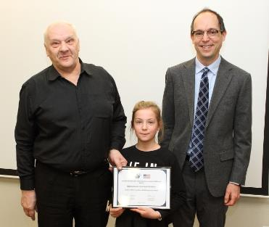
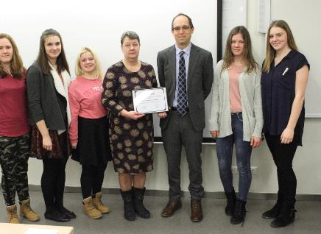
Certificates where handed by Deputy Chief of Mission of the USA Embassy in Latvia Mr. Paul Poletes

Slide 5
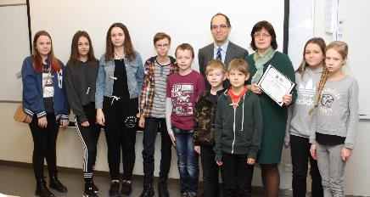
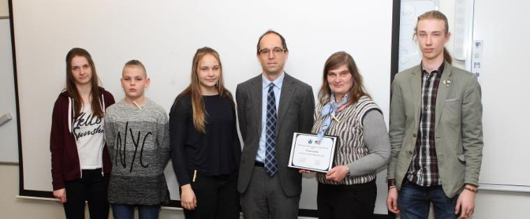
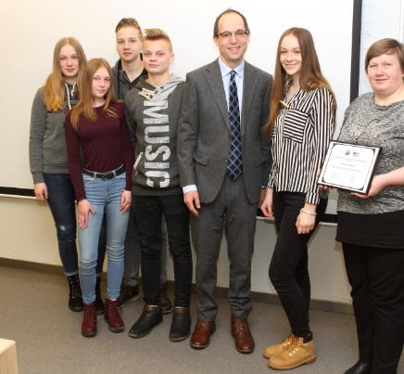
Certificates where handed by Deputy Chief of Mission of the USA Embassy in Latvia Mr. Paul Poletes

Slide 6
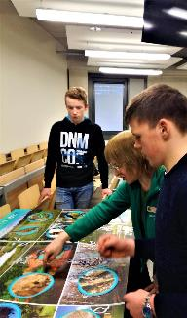
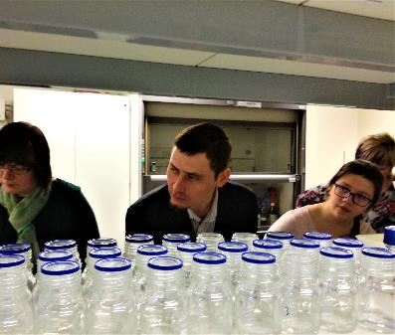
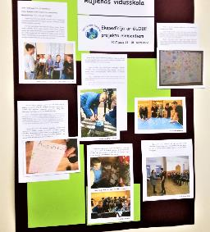
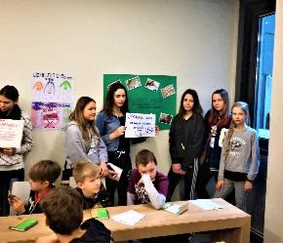
At the conference students also:
Presented work for environment they are proud with
Participated in different workshops
Enjoyed interesting lectures on science and public comunication

Slide 7
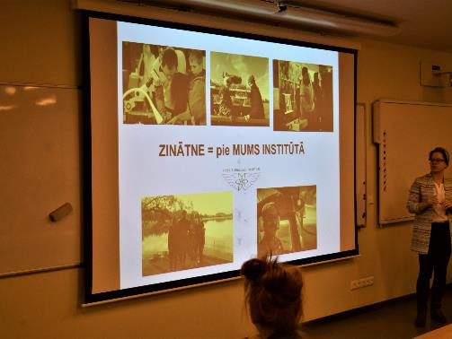
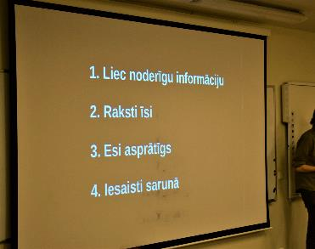
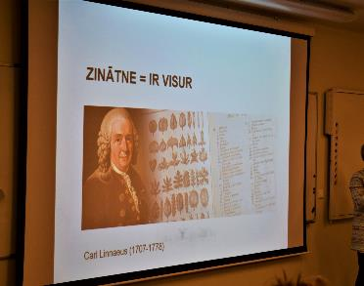

Slide 8
Thank you for your attention!
Contact us:
krisjanis@videsskola.lv
Follow us:
https://www.facebook.com/GlobeLatvija/
https://twitter.com/GLOBE_Latvija
http://www.draugiem.lv/globelv/

