Slide 1
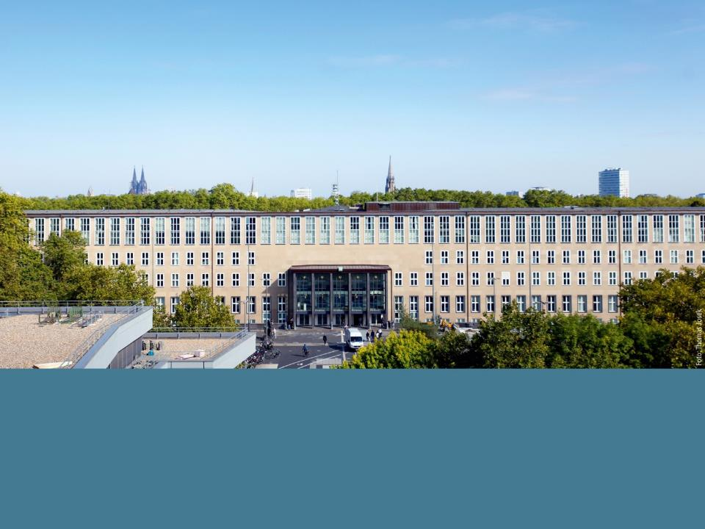

Prof. Dr. Karl Schneider Dr. Andreas Thiemer University of Cologne Institute of Geography | GLOBE Europe and Eurasia Regional Meeting 2018 Toulouse / France, Nov. 12th – 16th Highlights at University of Cologne

Slide 2


UoC’s GLOBE approach is focused on three main areas
Teaching
Research
Products
Lectures / Seminars
International lecture series
(40 – 80 students)
Scientific foundation
(30 – 40 students)
Statistical analysis
(20 – 30 students)
Inquiry-based learning
(20 students)
Training sessions
Further education
(30 participants)
Workshops
(10 participants)
Projects
Environmental Monitoring using Smartphones
(RheinEnergie Stiftung)
cubiC
(City of Cologne)
Proposal
PULCHRA
(Horizon 2020)
Theses
Bachelor theses (4)
Master theses (2)
E-Learning / Tutorials
Smartphone Apps
DataTool

Slide 3
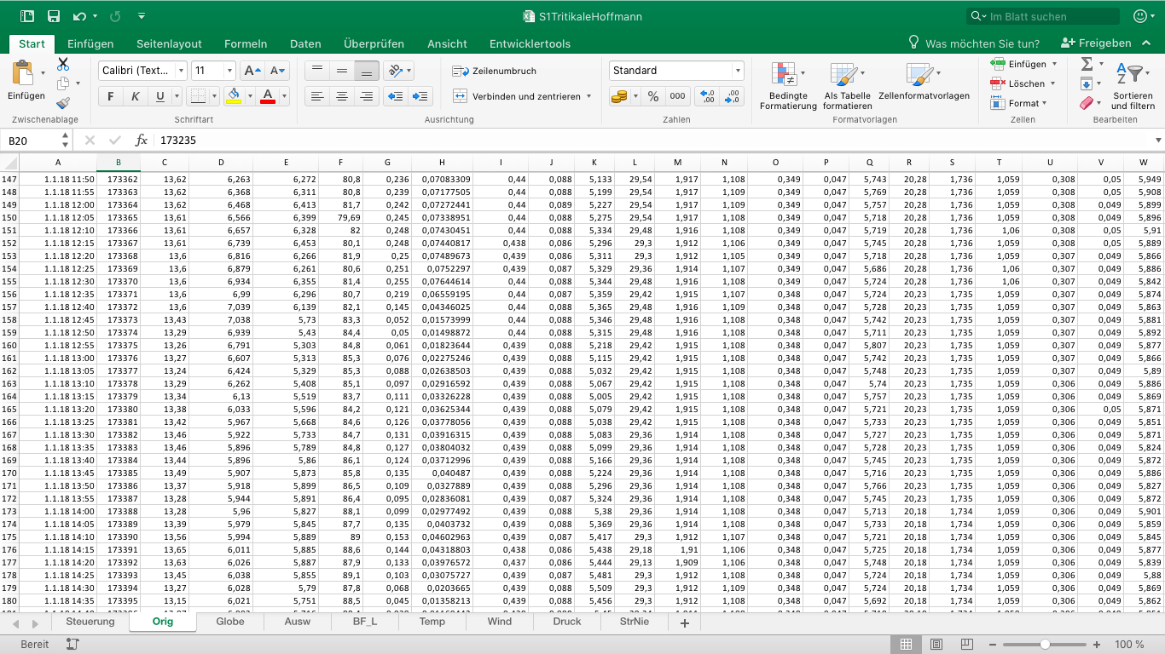

Working with large datasets is challenging
Measurements were taken every 5 minutes
288 measurements / day
2.016 measurements / week
8.640 measurements / month
105.120 measurements / year
…
DataTool converts data and submits measurements to the GLOBE database
Spreadsheet with measurements derived from the raw data of a weather station

Slide 4
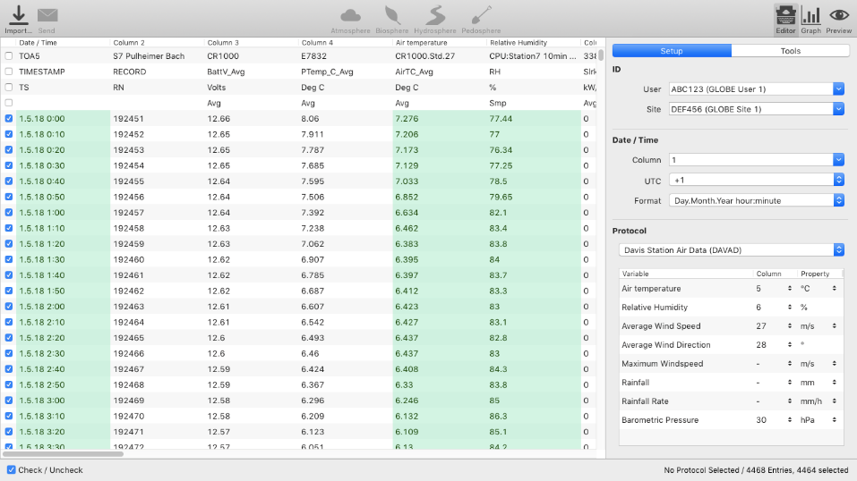
DataTool supports editing and formatting of CSV data
Data setup
Data to be evaluated is highlighted

Slide 5
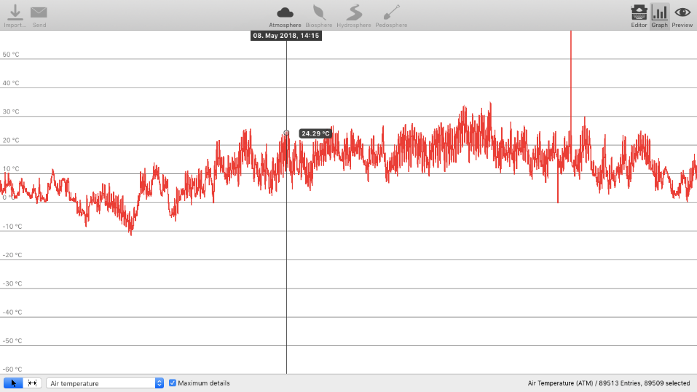
DataTool helps to visualize and analyze data
Timestamp and value
Identify outliers
Choose measurement

Slide 6
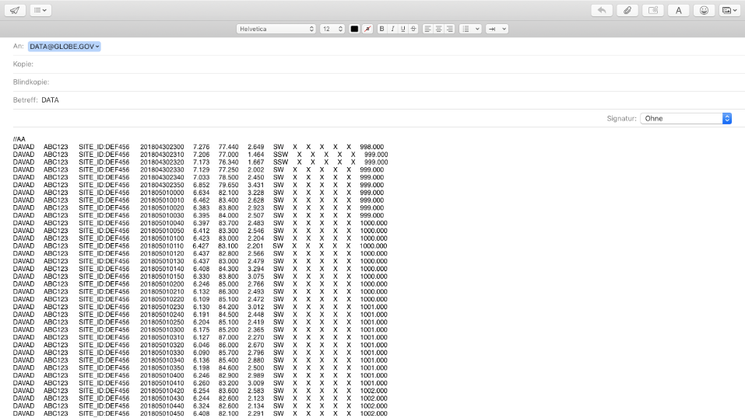
DataTool can use any e-mail client for submitting data
e-mail address
Subject
Formatted measurements

Slide 7
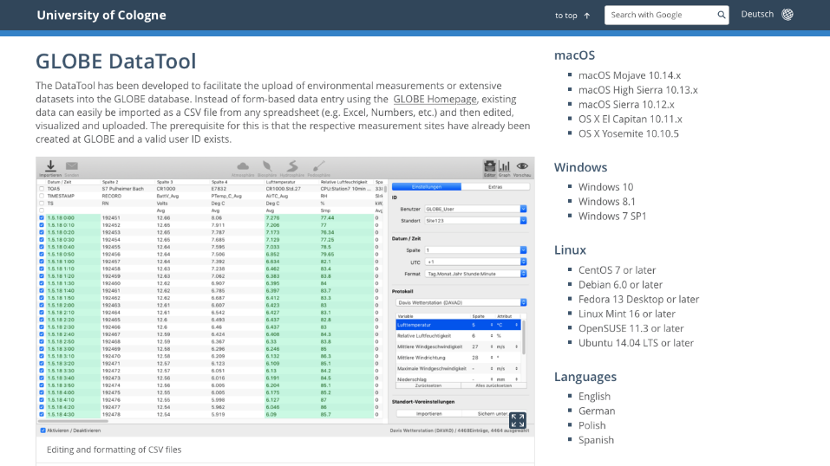
DataTool is available for the whole GLOBE community
In the making
Contributions are welcome
Download-Link: globe.uni-koeln.de/17467.html

