Slide 1
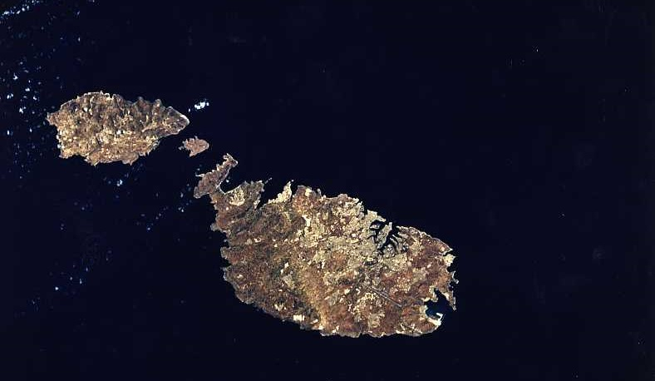
GLOBE Highlights from Malta

Slide 2
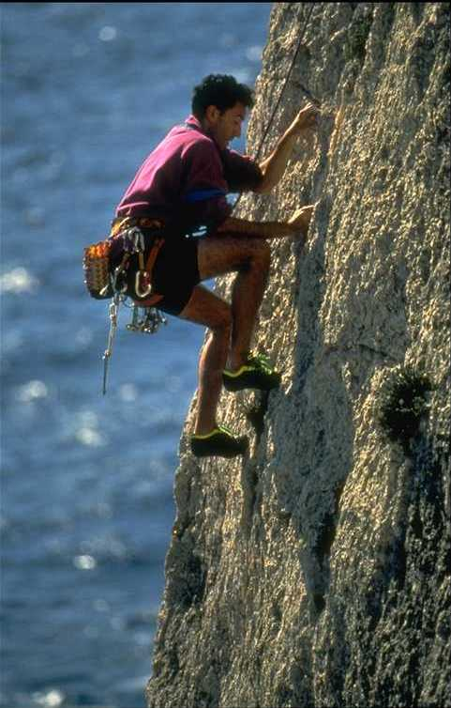
After 10 years of “inactivity”
Malta started
its
GLOBE journey

Slide 3
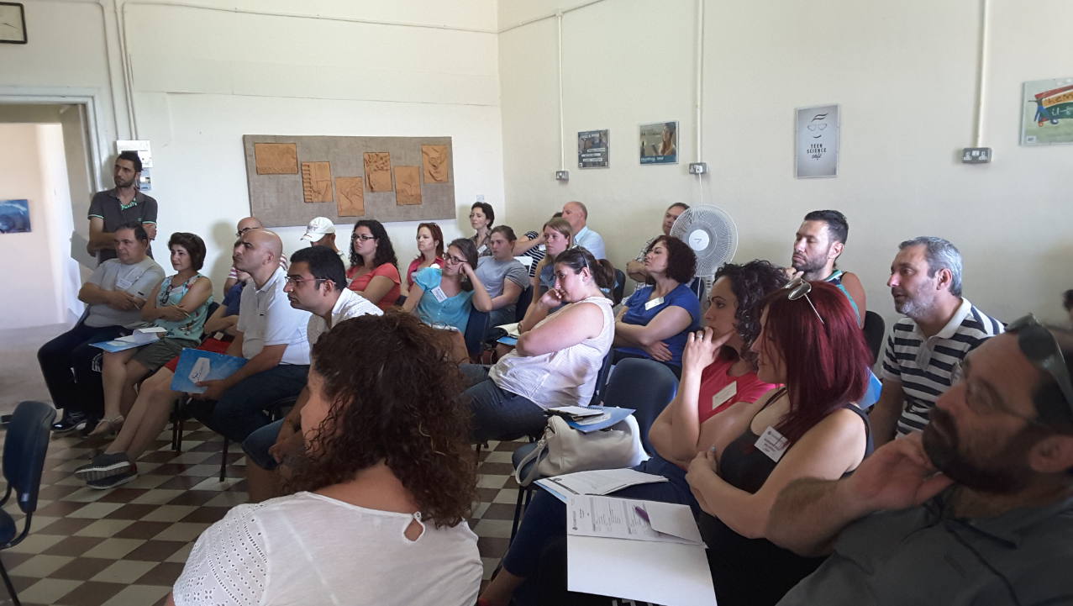
Initial plan: start GLOBE with 6 pilot schools
After training session: accept any interested school
17 schools have shown interest in starting GLOBE
(11 Primary; 5 Secondary and 1 Post-Secondary)

Slide 4
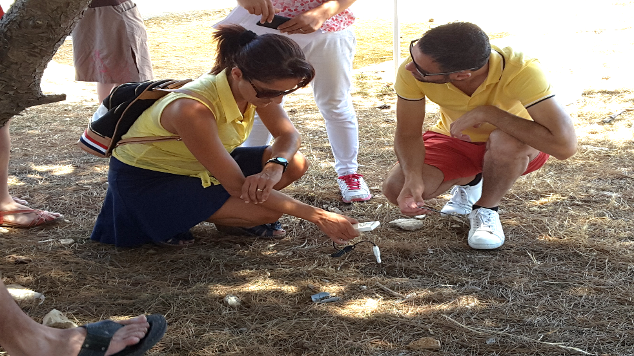
Main motivator was teacher enthusiasm
Examples of good practice from other GLOBE countries

