Slide 1
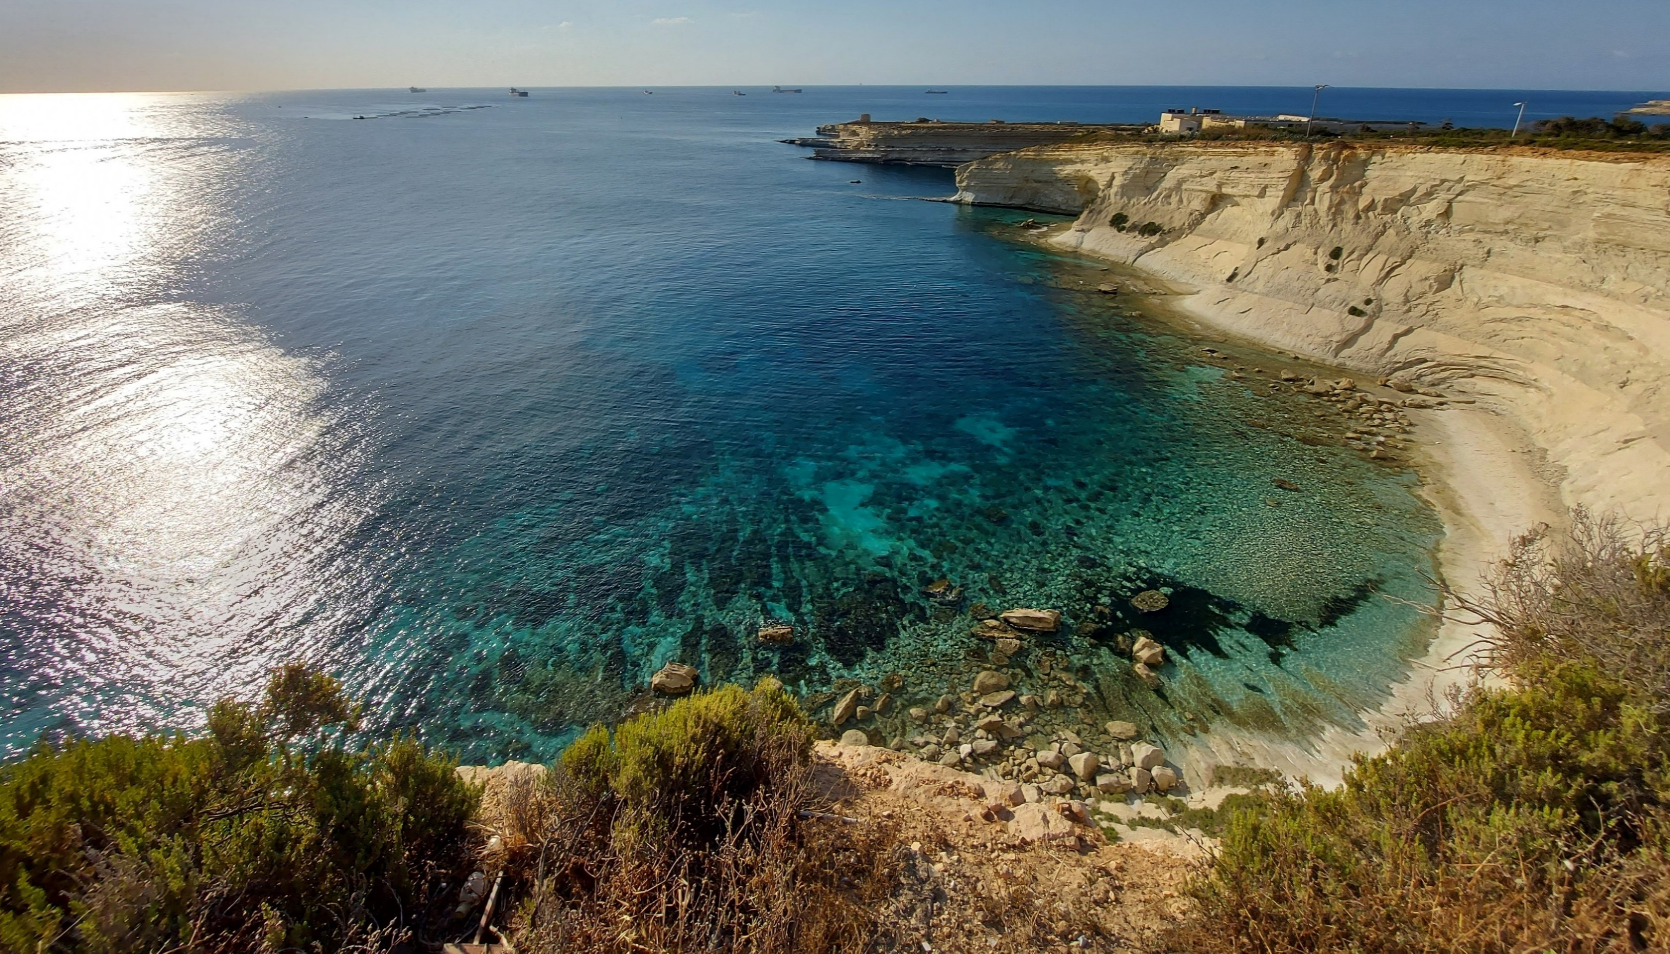
GLOBE Xrobb l-Għaġin Nature Park
A Platform for Collaboration

Slide 2
ESD @ Xrobb l-Għaġin organised virtual fieldwork to “take the outdoors indoors” during the pandemic.
The aim of the collaboration with GLOBE Malta was to showcase how GLOBE is:
an amazing opportunity to engage in DOING science rather than “study science for exams”
a versatile tool that makes citizen science easy, engaging and useful for all stakeholders

Slide 3
What was done?
Three different fieldwork sessions were offered to all school of the Maltese Islands and were delivered from the outdoors at the park throughout January to June 2021.

Slide 4
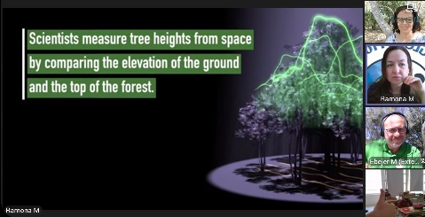
Fieldwork 1: Focus - Weather
Ms Ramona Mercieca GLOBE deputy coordinator for Malta delivered a presentation for each session where she introduced the GLOBE Program, illustrated how to use the GLOBE Observer App, and presented protocols and campaigns depending on the focus of the fieldwork.
Mr Neville Ebejer from Ambjent Malta was a guest speaker for the third type of fieldwork, demonstrating and inspiring students on why and how to sow and grow indigenous trees.
All sessions proceeded with my contribution where I made live online GLOBE observations with the participation of the students and guided them to use the GLOBE observations to understand local and global sustainable development (SD) matters.
Fieldwork 2: Focus – Greening Up
Fieldwork 3: Focus – Tree Height & Carbon Cycle

Slide 5
GLOBE Protocols and Campaigns presented:
How to take surface temperature
What is the Urban Heat Island Effect (UHIE)
How to measure Tree Height
The European Phenology Campaign
Greening Up and Greening Down protocols
Here is what some students shared about GLOBE elements....
J. Azzoppardi and K. Chetcuti from Mater Boni Consilii School, Paola

Slide 6
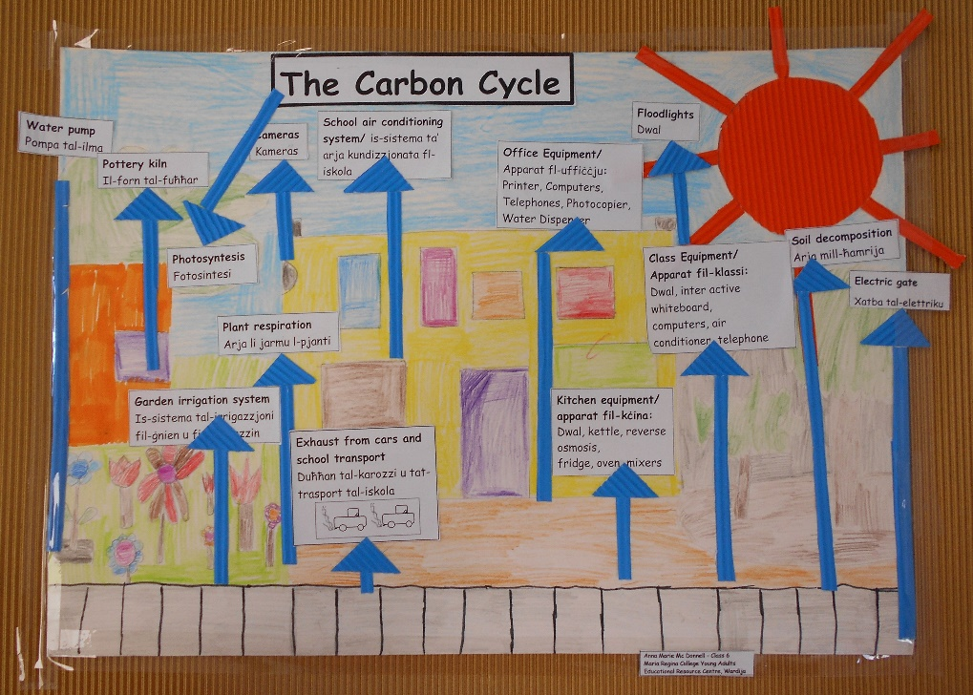
SD themes discussed:
UHIE
Climate change
Carbon cycle
Benefits of trees
Land use issues
Earth as a System
Actions needed to curb down changes in the environment
Placed within the international context through SDGs
Here is what some students shared about the environment and SD themes
...
A Carbon Map follow-up activity by Wardija Resource Centre students as suggested on the GLOBE website
K. Grasso & M. Bianco from Mater Boni Consilii School, Paola

Slide 7
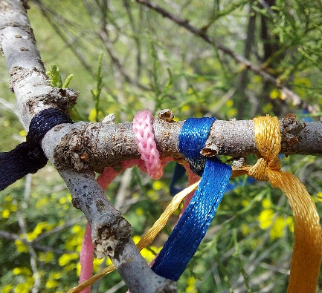
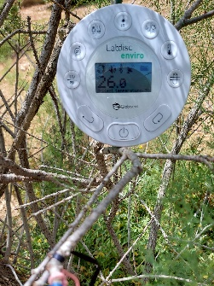
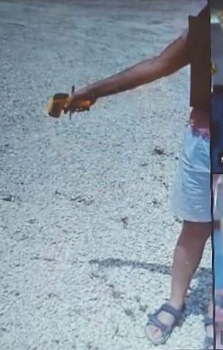
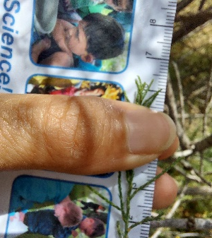
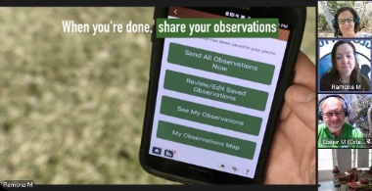
How was this achieved online?
Some details on fieldwork 2:
presented my on-going green-up observations of an African Tamarisk.
made weather observations together
took Surface Temperatures of bare land within the park were taken and compared to that of green patches.
Discussions highlighted:
How the very early greening up of the tree relates to the exceptionally hotter February noted in the weather observations (climate change?)
How bare land gives rise to the UHIE
How we can take action every day
How sharing our observations with GLOBE helps scientists monitor these changes and suggest actions needed
Presenting greening up observations
Taking surface temperature readings

Slide 8
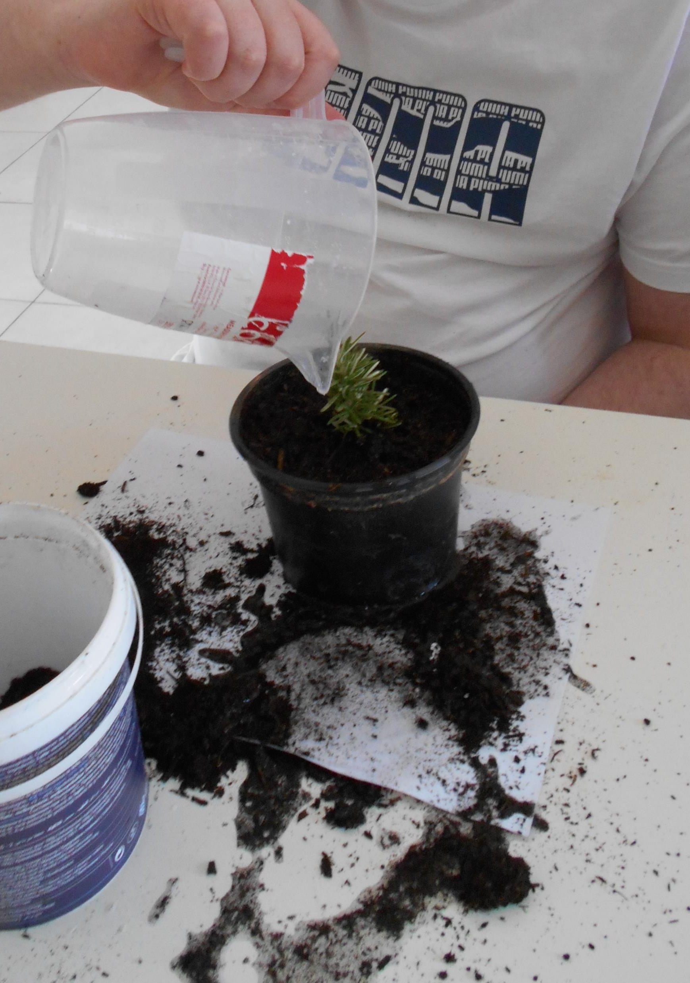
Some classes took action seriously with immediate effect!
(Pictures from Wardija Resource Centre in a session of Fieldwork 3)

Slide 9
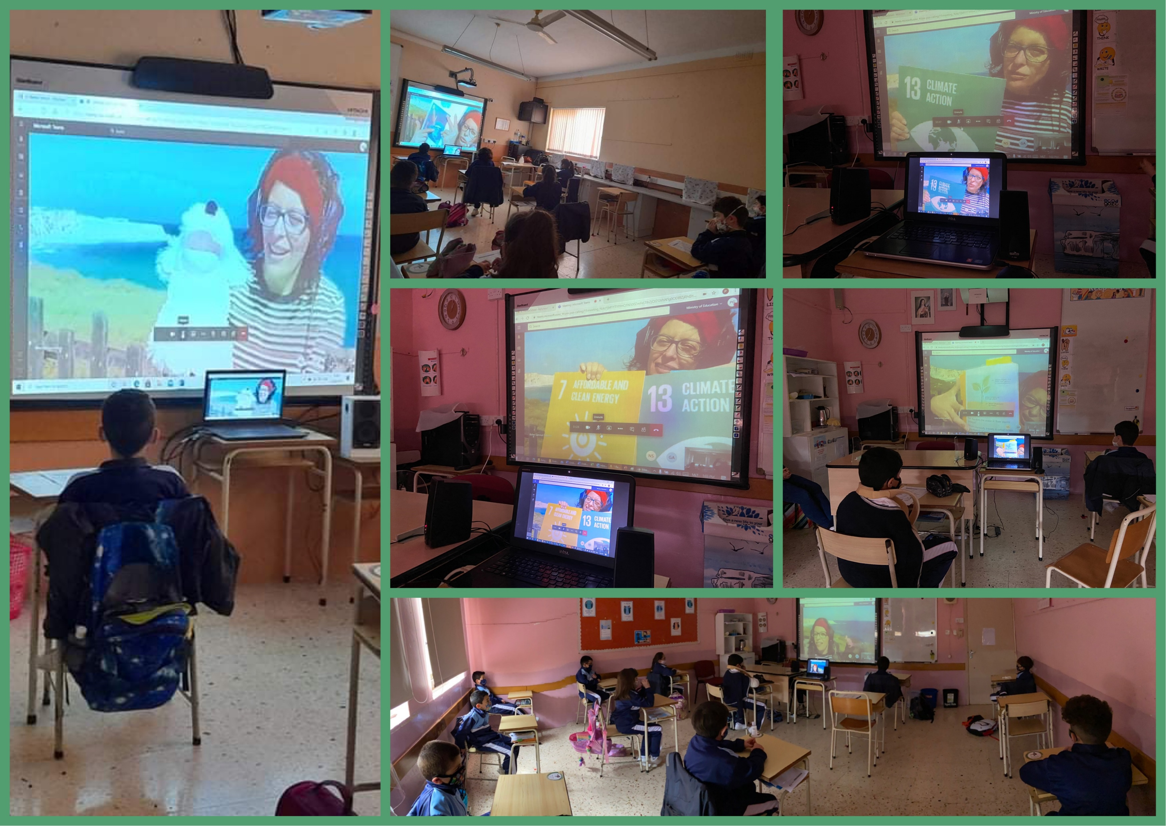
A sneak peek in the classroom...
(Picture collage from a session of Fieldwork 1: Sta. Theresa School, Kerċem, Gozo)

Slide 10
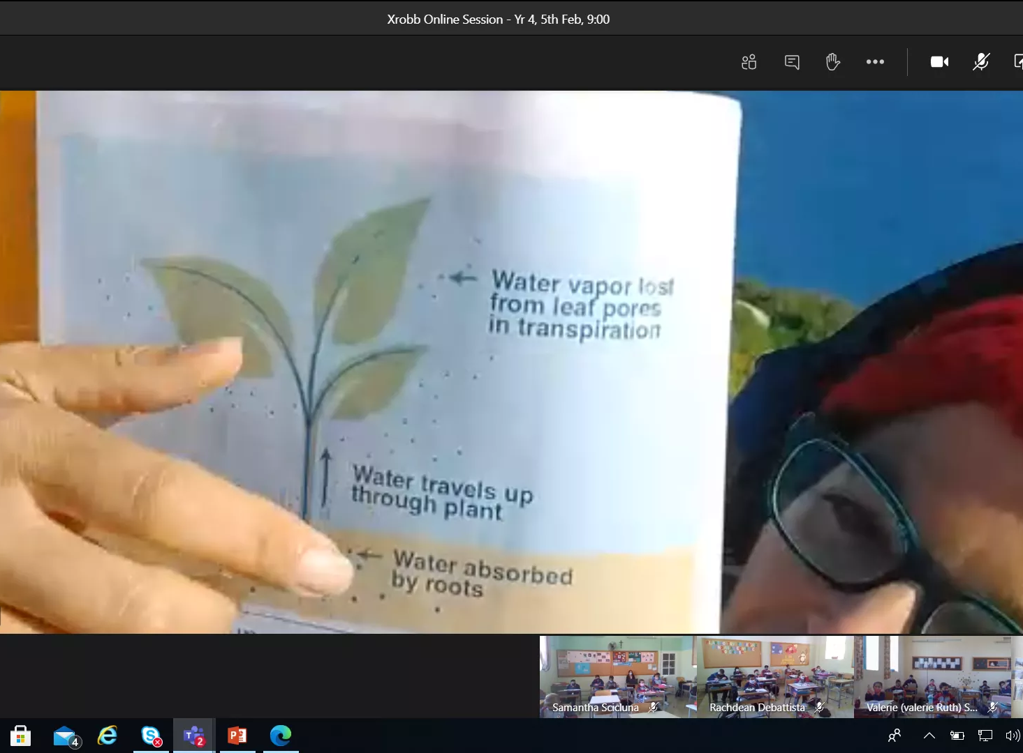
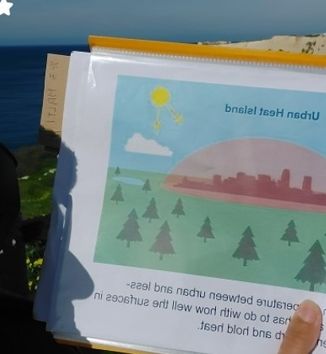
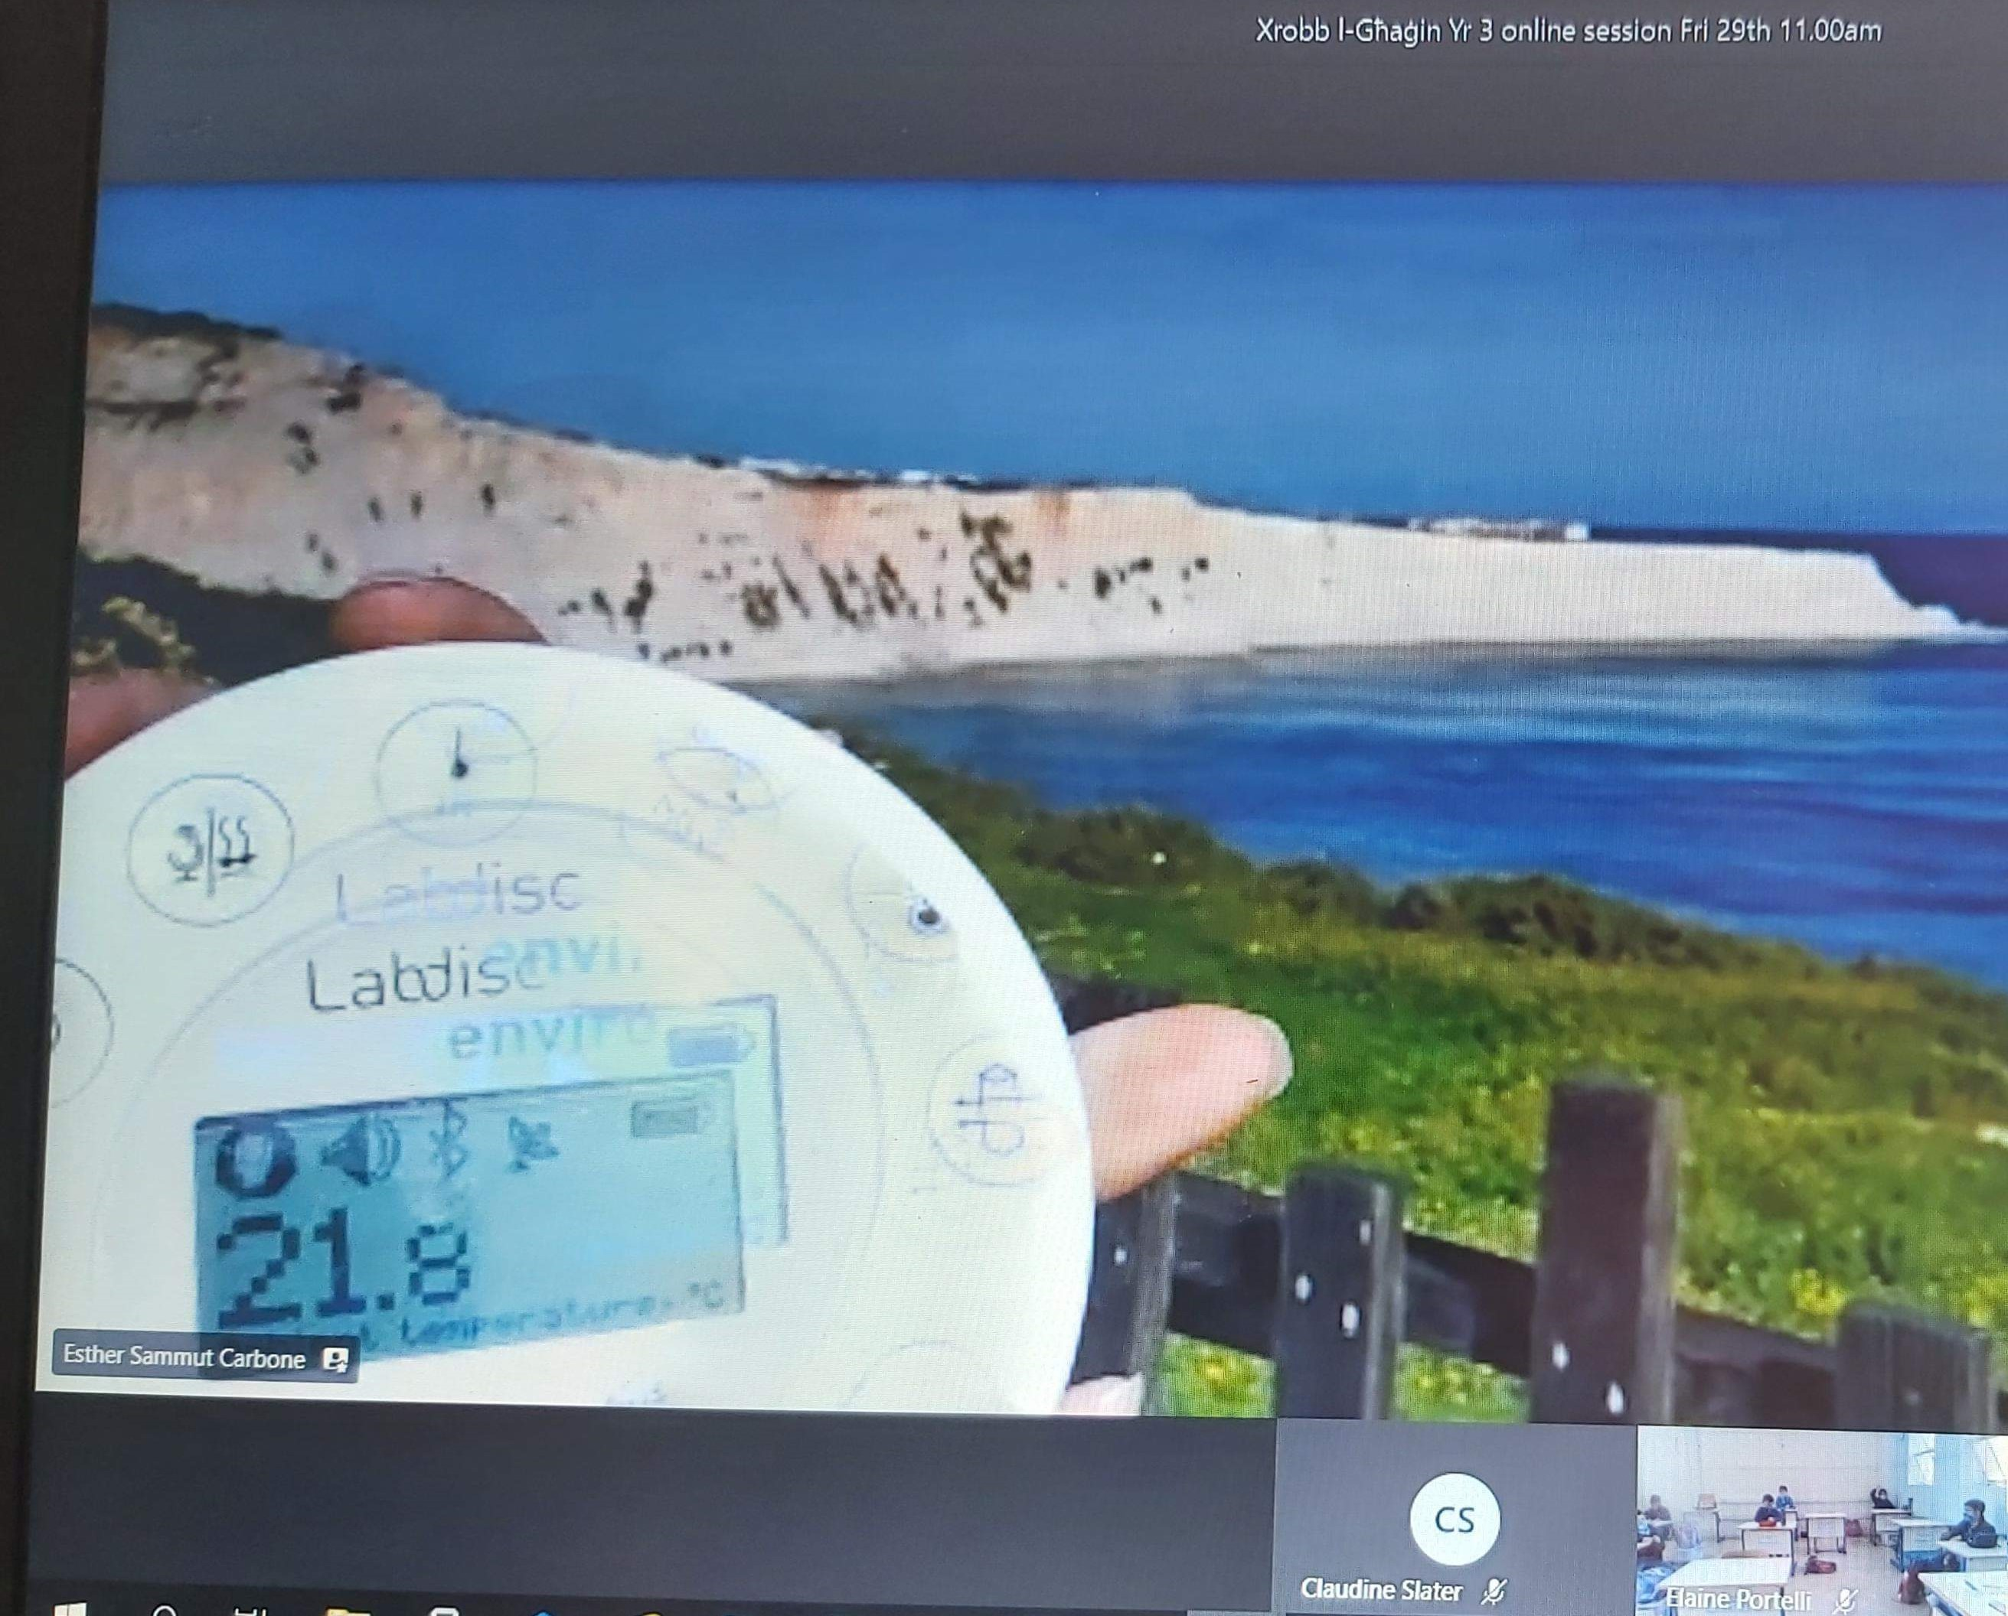
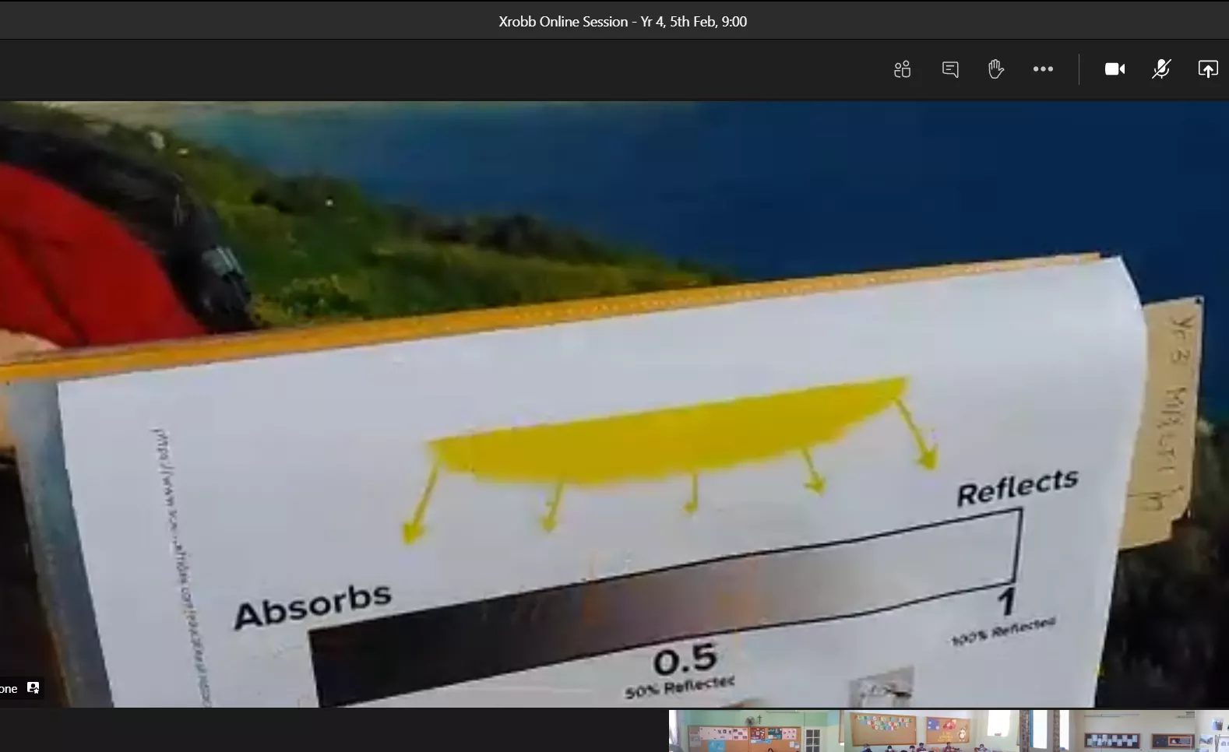
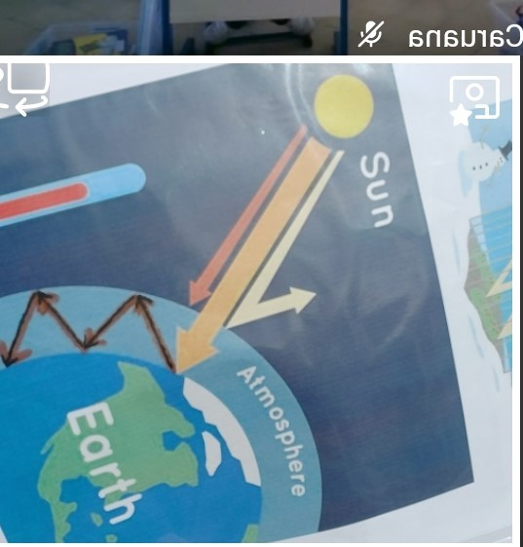
A few more snapshots and feedback...
Understanding UHIE
Taking measurements together.
Understanding Global Warming
“I just want to tell you well done. The students enjoyed it and learned a lot! The teachers were satisfied as well!” (Ms. Farrugia at St Aloysius College, Malta)
“I congratulate you on the interesting experience you offered our students.” (Ms. M.V. Demanuele at Sacred Heart, Malta)

Slide 11
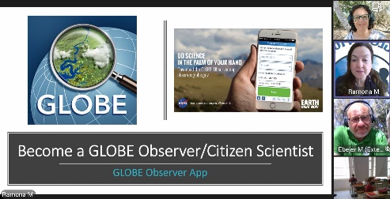
Reached 1674 students and educators across Malta and Gozo in state, private and church schools.
Students experienced how cool and easy it is to do science from the palm of your hand, especially by the user-friendly GLOBE Observer App...
“Thank you so much, it was a very informative session, will definitely try out the apps after the benchmark exams.”
(Ms Buttiġieġ from St Paul’s Missionary College)
Here’s what a Learning Support Educator shared about the experience
...
Mariella Gerada, LSE at Cospicua Primary

Slide 12
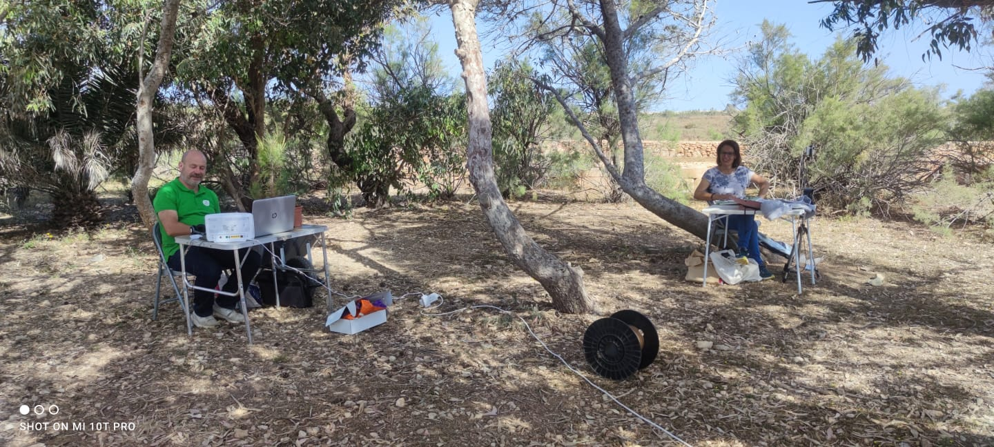
Plans for the future...
GLOBE Malta Deputy Coordinator, Ramona Mercieca stated: “thanks to these live observation sessions we managed to reach out to more students, teachers, and parents – and make them aware of the great opportunities offered by The GLOBE Program. GLOBE Malta is excited to get more students involved in data collection through new collaborations planned with Xrobb Għaġin Nature Park.”
My aim for the future is also to keep on integrating GLOBE in ESD @ Xrobb l-Għaġin and inspire schools in future on-site visits to get engaged in The GLOBE Program beyond their outing to Xrobb l-Għaġin Nature Park. Serving to motivate schools to become other GLOBE sites as a ripple effect of the outing to the park would be an honour!
Thanks for Your Attention
GLOBE – Xrobb l-Għaġin Nature Park, Malta
Guest speakers: R. Mercieca, N. Ebejer
Students & LSE: J. Azzoppardi, K. Chetcuti, K. Grasso, L. Camilleri, M. Bianco, M. Gerada
GLOBE teacher – Esther Sammut Carbone
esther.sammut.carbone@ilearn.edu.mt

