Slide 1
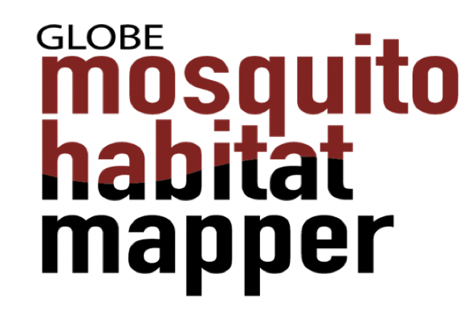
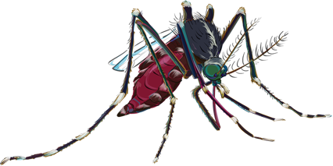
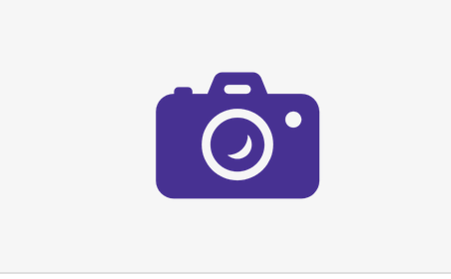
Citizen Science Data 2017-2020 Outcomes that Make a Difference
Russanne D. Low
NASA GLOBE Observer Science Lead
Mosquito Habitat Mapper
Virtual LAC Regional Meeting
November 20, 2020

Slide 2
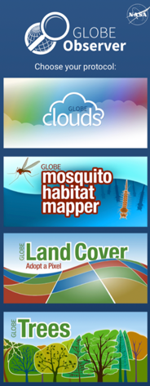
Outline
Why the Mission Mosquito campaign is important
Outcomes so far
What’s next
Let’s your students in mosquito vector research
How the GO MHM team can help you

Slide 3
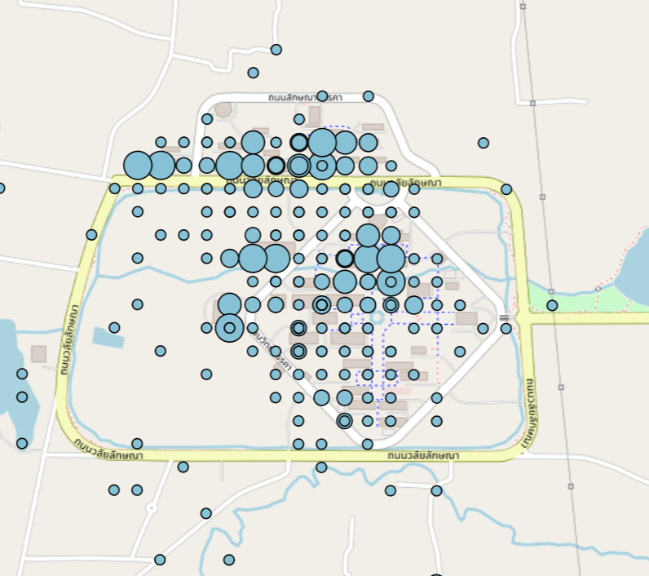
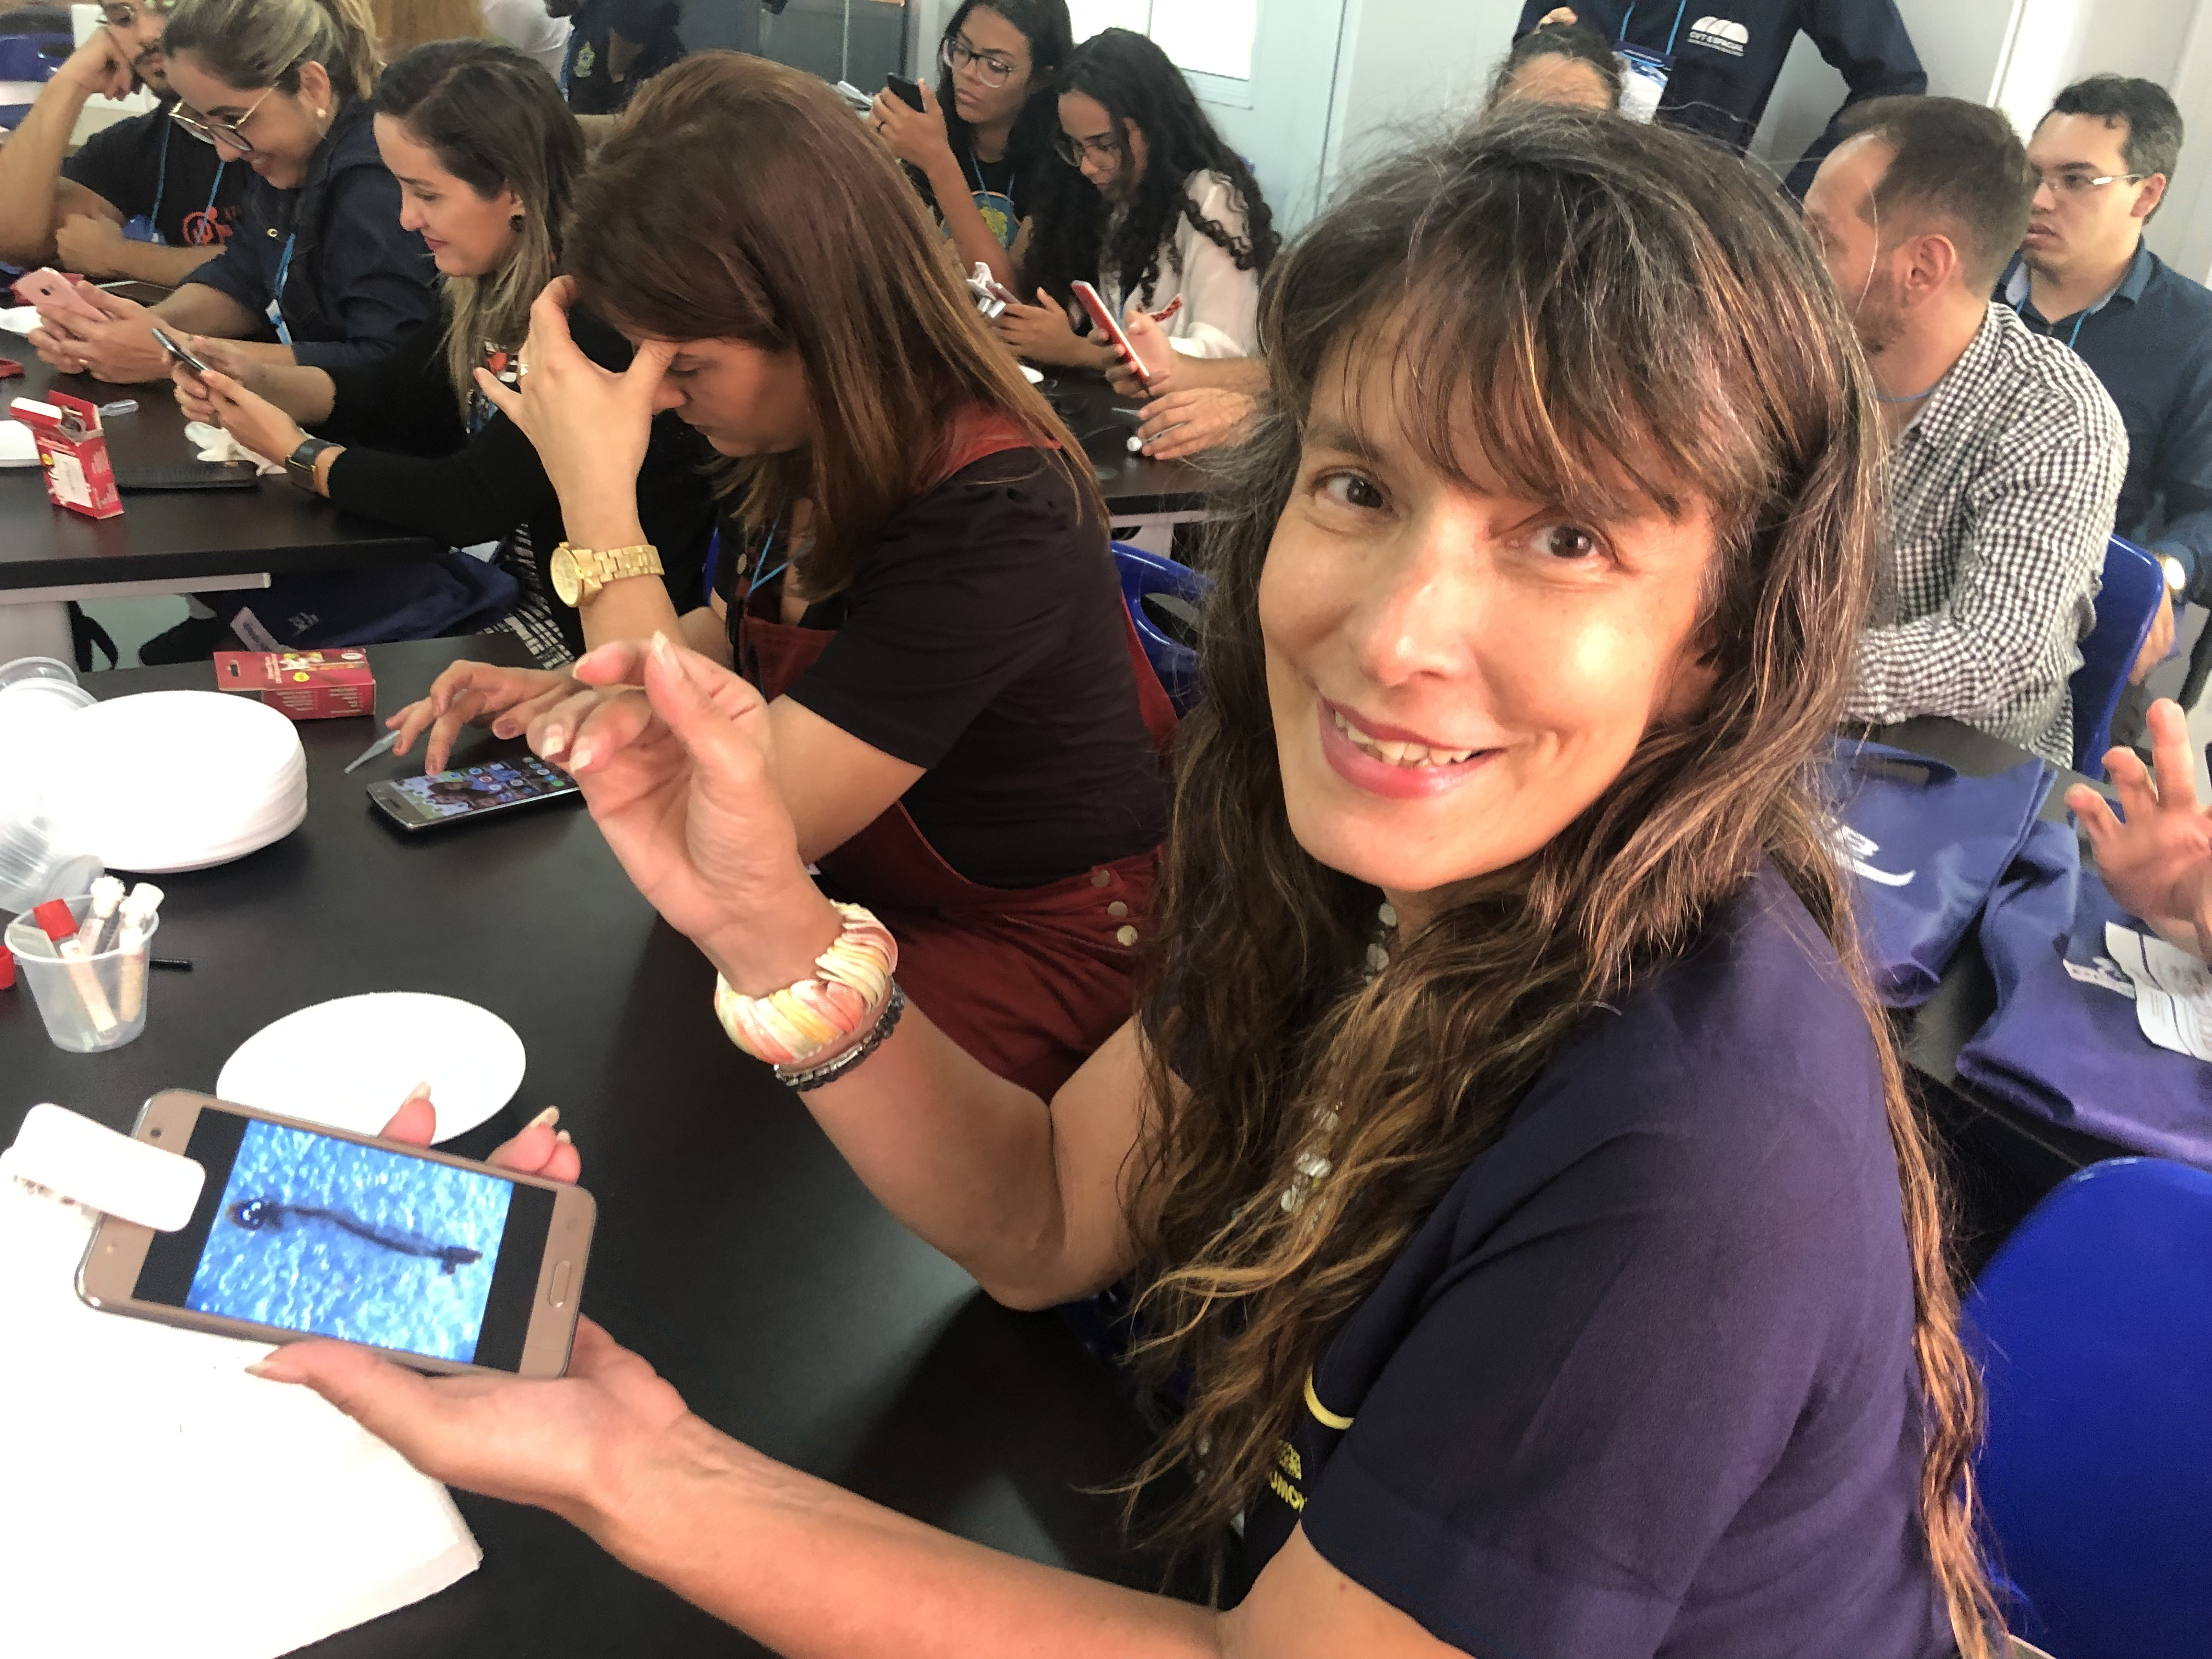
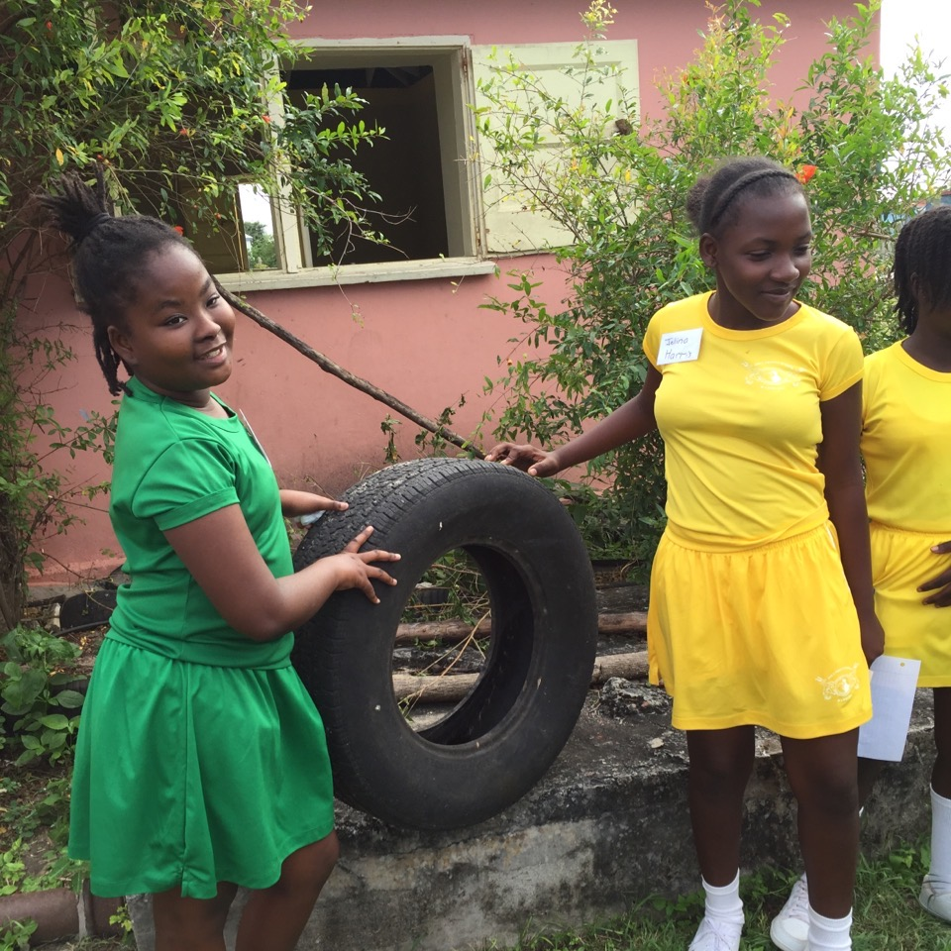
Project Goals:
Facilitate scientific research on mosquito vectors of disease by connecting breeding site data with land cover and satellite data: these data are used by scientists creating predictive models of mosquito vector-borne disease
Provide data that will support vector control and disease management at local, regional, and global scales
Educate the public about mosquito habitats and encourage vigilance and removal of potential and actual mosquito oviposition sites

Slide 4
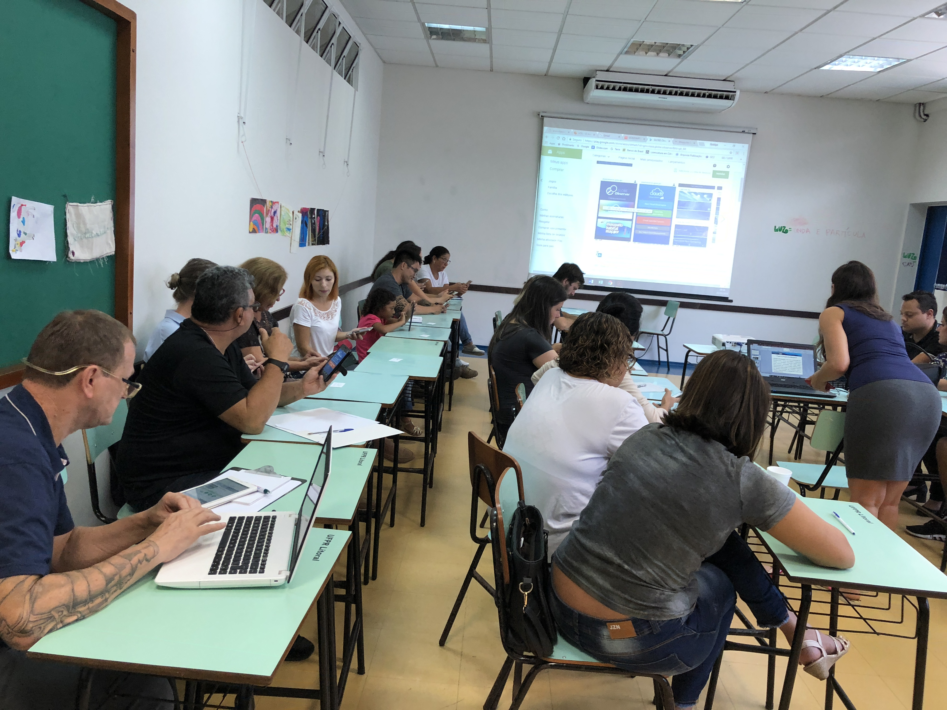
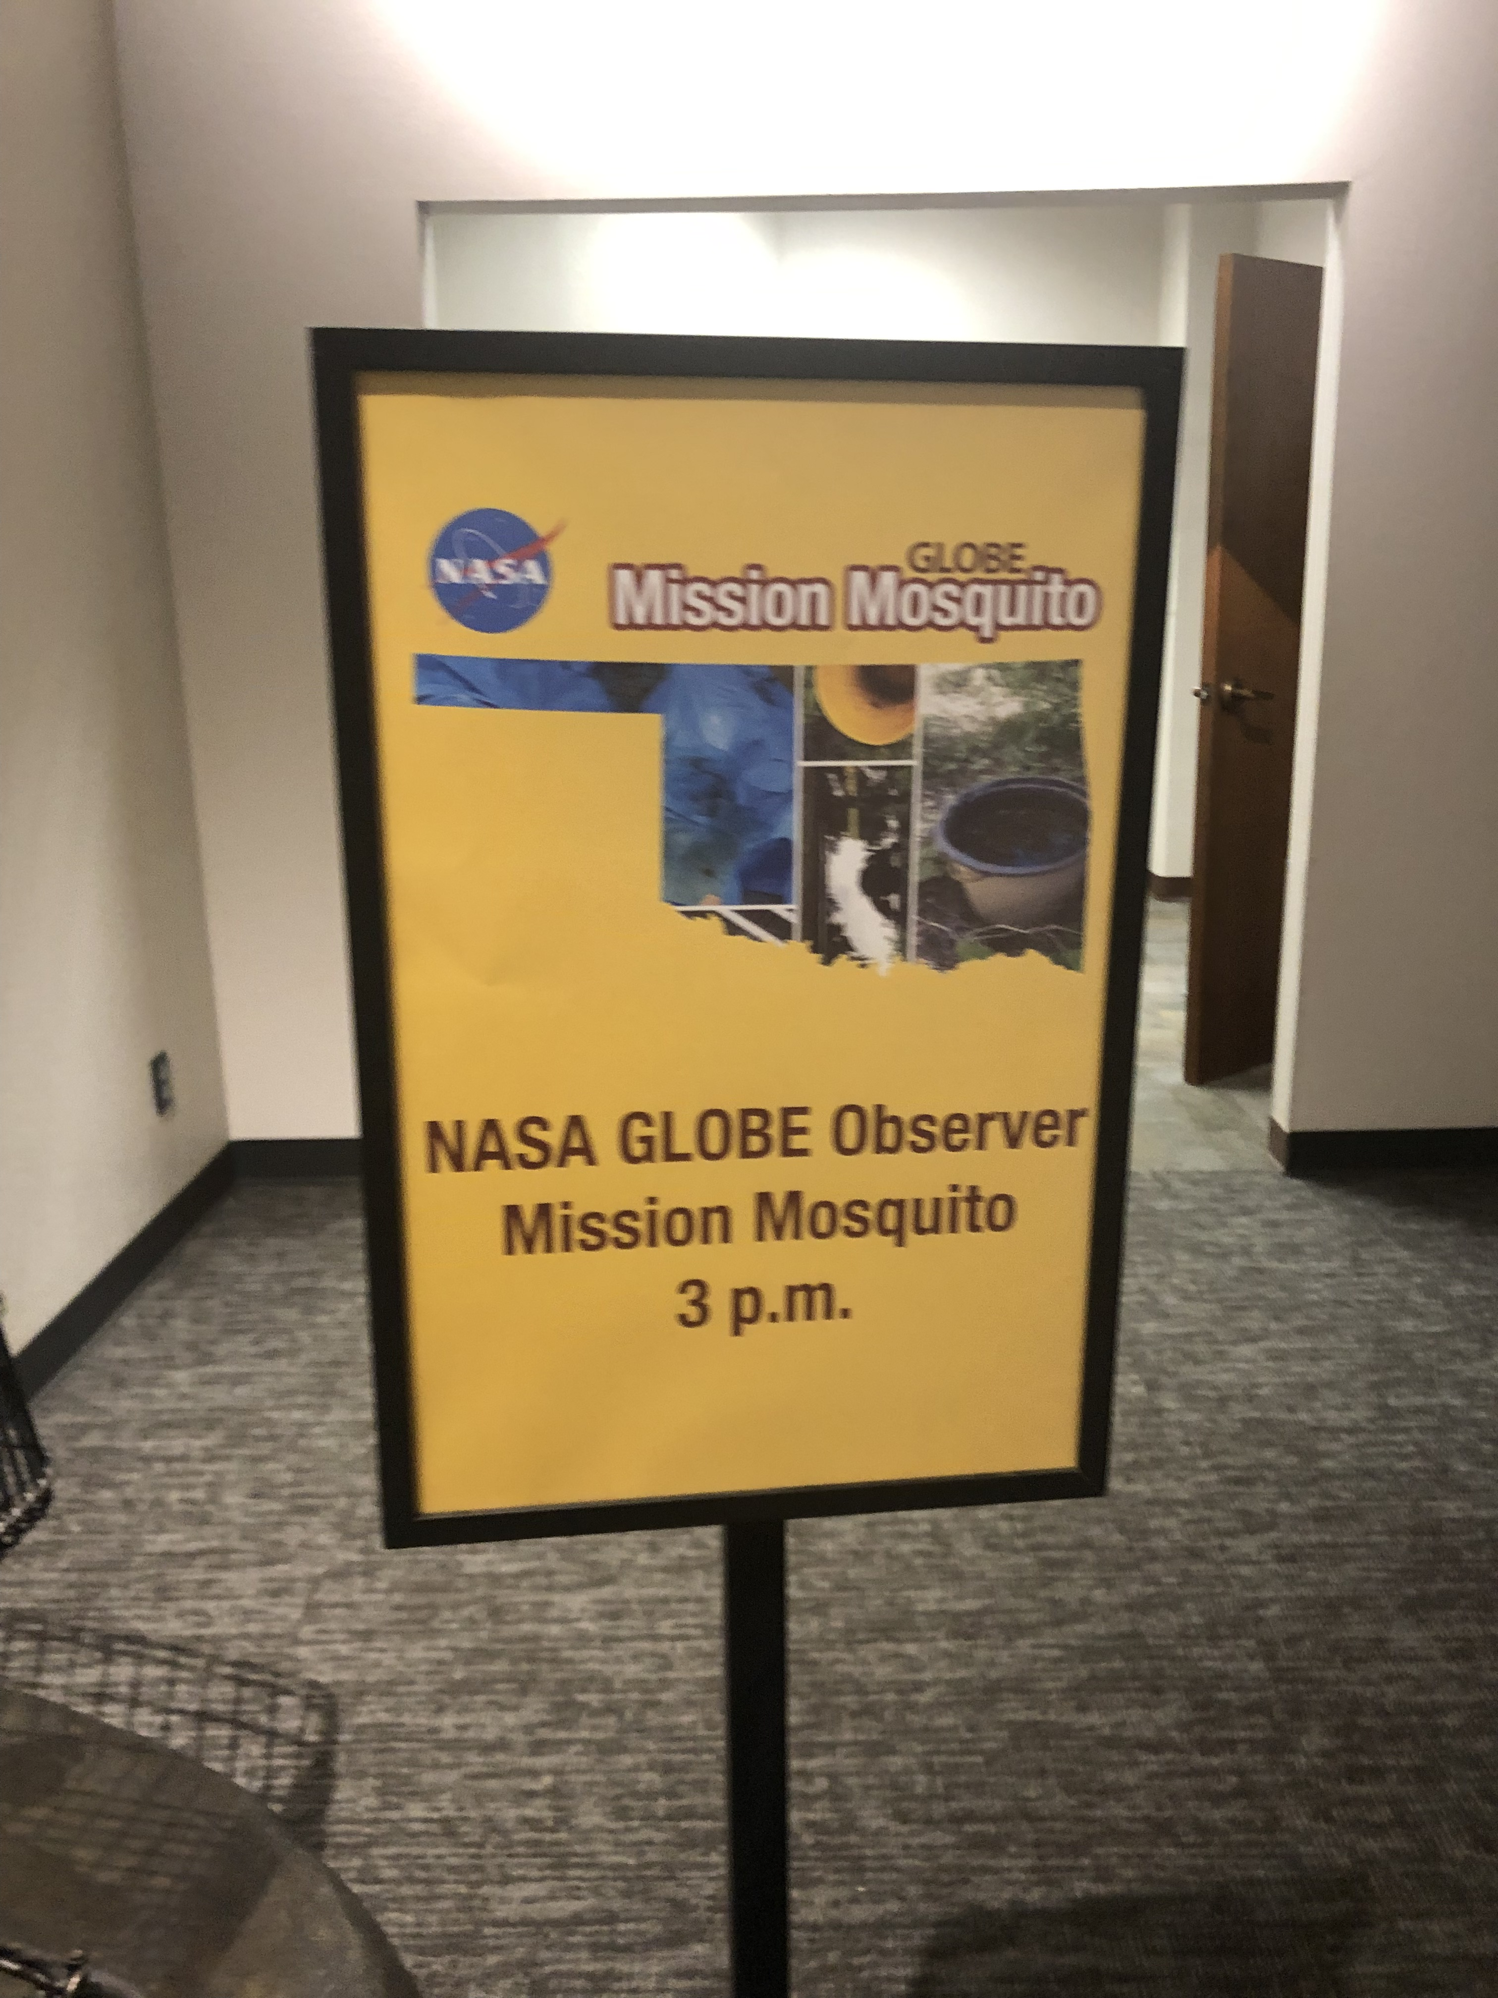
it is a powerful tool to create scientific collaborations across communities. Public health and mosquito control agencies have good reasons to collaborate with you
The tool can play several roles in a comprehensive public engagement and outreach initiative connected to work by public health departments and mosquito control agencies.

Slide 5
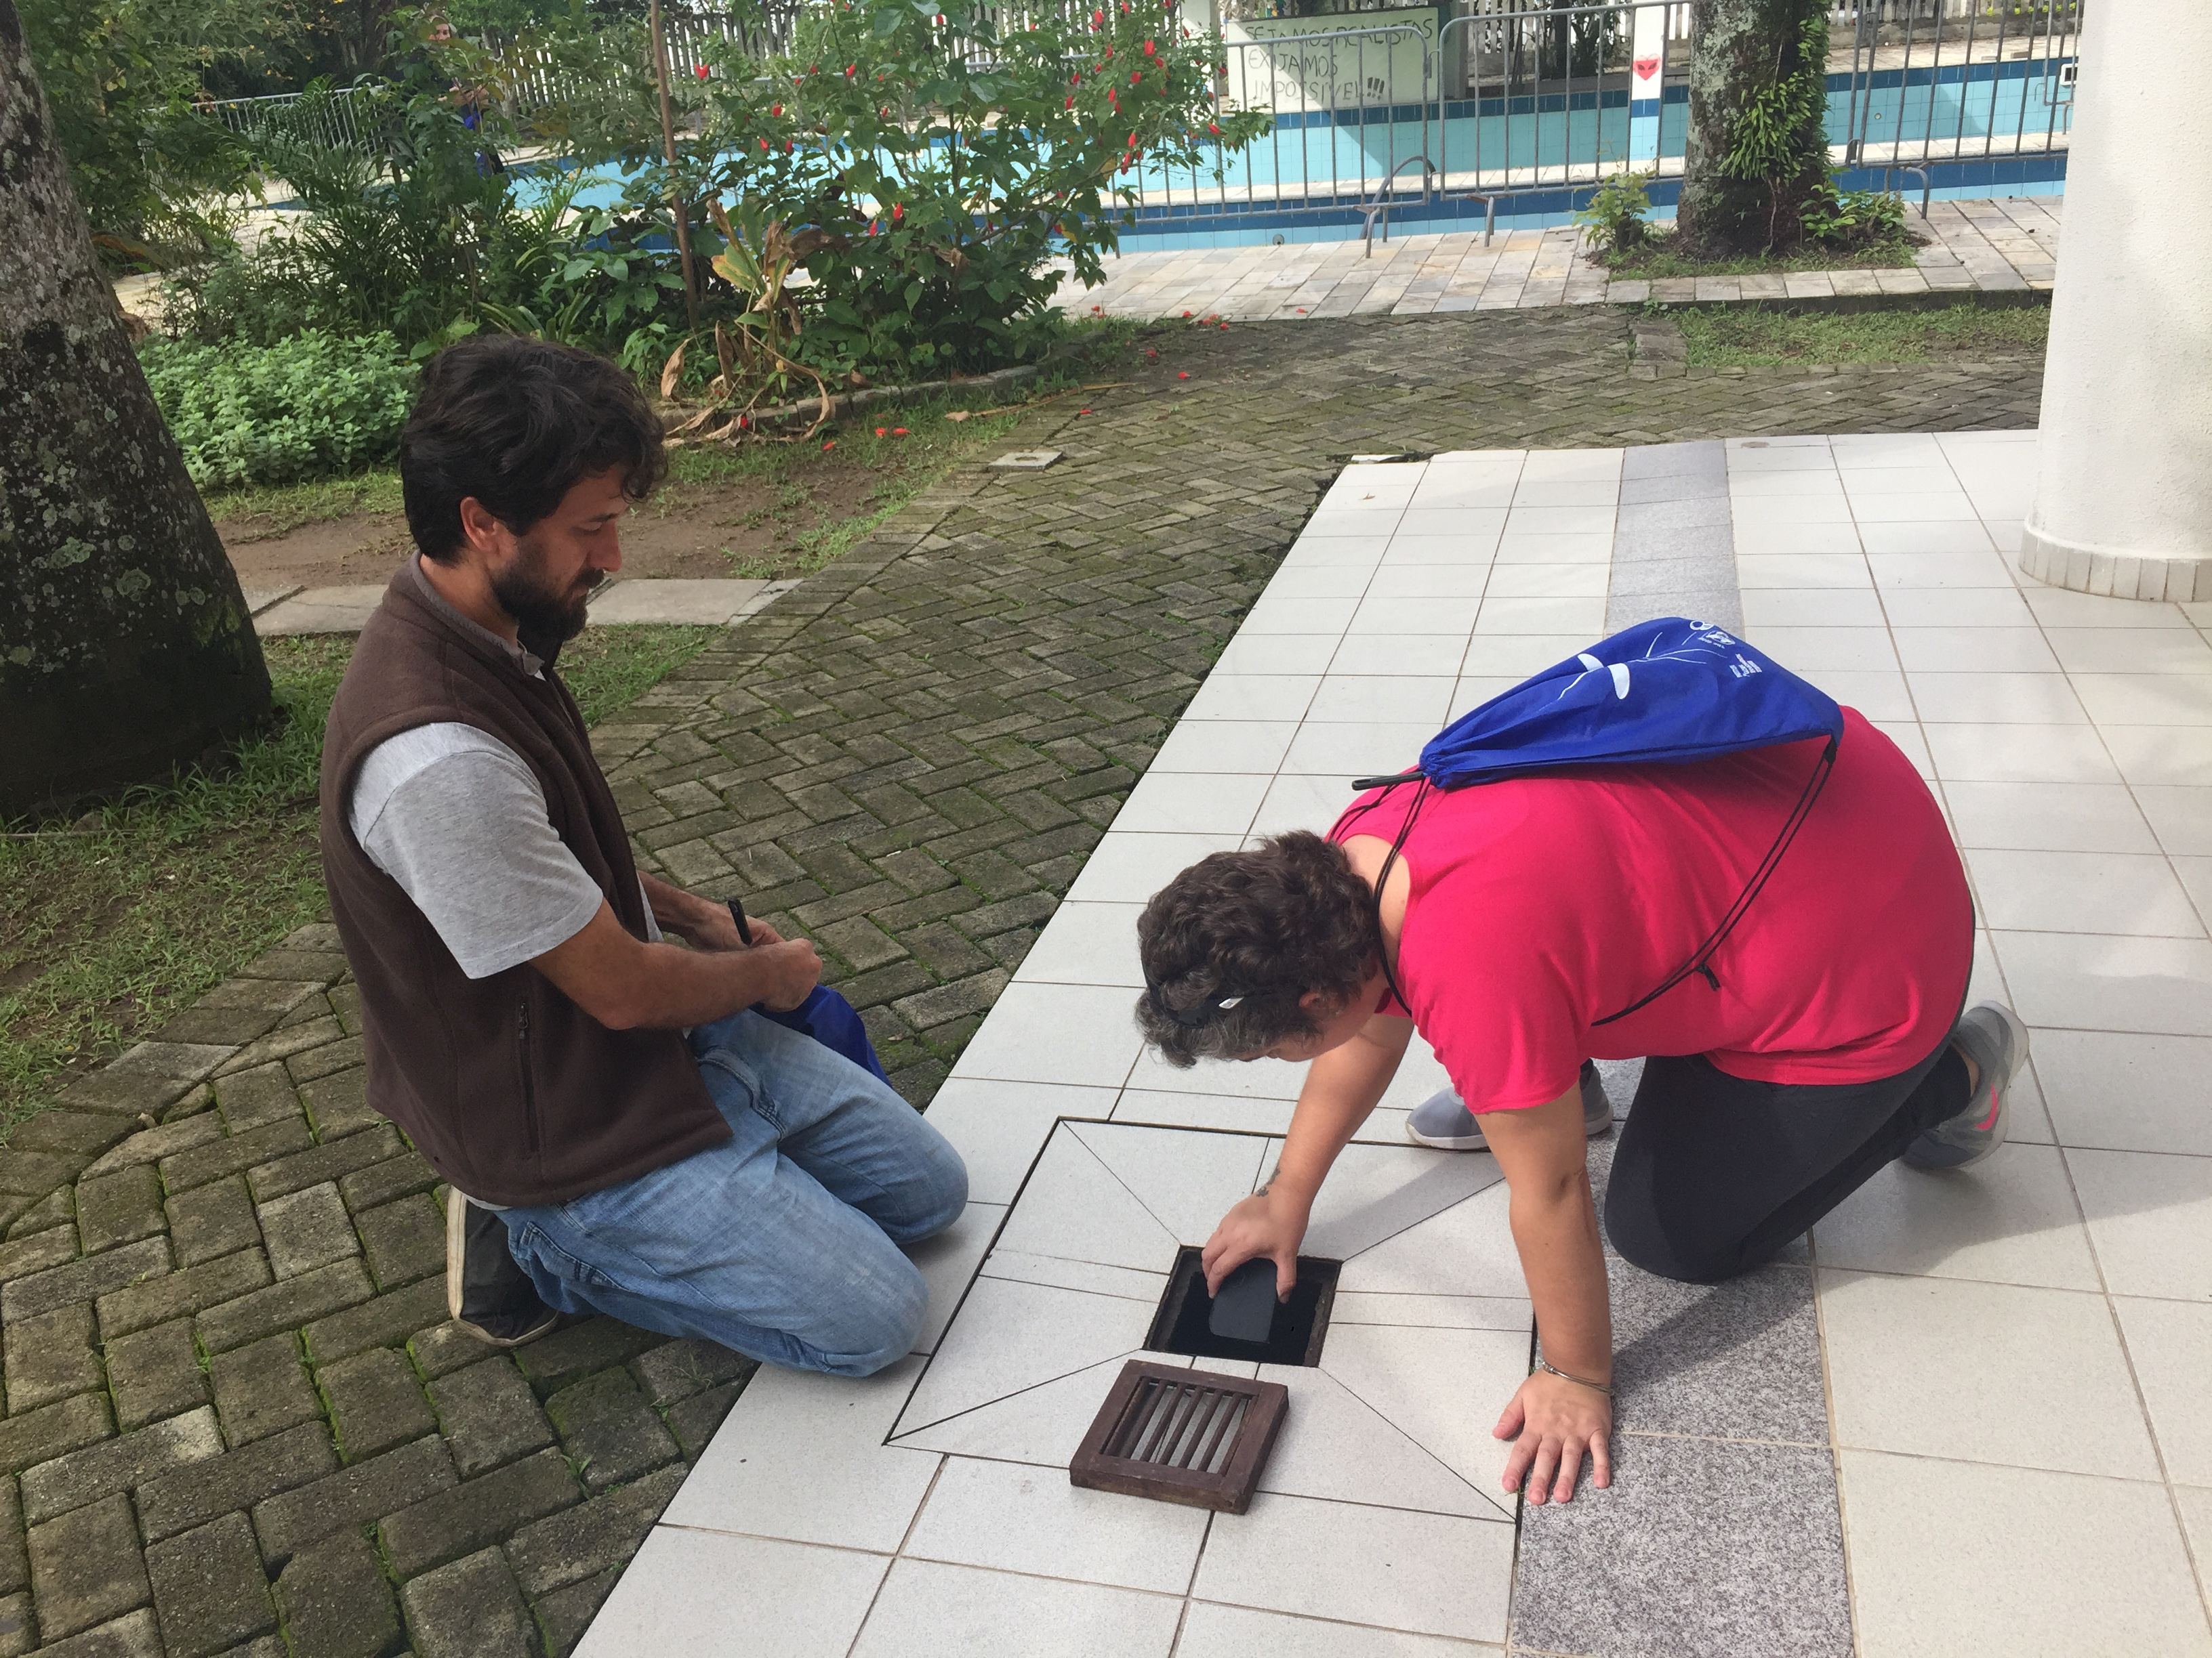
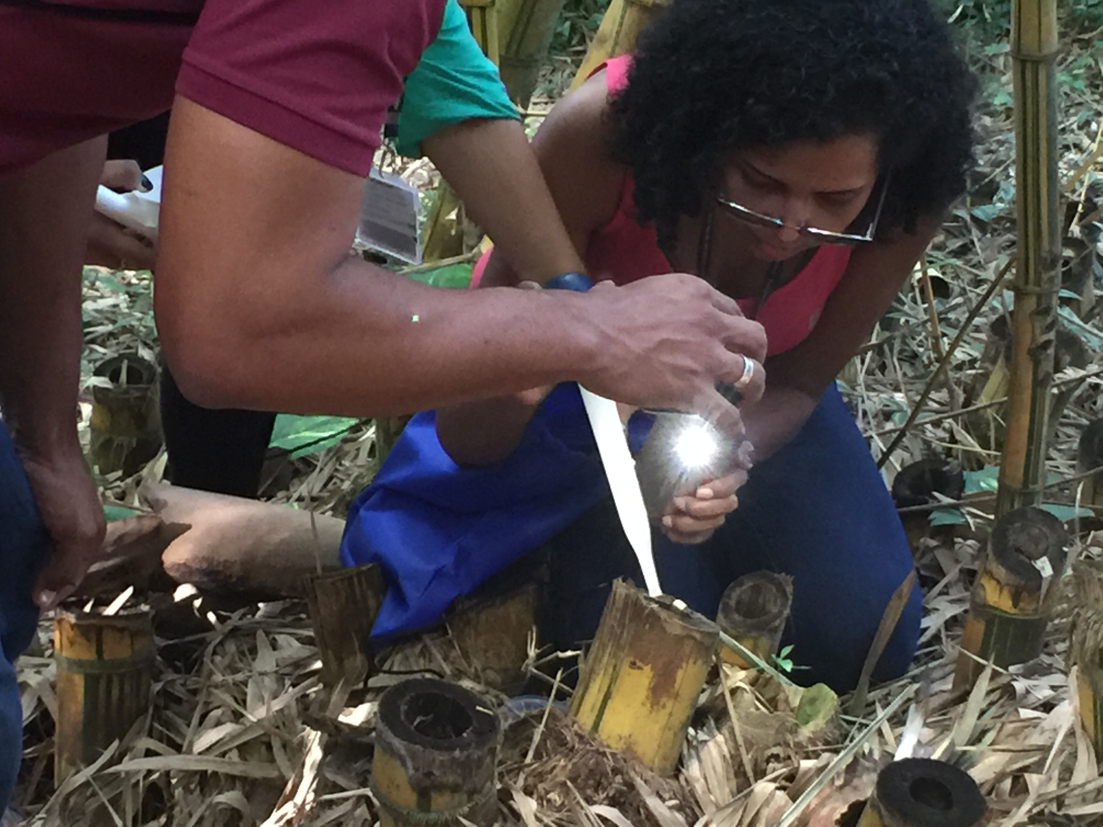
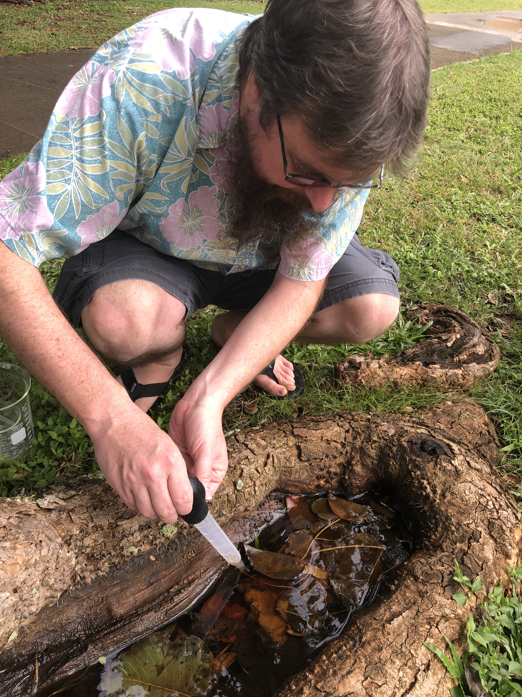
Surveillance: Using the app, the public can report when and where they have found a breeding site

Slide 6
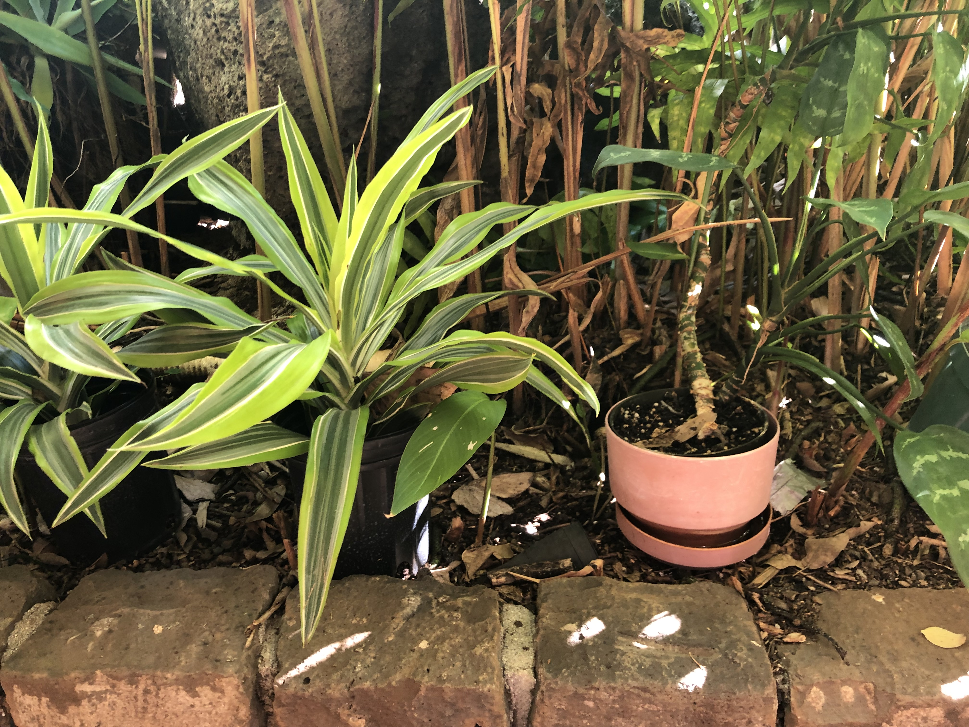
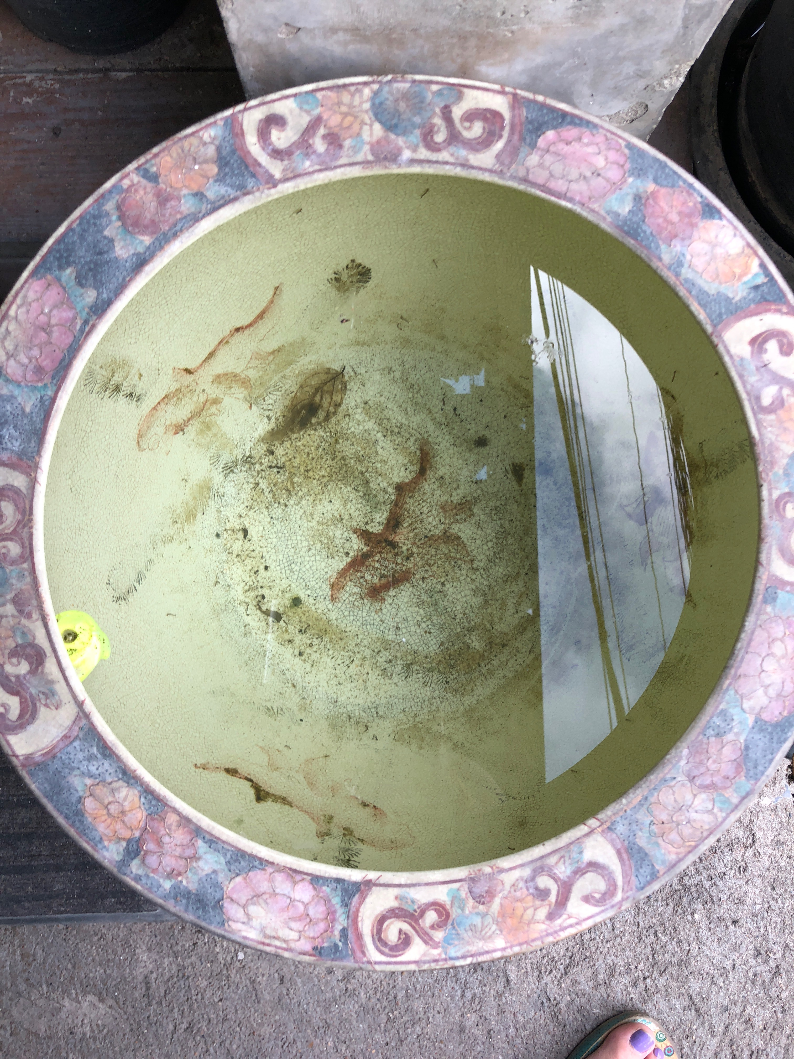
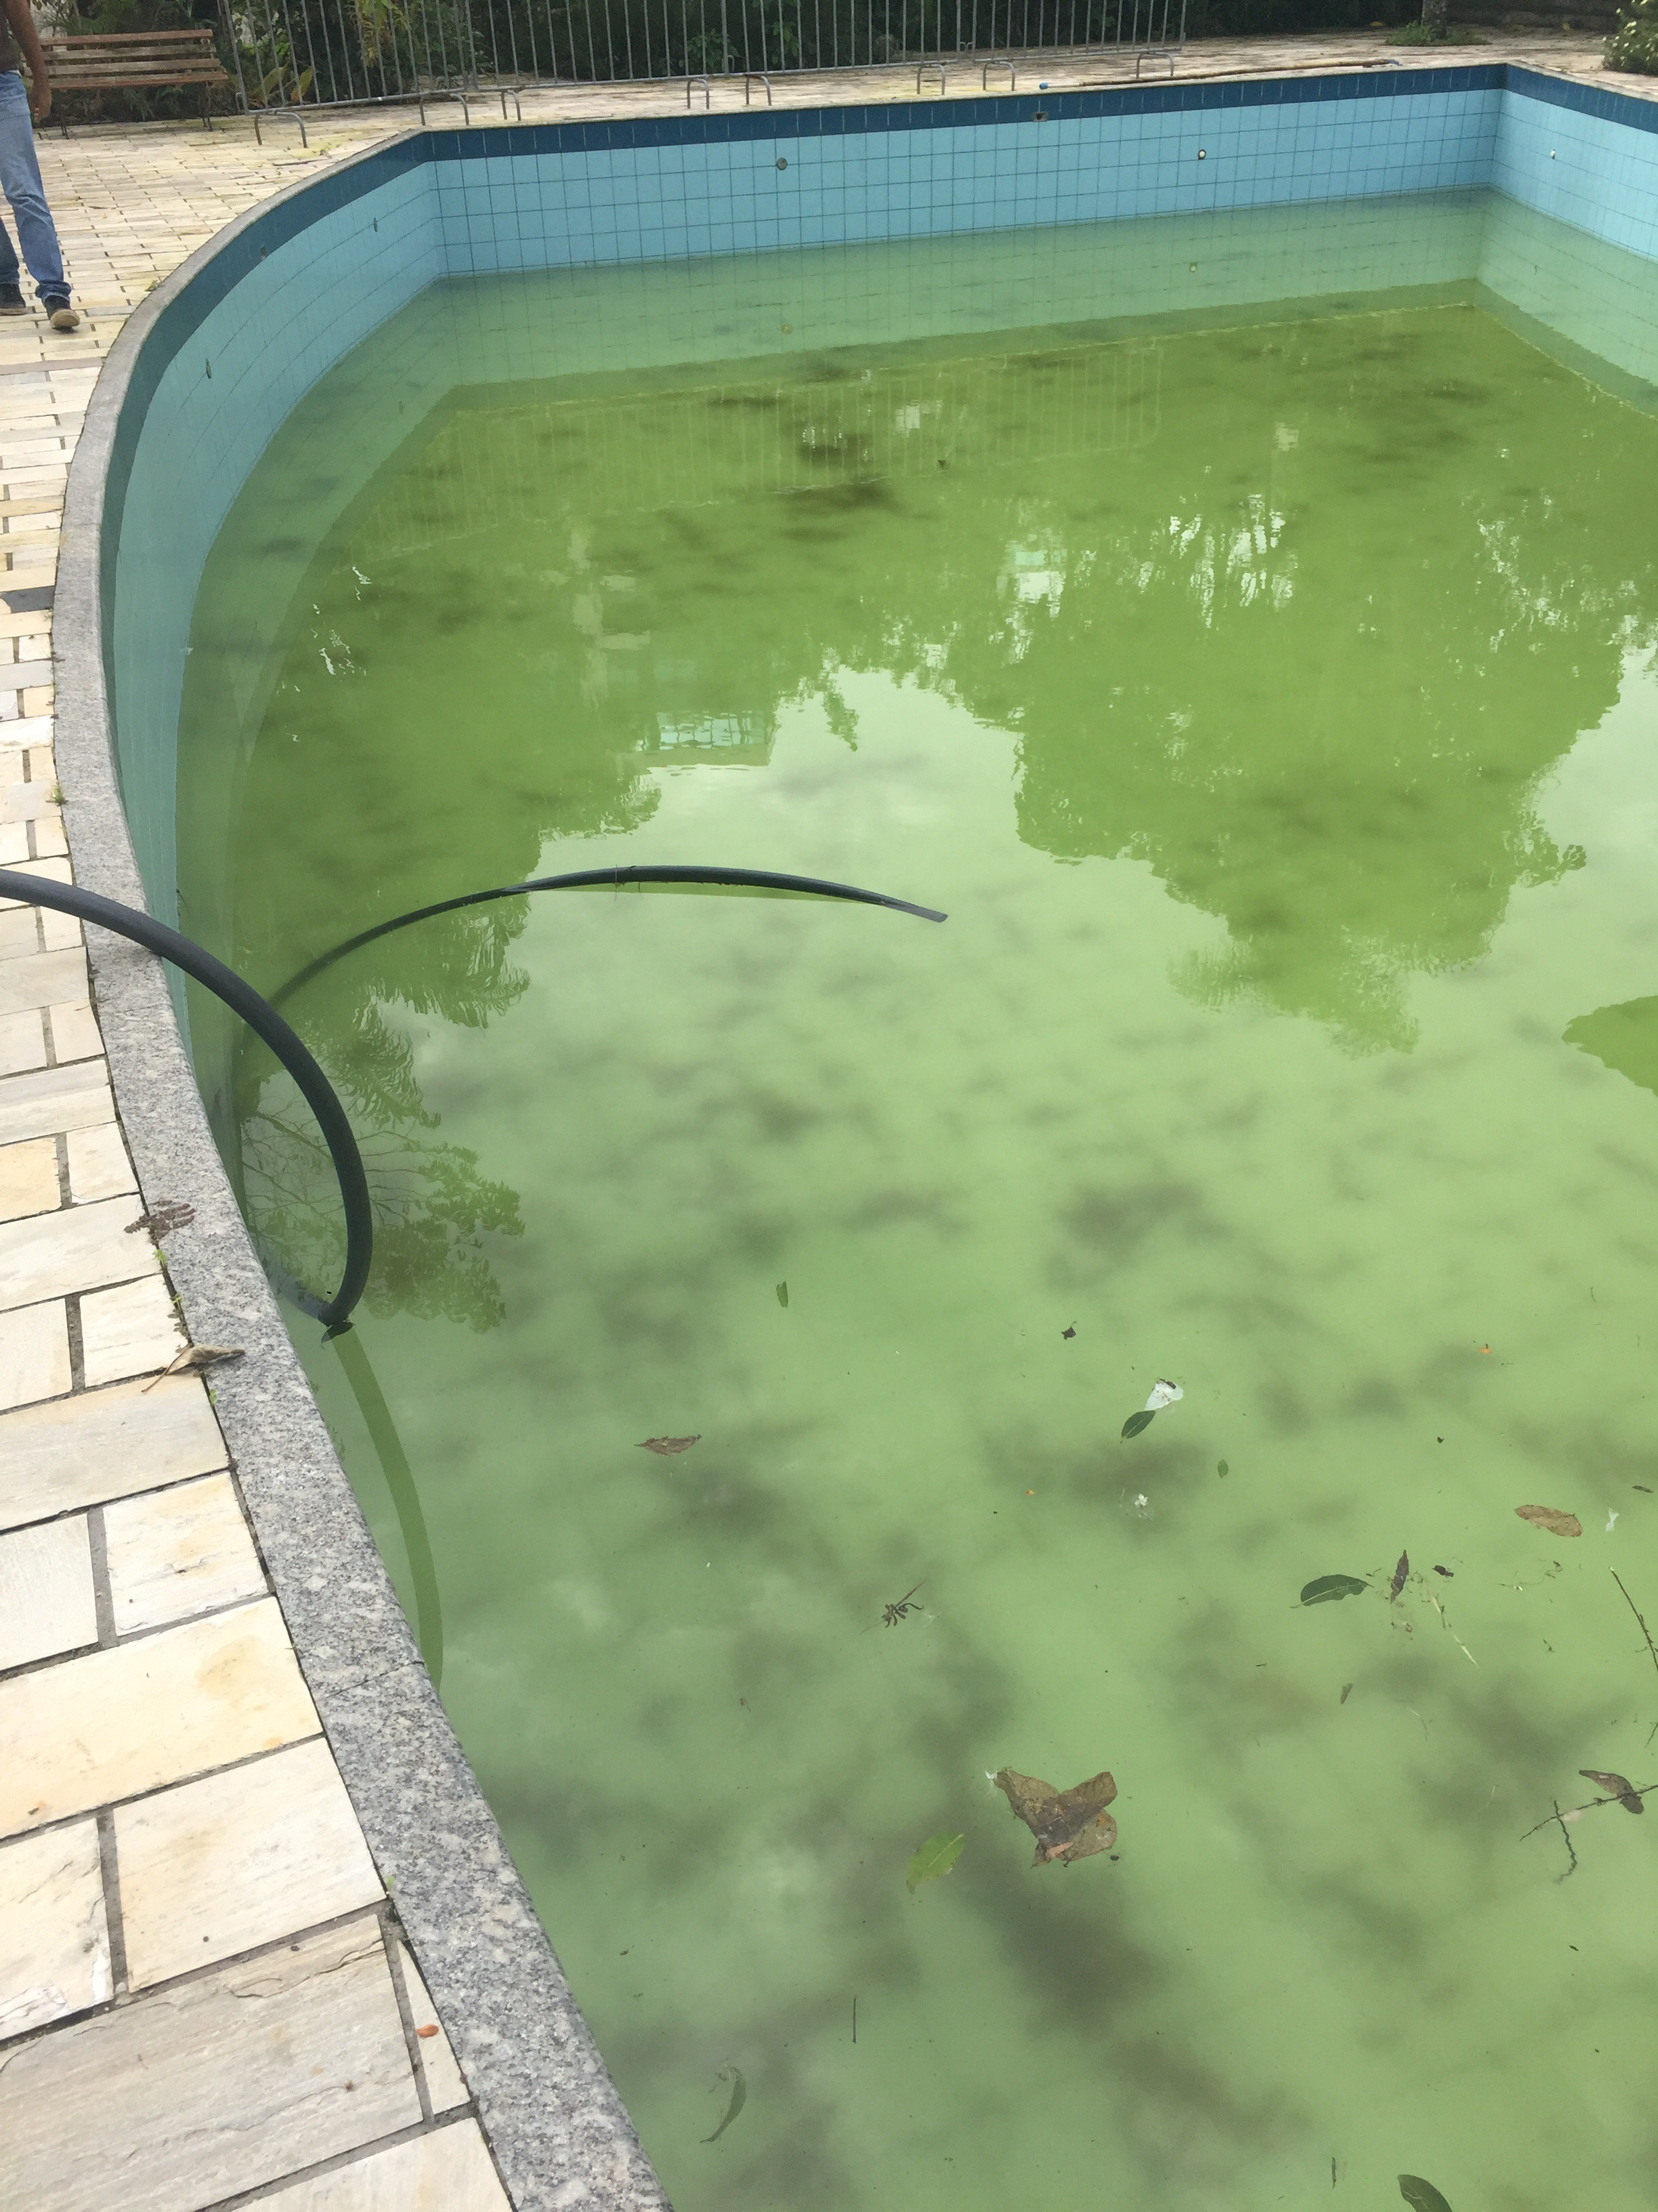
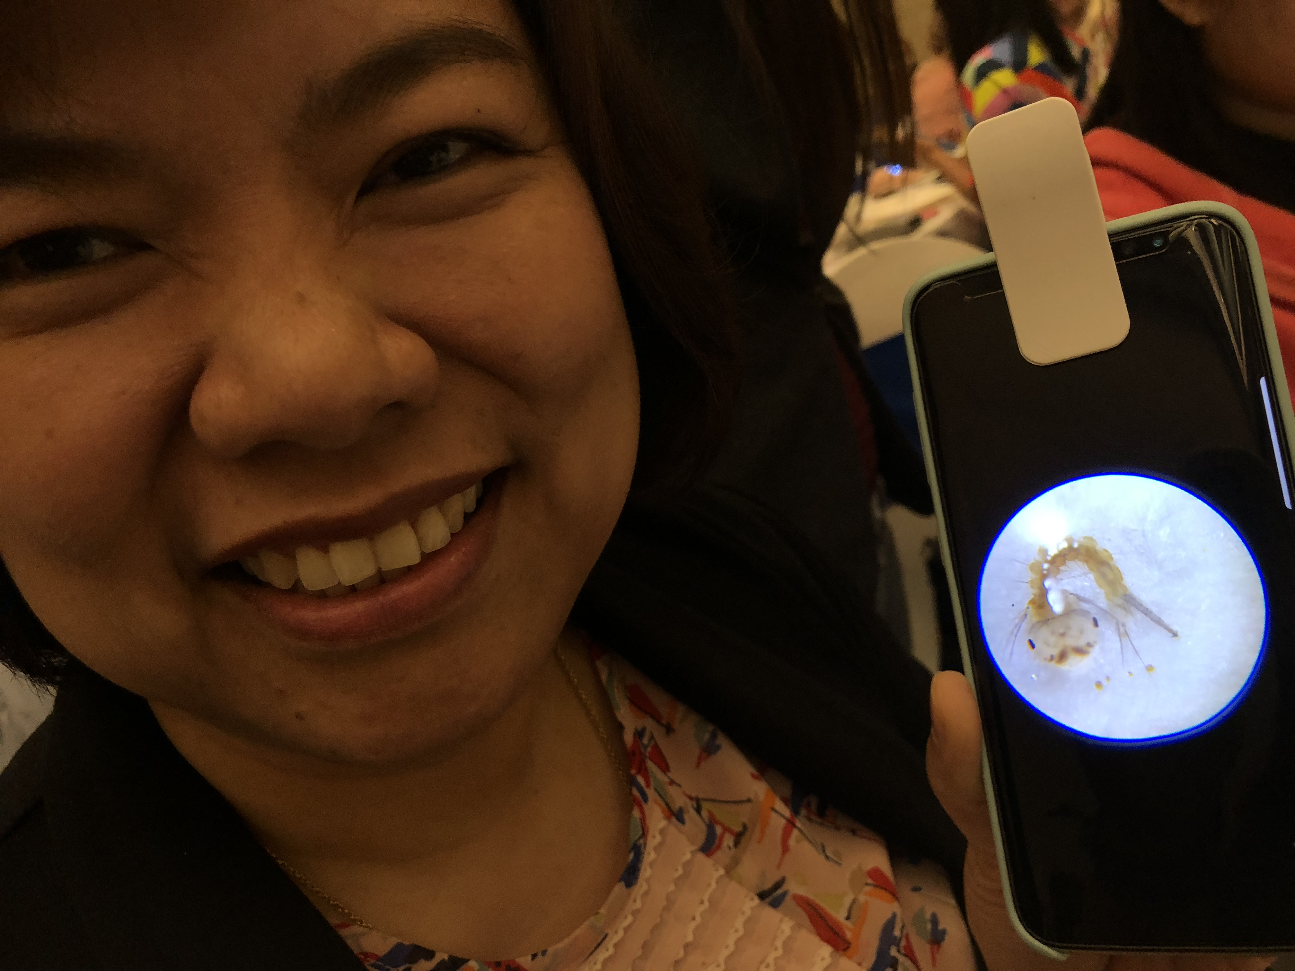
Education: The public becomes aware of mosquito larvae in stagnant water breeding sites, particularly containers in and around their homes and neighborhoods.

Slide 7
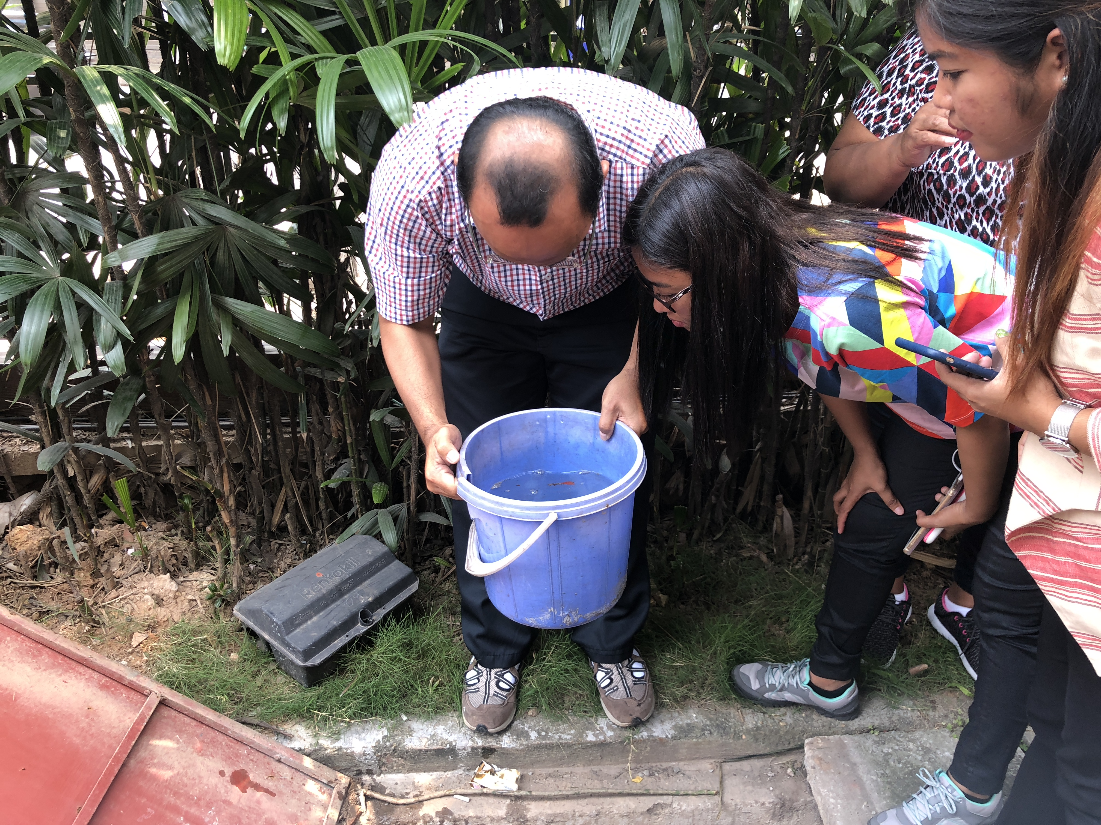
Source reduction: The app prompts the public to eliminate container breeding sites whenever possible. The app records when and where source reduction takes place.

Slide 8
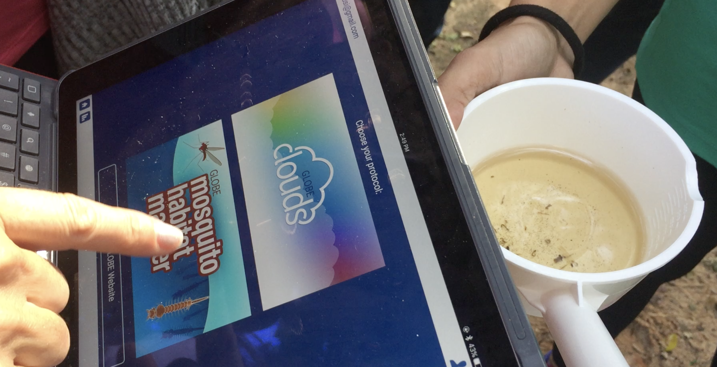
Available in 12 languages.
No prior knowledge is required, the scientific protocol is embedded in the app.

Slide 9
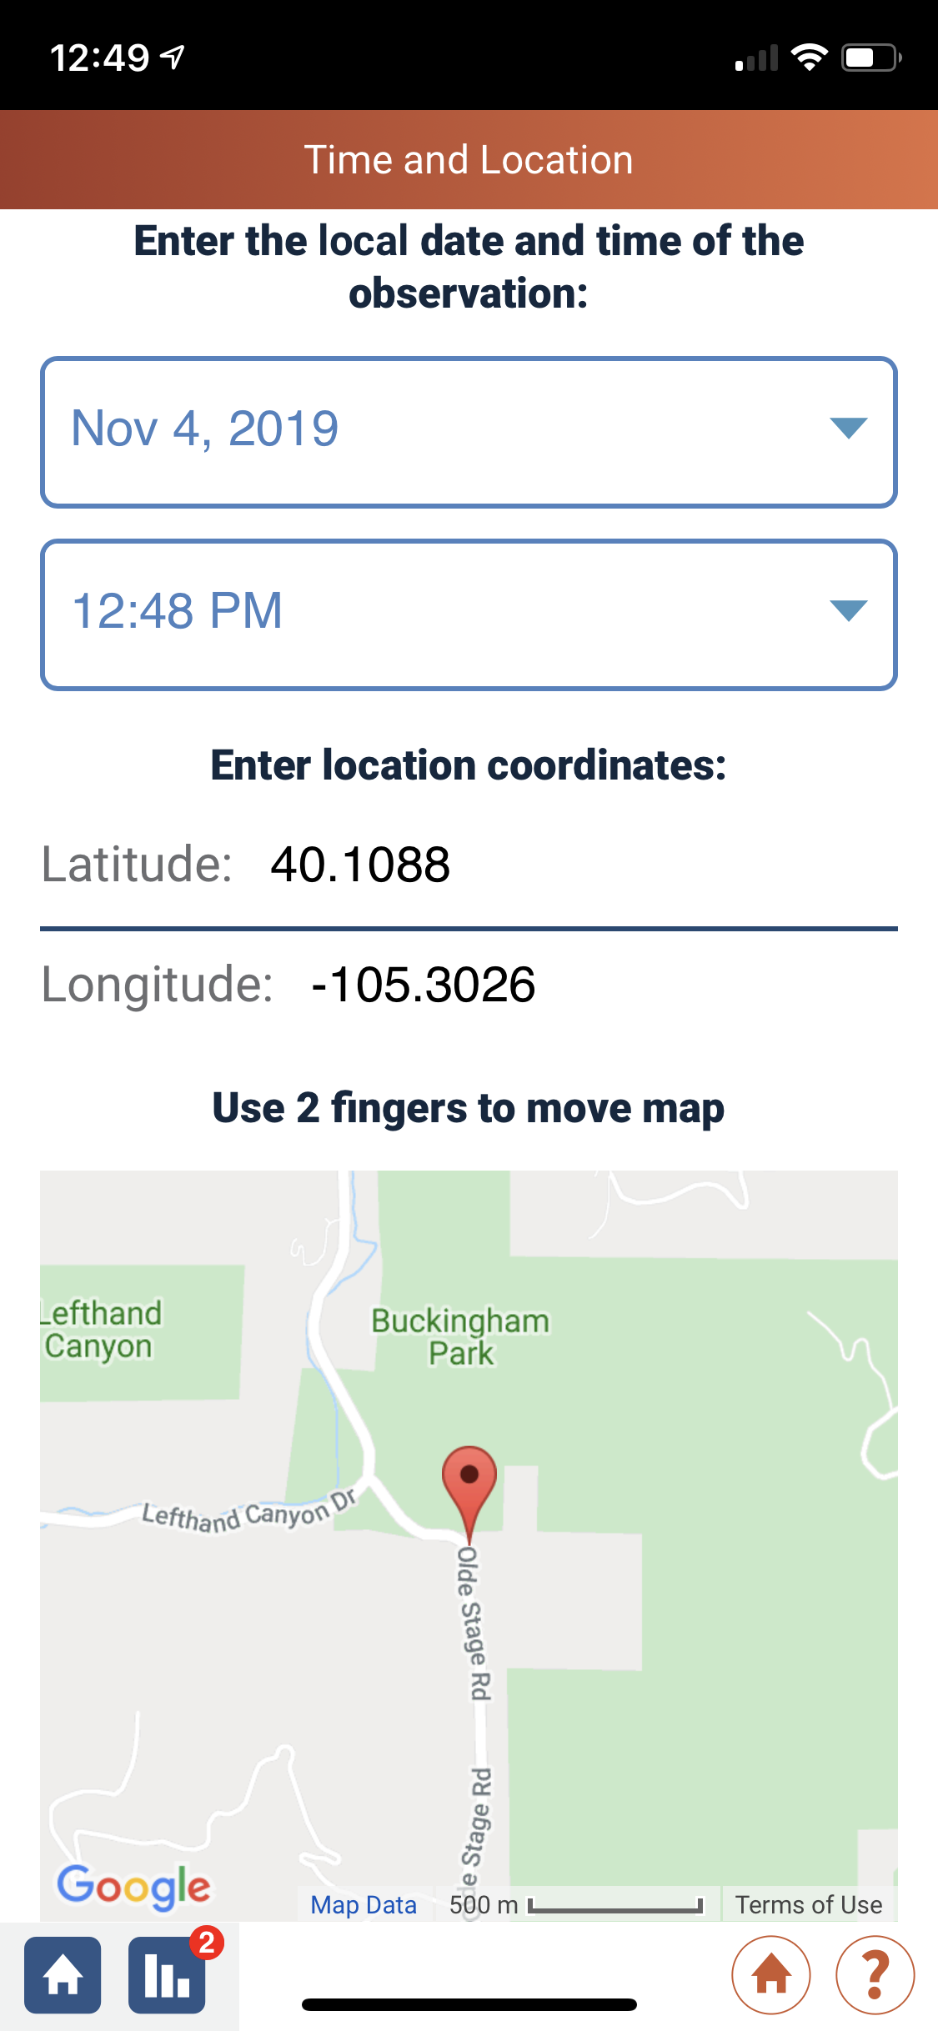
Citizen scientists proceed step by step
Each Mosquito Habitat Mapper observation is
Automatically located in time and space
The app works offline. Internet connection is only required to upload the data.

Slide 10
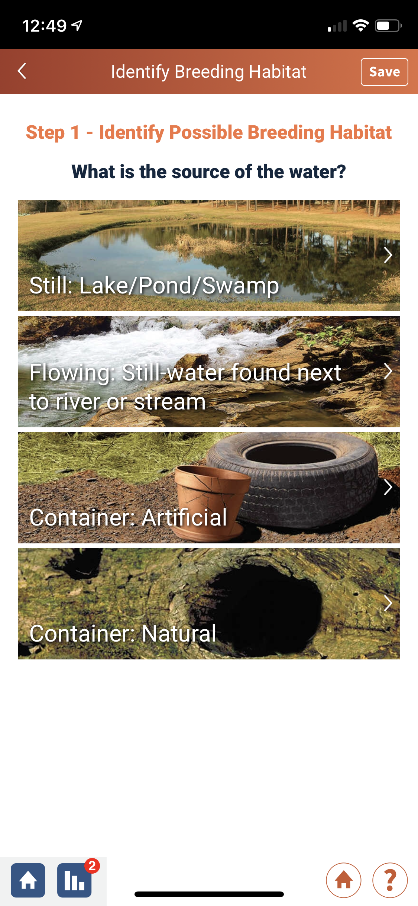
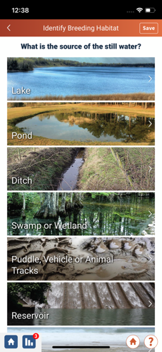
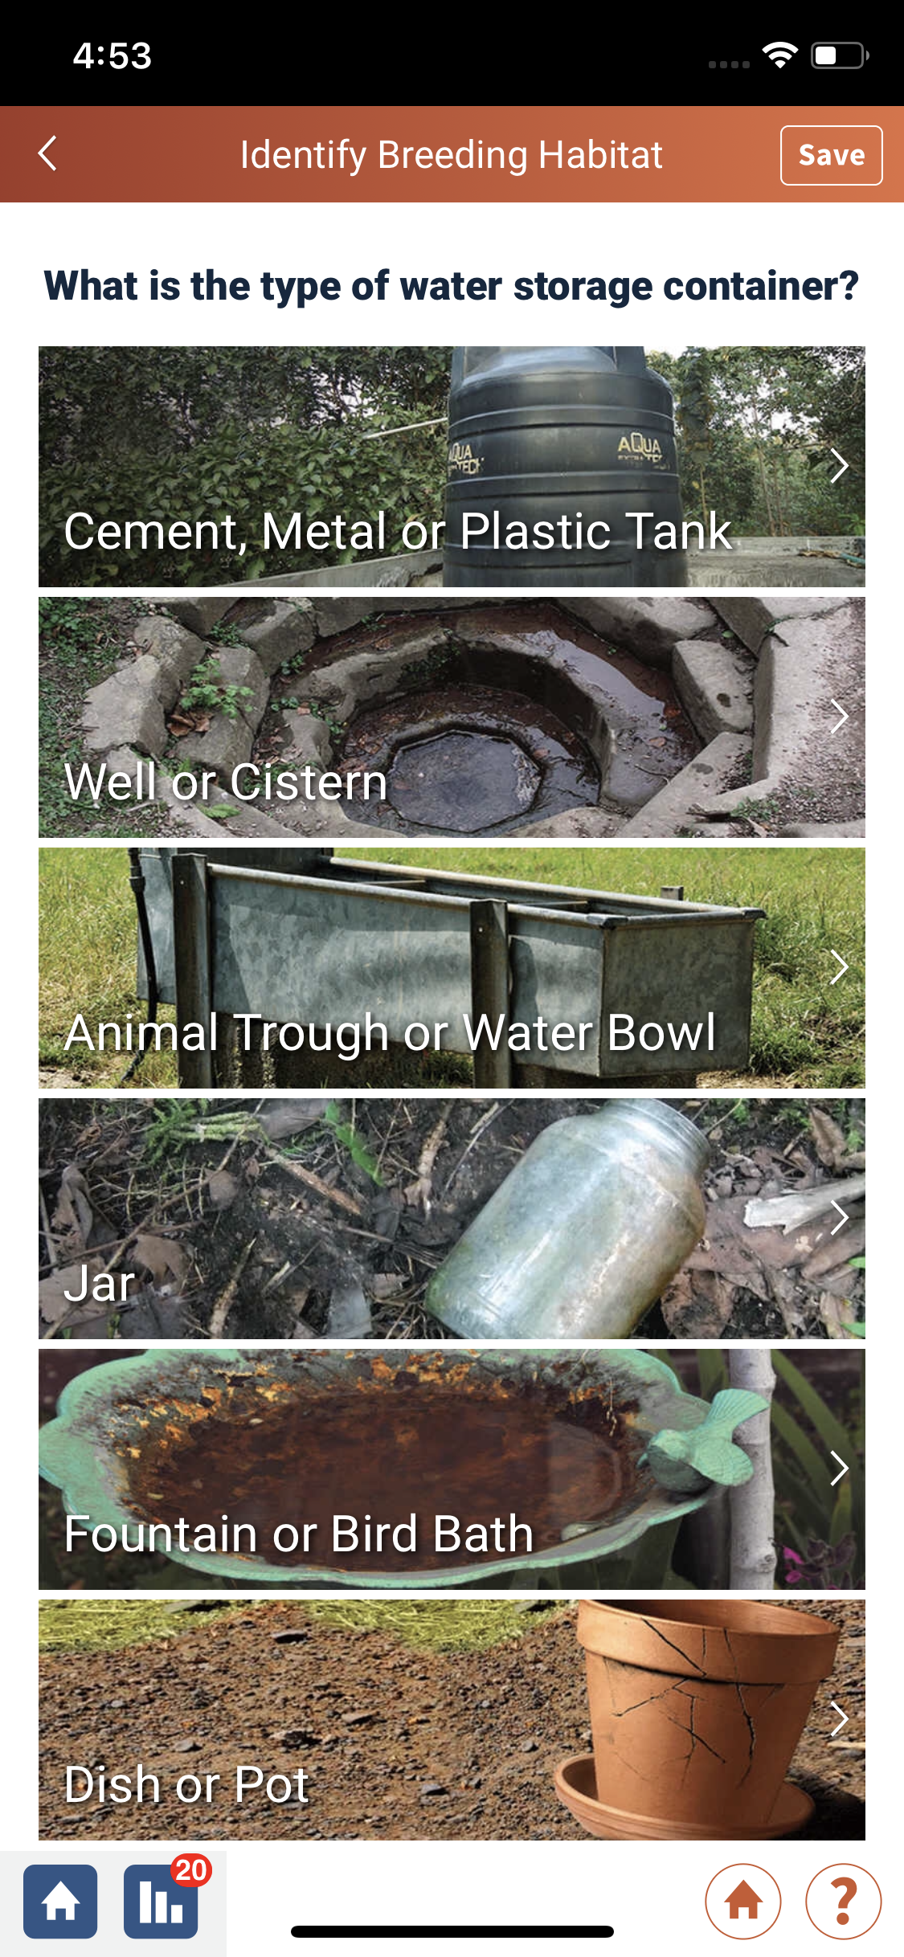
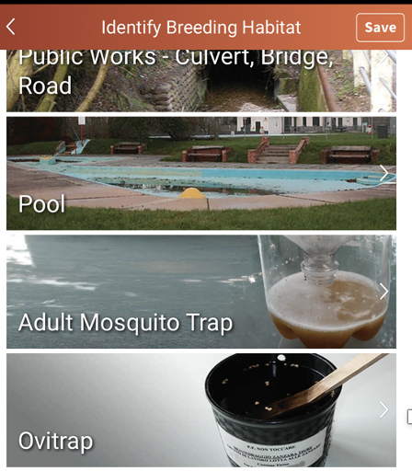
Citizen scientists use the app to describe
The habitat using drop down menus
Mosquito traps can also be selected to facilitate experimental research

Slide 11
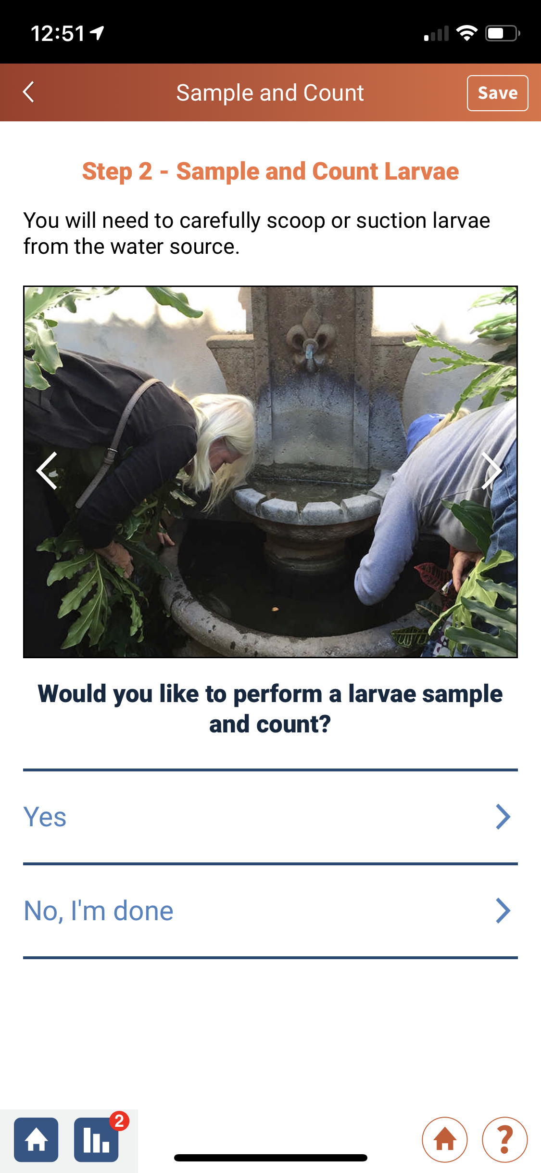
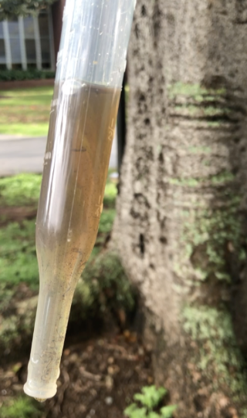
Users are asked to indicate if they see larvae, and if they want to provide a larvae count.
Organizations can decide what information they want local participants to collect, depending on the programmatic focus:
local surveillance, education or source reduction
Users can stop at any time

Slide 12
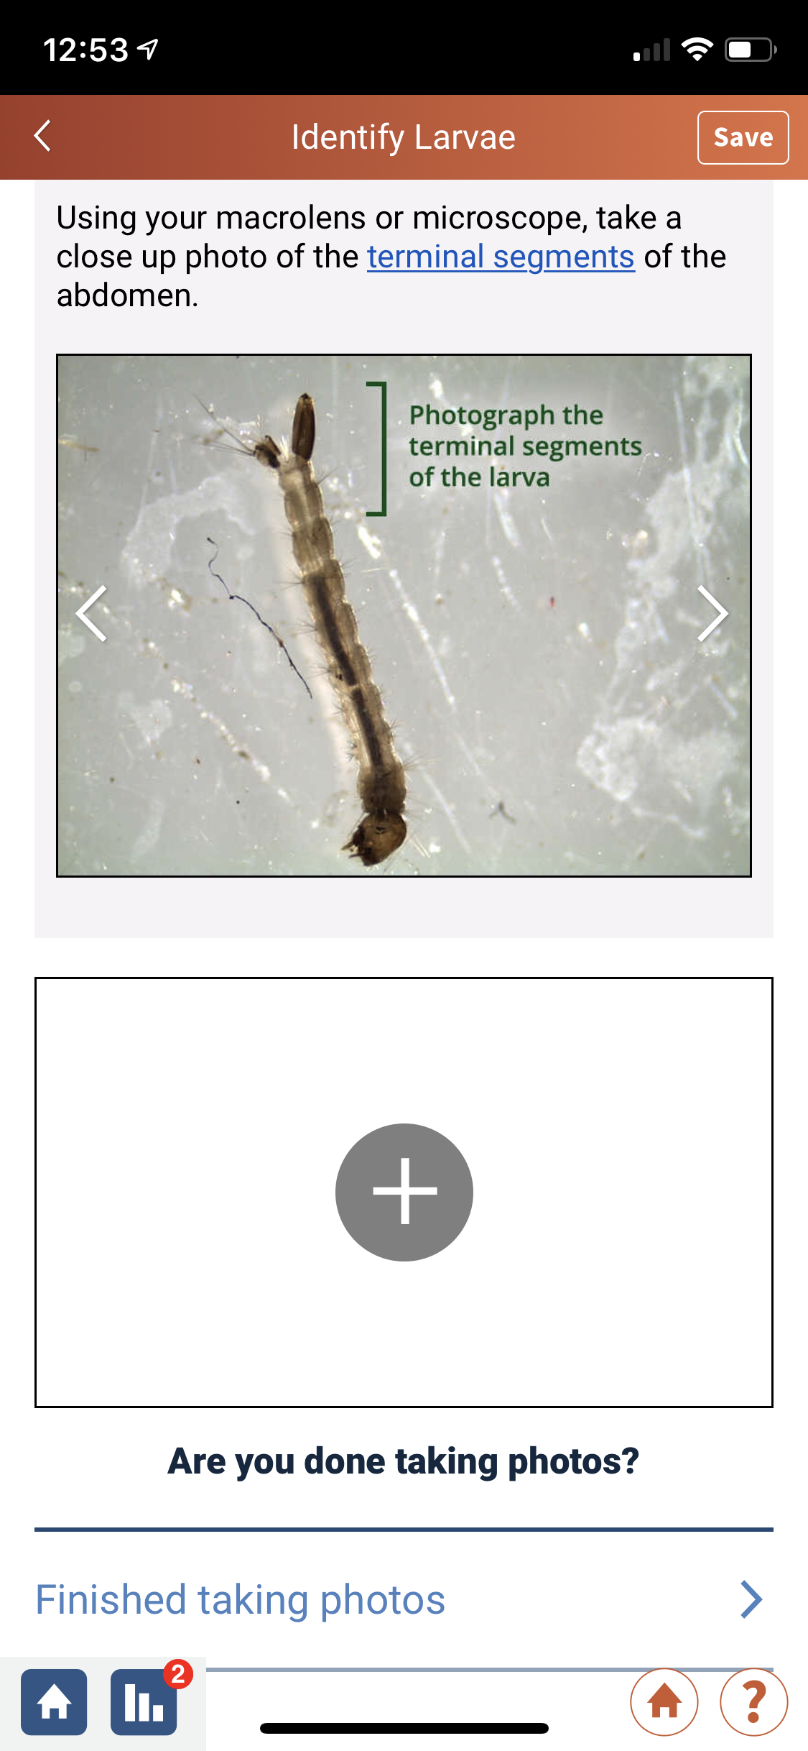
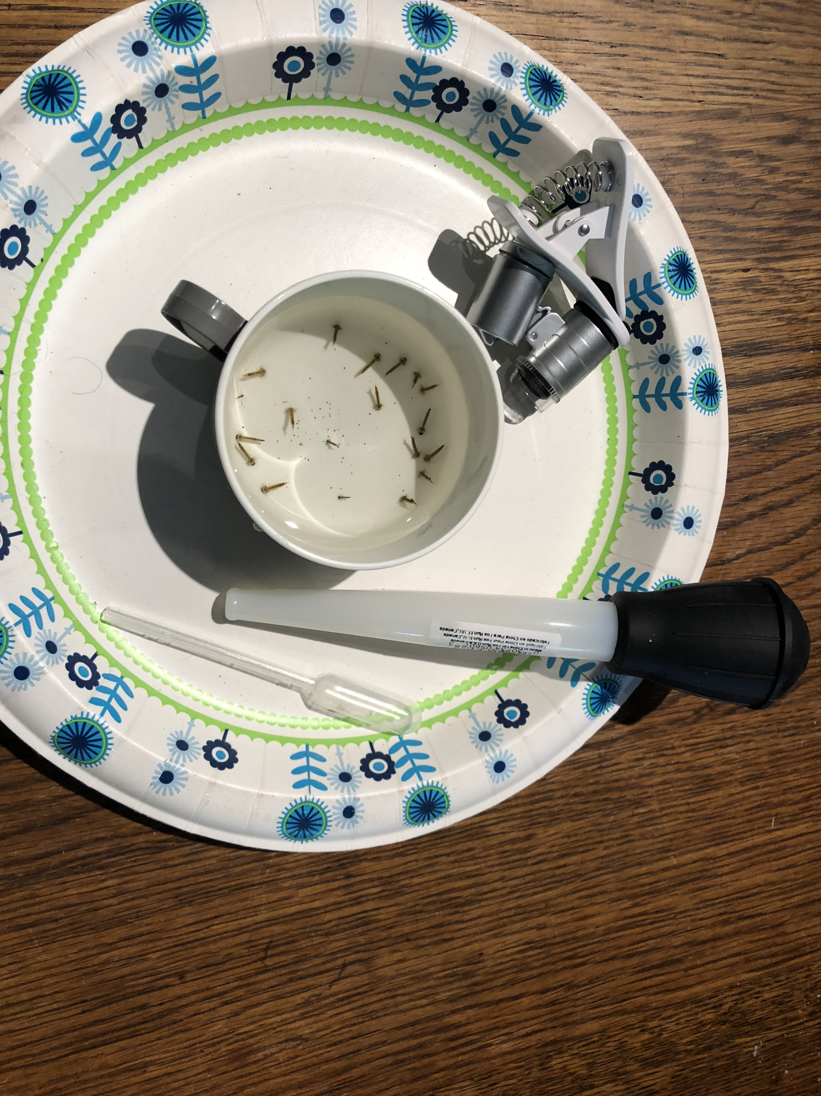
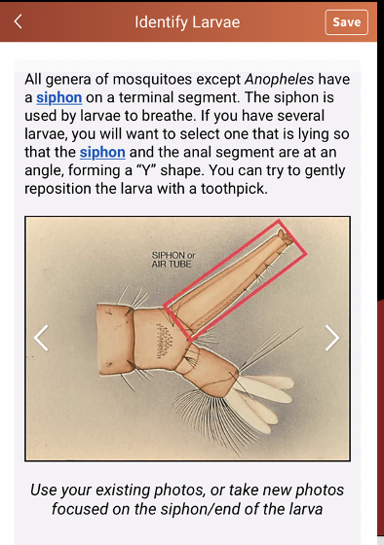
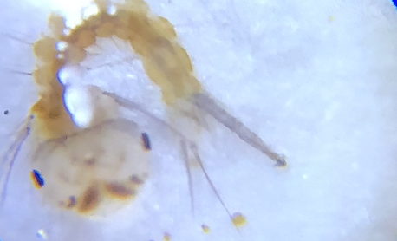
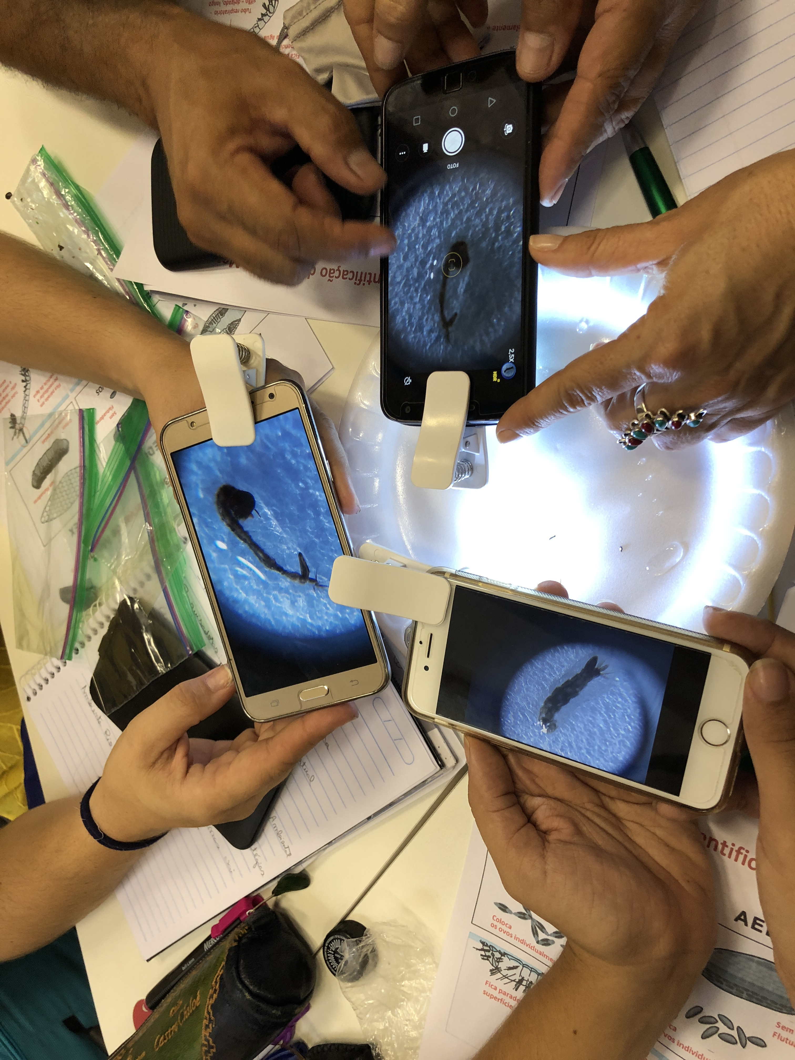
The citizen scientist has the option to use a built-in step-by-step taxonomic key that enables identification of:
Aedes aegypti
Aedes albopictus
Culex spp.
Anopheles spp.
For this optional step, we provide instructions for using an inexpensive clip-on magnifying device widely available in internet stores

Slide 13
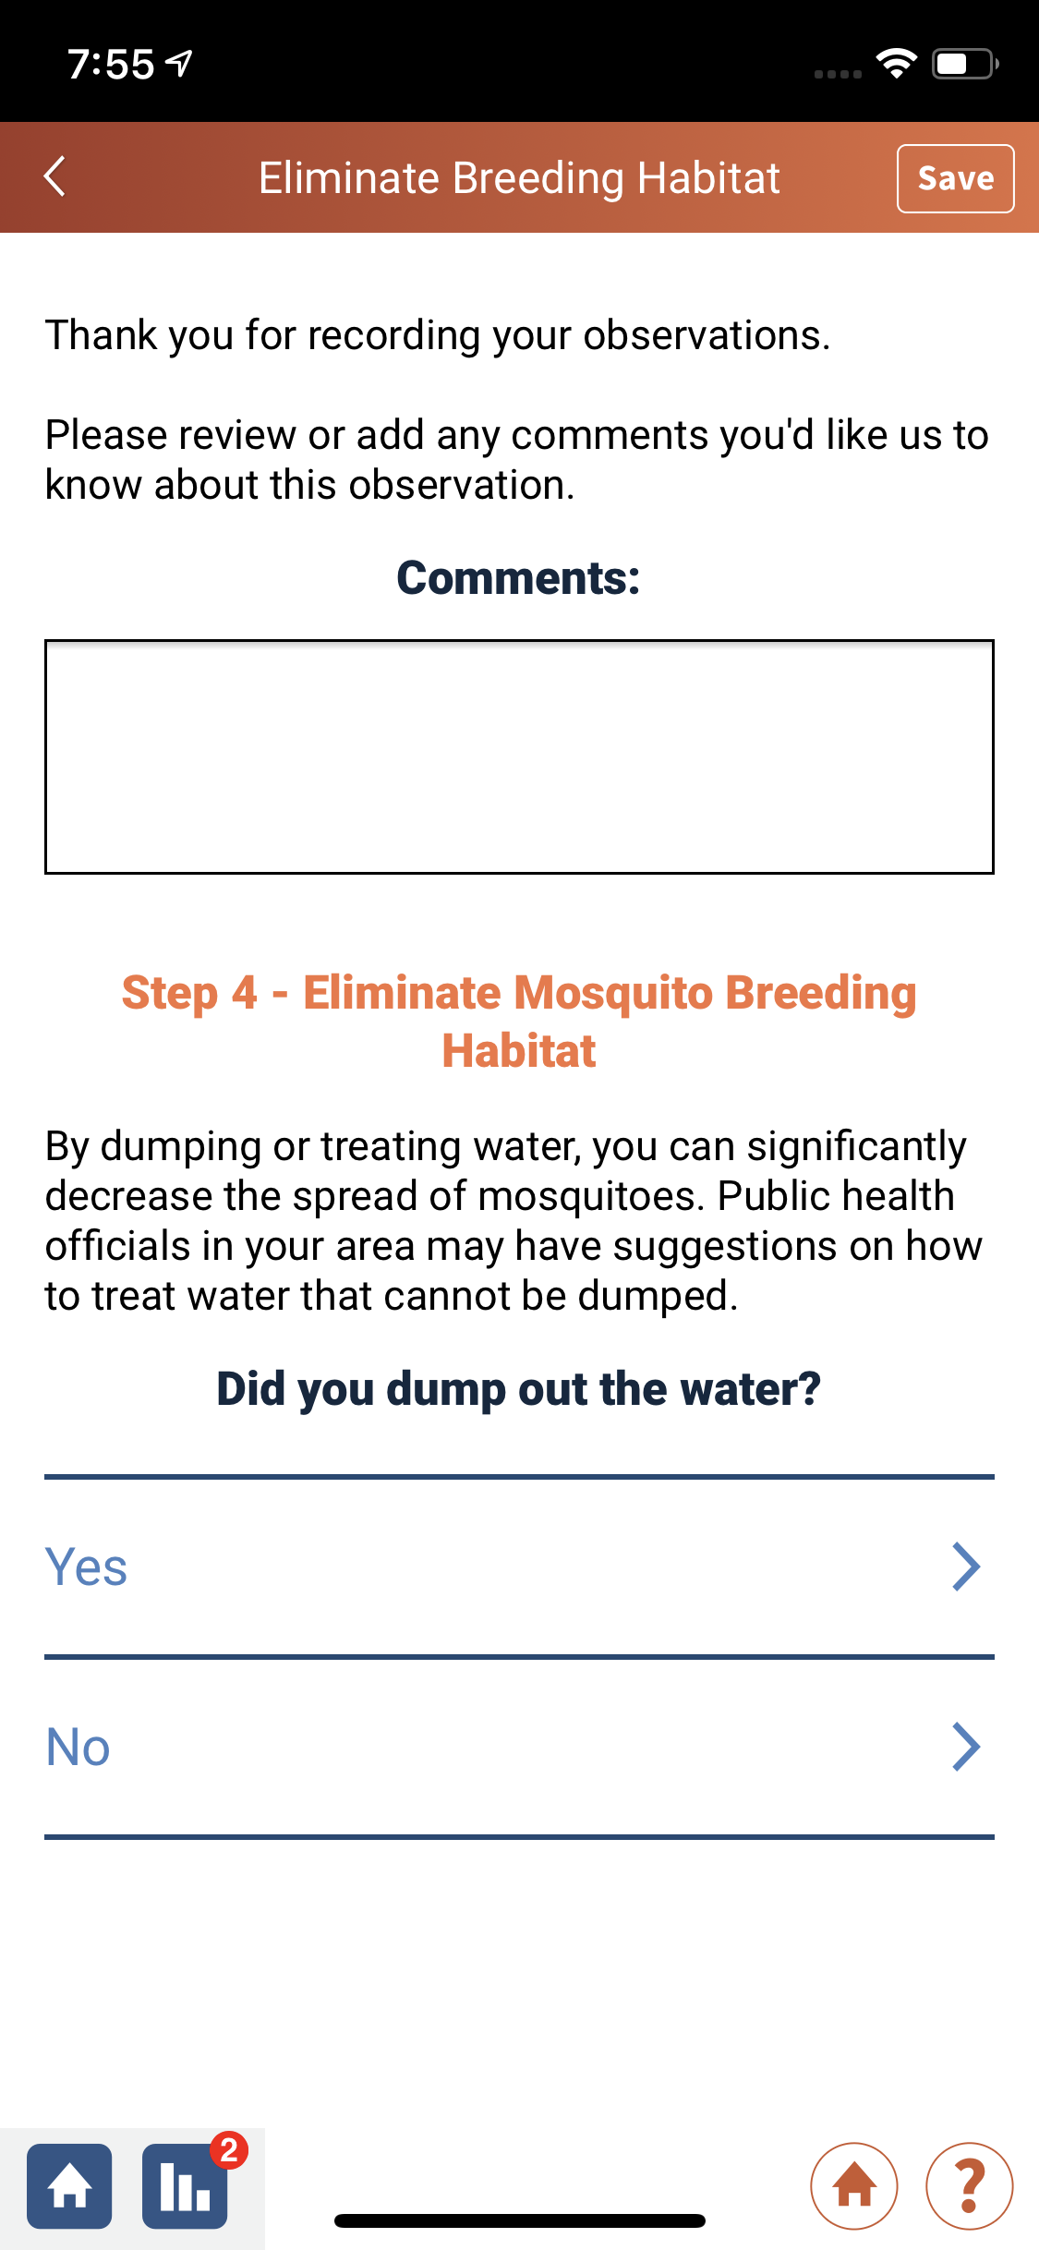
Source reduction: No matter what steps the citizen scientist complete, the last step prompts the user to dump out or cover containers.
Very compelling research outcomes- significant to vector
Control, public health departments- they will be interested
In this data

Slide 14
93% response to this question
Source reduction that took place because of citizen scientists using Mosquito Habitat Mapper
Why not 100%? Not always possible

Slide 15
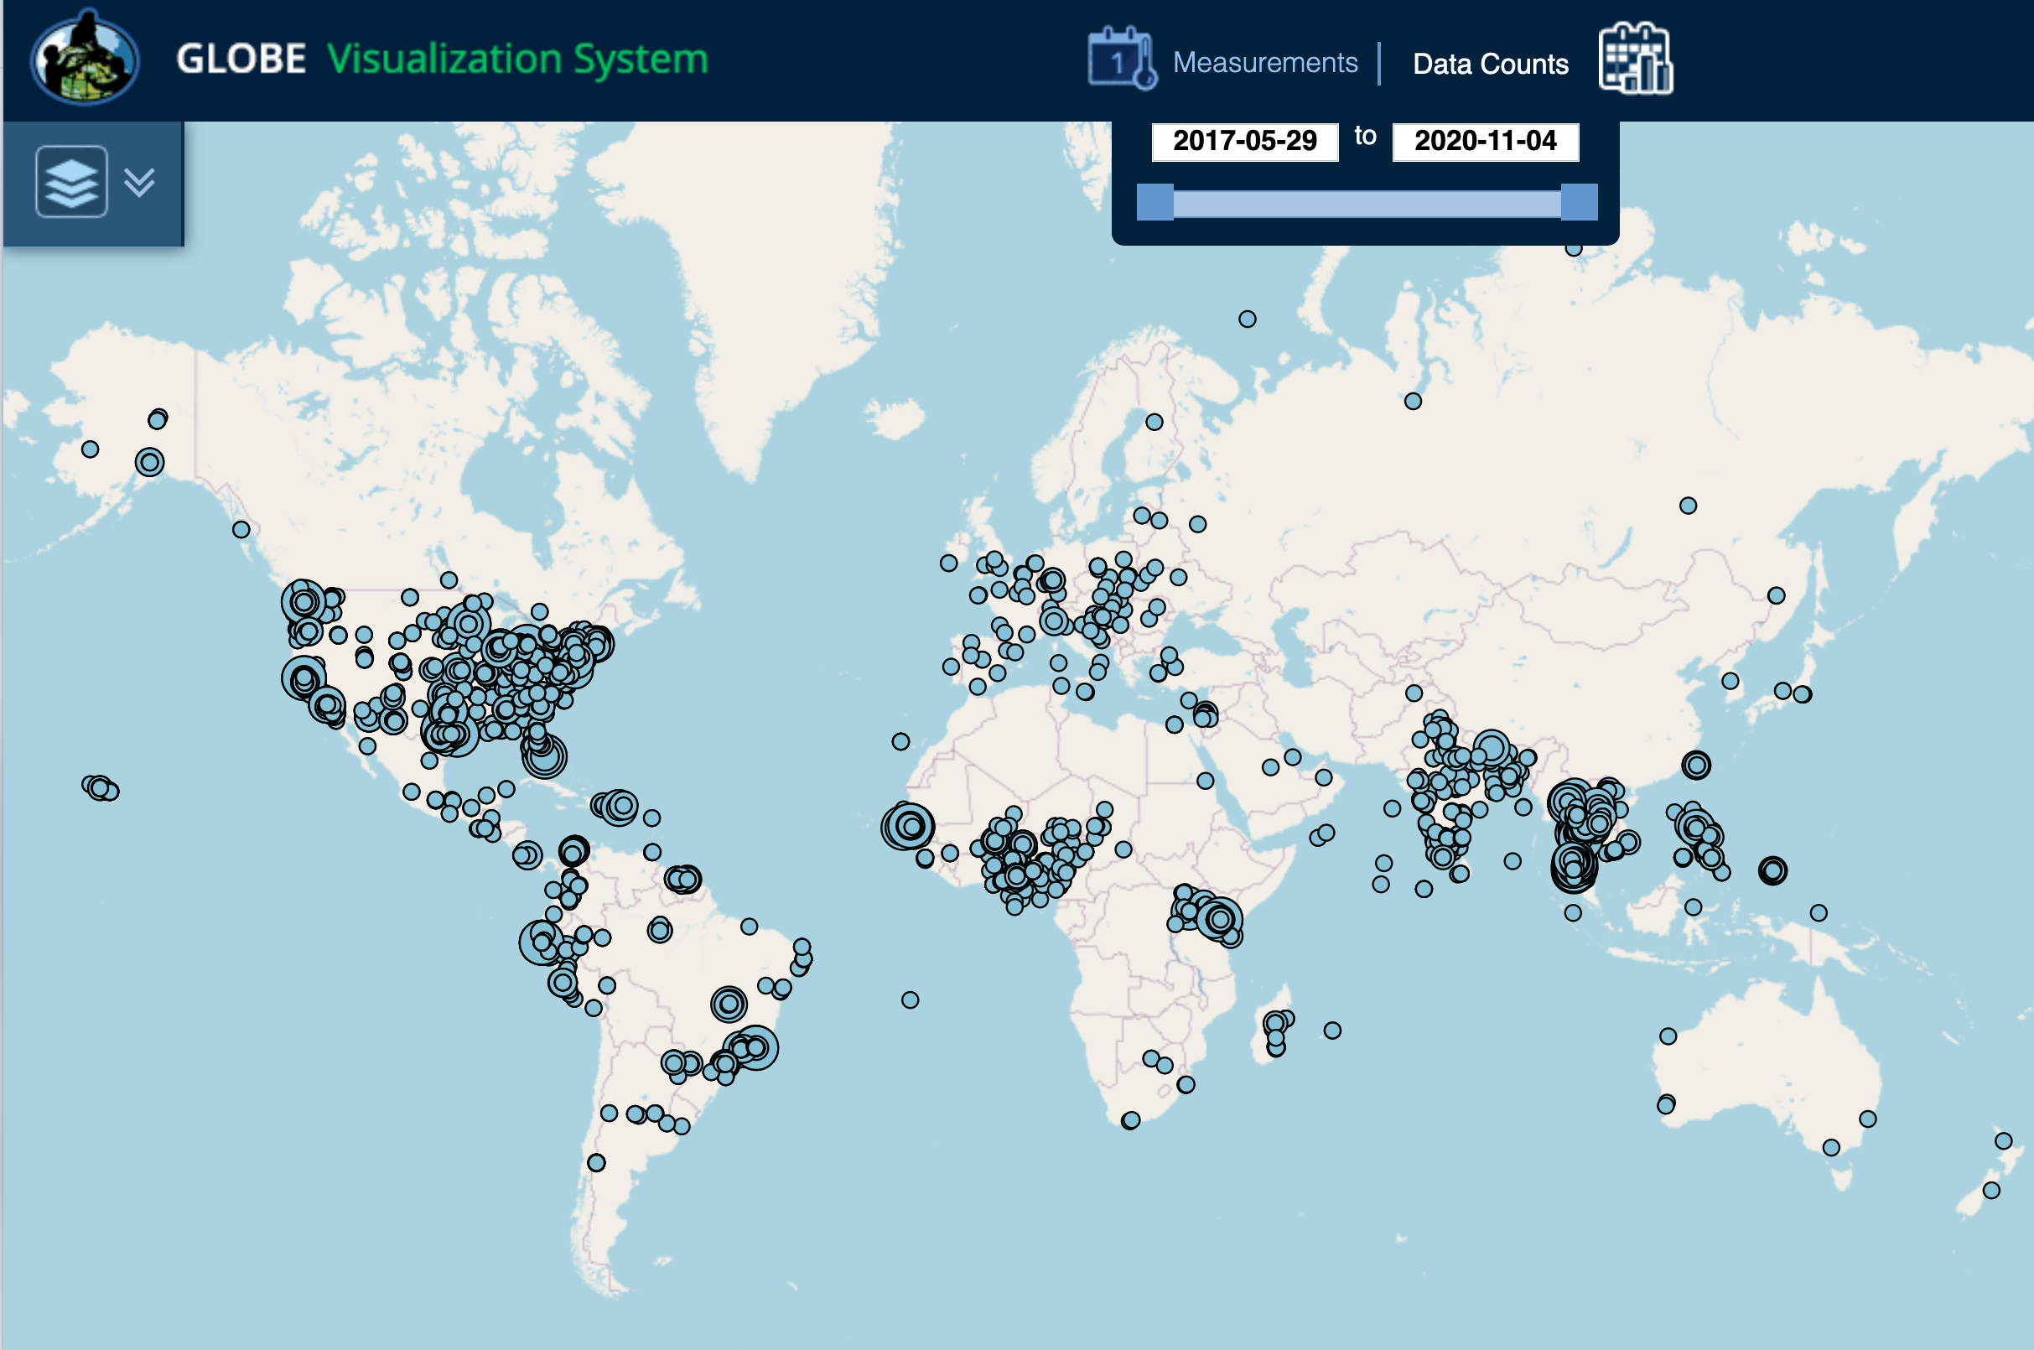
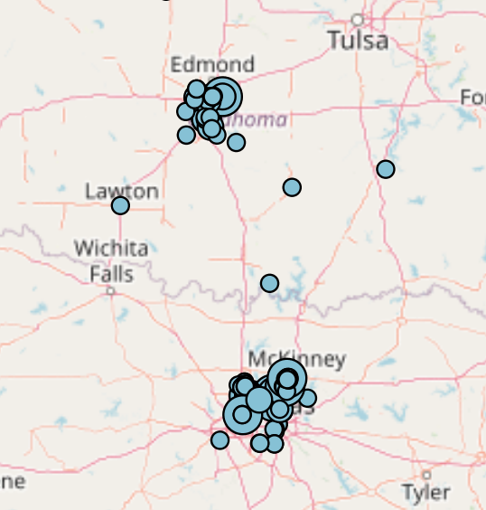
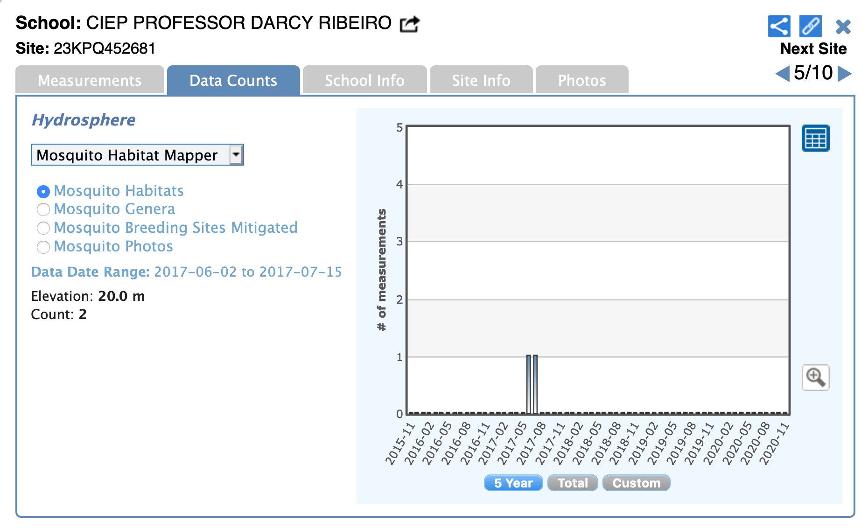
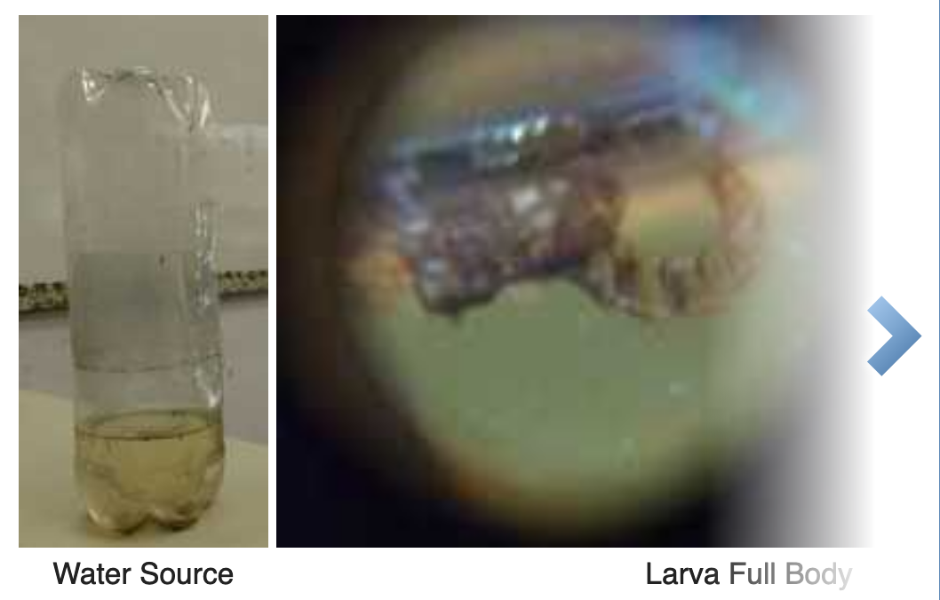
74 Countries
26K Observations

Slide 16
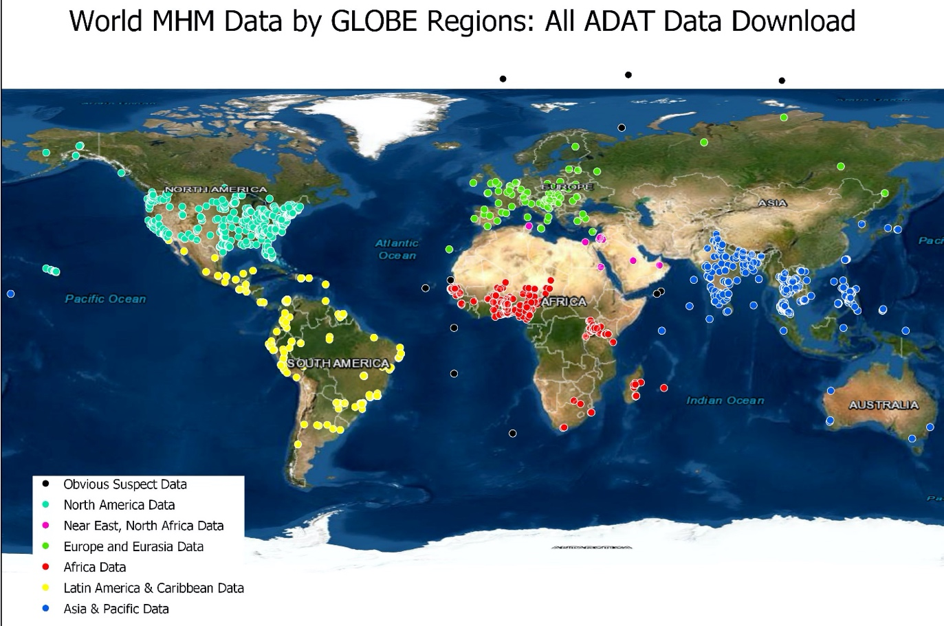
Data distribution by GLOBE Region: Aqua=North America, Yellow= Latin America and the Caribbean Green=Europe and Eurasia, Pink=North Africa and the Middle East, Red=Africa, and Blue=Asia and Pacific.

Slide 20
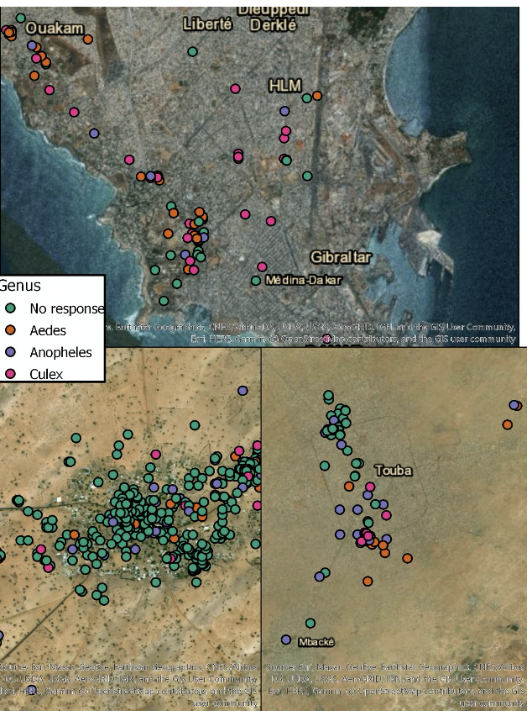
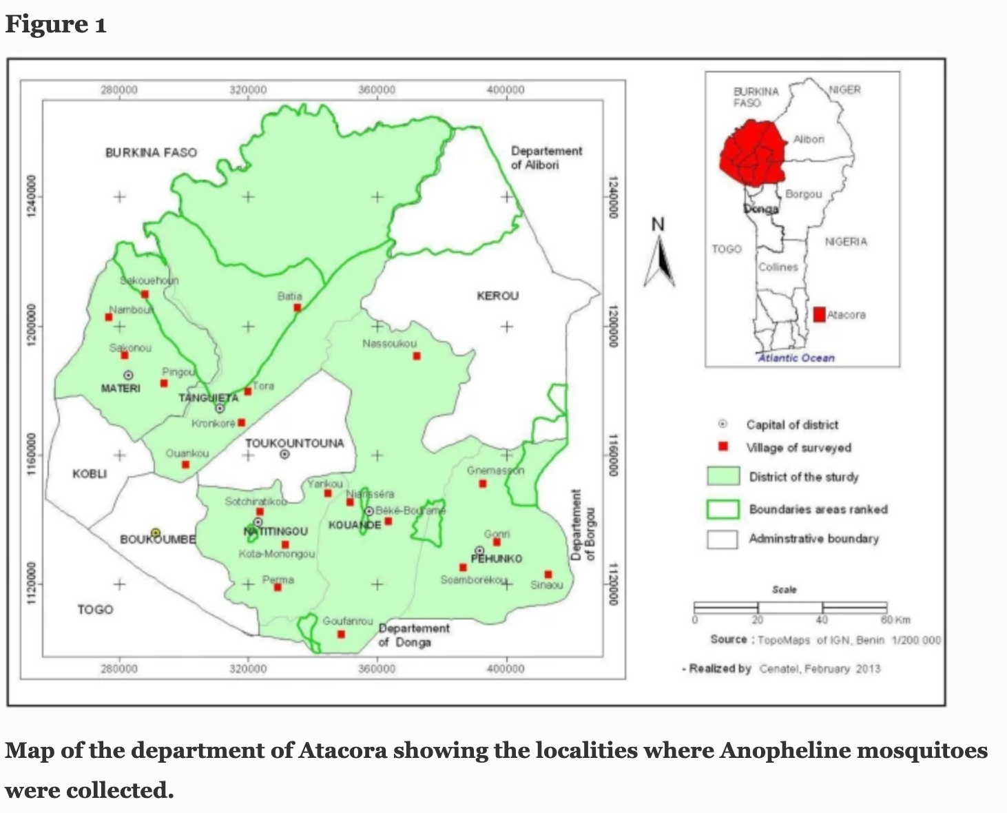
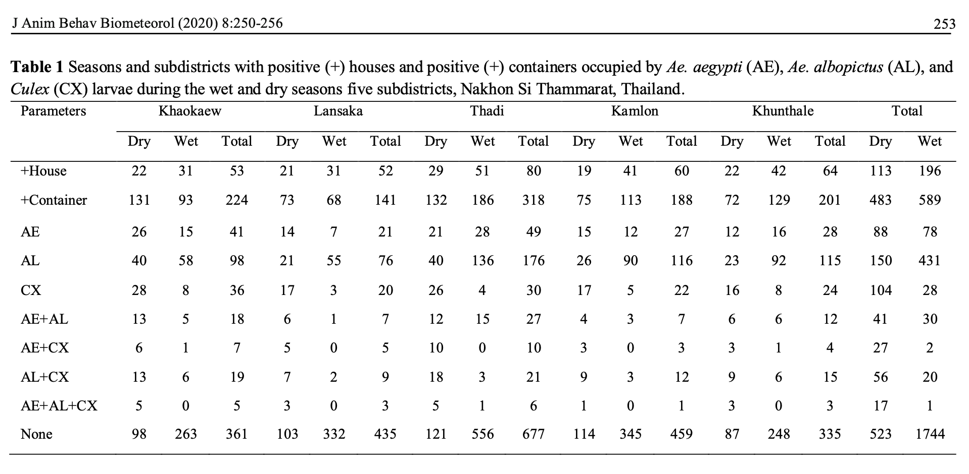
Data Snapshots from Published Papers
a. b. c.
a. Senegal: Low et al. (submitted) Exploration of Mosquito Habitat Mapper Data 2017-2020
b. Benin: Aïkpon et al. 2019 Assessment of population dynamics and biting trends of Aedes aegypti in northern Benin: Public health implications. International Journal of Mosquito Research2019;6(2):19-23
c. Thailand: Chumsi et al. 2020: Spatial and temporal variations on the coexistence of Aedes and Culex larvae in Southern Thailand . doi.org/10.31893/jabb.20033

Slide 21
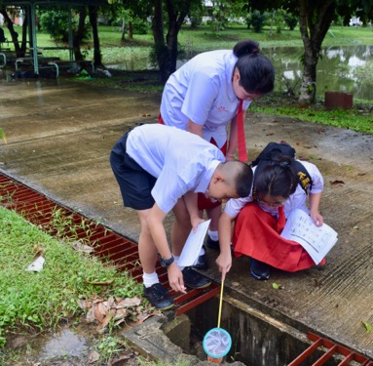
NASA GLOBE Observer can help you support partnerships through
Scientist Mission Experts
Outreach resources
GLOBE Mission Mosquito Campaign
Schools (middle-high school)
Universities
Scouts and 4H
Senior Citizens
Partners serving needs of low resource communities

Slide 22
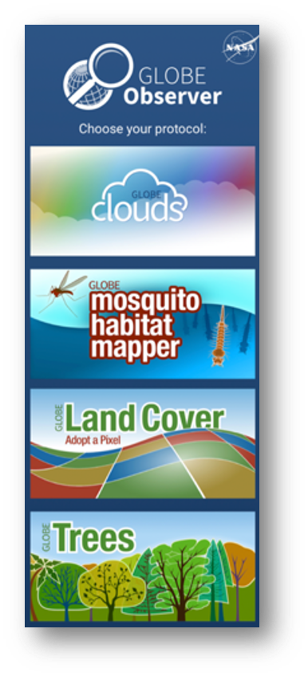
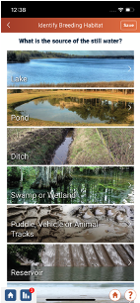
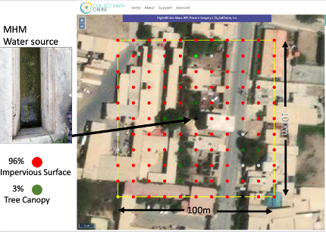
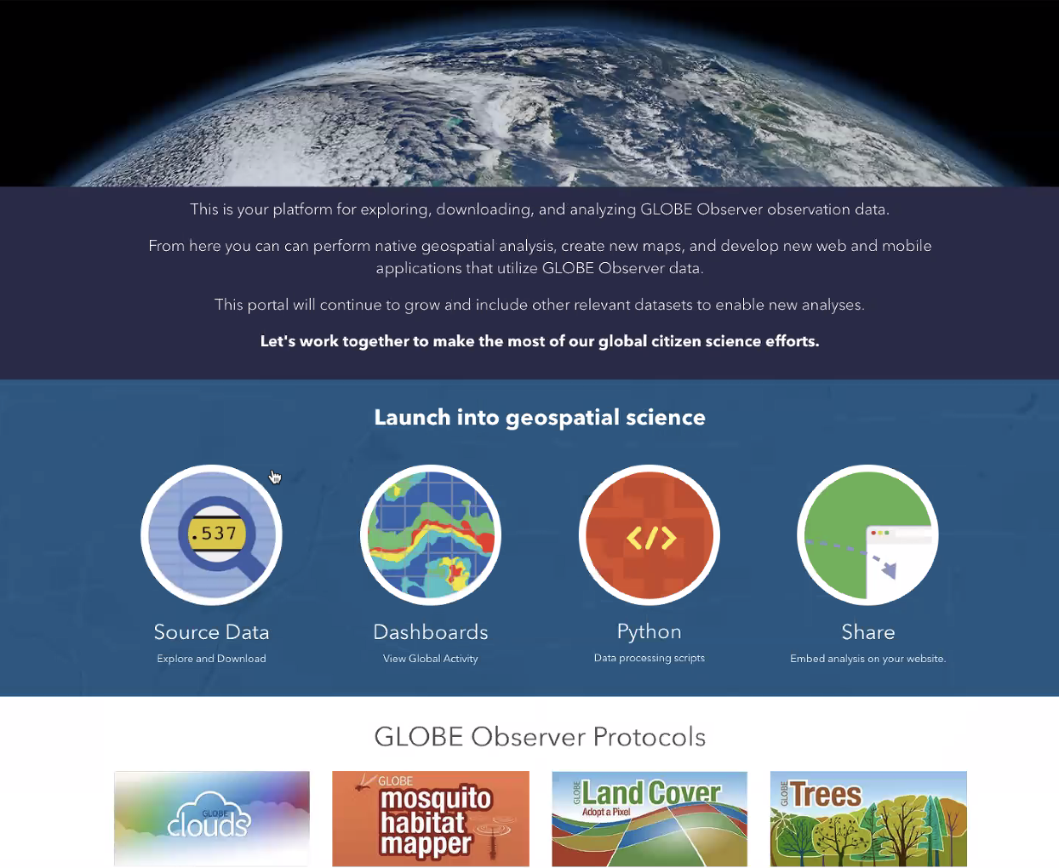
Next Steps:
New app release in 2021 will encourage coincident data collection using the Mosquito Habitat Mapper and the Land Cover tool
database enrichment using satellite data
to increase geospatial reliability
research grade, analysis ready data, plus data cleaning tools. Dashboard is in development
7000+ photos await AI for validation

Slide 23
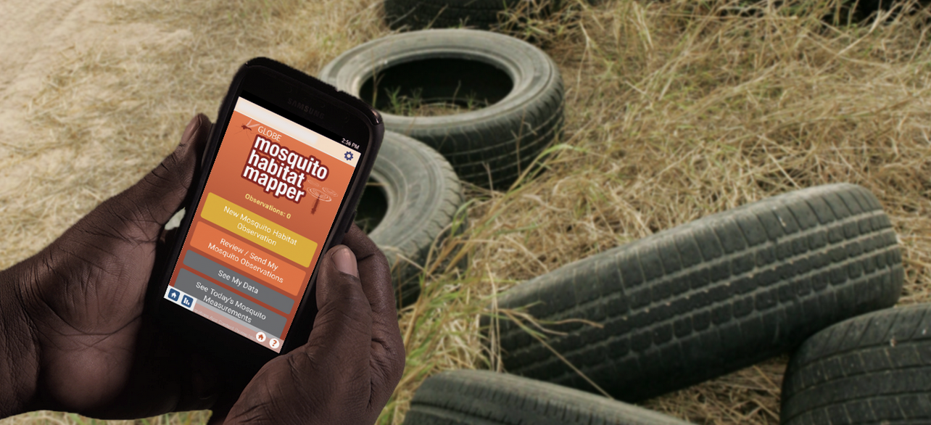
Take Away Message:
GO is a NASA‐funded app that enables anyone with a smart phone or mobile device with a built-in camera to participate in Earth system research.
GO is designed for field use and does not require cellular or wireless service for data collection.
Collected data are saved on the device and can be uploaded when an internet connection is available.
All data are freely available for analysis, education and vector control purposes.

Slide 24
Locate information about GLOBE Observer Mosquito Habitat Mapper https://observer.globe.gov/do-globe-observer/mosquito-habitats
Find outreach resources https://observer.globe.gov/toolkit/mosquito-habitat-mapper-toolkit
Connect with our project: rusty_low@strategies.org
Seeking your input, ideas and programmatic synergies- Please contact us!
Thank you!

