Slide 1

Exploring the Mangrove
Use of bioindicators for mangrove assessment

Slide 2

Mangrove Protocol Proposal
Geneviéve Sontowinggolo
Project coordinator
Green Heritage Fund Suriname
Suriname

Slide 3
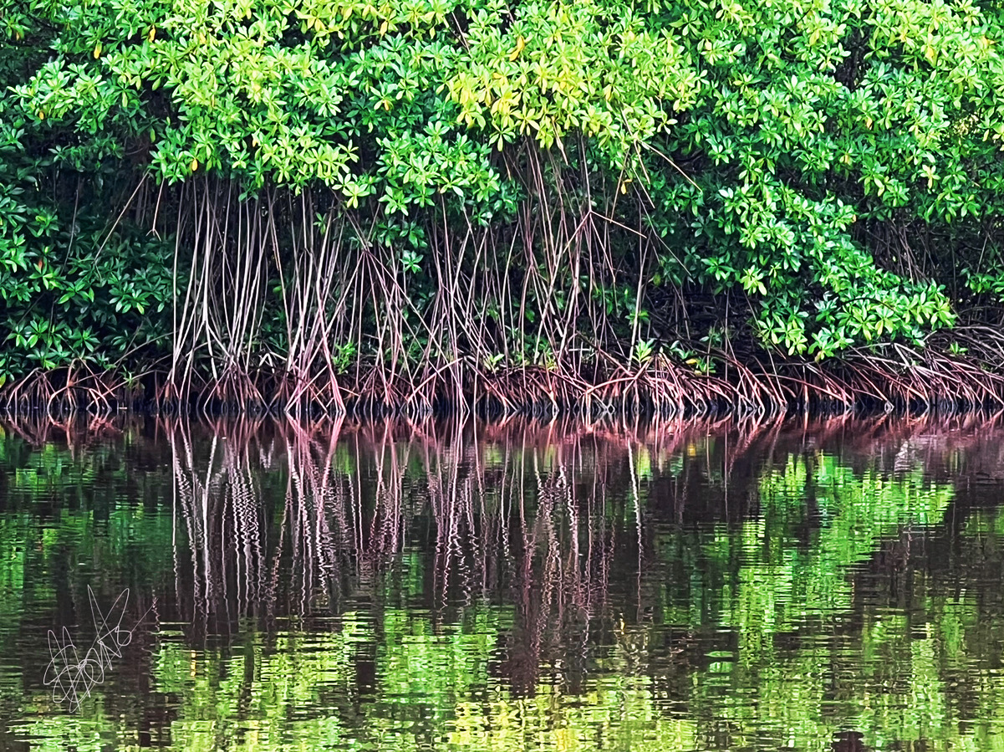
Background information
Mangrove ecosystems face increasing threats from human disturbance and environmental change, necessitating regular health assessments to inform management and restoration. Bio indicators, organisms, or ecological attributes sensitive to environmental conditions offer a practical and scientifically validated means for communities to monitor ecosystem health.
Photo by Geneviéve Sontowinggolo

Slide 4
Objective
Monitor key ecological parameters:
Vegetation structure
Faunal diversity
Abiotic conditions
Empower communities with actionable data to guide conservation efforts and adaptive management practices
To enable communities to assess mangrove health using bio indicators, detect degradation early, and guide conservation through accessible, science-based monitoring.
Detect early signs of degradation:
Reduced seedling density
Shifts in crab abundance
Bird diversity loss
Foster long-term stewardship by integrating local ecological knowledge with systematic monitoring frameworks
Notes:
To establish a standardized, community-based protocol for assessing mangrove ecosystem health through scientifically validated bioindicators, enabling local stakeholders to monitor key ecological parameters linked to mangrove resilience, including vegetation structure, faunal diversity, and abiotic conditions; detect early signs of degradation such as reduced seedling density, shifts in crab abundance, or bird diversity loss; empower communities with actionable data to guide conservation efforts and adaptive management practices; and foster long-term stewardship by integrating local ecological knowledge with systematic monitoring frameworks. This protocol aims to bridge scientific rigor and community accessibility, ensuring data reliability while promoting participatory conservation of mangrove ecosystems.

Slide 5
Bio indicators used for this assessment
Indicators selected based on their:
Representativeness: Accurately reflects ecosystem health and responds to both natural and anthropogenic changes.
Systematicity: Scientifically validated, with clear definitions and relevance to key ecosystem functions.
Feasibility: Practical for community monitoring, requiring minimal specialized equipment or training.
Key bio indicators for mangrove health include:
Bird diversity: Sensitive to habitat quality and structural complexity.
Mangrove vegetation structure: Composition, density, and regeneration (seedlings, saplings, mature trees).
Crab activity: Abundance and diversity of burrowing crabs, which influence soil aeration and nutrient cycling.
Water and sediment quality: Simple visual or rapid tests for water and sediment characteristics.

Slide 6
Surveys/ observations
Vegetation
Aerial roots
Crab burrows
Birds

Slide 7
Vegetation Survey
Objective:
To assess mangrove ecosystem health by quantifying tree species composition, generational structure (seedling, young, or adult), and the presence of aerial roots within a defined survey area.
Data Collection
Step 1: Choose and Mark Your Plot
Find a representative spot:
Use local knowledge and, if possible, aerial photos or maps to pick a spot that resembles your mangrove area (not too close to the edge or a disturbed site).
Measure out a 10×10 meter square:
Use a tape measure, rope, or marked sticks. Mark the four corners clearly (e.g., with stakes, flags, or painted stones).
Record the location:
Write down a description and, if possible, take GPS coordinates so you can find the same spot again.
Why This Design?
Easy to learn and repeat, no special equipment or technical skills needed.
Captures key changes in mangrove health and regeneration.
Builds ownership and understanding within the community, increasing the likelihood of long-term conservation success.
Flexible: Can be adapted to include additional indicators (e.g., crab holes, litter, or birds) if the community is interested
Notes:
During the vegetation survey, mangrove tree species are taxonomically identified and enumerated, with seedling density quantified to assess regenerative capacity. The presence and abundance of seedlings serve as a critical bioindicator of ecosystem resilience and successful recruitment dynamics within the mangrove community.

Slide 8
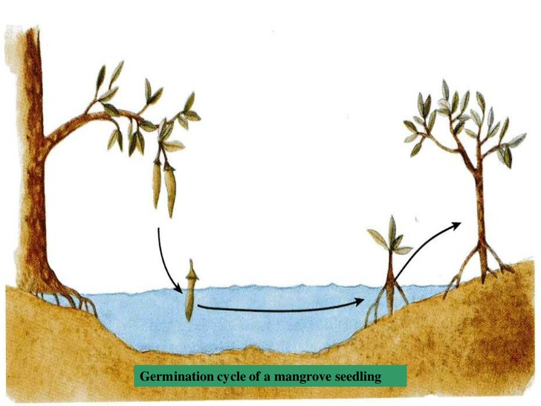
Vegetation Survey
Step 2: What to Record in the Plot
Tree Identification and Categorization:
For each tree within the plot:
Record the species in the plot (using standard taxonomic keys).
Record the three generational categories:
          Seedling: Height <1 m, no significant woody stem.
Young (sapling): Height 1-3 m but below reproductive maturity.
Adult: >3 m Mature, reproductive tree.
Tree health
Calculate how many seedlings there are per square meter
Notes:
During the vegetation survey, mangrove tree species are taxonomically identified and enumerated, with seedling density quantified to assess regenerative capacity. The presence and abundance of seedlings serve as a critical bioindicator of ecosystem resilience and successful recruitment dynamics within the mangrove community.

Slide 9
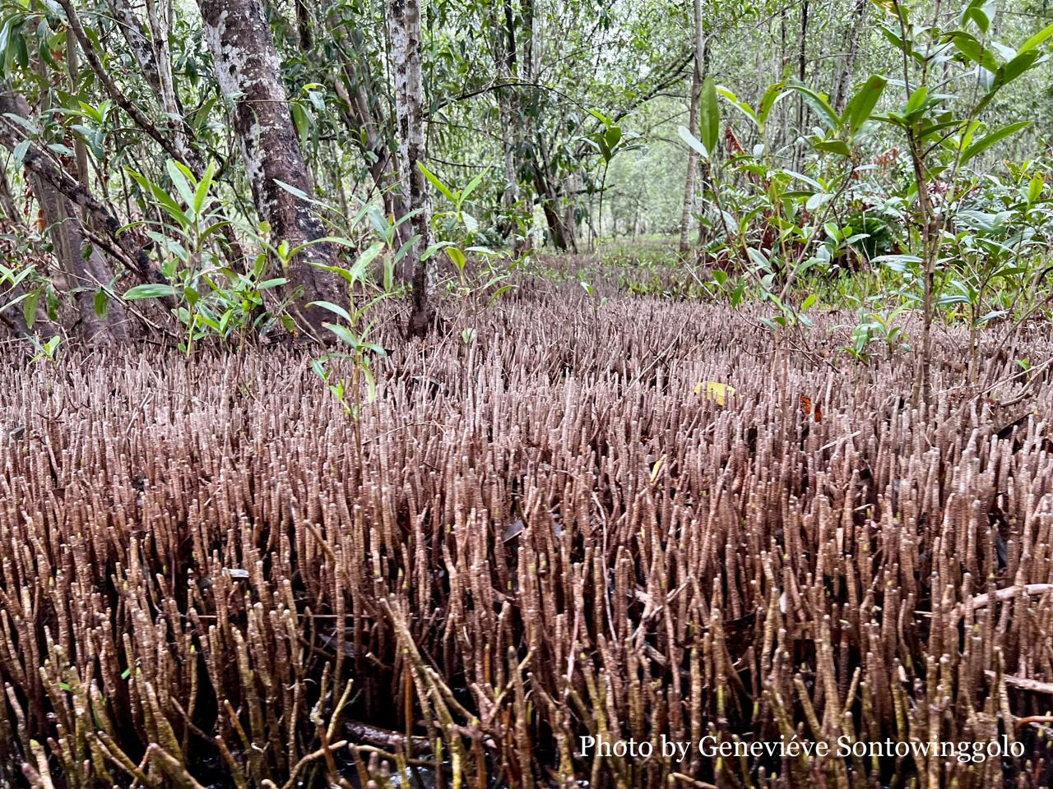
Aerial Root Survey
Objective:
To quantify and assess the density, structure, and condition of aerial roots within standardized subplots as a direct indicator of mangrove health, resilience, and ecosystem function.
Data Collection
Step 1: Choose subplots within the vegetation plot
Sample size: Aim for 3 plots of 50x50cm subplots within the 10x10m vegetation plot.
Step 2: What to record in subplots
Count all aerial roots within the 50x50 cm subplot
Calculate the average of the 3 plots.
Then calculate the density per square meter.
Notes:
Stratified random sampling.
Define Strata by Inundation Frequency
Confirm zones by observing watermarks, sediment types, or vegetation (e.g., Avicennia in high-frequency zones).
Sample size: Aim for 3–5 plots of 50x50cm subplots within the 10x10m vegetation plot.

Slide 10
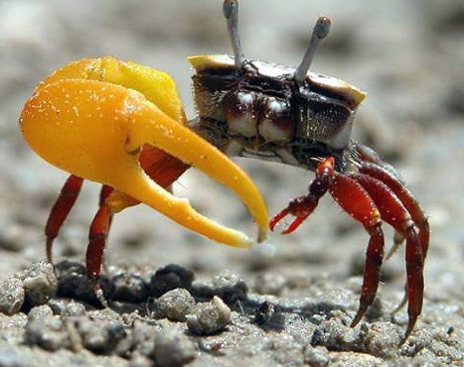
Crab Burrow Survey
Objective:
To systematically count and assess the density of crab burrows on the mudbank adjacent to mangrove plots as an indicator of mangrove ecosystem health.
Data Collection
Step 1: Choose plots within the vegetation plot or mud flat
Sample size: 2x2 m
Step 2: What to record in plots
Count all active crab burrows within the plot
Calculate the average of the plots.
Then calculate the density per square meter.
Notes:
Stratified random sampling.
Define Strata by Inundation Frequency
Confirm zones by observing watermarks, sediment types, or vegetation (e.g., Avicennia in high-frequency zones).
Sample size: Aim for 3–5 plots of 50x50cm subplots within the 10x10m vegetation plot.

Slide 11
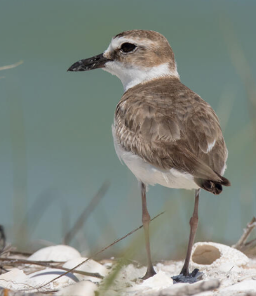
Bird Survey
Objective:
To assess the status of mangrove health by monitoring bird species richness, abundance, and community composition, using standardized bird surveys as a sensitive and practical indicator of ecosystem condition.
Data Collection
Step 1: Point Counts at Fixed Stations
Mark fixed points
Timer for half an hour
Use binoculars (if available) and a bird identification guide tailored to local species.
Step 2: What to record
Bird species (Focus on common, easily identifiable species (e.g., herons, egrets, kingfishers) rather than rare or cryptic birds)
Number of individuals
Time/date and tidal stage
Notable behaviors (e.g., nesting, feeding)

Slide 12

Mangroves Committee
Por favor agregar una foto suya con sus nombres debajo.
Geneviéve Sontowinggolo
Developer of mangrove protocol
Trainer
Suriname

