Slide 1
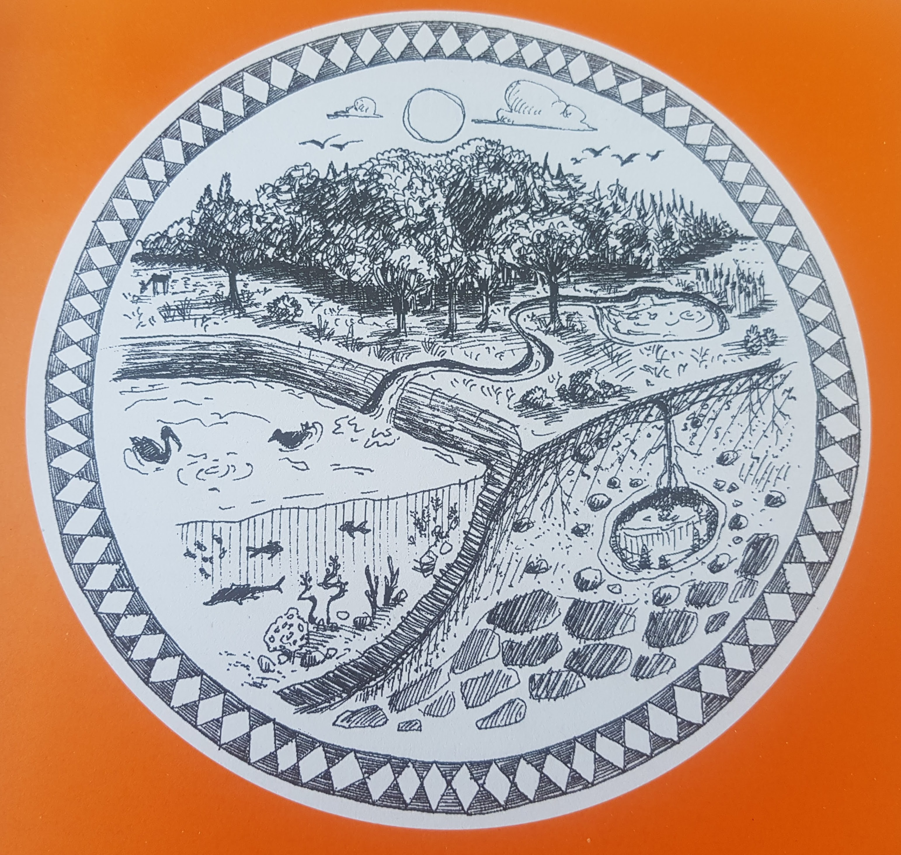
Biosphere
Notes:
GLOBE is an invitation to be curious and study how our local environments (and planet Earth) work!

Slide 2
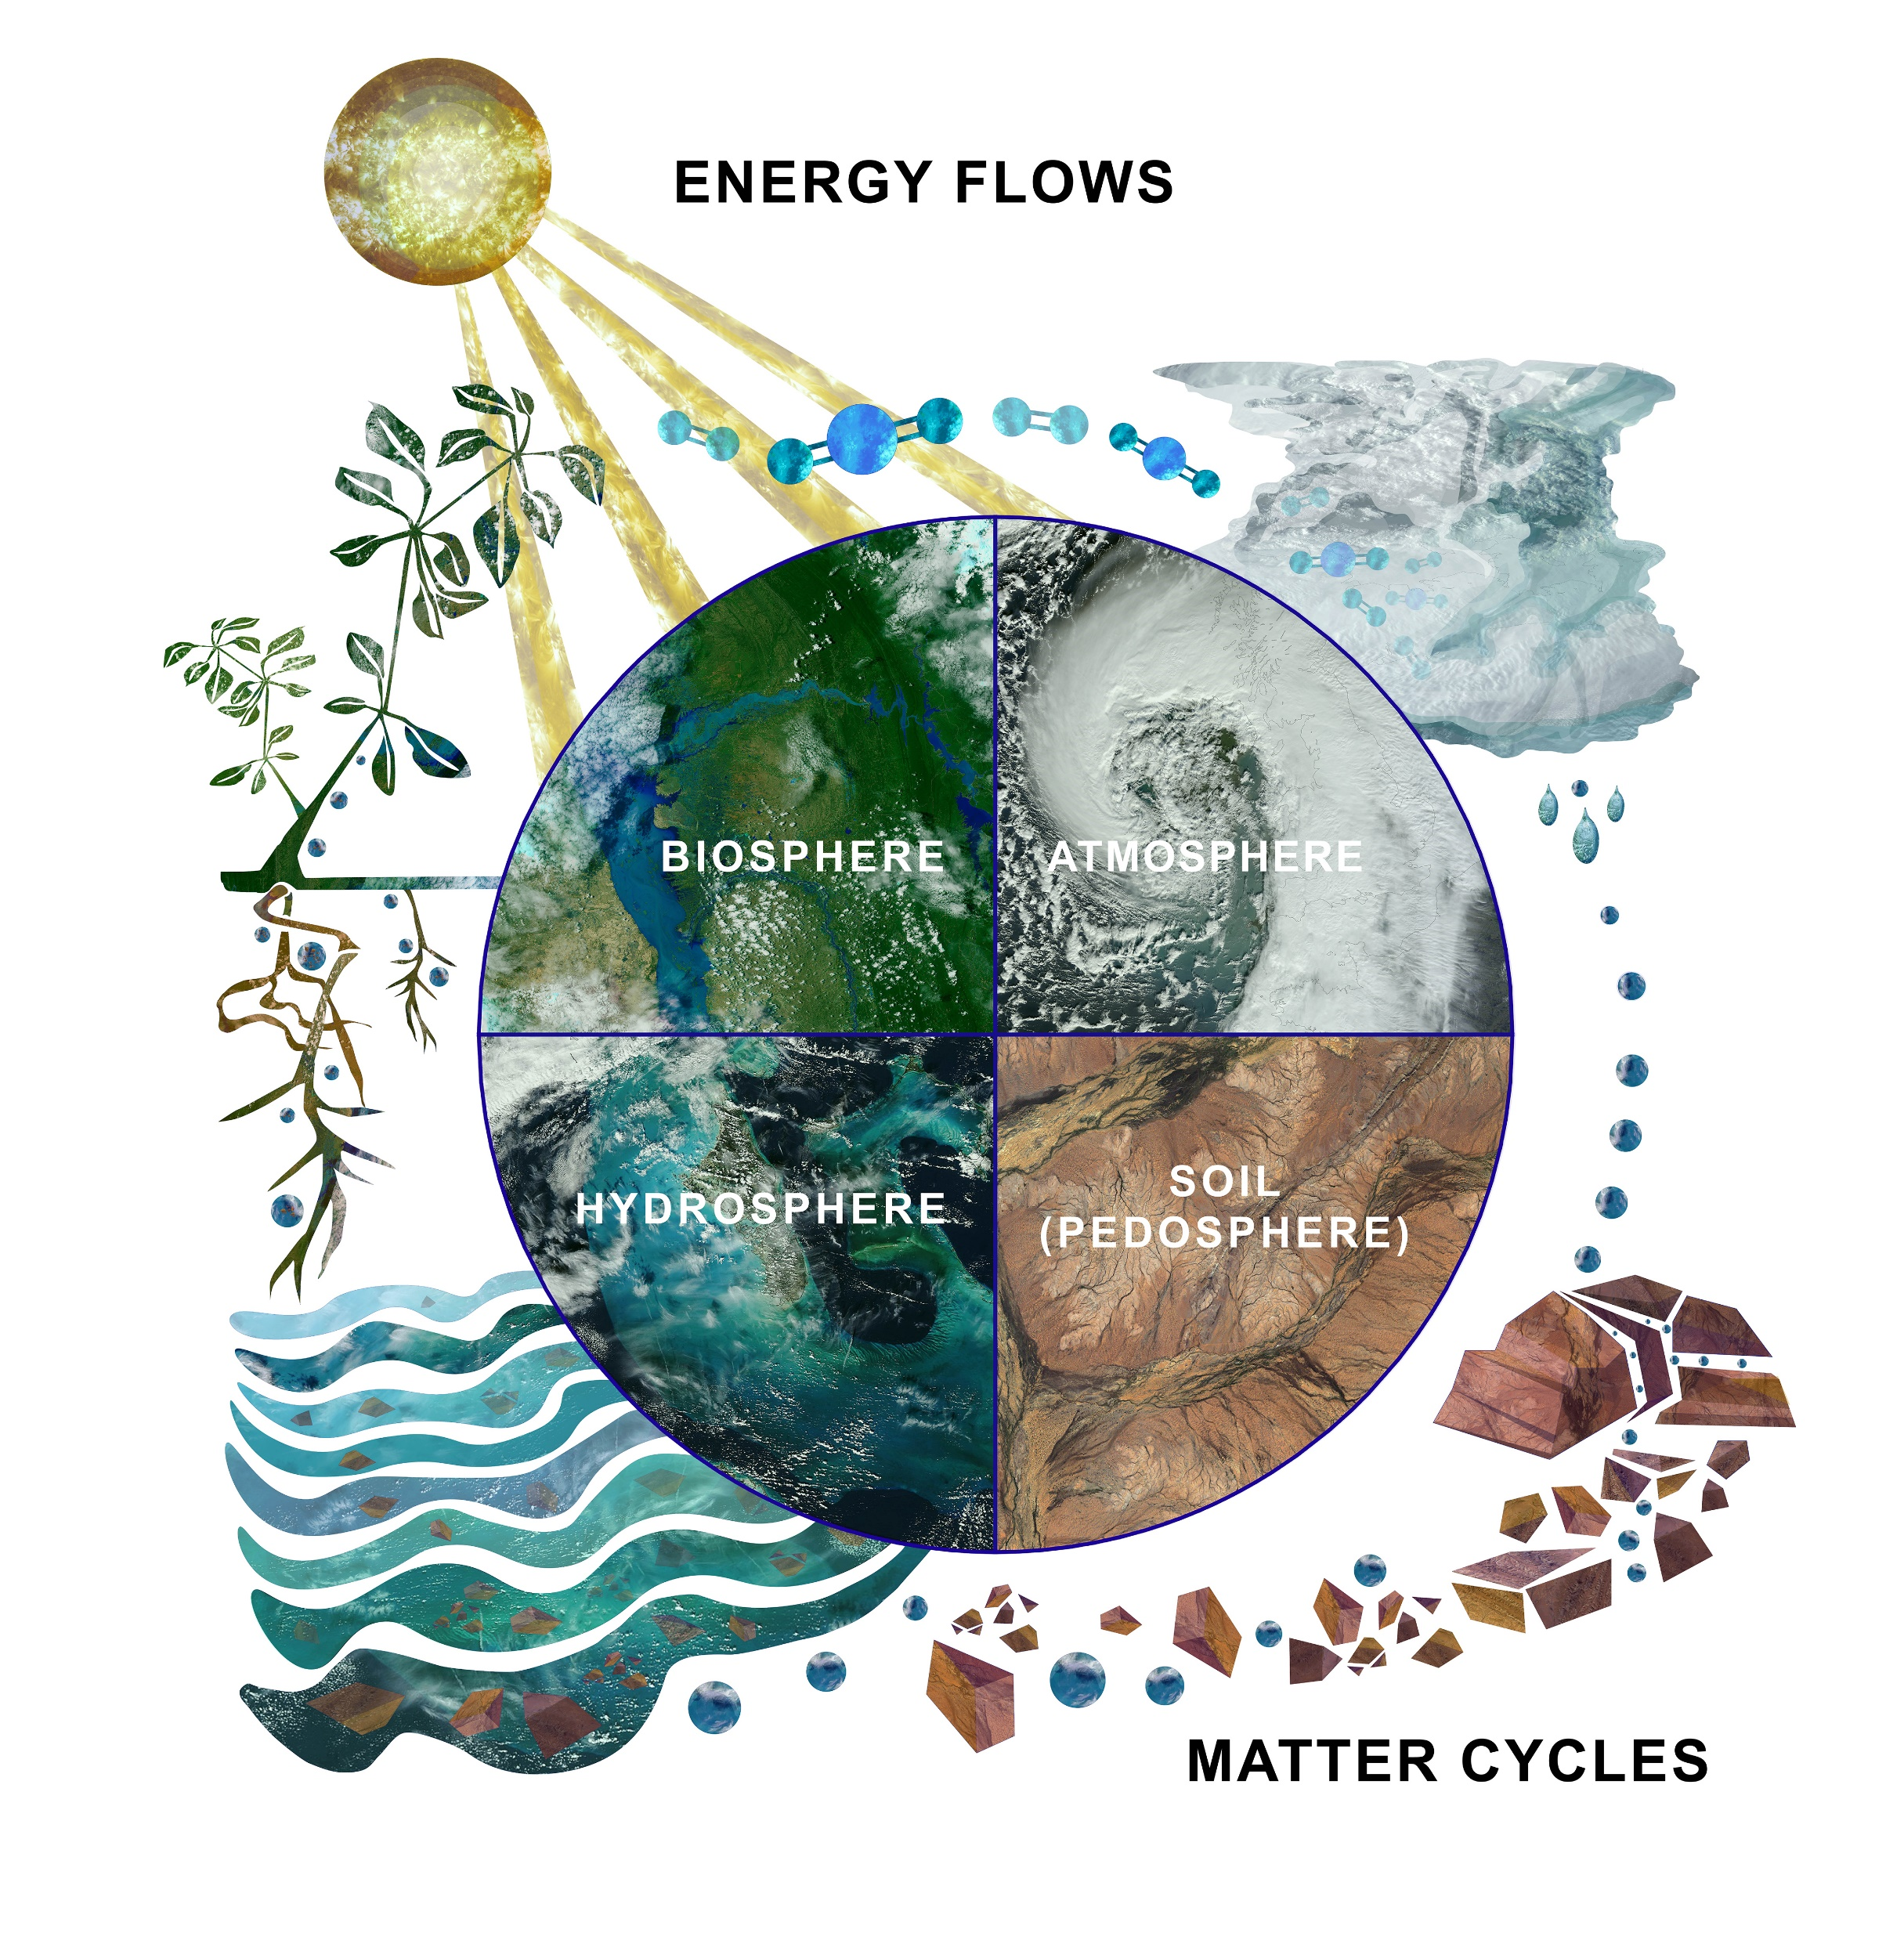
Notes:
Yesterday, we looked at weather measurements, which are part of a field of study called the Atmosphere. Today, we are going to look at the biosphere, which is the study of living things. Each sphere can be studied as a standalone (e.g. sample air quality), or you can look at how things interact. On Earth, everything is in interaction.

Slide 3
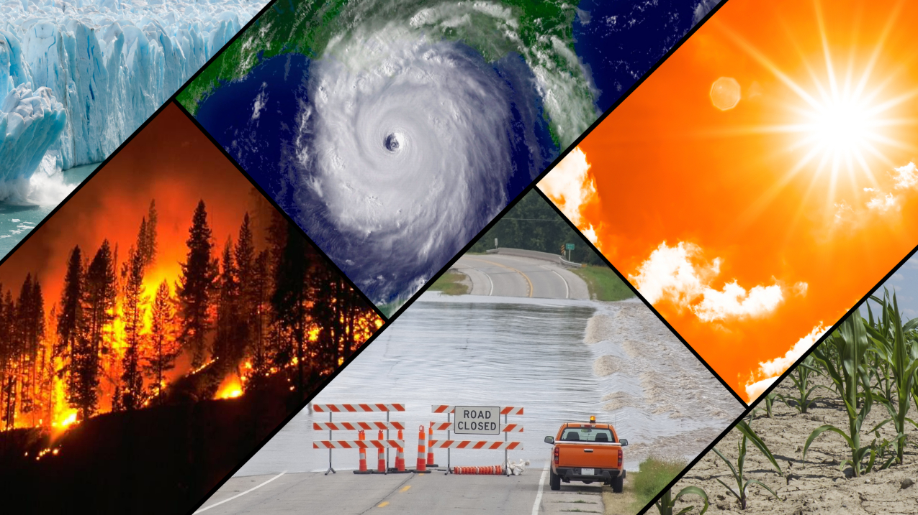
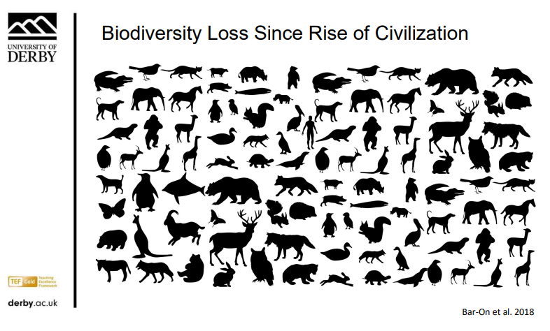
The ecological crises are interlinked
Notes:
With climate change, we see rising global temperatures and a disruption of the water cycle with drought and flooding becoming more frequent.
We are losing biodiversity at pace because of habitat loss (deforestation, draining of wetlands and changes to natural grasslands…), chemicals, climate change. With species dying out, our fabric (the web-of-life) is becoming fragile and our ecosystems with it.
Functioning large-scale ecosystems are seen as a key solution to protect ourselves from the worse effects of CC. Example of the Dodder river: restoration of the peatlands on the hilltops and creation of wetlands long the river.

Slide 4
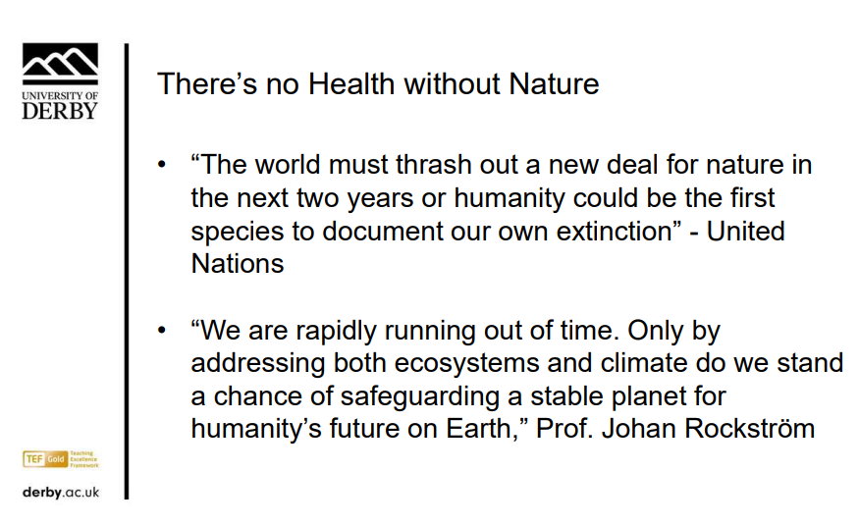

Slide 5
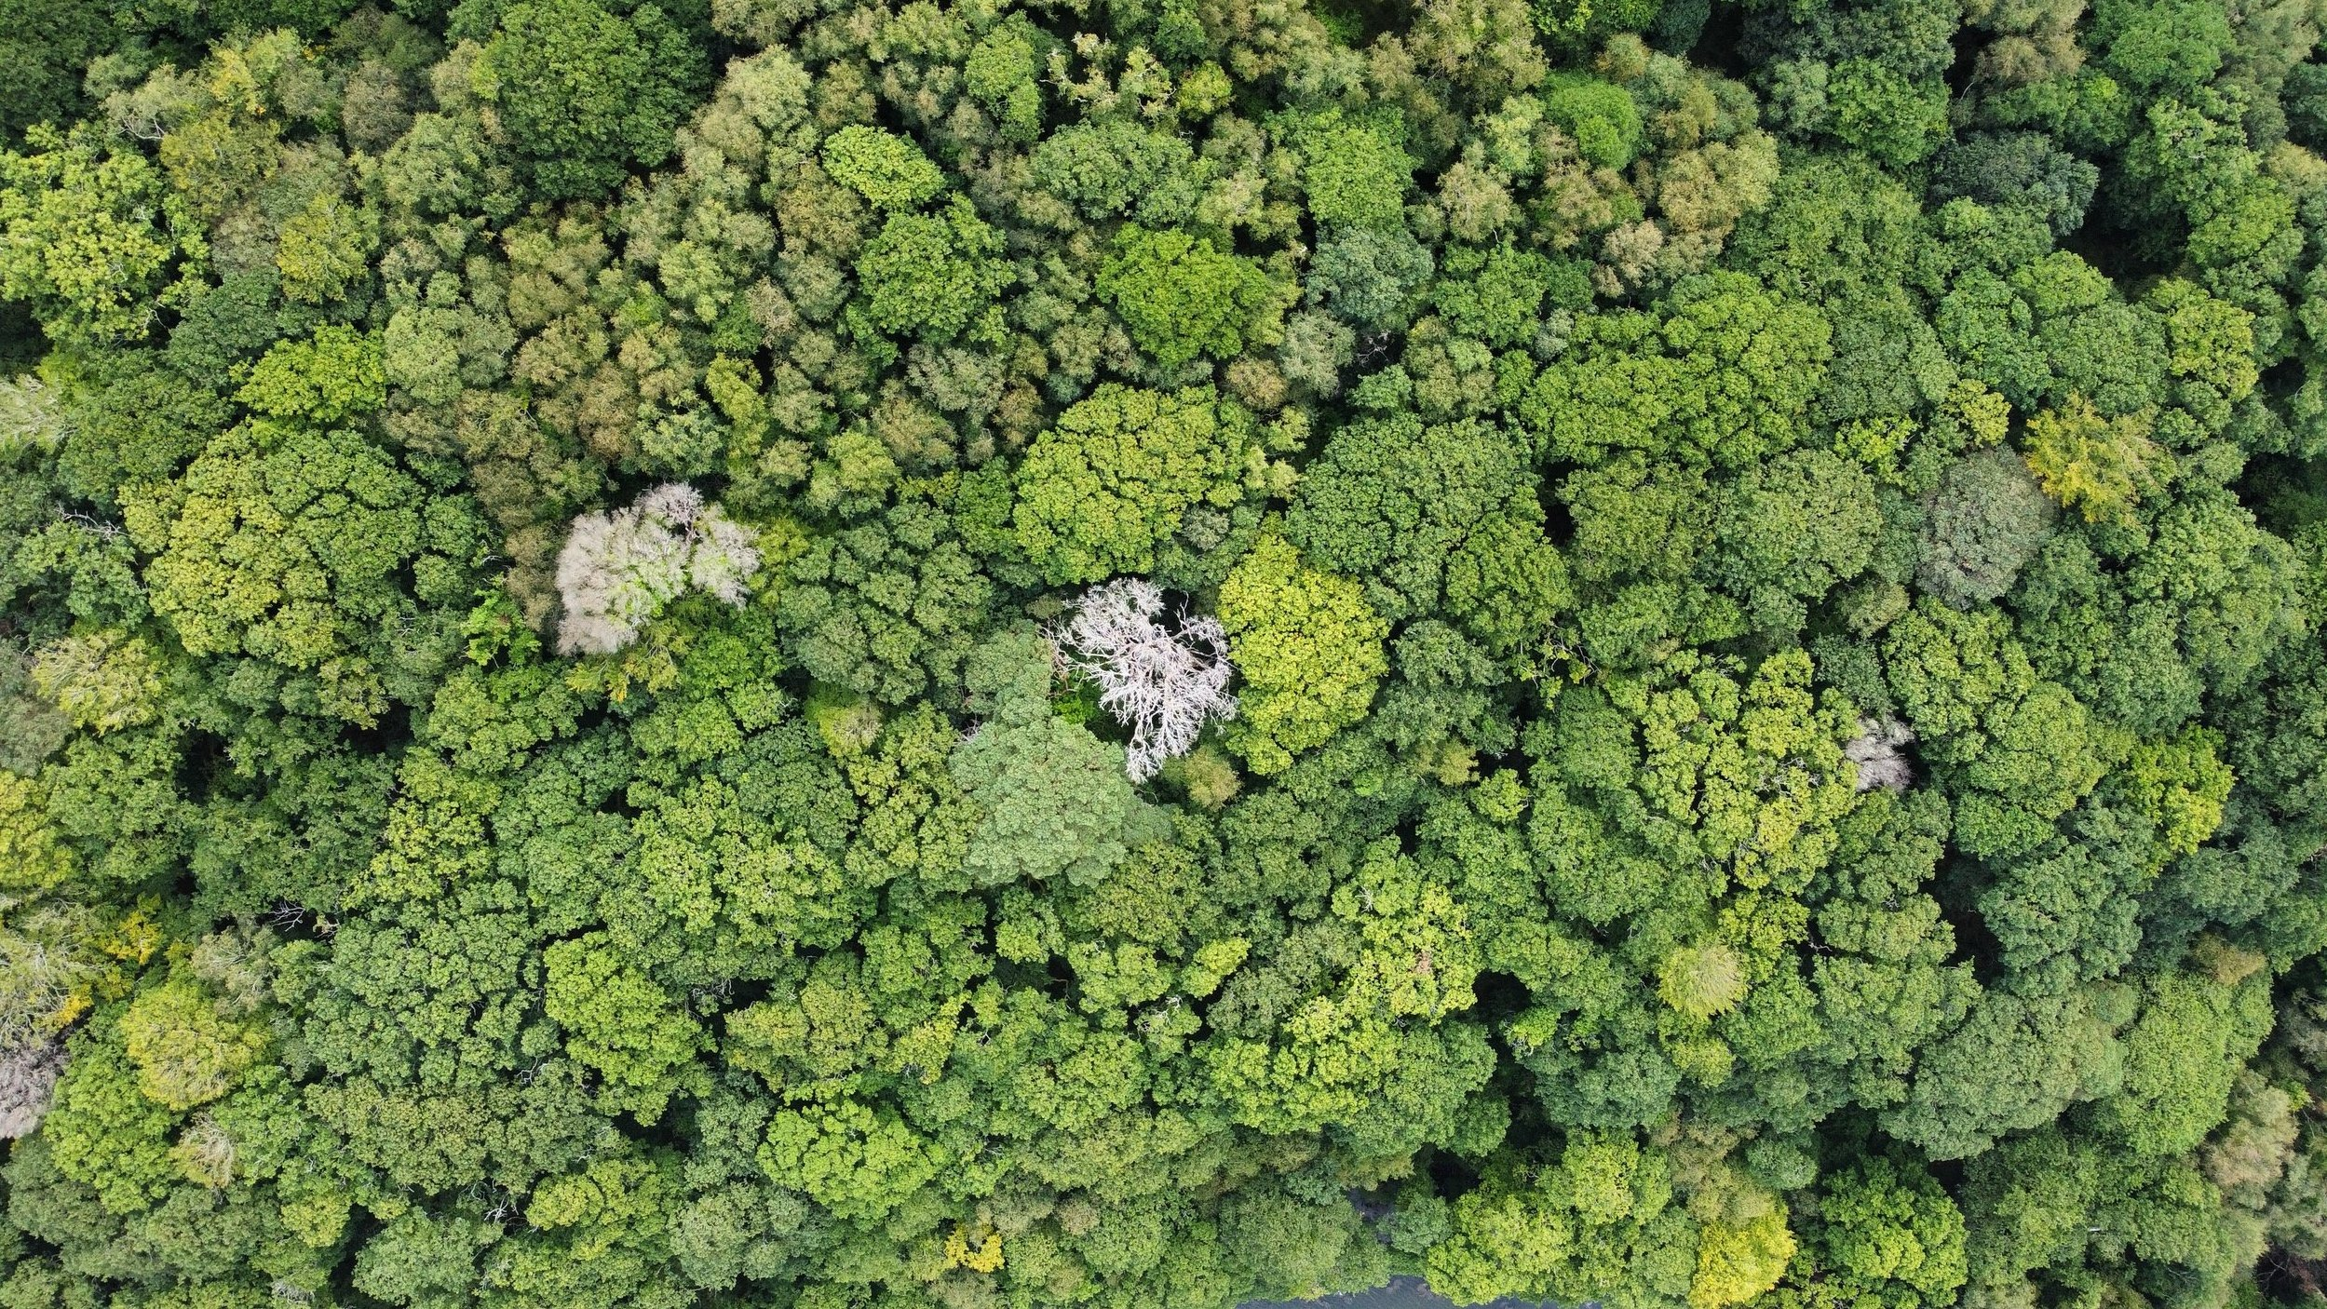
Notes:
There is an understanding at EU and national level that we need to develop nature-based solutions for biodiversity and climate resilience. To give an example (and we will hear more examples over the coming days), Hometree is an Irish organisation that is looking at bringing back the Irish rainforest on marginal lands in the West of Ireland. Their first pilot has captured the imagination of many people, including the local farmers who are helping with this happening. There plan is 4000 hectares of habitat restored.

Slide 6
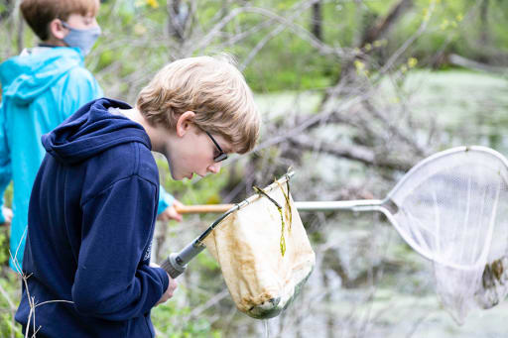
Notes:
As teachers and educators, there are a few things we can do:
Connect young people to their local environment by spending more time learning outdoors. Your school grounds can be a starting place to get familiar with GLOBE observations. You can then bring these tools with you on a school trip to study other environments.
Take simple positive actions for biodiversity in school… We see schools being more hands-off (no mow of some areas), planting tiny woodlands, composting… With CS, you could monitor the impact of these actions on biodiversity… get inspired and inspire others to take positive actions!
Letting them know about positive initiatives at the national level and beyond.

Slide 7
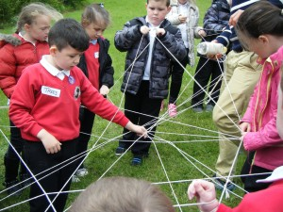
Web-of-life game
Notes:
Here, we are going to play a short game to highlight interactions between different components in a natural system.
To do - web-of-life card game – map it out and design it:
Sun
Tree (bio)
O2 (atmo)
CO2 (atmo)
Water (hydro)
Fallen leaves (bio)
Earth worms (bio)
Caterpillar (bio)
Bird (bio)
Soil (pedo)
Key takeaway: everything interacts in an ever cycle powered by the sun’s energy.

Slide 8
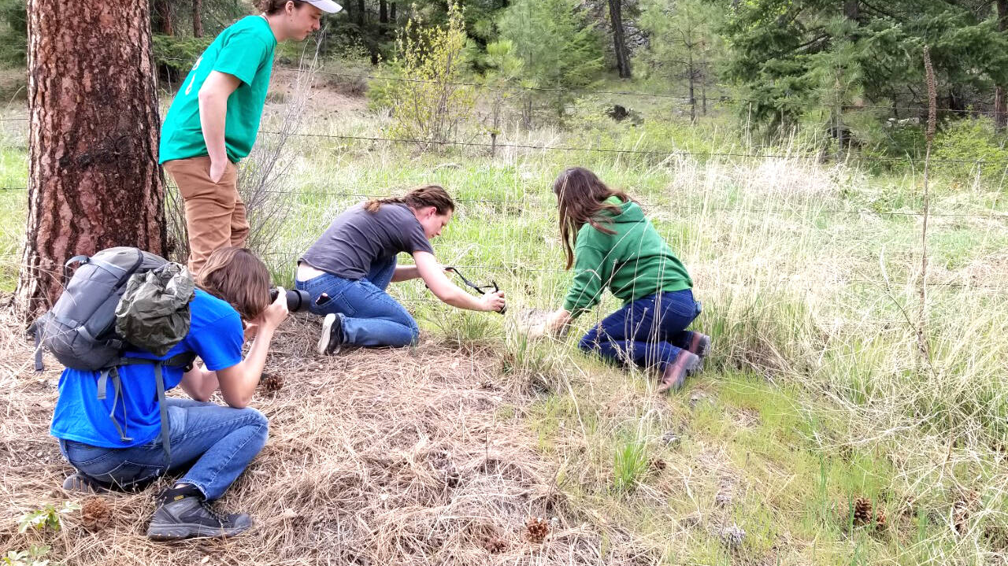
Observation time!
Notes:
An example of a simple activity that you can do with your students – scavenger hunt on your school grounds!

Slide 9
Practice time!
Aim: quick study of the biodiversity in school
Groups formed
Your task: observations of living things in an area and present back to the whole group:
  Observe in silence using your senses.
  Collect: sketching / picture, plant item, insect/invertebrate, evidence.
  Prep your 3’ presentation back to the group.
Location
Time and meeting point
Notes:
Using your senses (5 minutes): taking things in through sight, hearing, touch, smell, taste (only taste what you know!). For best results: in silence + experiment with closing your eyes to enhance your other senses. Once done, take notes of your observations.
Move on to collecting evidence of life in that area (10 minutes): plants, insects, animals… munched leaf, feather… use jars/ziplock bags/tray (to shake things of a plant for example); Demo how to use the hand lenses.
Prep your presentation: tell the story of what you observed. See next slide.
Location: a facilitator will bring you to a location in the park. You will pick an area to observe. It can be small 9m2 (3x3). A good idea to have a variety of things on the ground as this will create different habitats.
Your resources: see equipment slide. ! You do not need to know the names. Things can be described in general terms (insect/bee) or by shape/colour/behaviour…
We will meet back here at X time. You are responsible for your timekeeping.
Any questions?

Slide 10
Equipment for each group
To take notes and draw:
  3 of each: paper sheets + clipboards + pencils with rubber
  a bunch of colouring pencils (greens, browns, yellow, purple, pink, red, blue, grey, black)
To collect things and display them:
  a jam jars
  2 x zip lock bags
  a white tray
  A3, paper Sellotape, marker
  a printed map of Herbert park
To find and identify:
  2 x hand lenses
  a trowel
  a tree of life printed to help with what to look out for
  a tree ID guide
  your senses and curiosity!
Note: demo how to use the hand lenses.
Notes:
Facilitators guide the group to the chosen spot. They let them do the activities by themselves; they observe them at a distance ideally.
They may:
Share tips after a while such as areas that might not have been explored. Shake a bush or a branch with a tray underneath. Look at the leaf litter. Dig a hole or look under wood, stones…
If group interested in identification, they can help with it and point to apps/help with apps on their phone.
Or they can point to group presenting back in other ways: colours, touch… it does not have to be reporting back with the actual names.

Slide 11
Resources
FSC guides
NBDC guides
Map of Herbert Park
Apps (recommend to use pen and paper as much as possible; once interest is there, can go deeper by using some tools):
  Identification: inaturalist or Seek naturalist (free)
  Insect count: FIT-count (free)

Slide 12
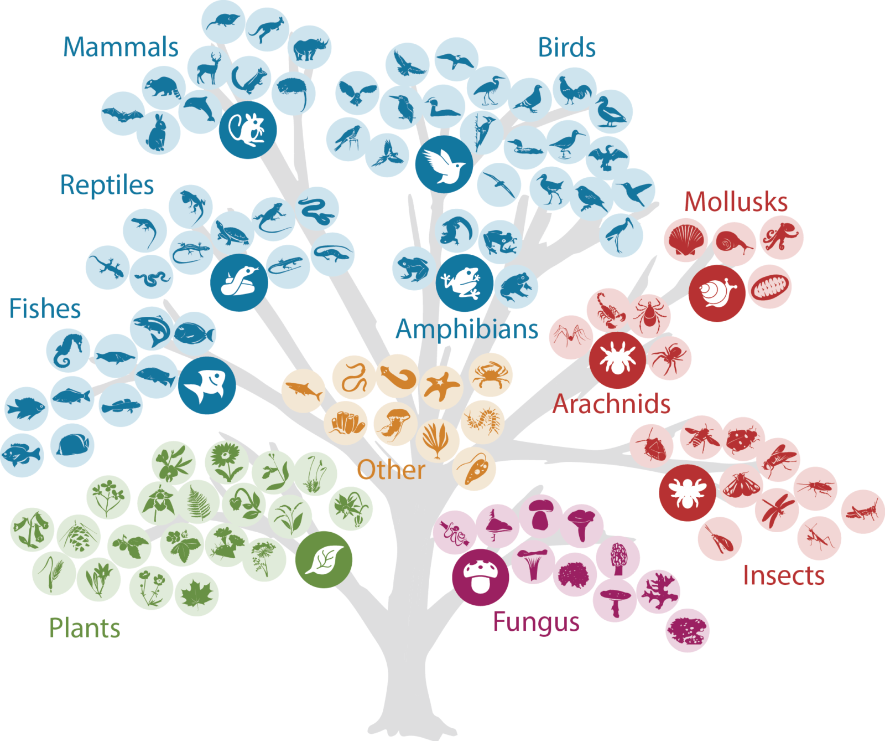
Notes:
https://pollychandlercoaching.com/inaturalist-break-down-silos-tool/

Slide 13
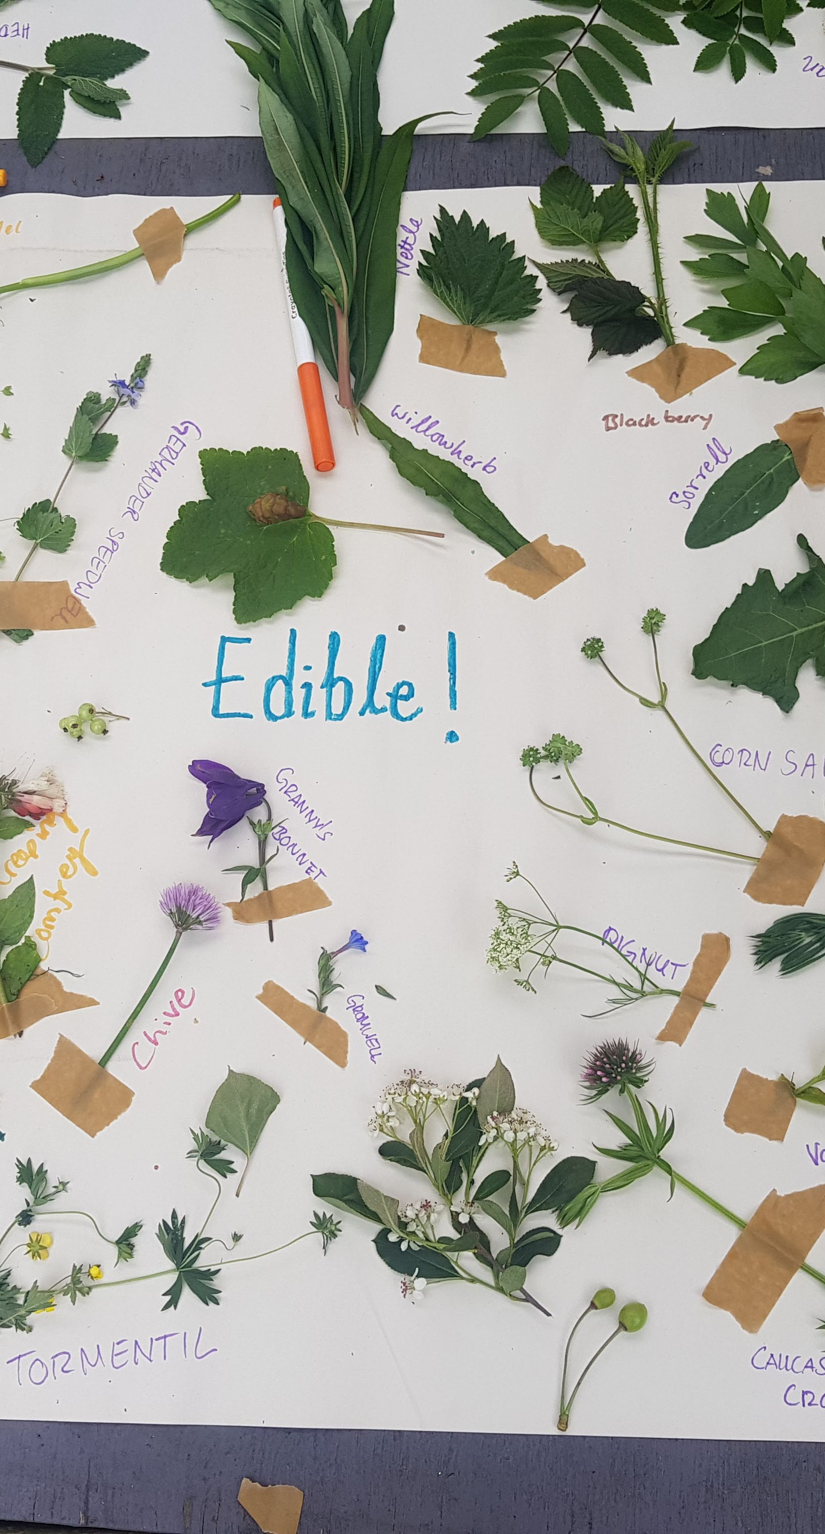
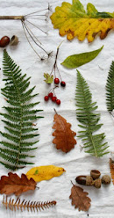
3-min presentation – Sample questions
Where were you in the park?
What was the area you studied like (size, vegetation, features…)?
What did you find (where)? What did you hear but did not see? What did you find out through touch? What interactions did you witness?
What questions do you have / what are you curious about?
…

