Slide 1
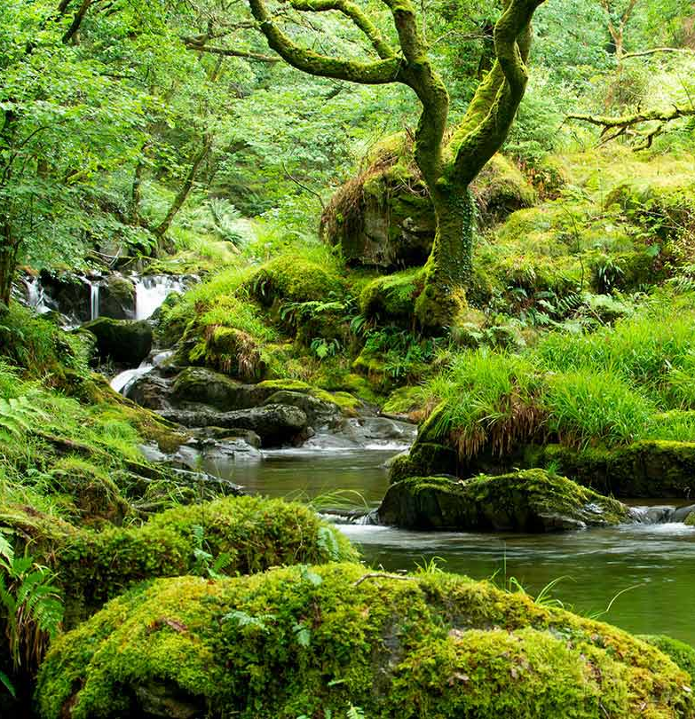
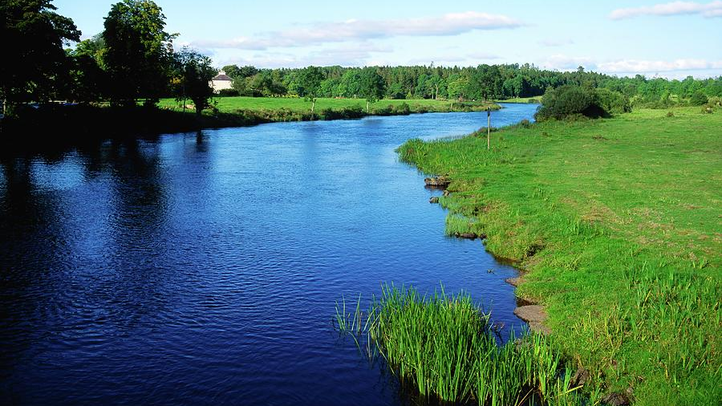
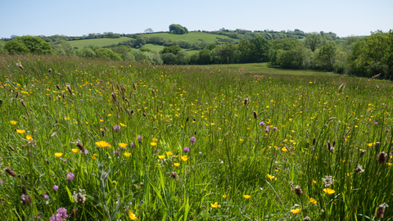
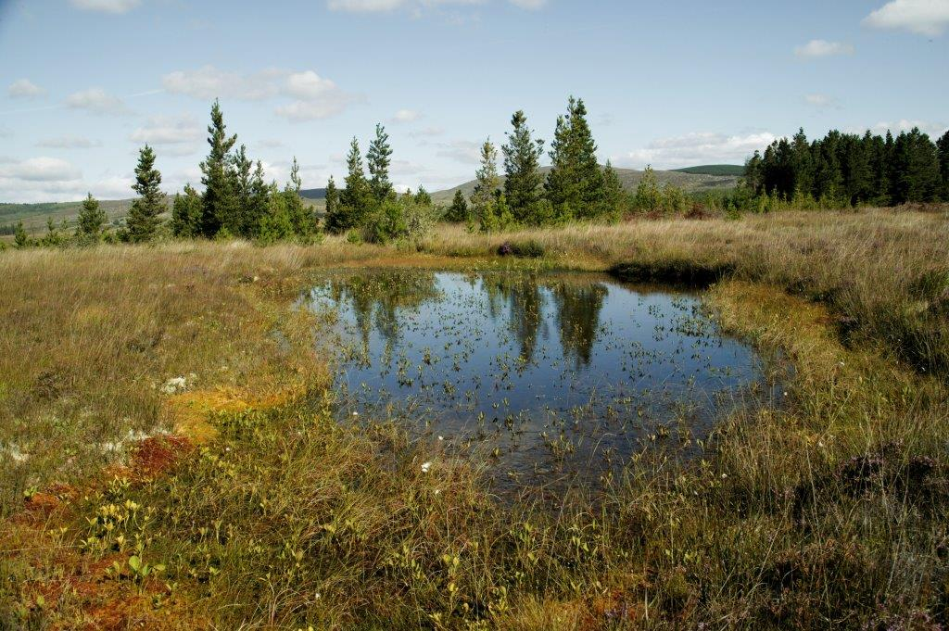
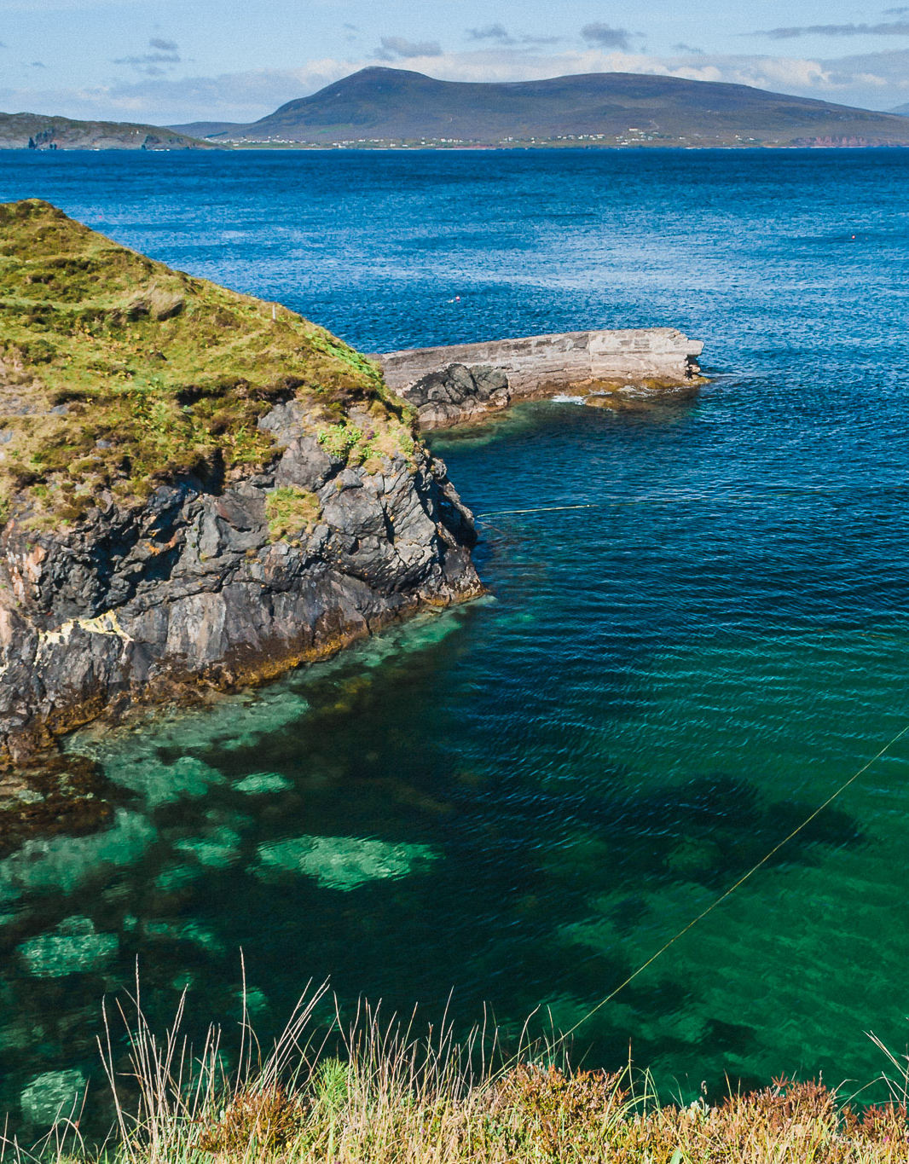
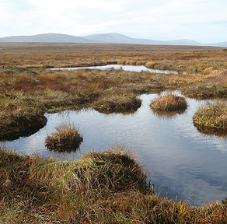
Ireland’s rich ecosystems as solutions

Slide 2
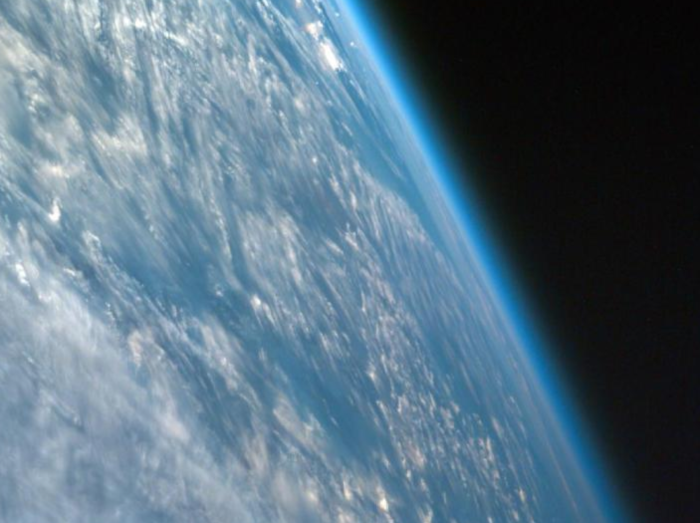
Our atmosphere is made of a thin layer of gases that makes Earth habitable!
Image: NASA
Notes:
In this picture, taken from a spacecraft orbiting at 200 miles above the surface, we can see the atmosphere as the thin blue band between the surface and the blackness of space. If the Earth were the size of a basketball, the thickness of the atmosphere could be modeled by a thin sheet of plastic wrapped around the ball!

Slide 3
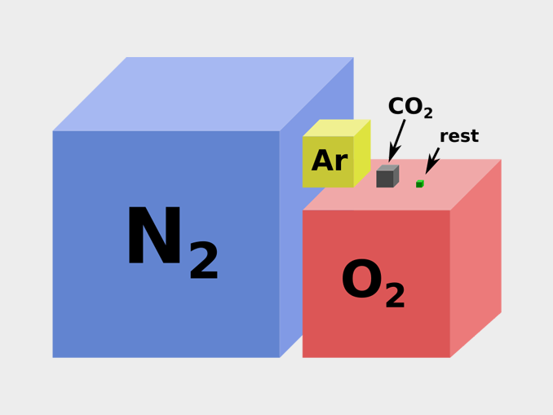
Do you know what gases make up the atmosphere?
Notes:
In decreasing order, the atmosphere is composed of: Nitrogen, Oxygen, Argon, Carbon dioxide (co₂) and other gases form the atmosphere.
There is a small portion of greenhouse gases in the atmosphere: water vapour (h₂o), carbon dioxide (co₂), methane (ch₄) and nitrogen dioxide (no₂). They play a role in the greenhouse effect.

Slide 4
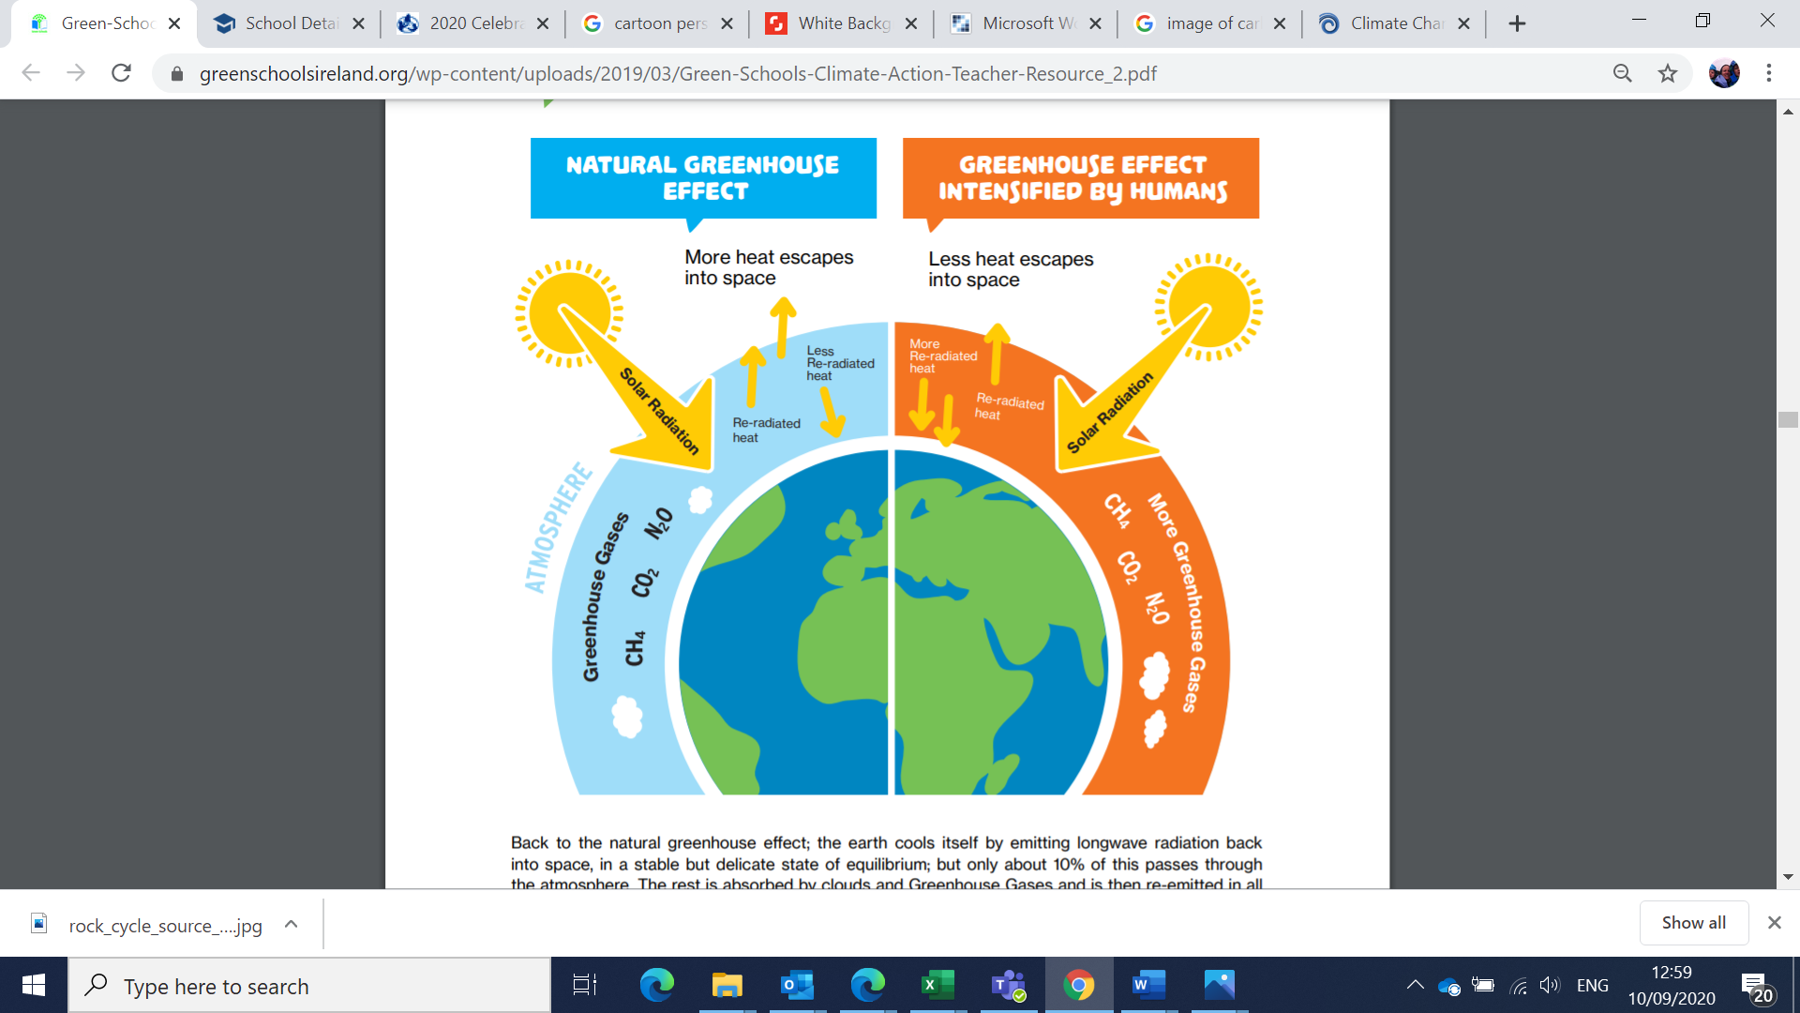
Greenhouse effect intensified by humans
Notes:
The atmosphere lets in some of the sun’s energy through. This warms up the Earth surface, which creates what we feel as “temperature”.
What is the temperature like today where you are?
Heat rises, but thanks to the atmosphere, which acts a little bit like a blanket, it does not all escape to space.
This special atmosphere is one of the reasons why life could develop on Earth. Thank you atmosphere!
The issue is that humans have been producing a lot of CO2 since 1700 and this is accelerating!

Slide 5
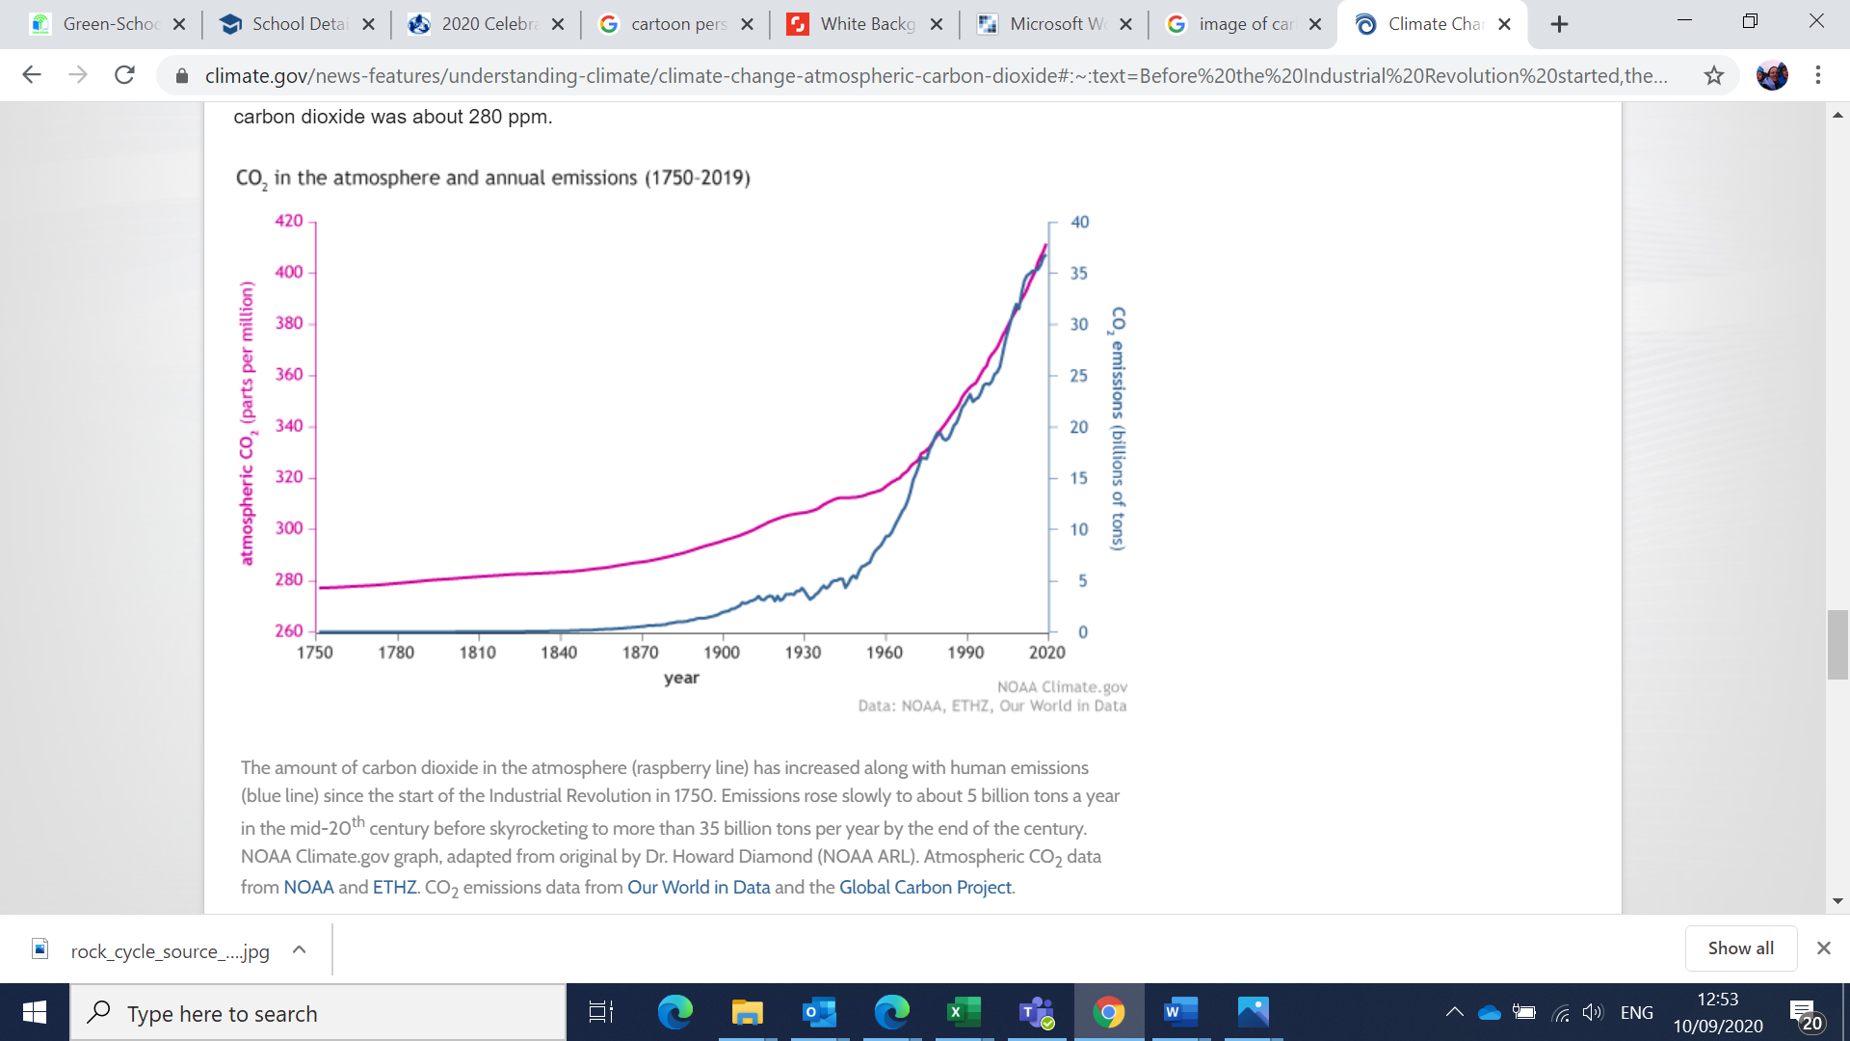
CO2 in the atmosphere and annual CO2 emissions
Notes:
Look closely at the graph below – the blue line (human CO₂ emissions) tracks closely with the pink line (CO₂ in the atmosphere)

Slide 6
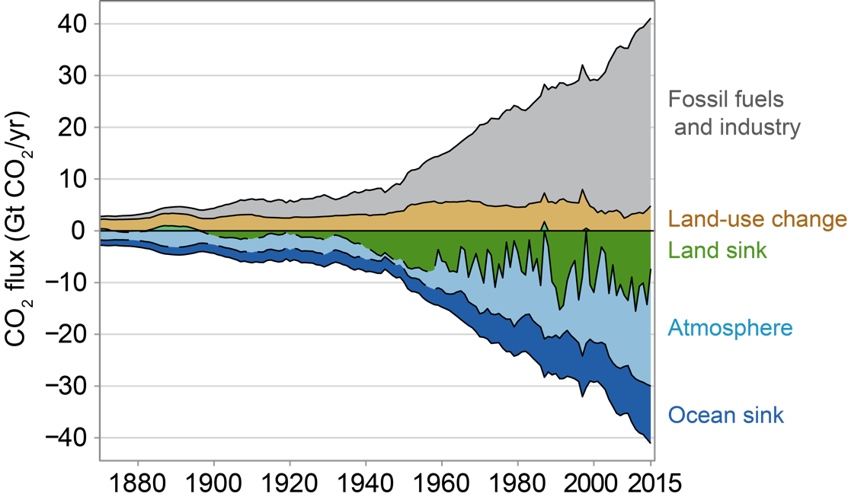
Greenhouse effect intensified by humans
This is where CO2 emissions are going.
Notes:
So, when it comes to new CO2 emissions, they go to:
Half of the CO2 created by humans is going into the atmosphere. The other half goes into the ocean and is absorbed by plants and ecosystems.
This rapid change is creating problems:
The extra CO2 in the atmosphere leads to more heat being trapped. If our atmosphere is acting like a blanket, it is as if this blanket was getting thicker. This change is happening rapidly and has impacts on everything and everywhere on Earth.
The extra CO2 in the ocean leads to ocean acidification, which has negative impacts on corals and shells for example.
This is the reason why countries all around the world, like Ireland, have set targets to reduce the amount of CO2 released every year and sequester carbon through natural processes.

Slide 7
What do humans do that creates CO2?
This is where CO2 emissions are coming from.
Notes:
In the past, most CO2 emitted was from the conversion of lands by humans for agriculture: deforestation, then draining of wetlands and peatlands… These ecosystems went from absorbing and storing CO2 to emitting it as they were degraded.
This net source of CO2 has persisted with fossil fuel burning becoming the main source of human-made emissions. Think of:
Transport (going around, travelling)
Energy consumption (electricity, heat)
Construction
Production of goods (computers, schoolbags, clothes, etc.)
Food
And more!
If fossil fuels are used in the process!
Follow-up: we need to become more efficient/sustainable in the way we move around, feel warm at home, build houses, etc. Is there a way we could do those things and create less CO2? We can do this by switching to renewable energy (for example, creating electricity with solar panels and wind turbines), producing/consuming less and producing more efficiently (when possible).
The good news is that this is happening all over the world. We need to make sure that this is happening fast enough!

Slide 8
Natural sequestration of atmospheric CO2
Notes:
A complementary way is asking nature for help! Many ecosystems are very good at absorbing CO2 from the air and keeping it for a long time. And CO2 is good for them.
Such ecosystems include wetlands, peatlands, woodlands, sea grass, etc. They are our allies, so let’s make sure we respect them as much as we can.
It is therefore a good idea to: 1) protect the ecosystems we have, 2) restore the ones that are not in good health, 3) create ecosystems where there are none. 4) Manage land and soils in agriculture in the most sustainable way.

Slide 9
Natural sequestration of atmospheric CO2
Notes:
One way that works very well is asking nature for help! Many ecosystems are very good at absorbing CO2 from the air and keeping it for a long time. And CO2 is good for them.
Such ecosystems include wetlands, peatlands, woodlands, sea grass, etc. They are our allies, so let’s make sure we respect them as much as we can.
It is therefore a good idea to: 1) protect the ecosystems we have, 2) restore the ones that are not in good health, 3) create ecosystems where there are none. 4) Manage land and soils in agriculture in the most sustainable way.

Slide 10
Interesting readings
A breathing planet, off balance by NASA (article & videos)

Slide 11
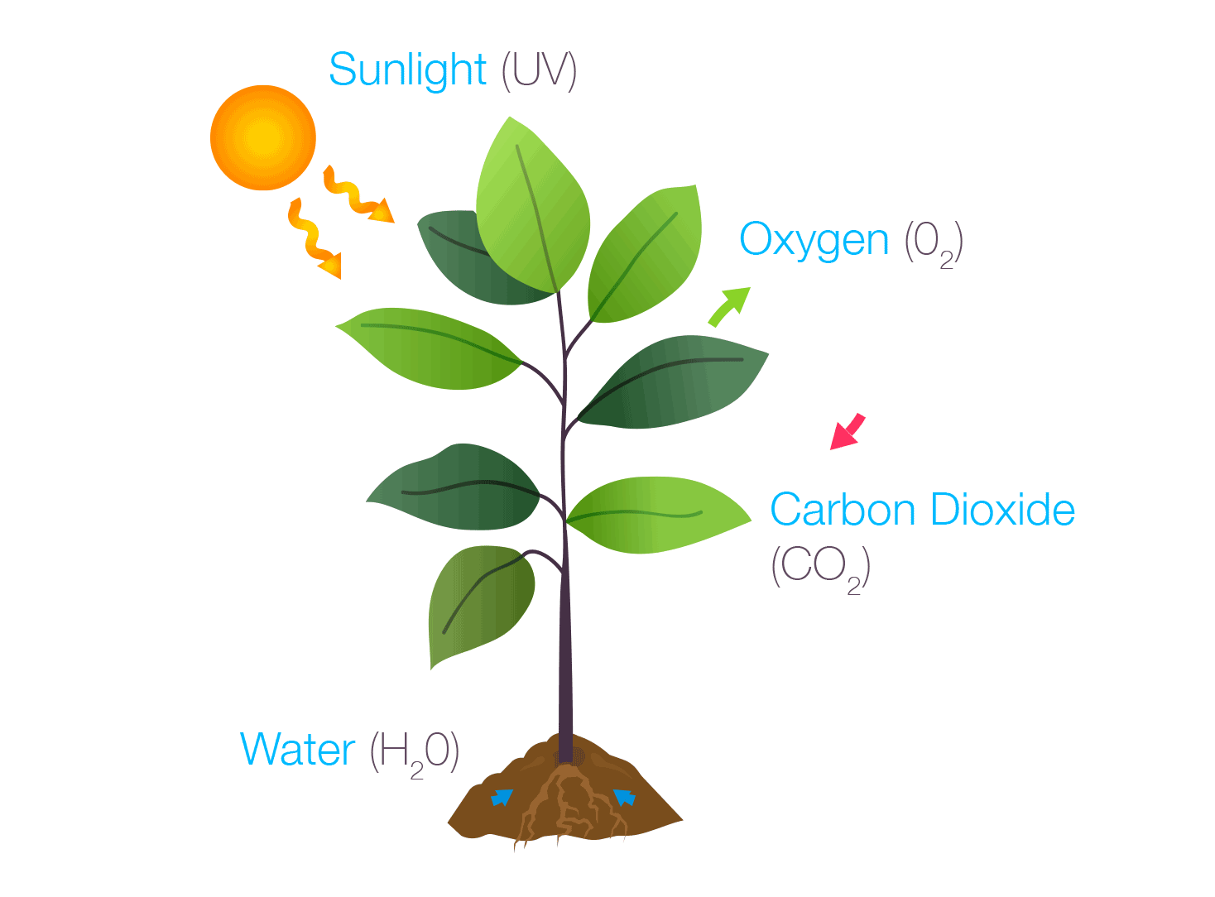
Plants store carbon over their lifetime
Carbon Dioxide + Water + Sunlight → Glucose + Oxygen
Notes:
Carbon is one of the favourite foods (!) of trees and plants. Trees take CO2 from the air, combine it with water drawn from their roots to form sugars. This is all powered by sunlight (a renewable energy!) and done in their tiny leaves. Does this sound like magic to you?!? It does to me.
So, instead of eating cereals and toasts at breakfast, you would be eating air and water. No need to go to the shops, the air and water is just there. All you need is a little solar power (or leaf) to transform the air and water into… sugars! And as solar energy is a renewable energy, this is all sustainable (no pollution)!
With these sugars the tree lives and grows up and builds its roots, branches, trunk and new leaves. Magic!

Slide 12
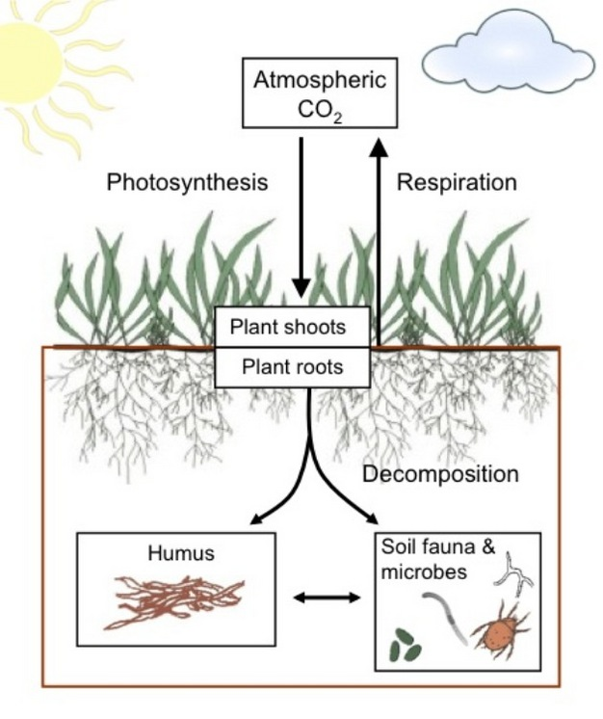
Soil as store of organic matter (carbon cycle)
Notes:
Soils are the biggest carbon pool on land (they store 75% of land carbon) — three times more than the amount stored in living plants and animals.
Some soils like peatlands and wetlands are very good at the long-term storing of carbon when intact. Globally, peatlands store 25-33% of soil carbon and represent 3-6% of land surface. BnM owns 7% of peatlands in Ireland. They are rehabilitating 33K hectares with NPWS.
The management of agricultural land can also lead to carbon sequestration, such as mob grazing and conservation tillage.
carbonsequestration (esa.org)

Slide 13






Time for positive action! You could…
Your ideas [please fill in]
Let people know about the (old) trees at your school and create a tree trail
Plant small woodlands or additional trees on school grounds
Can fence and bare wall support wall climbers? Can hedgerows be planted?
Plan clothes swap-shops, walk/cycle to school days, or other activities to lower the school’s carbon footprint.
Notes:
Think together about all the ideas you may have (even if they sound a little bit strange). Then, select your favourite ideas (easy, powerful, new) and give them a go. This is good for your community and the planet!
If you need help with your project, please contact Sabrina Moore: smoore@eeu.antaisce.org

