Slide 1
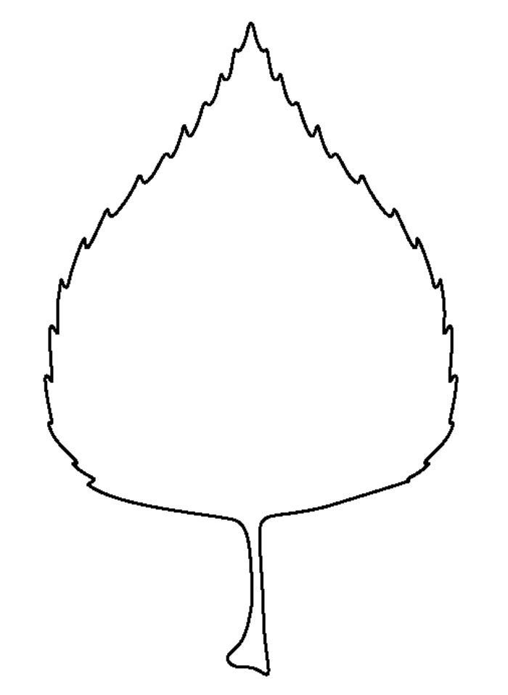
Observe
Green-down
Date ______________________
Your name _____________________
Tree name ________________
Instructions:
1. Gather your supplies:
GLOBE Plant Colour Guide
Pencil
2. Go outside and check your adopted 4 leaves.
3. What colour is each leaf? Match the colour on the GLOBE leaf color chart to each leaf.
3. Write the colour code on the corresponding leaf below. You can also colour the leaf in with a crayon that matches.
4. If the leaf has more than one colour, write the colour that takes up most of the leaf.
5. If the leaf has fallen, write “fallen” in the leaf.
Example:
5GY
7/12
Leaf 1
Leaf 1
Leaf 2
Leaf 3
Leaf 4
Credit: GLOBE Grandma series for primary grades, Arctic and Earth SIGNs project. C. Villano

