Slide 1
GLOBE Ireland Air Quality Campaign Classroom Resource
Secondary School Edition
Notes:
Teacher guidance: Introduce the topic

Slide 2
In this resource you will:
Learn about Air Pollution
Find out about the GLOBE Air Quality Campaign
Explore Air Quality Project Options

Slide 3
In this resource you will:
Learn about Air Pollution

Slide 4
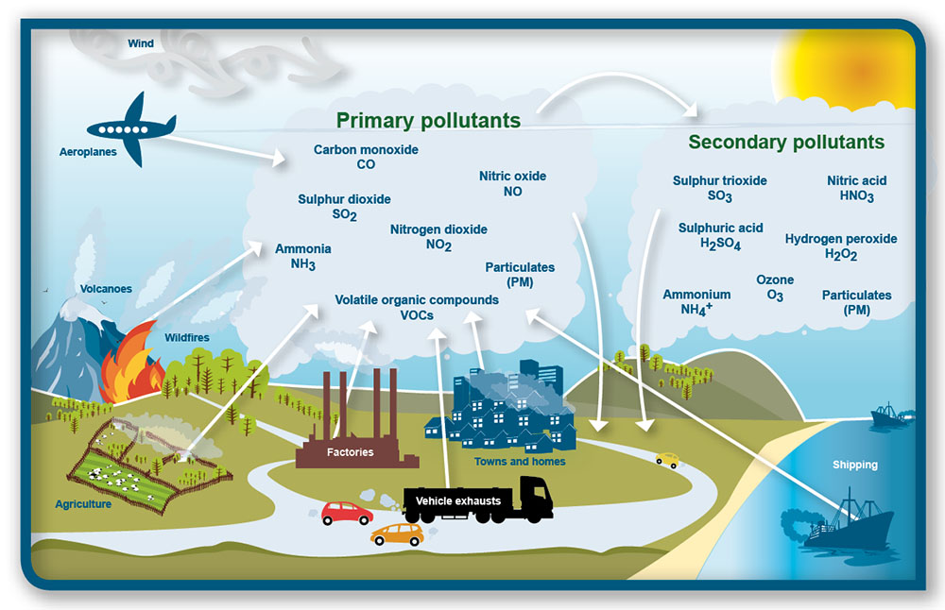
There are many sources and types of air pollutants that affect the human body and our environment
What different air pollutants do you know of?
What are the different sources of air pollution?
Which air pollutants do you think are most common around schools?
Why do we need to care about air pollution?
Notes:
Teacher Guidance:
Tell your students that there are many sources and types of air pollutants – we will focus on air pollution from transport for the Air Quality campaign.
Open up the discussion to the class to discuss the questions that appear with the animation.
You may wish to refer to the EPA guidance (What We Monitor | AirQuality.ie) on air pollution to learn more about each type of pollution
Watch: This is an excellent 25-minute Eco Eye programme on Ireland’s air quality and the challenges we face when tackling air pollution in Ireland – it includes a GLOBE school! https://www.youtube.com/watch?v=3cyZ9RnlDmM&t=1s

Slide 5
Air Pollution
Goal 3.9 By 2030, substantially reduce the number of deaths and illnesses air pollution
Goal 7.1 Ensure access to clean energy in homes
Goal 11.6 Reduce Environmental Impact of cities by improving air quality
Notes:
Air pollution is one of the greatest environmental risk to health. By reducing air pollution levels, countries can reduce the burden of disease from stroke, heart disease, lung cancer, and both chronic and acute respiratory diseases, including asthma.
In 2019, 99% of the world’s population was living in places where the WHO air quality guidelines levels were not met.
The combined effects of ambient air pollution and household air pollution are associated with 6.7 million premature deaths annually.
Ambient (outdoor) air pollution is estimated to have caused 4.2 million premature deaths worldwide in 2019.
Some 89% of those premature deaths occurred in low- and middle-income countries, and the greatest number in the WHO South-East Asia and Western Pacific Regions.
Policies and investments supporting cleaner transport, energy efficient homes, power generation, industry and better municipal waste management would reduce key sources of outdoor air pollution. Access to clean household energy would also greatly reduce ambient air pollution in some regions.

Slide 6
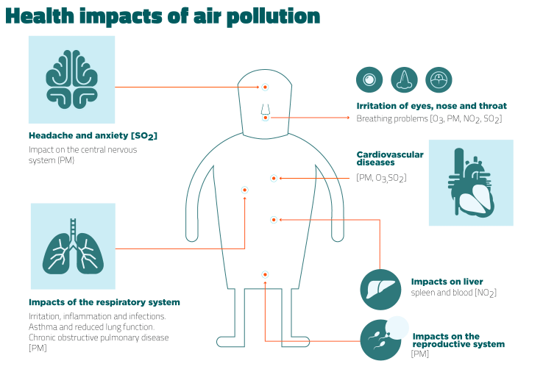
Air Pollution and Health
The air pollutants from traffic such as NO₂ (Nitrogen Dioxide), SO₂ (Sulphur Dioxide), and PM (Particulate Matter) negatively affect human health.
These pollutants also negatively affect our environment through acid rain, eutrophication of water bodies, and contributing to the Green House Gas Effect
Notes:
Teacher Guidance:
There is no safe level of air pollution.
1) The air pollutants from traffic such as NO₂ (Nitrogen Dioxide), SO₂ (Sulphur Dioxide), and PM (Particulate Matter) all negatively affect human health.
In the short term, they can cause headaches, difficulty breathing, or eye irritiation.
In the long-term they can have effects on the respiratory system influencing the ability to breathe. Long term exposure to high levels of air pollutants such as NO2, SO2 and PM has been proven to make the lungs more susceptible to lung infections.
This happens, as when we breathe these pollutants into our lungs, small particles migrate from the lungs to the blood vessels, causing inflammation. This causes damage to the inner lining of arteries, leading to their narrowing and stiffening. This can make us experience health problems like, astma, cancer in the lungs, that can make us cough, and have difficulty breathing. But all the pollution in the air also make us more vulnerable to impacts from infectious diseases like colds or flues
2) According to the European Environmental Agency air pollution is a major cause of premature death and disease and is the single largest environmental health risk in Europe. Heart disease and stroke are the most common reasons for premature death attributable to air pollution, followed by lung diseases and lung cancer.
In Ireland At least 150 Covid-19 deaths in Ireland are attributable to long-term exposure to air pollution, according to a new study. Three-quarters is pollution caused by fossil fuels.
3) These pollutants also negatively affect surrounding biodiversity through acid rain, eutrophication of water bodies, and contributing to the Green House Gas Effect
Possibly discuss the process of acid rain, what eutrophication means, and what the GHG effect is if valid to your lesson structure (extra slides are there on this at the end).

Slide 7
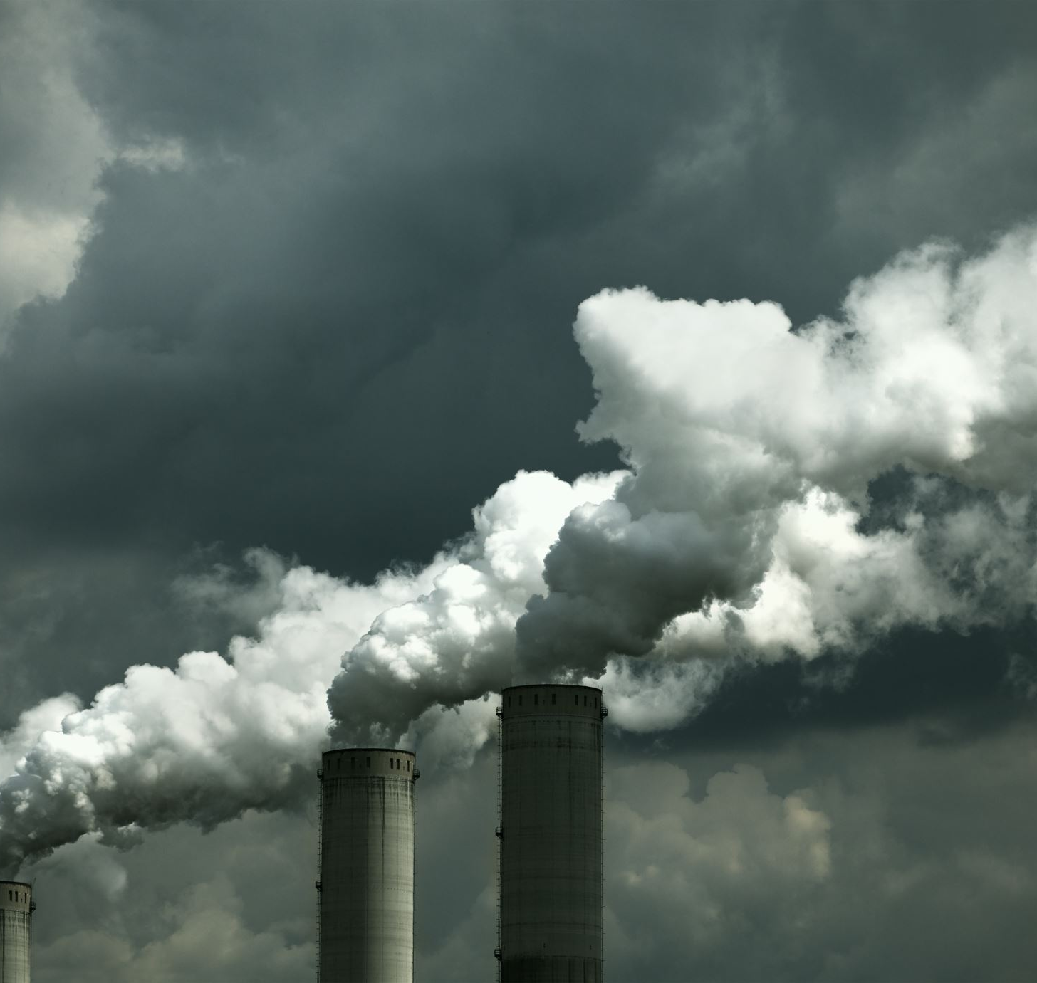
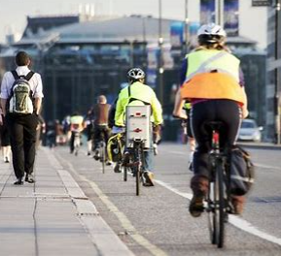
Who is most affected?
Some population groups are more affected by air pollution than others, because they are more exposed or more vulnerable to environmental hazards.
Lower socio-economic groups tend to be more exposed to air pollution
Older people
Children
Those with pre-existing health conditions are more vulnerable (e.g., asthma, pre-existing heart conditions)
Outdoor workers.
Discussion Question: Who should protect those who are more vulnerable?
Notes:
Teacher guidance:
1) The key message of this slide is to convey that air emissions affect different population segments differently. Some citizen are more vulnerable..
2) Take 5 min to discuss the question either as a group or individually and then as a group- think about where they are.

Slide 8
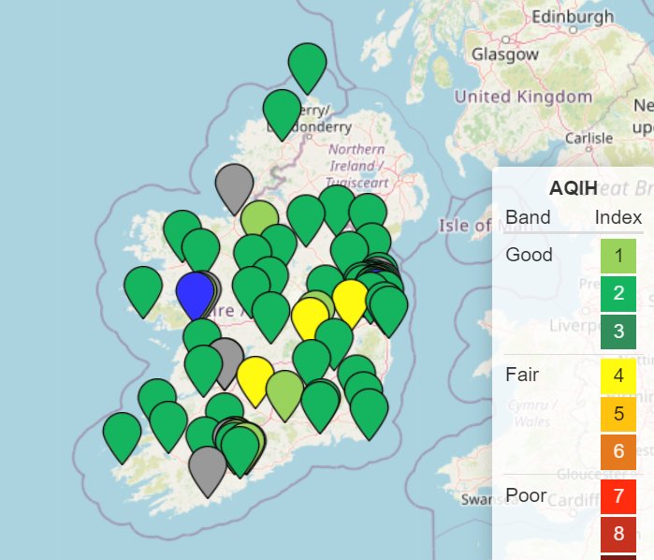
It is important to monitor how much NO₂ is in the air, so we can identify hotspots and work together to reduce emissions
EPA National Monitoring Stations
Notes:
Teacher guidance:
Due to the health impacts, it important to measure air emissions. The EPA has over 100 air quality monitoring stations, however, local air quality is not being measured.
While Ireland’s overall air quality is generally good by international standards it is now apparent that local air quality may not be as consistently good. It is now considered that any level of air pollution is not acceptable and poses a risk (World Health Organisation -WHO). In this resource, you will find up-to-date information on air pollution, with a particular focus on Ireland.

Slide 9
Find out about the GLOBE Air Quality Campaign

Slide 10
GLOBE Air Quality Campaign Timeline
Explore Topic and Create Clean Air Map
September 13th – September 26th
Teacher training Online September 20th
Receive Air Quality Pack and Put-Up Tubes
September 19th – September 26th ** Tubes UP
Student Webinar October 11th
Monitor Traffic and Weather
September 26th - October 24th ** Tubes Down
Take Tubes Down and Post them back using return envelope
October 24th ** Tubes Down
Receive Results and Create Clean Air Action Plan
November/December
Notes:
Teacher guidance: After presenting each step, show the students an overview of the whole process

Slide 11
In the GLOBE Air Quality Campaign, you will measure how much nitrogen dioxide (NO₂) is in the air around your school.
But what is NO₂ and where does it come from?
Notes:
Teacher Guidance:
Set the scene for focusing in on NO2
You might ask the students to brainstorm ideas about nitrogen dioxide, the smell, can you see it?
It is worth mentioning that the other traffic-related pollutants will also be circulating in the air, but we can’t see them as clearly, for example, particulate matter (PM)

Slide 12
NO₂ is a traffic-related air pollutant.
NO₂ levels may fluctuate throughout the year due to:
Traffic. The amount of traffic in the area is the most important factor controlling the level of NO_{2.}
Weather. Different weather can affect the levels of pollution.
Ventilation. A narrow street can record higher levels of pollution than a wide street as there is less space for air to move around.
Notes:
Traffic-related air pollution levels changes throughout the year because of:
Traffic Emissions from traffic are the main source of nitrogen oxides (along with electricity generating stations and industry). NO2 forms a brown colour/haze and can have a foul odour. Oxides of NO2 form acid rain and ozone.
Weather (In windy weather, air pollutants can be moved around, nitrogen dioxide can vary within 10s of metres of its source (car exhaust) whereas on very still days air pollutants can accumulate and may reach higher levels. If it is very rainy, the air pollutant can be washed to the surface as ‘acid rain’ which can damage plant life and buildings.
Ventilation (The architecture of your surrounding streets can also affect how much air pollution is in your area. A narrow street can be more polluted than a wide street due to poor ventilation i.e., the pollutant has no way to escape)

Slide 13
What is going to happen in this Air Quality campaign?
1) You will Create a School Clean Air Map
2a) You will receive and place 2 tubes that measure NO₂ pollution and 2b) You will monitor local traffic and weather.
3) You will receive your NO₂ results, and Create your School Clean Air Action Plan and Create a GLOBE Project
Notes:
Teacher guidance: Introduce your students to what they will do during and after the campaign.
The purpose of the campaign, in addition to collecting important nitrogen dioxide measurements, is to raise awareness around air pollution and empower students to make a difference. GLOBE Ireland will be collecting the nitrogen dioxide measurements you gather but we are also very interested in your local environment so it would be very helpful to understand: the traffic volumes around your school, where you placed your tubes, and the local weather conditions during the measurement period. We would love your students to participate fully in this investigation if time allows.

Slide 14
Step 1) Create a School Clean Air Map
Draw or use Google Maps (satellite view) and PowerPoint to create your Clean Air Map – see next slides for examples
You can mark:
The carpark
Pinch-points for traffic
Busy roads
Green areas
Prevailing wind
Identify heavy Traffic Zones at Your school
Notes:
Teacher guidance: Guide students in getting curious about how they could understand air pollution around the school.
You will be receiving your tubes for measuring nitrogen dioxide, a traffic-related pollutant, shortly. Your job is to decide where on the school grounds/surroundings to mount those tubes. This is a really important step in designing your study. How do you decide where to put your tubes?
Creating a ‘Clean Air Map’ and highlighting ‘Clean Air Zones’ will guide decision making on where to locate NO₂ Monitoring Tubes
Clean Air Zones – are areas around the school where there is heavy traffic and where students congregate or travel. A Clean Air zone is an area that needs to be managed to maintain good air quality. Identifying this area will help students choose where to locate their monitoring tubes and it is the first stage of developing your school’s Clean Air Action Plan

Slide 15
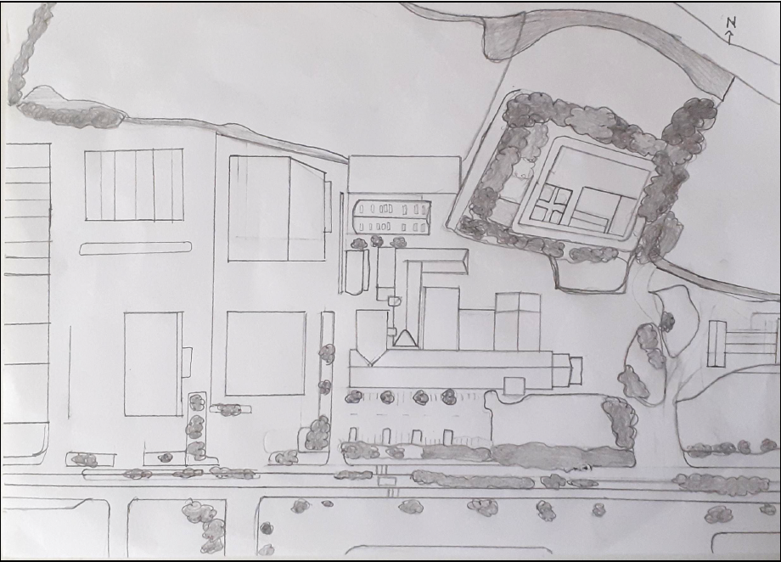
Step 1) Creating your Clean Air school Map example
Option 1) Hand-Drawn Example
Map Guidelines
You can mark:
The carpark
Busy roads
Green areas
Prevailing wind (arrow)
Identify Traffic Zones at Your school
Sheltered Area
Car Park
Busy Road
Hand-drawn map of secondary school – credit to Drimnagh Castle school student
Traffic Zones – are areas around the school where there is heavy traffic and where students congregate or travel.
Notes:
Teacher guidance: Show how a map could look. Note that the map they make could have more labels that include the wind direction, a legend/scale and any other points of interest.

Slide 16
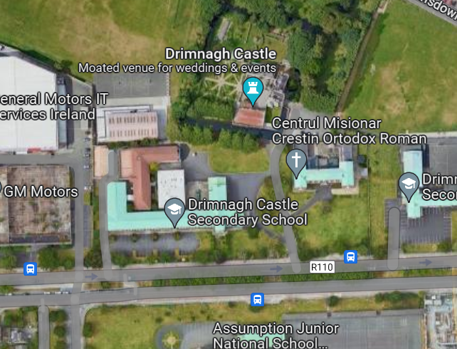
Step 1) Creating your Clean Air school Map example
Option 2) Google Map Satellite Example
Map Guidelines
You can mark:
The carpark
Pinch-points for traffic
Busy roads
Green areas
Prevailing wind (arrow)
Identify Traffic Zones at Your school
Sheltered Area
Car Park
Busy Road
Traffic Zones – are areas around the school where there is heavy traffic and where students congregate or travel.
Notes:
Teacher guidance: Show how a map could look. Note that the map they make could have more labels that include the wind direction, a legend/scale and any other points of interest.

Slide 17
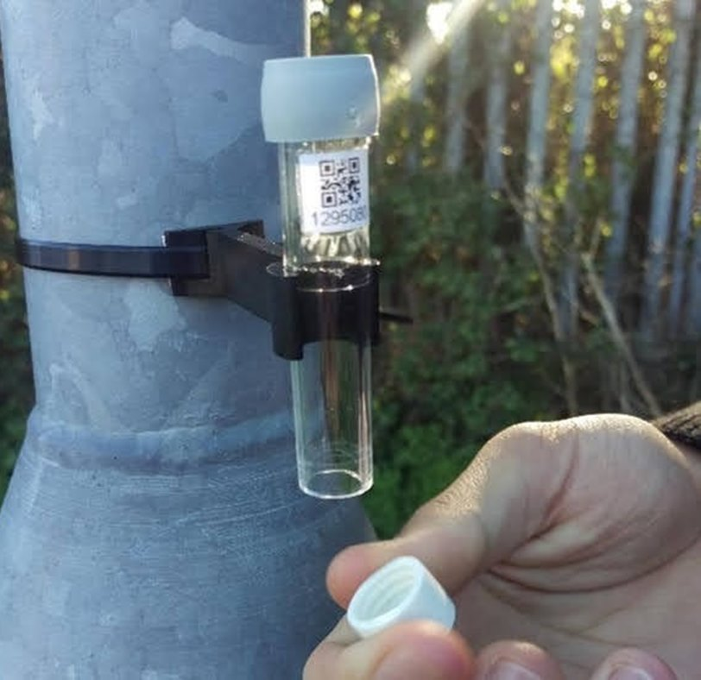
Step 2a) Receive your two NO₂ monitoring tubes and place them at the chosen spots around the school.
Location of Tubes:
Place 1 tube in your Traffic Zone (i.e., near a busy road or area with a lot of traffic)
Place 1 tube in a sheltered area(i.e., playing field or yard)
*You will measure how much NO2 is in the air around your school from September 26th until October 24th. It will take 3-4 weeks before results come back from the laboratory.
Traffic Zones – are areas around the school where there is heavy traffic and where students congregate or travel.
Notes:
Teacher guidance: Use your Clean Air Maps to discuss where they might want to place their tubes. Tell them about the 4-week measurement period.​
Remark that it will take 3-4 weeks before results come back.​
​

Slide 18
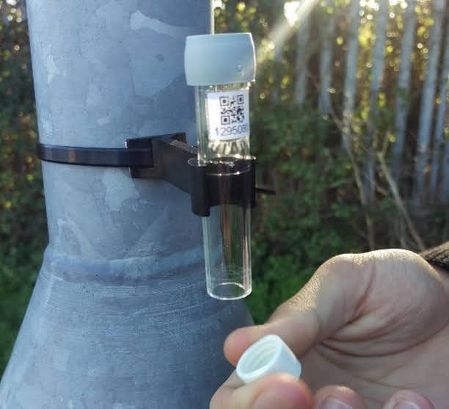
Step 2) How to place the diffusion tube
Grey Cap is left on
Holder
QR Code – record the number under the QR code
Cable-Tie
White cap is removed, please store somewhere safe as you will need to put back on afterwards
Notes:
Teacher guidance: Show the tube image and explain it will be up for one month. Then the tubes will be taken down and sent to a laboratory for analysis.
There is a mesh in the upper cap (grey cap) that has a chemical reagent – it reacts with the nitrogen dioxide circulating in the air (more details in ‘extra slides’) The laboratory analyses the mesh and determines the average amount of nitrogen dioxide in the air using the exposure period. We will be collecting information about your school’s tube numbers (under QR code) and the date and time you put up your tubes and take down your tubes to calculate the exact exposure period.

Slide 19
Step 2b) Monitor Traffic and Weather Conditions
Complete 2 Traffic Counts/per week during the 4-week air quality monitoring period
Monitor the Weather 2 times/week during the 4-week air quality monitoring period
Record here your observations on the Air Quality Observation Chart.
Notes:
We have provided a pdf with a GLOBE Weather and Traffic Observation Chart that you can print out (A2 landscape)
Ideally, students will be able to do traffic counts (twice per week) during the monitoring period by recording the number of cars that pass by during a 5-minute interval. A count of idling cars at drop off or pick up times would help understand if this is a problem at your school, if it is, an anti-idling campaign could be established to address this issue.
We also recommend recording weather observations on the GLOBE Cloud Observation Chart. You can collect cloud observations using the GLOBE Observer App and then submit your data directly to NASA/GLOBE. Instructions are available in the Clouds Guide. Students can collect rainfall, wind and wind direction observations from your school weather station/GLOBE equipment or directly from Met Eireann.

Slide 20
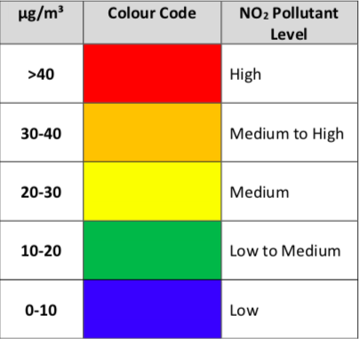
Step 3) Review your results
NO2 is measured in micrograms (μg) per cubic metre (m3)
The red colours, or over 40, shows a high amount of NO2. The EU recommends that air pollution should not go above 40 μg/m3 per year.
The yellow and green numbers show low to medium amounts of NO2.
The blue colour shows a low amount of NO2.
Your result shows an average of how much NO2 was in the air around the tube over the 4 weeks they were up.
The World Health Organisation recommends that the amount of NO2 in the air should not be more than 10 μg/m3 per year.
< 40 EU recommendation
< 10 WHO recommendation
Notes:
Teacher Guidance: It could be a little early to introduce students to the ‘how to understand results slide’. If you think this is the case, you may save the next two slides for when the tube results come back. If not, you can use this slide to show students what kind of numbers and information they can expect to receive from the measurement period.
1) You could state the measurement unit of NO2
2) Explain what the colours mean. E.g., between 10 and 0 is lower, but remind students that any amount of NO2 can be harmful to human health.

Slide 21
Step 3) Review your results
Your results show a snapshot in time.
We cannot say your NO₂ results are higher or lower than what the WHO or what the EU recommends as these guidelines are based on 1 year of measurements.
Do you remember why NO₂ levels change throughout the year?
> 40 EU recommendation
> 10 WHO recommendation
Notes:
Teacher Guidance:
Use this slide to explain that these results only show a snapshot in time. We cannot say your NO2 results are higher or lower than what the World Health Organisation or what the EU recommends as their guideline values are based on 1 year of measurement. This is because the amount of air pollution at any point in time can be affected by different things. That means that the amount of air pollution can change throughout the year. If your tubes were set up over the summer, they might come back with very different results. This is because air emissions levels change throughout the year.
Air pollution levels changes throughout the year because of:
Weather (In windy weather, pollution can move around where on very still days pollution can accumulate. If it is very rainy, the pollution can be absorbed or washed to the surface and later fall as something called ‘acid rain’ which can damage plant life and buildings.
Traffic ( As NO2 is a traffic related pollutant, the emissions tend to be higher around busy roads than quiet country roads)
Ventilation (The size of your surrounding streets can also affect how much air pollution is in your area. A narrow street can be more polluted than a wide street as there is less space for air to move around.)

Slide 22
Analysing your results
Consider: why are your results are what they are?
Is there a busy road near the school or no busy roads?
Is your school in a city, a town, or rural?
Is your school on a wide or narrow street?
What was the weather like during the time you collected your results?
How could these things have affected the results?
Notes:
Teacher Guidance:
Aim of this slide is to provide the means for students to consider the reasons for why their results are what they are.
It can also help understanding your results by comparing to previous years or the results of other schools.
This could be an open class discussion

Slide 23
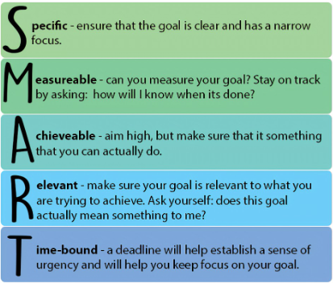
Let’s use our findings to make a change!
Step 5) Create your School Clean Air Action Plan
Creating your Action Plan
Introduction – Who are you? What do you want? (clear goal of achieving clean(er) air
Why do you want change (Why have a Clean Air Action Plan)
Describe traffic problems (Include traffic counts) and air pollution results
Include your annotated Clean Air Map
How? List your proposed solutions (e.g., More bike parking, anti-idling campaign, more trees) and include When?
Present to your Board of Management/local councillor
Notes:
Teacher Guidance:
Creating a Clean Air Action Plan for your school will help students synthesize their observations and their results and effectively communicate the science to local decision makers and/or the Board of Management of your school.
GLOBE Ireland will be providing a prize for the best Clean Air Action Plan created.

Slide 24
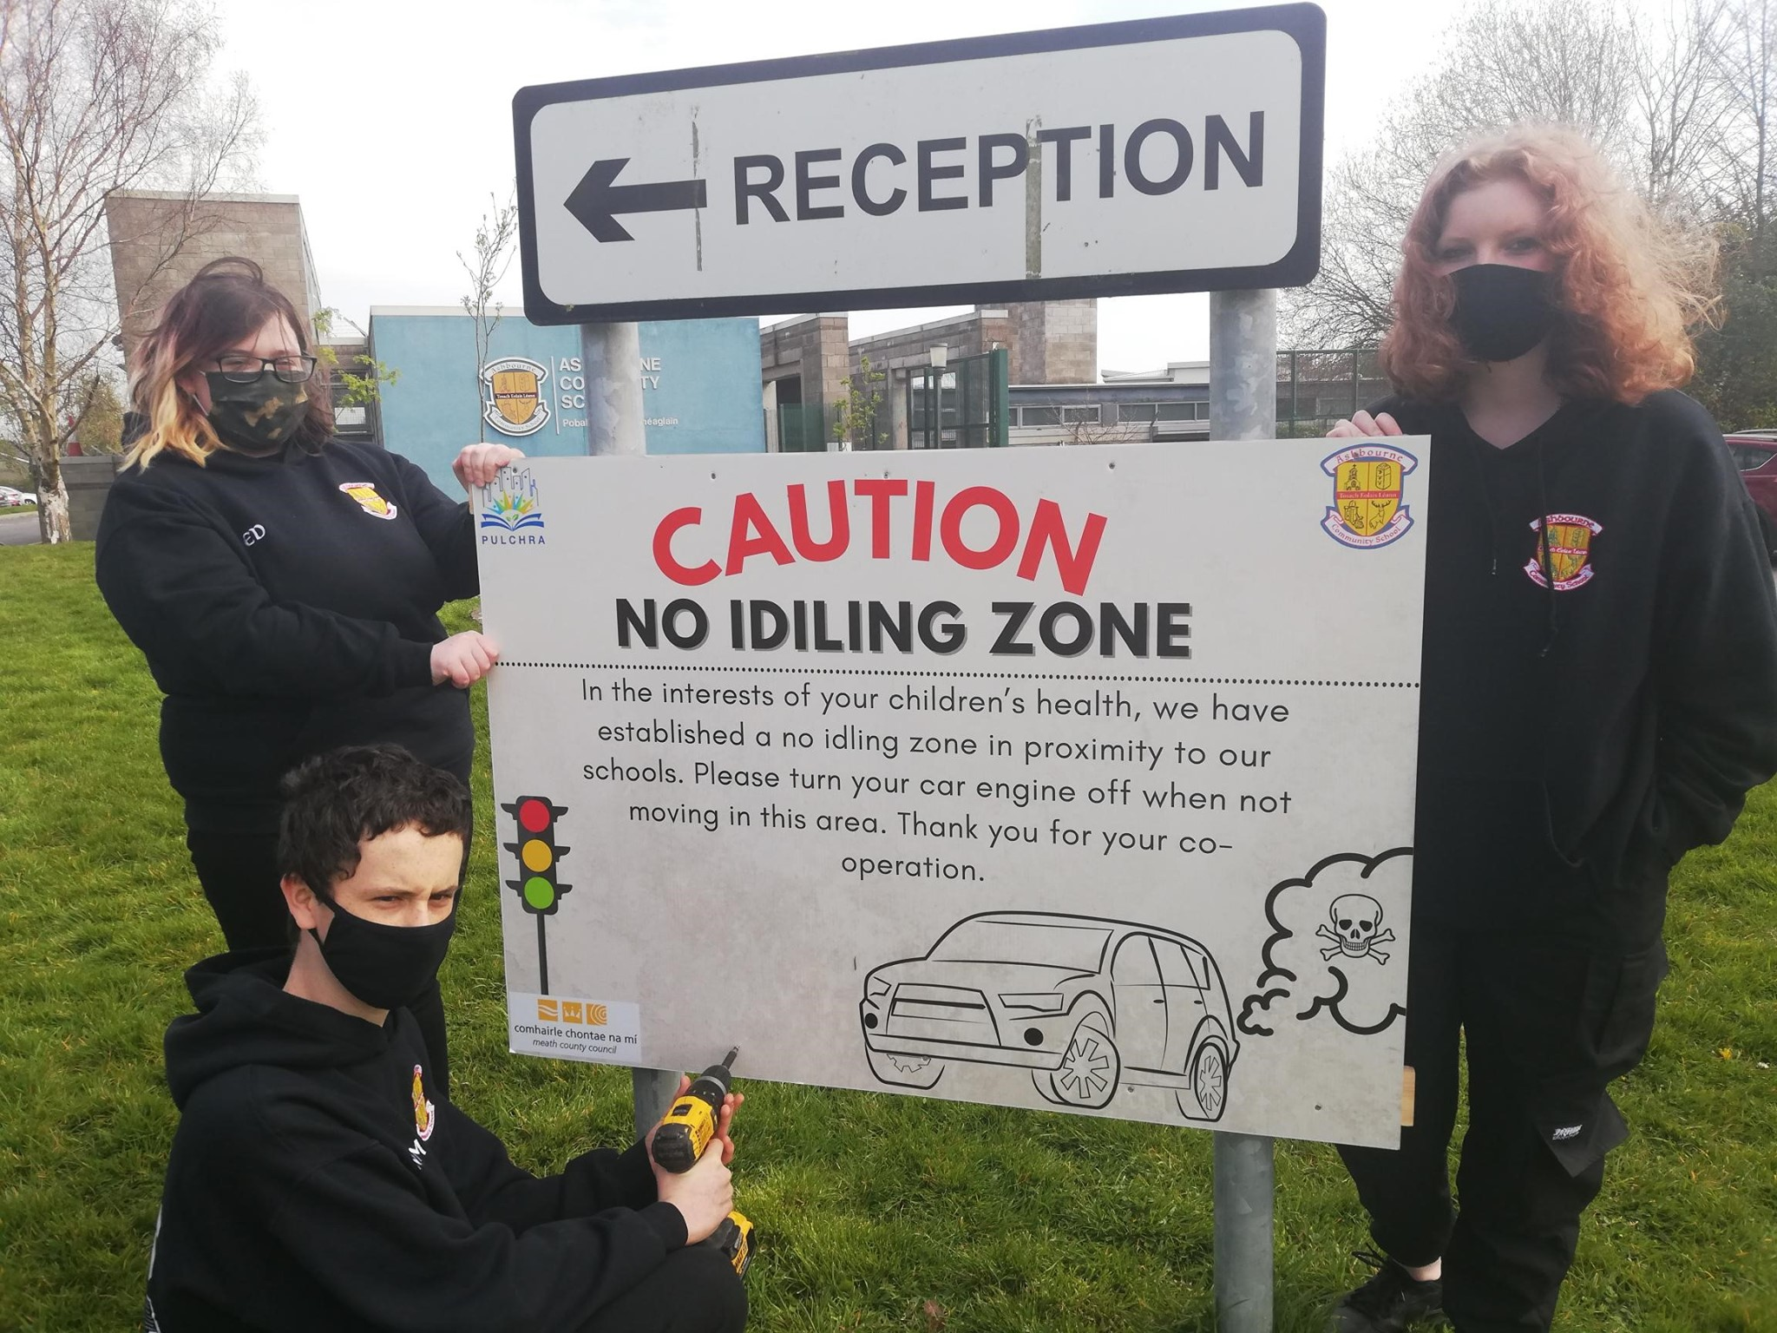
Step 5) Take action to reduce NO₂ pollution! How can we reduce NO₂ emissions around the school and improve air quality together?
Campaign
Run an anti-idling campaign to prevent parents from sitting in running cars during drop-off and pick-up.
Survey
Complete a mobility survey
Cycle
Cycle, walk or take public transport to school if it’s an option for you, promote behavior change
Consider
Consider how far your purchases have travelled. If you can, buy locally produced goods. Try bringing some regular foods items to school and map out how far they travelled.
Plant
Plant more plants and trees around your school
Notes:
Teacher Guidance:
Discuss your students ideas and then show the infographics.

Slide 25
Explore Air Quality Project Options

Slide 26
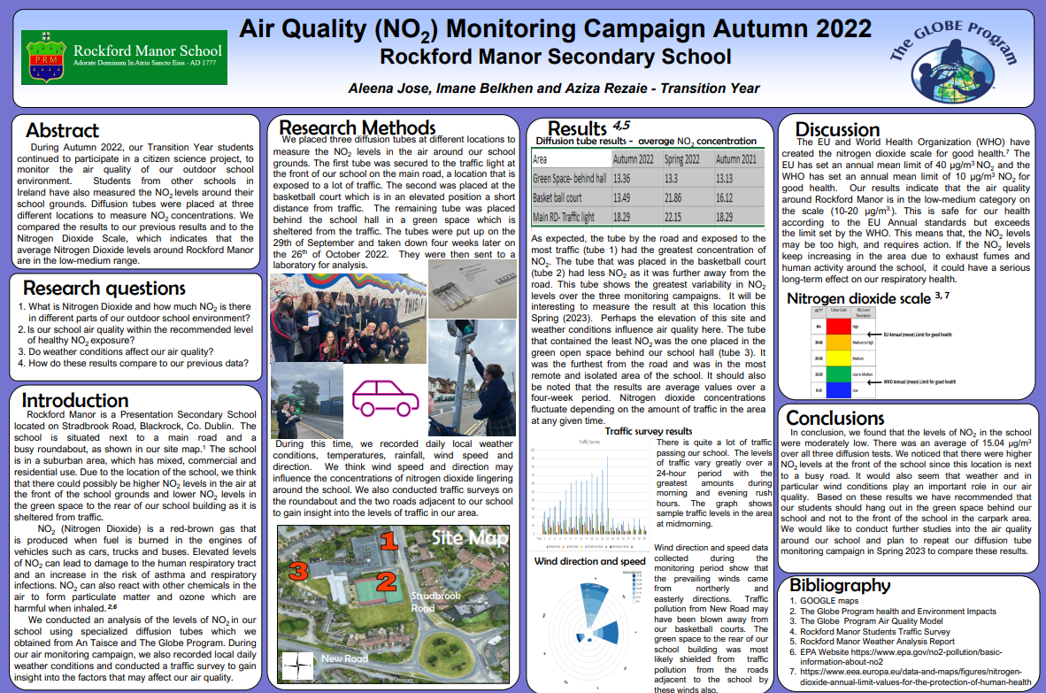
Option 1. Create a scientific research poster
Include your Clean Air school map
Include your traffic counts and idling car counts
Include your weather observations
A template has been provided here to help guide you through the poster creation process, but you can also use your own research poster style.
The poster can be displayed on the GLOBE Ireland website and can be used for science fairs (BT Young Scientist – entries are due in January).
Notes:
Teacher Guidance:
1) Explain briefly how they could do this, possibly by using the template.

Slide 27
Option 2. Creative Writing
Use your creative writing skills to complete a written piece about your air quality story (< 400 words).
Perhaps you’d like to be a reporter for a newspaper and write an article or write a blog post
Or maybe you prefer poetry? Express yourself with creative emotive words or perhaps you’d prefer to rhyme, do it your way!
Notes:
Teacher Guidance:
1) Explain briefly how they could do this using the notes on the slide

Slide 28
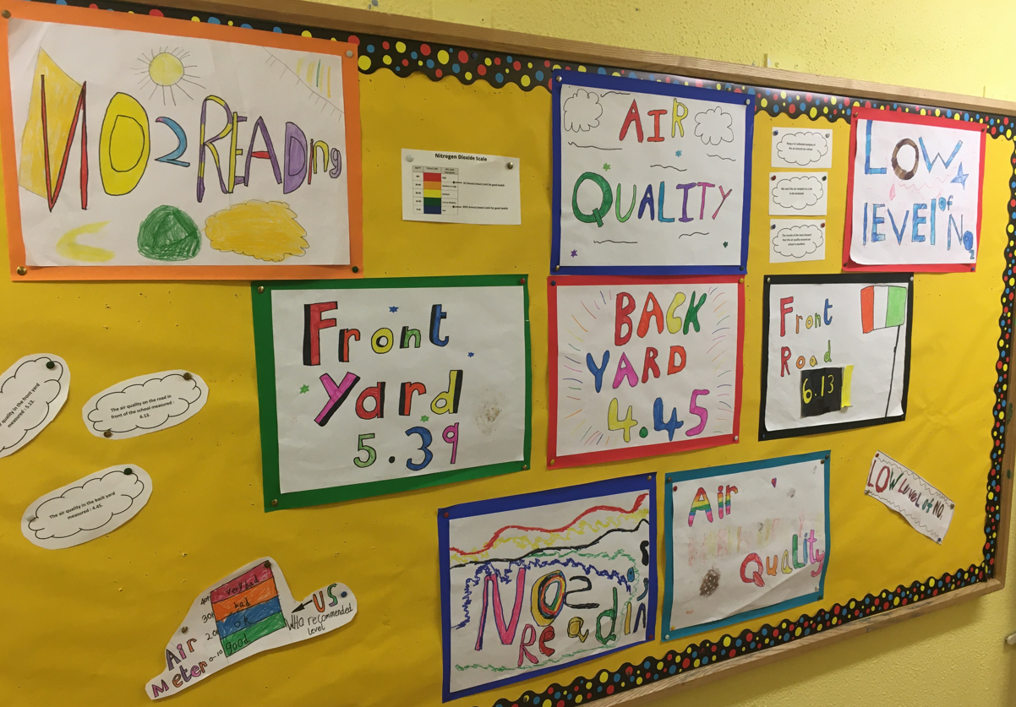
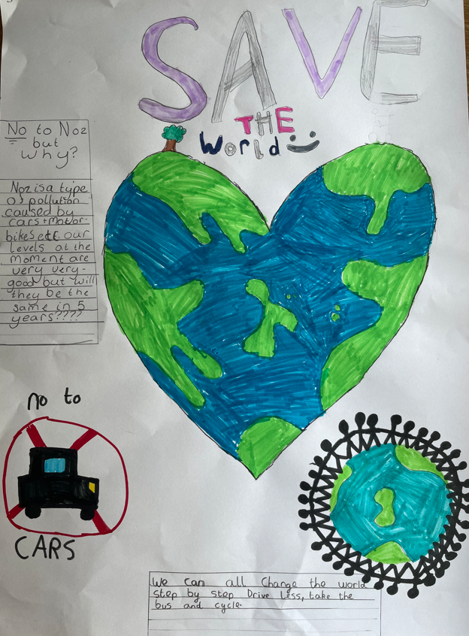
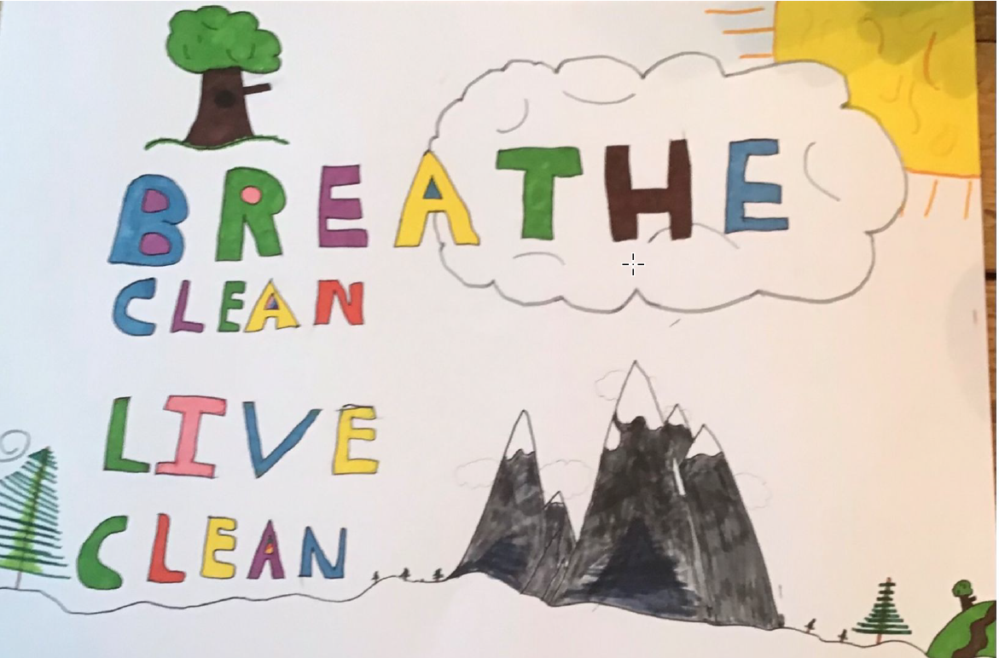
Option 3. Create air quality related creative artwork!
Notes:
Teacher Guidance:
1) Explain briefly how they could do this using the notes on the slide

Slide 29
Thanks for getting engaged to make the planet a better place for everyone!
Notes:
Teacher Guidance:
1) Congratulate your students for their engagement noting the importance of their actions.

Slide 30
Extra slides….

Slide 31
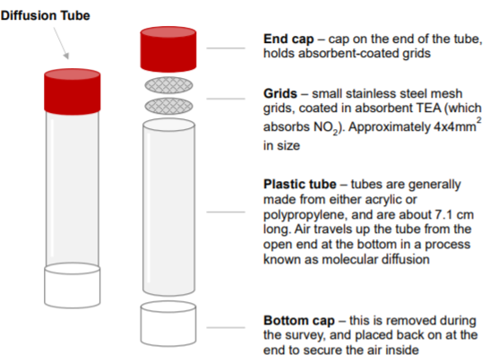
Diffusion Tubes:
Notes:
Teacher guidance: Consider showing how the tubes measure NO2
Under the coloured cap is a steel mesh disc which is coated with triethanolamine (TEA) a chemical that absorbs nitrogen dioxide. When gases pass over this mesh the chemical changes. This chemical change tells us how much nitrogen dioxide was in the air during the monitoring period.
Text for your reference:
Diffusion tubes are a cheap and easy way to measure nitrogen dioxide (NO2). They are supplied and analysed by laboratories. Councils use them to get an indication of nitrogen levels across their borough by putting tubes in lots of different places. Diffusion tubes can be used to measure other pollutants too, but for our work we are most interested in measuring nitrogen dioxide.
Diffusion tubes are small plastic tubes with a cap at each end one of which is coloured. Under the coloured cap is a steel mesh disc which is coated with triethanolamine (TEA) a chemical that absorbs nitrogen dioxide. When gases pass over this mesh the chemical changes. This chemical change tells us how much nitrogen dioxide was in the air during the monitoring period.
Tubes are attached in a vertical position with the coloured cap at the top to a stationary object such as a lamppost, road sign, railings or a drainpipe. The bottom white cap is removed so that the air can get into the tube in a process known as molecular diffusion.
Nitrogen dioxide in the air reacts with the chemical on the mesh at the top of the tube and changes into nitrite. The tube must be left in place for a month, then it is returned to the laboratory for analysis. In the laboratory, the steel mesh is removed and washed with distilled water which is then analysed. The concentration of nitrogen dioxide is found by shining ultra violet light (UV) through the water sample and observing how much light is absorbed.

Slide 32
How the tubes collect the data:

Slide 33
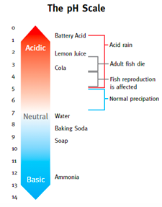
How air pollution can affect our environment: Acid Rain
Notes:
Acid rain is defined as any form of precipitation where the pH is less than 5.6. Some pollutants such as nitrogen dioxide and sulphur dioxide can become acidic. Image from an educational resource developed by the Scottish EPA, which can be found here. Acid rain occurs when acidic components, such as SO₂ and NO_{X} react with oxygen and other chemicals to form sulfuric and nitric acids. These then mix with water and other materials before falling to the ground as acid rain.
he major sources of man-made SO₂ and NO_{X} in the atmosphere are:
Burning of fossil fuels to generate electricity
Transport vehicles and heavy equipment
Manufacturing, oil refineries
Agricultural emissions

Slide 34
How air pollution can affect our environment: Eutrophication
Notes:
When acid deposition is washed into lakes and streams, it can cause some water bodies to turn acidic, which has a negative effect on aquatic ecosystem health, particularly fish.
Nutrient enrichment is when there is too much nutrient (nitrogen, potassium, phosphorus) available to organisms. Air pollutants, such as nitrogen dioxide, can transfer to the Earth’s surface and accumulate in the soil and water through time. This changes the nutrient balance in the habitat, there is simply too much nutrient available which leads to one or two organisms ‘overgrowing’ and using up all valuable resources. This is termed eutrophication.
As a result, the amount of oxygen can drop significantly, and sunlight can be blocked which effects the whole ecosystem health leading to a drop in biodiversity and habitat loss.
This image shows algae overgrowth in a water body in Ireland. This is an example of too many nutrients entering the water, resulting in eutrophication.

Slide 35
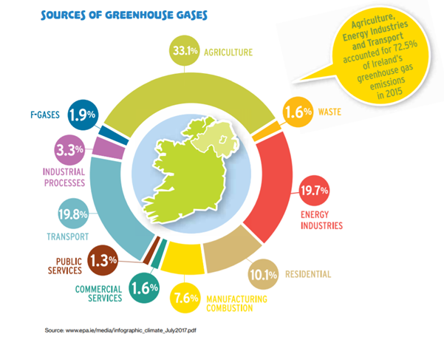
How air pollution can affect our environment: Green House Gas Effect
Notes:
Water Vapour (H₂O), Carbon Dioxide (CO₂), Methane (CH₄) and Nitrogen Dioxide (NO₂) are all greenhouse gases. A greenhouse gas is any gas that has the property of absorbing infrared radiation (heat) and therefore reduces heat loss to space. On Earth, we rely on these greenhouse gases to keep the surface temperature suitable for life. However, too much greenhouse gases in the air intensifies this process and causes the atmosphere to heat up.
Carbon dioxide (CO₂) levels and other greenhouse gases in the atmosphere rose to new records in 2019. We are now experiencing Climate Change. According to the United Nations, Climate change is affecting every country on every continent. It is disrupting national economies and affecting lives. Weather patterns are changing, sea levels are rising, and weather events are becoming more extreme.
The main sources of greenhouse gases in Ireland are Agriculture, Energy Industries and Transport (EPA source)

Slide 36
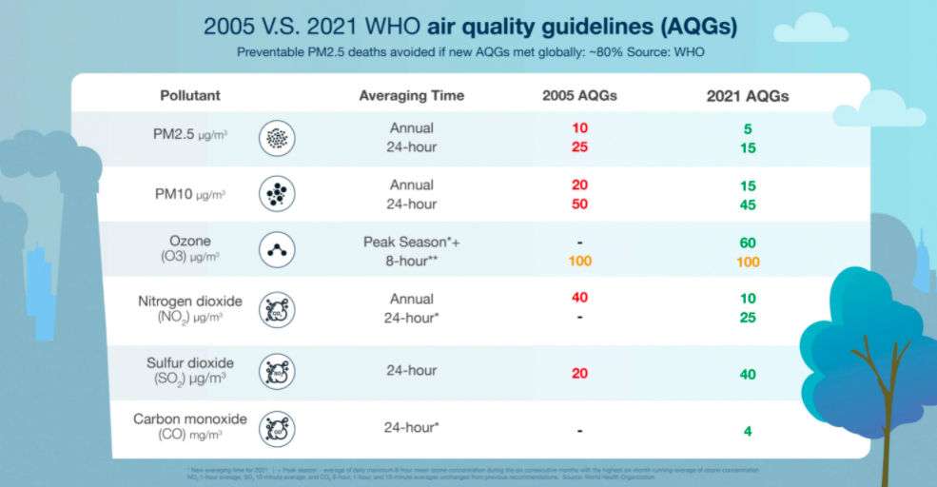
Side note: Why do EU and WHO recommendations differ?
In 2021 the WHO revised their air quality guidelines on the basis of science that suggested the previous guideline limits were too high due to observed impacts on human health.
The EU recommends NO₂ does not exceed 40 μg/m3 a year
WHO recommends that NO₂ does not exceed 10 μg/ m3 per year
Notes:
Teacher Guidance:
In 2021 the WHO revised their air quality guidelines on the basis of science that suggested the previous guideline limits were too high due to observed impacts on human health. The EU Air Quality Directive (legislation) is based on the WHO 2015 guidelines.
Consequently, there is presently a sizable difference between the EU, and the WHO’s limit values. For example, the EU recommends NO2 does not exceed 40 μg/m3 a year, where the WHO now recommends that NO₂ measurements should not exceed 10 μg/ m3 per year

Slide 37
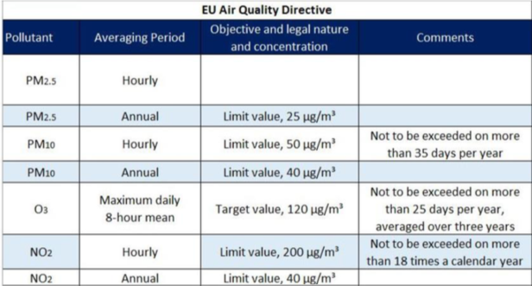
Why do EU and WHO recommendations differ?
Notes:
Teacher Guidance:
1) Explain that because of the new WHO guidelines, the EU plans to update the Air Quality Directive to reflect these changes.
However, it is likely that the EU guidelines cannot be as strict as the WHO, as they need the support of all 27 EU member states, which may be difficult as some Member States have very high levels of air pollution and struggle to reduce them. This can be because they have very car-dependent infrastructure, they burn a lot of fossil fuel (e.g. coal), or they have large amount of industry. Many reasons exist, and the next year will prove what the Air quality directive revisions will looks like.

