Slide 1
Global Weather Watchers Extreme/Weather and the Climate System An Earth SySTEM Project CASE STUDY New Jersey Event East Coast Blizzard 23 January 2016 John D. Moore GLOBE Distinguished Educator Fellow GLOBE Scientist mr.moore.john@gmail.com

Slide 2
A major winter storm is moving up the East Coast. How is it monitored and forecast?
Have you ever wondered how the National Weather Service can tell a major winter storm is brewing and will impact your area in the coming days or hours? How can meteorologists tell if a storm is intensifying and where it will bring the most snow?
It's a highly sophisticated process. It all starts with observing the current situation. The National Weather Service operates a widespread network of observing systems such as geostationary satellites. Doppler radars, and automated surface observing systems that constantly monitor the current state-of-the-art numerical computer models to provide a glimpse of what will happen next, ranging from hours to days. The models are then analyzed by NWS meteorologists who use their experience and expertise to write and send forecasts.
Want to learn more about the technologies? Visit weather.gov

Slide 3
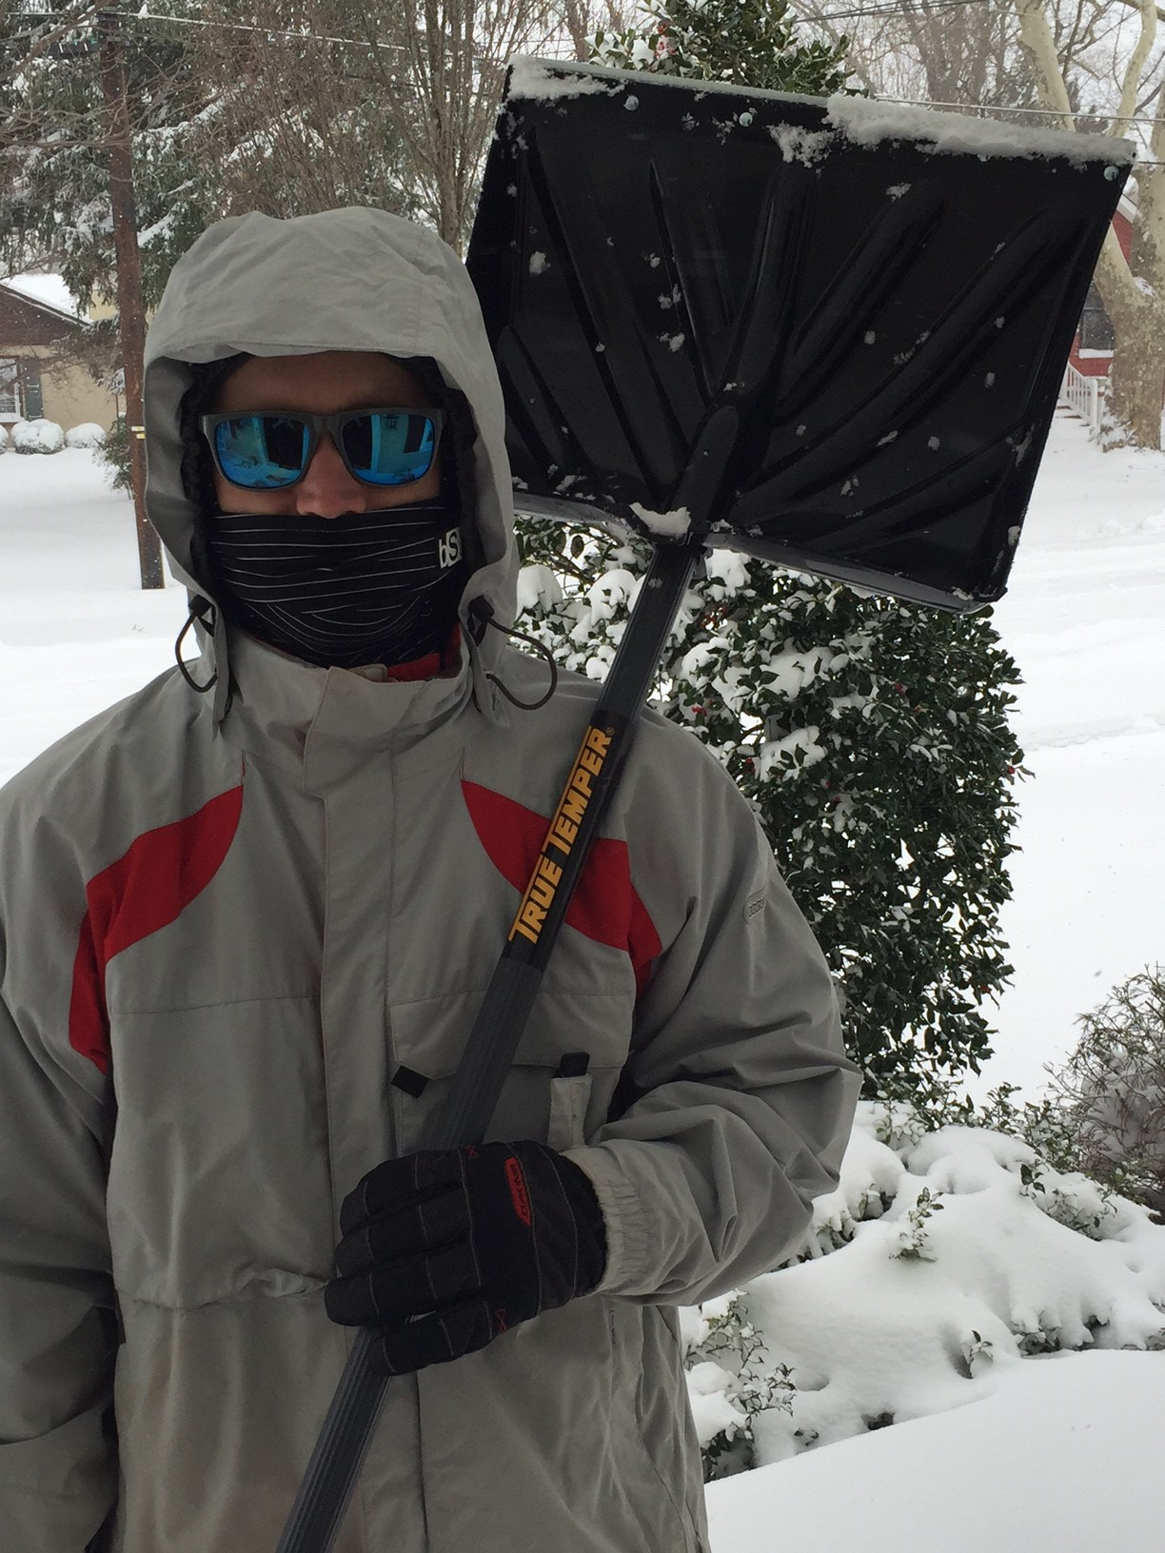
Blizzard Warning
URGENT - WINTER WEATHER MESSAGE
NATIONAL WEATHER SERVICE MOUNT HOLLY NJ
834 AM EST FRI JAN 22 2016
...A MAJOR WINTER STORM WILL AFFECT THE REGION TONIGHT INTO EARLY
SUNDAY...
.STRENGTHENING LOW PRESSURE WILL TRACK TO OUR SOUTH AND EAST TONIGHT THROUGH LATE SATURDAY NIGHT...BRINGING SIGNIFICANT SNOWFALL AND STRONG WINDS TO MUCH OF OUR AREA.
NJZ020-026-027-230245-
/O.CON.KPHI.BZ.W.0001.160123T0000Z-160124T1500Z/
OCEAN-COASTAL OCEAN-SOUTHEASTERN BURLINGTON-
INCLUDING THE CITIES OF...JACKSON...LONG BEACH ISLAND...
WHARTON STATE FOREST
834 AM EST FRI JAN 22 2016
...BLIZZARD WARNING REMAINS IN EFFECT FROM 7 PM THIS EVENING TO 10 AM EST SUNDAY...

Slide 4
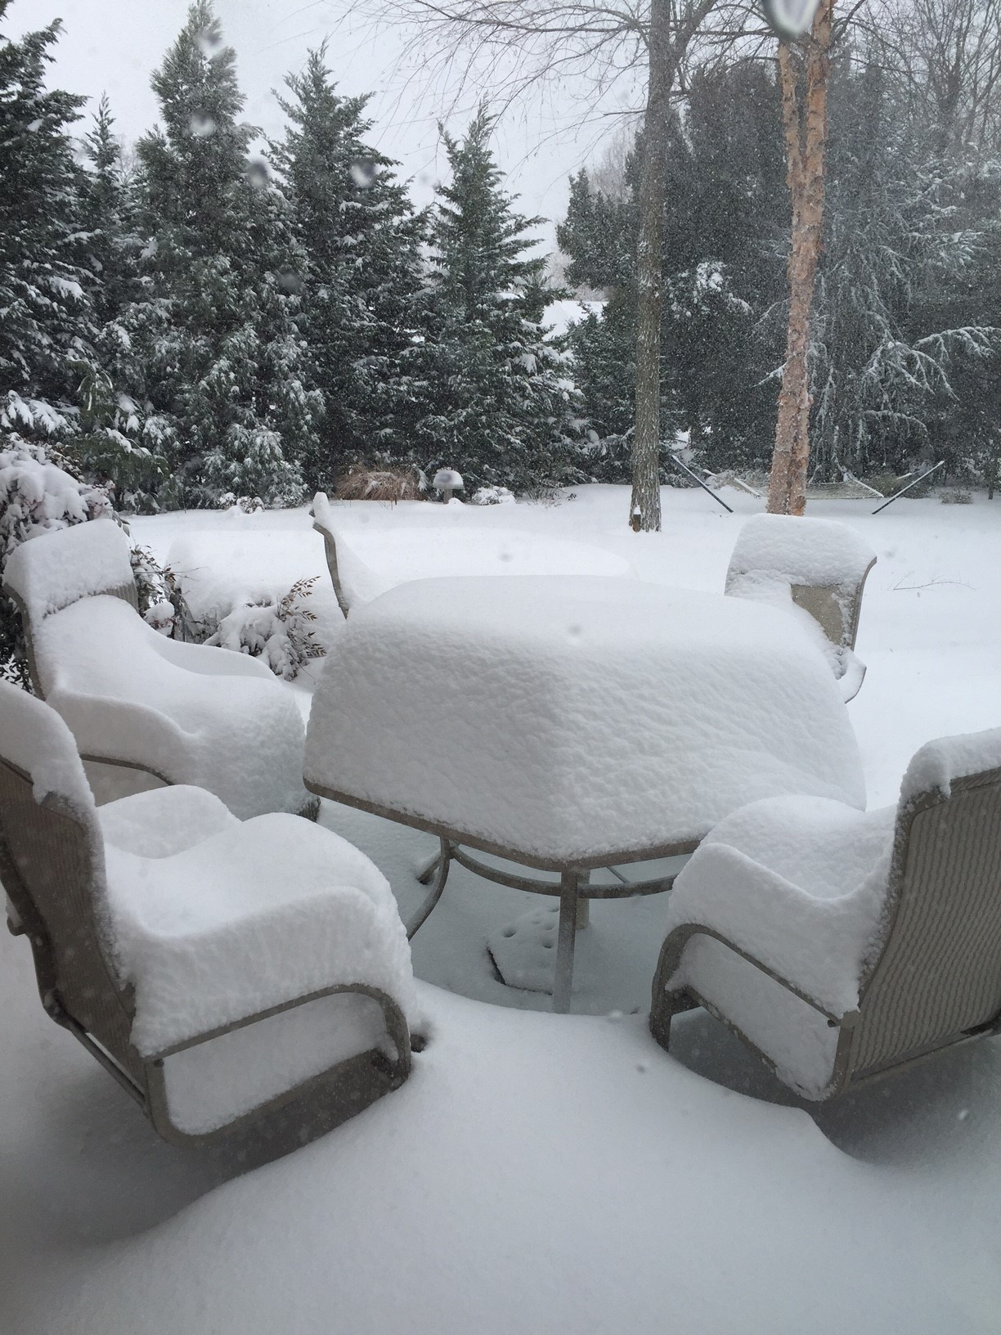
...BLIZZARD WARNING REMAINS IN EFFECT FROM 7 PM THIS EVENING TO 10 AM EST SUNDAY...
* HAZARD TYPES...HEAVY SNOW AND STRONG WINDS.
* SNOW ACCUMULATIONS...6 TO 12 INCHES... WITH THE HIGHEST
AMOUNTS MOSTLY INLAND FROM THE COAST.
* TIMING...SNOW IS EXPECTED TO BEGIN BETWEEN 7 AND 1O PM THIS
EVENING. THE SNOW WILL BE HEAVY AT TIMES TONIGHT. THE SNOW
SHOULD MIX WITH AND THEN BRIEFLY CHANGE TO SLEET AND SOME RAIN
FOR A TIME SATURDAY...THEN QUICKLY BACK OVER TO SNOW EARLY
SATURDAY EVENING BEFORE TAPERING OFF EARLY SUNDAY MORNING.
* WINDS...NORTHEAST INCREASING LATE TONIGHT AND SATURDAY TO 30
TO 40 MPH WITH GUSTS UP TO 55 MPH.
* TEMPERATURES...MAINLY IN THE LOWER 30S.
* VISIBILITIES...REDUCED TO ONE-QUARTER MILE OR LESS AT TIMES.

Slide 5
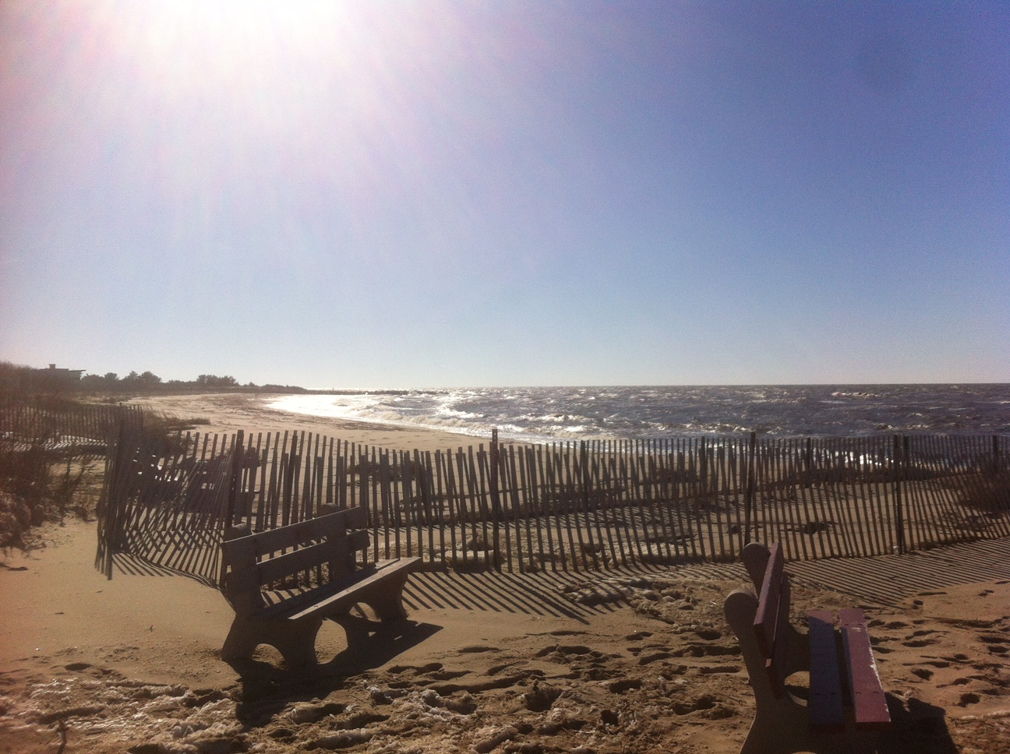
Coastal Flood Warning
NATIONAL WEATHER SERVICE MOUNT HOLLY NJ
130 PM EST FRI JAN 22 2016
...MAJOR COASTAL FLOODING IS EXPECTED THIS WEEKEND ACROSS PORTIONS
OF NEW JERSEY AND DELAWARE...
.STRENGTHENING LOW PRESSURE IS FORECAST TO PASS OFF THE NORTH
CAROLINA COAST TONIGHT BEFORE MOVING NORTHEASTWARD AND OUT TO SEA
OVER THE WEEKEND. THE STORM SYSTEM IS EXPECTED TO BRING STRONG ONSHORE WINDS TO THE COASTS OF DELAWARE AND NEW JERSEY FROM
TONIGHT INTO SATURDAY NIGHT.
24 January 2016 - Cape May, NJ
Photo Credit: Jim and Cheryl Kay

Slide 6
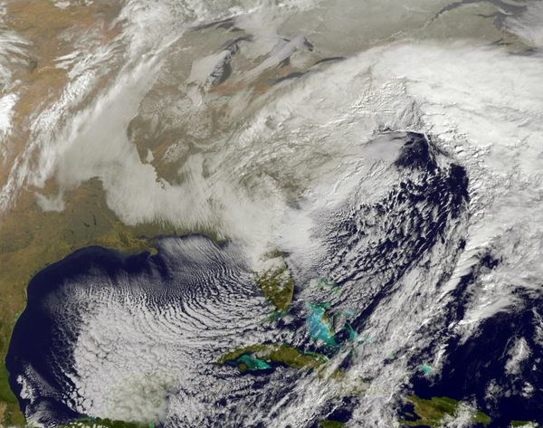

Slide 7
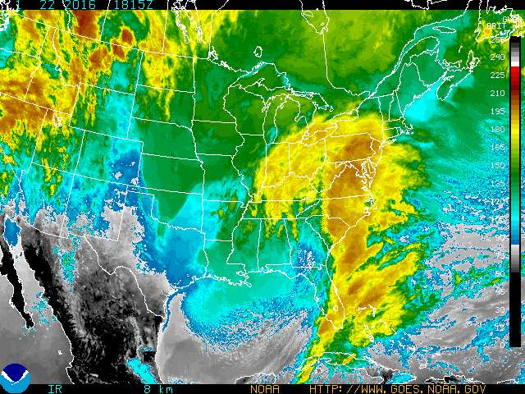

Slide 8
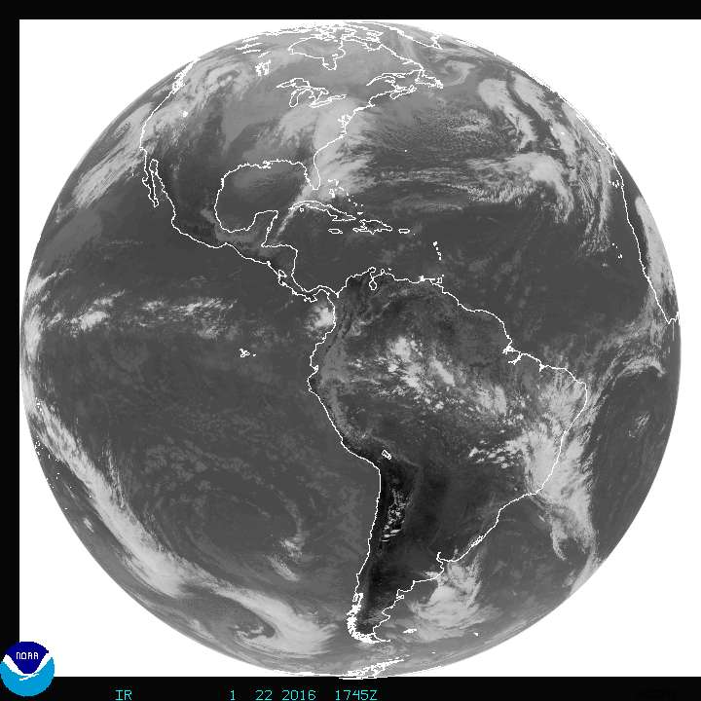

Slide 9
GOES Animation* of
23 January 2016 Storm over
New Jersey, USA
*move cursor over image to animate

Slide 10
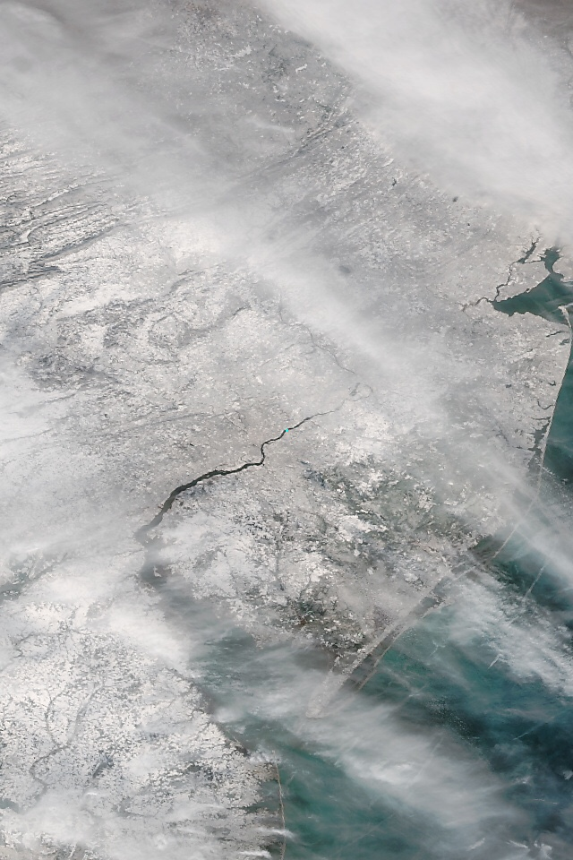
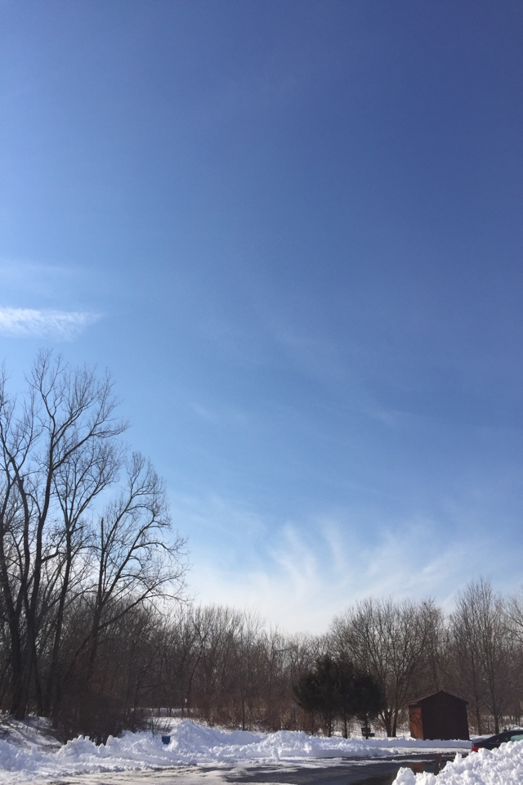
SatCam 25 January 2016, Suomi, 12:57 pm ET
Snow covered New Jersey
Palmyra Cove Nature Park
40.00 N 75.02 N

Slide 11
SNOWFALL TOTALS
BURLINGTON COUNTY...
MOUNT HOLLY WFO 20.5 1 AM
MOORESTOWN 19.0 705 PM
MOUNT LAUREL 18.0 930 PM
FLORENCE 22.5 330 AM
EASTAMPTON TWP 10.5 1250 PM
CAMDEN COUNTY...
GLOUCESTER TWP 18.0 945 PM
GLOUCESTER CITY 20.0 300 AM
SOMERDALE 16.0 730 PM
BELLMAWR 20.0 3 AM
RUNNEMEDE 14.0 340 PM
BERLIN 13.0 945 PM
LINDENWOLD 13.9 1100 PM

Slide 12
Max Temp F: 27.41
Min Temp F: 20.32
Rain/Month in: 2.09
Rain/Year in: 2.09
Wind Gust mph: 36.61
Last Light: 03:22 pm
Min Pressure “Hg: 29.56
Max Pressure “Hg: 30.01
Min Humid %: 100.00
Max Humid %: 100.00
Palmyra Cove Nature Park Observations
01/23/2016

Slide 13
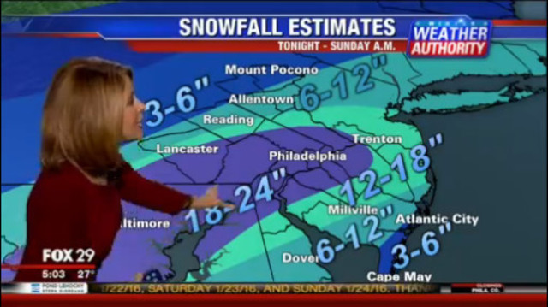
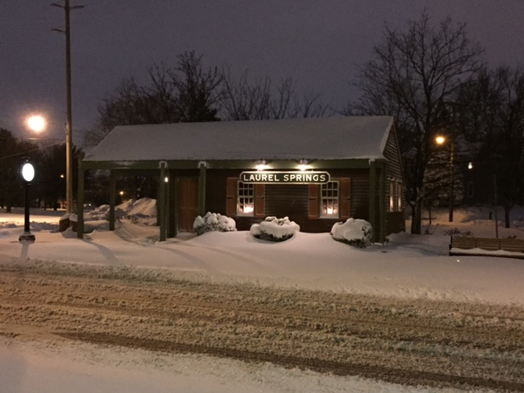
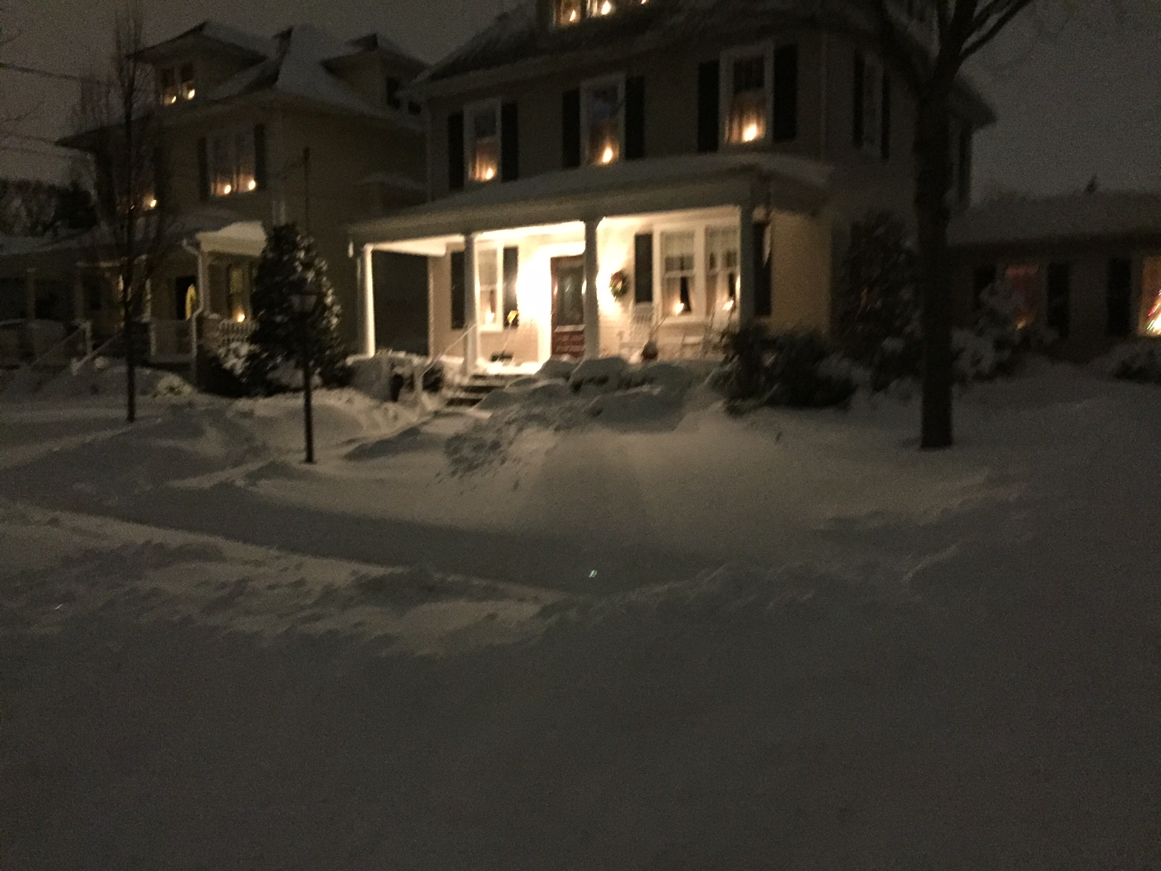
AMS Local Implementation Team Member -
AMS Broadcast Meteorologist Kathy Orr’s Forecast - Fox 29, Philadelphia, PA
The “Calm after the Storm”… skies clear to a Full Moon in Laurel Springs, NJ 39.49 N 75.00 W
23 January 2016

Slide 14
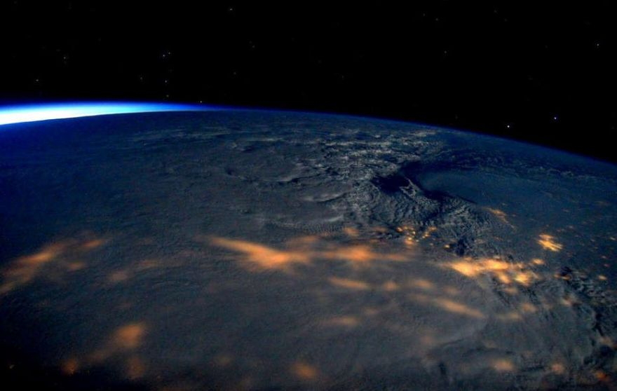
This image made available by NASA via Twitter posted on Saturday, Jan. 23, 2016, by space station commander Scott Kelly, shows a view from the International Space Station of a storm passing over the United States. (Scott Kelly/NASA via AP)

