Slide 1


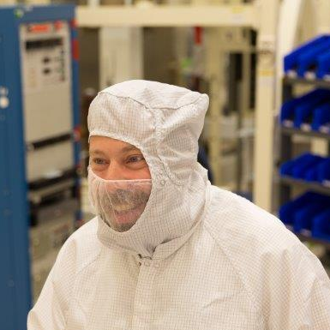


GOES-R ABI
(Advanced Baseline Imager)
  Timothy J. Schmit (tim.j.schmit@noaa.gov)
NOAA/NESDIS/Satellite Applications and Research
Advanced Satellite Products Branch (ASPB)
Madison, WI
GOES-R Education Proving Ground
Telecom
February 20, 2016
UW-Madison

Slide 2
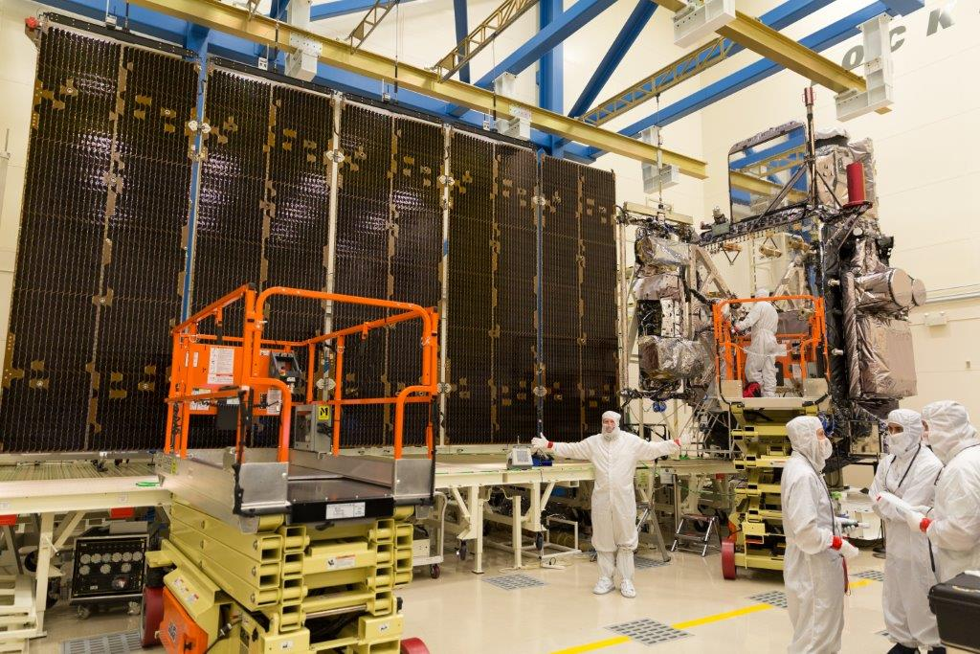
GOES-R ABI
  Spectral, Spatial and Temporal
  Improved, Improved and Improved
ABI
Me!
Lockheed Martin

Slide 3
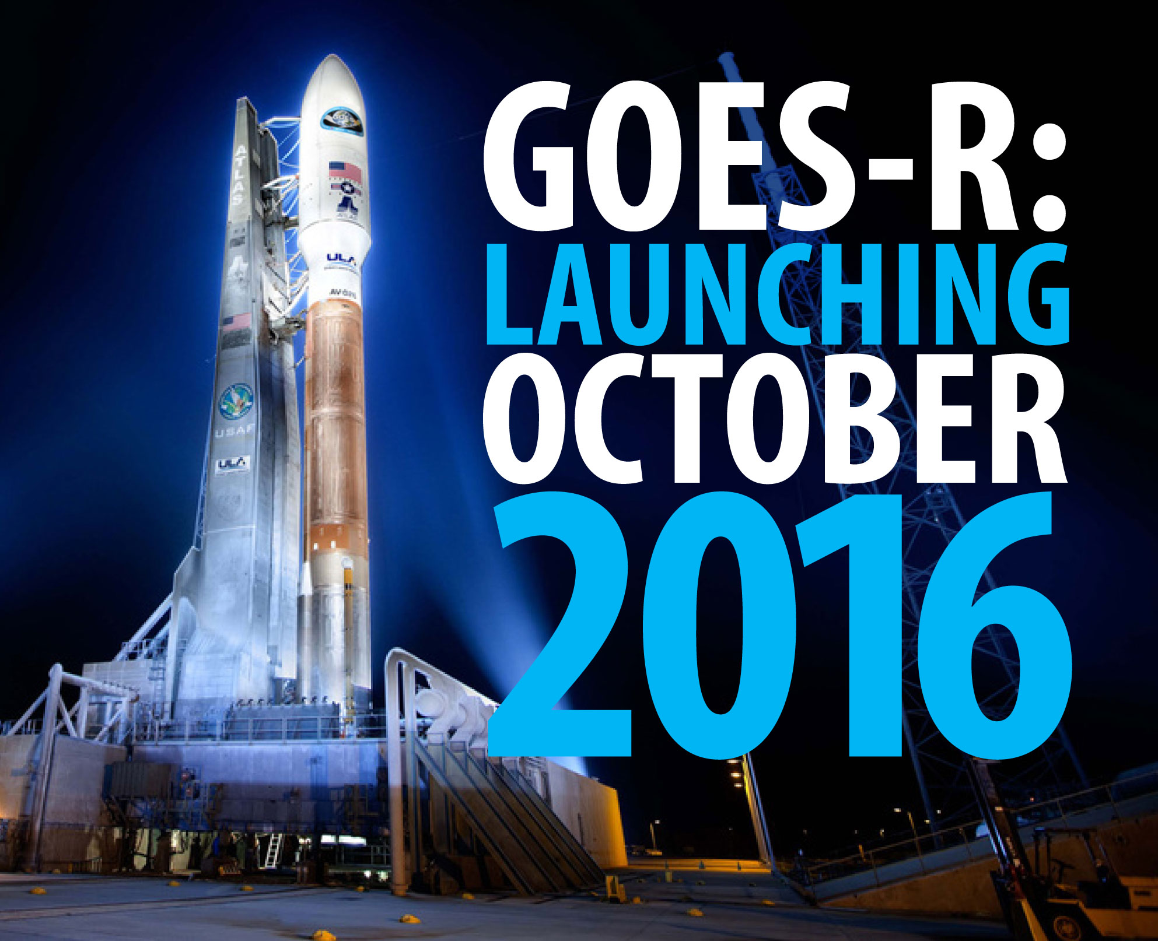
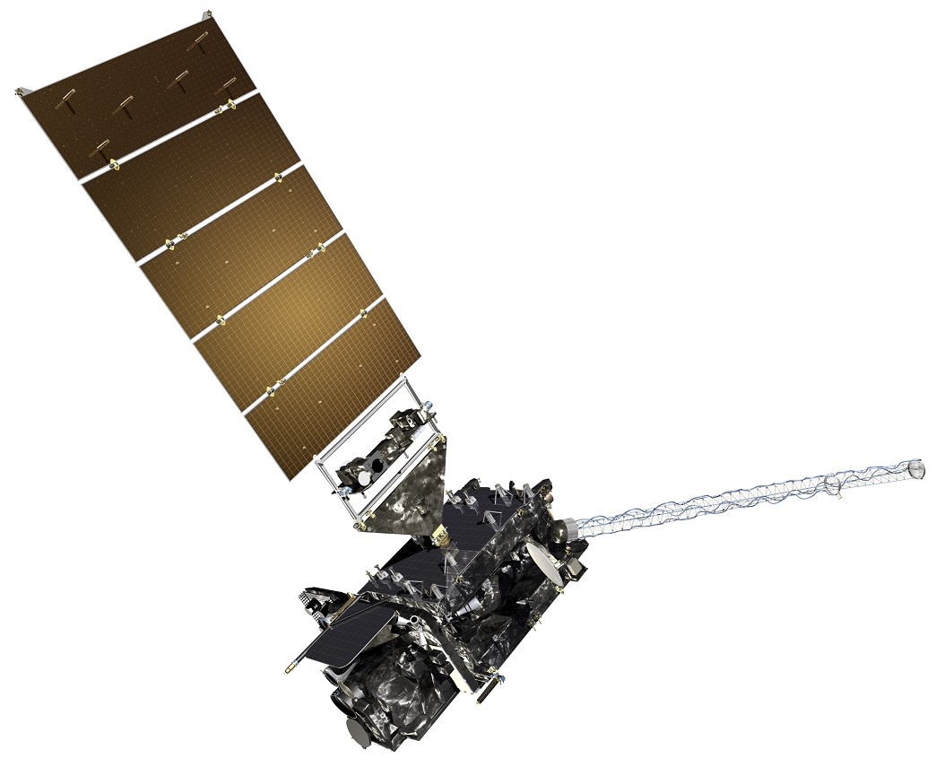
ABI

Slide 4
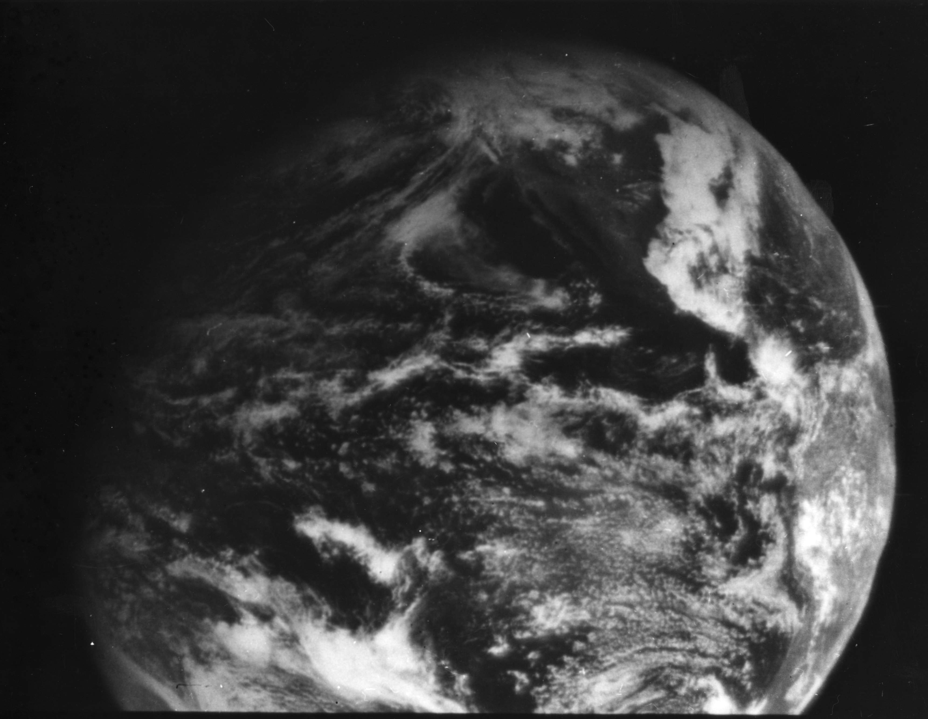
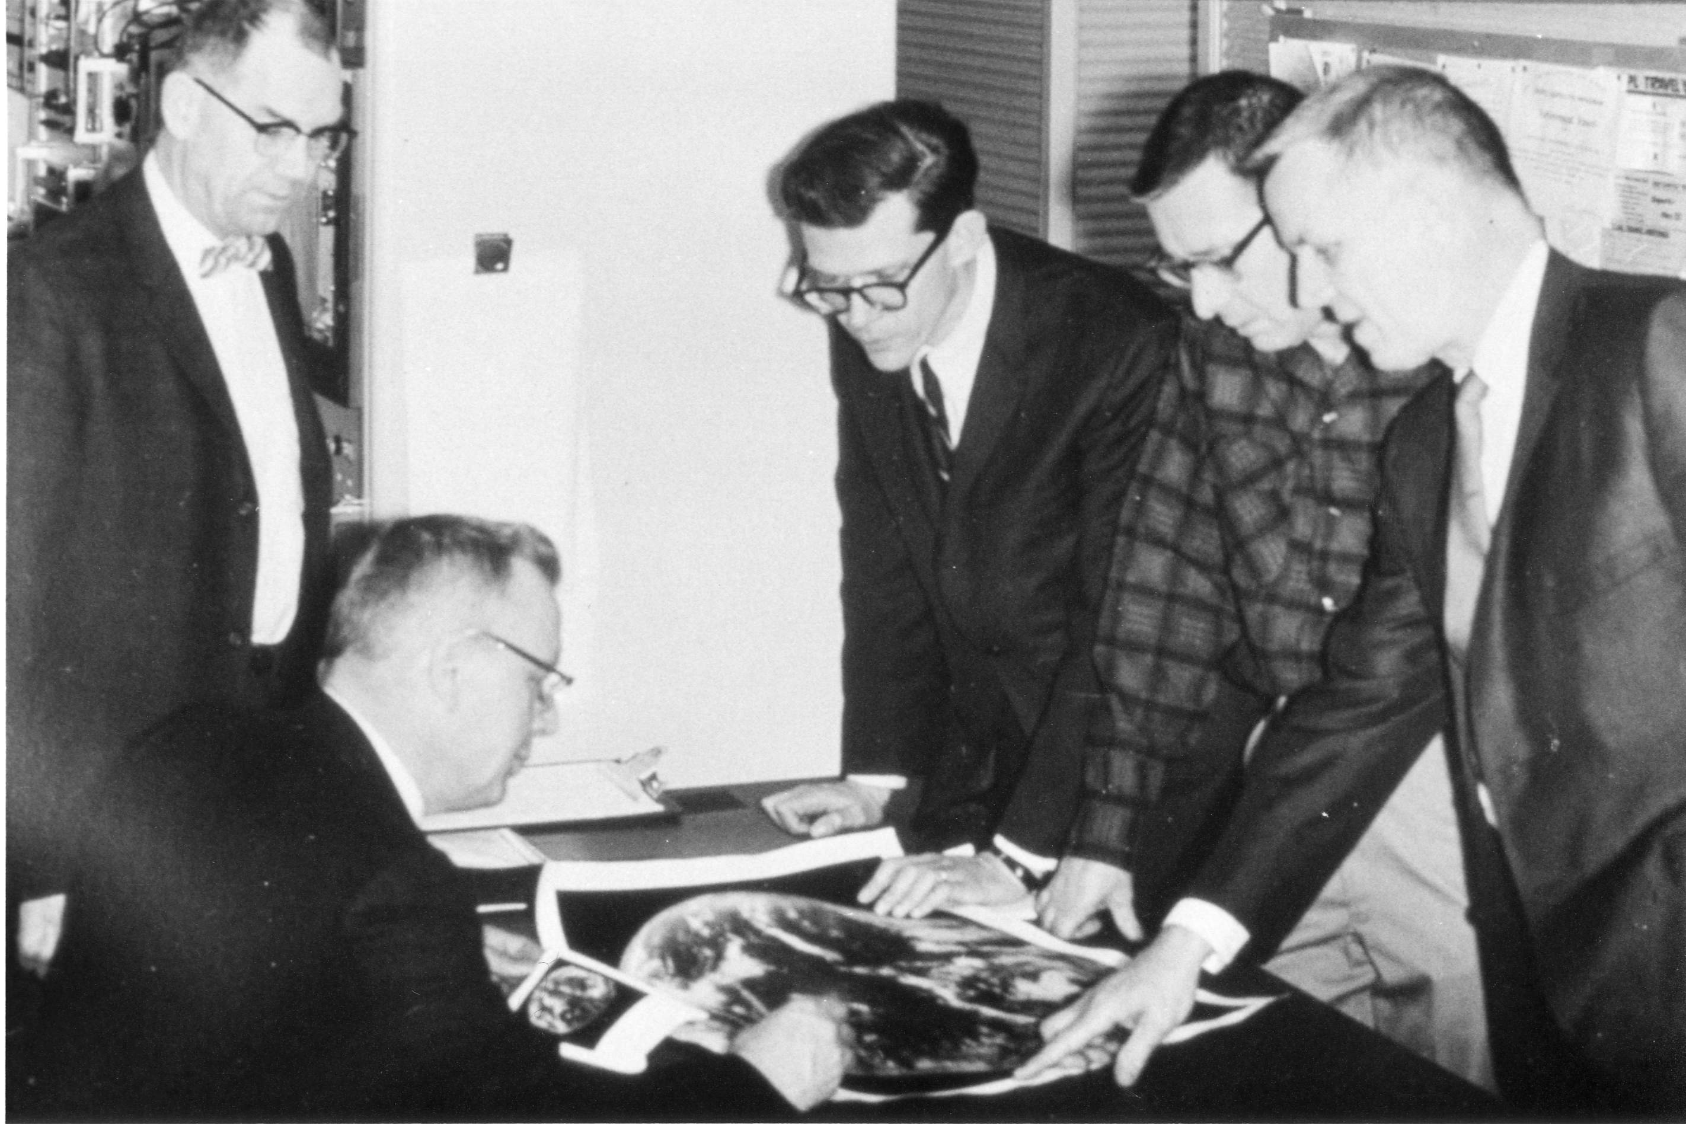
1966: ATS-1 launched
Applications Technology Satellite (ATS)-1 was the first geostationary imager, launched 6 December 1966. Imaging instrument designer and SSEC co-founder, Verner E. Suomi, proclaimed, “the clouds move, not the satellite”.
11 December 1966
Notes:
http://cimss.ssec.wisc.edu/news/geo_image_anniversary.html

Slide 5
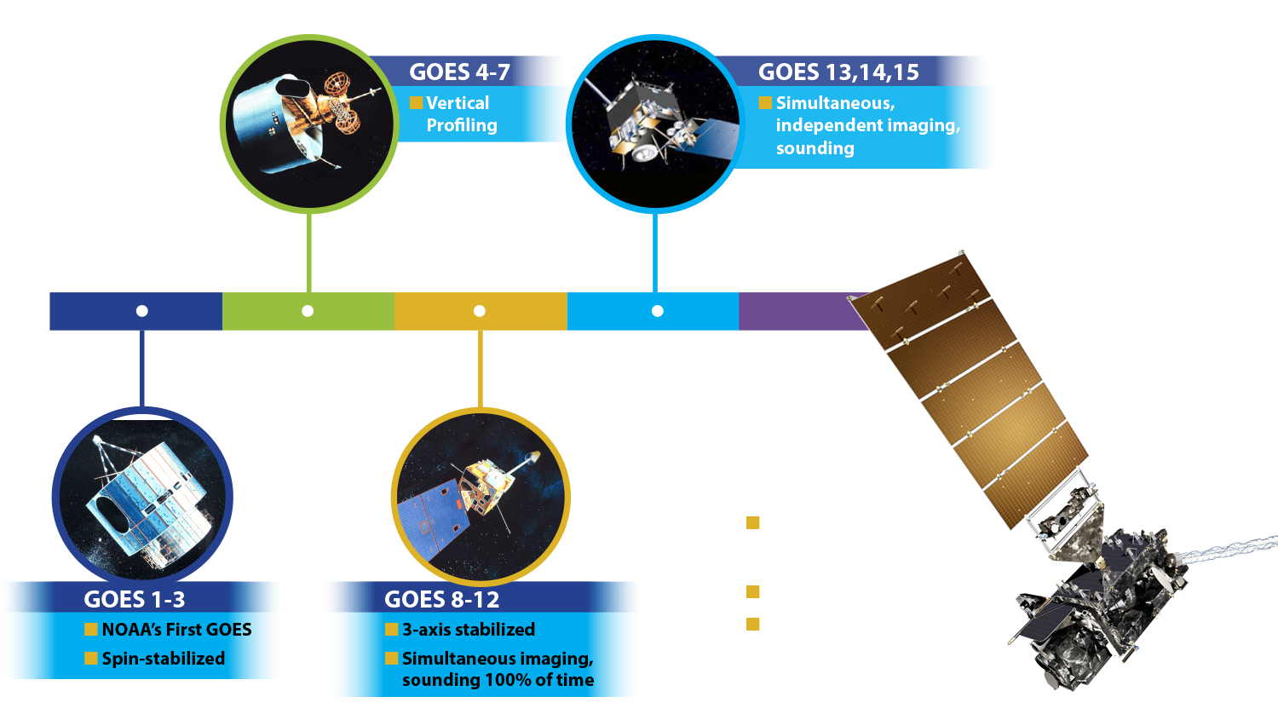
A History of GOES “Weather” Satellites
ATS
SMS
Notes:
The focus of this Short Course is to describe the advancements with the GOES-R series

Slide 6
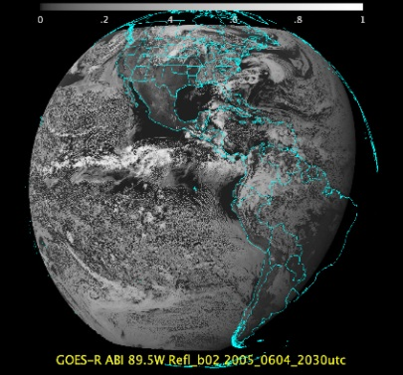
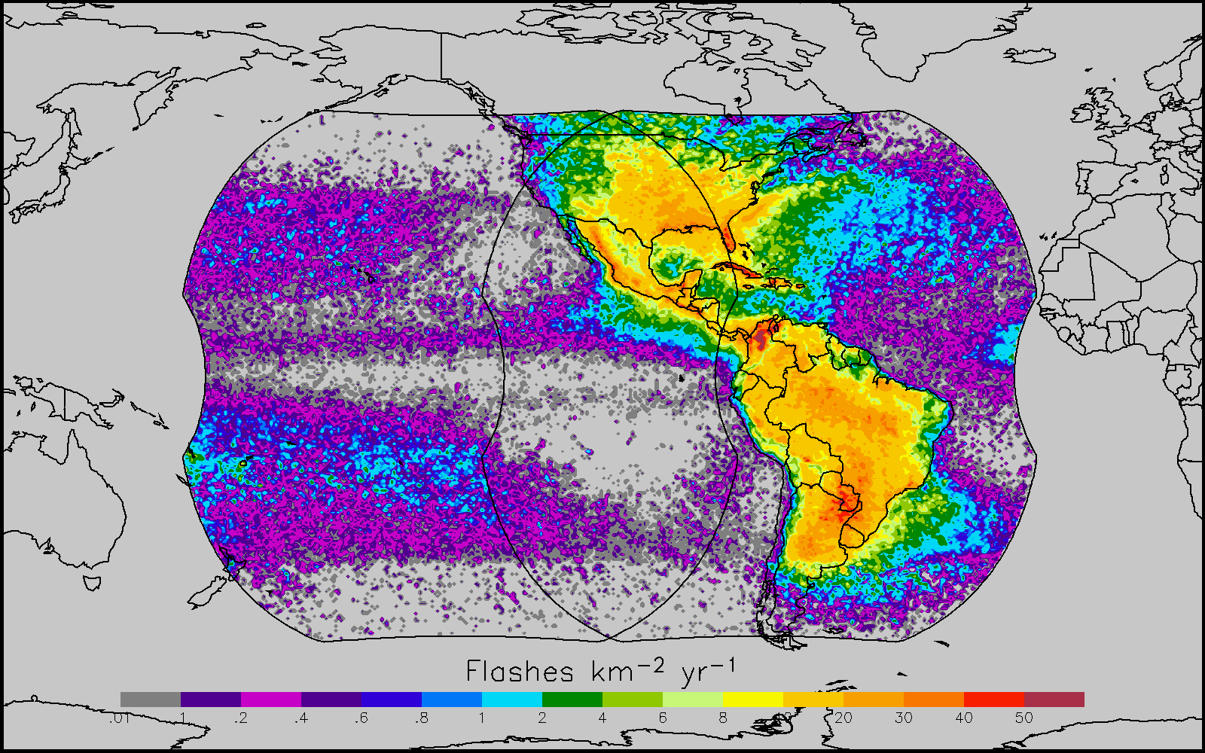
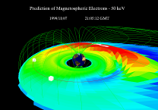
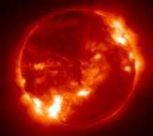
Why GOES-R ?
The GOES-R series will provide significant improvements in the detection and observations of meteorological phenomena that directly impact public safety,
protection of property, and our Nation’s economic health and prosperity.
ABI
GLM
SEISS and MAG
EXIS and SUVI
Visible & IR Imagery
Lightning Mapping
Space Weather Monitoring
Solar Imaging
  Improves hurricane track & intensity forecasts
  Increases thunderstorm & tornado warning lead time
  Improves aviation flight route planning
  Data for long-term climate variability studies
  Improved air quality warnings and alerts
  Improves solar flare warnings for communications and navigation disruptions
  More accurate monitoring of energetic particles responsible for radiation hazards to humans and spacecraft
  Better monitoring of Coronal Mass Ejections to improve geomagnetic storm forecasting
6

Slide 7
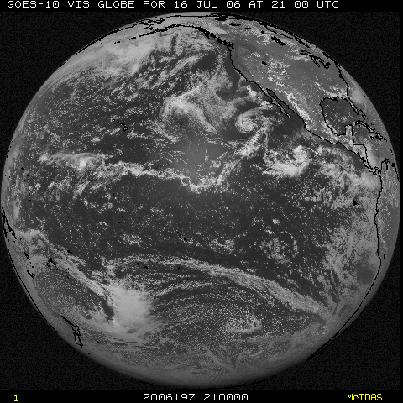
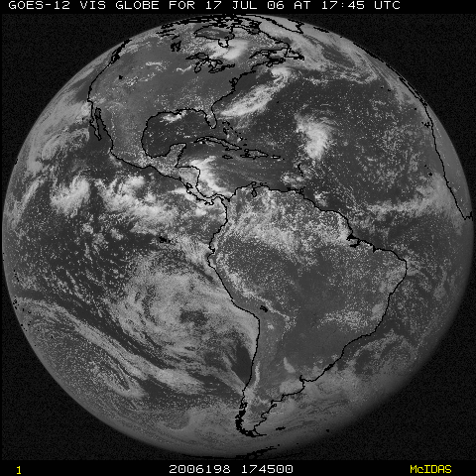
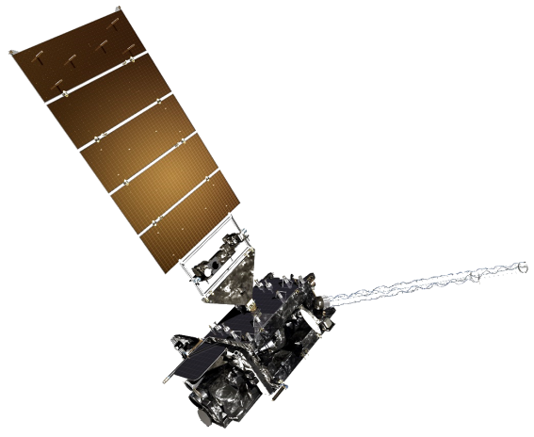
NOAA GOES Constellation
GOES-16 or -17
(75W)
GOES-16 or -17
(137W)
Operational
Operational
After GOES-R and -S are launched, checked out and operational!
Notes:
Template footer obscured. Fixed.
Estimate during mid-2010.

Slide 8
The Advanced Baseline Imager:
ABI Current
Spectral Coverage
16 bands 5 bands
Spatial resolution
0.64 μm Visible 0.5 km Approx. 1 km
Other Visible/near-IR 1.0 km n/a
Bands (>2 μm) 2 km Approx. 4 km
Spatial coverage
Full disk 4 per hour Scheduled (3 hrly)
CONUS 12 per hour ~4 per hour
Mesoscale Every 30 sec n/a
Visible (reflective bands)
On-orbit calibration Yes No
Notes:
The ABI allows more bands, finer spatial resolution, faster refresh rates and on-orbit calibration of all bands!

Slide 9
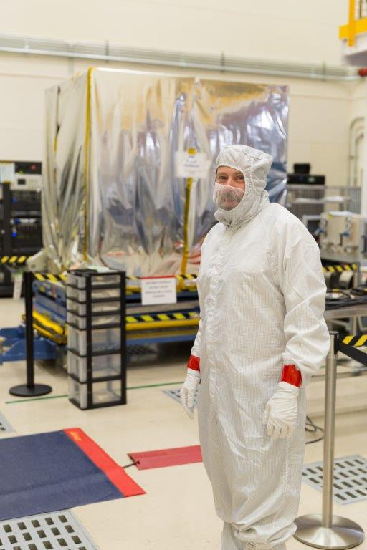
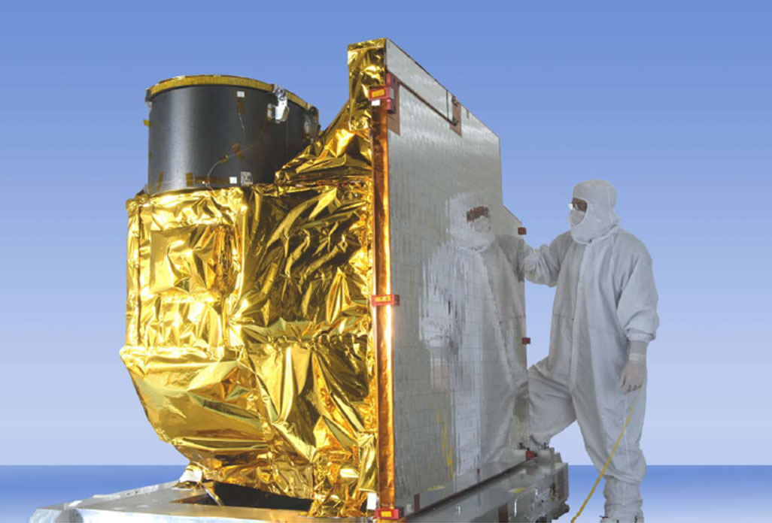
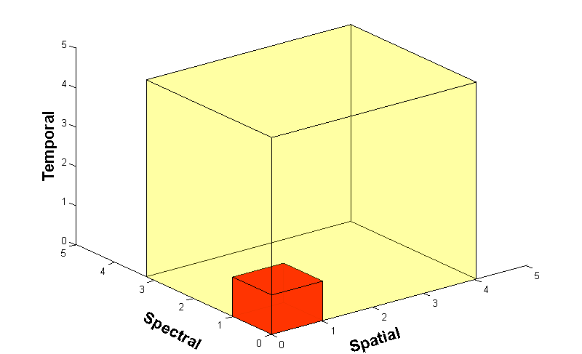
Advanced Baseline Imager (ABI)
ABI on GOES-S
5
4
3
X
Faster coverage
(5-minute full disk vs. 25-minute)
X
Improved spatial
resolution
(2 km IR vs. 4 km)
X
More spectral bands (16 on ABI vs. 5 on the current imager)
Notes:
Slide from J. Gerth, CIMSS.

Slide 10
ABI: Bands 1-6 (Visible / NearIR)
ABI Band | Wavelength (µm) | Wavelength range (µm) | Sub-point pixel spacing (km) | Descriptive Name
1 | 0.47 | 0.45 - 0.49 | 1 | “Blue”
2 | 0.64 | 0.60 - 0.68 | 0.5 | “Red”
3 | 0.864 | 0.847 - 0.882 | 1 | “Veggie”
4 | 1.373 | 1.366 - 1.380 | 2 | “Cirrus”
5 | 1.61 | 1.59 - 1.63 | 1 | “Snow/Ice”
6 | 2.24 | 2.22 -2.27 | 2 | “Cloud Particle Size”
Six visible or near visible bands on ABI, one on heritage imager
Notes:
Based on Schmit et al, 2017. stars = today’s imager band.

Slide 11
ABI: Bands 7-16 (IR)
ABI Band | Wavelength (µm) | Wavelength range (µm) | Sub-point pixel spacing (km) | Descriptive Name
7 | 3.90 | 3.80 - 3.99 | 2 | “Shortwave window”
8 | 6.19 | 5.79 - 6.59 | 2 | “Upper-level Water Vapor”
9 | 6.93 | 6.72 - 7.14 | 2 | “Mid-Level Water Vapor”
10 | 7.34 | 7.24 - 7.43 | 2 | “Lower/Mid-level Water Vapor”
11 | 8.44 | 8.23 - 8.66 | 2 | “Cloud-top Phase”
12 | 9.61 | 9.42 - 9.80 | 2 | “Ozone”
13 | 10.33 | 10.18 - 10.48 | 2 | “Clean longwave window”
14 | 11.21 | 10.82 - 11.60 | 2 | “Longwave window”
15 | 12.29 | 11.83 - 12.75 | 2 | “Dirty longwave window”
16 | 13.28 | 12.99 - 13.56 | 2 | “CO₂”
10 infrared bands on the ABI, four on heritage imager
Notes:
Based on Schmit et al, 2017. stars = today’s imager band.

Slide 12
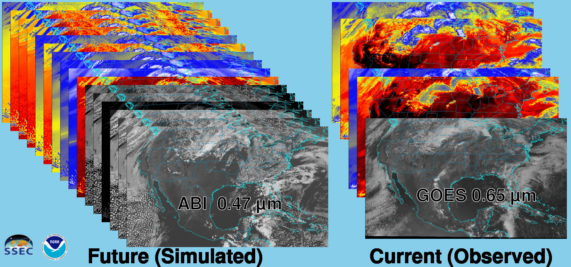
Future vs. Current Spectral Bands
The current GOES (right) has 5 spectral bands, while the GOES-R series ABI (left) will have 16 spectral bands.

Slide 13
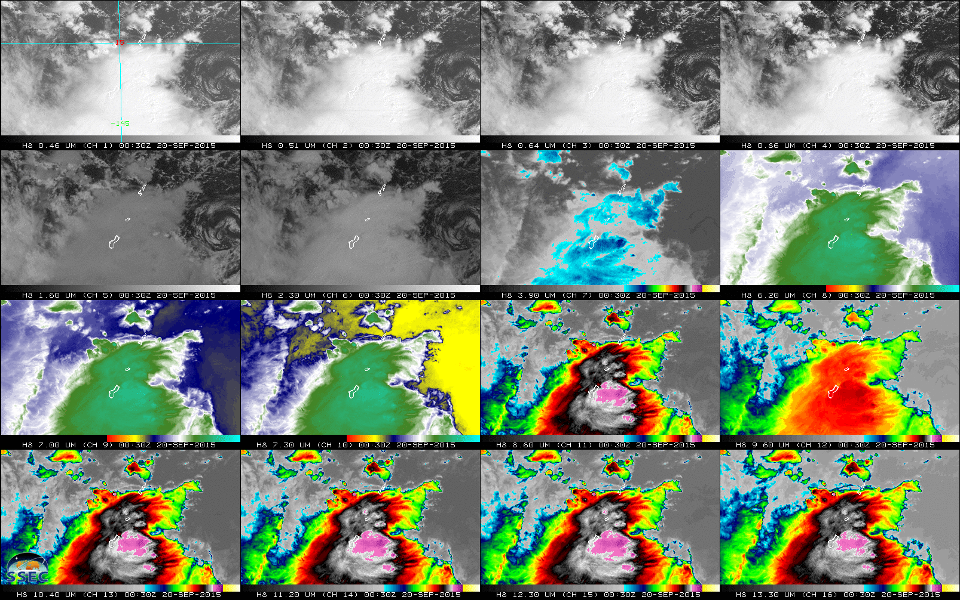
AHI: Spectral (20-September-2015)
Visible
Near- infrared
Infrared

Slide 14
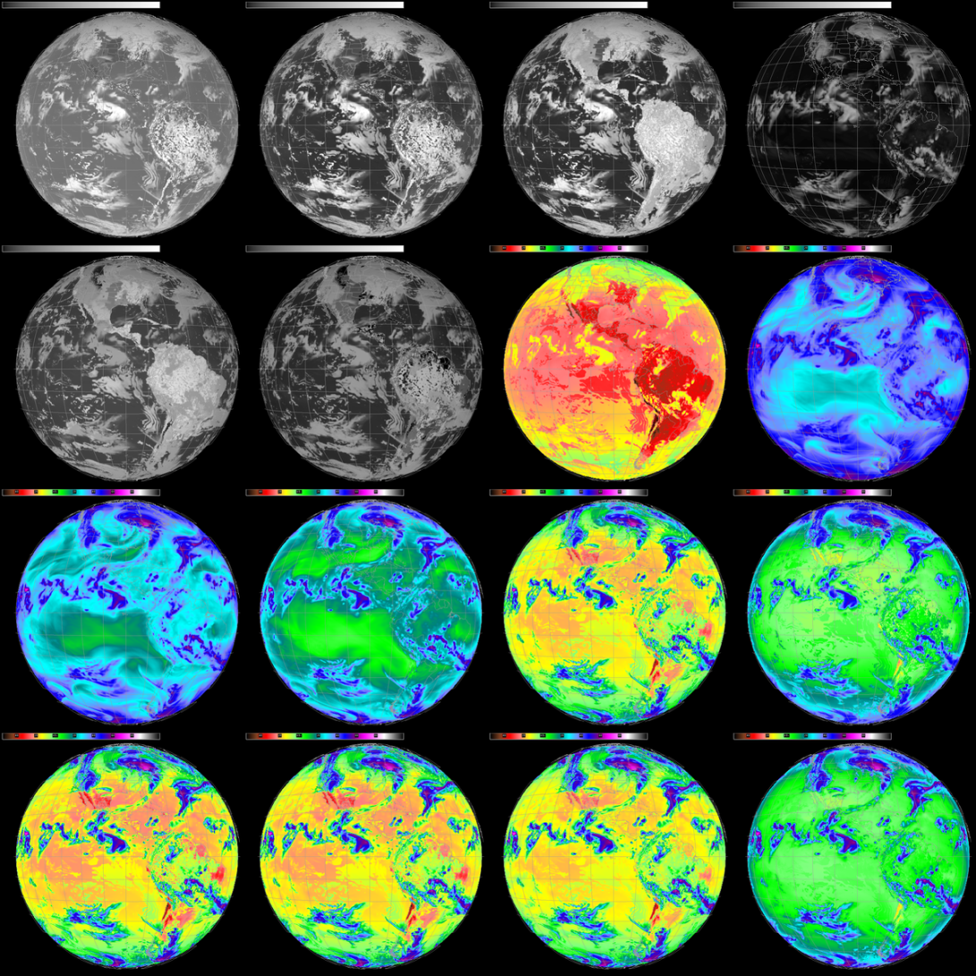
Current
GOES
Future
GOES

Slide 15
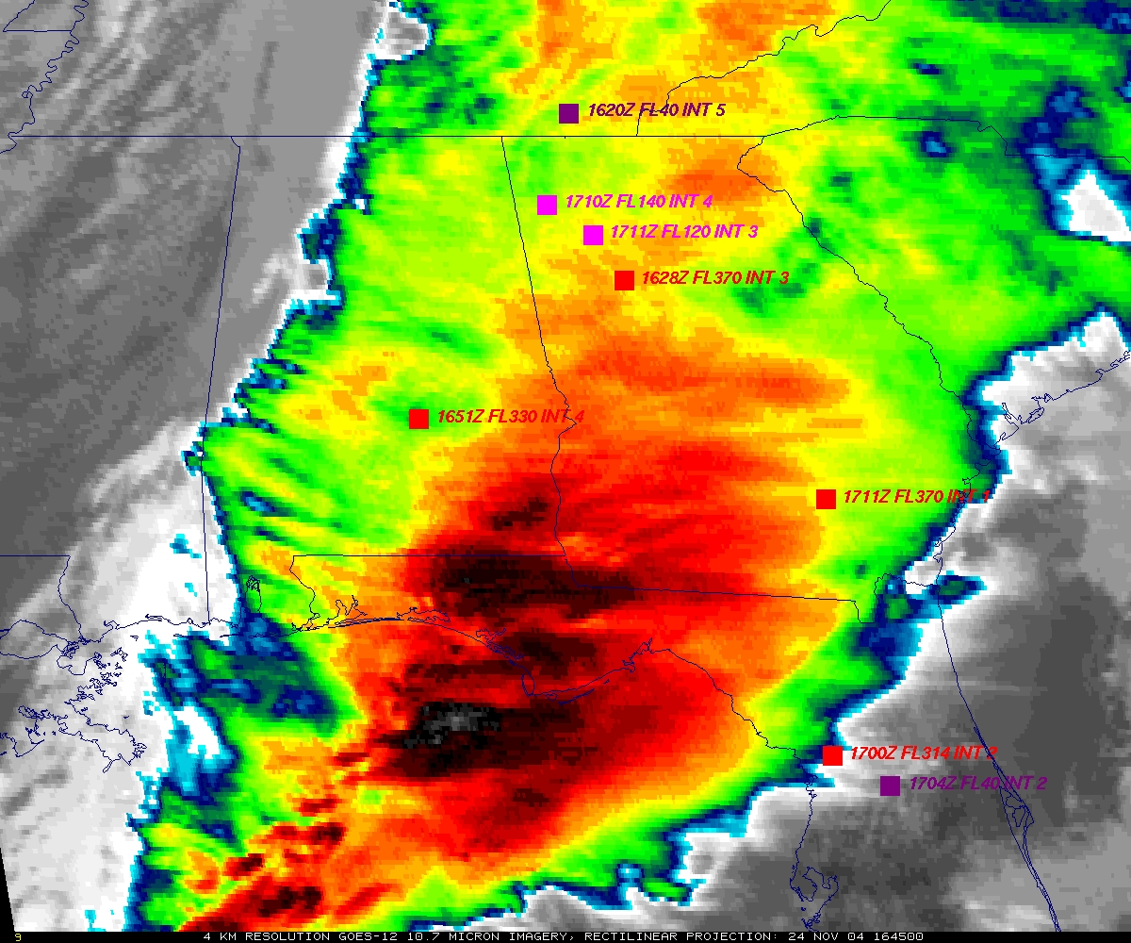
GOES
Figure courtesy of K. Bedka and W. Feltz

Slide 16
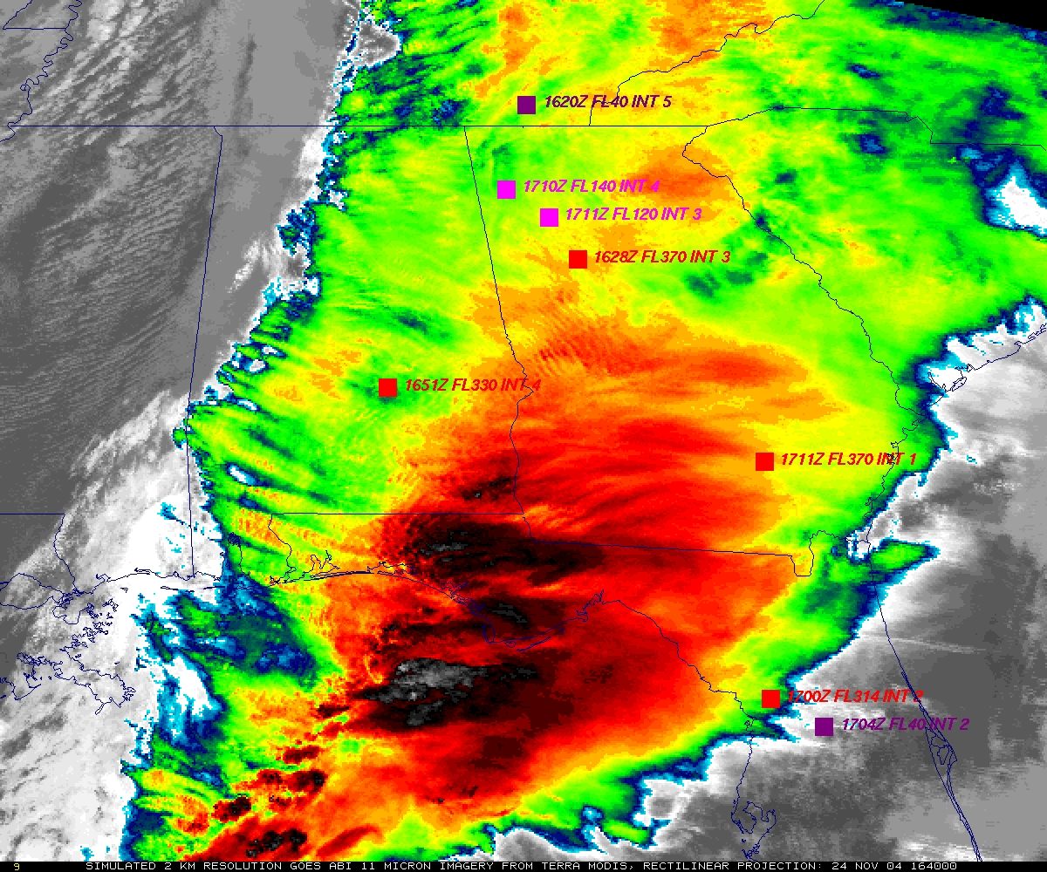
“ABI” from MODIS
Figure courtesy of K. Bedka and W. Feltz

Slide 17
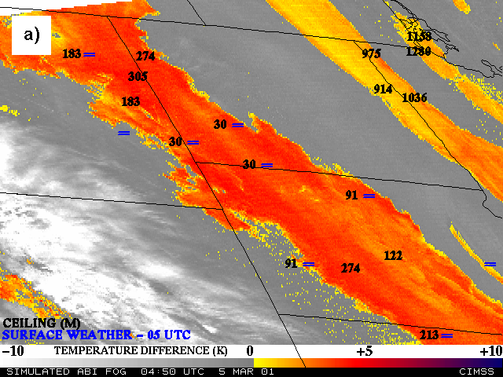
Nocturnal Fog/Stratus Over the Northern Plains
“ABI” 4 minus 11 μm Difference
ABI image (from MODIS) shows greater detail in structure of fog.
Notes:
Note the ABI (from MODIS) image is better spatial resolution and better signal-to-noise ratio then the GOES-10 imager.
Schmit, T. J., M. M. Gunshor, W. P. Menzel, J. J. Gurka, J. Li, and A. S. Bachmeier, 2005: Introducing the next-generation Advanced Baseline Imager on GOES-R. Bull. Amer. Meteor. Soc., 86, 1079-1096.

Slide 18
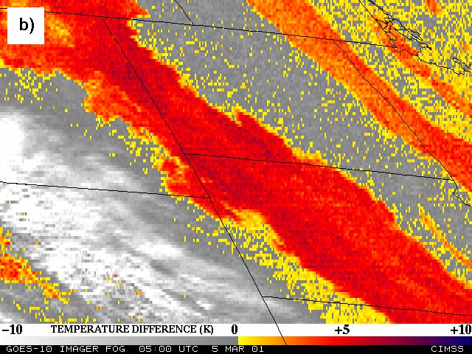
Nocturnal Fog/Stratus Over the Northern Plains
GOES-10 4 minus 11 μm Difference
ABI image (from MODIS) shows greater detail in structure of fog.
Notes:
Schmit, T. J., M. M. Gunshor, W. P. Menzel, J. J. Gurka, J. Li, and A. S. Bachmeier, 2005: Introducing the next-generation Advanced Baseline Imager on GOES-R. Bull. Amer. Meteor. Soc., 86, 1079-1096.

Slide 19
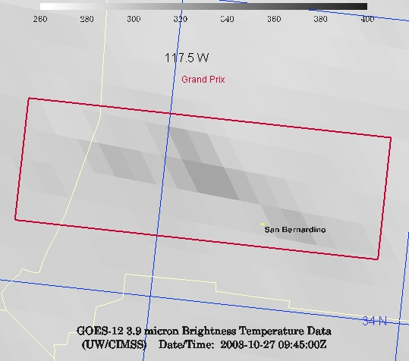
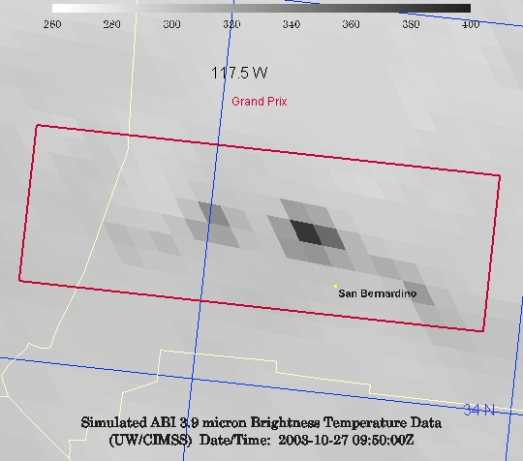
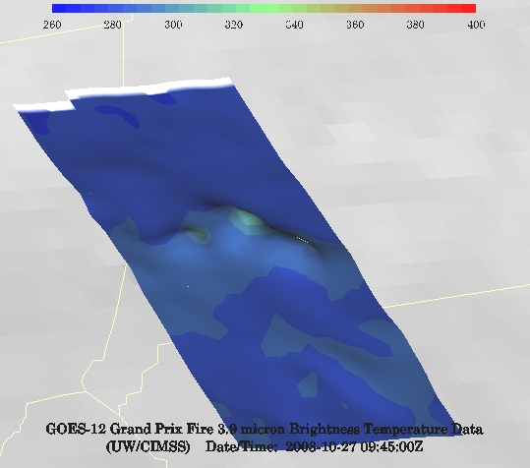
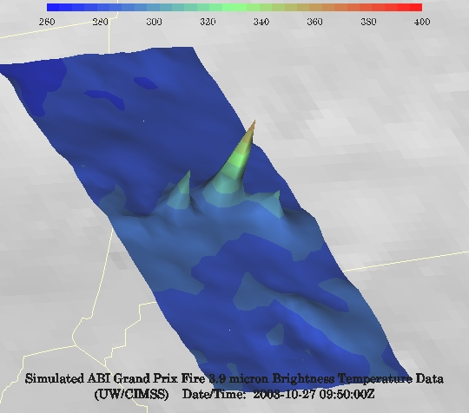
GOES-12 and GOES-R ABI
Simulation of Grand Prix Fire/Southern California
GOES-12
GOES-R ABI
GOES-12
GOES-R ABI
Notes:
Here are two different fires from J. Feltz of CIMSS (using mcidas-v). What we can see is a more defined peak in the higher resolution data and it is easier to pick out individual hotspots. In addition, the higher saturation temperature of the ABI allows us to see that the fire is around 370K. ABI is simulated from MODIS.

Slide 20
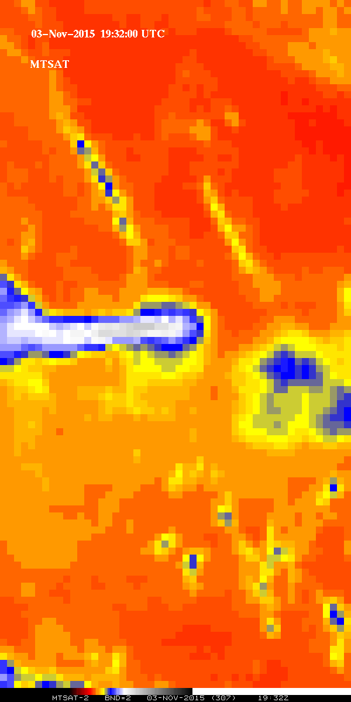
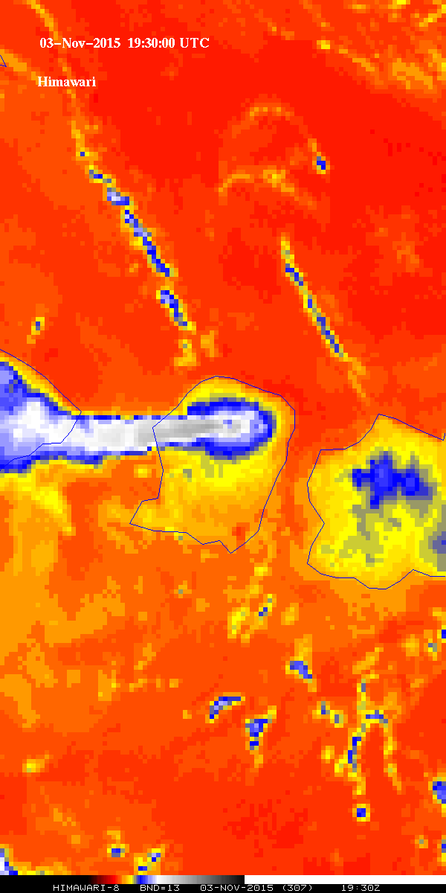
?
Arc clouds
?
Clouds
What’s this infrared image showing?
?
?
?
Plume
Hot spot
Land
?
Cooler
MTSAT
(older generation)
AHI
(new generation)
Improved spatial resolution of an advanced imager
Rinjani
Notes:
MTSAT vs AHI (Spatial) Plume is volcanic ash from Rinjani. Data from JMA, via STAR and the SSEC Data Center.

Slide 21
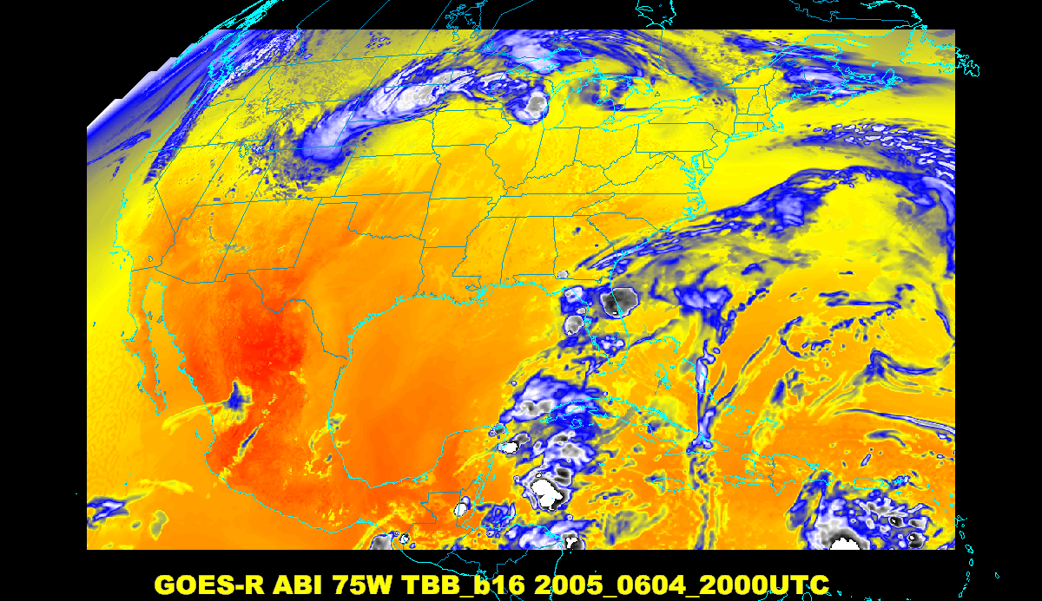
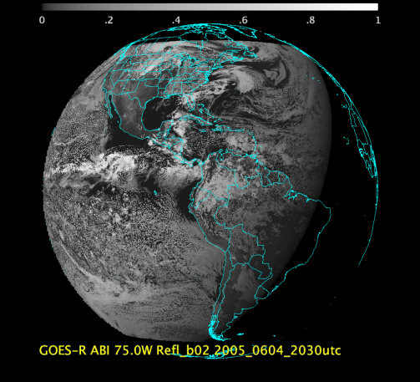
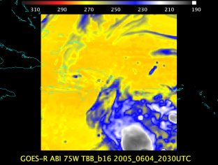
Baseline ABI Scan Modes
Scan mode (3) or ‘flex mode’ for the ABI:
- Full disk every 15 minutes + 5 min CONUS
+ 1-min mesoscales (2 locations).
[Scan mode (4) or ‘Continuous Full Disk’ (CFD) is a full disk every 5 min]
Notes:
CONUS image is the shifted center point.

Slide 22
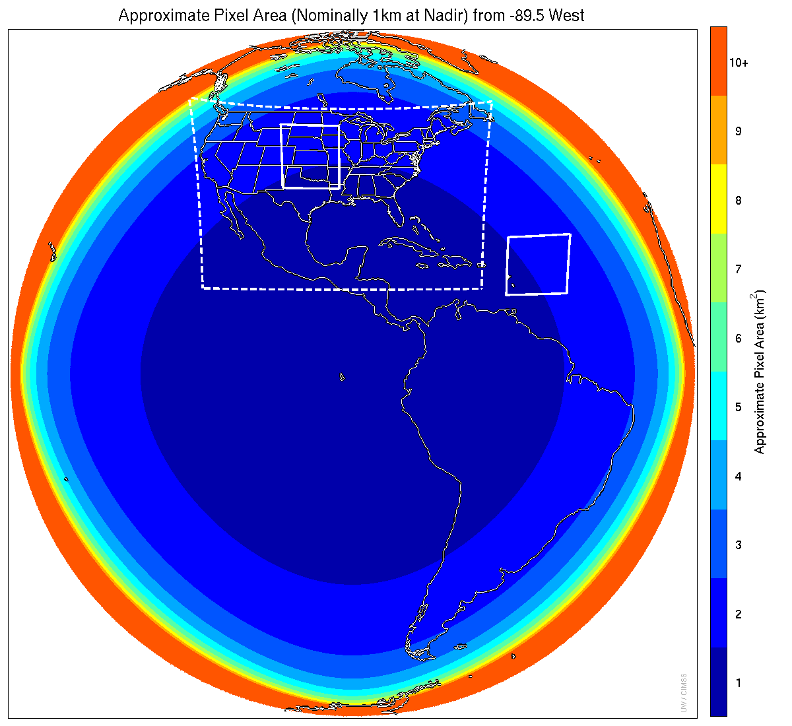
Meso-scale box locations are movable
1 min
5 min
1 min
15 min
Notes:
1-km² spatial resolution at satellite nadir. Pixel Areas are approximate. Each bin is rounded to the nearest 1km² until we get to 9.5km² and then all are binned into the red 10+ area. So the first, dark blue, ring covers pixel areas from 1 to 1.49km² and is labeled “1”, above 1.5 to below 2.5km² goes into the next ring and is called “2”, etc. GOES-Test location. PUG CONUS sector. Two meso-scale image sectors shown; these are selectable. The same central lat/lon used for these mesoscales produces a different sized and shaped area for different satellite locations.

Slide 23
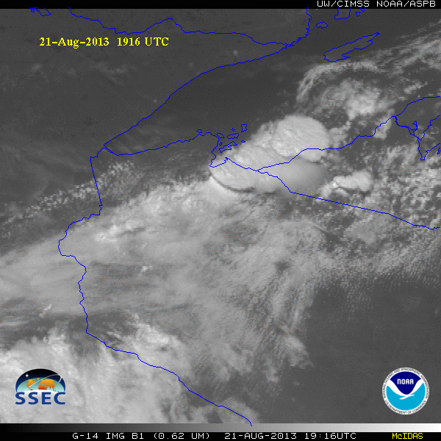
GOES-14 Super Rapid Scan Operations to Prepare for GOES-R (SRSOR)
SRSOR plans for 2015 include May 18-June 12, and August 10-22:
  http://cimss.ssec.wisc.edu/goes/srsor2015/GOES-14_SRSOR.html
  Data during parts of 2012 (Hurricane Sandy, convection), 2013 (CA Rim Fire, convection) and 2014 (Hurricane Marie, convection):
  http://cimss.ssec.wisc.edu/goes/srsor/GOES-14_SRSOR.html
  http://cimss.ssec.wisc.edu/goes/srsor2013/GOES-14_SRSOR.html
  http://cimss.ssec.wisc.edu/goes/srsor2014/GOES-14_SRSOR.html
GOES-14 provided very unique data and offered a glimpse into the possibilities that will be provided by the ABI on GOES-R in one minute mesoscale imagery
GOES-14 visible image showing rapid convective development
Notes:
http://cimss.ssec.wisc.edu/goes/srsor2015/GOES-14_SRSOR.html

Slide 24
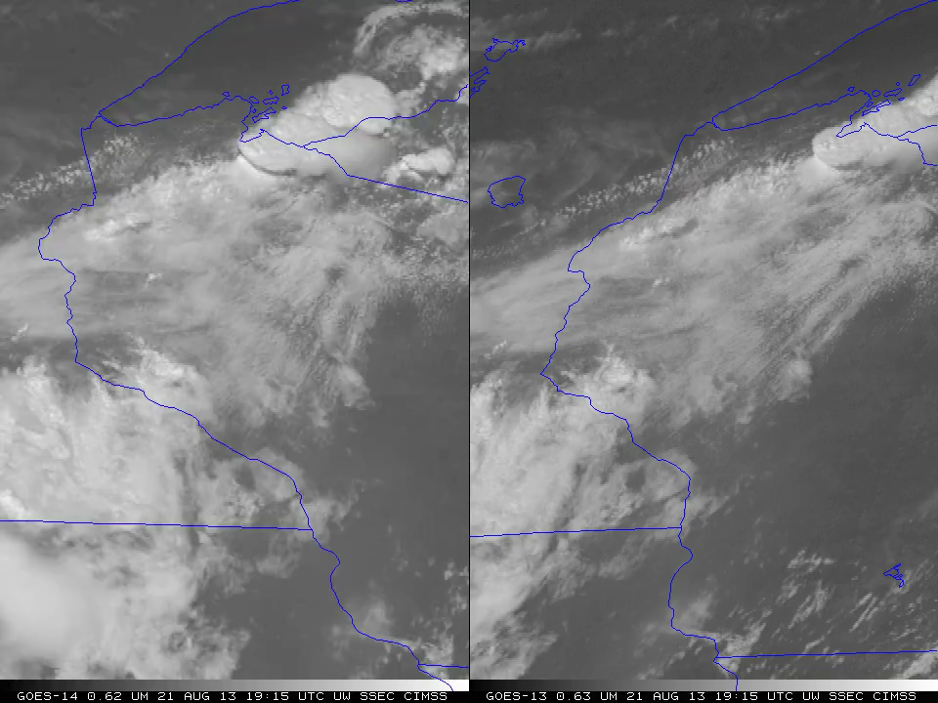
1-min imagery
1-min mode (SRSOR from GOES-14)
Operational (GOES-13)

Slide 25
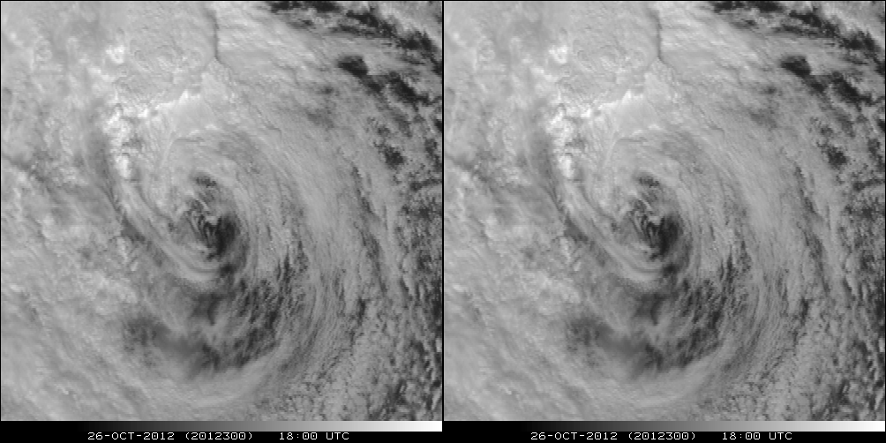
A Glimpse into the Future
ABI-like
Hurricane Sandy from GOES-14 at two temporal resolutions

Slide 26
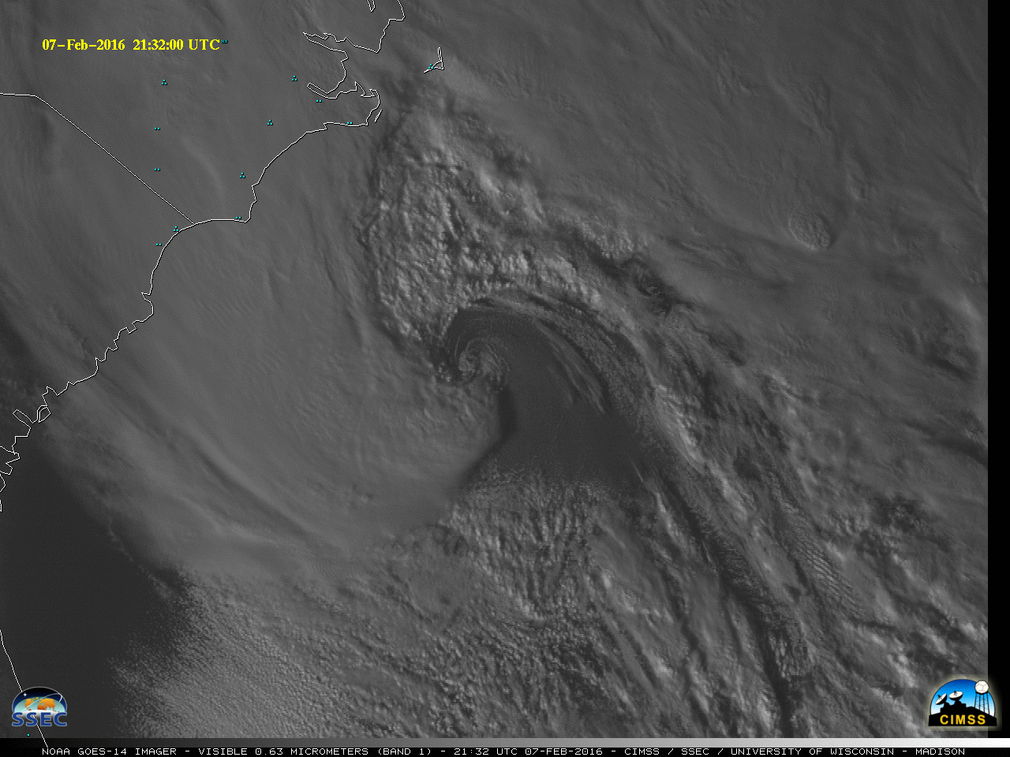
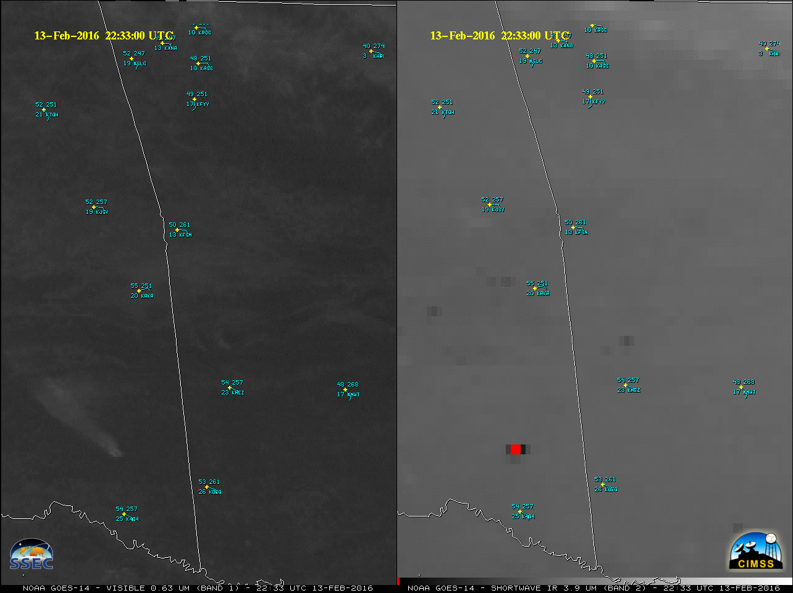
GOES-14 Super Rapid Scan Operations to Prepare for GOES-R (SRSOR)
SRSOR in 2016 include February 1- 25, and April 18 - May 15:
  http://cimss.ssec.wisc.edu/goes/srsor2016/GOES-14_SRSOR.html
  GOES-14 provided very unique data and offered a glimpse into the possibilities that will be provided by the ABI on GOES-R in one minute mesoscale imagery (lows, fires, convection, fog, smoke, hurricanes, etc.)
Notes:
http://cimss.ssec.wisc.edu/goes/srsor2015/GOES-14_SRSOR.html

Slide 27
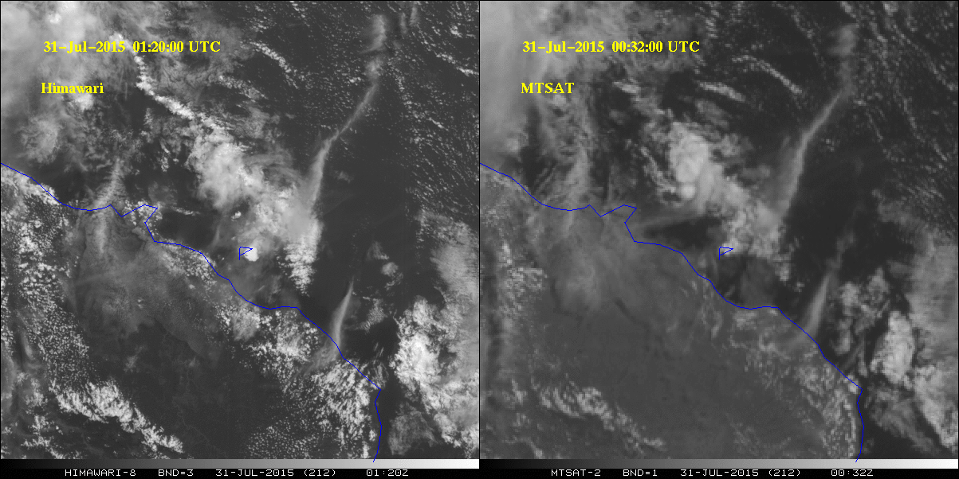
MTSAT (old generation) and
AHI (advanced imager)
Differences in the scanning intervals between images
Manum (volcano)

Slide 28
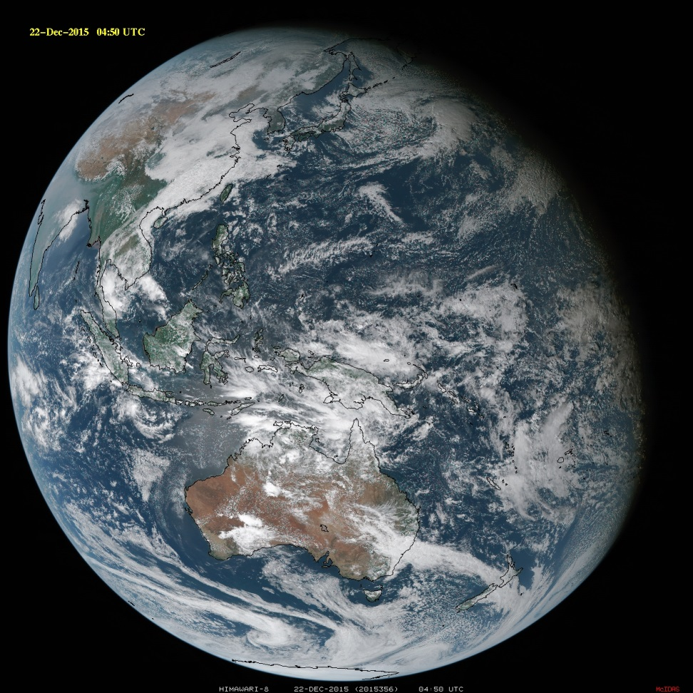
Summary
The ABI on GOES-R will improve over the current instrument in many aspects:
  Spatial, temporal, spectral, calibration, etc.
The great amount of information from the GOES-R will offer a continuation of current products and new products.
Thanks to JMA, Yasuhiko Sumida and SSEC
The ABI builds on previous experience/instruments
Similar imagers by Europe, Japan, Korea, etc.
  ABI-like coverage of most of the globe!

Slide 29
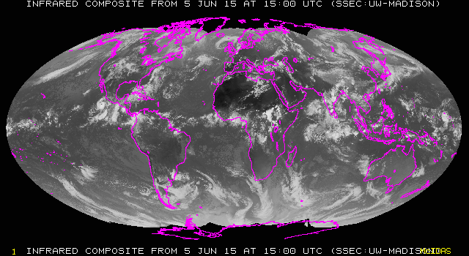
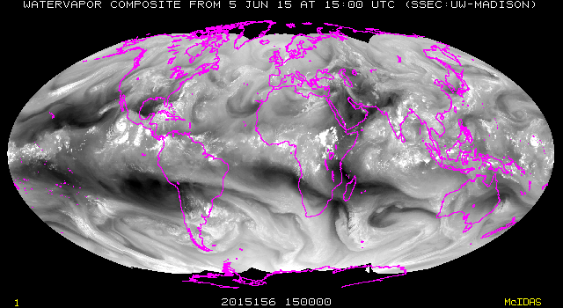
Conclusions
The ABI on the GOES-R series continues the critical continuity of geostationary imagers and will have huge positive societal impacts, given its improved temporal, spatial, spectral and radiometric attributes.
Impact areas include, but are not limited to: weather, Numerical Weather Prediction, severe weather, hazards (volcanic ash plumes), aviation, environmental (fires), health (smoke), oceanographic, cryosphere, land, etc.
Part of a global constellation.

Slide 30
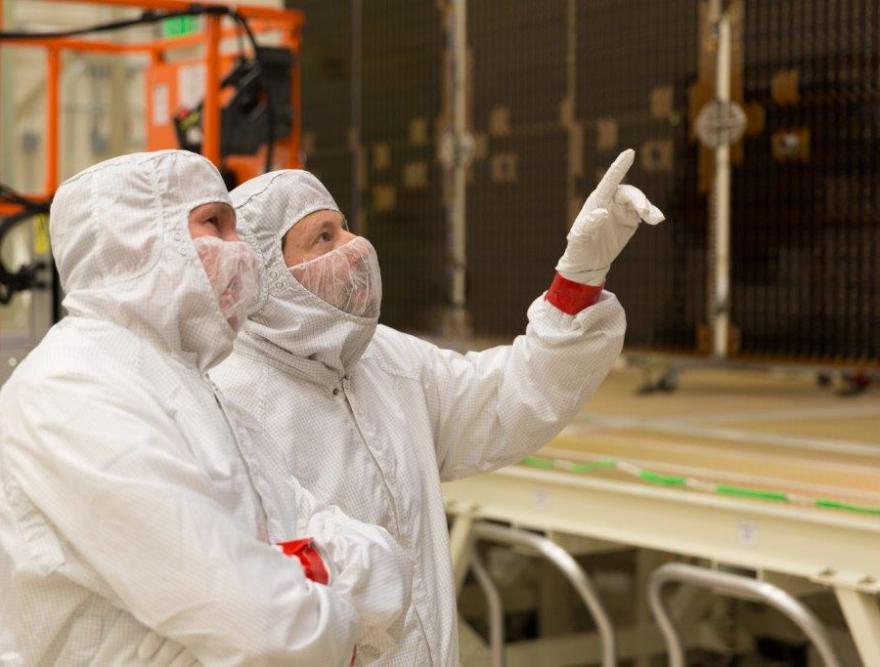
GOES-R Series web site
http://www.goes-r.gov
Lockheed Martin

